Slide 1
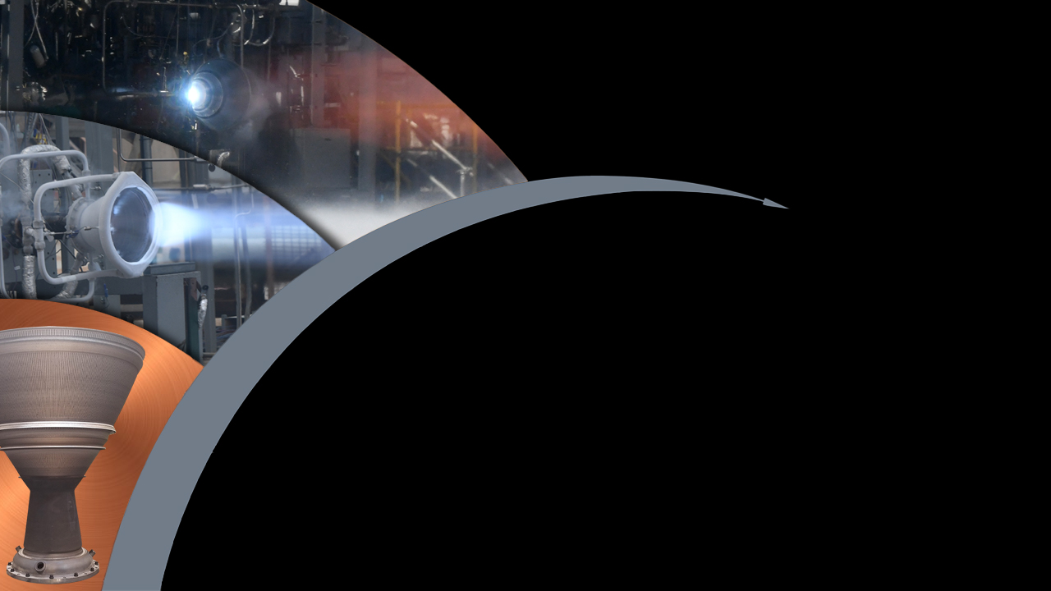

National Aeronautics and
Space Administration
Game Changing Development Program Office
Rapid Analysis and Manufacturing Propulsion Technology (RAMPT)
Composite Overwrap
December 7, 2023
Project Manager: John Fikes
Presenter: Allison Clark

Slide 2
RAMPT Composite Team
RAMPT MSFC Team:
Allison Clark (Lead), Luke Richard
Technicians: Phil Thompson, Andrew Martin, David Lawrence
RAMPT LaRC Team:
Cheol Park (Lead), Tyler Hudson, Christopher Stelter, Sang-Hyon Chu
Intern: Maria Santiago (Univ Puerto Rico, Mayaguez, Chem Eng)
KORD Team:
Jennah Durney
Mike Goetz, Brandon Connell, Adam Tuten
Former Team Members:
Terryl Wallace, Samuel Hocker, Christapher Lang, Joshua Fody, Larry Pelham, Sandi Miller
Intern: Paola Guzman (Univ Puerto Rico, Mayaguez, Chem Eng), Gavin Chung (UNLV, Mech Eng), Onelia Swaby (U Cent Florida, Chem Eng), Stephanie Morales (Univ Puerto Rico, Mayaguez, Chem Eng), Ricardo Martinez (Univ Puerto Rico, Mayaguez, Chem Eng), Pranav Iyer (Princeton, Mech & Aero Eng)

Slide 3
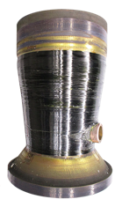
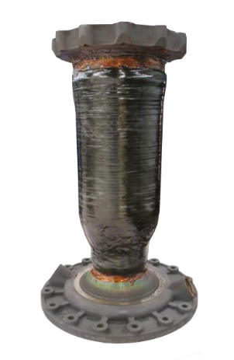
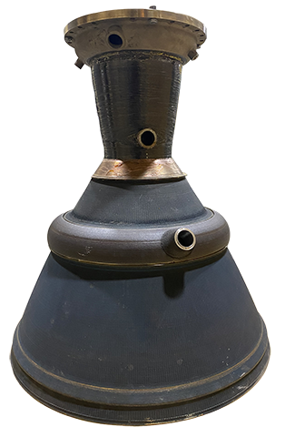
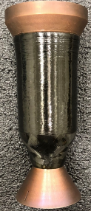
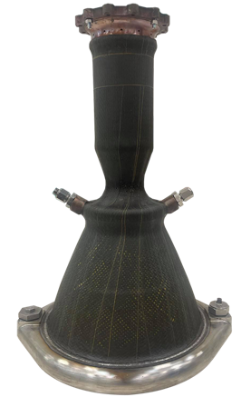
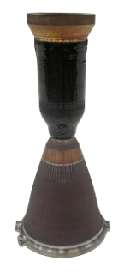
Composite Overwrap: Hardware Overview
The material thermal requirements varied among the 2k, 7k, and 40k-${lb}_{f}$ chambers
  2k-${lb}_{f}$ and 40k-${lb}_{f}$ are LOX/LH2 and have composite overwrap interface temperatures of -400 to 150 $℉$
  7k-${lb}_{f}$ hardware is LOX/LCH4 and has interface temperatures -230 to 450 $℉$
2k-lb_{f}
7k-lb_{f}
40k-lb_{f}
Decoupled Chamber
Decoupled Chamber
Decoupled Chamber
Coupled
Chamber
Coupled Chamber
Coupled Chamber

Slide 4
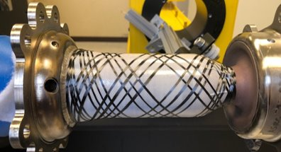
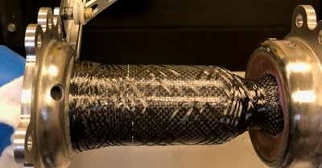
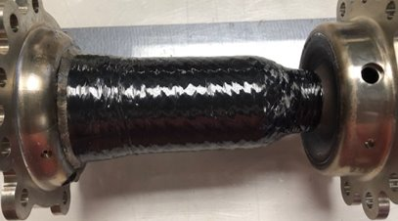
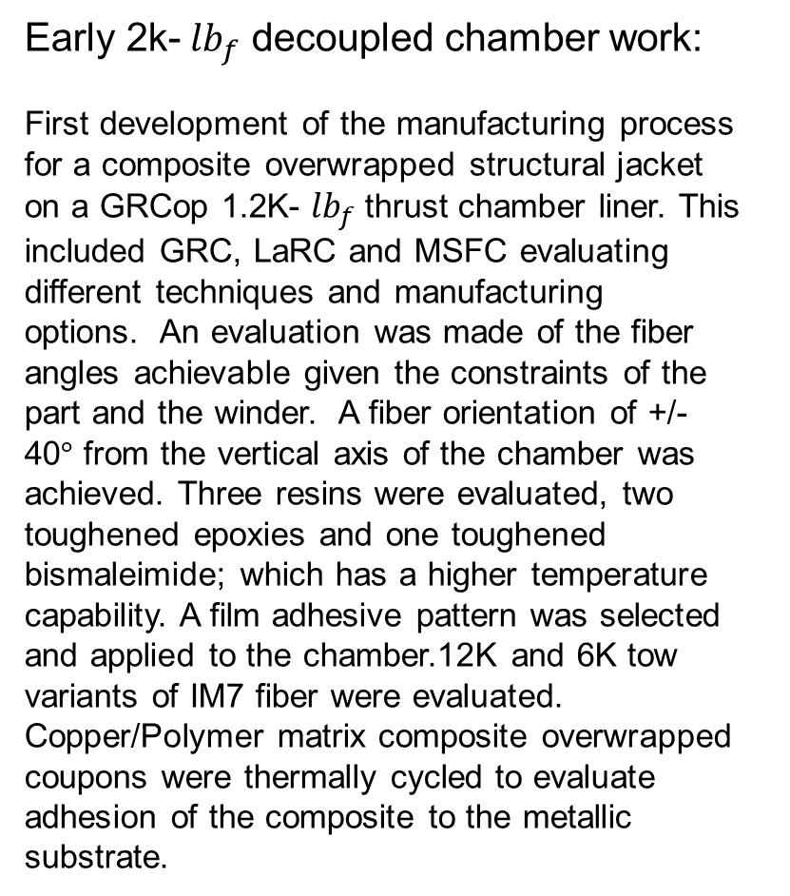
Composite Overwrap: Early Work
Early 2k- ${lb}_{f}$ decoupled chamber work:
First development of the manufacturing process for a composite overwrapped structural jacket on a GRCop 1.2K- ${lb}_{f}$ thrust chamber liner. This included GRC, LaRC and MSFC evaluating different techniques and manufacturing options. An evaluation was made of the fiber angles achievable given the constraints of the part and the winder. A fiber orientation of +/- 40$°$ from the vertical axis of the chamber was achieved. Three resins were evaluated, two toughened epoxies and one toughened bismaleimide; which has a higher temperature capability. A film adhesive pattern was selected and applied to the chamber.12K and 6K tow variants of IM7 fiber were evaluated. Copper/Polymer matrix composite overwrapped coupons were thermally cycled to evaluate adhesion of the composite to the metallic substrate.​
Top Left: Film Adhesive bonded to chamber.​
Top Right: Uni-directional tape placed over adhesive.​
Bottom: Angle plies and hoop wind with resin application.​

Slide 5
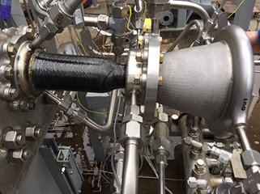
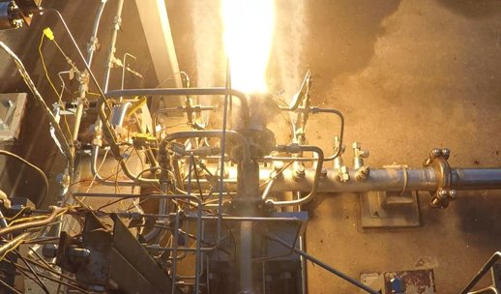
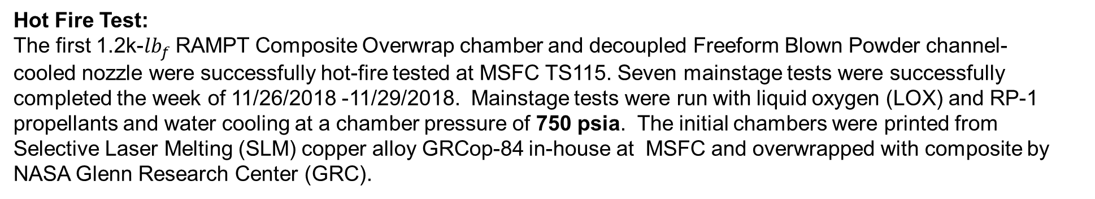
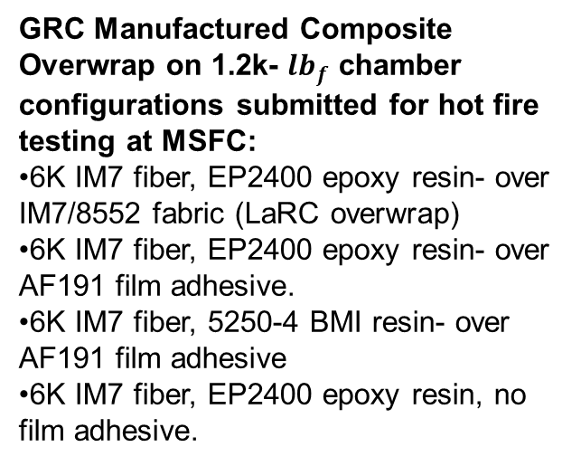
Composite Overwrap: Early Work
Hot Fire Test: ​
The first 1.2k-${lb}_{f}$ RAMPT Composite Overwrap chamber and decoupled Freeform Blown Powder channel-cooled nozzle were successfully hot-fire tested at MSFC TS115. Seven mainstage tests were successfully completed the week of 11/26/2018 -11/29/2018. Mainstage tests were run with liquid oxygen (LOX) and RP-1 propellants and water cooling at a chamber pressure of 750 psia. The initial chambers were printed from Selective Laser Melting (SLM) copper alloy GRCop-84 in-house at MSFC and overwrapped with composite by NASA Glenn Research Center (GRC).
GRC Manufactured Composite Overwrap on 1.2k- ${lb}_{f}$ chamber configurations submitted for hot fire testing at MSFC:​
6K IM7 fiber, EP2400 epoxy resin- over IM7/8552 fabric (LaRC overwrap)​
6K IM7 fiber, EP2400 epoxy resin- over AF191 film adhesive.​
6K IM7 fiber, 5250-4 BMI resin- over AF191 film adhesive​
6K IM7 fiber, EP2400 epoxy resin, no film adhesive.​

Slide 6
Composite Overwrap: Early Work
Bond/No Bond Configuration:
As-built, additively manufactured (AM) chambers have significant surface roughness.
Curing the overwrap directly on the chamber would lead to a bonded overwrap.
  Not ideal due to CTE mismatch between the metallic chamber and the composite overwrap.
    Metallic chamber would shrink and pull away from composite during curing and the initial cool-down of the hot-fire tests.
    This could lead to delamination or tearing damage of a bonded composite.
Not allowed to autofrettage as with traditional COPVs.
Ultimately the decision was made for an unbonded overwrap.
  Consistent with thick-walled pressure vessels.
  Procedure:
    Chamber surfaces polished with aluminum-free (due to potential for hydrogen embrittlement) 80 grit and 120 grit sandpaper to remove surface roughness and oxidation.
    Surfaces washed with ethanol, then treated with multiple coats of Frekote NC700 mold release agent.
Tradeoff: Metallic chamber must take entire pressure load until the composite overwrap is engaged.

Slide 7
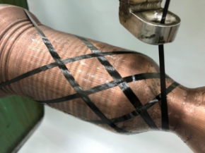
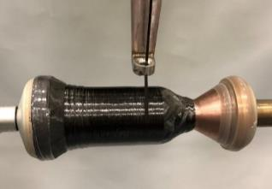
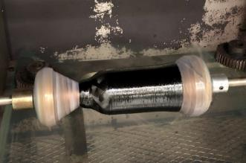
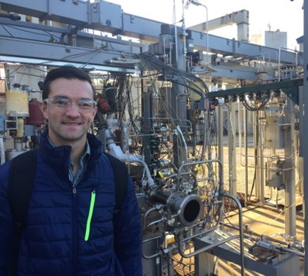
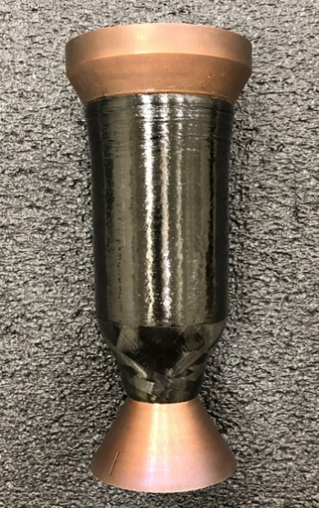
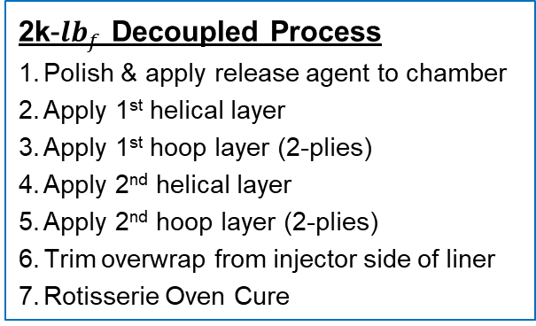


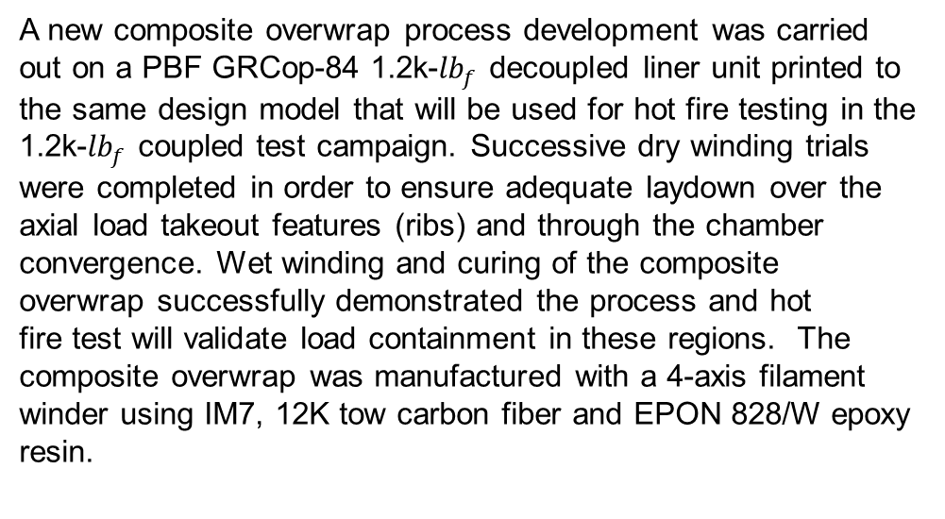
Composite Overwrap: 2k-${lb}_{f}$ Decoupled
A new composite overwrap process development was carried out on a PBF GRCop-84 1.2k-${lb}_{f}$ decoupled liner unit printed to the same design model that will be used for hot fire testing in the 1.2k-${lb}_{f}$ coupled test campaign. Successive dry winding trials were completed in order to ensure adequate laydown over the axial load takeout features (ribs) and through the chamber convergence. Wet winding and curing of the composite overwrap successfully demonstrated the process and hot fire test will validate load containment in these regions. ​The composite overwrap was manufactured with a 4-axis filament winder using IM7, 12K tow carbon fiber and EPON 828/W epoxy resin.
Helical
Hoop
Trimmed
2k-${lb}_{f}$ Decoupled Process
Polish & apply release agent to chamber
Apply 1st helical layer
Apply 1st hoop layer (2-plies)
Apply 2nd helical layer
Apply 2nd hoop layer (2-plies)
Trim overwrap from injector side of liner
Rotisserie Oven Cure
Final 2k-${lb}_{f}$ Part

Slide 8
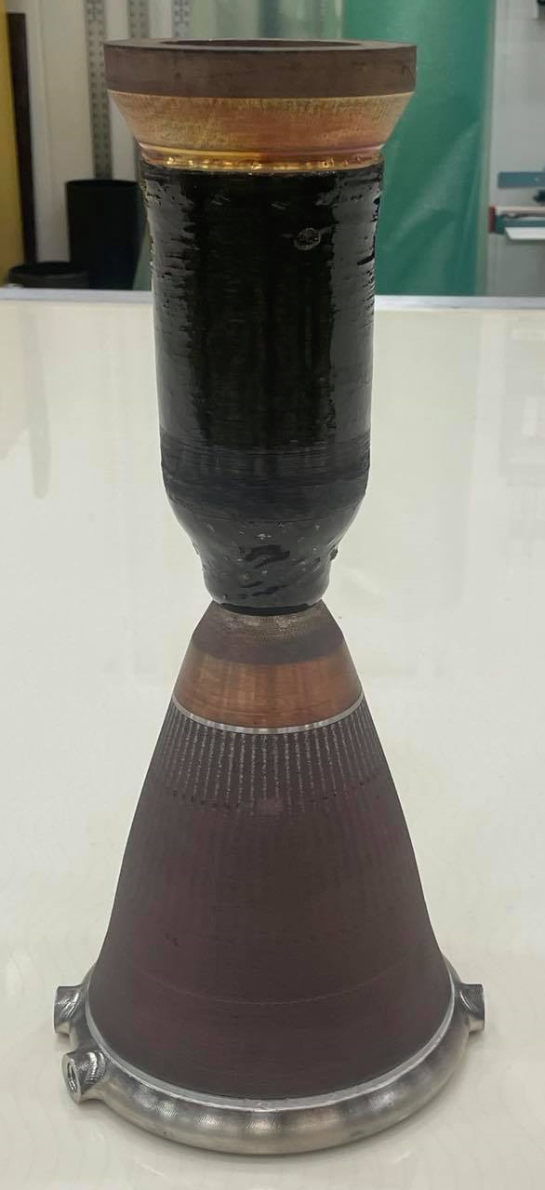
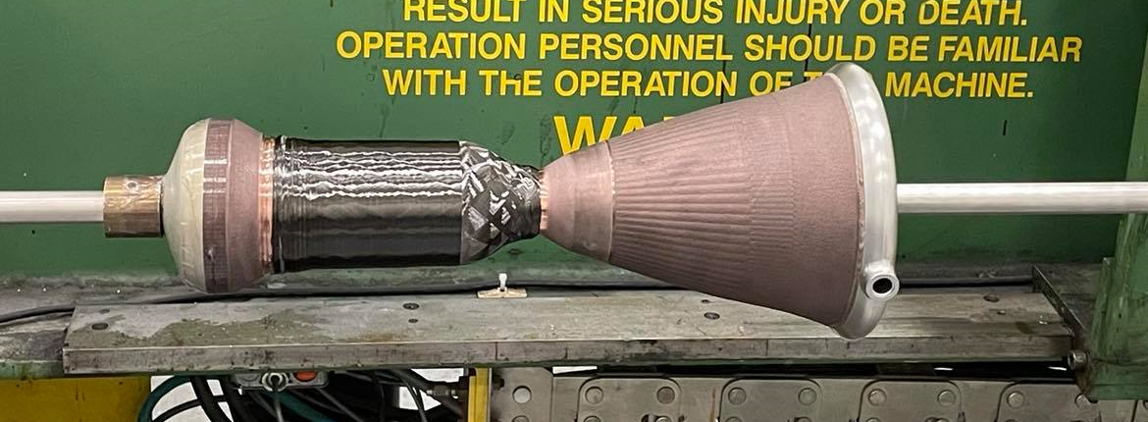
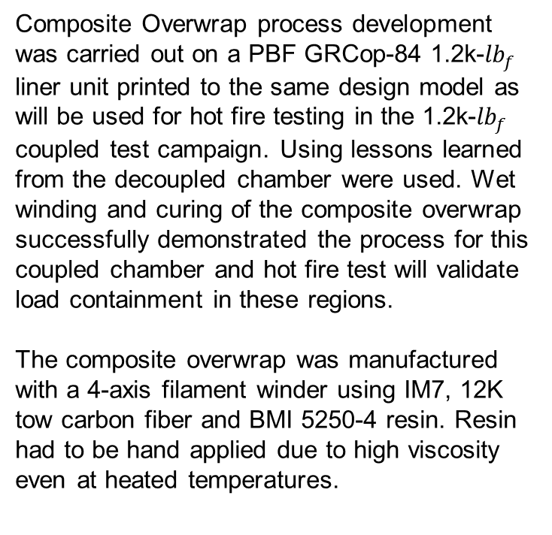

Composite Overwrap: 2k-${lb}_{f}$ Coupled
Composite Overwrap process development was carried out on a PBF GRCop-84 1.2k-${lb}_{f}$ liner unit printed to the same design model as will be used for hot fire testing in the 1.2k-${lb}_{f}$ coupled test campaign. Using lessons learned from the decoupled chamber were used. Wet winding and curing of the composite overwrap successfully demonstrated the process for this coupled chamber and hot fire test will validate load containment in these regions.
The composite overwrap was manufactured with a 4-axis filament winder using IM7, 12K tow carbon fiber and BMI 5250-4 resin. Resin had to be hand applied due to high viscosity even at heated temperatures.
​
Dry Winding
2k Coupled Process
Polish & apply release agent to chamber
Apply 1st helical layer
Apply 1st hoop layer (2-plies)
Apply 2nd helical layer
Apply 2nd hoop layer (2-plies)
Trim overwrap from injector side of liner
Rotisserie Oven Cure
Cured Part

Slide 9
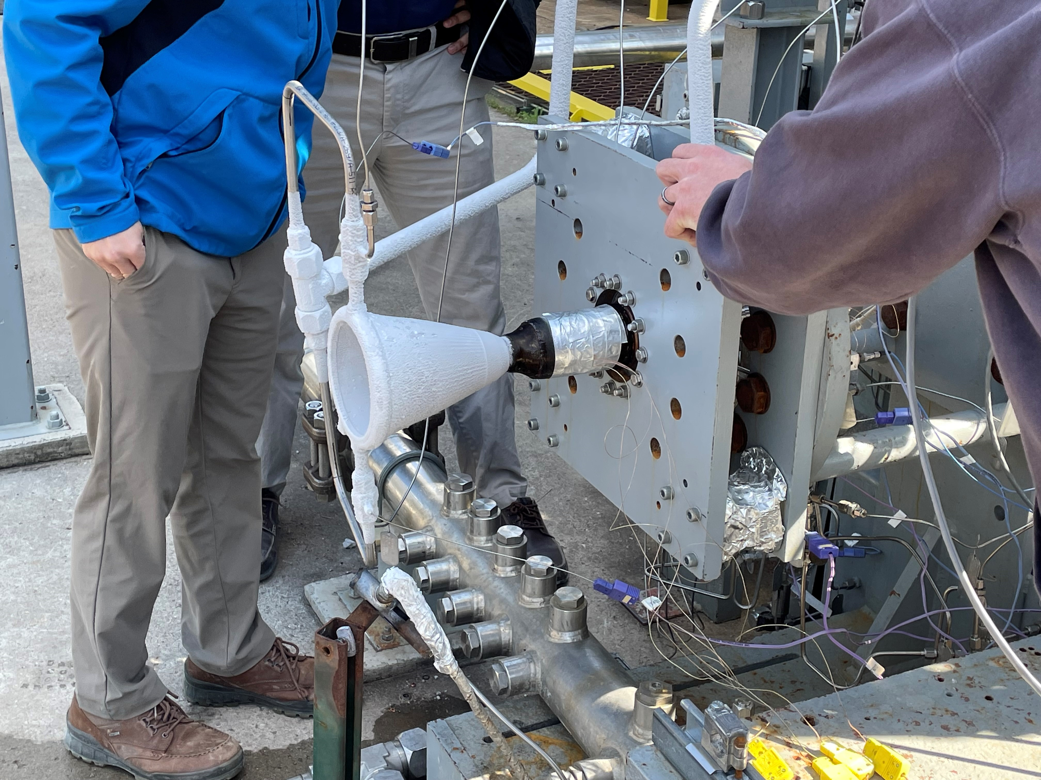
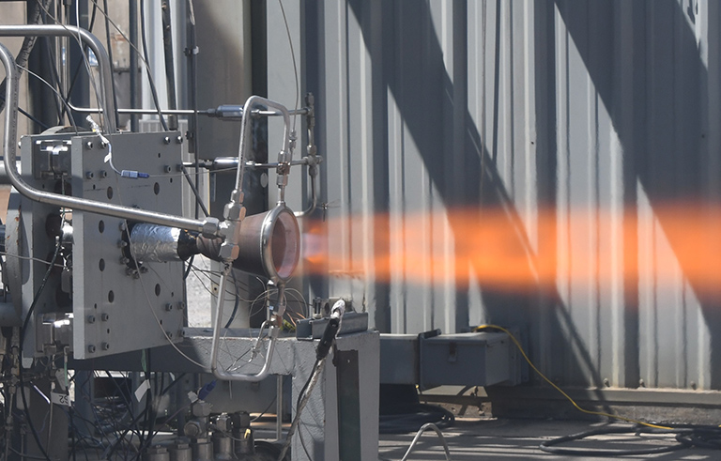

Composite Overwrap: 2k ${lb}_{f}$ Hot Fire
Hot Fire Test:
The project completed hot-fire testing of the 2.5k-lb_{f} coupled chambers from March 28, 2022 to April 1, 2022. The team tested two identical coupled thrust chamber assemblies (TCA) over the five-day period with LOX/hydrogen and achieved 7 starts and 335.2 seconds of overall run time. The TCA incorporated a composite overwrap structural jacket over the chamber that was applied using fiber winding equipment in the MSFC Materials Lab. The temperatures measured were -356°F at start of test to 399°F during testing.
The team performed five starts on TCA 1 for a total of 185.2 seconds with a chamber pressure up to 730 psia. Two starts were performed on TCA 2 for a total of 150 seconds with a chamber pressure up to 774 psia. The visual inspection of the TCAs after testing revealed no changed or damages to the composite overwrap.

Slide 10
Composite Overwrap: Hardware Overview
The material thermal requirements varied among the 2k, 7k, and 40k-${lb}_{f}$ chambers
  2k-${lb}_{f}$ and 40k-${lb}_{f}$ are LOX/LH2 and have composite overwrap interface temperatures of -400 to 150 $℉$
  7k-${lb}_{f}$ COMET hardware is LOX/LCH4 and has interface temperatures -230 to 450 $℉$
2k-lb_{f}
7k-lb_{f}
40k-lb_{f}
Decoupled chamber
Decoupled chamber
Decoupled chamber
Coupled chamber
Coupled chamber
Coupled chamber

Slide 11
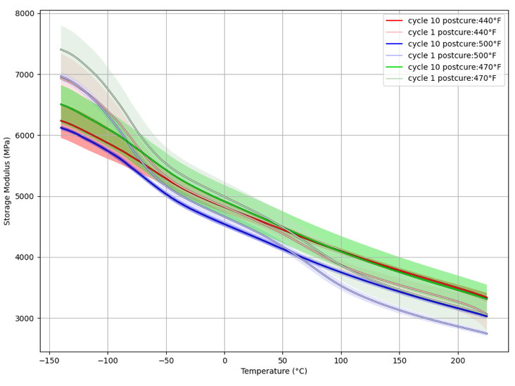
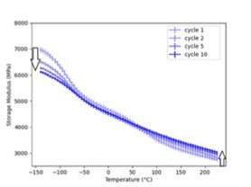
Composite Overwrap: BMI DMA
Storage Modulus from DMA (Dynamic Mechanical Analysis) Testing Runs: Cycling Test
TA Q800 DMA: 1Hz, 5˚C/min
DMA cycling tests (10 cycles) for three different samples (resin BMI 5250-4) for each post-cure temperature (440, 470, and 500˚F) were completed. DSC tests for each sample were performed as well for comparison.
In these graphs, the solid line represents the average of 3 repeated cycling tests (cycles 1 and 10) for 3 post-cure temperatures (440, 470, and 500˚F). The error bars (or shaded regions) represent the average errors in 3 measurements.
  The storage modulus gradually decreased with increasing temperature for all post-cure temperatures.
  The storage modulus decreased at low temperatures and slightly increased at high temperatures after cycling tests.
  Overall 470˚F post-cure sample showed the best performance throughout the entire temperature ranges and 10 cycling tests.

Slide 12
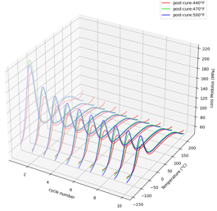
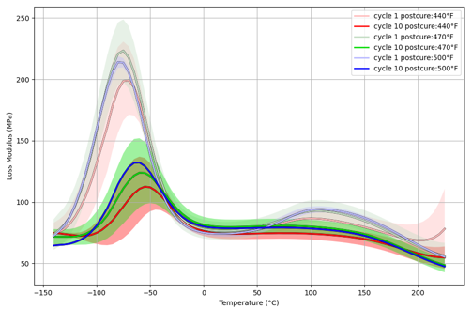
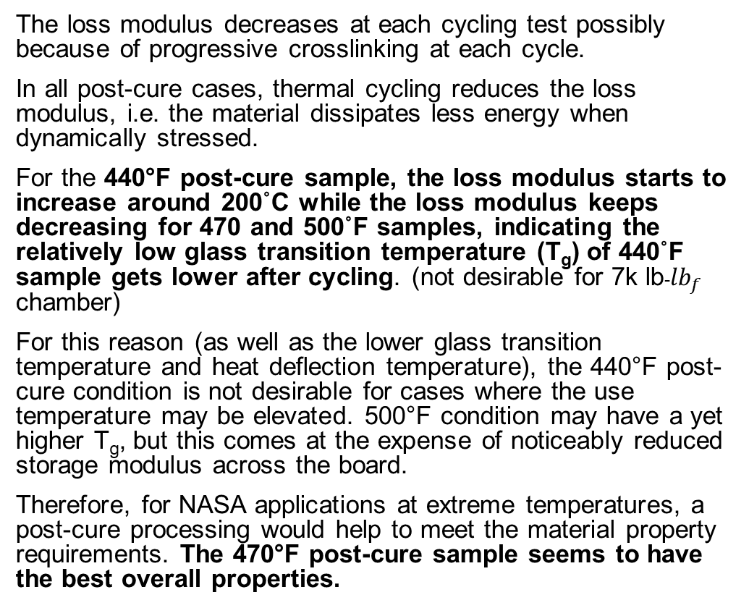
Composite Overwrap: Loss Modulus (DMA)
The loss modulus decreases at each cycling test possibly because of progressive crosslinking at each cycle.
In all post-cure cases, thermal cycling reduces the loss modulus, i.e. the material dissipates less energy when dynamically stressed.
For the 440°F post-cure sample, the loss modulus starts to increase around 200˚C while the loss modulus keeps decreasing for 470 and 500˚F samples, indicating the relatively low glass transition temperature (T_{g}) of 440˚F sample gets lower after cycling. (not desirable for 7k lb-${lb}_{f}$ chamber)
For this reason (as well as the lower glass transition temperature and heat deflection temperature), the 440°F post-cure condition is not desirable for cases where the use temperature may be elevated. 500°F condition may have a yet higher T_{g}, but this comes at the expense of noticeably reduced storage modulus across the board.
Therefore, for NASA applications at extreme temperatures, a post-cure processing would help to meet the material property requirements. The 470°F post-cure sample seems to have the best overall properties.

Slide 13
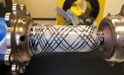


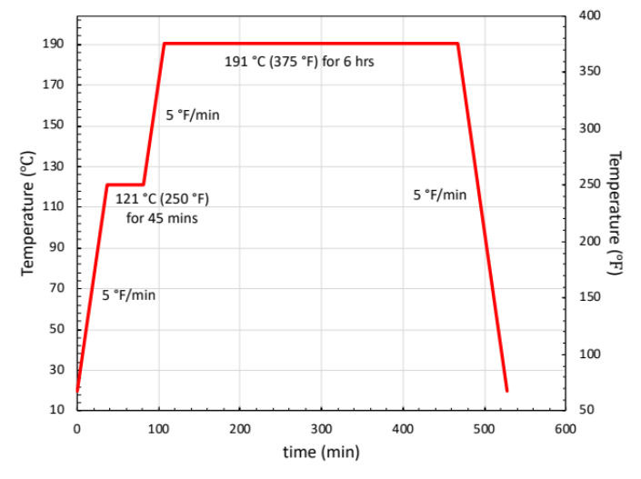
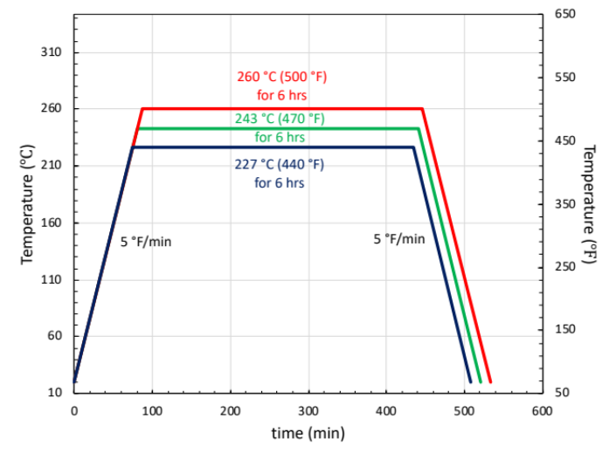
Composite Overwrap: 5250-4 BMI Resin
Composite overwrap development: Materials Characterization: Dynamic Mechanical Analysis (DMA)
Dynamic Mechanical Analysis (DMA) was performed on three post-cure conditions to determine the effect of post-cure temperature on modulus and glass transition temperature (T_{g}) of the resin utilized in the composite overwrap.
Summary of testing results:
227˚C (440˚F) post-cure has higher modulus for all temperatures until modulus drop at 236˚C (457˚F). The 243˚C (470˚F) post-cure has a higher modulus than the 260˚C (500˚F) post-cure.
Modulus drops first for 227˚C (440˚F) post-cure, followed by 243˚C (470˚F) post-cure, then 260˚C (500˚F) post-cure.
Standard cure cycle for CYCOM 5250-4 BMI resin for the composite overwrap.
Post-cure cycle for CYCOM 5250-4 BMI resin for the composite overwrap.

Slide 14
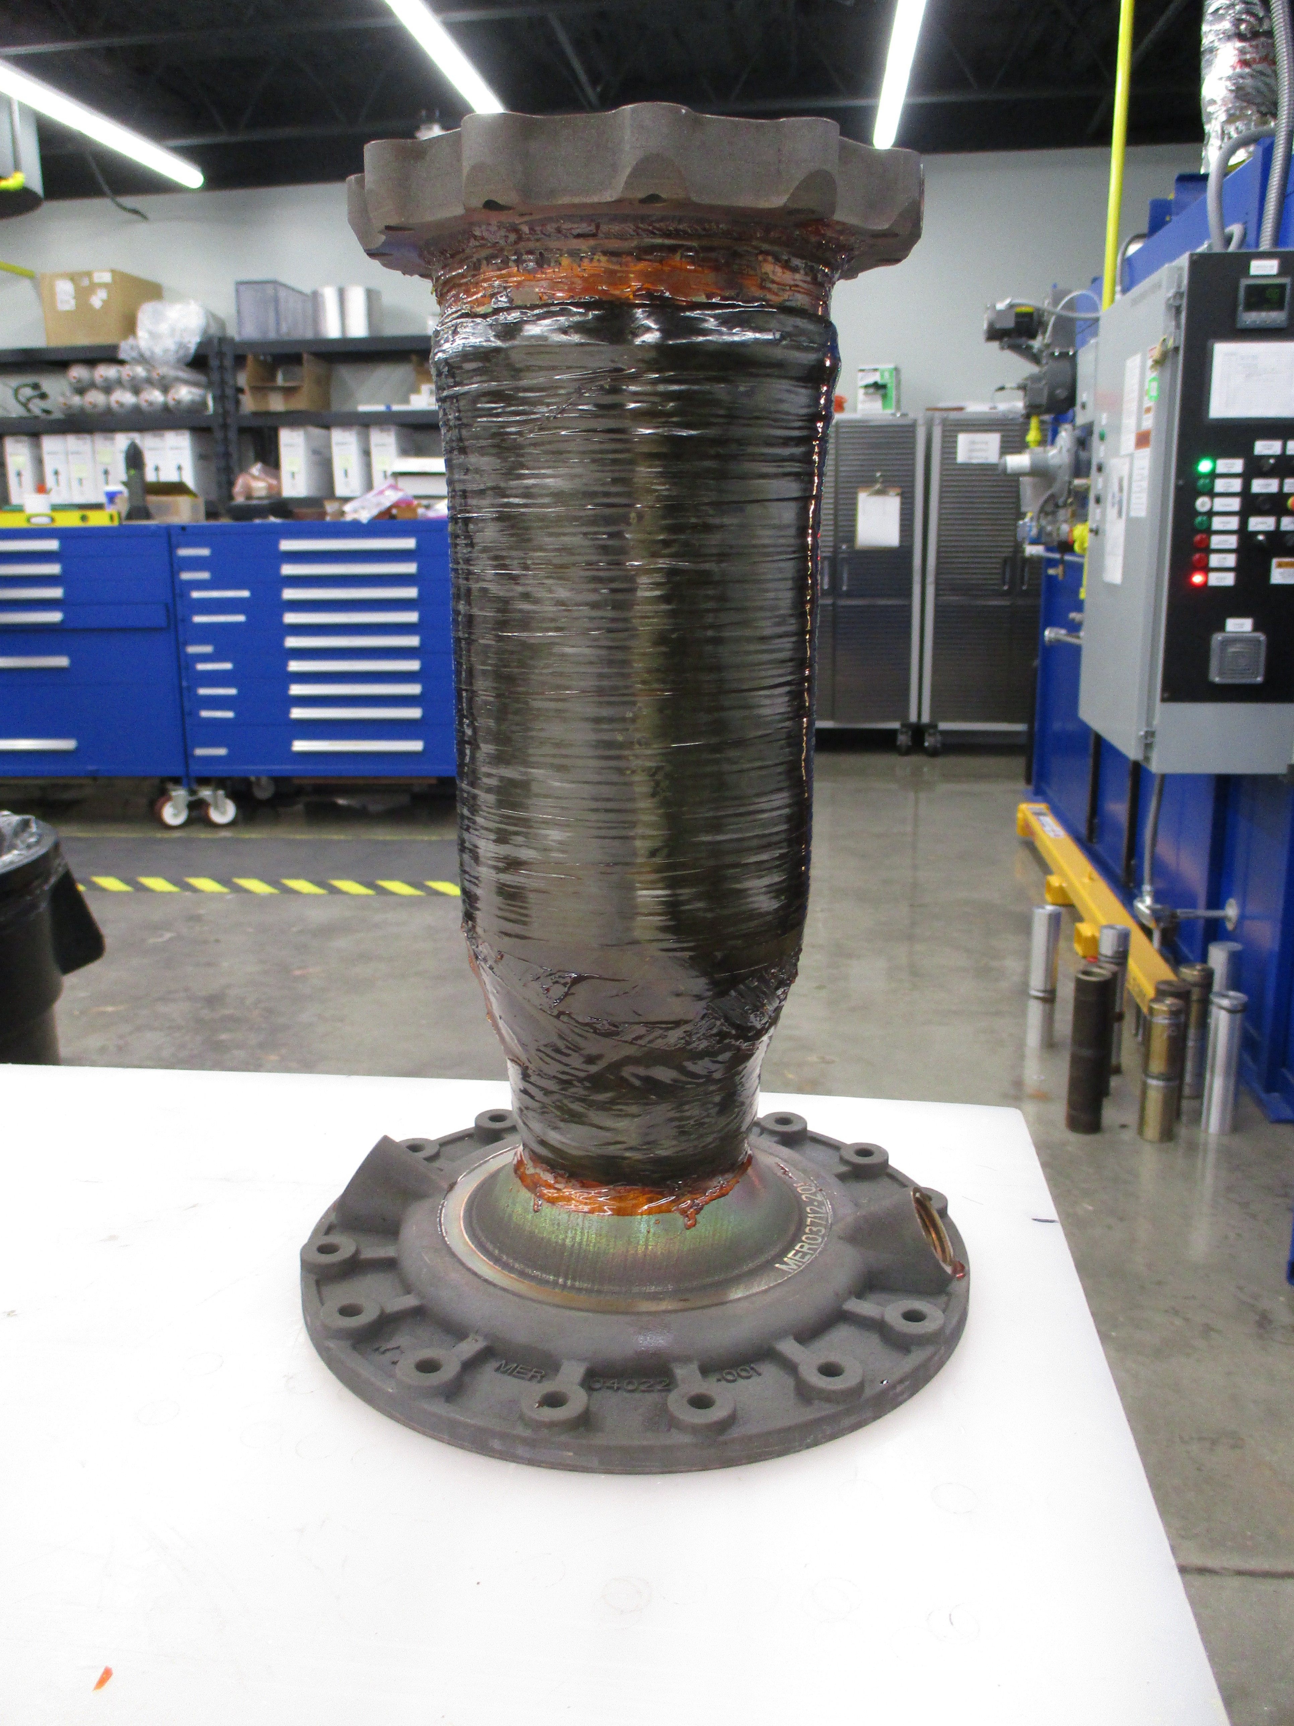
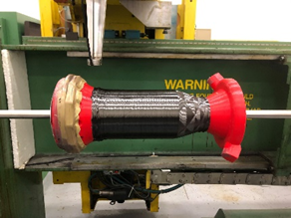
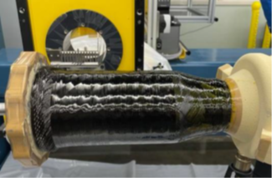
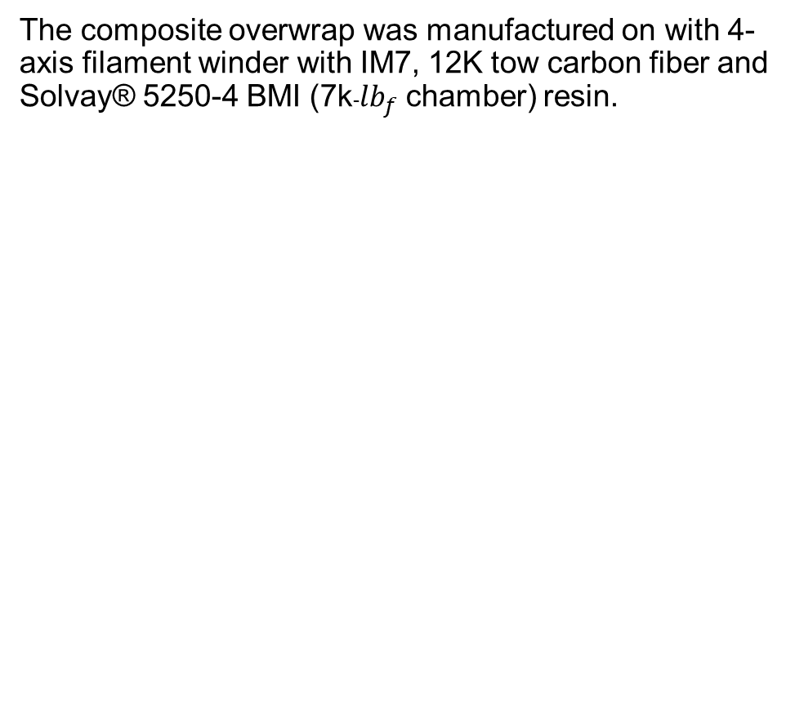

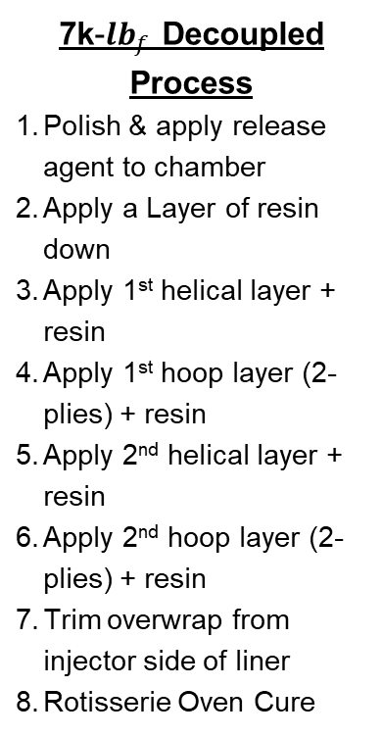
Composite Overwrap: 7k-${lb}_{f}$ Development
The composite overwrap was manufactured on with 4-axis filament winder with IM7, 12K tow carbon fiber and Solvay® 5250-4 BMI (7k-${lb}_{f}$ chamber) resin.
7k-${lb}_{f}$ Decoupled Process
Polish & apply release agent to chamber
Apply a Layer of resin down
Apply 1st helical layer + resin
Apply 1st hoop layer (2-plies) + resin
Apply 2nd helical layer + resin
Apply 2nd hoop layer (2-plies) + resin
Trim overwrap from injector side of liner
Rotisserie Oven Cure
3D Printed Plastic Model
High temperature Foam Mandrel
Once the fiber layup was successfully defined using a plastic 3D model, a high temperature foam (FR-4718) closed cell polyurethane model that had been machined with a representative geometry was used for wet-winding and cure trials

Slide 15
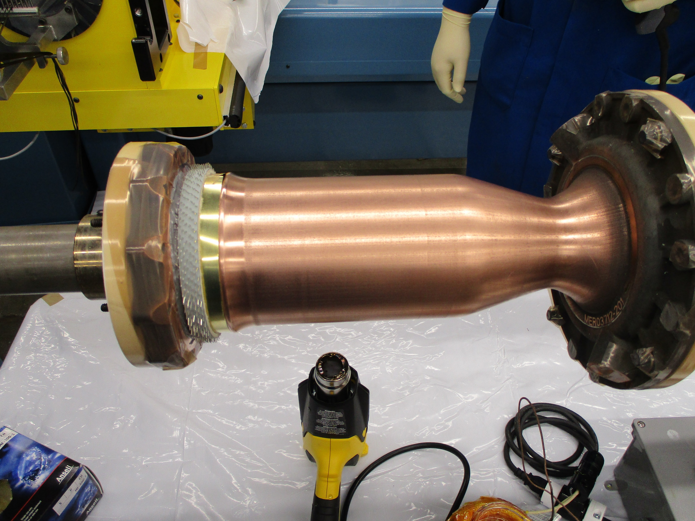
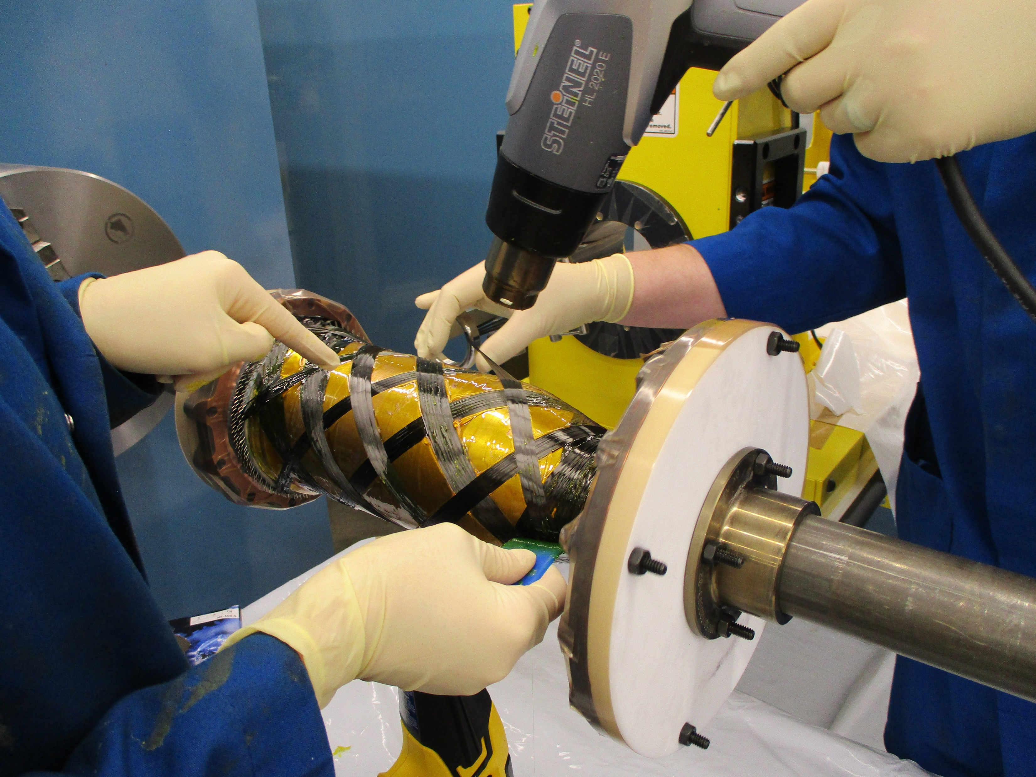

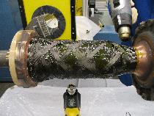

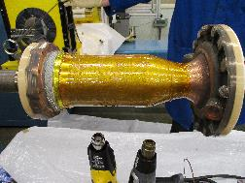


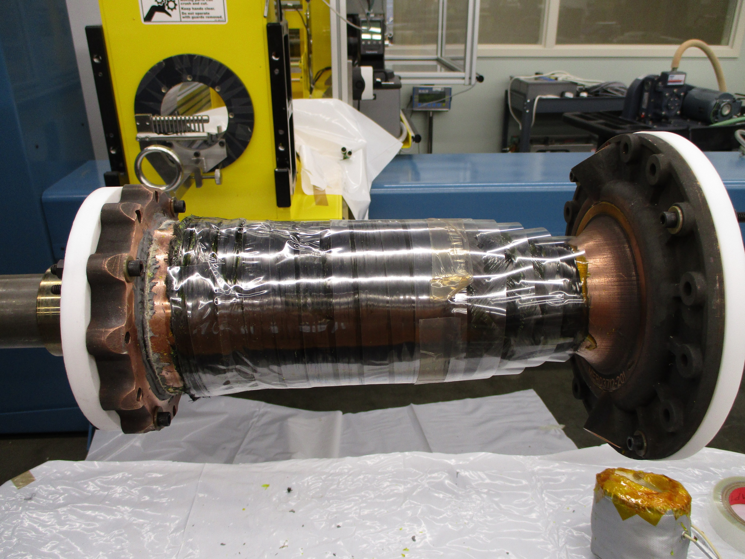
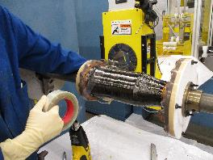

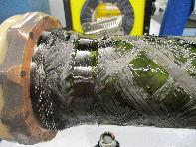


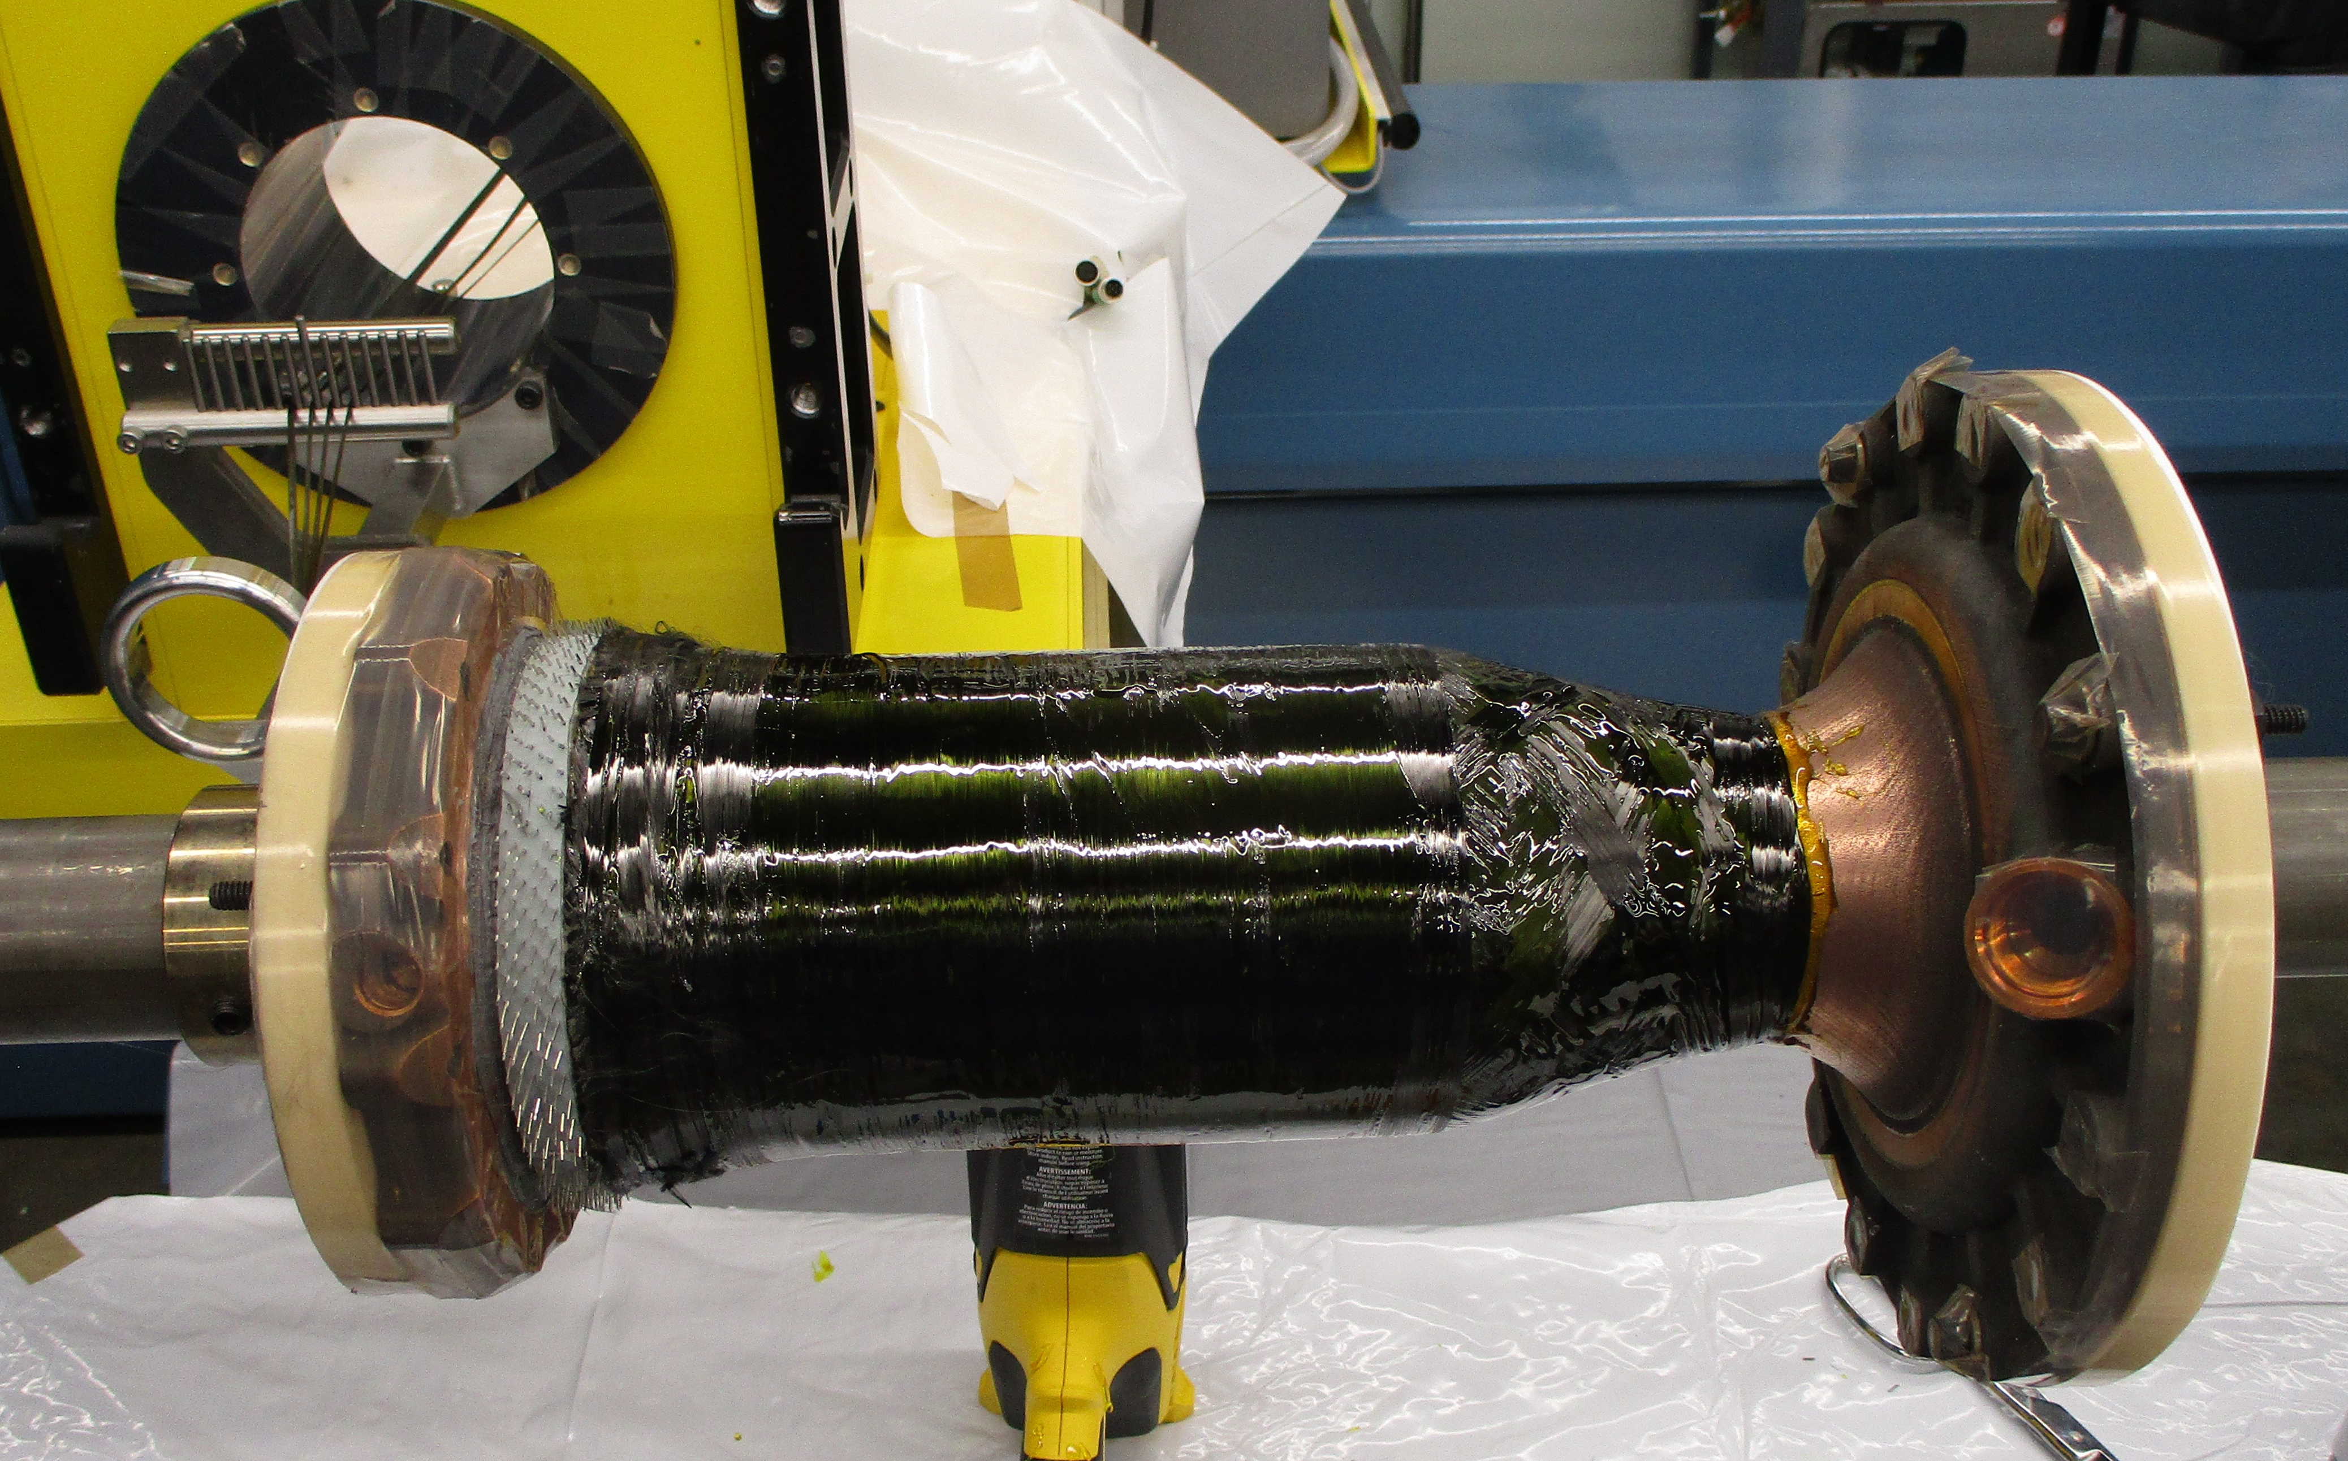

Composite Overwrap: 7k-${lb}_{f}$
Surface Prep
Resin Application
Helical Layer
Helical Layer
Hoop Layer
Hoop Layer
Shrink Wrap
Final Part before Oven

Slide 16

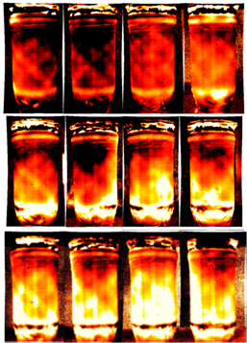
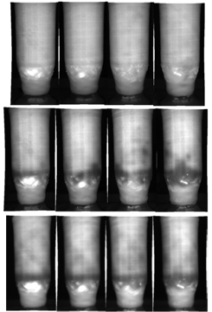



Composite Overwrap: NDE
7k-lb_{f} Nondestructive Evaluation.(NDE)
Figure A shows the results of the 7k-${lb}_{f}$ chamber flash thermography cooling rate from before the hot fire test (bottom row); after the first hot-fire test (middle row); and following second hot-fire tests (top row). The first test occurred in Feb 2021 and the second test occurred in Apr 2021.
  The color map is from -0.4 (black) to -0.9 (bright red), such that a flatter slope (aka cooling rate) (closer to -0.4) is assigned a darker color and a steeper negative slope (closer to -0.9) is assigned brighter red color.
  With a flatter slope, the darker areas indicate less intimate contact between the overwrap and chamber as a gap between overwrap and chamber slows cooling.
  With a steeper negative slope, the brighter areas indicate more intimate contact between the overwrap and chamber because of the rapid cooling caused by the underlying copper chamber.
Figure B shows results of the 7k-${lb}_{f}$ chamber flash thermography cooling amplitude.
  The information gathered from this NDE test is the high porosity and/or delamination areas (seen as white areas in the images) near the aft end of the chamber.
  The high temperatures (white color) at these areas during the cooling process indicate that heat is being trapped in the overwrap, which is an indication of a defect (e.g., porosity, delamination) in the composite overwrap.
3
Figure A: Flash Thermography
Cooling Rate
Figure B: Flash Thermography
Cooling Amplitude
Figure C: X-ray Computed Tomography (CT)
From X-ray CT, voids in the laminate can be identified and exact overwrap thickness measurements can be made. Accurate thickness measurements will be critical for 40k-${lb}_{f}$chambers where the overwrap will have to carry a significant portion of the testing load.

Slide 17






Composite Overwrap: 7k-${lb}_{f}$ Hot Fire
Kord Technologies in Huntsville, Alabama completed the composite overwrap structural jacket on a 7k- ${lb}_{f}$ additive manufactured GRCop-42 chamber. This manufacturing technology demonstration (MTD) for the composite overwrap structural jacket was completed in January 2021 and was used as a piggyback test article.​
​
Piggyback test #1: 2/25/2021​
Ran for 10 seconds.​
​
Composite was shown to be completely unbonded before the test.​ The composite was also exposed up to greater than 450 °F during testing.​
​
Piggyback test #2: 4/2/2021​
​
Total of 3 starts at 125 seconds cumulative mainstage duration.​
​
The last test achieved a chamber pressure of 755 psi and was able to withstand a high mixture ratio of 3.57 for over 60 seconds. ​
​
Maximum skin temperature measurement of 380 °F was observed near the coolant outlet but only when chamber hardware was pushed to a long duration, a low throttle point, and high mixture ratio. ​
Piggyback Hot Fire Test #1 of the 7k$-{lb}_{f}$
Composite Overwrap Structural Jacket MTD​
Piggyback Hot Fire Test #2 of 7k-${lb}_{f}$ Composite Overwrap Structural Jacket MTD ​

Slide 18





Composite Overwrap: Coupled 7k-${lb}_{f}$
Composite Braiding: Task with Auburn University​
A Mid-scale 7k- ${lb}_{f}$ Chamber + Nozzle (coupled) has been delivered DB Technologies for a braided wrap resin infusion lay up.​
Preliminary lay up discussed will include four layers of two helical strength-oriented plies and two hoop strength-oriented plies in a biaxial style weave pattern.​
Final layup due to extra time crunch conditions was one braided layers around the entire chamber.​

Slide 19




Composite Overwrap: Coupled 7k-${lb}_{f}$
The 7k- ${lb}_{f}$coupled chamber with a composite braided overwrapped structural jacket was installed in MSFC test stand 115 late 2021. During the first hot fire test, the 7k- ${lb}_{f}$coupled chamber failed at a pressure of 695 psia in the throat area. ​
​
In order to meet the available test window in October with this coupled unit, a lower TRL braiding operation was selected. The braiding technology is capable of more rapidly covering asymmetric features such as coolant inlets required for thrust chambers, so braiding was selected with the acceptance of the low TRL and limited modeling to meet the test schedule. Although the failure was not desirable, it provided an excellent validation case for structural modelling of 3D printed composite overwrapped coupled thrust chambers and with this evaluation and the lessons learned ​

Slide 20
Composite Overwrap: Hardware Overview
The material thermal requirements varied among the 2k, 7k, and 40k-${lb}_{f}$ chambers
  2k-${lb}_{f}$ and 40k-${lb}_{f}$ are LOX/LH2 and have composite overwrap interface temperatures of -400 to 150 $℉$
  7k-${lb}_{f}$ COMET hardware is LOX/LCH4 and has interface temperatures -230 to 450 $℉$
2k-lb_{f}
7k-lb_{f}
40k-lb_{f}
Decoupled chamber
Decoupled chamber
Decoupled chamber
Coupled chamber
Coupled chamber
Coupled chamber

Slide 21






Composite Overwrap: 40k-${lb}_{f}$ Analysis
Stress diagram
The stresses of the un-wrapped 40K-${lb}_{f}$ thrust chamber if subjected to a 2300 PSI static pressure in the coolant channels at room temperature.
The goal of this work was to capture what the chamber stresses would be if there was no overwrap. That way the team can identify the weak points of the chamber that will need the overwrap the most and in case the overwrap loses contact with the chamber due to thermal contraction​.
NDE Scan of the 40k-${lb}_{f}$ composite wrapped chamber (de-coupled)
​
The goal of the thermography (top left) inspection was to identify defects of interest including delaminations, voids, cracks, and any other features affecting overwrap. NASA was also looking for porosity and bonded vs unboned between chamber and overwrap in the CT scans.​
The CT (top right) scan area covered points 67 – 279 which is where the composite resides. The slices are taken in the X direction as seen in the figure below. ​
The CT scan can give the porosity bonded information, but it can also give us a maximum and minimum thicknesses of the overwrap overall.

Slide 22





Composite Overwrap:40k-${lb}_{f}$ Development
Lessons Learned from Chamber Trial 1
For this first chamber trial, only a single layer of shrink tape was applied to entire composite and preshrunk before oven curing. After cure the chamber was satisfactory, except for the area around the port. The prepreg pieces ended up wrinkling in the exposed regions and there was resin pooling around the port hole. The main take away from trial 1 was that the team needed a better tooling system besides shrink tape alone to keep the fabric from wrinkling. While adding fabric in between wet wound layers is not a novel idea, usually they are fully covered after. The hoop wraps squeezed the prepreg causing them to buckle in the open regions when the resin reached low viscosity during oven cure.
Lessons Learned from Chamber Trial 2
The filament winding process was essentially the same as the first trial but added hoop layers to the part. Along with shrink tape, a silicone caul sheet was made to wrap around the part during cure to help with the wrinkling. However, this still did not provide enough pressure to keep the prepreg from wrinkling in the exposed areas. It was hard to control resin application with it being too viscous at room temperature. With further improvements to techniques and modifications to machinery, the team believes it can be done, but in the interest of time to the project, the team decided to switch back to the 828 epoxy. For the wrinkle control, a soft caul plate was not enough to keep the ridges from forming in the prepreg; something more ridged needed to be added.
Chamber Trial 1: ([fiberglass][+90][prepreg][-90][prepreg][+90][prepreg][-90])
Chamber Trial 2: ([fiberglass][+90][prepreg][-90][prepreg][+90][prepreg][-90][+90]fwd-end[-90]fwd-end)

Slide 23









Composite Overwrap: 40k-${lb}_{f}$ Development
MSFC Chamber Trial 3: ([prepreg][+90][prepreg][-90][prepreg][+90])
First Prepreg Layer
First Hoop and Second Prepreg Layer
Second Hoop Layer
Final Prepreg Layer
Final Part Before Cure
Tooling

Slide 24

Composite Overwrap: 40k-${lb}_{f}$ Development
Lessons Learned from Chamber Trial 3
The main goal of this trial was to improve the tooling technique. A gap had been observed around the port hole and would extend circumferentially around the chamber. To reduce this gap during winding, MSFC used manual techniques to guide the fibers while still under tension to close the gap as much as possible. Two triangular gap shapes were used around the port to reduce the discontinuity around the entire chamber.
The team started with:
  A shrink tape layer again and a layer of Teflon® tape for a resin leakage barrier
  Two triangular rubber inserts to fit into the spaces between the hoop layers left open
  A custom caul sheet made of IM7/8552
  To provide significant pressure to the caul plate and rubber inserts, another layer of cheaper fiber was dry wound overtop at 8 lb_{f} of tension.
The final product had significant improvement compared to the previous trials and reduced prepreg wrinkling and improved resin consolidation.

Slide 25




Composite Overwrap: 40k-${lb}_{f}$ Coupled
Kord Technologies completed the composite structural jacket for the coupled 40k-lb_{f} chamber and nozzle configuration.
  Materials: IM7 carbon fiber, Epon 828/Epikure W resin system
    Manufacturing Technique: Filament winding + hand lay up
    Cure: Rotational cure with shrink tape and caul plate tooling
The composite overwrap surpassed the minimum thickness required and good resin consolidation was achieved.
The seal around the port failed during cure and allowed resin to flow into chamber through port hole.
Some resin was observed using a borescope on the inside the manifold where the channels begin. Further NDE was required to observe the channel holes for blockages.
Photo from RPMI, 4/7/2022

Slide 26





Composite Overwrap

Slide 27



Composite Overwrap: 40k-${lb}_{f}$ Hot Fire
Hot Fire:
On 9/9/2023 they conducted Hot Fire (HF)10 for a successful full-duration of 3 seconds of mainstage duration with an average chamber pressure of 1280 psia.
On 9/19/2023 they attempted the second hot-fire test on this TCA, HF11. HF11 achieved a maximum chamber pressure of 1220 psia and a mainstage duration of 0.2 seconds.
Then they conducted HF12 for a successful full-duration of 10 seconds of mainstage with a chamber pressure of 1260. The weld repair successfully stopped the fuel coolant leakage at the bimetallic joint and the hardware performed well. They continued with HF13. This is the maximum test duration possible for these test conditions at TS116. HF13 achieved a chamber pressure of 1250 psia.
The composite overwrap was successfully demonstrated and showed no signs of change or damage after testing.

Slide 28


Composite Overwrap LaRC X-Winder
LaRC X-Winder® Final Experimental Setup
LaRC X-Winder® Octagonal Mandrel
Flat composite sample development
[4]
3.5 in.
[2]
[1]
[3]
[1] Stainless Steel Octagonal Mandrel (0.19 in. thickness, 5 in. side length, 12.07 in. width)
[2] Carbon Fiber Roll Magnetic Tension Retaining Holder
[3] Plastic Resin Bath and Filament Rollers
[4] Mandrel Stepper Motor and 3D printed Mandrel Holders (PLA, 100% infill)

Slide 29



Composite Overwrap: Decoupled 40k-${lb}_{f}$
Filament Winding Trials
Hoop wraps were able to be applied in areas A and B
  Hoop wraps are unable to be applied in high angled areas such as the transitions to the throat.
  However, it was planned to have helical across the whole chamber.
The team wanted to apply a helical form the FWD end dip to the throat
  After MANY programming attempts on the winder for a helical it was determined other methods would need to be used.
  The angle from the dip area around area A to the throat was too steep and too short for a helical to be able to climb and loop around the chamber without significant slipping.
  The port hole located at various spots around the manifolds also proved to be in the way at times of the winding needle head. This prevents the winder from getting all the way in the dip area at the FWD which would have helped hook the helical into place.
A
Helical slipping
B
Throat
Dip at FWD end
29

Slide 30



Composite Overwrap: Decoupled 40k-${lb}_{f}$
Hand Application Cont.
Techs continued to lay up in a pattern below.
  Apply hoop layer 1
  Apply helical layer 1
  Apply helical layer 2
  Apply hoop layer 2
  Apply helical layer 3
  Apply helical layer 4
  Apply hoop layer 3
  Apply helical layer 5
  Apply helical layer 6
  Apply hoop layer 4
  Apply helical layer 7
  Apply helical layer 8
  Apply hoop layer 5
Debulking steps were carried out after every 2 helical layers
  Debulking involves using the vacuum see bag at 28 inches of mercury for a certain amount of time or overnight.
  This helps the next layers lay down more smoothly.
30

Slide 31



Composite Overwrap: Decoupled 40k-${lb}_{f}$
Hand Application Cont.
The last layer was a final hoop wrap on each end of the chamber.
After a final debulking step, a layer of release film was added to the surface of the chamber.
Tacky tape was applied for a seal.
28 inches of mercury vacuum was applied to the chamber in bagging film.
Cured at 350 $℉$ for 2 hours with a ramp rate of 1 degree $℉$/min.

Slide 32


Composite Overwrap
Hot Fire
Thursday 8/31/23
  HF06 ran for a successful full-duration 10 seconds of mainstage with a chamber pressure of 1333 psia. The composite overwrap structural jacket seems to have performed extremely well. There is no sign of wear or deformation on the composite jacket.
Thursday 9/7/23
  HF08 ran for a successful full-duration of 30 seconds of mainstage duration with a chamber pressure of 1335 psia. Composite performed well.
  HF09 ran for a successful full-duration of 30 seconds of mainstage with a chamber pressure of 1480 psia. The composite overwrap made it through all tests without a significant failure.

Slide 33


RAMPT/ORCA Samples in Materials International Space Station Experiment 20 (MISSE-20)
RAMPT/ORCA Team MISSE Proposal was selected (10/31/23) for MISSE-20 Flight Mission.
Experiment MISSE-20-5 (Launch schedule: 8/1/24)
  Candidate Materials: Overwrap composites, GRCoP-42, HR-1, GRX-810 and so on
Flight orientation and corresponding surface area Requested in proposal:
 | Surface Area Requested | Preference
Zenith | 1.0'' X 1.0'' each sample (four samples) | 2
Ram | 1.0'' X 1.0'' each sample (four samples) | 1
Wake | NA | NA
Nadir | NA | NA
Area offered by ISSPO: 8 square inches
 | Surface Area | Size | Thickness
Zenith | Four samples | 1.0'' inches sq X 1.0'' inches sq each sample | Must be less than 0.4" thick
Ram | Four samples | 1.0'' inches sq X 1.0'' inches sq each sample | Must be less than 0.4" thick
Wake | NA | NA
Nadir | NA | NA

Slide 34

Composite Overwrap: Conclusion
The RAMPT project team has designed and successfully manufactured a series of additively manufactured (AM) GRCop copper-alloy combustion chambers with a composite overwrap to push the boundaries of current engine designs. Significant progress on the designs up to 40k-${lb}_{f}$ thrust chambers contributed to good progress of the combined AM-composite technology during 2021 and 2022. Despite the chamber being considerably more difficult to wrap, the team was able to reach a final layup and tooling configuration that meet the given requirements.
With the successful build and demonstration of the 2k, 7k, and 40k-${lb}_{f}$ chambers, the building block approach for RAMPT has been proven and the lessons learned can be applied to even larger sized thrust chambers. There have been successful tests of 2k and 7k-${lb}_{f}$ chambers and the team anticipates the future testing of the 40k-${lb}_{f}$ in 2023. This new hardware design and manufacturing approach can help the aerospace industry grow in creating more complex designs that lead to significant weight reduction, sustainable lower cost, and lead time reduction of flight hardware.

Slide 35
Composite Overwrap: References
1. Protz, C.S., Gradl, P.R., Fikes, J., Garcia, C., Pelham, L., Clark, A., Hudson, T.B., Miller, S., Ogles, M., “Large-scale lightweight composite overwrap combustion chambers and nozzles under the rapid analysis and manufacturing propulsion technology (RAMPT project),” 2019 Joint Army-Navy-NASA-Air Force (JANNAF), 11th Liquid Propulsion Subcommittee (LPS) Proceedings, Tampa, FL, December 9-13, 2019.
2. Protz, C.S., W.C. Brandsmeier, K.G. Cooper, J.C. Fikes, P.R. Gradl, Z.C. Jones, C.R. Medina., D. L. Ellis, K.M. Taminger, “Thrust Chamber Assembly Using GRCOP-84 Bimetallic Additive Manufacturing and Integrated Nozzle Film Coolant Ring Supporting Low-Cost Upper Stage Propulsion,” 10th JANNAF Liquid Propulsion Subcommittee Meeting, Long Beach, CA, 2018.
3. Clark, A., Hudson, T.B., Miller, S., Edrington, S., Park, C., Protz, C., “Lightweight Thrust Chamber Composite Overwrap Lessons Learned,” The Composite and Advanced Materials Expo, Dallas, TX, 2021.
4. Gradl, P.R., Protz, C.S., Fikes, J., Clark, A., Evans, L., Miller, S., Ellis, D., Hudson, T.B., “Lightweight thrust chamber assemblies using multi-alloy additive manufacturing and composite overwrap,” AIAA Propulsion & Energy Forum Proceedings, New Orleans, LA, August 24-26, 2020.
Gibson, J.T., Gradl, P.R., Katsarelis, C.C., Teasley, T.W., Garcia, M.B., Clark, A.M., Stark, J.B., “Maturation and Hot Fire Testing of Additively Manufactured Bimetallic Composite Overwrap Thrust Chamber Assemblies,” 13th JANNAF Liquid Propulsion, 12th Spacecraft Propulsion Subcommittee Meeting, Huntsville, Al, 2022.
Clark, A., Hudson, T.B., Park, C. Miller, S. Goetz, M., Connell, B. Gradl, P., “NASA’s Composite Overwrap Lessons Learned on 40k Thrust Chamber Assemblies,” SAMPE Conference and Exhibition, Seattle, WA, April 17-20,2023.

Slide 36
Composite Overwrap
EXTRA SLIDES

Slide 37








Composite Overwrap: Early Work
Creation of Preforms:
45 arc section surface extracted from the 3D CAD.
Pattern flattened into 2D CAD file.
Hand layup of digitally cut pattern onto part.
Digital Cutting of Fabric Preforms for Hand Layup
The Thermal Quench:
Immersion in LN₂ (-196°C)
No visible delamination
After immersion in LN₂
Part at Room Temperature After Quench
37

Slide 38





Composite Overwrap: Early Work
Evaluated adhesive and fabric prepreg overwrap of complex geometry.
Quasi-isotropic 4 ply layup for MDA.
Developed template(s) for a consistent overlap of adjacent plies.
Evaluated multiple bagging schemes on copper (and preceding aluminum) chambers for reduction of defects (wrinkles) in final cured part.
Investigated surface preparation with initial procedure determined for MDA.
Template for ply 1 (Separate templates for adhesive and each ply accounting for thickness of material).
Surface prep of copper chamber (grit blast and AC-130-2 surface pre-treatment).
Plain weave fabric overwrap of chamber and adhesive.
Vacuum bag setup prior to cure.
38

Slide 39





Composite Overwrap: Early Work
PMC Overwrap: Evaluated two ply configurations on copper for thermal cycling.​
±40, 90, ± 40, 90​
0, ±40, 90, ± 40, 90​
​
Prepared coupons with and without film adhesive.​
​
Unidirectional layers were prepared in-house using a hot-melt pre-pregger.​
​
The thermal cycle used on the overwrap coupons followed:​
​
-100oF, hold 10 min​
+400oF hold 10 min​
​
10 cycles. ​
Without film adhesive, the overwrap separated from the copper after 1-4 cycles.​

Slide 40





RAMPT Samples in Materials International Space Station Experiment 15 (MISSE-15)
RAMPT Samples in Materials International Space Station Experiment (MISSE)
MISSE-15: The MISSE-FF (Flight Facility) enables integrated testing of the effects of ultraviolet radiation (UV), Atomic Oxygen (AO), ionizing radiation, ultrahigh vacuum (UHV), charged particles, thermal cycles, electromagnetic radiation, and micro-meteoroids and orbital debris (MMOD).
RAMPT material samples: Additive Manufactured GRCop-42 & HR-1 were selected to be part of MISSE 15 sample sets in ISS (operated by AEGIS Aerospace).
The material samples were delivered to ISS by SpaceX on August 28, 2021. The samples were deployed outside of the ISS in November to be exposed for six months.
The GRCop42 samples were exposed to mainly UV, atomic oxygen, space radiation, thermal cycles (16 times per day) and MMOD.
The HR1 samples were exposed to thermal cycles and UHV.
The RAMPT material samples were returned to earth by SpaceX CRS-25 on August 19, 2022.
SpaceX Falcon 9 23rd CRS Mission (August 28, 2021)
International Space Station
MISSE Science Carrier (MSC)
Optical images taken before and after launch (in space)

Slide 41

Glass Transition Temperature (T_{g}) (DMA and DSC)
and Storage Modulus (DMA) of BMI Resin
DSC: 5˚C/min
DMA: 5˚C/min
 | T_{g} (DSC) | T_{g} (DMA) | Unknown transitions (DSC)
BMI 440F Post-Cure | 265˚C | 264˚C | 159, 198˚C
BMI 470F Post-Cure | 293˚C | 283˚C | 160, 213, 232˚C
BMI 500F Post-Cure | 311˚C | 304˚C | 151, 220-230˚C
The T_{g} values measured by DSC for 3 BMI post-cure samples are consistent with those of DMA.

Slide 42











FOD Post Manufacturing of 40k-lb_{f} Chamber 1 and Overwrap Removal
LARC trials to remove resin from HR-1 and GRCop-42
HR1 and GRCoP42 Coated with 828/W Epoxy: Chemical Etching
HR1 and GRCoP42 Coated with 828/W Epoxy: Thermal Decomposition
Methylene chloride drop on top of samples. Not noticeable dissolution observed. (No changes after 1 day)
Blue M Oven
Temperature: 500˚C (932˚F)
Duration: 2 hour and slow cooling
Atmosphere: Air
After Compressed Air
After Isopropanol/
Acetone Wash
1 min
1 hour
After Rubbing with
Paper Towel
After Polishing
Epoxy coated on HR1 was cleanly removed without any residue while that coated on GRCoP42 left a minor residue.
Compressed air, IPA/Acetone wash, and rubbing with a paper towel did not completely clean up the residue.
3 hour
1 day

Slide 43
Composite Overwrap Candidate Resin Materials
Material | Vendor | T_{g} | Tensile strength and modulus | Compression Strength | CAI (Compression After Impact) | Minimum Resin Viscosity | Notes
5250-4/ BMI (currently using) (RAMPT) | Solvay | 280˚C (536˚F) at 227˚C cure (DSC) 300˚C (572˚F) at 243˚C cure (DSC) 310˚C (590˚F) at 260˚C cure (DSC) | -67˚F, 420 ksi 75˚F, 380 ksi 350˚F wet, 330 ksi (IM7 fiber, 0º strength) | 75F, 235 ksi 350ºF, wet, 140 ksi (IM7 fiber, 0º strength) | 36 ksi | ~ 500 cP, 120ºC – 140ºC | Decomposition temp: ~ 395˚C Selected
Epon 828W Toughened epoxy (RAMPT) | Hexion | 164˚C (372˚F) (DMA) 171˚C (340˚F) (DSC) | RT: 229 ksi (note: IM7 fiber, 12K tow (90,0)_{2s}) |  |  | 11,000–15,000 cP at RT | Decomposition temp: ~ 350˚C Selected
LCWR4 (ORCA) | Lattice Composite | 210˚C (410˚F) (DMA) 211˚C (412˚F) (DSC) | Modulus: -50˚C (-238˚F): 3.5 GPa (DMA) RT: 3.0 GPa (DMA) RT: 2.6 GPa (tensile) |  |  | ~ 100 cP at RT | Decomposition temp: ~ 307˚C ORCA resin cadidate

Slide 44
Composite Overwrap Candidate Resin Materials
Material | Vendor | Wet T_{g} | Tensile strength | Compression Strength | CAI (Compression After Impact) | Minimum Resin Viscosity | Notes
5250-4/ BMI (currently using) | Solvay | 383ºF (195˚C), Steady service (400ºF), short service (450^{K}F) | -67˚F, 420 ksi 75˚F, 380 ksi 350˚F wet, 330 ksi (IM7 fiber, 0º strength) | 75˚F, 235 ksi 350ºF, wet, 140 ksi (IM7 fiber, 0º strength) | 36 ksi | ~ 500 cP, 120ºC – 140ºC | CAI details 1.0 in-lb/in 1500 in-lb/in [ +, -, 90, 0, 0, +, 0, 0, +, -, 0] 12 IM7 fiber
M65/ toughened BMI | Hexcel | 437ºF (225˚C) | RT: 229 ksi (note: IM7 fiber, 12K tow (90,0)_{2s}) | RT: 179 ksi, 450ºF: 152 ksi (note: IM7 fiber, 12K tow (90,0)_{2s}) | 26.3 ksi (note: IM7 fiber, 12K tow (45,90,-45,0)4_{s}) | ~ 10,000 cP, 90ºC – 140ºC | CAI details 1500 in-lb,
RS8HT/ BMI | Tencate (Toray) | 567ºF (297˚C) DMA after 168 hr soak at 71˚C (160˚F) | Room temp: 252 ksi, (uni) (Laminate T300-6K/RS-8HT) | Room temp: 184 ksi (uni) (Laminate T300-6K/RS-8HT) | 24.9 ksi | ~ 500 cP, 135ºC – 165ºC | CAI details from Toray RS-8HT/T800GC-24k UD Tape 145gsm/34%RC CAI @ 1500in-lb/in impact= 24.9ksi
UHTR | Techneglas | TBD | RT (~70˚F), 49.7 ksi for UHTR reinforced with 40-50% carbon fiber RT (~70˚F), 8.0 ksi for UHTR reinforced with 40-50% silica fiber | TBD | TBD | ~35k-50k cP @ 100ºC 100 cP @ RT in 35% isopropyl/65% resin solution | Resin flake melt/flow temperature, no solvent-neat resin, unmeasured estimate-flows like honey. Resin only suitable for infusion with solvent.

Slide 45
Composite Overwrap Candidate Resin Materials
Material | Vendor | Wet T_{g} | Tensile strength | Compression Strength | CAI (Compression After Impact) | Minimum Resin Viscosity | Notes
RM-3000/ BMI | Renegade | 447˚F | 26 ksi (3K Standard Modulus Carbon Biaxial Fabric (±45)) | 36 ksi (3K Standard Modulus Carbon Biaxial Fabric (±45))
Avimid/Polyimide | Solvay | 487˚F | -67˚F, 125 ksi 71˚F, 125 ksi 500F wet, 109 ksi T650-35 carbon fiber reinforced 8 harness satin fabric, [0, 90]_{3s} | -67˚F, 124 ksi 71˚F, 118 ksi 500F wet, 52 ksi T650-35 carbon fiber reinforced 8 harness satin fabric, [0, 90]_{4s} | 42 ksi |  | CAI details 1500 in-lb/in T650-35 carbon fiber reinforced unidirectional tape (12K tow)
EP2400 (currently using) | Solvay | 325˚F | 73˚F: 110 ksi (12K HTS40 536gsm BX NCF) | 75˚F, 116 ksi 180˚F, wet, 77 ksi ((0/90), 3K T300 PW) | 32 ksi 3K T300 PW 30J impact | 10 hours at <300cP at 100°C (212°F) 20 cP at 120°C (248°F)
D.E.R.TM 383 resin Jaffamine polyetheramine hardner | DOW Huntsman |  |  |  |  | 9000 – 10500 cP @ 25°C, below 100 cP @100˚C | Jeffamine hardner usually provides relatively low Tg around 100˚C or below Too many variations

