Slide 1
Managing Maintenance Error
Six lessons from aviation maintenance
Alan Hobbs Ph.D.
San Jose State University Research Foundation
NASA Ames Research Center
Moffett Field, CA
alan.hobbs@nasa.gov

Slide 2
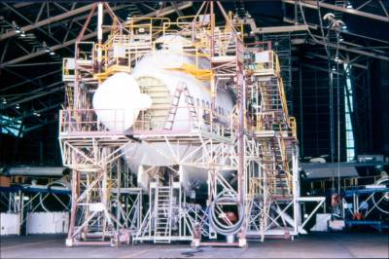
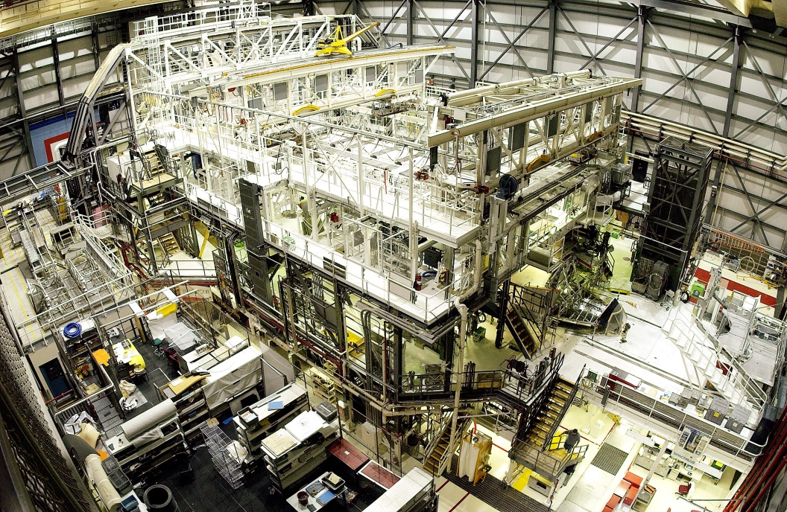
Maintenance and ground processing
Aviation
Space
Maintenance error involved in 20-30% of in-flight engine shutdowns.
Maintenance error was a factor in 12% of aircraft accidents
IATA Safety Report, 2013-2017
“The predominant causes of [shuttle processing] mishaps are human factors”
Perry Report on Shuttle Processing, 1993
Source: Author
Source: NASA

Slide 3
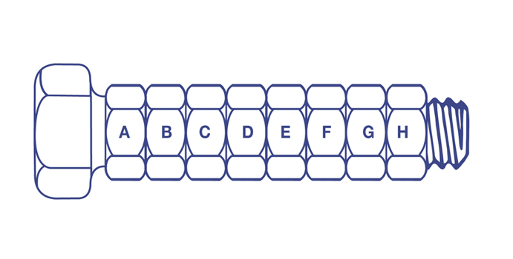
Maintenance error probabilities
Install nuts and bolts 0.2%
Connect electrical cable 0.3%
Install O ring 0.3%
Tighten nuts and bolts 0.4%
Read pressure gauge 1.1%
Install lock wire 3.2%
Check for error in another person’s work 10.0%
Source: Irwin, Levitz and Freed (1964) Human Reliability in the Performance of Maintenance, Aerojet General Corp, Liquid Rocket Operations
.
Notes:
Over 40,000 ways to put back incorrectly

Slide 4
Airline maintenance errors
Equipment or part not installed
Incomplete installation
Cross-connections
Other installation errors
Wrong location errors
Wrong equipment or part
System not reactivated or deactivated
Source: Boeing

Slide 5
Rasmussen’s Skill-Rule-Knowledge framework
Skill: Routine tasks controlled by automatic action routines.
  Can proceed without conscious awareness
  e.g. Lock-wiring, replacing caps and covers, checking fluid levels.
  MX personnel describe such tasks as “monotonous”
  Seemingly complex tasks can also be taken over by skill routines (reading, signing documents, slips of the tongue)
Rule: Familiar tasks, but performance needs to be guided by “if-then” rules
  Often need to stop and check before acting
  Need to identify situation before applying a familiar procedure
Knowledge-based: Situations that require conscious thought and/or problem-solving
  e.g. fault diagnosis
  Reference to documents
  In maintenance, often involves consultation/team performance

Slide 6
Broad categories of maintenance
Maintenance
Corrective
Preventative
Fault isolation
Remove & replace
Test & inspect
Software updates
Time replacement
Repair
Source: Adapted from Department of Defense (1997). Designing and Developing Maintainable Products and Systems. Military Handbook 470-A.

Slide 7
Lessons for space systems from aviation maintenance
Design for assembly, test, and maintenance
Non-technical skills
Maintenance procedures
Reduction of iatrogenic injury
Barrier and control analysis
Learning from quality lapses

Slide 8
Error-producing conditions in aircraft maintenance
Data from 643 maintenance reports. Hobbs, A., & Williamson, A. (2003). Associations between errors and contributing factors in aircraft maintenance. Human Factors, 45, 186-201.

Slide 9
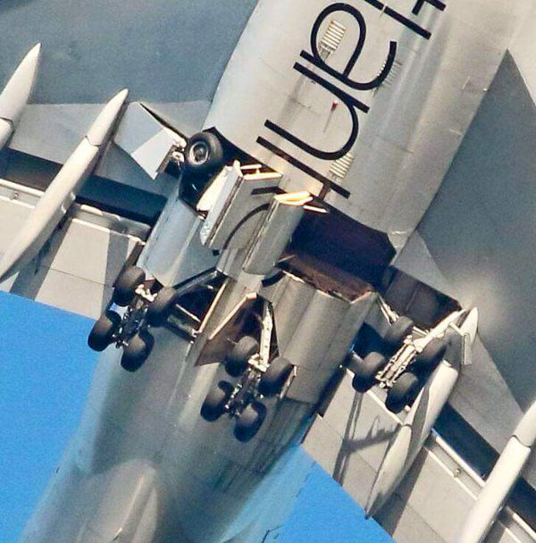
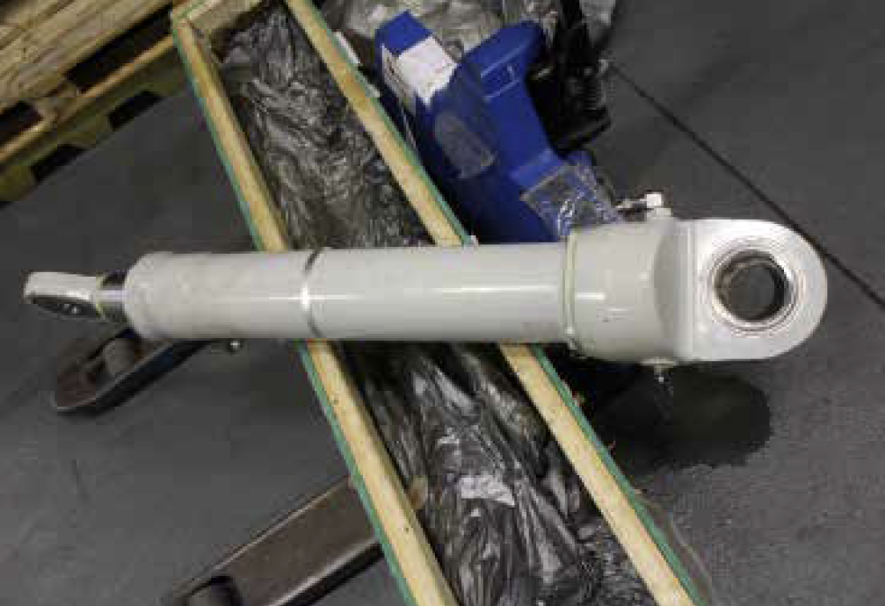
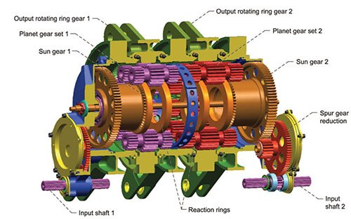
1. Design for assembly and maintainability
Aviation
Space
“The right wing landing gear struck the gear door, preventing the gear leg from fully deploying. … the maintenance team … had rotated [the actuator] 180° about its long axis during installation, effectively installing it upside down.”
UK Air Accident Investigation Board.
“NASA engineers have discovered that gears within actuators that control the rudder speed brakes on space shuttle Discovery suffered a number of problems, including one gear that had been originally installed backwards.”
www.spacetoday.net
Source: UK Government Air Accident Investigation Branch AAIB Bulletin: 10/2015 Investigation to Boeing 747-443, G-VROM
Source: . NASA/TM—2015-218846
Notes:
Night shift installed gear actuator. 85 KG, had to be manhandled for 30 minutes to make it fit.

Slide 10
Background – Shuttle Mishap Data
Slide courtesy of Tim Barth, Ground Operations Human Factors Task Analysis Pathfinder, IAASS, May 2016.

Slide 11
Maintainability standards with human factors guidance
FAA Human Factors Design Standard, HF-STD-001B, section 5.2. Designing Equipment For Maintenance.
Department of Energy Handbook 1140-2001 Human factors/ergonomics handbook for the design for ease of maintenance.
MIL-Handbook-470A, 1997, Designing and developing maintainable products and systems.
Mil-STD-1472G, Design Criteria Standard Human Engineering.
MIL-HDBK-727 Design Guidance for Producibility.
UK Ministry of Defence, Standard 00-250: Human Factors for Designers of Systems.

Slide 12
Design for assembly and maintainability
FAA HFSD & MIL Handbook 1472
“Equipment shall include physical features that prevent improper mounting or alignment, or at least have labels or codes to identify proper mounting and alignment.”

Slide 13
Placement and component reliability
FAA HFDS 4.9.2.1.5 Unreliable components. If a module contains some parts that are significantly less reliable than the remaining parts, the unreliable parts should be accessible without removal of the module.
FAA HFDS 2.1.2.11 Placement of low reliability components within module. Unitizing the module with the low reliability components removable from the exterior of the package should be considered if all components of a module except for one or two are reliable.

Slide 14
Design to support the positive human contribution
Examples:
Light colored surface assists with leak detection
Guides or objects in same orientation to enable “normal” to be denoted
Enable serendipitous discovery of damage
  e.g. bruising of composites

Slide 15
The Devil’s Design Principles or “How to design an error prone system”
0
Ensure components are difficult to access
Obstruct line of vision
Make it difficult to achieve necessary levels of precision or force
Ensure closely-located systems are difficult to distinguish from each other
Make it necessary to disconnect unrelated components to get access
Ensure plumbing or electrical connections permit cross-connection or connect to wrong system
Ensure that components can be installed backwards or upside down

Slide 16
Error-producing conditions in aircraft maintenance
Data from 643 maintenance reports. Hobbs, A., & Williamson, A. (2003). Associations between errors and contributing factors in aircraft maintenance. Human Factors, 45, 186-201.

Slide 17
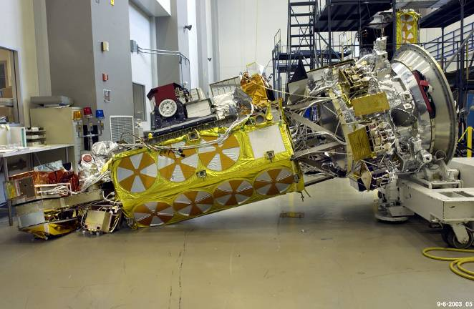
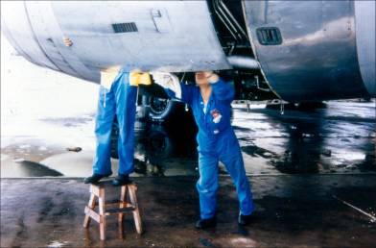
2. Non-technical skills
Aviation
Space
“An airframe and engine technician did not properly secure an oil line. I did not say anything, though I seem to remember noticing, as electrical instrument technician’s comments on engine/airframe systems are unwelcome/unheeded.”
Incident Report
Source: NASA
“At least one of the crew members was uncertain and nervous about seeing ‘holes with threads’, but did not have sufficient experience with the [turnover cart]-to-spacecraft configuration to recognize the reality of the situation.”
NOAA-N-Prime Mishap Investigation Report
Source: Author
Notes:
Verbal communication error rate of around 3%

Slide 18
European Aviation Safety Agency (EASA) Part 145 Human Factors Syllabus Includes:
Safety culture
Human error
Violations
Fatigue
Time pressure & stress
Distractions and interruptions
Visual inspection
Norms
Communication
Shift handover
Teamwork
Assertiveness

Slide 19
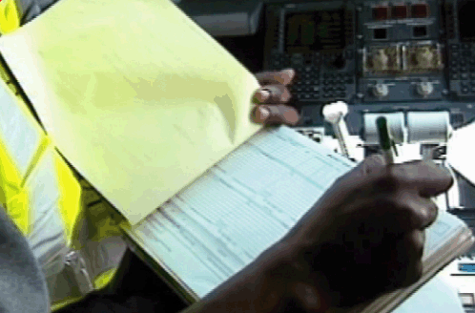
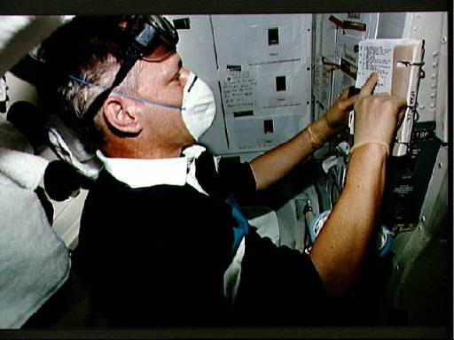
3. Maintenance procedures
Poor documents and procedures lead to:
Errors
Non-compliance
  Reliance on informal data sources
  Procedure workarounds
Aviation
Space
Source: Federal Aviation Administration
Unscheduled in-flight maintenance on the shuttle waste collection system. Source: NASA
Notes:
STS-46 European Space Agency (ESA) Mission Specialist (MS) Claude Nicollier, wearing goggles, face mask, and rubber gloves, reviews inflight maintenance (IFM) checklist procedures before starting waste collection system (WCS) fan separator repair. One of two fan separators used to transfer waster water from the waste management compartment (WMC) to the waste water tank has failed. The suspected accumulation of water in the separator was believed to have occurred during a test dumping of waste water at a lower than normal pressure to evaluate the performance of new nozzles. The WMC is located on the middeck of Atlantis, Orbiter Vehicle (OV) 104.

Slide 20
3. Maintenance procedures
Simplified Technical English
European Association of Aerospace Industries (AECMA)
The English word “Tap” can mean:
        = remove fluid from a barrel
        = object above a sink
        = intercept a phone conversation
        = a type of dance
In AECMA English “Tap” always = hit lightly (as with a hammer)

Slide 21
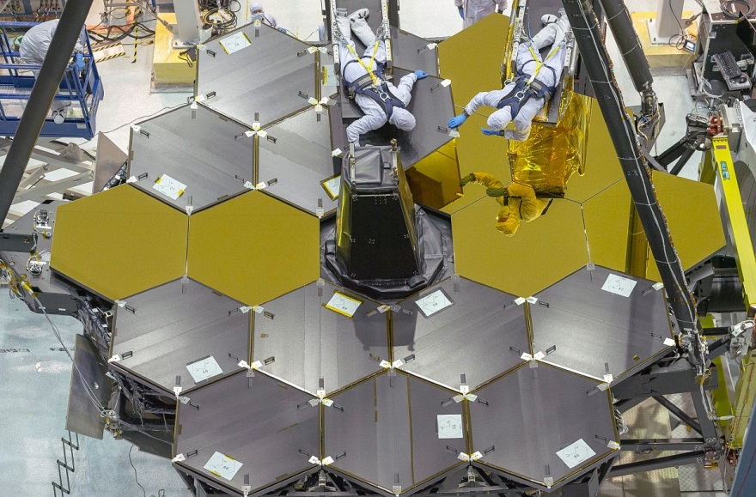
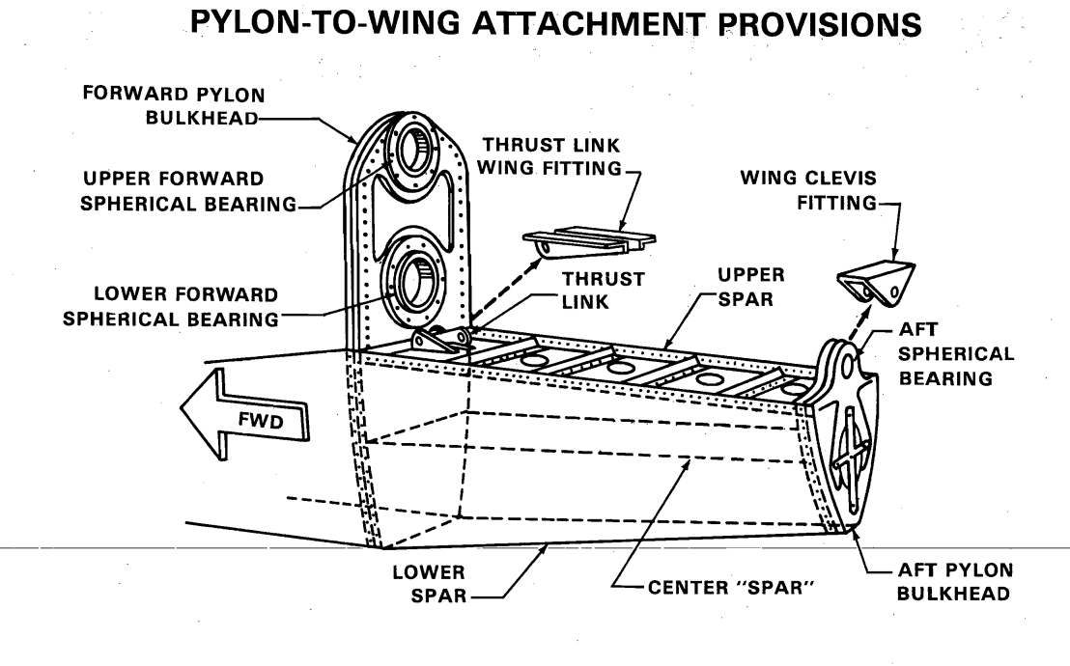
4. Iatrogenic injury
iatrogenesis noun iat·​ro·​gen·​e·​sis : the unintentional causation of an unfavorable health condition (such as disease, injury, infection, or an adverse drug reaction) during the process of providing medical care (such as surgery, drug treatment, hospitalization, or diagnostic testing)
Aviation
Space
“… maintenance-induced damage [led] to the separation of the No. 1 engine and pylon assembly at a critical point during takeoff … improper maintenance procedures led to failure of the pylon structure.​” NTSB report AAR-79-17
“… improper test wiring … caused excess voltage to be applied to transducers. The error resulted from an improper interpretation of a process step. The error should have been detected by the inspector, who did not inspect, but relied on the technician’s word that he had done the wiring correctly.”
James Webb Space Telescope, Incident Report, May 31, 2018. NASA
Source: National Transportation Safety Board

Slide 22
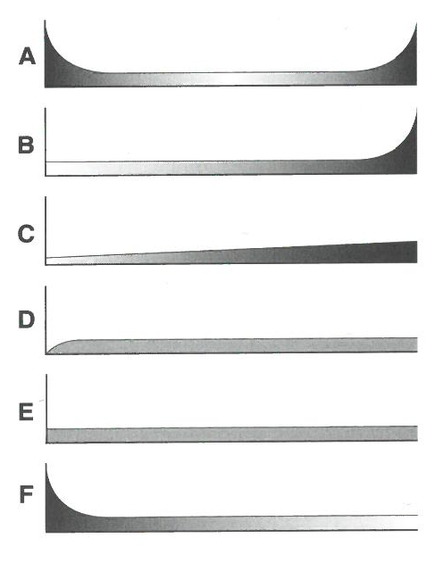
Reliability-centered maintenance
Many failure patterns do not adhere to the “bathtub curve”
4%
2%
5%
7%
14%
68%
Failure patterns for electrical and mechanical items. Source: Nowlan, F. S., & Heap, H. F. (1978). Reliability-centered maintenance.

Slide 23

5. Barrier and control analysis
Three functions of barriers & controls
Prevent errors
Capture/correct errors
Contain errors

Slide 24
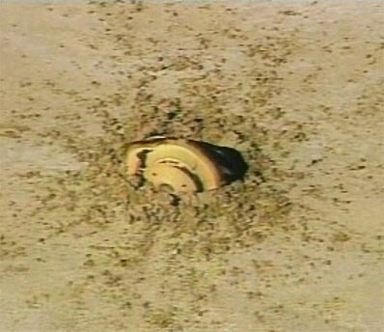
5. Barrier and control analysis
Aviation
Space
Beech 1900, 21 fatalities
Elevator cables incorrectly adjusted night before the accident. Supervisor signed off quality assurance inspection. No functional check at end of task.
Genesis Spacecraft, drogue parachute did not deploy
Gravity sensors were installed upside down. Centrifuge test that would have captured the error was cancelled.
Source: NTSB Report AAR-04/01
Source: NASA. Genesis Mishap Investigation Board Report, 2005.

Slide 25
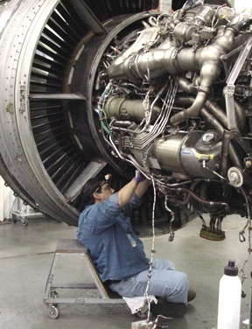
6. Learning from maintenance quality lapses
Maintenance errors often latent
Errors may be “fixed” without record
Multiple organizations may be involved
Work may be less visible to management
In aviation industry, heavy reliance on self-disclosure of incidents
May be long delay between error and consequences
Image source: Federal Aviation Administration

Slide 26
6. Learning from maintenance quality lapses
Reactive
Proactive
Predictive

Slide 27
In conclusion
Lessons for space systems from aviation maintenance:
Design for assembly, test, and maintenance
Non-technical skills
Procedures
Reduction of iatrogenic injury
Barrier and control analysis
Learning from quality lapses

Slide 28
Additional references
Hobbs, A. (2021). Aircraft maintenance and inspection. In R. Vickerman (Ed.). International Encyclopedia of Transportation, Vol 2 (pp 25-32). Elsevier.
Kinnison, H. A., & Siddiqui, T. (2013). Aviation maintenance management. McGraw Hill.
Moubray, J. (2001). Reliability-centered maintenance. Industrial Press Inc.
Reason J., & Hobbs, A. (2003). Managing Maintenance Error. A Practical Guide. Ashgate.

