Slide 1
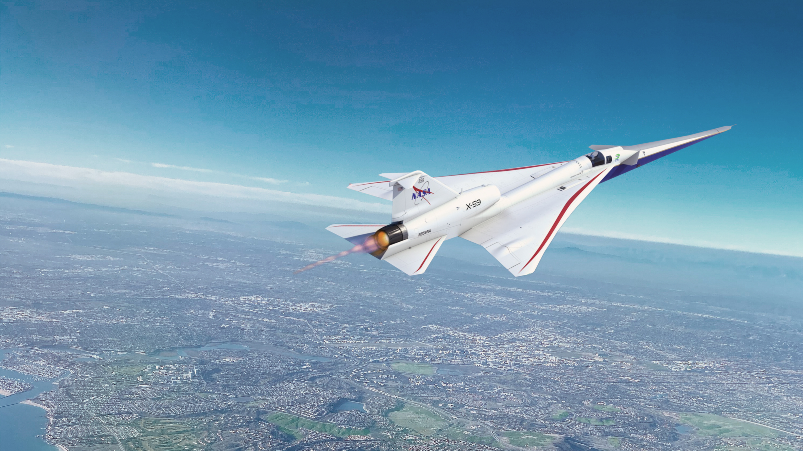


2aNSb3
Simulations of X-59 sonic thumps and traditional sonic booms propagated around the world for three atmospheric models
William J. Doebler and Victor W. Sparrow
Acoustics 2023 Conference, Sydney | 12/5/2023
www.nasa.gov

Slide 2
Propagation simulations were conducted to predict the loudness of supersonic aircraft around the world
Talk Outline
Motivation for the study of supersonic aircraft noise
Overview of simulation process
  Selection of
    atmospheric models
    aircraft and flight conditions
    propagation locations
  Bootstrap forest model to assess important factors
  Multiple linear regression models to predict outside of the selected propagation locations
Results
  Comparison of predicted loudness for different atmospheric models
  Comparison between N-waves and quiet supersonic signatures
  Assessment of effects of climate zone on loudness
Summary

Slide 3
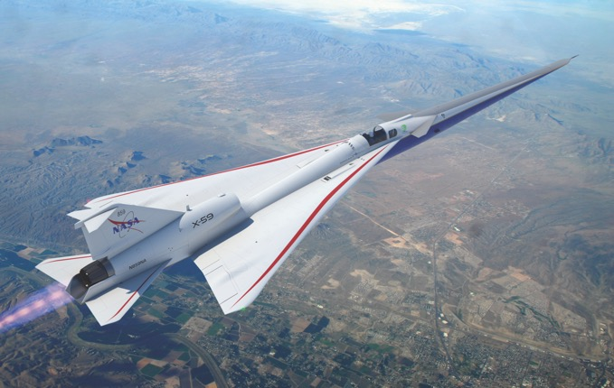

Motivation: Civilian supersonic aircraft noise certification standards are under development and need to be globally effective
Overland supersonic flight currently prohibited
New technology reduces loudness of sonic booms
New supersonic aircraft noise certification standards needed
NASA X-59 aircraft
  low-boom noise source for community noise surveys
  will inform noise regulations
Atmosphere influences effectiveness of low-noise supersonic aircraft design
Noise regulations should be effective regardless of location
Goal of this propagation simulation study:
  Identify regions and climates that may experience increased loudness
  Assess differences between
    predictions from three atmospheric models
    meteorological impacts on traditional N-wave sonic booms and shaped booms

Slide 4
Process flow for a sonic boom propagation study
Select:
aircraft and flight conditions
atmospheric model
propagation locations
timespan
PCBoom 7.3
Enhanced Burgers
Module
Compute loudness and exposure region sizes
Fit prediction models
Setup
Propagate
Analyze
Notes:
Select aircraft and flight conditions
Select atmospheric model
Select propagation locations
Select timespan
Propagate near-field pressure data through atmospheric profiles at all locations for all aircraft and flight conditions
Compute the loudness and exposure region sizes for each boom carpet
Fit models to predict loudness and exposure region size for locations other than those selected

Slide 5
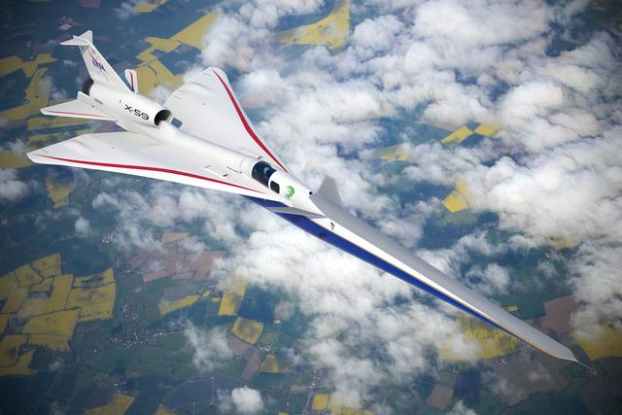
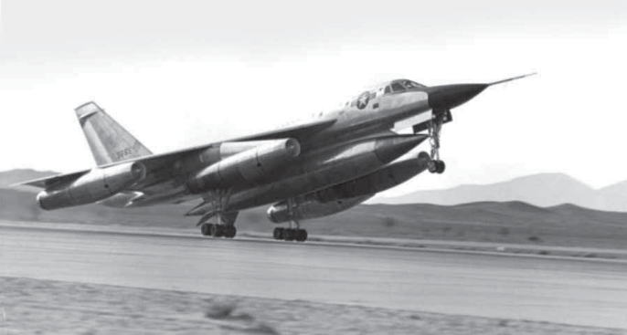

Global propagation study details
X-59
Quiet: Mach 1.4, 53200 ft
Loud: Mach 1.3, 43000 ft
B-58
Mach 1.4, 53200 ft
Selections:
Aircraft and flight conditions
  X-59 (Quiet/Loud), B-58
  4 cardinal directions
Atmospheric models
  ERA5, CFSv2, GFS
Propagation locations
  100 global locations
Timespan
  1 year, every 6 hours
Setup
 | ERA5 | CFSv2 | GFS
Horizontal Resolution | 0.25° x 0.25° | 0.5° x 0.5° | 0.25° x 0.25°
Vertical Resolution | 37 isobars from 1000 mbar to 1 mbar | 37 isobars from 1000 mbar to 1 mbar | 34 isobars from 1000 mbar to 0.4 mbar
Temporal Resolution | 1 Hour | 6 Hour | 3 Hour
Ground Elevation
Pressure
Temperature
Winds
Humidity
Notes:
Select aircraft and flight conditions
X-59 (“C612A”) in its quiet cruise configuration
X-59 (“C612A”) in a loud cruise configuration
N-wave aircraft (weight-modified B-58) with the same flight conditions as X-59 in quiet cruise
4 cardinal aircraft headings
Select atmospheric models
ERA5, CFSv2, and GFS
Select propagation locations
100 locations selected
Select timespan
1 year, every 6 hours
Reference RUMBLE study where ERA5 was compared to balloon data and compared well

Slide 6
Global propagation parallelization details
Selections:
Aircraft and flight conditions
  X-59 (Quiet/Loud), B-58
  4 cardinal directions
Atmospheric models
  ERA5, CFSv2, GFS
Propagation locations
  100 global locations
Timespan
  1 year, every 6 hours
Setup
PCBoom 7.3
Enhanced Burgers
Module
Propagate
Write millions of PCBoom input files
Set up parallelization
  Create master list of all runs
  Split list into batch segments
  Assign batch segment to cluster computer
Propagation over about 2 weeks
  NASA Langley’s K-cluster supercomputer
    Hardware:
      Intel Gold 6148 Skylake (Dual socket 20 core 2.40 GHz)
      Intel E5-2697 V3 Haswell (Dual socket 14 core 2.60 GHz)
      Intel E5-2670 Sandybridge (Dual socket 8 core 2.60 GHz)
    72-hour max per job
    3000 CPU limit for running jobs
3 aircraft configurations x 4 aircraft headings x 3 atmospheric models
x 100 locations x 365 days x 4 atmospheric profiles per day
= 5.256 million carpets generated
Notes:
Select aircraft and flight conditions
X-59 (“C612A”) in its quiet cruise configuration
X-59 (“C612A”) in a loud cruise configuration
N-wave aircraft (weight-modified B-58) with the same flight conditions as X-59 in quiet cruise
4 cardinal aircraft headings
Select atmospheric models
ERA5, CFSv2, and GFS
Select propagation locations
100 locations selected
Select timespan
1 year, every 6 hours

Slide 7
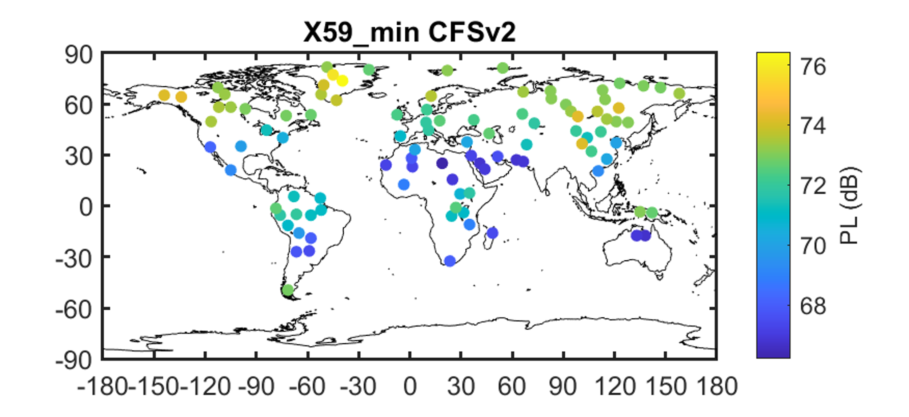
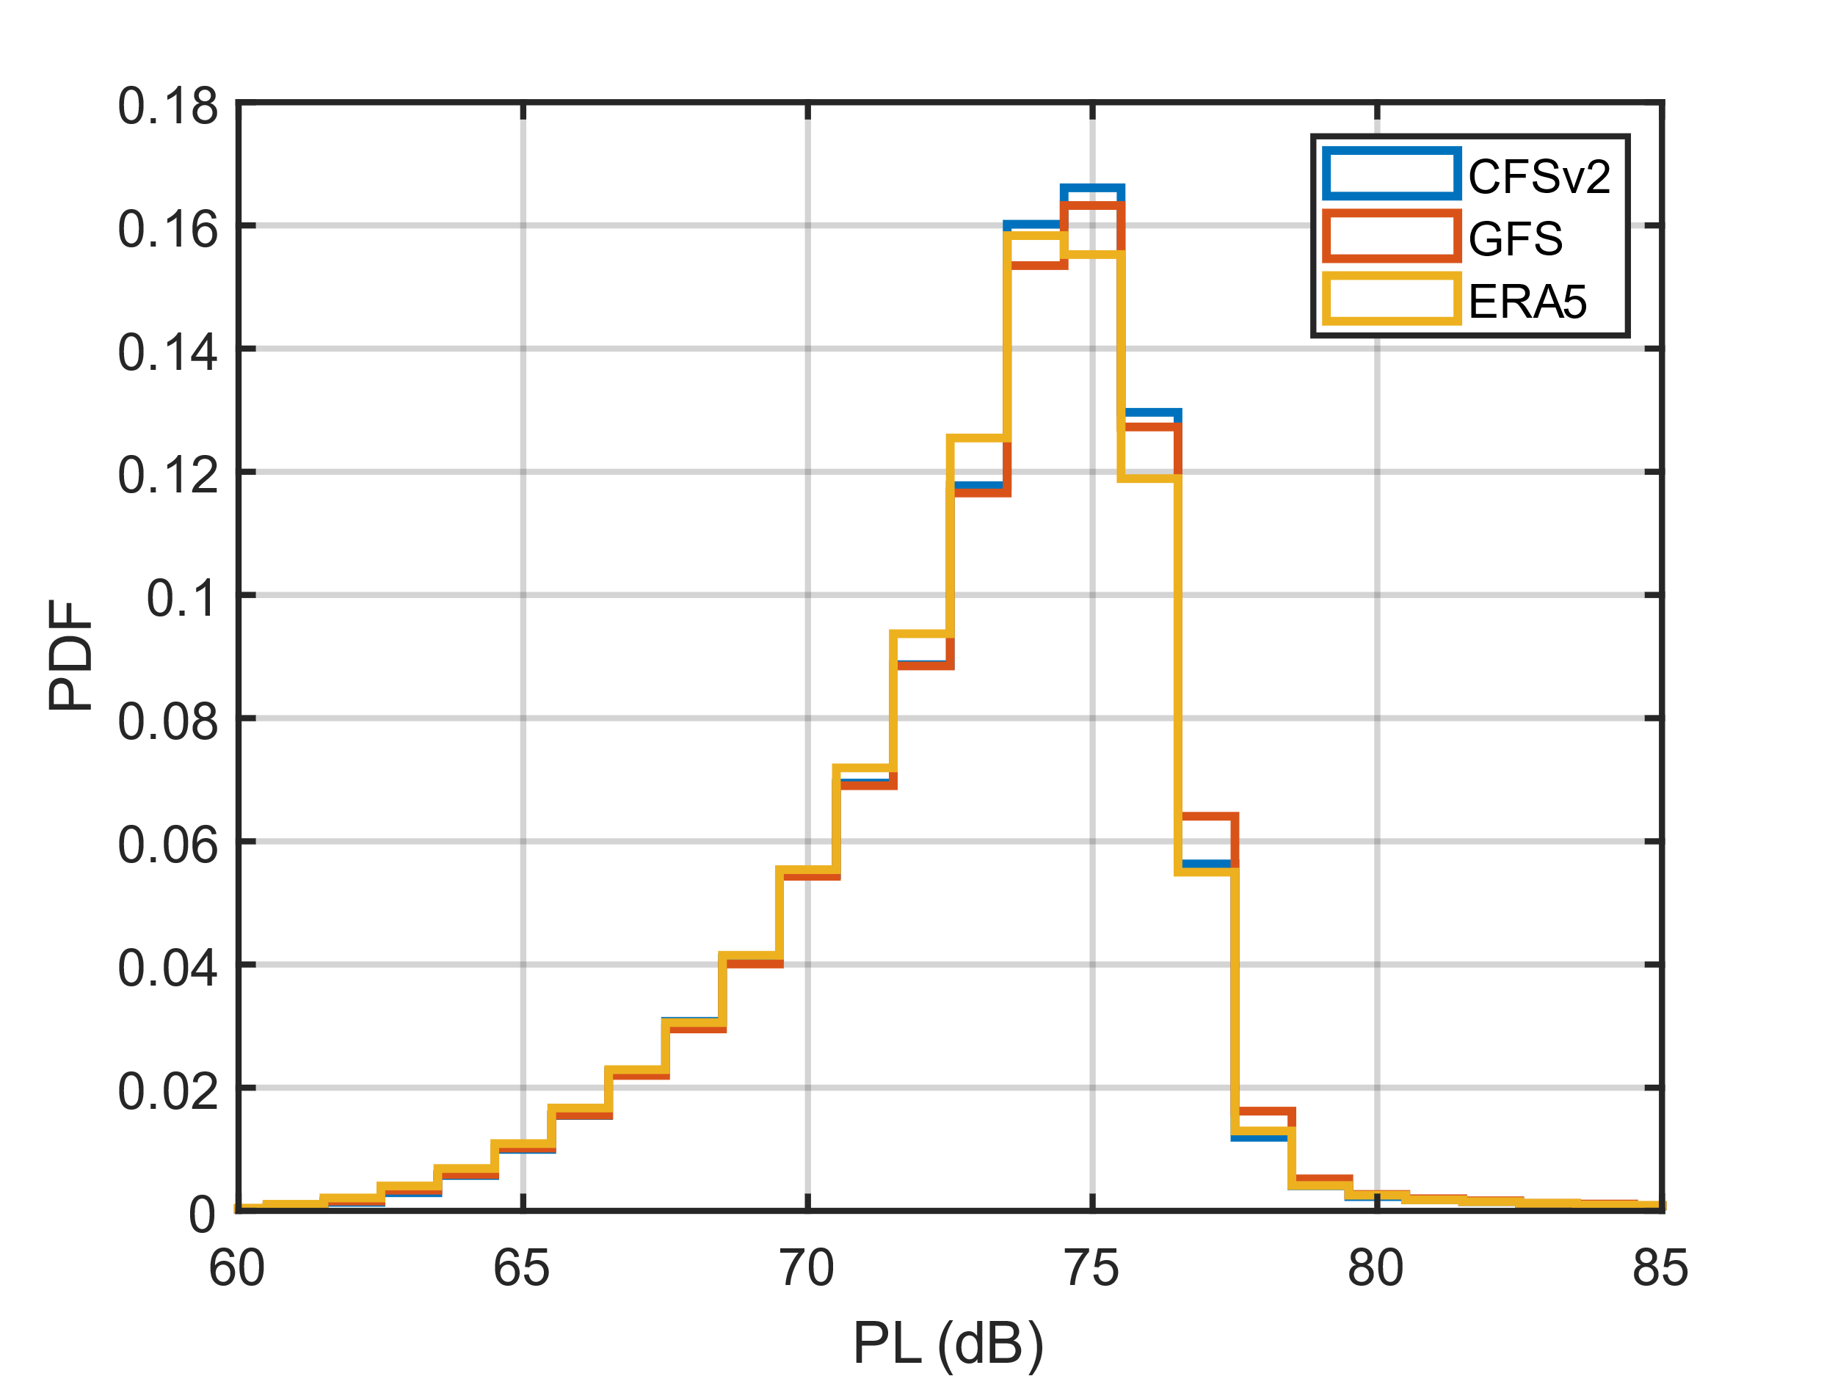
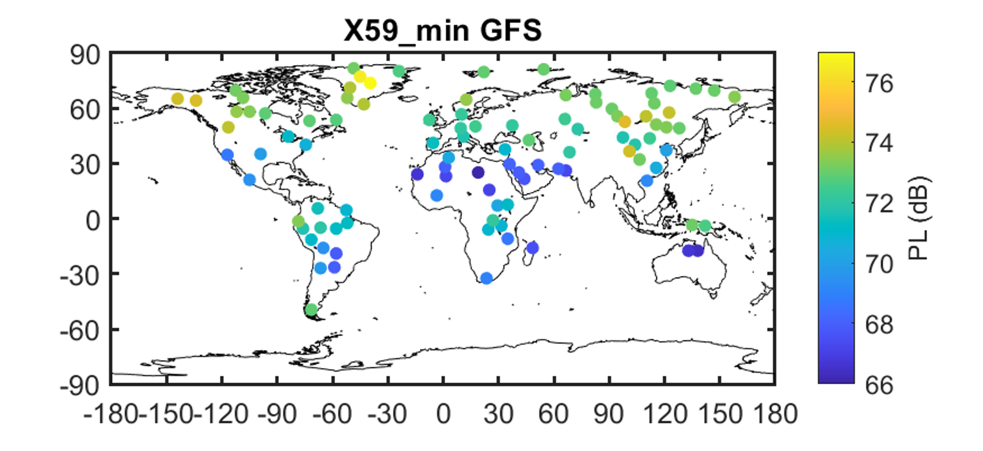

Loudness predictions differ very little between three atmospheric models
Results match well between atmospheric models
  Example:
Bootstrap forest model used for predictor screening
  Predictors considered
    Latitude, longitude, aircraft, heading,
    atmospheric model, ground elevation,
    climate zone, season, and time of day
  Top 3 most important factors
    Climate zone, season, latitude
  Unimportant factors
    Atmospheric model, time of day
Notes:
Explain that time of day was found not to be important in US-only study
Be sure to explain what is being plotted thoroughly
Say that there will be variability around these mean levels

Slide 8
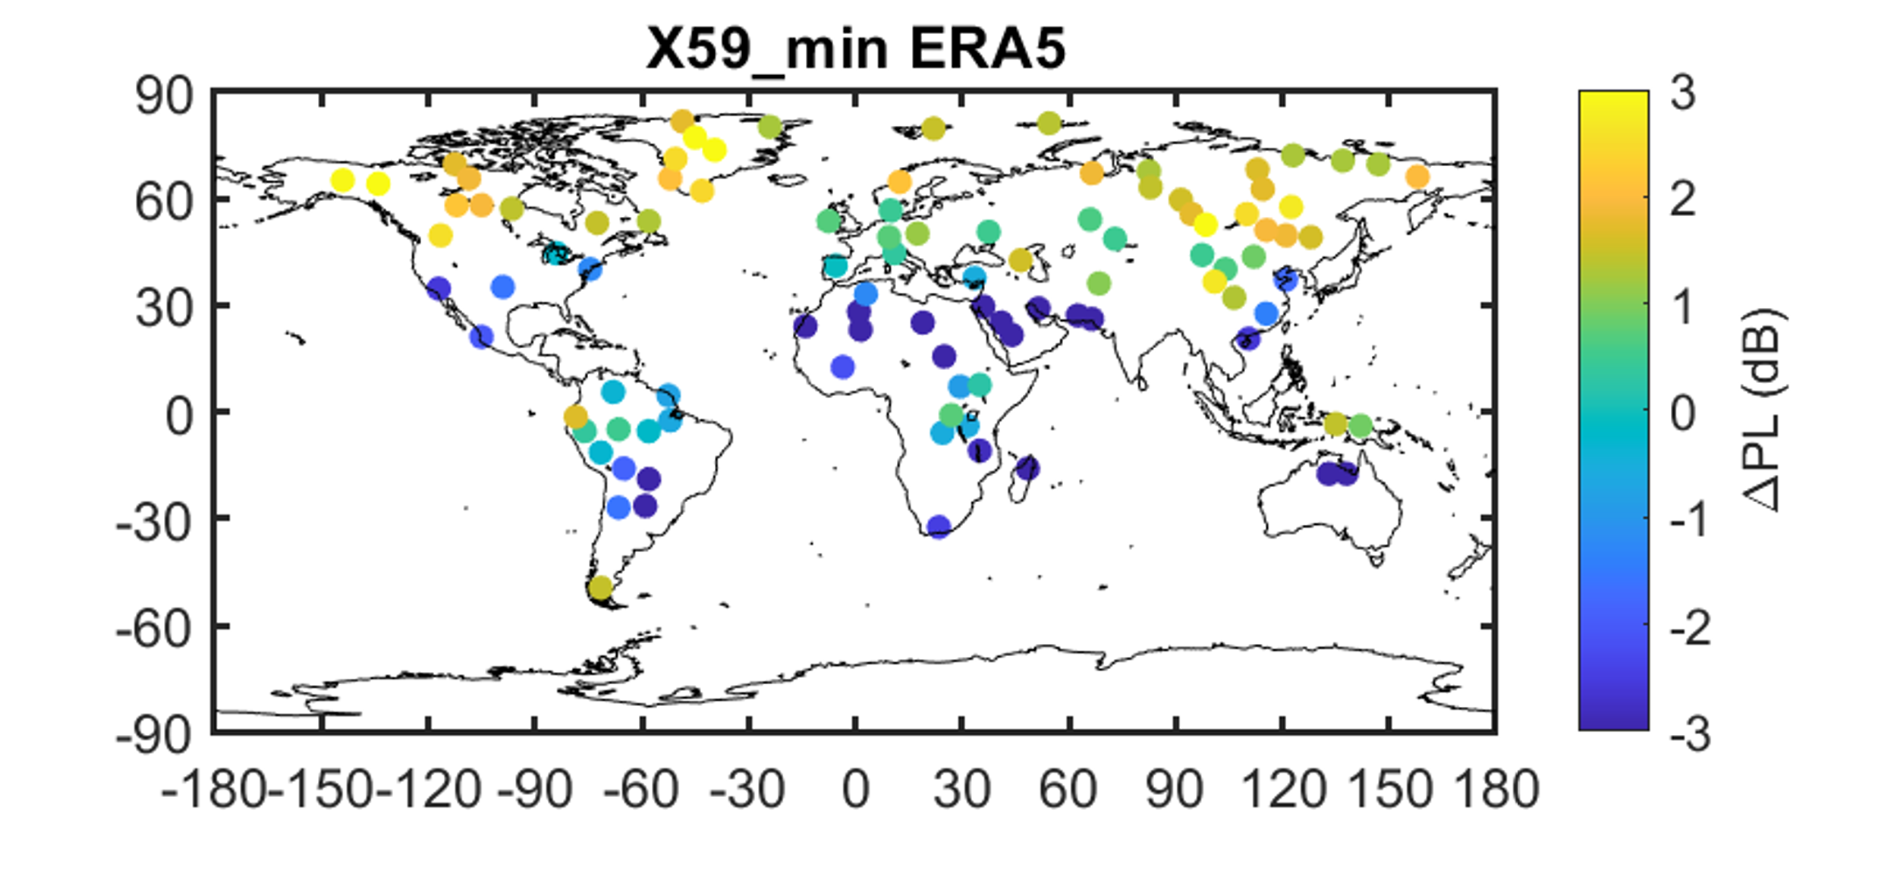
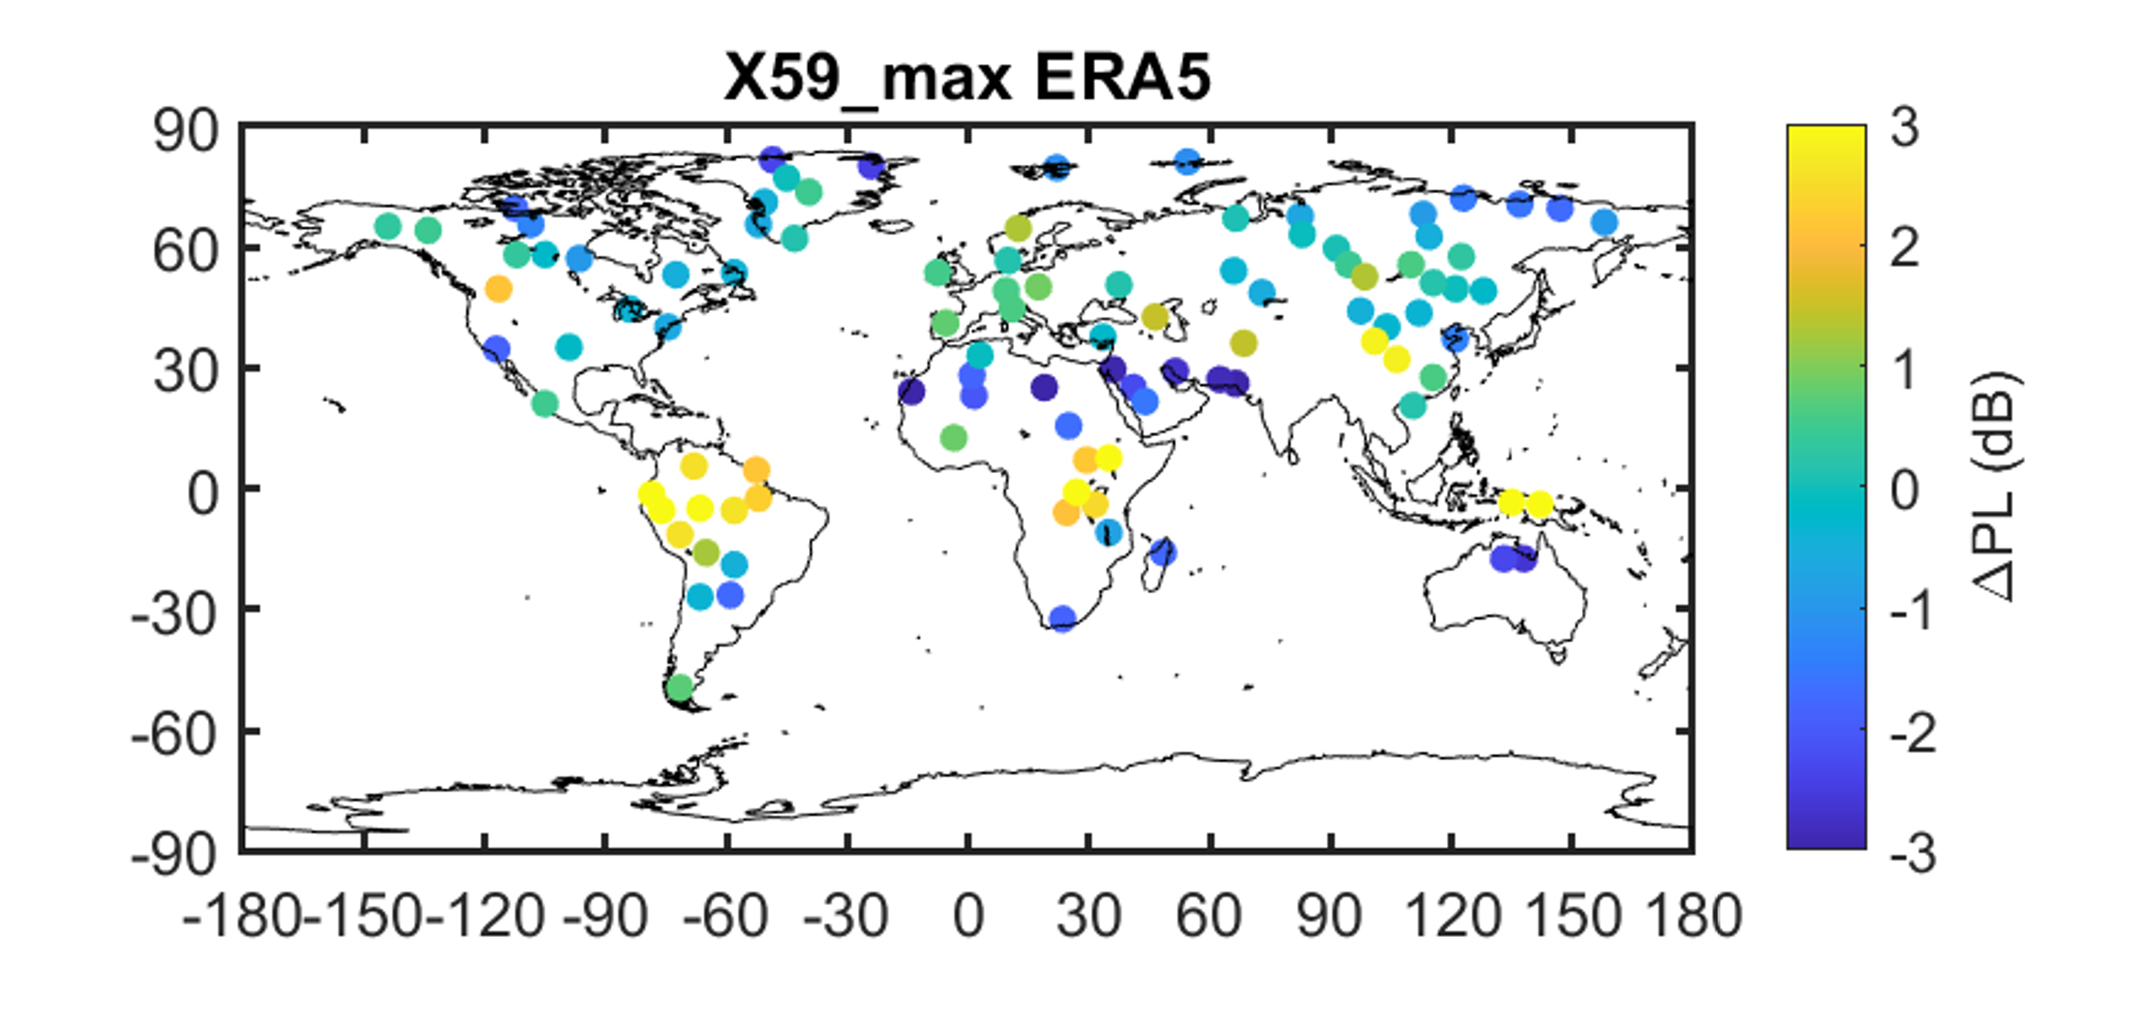

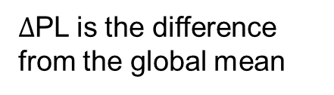
Differences in trends between are apparent between low-booms and N-waves
Shaped front
with tail shock
Low-boom
N-wave
$Δ$PL is the difference from the global mean
Notes:
Point out differences in N-wave and low-boom trends, particularly along the latitude band making up the rainforest/northern South America/midcentral Africa/and Malasia.
Point out trend differences in latitude

Slide 9
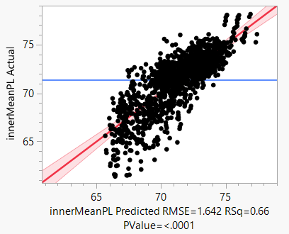
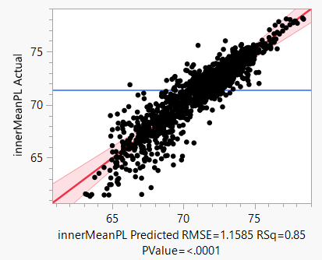
Multiple linear regression models fit to predict at additional locations
Direct effects model
Direct effects and single interactions model

Slide 10
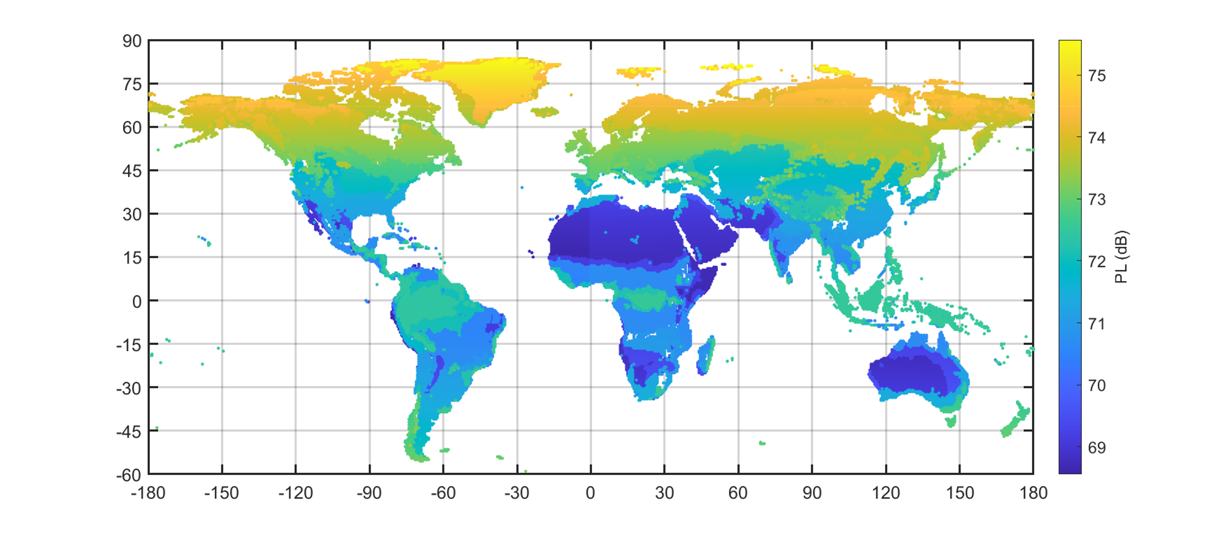
Global predictions from multiple linear regression models
Undertrack level X-59 quiet configuration, eastbound, winter
Notes:
With the regression model, you can predict loudness at any location
Point out Australia’s lower predicted loudness

Slide 11
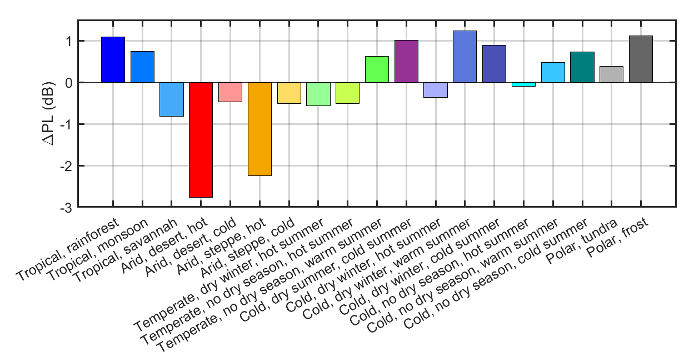

Impact of climate zone on X-59 low-boom mean PL
Beck et al. (2018) Koppen-Geiger Zones doi: 10.1038/sdata.2018.214
Sort by $\text{ΔPL}$

Slide 12
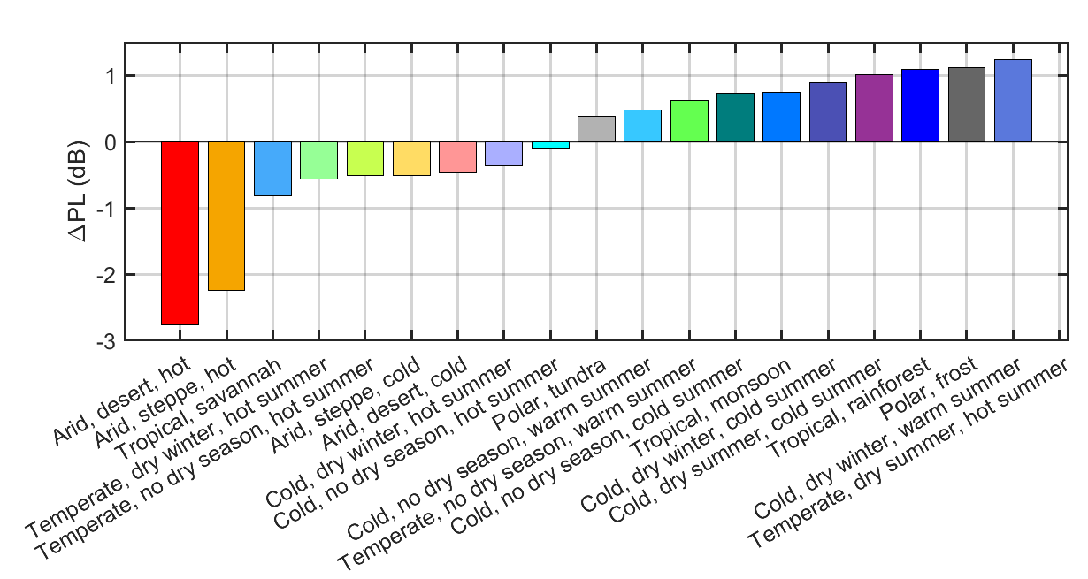
Impact of climate zone on X-59 low-boom mean PL
Beck et al. (2018) Koppen-Geiger Zones doi: 10.1038/sdata.2018.214
Notes:
Note implications of lower loudness potentially causing increased permissible operations for a cumulative metric

Slide 13
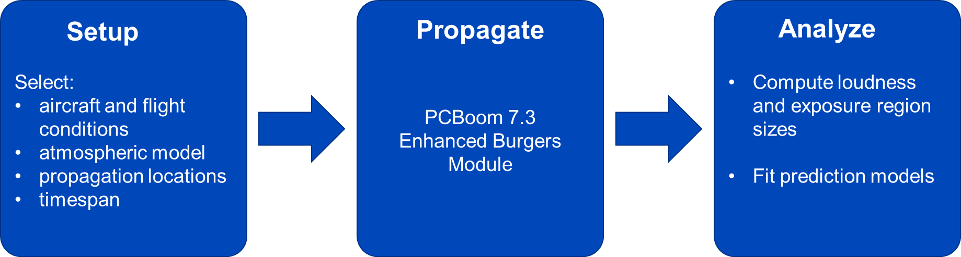
Summary
Global sonic boom propagation study undertaken
  Over 5 million sonic boom carpets generated
    X-59 and an N-wave-producing aircraft
    100 locations
    Carpets generated over 1 year, every 6 hours
    3 atmospheric models studied
Modeling
  Bootstrap forest predictor screening
    Climate zone, season, and latitude were the most important
    Atmospheric model was unimportant
  Multiple linear regression models fit that allow global prediction
Key Takeaways
  Trends in low-boom loudness differ from N-waves
  Climatic differences ranged between -3 and +1 dB from the mean
These takeaways will be important to consider when setting future noise regulations

Slide 14

Quesst
www.nasa.gov |
14

Slide 15


Back-Up
www.nasa.gov |
15

Slide 16
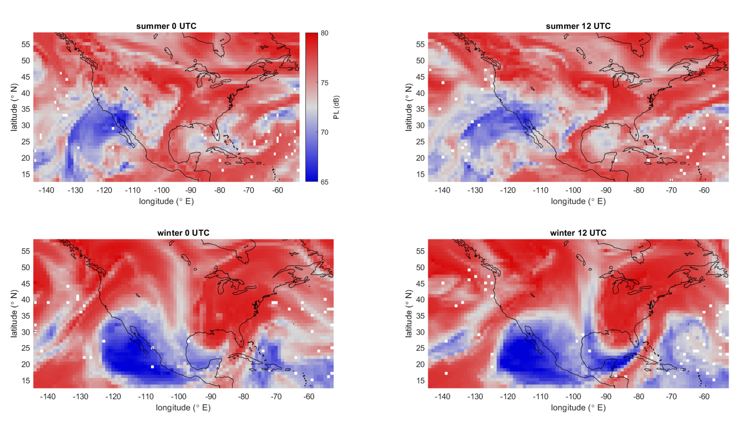
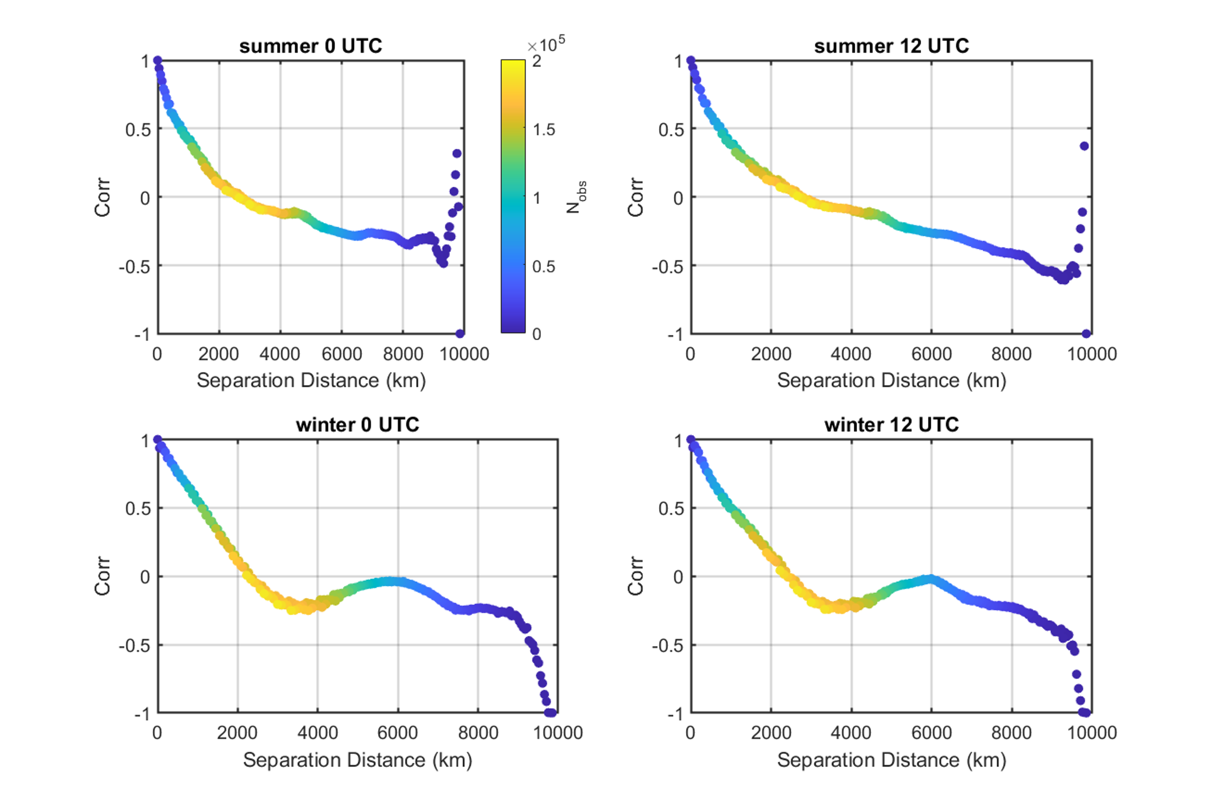
Separation distances: computing spatial correlation at fixed time
Analysis of data made available by
Leal et al. (2021) doi: 10.2514/1.J059209
Partial correlation is desirable for modeling
Selected locations’ correlation is too low?
  Polka dot map plots, hard to interpolate between points.
Selected locations’ correlation is too high?
  Waste of computational resources due to little information gain from point to point
Correlation of 0.5 is observed between 675 and 1100 km
Correlation of 0 is observed between 2350 and 2700 km

Slide 17
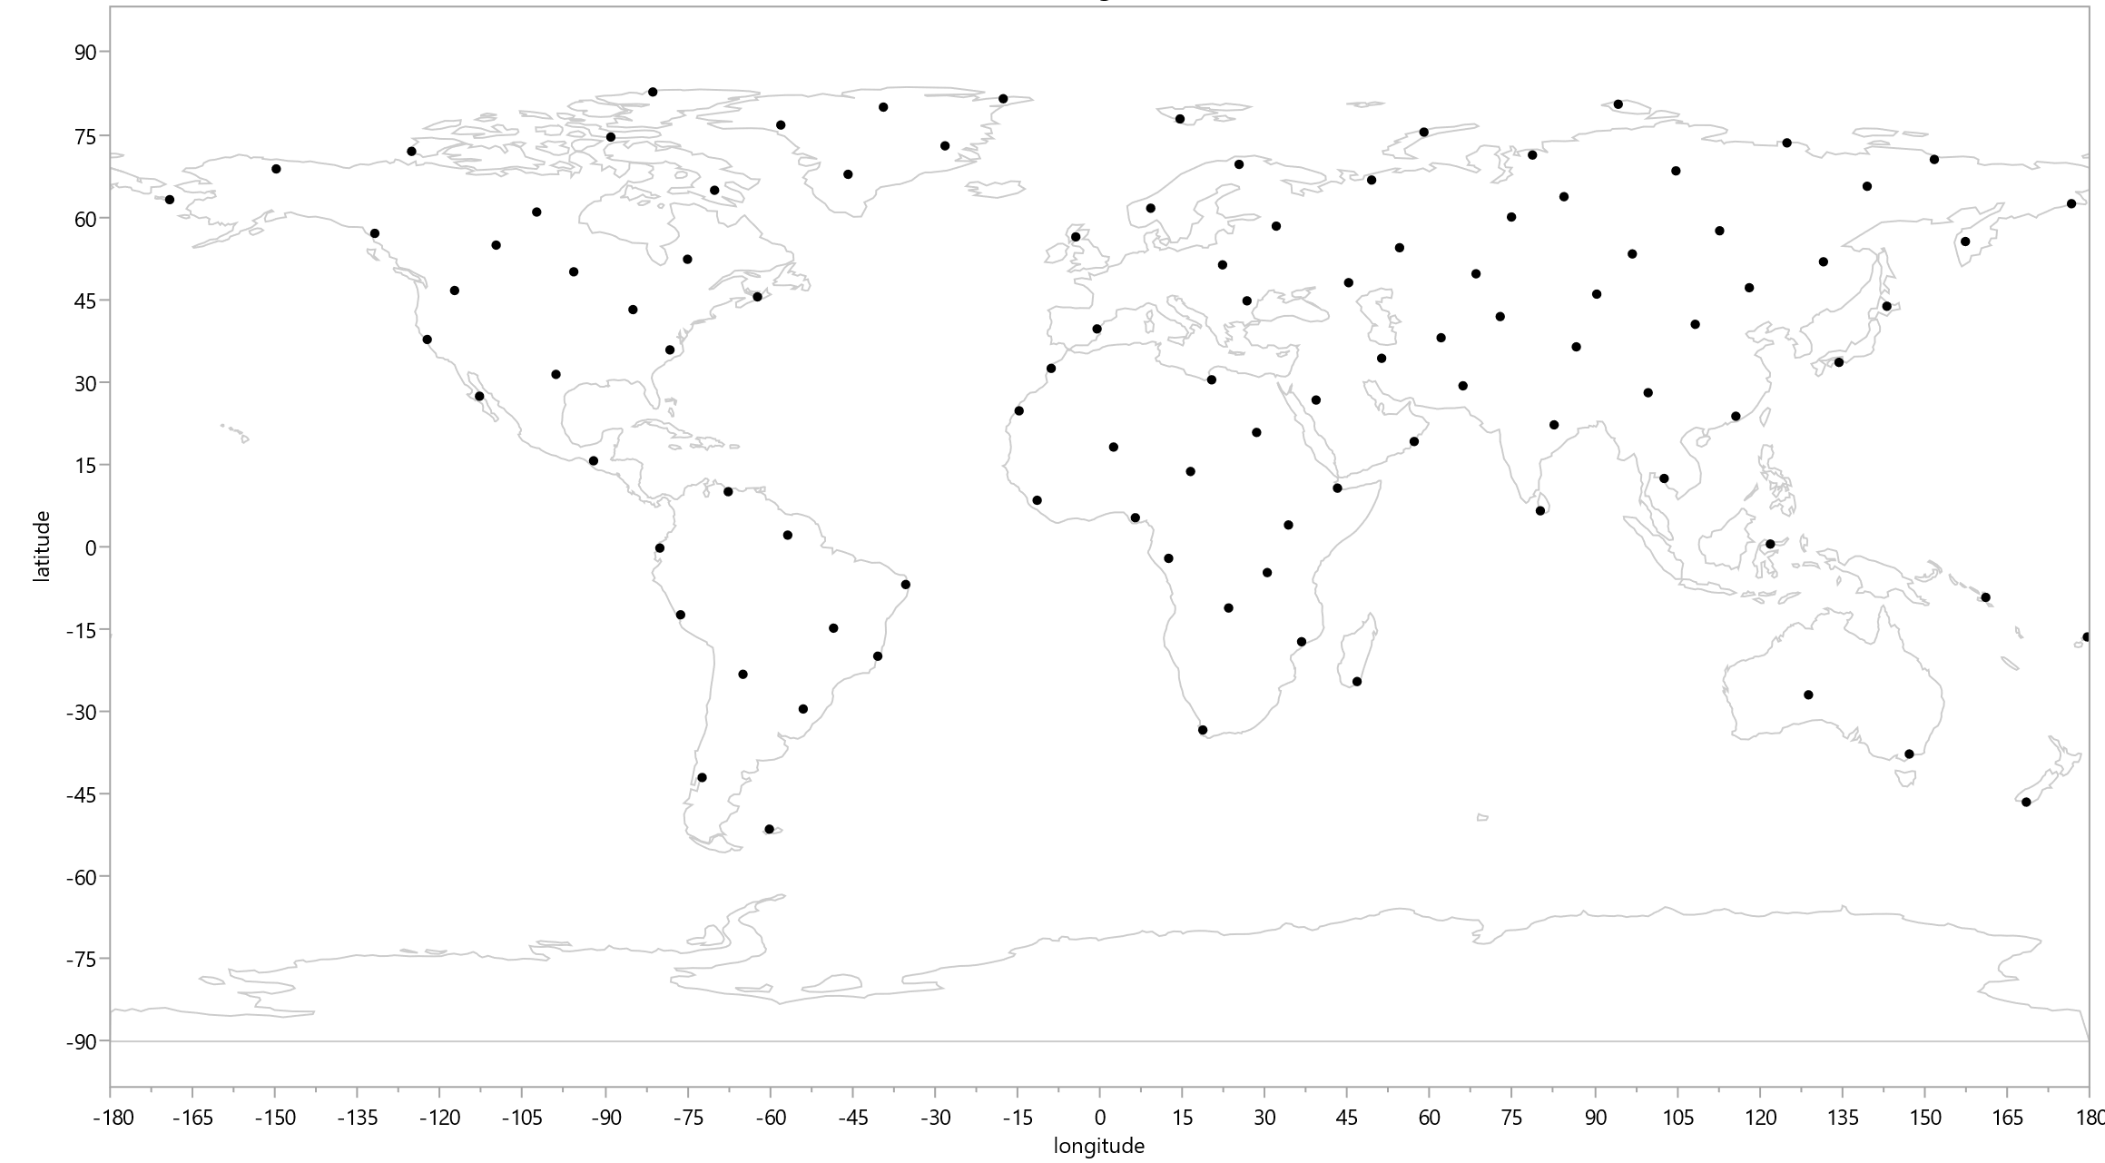
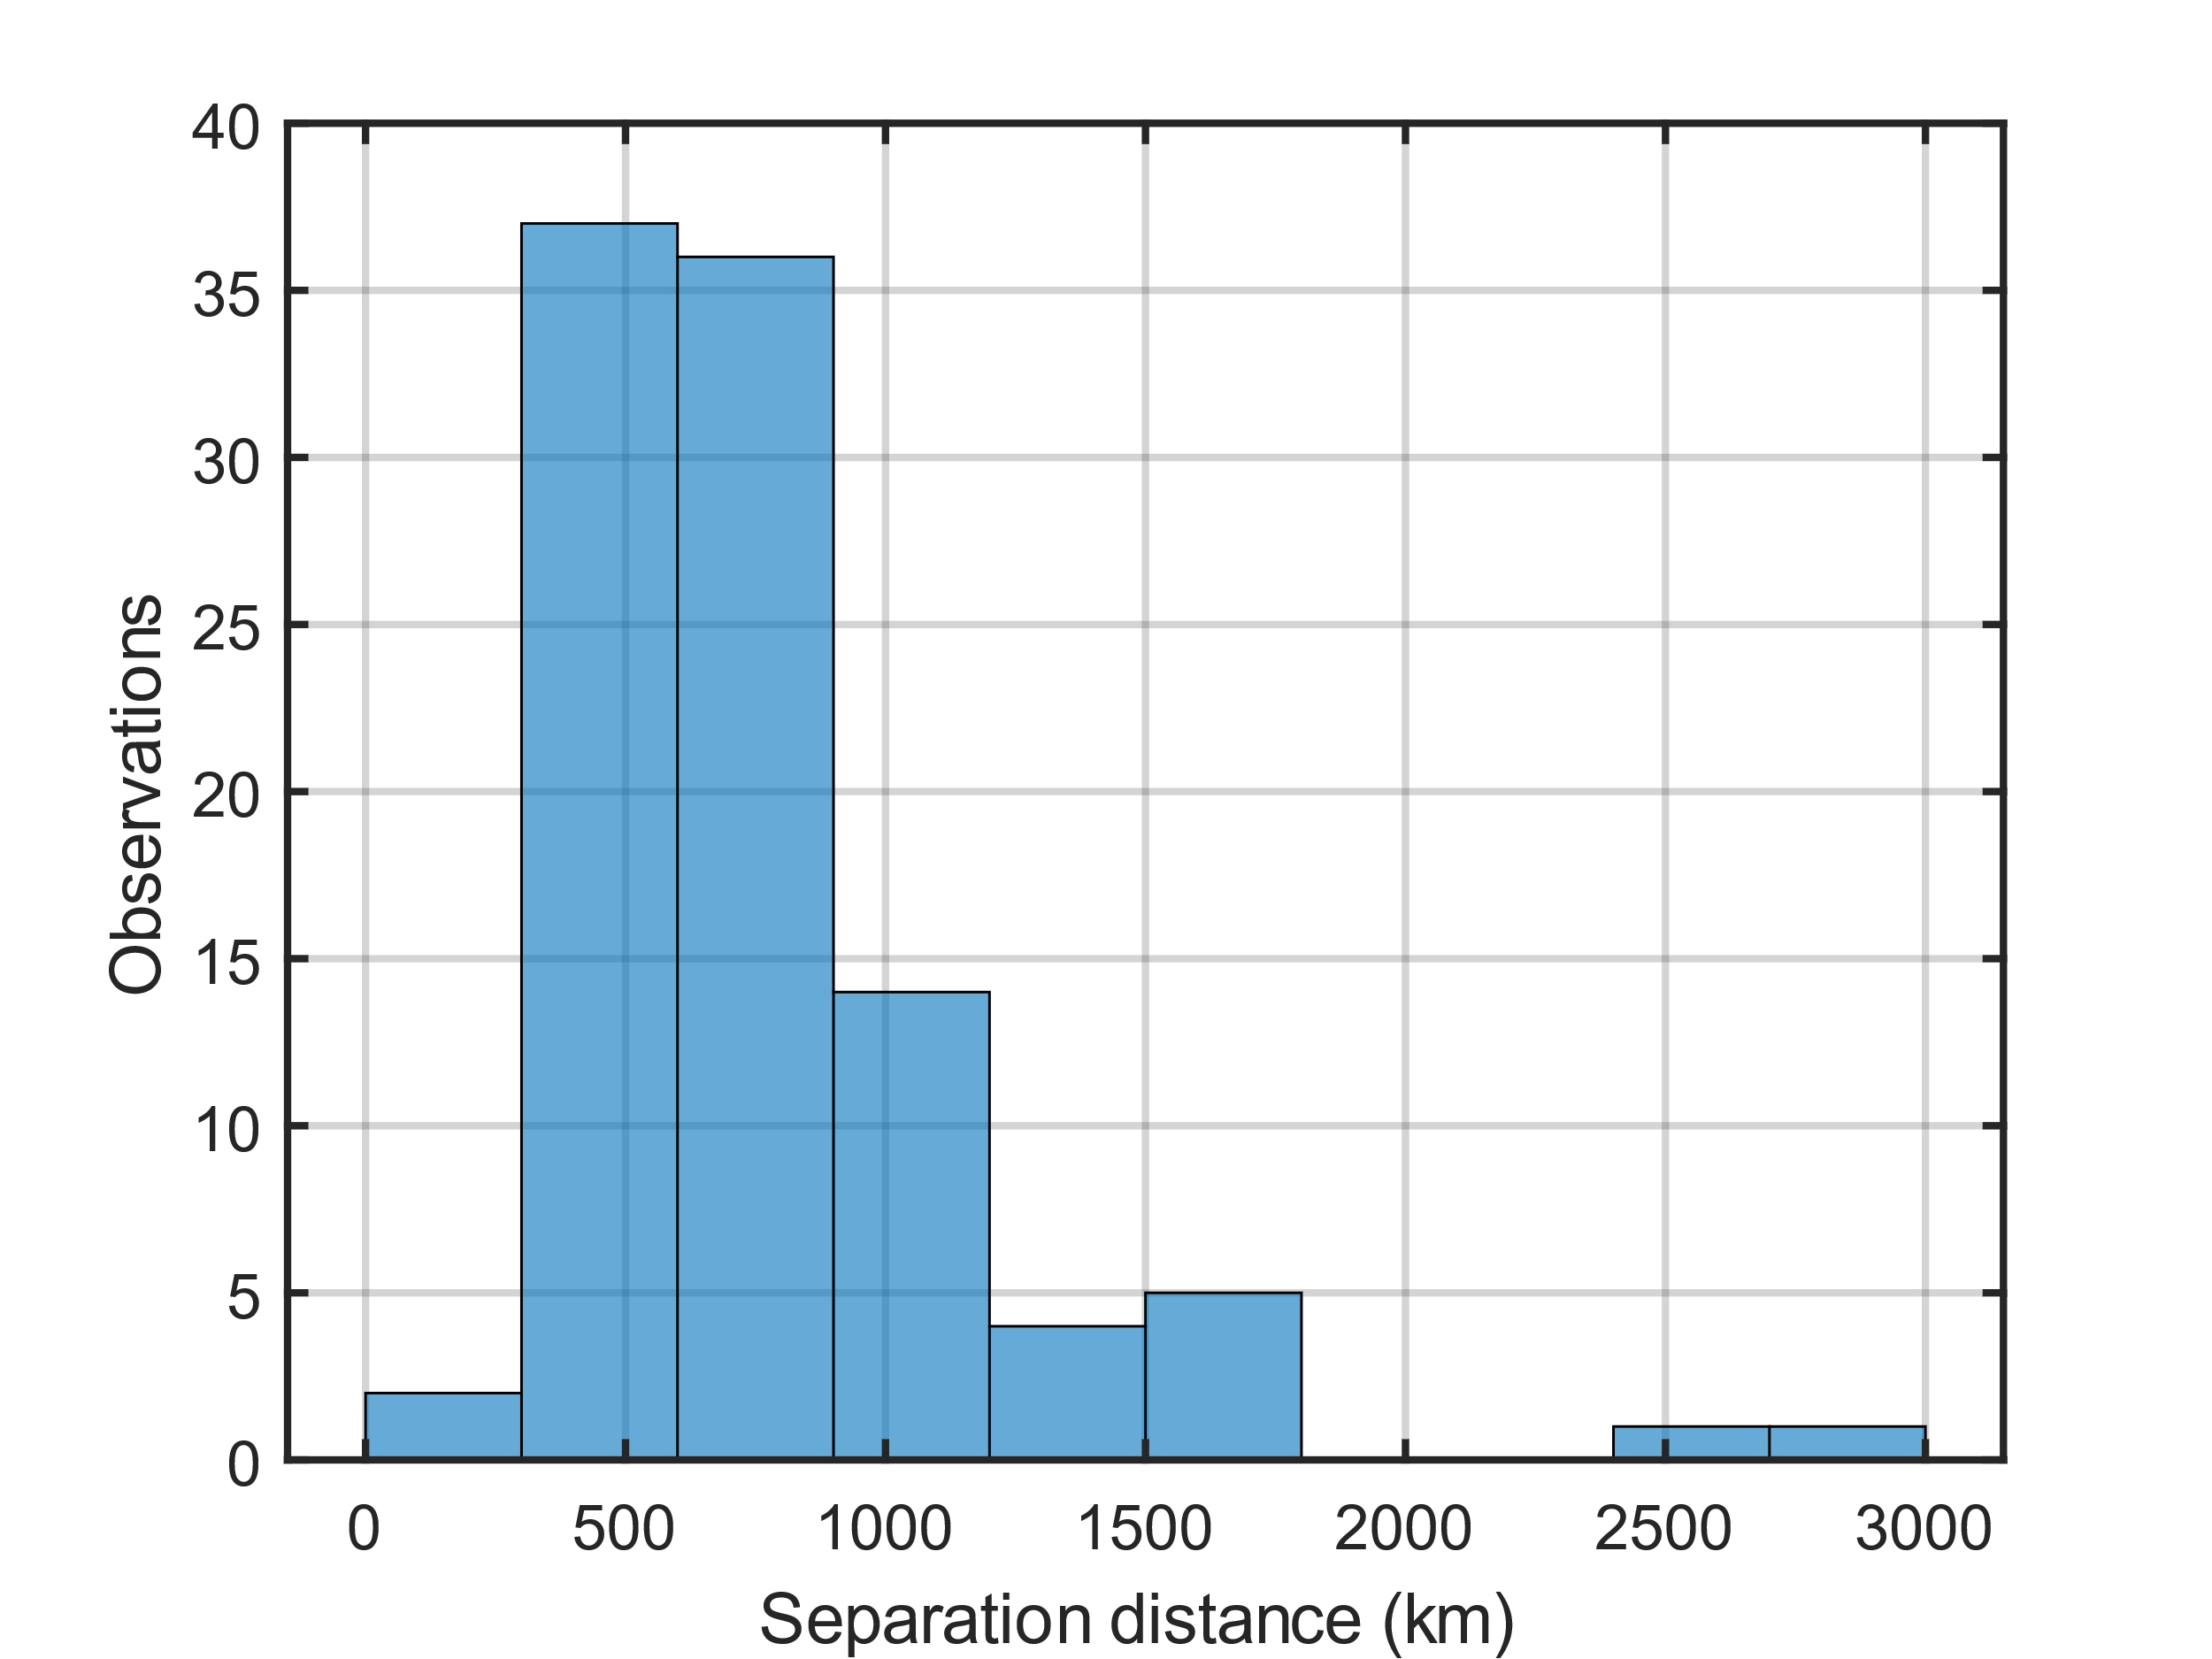
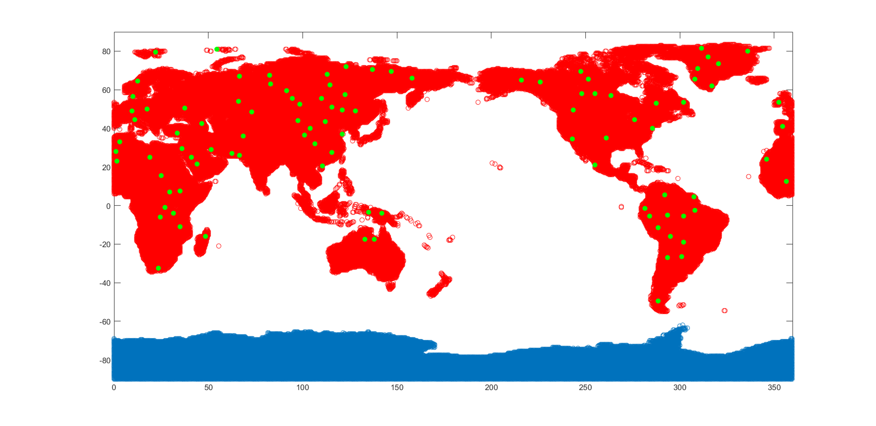
Space-filling vs Restricted Monte Carlo
The space-filling approach pushed too many locations to be along the coast
Used a restricted Monte Carlo approach instead, and required each point to be
400 km apart at minimum
Space-filling
Majority of selected locations are
< 1100 km from nearest neighbor
Restricted
Monte
Carlo
Restricted
Monte
Carlo

Slide 18
Abstract
Propagation simulations of sonic booms from supersonic aircraft through atmospheric data over time at fixed locations provides the opportunity to assess noise exposure statistics for different climate regions. Knowledge of climate-based differences in sonic boom noise exposure statistics is important to ensure that future civil supersonic aircraft noise certification standards are globally applicable and effective. In this presentation, simulated sonic booms from the NASA X-59 Quesst quiet supersonic aircraft and conventional supersonic aircraft were propagated through atmospheric data at 100 locations across the world using PCBoom. Noise exposure statistics are compared for propagation results from three different atmospheric databases (NOAA Global Forecast System, NOAA Climate Forecast System Version 2, and the ECMWF Reanalysis Version 5). These atmospheric models were chosen due to their global coverage, popularity, and database availability. Preliminary statistical models are fit to assess the impact of several factors including flight direction, season, ground elevation, and climate on noise exposure size and loudness. Areas with prevalence of higher noise due to their climate are identified, which could help inform future supersonic aircraft noise standards.

