Slide 1

Higher-order statistical moments of predicted sonic
boom waveforms through turbulence
Joel B. Lonzaga
NASA Langley Research Center
Hampton, Virginia
joel.b.lonzaga@nasa.gov
185th Meeting, Acoustical Society of America
Acoustics 23 Sydney
Dec 4-8, 2023
Notes:
In this presentation, although I will mainly focus on the development of the variance of predicted sonic booms through turbulence,
I will also provide a review of the development of the mean effects of turbulence.
Turbulence fields scatter acoustic signals similar to the scattering in multiphase propagation media.
The first and second order statistical moments are needed to bound our prediction of the loudness of sonic booms in such a random medium.
Being able to bound our prediction using an efficient, physics-based approach is something we don’t have at NASA.

Slide 2
Outline
Motivation of theoretical work
Use of the Multiple Scattering Theory
  Acousto-turbulence interaction
  Review of the mean scattering effects
Derivation of the root-mean-square acoustic pressure
Incorporation of the scattering effects into a Burgers equation
Modeling using the Burgers equation
Qualitative comparison with measured data
Conclusion
Notes:
For the outline, first I will provide the motivation of this theoretical work.

Slide 3
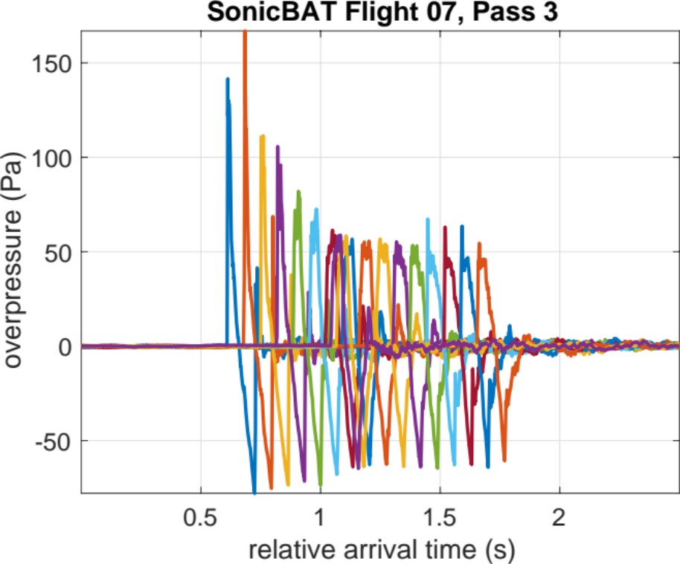
Motivation: Turbulence Effects on Measured Sonic Booms
Single Flight: Sonic Boom Arrivals
SonicBAT Flight Test in Edwards AFB
Measured booms from 18 microphones within a linear array, each ~30 m apart
  Without turbulence, booms should have been nearly identical
The variability among the booms is observable, especially when booms are aligned
Notes:
The figure on the left shows different sonic boom waveforms from a SonicBAT supersonic pass flown in Edwards Airforce Base.

Slide 4
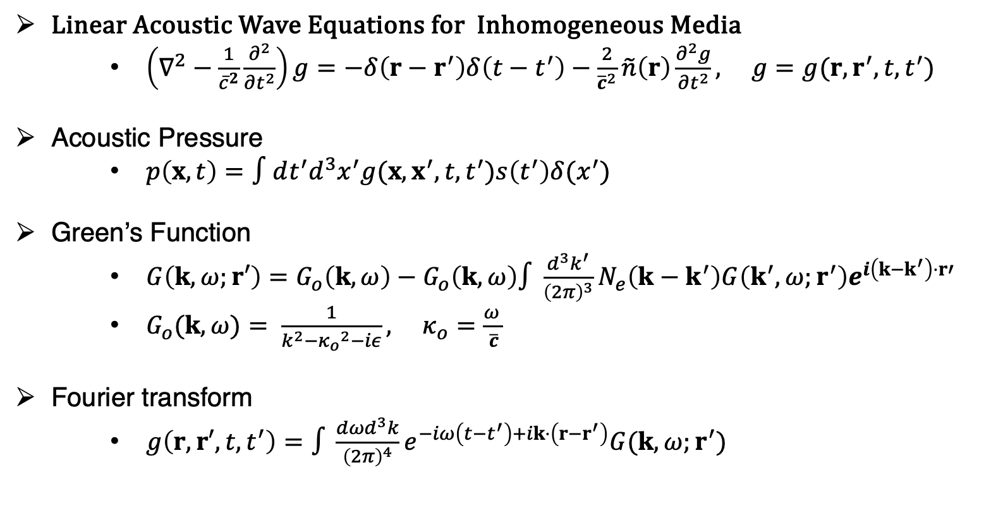
Green’s Function in Fourier Domain
Linear Acoustic Wave Equations for Inhomogeneous Media
    $\left(∇^{2}−\frac{1}{{\overline{c}}^{2}}\frac{∂^{2}}{∂t^{2}}\right)g=−δ\left(r−r^{′}\right)δ\left(t−t^{′}\right)−\frac{2}{{\overline{c}}^{2}}\tilde{n}\left(r\right)\frac{∂^{2}g}{∂t^{2}}, g=g(r,r^{′},t,t^{′})$
Acoustic Pressure
    $p\left(x,t\right)=∫dt^{′}d^{3}x^{′}g(x,x^{′},t,t^{′})s\left(t^{′}\right)δ(x^{′})$
Green’s Function
    $G\left(k,ω;r′\right)=G_{o}\left(k,ω\right)−G_{o}\left(k,ω\right)∫\frac{d^{3}k^{′}}{{\left(2π\right)}^{3}}N_{e}\left(k−k^{′}\right)G\left(k^{′},ω;r^{′}\right)e^{i\left(k−k^{′}\right)⋅r′}$
    $G_{o}(k,ω)= \frac{1}{k^{2}−{κ_{o}}^{2}−iε}, κ_{o}=\frac{ω^{ }}{\overline{c}}$
Fourier transform
    $g\left(r, r′,t,t^{′}\right)=∫\frac{{dωd}^{3}k}{{\left(2π\right)}^{4}}e^{−iω\left(t−t^{′}\right)+ik⋅\left(r−r^{′}\right)}G(k,ω;r^{′})$
Notes:
The theoretical approach involves the use of this wave equation for linear acoustics// in an inhomogeneous medium.
This equation is obtained after decomposing each of the properties of the medium into a sum of the mean field and the randomly fluctuating field, and after using some approximations.

Slide 5
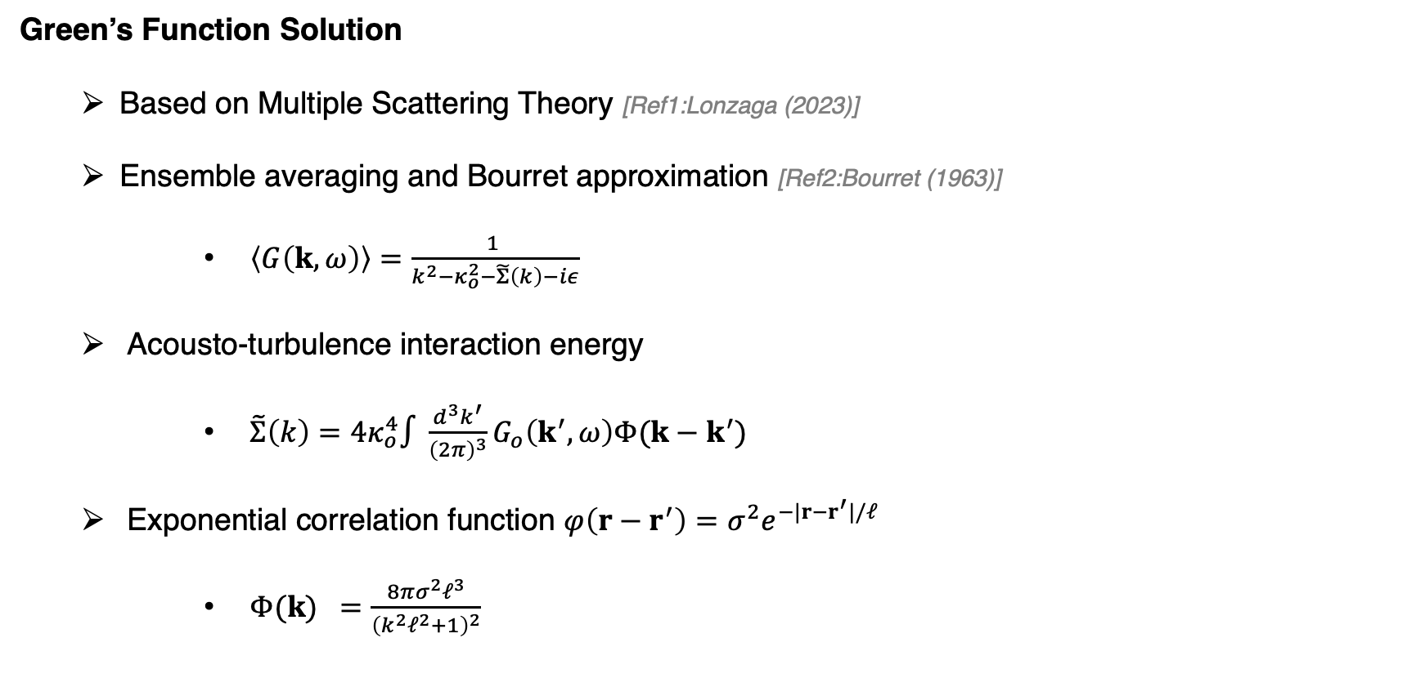
Turbulence Effects in the Burgers Equation(1)
Green’s Function Solution
  Based on Multiple Scattering Theory [Ref1:Lonzaga (2023)]
  Ensemble averaging and Bourret approximation [Ref2:Bourret (1963)]
      $\left\langle G\left(k,ω\right)\right\rangle =\frac{1 }{k^{2}−κ_{o}^{2}−\tilde{Σ}\left(k\right)−iε}$
  Acousto-turbulence interaction energy
      $\tilde{Σ}\left(k\right)=4κ_{o}^{4}∫\frac{d^{3}k^{′}}{{\left(2π\right)}^{3}}G_{o}\left(k^{′},ω\right)Φ(k−k^{′})$
  Exponential correlation function $φ\left(r−r^{′}\right)=σ^{2}e^{−|r−r^{′}|/ℓ}$
      ${Φ(k) }_{ }=\frac{8π{σ^{2}ℓ}^{3}}{{\left(k^{2}ℓ^{2}+1\right)}^{2}}$
Ref1: Lonzaga (2023), “Multiple scattering theory for modeling sonic booms in atmospheric turbulence”
Ref2: Bourret (1963), “The scattering of sound in a turbulent and thermally random medium by the method of bilocal perturbations”
Notes:
As a review, the approach is to use an iterative technique, which can be interpreted as multiple scattering,
where the zeroth order is simply the free-space Green's function.

Slide 6
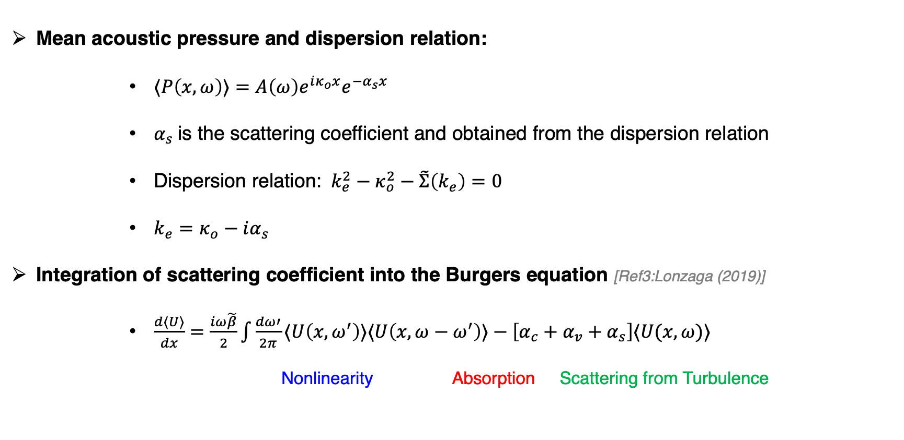
Turbulence Effects in the Burgers Equation(2)
Mean acoustic pressure and dispersion relation:
      $⟨P\left(x,ω\right)⟩=A\left(ω\right)e^{iκ_{o}x}e^{−α_{s}x}$
      $α_{s}$is the scattering coefficient and obtained from the dispersion relation
      Dispersion relation: $k_{e}^{2}−κ_{o}^{2}−\tilde{Σ}\left(k_{e}\right)=0$
      $k_{e}=κ_{o}−iα_{s}$
Integration of scattering coefficient into the Burgers equation [Ref3:Lonzaga (2019)]
      $\frac{d⟨U⟩}{dx}=\frac{iω\tilde{β}}{2}\int{\frac{dω′}{2π}⟨U\left(x,ω^{′}\right)⟩⟨U\left(x,ω−ω^{′}\right)⟩−\left[α_{c}+α_{v}+α_{s}\right]⟨U(x,ω)⟩}$
Nonlinearity Absorption Scattering from Turbulence
Ref3: Lonzaga (2019), “Recent Enhancements to NASA’s PCBoom Sonic Boom Propagation Code”
Notes:
In the spatial domain, convolving the source and the Green’s function, we can obtain the mean acoustic pressure given by this equation.

Slide 7
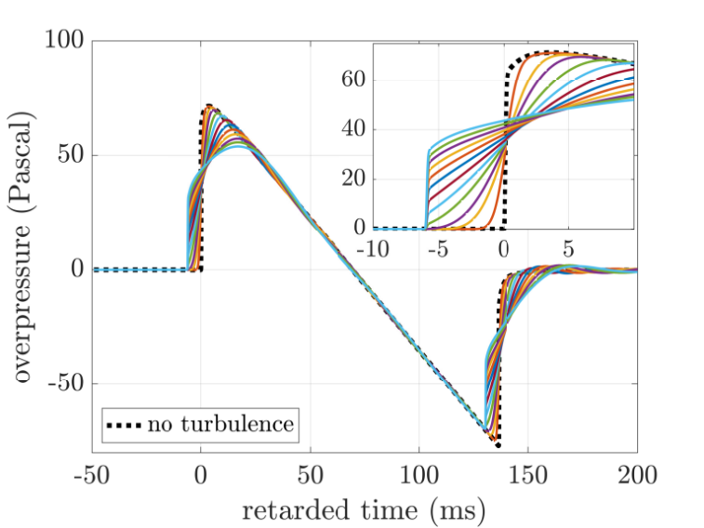
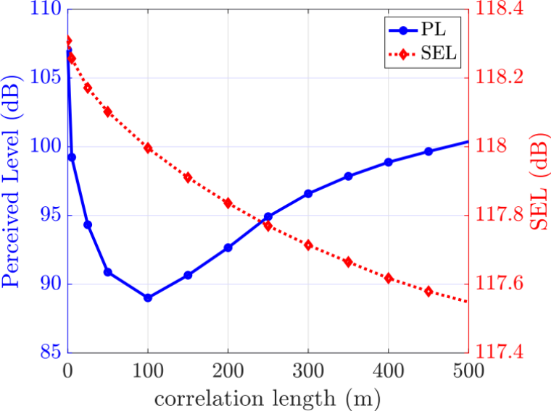
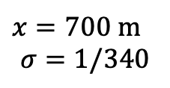
Modeling Turbulence Effects Using Different Correlation Lengths
Burgers equation was used to generate the model waveforms through turbulence fields
Larger correlation lengths result in waveforms with smaller peak overpressures and larger rise times
On average, turbulence weakens and thickens shocks
  Energy reduction (SEL)
  Loudness reduction (Perceived Level) until minimum is reached
  Loudness starts to increase due to emergence of a weak shock to the left of the original shock
Reduction consistent with acoustic measurements
Results have been published with JASA [Ref1:Lonzaga 2023]
Sonic booms through turbulence with different correlation lengths
$x=700$ m
$$σ=1/340$$
Sonic boom energy content (SEL) and loudness (PL)
Ref1: Lonzaga (2023), “Multiple scattering theory for modeling sonic booms in atmospheric turbulence”
Notes:
The Burgers equation was used to model N-waves through a turbulence field, which has a fixed strength represented by sigma but a varying correlation length.

Slide 8
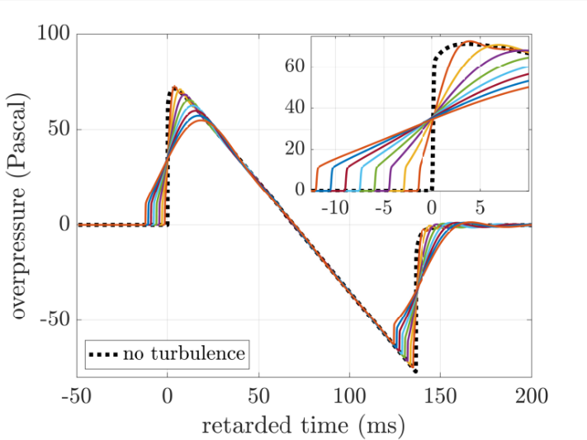
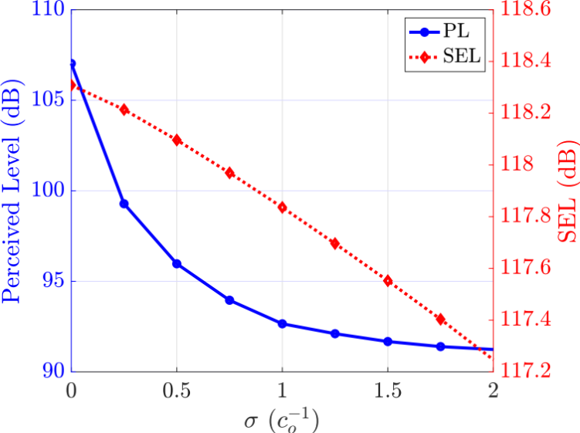
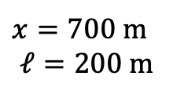
Modeling Turbulence Effects Using Different Variance
Larger turbulence variances result in waveforms with smaller peak overpressures and larger rise times
Turbulence weakens and thickens shocks
Reduction of energy (SEL) and loudness (PL)
Reduction consistent with sonic boom measurements
Sonic booms through turbulence with different variances
$x=700$ m
$$ℓ=200 m$$
Sonic boom energy content (SEL) and loudness (PL)
Notes:
This is similar to the case study in the last slide, but here the correlation length is fixed at 200 m with a varying turbulence strength sigma.
As with the previous case,
1. larger turbulence variance or strength correspond …
2. Turbulence simultaneously weakens and thickens the shocks,
3. Turbulence leads to energy and loudness reduction
Such reduction is consistent with acoustic measurements …

Slide 9
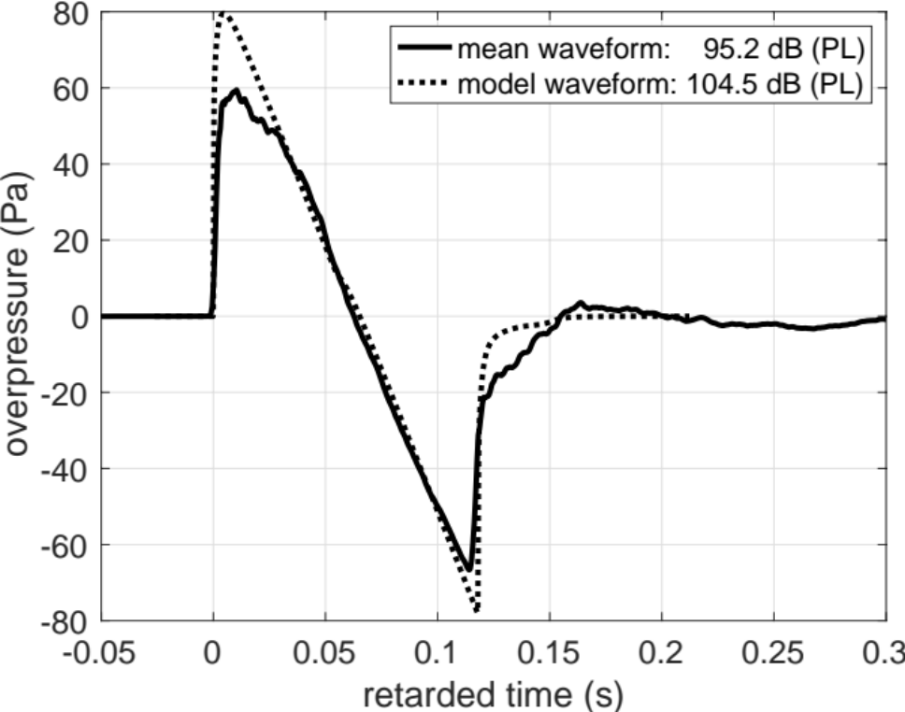
Mean-Valued Waveform From Recorded Sonic Booms
Measured sonic boom waveforms from a steady supersonic flight pass,
  Without turbulence, waveforms should be nearly identical
Mean waveform is shown with model waveform without turbulence
Loudness reduction of about 10 dB (PL)
  Consistent with numerical simulations over a range of turbulence parameters during the flight test

Slide 10
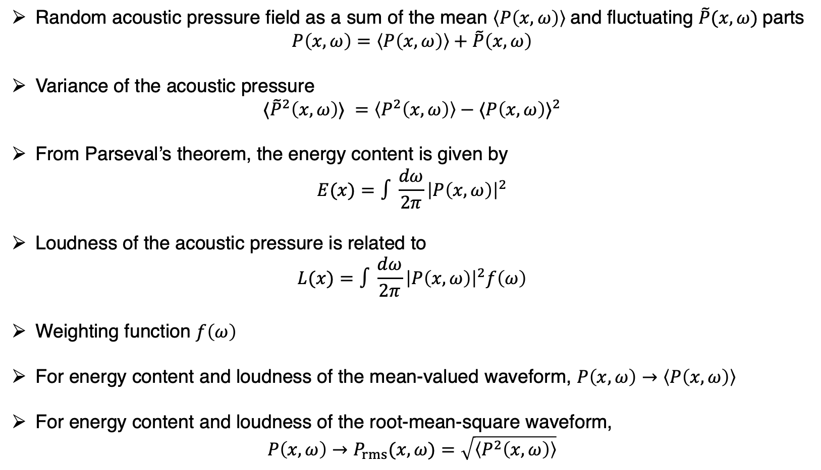
Modeling the Variance of the Loudness of Sonic Booms
Random acoustic pressure field as a sum of the mean $\left\langle P\left(x,ω\right)\right\rangle$and fluctuating $\tilde{P}(x,ω)$parts
$$P\left(x,ω\right)=\left\langle P\left(x,ω\right)\right\rangle +\tilde{P}\left(x,ω\right)$$
Variance of the acoustic pressure
$$⟨{\tilde{P}}^{2}\left(x,ω\right)⟩ ={\left\langle P^{2}\left(x,ω\right)\right\rangle −⟨P\left(x,ω\right)⟩}^{2}$$
From Parseval’s theorem, the energy content is given by
$$E(x)=∫\frac{dω}{2π}{\left|P\left(x,ω\right)\right|}^{2}$$
Loudness of the acoustic pressure is related to
$$L(x)=∫\frac{dω}{2π}{\left|P\left(x,ω\right)\right|}^{2}f\left(ω\right)$$
Weighting function $f\left(ω\right)$
For energy content and loudness of the mean-valued waveform, $P\left(x,ω\right)→\left\langle P\left(x,ω\right)\right\rangle$
For energy content and loudness of the root-mean-square waveform,
$$P\left(x,ω\right)→P_{rms}(x,ω)=\sqrt{\left\langle P^{2}\left(x,ω\right)\right\rangle }$$
Notes:
We now discuss the modeling of the variance of the loudness of sonic booms.
In a turbulence field, the acoustic pressure field is treated as a sum of the mean part and the random part, denoted by P tilde.

Slide 11
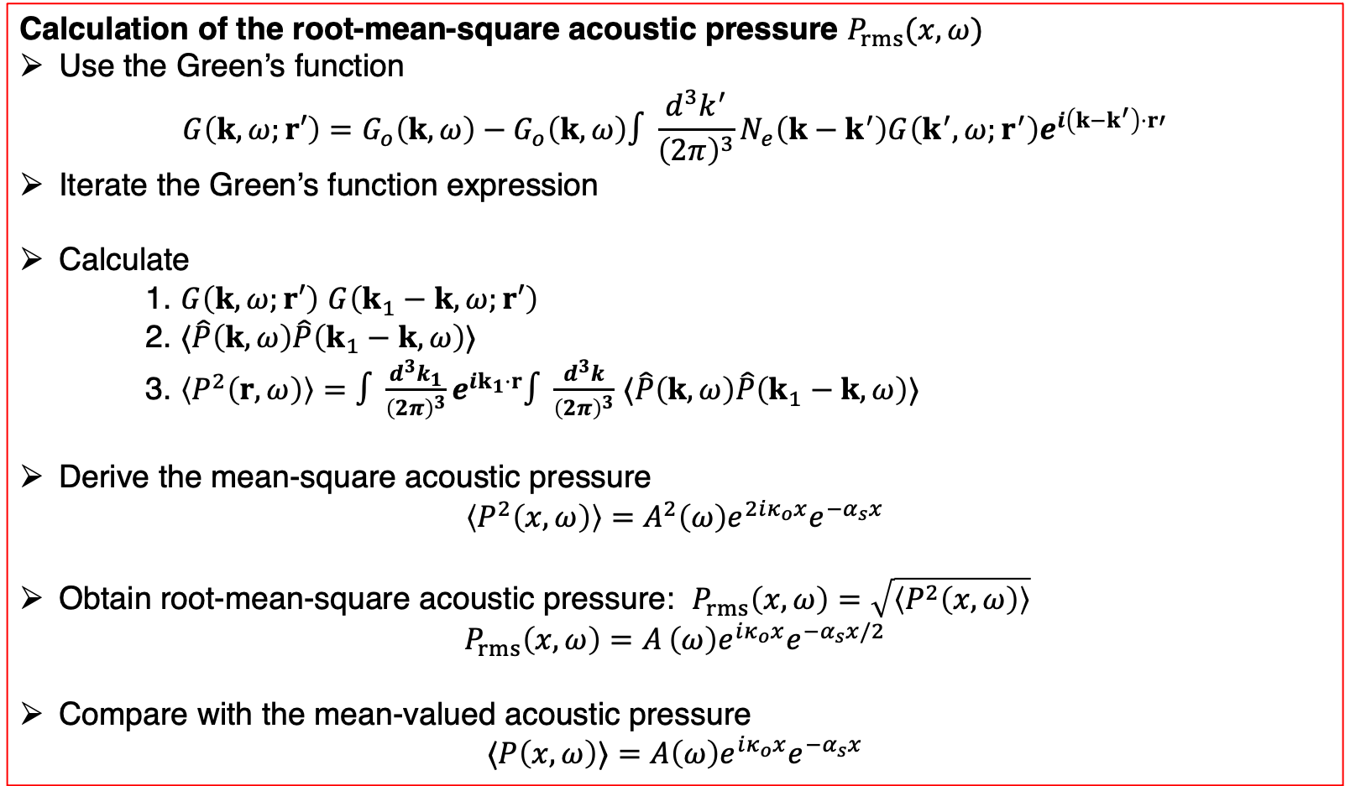
Modeling the Variance Of The Acoustic Pressure
Calculation of the root-mean-square acoustic pressure $P_{rms}(x,ω)$
Use the Green’s function
$$G\left(k,ω;r′\right)=G_{o}\left(k,ω\right)−G_{o}\left(k,ω\right)∫\frac{d^{3}k^{′}}{{\left(2π\right)}^{3}}N_{e}\left(k−k^{′}\right)G\left(k^{′},ω;r^{′}\right)e^{i\left(k−k^{′}\right)⋅r′}$$
Iterate the Green’s function expression
Calculate
1. $G\left(k,ω;r′\right)$ $G\left(k_{1}−k,ω;r′\right)$
2. $⟨\hat{P}\left(k,ω\right)\hat{P}\left(k_{1}−k,ω\right)⟩$
3. $\left\langle P^{2}\left(r,ω\right)\right\rangle =∫\frac{d^{3}k_{1}}{{\left(2π\right)}^{3}}e^{ik_{1}⋅r}∫\frac{d^{3}k}{{\left(2π\right)}^{3}}$ $⟨\hat{P}\left(k,ω\right)\hat{P}\left(k_{1}−k,ω\right)⟩$
Derive the mean-square acoustic pressure
$$\left\langle P^{2}\left(x,ω\right)\right\rangle =A^{2}\left(ω\right)e^{2iκ_{o}x}e^{−α_{s}x}$$
Obtain root-mean-square acoustic pressure: $P_{rms}\left(x,ω\right)=\sqrt{\left\langle P^{2}\left(x,ω\right)\right\rangle }$
$$P_{rms}\left(x,ω\right)=A^{ }\left(ω\right)e^{iκ_{o}x}e^{−α_{s}x/2}$$
Compare with the mean-valued acoustic pressure
$$⟨P\left(x,ω\right)⟩=A\left(ω\right)e^{iκ_{o}x}e^{−α_{s}x}$$
Notes:
In addition to the mean acoustic pressure field, we are also interested in the rms acoustic pressure field so we can bound our predictions through a random turbulence field.
To obtain an expression for the rms acoustic pressure, we use this expression for the Green’s function, which we have already discussed.
We then iterate to second order and calculate this convolution of the Green’s function with itself, at the same frequency.

Slide 12
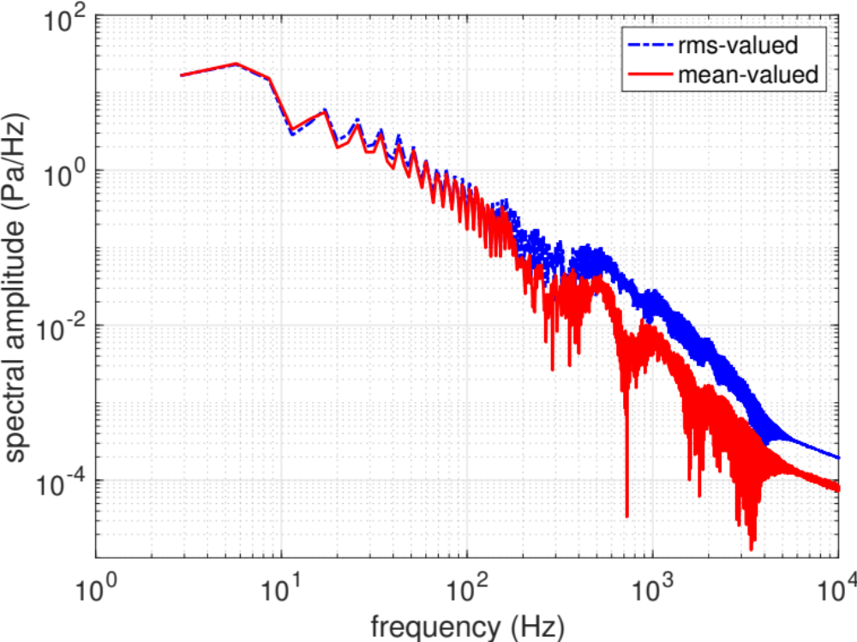
Measured Waveforms: RMS Acoustic Pressure
Measured sonic boom waveforms from the SonicBAT Flight Test
RMS spectrum has PL = 98.5 and is shown along with the mean-valued spectrum that has a PL = 95.2
Demonstrating applicability of the methodology
rms: PL = 98.5 dB
mean: PL = 95.2 dB

Slide 13
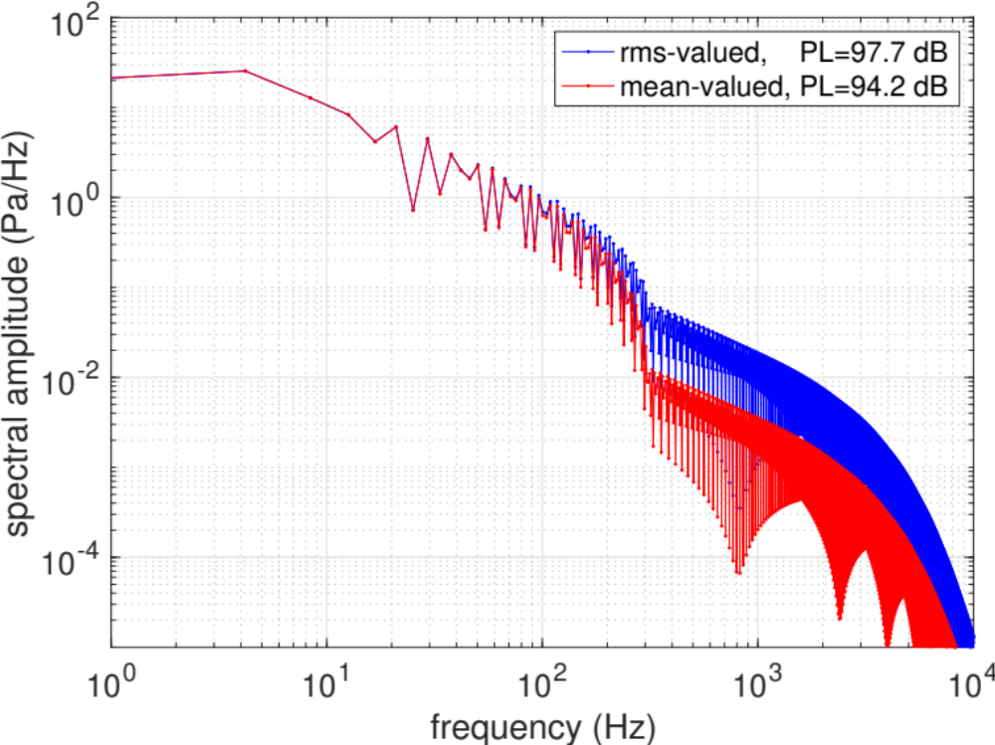
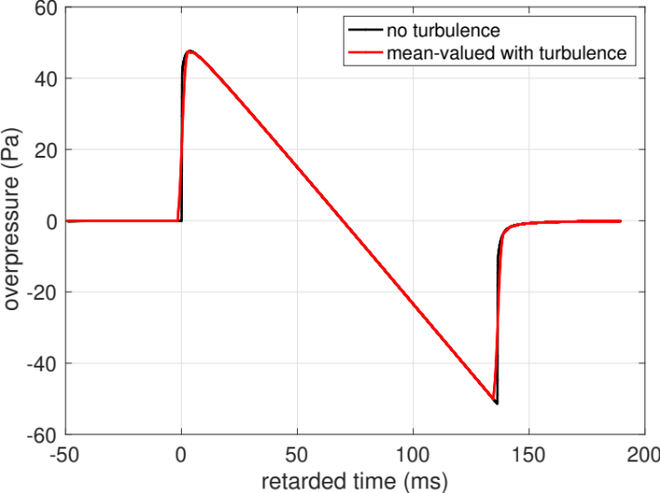
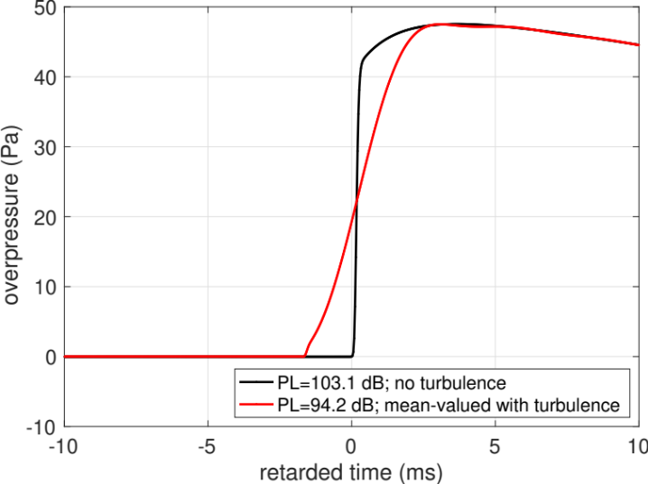
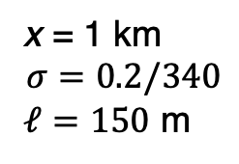
Modeling RMS Acoustic Pressure
x = 1 km
$$σ=0.2/340$$
$ℓ=150$ m
RMS acoustic pressure has
  larger spectral amplitude at higher frequencies
  larger PL value
than the mean-valued acoustic pressure
Notes:
The rms acoustic pressure can be predicted if turbulence parameters are accurately estimated.
In the absence of such parameters and to illustrate the utility of the methodology, I use a propagation distance of x =1 km,
as well as a turbulence strength sigma of 0.2/340 and a correlation length ell of 150 m.

Slide 14
Conclusion
Ubiquity of turbulence effects in measured sonic booms
Mean and variance of the loudness needed to bound loudness prediction
Need for an efficient, Burgers-based sonic boom propagation solver
Development of Multiple Scattering Theory to predict
  Mean-valued acoustic pressure and loudness
  RMS acoustic pressure and loudness
Future work to resolve if the loudness probability density function is Gaussian-distributed

