Slide 1
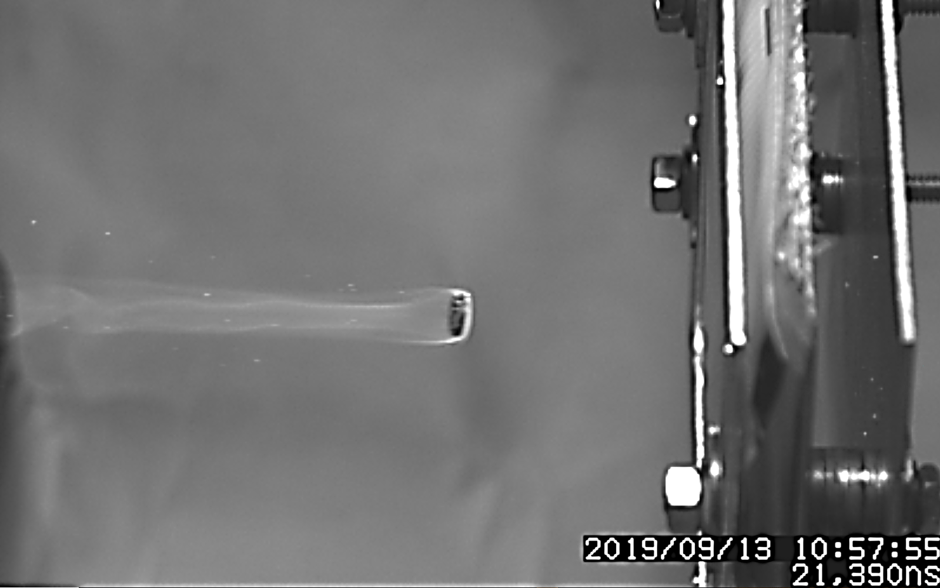
Engineering Launch Methods for Non-Spherical Hypervelocity Projectiles
Daniel Rodriguez
Trade names and trademarks are used in this presentation for identification only. Their usage does not constitute an official endorsement, either expressed or implied, by the National Aeronautics and Space Administration.

Slide 2
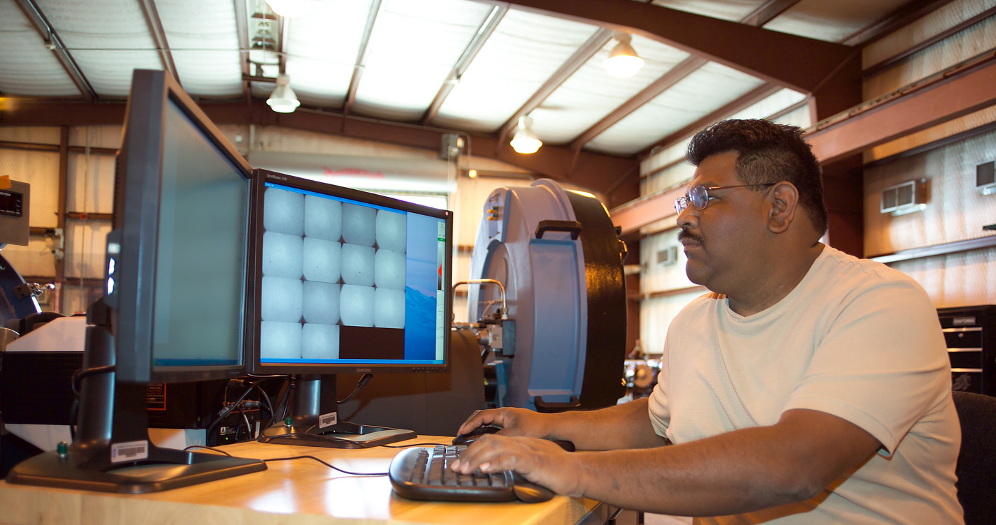
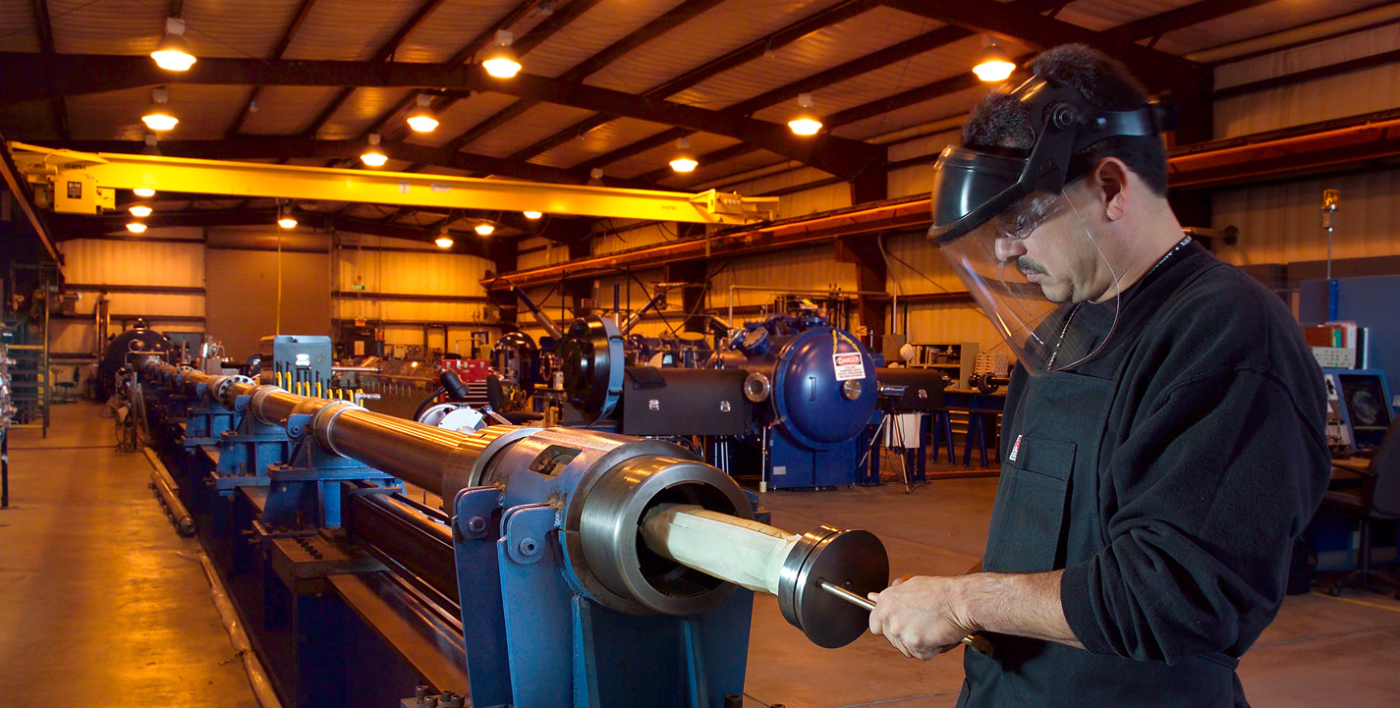
ACKNOWLEDGEMENTS
NASA White Sands Test Facility
NASA Johnson Space Center
Sierra Lobo Inc.

Slide 3
INTRODUCTION
The National Engineering Safety Center (NESC) recommended categorizing debris shapes and establishing a correlation between characteristic length and mass/shape parameters.
An extensive dataset was gathered to characterize the shapes of a significant portion of this debris.
It was determined that a considerable amount of this debris is primarily composed of carbon-fiber-reinforced polymer (CFRP) with length-to-diameter (L/D) ratios of approximately 1/3 (thin plate) or 3/1 (long rod).

Slide 4
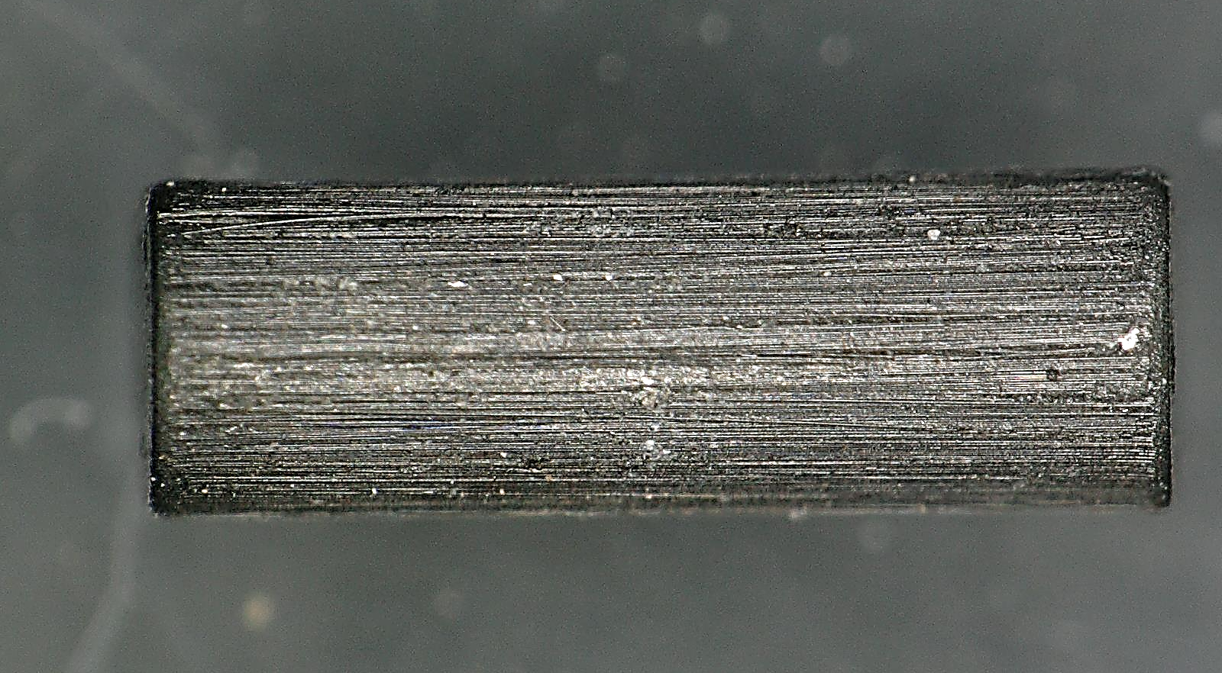
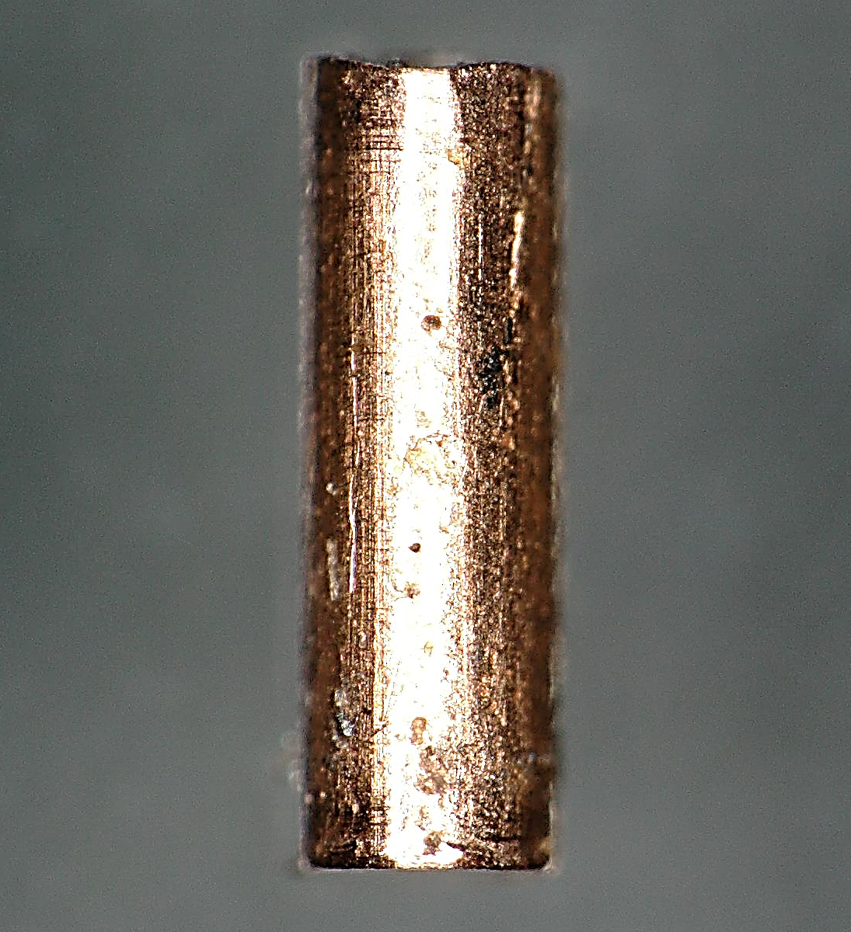
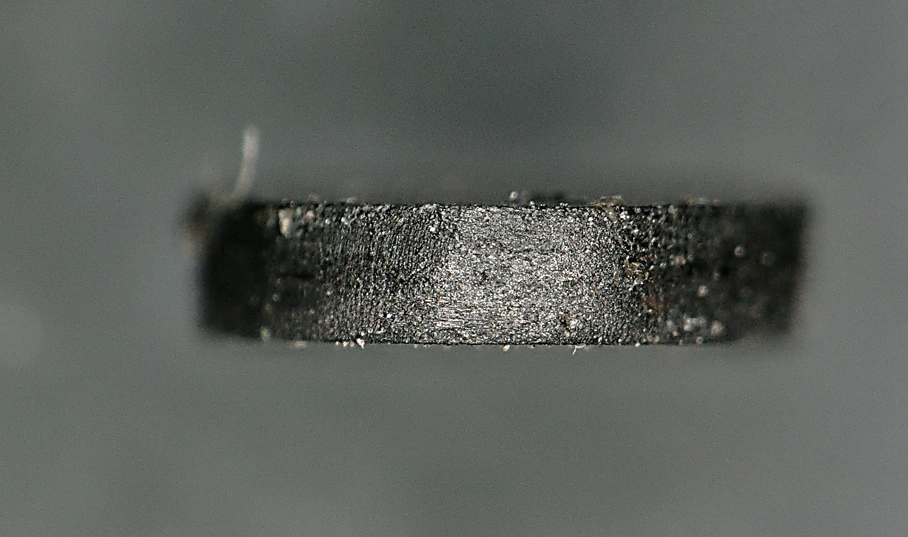
The Remote Hypervelocity Test Laboratory (RHTL) team received a request from the Johnson Space Center (JSC) Hypervelocity Impact Technology (HVIT) group to conduct experiments involving the launch of carbon, steel, and copper projectiles of diverse shapes.
The overarching objective of these experiments was to establish the capacity for the successful launch and measurement of the impact orientation of cylindrical projectiles at various L/D ratios, including 1/5 (thin plate), 2/3 (sphere equivalent mass), and 3/1 (long rod), targeting a designated shield.

Slide 5
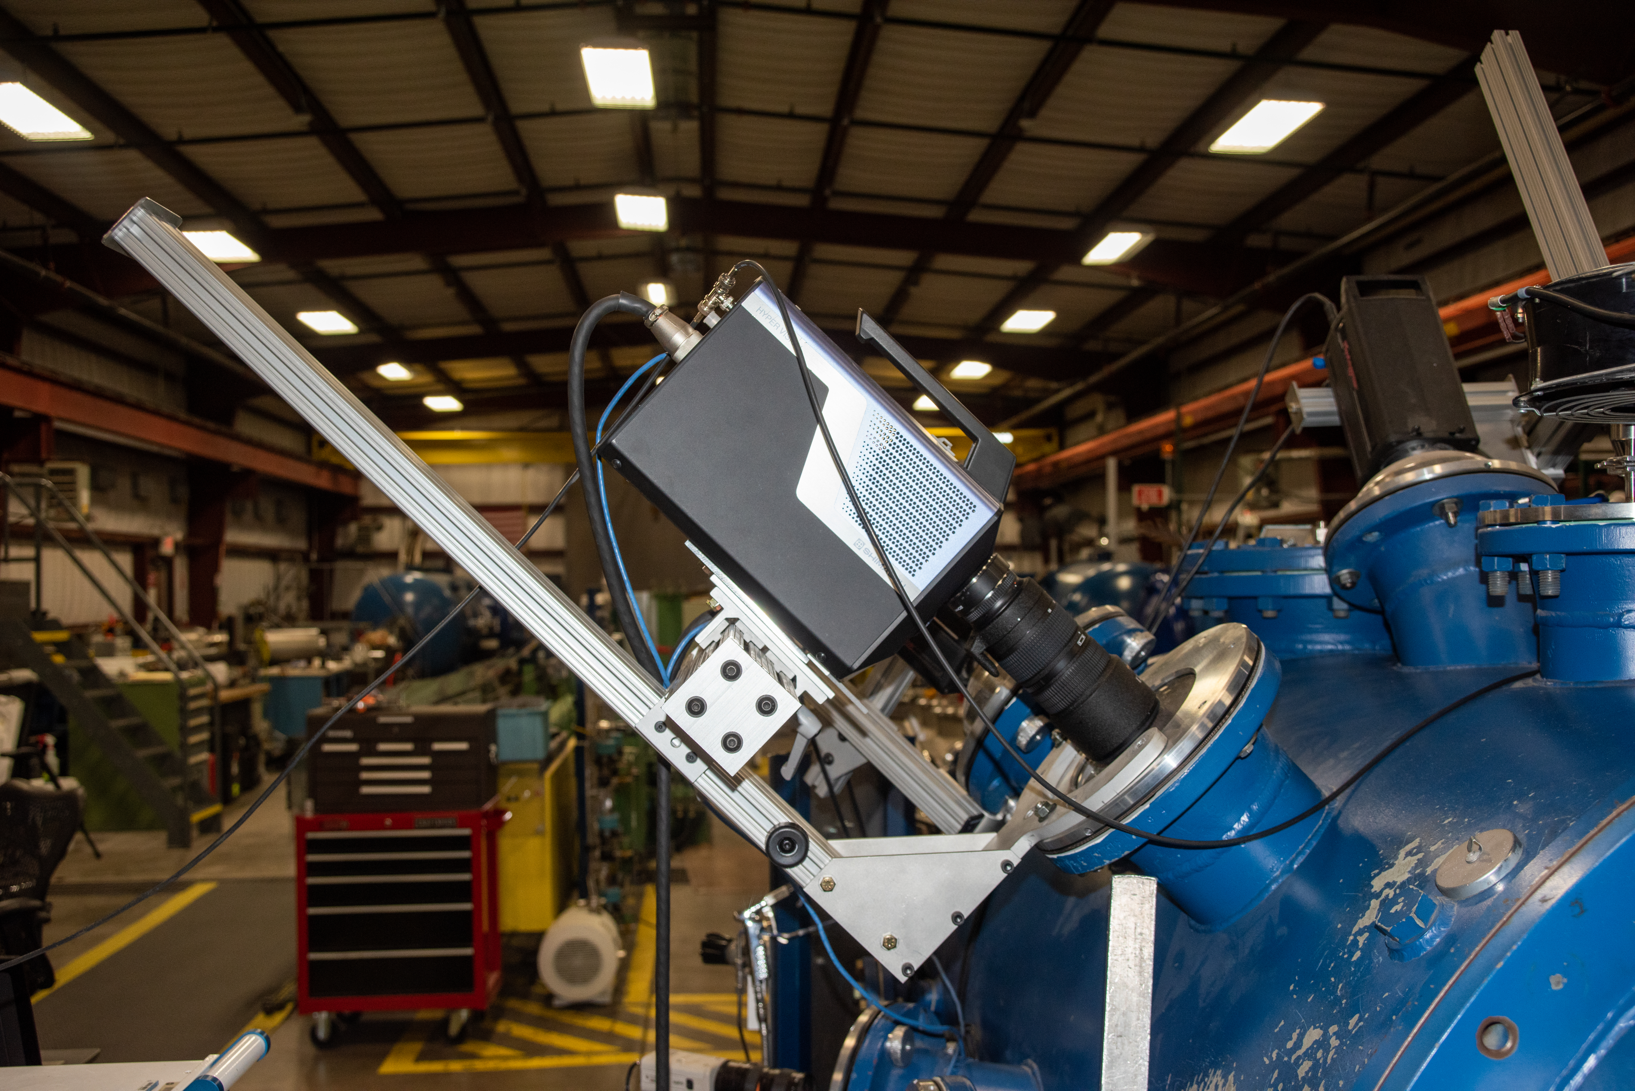
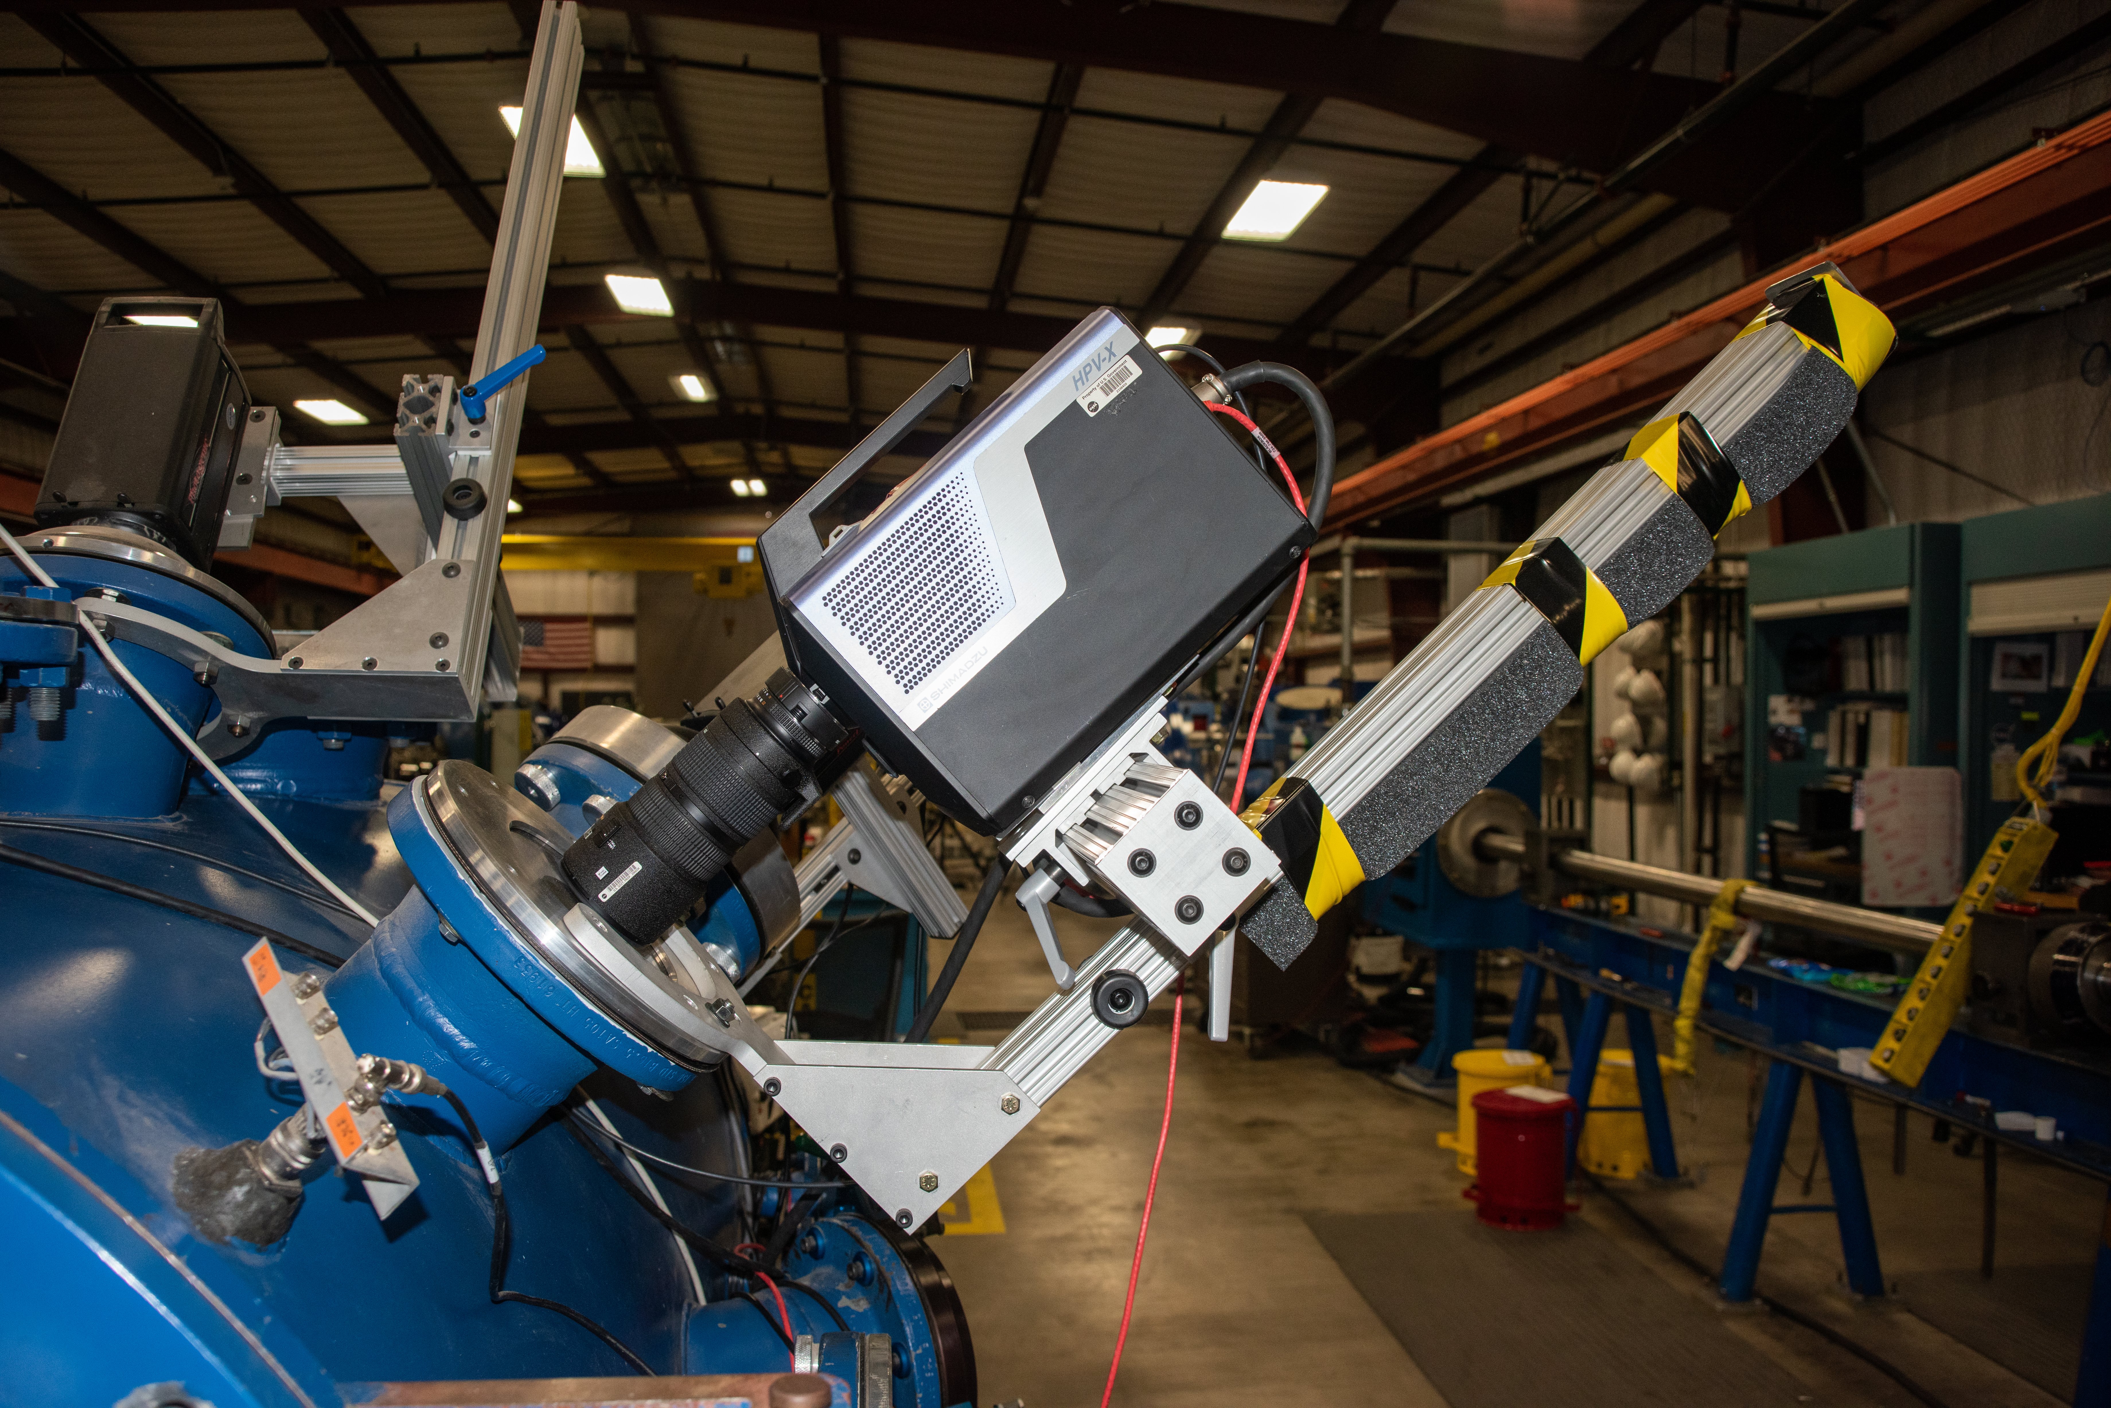
HIGH-SPEED IMAGE SETUP
Two Shimadzu™ HyperVision HPV-X cameras were employed to record both the in-flight orientation of the projectile and its post-impact damage.
Both cameras were strategically positioned orthogonal to each other, outside the target chamber.
These high-speed cameras possess the capacity to capture footage at frame rates of up to 10 million frames per second (fps). However, for the specific requirements of these experiments, a frame rate of 2 million fps was deemed more suitable.

Slide 6
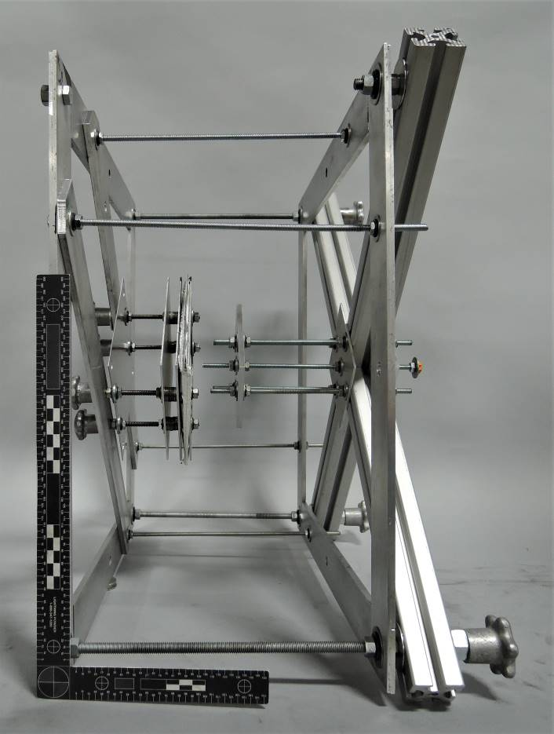
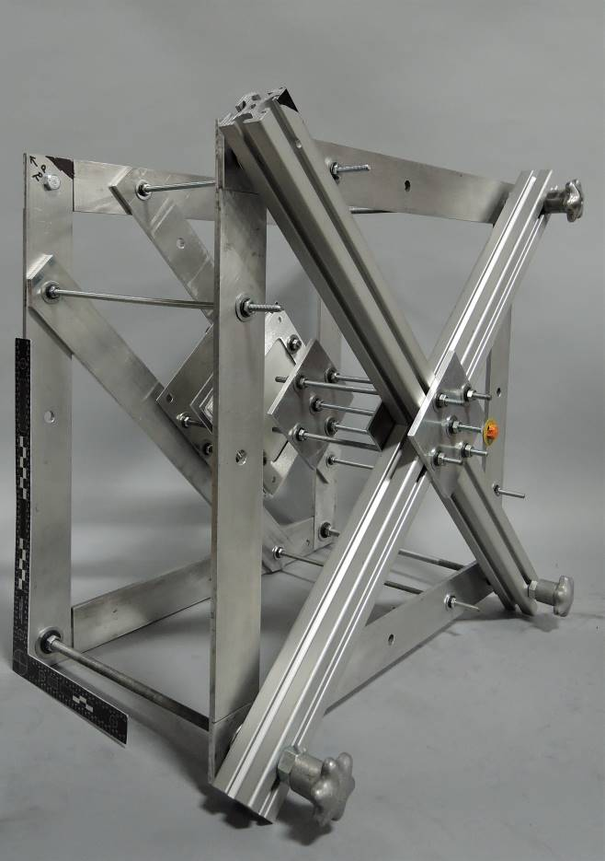
HIGH-SPEED IMAGE SETUP (Cont.)
The precision of camera alignment was ensured through the use of an alignment fixture, focusing the cameras on the anticipated flight path of the projectile while maintaining their orthogonality.

Slide 7
Test Summary
Test # | Projectile Material | Diameter (mm) | Length (mm) | Mass (g) | Velocity (km/s) | Notes
1 | CFRP | 5 | 3.33 | 0.1007 | 6.94 | Clean Test
2 | CFRP | 5 | 3.33 | 0.1002 | 6.99 | Clean Test
3 | CFRP | 5 | 3.33 | 0.0999 | 6.96 | Clean Test
4 | CFRP | 6 | 1.2 | 0.0528 | 6.83 | Projectile Breakup
5 | CFRP | 2.5 | 7.5 | 0.0564 | 6.97 | Projectile Impacted Stripper Plate
6 | CFRP | 2.5 | 7.5 | 0.057 | 6.97 | Clean Test
7 | CFRP | 2.5 | 7.5 | 0.0572 | 6.99 | Clean Test
8 | CFRP | 3.45 | 2.3 | 0.0327 | 6.94 | Clean Test
9 | CFRP | 7.94 | 1.58 | 0.1163 | 6.95 | Clean Test
10 | CFRP | 7.94 | 1.58 | 0.1162 | 6.97 | Projectile Breakup
11 | CFRP | 7.94 | 1.58 | 0.1166 | 6.96 | Projectile Impacted Stripper Plate
12 | CFRP | 1.78 | 5.3 | 0.0204 | 7.00 | Clean Test
13 | CFRP | 7.94 | 1.58 | 0.1161 | 6.99 | Projectile Breakup
14 | CFRP | 7.94 | 1.58 | 0.117 | 5.96 | Clean Test
15 | CFRP | 7.94 | 1.58 | 0.117 | 6.63 | Clean Test
16 | CFRP | 7.94 | 1.58 | 0.117 | 6.84 | Projectile Impacted Stripper Plate
17 | CFRP | 7.94 | 1.58 | 0.1146 | 7.28 | Projectile Impacted Stripper Plate
18 | CFRP | 4 | 1.58 | 0.0302 | 6.63 | Clean Test
19 | CFRP | 6 | 1.58 | 0.0663 | 6.55 | Impacted Stripper
20 | Stainless Steel | 1.2 | 0.8 | 0.0071 | 6.88 | Clean Test
21 | Stainless Steel | 1.2 | 0.4 | 0.0036 | 6.85 | Clean Test
22 | Copper | 0.7 | 2 | 0.0071 | 6.85 | Clean Test
23 | Copper | 0.7 | 2 | 0.0069 | 6.83 | Clean Test
24 | CFRP | 1.8 | 5.27 | 0.02 | 6.97 | Clean Test
More than 80% of the experiments employed CFRP due to its prevalence in the composition of most debris.
The success rate achieved in this series of experiments stood at 66%, with unsuccessful attempts primarily attributed to either projectile failure or inadvertent collisions with the stripper plate.

Slide 8
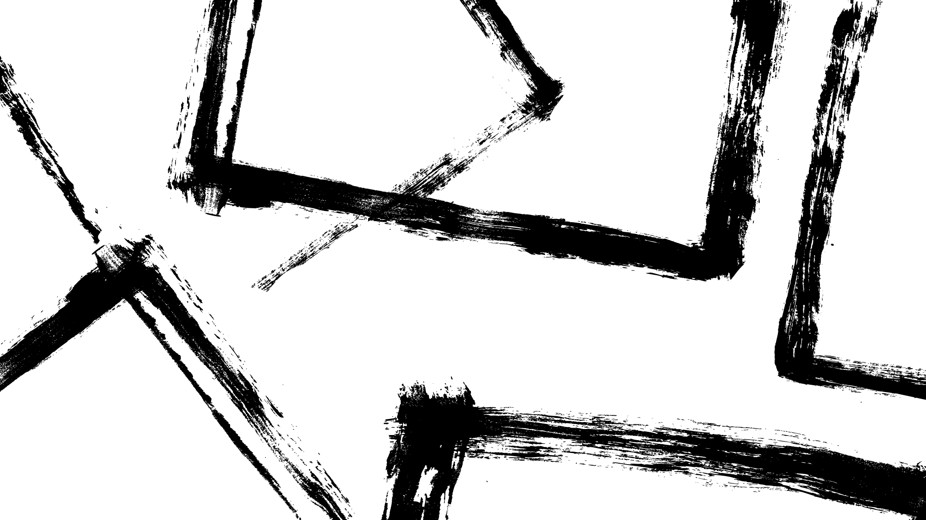
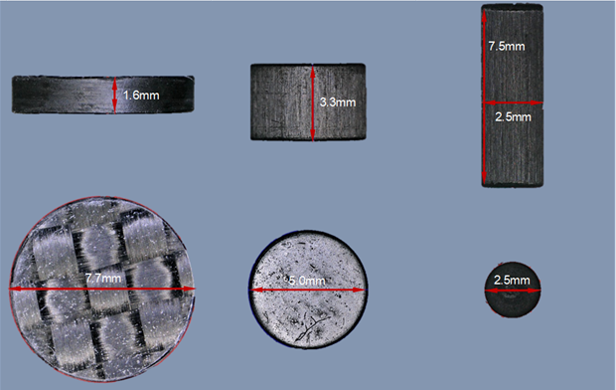
CFRP Projectile details
The long CFRP cylindrical projectiles employed in this series of tests were fabricated from pultruded rods. In contrast, the disks were manufactured through turning or water jet-cutting processes from CFRP sheets.
Fiber Volume | 63%
Tensile Strength | 2.4 Gpa
Tensile Modulus | 240 Gpa
Compression Strength | 1.00 Gpa
Ultimate Elongation | 1.10%
Glass Transition Temp. | 120 C
Resin Type | Bisphenol A

Slide 9
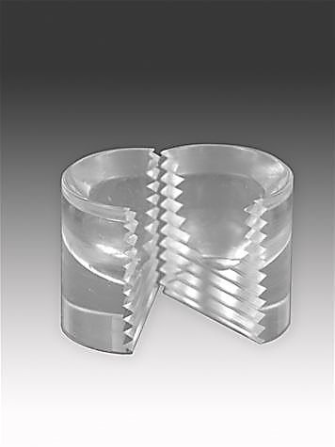
Sabot Design
Key Optimizations:
Minimized launch package mass.
Minimized the Sabot Projectile’s Pocket Depth.
The launch of a flat disk presents a particularly formidable challenge. Specifically, the 1/5 (L/D) ratio.
A redesigned pocket was developed with the primary objective of mitigating the compressive forces acting on the projectile during the launch phase.

Slide 10
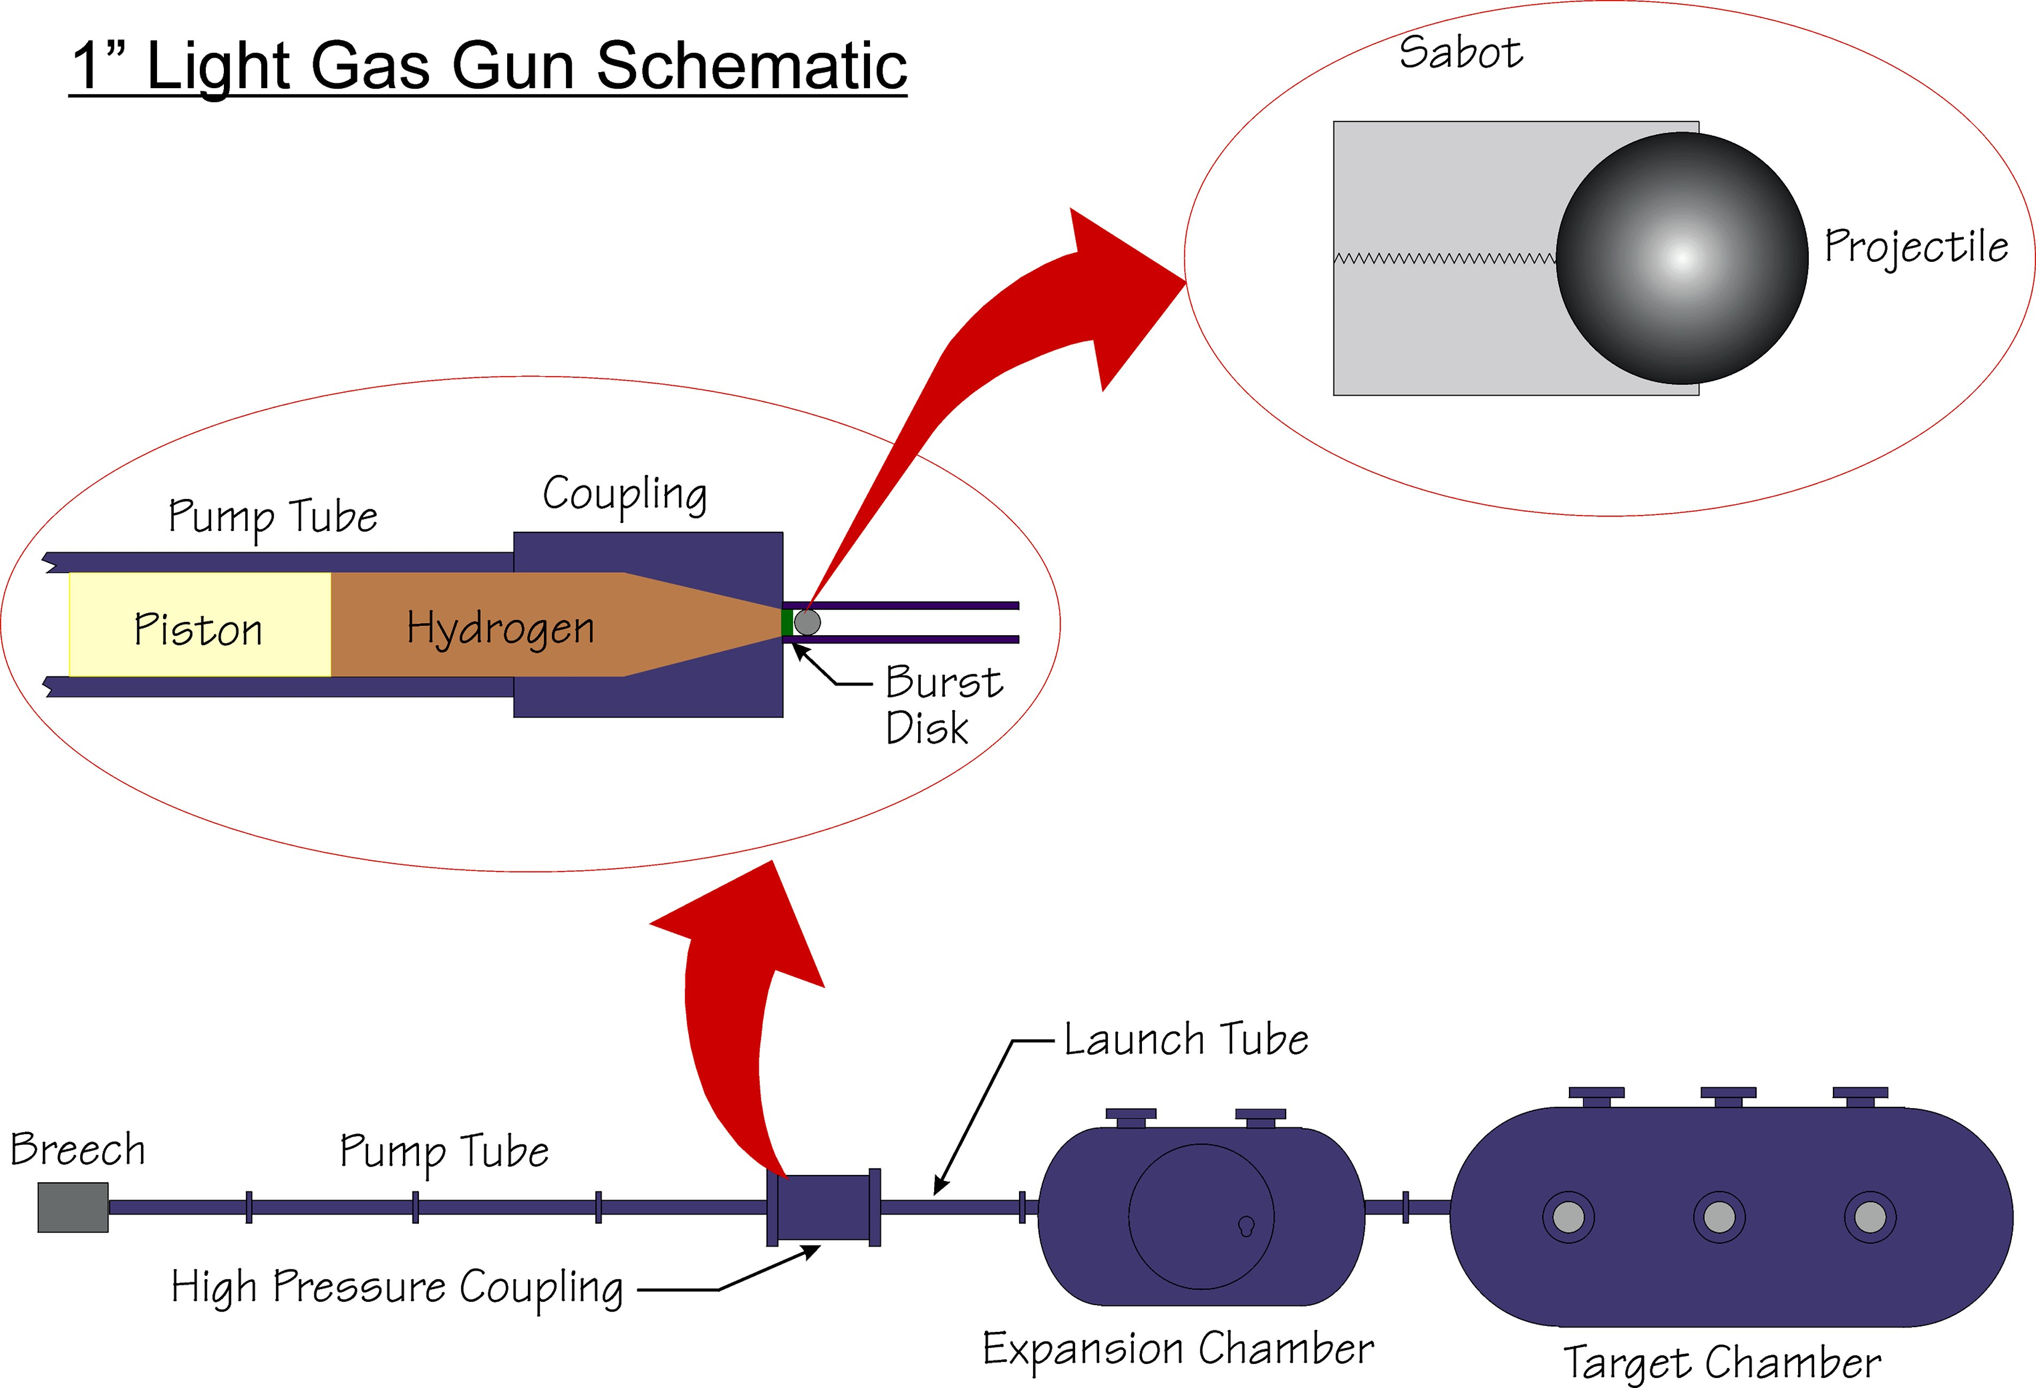
Gun Barrel Optimization
The inclusion of a compact bore with a tapered entrance angle affords the distinct benefit of enhancing power transmission without the need for supplementary energy to compensate for losses. This judicious optimization leads to a reduction in the magnitude of applied stresses, as it necessitates a lowered upstream pressure to attain the desired projectile velocity.

Slide 11
Flight range pressure
The enhanced sabot design facilitated a deliberate reduction of flight range pressure.
This reduction played a significant role in mitigating projectile ablation during flight.

Slide 12
SUMMARY
The research has successfully demonstrated the feasibility of launching shaped projectiles.
The most challenging projectile shape to launch was the CFRP disk. Initial issues arose due to projectile compression within the sabot pocket, prompting subsequent modifications aimed at reducing applied stresses.
The enhanced sabot design facilitated a deliberate reduction of flight range pressure by 40%. This reduction played a significant role in mitigating projectile ablation during flight.

Slide 13
THANK YOU

