Slide 1


NASA GPM Status
George J. Huffman
NASA Goddard Space Flight Center, Greenbelt, MD
george.j.huffman@nasa.gov

Slide 2
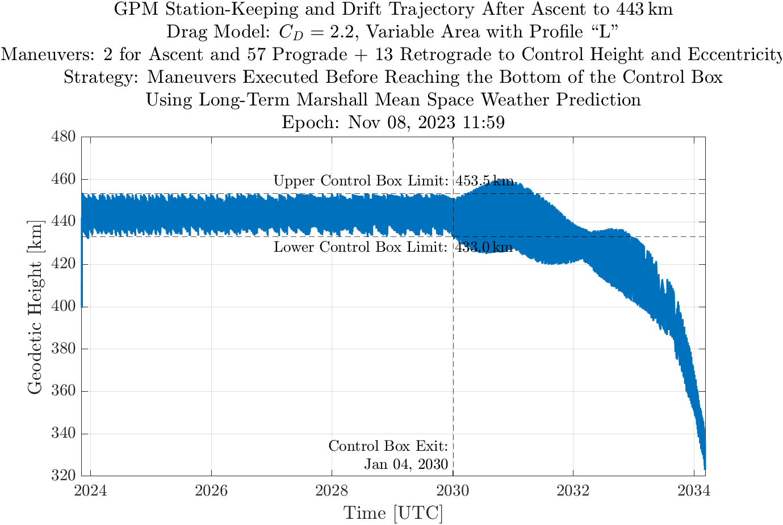
Core Observatory (1/2)
The high Solar activity has continued to decrease the lifetime of the GPM-CO
• originally expected to end in ~2032-2034
• now forecast to end in 2027
• there is a strong desire to keep GPM-CO flying long enough to overlap with the planned AOS mission
• solution is to boost the orbit from 400 to 435 km
Orbit altitude forecast after boost
480
460
440
420
400
380
360
340
320
height (km)
end of altitude-keeping fuel
2024 2026 2028 2030 2032 2034
[courtesy of GPM Mission Operations]

Slide 3
Core Observatory (2/2)
orbit boost approved by NASA and JAXA
• currently scheduled for November 7-8
• changes observing parameters – footprint size, Earth incidence angle
• impact on algorithms varies – less for GPROF, more for DPR and Combined
• some algorithms won’t return to full operation until February
• latest news at https://gpm.nasa.gov/missions/gpm/orbit-boost
Orbit altitude forecast after boost
480
460
440
420
400
380
360
340
320
height (km)
end of altitude-keeping fuel
2024 2026 2028 2030 2032 2034
[courtesy of GPM Mission Operations]

Slide 4
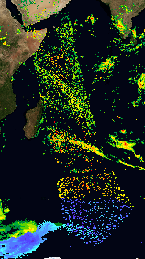
Algorithms
Version 07
• core products (microwave, radar, combined) are out and being used
• IMERG Final is out, but Early and Late pending other actions in PPS
• GPM-CO orbit boost requires modifications to V07 core algorithms
• this accentuates the importance of a timely V08 (early 2026)
• challenge: good science data during the ~4-year drift-down is going to require flexibility in the algorithms
Late-breaking news
• occasional bad orbits of GPROF estimates have been found (now 40 in 23 years)
• an innovative “auto-encoding” machine learning scheme is proving a whole new level of quality control
• offending GPROF estimates are being removed and parts of IMERG will have to be re-run
[courtesy of Jackson Tan]

Slide 5
Some Statistics
GPM product distribution through NASA continues to grow
• PPS and GES DISC file numbers and data volume can be combined
• they track together, but not closely – ratio is affected by sizes of products downloaded
• “unique” user counts can’t be combined, since there might be overlap
The total count of GPM-related papers is roughly 910 at present

