Slide 1


U.S. GPM Status
George J. Huffman
NASA Goddard Space Flight Center, Greenbelt, MD
george.j.huffman@nasa.gov

Slide 2
Core Observatory (1/3)
Mission Operations Center continues to do an amazing amount of work
• collision avoidance
• contingency planning for reaction wheel failure
• 4 of 5 functioning, 1 has shown problems; having 3 is fine, 2 is challenging
• 2-wheel patch for safehold uploaded in April 2023
• 2-wheel patch for science under development (for 2025-2026 depending on Senior Review overguide funding)
• all other subsystems and the instruments are all fully functional

Slide 3
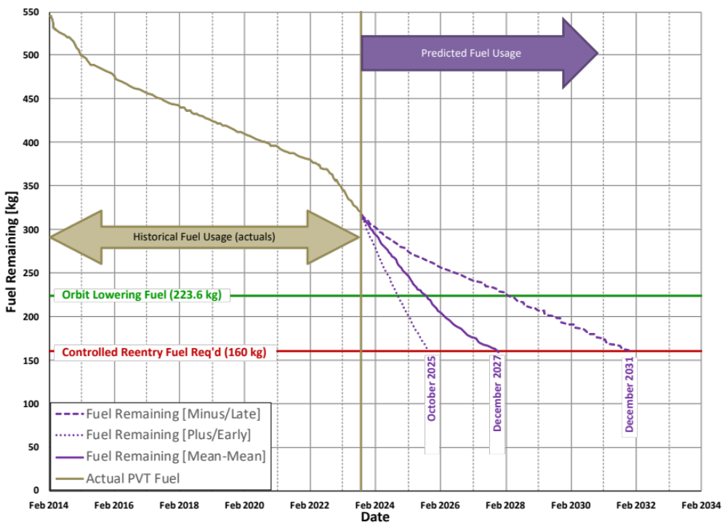
Core Observatory (2/3)
The high Solar activity has continued to decrease the lifetime of the GPM-CO
• originally expected to end in ~2032-2034
• now forecast to end in 2027
• there is a strong desire to keep GPM-CO flying long enough to overlap with the planned AOS mission
• solution is to boost the orbit from 400 to 435 km
15 September 2023 Fuel Predictions
550
500
450
400
350
300
250
200
150
100
50
0
fuel (kg)
15 Sep 2023 Fuel Predictions
(Solar Array Profile L – MSFC Solar)
[courtesy of GPM Mission Operations]
0
2/14 2/16 2/18 2/20 2/22 2/24 2/26 2/28 2/30 2/32 2/34

Slide 4
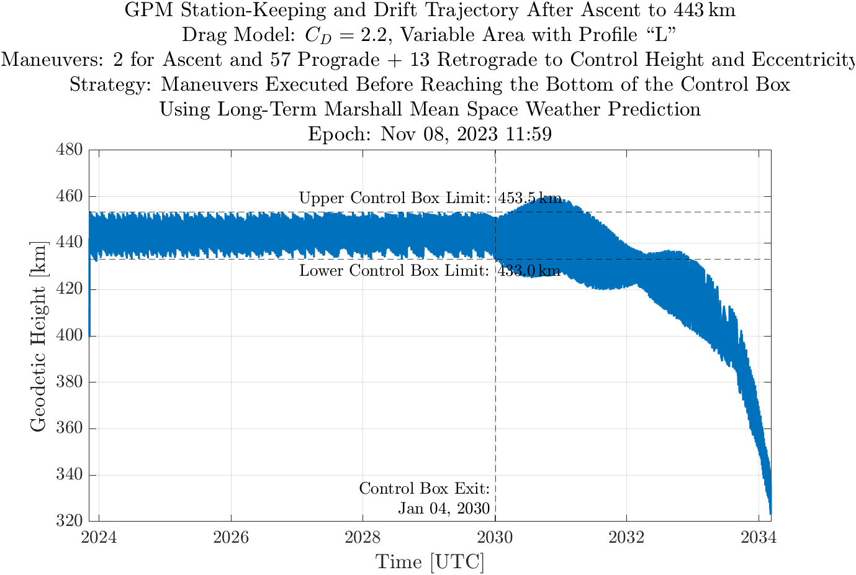
Core Observatory (3/3)
orbit boost approved by NASA and JAXA
• currently scheduled for November 7-8
• changes observing parameters – footprint size, Earth incidence angle
• impact on algorithms varies – less for GPROF, more for DPR and Combined
• some algorithms won’t return to full operation until February
• latest news at https://gpm.nasa.gov/missions/gpm/orbit-boost
Orbit altitude forecast after boost
480
460
440
420
400
380
360
340
320
height (km)
2024 2026 2028 2030 2032 2034
[courtesy of GPM Mission Operations]

Slide 5
Algorithms
Version 07
• core products (microwave, radar, combined) are out and being used
• IMERG Final is out, but Early and Late pending other actions in PPS
• GPM-CO orbit boost requires modifications to V07 core algorithms
Future
• we expect Version 08 in early 2026
• several algorithms are going to have significant modifications
• possible corrections due to the boost accentuate the importance of a timely V08
• challenge: good science data during the ~4-year drift-down is going to require flexibility in the algorithms
• a final reprocessing is scheduled as part of the End Of Mission activities
• limited to technical corrections (bugs, input dataset updates)

Slide 6
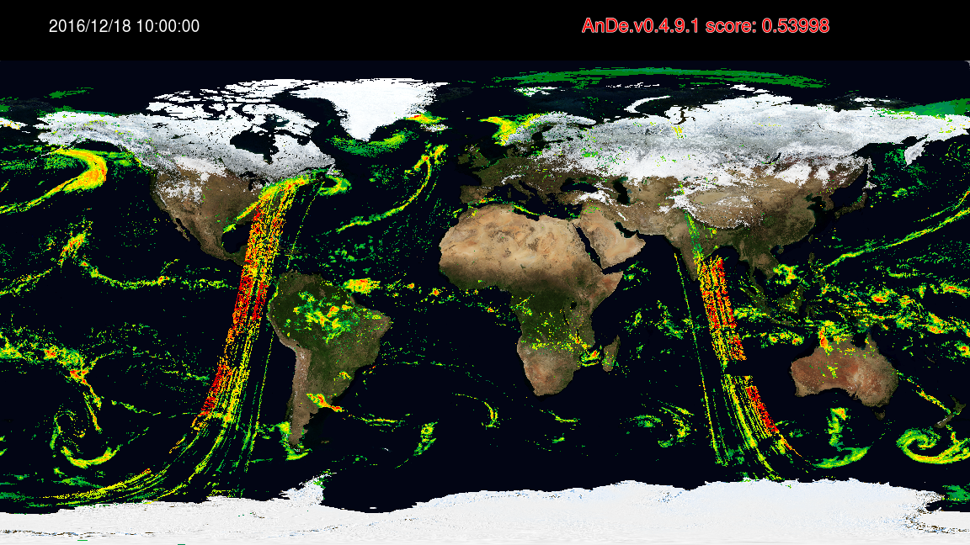
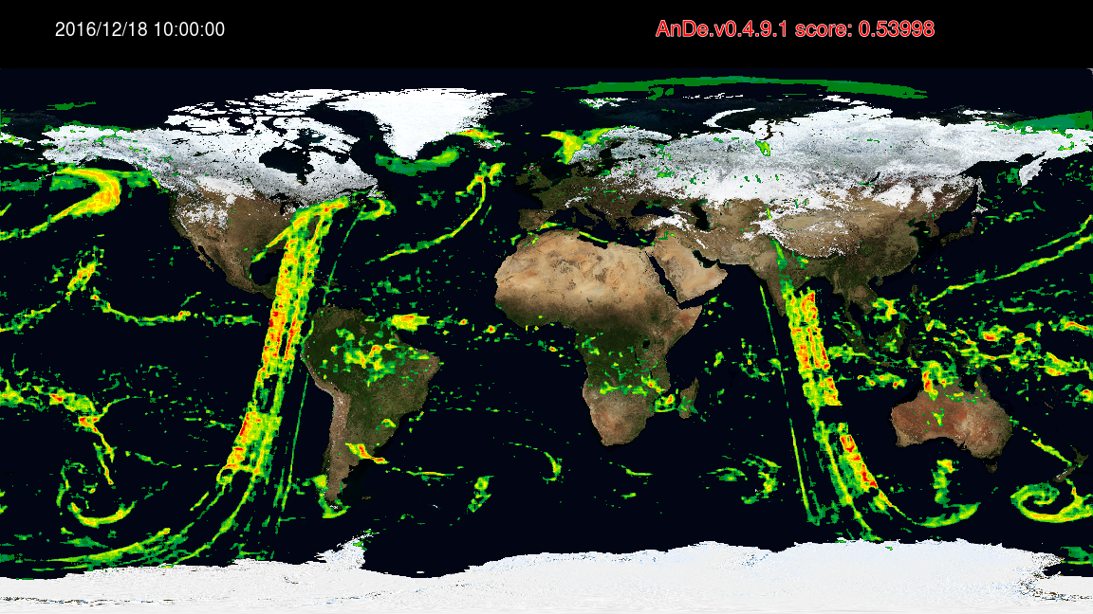
Advancing GPROF Quality Control (1/2)
Early analysis of V07 IMERG showed a (spectacularly) bad GPROF orbit segment
• this was at the level of contaminating the monthly average
• Jackson Tan has led an innovative “auto-encoding” machine learning scheme that is proving a whole new level of quality control – Anomaly Detector (AnDe)
• this example is in IMERG, but it’s cleaner to run AnDe on GPROF
• grand-average RMS difference gives the AnDe score
AnDe score = grand-average RMS difference between maps
original IMERG
upscaled/downscaled
[courtesy of Jackson Tan, U. of Md. Balt. County & GSFC]

Slide 7
Advancing GPROF Quality Control (2/2)
• GPROF screening is still in process, but so far we have identified ~40 orbits from various satellites over the period 2000-present
• bad GPROF data range from spectacular to barely noticeable
• as such, we will have to make choices about the cut-off for “bad”
• the Level 1 microwave channels seem reasonable, so it remains for study to see what combinations of channel values provoke these GPROF errors
• offending GPROF estimates are being removed
• contaminated IMERG times will have to be re-run
• “sufficiently bad” cases can contaminate the whole month of IMERG due to the adjustment to gauge data affecting every half hour in the month
• in V07 we are considering only re-running the “sufficiently bad” IMERG cases
• the GPM-era September-October-November climatological calibration for MHS is contaminated, so we will have to rerun those months during GPM
• the plan is to adapt AnDe as a back-end for GPROF “soon” to avoid manual processing

Slide 8
Data Systems
Precipitation Processing System does the heavy lifting for project computing
• core products and IMERG
• take in code from developers
• run Integration and Test Experiments to check out code and concepts
• access, store, and organize required input data
• compute products
• create “value-added” products
• make data available in multiple formats
GES DISC has long-term responsibility for archiving GPM products
• creates more value-added products
• provides multiple schemes for accessing data
• hosts Giovanni on-line analysis and display web tool
• working toward Cloud-based operations
• IMERG is a pathfinder for Cloud testing

Slide 9
Some Statistics
GPM product distribution continues to grow
• PPS and GES DISC file numbers and data volume can be combined
• they track together, but not closely – ratio is affected by sizes of products downloaded
• “unique” user counts can’t be combined, since there might be overlap
The total count of GPM-related papers is roughly 910 at present

Slide 10
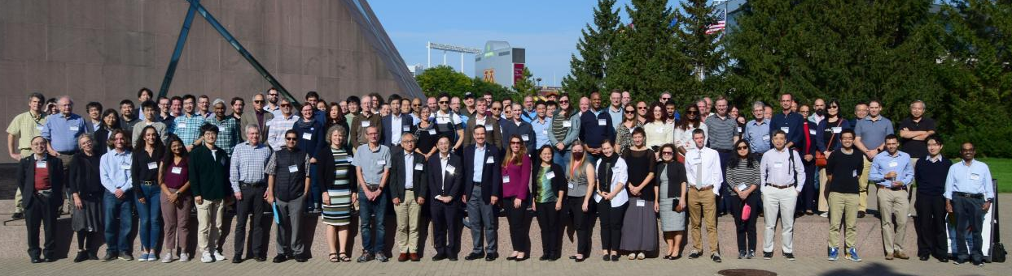
U.S. PMM Science Team Meeting
• September 18–22, 2023, in Minneapolis, MN, as a hybrid meeting
• 137 attendees from NASA, JAXA, universities, partner agencies, and ~22 virtual
• 46 plenary talks spread across 7 thematically-focused sessions and 77 posters presentations split between two sessions
• special sessions: NASA-JAXA JPST, CEOS-PVC, GPM Mentorship Program
• topically-focused groups: Applications, Hydrology, Land Surface, Latent Heating, Multi-satellite, Inter-satellite Calibration (XCAL), Ground Validation (GV), Particle Size Distribution (PSD), and Oceanic Areas.
[courtesy of Chris Kidd, U. Md. College Park & GSFC]

Slide 11
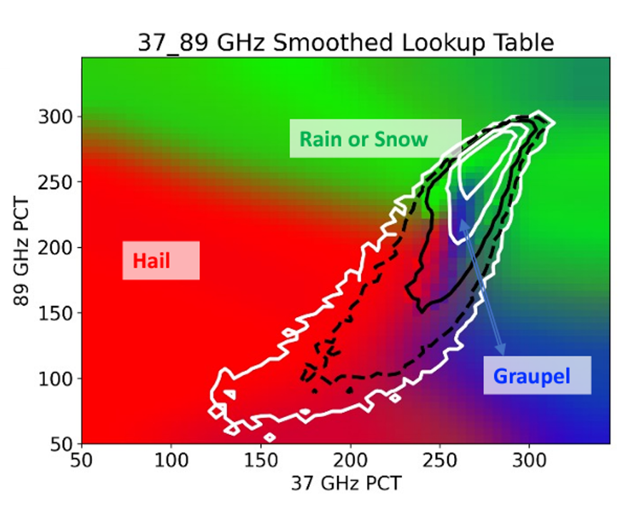
Science
Hydrometeor habit is critical information – rain, snow, graupel, and hail
• detecting these from space is challenging
• how well can passive microwave channel data do?
• start with GMI data
• use the GPM Validation Network (selected U.S. and international radars) as ground truth
• construct lookup-tables of the likelihood of a hydrometeor habit
• the figure indexes habit probabilities as functions of Polarization Corrected Temperatures for two channels (37 and 89 GHZ)
• snow and rain are combined into one category here (green), but are separate in the lookup tables
• relative frequency is contoured
[courtesy of Dan Cecil, NASA Marshall Space Flight Center]

Slide 12
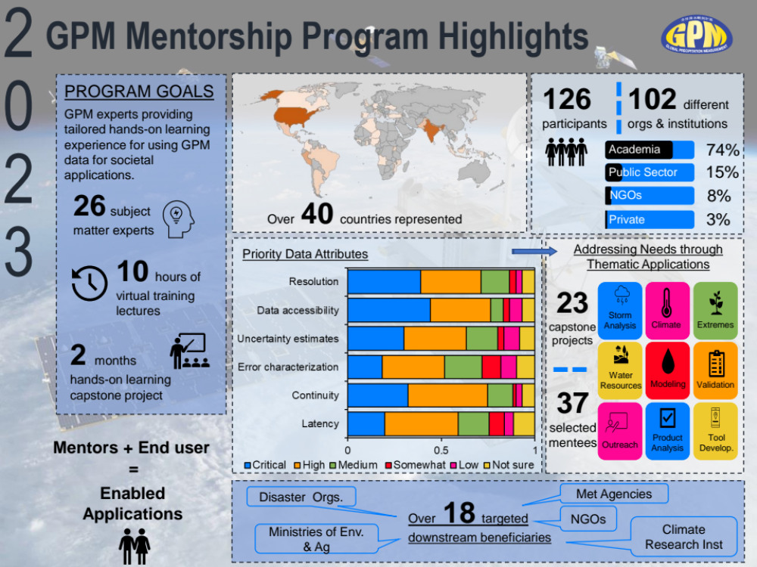
Mentorship Program
Capacity building and precip training
2022
• 53 participants across 25 countries
• 13 subject matter experts from the U.S. PMM ST
• 12 capstone projects
2023
• 126 participants across 42 countries
• 26 subject matter experts from the U.S. PMM ST
• 22 capstone projects
Planning underway for 2024
[courtesy of Andrea Portier, SSAI & GSFC]

Slide 13
Closing Thoughts
A lot of things are happening in the next 6 months
• orbit boost, algorithm adjustments, bad-orbit removal, PPS operating system upgrade
Data users are engaged and value GPM data
The upcoming V08 release is important to solidify changes
It is important to help shape the future of precipitation science
• AOS
• next-generation multi-satellite algorithms

