Slide 1


U.S. IMERG Status
George J. Huffman
NASA Goddard Space Flight Center, Greenbelt, MD
george.j.huffman@nasa.gov
Dave Bolvin, Bob Joyce, Eric Nelkin, Jackson Tan
also Owen Kelley, Daniel Watters, Jason West, Yalei You

Slide 2
IMERG Data Availability During the GPM-CO Orbit Boost
(Projected Date)
NRT CORRA available
(Projected Date)
Research CORRA available
Orbit boost
Jun 2023
Jul 2023
Aug 2023
Sep 2023
Oct 2023
Dec 2023
Final
Nov 2023
V07A
V07B
Early/Late
4-h/12-h latency; calibrated to CORRA
4-h/12-h latency;
frozen calibration
4-h/12-h latency;
calibrated to CORRA
V06D
V07B
1 Nov 2023
1 Dec
1 Jan 2024
1 Feb
1 Mar
1 Apr
calendar date
Final processing as per usual
Final processing delayed but calibration unaffected
Early/Late processing as per usual
Early/Late calibration affected but on schedule
Last updated: 24 Oct 2023

Slide 3
V06-to-V07 Status
V06 Final Run
• June 1, 2000 – September 30, 2021
• driven by requirement for homogeneity; didn’t want to include V07 products
• now superseded by V07 (current, through May 2023)
Early and Late Runs continued
• accepted successive introduction of V07 inputs
• shift to V07 IMERG depends on PPS priorities
Thereafter, V07 IMERG for January 1998 – February 2000 will be tested and run with GridSat IR in place of the unavailable CPC 4 km Global Merged IR
• February-May IMERG calibrations will have a blend of CPC and GridSat IR
• February-May IMERG fields will only include CPC IR

Slide 4
Projected Timeline for IMERG V07 Reprocessing
Final
Jun 2000–May 2014
Jan 1998–May 2000
Jun 2014–Apr 2023
routine Initial Processing ………
routine Initial Processing …
Jan 1998–May 2000
Early/Late
Jun 2000–Dec 2023
1 Jul 2023
1 Sep
1 Nov
1 Jan 2024
1 Mar
calendar date
Last updated: 2 Nov 2023

Slide 5
V07 Enhancements (1/3)
Scheme for Histogram Adjustment with Ranked Precipitation Estimates in the Neighborhood (SHARPEN)
• undo distortion of PDF due to averaging in Kalman filter combination of forward- and backward-propagated PMW, IR
    Modified Kalman Averaging Scheme
    • apply Kalman filter at PMW overpass times
    • modest improvement in skill, but mitigates “flashing” in animations
Switch from PERSIANN-CCS to PERSIANN Dynamic Infrared–Rain Rate (PDIR-Now)
• UC-Irvine ported PDIR-Now from MatLab to C
A long-standing bug in the PMW gridder was fixed
• systematic shift of PMW east by 1 grid box (0.1⁰)
• escaped notice in code validation done a decade ago at 0.025⁰
SAPHIR removed pending better spatial calibration

Slide 6
V07 enhancements (2/3)
  (Floating) bias in calibration process was corrected
  • there were three factors contributing!
  • GPROF outside/inside the Ku swath differ by +/- 2%
  • needed consistent spatial resolution
  • GPCP calibration over land in V06 was not helpful
  Variable name changes
  • reduce user confusion about “right” variable
  • yes, breaks some current code – sorry!
  HQprecipitation ➔ MWprecipitation
  HQobservationTime ➔ MWobservationTime
  HQprecipSource ➔ MWprecipSource
  precipitationCal ➔ precipitation
  IRkalmanFilterWeight ➔ IRinfluence

Slide 7
V07 enhancements (3/3)
  Precipitation motion vectors a recomputed using multiple MERRA-2/GEOS-5 model variables
    • Precip (PRECTOT), then Total Precipitable Liquid Water (TQL), then TQV
    Blended Fuchs-Legates wind-loss correction
IR quality control module
• “fixes” for periodic GOES-W cooling issues and other known IR artifacts
• introduced mid-stream in V06
  Raise cap on precip rates to 200 mm/hour
  • in V06 120, 50 mm/hour, respectively, for PMW, IR
  Include PMW estimates over frozen surface
  • but given a lower certainty
  • V07 is fully global except some boxes near the poles

Slide 8
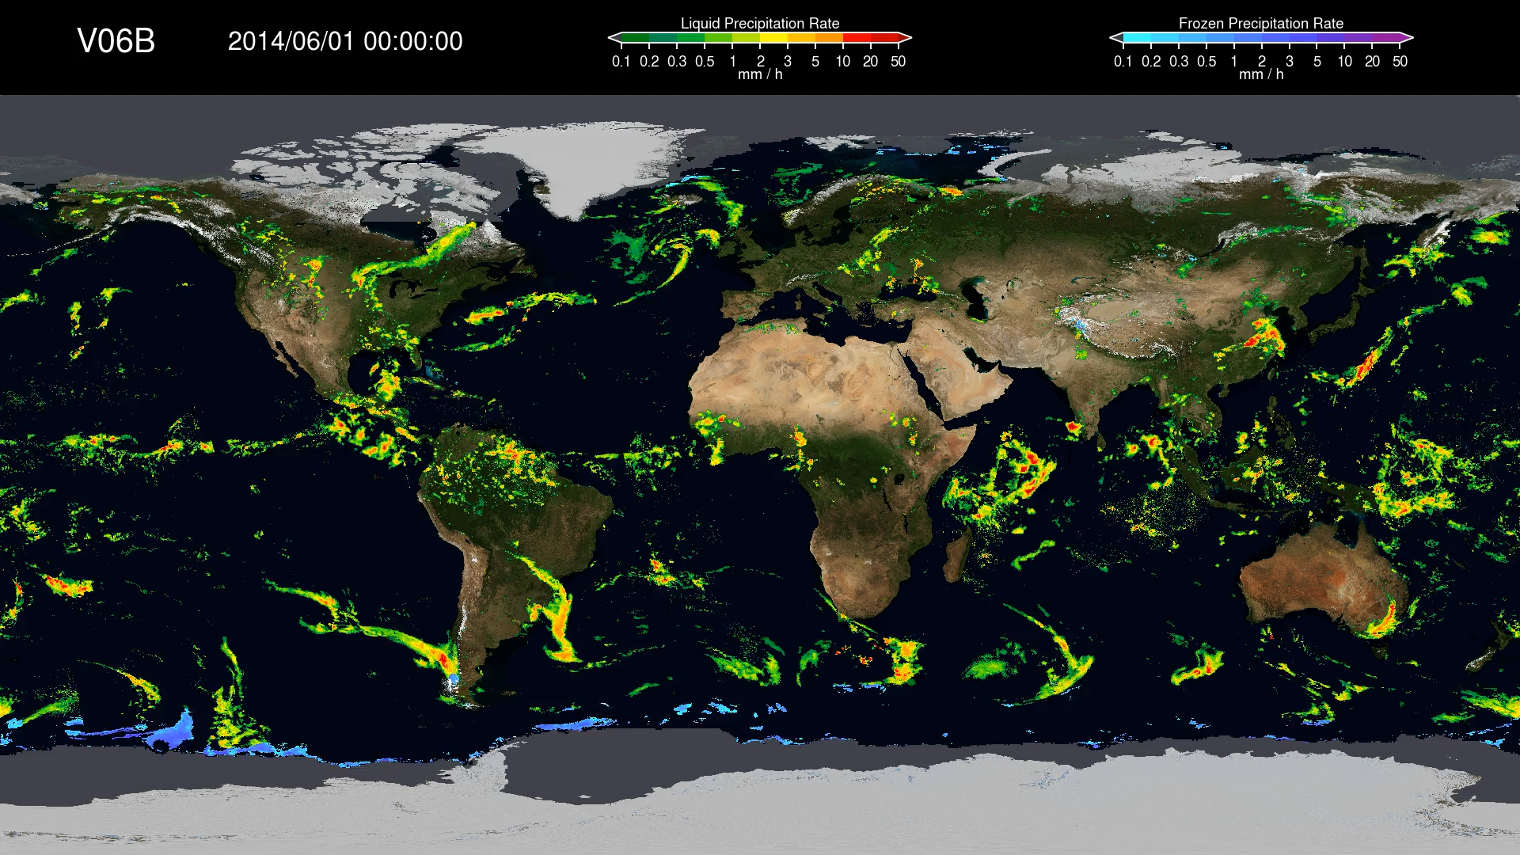
Comparing V06 and V07
Alternate days of V06 and V07
    • GPROF used over snow/ice in V07
    • smoother behavior in V07
[courtesy of Jackson Tan, UMBC & GSFC]

Slide 9
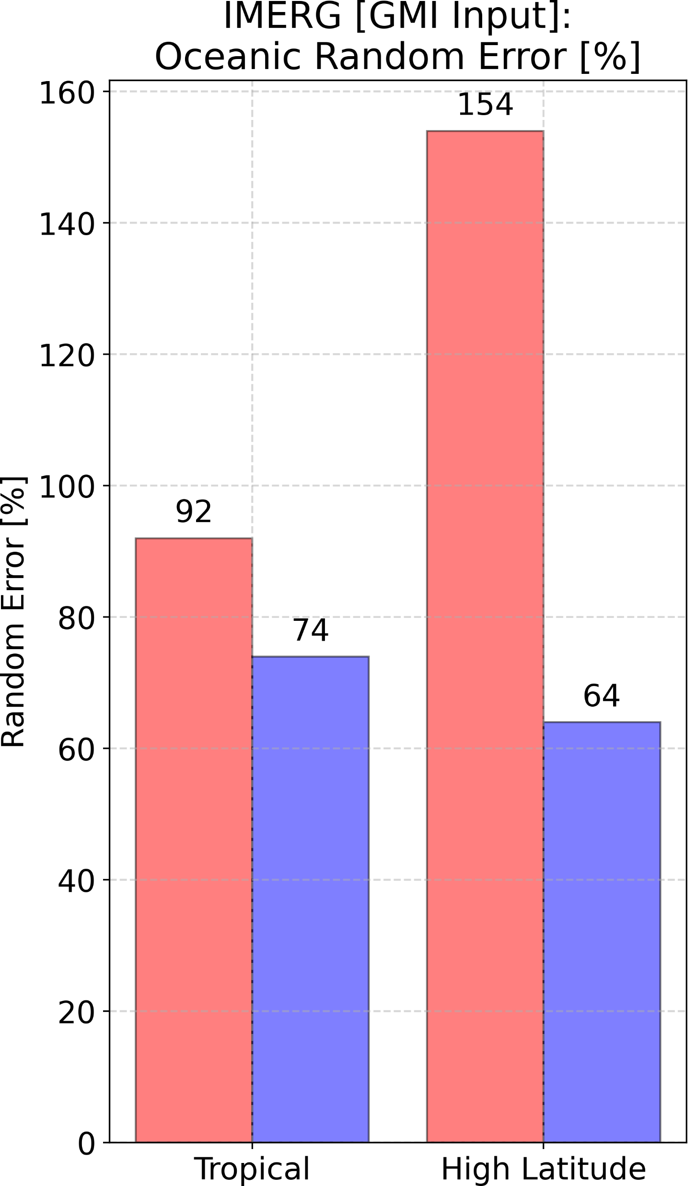
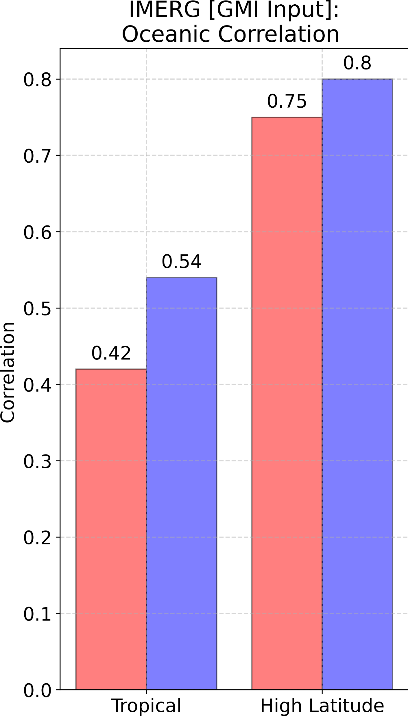
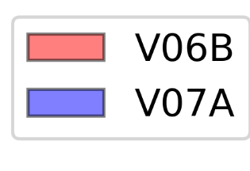
V07 GV over Ocean
IMERG V07 improves on V06 for high-latitude and tropical oceanic precipitation [GMI overpasses only]
Strong improvements in V07 statistics particularly over Gulf of Alaska
IMERG systematic and random errors decrease with increasing precipitation intensity
[courtesy of Daniel Watters, NPP MSFC]

Slide 10
V07 known issues
  The TRMM-era t = 0 Kalman stats unintentionally reduce weights for instantaneous sounder estimates over the ocean
  Use of a single GMI-to-other-satellite land calibration can lead to instabilities in certain regions/seasons
  We are investigating a CORRA discontinuity at the TRMM boost
  We are investigating occasional bad GPROF retrievals that leaked into IMERG
  • ~40 orbits, currently screening entire L2 GPROF archive
  • “really bad” orbits contaminate the entire month of IMERG Final half-hourly files
  • bad orbits contaminated the GMI-MHS climatological adjustment for Sep-Oct-Nov in the GPM era
  • we have to decide whether to re-reprocess V07 IMERG Final in part or completely
  • the vast majority of IMERG files are uncontaminated, but it might be easier to just start over

Slide 11
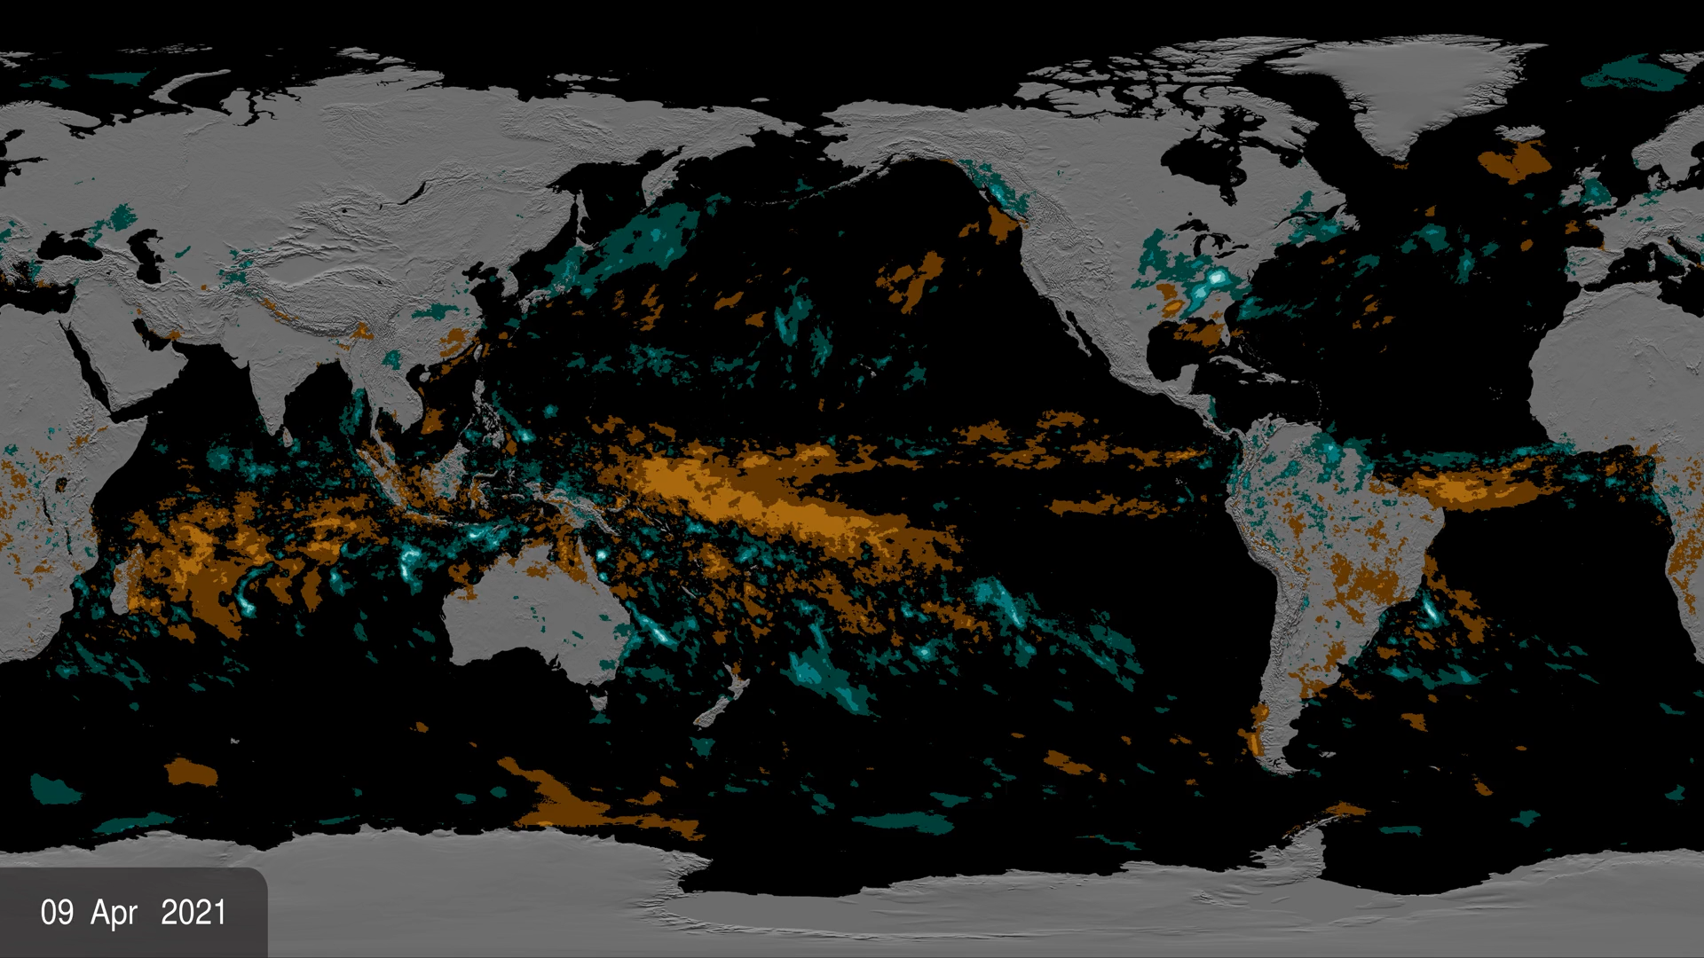
IMERG – the last year of global variation
The tropical Pacific starts in a La Niña pattern that shifts to El Niño over the summer
• note other dry and wet areas, for example across CONUS
• streaks (mostly over ocean) from tropical cyclones
https://svs.gsfc.nasa.gov/4897/

Slide 12
V08 IMERG priority actions
  Finalize GPROF filter for bad output data, implement as a post-processor in V07 GPROF as soon as ready
  • until then, run AnDe on the V07 GPROF output as an extra step
Improve the homogeneity between the TRMM and GPM eras
  • perhaps by enforcing spatial scale consistency
Devise additional automated quality control for artifacts in the IR Tb’s
Accommodate new PMW sensors, including the next generation of small-sats
• TROPICS, H8-STP (TEMPEST+COWVR combination)
  Re-integrate SAPHIR into the IMERG inputs
  Apply sensor prioritization when merging the PMW sensors
Implement a more modern water surface file in IMERG
Compute the instantaneous Kalman correlations in the Kalman module instead of using climatological values
Evaluate and investigate orographic enhancement

Slide 13
Future
  How does the U.S. team move to the next-generation multi-satellite product?
  • we have a wide user community
  • we have the constellation
  • but need to ensure continued resolution and channel selection that support high-quality precip estimates
  • we need to continue the active/passive calibrator in an inclined orbit
NASA is investigating a revised institutional strategy
  • for 2 satellite generations (TRMM, GPM) the mission has carried the cost
  • AOS is not funded to support multi-satellite products

