Slide 1

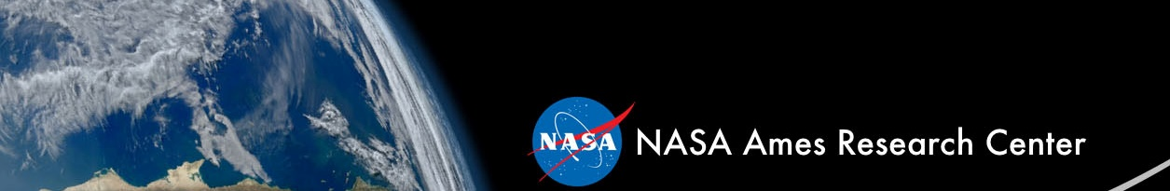
Synthetic Biology for Deep Space Exploration
A. Mark Settles
Life Support Studies AST
Bioengineering Branch
andrew.m.settles@nasa.gov

Slide 2


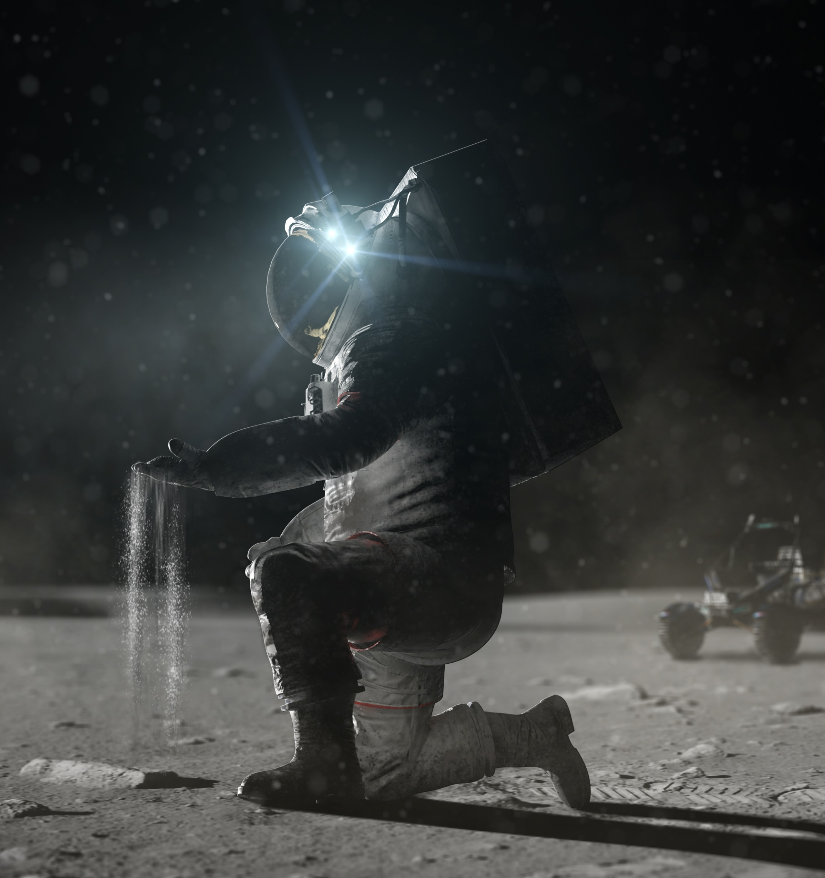
Image credit: NASA

Slide 3
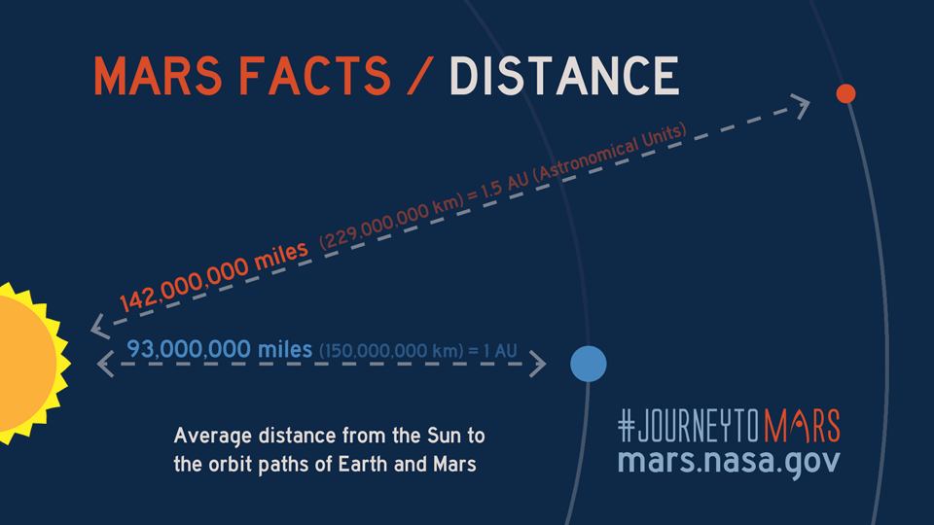
Moon to Mars:
Distance from Earth increases mission cost and risk
Mission resources will need to be produced on-site to increase sustainability and to reduce costs of deep space exploration.
Fuels, food, essential nutrients, chemicals, plastics, binders, and medicines are resources that could be produced in mission.
Biomanufacturing can provide some compounds that abiotic systems cannot.
Image credit: NASA

Slide 4
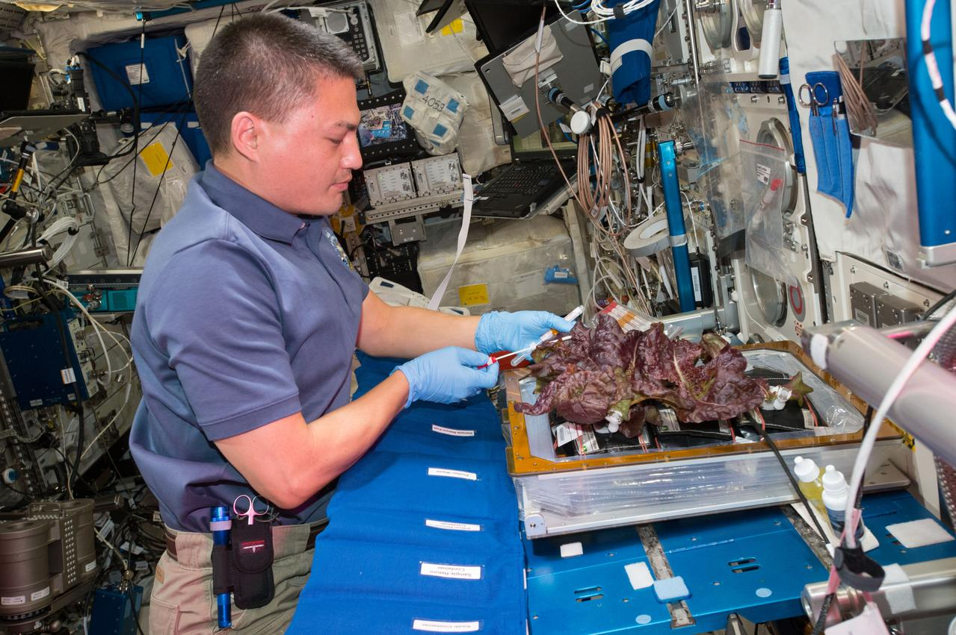
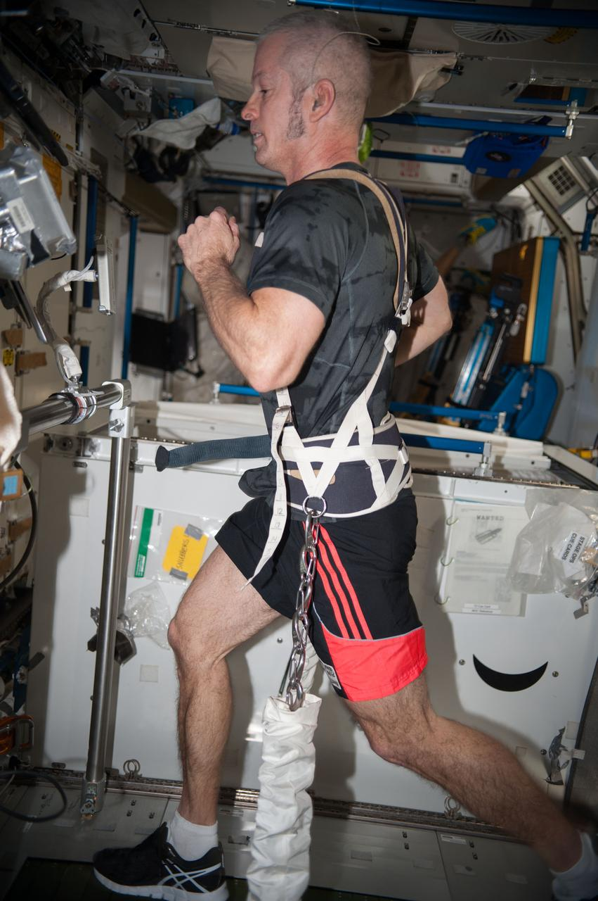
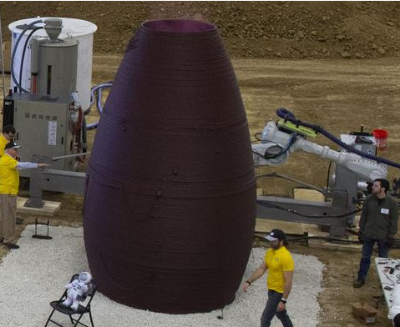
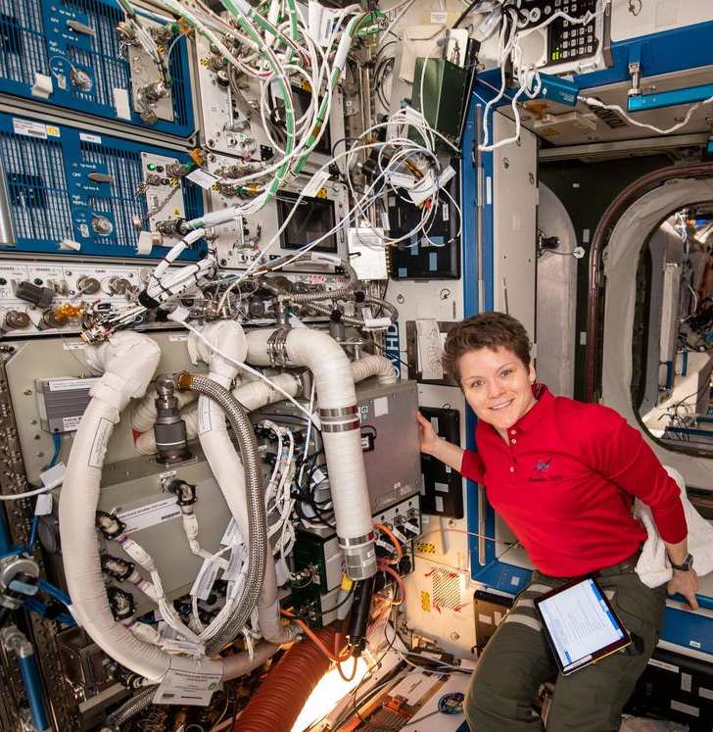
Opportunities to close technology gaps with Synthetic Biology
Food production is needed to provide essential nutrients that degrade in preserved food storage
Space medicine/countermeasures need to be responsive to the adverse conditions of deep space
In situ Manufacturing (ISM) is needed to increase the resilience of deep space missions
In situ Resource Utilization (ISRU) can reduce the cost of taking all supplies from Earth
Closed-loop life support regenerates air, water, and materials from waste
Image credits: NASA

Slide 5
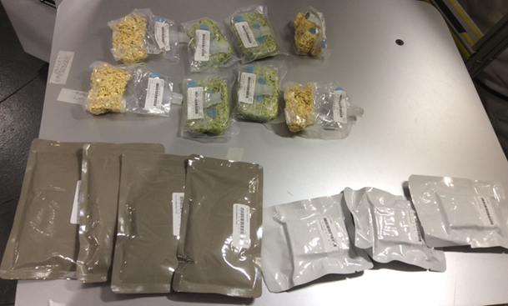
Pre-packaged foods in the NASA Food System have a limited shelf life
The NASA food system needs to have a 5-year shelf-life to go to Mars.
Current pre-packaged foods lose palatability and essential nutrients during long-term storage.
Food Stabilization Processes
Dehydrated
Thermostabilized
Extended shelf-life baked goods
Adapted from Zwart et al (2009) Food Science 74(7):H209-H217.
https://doi.org/10.1111/j.1750-3841.2009.01265.x

Slide 6
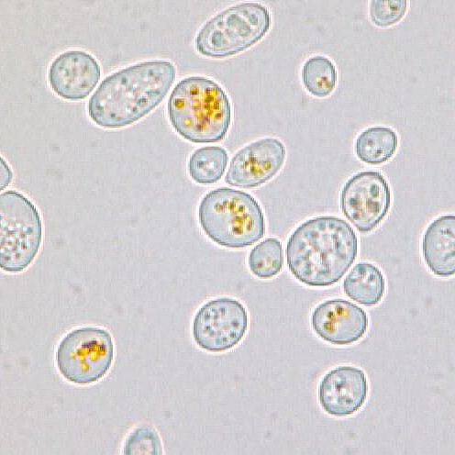
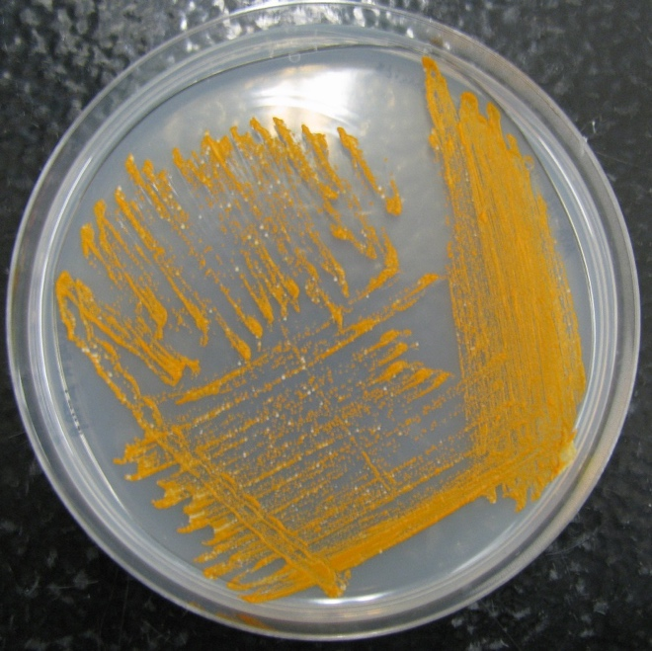
Space Synthetic Biology: BioNutrients
Microbially fermented foods to produce essential nutrients
Rationale: Engineer yeast and/or bacteria to produce essential nutrients when grown for a short period of time in edible media.
Rapid, on-demand production
Room temperature storage of organisms
Enriches pre-packaged foods with labile nutrients
Carotenoids selected as initial nutrient:
Light sensitive and degrades in packaged foods
Important to protect from macular degeneration
Antioxidant activity to protect against DNA damage
S. cerevisiae var. boulardii producing β-carotene

Slide 7
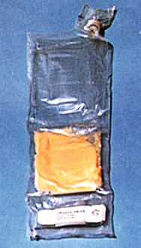
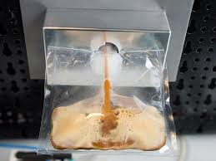
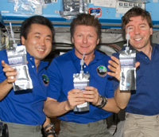
BioNutrients: Future implementation concept
Dry media and microbes
Ambient temperature storage
Hydrate and dissolve media
Incubate to grow microbes
Deactivate microorganisms
Consume as a supplement
Image Credits: NASA

Slide 8
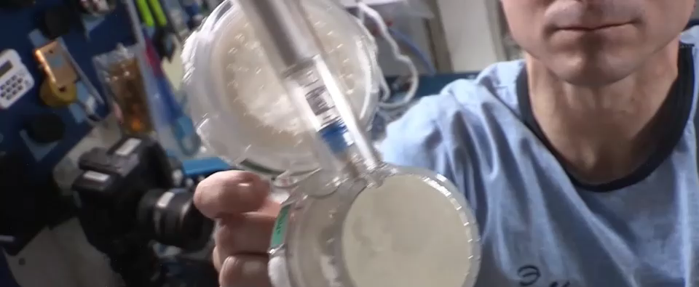
BioNutrients-1: On-orbit Operations
Image Credits: NASA

Slide 9
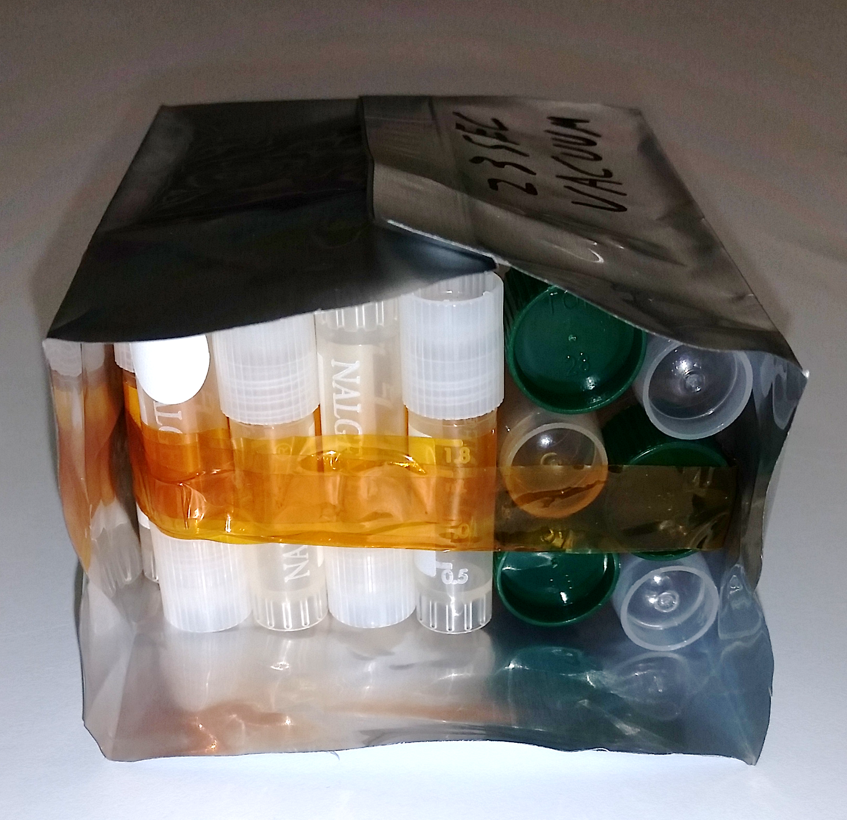
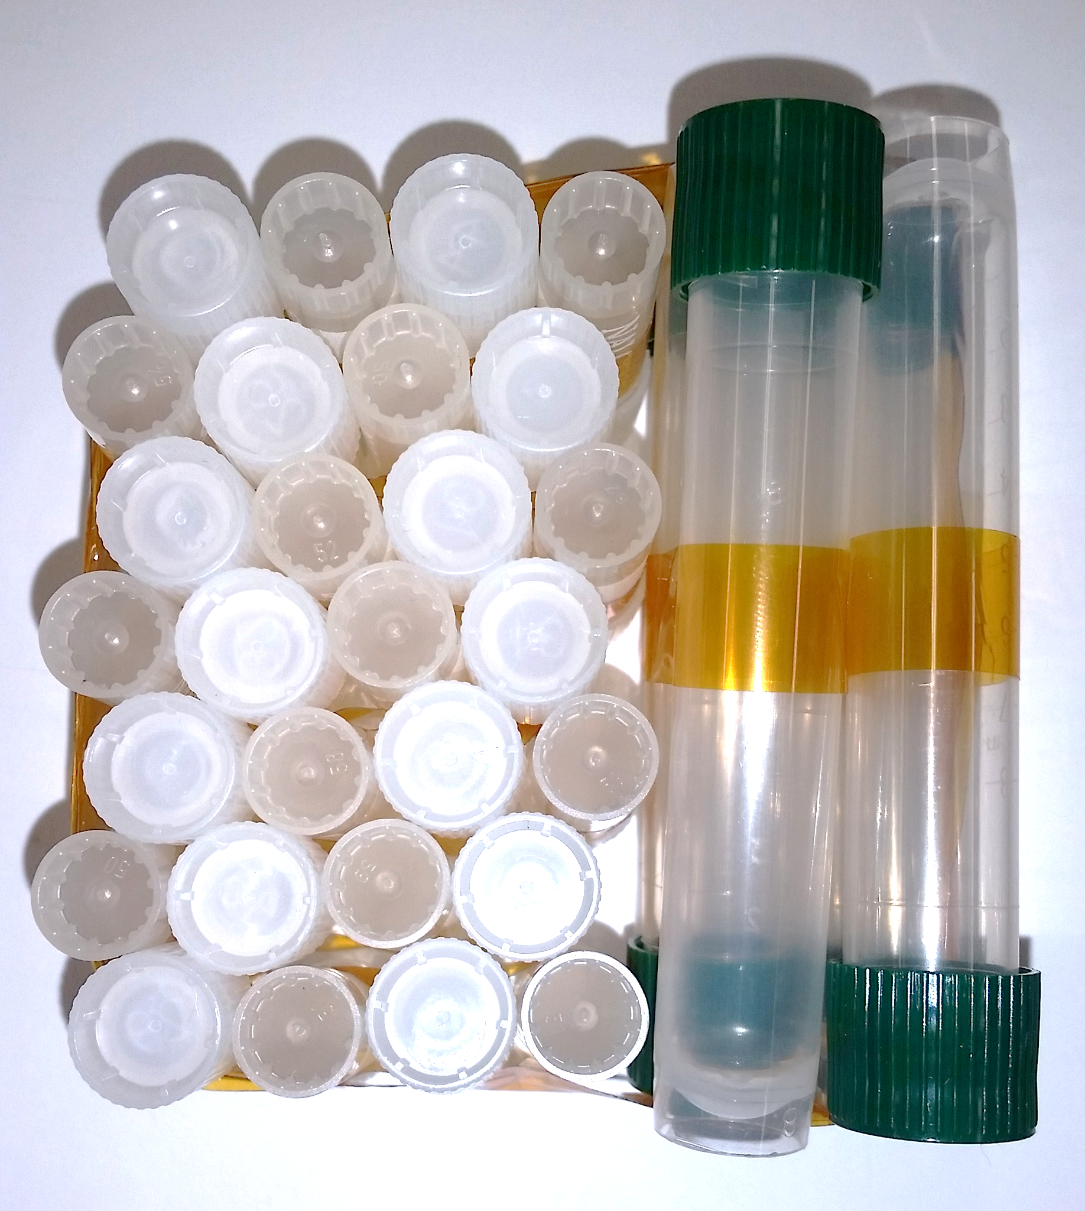
BioNutrients-1: Stasis Packs
Research Questions:
Are there microbial species that are stable at ambient temperature storage for 5 years?
  Nine species compared
Does alginate encapsulation improve long term viability of most microbes?
  Five species compared
Are there common genes required for long-term viability?
  Five species mutagenized for increased diversity
Can genetic engineering improve long-term viability?
  Three engineered strains with antioxidant or desiccation tolerance genes engineered
Will microbial media be stable for five years?
  Three media types stored
Two vacuum sealed Mylar packs per time point
56 x 2 mL vials of microorganisms
12 x 10 mL vials of media
Image Credits: NASA

Slide 10
Timeline of BioNutrients Flight Experiments
BN1 Launch
BN2 Launch
2019
2020
2021
2022
2023
2024
BioNutrients-1 Production Packs
1
2
3
4
5
6
BioNutrients-1 Stasis Packs
1
2
3
4
5
6
7
8
9
10
11
12
BioNutrients-2 Production Bags
1
2
BioNutrients-1 has a 5-year timeline to test ambient storage.
BioNutrients-2 tested new bioreactor and a additional products.

Slide 11
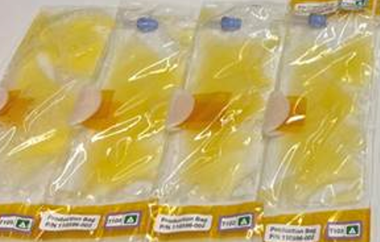
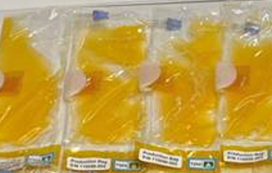
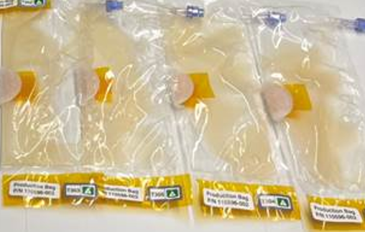
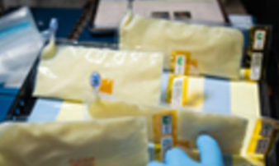
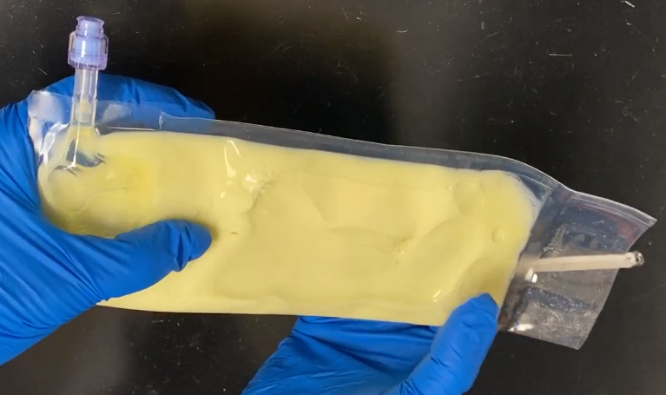
BioNutrients-2: Expanding products and reducing bioreactor mass
Strains for flight testing | Product | Purpose
Saccharomyces cerevisiae | Zeaxanthin | Aid in macular degeneration
Saccharomyces cerevisiae var. boulardii | β-carotene | Vitamin A precursor
Kluyveromyces lactis | Follistatin | Protein therapeutic to promote muscle formation
Streptococcus thermophilus | GFP | Demonstrate ability to engineer yogurt organism
Kefir-producing mixed organism culture | Kefir | Test production quality using a commercial kefir starter
Streptococcus thermophilus & Lactobacillus bulgaricus | Yogurt | Test production quality using a commercial yogurt starter

Slide 12
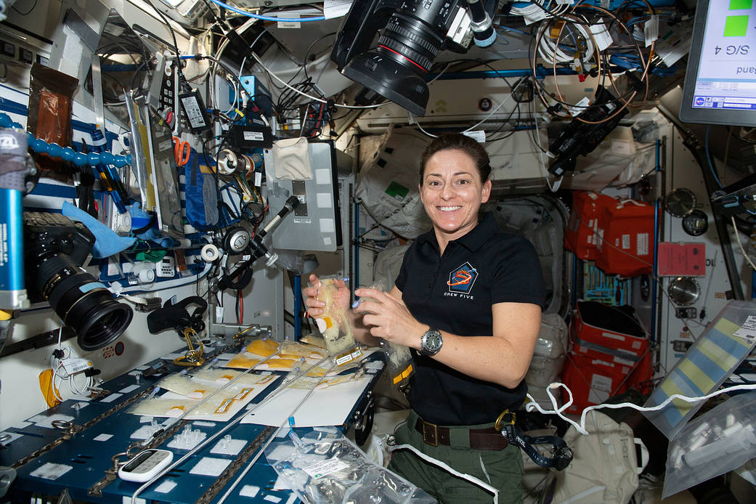
BioNutrients-2: Implements a production bag
Jan. 3, 2023 --- NASA astronaut and Expedition 68 Flight Engineer Nicole Mann works in the International Space Station's Harmony module on the BioNutrients-2 investigation that uses genetically engineered microbes to provide nutrients, and potentially other compounds and pharmaceuticals, on demand in space.
https://www.nasa.gov/image-feature/astronaut-nicole-mann-works-on-the-bionutrients-2-investigation
Image Credits: NASA

Slide 13
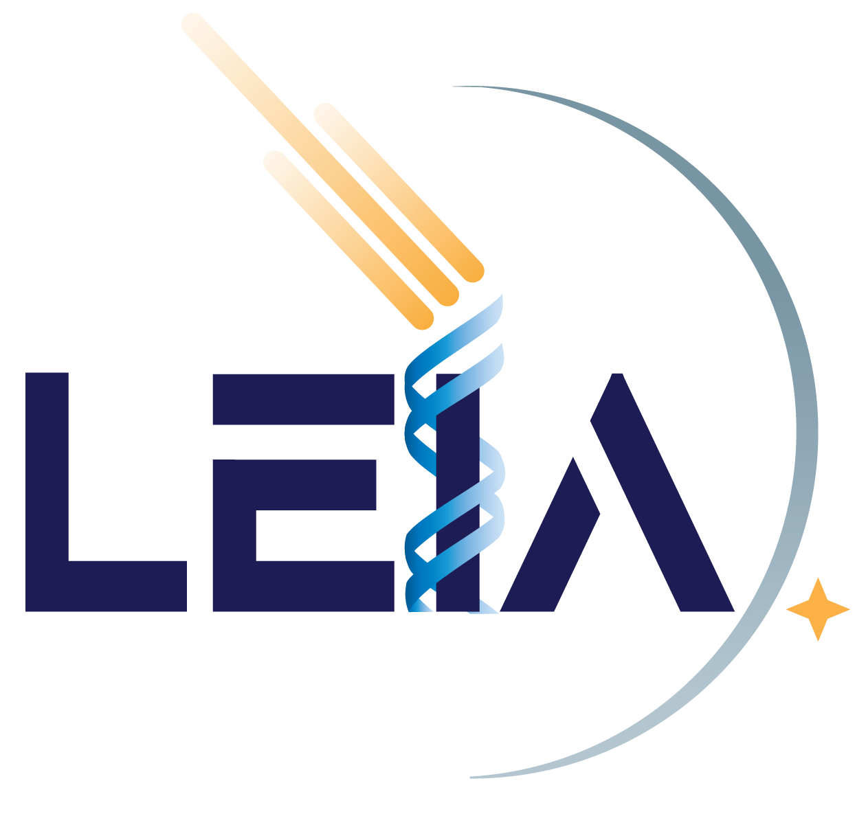
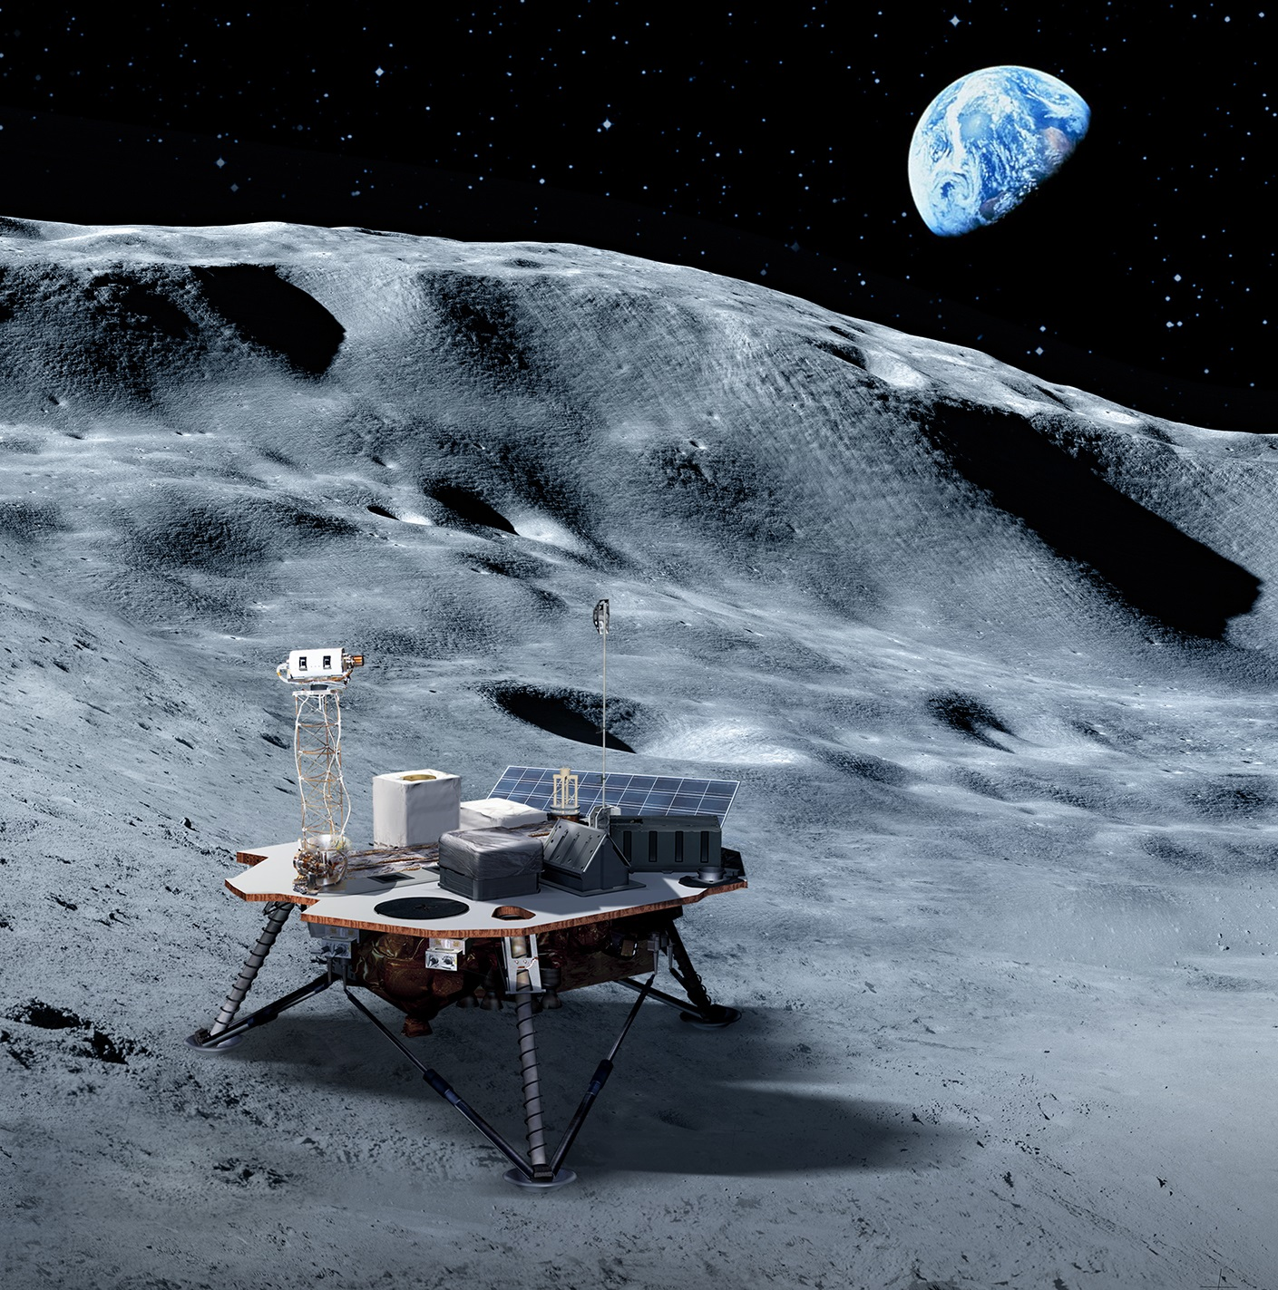
Biomanufacturing: Transitioning from the ISS to the lunar surface
Radiation dose on the lunar surface is higher than in low Earth orbit.
Will there be an impact on bioproduction of engineered yeast?
LEIA: Lunar Explorer Instrument for space biology Applications seeks to address this question.
Image credits: NASA

Slide 14

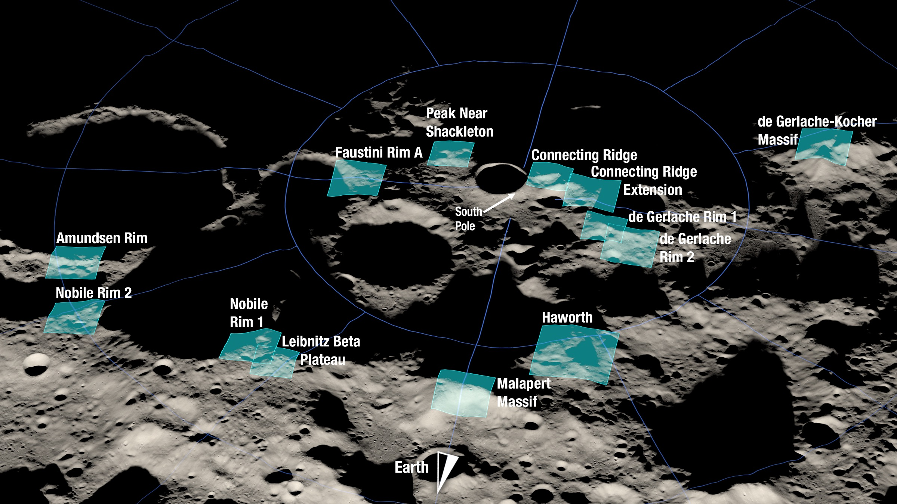
Lunar Explorer Instrument for space biology Applications:
a South Pole Lunar surface investigation
Motivation.
What are the radiation health risks for crewed exploration of the lunar surface?
Will proposed mitigations for crew health using in-space biomanufacturing be effective beyond low Earth orbit?
Approach.
Engineer yeast strains to test growth and metabolism for sensitivity to radiation.
Measure biologically relevant radiation in transit and on the lunar surface.
Central goal.
Identify genetic factors impacting cellular response to lunar surface radiation and gravity.
Artemis III candidate landing regions
Team: Dr. A. Mark Settles (PI), Dr. Sergio Santa Maria (Deputy PI), Dr. Donald M. Hassler (Co-I, SwRI), David Pletcher (PM), Leandro James (SE)
For more information: https://www.nasa.gov/press-release/nasa-selects-new-instruments-for-priority-artemis-science-on-moon
Image credits: NASA

Slide 15
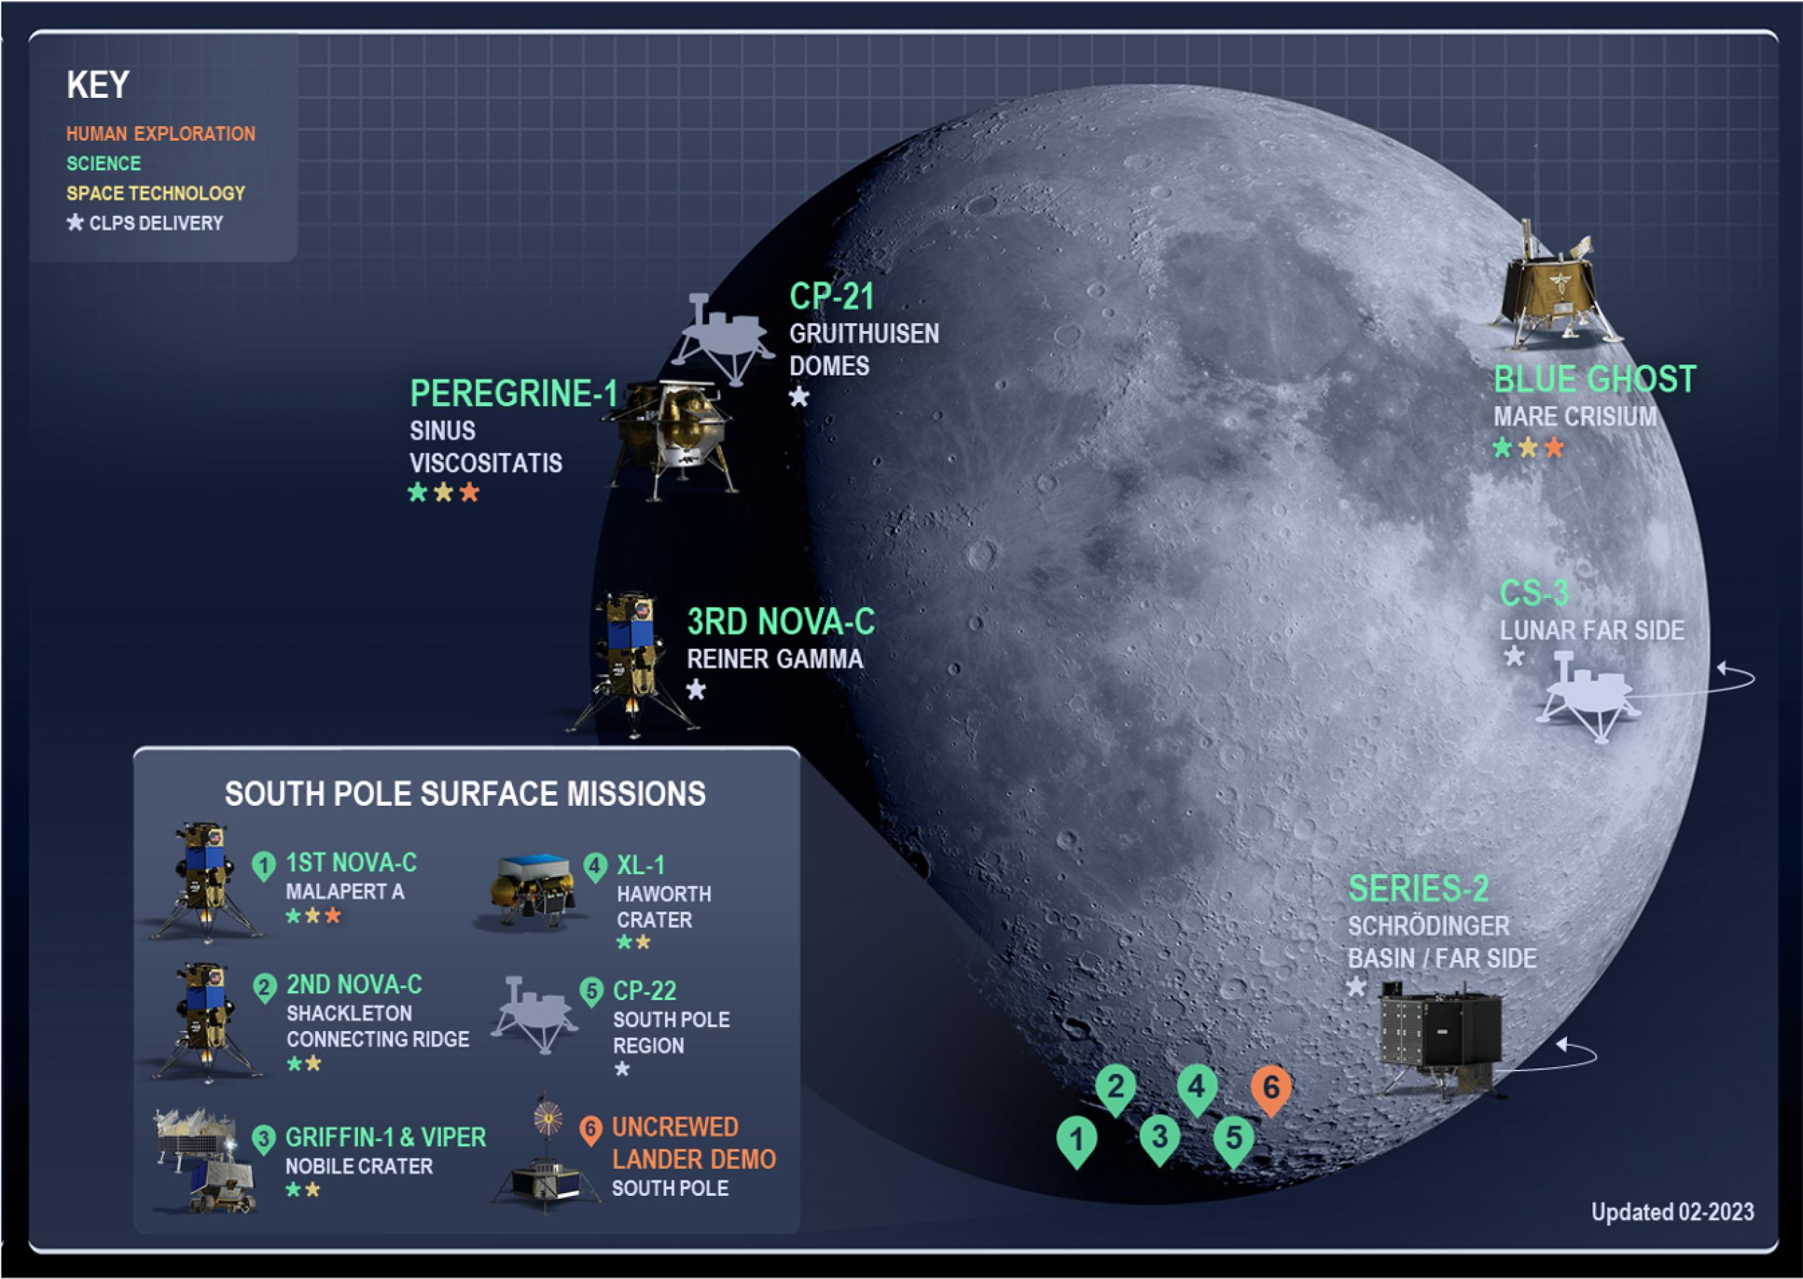
LEIA is a Commercial Lunar Payload Services (CLPS) Delivery
CLPS relies on American companies to deliver NASA payloads from Earth to the surface of the Moon.
Artist’s infographic shows approximate landing locations for planned missions.
LEIA is a payload on CP-22 and scheduled to land in late 2026.
Image Credit: Jenny Mottar, NASA

Slide 16
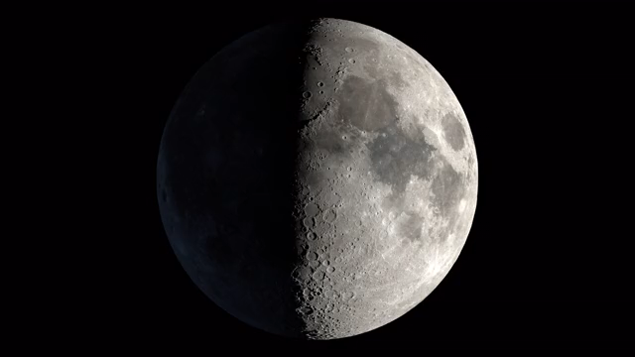
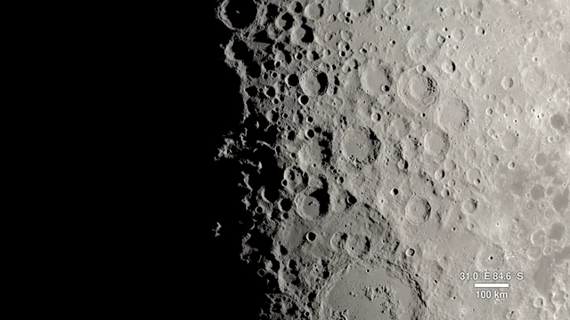
CP-22 planned landing site is at Mons Mouton
Mons Mouton is a mesa-like lunar mountain near the Nobile Crater.
Mons Mouton is visible from Earth and roughly the size of the state of Delaware.
The VIPER mission will survey an area adjacent to the western rim of the Nobile Crater.
LEIA will be positioned in a more central region of the mountain.
Video Credit: Ernie Wright, NASA

Slide 17
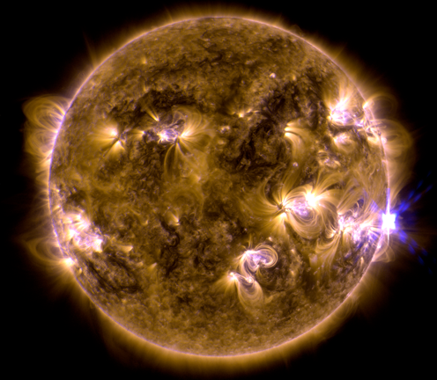
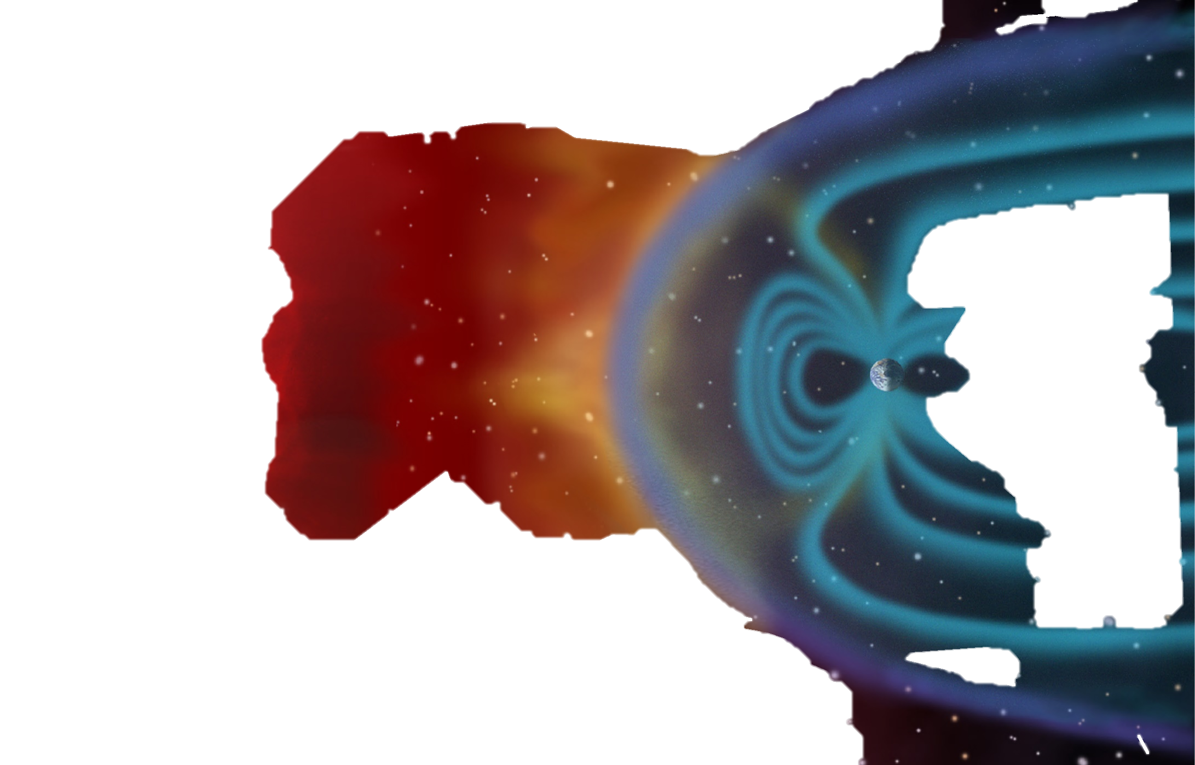
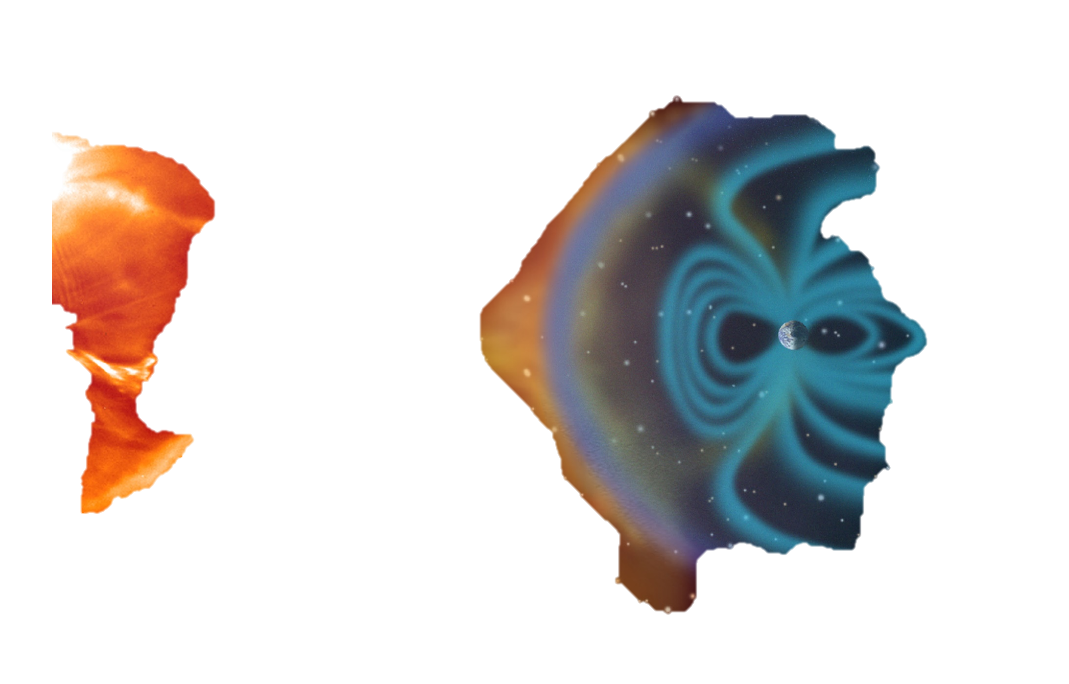
Sources of deep space radiation
Galactic Cosmic Rays (GCRs)
Solar Particle
Events (SPEs)
Trapped particles
SPEs: sporadic, transient (mins to days); high proton flux (low-medium energy)
GCRs: high-energy protons and highly charged, energetic heavy particles
GCRs are not easy to shield
Deep space radiation levels are modulated by the 11-year solar cycle
Image credit: NASA

Slide 18
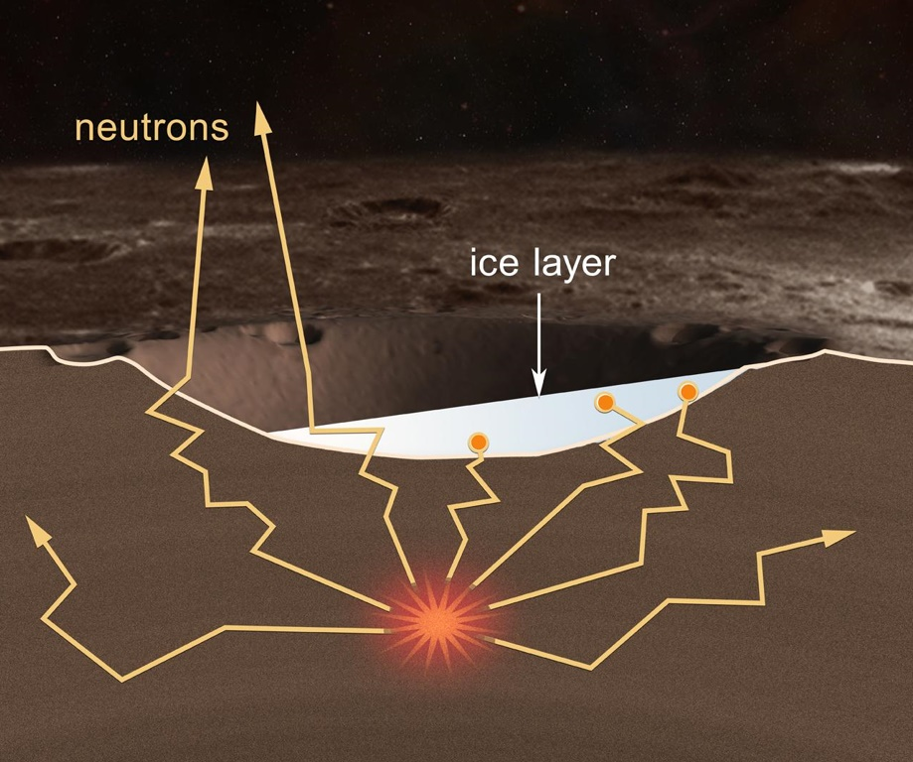
Lunar surface radiation is a distinct environment from deep space
GCR
γ
Estimates of fast neutrons in lunar surface radiation
Mission | Project | Dose Type | % Fast Neutron
Lunar Prospector | LP | Effective | 16-18%
LRO | CRaTER | Absorbed | 0.7%
Chang’E 4 | LND | Absorbed | 23%
Lunar regolith absorbs galactic cosmic radiation (GCR) to produce secondary albedo neutrons
    High-energy, fast neutrons cause direct cellular damage
    Fast neutrons also produce ionizing radiation
    Estimates of surface neutron doses vary widely
Image credits: NASA

Slide 19
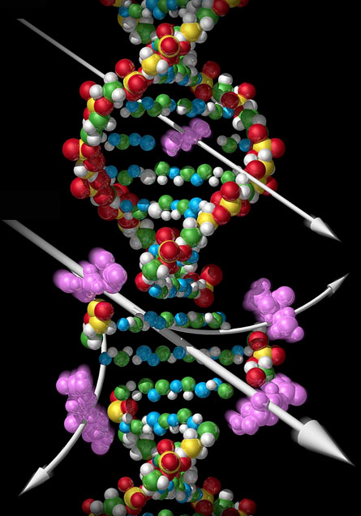
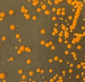
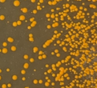
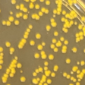
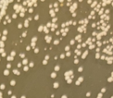
Radiation is a significant risk for organisms in deep space
X-ray
SB2022 (β-carotene)
Protein & Ion Leaks
Cellular Effects of ROS Damage
Cell cycle arrest
23°C
Peroxidation of lipids
Heavy ion
25°C
Low ATP
DNA Damage
Repressed translation
30°C
35°C
Radiation causes cellular stress through DNA damage and Reactive Oxygen Species (ROS).
During environmental stress cells shift energy from growth and production to repairing damage.

Slide 20


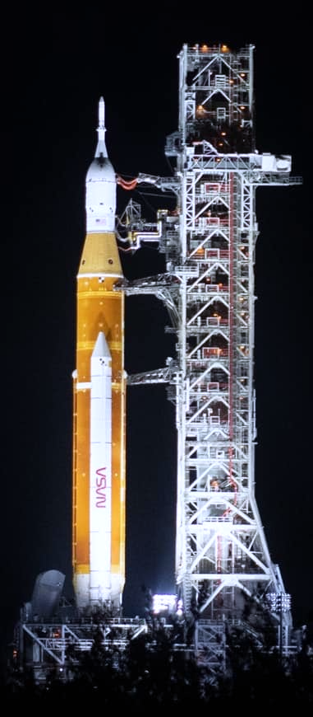
LEIA leverages technology from CubeSat biological missions
E. coli GeneSat-1 (2006 / 3U): gene expression
EcAMSat (2017 / 6U): antibiotic resistance
S. cerevisiae PharmaSat (2009 / 3U): drug dose response
BioSentinel (2022 / 6U): cell damage repair
B. subtilis O/OREOS* (2010 / 3U): survival, metabolism
*Organism/Organic Response to Orbital Stress
C. richardii SporeSat-1 (2014 / 3U): ion channel sensors, µ-centrifuges
Image credits: NASA

Slide 21
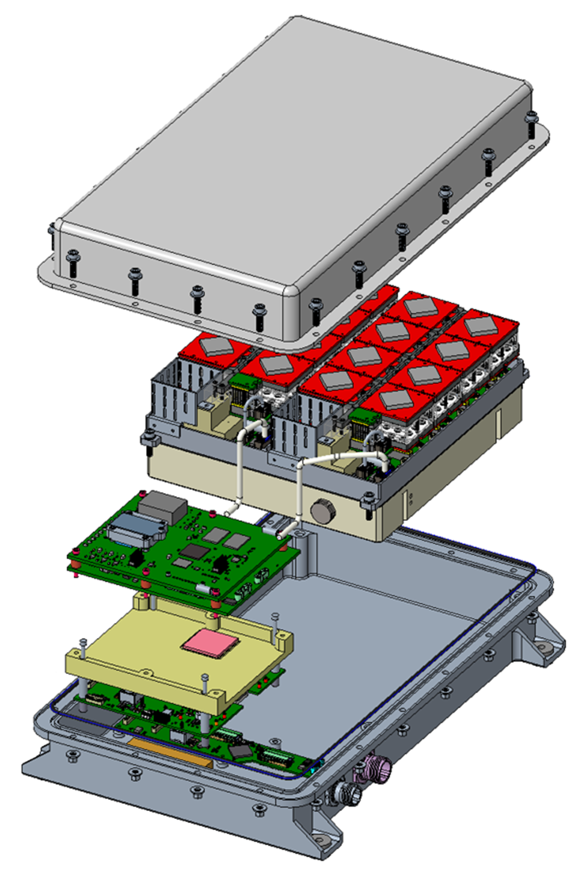
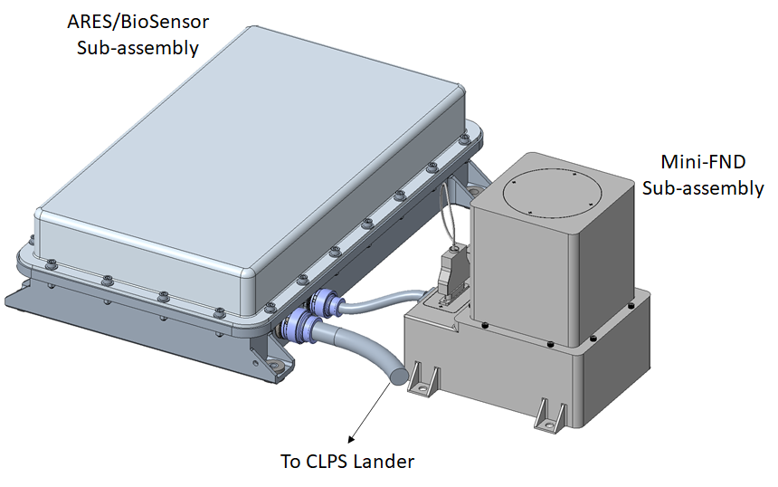
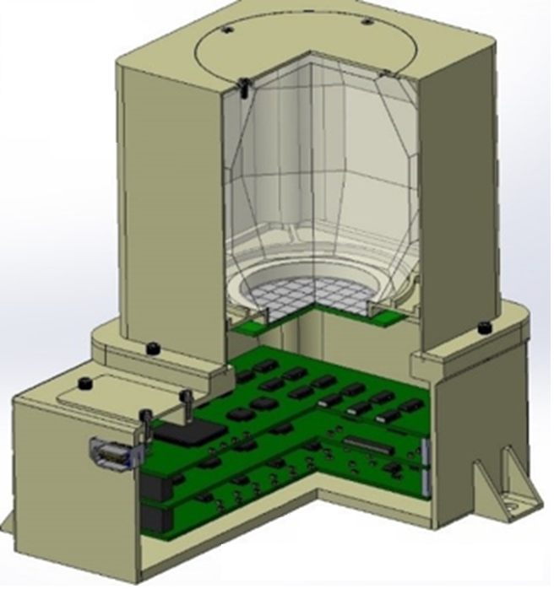
LEIA Instrument suite
BioSensor
ARES LET Spectrometer
BioSensor is a microfluidic culturing system to measure yeast growth and metabolism.
ARES Timepix3 spectrometer measures charged particle radiation.
Mini-FND is a fast neutron detector.

Slide 22
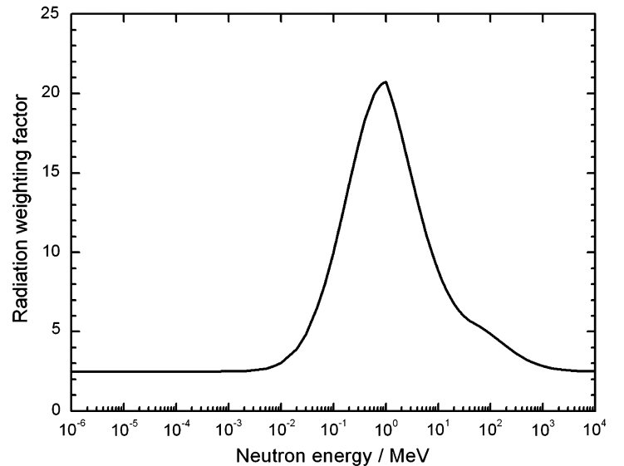
Why are neutron measurements important for LEIA?
Neutrons pass through common shielding materials but have a high interaction cross section with hydrogen.
Biological tissues, such as yeast cells, have a high radiation weighting factor for fast neutrons.
Mini-FND energy detection range is targeted to sample the peak of the radiation weighting factor curve.
Mini-FND
Detection
Range

Slide 23
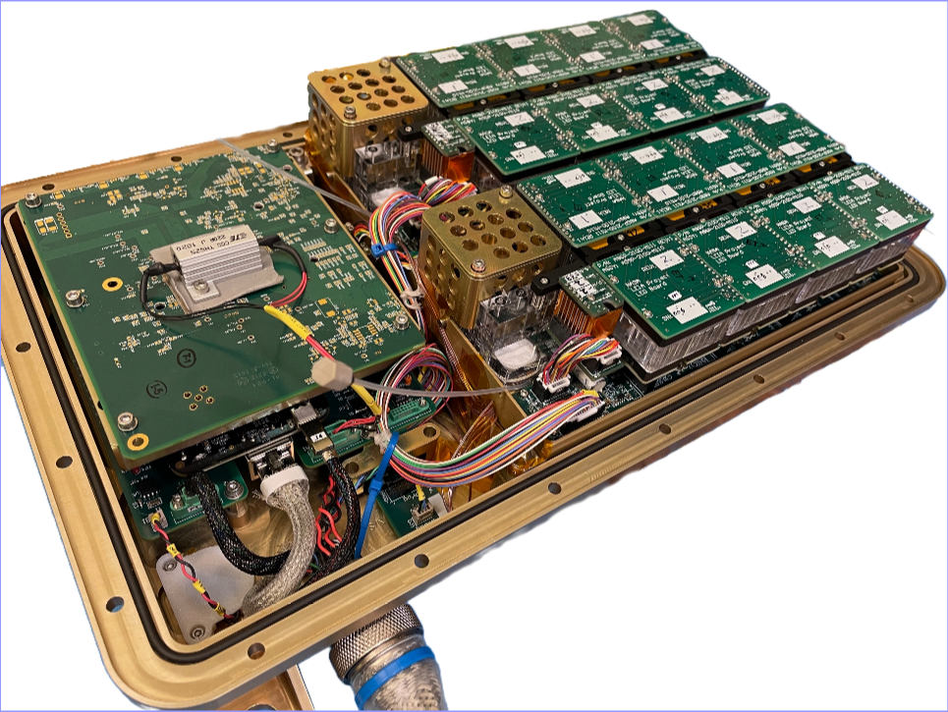
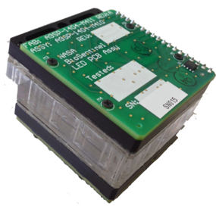
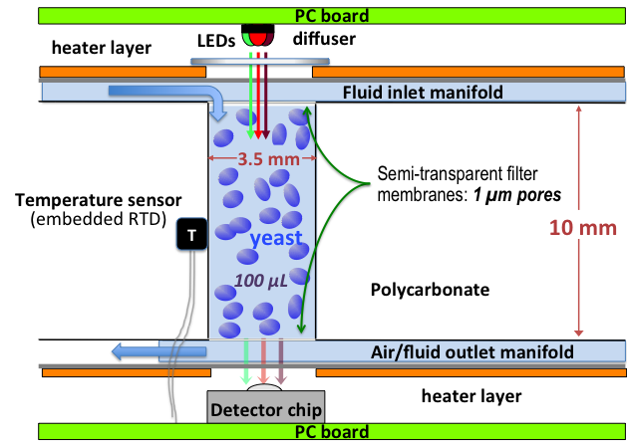
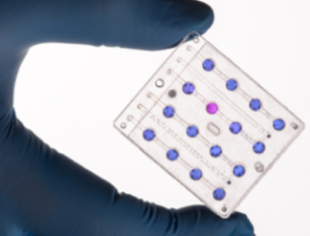
BioSensor monitors cell growth in microfluidic culture wells
BioSensor Prototype
Microfluidic Card
Individual Cell Culture Well
4 cm
~5 cm
For LEIA:
BioSensor contains 16 microfluidic cards
Pumps and valves control medium addition through 2 separate manifolds
Each card has 16 culture wells (256 wells total)
Each well can record light absorbance data at 3 LED wavelengths

Slide 24
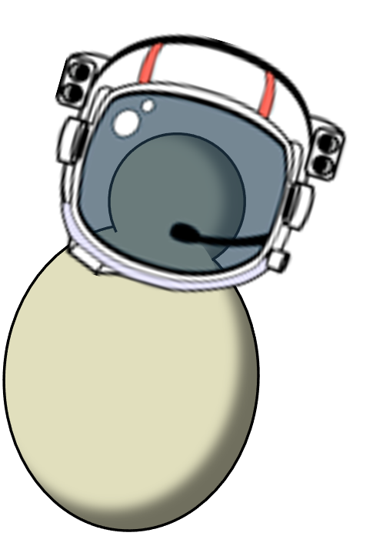
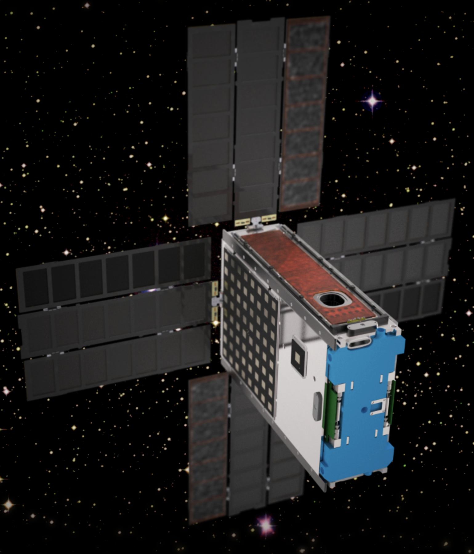
LEIA benefits from lessons learned in BioSentinel missions
BioSentinel
Key mission accomplishments:
Measured LEO radiation with Timepix.
Demonstrated microfluidics and optics systems.
Demonstrated yeast storage and growth.
Mission Duration:
6 months
9 timepoints
2 strains
-ISS
Stress response
Crewed LEO flight
-Deep Space
Key mission accomplishments:
Measured deep space radiation with Timepix.
Demonstrated microfluidics and optics systems.
Demonstrated CubeSat avionics, COTS electronics, solar power system, and DSN comms.
Mission Duration:
24 months
9 timepoints
2 strains
Stress response
Artemis I free-flyer
Lessons Learned & Mission-specific changes:
Late load capability to reduce yeast storage period.
Improved ECLSS for the yeast storage period.
Detect carotenoid production
Add Mini-FND neutron detector.
16 strains
Surface Ops:
7-10 days
2 timepoints
Stress response
Bioproduction
Genetic countermeasures
CLPS Lander
2013
Dec 2021
Nov 2022
Nov 2024
late 2026
BioSentinel
ISS
Deep Space
LEIA
CP-22

Slide 25
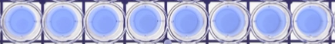
Adapting BioSensor to track both alamarBlue (aB) and carotenoids
O⁻
N⁺
Resazurin
(Blue)
HO
O
O
N
Resorufin
(Pink)
465 nm
570 nm
630 nm
HO
O
O
Y55
Extract
aB
H
N
Dihydroresorufin
(Colorless)
Relative Absorbance/Emission
HO
O
OH
350
400
450
500
550
600
650
700
Reduction of aB changes dye color.
570 nm – measures pink aB
630 nm – measures blue aB
850 nm – measures cell growth
Wavelength (nm)
Carotenoids absorb in blue wavelengths.
Replace 570 nm with a 465 nm LED.

Slide 26
Yeast mutants can report sensitivity to the mission environment
Strains tested for the BioSentinel mission focused on DNA repair mutants, e.g. rad51Δ.
These mutants show slower metabolic activation and higher sensitivity to exposure to simulated GCR.

Slide 27
Yeast mutants can report sensitivity to the mission environment
Strains tested for the BioSentinel mission focused on DNA repair mutants, e.g. rad51Δ.
These mutants show slower metabolic activation and higher sensitivity to exposure to simulated GCR.
Simulated GCR inhibits rad51Δ metabolism at 30- to 40-fold lower doses compared to gamma radiation.
Additional mutants will be generated to test multiple genes involved in ROS scavenging and DNA damage.

Slide 28
Adapting BioSensor to track both alamarBlue (aB) and carotenoids
MYA-796
Wild-type
SB2022
β-carotene
Ground Support Equipment (GSE) readings
Spectral difference growth curves calculated by subtracting 850 nm from 465 nm readings show increased blue light absorbance in β-carotene strains.

Slide 29
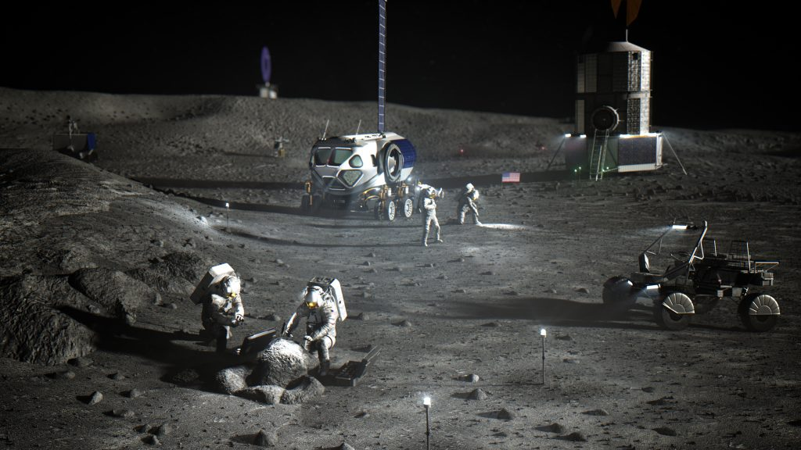
Expected outcomes
Determine cellular sensitivity to the lunar environment.
Evaluate feasibility of bioproduction on the Moon.
Test genetic strategies to enhance cellular tolerance to the lunar environment.
Determine ground truth radiation risks for crew.
Image credits: NASA

Slide 30

Space Synthetic Biology Project Team
Frances Donovan, PM
Lisa Anderson
Natalie Ball
Jessica Chau
Michael Dougherty
Sadie Downing
Jon Galazka
Amy Gresser
Aditya Hindupur
John Hogan
Harry Jones
Hiromi Kagawa
Jessica Kong
Aphrodite Kostakis
Leonard Lee
Julie Levri
Paul Milazzo
Marilyn Murakami
Satro Narayan
Matthew Paddock
Hami Ray
Oscar Roque
Jason Samson
A. Mark Settles
Kevin Sims
Sean Sharif
Mathangi Soundararajan
Daniel Varnum-Lowry
Alyssa Villanueva
Sandra Vu
Funding
NASA Space Technology Mission Directorate
NASA Exploration Systems Development Mission Directorate

Slide 31

Project Team
A. Mark Settles (Principal Investigator)
Sergio Santa Maria (Deputy PI)
Donald M. Hassler (Co-I, SwRI)
David Pletcher (PM)
Linda Timucin (Deputy PM)
Science Team
Natalie Ball
Jared Broddrick
Jessica Chau
Natalya Dvorochkin
Jennifer Gil Acevedo
Diana Gentry
Chinmayee Govinda Raj
Aditya Hindupur
Jessica Lee
Lauren Liddell
Jack Miller
Sandra Vu
Engineering Team
Leandro James (Lead SE)
Earl Daley (Mechanical)
Matt McKay
Mike Padgen (Fluidics)
Victor Yeh
Brandon Schmitt (Software)
Bryan Kirsch
Mareyna Karlin
Nicholas Stoffle (ARES)
Brett Stroozas (OPS Lead)
Steven Ormsby
Alex Szerszen (Thermal)
H. K. Vogelsong (I&T Lead)
Shang Wu (Electrical)
Nghia Mai
Neil Davies
Aidan Remy
Mini-FND (SwRI)
Michael Vincent (PM)
Yvette D. Tyler (SE)
Jianxin Chen
Bent Ehresmann
Bryan Pike
Travis Smith
Eddie Weigle
Cary Zeitlin (JSC)
Lu Zheng
SMA
Mariano Perez (CSO)
Ted Drude (SQA)
NASA Interns
Kylie Akiyama
Jennifer Gil Acevedo
Stephen Lantin
Dylan F. Walsh
Dunya Shuman
Payne E. Turney
Funding
NASA Planetary Missions Program Office - PRISM
NASA Biological & Physical Sciences - Space Biology
Image credits: NASA

