Slide 1



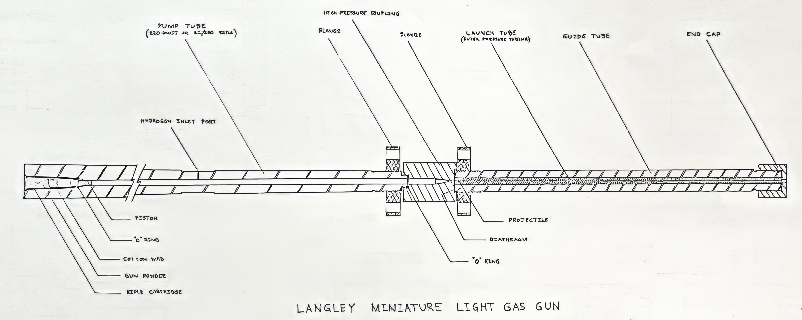
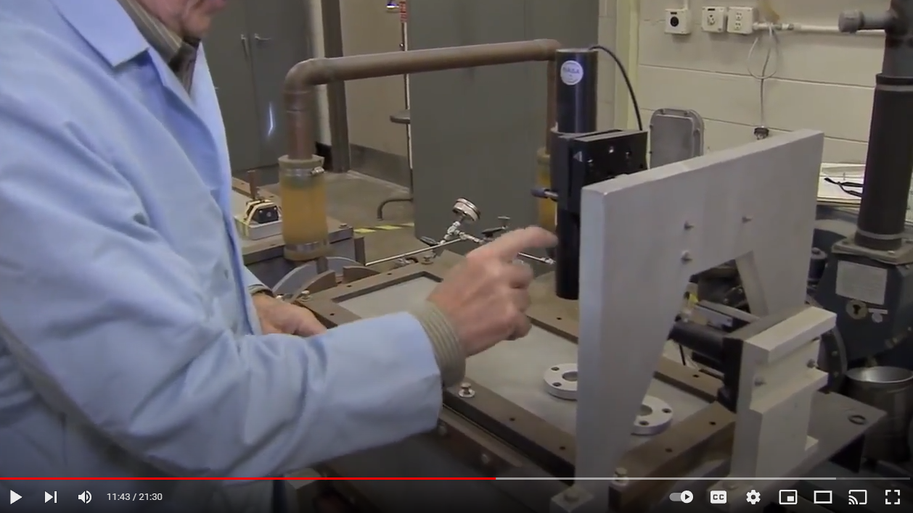
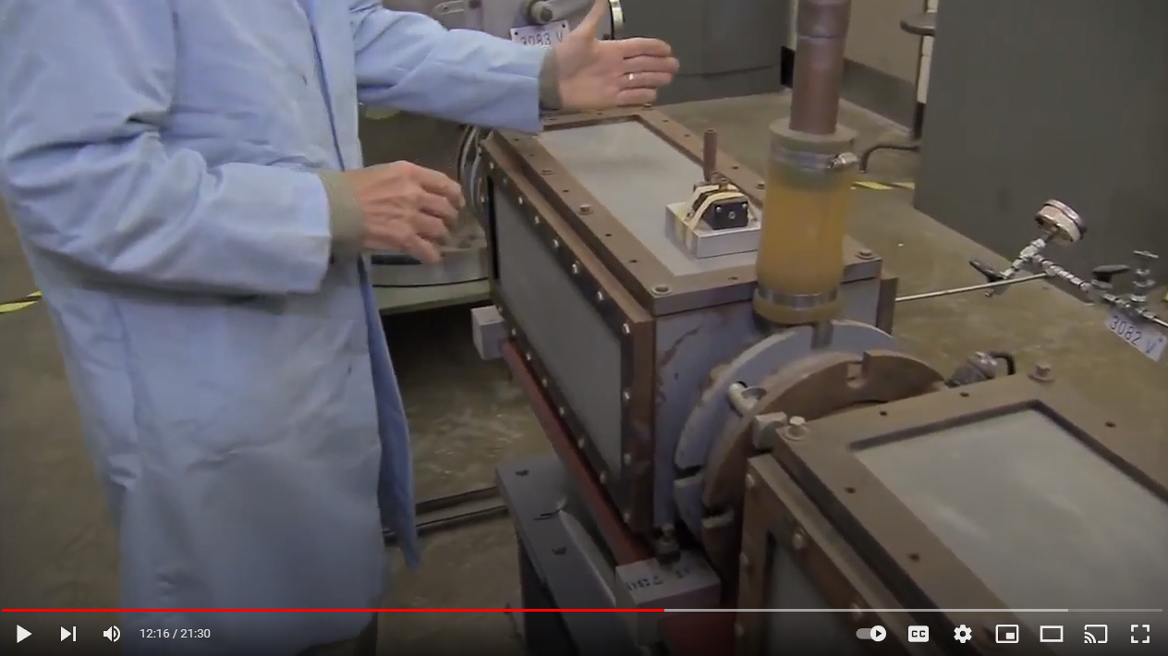
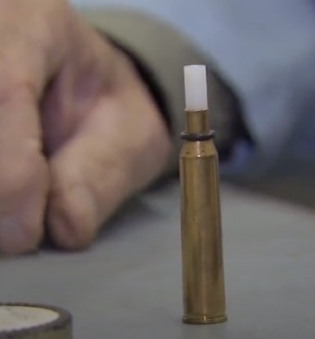
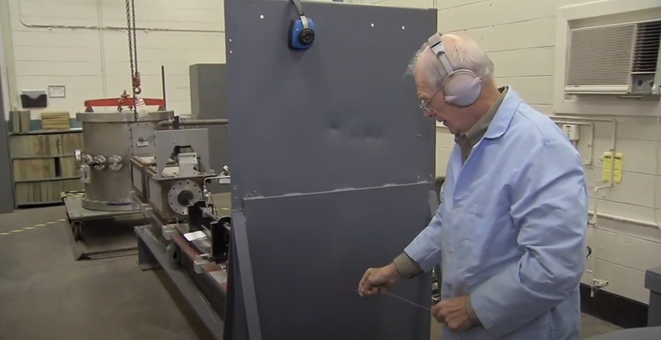
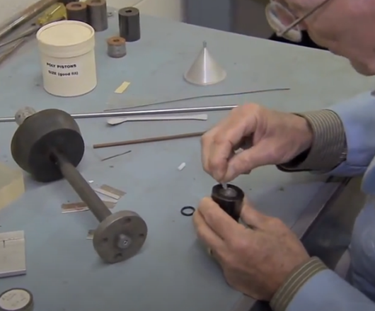
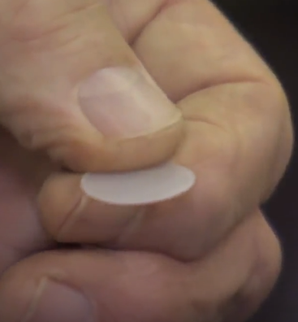
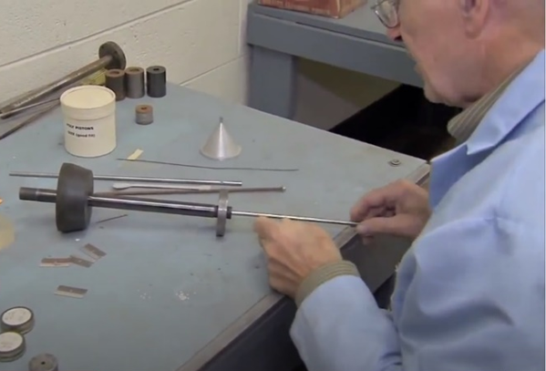
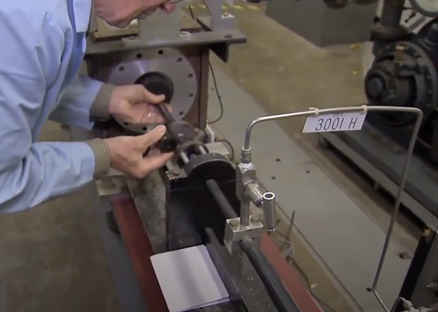

An Efficient and Effective Light Gas Gun Design
for Millimeter-scale Hypervelocity Testing
Scott Hull¹, Mark Kulick², Donald Humes³
¹NASA Goddard Space Flight Center, Greenbelt, MD, Scott.Hull@NASA.gov ²Analytical Mechanics Associates, Hampton, VA, Mark.A.Kulick@NASA.gov ³NASA Langley Research Center (Retired), Hampton, VA
Abstract
This paper serves to document a design for a light gas gun that was used for 3 decades at NASA’s Langley Research Center. By adapting readily-available equipment and supplies, this apparatus was capable of accelerating projectiles at up to 9 kilometers per second (when new). The lack of a projectile-carrying sabot sacrifices some adaptability in projectile size, but results in a design that can be cleaned and cycled with far less labor input. Overall limitation on the projectile impact energies attainable effectively limit the applications to assessing the relatively thin shields employed for robotic spacecraft (less useful for those used for manned missions). The original gun has been decommissioned, but it is believed that this design has application for robotic spacecraft shield testing in the modern world, allowing cost-effective generation of larger sample sizes than with conventional sabot-based light gas guns.
Introduction
Space debris (orbital debris and meteoroids) can damage spacecraft components
Testing is performed using a variety of projectiles and velocities
  Enables risk assessments and shielding designs
This gun was typically used to fire projectiles at 2 to 7 km/s velocity
The simple design allowed high efficiencies, but with some limitations
Much of the testing cost is labor, which is minimal with this design
History
The Langley Light Gas Gun was designed and built by Don Humes in 1970
Used readily available components
First stage was a hunting rifle, and launch tube was off the shelf SS tubing
Remainder of the parts were machined at Langley in the machine shop
First used to support flight missions Feb. 1971 to test the housing of a Radioisotope Thermoelectric Generator at 6.8 to 8.3 km/s (passed)
Switched from helium gas to hydrogen for higher velocities
Up to 30-40 tests per week were performed
The original gun has been deactivated, and donated to the Smithsonian
Don Humes: Developing the Light Gas Gun – YouTube
https://www.youtube.com/watch?v=7-7dVrTcgmg
Unique Characteristics
Inexpensive gun to build
  First/second stage was a modified 220 Swift hunting rifle
    Smooth bore, threaded muzzle, and a machined gas port
This design did not use a sabot to carry the projectile
  Projectile diameter was matched to the inner diameter of the Launch Tube
  All of the force from the second stage was imposed directly on the projectile
  No energy was lost either accelerating or rotating the sabot
Used less powder, because there was no sabot to accelerate
  Inherently safer design, with less explosive force used
This gun was shorter than most other designs
  Used a hunting rifle for the entire second stage pump
  Could fit into a room less than ten feet long
More efficient operations
  Pump tube cleaning used standard rifle supplies
  Launch tube was often replaced (re-used for 2-3 shots)
  Less powder used in each charge
  Cycle time for one person was about 1 shot per hour
  Cheaper and faster tests allowed higher test volume, and higher confidence
  Advantages
Inexpensive Construction
Inexpensive Operation
Safer to Operate than similar larger guns with the same capacity
  Limitations
Must match projectile diameter to Launch Tube (less flexibility)
Limited to about 3.2 mm projectile diameter
Limited to about 7 km/s for routine operations (typical for LGGs)
Description of the Design/Operation
First Stage: 220 Swift rifle cartridge, 0.4 to 1.3 grams of pistol powder
Second Stage: 220 Swift rifle barrel, smooth bore
  High density polyethylene piston
  Barrel pre-charged with 90 psi hydrogen gas
Tapered High Pressure Coupling
  Mylar (PET) diaphragm controls maximum pressure
Guide Tube/Launch Tube Assembly (~50 mTorr vacuum here to sample)
  Launch Tube was off-the-shelf stainless-steel high pressure tubing
  Threaded connection to the High Pressure Coupling
  Large rubber stopper connection to the Velocity Measurement Chamber
Projectile: Matched to the diameter of the Launch Tube
Velocity Measurement Chamber
  He-Ne laser; projectile broke the beam twice, 10 cm apart
Test Chamber
  Holds the test sample
  Optical detector for impact timing (second velocity check)
Performance
This gun was used for over 30 years
Most tests in the range of 2 to 7 km/s, but capable of 9.2 km/s when new
Spherical and cylindrical projectiles; some sabots for very small projectiles
Nylon, glass, aluminum, and steel projectiles
Expendable materials (projectile, diaphragm, piston, pistol powder, and a primer cap) cost $1.25 per shot in 1990’s
Labor cost of ~1 hour per shot; compare to 4-6 person-hours for most guns
Crewed and robotic missions: Pioneer, Voyager 1, LDEF, Lunar Orbiter, ISS
Conclusions
This was an elegant and efficient design, used for 30+ years
Simple design was inexpensive to build, operate, and maintain
Sacrifices flexibility in projectile selection for efficiency and many tests
Limited value with respect to modern crewed missions
Capable of testing in support of robotic missions, with less shielding
This instrument was used for over three decades, firing a wide variety of projectiles in support of a diverse set of missions.
This piece of history has now been retired, but elements of the design still have value for modern spacecraft component protection.
YouTube video showing this gun in action

