Slide 1
Quantum Computing Showcase for Climate Science – Quantum Computing in the Exploration and Space Communications Division
Dr. Harry Shaw
Staff Engineer, Telecommunication and Network Technologies Branch, NASA/GSFC
Advanced Communications Capabilities for Exploration and Science Systems (ACCESS) Project office
November 29,, 2023

Slide 2
Introduction
I lead the technical work in quantum research in the Exploration and Space Communications division, Advanced Communications Capabilities for Exploration and Science Systems (ACCESS) Project office at NASA/GSFC along with Dr. Haleh Safavi
We emphasize STEM through our primary focus areas:
  Basic and applied research with our partners to support the development of doctorates in quantum-related fields.
    Some of them will end up within NASA
  Planning for eventual operations of quantum enabled satellites
  Improving “quantum literacy” within the American student population with an emphasis on bringing women and underrepresented minorities into the quantum world
    We have a very robust intern program.
  We are not full-time researchers. We have “day jobs” operating communications satellites and ground stations

Slide 3
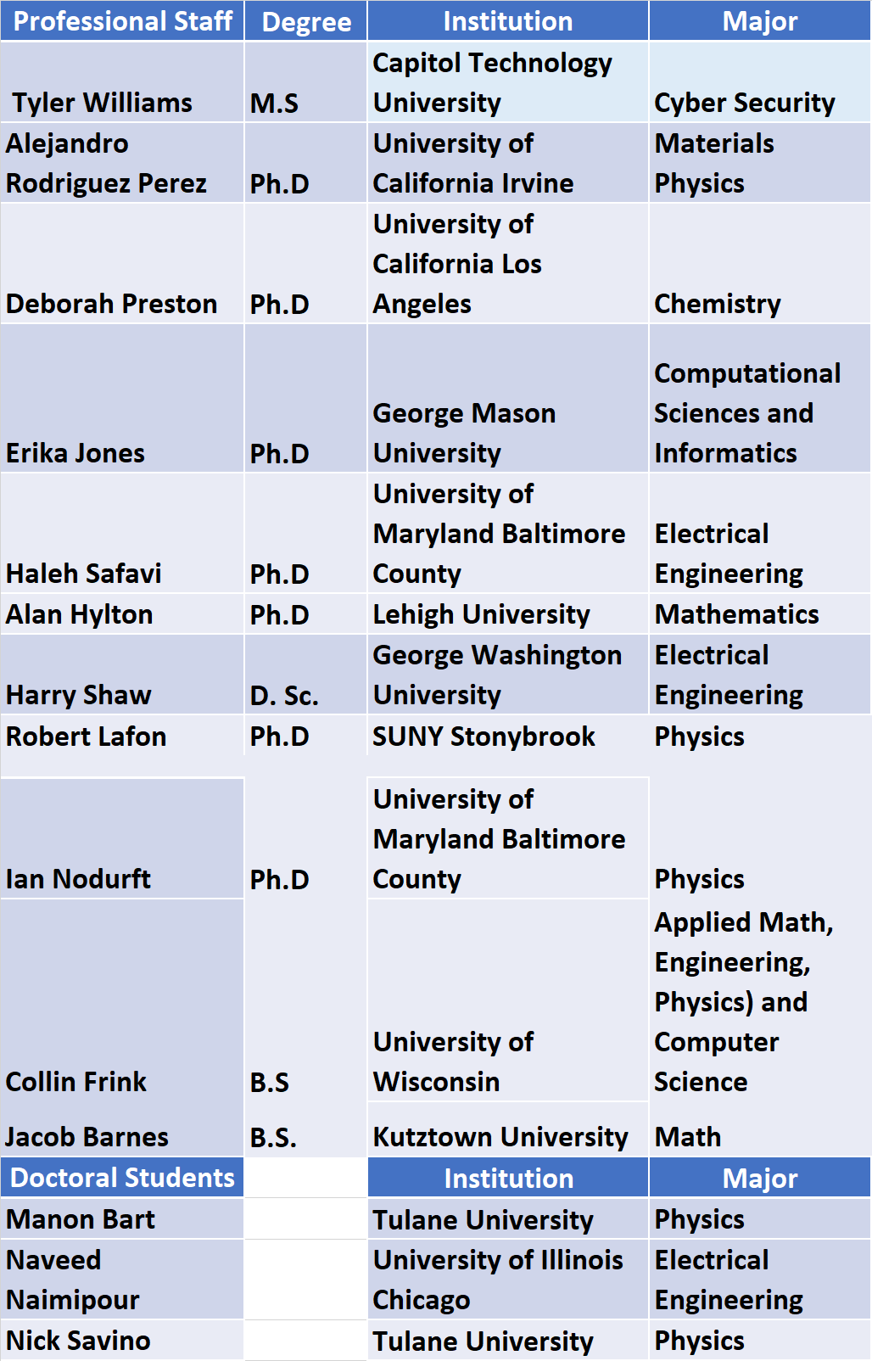
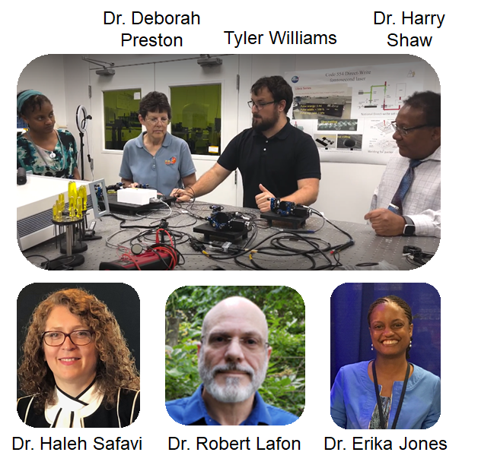
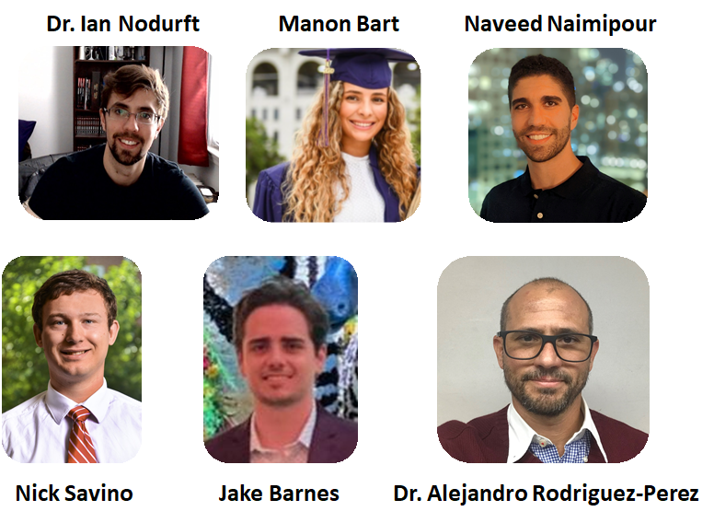
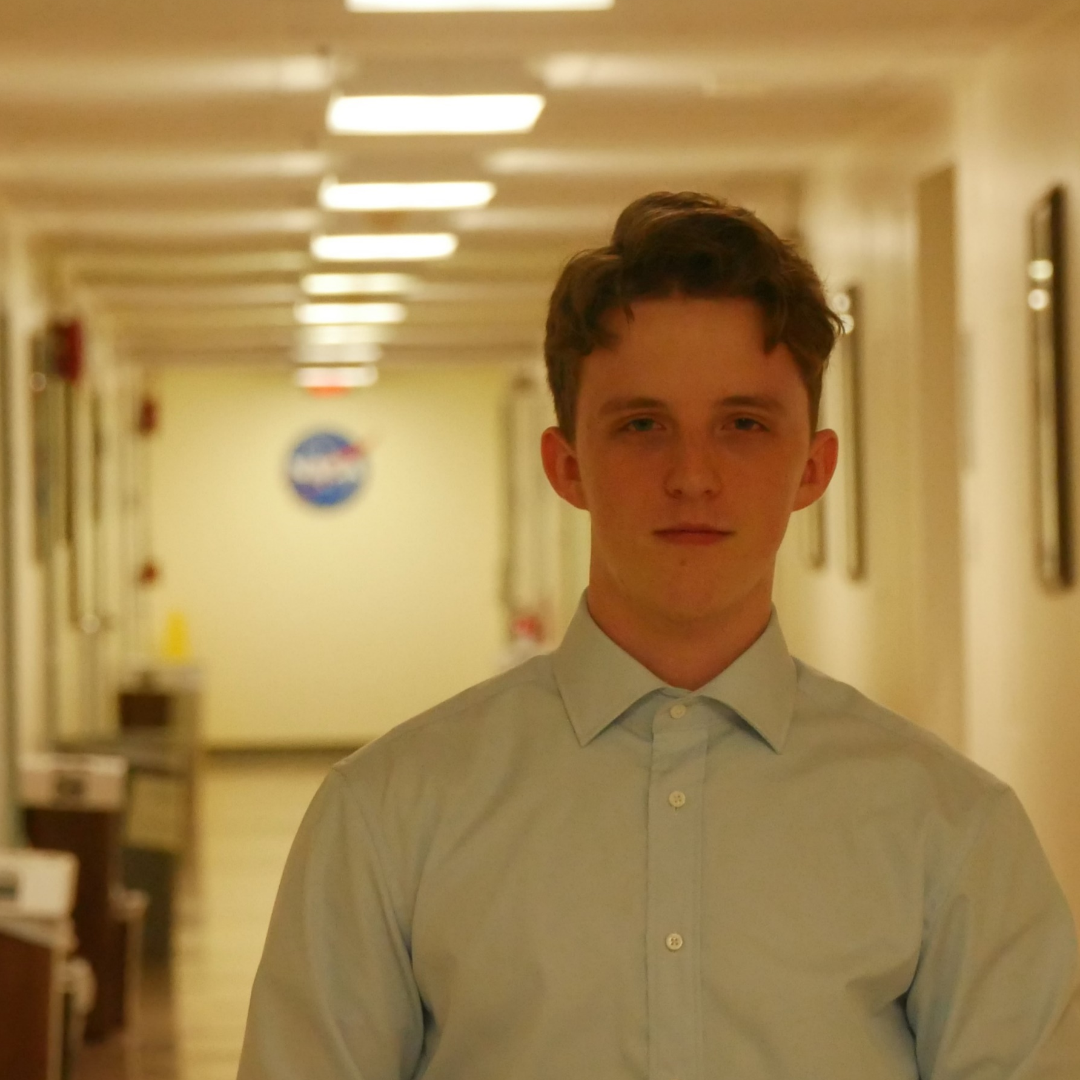
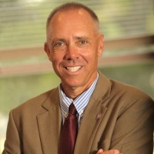
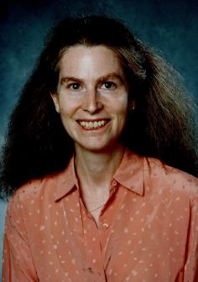
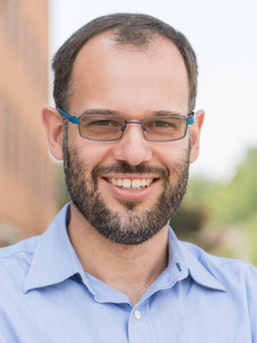
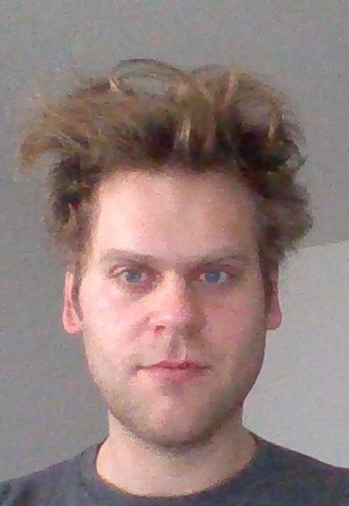
Quantum Space Telecommunication and Algorithms Research (Q-STAR) Laboratory Team
Grants and Subcontracts
Collin Frink
New Mexico State (PI Steven Stochai) – Development of an optical communications testbed
Michigan State (PI Virginia Ayres) - Quantum Demonstration Project
UMBC (PI Sebastian Deffner) – Quantum Thermodynamics
3
Alan Hylton

Slide 4
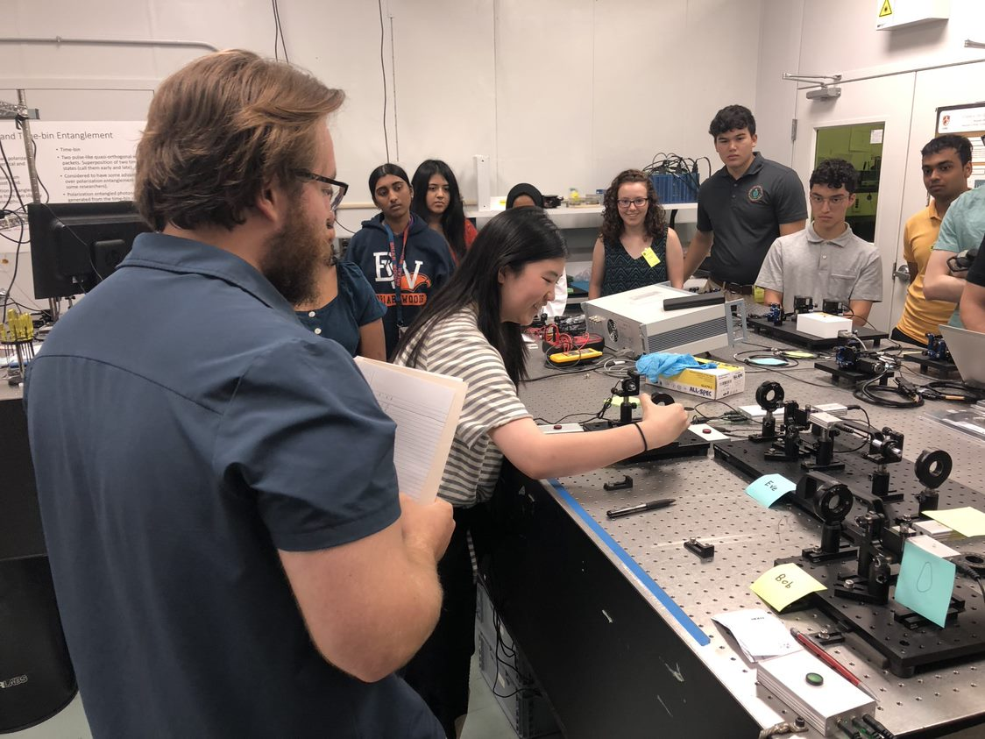
Overview of the Q-STAR activities
STEM and Outreach in quantum communications and computing.
We have two quantum communications laboratories staffed by professionals dedicated to pursuing research goals through STEM
Every intern that comes into the organization will get a ‘hands on’ opportunity with the quantum lab equipment. We are expanding to include high school students.
KIPP Washington, DC High School students getting a hands-on experience with Quantum Key Distribution taught by a GSFC Summer intern

Slide 5
Quantum Computing Goals
Make Quantum Computing as a Service (QaaS) a routine activity
  Access, test and benchmark quantum computing resources for NASA’s long-term needs​
  Experience has shown us that access to industry resources alone is a daunting process​
    Quantum computing is a new paradigm for problem solving within NASA and the needs will vary greatly across subject areas. Gauging the required level and timing of industry involvement is important due to limited Government resources.
    Industry resources may not be readily available to the Government due to IT security restrictions,
    Industry resources must be evaluated against the complexity of the problems to be considered. (*Is it a million qubit problem?)
Demonstrate expertise in both development and implementation of quantum algorithms on quantum resources​
  Quantum Sparse Sensing (QSS) protocols​ are first.
  The application is compression of LIDAR data sets
Establish a path to low-cost quantum computing
  The Q-STAR team is ready to attack new problems within whatever constraints NASA dictates
Contribute to the advancement of quantum computing by fostering research ideas and STEM training for personnel in quantum computing.

Slide 6
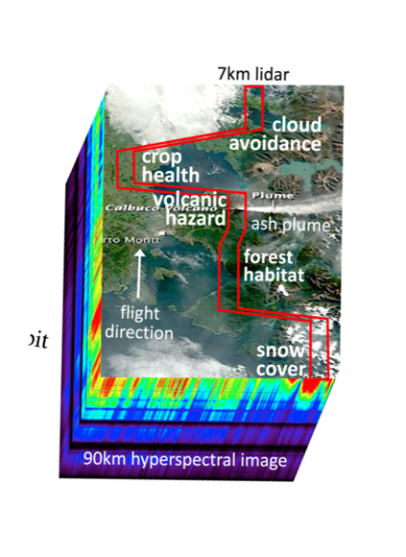
Q-STAR Quantum Computing – Why LIDAR? ​
Lots of available data within GSFC​
It is a tractable problem that we could compare quantum sparse sensing to classical compressive sensing that is already being done.​
It provides a problem that we can determine if there is a quantum advantage over classical compressive sensing​
We have the required personnel and capabilities

Slide 7
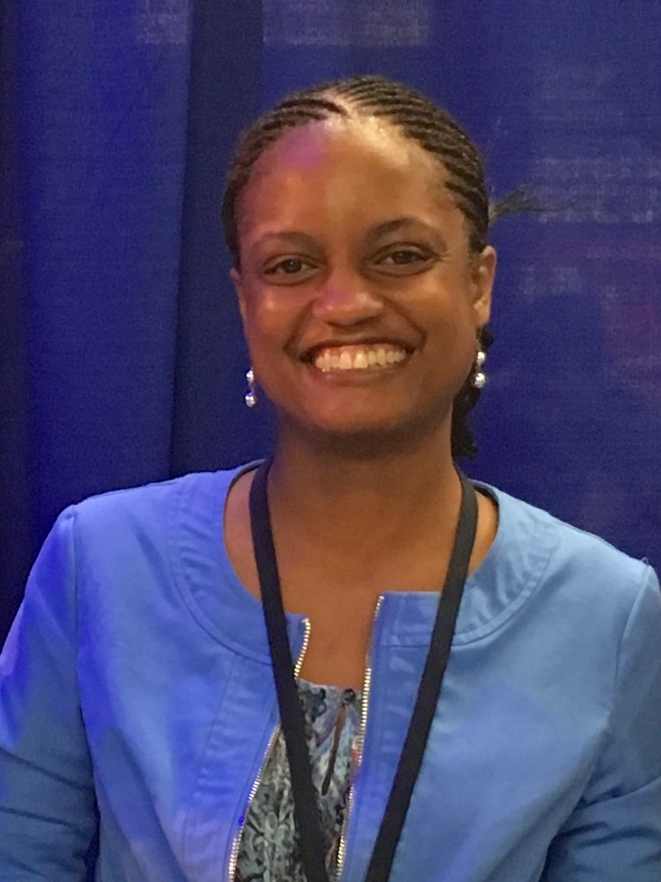
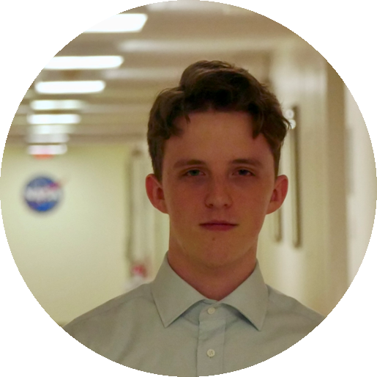
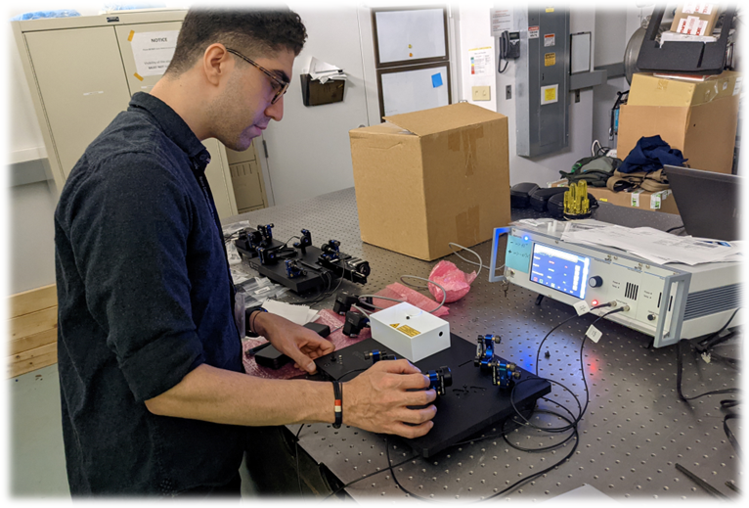
Quantum Computing Focus Team
Dr. Erika Jones, Computational Sciences and Informatics, PhD
George Mason University
Team Lead
Naveed Naimipour, Doctoral
Graduate Student, EE, University of Illinois-Chicago & Originator of our quantum compressive sensing thrust through doctoral research.
Collin Frink, University of Wisconsin, Madison
B.S. in AMEP (Applied Math, Engineering, Physics) and Computer Science) Former GSFC Intern and New Hire. Coding the quantum algorithms and establishing benchmarks
The team also has access to our external partners

Slide 8
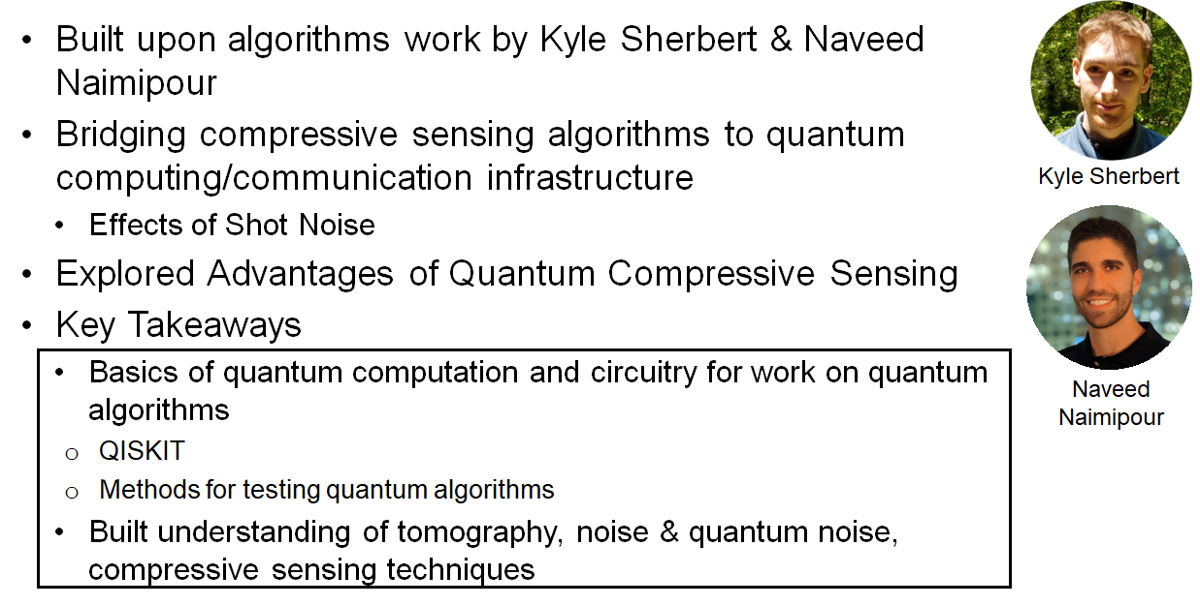
Quantum Sparse Sensing Algorithms
Sherbert, Kyle M*., Naveed Naimipour**, Haleh Safavi, Harry C. Shaw, and Mojtaba Soltanalian. "Quantum compressive sensing: mathematical machinery, quantum algorithms, and quantum circuitry." Applied Sciences 12, no. 15 (2022): 7525.

Slide 9
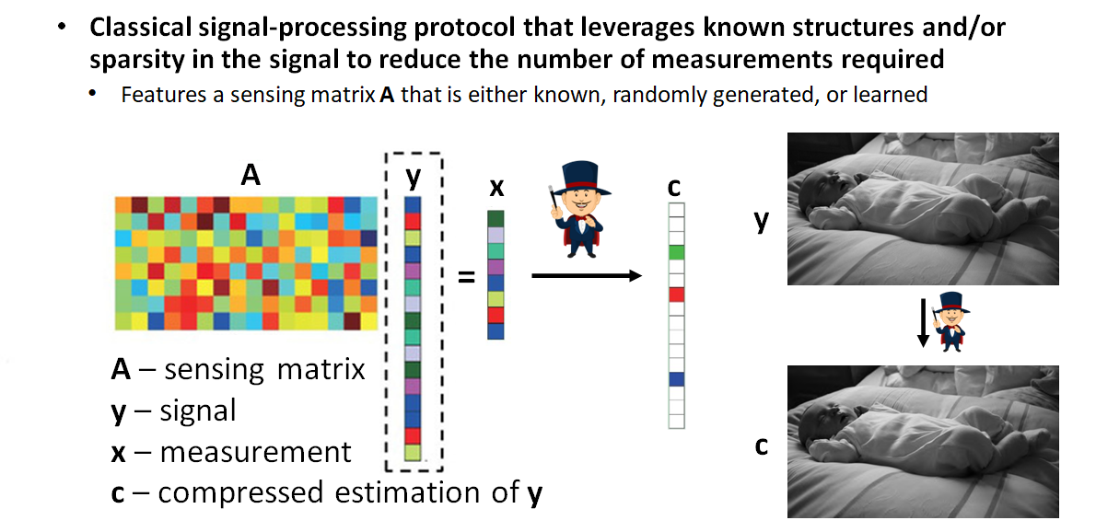
Compressive Sensing

Slide 10
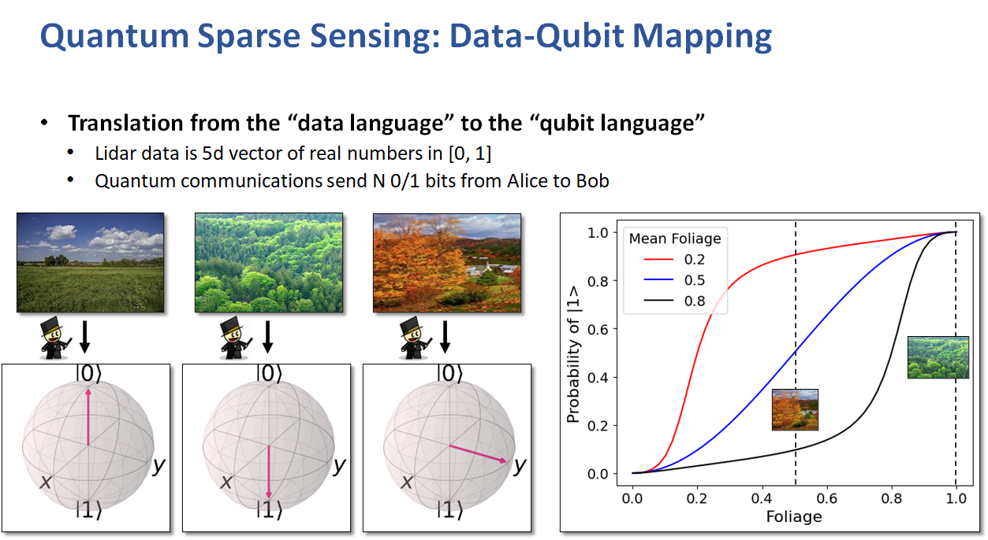
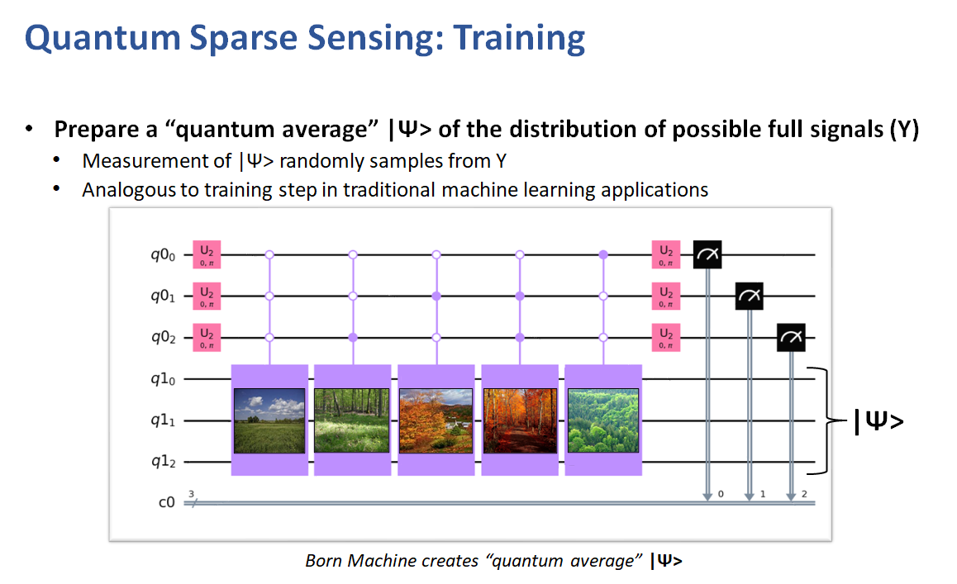
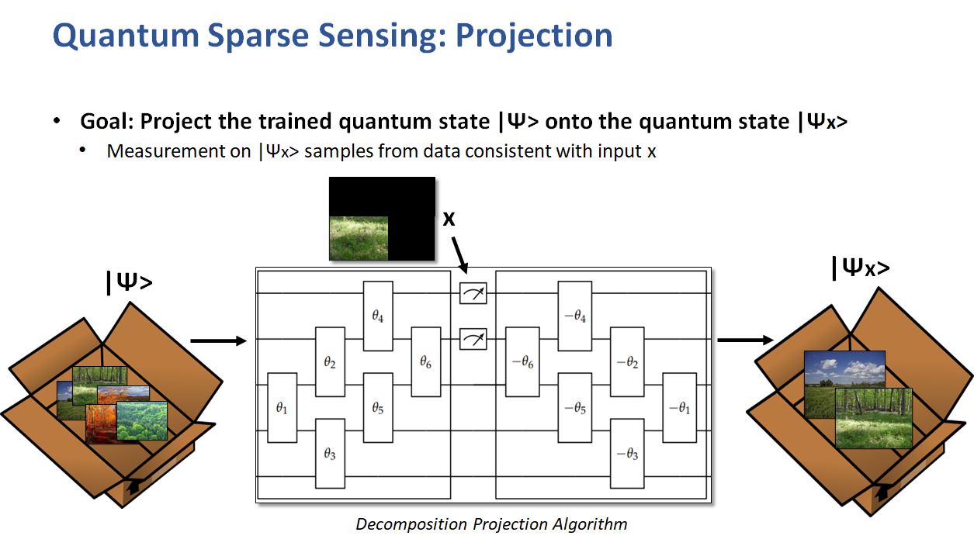
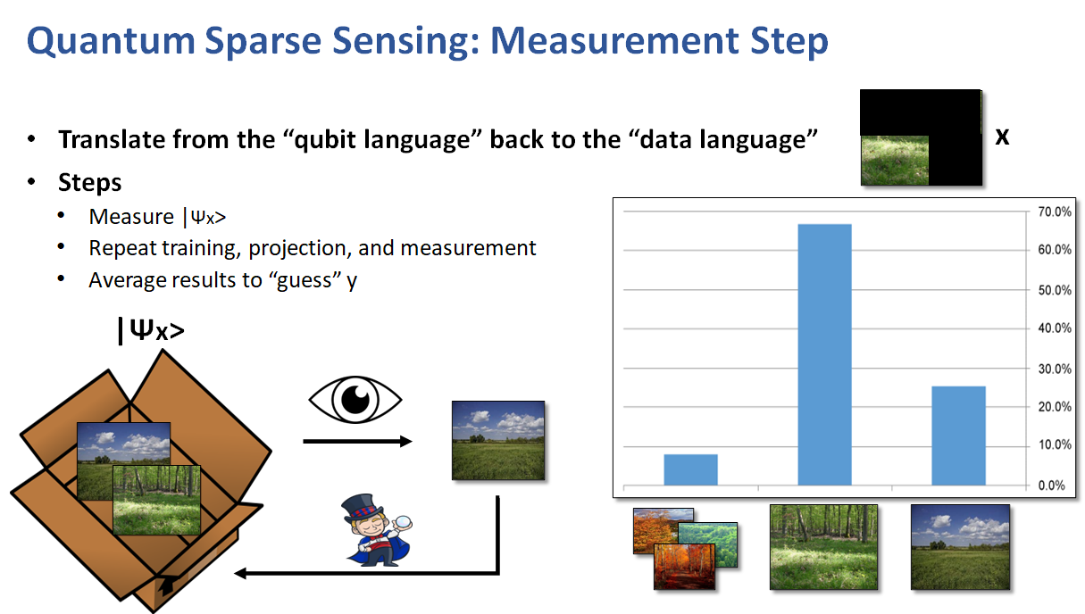
Quantum Sparse Sensing Overview

Slide 11
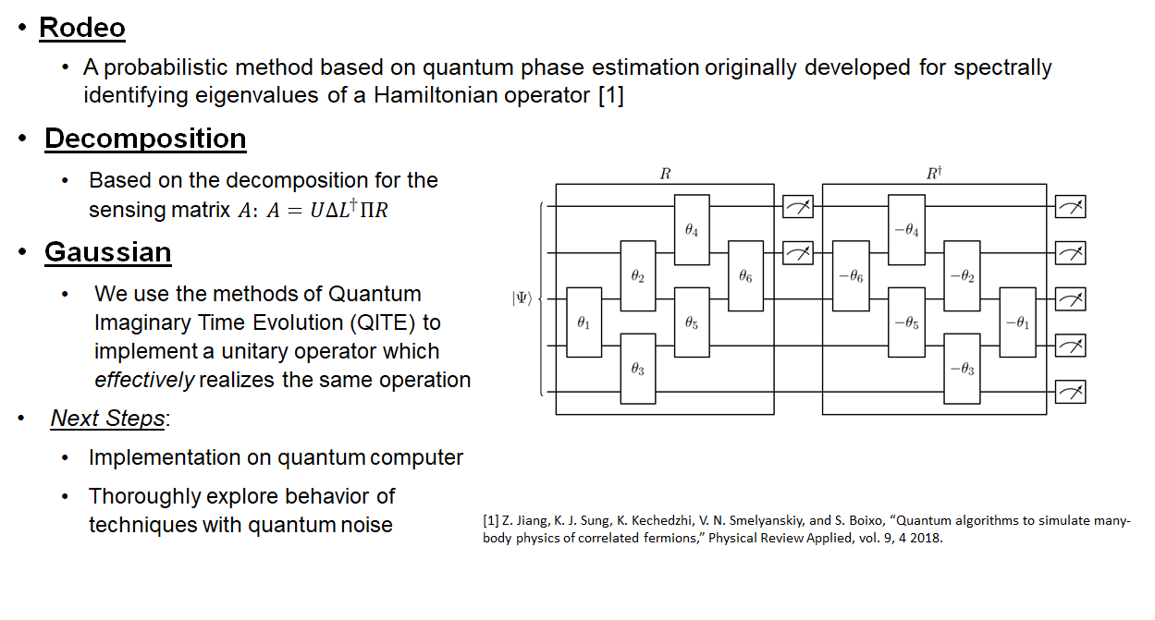
Projection Method for Quantum Phase Estimation

Slide 12
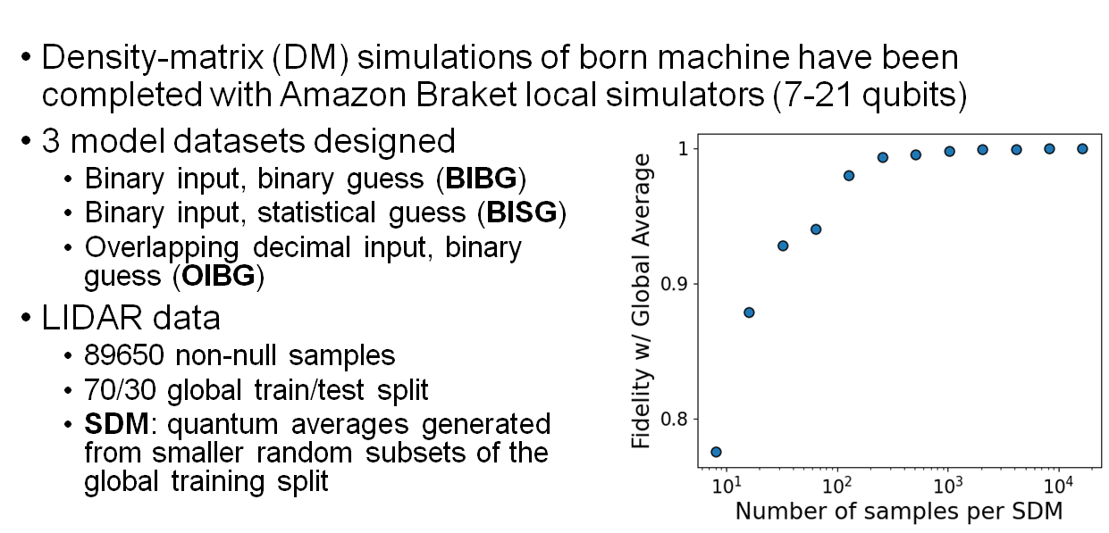
Braket: Training Results

Slide 13
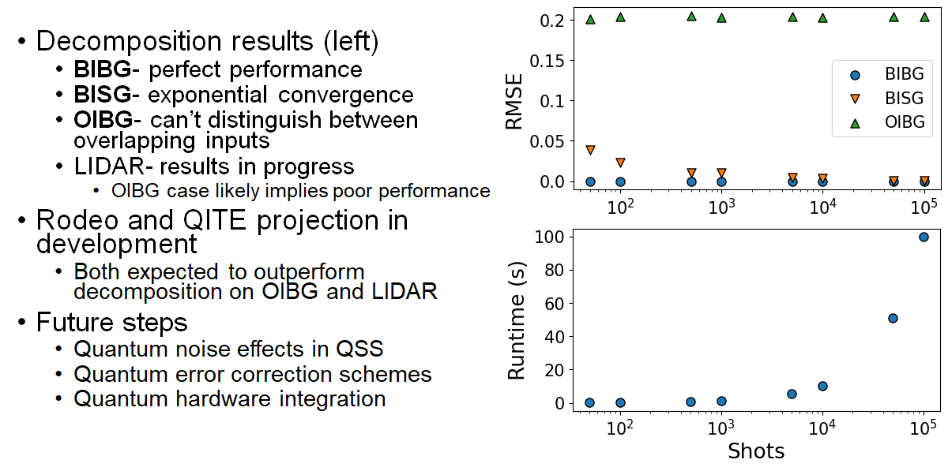
Braket: QSS Projection and Beyond

Slide 14
Conclusions
We have a robust effort in Quantum Computing at NASA/Goddard Space Flight Center in the Exploration and Space Communications division
We are interested in finding new problems for which we can determine if quantum computing provides a quantum advantage over classical computing.
  But we cannot contribute to solving problems that we are not aware of.
  We need stakeholders to bring us problems that we can evaluate.

