Slide 1
ACCESS Rationale
Michael J. Wright, EDL Strategic Capability Lead (Acting)
Eric Stern, ACCESS NASA Technical Lead
NASA’s Space Technology Mission Directorate​
November 29, 2023

Slide 2
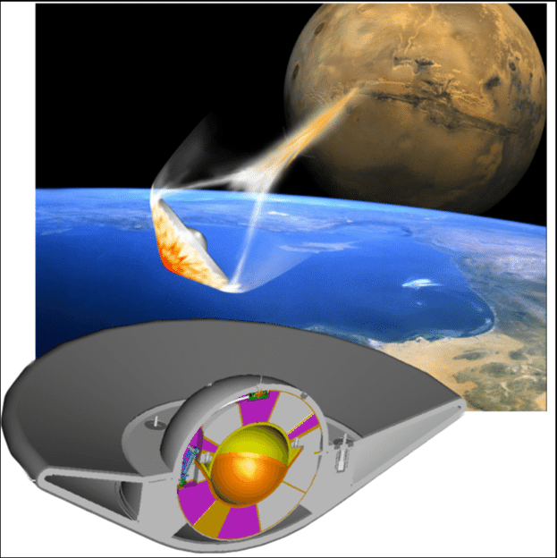
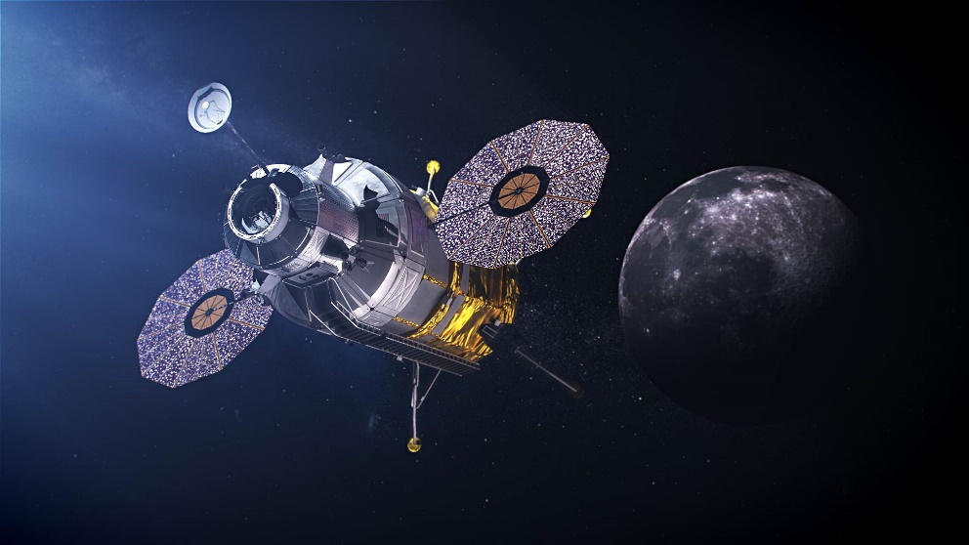
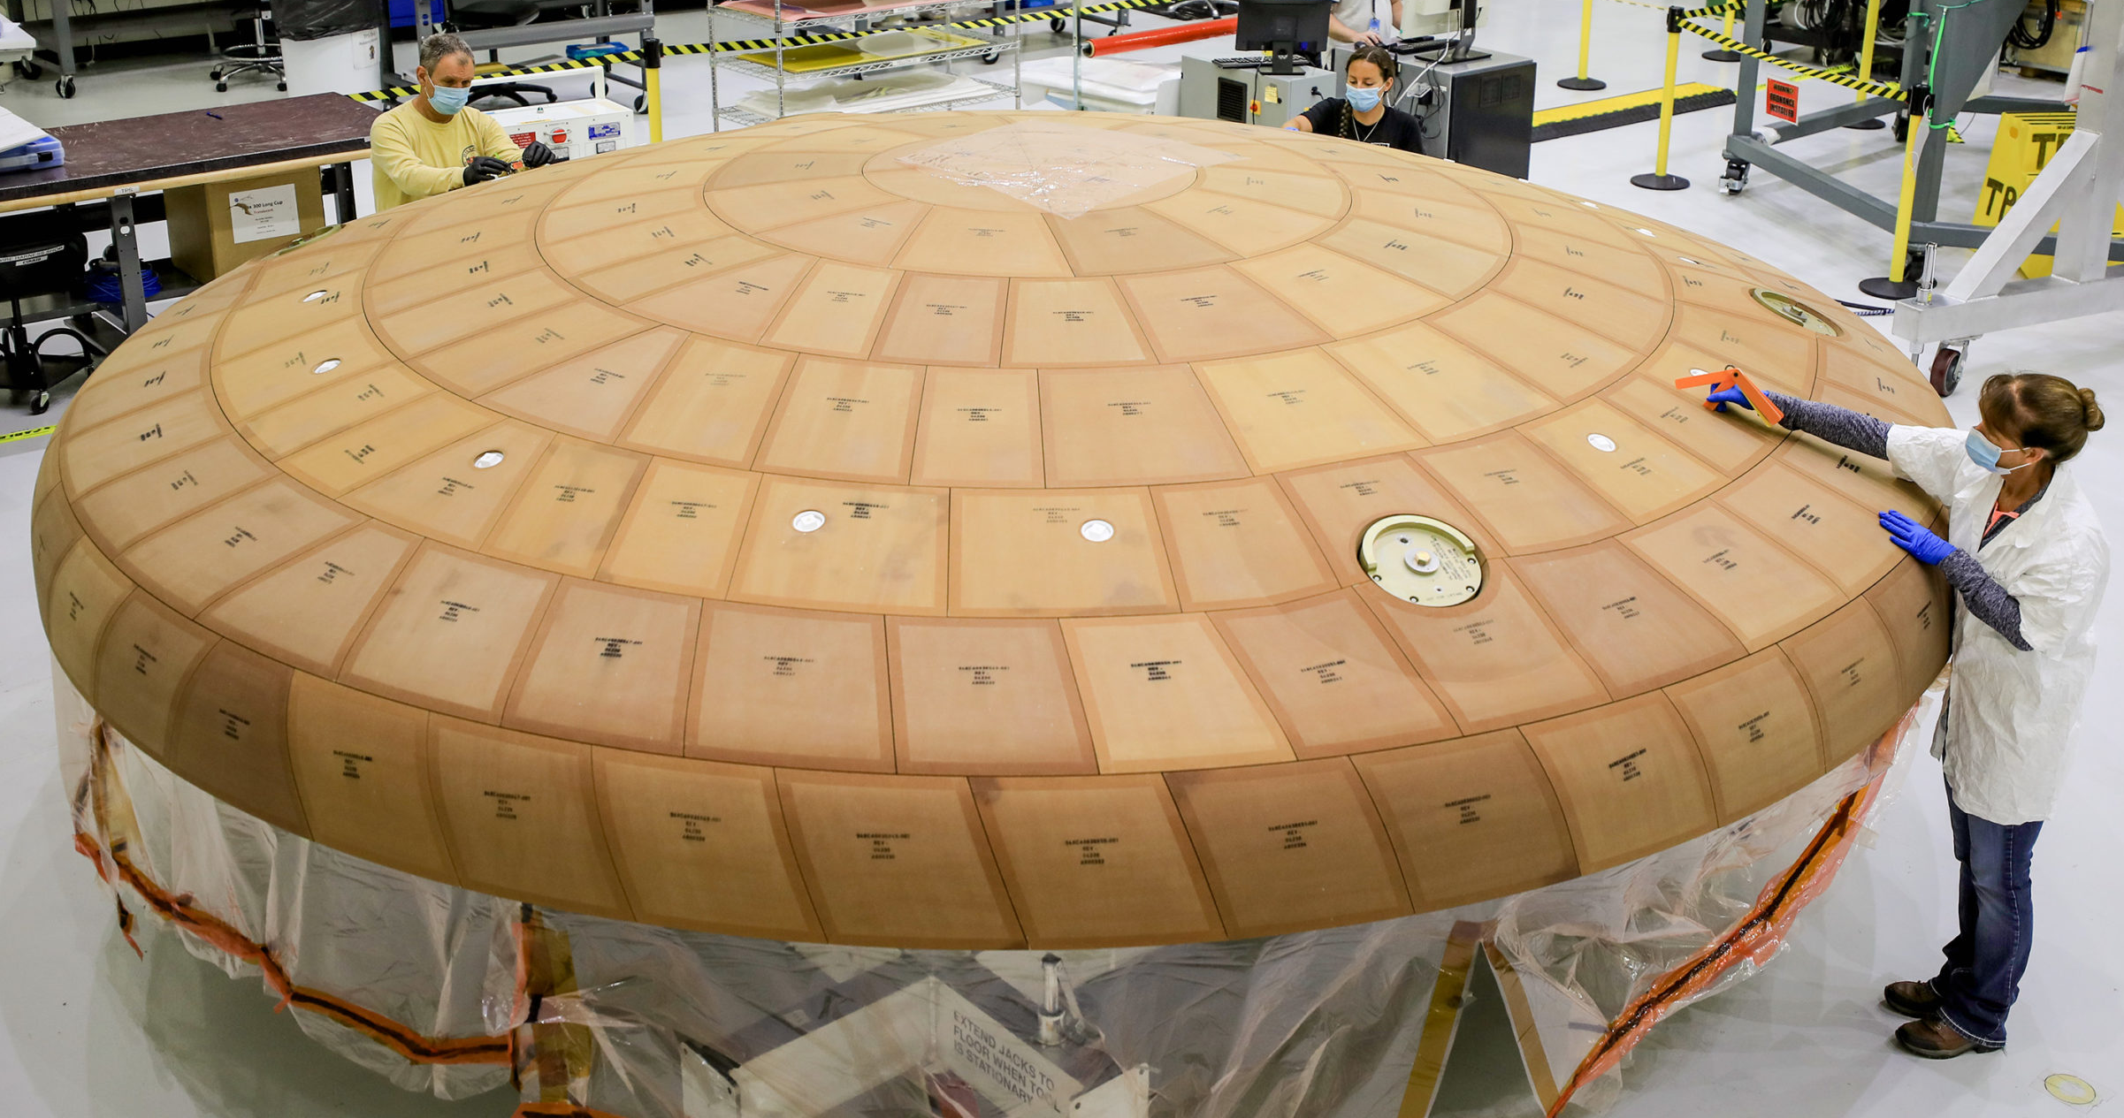
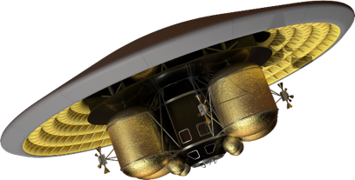
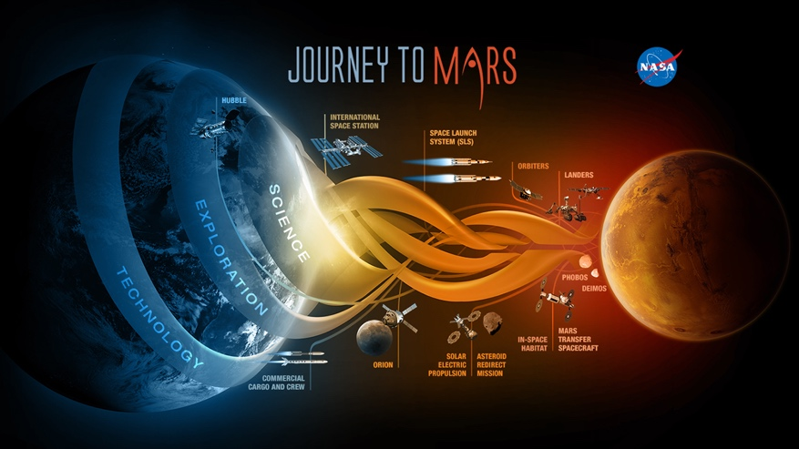
ACCESS STRI: Motivations
Mars Sample Return
Artemis
Missions like operational crewed Moon/Mars exploration and Mars sample return demand an ability to quantify entry system reliability prior to flight
Key Needs:
Risk and performance based architecture trades
Establish system reliability for flight certification
Bridge ground-to-flight testing gap; reduce system risk
Support sustainability and block upgrades
Topic designed to complement and supplement in-house research, leveraging an academic base created from NASA & DOD entry system funding. Institute products address multiple EDL gaps and are directly relevant to the “Land 20 Tons” and “EDL to Enable Planetary Science” Envisioned Future Priorities.
Human Mars Exploration

Slide 3
ACCESS STRI: Intended Scope
Objective: Fundamentally advance the SoA in modeling and simulation of entry systems for future NASA missions; emphasis on tools to predict system response to off-nominal events of critical importance.
Required Elements:
Detailed modeling of kinetic rates and physical processes that govern key chemical kinetic, material behavior, and fluid dynamic phenomena. [295, 296, 324, 325]
Tightly-coupled multi-disciplinary analysis of aerodynamics, aerothermodynamics, shock layer radiation, material response, and thermostructural behavior. [329]
High-fidelity modeling of thermal protection material damage initiation/propagation, and failure mode identification. [295, 296, 1440]
Rigorous techniques for uncertainty quantification and established methodology to make physics-based reliability estimates for NASA entry system concepts. [323]
Other Considerations:
Model validation is key across all objectives
Effective solution will likely require emerging heterogeneous Peta- and Exascale computing technology [330]
ACCESS is NASA’s Primary investment in 323 and 329 at this time
[xx]: EDL&PL Gap Addressed

