Slide 1
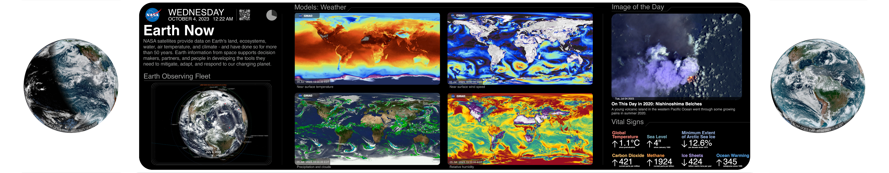

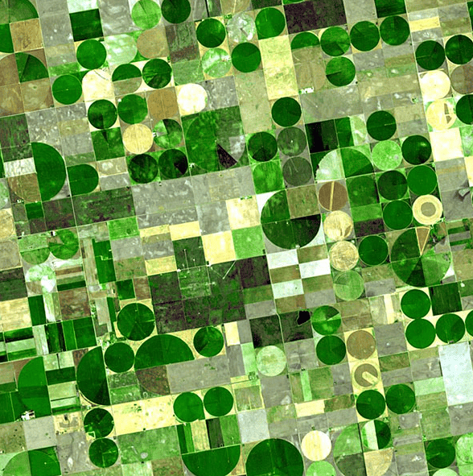


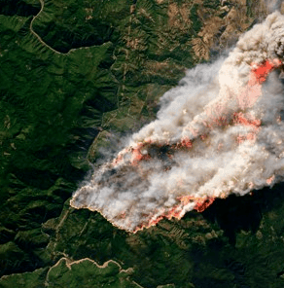
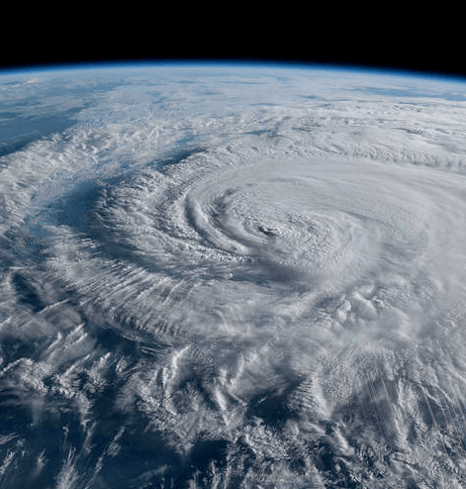




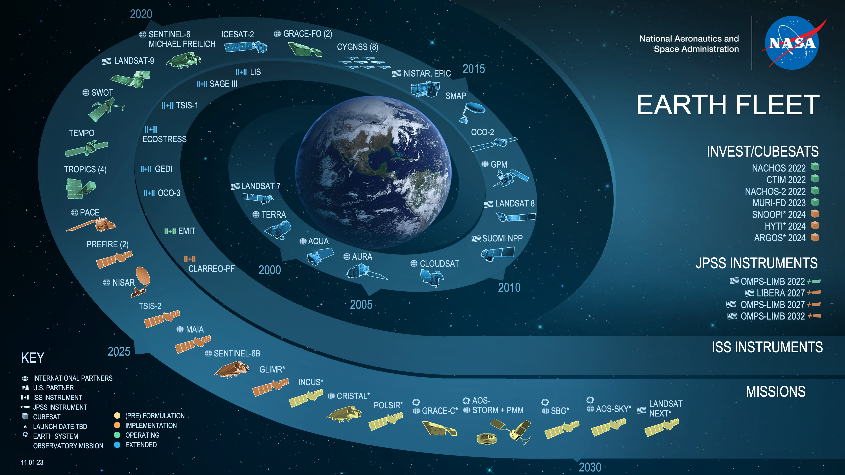

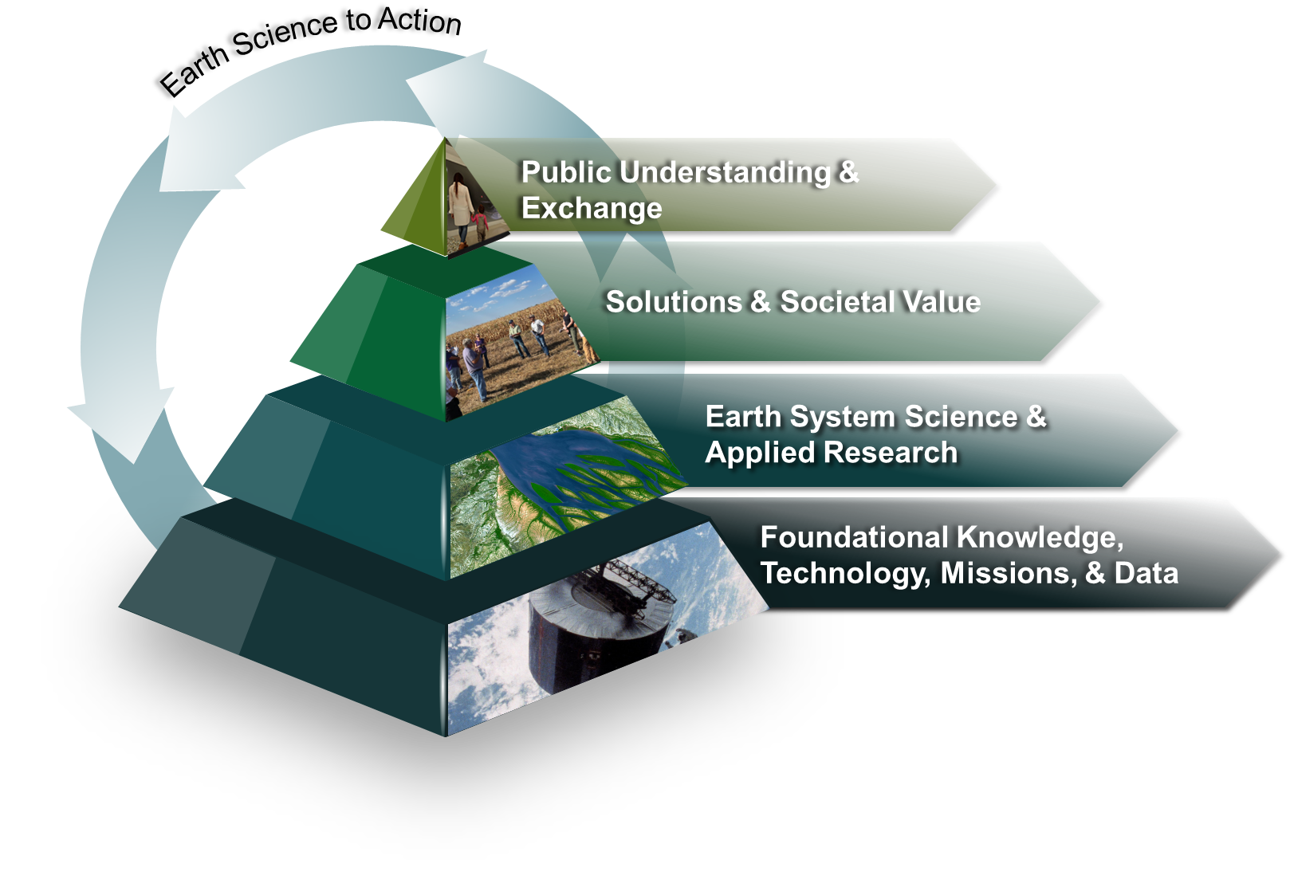

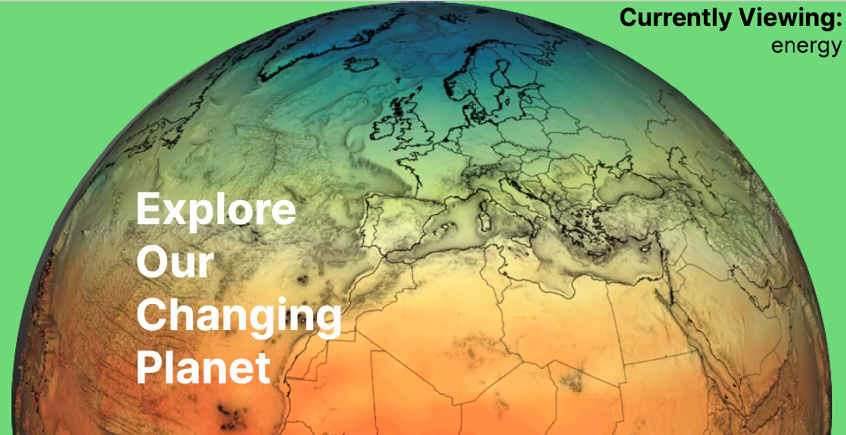

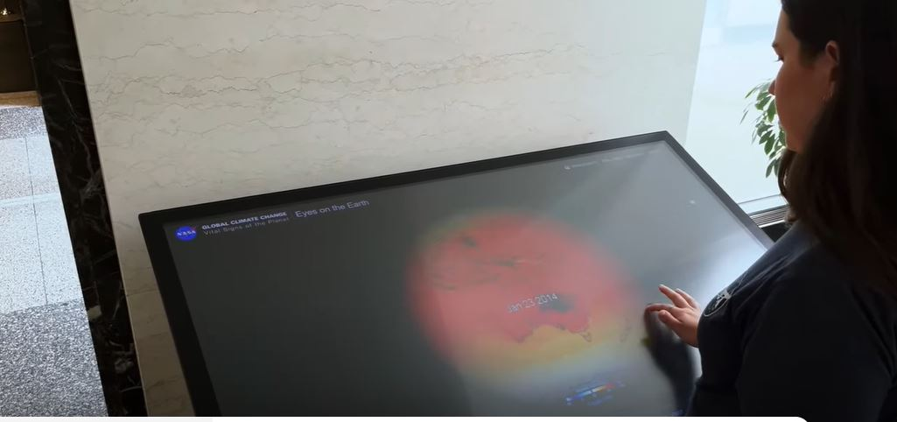
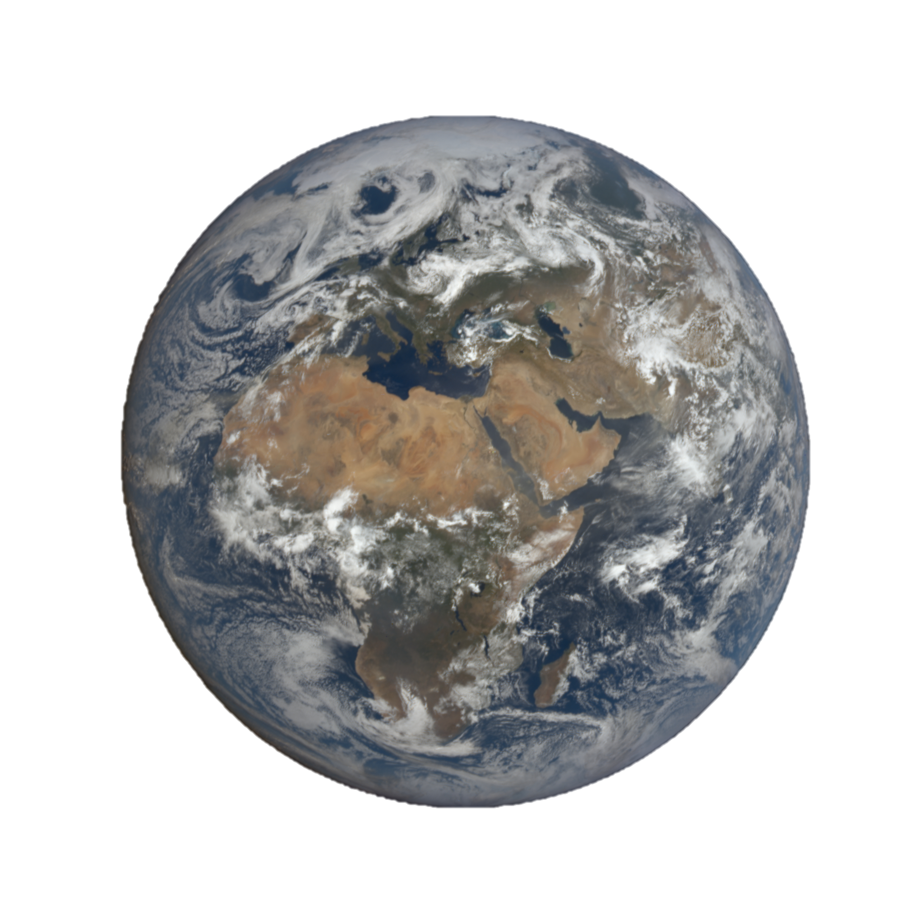

Exploring Innovative Methods for Earth Science Communication Through NASA’s Earth Information Center
Nicole Ramberg-Pihl, PhD^{1,2,3},Eleanor Stokes, PhD², Laura Rogers^{2,4}, Erica Bernhard⁵, Michael Chyatte^{1,6}, Daniel Duffy¹, Dan Goods⁵, Alex Gurvich^{1,3}, Lauren Katz², Brenda Lopez-Silva^{1,3}, Mark SubbaRao¹, David Rager²
¹NASA Goddard Space Flight Center, ²NASA Headquarters, ³Science Systems and Applications, Inc., ⁴NASA Langley Research Center, ⁵Jet Propulsion Laboratory, ⁶Adnet Systems Inc.
Abstract
Earth Information Center Exhibits
Thematic Areas
HYPERWALL
Highlight the applications of actionable Earth data at regional and global scales
Environmental challenges stemming from unprecedented changes in our planet have increased the need to communicate our understanding of Earth as a connected system. In June 2023, NASA unveiled the Earth Information Center (EIC), part of NASA’s Earth Action Strategy aimed at amplifying NASA’s Earth science impact by engaging decision-makers beyond the scientific community. Existing in both physical and virtual space, the EIC provides critical information on how the planet is changing and affecting livelihoods across the globe. For over fifty years, NASA has utilized the unique vantage point space offers to monitor Earth in collaboration with Federal partners. Through an expanding fleet of Earth observing satellites and sensors, NASA informs local to global decision making within nine thematic areas: agriculture, biodiversity, disasters, greenhouse gases, health and air quality, sea level rise and coastal impacts, sustainable energy, water resources, and wildfires. Visitors to the inaugural location of the EIC at NASA Headquarters in Washington D.C., can interact with Earth observation data and models through innovative exhibits and storytelling. Designed by an interdisciplinary team, the EIC is designed for multiple modality learning to reach a wide base of end-users. Data driven visualizations, near real-time information, and curated stories highlight the applications of Earth observations to address environmental challenges. Complementary exhibits and immersive storytelling allow visitors to physically step inside environmental data and connect with information on an emotional level. Taken together, the collective EIC provides scientists and non-scientists alike with the ability to see our home planet as NASA sees it, as a system of systems, while delivering easily accessible information to those who need it most.
Large format digital display, approximately twenty feet in length, that cycles through three modes containing near real-time information, models, and visualizations. The main screen is centered between two round port holes that display accompanying content.
Agriculture
Air Quality
Biodiversity
Wildfire
Disasters
One hyperwall display, three modes of science communication
Dashboard mode provides a mission control aesthetic connecting visitors to the abundance of Earth data collected and modeled by NASA and inter-agency partners that allow us to better understand our planet. An example of the Earth Now dashboard is shown above.
Narrated story mode provides further insight into the environmental impacts of a changing climate and communicates how NASA and interagency Earth observations can inform end-user decision making across the EIC’s thematic areas.
Beauty visualization mode captivates visitors with data driven visualizations that both inform and inspire.
Water Resources
1
Energy
2
Sea Level Rise
Greenhouse Gases
EIC Mission
Deliver easily accessible information to those who need it most
3
The EIC disseminates information on the applications of Earth data to address environmental challenges across the nine thematic areas shown above. While these themes highlight key areas of interest, they do not exist in isolation .Through a combination of narrated storytelling and visualizations, the EIC communicates the nature of an interconnected planet, one system of systems.
The Earth Information Center’s (EIC) aim is to serve as a gateway to Earth observation information and highlight the applications of actionable information in daily decision-making on a local to global scale. The EIC is an interdisciplinary, multi-center, and inter-agency effort.
Existing in both physical and virtual space, the center invites visitors to experience our changing planet and delivers critical information to those who need it most in a user-friendly manner.
The first instantiation of a physical EIC is located at NASA Headquarters in Washington, D.C. and launched in partnership with six founding agencies:
Federal Emergency Management Agency (FEMA)
National Oceanic and Atmospheric Association (NOAA)
United States Agency for International Development (USAID)
United States Department of Agriculture (USDA)
Environmental Protection Agency (EPA)
United States Geological Survey (USGS)
Interactive exhibits and immersive storytelling blend science and art to communicate environmental challenges stemming from unprecedented changes in Earth’s climate and the need to understand Earth as a connected system.
The EIC is designed for multiple modality learning to reach a wide base of end-users and connect with visitors on a scientific and emotional level.
The Earth Information Center features awe inspiring data visualizations, near real-time information, and curated stories that highlight the applications of Earth observations to address environmental challenges affecting livelihoods across the globe.
Experience Our Changing Planet
.
Through an expanding fleet of Earth observing satellites and sensors, including the missions shown here, NASA and inter-agency partners can monitor Earth and its resources at a scale that informs local to global decisions-making.
EARTH PULSE
Light sculpture in a spiral chandelier formation that responds to live communication with a selection of NASA’s fleet of Earth observing missions in the Near Space Network (NSN). First a mission name is shown on the sculpture, followed by varying quantities of light moving upwards and downwards. The directionality and quantity of light represents information being sent from ground stations directly to satellites or information being sent from satellites down to Earth, The NSN is managed by the Space Communications and Navigation (SCaN) program.
Earth.gov
User-friendly access to inter-agency Earth data that enables deeper understanding and decision-making
NASA’s Earth to Action strategy aims to amplify the impact of Earth observation data in end-user decision making. The strategy is depicted in a distinct pyramid shape. The EIC sits at the top of the pyramid engaging public audiences and serving as an entry point to Earth data exploration.
Image Credit: Dan Goods
Earth.gov is a multi-phased and intergovernmental approach to provide users with actionable data from NASA and inter-agency partners, including FEMA, NOAA, USAID, USDA, EPA, and USGS.
Expanding the EIC’s virtual presence provides opportunities for deeper Earth data exploration beyond physical installations and the ability to connect end-users across the globe with the publicly available data.
IMMERSIVE INSTALLATION
Space for Earth is an immersive installation that invites visitors to experience Earth as an interconnected system. The 7:50 story is narrated by two retired astronauts Nicole Stott and Drew Feustel, who describe their experience viewing Earth from space. The show features imagery collected from Earth observing satellites, near real-time data, and interactive visualizations. The image to the left shows Amazonian leaders visiting Space for Earth in November 2023.
Image Credit: NASA
Earth.gov contains information featured at physical locations, but users can explore that information anywhere internet access is available.
The Earth Information Center Ribbon Cutting Ceremony was held on June 21, 2023, at NASA Headquarters in Washington, D.C. Agency Leadership from NASA and founding Federal partners were in attendance.
INTERACTIVE EXHIBITS
The Eyes on the Earth kiosk is an example of interactive technology that allows users to zoom into regions of interest and explore a variety of datasets including temperature, air quality, wildfires, and precipitation. Users can also select satellites orbiting the Earth to learn more about a specific mission or read about recent weather events across the globe.
Still have questions?
Contact
Nicole Ramberg-Pihl, PhD
EIC Project Manager
nicole.c.ramberg-pihl@nasa.gov
Image Credit: NASA
Image Credit: NASA
Find us online

