Slide 1


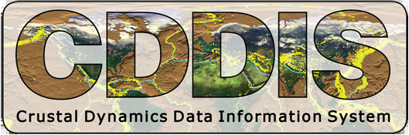





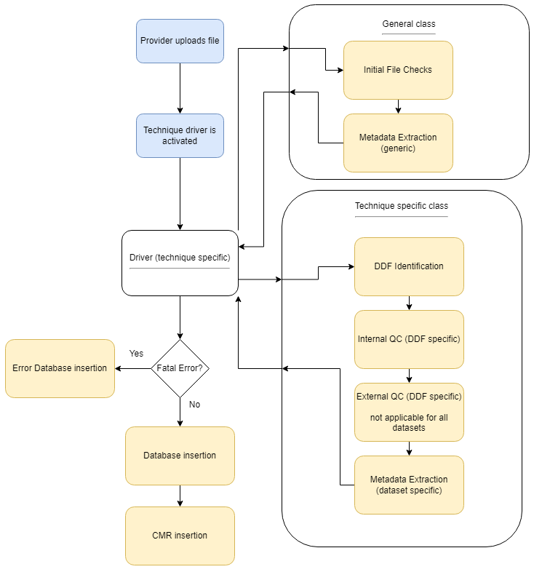
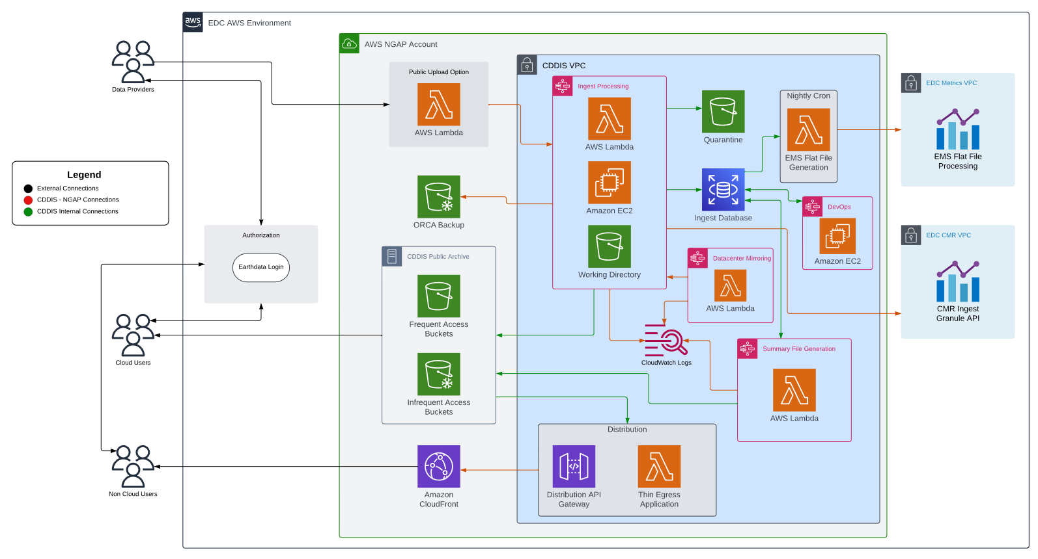
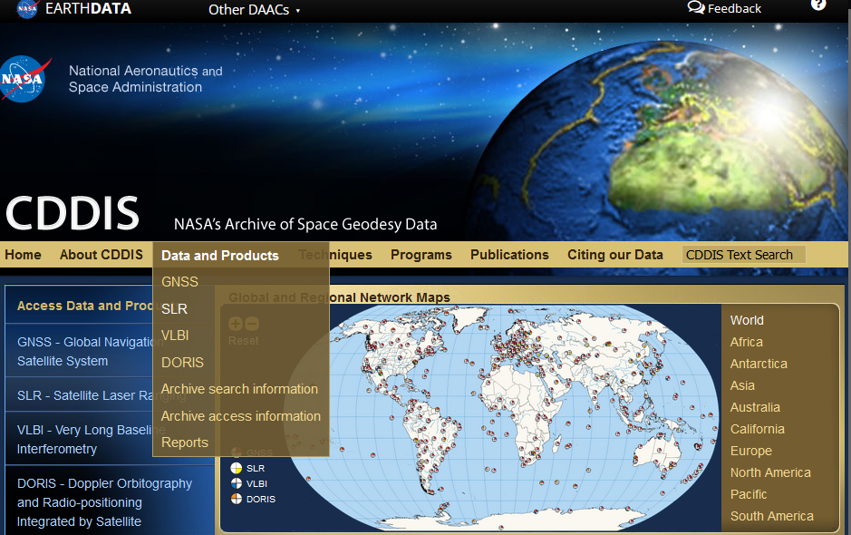

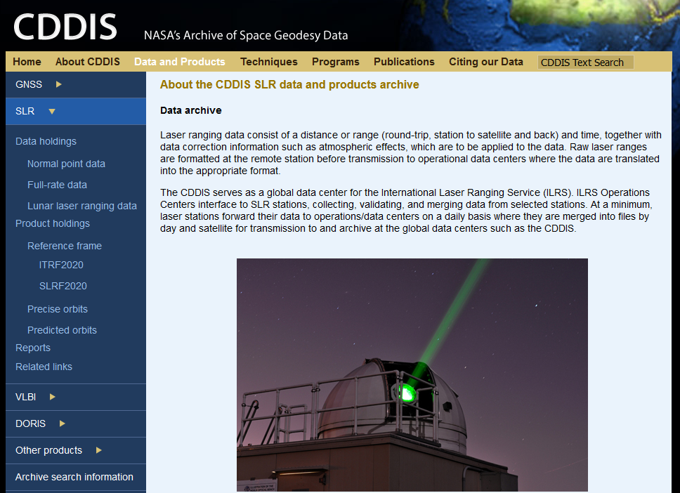


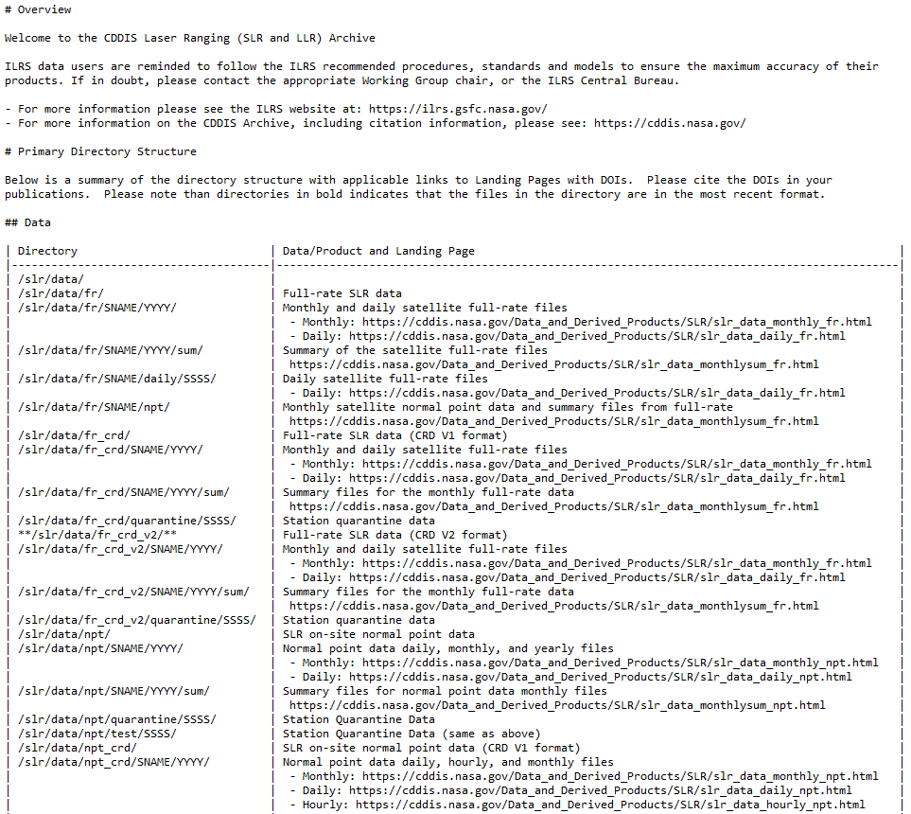
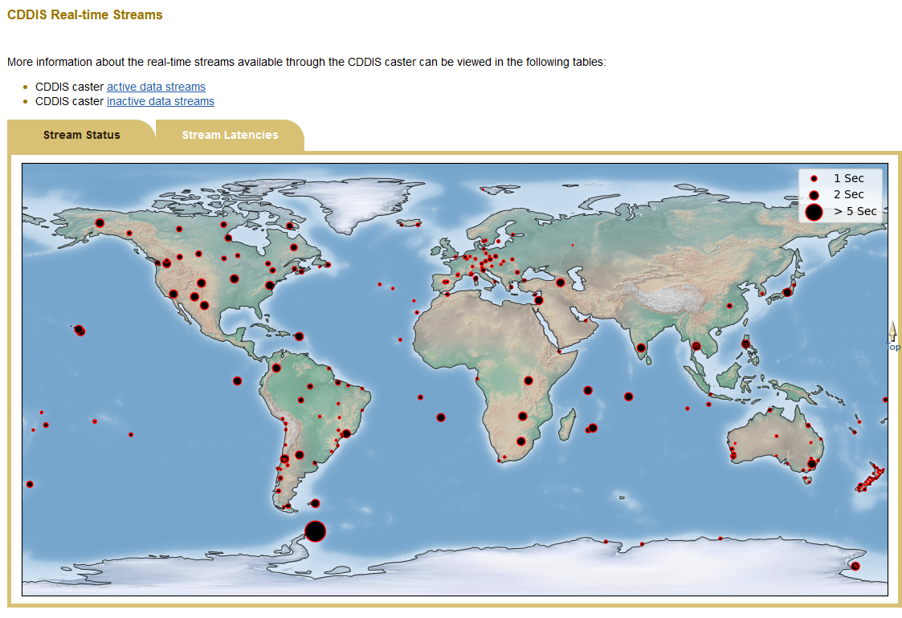
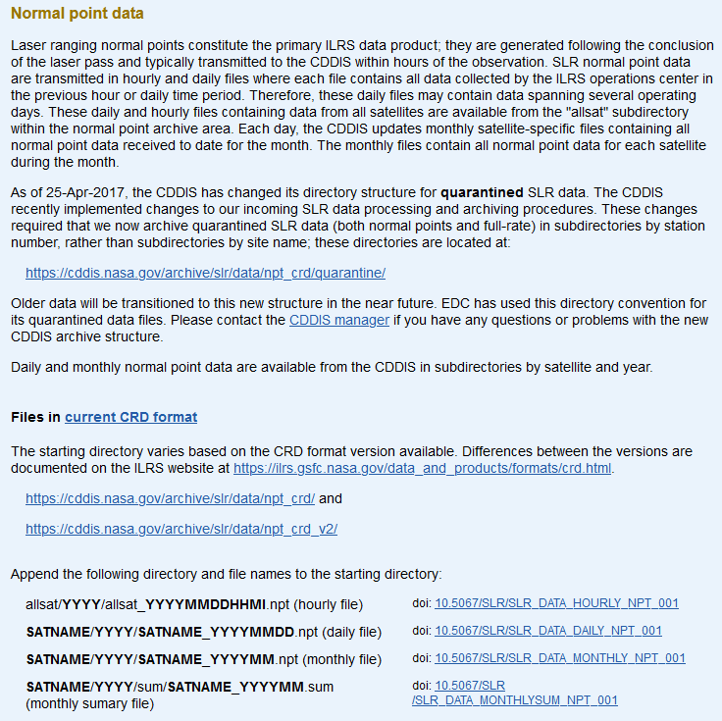
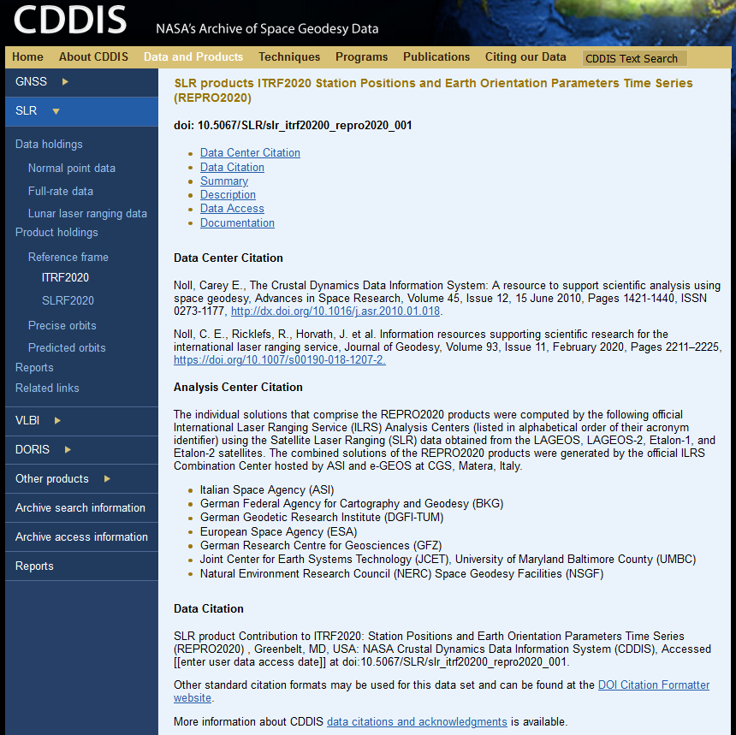

The Crustal Dynamics Data Information System (CDDIS) – Updates and Future Developments
G41C-0465
Justine Woo (1), Taylor Yates (1), Benjamin Patrick Michael (2)
1. Science Systems and Applications, Lanham, MD, USA 2. NASA Goddard Space Flight Center, Greenbelt, MD, USA
GNSS GUARDIAN NEAR-REAL-TIME IONOSPHERIC TOTAL ELECTRON CONTENT PRODUCT
ABSTRACT
SLR ITRF2020 PRODUCTS (REPRO2020)
As earth observing services and techniques have flourished, data and products have exponentially grown, like the proliferation of Global Navigation Satellite System (GNSS) stations capable of providing real-time data, Satellite Laser Ranging (SLR) stations shifting to kHz lasers, and Very-Long-Baseline Interferometry (VLBI)’s implementation of VLBI Global Observing System (VGOS) telescopes. The CDDIS is continually evolving to fulfill the new storage, quality check, and latency requirements that these changes bring, as well as meet new standards such as the shift toward FAIR and open science. These have shaped how the CDDIS develops new software and resources. Beginning next year, the CDDIS will begin to transition their data and products to the Amazon Web Services (AWS) cloud, beginning with DORIS data. This poster will highlight the CDDIS’s recently updated processing system, new data and products available, and future work.
Description: The International Laser Ranging Service (ILRS) contributions to the newest International Terrestrial Reference Frame, ITRF2020, includes station positions and earth orientation parameters time series. Its main products are weekly and bi-weekly station position estimates along with daily and 3-day average Earth Orientation Parameters (EOP) estimated over 7-day arcs and 15-day arcs from 1983-1993.
Uses:
International Terrestrial Reference Frame
Station data quality and systematic error modeling
Gravity modeling
CDDIS Support: The REPRO2020 is the first SLR product in which direct input from the ILRS community was obtained to create the landing pages. The community helped ensure credit was provided to the analysis centers, that the location of the landing page was clear, and encouraged the use of DOIs.
Description: Developed at NASA Jet Propulsion Laboratory (JPL), the GNSS-based Upper Atmosphere Realtime Disaster Information and Alert Network (GUARDIAN) is near-real-time (NRT) ionospheric monitoring software (Martire et al, 2023). Its main products are NRT total electronic content (TEC) time series, allowing users to explore ionospheric TEC perturbations due to natural and anthropogenic events on Earth. The NRT GUARDIAN time series are validated against well-established post-processing methods. Currently, time series are computed for more than 90 GNSS ground stations distributed around the Pacific Ring of Fire, which monitor the four main GNSS constellations (GPS, Galileo, BDS, and GLONASS).
Uses:
Earthquake
USGS Tsunami Watch
Volcanic Eruptions
Geomagnetic Storms
CDDIS Support: The product is stored in the CDDIS archive. To support latency needs for the NRT data, the CDDIS shifted from processing at scheduled intervals to processing files using middleware. This allows for files to be queued for ingest. In addition to the change in upload procedures, the CDDIS has also updated their processing software to simplify CDDIS’s transition to the EarthData Cloud.
CDDIS CLOUD ONBOARDING
CDDIS DOI
Landing Page
GUARDIAN
Website
CDDIS DOI
Landing Page
Description: The CDDIS is transitioning to the Earthdata Cloud to fully realize NASA’s goals for open science. The primary focus of these efforts is to ensure the accessibility of NASA data by reducing the barriers to entry within the science community while increasing traceability and reproducibility of research.
Once the CDDIS has shifted to the Earthdata Cloud, users will have access to the following benefits:
Access to full features on Earthdata Search including searchability and download directly from Earthdata
Ability to work with the CDDIS data and products in the cloud – downloads will no longer be required, reducing the need to invest in on-premises resources
Easier identification of collocated data from across the NASA DAACs
Access to new tools for subscribing and analyzing data
The CDDIS is also working to ensure the following as data and products are migrated to the cloud:
Guaranteeing the data and products have a DOI and landing page, especially for older data sets
Reorganize the data/products into clearer collections with the input from representatives of the techniques supported
More through QC is created for each of the file types
Data can be downloaded based on temporal specifications
Please note that, even as the CDDIS transitions to the cloud, users will still be able to download data to their servers and the original archive structure will still be maintained. EOSDIS is also investing in helping scientists transition to the cloud through training initiatives.
Current Progress: In the summer and fall of 2023, the CDDIS began onboarding to the EOSDIS Ingest and Archive train. With a focus on project planning and gaining familiarity with the software environment (AWS and CUMULUS), the preliminary steps taken are essential to make concrete progress in 2024.
SLR2020 PRODUCTS
Description: In addition to contributions to the ITRF2020, the SLR2020 products include an expanded set of SLR station positions and velocities in the ITRF2020 frame. It includes historical sites that are not included in the ITRF2020 and new stations accepted after the creation of the ITRF2020.
Uses:
Monitor station performance
Corrections for SLR tracking data
CDDIS Support: In addition to archiving and creating the landing pages for these products, the CDDIS updated the ILRS website with the newest files for analysts to access.
CDDIS DOI
Landing Page
JPL
Load Balancer
HOW TO CITE OUR DATA
Middleware
The CDDIS would like to encourage users to cite our data to ensure providers are given proper credit for their contributions in addition to improving reproducibility and other benefits. On the CDDIS website, find the appropriate landing page under the “Data and Products” tab and the technique. In addition to finding landing pages via the README files, users can also find DOIs via the CDDIS Website.
CDDIS
Website
Figure 5: The CDDIS Website
Figure 3: The CDDIS Flow Diagram for onboarding to the Cloud
Select the “Data and Product” tab and the technique from which data or product was used:
Figure 1: The CDDIS Processing V4 Software Flow Diagram
Next Steps: In 2024, the CDDIS hopes to have its first collections in the Earthdata Cloud. Their first focus will be on the DORIS data and, once available, the CDDIS will work with the community to transition.
GNSS REAL-TIME (NTRIP) SYSTEM STATUS AND LATENCIES
CHANGES TO README FILES – FOCUS ON LANDING PAGES
Description: The CDDIS has real-time streaming software (NTRIP, Networked Transport of RTCM via Internet Protocol) for receipt and transmission of real-time GNSS data and product streams in support of the International GNSS Service (IGS) Real Time Service. The available product streams consist of GNSS orbit and clock corrections
Use:
Precise point positioning
Time synchronization
Disaster monitoring
CDDIS Support: The CDDIS has been supporting GNSS real-time data streaming since 2018 via the CDDIS-Caster NTRIP broadcaster. This year, to provide additional usability and clarity to users, the CDDIS created a real-time map showing which streams are active and their latencies.
Description: The CDDIS ReadMe files are used to provide an overview of files available in the CDDIS archive. Beginning with SLR, the CDDIS listed all the subdirectories under the technique including corresponding landing page. The landing pages contain through information about the data/products and include information on how to cite the data via DOIs.
Please cite our data!
CDDIS-Caster NTRIP Broadcaster
Real-time Map
Figure 6: SLR Page on the CDDIS Website
Then select the data or product used from the left navigation panel.
Some pages contain links
to the landing pages:
While others go directly
to the landing page
Figure 7: Sample Page that Requires Additional Navigation to Reach the Landing Pages
Figure 8: Sample Landing Page
For more information on citing our data:
Figure 2: The CDDIS Real-Time Steam Latencies Map
Figure 4: Partial Screenshot of the SLR README File

