Slide 1
Alignment Verification of the Roman Space Telescope using Machine Learning
Joseph M. Howard (NASA)
Robert Campion (NASA/Chesapeake)
Ariba Khan (MIT)
Samuel Becker (University of Rochester)
Brian Daley (Columbia University)
Samuel Nissim (NASA)

Slide 2
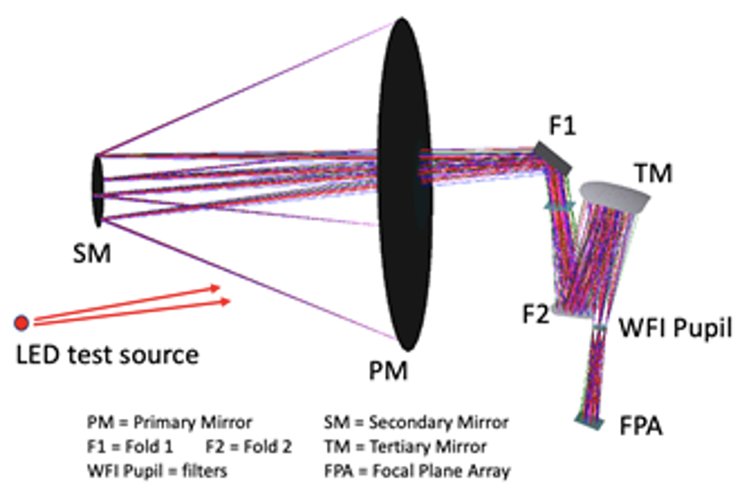
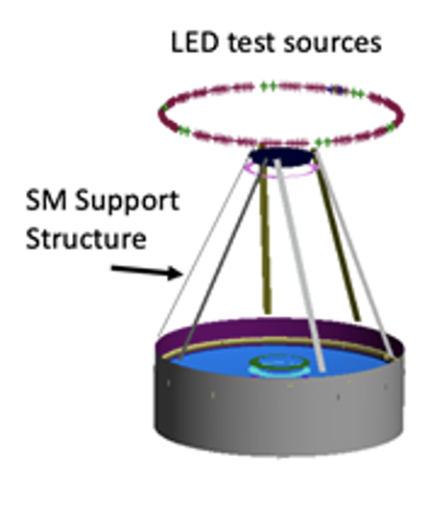
Background
Roman Space Telescope Observatory Alignment Test
  Purpose: to verify the “pupil alignment” interface between the telescope exit pupil and the entrance pupil of the Wide-Field Instrument (WFI).
  Method: Multiple LED sources of light are illuminated one at a time towards the entrance pupil of the telescope (i.e. Primary mirror, PM), which projects shadows from the secondary mirror support structure and internal pupil masks located at the WFI entrance pupil.
  These shadows are captured by the focal plane array (FPA), and are then analyzed for proper pupil alignment between the telescope and instrument (WFI).
  While one can imagine multiple methods for analyzing the test images, including use of edge detection and model-based correlation with the images, this presentation centers on our use of machine learning algorithms to recover this alignment.
Figure 1. Test source concept for creating shadows at the focal plane array of RST

Slide 3
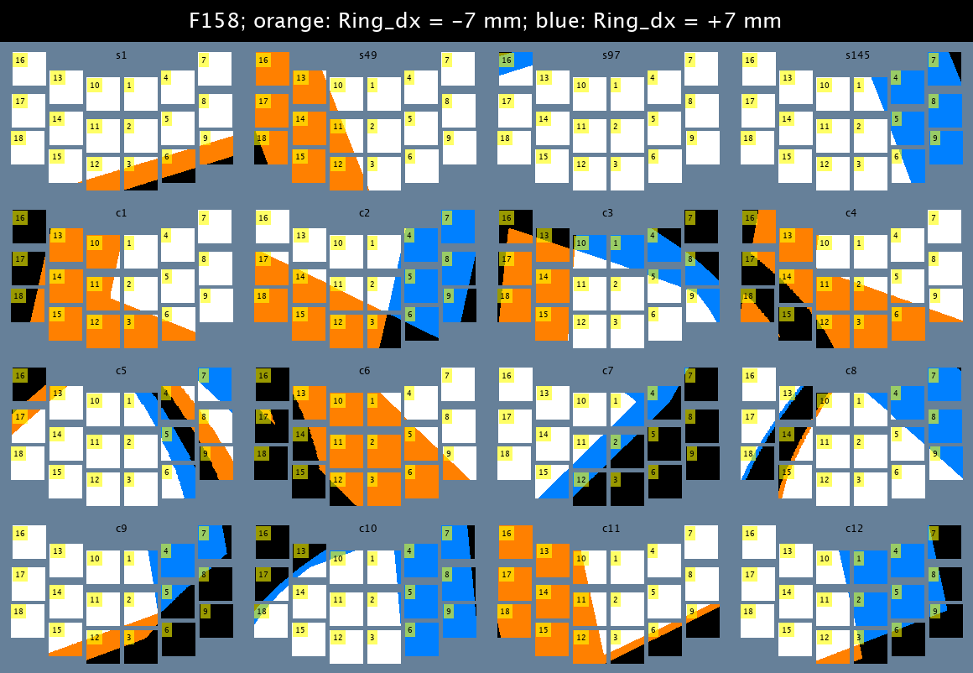
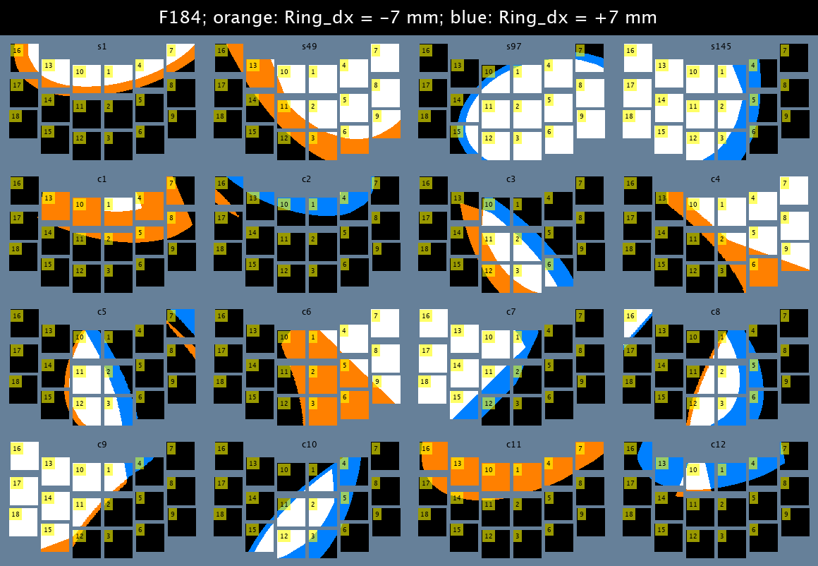
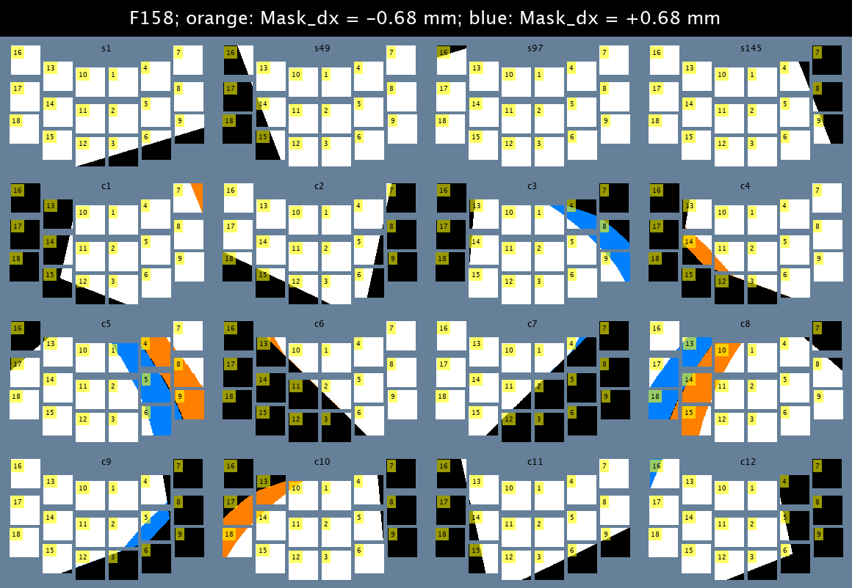
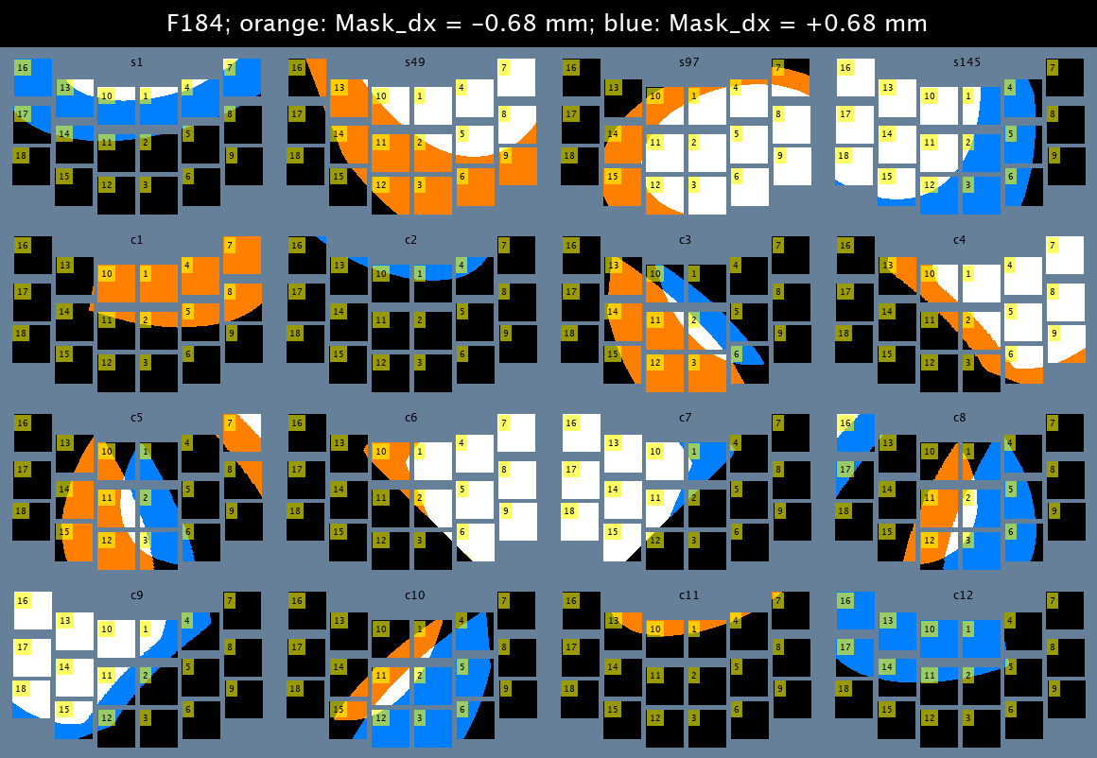
RST Component Sensitives
To visualize the sensitivities of the shadows, comparison images were developed using CODEV with each component moved to the upper and lower limits of the range of each expected uncertainty metric.
Each Mosaic of SCA detectors represents one led, each image shows all LEDs for one mask. Orange represents light at only the negative extreme, blue shows light only the positive extreme, white is light in both conditions and black is shadow in both conditions.
The LED Ring structure, the Mask and the Stop are the three largest causes for shift in the shadow. Mask shifts were also much more visible with the F184.
LED Ring Structure Decenter x
Mask Decenter x
F158 Mask
F184 Mask
F158 Mask
F184 Mask

Slide 4
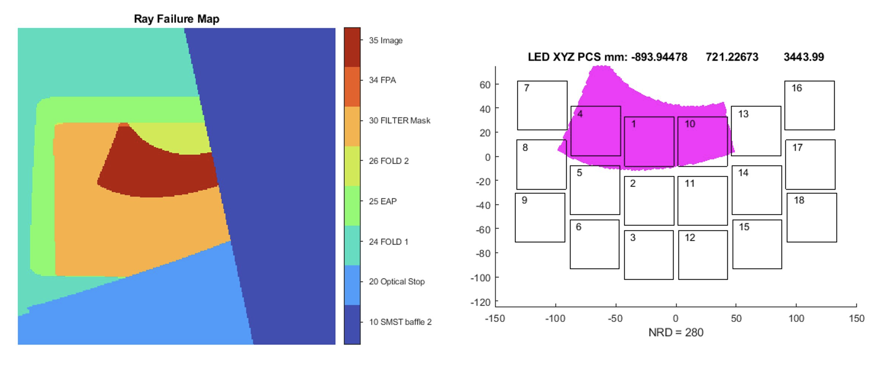
Ray Failure Maps
Ray failure maps help provide intuition of what surfaces are causing the edges of the shadows at the focal plane array.
In this example, a baffle on the strut holding the secondary mirror (i.e. telescope entrance pupil space) is adjacent to shadows from the filter mask (i.e. instrument entrance pupil).

Slide 5
Intro to Machine Learning (ML) for Optical Alignment
The Process of Using Machine Learning (ML) Algorithms:
  Generate a large dataset of modeled LED images, such as from a Monte-Carlo analysis (e.g. 1500 cases).
    Each run represents a telescope to instrument mis-alignment case, and contains multiple LED images
    Tag each run with the actual perturbation variables that were used in make the image (e.g. Pupil decenter value, etc.)
    Split the data randomly into training (e.g. 960), validation (e.g. 240), testing (e.g. 300) sets
  Pre-Process the images to make them readily accessible by the ML algorithms
  Train the ML algorithm on a subset of the generated images (such as 80%)
    Choose a specific architecture of ML algorithm (#, layers, etc.)
  Validate the ML algorithm on a subset of the training data (typically 20%)
    This subset of data monitors the training of the ML algorithms, using the same sets of data to see how well the training is improving with each “epoch” of training
  Test the ML algorithm (20%)
    This is the final performance check of the trained algorithm
    If the results “pass” the requirements, then the routine is ready to be applied!

Slide 6
First Approach: Test Small Alignment perturbations

Slide 7
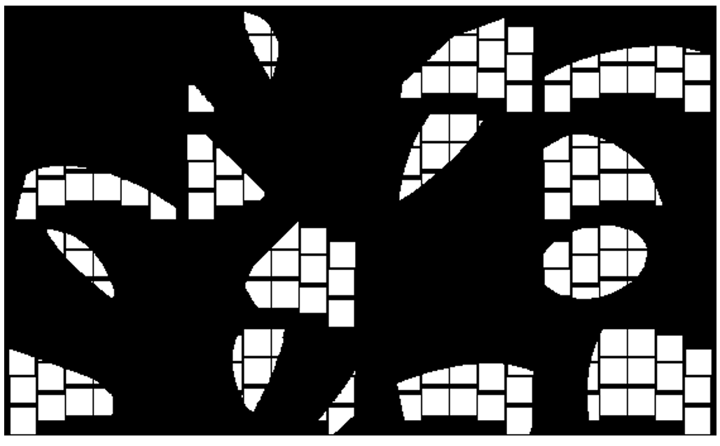
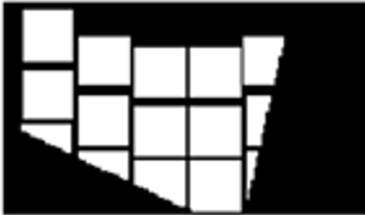
Pre-Processing the multiple LED images helps ML algorithms
For each example/run, tile the images of 16 LEDs into a 2d array / grid, making a super image
Converted binary images into RGB images and resized each image into 64 x 64 x 3
Each image is tagged with a label for supervised learning: SHEAR (dx, dy) and CLOCKING (dclock) of the pupil interface.
tile
16 LED images
Figure 3. 16 LED images tiled into 4x4 array

Slide 8
TWO Machine Learning Models are considered for this effort
1. Convolutional Model
  3 convolutional layers (size 32, 64, 64)
  ____________________________________
  Layer (type) Output Shape Param #
  ==================================================
  conv2d_3 (Conv2D) (None, None, None, 32) 896
  max_pooling2d_2 (None, None, None, 32) 0
  (MaxPooling2D)
  conv2d_4 (Conv2D) (None, None, None, 64) 18496
  max_pooling2d_3 (None, None, None, 64) 0
  (MaxPooling2D)
  conv2d_5 (Conv2D) (None, None, None, 64) 36928
  flatten_2 (Flatten) (None, None) 0
  dense_5 (Dense) (None, 64) 14745664
  dense_6 (Dense) (None, 3) 195
  ==================================================
  Figure 5. Convolutional model architecture summary
2. Fully Connected Model
  2 Hidden Layers (size 50 and 20)
  _________________________________________________
  Layer (type) Output Shape Param #
  ==============================================
  flatten_2 (Flatten) (None, 196608) 0
  dropout_1 (Dropout) (None, 196608) 0
  dense_5 (Dense) (None, 50) 9830450
  batch_normalization_2 (None, 50) 200
  (BatchNormalization)
  dense_6 (Dense) (None, 20) 1020
  batch_normalization_3 (None, 20) 80
  (BatchNormalization)
  dense_7 (Dense) (None, 3) 63
  ==============================================
  Figure 4. Fully connected model architecture summary

Slide 9
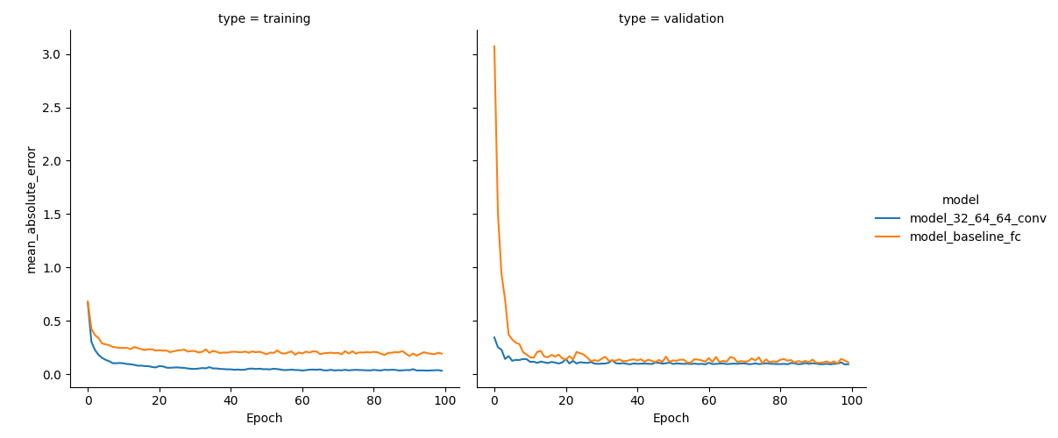
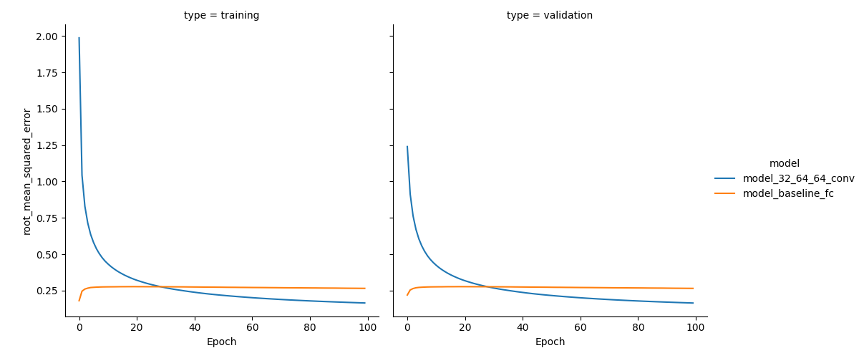
Training the algorithm
Hyperparameters:
  Epochs = 100
  Learning Rate = 0.001
  Batch Size = 24
Loss (aka figure of merit)
  (Top) Mean Absolute Error
  (Bottom) Root Mean Square Error
Figure 6. Training and validation loss plots

Slide 10
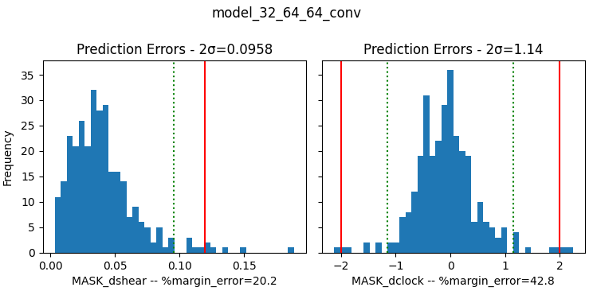
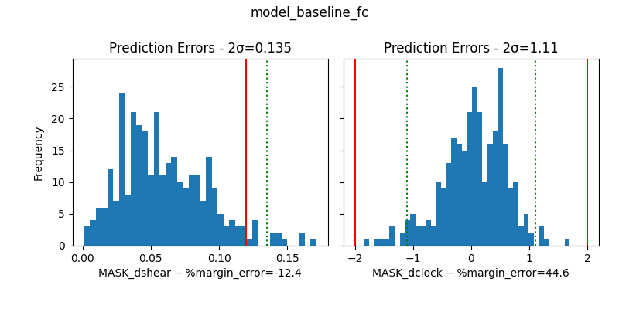
Approach 1 Results
Histogram of predicted errors for the SHEAR (mm) and CLOCKING (mrad) using the TEST data.
  dx and dy were combined to form dshear (radial distance)
  Performance two-sigma values are plotted in green.
  Requirement values are plotted in red (0.12 mm for shear and 2.0 mrad for clocking).
Figure 7. Histograms of predicted errors for shear and clocking values

Slide 11
Summary: Approach 1
Explored machine learning algorithms for pupil alignment recovery.
The convolutional model performed better than the fully connected model.
The approach shows promise as a quick crosscheck and “first look” at the data.

Slide 12
Second Approach: Increase variety and magnitude of alignment perturbations

Slide 13
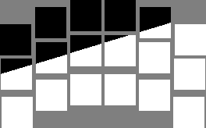


Pre-Processing
With a larger dataset using the full images caused the model to run prohibitively slowly.
To overcome this only the borders of the SCA images were passed into the model. This reduced the amount of data while maintaining sufficient information on the shadow edge.
Example FPA output. Each square represents one SCA
Example pixel selection for one SCA

Slide 14
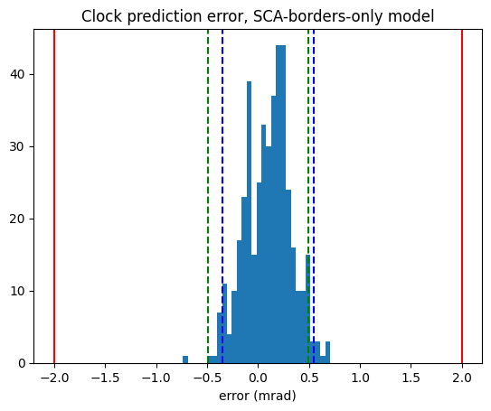
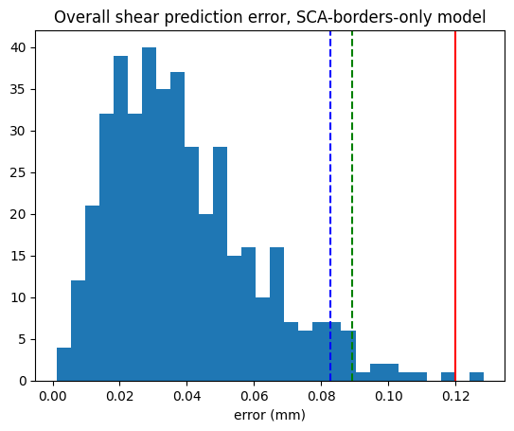
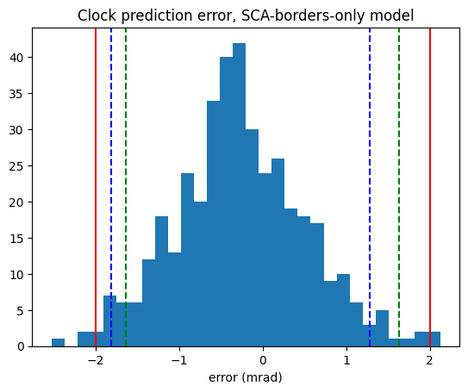
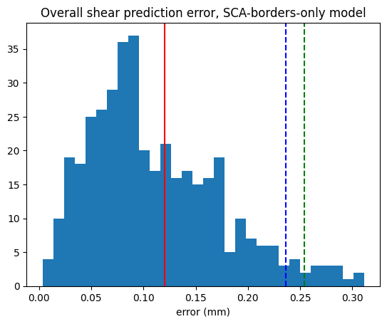
Approach 2 Results
Results from approach 1 dataset with approach 2 model
Requirement (red)
2.0 mrad
2 RMS (green)
0.49 mrad
Requirement (red) 0.12 mm
2 RMS (green) 0.089 mm
Results from approach 2 dataset with approach 2 model.
Requirement (red) 2.0 mrad
2 RMS (green)
1.63 mrad
Requirement (red) 0.12 mm
2 RMS (green) 0.254 mm

Slide 15
Summary: Approach 2
Explored machine learning algorithms for expanded alignment perturbations for pupil alignment recovery.
Achieve improved results applying the approach 2 model to the approach 1 data
Further effort is necessary to meet the performance requirement on the increase alignment perturbations

Slide 16
Summary & Future Work
Summary
  Explored machine learning algorithms for pupil alignment recovery.
  The convolutional model performed better than the fully connected model.
  The approach shows promise as a quick crosscheck and “first look” at the data.
Future Work
  Expand the dataset (beyond 1500 runs).
  Add more tolerances expected to see during the test.
Test date: 2025/2026
Launch date: 2027

Slide 17
Resources
Overall
https://www.elementsofai.com/
https://developers.google.com/machine-learning/crash-course
http://introtodeeplearning.com/
https://www.coursera.org/learn/machine-learning
Model Architecture
https://www.amazon.science/blog/how-to-construct-the-optimal-neural-architecture-for-your-machine-learning-task
https://towardsdatascience.com/designing-your-neural-networks-a5e4617027ed
https://www.v7labs.com/blog/neural-network-architectures-guide

