Slide 1
NASA’s Commercial Smallsat Data Acquisition (CSDA) Program Data System Services
Aaron Kaulfus¹, Helen Parache¹, Manil Maskey¹, Alfreda Hall², Sandra Blevins²
¹NASA MSFC, ²NASA GSFC
13 December 2023
IN34B: Commercial Earth Observation Data: Research and Applications
American Geophysical Union Annual Meeting 2023; San Francisco, CA
Notes:
Session Number and Title: IN34B: Commercial Earth Observation Data: Research and Applications II Oral
Session Date and Time: Wednesday, 13 December 2023; 16:00 – 17:30 PST
Presentation Length: 16:40 – 16:50 PST
Location: Moscone Center, 2014 - West

Slide 2
CSDA Program Overview
Pilot Program established in November 2017, transitioned to a sustained Program in early 2020
Objectives:
Establish continuous and repeatable processes to onramp new commercial data vendors and evaluate data for its potential to advance NASA’s Earth science research and application activities
Enable the sustained use of purchased data for broader use and dissemination by the Earth scientific community
Ensure long-term data preservation through the establishment of data management processes and systems to support rapid evaluation, access and distribution of purchased data, and long-term access to purchased data for scientific reproducibility
Coordinate with other U.S. Government agencies and international partners on the evaluation and scientific use of commercial data
https://earthdata.nasa.gov/csda

Slide 3
Data Management Overview at MSFC
Evaluation
Transition
Long-term Sustained Use
PIs directly interact with vendors to request and access data
Vendors provide an inventory of requested data
NASA mirrors data
Manage and archive mirrored data in NASA cloud
Provide search and access to the data (SDX)
Make data available to approved researchers
  Verify users
  Validate quotas
Users first search whether the desired data is already available in NASA catalog
Users will directly interact with vendors for new orders
Earthdata cloud will host the data long-term and provide an egress solution
Make data available to approved researchers
Verify users

Slide 4
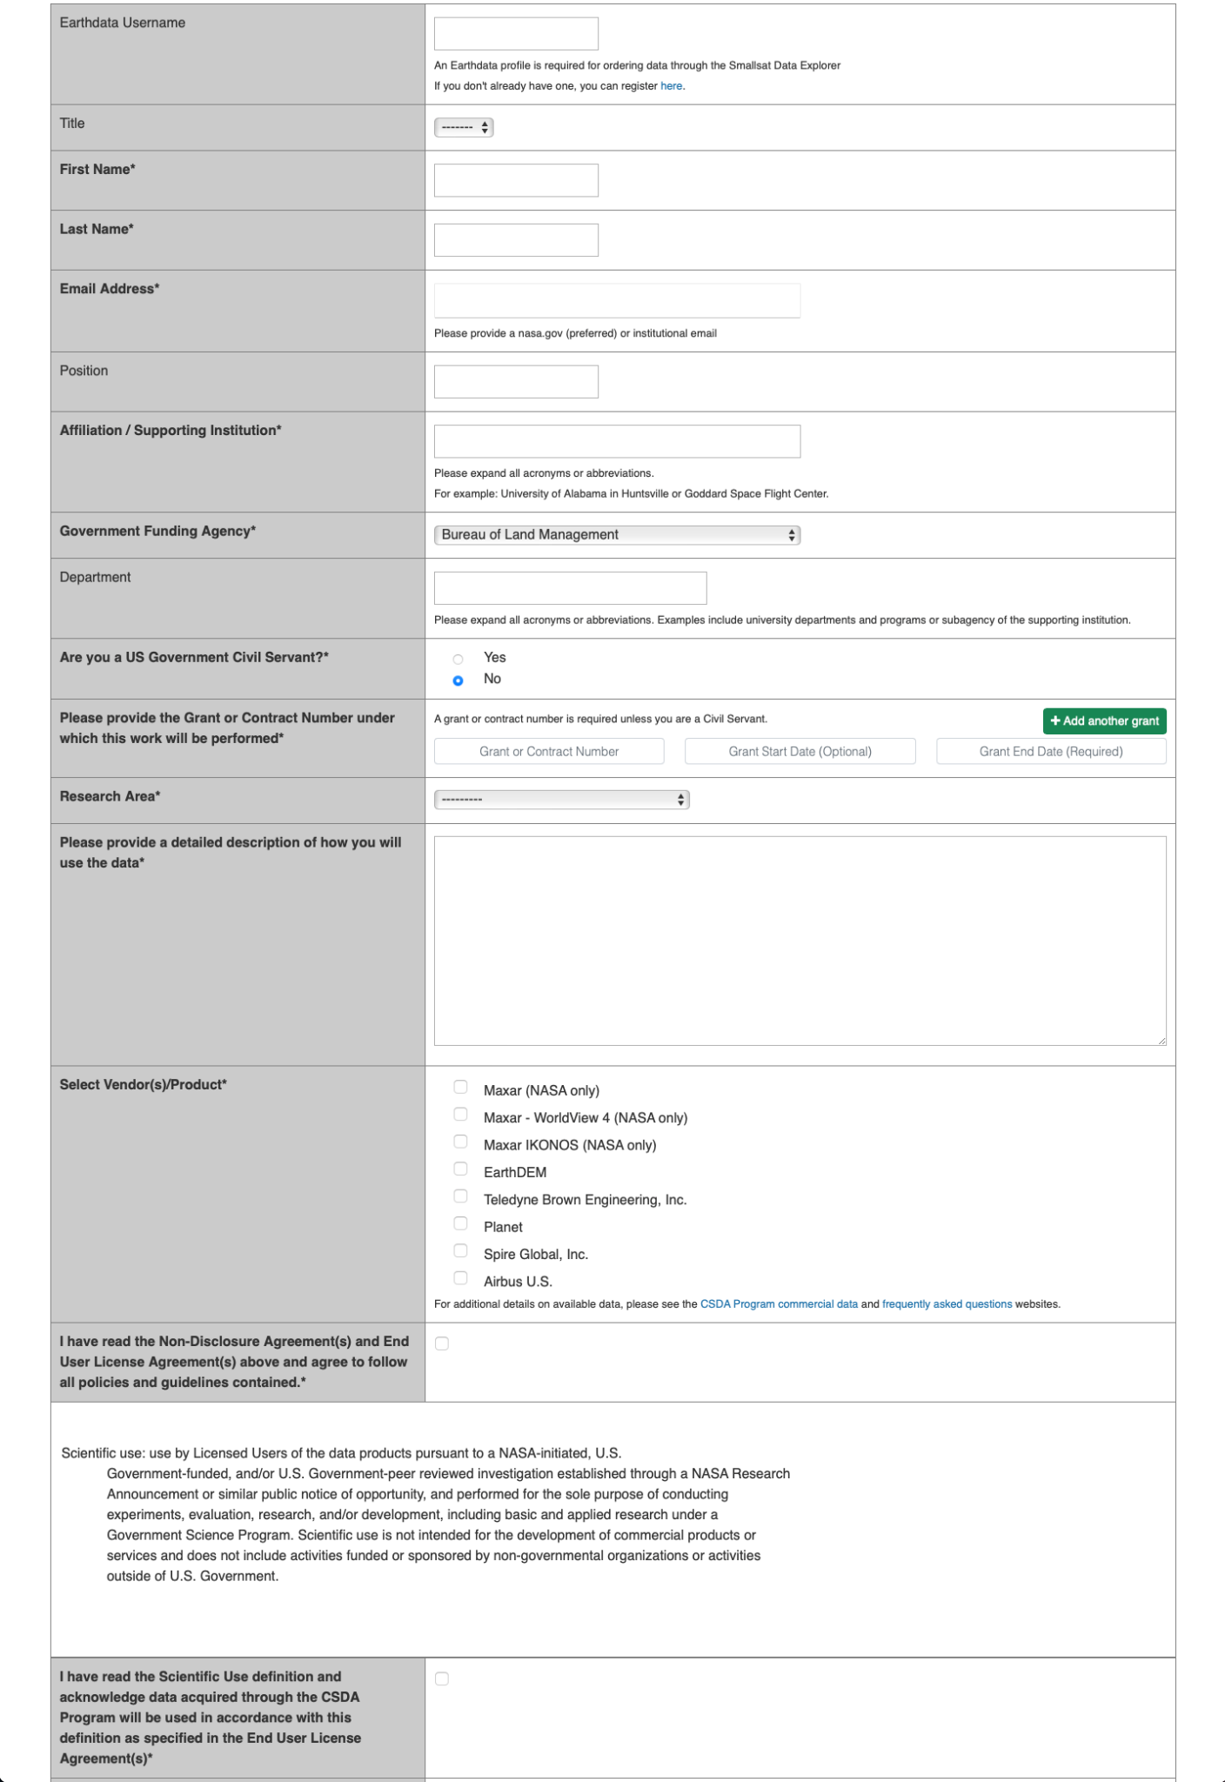
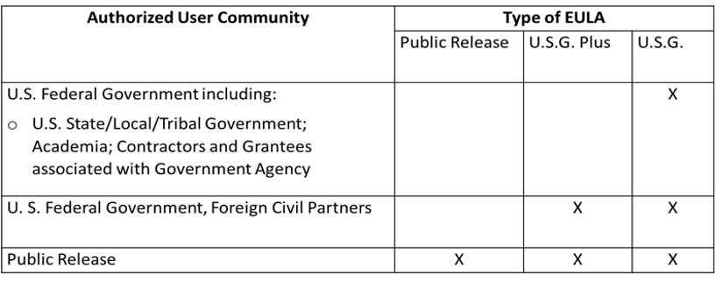
User Verification
All prospective users are subject to authorization prior to approving any data distribution request
Agree to the vendor specific science use EULA
Ability to copy, store, share and use data and derivatives including in scientific and technical articles and publishing academic, technical or professional journals, symposia proceedings, or similar works.

Slide 5
Available Data
Vendor | Constellations/ Products | Availability Dates | Spatial Resolution
Planet | PlanetScope, RapidEye | 12/31/2005 - Present | 3 - 6.5 m
 | SkySat | 3/10/2015 – 12/12/2019 | < 1 m
Spire Global, Inc | GNSS Radio Occultation and Grazing Angle Reflectometry, Satellite Precise Orbit Determination and Satellite Attitude, Total Electron Content, Ionospheric Profiles, Scintillation, Magnetometer, Bistatic radar, Ocean Winds, Soil Moisture | 9/24/2018 - 4/18/2019 (partial) 11/1/2019 - Present (all)
Maxar Technologies | Worldview 1-4, GeoEye-1, QuickBird, IKONOS | 10/24/1999 - Present | 0.31 - 4.0 m
Teledyne Brown Engineering, Inc. | DESIS L1B, L1C, and L2A | 11/21/2018 - Present | 30 m
EarthDEM | Individual strips and Mosaics | 2009 - Present | 2 m
Airbus U.S. | TerraSAR-X, TanDEM-X, PAZ X | 11/19/2007 - 11/4/2022 | <1 - 50 m
https://www.earthdata.nasa.gov/esds/csda/commercial-datasets
Notes:
https://www.earthdata.nasa.gov/esds/csda/commercial-datasets

Slide 6
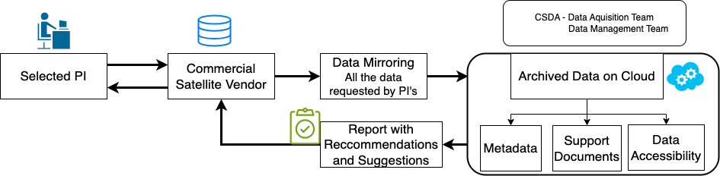
Data Publication - Information Assessments
Developed metadata and information evaluation framework to assess data system integration readiness of vendors
Evaluation Framework
Type | CSDA Program Required files | Required For CSDA Data System | Information Required From Vendors | Recommendation for vendor
Metadata
Documentation
Other

Slide 7
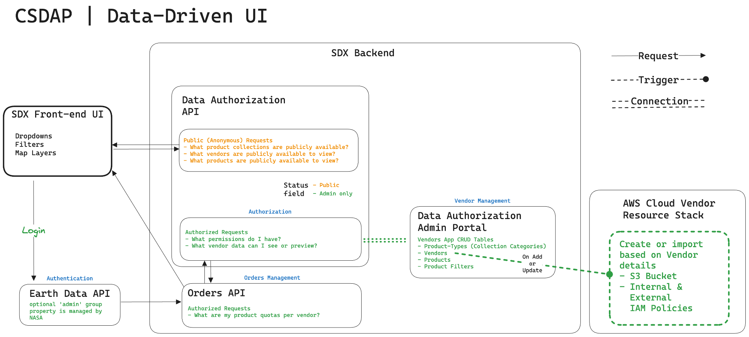
Data Publication - Vendor Management
Automatically create or update resources, workflows, interfaces for new data publication
Create data delivery S3 buckets
Initiate metadata conversion workflows
Update SDX Home, Explore, and User Guide

Slide 8
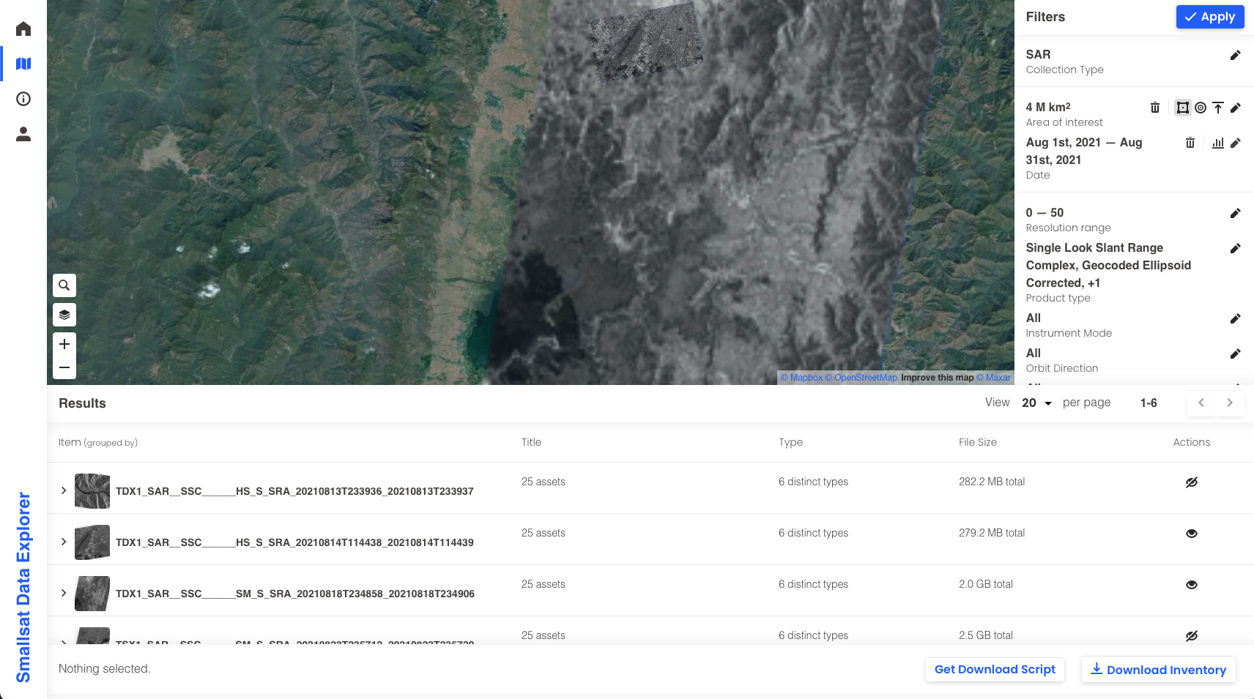
Smallsat Data Explorer (SDX)
Web application to search, discover, and download NASA acquired commercial data
Available archive:
*Planet - 2.7 M sq km
Spire - 78 TB
EarthDEM - 13.8 TB
Airbus U.S. - 4.1 TB
*Only SkySat data available through SDX
Menu
Faceted Search Options
Data Download
CSDA Smallsat Data Explorer (SDX) with thumbnails from Airbus U.S. displayed
Notes:
For Batu

Slide 9
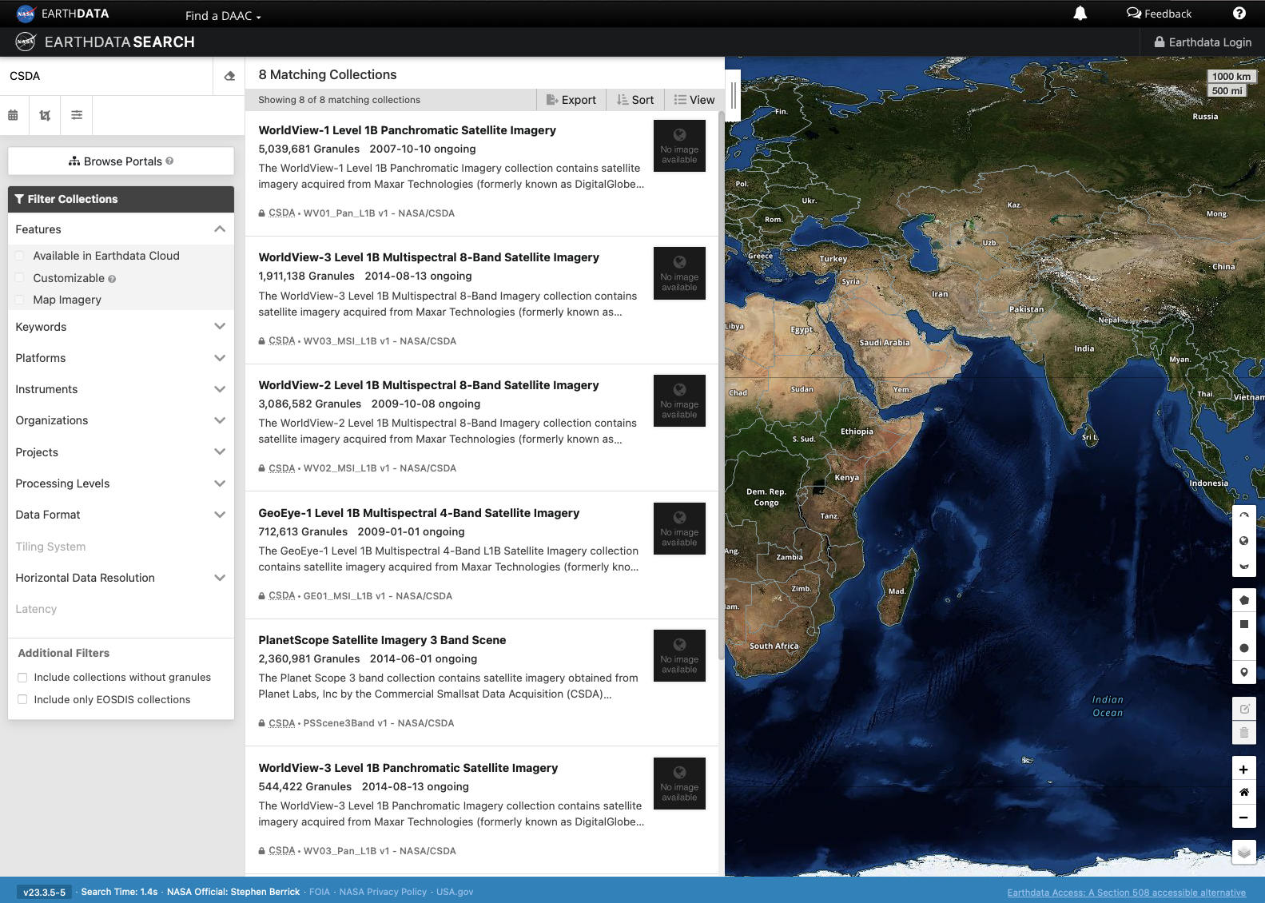
Earthdata Cloud
Reuse NASA ESDIS Enterprise Services for data publication
Common Metadata Repository (CMR)
ESDIS managed DOI service
Unified Metadata Model (UMM)
Metadata Management Tool (MMT)
Cumulus
Earthdata Search Client
Data Archived:
Granules: ~16 Million
Volume: 7.2 PB

Slide 10
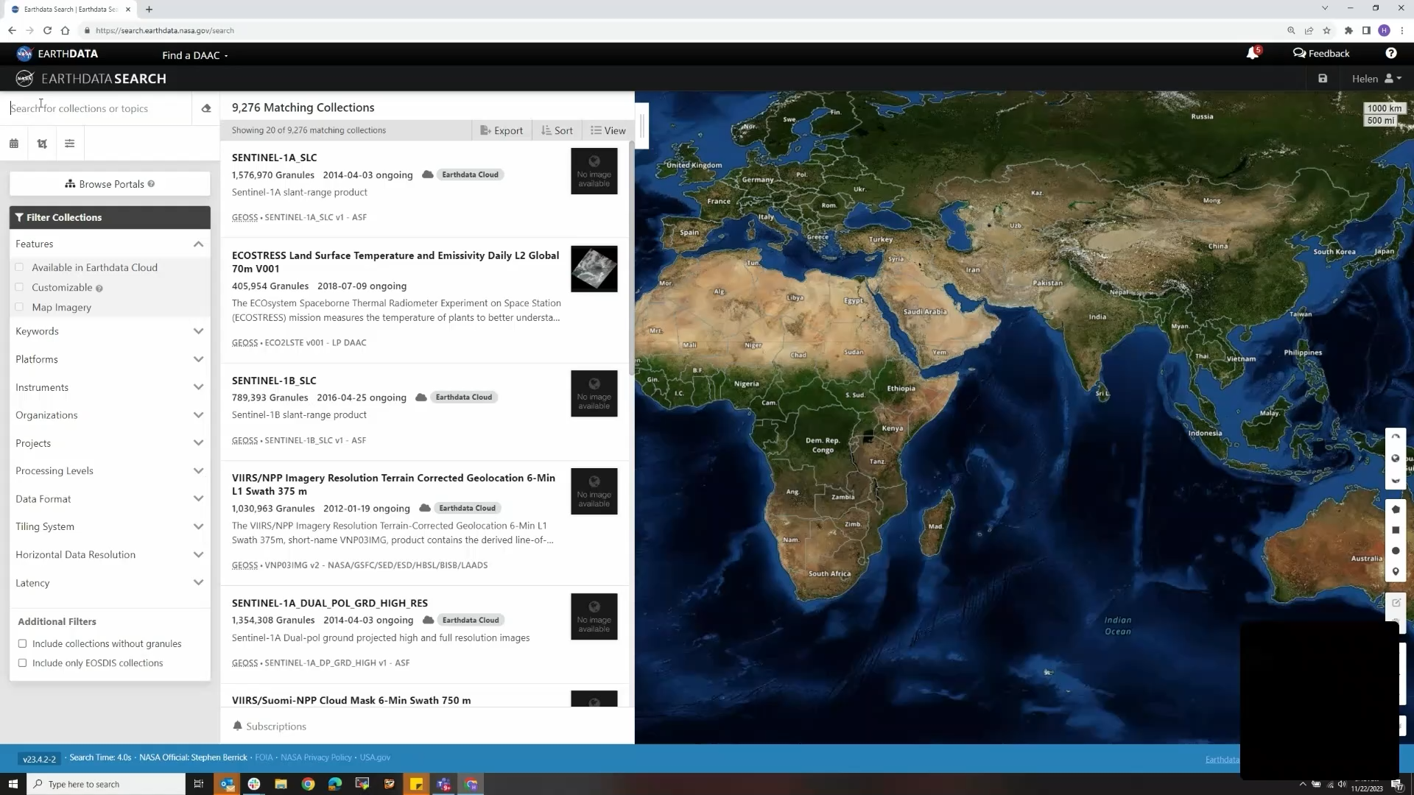
Earthdata Cloud Demo

Slide 11
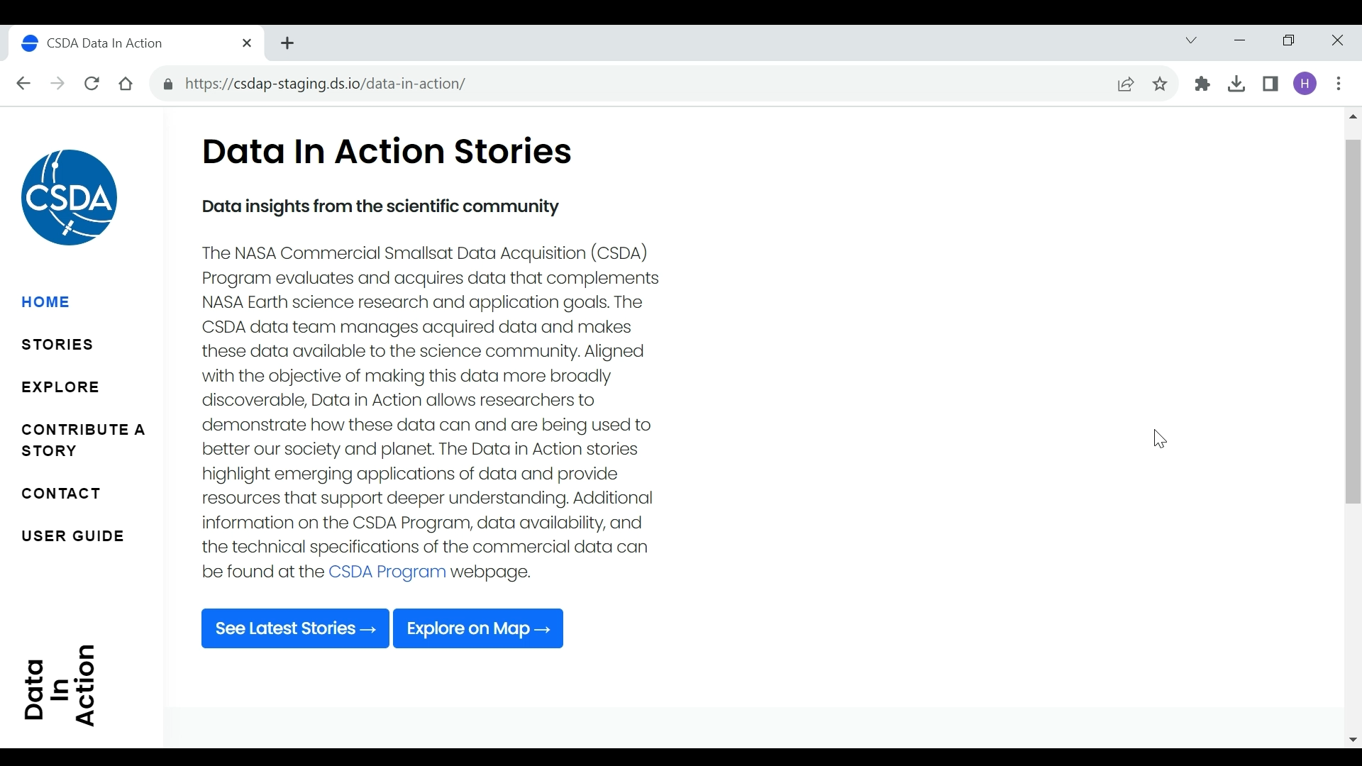
User Services - Data in Action
Goal: Communication and promote community use of commercial data
Notes:
Data in Action
Communicate commercial data availability and ongoing scientific research and applications using commercial data.
Enhance search and discovery of commercial data available through the CSDA Program.
Promote community development of open source software for data use lowering the barrier to science.

Slide 12
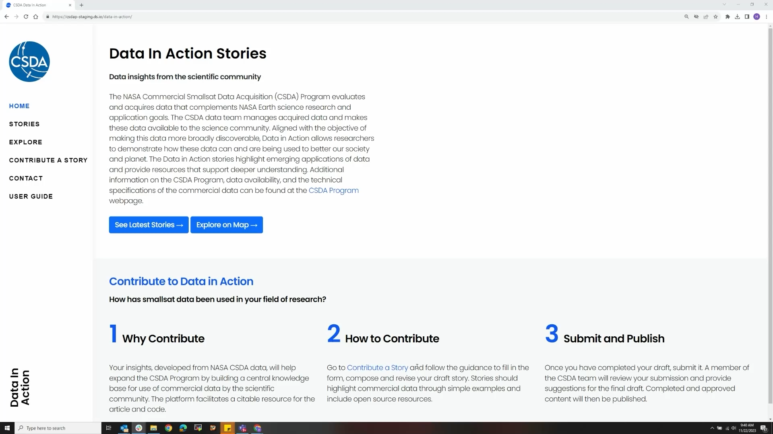
User Services - Data in Action
Goal: Communication and promote community use of commercial data
Notes:
Data in Action
Communicate commercial data availability and ongoing scientific research and applications using commercial data.
Enhance search and discovery of commercial data available through the CSDA Program.
Promote community development of open source software for data use lowering the barrier to science.

Slide 13
Looking Forward
On-ramp #3 Evaluations
GHGSat, Inc
GeoOptics, Inc
ICEYE US, Inc
Capella Space
Data Management Activities
Publish acquired data during the BlackSky evaluation (On-ramp #2)
Continued Earthdata Cloud publication - support direct cloud access
Make On-ramp #3 data available as evaluations are complete
Enhance user services and data usability

Slide 14
Thank you!
aaron.s.kaulfus@nasa.gov

