Slide 1

A Procedure to Quantify Interlaminar Damage in Refractory Composites by In-Situ Micro-X-Ray Computed Tomography
Bryan A. Kubitschek
NASA Langley Research Center, Hampton, VA 23681, USA
Bryson A. Marretta
Analytical Services & Materials, Hampton, VA 23666, USA
AIAA SciTech, 8-12 January 2024, Orlando Florida

Slide 2
Outline
Introduction
Test setup
Data processing
Concluding remarks

Slide 3
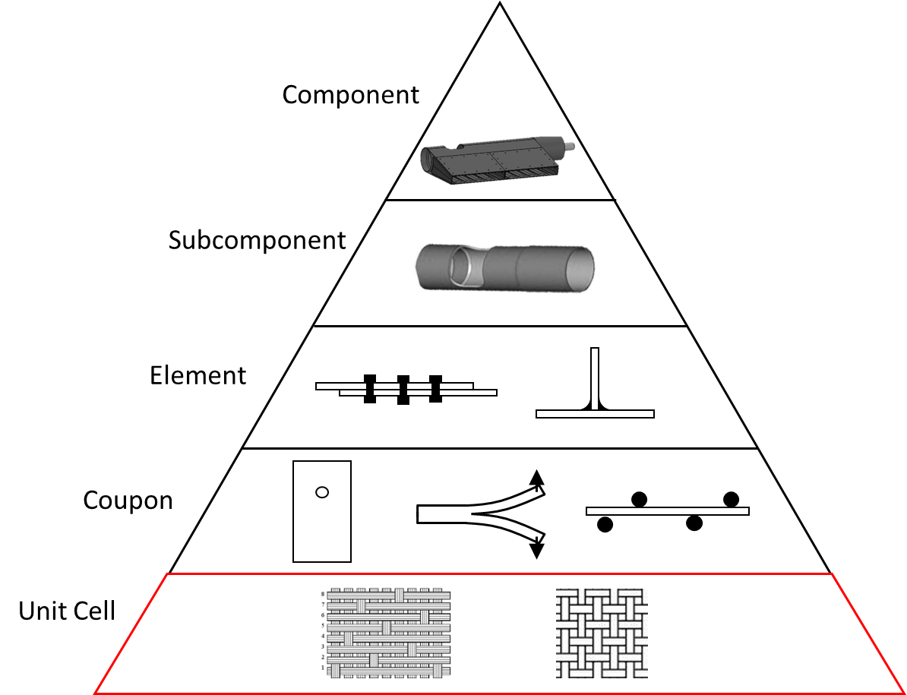
Introduction
Composite material maturation into a flight component is a lengthy and expensive process
Developing models to predict material properties requires improved empirical data at the unit cell level
Material databases will require fewer empirical tests if a feedback loop between a model and empirical observations can be improved

Slide 4
Introduction, continued
Goal
Collect empirical data on the progressive failure of refractory composites to improve current simulations.
Objective
Develop a procedure to capture the progressive failure in ASTM-sized specimens throughout volume of the specimen.
Approach
Test and observe specimens utilizing a load frame located within a micro-x-ray computed tomography (CT) machine in an iterative manner.

Slide 5
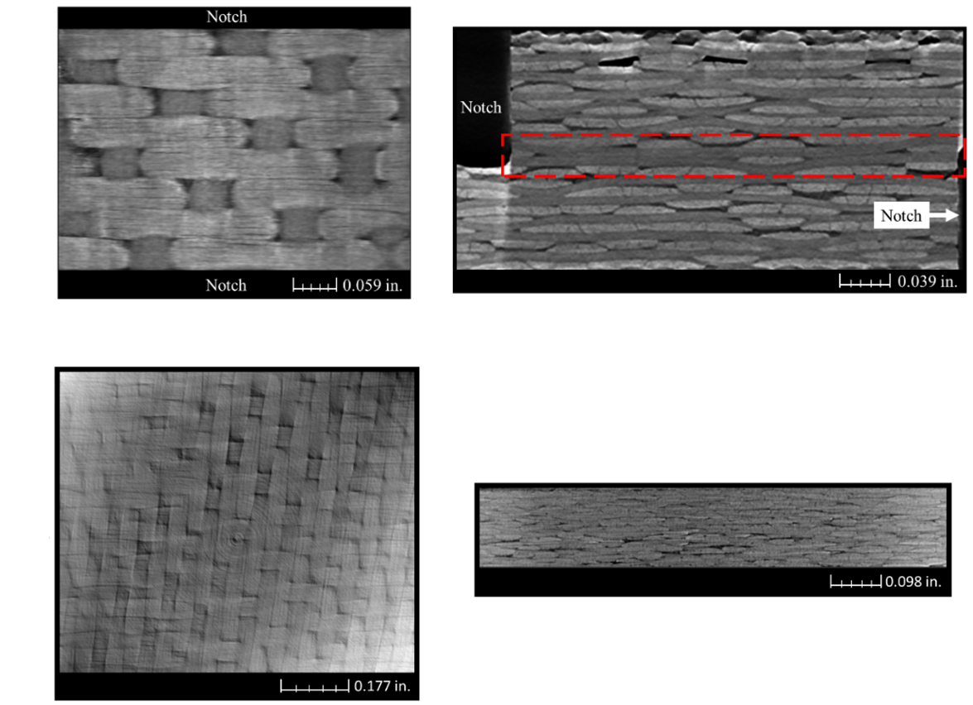
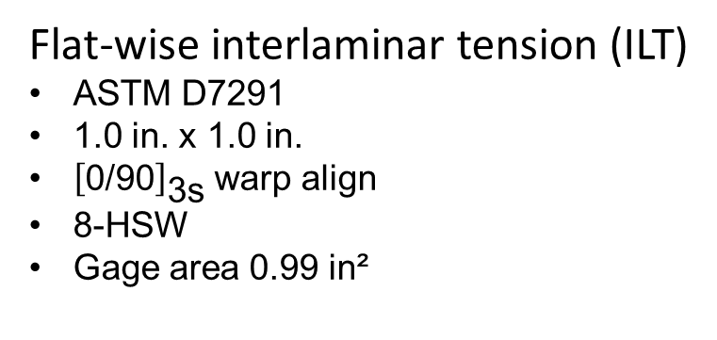
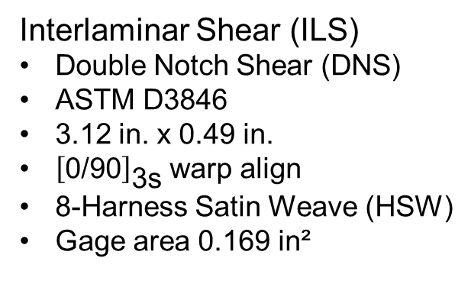
Specimens
Interlaminar Shear (ILS)
Double Notch Shear (DNS)
ASTM D3846
3.12 in. x 0.49 in.
${\left[\text{0/90}\right]}_{\text{3}\text{s}}$ warp align
8-Harness Satin Weave (HSW)
Gage area 0.169 in²
Flat-wise interlaminar tension (ILT)
ASTM D7291
1.0 in. x 1.0 in.
${\left[\text{0/90}\right]}_{\text{3}\text{s}}$ warp align
8-HSW
Gage area 0.99 in²

Slide 6
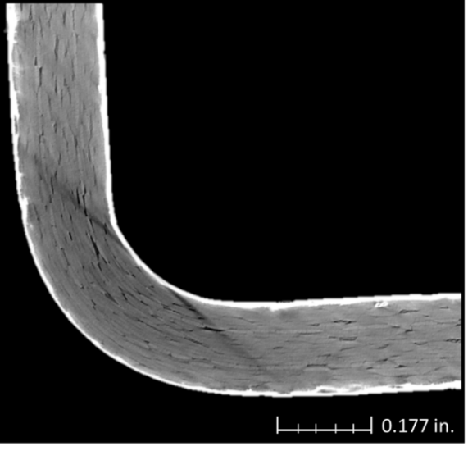
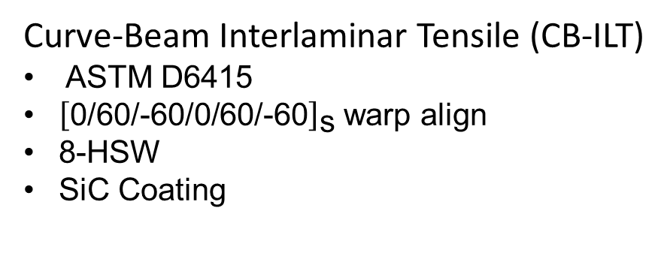
Specimens, continued
Curve-Beam Interlaminar Tensile (CB-ILT)
ASTM D6415
${\left[\text{0/}\text{60/−60/0/60/−60}\right]}_{\text{s}}$ warp align
8-HSW
SiC Coating

Slide 7
Outline
Introduction
Test setup
Data processing
Concluding remarks

Slide 8
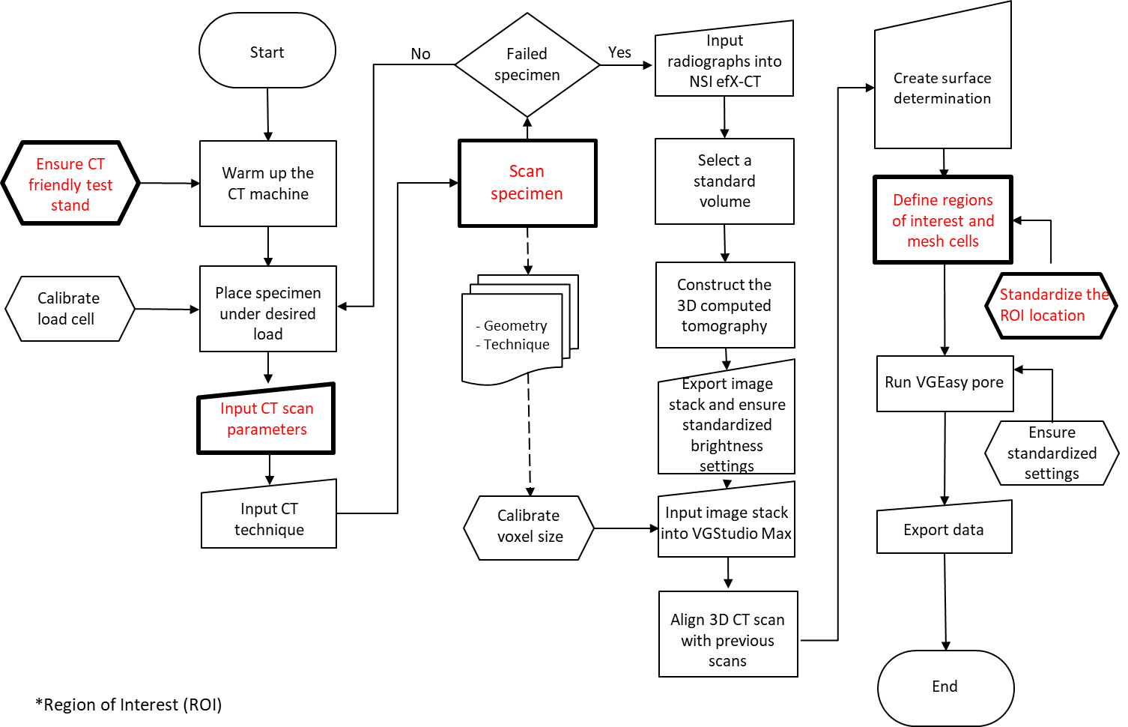
Testing Procedure

Slide 9
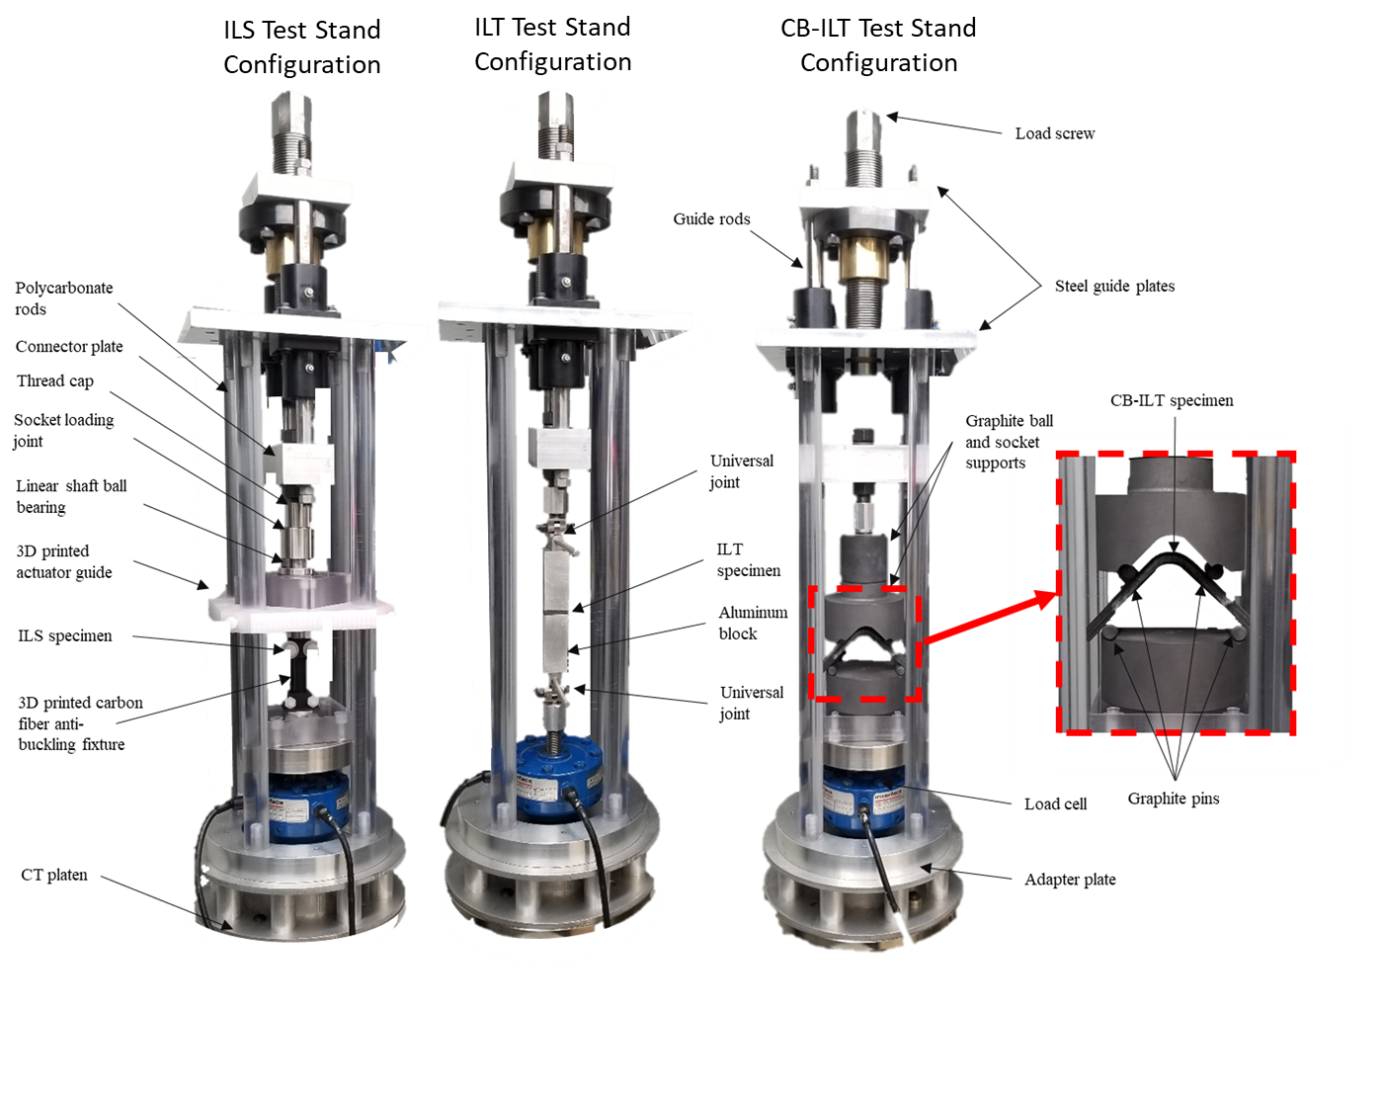
Test Stand Schematic
Materials used in the vicinity of the beam are x-ray friendly
Load frames are bolted to the CT platen
Tests were loaded incrementally by hand
Interface 1201-BJ 10 Kip load cell
Interface model 9840 data acquisition system

Slide 10
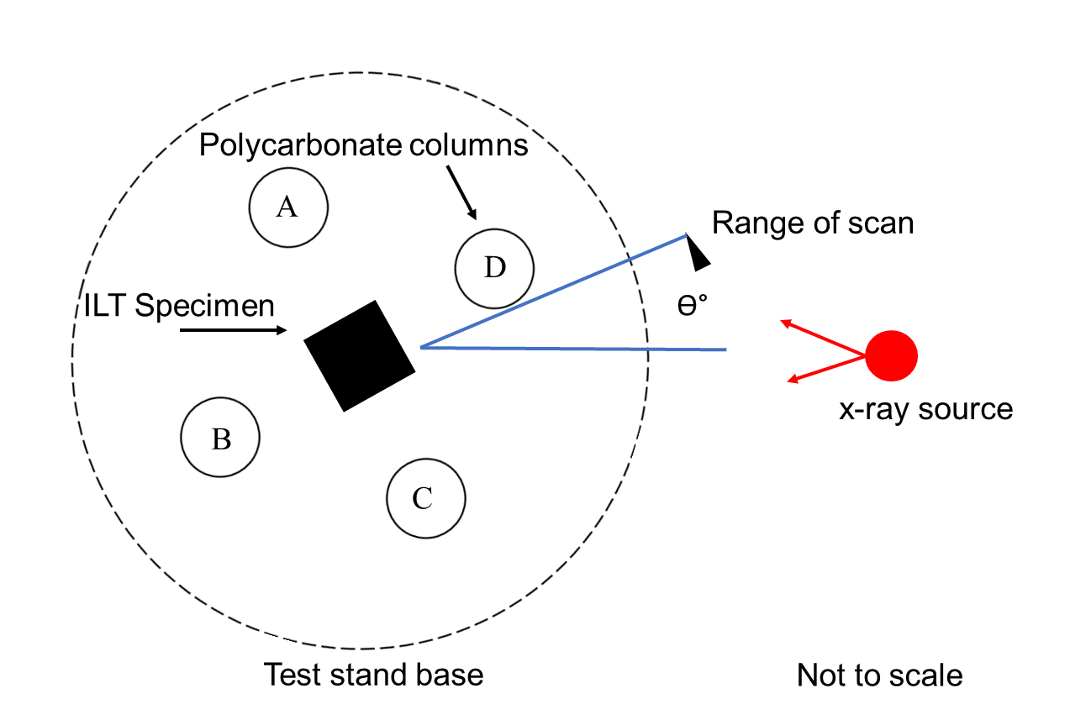
X-Ray Scan Configuration
North Star Imaging (NSI) X3000 CT machine with Varian detector
Voxel resolution
Minimum voxel resolution for feature detection
CT Scan Parameters
CT Technique Parameters

Slide 11
Outline
Introduction
Test setup
Data processing
Concluding remarks

Slide 12
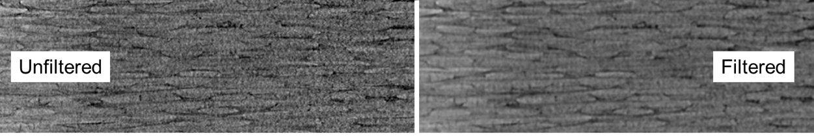
Image Filtering
All ILT data required image filtering before performing an image analysis
Conducted adaptive Gaussian function
A lowpass filter - focuses on the attenuation of grayscale intensity
Linear - replaces the voxel with a weighted summation of the value from its surrounding neighbor
Standard deviation in the grayscale value decreased 13.8% with the addition of the filter

Slide 13
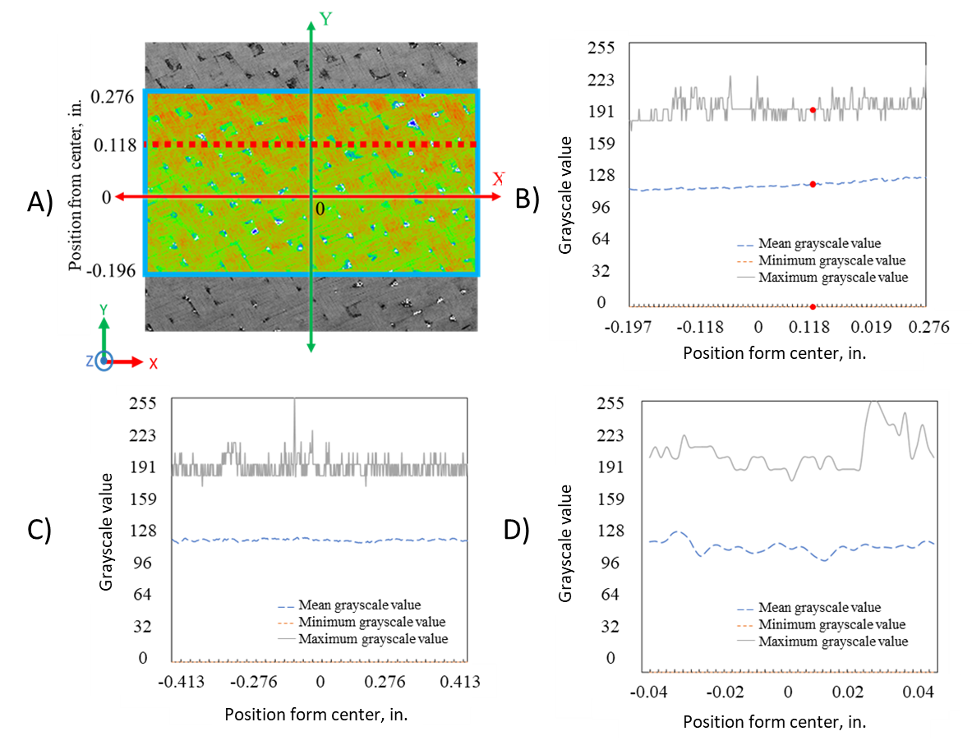
Directional Variability
Quantifies the uniformity of the grayscale value throughout the volume of the reconstruction
CT slice of the ILT baseline scan
X-directional variability of grayscale value
Y-directional variability of grayscale value
Z-directional variability of grayscale value
A)
B)
C)
D)

Slide 14
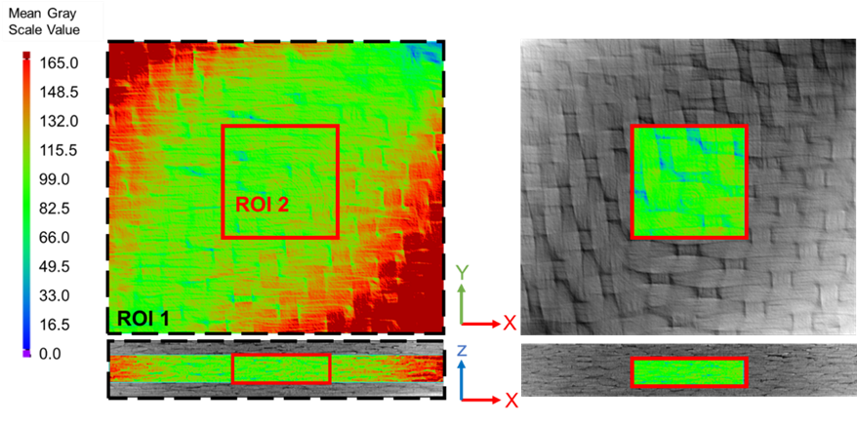
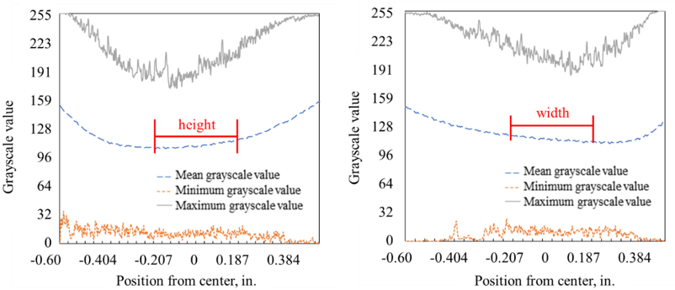
Directional Variability, continued
Used grayscale deviation for region of interest (ROI) placement for ILT analysis
XY grayscale variability analysis heat map
Aspire to have the ROI mean and standard deviation (SD) grayscale value be close to the baseline scan

Slide 15
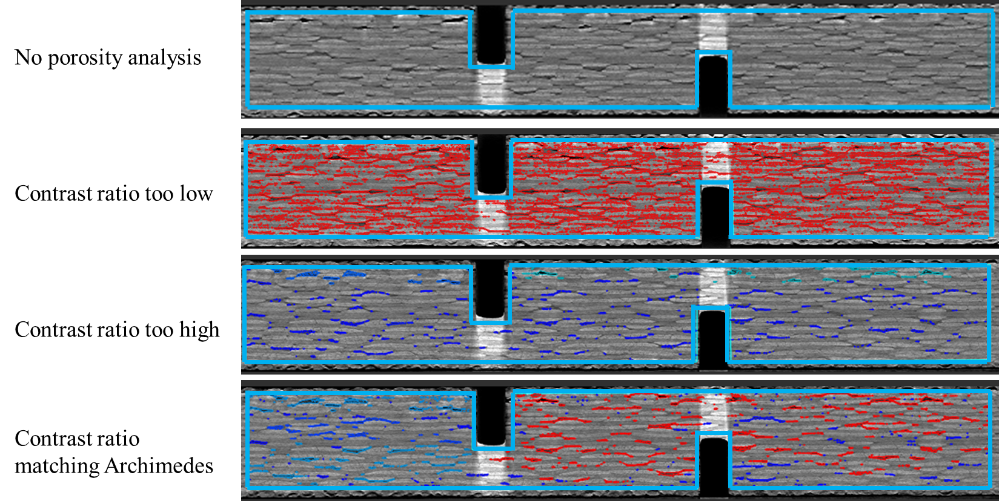
Porosity Analysis
Used VGStudioMax porosity inclusion analysis to capture pores and damage

Slide 16
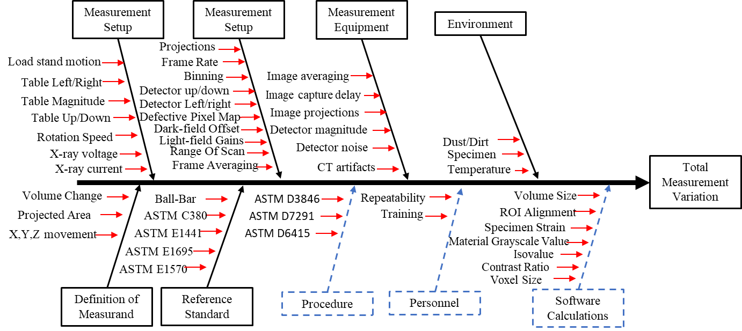
Sources of Uncertainty
While an uncertainty quantification has not yet been completed, identifying the sources is the first step

Slide 17
Outline
Introduction
Test setup
Data processing
Concluding remarks

Slide 18
Concluding Remarks
Developed a procedure to capture the progressive failure in ASTM-sized specimens throughout volume of the specimen
Discussed the details on
CT test stand configuration
Created a micro-x-ray CT configuration
CT Scan Parameters
CT Technique
Data processing
Image filtering
Directional variability
Porosity analysis
Sources of uncertainty

Slide 19
Acknowledgements
Support was provided by:
NASA Langley Structural Mechanics and Concepts Branch

