Slide 1
Simulations of the Modular Axisymmetric Scramjet Test Rig
Under Reacting Flow Conditions
Jacob Lampenfield
Analytical Mechanics Associates Inc
Tom Drozda, Matthew O’Connell
Hypersonic Air-Breathing Propulsion Branch (HAPB), NASA Langley Research Center
Tim Ombrello
AFRL, WPAFB
JANNAF, December 2023
Statement A -- Approved for public release; distribution is unlimited.

Slide 2
Introduction
Motivation:
Supersonic combustion ramjet (scramjet) powerhead design, leading to efficient fuel-air mixing, flame- holding, and combustion remains one of the key challenges in scramjet flowpath design
Flameholding devices are typically employed to support robust and stable combustion
  Intrusive methods, aerodynamic wakes of strut injectors
  Non-intrusive method, cavity flameholders
The Modular Axisymmetric Scramjet Test Rig (MASTeR) is a new 1X-scale axisymmetric combustor expected to be tested in Research Cell 19 (RC19) at AFRL over the next couple of years
Goals:
Demonstrate the application of an automated unstructured grid adaptation tool in VULCAN-CFD for reacting Reynolds-averaged simulations (RAS)
Explore the experimental space of MASTeR to provide a high-level understanding about operating performance

Slide 3
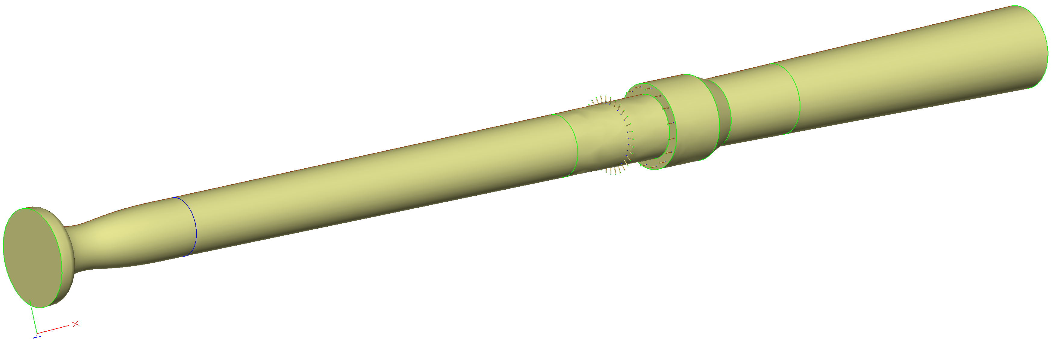
MASTeR Geometry
Axisymmetric modular test article
Mach 2 or 3 facility nozzle
Variable length (L) and depth (D) cavity flame holder, depths of 0.25, 0.75, and 1.25 inches, and L/D of 4, 6, and 8
32 primary injectors and 16 secondary injectors with a diameter of 0.05 inches
Powerhead
Isolator
Combustor
Facility Nozzle
Cavity Flameholder
Primary Injectors (ER1)
Secondary Injectors (ER2)
X = 0 in

Slide 4
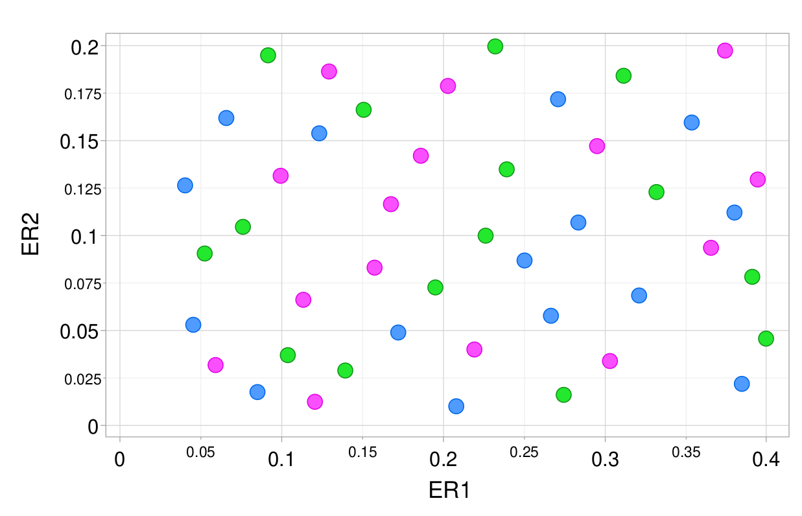
Flow Conditions
Property | Air | Fuel (Ethylene)
Mach | 2.0 | Varies
P₀ (psi) | 50 | Varies
T₀ (F) | 600 | 80
Mole Fraction | 79% N 21% O2 | 100%
Independent Variables
ER1 (Primary Injector) | 0.04-0.4
ER2 (Secondary Injector) | 0.01-0.2
L/D | 4, 6, 8
Latin hypercube sampling (LHS) was used to generate a list of cases to simulate
A total of 45 cases were simulated (15 for each L/D) resulting in 450 auto-generated grids
The colors green, blue, and magenta denote the L/D values of 4, 6, and 8, respectively

Slide 5
Numerical Simulation Details
VULCAN-CFD used as flow solver
Unstructured 3D Reynolds-averaged simulations (RAS)
Advective terms computed using a MUSCL scheme with the Low-Dissipation Flux-Split Scheme (LDFSS)
Governing equations integrated using the Symmetric Gauss-Seidel (SGS) method
Menter Baseline blended k-ω/k−ε turbulence model
Thermodynamic properties of mixture components computed using McBride curve fits
Reynolds heat and species mass fluxes modeled using a gradient diffusion model, turbulent Pr_{t} = 0.9, turbulent Sc_{t} = 0.5
Wilcox wall matching functions used where appropriate
Chemical reactions modeled using 6-species, 3-reaction reduced chemical kinetics model

Slide 6
Adaptation Methodology Flowchart
Computational geometry is built using Engineering Sketch Pad (ESP)
After the geometry is built, the initial mesh is created using Tetgen and passed to refine
CFD simulations commence, and new grids are adapted using refine based on error estimates of a specified flow field parameter (e.g., Mach number) obtained from CFD simulations

Slide 7
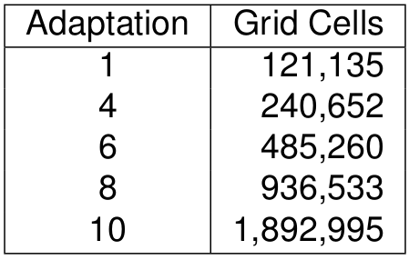
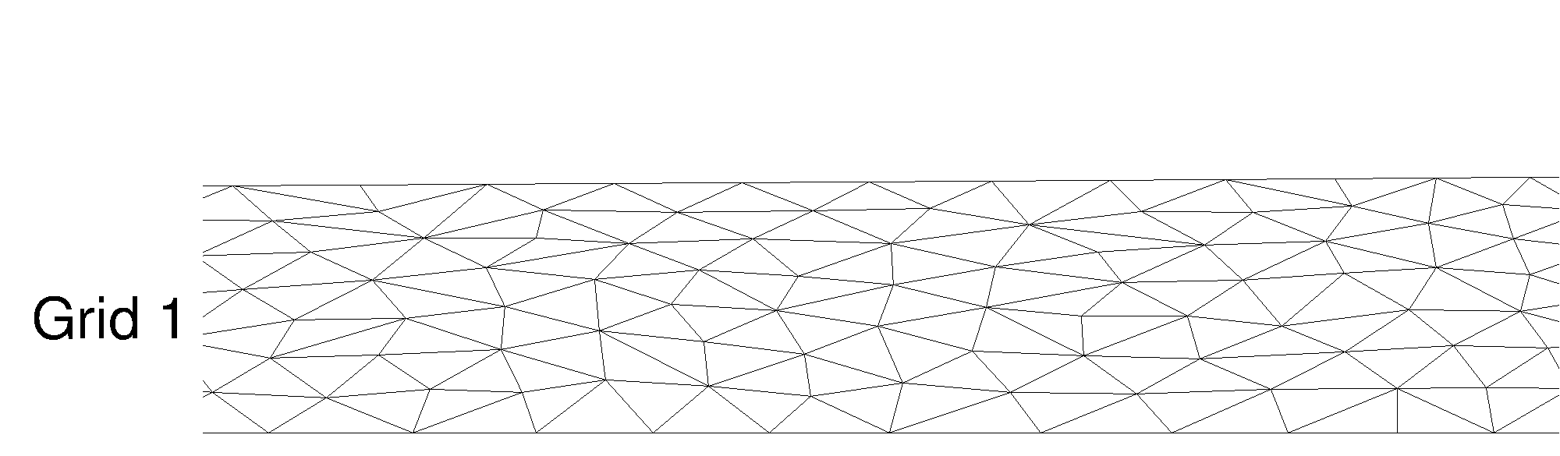
Adaptation Methodology
Aggressive strategy adapts grids more rapidly
    Adaptation uses 1 “smoothing” stage, called a stride, after which grid count is doubled
    Simulations for adaptations 1-3 utilize only 1st-order numerics
    Simulations for adaptations 1-5 utilize an ignition sub-domain spanning the cavity flameholder volume
    Simulations for adaptation 6-10 utilize 2nd-order numerics and ignition sub-domain was turned off
Animation of the grid refinement around the shock train formed upstream of the powerhead due to backpressure from combustion

Slide 8
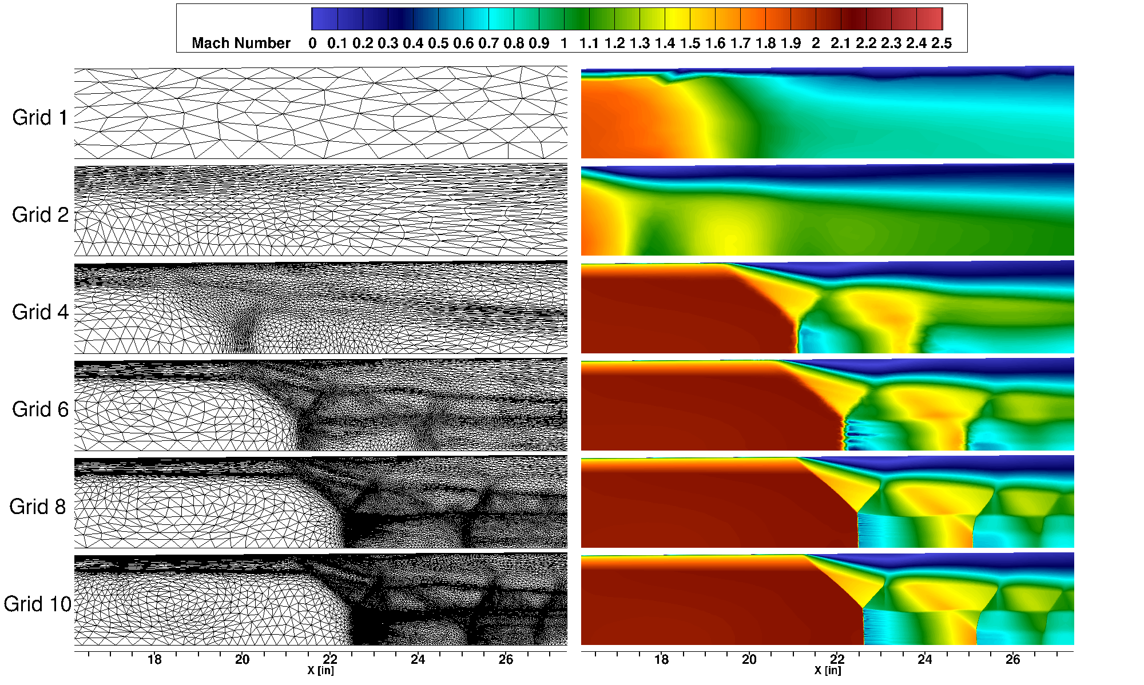
Results: Adaptation Solution Progression
First grid is very coarse and does not resolve the boundary layers
  Simulation introduces near-wall gradients which prompts refine to initiate grid clustering
By grid four, boundary layer and stronger shocks are being refined
By grid six, downstream interacting shocks are identified
Flow features are refined and user-determined grid convergence is reached by grid 10

Slide 9
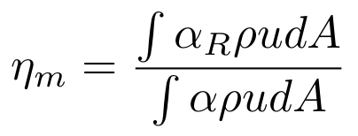
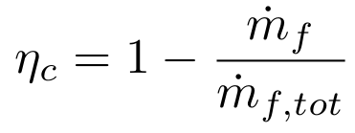
Metrics of Interest and Convergence
Mixing efficiency and combustion efficiency are used to assess rate of convergence
Unstructured grid convergence assessed by examining change in mixing efficiency and combustion efficiency with grid adaptation. User subjectively determines the change between solutions is "small enough"

Slide 10
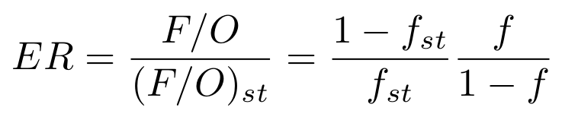
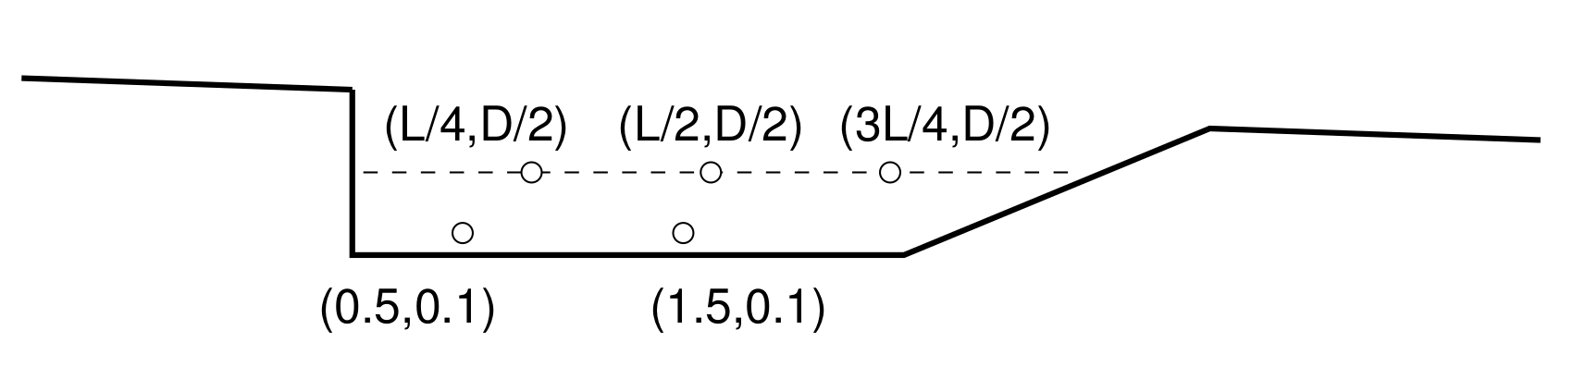
Metrics of Interest
Equivalence ratio (ER) is evaluated at several locations in the cavity
These locations help characterize the extent of variation of flow properties in the cavity
Mixture fraction
Schematic of the cavity flameholder with circles denoting lactations where ER and other quantities are extracted from the simulations

Slide 11
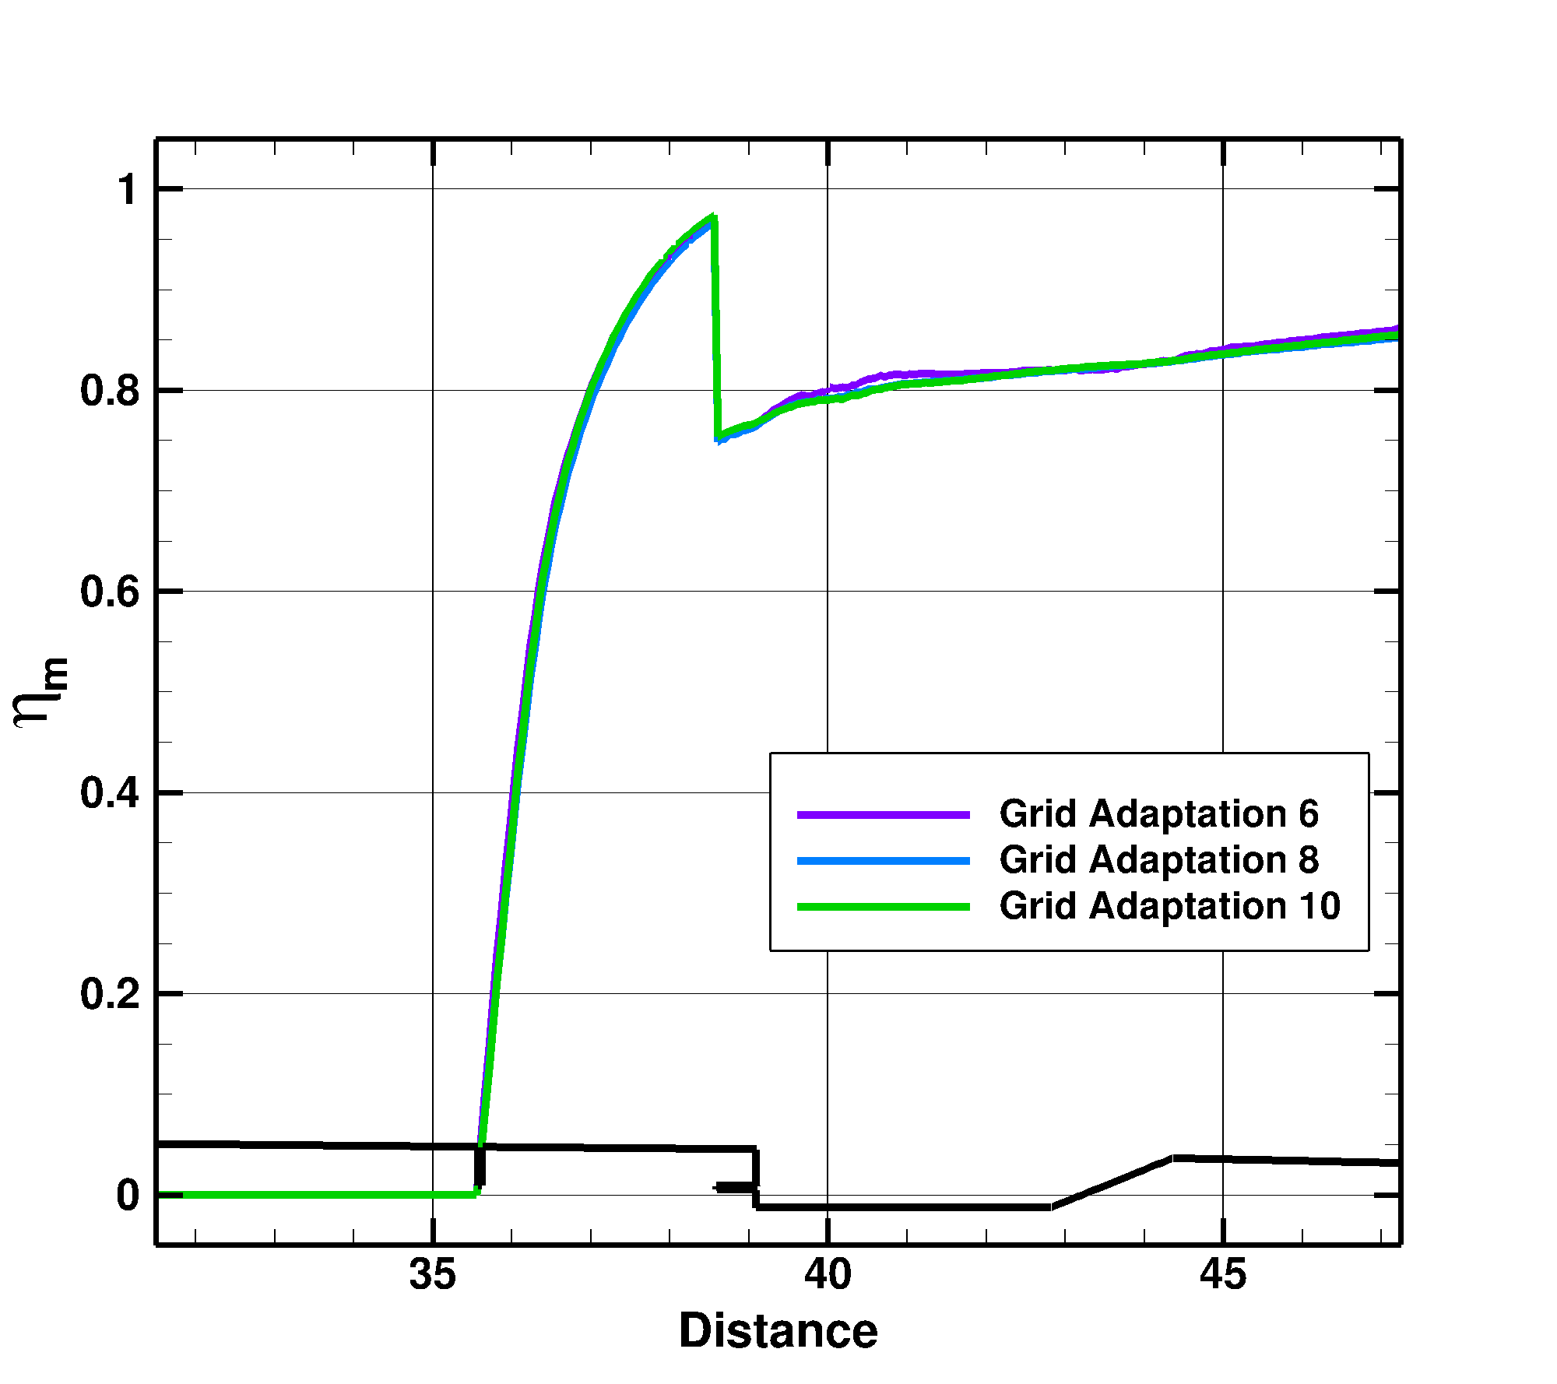
Results: Mixing Efficiency (ER1=0.208, ER2=0.01, L/D=6)
Only the cavity region is displayed, and both sets of fuel injectors are intended to fuel only the cavity
Grids 2 and 4 are not shown because the ignition sub-domain was present
By grid 10 the change in mixing efficiency was deemed to be small enough for this exploratory study
The fuel from the primary injectors rapidly mixes until the start of the cavity
The drop in mixing efficiency at the start of the cavity is due to additional fuel added through the secondary cavity injector
The mixing after the start of the cavity displays a less rapid rate

Slide 12
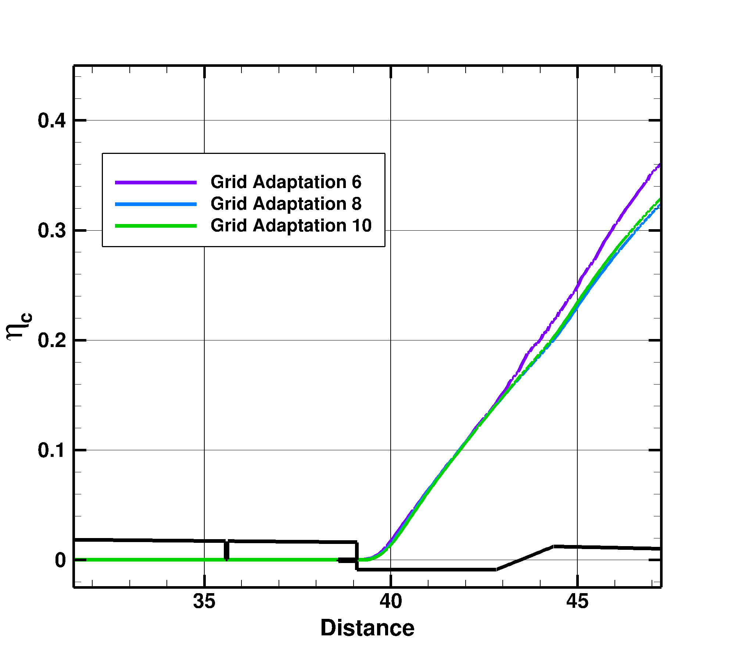
Results: Combustion Efficiency (ER1=0.208, ER2=0.01, L/D=6)
The change in combustion efficiency with adaptation is more pronounced than that for the mixing efficiency
However, by grid 10 the change in combustion efficiency was also deemed to be small enough for this exploratory study
Mixed fuel does not auto ignite upstream of the cavity even though the primary injectors create a wake and counter-rotating vortex pairs which provide some flameholding potential
Combustion begins to occur once the mixed fuel reaches the cavity
Combustion continues at a robust rate after the cavity, which indicates that the cavity flameholder is operating as intended
Results from a cavity L/D of 6, ER1 = 0.208 and ER2 = 0.01

Slide 13
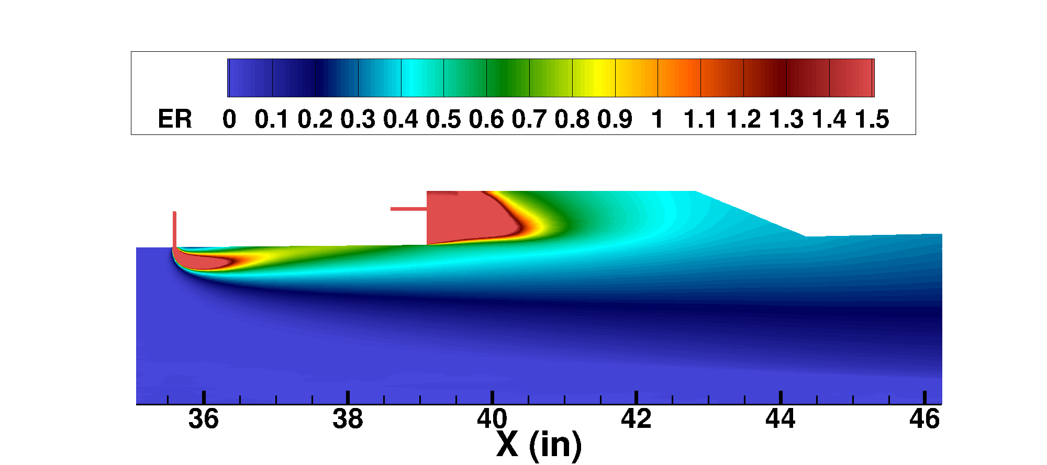
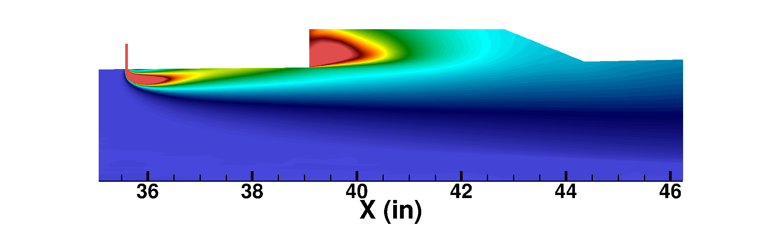
Results: Cavity ER Contours (ER1=0.208, ER2=0.01, L/D=6)
Slices are through the cavity injector (left) and between cavity injector (right)
Fuel from upstream injector travels along the wall and is entrained into the cavity with some fuel bypassing the cavity and traveling into the core flow
Fuel from cavity injector stays closer to the cavity backward face

Slide 14
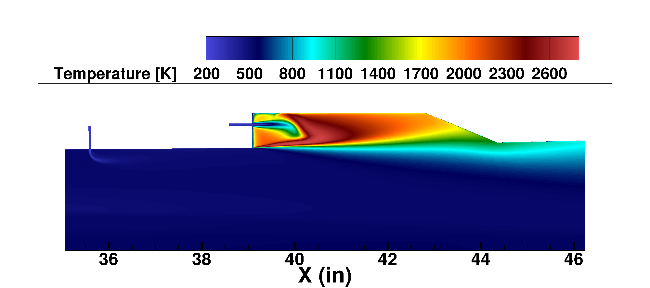
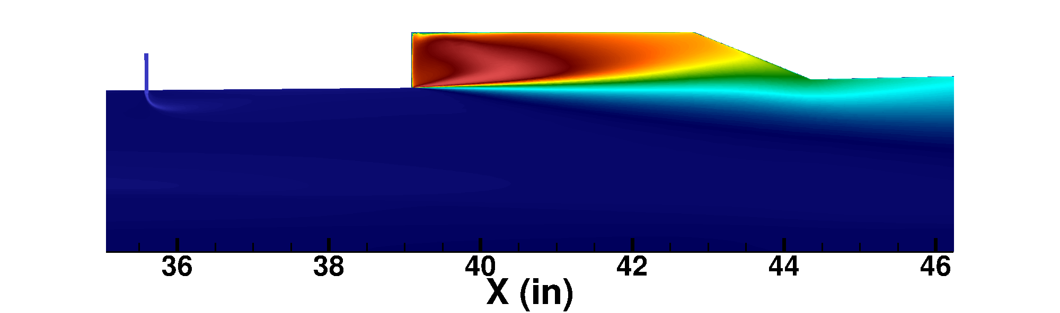
Results: Cavity Static Temperature Contours (ER1=0.208, ER2=0.01, L/D=6)
Slices are through the cavity injector (left) and between cavity injector (right)
Both symmetry planes indicate high temperatures and robust combustion inside the cavity
The cold fuel from the secondary cavity injector does not ignite immediately and needs a rise in temperature from the surrounding air to start burning
Combustion products convect out of the cavity and mix into the remaining fuel to initiate combustion downstream of the cavity

Slide 15
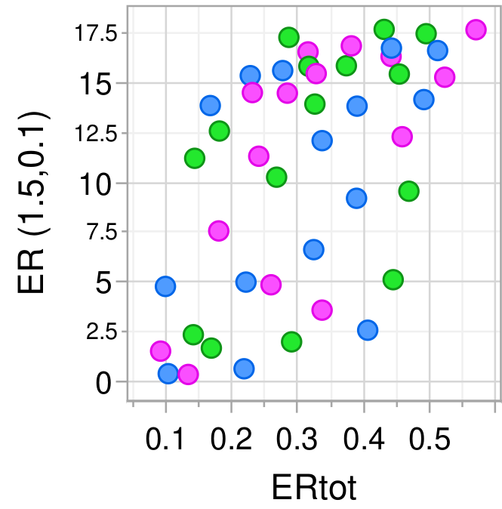
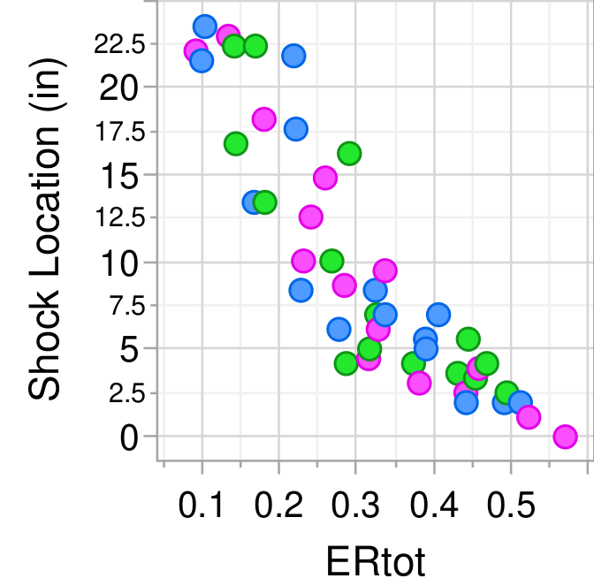
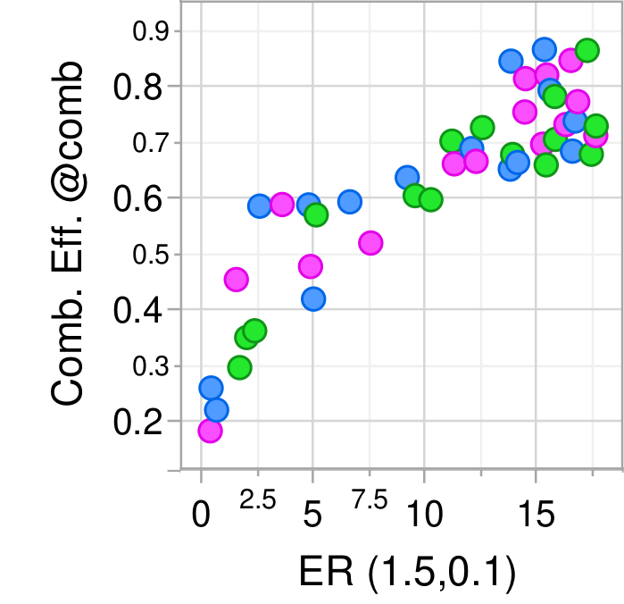
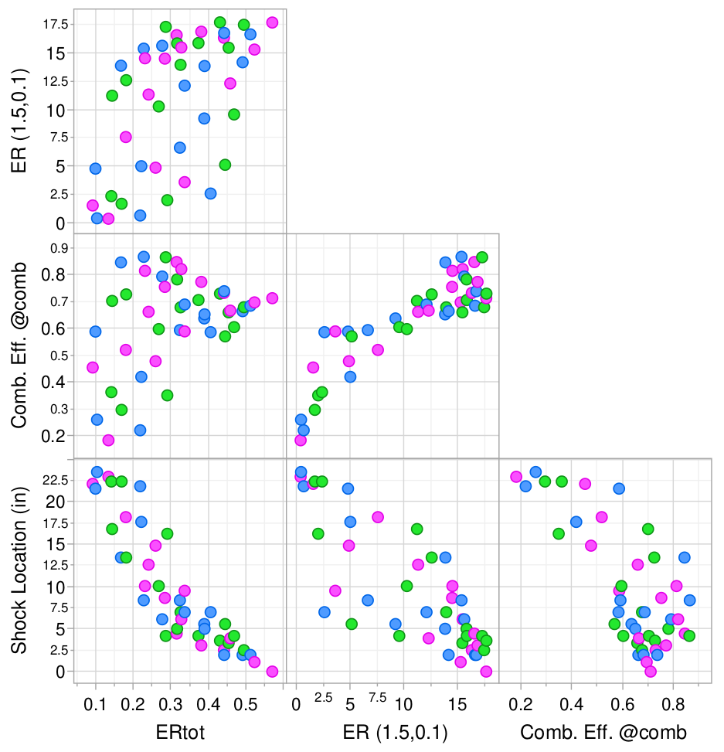
Results: Scatter Plot
Strong correlation between total ER and leading shock train location (fuel is burning even at high ER1 and ER2)
Weak correlation between total ER and local cavity ER (approx. the same amount of fuel gets entrained into the cavity independently of the amount of ER1)
Pronounced correlation between the local cavity ER and the combustion efficiency at the exit of the combustor (cavity is doing its job of flameholding except maybe for the highest values of total ER, ie high ER1 and ER2)
Correlation between the combustion efficiency and shock train location (shocktrain movement is driven by combustion)
The colors green, blue, and magenta denote the L/D values of 4, 6, and 8, respectively

Slide 16
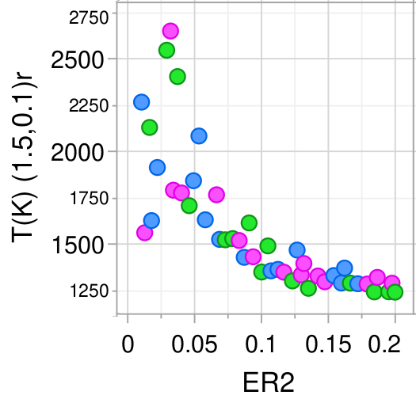
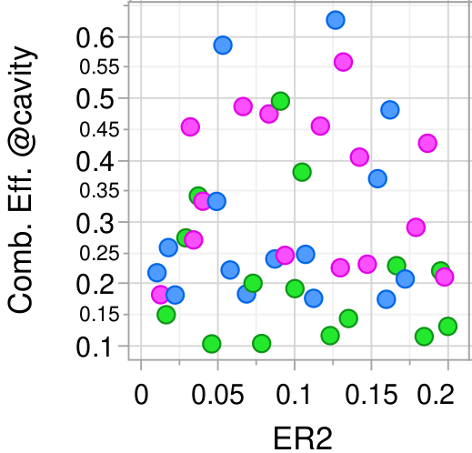
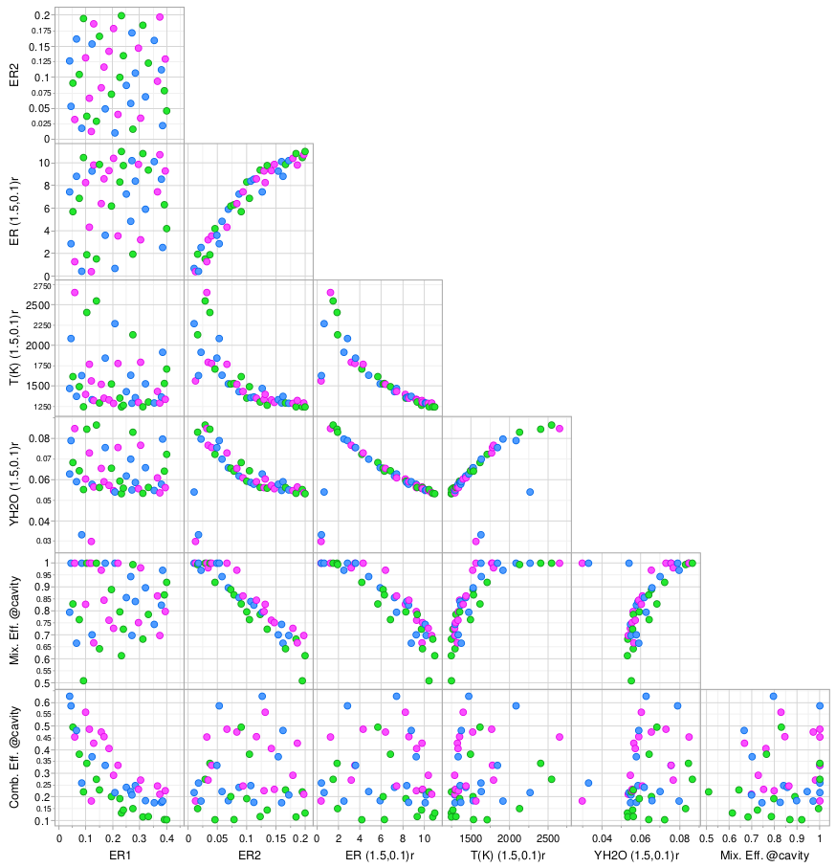
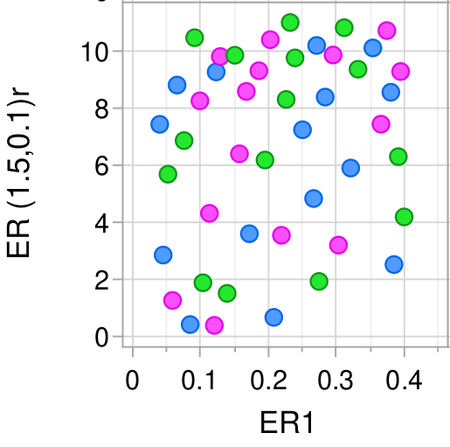
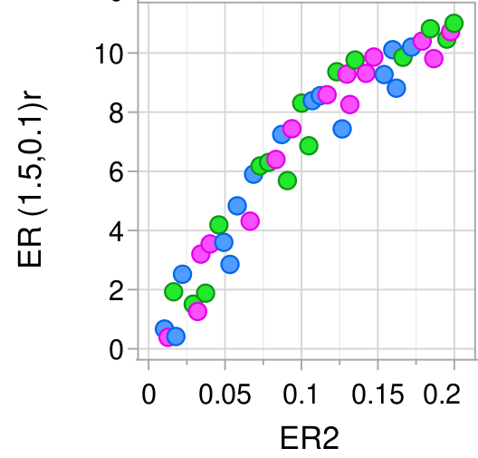
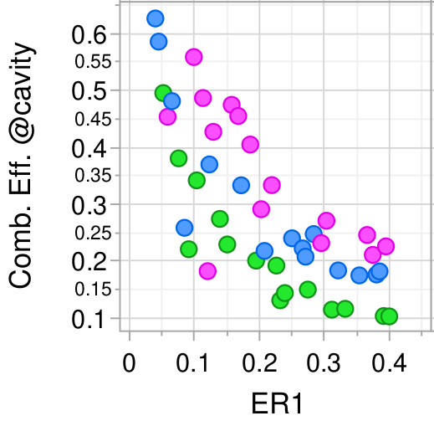
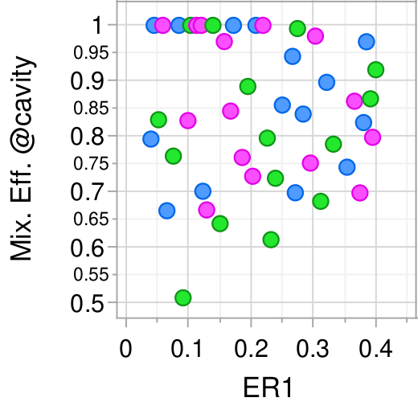
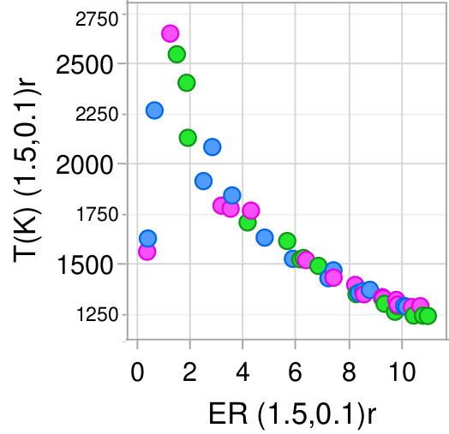
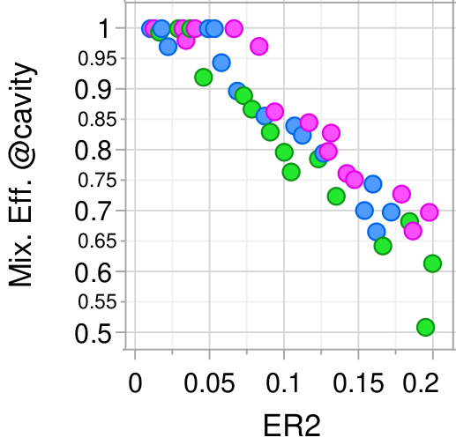
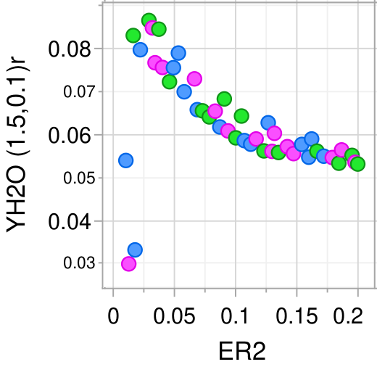
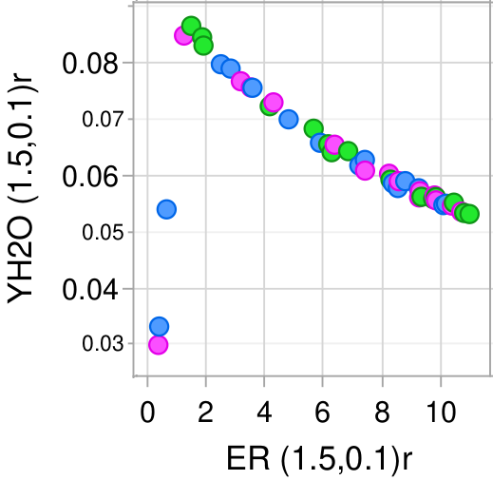
Results: Scatter Plot All Metrics
There are at most weak correlations between ER1 and other quantities (indicating that the amount of fuel entering the cavity is approx. independent of ER1)
The correlation between combustion efficiency at the end of the cavity and ER1 is an indicator that increasing amount of unburnt fuel is bypassing the cavity (expected with increasing ER1)
The mixing efficiency for many of the lower ER1 values reach 1 by the end of the cavity.
These cases also correspond to the low ER2 values. But, for higher ER2 values, mixing efficiency decreases.
No correlation between ER2 and combustion efficiency (fuel is burning well in the cavity but outside has not ignited)
Strong correlations between ER2 and local cavity ER, static temperature, and water mass fraction.
Flamelet-like correlations emerges for ER2 and temperature and water mass fraction.
The colors green, blue, and magenta denote the L/D values of 4, 6, and 8, respectively

Slide 17
Summary and Conclusions
The automated unstructured grid generation and adaptation tool was used to provide knowledge of the operating performance of the MASTeR.
The correlations between the independent variables ER1 and ER2, and the metrics of interest such as mixing efficiency, combustion efficiency, local ER, and isolator shock train location were determined.
The cavity operated robustly and somewhat independently of the core flow.
There was a positive correlation between the local ER measured in the cavity and combustor efficiency at the combustor exit.
The total injected ER correlated well with the shock train upstream position.
The local cavity ER was not correlated with the amount of fuel injected upstream of the cavity (ER1) which indicates that about the same amount of fuel is entrained into the cavity independently of ER1

Slide 18
Acknowledgements
This work is supported by the Hypersonic Technology Project (HTP) in the Advanced Air Vehicles Program (AAVP) of the NASA Aeronautics Research Mission Directorate (ARMD). Computational resources are provided by the NASA Langley Research Center and the NASA Advanced Supercomputing (NAS) Division.

Slide 19
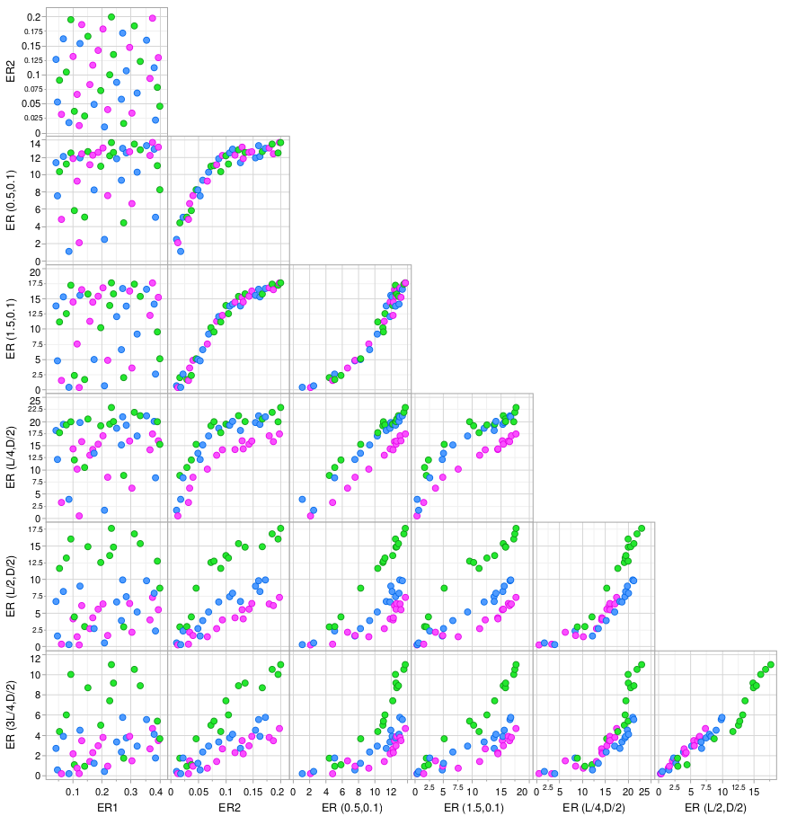
Results: Scatter Plot Local ER
No clear correlations between ER1 and local cavity ER. The fuel from upstream injector that enters the cavity does not significantly change when increasing ER1.
Correlations between ER2 and all local cavity ER locations.
All local ER values are correlated with each other. The fuel and air are uniformly mixed in the cavity.
The L/D=4 cavity (denoted by green markers) appears to produce the most uniform mixtures in the cavity.
The strength of the correlations increase the farther downstream the local
ER value is probed, i.e., the clustering of the points about a trendline is well defined. This is due to the fuel mixing more the farther downstream it travels.
The colors green, blue, and magenta denote the L/D values of 4, 6, and 8, respectively

Slide 20
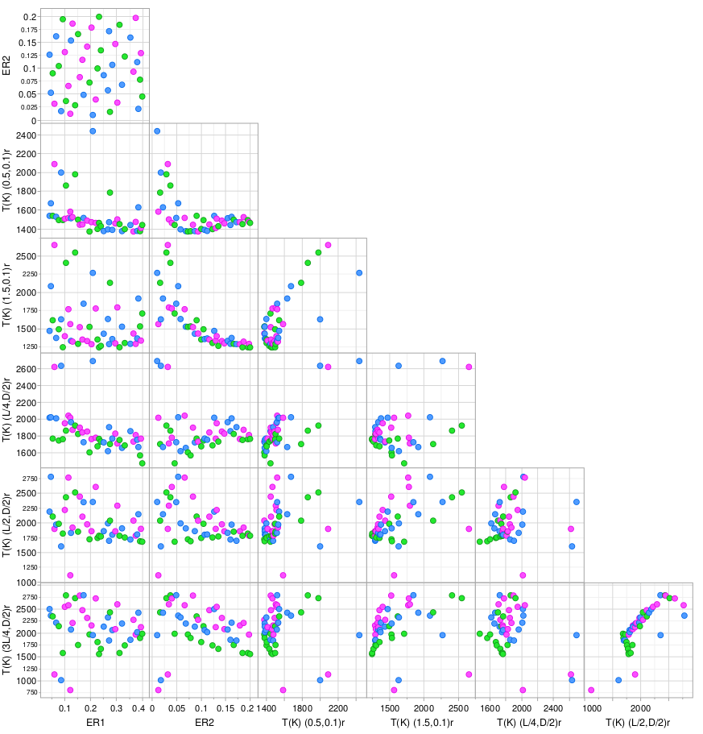
Results: Scatter Plot Static Temperature
The static temperatures are somewhat independent of ER1.
A flamelet-like correlation emerges for ER2, especially for the two near-wall (i.e., 0.1) probe locations.
For the other probe locations, this flamelet-like correlation between static temperature and ER2 can be observed for the individual values of cavity L/D.
The static temperatures are also well correlated at various locations. These correlations emerge as vertical clusters that “tilt” toward linear correlation as the data is compared with the downstream probes.

Slide 21
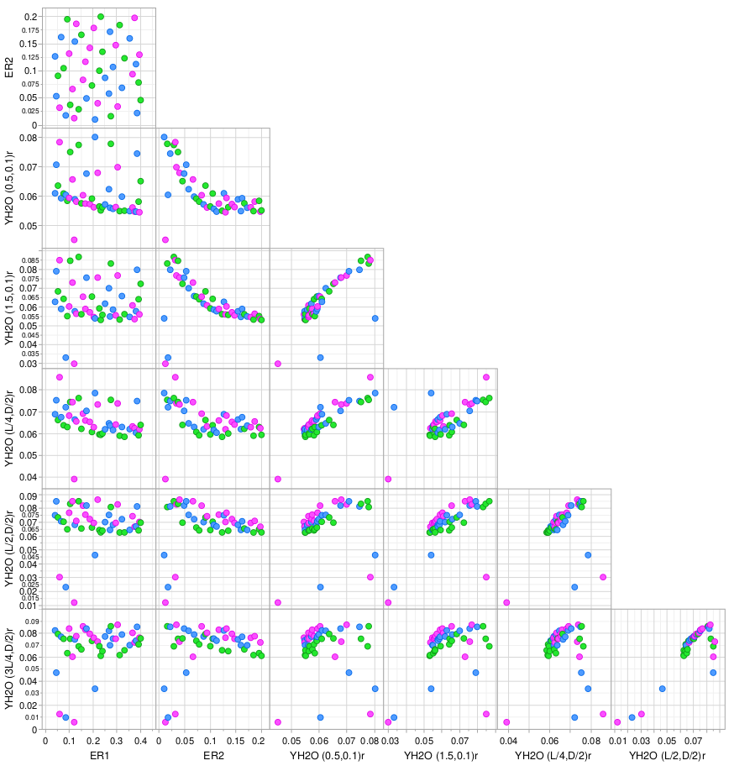
Results: Scatter Plot Water Mass Fraction
The character of correlations between ER1 and ER2, and water mass fraction is comparable to that found for the temperature.
For all locations, the mass fraction of water tends to approach similar values regardless of ER1.
The very lean overall and lean in-cavity cases (larger symbols) are below the group clustering. The local ER in the cavity could be approaching the local extinction limit
ER2 follows a flamelet-like characteristics, with peak water mass fraction around stoichiometry and decreasing values away from it.
The water mass fractions are well correlated with each other except for a few outlier cases. These correlations emerge as vertical clusters that turn toward linear correlation as the ER values increase.

