Slide 1

Exploring Lightning and Convective Processes Using the Ground-Radar Multiplatform Precipitation Feature Database
Sarah M. Stough¹, Sarah D. Bang², Emma Belscher³, Timothy J. Lang², Patrick N. Gatlin²
¹ Earth System Science Center, The University of Alabama in Huntsville, Huntsville, Alabama, USA
² Earth Science Branch, NASA Marshall Space Flight Center, Huntsville, Alabama, USA
³ Department of Atmospheric and Earth Science, The University of Alabama in Huntsville, Huntsville, Alabama, USA
Supported by NASA Earth from ISS program funding, provided to UAH through Cooperative Agreement #80MSFC22M0004.

Slide 2
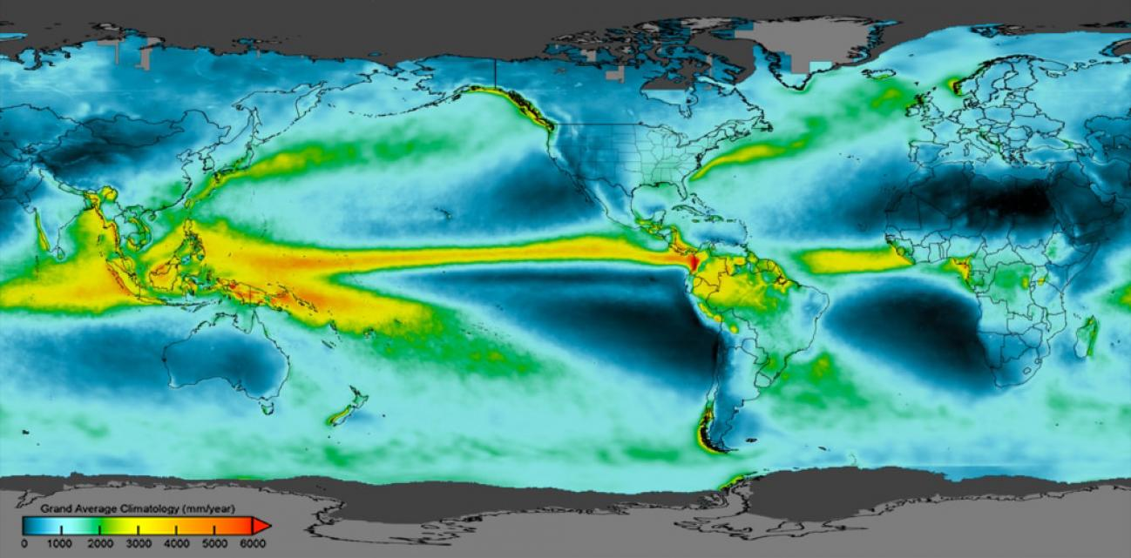
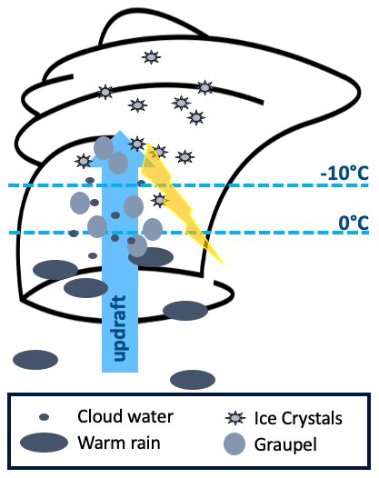
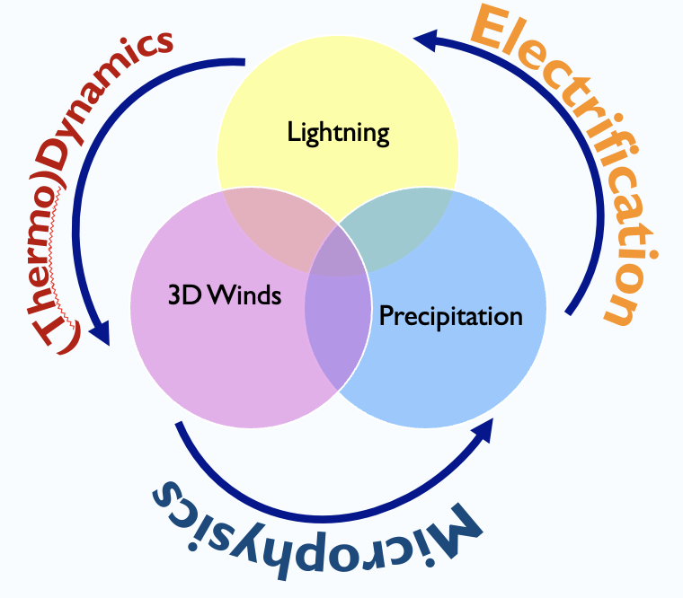
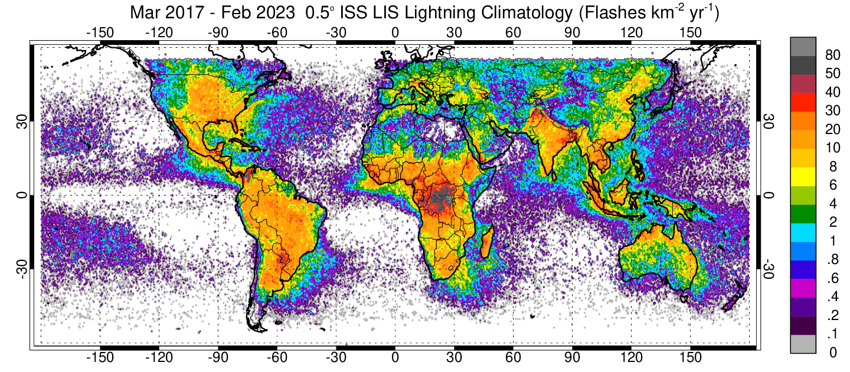
Links between Deep Convective Properties & Processes
Lightning-updraft relationships offer powerful insights regarding convective intensity, longevity, and potential for human impacts
→ extend to spaceborne assets, global networks for greater scope, scale scale of analysis
Notes:
Convective Updrafts Fuel:
Mixed-phase Precipitation, lightning, and ultimately, high-impact phenomena
Combined lightning, precipitation, and wind data can provide value-added information about the electrical characteristics, microphysics, thermodynamics, and dynamics of deep convection.

Slide 3
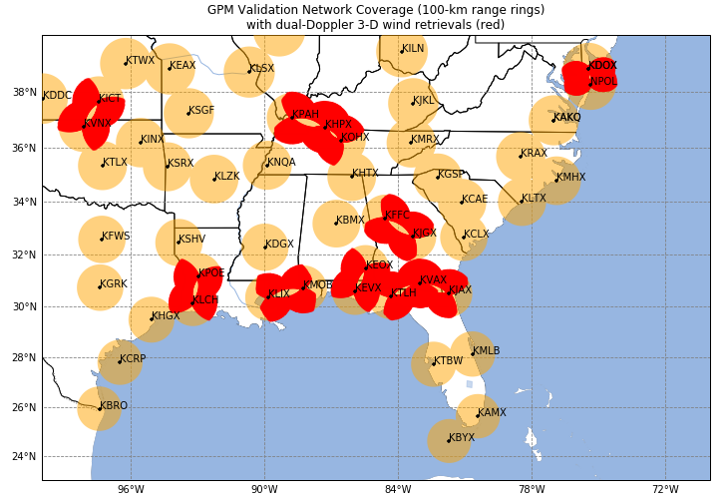
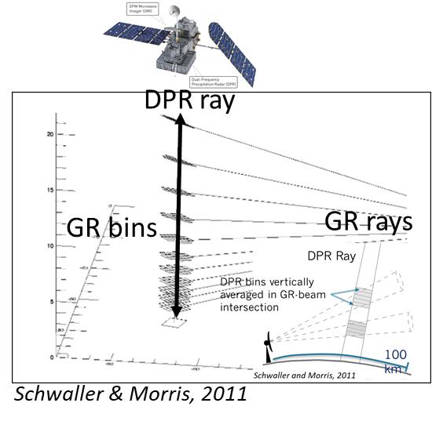
Multiplatform Precipitation Feature (MPF) Origins
Independent NASA assets and datasets can be linked, leveraged toward improved diagnosis of deep convection from space
Lightning Imaging Sensor
on the International Space Station (ISS LIS)
Global Precipitation Measurement Mission (GPM)
  Dual-Frequency Precipitation Radar (DPR)
  Ground-based Validation Network (VN)
    Ground validation software system and database for GPM Core Observatory instruments and algorithms
    Includes many polarimetric radars in CONUS;
    hydrometeor identification, 3D wind retrievals

Slide 4
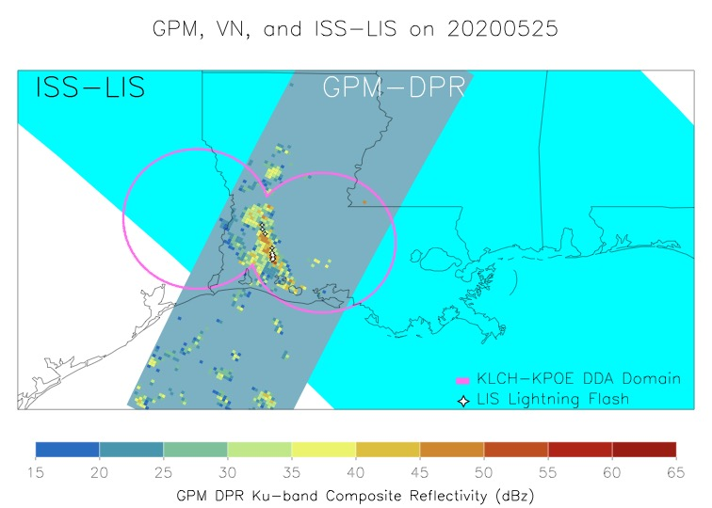
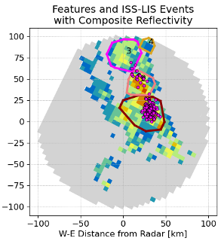
Multiplatform Precipitation Feature (MPF) Origins
Linked NASA assets and datasets can be linked, leveraged toward improved diagnosis of deep convection from space…
…but to address storm-based analyses, need to cast data into common storm feature framework
→ Multiplatform
Precipitation
Feature (MPF)
Bang et al. 2023
Follows from the
Precipitation
Feature Database
(Nesbitt et al. 2000; Liu et al. 2008)

Slide 5
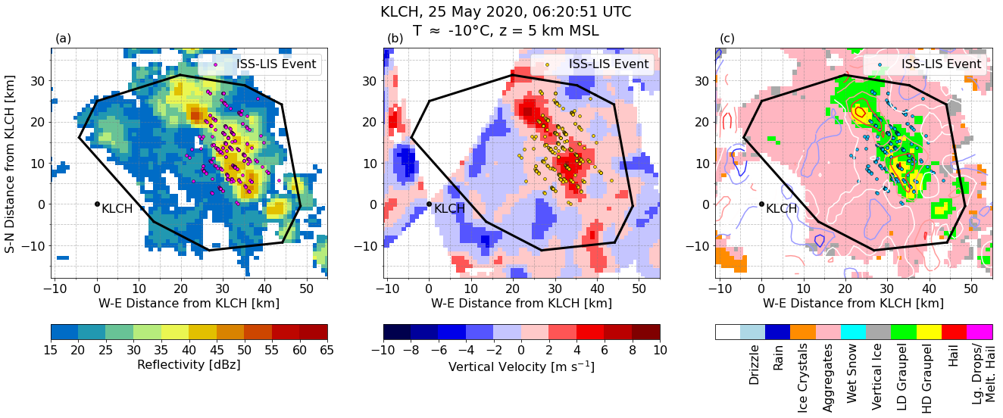
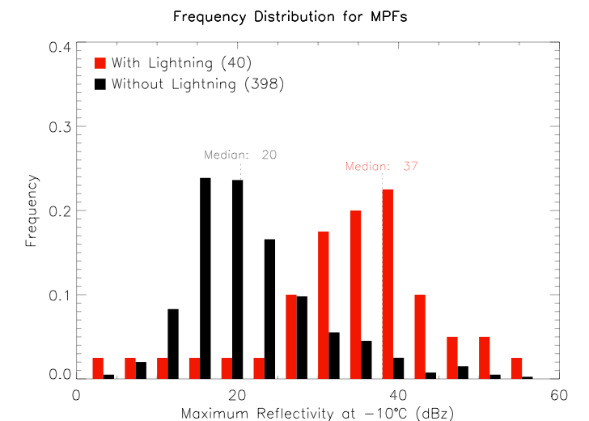
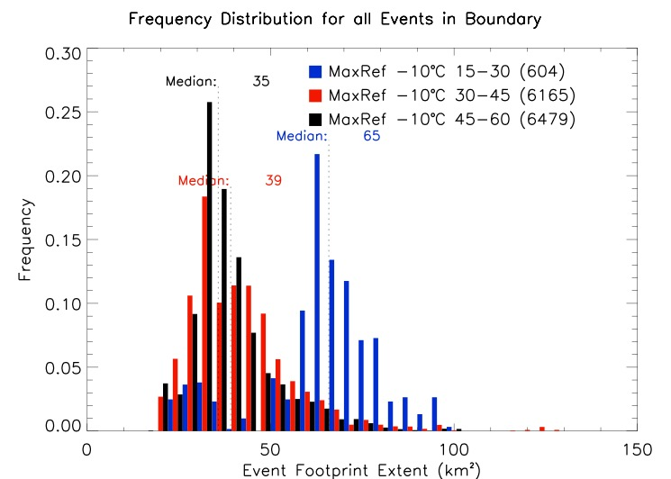
MPF Database for Storm-Level Analyses: Statistics or Case Studies
Version 1 MPF (Bang et al. 2023) : GPM Dual-Frequency Precipitation Radar + GPM VN ground radar retrievals + ISS LIS Lightning
Each MPF file facilitates case study analyses:
102 ISS LIS events within this MPF, located near/around the strongest updraft and graupel particles in deep convection
Only 40 MPFs with vertical wind retrievals
Decouple the MPF database from the GPM VN
Pair ISS LIS data with NEXRAD radars that facilitate dual-Doppler wind retrievals
Phase 2
MPF database enables comprehensive statistical analysis:
As MPF maximum reflectivity increases, the median spatial scale of lightning decreases. This may discern stratiform from convective regimes.
Median reflectivity for all MPFs with lightning is 37 dBz
vs.
median of 20 dBz without lightning in ISS LIS FOV

Slide 6
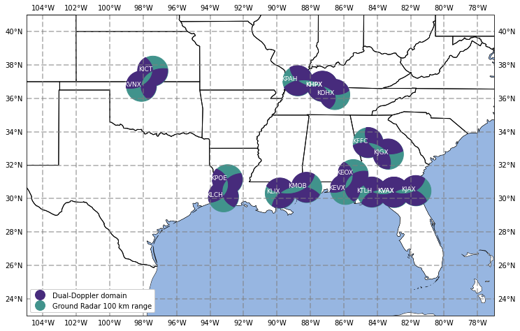
Expanding the MPF Database Using Ground-Based Radars
Step 1 – Data Selection
NEXRAD sites:
Vertical wind retrievals in the VN use 9 sets of proximal NEXRAD sites
ISS LIS overpass coincidence
  1,982 radar overpasses (2017-2020)
Step 2a – Radar Data Pre-Processing
Radar data QC’d following VN techniques
  Filtering by reflectivity, differential reflectivity, and copolar correlation coefficient thresholds
  Region-based dealiasing
  Texture fields to reduce non-meteorological echo
  (Py-ART; Helmus and Collis 2016)
Purple regions: Dual-Doppler wind retrievals
Step 2b – Radar Data Retrievals
Gridding: 1 km x 1 km x 1 km spacing
Hydrometeor identification
(Dolan et al. 2009, 2013)
3DVAR method for wind retrieval
(PyDDA; Shapiro et al. 2009, Potvin et al. 2012, Jackson et al. 2021)

Slide 7
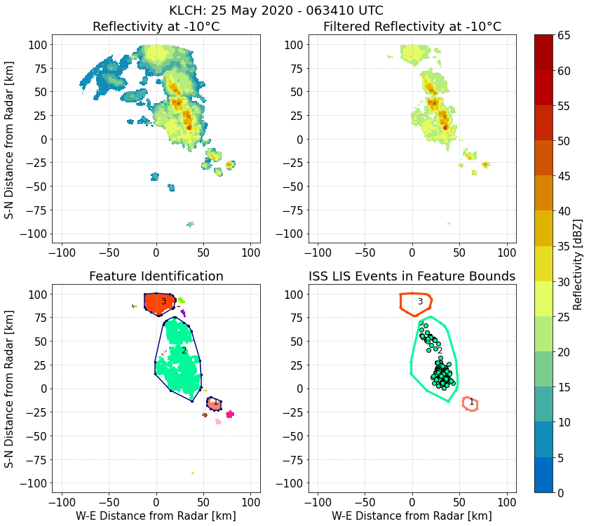
Creating MPFs from Ground-Based Radar Data
Step 3 – Prepare Reflectivity for Feature Selection
Gridded reflectivity data within 100 km of radar site at height of -10°C
  Temperature profile based on model reanalysis data
  Highlights region of primary electrification
Filtered to exclude<20 dBz to distinguish convection
Step 4 – ID and Label Feature Regions
Scipy ndimage algorithm distinguishes isolated regions
Step 5 – Fit Feature Boundary
Convex hull determined around regions identified by ndimage, serves as final MPF container
Step 6 – Find Lightning in MPF
ISS LIS lightning data identified within each MPF

Slide 8
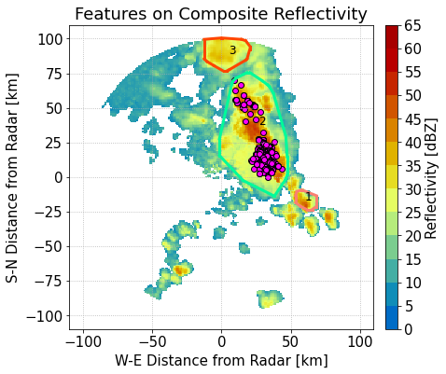
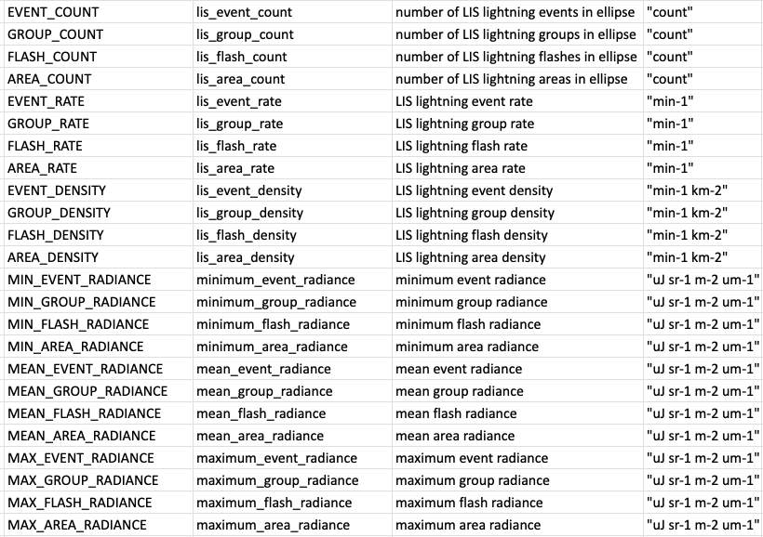
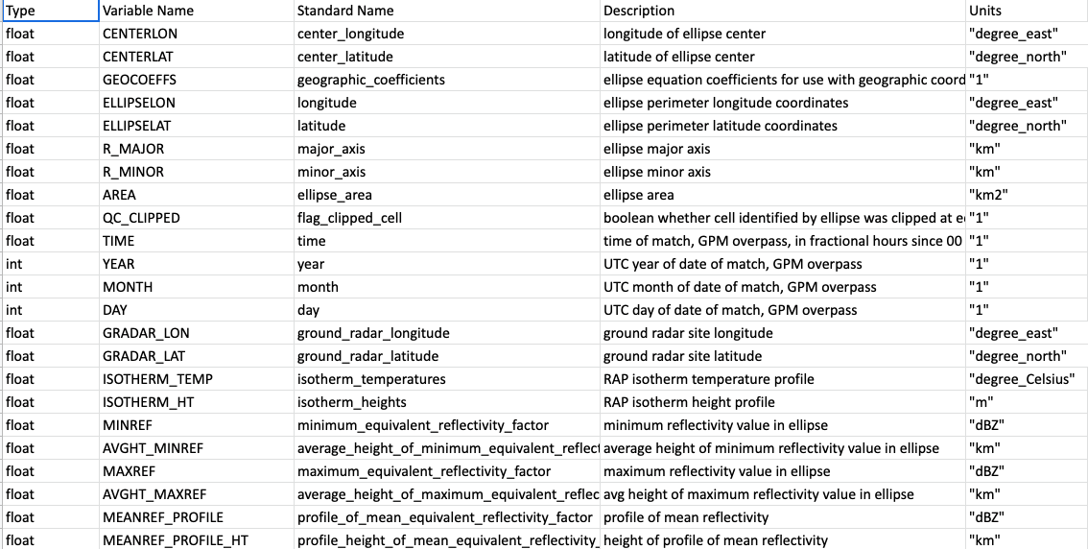

Creating a Database of Ground-Based MPFs
Final – MPF Boundary Used to Accumulate Storm Statistics
Numerous relevant and representative radar and lightning characteristics saved to a Network Common Data Form (netCDF) file for each MPF
Interested in MPFs identified within viable NEXRAD dual-Doppler domains
9 radar pairs; 2,043 MPFs

Slide 9
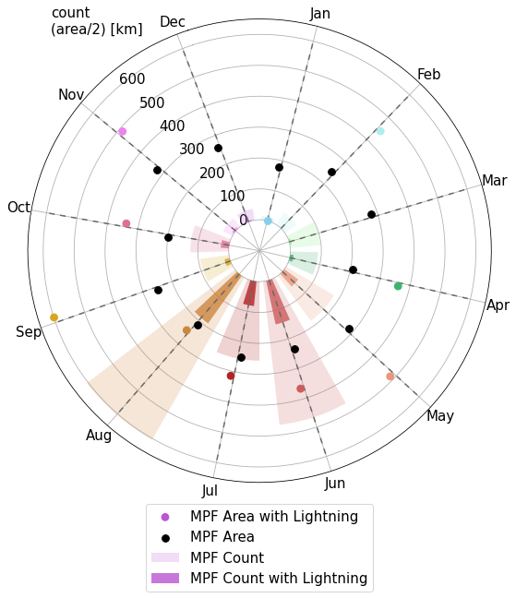
MPF Database Characteristics
Feature Counts
Fewest features identified Nov-Feb
Most features identified Jun-Aug
Greater lightning fraction in features May-Oct
Feature Size
Features are generally slightly larger in cool and transitional seasons
MPFs with active lightning are generally larger year-round
Lightning MPFs smallest in summer
Notes:
Uses LIS events for ”has lightning”

Slide 10
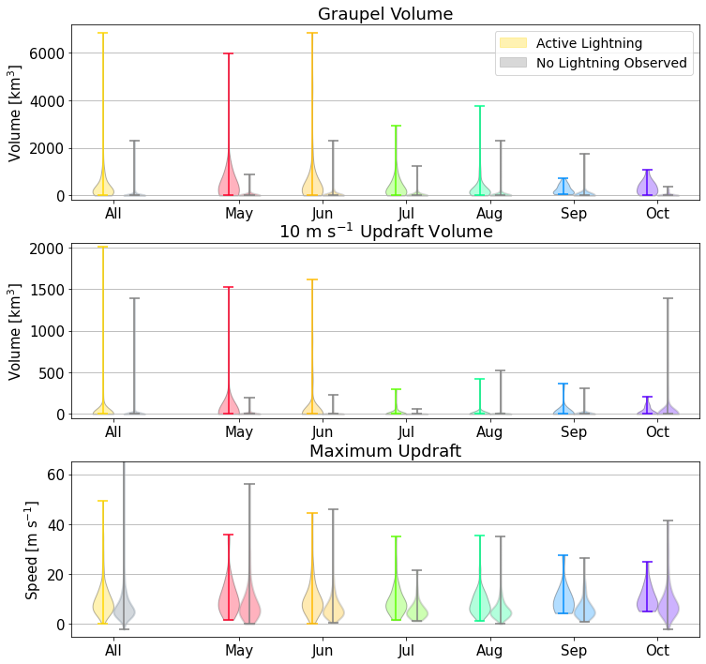
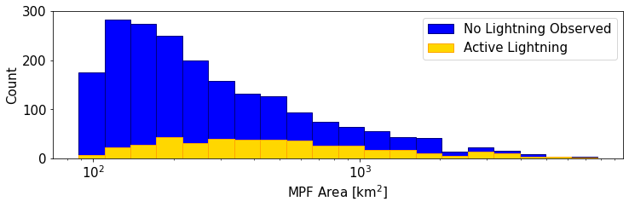
MPFs with and without Observed Lightning
Lightning activity corresponds with metrics that relate to updraft’s ability to produce precipitation ice → non-inductive charging (e.g., Deierling et al. 2008, Deierling and Peterson 2008, Carey et al. 2019)
How do “flashing” vs. “non-flashing” MPFs compare in terms of:
  Graupel volume
  Updraft volume
  Maximum updraft speed

Slide 11
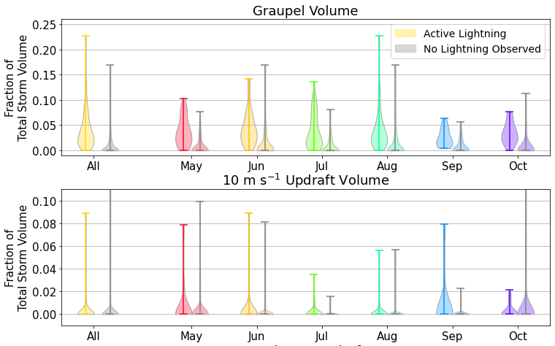
MPFs with and without Observed Lightning
Results reinforce that:
The presence of lightning indicates graupel and updraft speeds > 7 m/s, as graupel relies on an updraft (e.g., Dye et al. 1986, Zipser and Lutz 1994)
Some minimum graupel quantity in a storm matters more than relative amount of graupel in storm space for lightning production
Weak/small updrafts can support sufficient graupel content for electrification
Updraft characteristics vary by season
Caveat: LIS might not have observed lightning during overpass (roughly 90 s on average), though storm might have been producing lightning shortly before or after

Slide 12
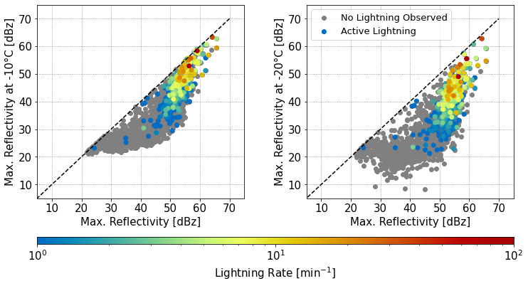
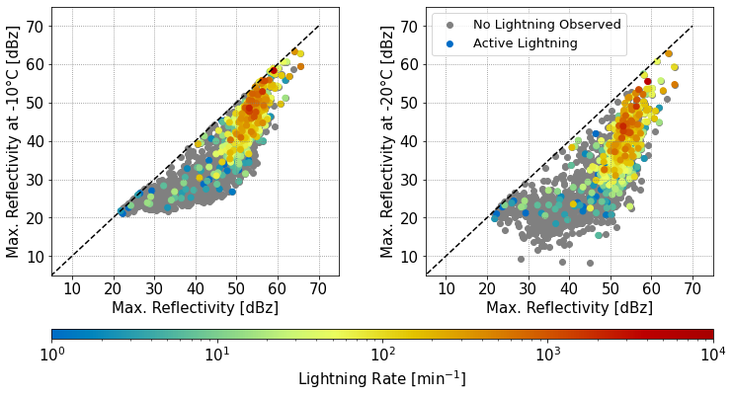
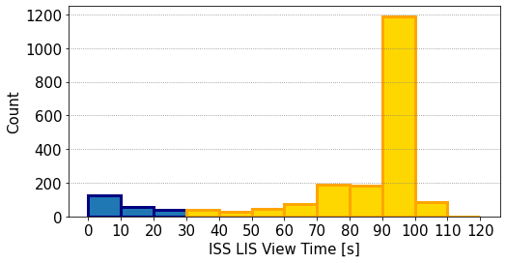
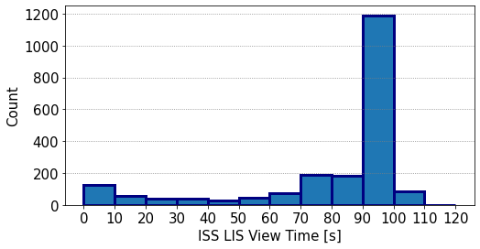
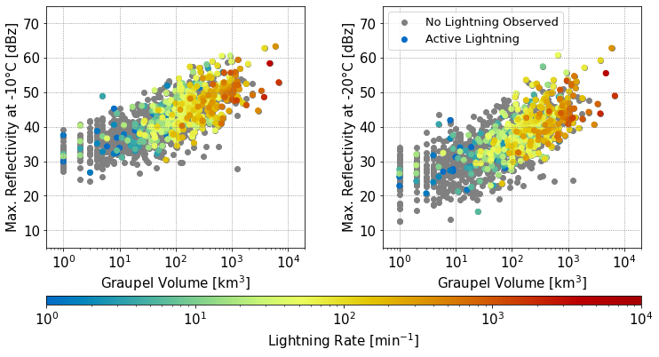
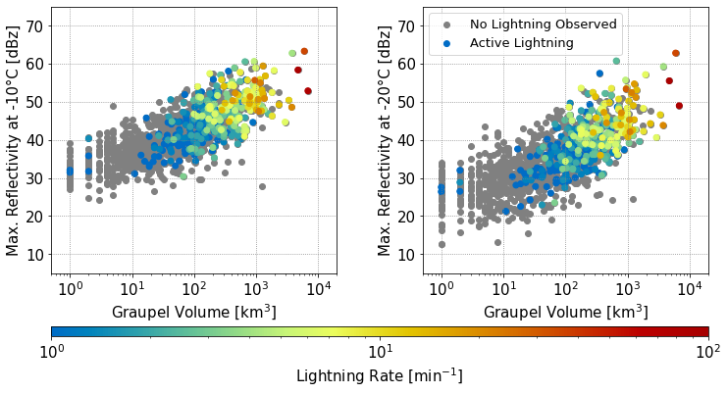
What Do Traditional Flash Rate Relationships Look Like?
1-min ISS LIS flash rate calculated for MPFs viewed by ISS LIS for > 30 s
Using simple reflectivity relationships (available from spaceborne precipitation radar), most LIS flashes occur when
    MPF maximum reflectivity > 40 dBz
    Reflectivity at -10°C > 30 dBz
    Reflectivity at -20°C > 20 dBz
LIS flash rates increase with increasing graupel, loosely indicated by reflectivity magnitudes
LIS detections follow a detection hierarchy (“events” make up “groups”, “groups” make up “flashes”), where flashes require minimum size criteria
  Events occur at all reflectivity ranges, but event rates follow similar flash rate relationships with dBz, graupel volume

Slide 13
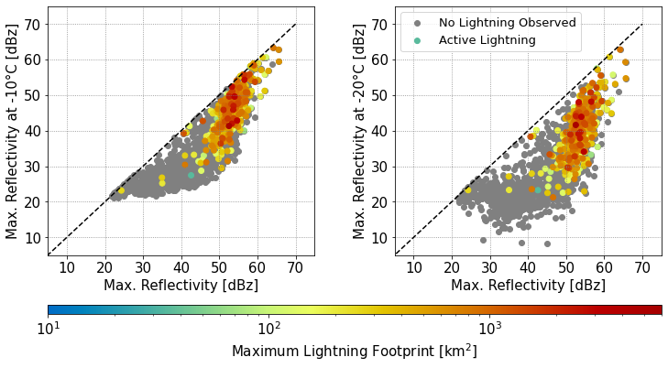
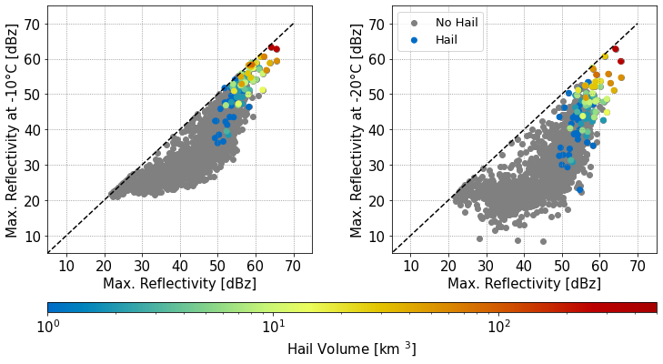
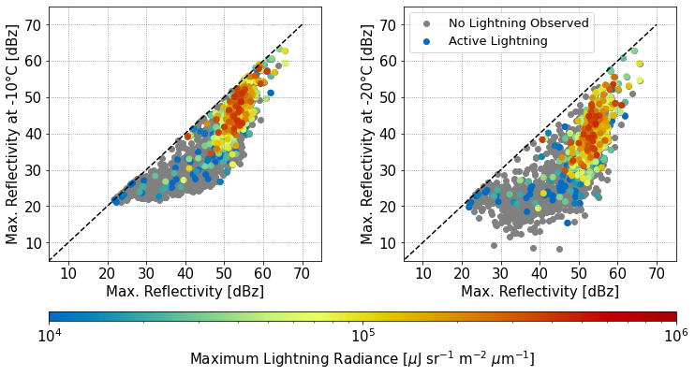
Are There Other Lightning-Convective Relationships from the LIS Perspective?
Flashes
Larger flash footprints and lower event radiance (i.e., light energy density) in higher max reflectivity regions, coincident with increasing hail volume in addition to increasing graupel volumes
In line with “hail holes” observed where lightning minima observed in coincidence with large hail
Not specifically large hail, given low particle concentration, but greater water content supporting hail growth that may increase light extinction (↓ radiance) and expand light pool (↑ footprint)
Events

Slide 14
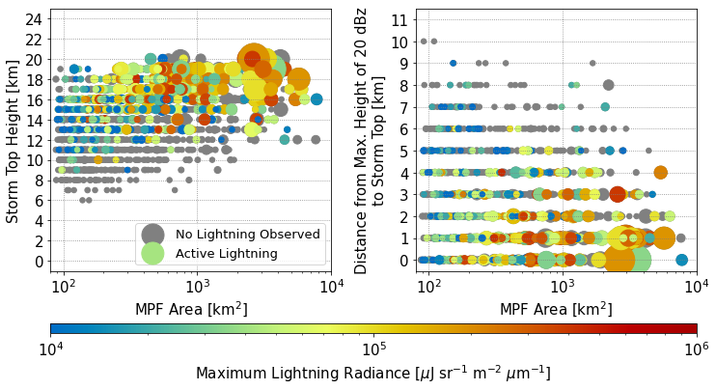
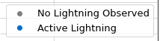
What Else Might LIS-Observed Lightning Convey?
Similarly, lightning gets “brighter” in deeper, larger features
… but especially so when the 20 dBz volume (associated with charged precipitation-sized ice) is nearer to storm top, placing lightning closer to the observing platform
Pathway for radiance to inform about updraft intensity?

Slide 15
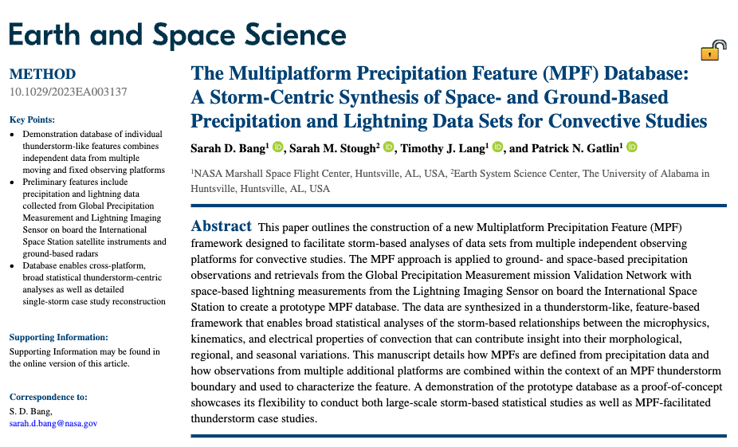
Ongoing Work and Future Opportunities for Growth
Dataset expansion
Global ground radar; NEXRAD with wind retrievals, 2020-present
Opportunity to advance space-based lightning science
  Proven flexibility to incorporate observations from ground or space
  Satellite radar and ISS LIS or GLM
Impacts:
Improving knowledge of diversity of lightning-convective relationships
Defining new satellite lightning relationships with convection (radiance, optical footprint size)
Increasing value of lightning data for diagnosis of deep convection in the absence of other satellite and radar data
Contact:
MPFs: sarah.m.stough@nasa.gov, sarah.d.bang@nasa.gov, ISS LIS: timothy.j.lang@nasa.gov, GPM VN: patrick.n.gatlin@nasa.gov
Acknowledgements: Supported by NASA Earth from ISS program funding, provided to UAH through Cooperative Agreement #80MSFC22M0001.

