Slide 1


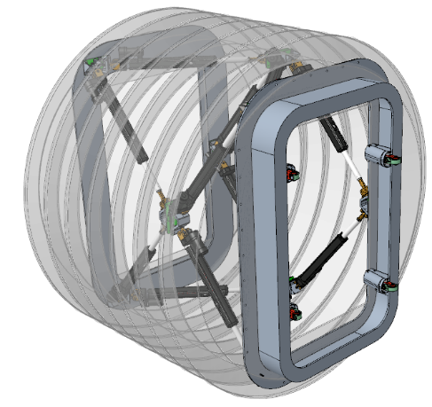
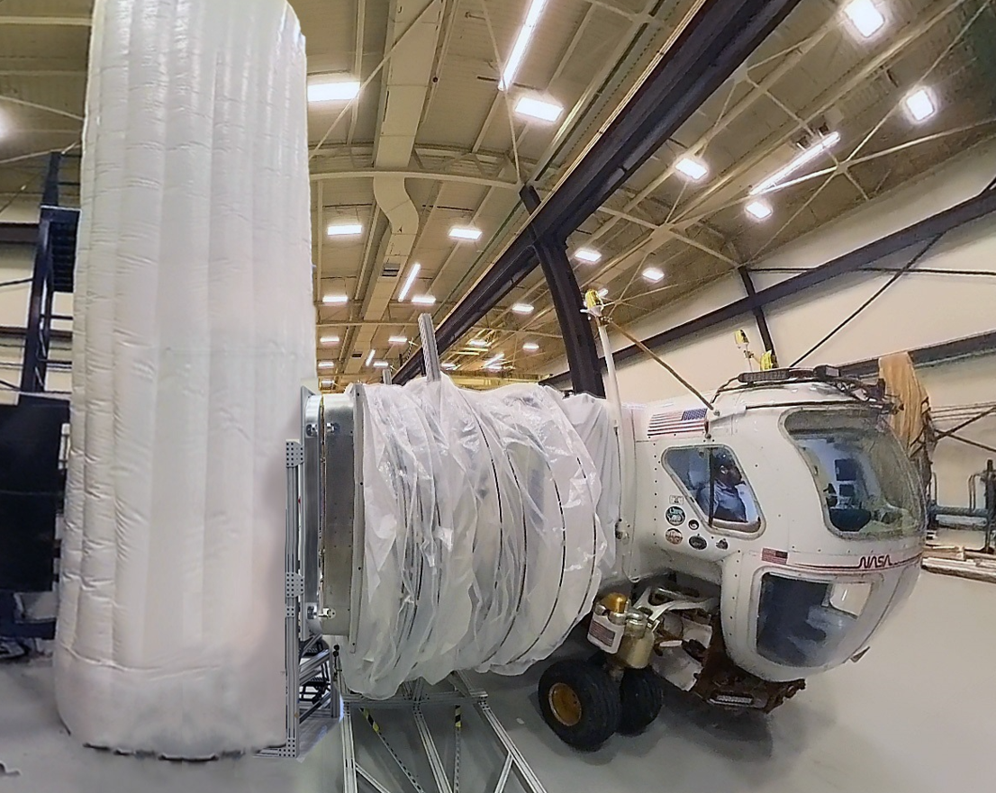
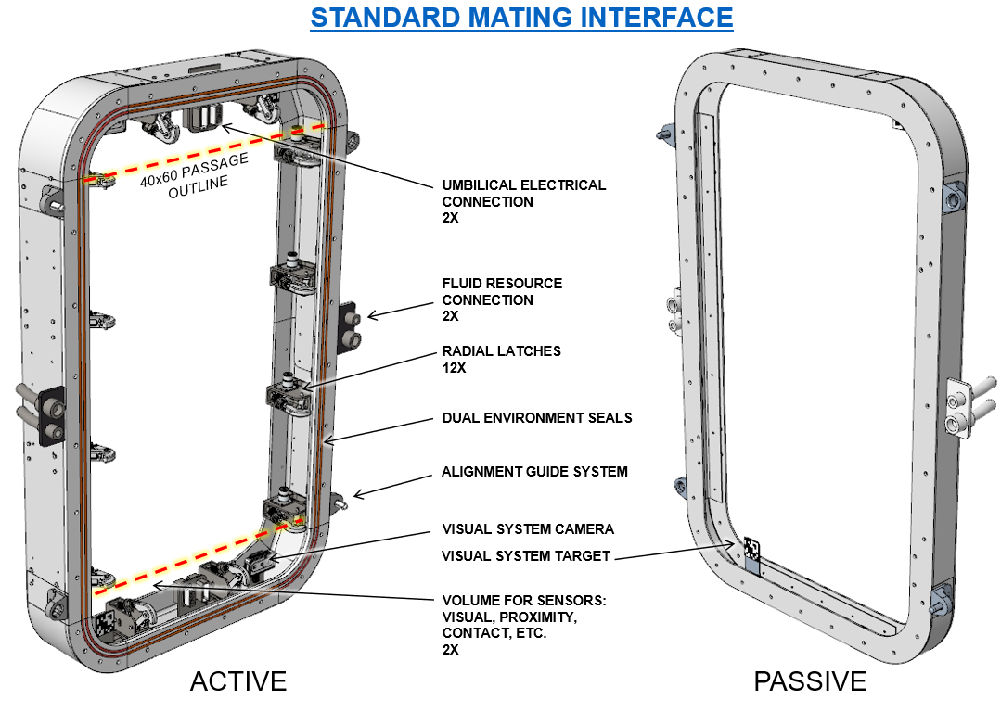
Surface Mating and Attachment
TBD
PM / PI Info Thang Le thang.d.le@nasa.gov
EXECUTIVE SUMMARY
A flight-like articulating mechanism with mating standard interface and inflatable enclosure will be built and tested at 10.2 PSIG. The results will support further collaboration with partners working to develop Surface Mating and Pressurized Transfer capability.
Innovation
Pressurized crew and cargo transfer capability on surface minimizes the number of EVAs required, lessen the frequency of suit maintenance, and focus crew EVA time for science. Additionally, this capability can enable pressurized logistic transfer. The design will address articulation, mis-alignment accommodation, latching, sealing surface protection, materials, crew passageway integration and features to support transfer operations between surface elements. Eventually, mating interface standardization will provide for commercial industry and international space agencies collaboration for sustained surface operations.
This capability currently does not exist.
Collaboration
GRC Materials & Structures Div (Environment seals)
Paragon Space Development Corp (Inflatable softgoods)
Pressurized Articulating Tunnel
Outcomes & Infusion
Increasing the level of maturity of the design that consists of a 6-DOF articulation mechanism to correct docking misalignments and an inflatable shell enclosure for pressurized transfer.
Working closely with Paragon Space Development Corp for a parallel path on alternative designs of the shell softgoods and their testbeds, in both full-scale and sub-scale setups.
Future Work
Continue to further detail design the articulating mechanism and the inflatable shell enclosure. Further analysis and optimization are planned to improve mass efficiency.
Upgrade the existing testbed to perform pressurization testing under the desired conditions.
Develop Hi-fidelity test bed to evaluate human factors and operational scenarios.
Standard Docking Interface Development
Current Testbed
DAA# | 20230017717
NTR#(s) | NA

