Slide 1
IN42B-01
Multidimensional data aggregation in the cloud with application to geostationary satellite-based air quality monitoring
Daniel Kaufman¹
Hazem Mahmoud¹
Luis Lopez²
Walter Baskin¹
¹ NASA Langley Research Center, Atmospheric Science Data Center, Hampton, VA, U.S.A.
² National Snow and Ice Data Center, Boulder, CO, U.S.A.
Notes:
STILL

Slide 2
Outline
Motivating mission and data
The tools at hand
Challenges to overcome
Aggregating data in the cloud

Slide 3
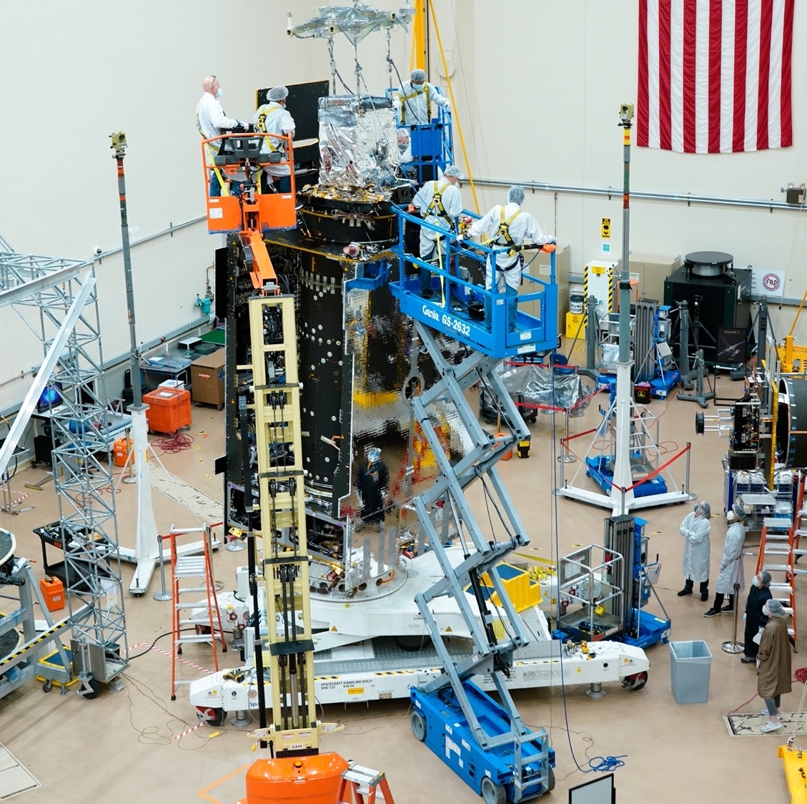
The mission
Tropospheric Emissions: Monitoring of Pollution
Was selected as NASA’s first Earth Venture Instrument in 2012
Principal Investigator is Dr. Kelly Chance, from Smithsonian Astrophysical Observatory (SAO)
Goal: to measure Air Quality
http://tempo.si.edu/gallery.html

Slide 4
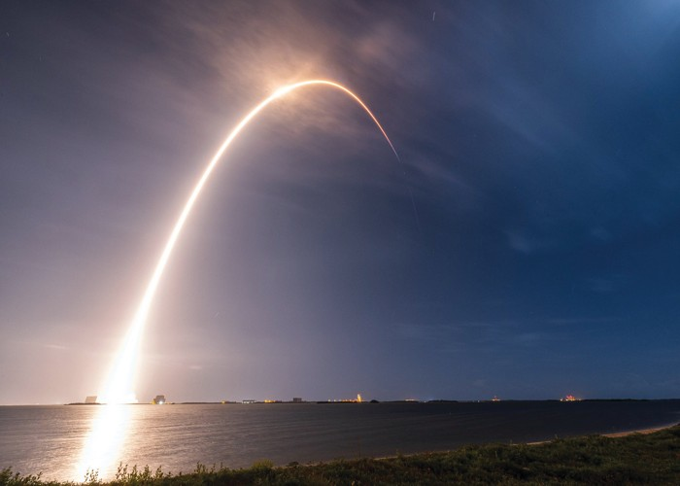
TEMPO launched aboard a SpaceX Falcon 9 vehicle on April 7, 2023
https://pweb.cfa.harvard.edu/news/liftoff-tempo-instrument-soars-space

Slide 5
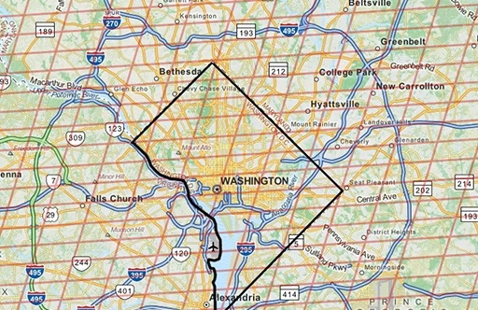
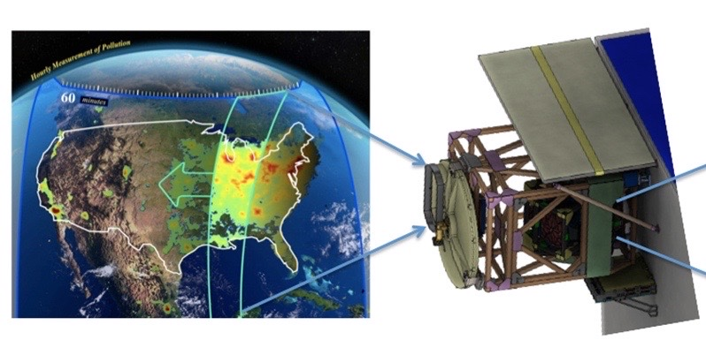
Air quality measurements
UV/Visible spectrometer view of North America
Geostationary orbit at altitude of ~36,000 km (~22,000 mi)
Measures ozone, nitrogen dioxide, formaldehyde, aerosols, and other pollutants
Resolution:
Hourly (~10 mins for special studies)
Approximately 2.4 km N/S × 5.4 km E/W
http://tempo.si.edu/instrument.html

Slide 6
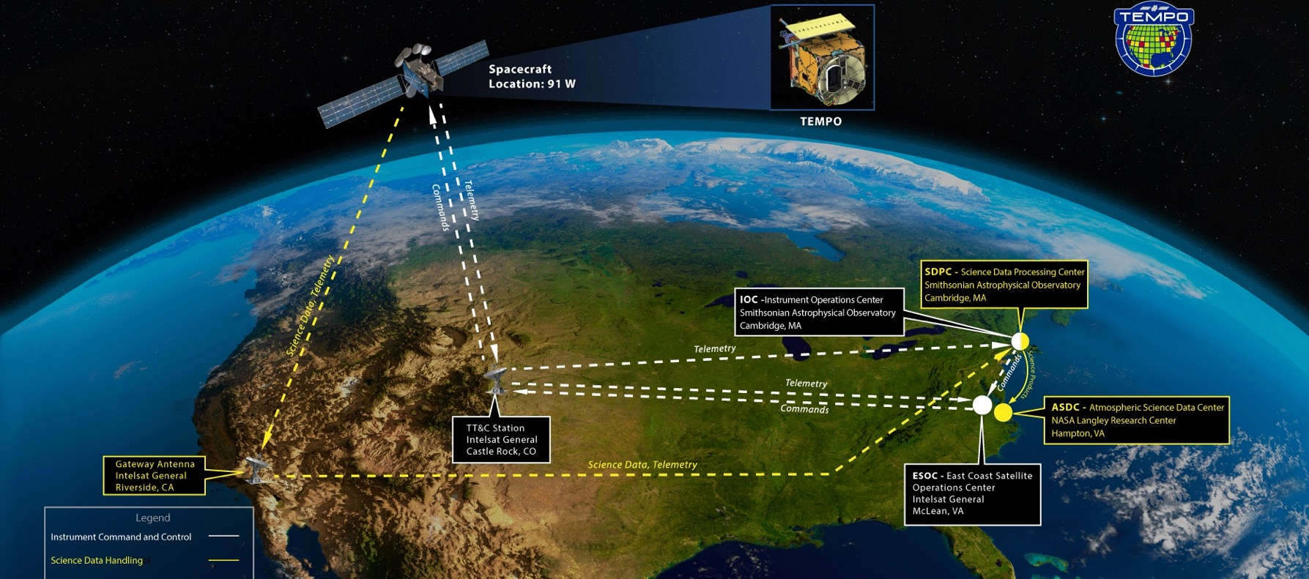
Atmospheric Science Data Center (ASDC) in Hampton, VA, to ingest, archive, and distribute TEMPO data
http://tempo.si.edu/gallery.html

Slide 7
Data Structure

Slide 8
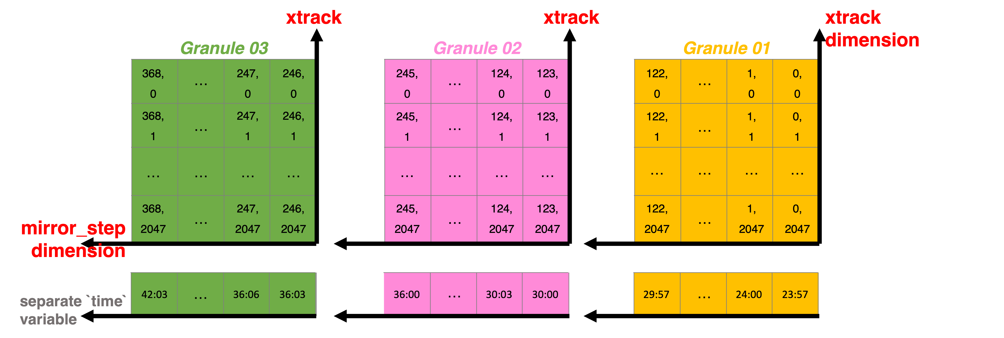
Data Structure
(for Level-2, two dimensional variables)

Slide 9
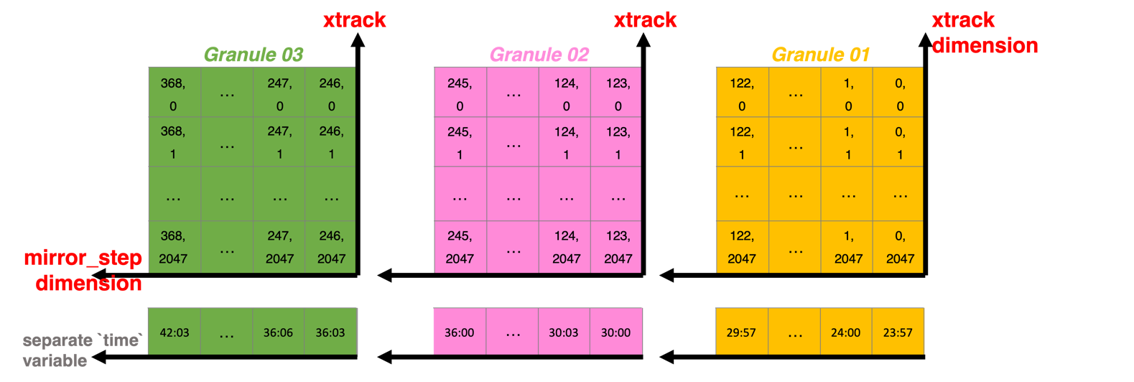
Data Structure
(for Level-2, two dimensional variables)
SCAN 1

Slide 10
Data Structure
(for Level-2, two dimensional variables)
SCAN 1
SCAN 2
SCAN 3

Slide 11
Objective
Support the ability for users to download multiple files aggregated into a single file.
With this ability, users will more easily be able to analyze multiple scans across an area of interest (e.g., Continental USA).

Slide 12
Tools already at hand
Harmony (https://harmony.earthdata.nasa.gov/ and https://github.com/nasa/harmony)
CONCISE (CONCatenatIon SErvice; https://github.com/podaac/concise)
Other open-source libraries

Slide 13
NASA’s Harmony project
“Bringing Data Together by Bringing Services Together”
Regardless of science domain, users will be able to use OGC-compatible tools and a customized API to access cloud hosted data.
APIs will allow users to request only the data they want, in the format and projection they want, allowing them to skip manual intermediary processing steps.

Slide 14
Harmony
APIs
DAAC 1 User
WMS
Common Message
Harmony API
WCS
NNT

Slide 15
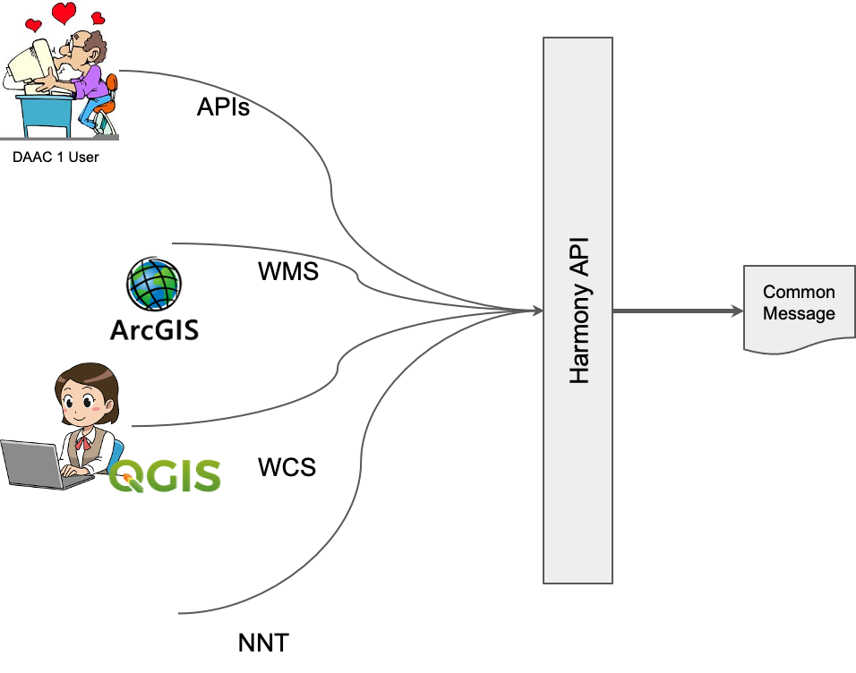
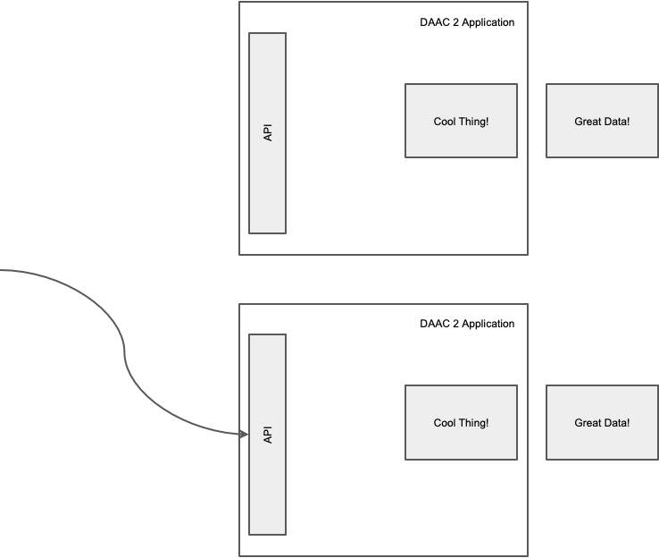
Harmony
Service 1
Service 2

Slide 16
CONCISE (“stacking”)
Existing Harmony Concatenation Service
combines data by creating a new dimension

Slide 17
Challenges to overcome

Slide 18
Challenges to overcome
Handling group structure

Slide 19
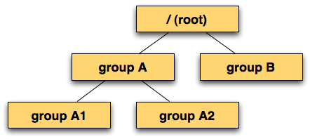
Challenges to overcome
netCDF-4 (Network Common Data Form) groups
Handling group structure
https://www.unidata.ucar.edu/software/netcdf/workshops/2011/groups-types/GroupsIntro.html

Slide 20
Challenges to overcome
Handling group structure
Creating a new process for concatenation without “reinventing the wheel”

Slide 21
Challenges to overcome
Handling group structure
Creating a new process for concatenation without “reinventing the wheel”
Hooking up the new process to Harmony system

Slide 22
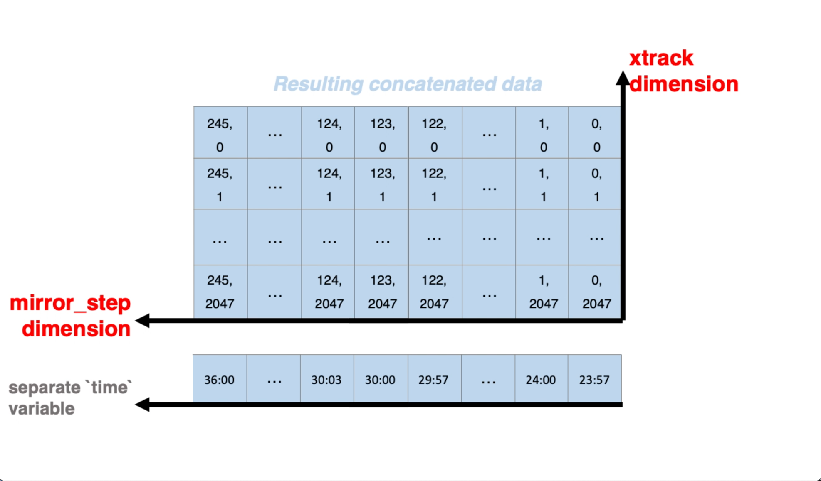
CONCISE (“stacking”)
New Harmony Concatenation Service
that combines data along an existing dimension
Stitchee
(“extending”)

Slide 23
“Stacking” and “Extending”

Slide 24
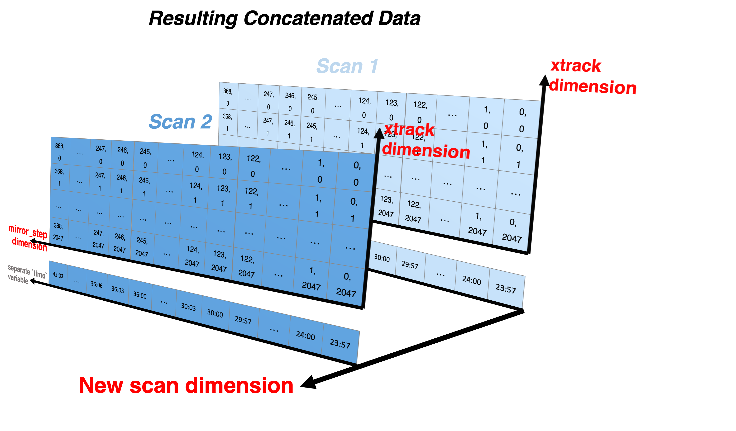
An intuitive structure for further exploration and analysis

Slide 25
Functionality Overview
+ Dimension Name
Concatenate along dimension

Slide 26
Functionality Overview
- List of file paths
- Concat dimension
Each file
Flatten groups
Validate input files
xarray.concat()
Reconstruct groups
Open as an xarray Dataset
Save to disk

Slide 27
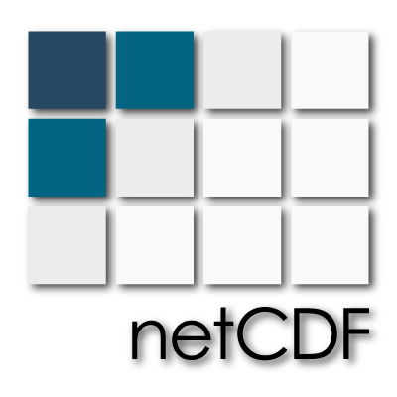
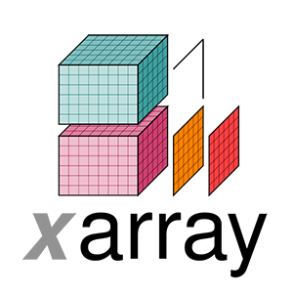
Functionality Overview
- List of file paths
- Concat dimension
Each file
Flatten groups
Validate input files
xarray.concat()
Reconstruct groups
Open as an xarray Dataset
Save to disk

Slide 28
Functionality Overview
- List of file paths
- Concat dimension
For each file
Flatten groups
Reconstruct groups
Open Dataset object in append mode
Open new Dataset file in write mode
Validate input files
(Exclude empty data files)
Create renamed root-level variables (w/coords)
xarray.concat()
Create groups based on variable name delimiters
Create renamed root-level dimensions, and create corresponding coordinate variable if doesn’t exist
Create dimensions in appropriate groups
Create variables in appropriate groups, with copied attributes. Shuffle, chunk sizes, compression are newly determined.
Traverse nested groups, creating (at root level) renamed variables, coord attributes, and dimensions
(Optionally)
Make new directory
with copies
Reconstruct group paths in coordinate attributes
Delete non-root groups
Open as an xarray Dataset
Save to disk

Slide 29
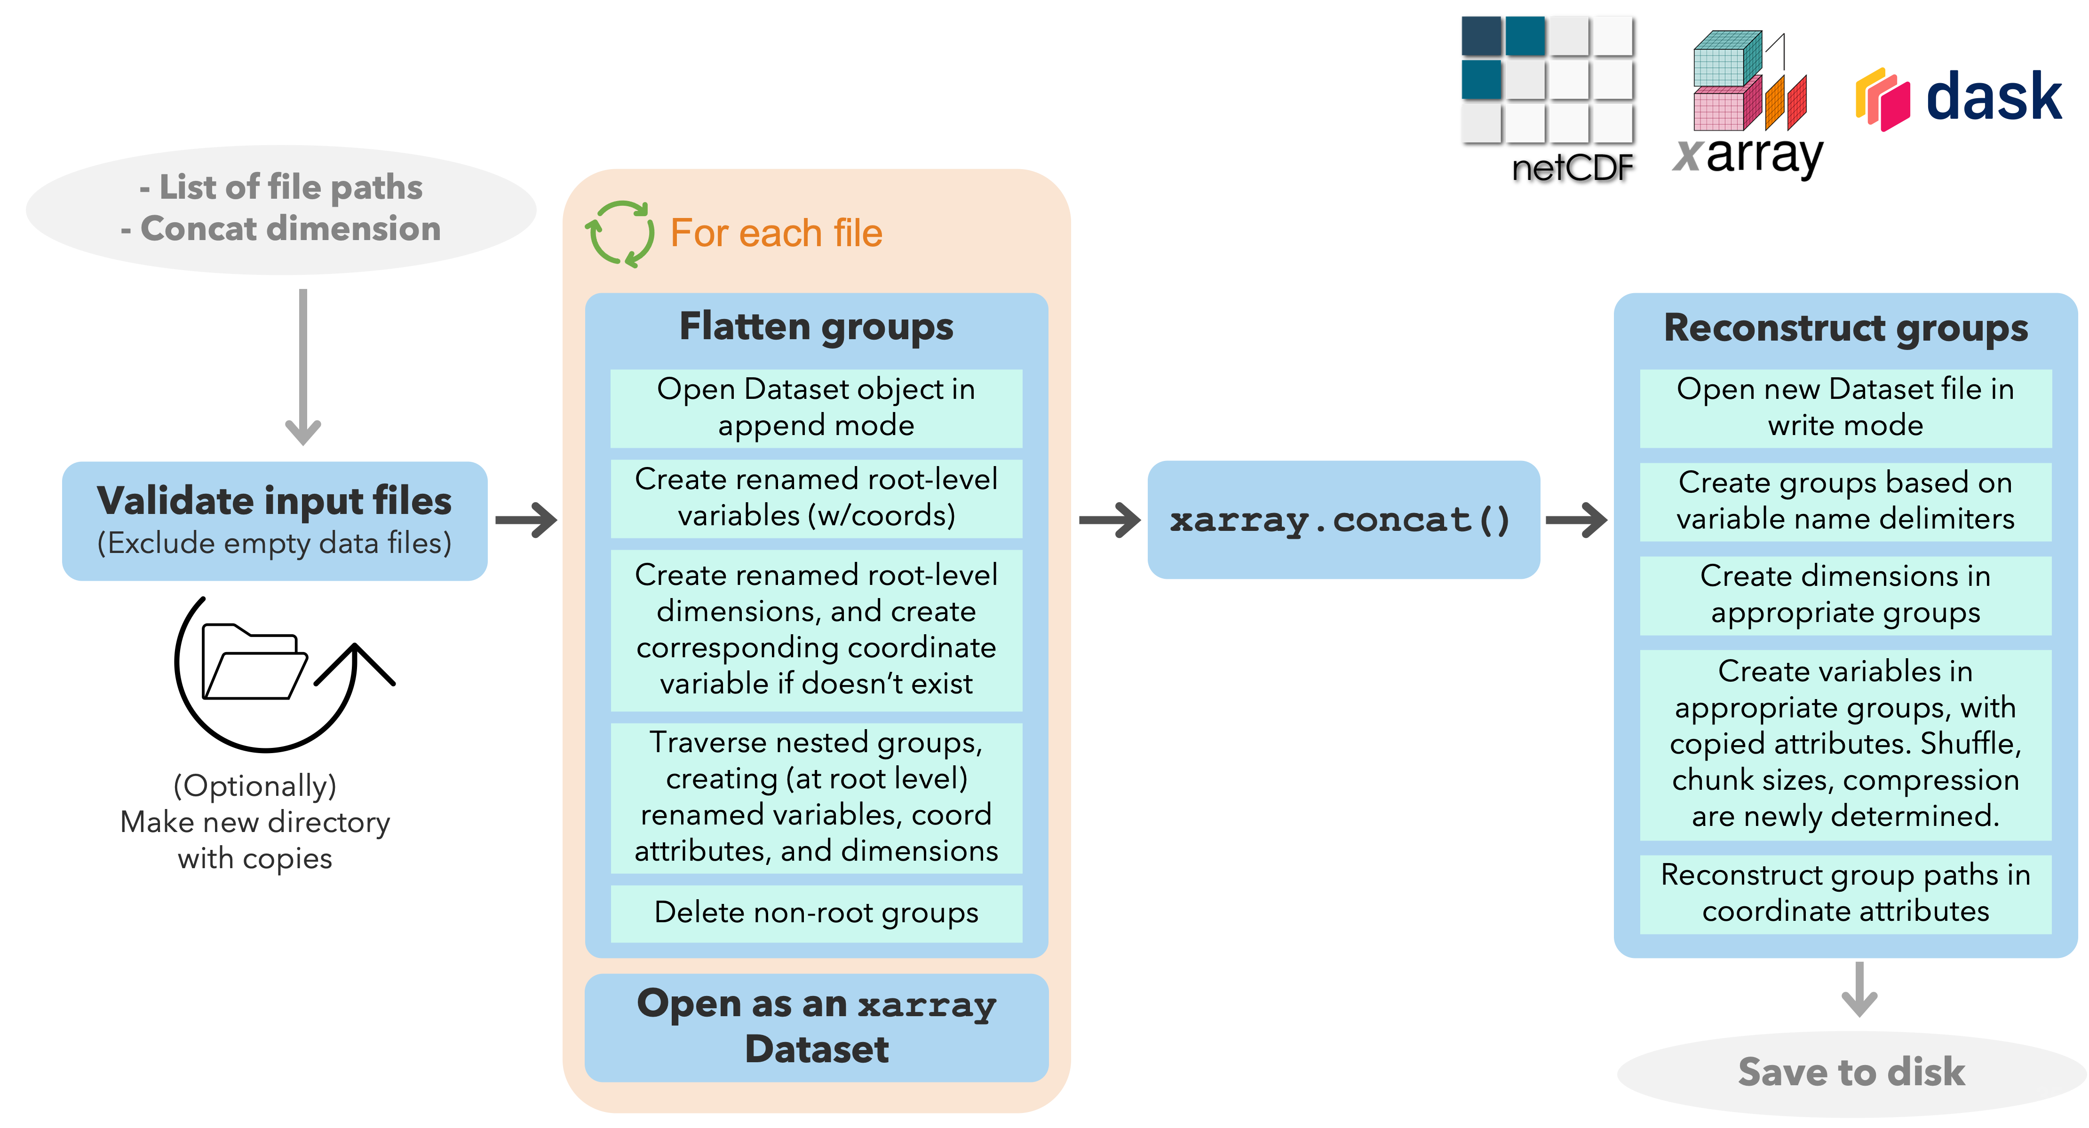
Functionality Overview

Slide 30
Service 1
Service 2

Slide 31
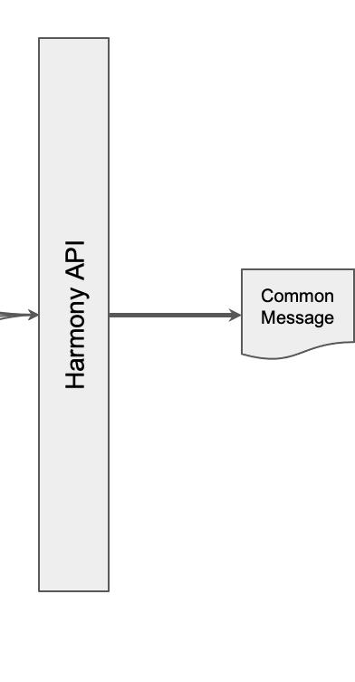
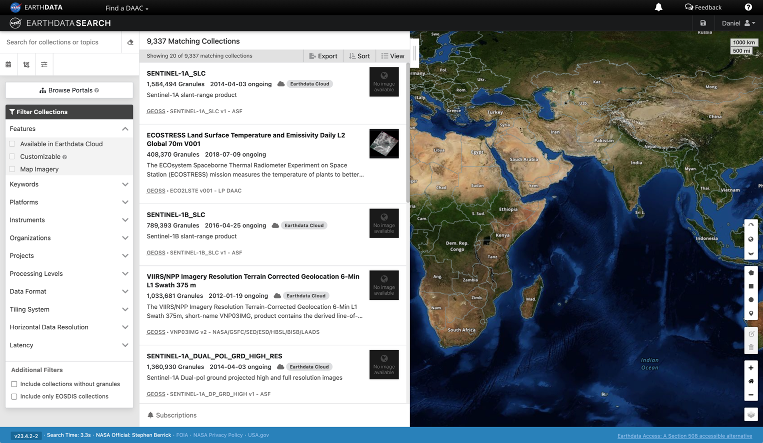
For example: Earthdata Search
(https://search.earthdata.nasa.gov/search)
Service 1
Service 2

Slide 32
Summary
TEMPO data will provide unprecedented views of air quality over North America
Transforming data on-demand for users requires sophisticated data management and data-operations orchestration
Software to concatenate data arrays by creating a new dimension is insufficient for enabling intuitive usage of high temporal geostationary data like TEMPO
A new software tool has been developed — and is being tested and improved — to concatenate data arrays along an existing dimension
It will seamlessly integrate with the existing subsetting and concatenation services
It will be invoked and run when queries are sent to Earthdata via Earthdata Search, Harmony-py, etc.
Work is underway to expand its capabilities to additional datasets, including the Clouds and the Earth's Radiant Energy System (CERES) radiation budget; Orbiting Carbon Observatory 3 (OCO-3); and the Ice, Cloud, and land Elevation Satellite (ICESat) and ICESat-2.
To keep in mind:
TEMPO data (level-2 and level-3) are anticipated to be publicly available in April, 2024
Questions can be directed to the Earthdata Forum (https://forum.earthdata.nasa.gov/)

