Slide 1

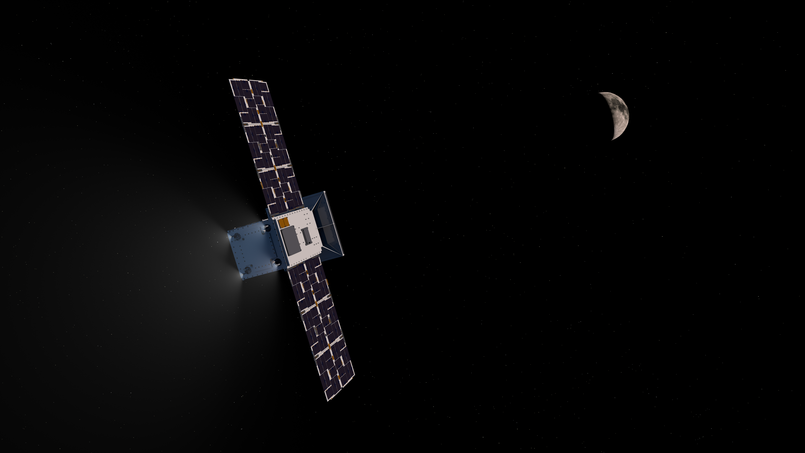

Space Technology Mission Directorate
Small Spacecraft Technology
National Aeronautics and
Space Administration
National Aeronautics and
Space Administration
National Aeronautics and
Space Administration
NASA Small Spacecraft Technology Program
Elwood F. Agasid
Deputy Program Manager
Small Spacecraft Technology Program
2023 AGU Fall Meeting
San Francisco, CA ✦ 12 December 2023

Slide 2
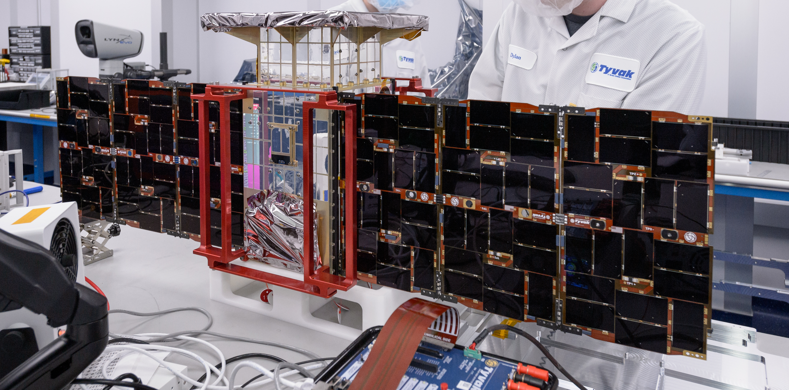
CAPSTONE
Image Credits: NASA
2

Slide 3
Cislunar Autonomous Positioning System Technology Operations and Navigation Experiment
Objectives: Demonstrate how to enter and function in a near rectilinear halo orbit around the Moon and demonstrate spacecraft-to-spacecraft navigation.
Timeline:
Launched: June 28, 2022
Arrived at Lunar Orbit: November 13, 2022
First demonstration of two-way ranging with LRO: October 14, 2023
Spacecraft and Lunar Orbit:
Size: 12-unit CubeSat platform
Dimensions and Weight:
Lunar Orbit: Within 1000 miles of one lunar pole on its near pass and 43,500 miles from the other pole at its peak, every seven days
CAPSTONE Spacecraft
Image Credit: NASA
CAPSTONE in NASA’s Eyes Demonstration

Slide 4

National Aeronautics and Space Administration
Select Online Tool Demonstration
2024 AGU Fall Meeting
San Francisco, CA
12 December 2023
Craig D. Burkhard, Ph.D.
Deputy Director, NASA Small Spacecraft Systems Virtual Institute
www.nasa.gov/smallsat-institute
www.nasa.gov

Slide 5
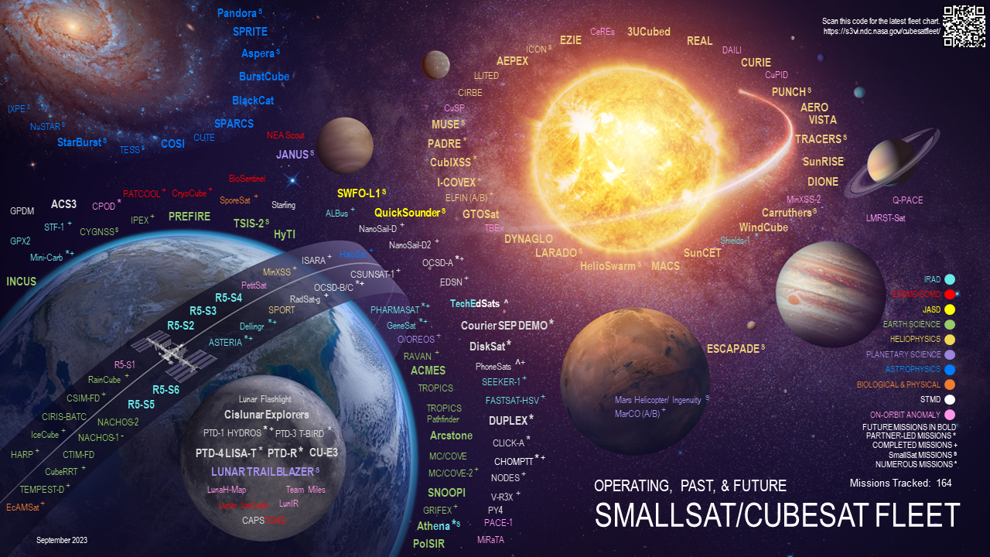

Slide 6
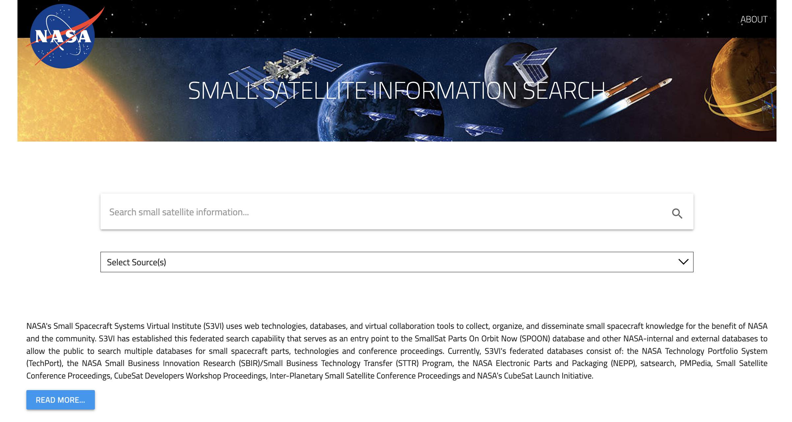
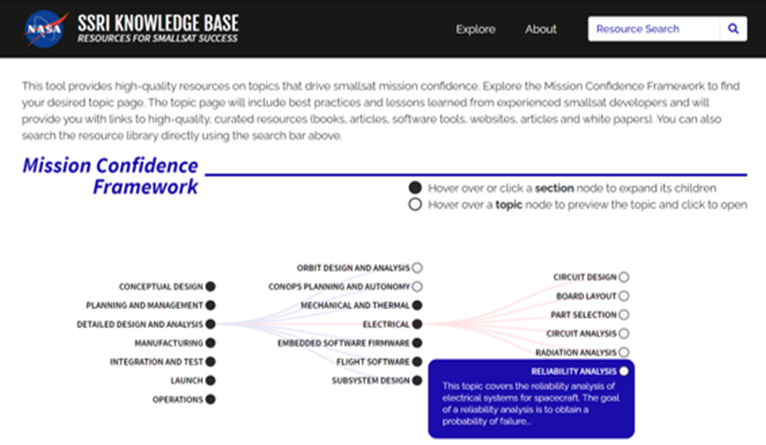
Small Satellite Search Resources
Leverage knowledge from the SmallSat Community
Free, publicly available tool targeting SmallSat mission successes
Go-to starting place for information on a broad range of topics
https://s3vi.ndc.nasa.gov/
Disseminate small spacecraft knowledge for the benefit of the community
Free, publicly available tool targeting SmallSat internal and external databases
Currently contains ~38,000 records
https://s3vi.ndc.nasa.gov/ssri-kb/
18

Slide 7



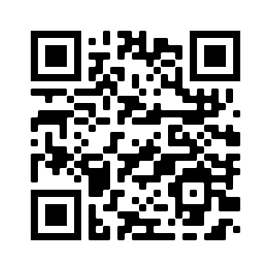

Questions
FLEET CHART
INFORMATION SEARCH
2022 SMALLSAT STATE OF THE ART
SSRI KNOWLEDGE BASE TOOL
COMMUNITY
OF PRACTICE WEBINAR SERIES

