Slide 1
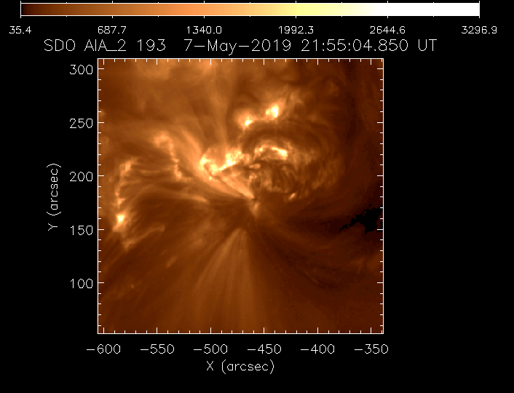
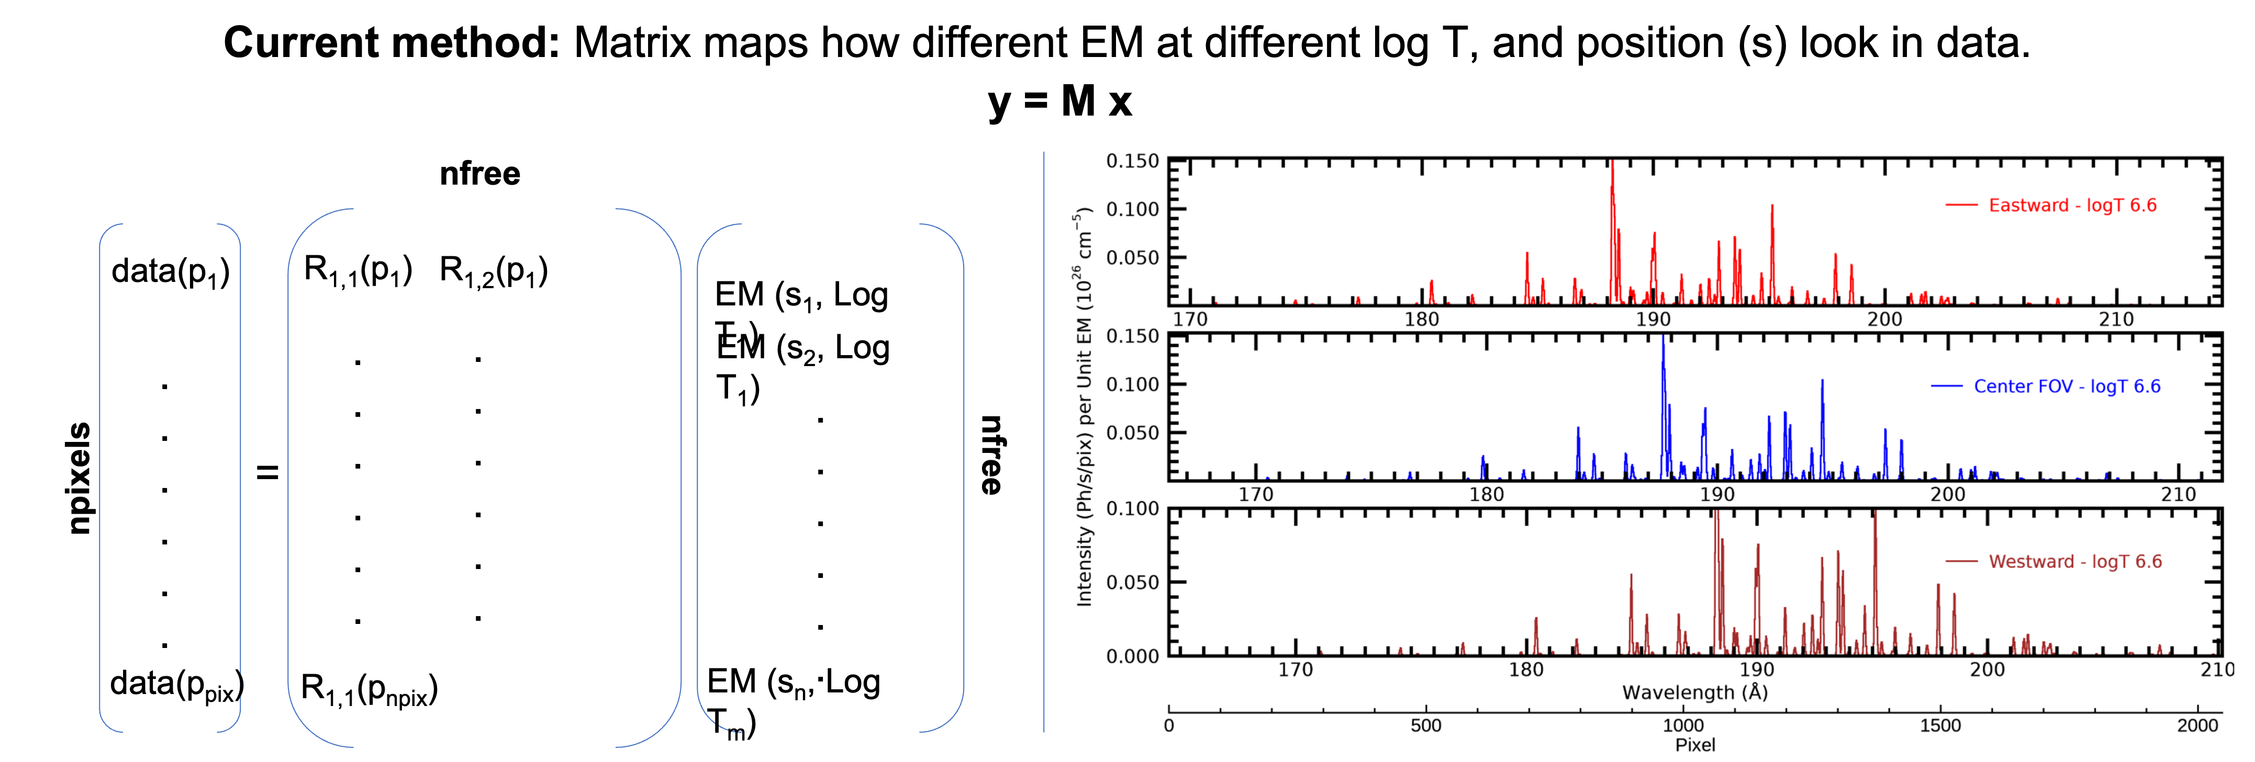
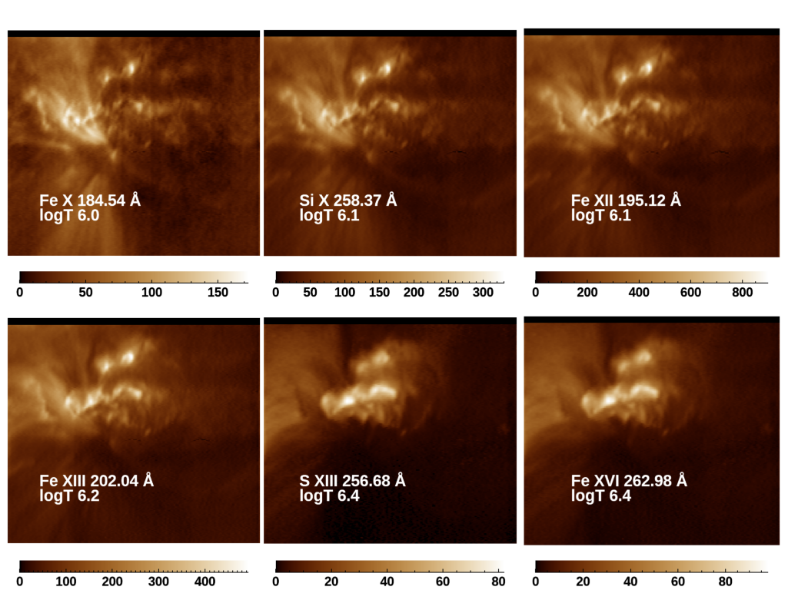
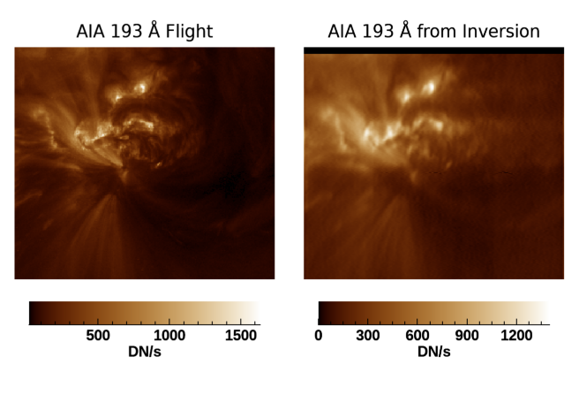
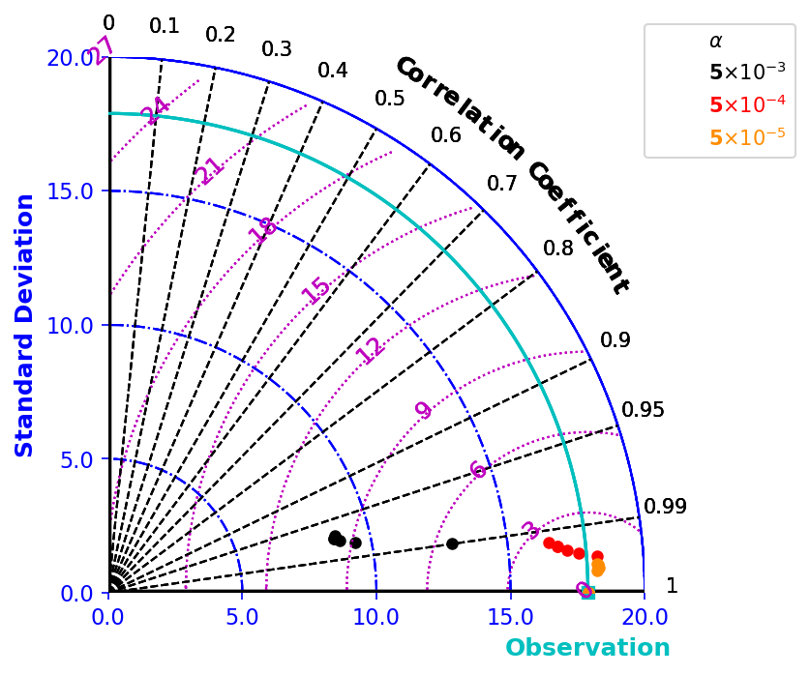
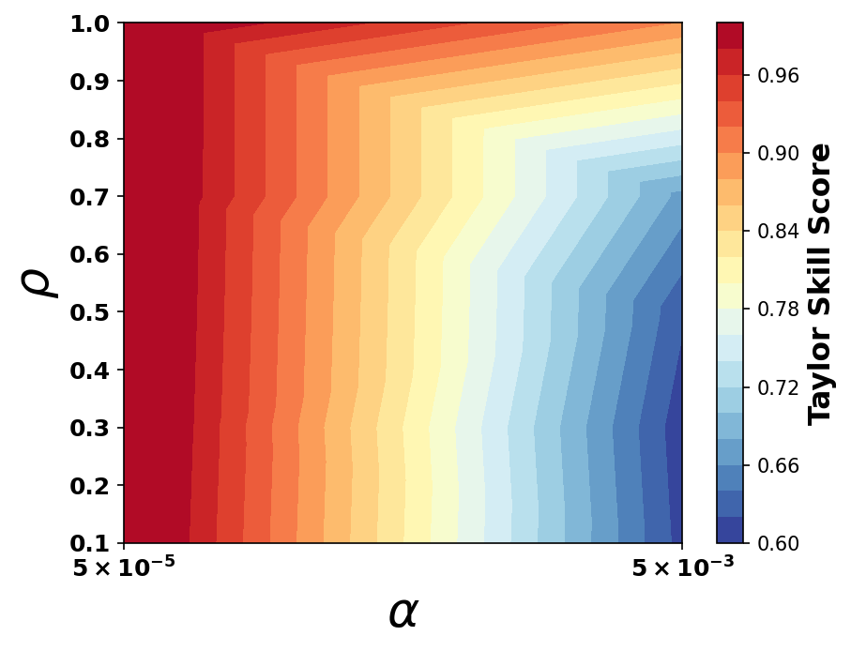
Study of Coronal Heating in Solar Active Regions Using Wide-Field Imaging Spectroscopy: Hinode EIS Slot Observations P.S. Athiray^{1,2}, Amy Winebarger², David Brooks³, Sanjiv Tiwari⁴ ¹The University of Alabama in Huntsville, ²NASA Marshall Space Flight Center, ³George Mason University, ⁴Bay Area Environmental Research Institute
I - OVERVIEW
II - EIS Observation – Case study
II - EIS Observation – Case study
Hinode - Extreme Ultraviolet Imaging Spectrometer (EIS)^{[1]}, a slit spectrometer (1” and 2” slits), designed to produce high resolution EUV spectra of solar corona for plasma diagnostics (Temperature, Density, Abundances and Velocity). It also carries two wide slots - 40” and 266” wide, which produces spatially overlapped spectral images from a wide field of view, known as “spectroheliogram”. EIS slot data have not been explored used due to spatial-spectral confusion. Here, we use the state-of-the art unfolding method, developed and tested on the MaGIXS sounding rocket^{[2,3]}, to invert EIS spectroheliogram data.
AR 12740
Fig. 1: Hinode/EIS 255” slot FOV
Fig. 2: Level1 EIS spectroheliogram, with He II emission (near 252 Å) masked.
III - INVERSION METHOD
IV - RESULTS
Observed intensity of an emission line on a detector pixel can be written as:
$$I_{obs}\left(pix\right)=\sum_{T}{\sum_{s}{M \left(pix, T, s\right) EM (T,s)}}$$
where ‘s’ → field angle, M → response function, which includes effective area^{[4]}, wavelength (λ) map, and atomic physics of plasma (T, n), and EM (T, s) → Emission Measure
The inversion technique follows framework in^{[5,6]}, implemented via Elastic Net Regularization method, a scikit tool in Python
$x\#= argmin[ W|\left|y−Mx\right||\text{2}2$+ ⍺⍴ ||x||₁ + 0.5 ⍺ (1-⍴) ||x||₂² ]
Where, w is the weights defined by, $W= 1/{σ_{ph}^{2}}$
⍺, ⍴ → hyperparameters, which are L1 and L2 norm, controls penalty and sparseness vs smoothness of the inversion.
Hyperparameter Optimization:
Perform inversions with range of ⍺ and ⍴, compare with observations
Employ Taylor diagram^{[7]} for statistical summary of models Vs observations using standard deviation, Pearson’s correlation coefficient, and RMS difference
To identify well matching model(s), we define Taylor skill score ‘S’ as
$$S= \frac{4(1+R)}{{(σ}_{n}^{^}+1/{σ_{n}^{^})2+(1+R0)}}$$
Where, R → correlation coefficient, $σ_{n}^{^} →$ ratio of standard deviation of model and observation, R₀ is maximum correlation (assumed 1)
Fitted Spectroheliogram Data
The best fitting model shows a good agreement in most of the observed emission lines.
However, some lines in the long wavelength show discrepancy with flight data, which could be due to different plasma assumption like density and/or offset in the instrument response.
Figure 2: Schematic of inversion via matrix method (left). EIS spectral response for three different field positions (right). (1) On-axis (middle) and (2,3) off-axis (top and bottom) at log T=6.6
Fig. 4:Comparison of flight data with the best matching inversion. (Top) shows flight image in SW and LW. (Bottom) shows corresponding overlapped spectra summed over the rows between horizontal lines.
Abundance | Density | Electron speed | Ionization balance
Coronal | 10^{9.5} | Maxwell Distribution | Equilibrium
Response (M) Assumptions
Spectrally Pure Images
Best fit EM is folded through emissivity function for each ion for spectrally pure images
Comparison with AIA
A good comparison is observed between flight AIA data and synthetic AIA data calculated using inverted EM cube
Fig. 5: Spectrally pure images of some of the EIS emission lines in units of Ph/s/pixel derived from the inverted EM cube. MOSS structure clearly appears at low temperatures, while AR core loop structure glows at warm temperatures.
Fig. 6: Comparison of AIA 193 Å image (Level 1.5) from flight with synthetic AIA 193 Å image using inverted EM cube from EIS data.
Figure 3: (Left) Taylor diagram shows standard deviation, centered RMS difference, and Pearson correlation coefficient for each model. (Right) Dependence of ⍺ and ⍴ with respect to Taylor score (S)
V - CONCLUSION
Successfully demonstrated inversion of Hinode/EIS slot data to yield spectrally pure images,
Fitted data summed over spatial pixels closely agree with most of the dominant emission lines (Fe VIII, XII, XIII, XV)
A systematic discrepancy is observed in the long wavelength near 260 – 270 Å.
Ongoing/Future Work :
* Validate slot inversion against slit data with back-to-back observations.
* Investigate of inversion with different plasma assumptions (abundance, density)
* Investigate variations in the instrument response - variation of intensity across the slot
References:
[1] Culhane et al. ,2007, PASJ ,; [2] Athiray, P. S., & Winebarger, ApJ (Under Review) ; [3] Savage, S et al. 2023, ApJ ; [4] Del Zanna , G et al., 2023, ApJ, [5] Cheung, M. C. M., et al. 2019, ApJ ; [6] Winebarger, A. R et al. 2019, ApJ ; 7] Taylor, K. E, 2001, JGR

