Slide 1
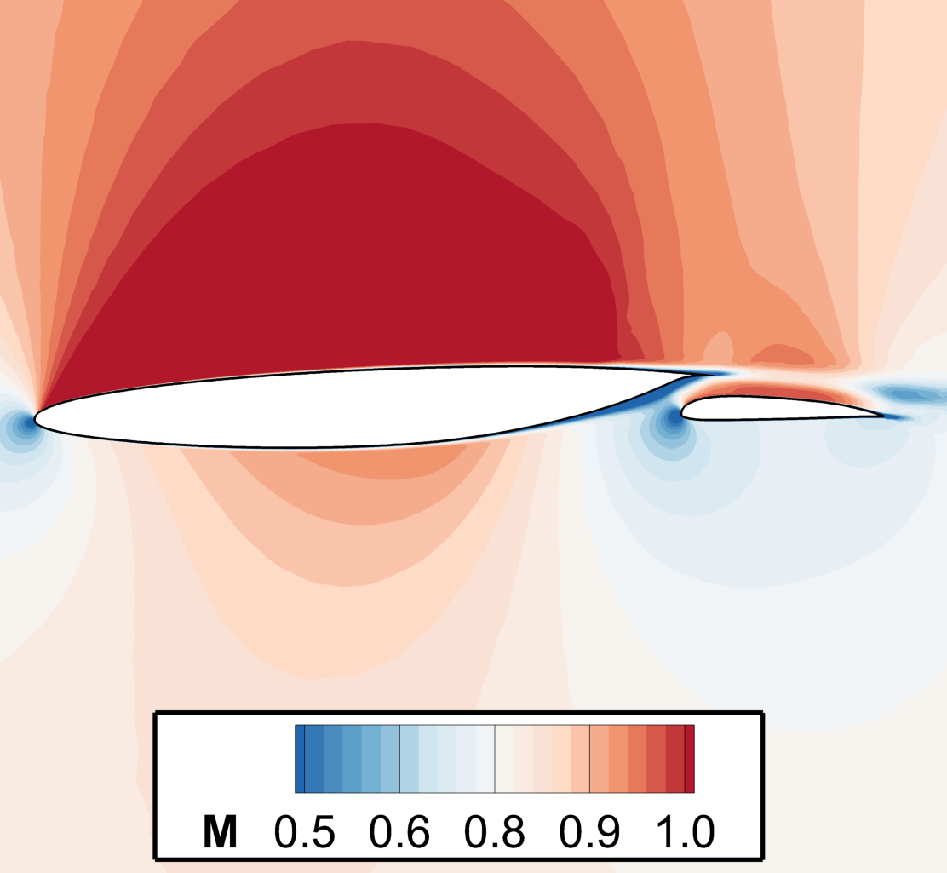
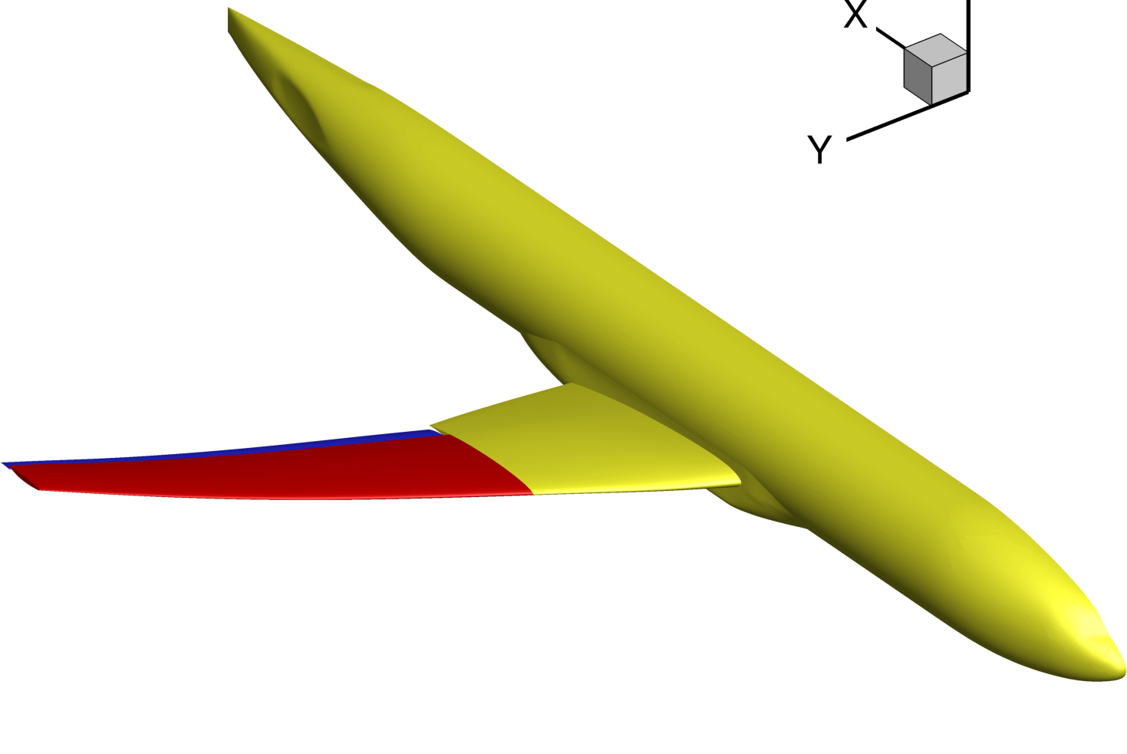
Transonic Cruise Slotted Wing Design for
Commercial Transport Aircraft using CDISC
Brett Hiller, Richard Campbell, and Michelle Banchy
NASA Langley Research Center
AIAA SciTech Forum, January 2024
Copyright 2024 United States Government as represented by the Administrator of the National Aeronautics and Space Administration. No copyright is claimed in the United States
under Title 17, U.S. Code. All Other Rights Reserved. Published by the American Institute of Aeronautics and Astronautics, Inc. with permission.
Notes:
0

Slide 2
Outline
Introduction
Geometry and Design Conditions
Computational Tools and Design Constraints
Design Approach
Design Results
Concluding Remarks

Slide 3
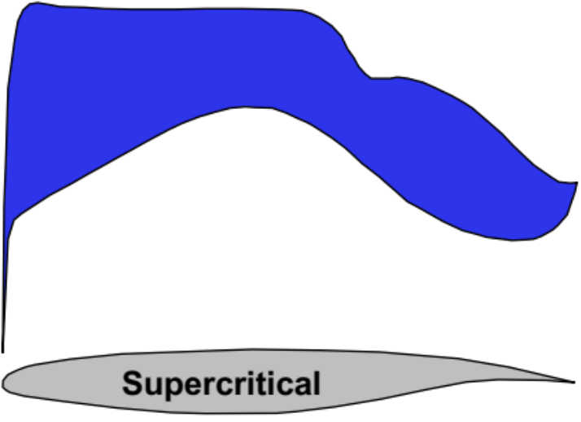
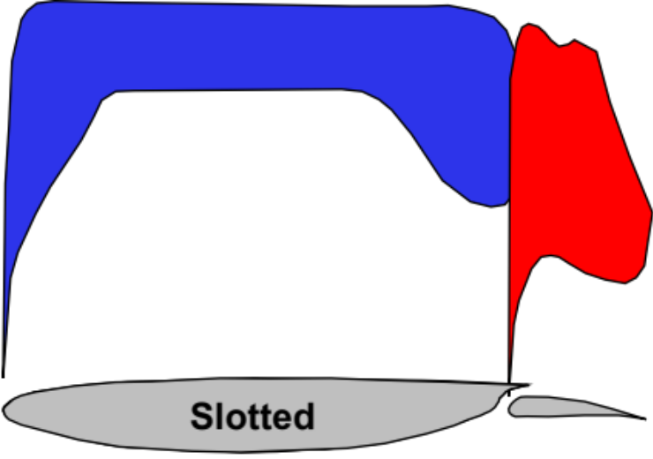
Cruise Slotted Wing Technology
Concept
The Cruise Slotted Wing (CSW) is a transonic multielement wing concept with a forward main element and an aft flap element, separated to form an intermediate slot.
Design Advantage
Flow-through slot permits stronger pressure recovery without separation,
enables greater aft loading to help reduce shock strength and pressure drag

Slide 4

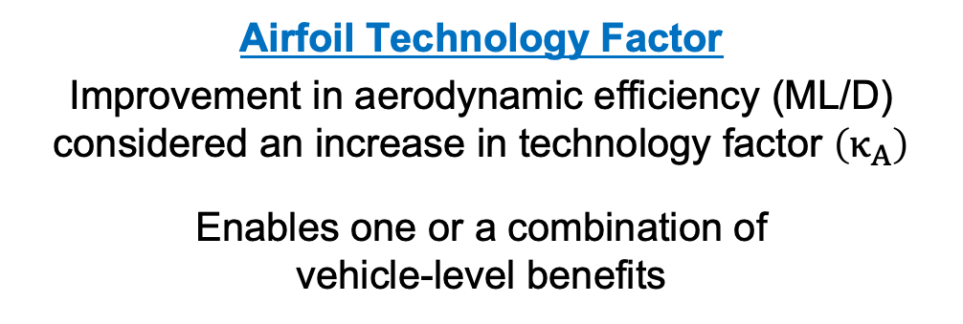
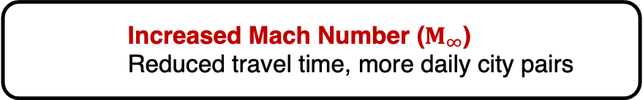
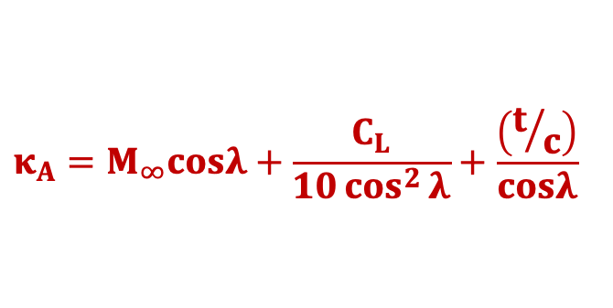

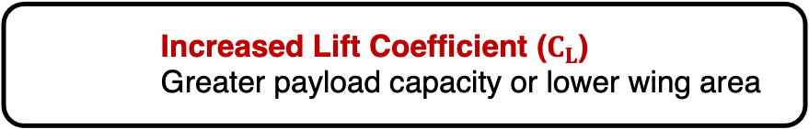
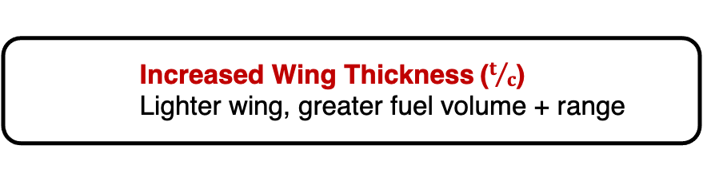
Cruise Slotted Wing Design Trades
Korn Equation
Competing design trades analytically described
using 3D Korn Equation for transonic wing performance
Design Benefits
Decreased Cruise Drag
    Less fuel consumption, lower emissions
Increased Mach Number ($M_{∞}$)
    Reduced travel time, more daily city pairs
$$κ_{A}=M_{∞}cosλ+\frac{C_{L}}{10\cos^{2}{λ}}+\frac{\left(t/c\right)}{cosλ}$$
Increased Lift Coefficient ($C_{L}$)
    Greater payload capacity or lower wing area
Airfoil Technology Factor
Improvement in aerodynamic efficiency (ML/D)
considered an increase in technology factor $\left(κ_{A}\right)$
Enables one or a combination of
vehicle-level benefits
Increased Wing Thickness ($t/c$)
    Lighter wing, greater fuel volume + range
Decreased Wing Sweep ($λ$)
    Lighter wing, potential laminar flow benefit

Slide 5
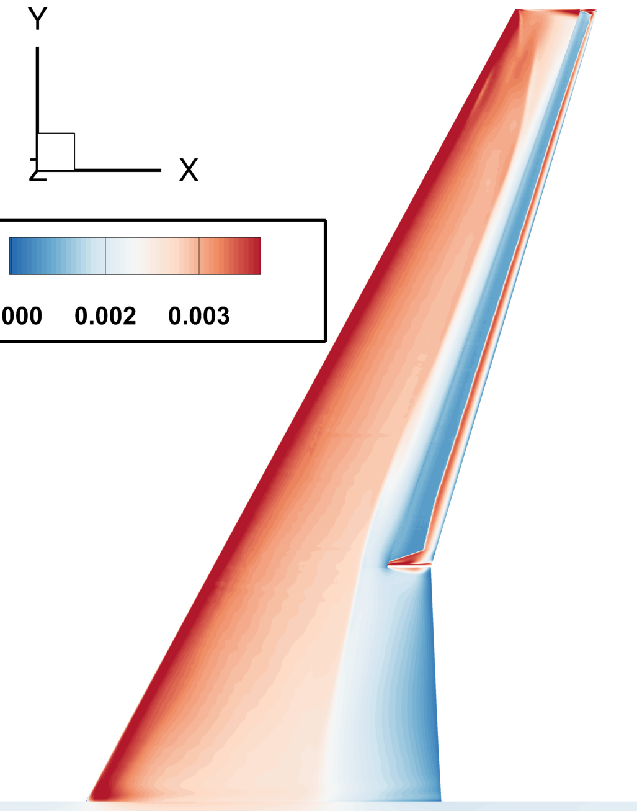
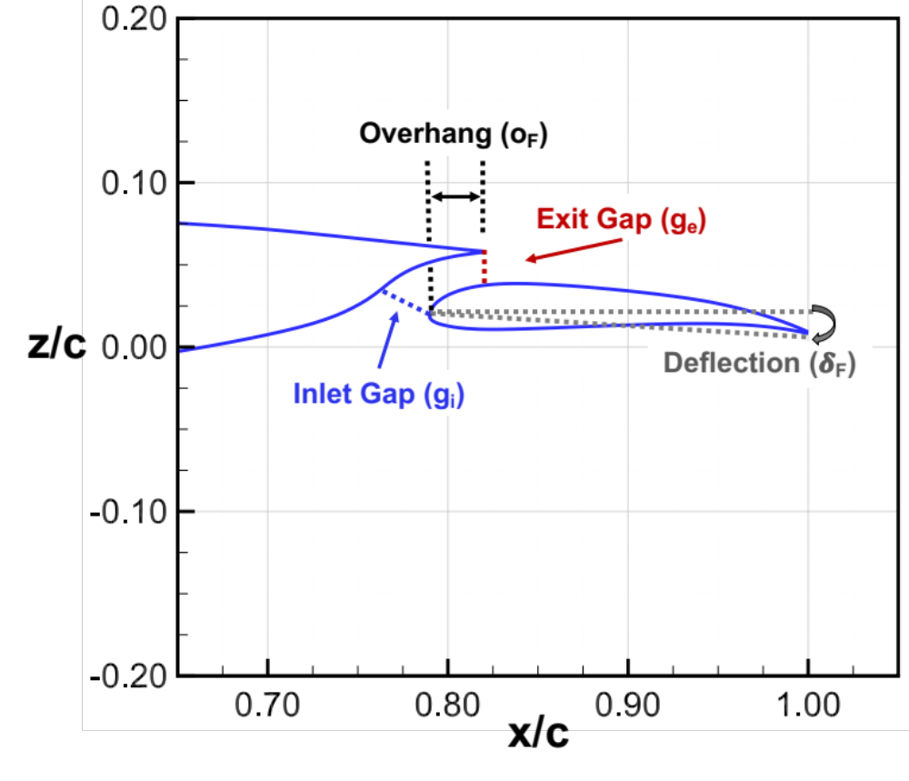
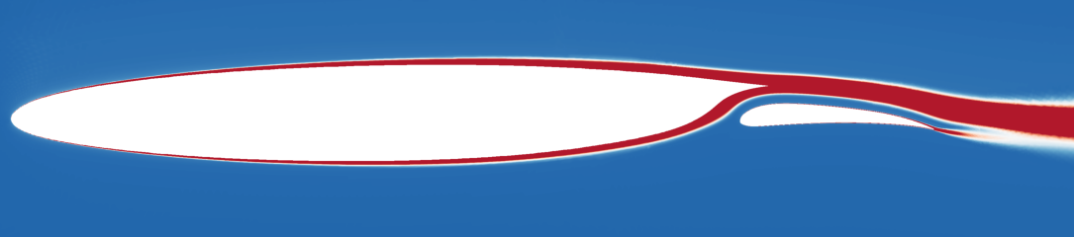
Research Plan
Objective
Quantify the potential vehicle performance benefits of CSW technology
in application to next-generation, single-aisle transonic commercial transports
with cruise speeds near Mach 0.8
CDISC Development
2D Airfoil Design
3D Wing Design
Goal: To develop design tool
AIAA Paper 2021-2525
Goal: To quantify drag benefit
AIAA Paper 2021-2525
Goal: To confirm drag benefit
Current Paper
Aft Laminar Multielement Airfoil (ALMA)
2.7% profile drag reduction
relative to supercritical airfoil

Slide 6
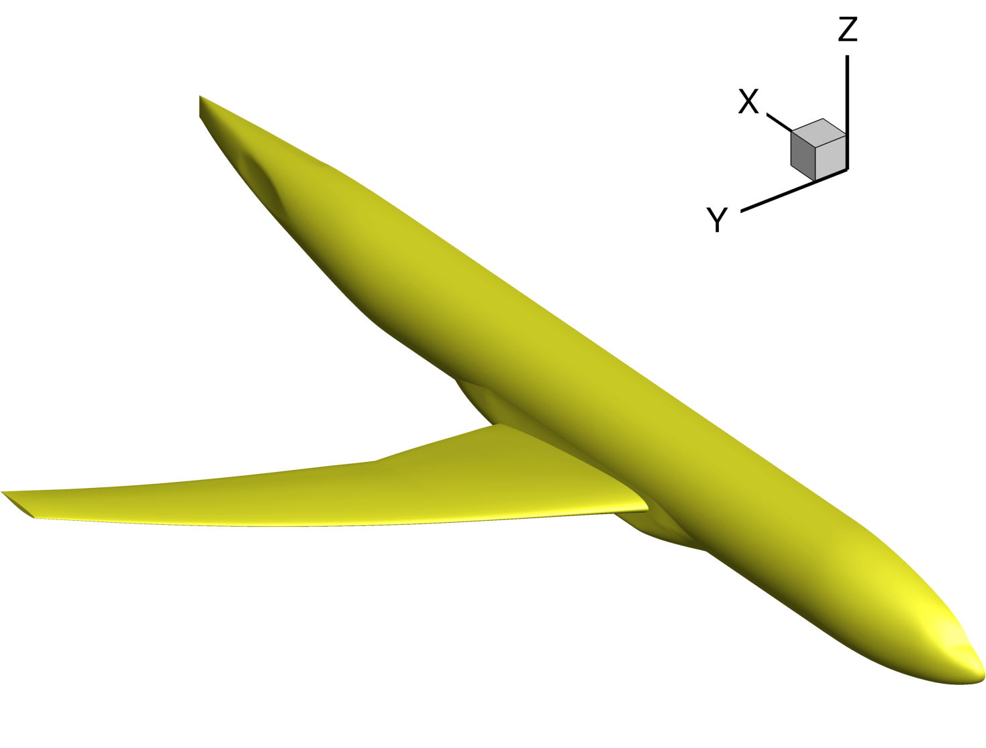
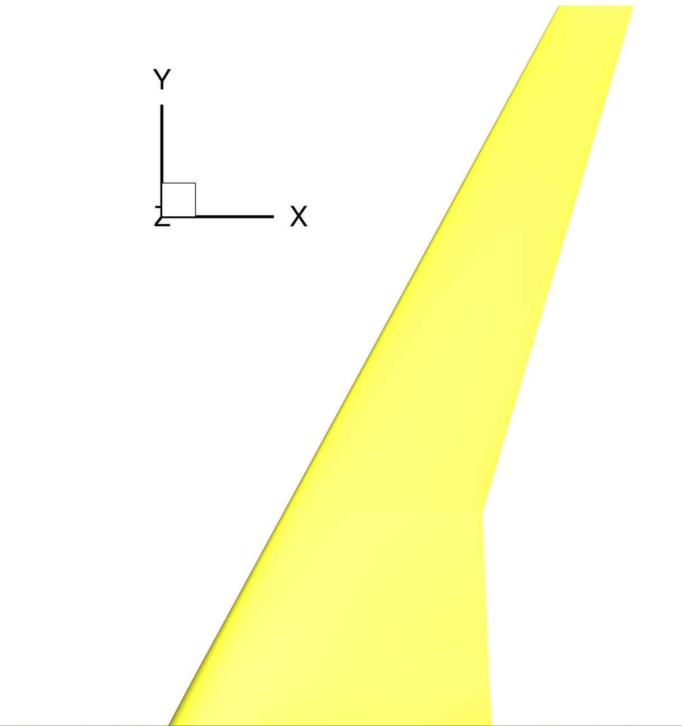
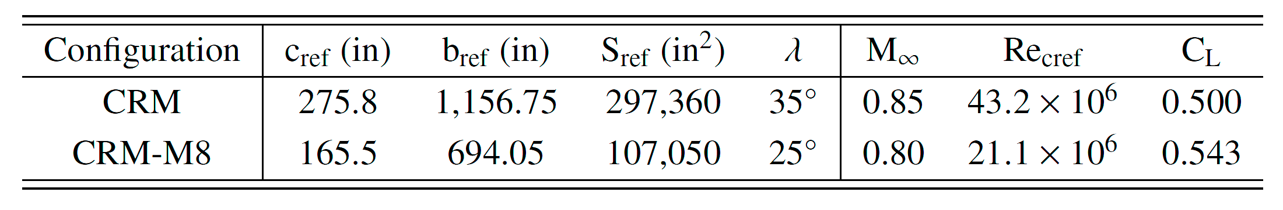

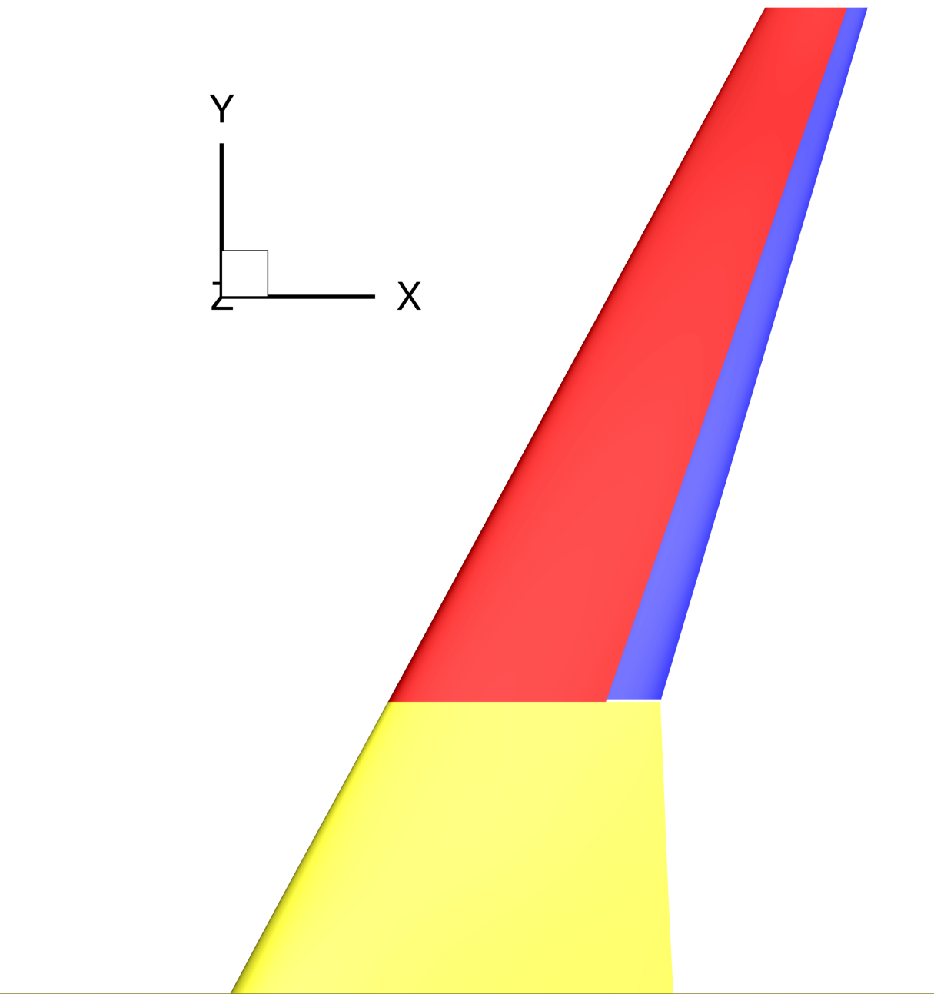
Geometry and Design Conditions
Baseline Conventional Wing
Mach-0.8 variant of the Common Research Model (CRM-M8) created for a representative
single-aisle, transonic transport aircraft model
CRM-M8 Conventional Wing
Baseline Cruise Slotted Wing
MAKESLOT code creates partial-span,
slotted wing geometry from conventional wing
Features common fuselage and inboard wing,
outboard slotted wing with main element and flap
CRM-M8 Cruise Slotted Wing

Slide 7
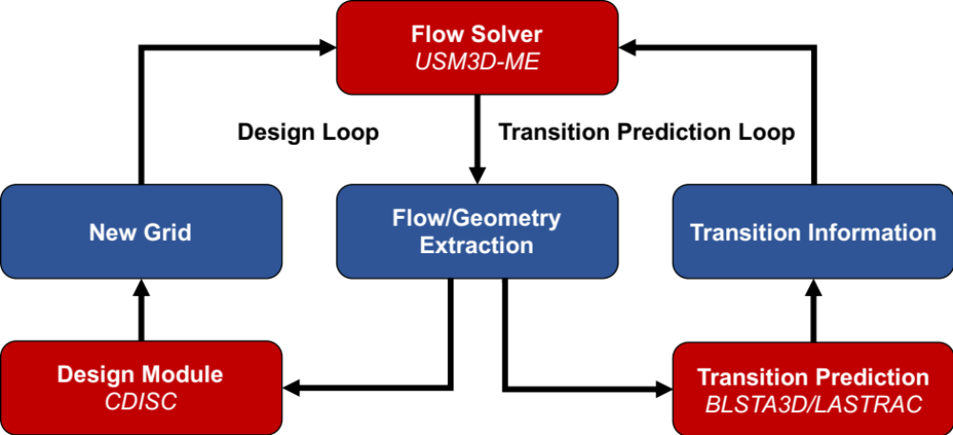
Computational Tools

Slide 8
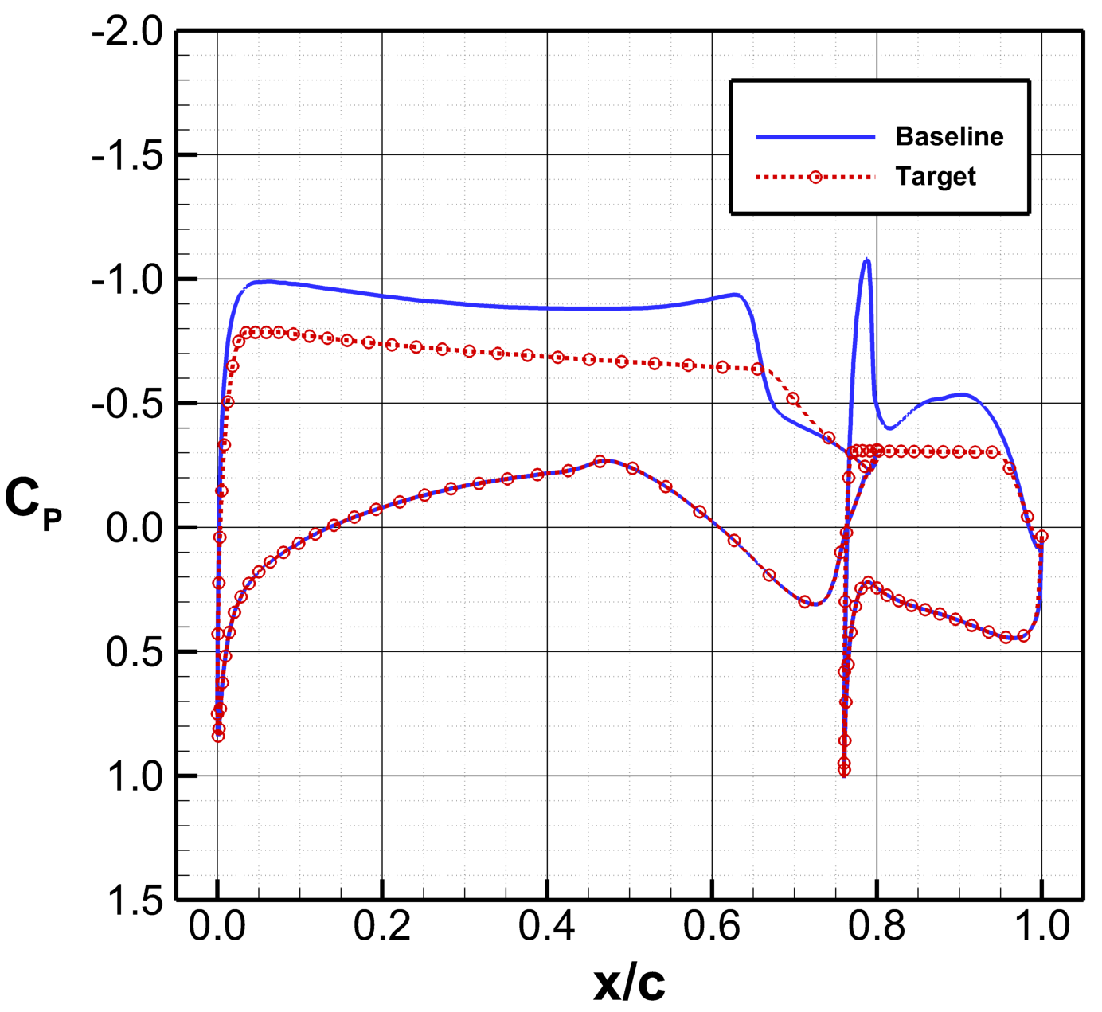
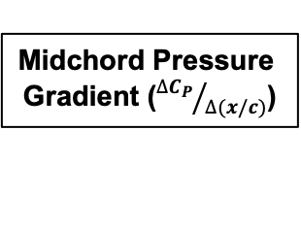
CDISC Multielement Design Constraints
Flow Constraints
Target Pressure Generation
End of Initial Acceleration
  → Main: multipoint best practice
  → Flap: 5% of flap chord, limited crossflow (CF)
  concern due to low Re_{c} and sweep
Midchord Pressure Gradient
  → Main: multipoint best practice
  → Flap: control Tollmien-Schlichting (TS)
Start of Pressure Recovery
  → Main: stable shock at 70% total chord
  → Flap: attached recovery at 95% total chord
Multielement Load Balancing
Alters sectional lift required for both elements
  → loading ratio = c_{l,flap} / c_{l,main}
Midchord Pressure
Gradient (${∆C_{P}}/{∆(x/c)}$)
C_{P}*
End of Initial
Acceleration (x₁)
Start of Pressure
Recovery (x₂)
Subsonic Flap
Load Balancing
CDISC Slotted Airfoil Target Pressures

Slide 9
CDISC Multielement Design Constraints
Geometry Constraints
Flap Overhang (o_{F})
Horizontal distance between the flap leading edge (LE) and the main element trailing edge (TE) → slot length
Flap Deflection (𝛅_{F})
Flap incidence angle relative to the 𝛂 = 0° reference line
→ flap loading
Slot Exit Gap (g_{e})
Vertical distance between the main element TE
and the flap upper surface → min. wake interference
Slot Inlet Gap (g_{i})
Shortest distance between flap LE and the max. surface slope point on the main element lower surface
→ increase main element camber and aft loading
CDISC Slotted Airfoil Parameterization

Slide 10
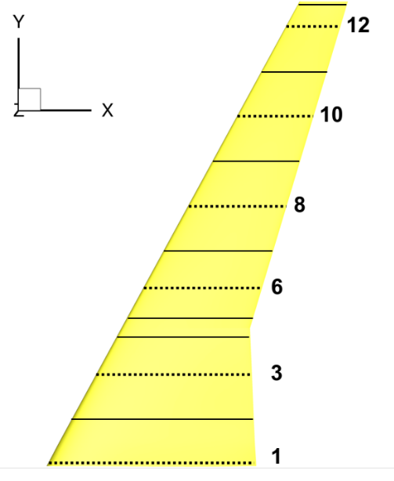
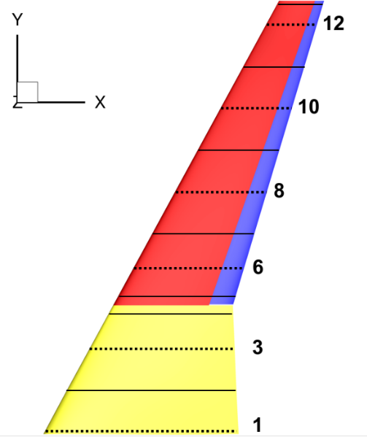
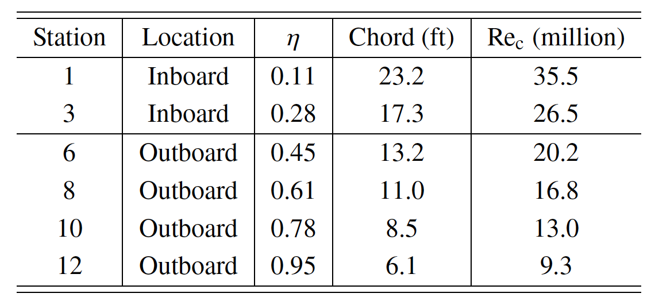
Design Approach
Design Stations (13 Total)
Design Strategy
Conventional Wing
CDISC best practices for turbulent supercritical wing design, used target pressure constraint
Cruise Slotted Wing
Matched design 𝛂 of conventional wing
→ Limit change in fuselage/fairing drag
Matched spanwise lift distribution
→ Limit change in induced drag
Identical inboard wing design constraints
→ Isolate drag change to outboard wing
Outboard wing design using new constraints
→ Min. shock strength with subsonic flap

Slide 11
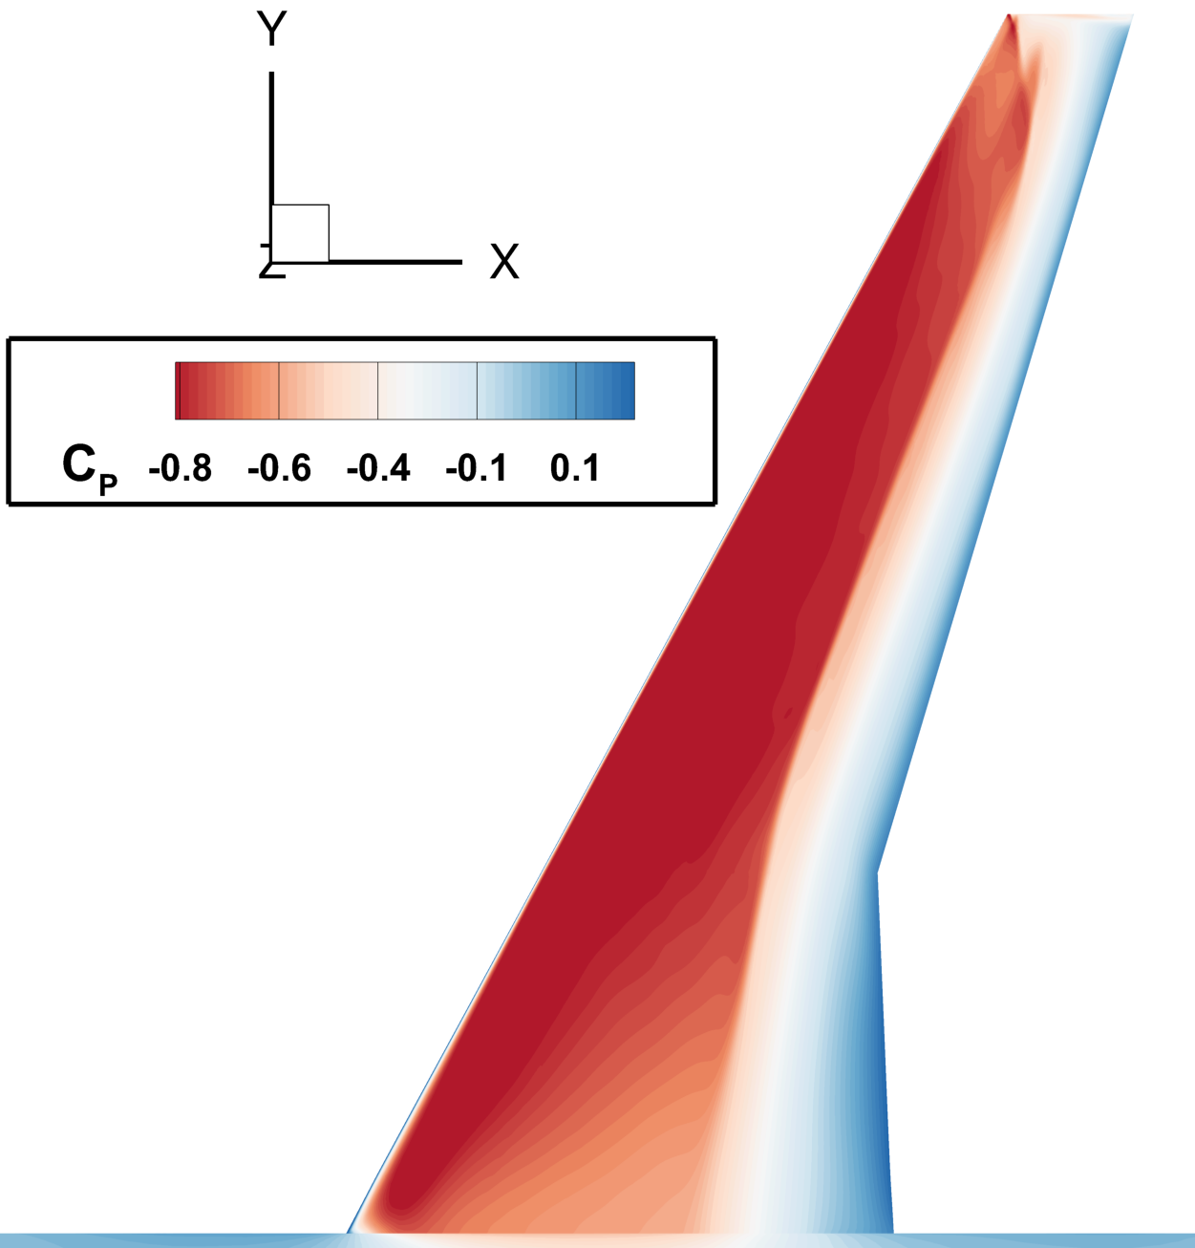
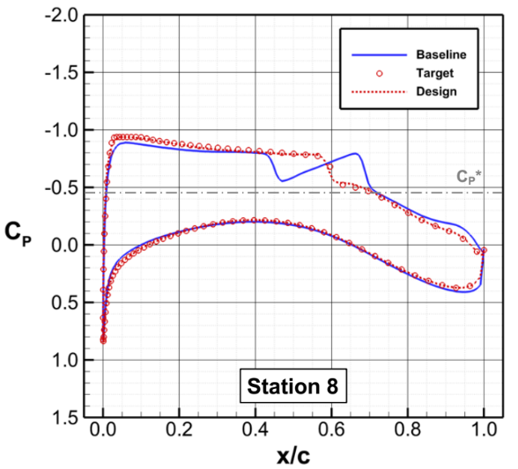
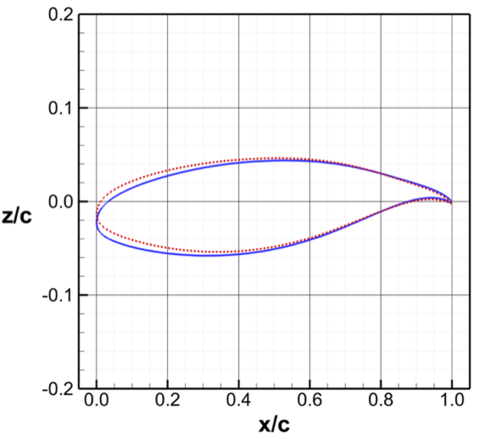
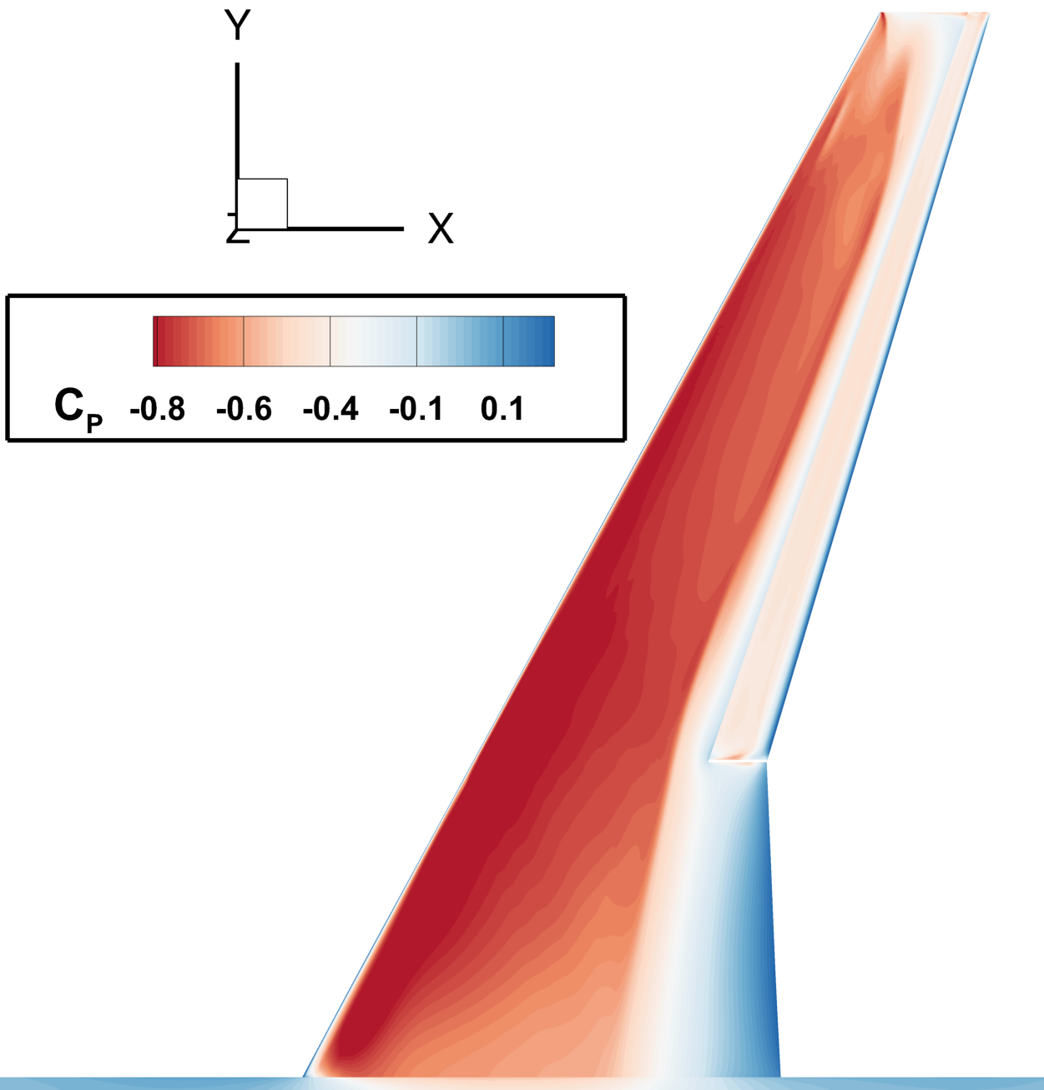
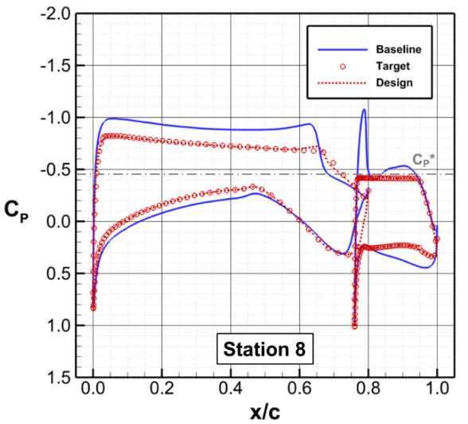
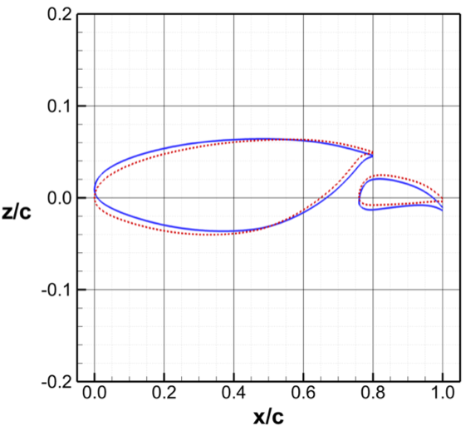
Design Results: Pressures and Geometry
M = 0.8, Re_{cref} = 21.1 million, C_{L} = 0.543
Conventional
Wing
8
Slotted
Wing
8

Slide 12
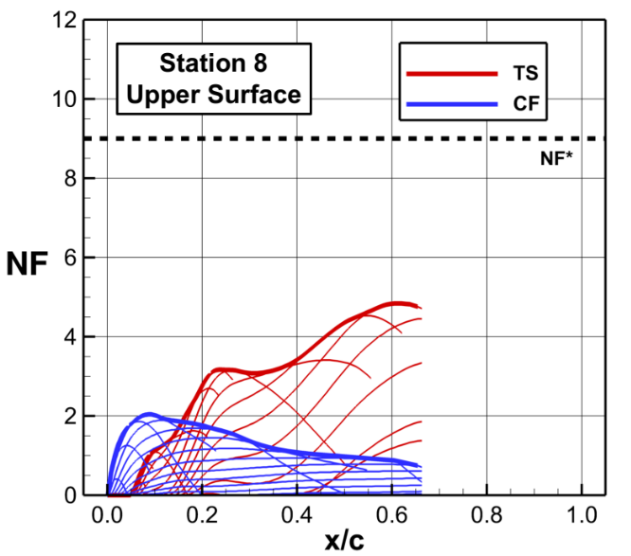
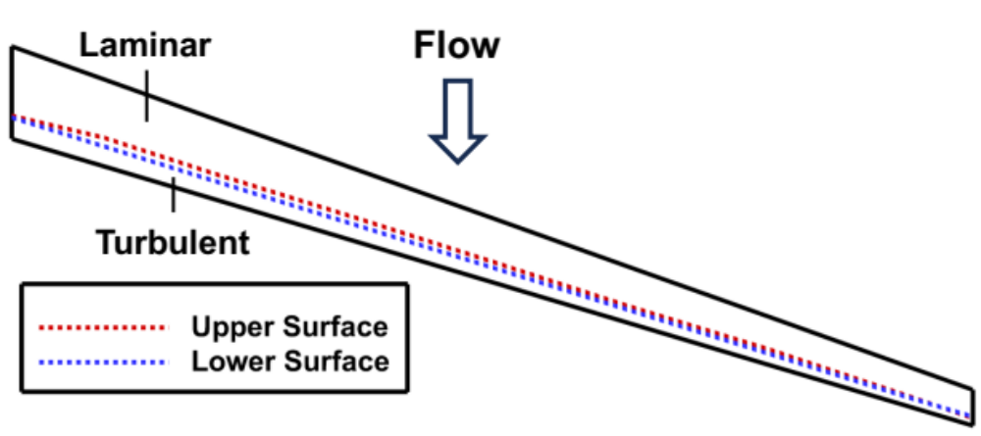
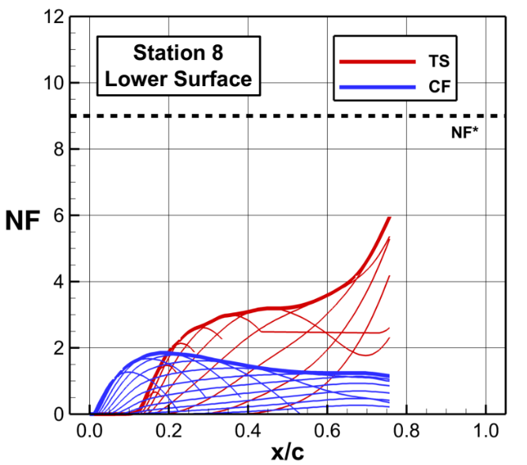
Design Results: NLF Predictions
NLF Predictions for Flap Design
Transition predictions estimate NLF for
71% of upper surface and 77% of lower surface
using critical N-factor (NF) of 9

Slide 13
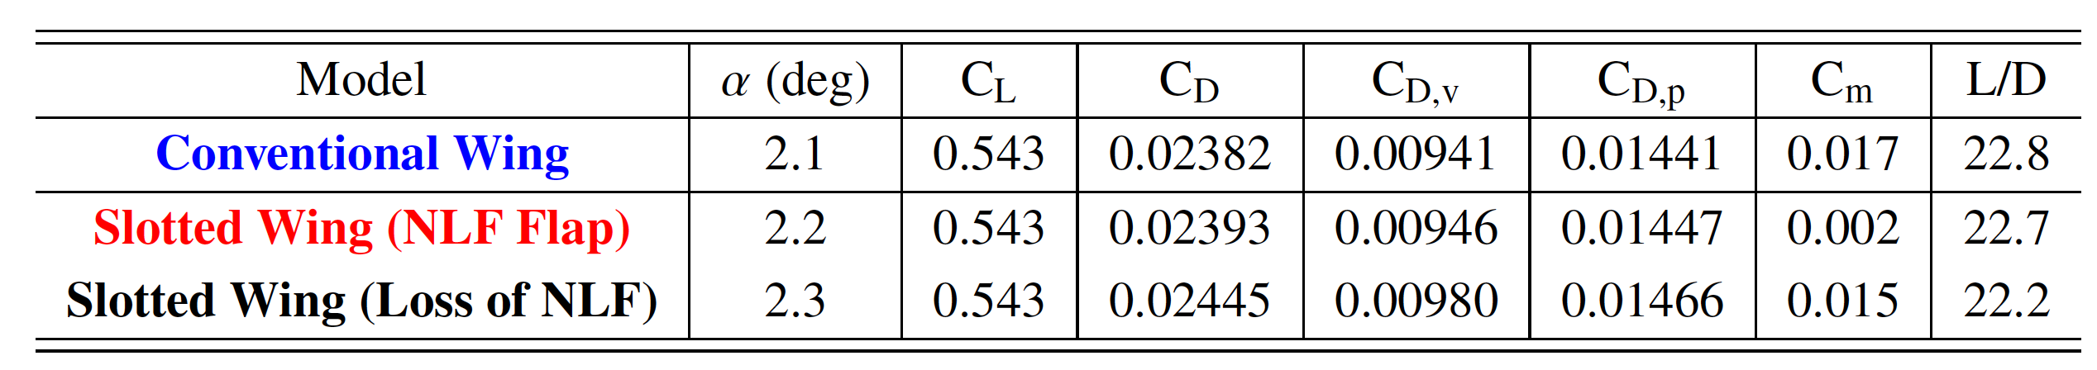
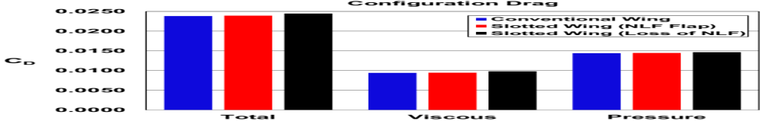
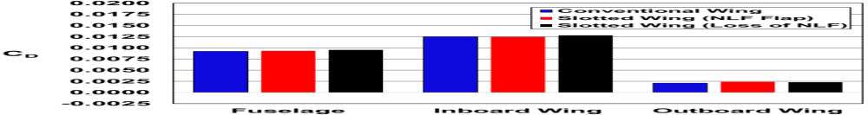
Design Results: Cruise Forces and Moments
Cruise Assessment (M = 0.8, Re_{cref} = 21.1 million)
The CSW shows comparable cruise drag (~1 ct.) to the conventional wing.
NLF flap significantly reduces skin-friction penalty, but no pressure drag savings at design condition
+2.5 ct
125 ct
+0.6 ct
92 ct
+3.9 ct
+0.5 ct
21 ct

Slide 14
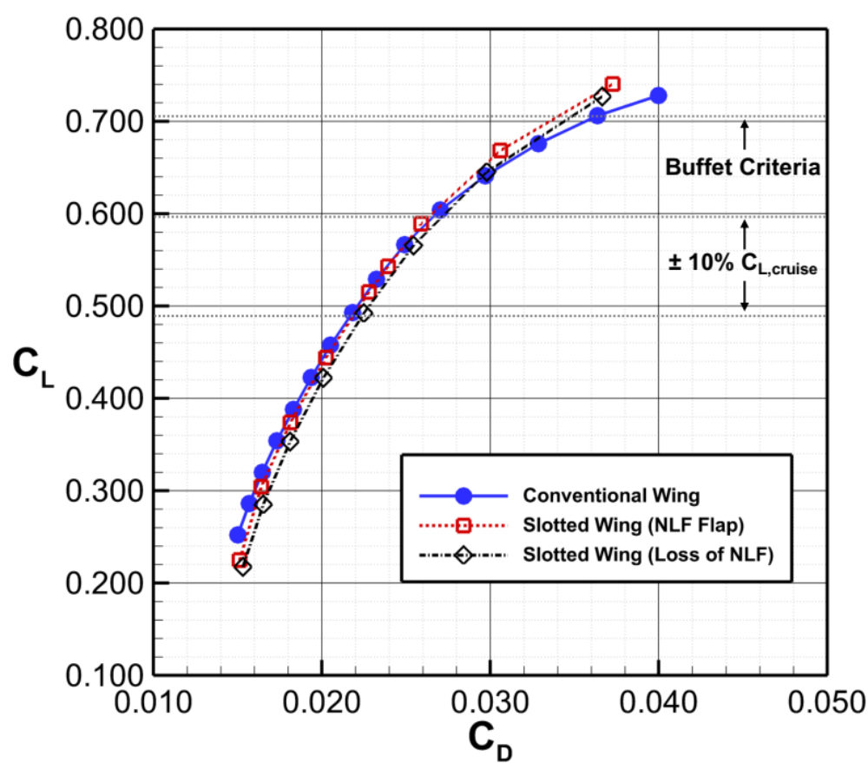
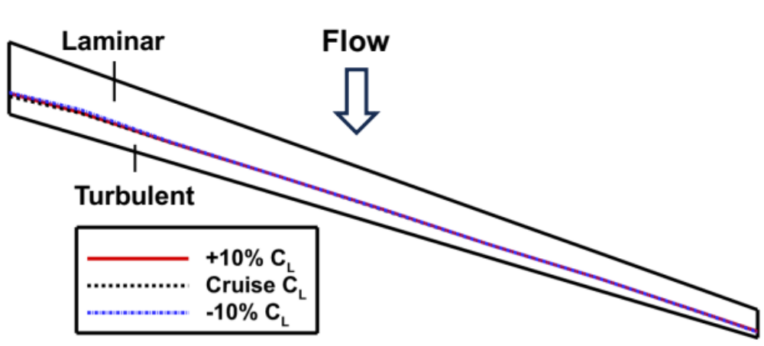
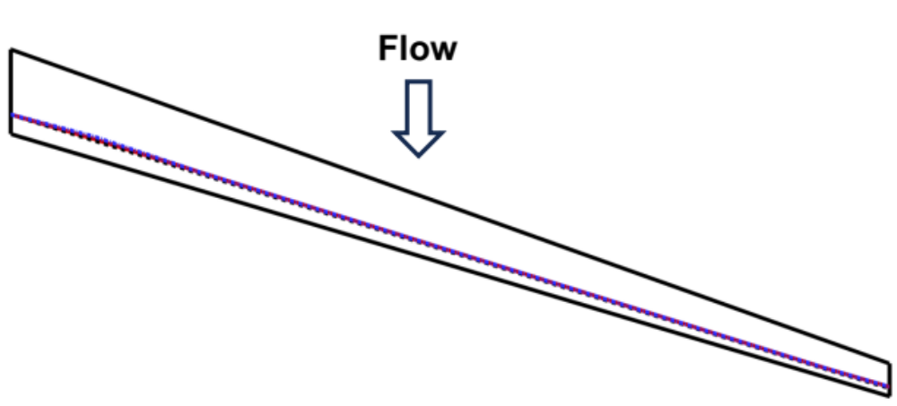
Design Results: Off-design Performance
M = 0.8, Re_{cref} = 21.1 million
Flap Upper Surface
Flap Lower Surface

Slide 15
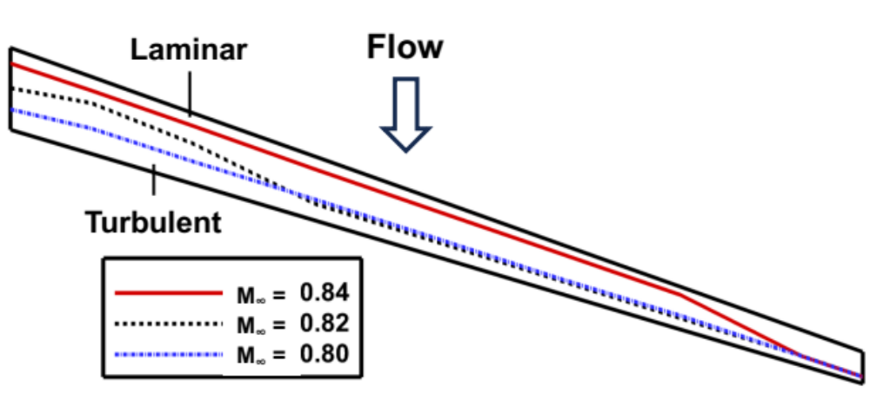
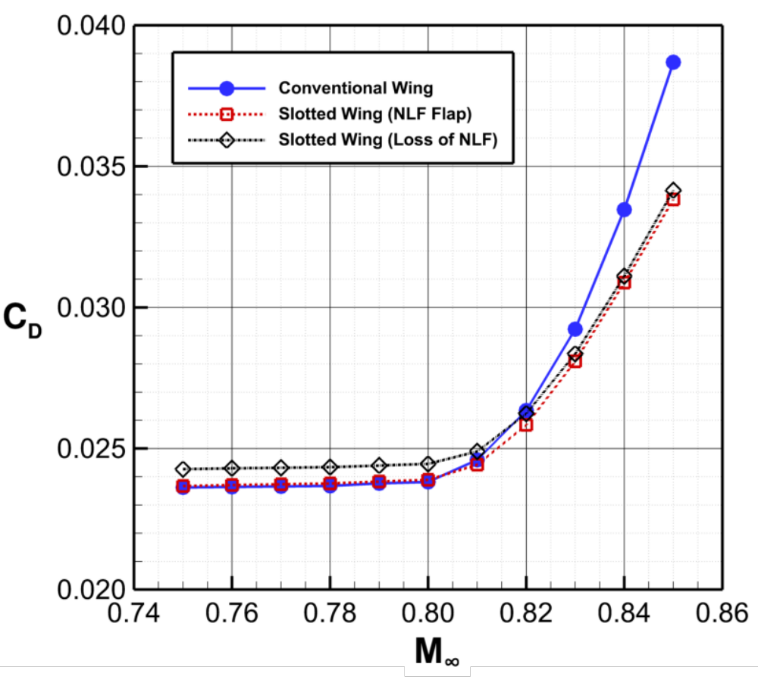
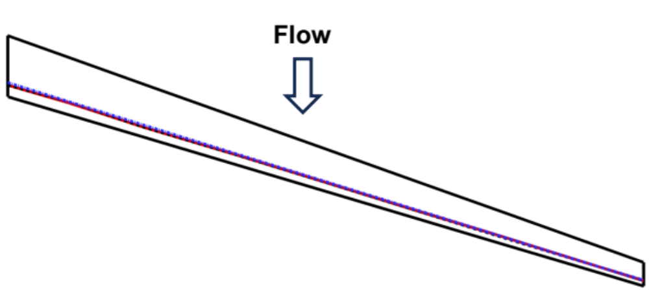
Design Results: Off-design Performance
C_{L} = 0.543, Re_{cref} = 21.1 million
Flap Upper Surface
Flap Lower Surface

Slide 16
Concluding Remarks
Series of CDISC multielement flow and geometry constraints created to enable the computational design of transonic cruise slotted wings
Partial-span, Cruise Slotted Wing (CSW) designed for a Mach-0.8 variant of the CRM
  Subsonic flap loading was maximized to reduce main element shock strength and shift terminating shock location aft by 10% chord relative to supercritical wing
  Leverages Aft Laminar Multielement Airfoil (ALMA) concept to achieve NLF on approximately
  75% of flap surface area (upper/lower surfaces)
  Cruise drag estimates from USM3D-ME showed comparable performance relative to supercritical wing at flight conditions representative of single-aisle, transonic transports
  Off-design assessments showed limited NLF sensitivity to 𝛂 and more gradual drag rise
Future work planned to explore other trades and CSW design with full-chord NLF
  Explore alternative design trades, including Mach number, thickness, etc.
  Crossflow Attenuated Natural Laminar Flow (CATNLF) methods used to design main element
    Achieves skin-friction drag reductions and improved drag rise behavior

Slide 17

Contact: Brett Hiller <brett.hiller@nasa.gov>

