Slide 1
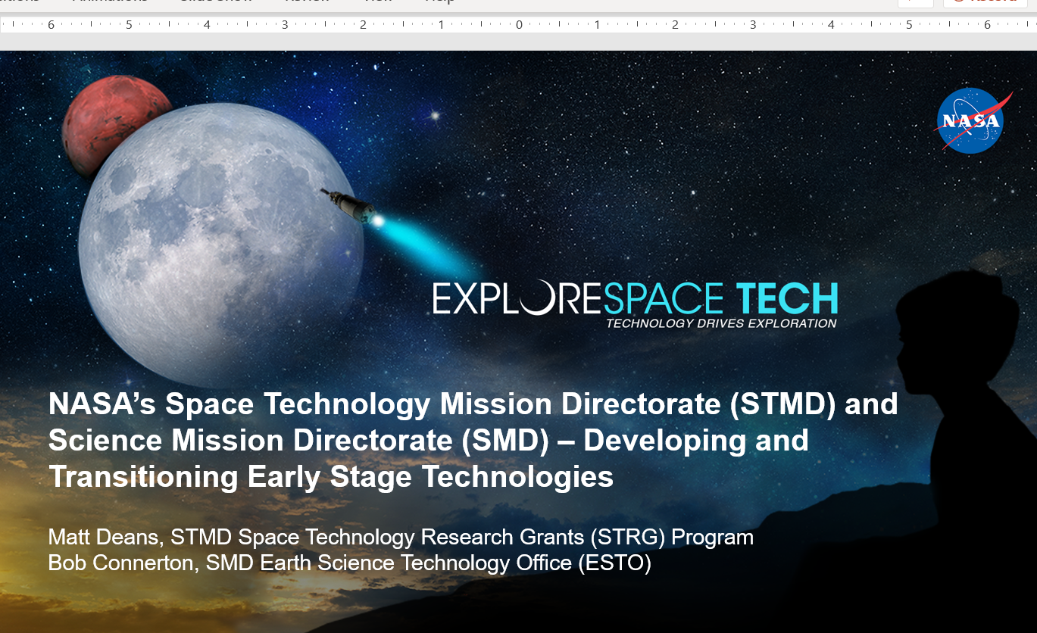
Space Technology Research Grants (STRG) Program
NASA Space Technology Graduate Research Opportunities (NSTGRO)
Program Executive: Dr. Matt Deans

Slide 2
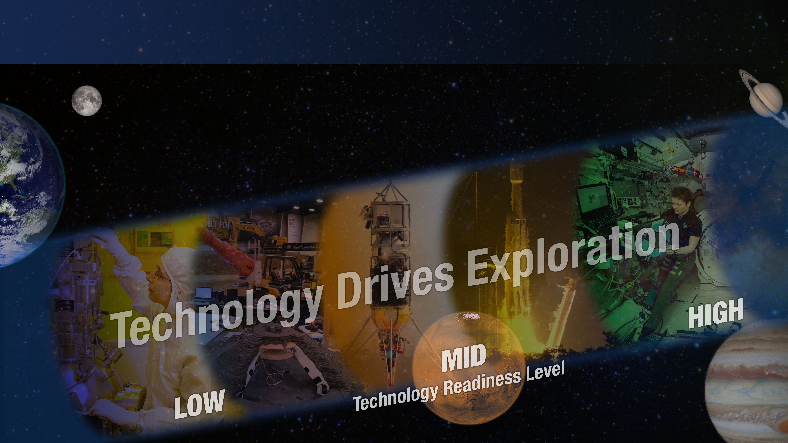
SPACE TECHNOLOGY PORTFOLIO
EARLY STAGE INNOVATION
AND PARTNERSHIPS
Early Stage Innovation
  Space Tech Research Grants
  Center Innovation Fund
  Early Career Initiative
  Prizes, Challenges & Crowdsourcing
  NASA Innovation Advanced Concepts
Technology Transfer
SBIR/STTR PROGRAMS
Small Business Innovation Research
Small Business Technology Transfer
TECHNOLOGY MATURATION
Game Changing Development
Lunar Surface Innovation Initiative
TECHNOLOGY DEMONSTRATION
Technology Demonstration Missions
Small Spacecraft Technology
Flight Opportunities
Notes:
Introduce STMD, including the portfolio and program structure
Key takeaway: STMD has a lot of power/energy investments across all stages of development
Preview that you will give you some high-level examples of R&D in each of these areas, many of which they will hear more about over the next few days

Slide 3




Early Stage Innovations and Partnerships (ESIP) - Strategic Framework
Vision
American aerospace innovation enables NASA's mission and invigorates our economic future
Mission
Empower a community of innovators spearheading aerospace research and game-changing technology ventures
Goals
Goal 1
Goal 2
Goal 3
Goal 4
Early-Stage Investments
Breadth of Innovators
Transition Pathways
Program Champion
Curate a diversified portfolio of ambitious, risk-informed early-stage technology investments
Build and nurture diverse communities across the portfolio's R&D cycle
Expand access to new and existing technology transition pathways
Grow support for the portfolio by communicating its transformative impact and potential

Slide 4







The Early Stage Innovation and Partnerships (ESIP) Portfolio
Working together, ESIP amplifies the value and impact of STMD’s and NASA’s early-stage technology development and tech commercialization programs. Each of ESIP’s programs and activities play an important role in this work.
NIAC
STRG
CIF/ECI
PCC
ESIC
SBIR/STTR
T2
NASA Innovative Advanced Concepts
Space Tech Research Grants
Center Innovation Fund / Early Career Initiative
Prizes, Challenges, & Crowdsourcing
Early-Stage Innovation and Commerce
Small Business Innovation Research / Small Business Technology Transfer
Technology Transfer
Nurtures visionary ideas that could transform future NASA missions by engaging America’s innovators and entrepreneurs as partners in the journey.
Challenges the spectrum of academic researchers to making science, space travel, and exploration more effective, affordable, and sustainable.
Stimulate and encourage creativity and innovation within the NASA Centers and Early Career leaders.
Makes opportunities available for public participation in NASA research and technology solutions to support.​
Advances joint priorities and innovative pilots to under-represented communities, academic research and public private partnerships.
Engages small businesses, research institutions, and entrepreneurs in technology R&D that meet NASA needs and could be commercialized.
Ensures that innovations developed for exploration and discovery are maximizing the benefit to the Nation and enabling spinoffs.
30+ grants annually
300+ grants with dozens of universities
~140 projects across NASA Centers
>40
Activities
  ~10 pilot investments/ projects
>500 contracts with hundreds of small businesses
  >1,500 Active Patents & >700 Licenses
-------------------------- Cross-Cutting Activities --------------------------
4
Diversity, Equity, Inclusion, and Accessibility (DEIA) • I-Corps and Entrepreneurial Projects

Slide 5
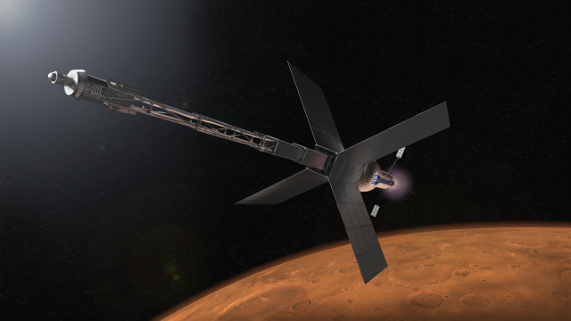
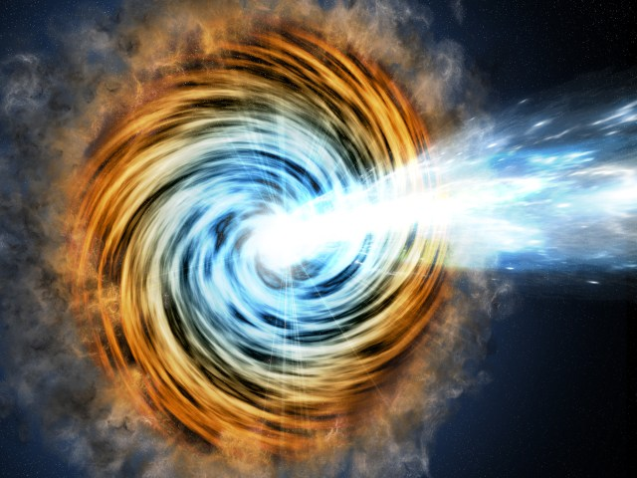
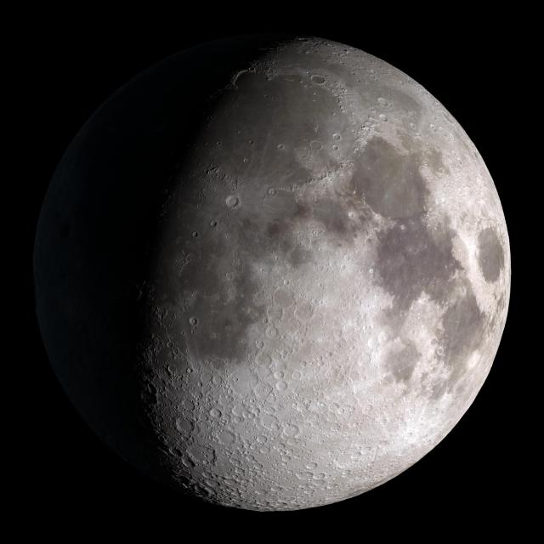
Space Technology Research Grants (STRG) - Program Overview
Engage Academia: tap into spectrum of academic researchers, from graduate students to senior faculty members, to examine the theoretical feasibility of ideas and approaches that are critical to making science, space travel, and exploration more effective, affordable, and sustainable.
STMD Monthly
Space Technology
Research Grants Program
NASA Space Technology Graduate Research Opportunities (NSTGRO) - ~$84k per year, ~2 to 4 years
  Graduate student research in space technology; research conducted on campuses and at NASA Centers and not-for-profit R&D labs
Early Career Faculty (ECF) - ~$200k per year, up to 3 years
  Focused on supporting outstanding faculty researchers early in their careers as they conduct space technology research of high priority to NASA’s Mission Directorates
Early Stage Innovations (ESI) - up to $250k per year – NTE $650k total, up to 3 years
  University-led, possibly multiple investigator, efforts on early-stage space technology research of high priority to NASA’s Mission Directorates
  Paid teaming with other universities, industry, and non-profits permitted
Lunar Surface Technology Research (LuSTR) Opportunities - up to $2M total, up to 2 years
  University-led efforts addressing high priority lunar surface challenges
  Short duration, high value grants with emphasis on technology development and potential infusion
  Paid teaming with other universities, industry, and non-profits encouraged
Space Technology Research Institutes (STRI) - up to $3M per year, planned for 5 years
  University-led, integrated, multidisciplinary teams focused on high-priority early-stage space technology research for several years
Program Executive:
Claudia Meyer
Presented by:
Jerry Niemczura
Jan Rogers
January 19, 2021
Accelerate development of groundbreaking high-risk/high-payoff low-TRL space technologies

Slide 6

Space Technology Research Grants (STRG) - Quantum Technologies for Remote Sensing
Solicitation:
  STRI22 Solicitation featured a Quantum Technologies for Remote Sensing topic
  Goal:
    Develop quantum-based technologies that can improve NASA’s science investigations, and to perform research and development that will result in a path toward their advancement for remote sensing space instruments.
    Develop a quantum sensor system to TRL 2-3 for sensor(s) and/or instrument(s) for space-based operation for future Earth Science needs as described in the 2017 Earth Science Decadal Survey
STMD Monthly
Space Technology
Research Grants Program
Award:
  The University of Texas at Austin, Dr. Srinivas Bettadpur, will lead the Quantum Pathways Institute
  Partners include University of Colorado Boulder; University of California, Santa Barbara; California Institute of Technology; and the National Institute of Standards and Technology
  The institute will work to further advance the physics underlying quantum sensors, design how these sensors could be built for space missions and understand how mission design and systems engineering would need to adapt to accommodate this new technology
January 19, 2021

Slide 7

SBIR Ignite
Key Differences from the SBIR Mainline Solicitation
  Commercialization: Seeks tech that will stimulate the market and for which NASA is not the primary customer.
  Engagement: Includes direct engagement with a panel of experts for down-selected companies.
  Topics: Features a select few topics relevant to emerging commercial markets in aerospace.
  Less Prescriptive Solicitation: Encourages companies to maintain their go-to-market strategies
  Shorter Proposal: Requires a short proposal and a slide deck in response to the solicitation
  Accelerated Award Schedule: Phase II proposal due earlier in the Phase I period, allowing Phase II awards to be made faster
Planned solicitation release: August 2024
Phase I award - $150k
Phase II award - $850k
Submission includes
  15-page Slide Deck
  7-page White Paper
Selected proposal to present a Pitch before final selection

Slide 8
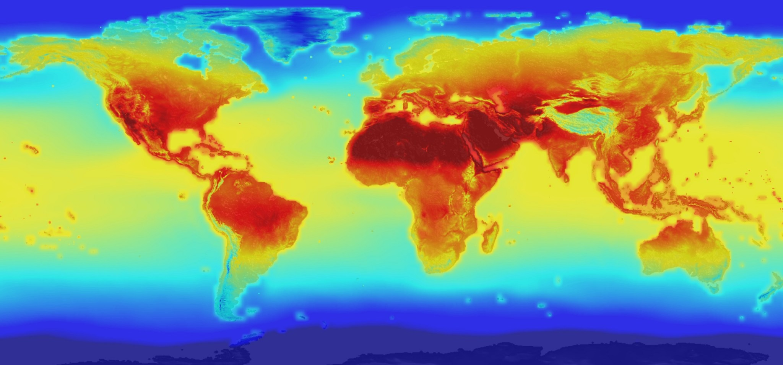
SBIR Ignite
Recent SBIR Ignite topics in collaboration with NASA Science Mission Directorate:
2022: Technologies Using NASA Data to Foster Climate Resilience
  StormImpact Inc., Dublin, Ohio: Optimizing vegetation management to improve the resilience of the electrical power system to extreme weather
  Terrafuse, Inc., Pleasanton, California: Wildfire Mitigation through Explainable Risk Predictions
2023: Earth Science Decision Support Tools with a Focus on the Mitigation of Climate Change Impacts in the areas of Wildfires and Water Management

Slide 9
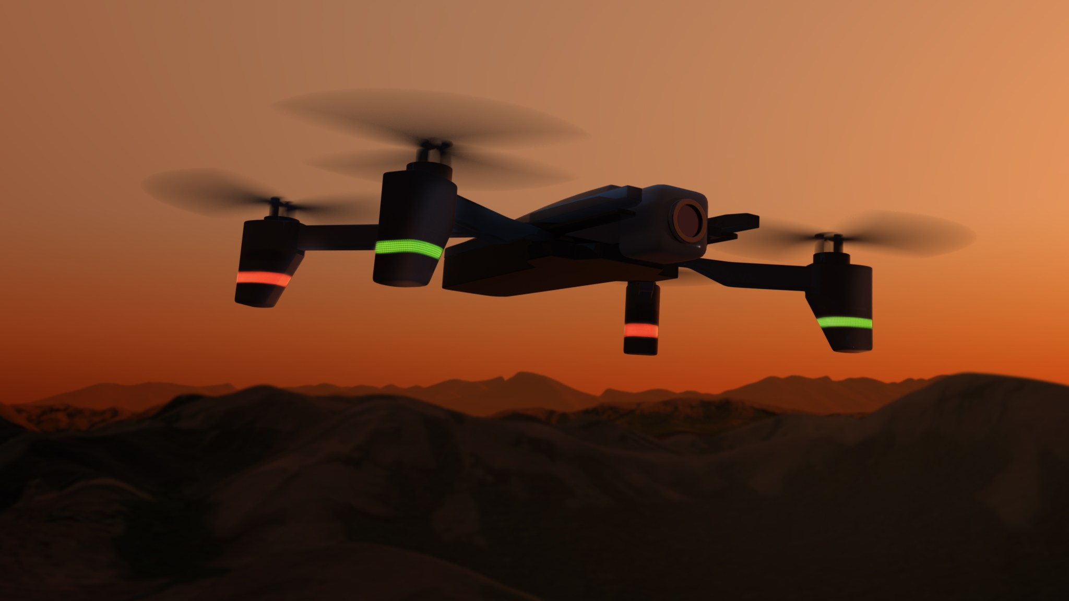
SBIR Sequentials
Per SBIR/STTR policy and authorized exceptions, NASA may operate various Post Phase II mechanisms to enable the further development and transition of technologies, including Sequential Phase II award mechanisms
Per the SBIR/STTR Policy Directive, a Phase II awardee may receive one additional Sequential Phase II award to continue the work of an initial Phase II award
These opportunities may be featured on the NASA SBIR/STTR website (sbir.nasa.gov), featured in NASA SBIR/STTR communications, and posted on SAM.gov.
In a recent solicitation, NASA sought technologies to help address wildfires, supporting both the NASA FireTech program, run by NASA’s Earth Science Technology Office, and broader NASA initiatives
STMD Monthly
Space Technology
Research Grants Program
Program Executive:
Claudia Meyer
Presented by:
Jerry Niemczura
Jan Rogers
Makel Engineering in Chico, California, will advance a chemical microsensor instrument package for uncrewed aerial vehicles (UAVs). This will enable chemical and particulate detection for pre-fire, active fire, and post-fire studies to better understand and manage wildfires and their impacts
Xiomas Technologies in Ann Arbor, Michigan, is developing a thermal mapping and measurement system that may be deployed on air platforms like UAVs or on small satellites to enable active fire front detection and enhanced wildfire studies
January 19, 2021

