Slide 1
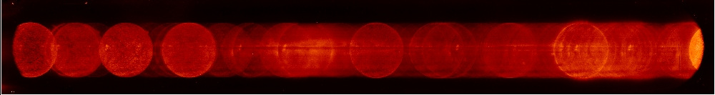
Alternate Inversion Paradigm for Spectroheliogram Data
Amy Winebarger, P.S. Athiray, Giulio del Zanna, Arthur Hochedez, Dyana Beabout, Katharine Reeves
¹NASA Marshall Space Flight Center
²University of Alabama – Huntsville
³University of Cambridge
⁴Mines Paris - PSL
⁵Smithsonian Astrophysical Observatory

Slide 2
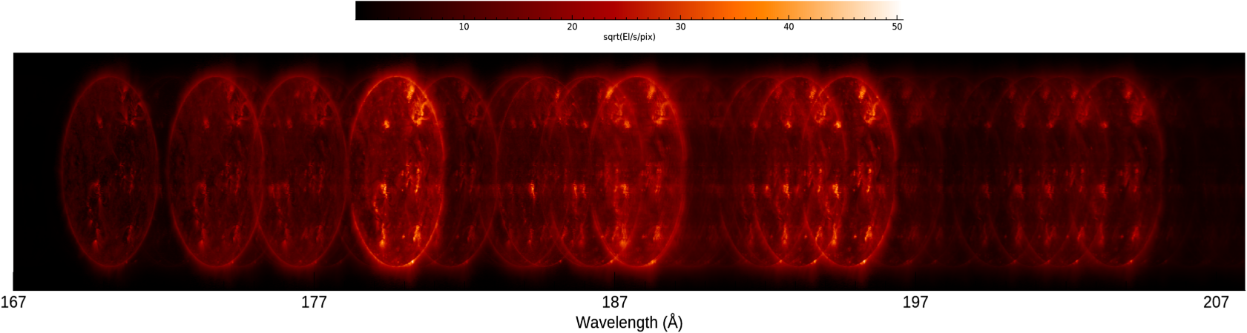
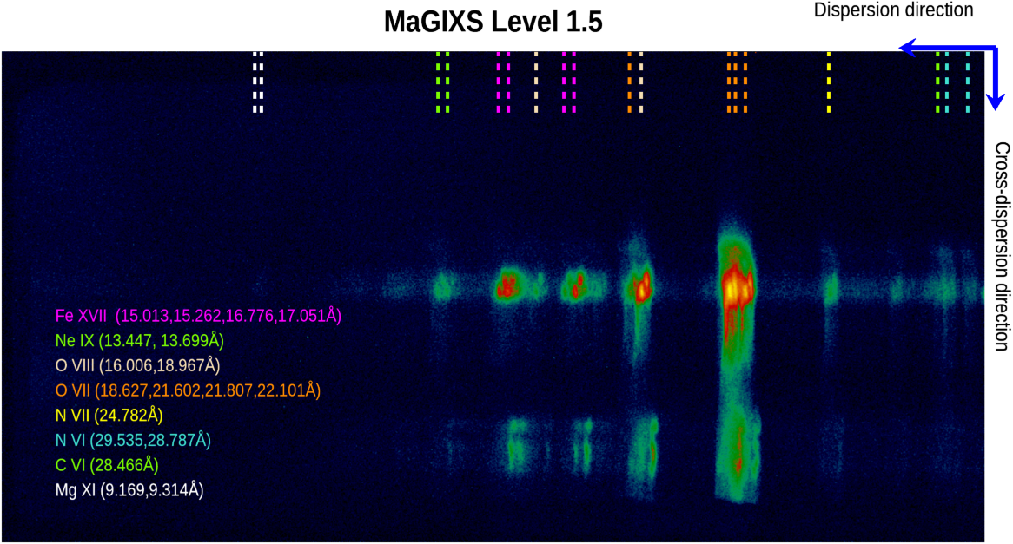
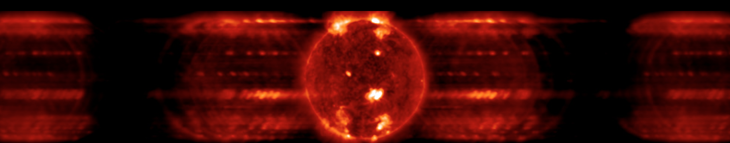
The goal of today’s talk
Imaging Spectrographs provide useful, powerful, interpretable data.
Expected ECCCO Long Wavelength Channel
MaGIXS Flight Data
Expected MOXSI data
Notes:
Today I am going to break the cardinal rule of giving a talk – I am not going to give you a highly focused talk on a single specific topic. I am going to cover a lot of different topics, a lot of different instruments and even talk about poorly constrained inversion problems. My main goal of today’s talk is to convince you that this type of data, data taken from a slitless spectrograph, is extremely useful and should be pursued in the next decade of solar observations.

Slide 3
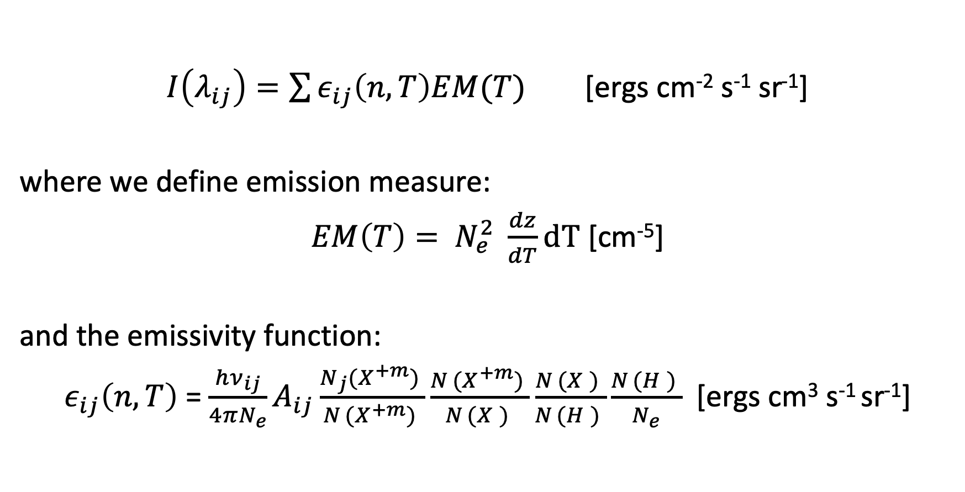
Line Intensity from a single ion
$I\left(λ_{ij}\right)=\sum{ε_{ij}\left(n,T\right)EM(T)}$ [ergs cm⁻² s⁻¹ sr⁻¹]
where we define emission measure:
$EM\left(T\right)= N_{e}^{2} \frac{dz}{dT}dT$ [cm⁻⁵]
and the emissivity function:
$ε_{ij}\left(n,T\right)$ = $\frac{hν_{ij}}{4πN_{e}}A_{ij}\frac{N_{j}{(X_{ }^{+m})}_{ }}{N_{ }{(X_{ }^{+m})}_{ }}\frac{N_{ }{(X_{ }^{+m})}_{ }}{N_{ }{(X_{ }^{ })}_{ }}\frac{N_{ }{(X_{ }^{ })}_{ }}{N_{ }{(H_{ }^{ })}_{ }}\frac{N_{ }{(H_{ }^{ })}_{ }}{N_{e}}$ [ergs cm³ s⁻¹ sr⁻¹]
Atomic physics assumptions
Notes:
Intensity of an emission line from a single ion is related by this eqn. which is the emissivity function times the DEM. The emissivity function contains probability of transition from a j→i state times number density of the ion in a given state. DEM measures the amount of plasma integrated along the line of sight as a function of temperature.

Slide 4





Finding the EM distribution
$$\left\{I\left(λ_{ij}\right)\right\}=\left\{ε_{ij}\left(n,T\right)\right\} EM(T)$$
observed
known
unknown
nfree
$ε_{1}$(T₂)
.
.
I_{line1}
$ε_{1}$(T₁)
EM (T₁)
Matrix multiplication.
Multiple methods to find EM(T).
.
.
.
.
.
.
.
.
.
.
.
.
.
.
.
.
.
.
.
.
.
.
.
.
EM (T₂)
.
.
.
.
.
.
.
.
.
.
.
nlines
=
nfree
I_{line n}
$ε_{n}$(T_{m})
$ε_{n}$(T_{m})
EM (T_{m})
Y = Mx
Notes:
Intensity of an emission line from a single ion is related by this eqn. which is the emissivity function times the DEM. The emissivity function contains probability of transition from a j→i state times number density of the ion in a given state. DEM measures the amount of plasma integrated along the line of sight as a function of temperature.

Slide 5
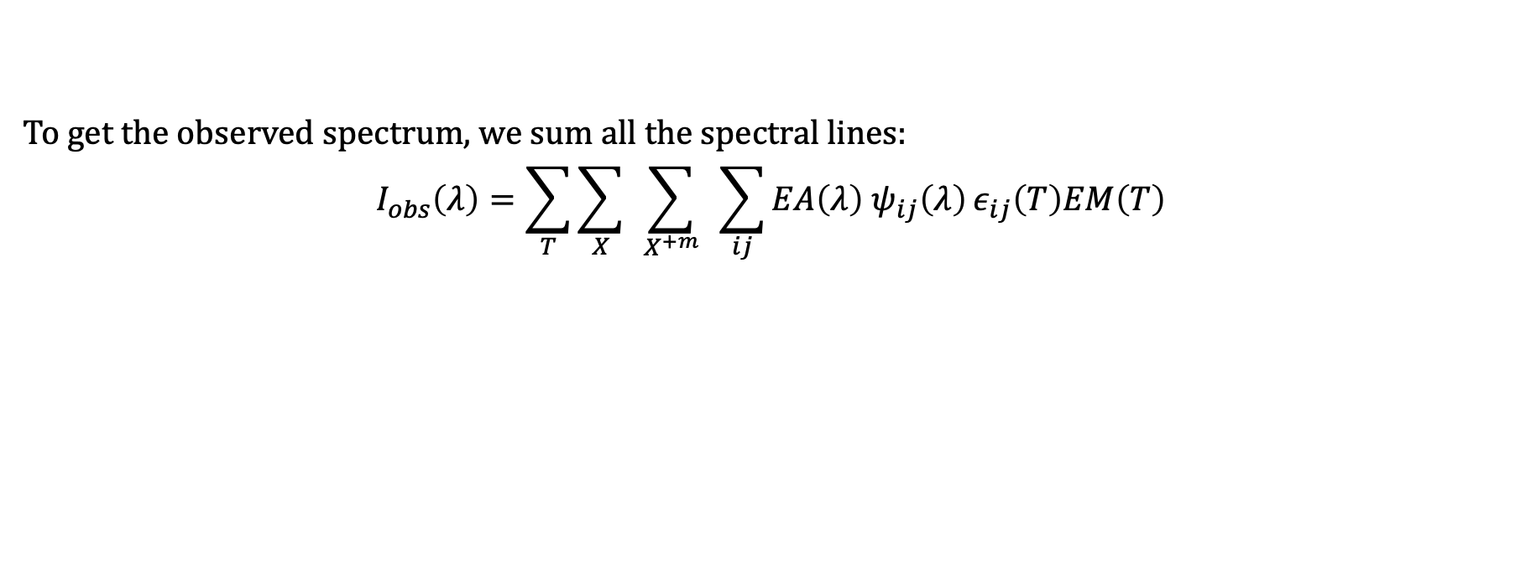
Full spectrum
*ignoring continuum for simplicity
To get the observed spectrum, we sum all the spectral lines:
$$I_{obs}\left(λ\right)=\sum_{T}{\sum_{X}{ }\sum_{X^{+m}}{ }}\sum_{ij}{{EA\left(λ\right) ψ}_{ij}\left(λ\right)}ε_{ij}\left(T\right)EM\left(T\right)$$
Unknown
Observations
All transitions from a single ion
All ions of a single element
All elements
Known Response, R, contains instrument and atomic parameters

Slide 6
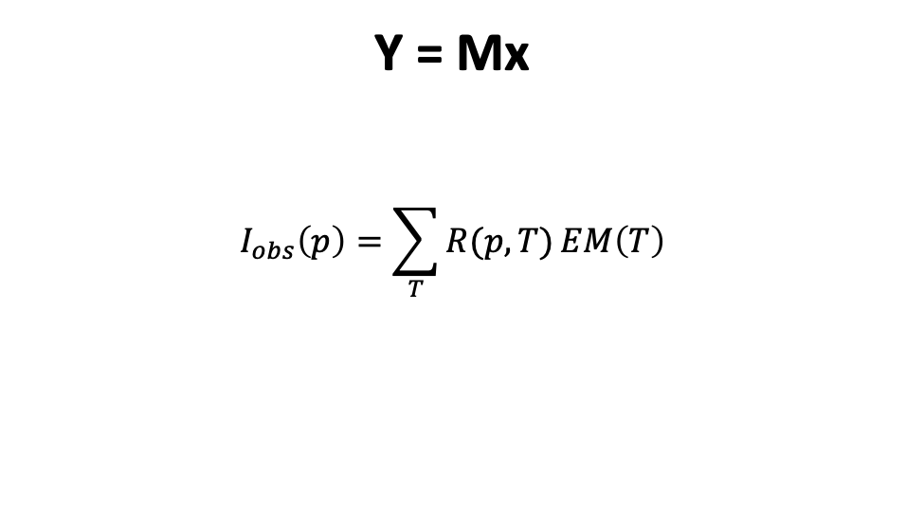
Write this as a matrix
Full detector - Slit
Y = Mx
$$I_{obs}\left(p\right)=\sum_{T}{R(p,T)}EM\left(T\right)$$
nfree
I(p₁)
R(p₁,T₁)
R(p₁,T₂)
EM (T₁)
.
.
.
.
.
.
.
.
.
.
.
.
EM (T₂)
.
.
.
.
.
.
.
.
.
.
.
.
npixels
=
Matrix multiplication.
Multiple methods to find EM(T).
nfree
I(p_{pix})
R(p_{npix},T₁)
EM (T_{m})
Y = Mx
Notes:
Motivate with EIS matrix without s

Slide 7
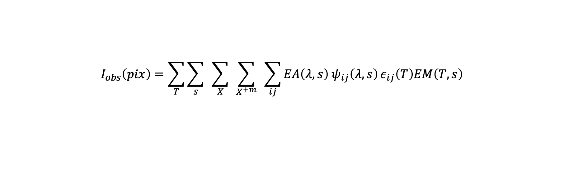
Data from slitless imaging spectrograph
*ignoring continuum for simplicity
Response
$$I_{obs}\left(pix\right)=\sum_{T}{\sum_{s}{ }\sum_{X}{ }\sum_{X^{+m}}{ }}\sum_{ij}{{EA\left(λ,s\right) ψ}_{ij}\left(λ,s\right)}ε_{ij}\left(T\right)EM\left(T,s\right)$$
Unknown
Observations
All transitions from a single ion
All ions of a single element
All elements
All spatial locations on the Sun
Where ${ ψ}_{ij}\left(λ,s\right)$also maps the wavelength and spatial location into detector pixel coordinates.

Slide 8
Slit →Slitless response function
Y = Mx
Slitless
Slit
nfree
nfree
I(p₁)
R(p₁,s₁,T₁)
R(p₁,s₂,T₁)
I(p₁)
R(p₁,T₁)
R(p₁,T₂)
EM (s₁, T₁)
EM (T₁)
.
.
.
.
.
.
.
.
.
.
.
.
EM (s₂, T₁)
.
.
.
.
.
.
.
.
.
.
.
.
EM (T₂)
.
.
.
.
.
.
.
.
.
.
.
.
.
.
.
.
.
.
.
.
.
.
.
.
npixels
=
npixels
=
nfree
nfree
I(p_{pix})
R(p_{npix},s_{1,} T₁₎
EM (s_{n}, T_{m})
I(p_{pix})
R(p_{npix},T₁)
EM (T_{m})
M → Instrument calibration * Atomic Physics
Notes:
Motivate with EIS matrix without s

Slide 9
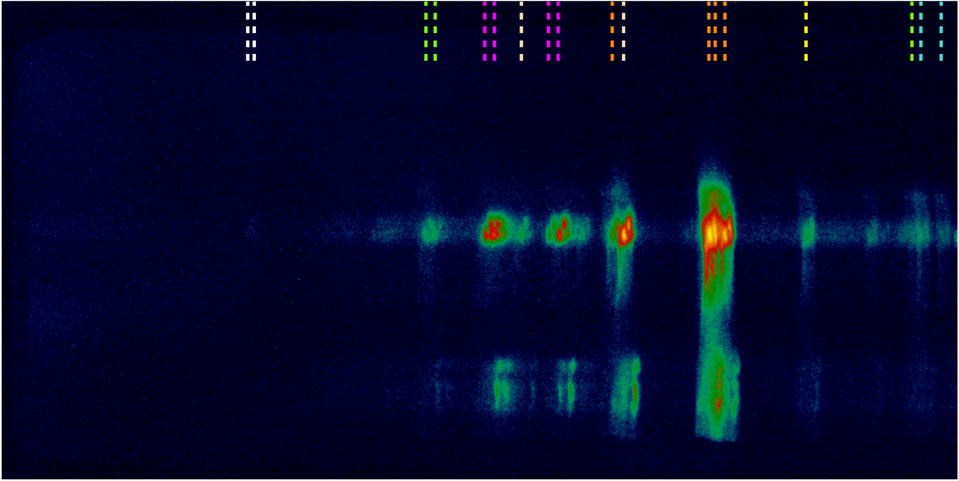
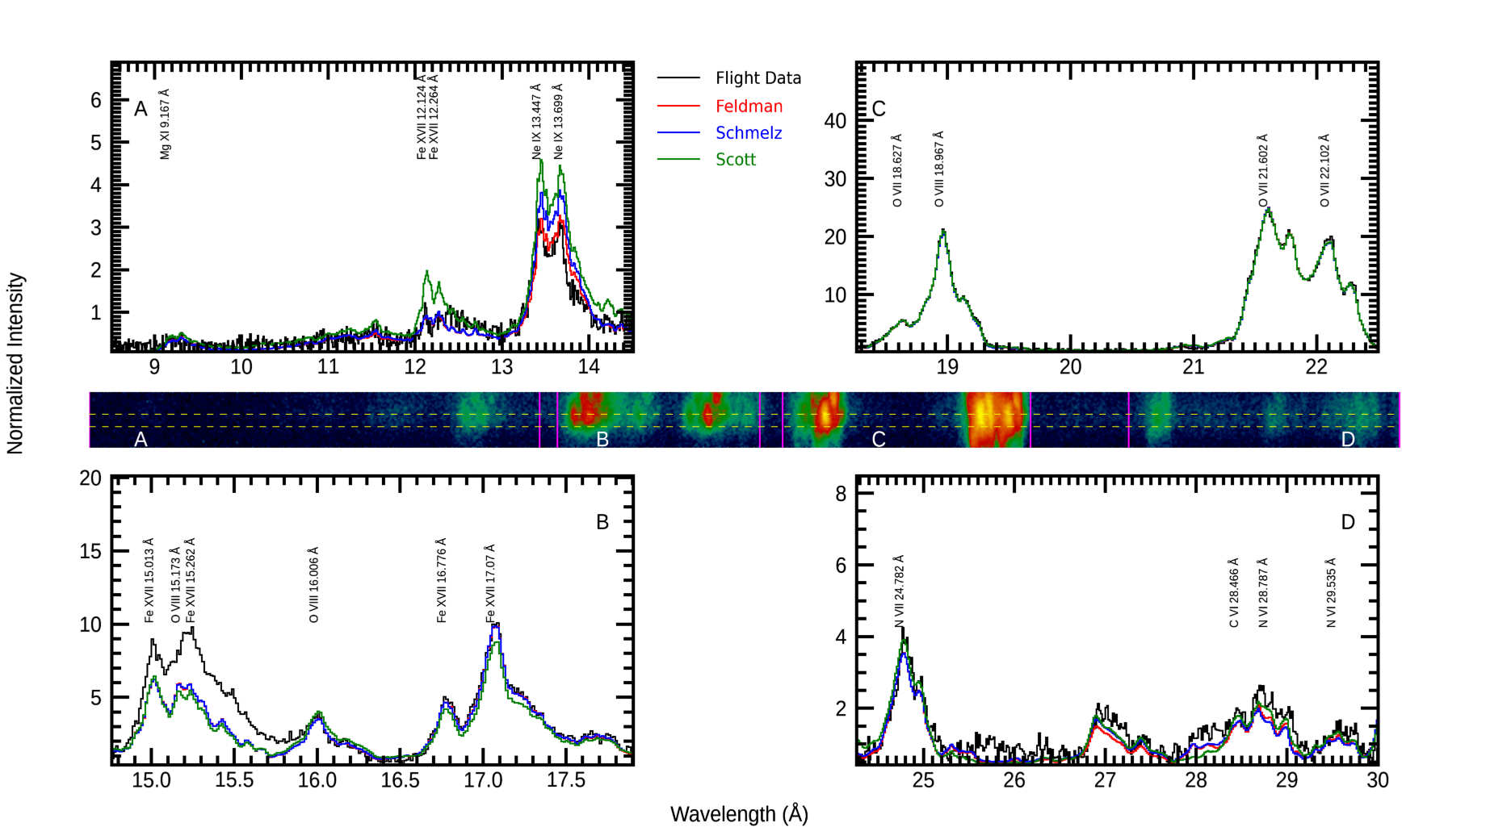

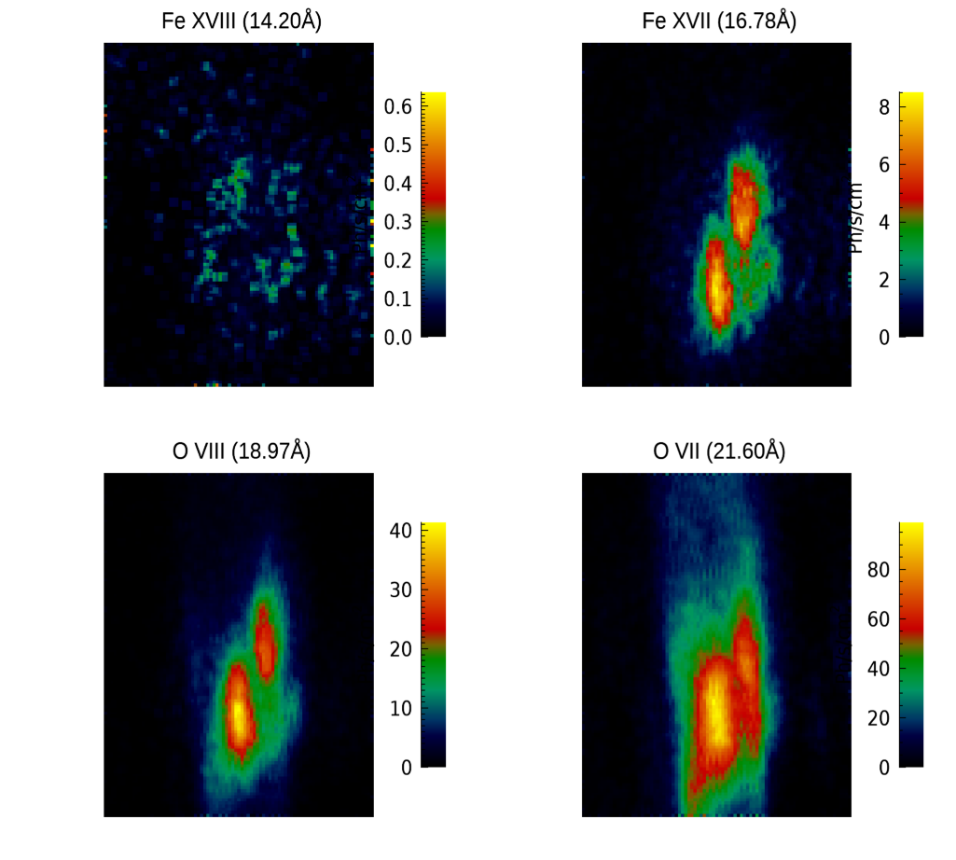
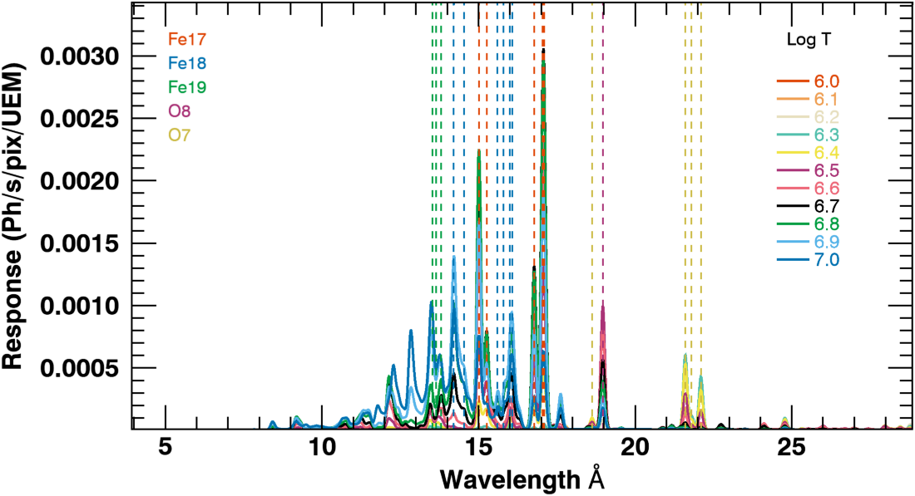

Inversion process
Inputs
Inversion Algorithm
Outputs
EM cubes
Fitted spectra
Overlappogram
e.g., ELASTIC NET (available from scikit in python)
Response Ph/s/Unit EM
y= Mx
Atomic data + Instrument Response
sparse
smooth
Spectrally Pure Maps
Weights can also be added.
Cheung et al, De Pointeu et al, Winebarger et al 2019
Notes:
This inversion uses machine learining, we developed. There could be other solutions, to probe, students can run multiople inversion with different knobs.. Bring student invovlement

Slide 10
Limitations of DEM inversion
Dependency on Atomic physics assumptions
  Abundance
  Ion equilibrium
  Electron distribution (Maxwellian, Kappa)
Can we break these assumptions?
Notes:
Multi ion vs single ion define them here. Tell them here no longer standard dEM

Slide 11
Data from slitless imaging spectrograph
*ignoring continuum for simplicity
Response
$$I_{obs}\left(pix\right)=\sum_{T}{\sum_{s}{ }\sum_{X}{ }\sum_{X^{+m}}{ }}\sum_{ij}{{EA\left(λ,s\right) ψ}_{ij}\left(λ,s\right)}ε_{ij}\left(T\right)EM\left(T,s\right)$$
Unknown
Observations
All transitions from a single ion
All ions of a single element
All elements
All spatial locations on the Sun

Slide 12
Data from slitless imaging spectrograph
*ignoring continuum for simplicity
Response
$$I_{obs}\left(pix\right)=\sum_{T}{\sum_{s}{ }\sum_{X}{ }\sum_{X^{+m}}{ }}\sum_{ij}{{EA\left(λ,s\right) ψ}_{ij}\left(λ,s\right)}ε_{ij}\left(T\right)EM\left(T,s\right)$$
Unknown
Observations
All transitions from a single ion
All ions of a single element
All elements
All spatial locations on the Sun

Slide 13
Multi -> Single ion inversion
Multi ion
Single ion
nfree
nfree
R_{1,1}(p₁)
R_{2,1}(p₁)
I(p₁)
R_{1,1,1,1}(p₁)
R_{2,1,1,1}(p₁)
I(p₁)
EM (s₁, T₁)
EM (X₁,X^{m+}₁, s₁, T₁)
.
.
.
.
.
.
.
.
.
.
.
.
.
.
.
.
.
.
EM (X₂,X^{m+}₁, s₁, T₁)
.
.
.
.
.
.
.
.
.
.
.
.
EM (s₂, T₁)
.
.
.
.
.
.
.
.
.
.
.
.
.
.
.
.
.
npixels
npixels
=
=
nfree
nfree
I(p_{pix})
EM (s_{n},,T_{m})
I(p_{pix})
R_{1,1,1,1}(p_{npix})
EM (X_{m},X^{m+}_{n}, s_{o}, T_{p})
R_{1,1}(p_{npix})
nfree is growing much larger
Notes:
Motivate with EIS matrix without s

Slide 14

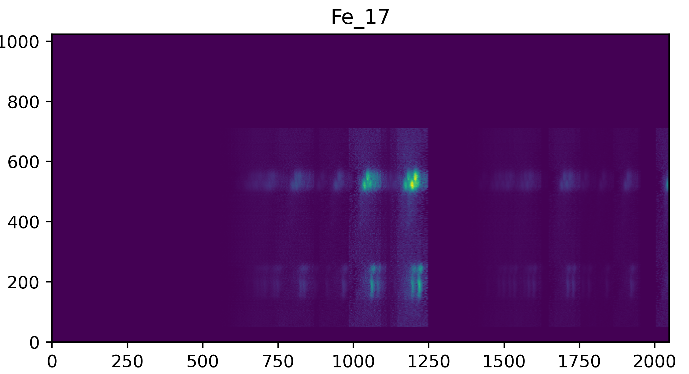
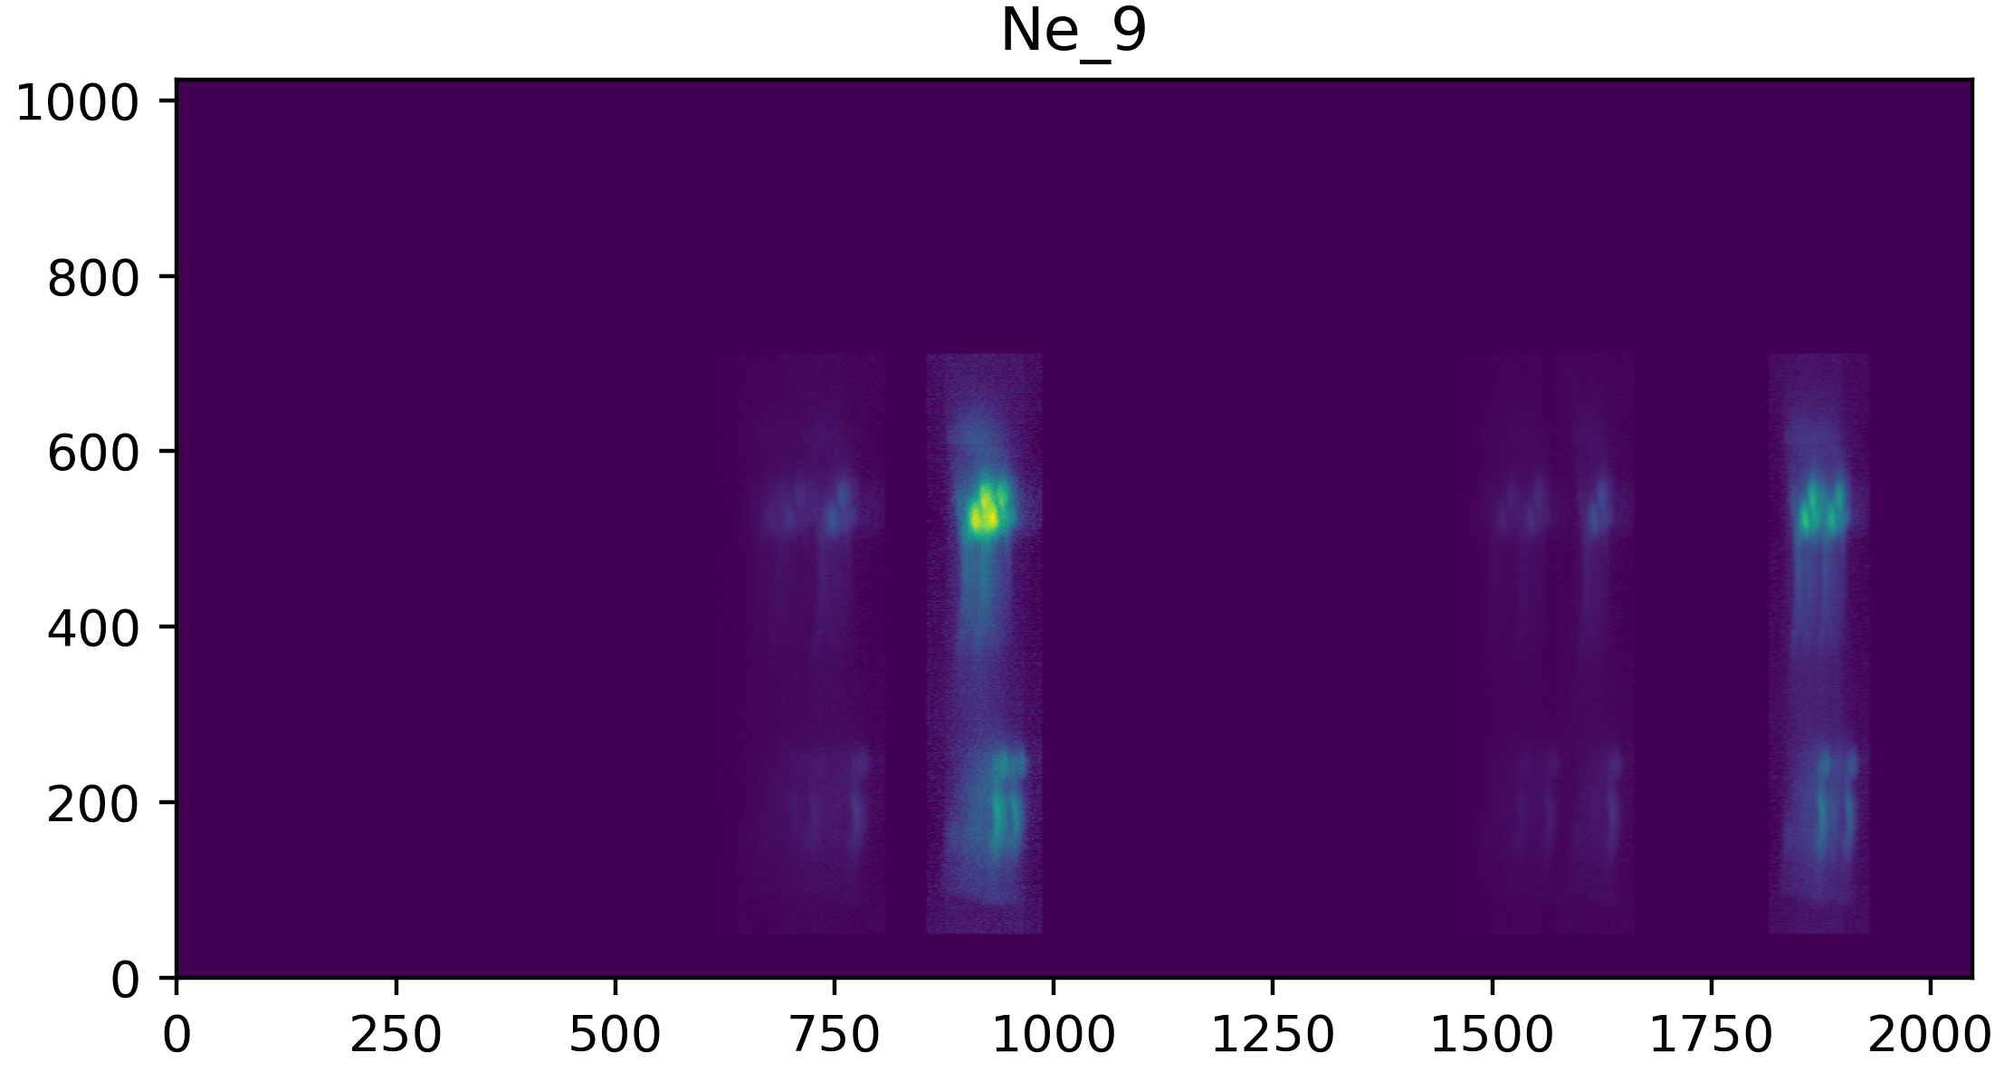
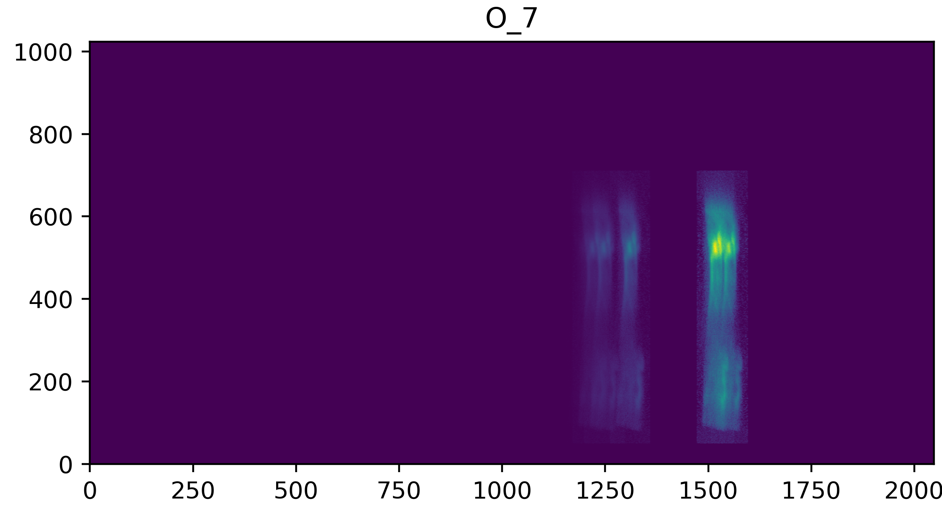
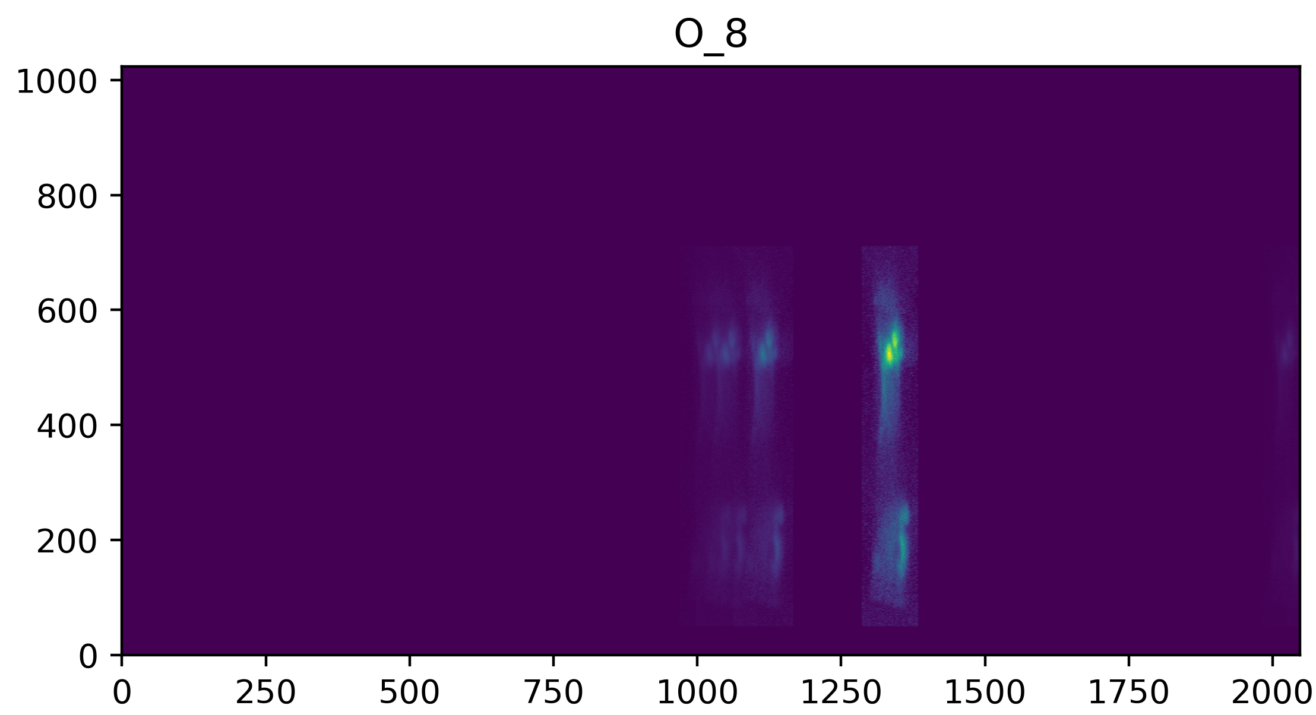
Why (when) does the inversion work?
MaGIXS field
335Å
Dominant bright emission lines from multiple ions are well isolated
Multiple copies of the same field observed at different locations on the detector from several ions
Notes:
Replace this with temperature slide

Slide 15
Single Ion Inversion Results

Slide 16
Single Ion Take Aways
Multi Ion inversion works, similar to standard DEM inversion, but it has baked in atomic physics assumptions
Single ion inversion can decouple inversion from atomic physics assumptions
Preliminary analysis with MaGIXS data suggest promising output
Further investigation is under progress
Will be helpful for ECCCO and MOXSI inversion

Slide 17
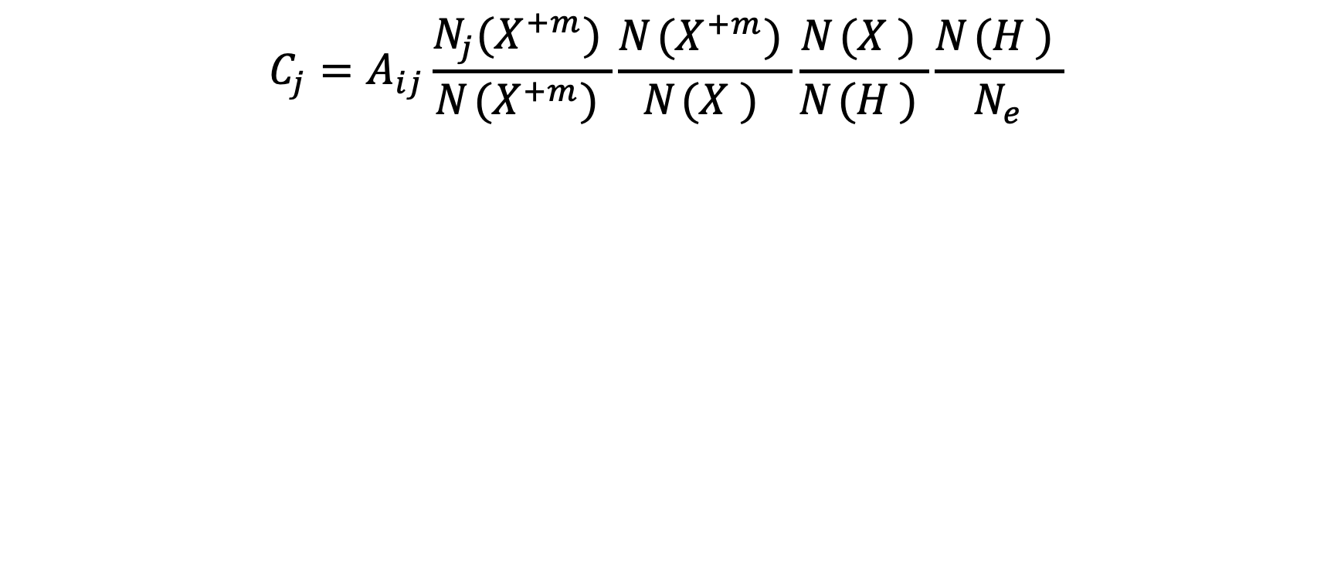
Contribution function
$$C_{j}=A_{ij}\frac{N_{j}{(X_{ }^{+m})}_{ }}{N_{ }{(X_{ }^{+m})}_{ }}\frac{N_{ }{(X_{ }^{+m})}_{ }}{N_{ }{(X_{ }^{ })}_{ }}\frac{N_{ }{(X_{ }^{ })}_{ }}{N_{ }{(H_{ }^{ })}_{ }}\frac{N_{ }{(H_{ }^{ })}_{ }}{N_{e}}$$
Einstein coefficient
Rate transitions occur
Ionization Balance
Temperature dependent
Known for ionization equilibrium
Hydrogen to electron density (known constant)
Relative population
Temperature and density dependent
Solved for in CHIANTI assuming Maxwellian or Kappa distributions
Elemental Abundance
(varies from structure to structure)
Notes:
The number density of an ion in a given state is given by fraction of population of excited level (T, n, k); times relative abundance of an ion (T, ioneq) ; times relative abundance of element w.r.t H; number

Slide 18
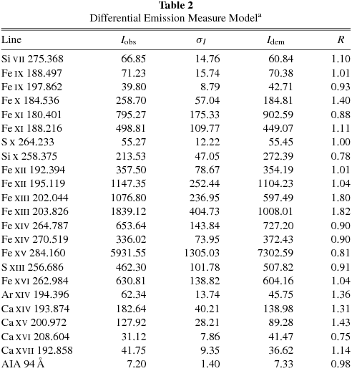
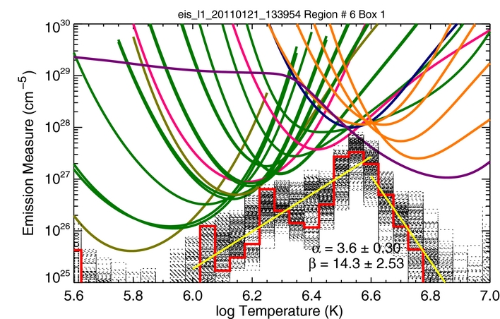
DEM from Typical EIS analysis
Calculate Emission Measure Distribution with a least squares solver (there are several) that minimizes the differences between predicted and observed values.
Arrive at a list of intensities and errors. This requires good radiometric calibration.
Warren et al

Slide 19
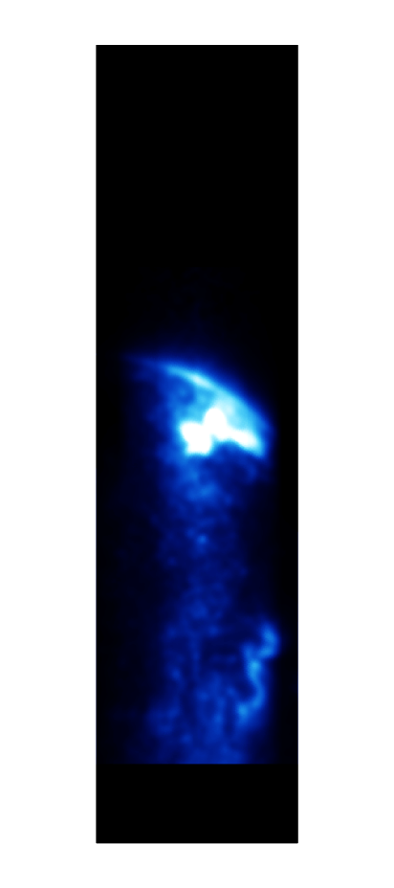
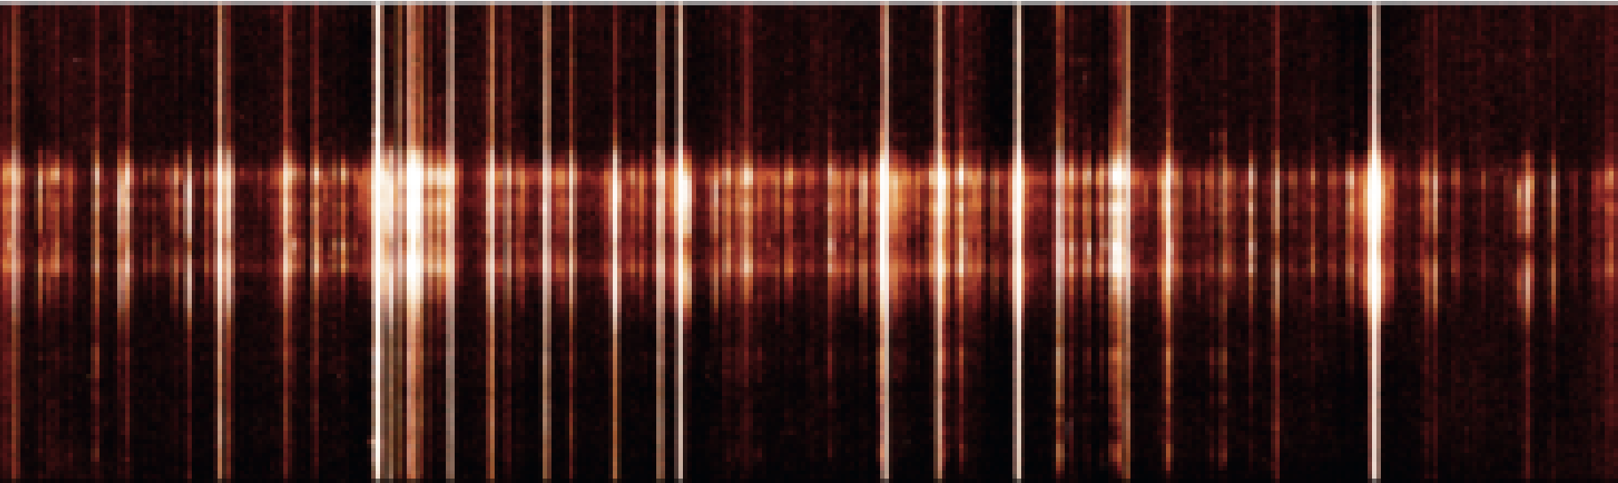
Slit → Slitless imaging spectroscopy
Each detector pixel contains a linear combination of line intensities from several ions from different points on the Sun
Line intensity (Ph/pix) from a point on the Sun can be directly read off from detector pixels
Off–axis - 1
On–axis
p0 | p1 | p2
Off–axis + 1
Detector Pixels
Goal : Precisely determine the number of photons in every pixel from all observed emission lines

Slide 20
Can we decouple inversion from atomic physics assumptions?
$$C_{j}=A_{ij}\frac{N_{j}{(X_{ }^{+m})}_{ }}{N_{ }{(X_{ }^{+m})}_{ }}\frac{N_{ }{(X_{ }^{+m})}_{ }}{N_{ }{(X_{ }^{ })}_{ }}\frac{N_{ }{(X_{ }^{ })}_{ }}{N_{ }{(H_{ }^{ })}_{ }}\frac{N_{ }{(H_{ }^{ })}_{ }}{N_{e}}$$
Einstein coefficient
Likelihood a transition will occur
Ionization Ratio
Temperature dependent
Known for ionization equilibrium
Hydrogen to electron density (known constant)
Relative population
Temperature and density dependent
Solved for in CHIANTI assuming Maxwellian or Kappa distributions
Elemental Abundance
(varies from structure to structure)
Notes:
The number density of an ion in a given state is given by fraction of population of excited level (T, n, k); times relative abundance of an ion (T, ioneq) ; times relative abundance of element w.r.t H; number

Slide 21
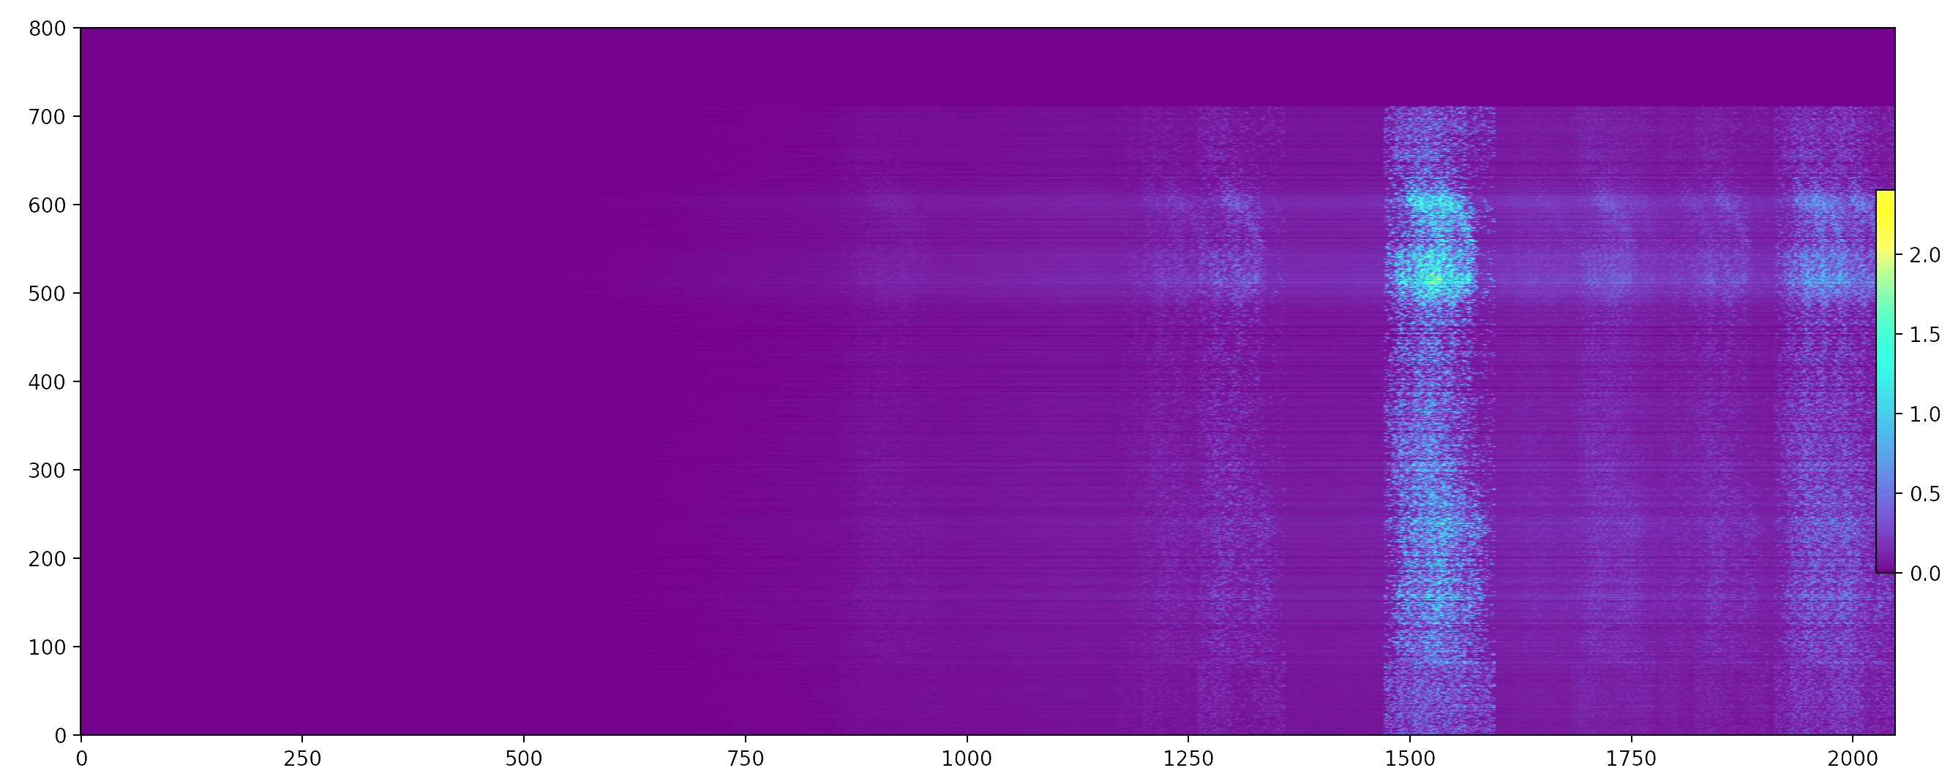
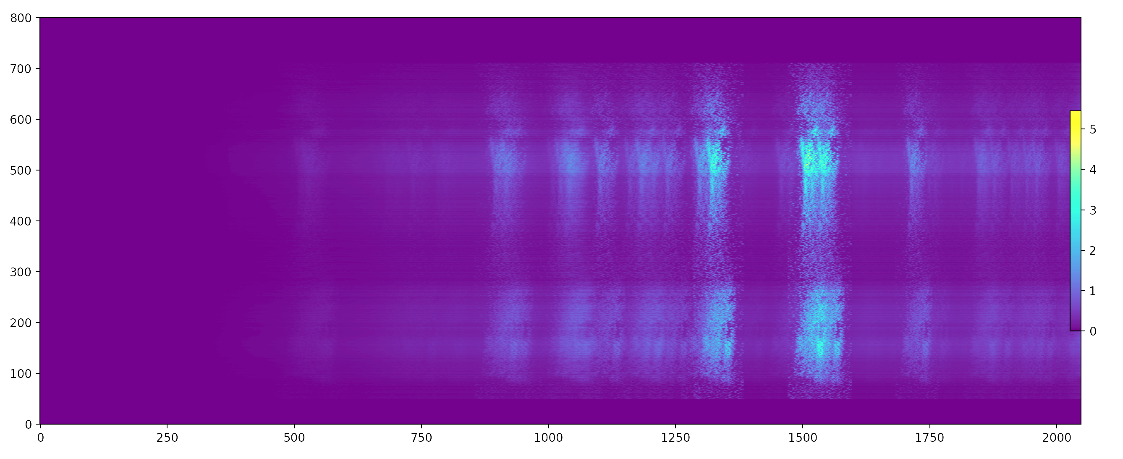
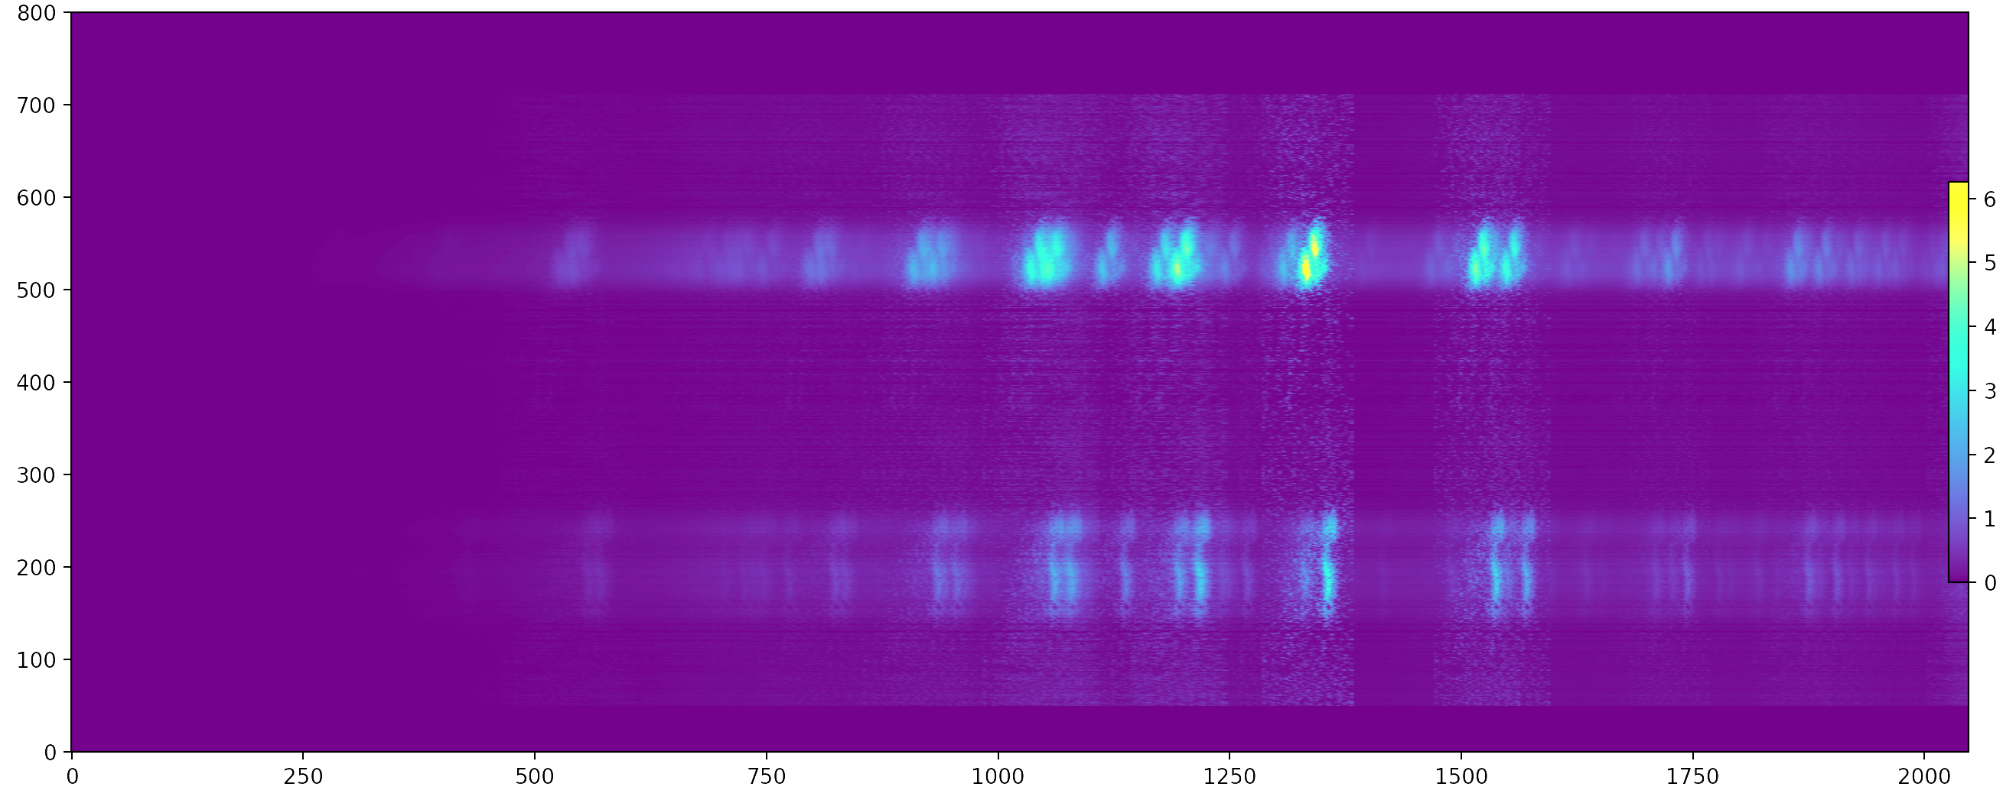
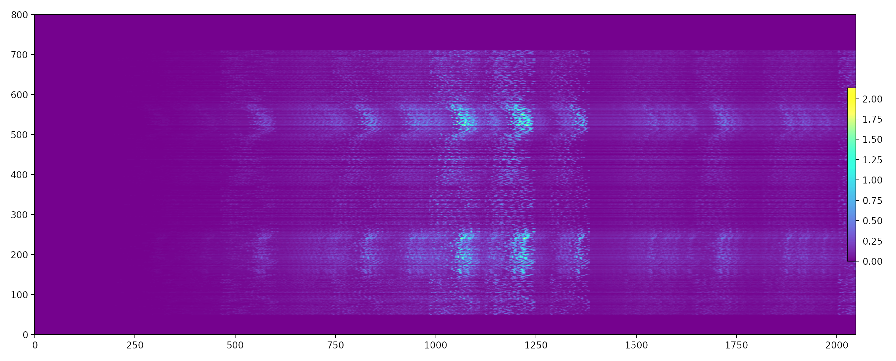
Why (when) does the inversion work?
MaGIXS field
335Å
C VI
O VIII
O VII
N VII
C VI
O VII
N VII
Ne IX
O VIII
Ne IX
O VIII
Fe XVII
Fe XVII
logt 6.0
logt 6.3
Ne IX
O VIII
O VII
N VII
C VI
N VII
C VI
Mg XI
O VIII
Ne IX
Ne IX
O VIII
O VIII
O VII
Ne IX
Fe XVII
Fe XVII
Fe XVII
Mg XI
Fe XVII
Fe XVII
Fe XVII
logt 6.4
logt 6.6
Multiple copies of several ions observed at different wavelengths offer excellent temperature diagnostics
Notes:
Replace this with temperature slide

Slide 22
Slit Vs Slitless : Parallels
Slit Inversion | Slitless Inversion
Blended lines are accounted from unblended lines from same ion using atomic physics | Blended lines are accounted from unblended lines from same ion using atomic physics
EM map
Fitted spectrum
Assume Atomic physics parameters during a single inversion – abundance, plasma state
Single slit at a time | Wide field at a time

