Slide 1


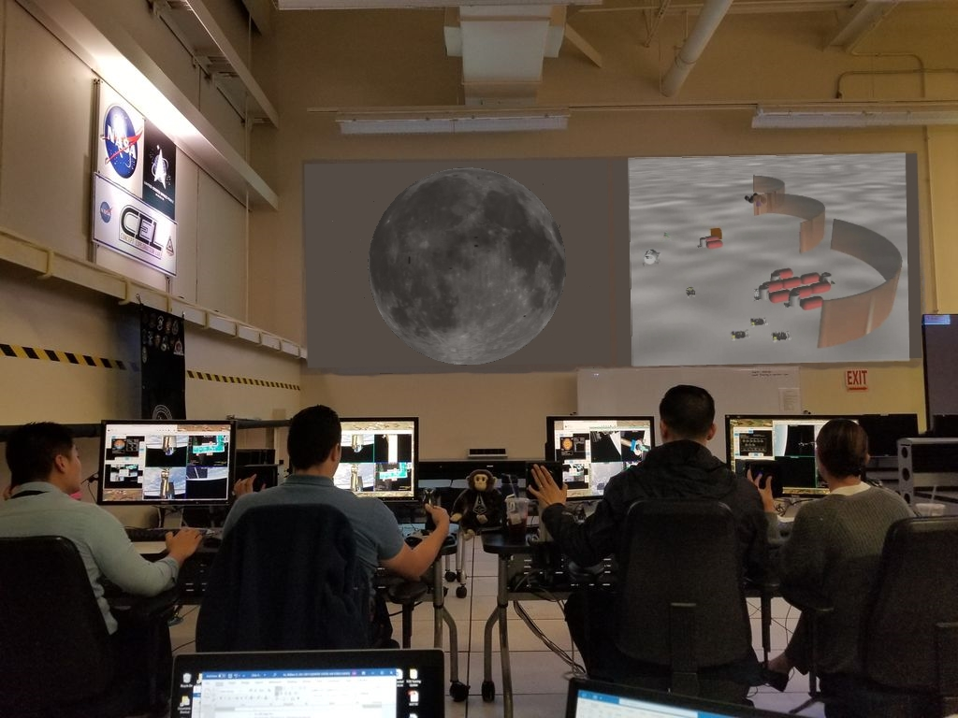
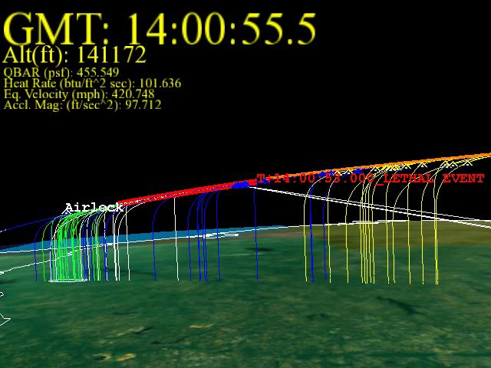
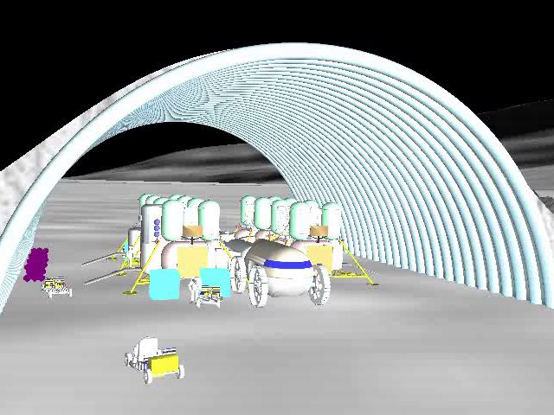
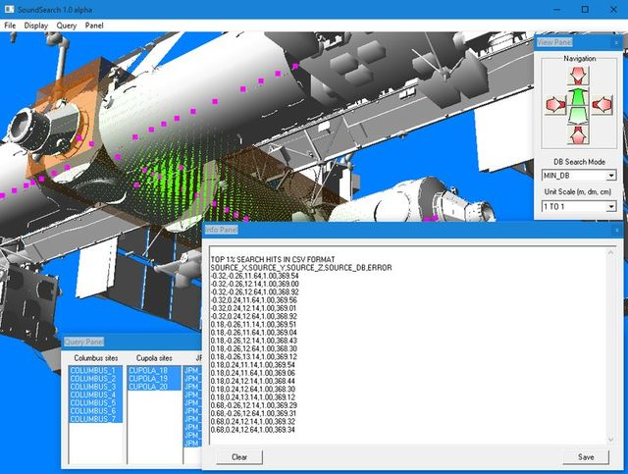
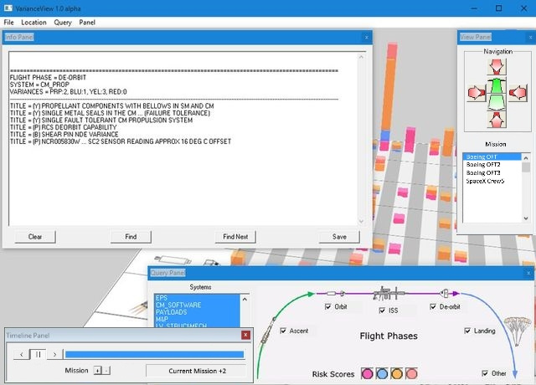
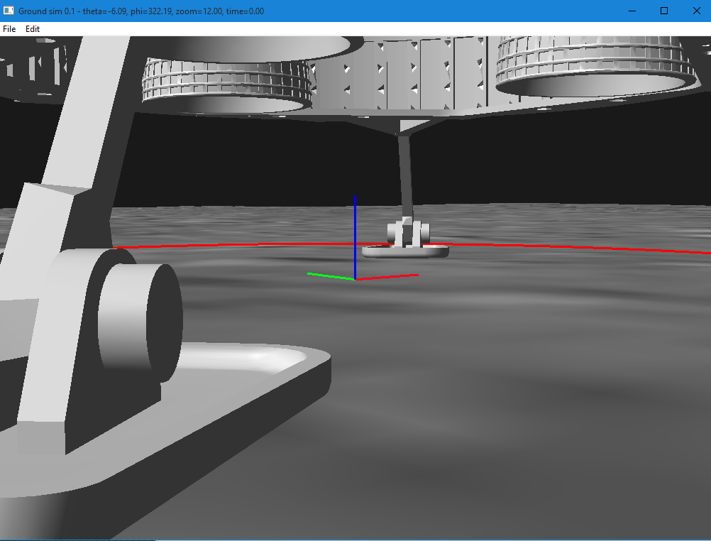
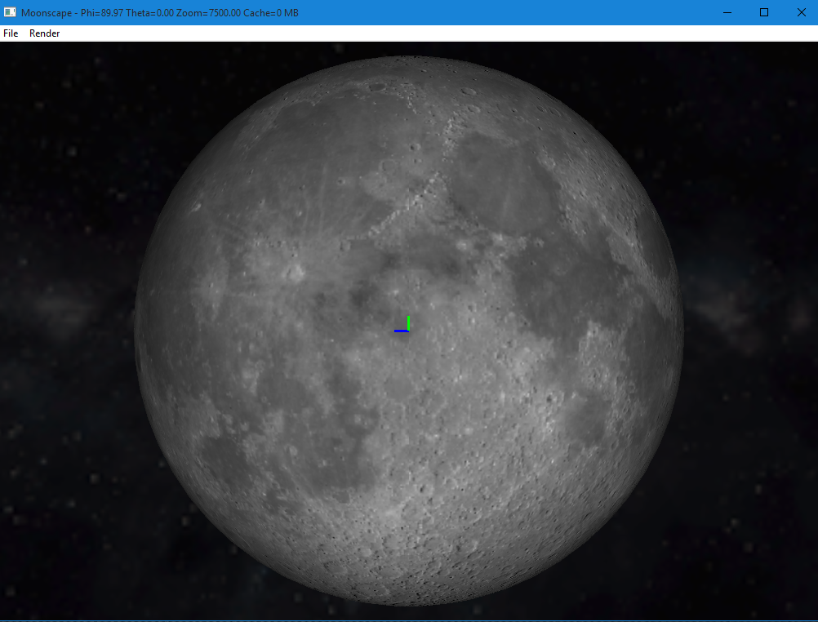
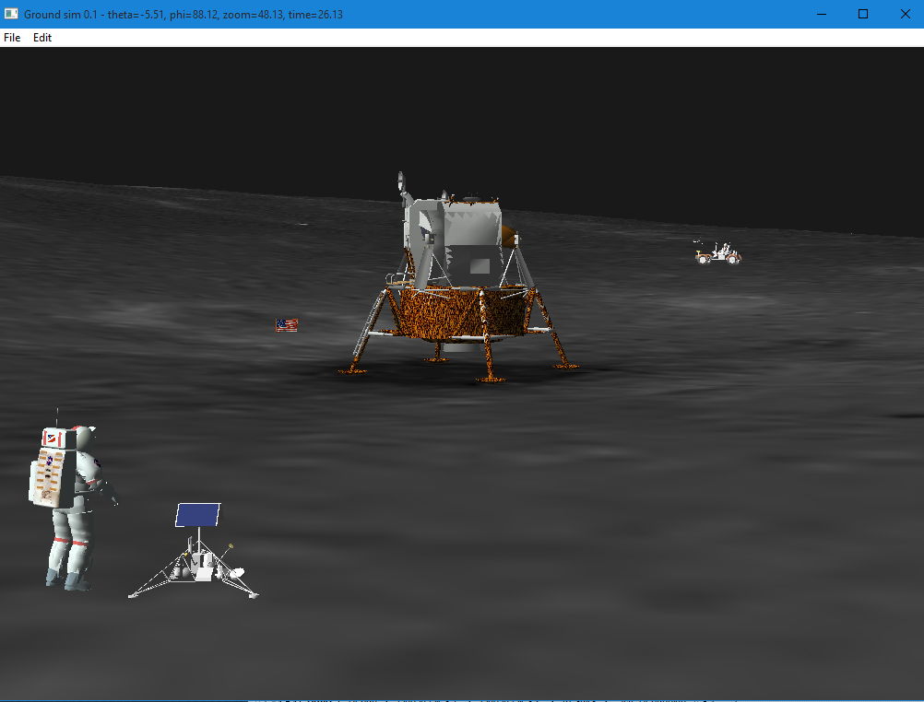
Collaborative Host Facility for
Lunar Operations
TBD
PM / PI Info Tom Duncavage | tom.c.duncavage@nasa.gov / Ivan Delgado | Ivan,delgado@nasa.gov
Executive summary: a PROPOSAL
This project establishes a new collaborative simulation connectivity capability for JSC utilizing existing facilities. The principal collaborating organizations are Safety & Mission Assurance (Code NA) and Engineering Directorate (Code EA), but the capability is open for any JSC user. The core of the connectivity resides in Code ER7’s Concept Exploration Laboratory (CEL) and is part of ER7’s Systems Engineering Simulator (SES) complex. NA Subject Matter Experts (SMEs) work proactively in situ with EA and commercial crew counterparts to evaluate Safety Review Panel (SRP) protocols for landers, habitation modules, and lunar roving systems using the same tools, terrain models and data as the designers. NA software initiated under two JSC Center Innovation Fund (CIF) and Innovation Charge account (ICA) funded projects will be used to configure the CEL to function as an EA maintained facility. Collaboration via the CEL with the U.S. Space Force (USSF) provides visibility for USSF. The potential for commercial crew and vehicle suppliers will require IT security and associated security architecture to be implemented in additional CIF based proposals.
CEL HISTORY
CEL began as a JSC Center Director Discretionary Fund project in 1998 as a follow on to the reconfigurable orbiter cockpit and the reconfigurable exploration crew station, and now functions as ER7’s Simulation Mission Control Center. CEL is based on DoD 5000 standard for simulation driven concept exploration as a means to reduce early program risk by data fusion. This effort created a visual evaluation environment using PC based hardware, software and NASA/DoD collaboratively derived tools. The Navy’s Global Visualization Process (GVP) software was utilized during the Columbia Accident Investigation and Return to Flight endeavors. Similarly, the NA FY23 CIF initiated full lunar surface simulation should be utilized for lunar exploration development. The CEL/SES complex planetary surface simulation supports con-ops, test, verification, and training through launch, orbit, land, and crew return mission phases.
INTEGRATION WITHIN NA
NA, EA, commercial crew (and other orgs) would be able to collaborate in parallel during the life cycle of lunar hardware/software development.
Safety certification methodologies and lunar mission certification could be done proactively as new hardware and mission profiles are conceived.
Mission residual risk would be minimized through earlier discovery of issues and concerns with fewer assumptions made between NA experts and contractors.
Early risk assessment and preview capability for all phases of the Artemis program: TRN, landing control, hazard detection / avoidance, navigation etc.
Ability to assess the safety of landers, habitation modules, rovers, and other equipment in simulated environments during the design phase, pre-deployment.
COllaboration
ER7, JSC Institutional Facility Support (CEL & SES).
ER7, Chief Engineer, Program Technical and Mission Expertise.
NA, Dep. Director NA, SRP Support and feedback on utility of approach and capabilities
KSC, Technical collaboration project lead for Moon Tycoon
XI, JSC, Artemis geospatial team tech advisory team.
NA, Strategic Council DUE – supplemental funding and Strategic Planning.
USSF, Space Test Course Edwards Air Force Base
EA AND NA INTEGRATION
The SMA full lunar surface simulator created for the FY23 CIF produced methods for lunar terrain elevation refinement and surface reflectance estimation
LRO / LOLA team members (Dr. Sam Lawrence) at JSC expressed interest in using these refined terrain models to confirm consistency and integrity within their own data sets
EA training simulation teams working to determine lunar lighting conditions and shadow coverage have expressed interest in the surface reflectance estimates
The simulator code could be converted into a license free, shared source, gaming engine alternative, for other NASA teams working on lunar operations, such as Moon Typhoon / KSC.
Hosting the full lunar surface simulator in the CEL would facilitate the CEL integrating seamlessly with other code EA products such as Trick Lab dynamics, etc.
ARTEMIS PROGRAM Integration
As a collaborative environment, CEL could host NA and SAIC SME’s working jointly to assess current and future risk analyses involving variance data
The CEL arcserver warehouses both NA safety data sets and SAIC variance data, making it a conduit for joint data fusion, mining, as well as safety and design analytic activities
The Aggregate Risk Tool, VarianceView, and other delivered software packages from ICA and IRAD work could be also hosted in the CEL, utilizing the connectivity and ability to data share remotely at JSC.
Enhanced terrain models from the EA / NA FY23 full lunar surface IRAD work have been provided to SAIC / commercial crew teams working on lander studies, etc. Utilizing the CEL, these are then open to the JSC community at large
FY24 CEL lunar host facility mock-up
Columbia investigation (2005)
JSC lunar architecture 6 (2006)
SoundSearch FY22 IRAD work
VarianceView FY22 ICA work
FY23 CIF lander topple study
FY23 CIF Full lunar surface sim
FY23 CIF Apollo recreation
DAA# | 20230017846
NTR#(s) | NA

