Slide 1



Creating IR-verified Gridded Fire Burn Maps using Public NASA and Satellite Data
Emily Gargulinski, Elizabeth Wiggins, Amber Soja, Noam Rosenthal,
Yaling Liu

Slide 2
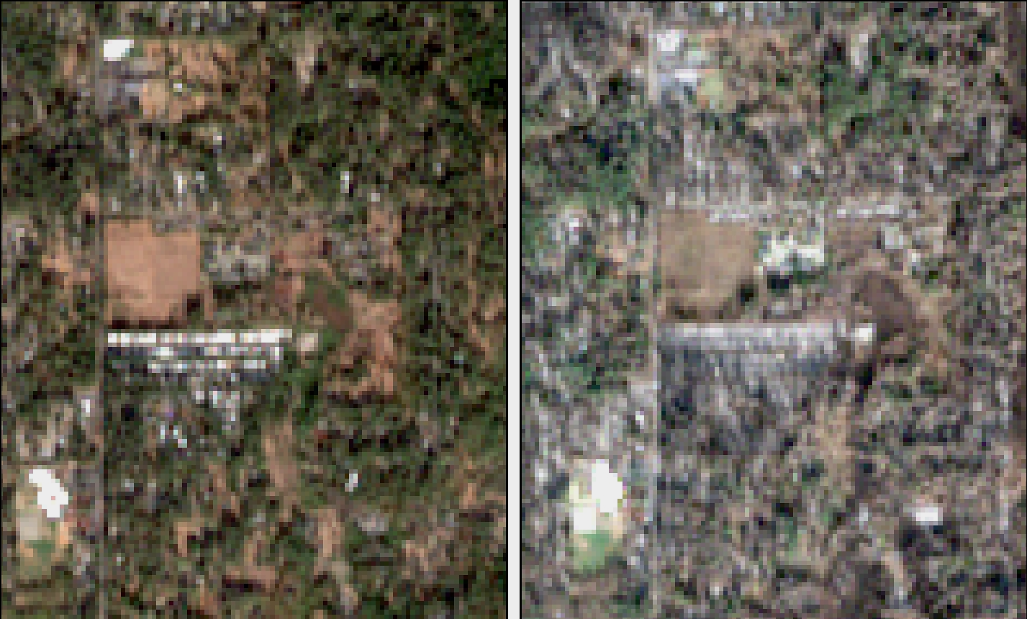
Satellite use for burned area grids
Pre-fire: 11/06/2018
Post-fire: 12/06/2018
Wildland fire is a natural and integral force on our landscapes and when uncontained, can devastate communities, threaten our health, and result in substantial economic losses
  Between 2017 - 2021 wildfire insurance claims increased more than $50B.
Verification of property loss is needed for affected homeowners receive payouts, allowing them to rebuild their lives
Camp Fire, CA (2018): Homes leveled by the Camp Fire line in the Rodgewood Mobile Home Retirement community in Paradise, CA.

Slide 3
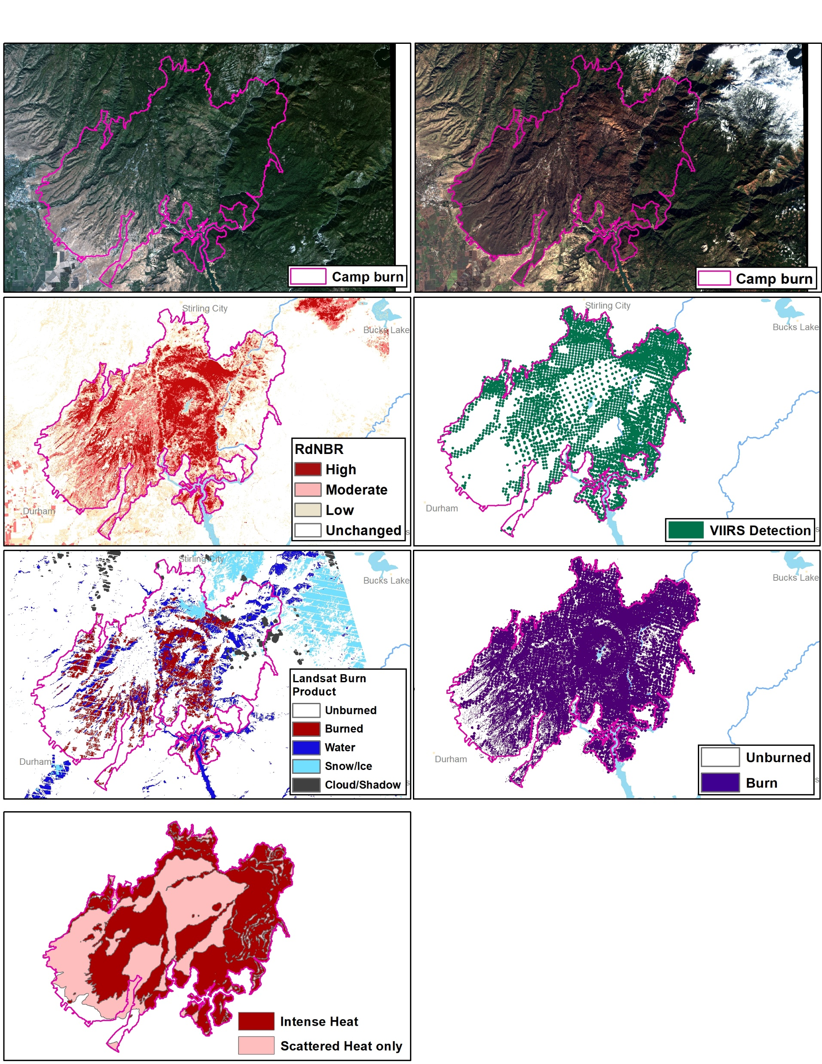
Burned Area Product Process
A fire is considered out or has diminished greatly according to SIT-209 reports
Buffer VIIRS fire detections to 375m
Combine with RdNBR layer, keeping areas that signify burn
Remove water and ice features
Keep burn area touching or within official burned area National Interagency Fire Center (NIFC) perimeters

Slide 4
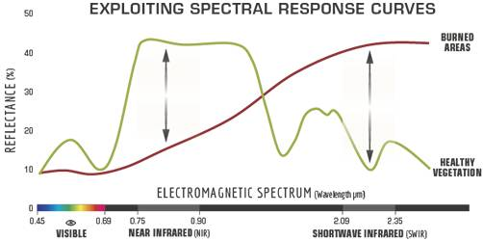

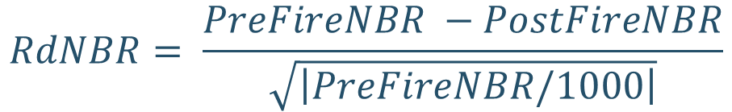
Relative Difference Normalized Burn Ratio Index (RdNBR)
Sentinel-2 (20-m) Pre- and Post- fire scenes
Relative dNBR index used to provide a more consistent definition of severity between landscapes and allow for higher accuracies in high severity burn in heterogeneous landscapes.
High and moderate burn areas or areas marked as low with VIIRS detection are marked as “burned”
https://www.fs.fed.us/eng/rsac/baer/barc.html
$$NBR= \frac{NIR −SWIR}{NIR+SWIR}$$
$$RdNBR= \frac{PreFireNBR −PostFireNBR}{\sqrt{\left|PreFireNBR/1000\right|}}$$
Severity Category | RdNBR
Unchanged | <69
Low | 69 - 315
Moderate | 316 - 640
High | >=641
Miller and Thode 2006

Slide 5
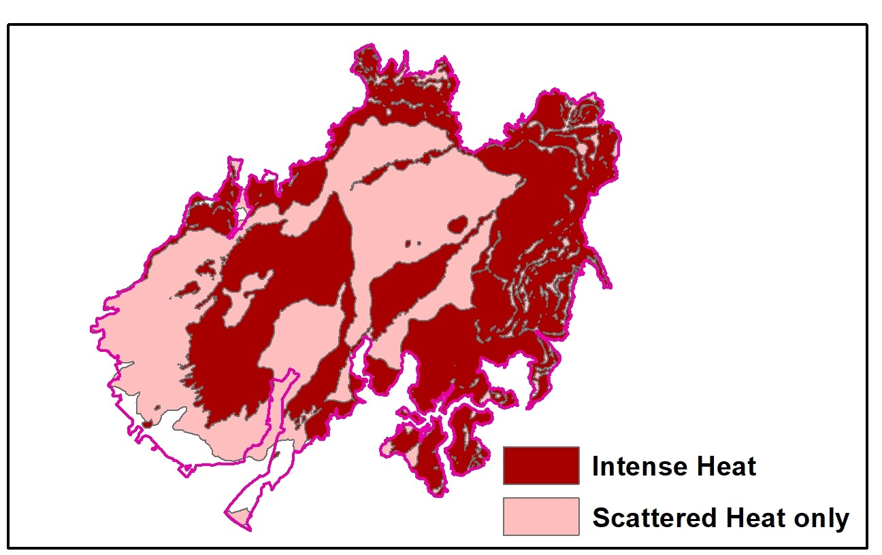
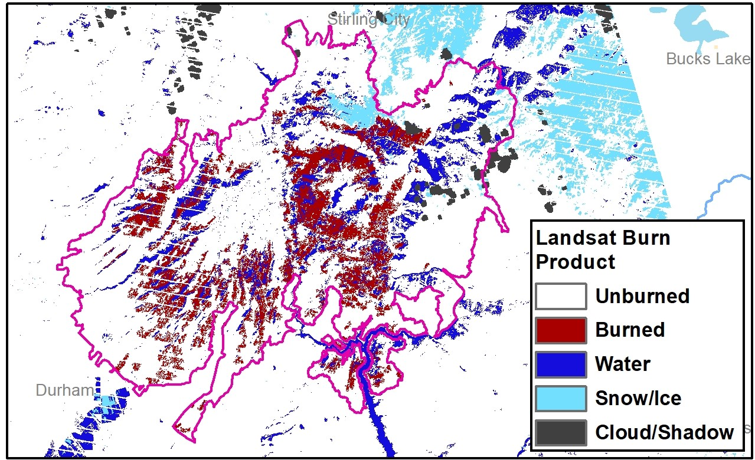
Landsat Burn Product and NIROPS IR products
NIROPS IR polygons
Landsat Category | NIROPS Scattered heat only | NIROPS Scattered + Intense heat | NIROPS Intense heat | Our Burn Product
Unburned | 61% | 66% | 70% | 63%
Burned | 20% | 16% | 13% | 19%
Water | 12% | 12% | 12% | 12%
Snow/Ice | 2% | 2% | 1% | 2%
Cloud/Shadow | 0% | 1% | 2% | 1%
NoData | 4% | 3% | 3% | 3%
 | Intersection of our burn product and NIROPS IR products
Our Burn Product | 74 | 79 | 84
Landsat Burn Classification

Slide 6
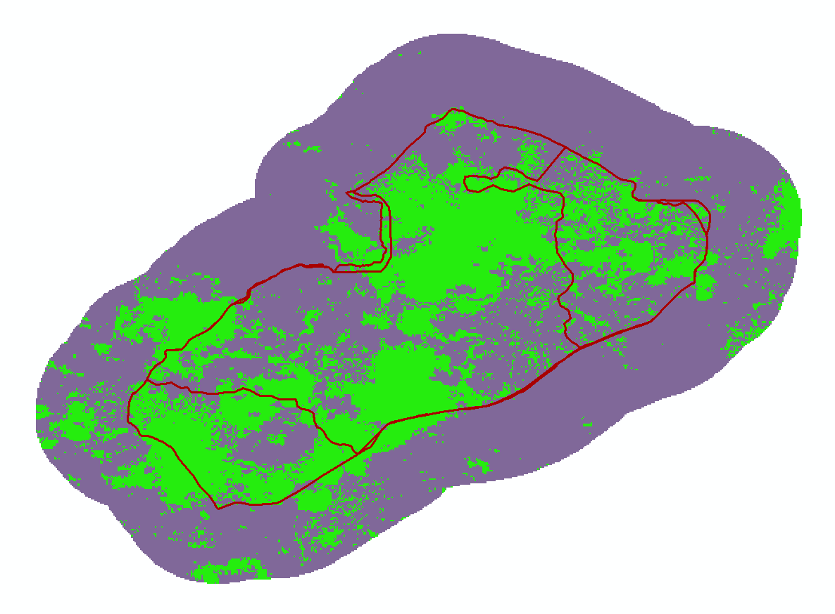

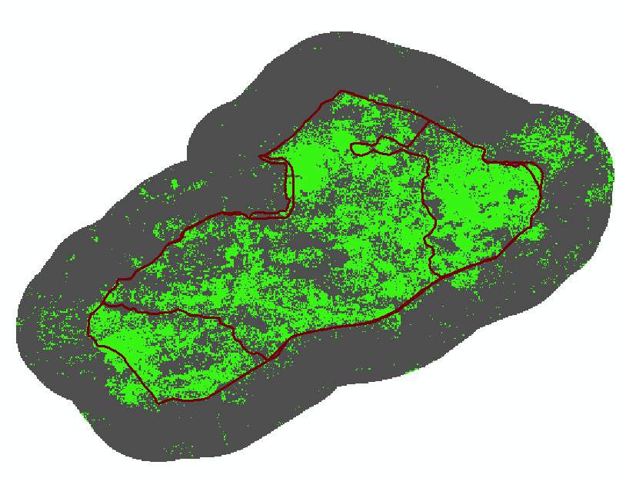
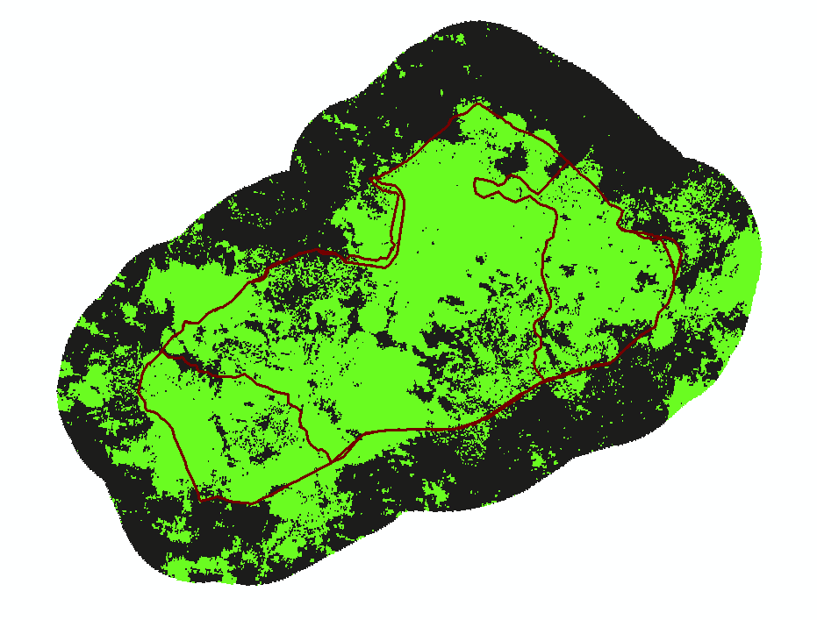
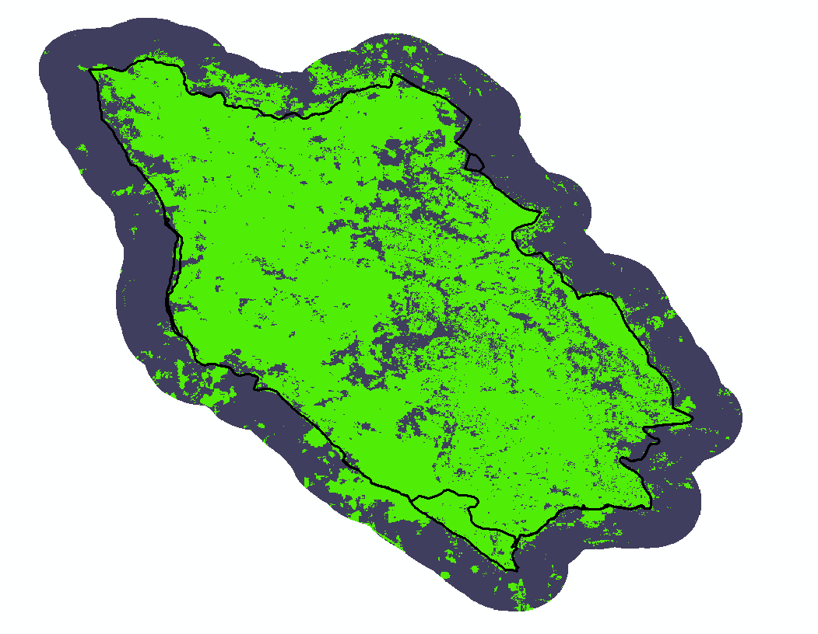
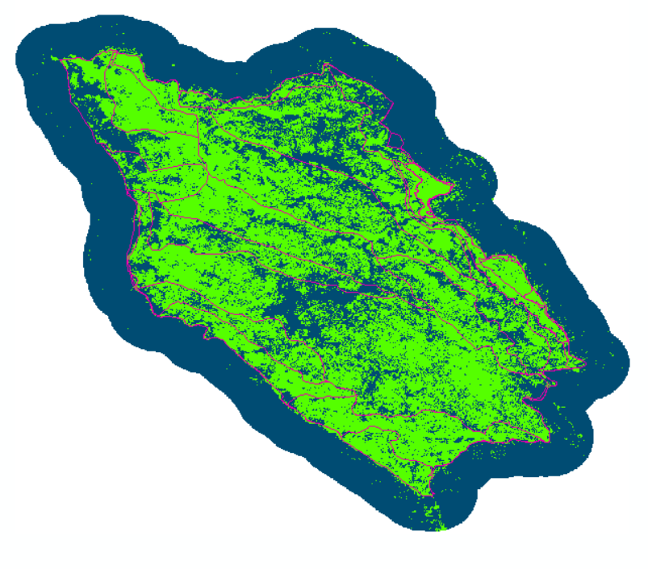
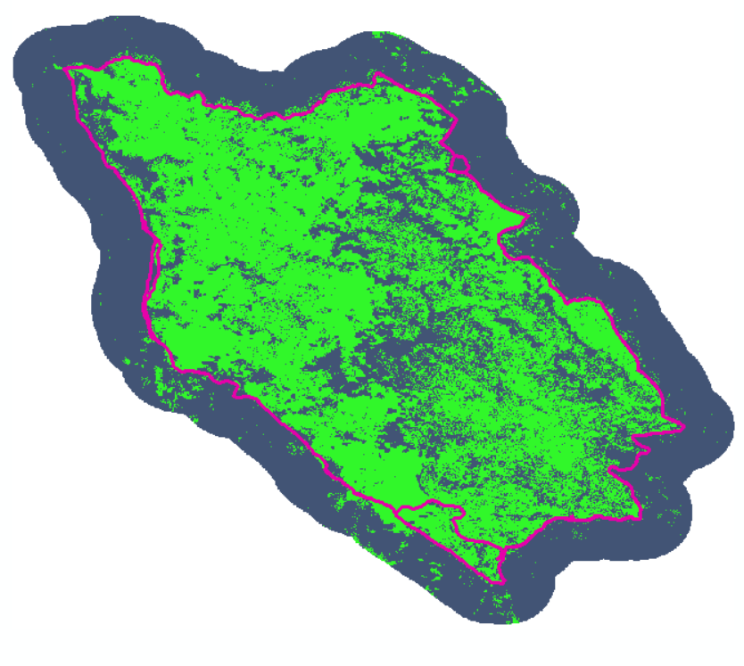
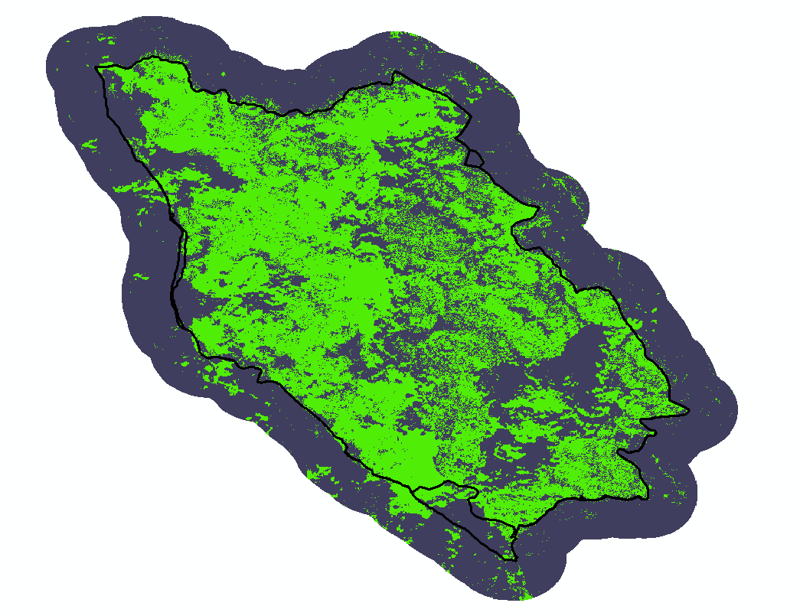
Slide Title
Methodology Iterations
One pre/post RdNBR
Max RdNBR
75th Percentile RdNBR + <%10 CC
75th Percentile RdNBR only
Boulin Fire
Final burn flag
Body text here
Castle Fire
Final burn flag

Slide 7
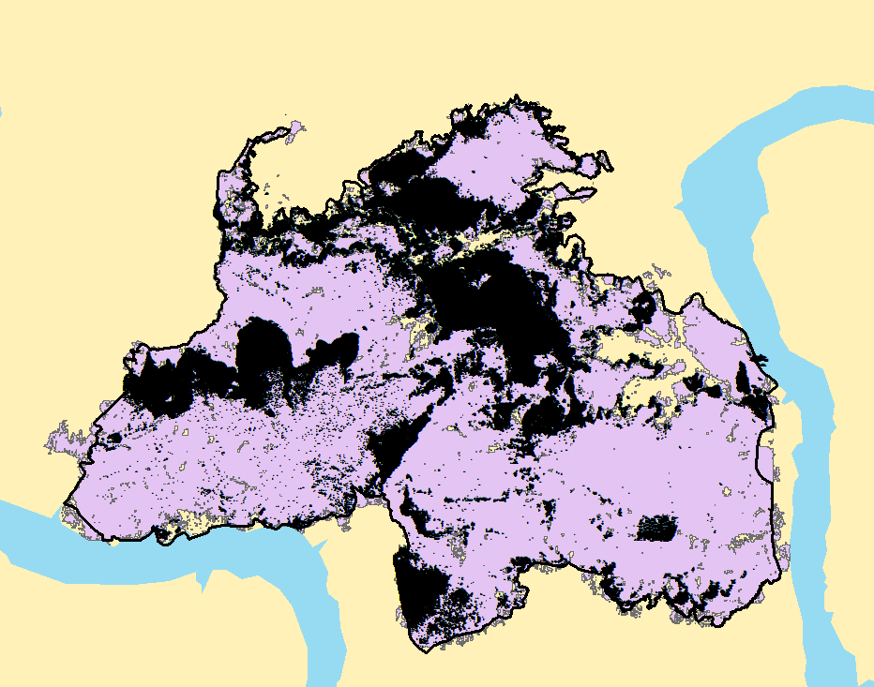
Modis ASTER Infrared (MASter IR) Samples
To verify what we consider burned pixels, we use MASTER IR data flown on the DC-8 during FIREX-AQ 2019 campaign.
Each point is a MASTER pixel sample that marks a point actively burning when the DC-8 flew over the fire.
We compared all FIREX-AQ wildfires and counted points that match what we call burn and points that did not.
Williams Flats Fire, 2019: 542,054 MASTER points sampled

Slide 8
Fire | One Pre/Post Scene RdNBR Agreement | MAX RdNBR Agreement | 75th percentile, <10% CC Agreement | 75th percentile Agreement
Lick Creek | 99% | 99% | 99% | 99%
Snow Creek | 99% | 97% | 99% | 99%
Ridgetop | 98% | 100% | 100% | 98%
Sheridan | 97% | 97% | 99% | 99%
Springs | 94% | 97% | 70% | 97%
Sheep | 90% | 99% | 96% | 97%
Saber | 75% | 84% | 85% | 78%
Left Hand | 95% | 100% | 99% | 99%
Boulin | 86% | 94% | 72% | 88%
Castle | 64% | 91% | 80% | 79%
Trumbull | 81% | 94% | 85% | 85%
Horsefly | 98% | 99% | 98% | 98%
Ikes | 39% | 87% | 63% | 61%
North Hills | 96% | 97% | 98% | 98%
 | 88% | 95% | 90% | 90%

Slide 9
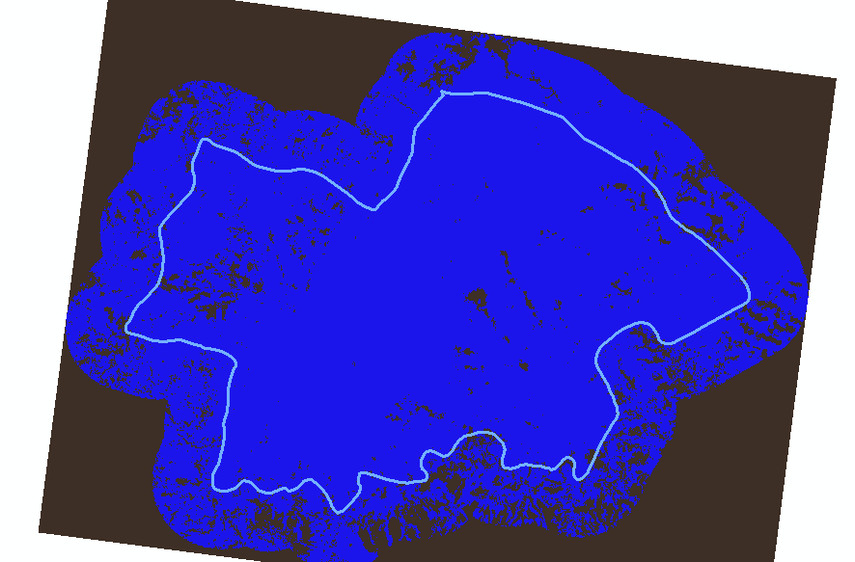
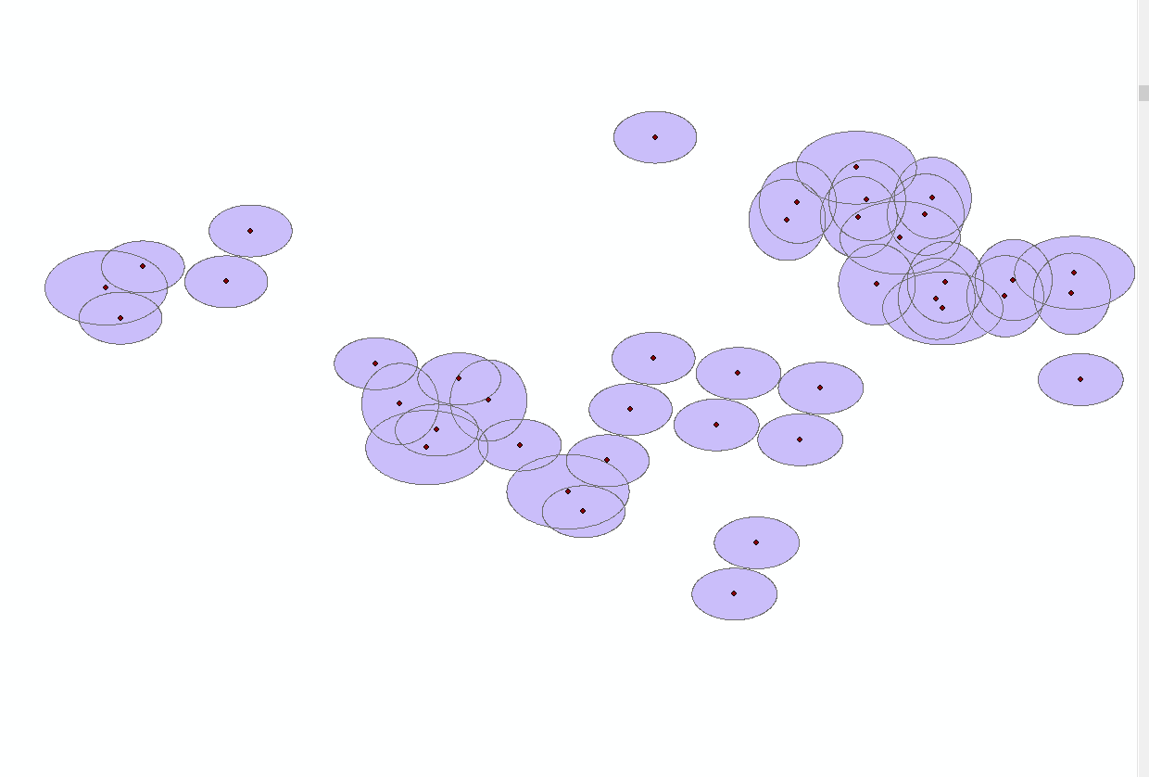
Future steps
Analysis on false positives
Incorporate track and scan angle for VIIRS
Analyze ecosystem sensitivities (rock/bare regions)
Automate in Google Earth Engine and ArcGIS
Bare soil and rocky regions often flag as burn
VIIRS fire detections scan and track angle changes detection shape

Slide 10
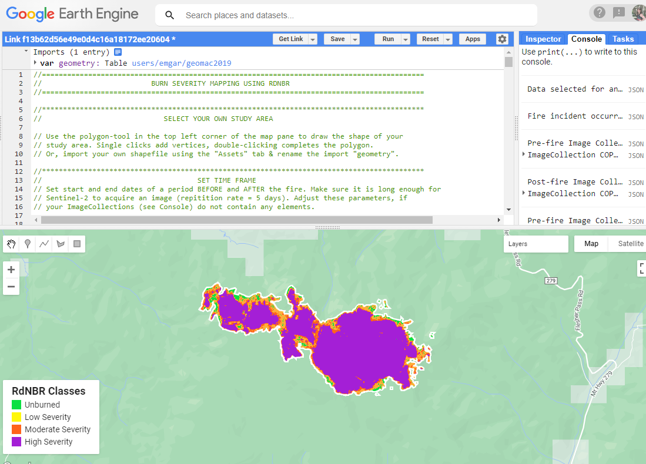
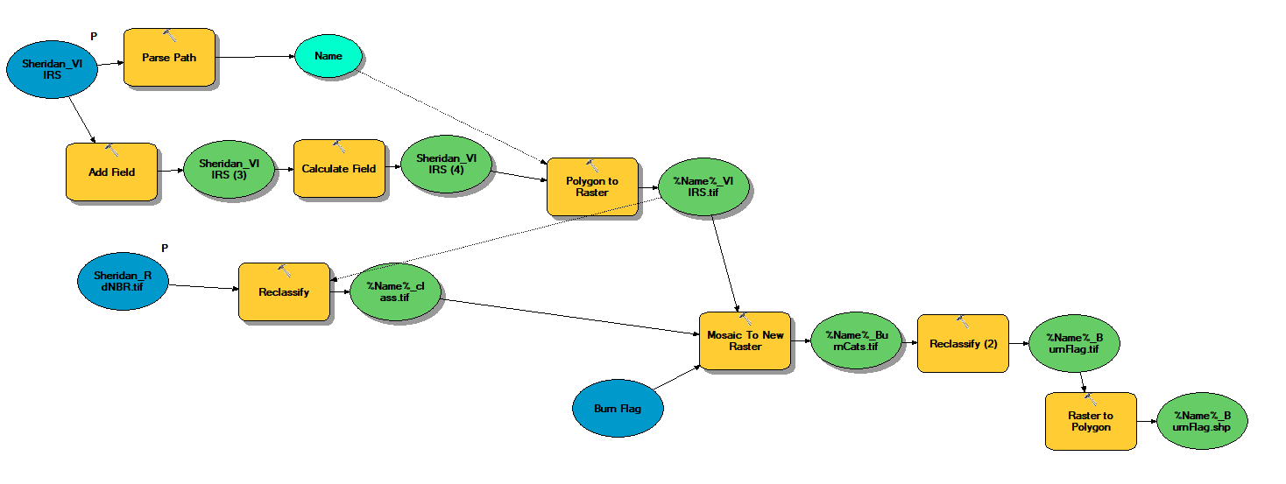
Publicly Available
Burned area grids for fires will be available online to the public (NASA DAAC)
GEE and ArcGIS model made available if users would like to run their own processing
Currently targeting fires in CA as test cases, but process would work all over the world.

Slide 11
Emily.m.Gargulinski@nasa.gov

