Slide 1
VERIFICATION OF THE GENERALIZED AEROSPACE SIMULATION IN SIMULINK® AAS-24-081 Nicholas Olson (Jacobs), Justin Ganiban (Jacobs), Juan Orphee, Matt Hawkins NASA Marshall Space Flight Center – Huntsville Alabama
2/3-7/2024
46th AAS Guidance and Control Conference 2024
Breckenridge, CO

Slide 2

Overview
Introduction
NESC Check Case Introduction
GLASS Framework
Verification Plan
Orbital Check Case Verification
Conclusions

Slide 3
The big question is, “What is the best way to verify the dynamics of a 6-DoF aerospace vehicle simulation?"
6-DoF Aerospace Vehicle Verification
Use Real World Data
Compare to other in-house simulations
NASA NESC 6-DoF Check Cases
Complex dynamics interactions
Data rates
Data availability
Simulation complexity
Is the other sim verified?
Multiple cases incrementally building complexity
Multiple simulations to compare against
Is there another in-house simulation to compare to?

Slide 4
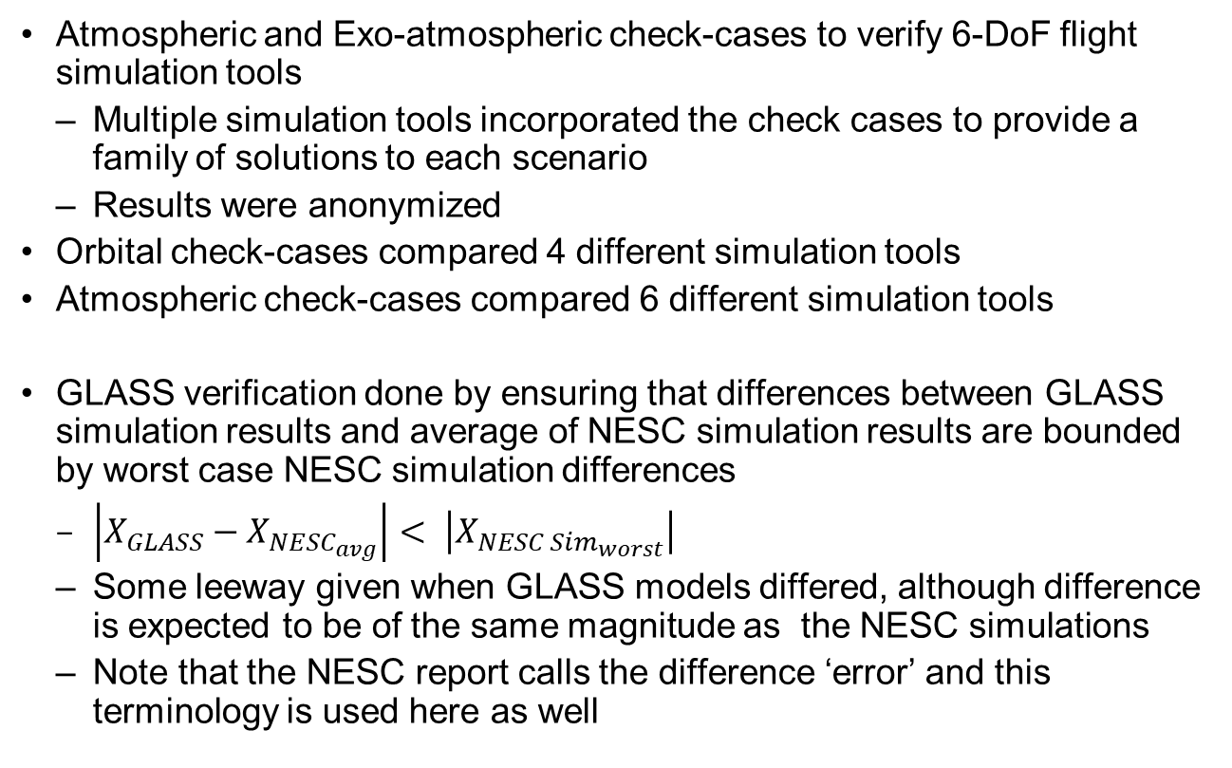
NESC Check Case Introduction
Atmospheric and Exo-atmospheric check-cases to verify 6-DoF flight simulation tools
Multiple simulation tools incorporated the check cases to provide a family of solutions to each scenario
Results were anonymized
Orbital check-cases compared 4 different simulation tools
Atmospheric check-cases compared 6 different simulation tools
GLASS verification done by ensuring that differences between GLASS simulation results and average of NESC simulation results are bounded by worst case NESC simulation differences
$\left|X_{GLASS}−X_{NESC_{avg}}\right|< \left|X_{{NESC Sim}_{worst}}\right|$
Some leeway given when GLASS models differed, although difference is expected to be of the same magnitude as the NESC simulations
Note that the NESC report calls the difference ‘error’ and this terminology is used here as well

Slide 5
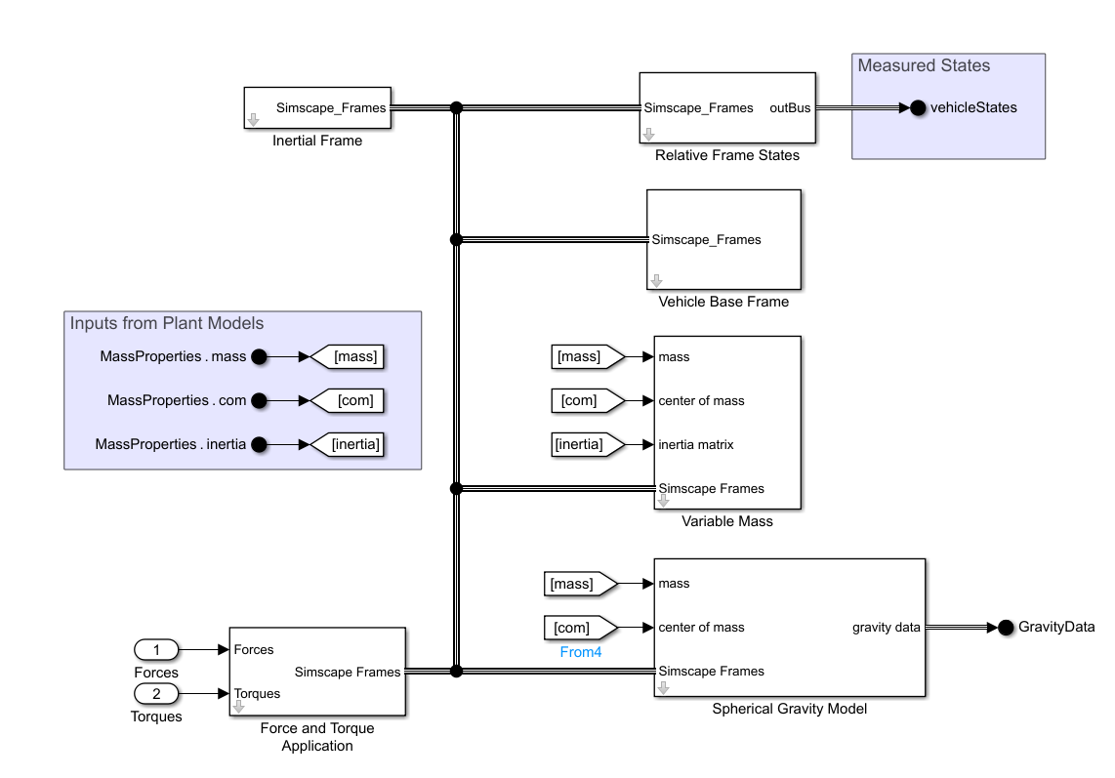
GLASS Framework
GLASS is designed to be modern, modular, user-friendly, and efficient simulation framework
Built in Simulink utilizing Simscape Multibody® as the dynamics engine
Basic simulations can be constructed with as little as 6 GLASS blocks
GLASS’s primary role is within the HLS Guidance Navigation and Control (GNC) Insight Team
Simulate and test HLS Commercial Partners GNC algorithms

Slide 6
Verification Plan Against NESC Check Cases
Focused on orbital check-cases
Main area of insight work with GLASS in the HLS program
Atmospheric check-cases will be completed in the future
All orbital cases were simulated using GLASS
Cases shown below are discussed in report
Highlighted cases presented here for brevity:
Case Number | Case Name | Verifies
2 | Keplerian Propagation | Integration, RNP, orientation
3B | 8x8 gravitation model | 8x8 harmonic gravitation model
4 | Planetary Ephemeris | Third body gravitational forces
6B | Aero Drag with Dynamic Atmosphere | Response to dynamic drag
9D | Non-Zero Initial Rate w/ T + F | Rotational response
10D | Non-Zero Initial Rate; Elliptical Orbit | Gravity gradient modeling
FULL | Integrated 6-DOF Orbital Motion | Combined effects response

Slide 7
NESC Orbital Check Case Verification

Slide 8
Orbital Check Case 2 – Keplerian Propagation
Case Conditions
Inverse-square gravitational model
Checks
Integration methods
Earth rotation models (rotation, nutation, precession)
Analytical solution exists to compare to!
If you don’t have this one right, you’re not going anywhere!
GLASS modeling differences/assumptions
No nutation/precession for Earth-Centered Earth-Fixed (ECEF) frame
This holds true for all cases
SPICE rotation, nutation, precession matrices did not agree with the orientation of the frame in the study to desired accuracy
All GLASS simulation results fell within error bounds

Slide 9
Orbital Check Case 2 – Keplerian Propagation
Earth Inertial (EI) Position
Accurate to within 10⁻³ m
EI Velocity
<10⁻⁶ m/s of error

Slide 10
Orbital Check Case 2 – Keplerian Propagation
EI Acceleration
10⁻⁷ m/s² of error
ECEF Position
< 0.3 m of error

Slide 11
Orbital Check Case 2 – Keplerian Propagation
Body Angular Rates
<10⁻⁸ rad/s of error
LVLH Euler Angles
<10⁻⁶ rad of error

Slide 12
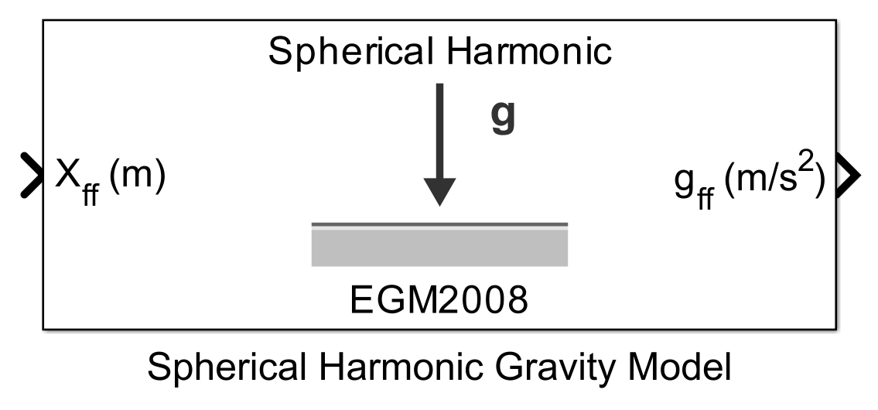
Orbital Check Case 3B – 8x8 Gravitation Model
Case Conditions
8x8 spherical harmonic gravity model
Checks
Spherical harmonic gravitation model
GLASS modeling differences/assumptions
Utilized Mathworks Aerospace Blockset spherical harmonic gravity model with EGM2008 parameters
No nutation/precession for Earth-Centered Earth-Fixed (ECEF) frame
All GLASS simulation results fell on the same order of magnitude of difference scale of the NESC simulation errors

Slide 13
Orbital Check Case 3B
Gravitational Acceleration
<10⁻⁵ m of error

Slide 14
Orbital Check Case 3B
EI Position Comparison
<10 m of error
ECEF Position Comparison
<10 m of error

Slide 15
Orbital Check Case 4 – Planetary Ephemeris
Case Conditions:
3rd body gravitational effects from Sun and Moon
Checks
Ephemeris data accuracy
3rd order gravitational effect models
GLASS modeling differences/assumptions
No nutation/precession for Earth-Centered Earth-Fixed (ECEF) frame
All GLASS simulation results fell within error bounds

Slide 16
Orbital Check Case 4
EI Position Comparison
<0.02 m of error

Slide 17
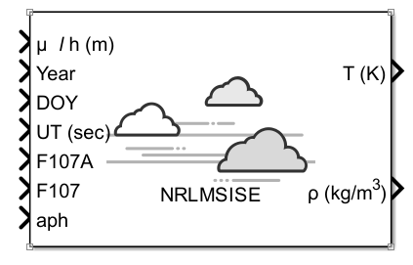
Orbital Check Case 6B – Aero Drag with Dynamic Atmosphere
Case Conditions:
Thermosphere Atmospheric model
Drag
Checks
Atmospheric model
Drag modeling effects
GLASS modeling differences/assumptions
No nutation/precession for Earth-Centered Earth-Fixed (ECEF) frame
US Naval Research Laboratory Mass Spectrometer and Incoherent Scatter Radar 00 (NRLMSISE-00) atmospheric model from Mathworks Aerospace Blockset used instead of Marshall Engineering Thermosphere (MET) model
Most GLASS simulation results fell within error bounds except for atmospheric properties due to model differences
These differences were expected and accepted

Slide 18
Orbital Check Case 6B
Atmospheric Properties Comparison

Slide 19
Orbital Check Case 6B
EI Position Comparison
<20m of error

Slide 20
Orbital Check Case FULL – Integrated 6-DOF Orbital Motion
Case Conditions:
Non-zero initial rates
Elliptical Orbit
8x8 Spherical Harmonic Gravity Model
Gravitational Gradient Model
Checks
All previous effects except manual force and torque application
GLASS modeling differences/assumptions
No nutation/precession for Earth-Centered Earth-Fixed (ECEF) frame
Utilized Aerospace Blockset spherical harmonic gravity model with EGM2008 parameters
NRLMSISE-00 atmospheric model from Aerospace Blockset used instead of MET model
Most GLASS simulation results fell within error bounds except for those associated with previously mentioned modeling differences
These differences were expected and accepted

Slide 21
Orbital Check Case FULL
EI Position Comparison
< 10m of error
EI Acceleration Comparison
<10⁻⁵ m of error

Slide 22
Orbital Check Case FULL
LVLH Euler Angles
Similar trends and magnitudes throughout flight
Body Angular Rates
Similar trends and magnitudes for half of flight
2nd half stays bounded

Slide 23
Conclusions
The GLASS framework was successfully verified against the NESC 6-DOF simulation study
This verified:
Simscape Multibody solver
Gravitational models
Atmospheric models
GLASS framework and related code
Small differences seen are attributable to modeling choices:
Gravitational model differences
Gravitational gradient model differences
Atmospheric model differences

Slide 24
Thank you Thanks to... Co-Authors: Nicholas Olson (Jacobs), Justin Ganiban (Jacobs), Juan Orphee, Matt Hawkins Also, we would like to thank the Human Landing System project and NASA NESC, both supporting this verification activity
Any questions?

Slide 25
Backup

Slide 26
Orbital Check Case 9D – Non-Zero Initial Rate w/ T + F
Case Conditions:
Non-zero initial rates
Torque and force application
Checks
Translational response
Rotational response
GLASS modeling differences/assumptions
No nutation/precession for Earth-Centered Earth-Fixed (ECEF) frame

Slide 27
Orbital Check Case 9D
EI Position Comparison
<10⁻³ m of error
EI Acceleration Comparison
<10⁻⁸ m of error

Slide 28
Orbital Check Case 9D
Body Angular Rates
<10⁻⁸ rad/s of error
LVLH Euler Angles
<10⁻⁵ rad of error

Slide 29
Orbital Check Case 10D – Non-Zero Initial Rate; Elliptical Orbit
Case Conditions:
Non-zero initial rates
Elliptical Orbit
8x8 Spherical Harmonic Gravity Model
Gravitational Gradient Model
Checks
Gravitational gradient model effects
GLASS modeling differences/assumptions
No nutation/precession for Earth-Centered Earth-Fixed (ECEF) frame

Slide 30
Orbital Check Case 10D
Body Angular Rates
Roll: <10⁻¹⁷ rad/s of error
Pitch/Yaw: <10⁻⁵ m of error
LVLH Euler Angles
Similar trends and magnitudes throughout flight

Slide 31
Orbital Check Case 10D
EI Position Comparison
<10⁻⁵ m of error

