Slide 1
AIAA SciTech Forum, January 2024
Flight Dynamics and Navigation Performance of the BioSentinel Mission
Andres Dono Perez^{1,2}, NAV Lead
Jose Luis Alvarellos^{1,3}, NAV
Nahum Alem¹, NAV
Matthew Napoli¹, PM
Lisa Policastri⁴, NAV
Ryan Lebois⁴, NAV
Spaceflight Division, NASA Ames Research Center
Axient
ASRC Federal
Space Exploration Engineering
January 9, 2024

Slide 2
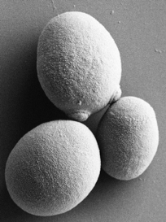
BioSentinel Mission
HQ Directorate: ESDMD Mars Campaign Development (MCD) (formerly AES)
Objective: develop a deep space tool with autonomous life support technologies to study the biological effects of the space radiation environment
NASA’s first biological study in interplanetary deep space
  First CubeSat to combine bio studies with autonomous capability & dosimetry beyond LEO
  Far beyond the protection of Earth’s magnetosphere
  BioSentinel allows to compare different radiation & gravitational environments (deep space, ISS, Earth surface)
BioSentinel escapes into a heliocentric orbit
Lunar transit
(3-7 days)
Distance to ISS: ~ 350 km
Distance to the Moon: ~385,000 km
Distance at 6 months: ~16,000,000 km
Secondary payload
deployment (L+4 hrs)
Credit: Hanel & Santa Maria, 2019
Notes:
Yeast image credit: Bob Hanel & Sergio Santa Maria, “BioSentinel – Spacecraft and BioSensor Flight Unit Development”, Interplanetary Small Sat Conference 2019.

Slide 3
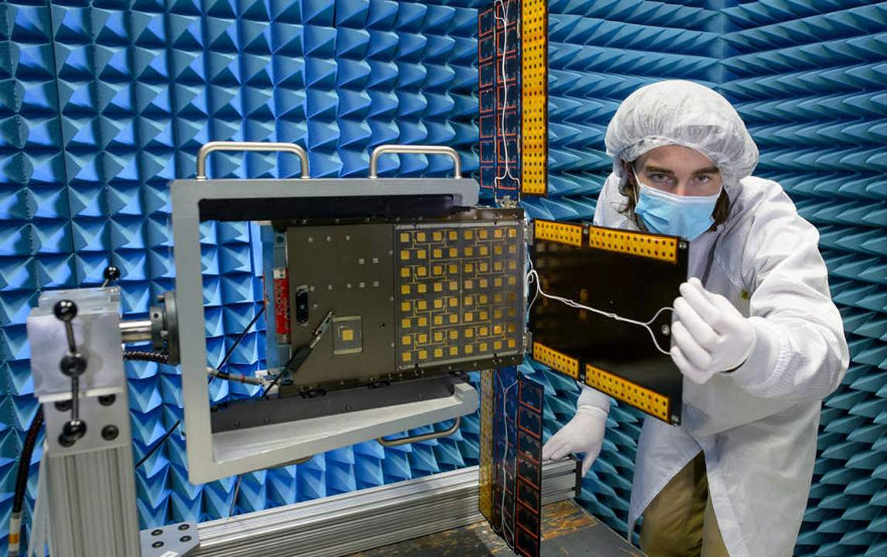
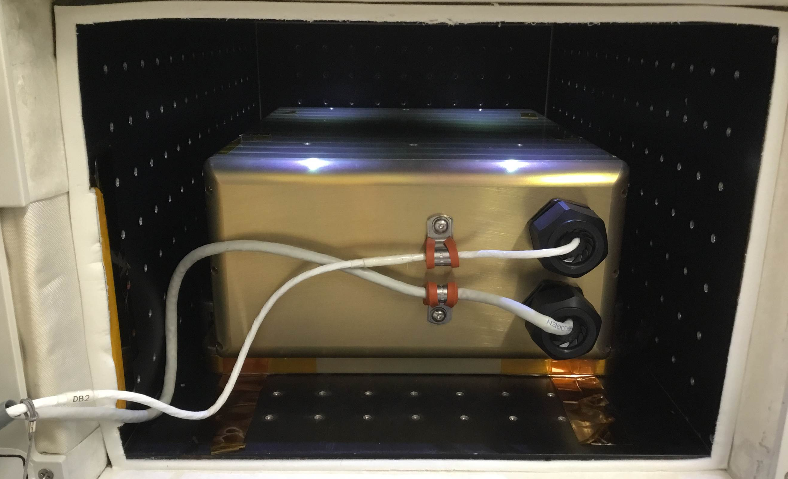
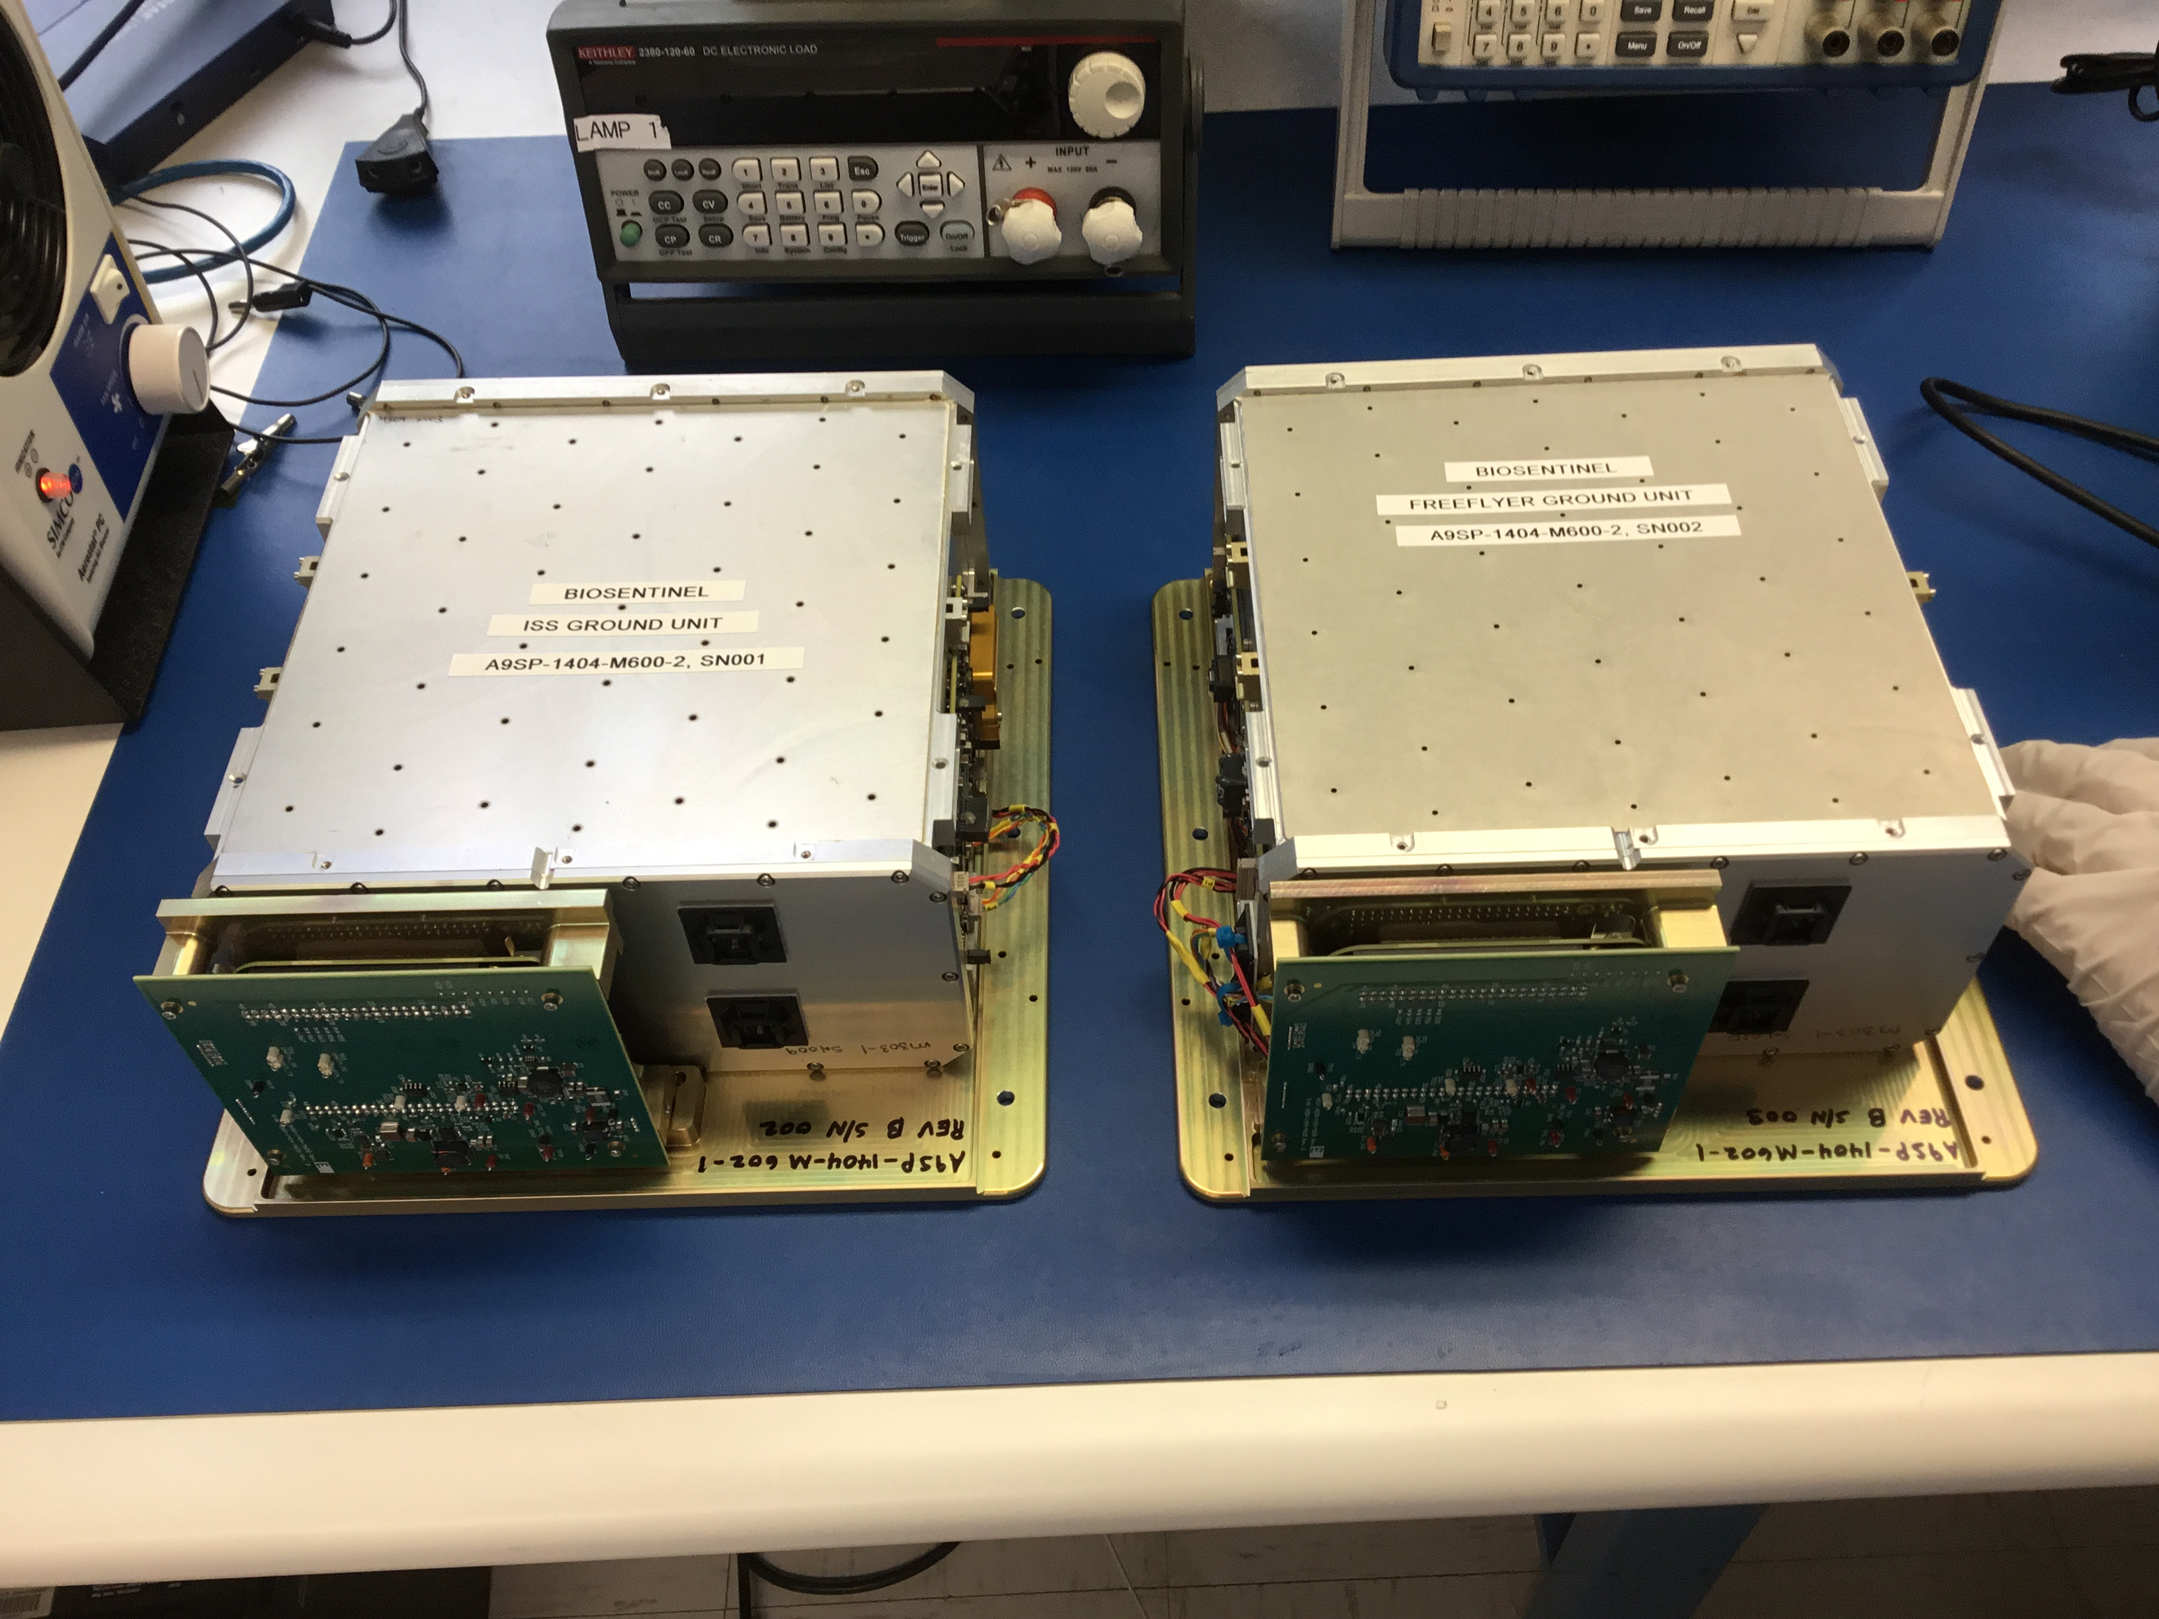
Project Description
BioSentinel is performing the first long-duration biology experiment in deep space. Its six-month science investigation is studying the effects of deep space radiation on a living organism, yeast. There are three segments to the project:
      Freeflyer Spacecraft - deep space experiment on Artemis 1
      ISS Segment - control experiment in LEO on the International Space Station
      Ground Segment – control experiment on ground
The three segments are all part of the BioSentinel mission and share identical BioSensor payloads.
Credit: Dominc Hart/NASA
Credit: Jeff Homan/NASA
Credit: Jeff Homan/NASA
Freeflyer Spacecraft ISS Segment Ground Segment
Notes:
Freeflyer Image Credit: NASA/Dominic Hart. ISS & Ground Image Credits: NASA/Jeff Homan

Slide 4
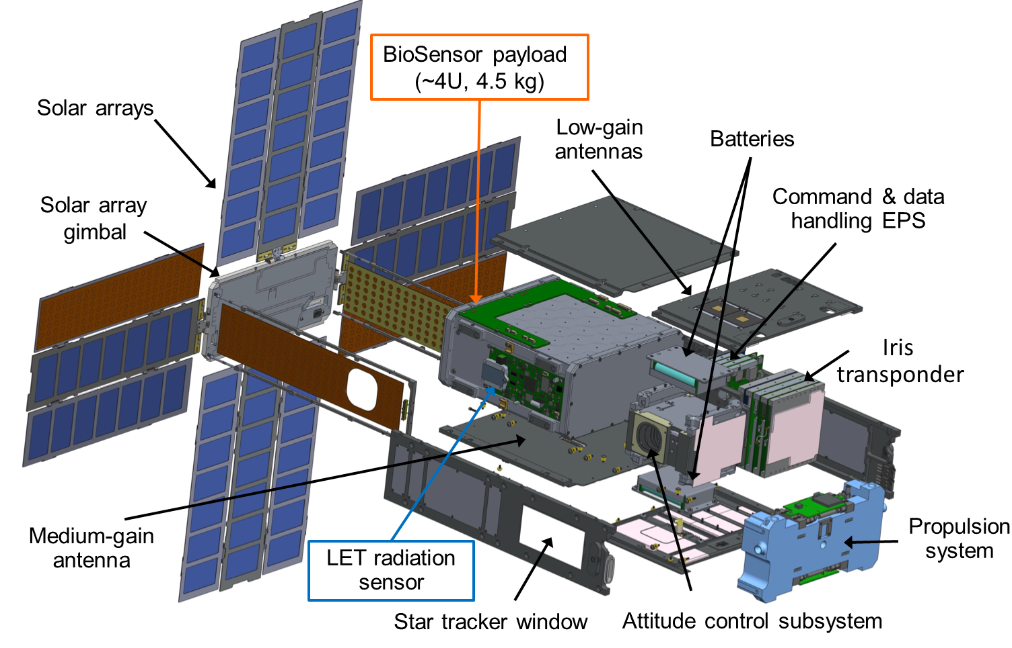
Project Description (Cont.)
Credit: Bob Hanel & Sergio Santa Maria, “BioSentinel – Spacecraft and BioSensor Flight Unit Development”, Interplanetary Small Sat Conference 2019.
LET: ‘Linear Energy Transfer’ spectrometer

Slide 5
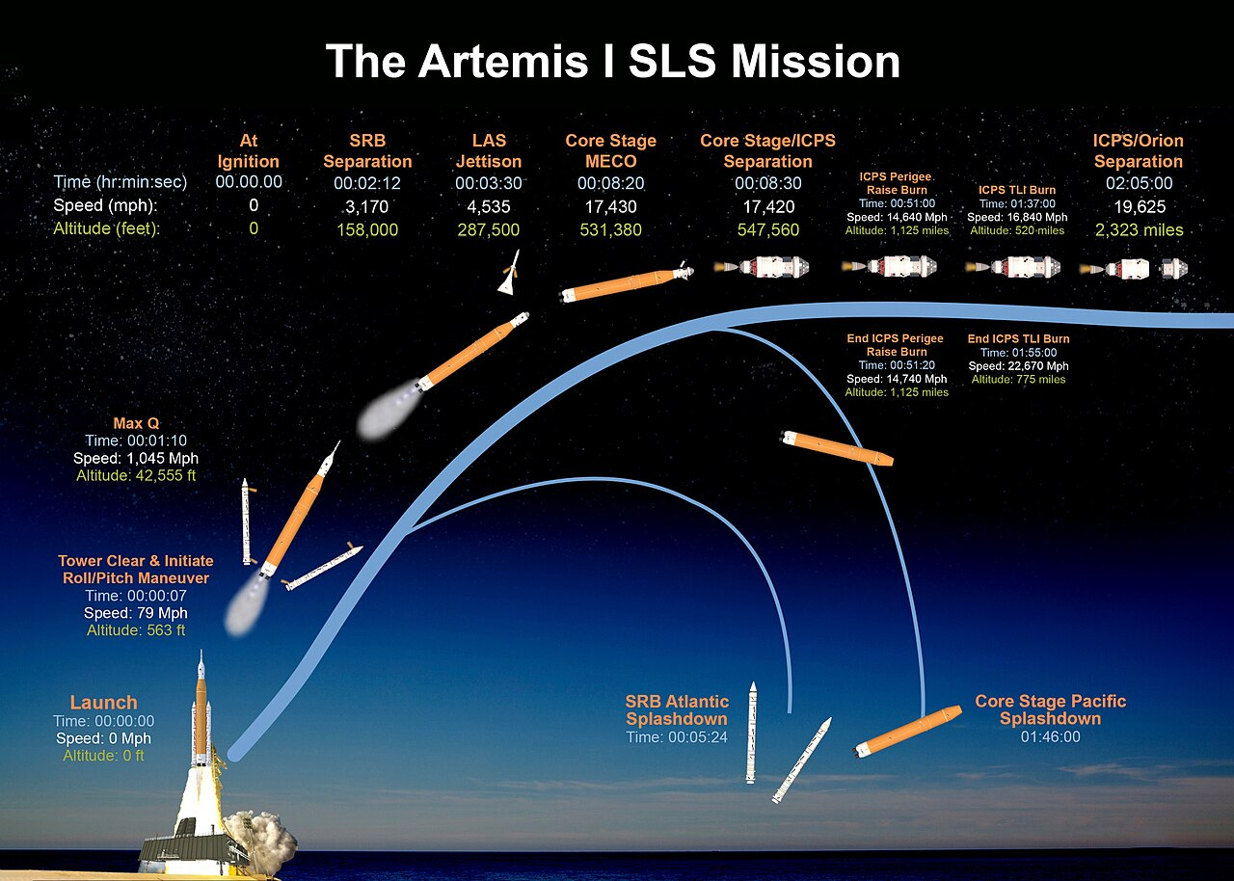
SLS mission
Object placed in orbit:
  ICPS/Orion
  10 CubeSats
Image credit: https://www.nasa.gov/specials/artemis-i-press-kit/
Notes:
https://www.nasa.gov/specials/artemis-i-press-kit/

Slide 6
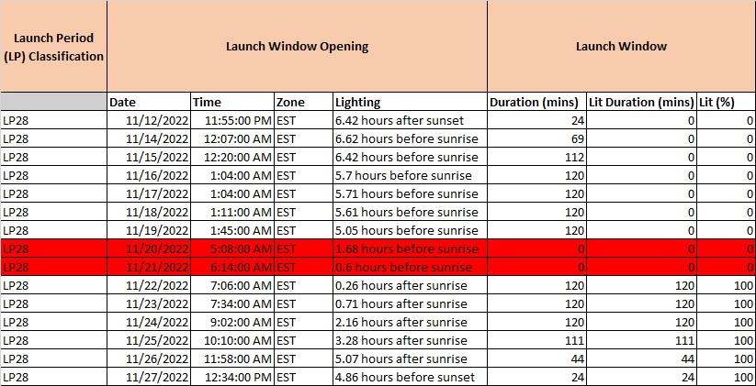
Launch Period 28 launch dates

Slide 7
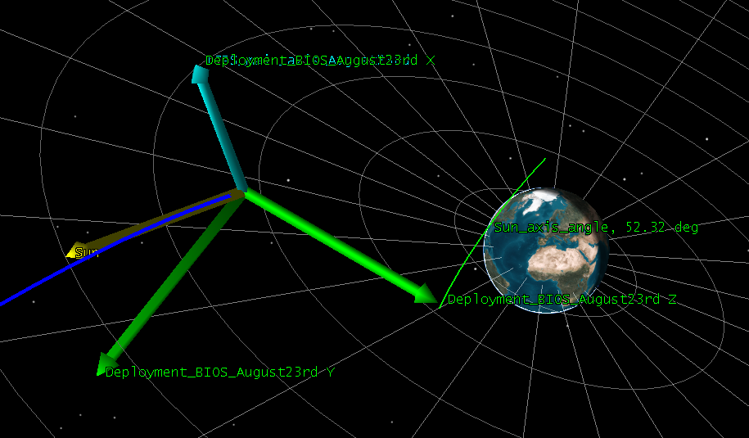
Monte Carlo Simulation assumptions
BioSentinel is a free-flyer spacecraft that will deploy from the main ICPS vehicle in Bus Stop 1.
After deployment, BioSentinel is not expected to perform any maneuver that will alter the trajectory achieved by the ΔV imparted by the deployment system.
The ΔV imparted can have a significant effect on the trajectory outcome, since it occurs 5-6 days prior to the lunar flyby. Even a small ΔV amount, that early in the trajectory, can create a difference of several of hundreds of kilometers in altitude of periselene at the time of the lunar flyby.
The ICPS has a nominal altitude of periselene of around 200 km, which has been consistent through the various trajectories and launch dates provided.
If the ΔV imparted to BioSentinel at the time of deployment has a relatively large component in the velocity direction of the ICPS, this creates the most impactful results, leading to either a higher altitude of periselene (positive velocity direction component), or an impact with the Moon (negative velocity direction component).
Therefore, the most important factor is to know the attitude of the ICPS at the time of deployment, since this will determine the main component of the deployment vector.
ICPS main axis of rotation
Situation at the time of deployment for launch date August 23rd
For this particular launch date, the Sun vector is almost aligned with the velocity vector at the time of deployment.

Slide 8
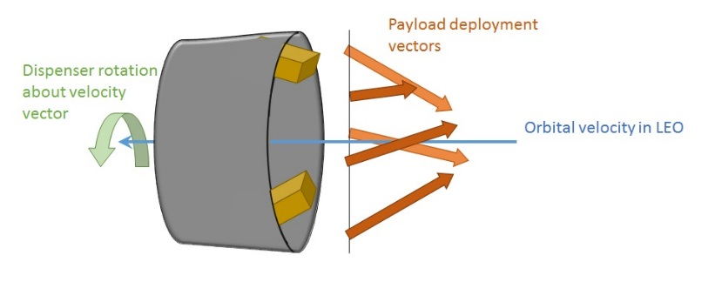
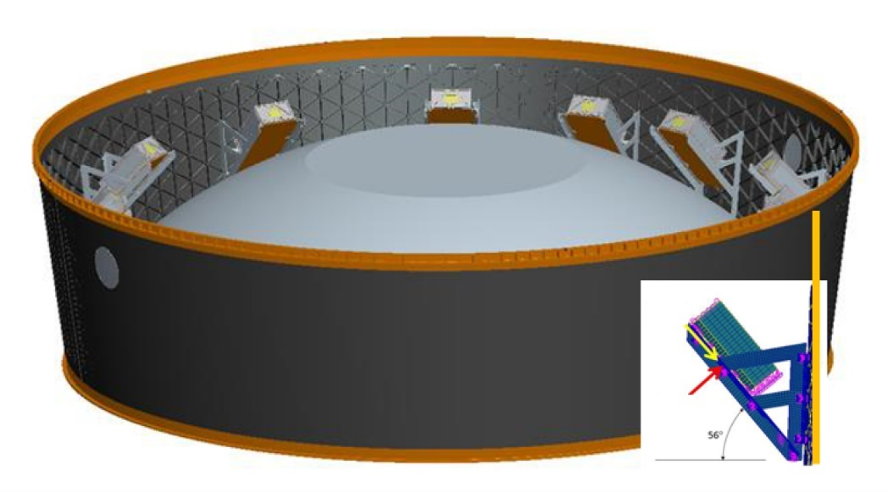
Deployment cases: approx. 55 deg off Sun vector
Rotational deployment – ICPS Sun oriented, 55 deg off
Uncertainties in the deployment vector for ALL cases
15% nominal magnitude of mass which affects the deployment ΔV due to the spring force (3σ)
Pointing - 14 deg (3σ)
Random clock angle 0-360 deg
1000 cases
Φ
55 deg off Sun vector
ICPS main axis of rotation
Payloads are placed and deployed in the main ICPS body at 56 deg with respect to the main axis.
The Payload office has provided the expected orientation of the ICPS for a given launch date, together with the ephemeris
On top of that, we assume 14 deg (3σ) of pointing inaccuracy and the uncertainties explained in the box (top left)

Slide 9
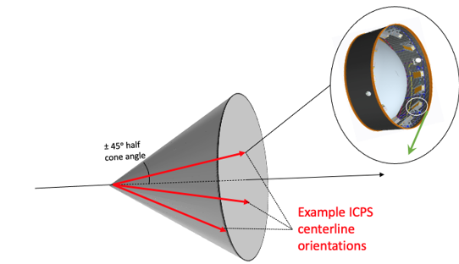
Monte Carlo Analysis
Baseline CONOPS did not have a ΔV maneuver planned. Initial lunar impact risks of <10% was deemed an acceptable risk.
Monte Carlo analyses for 2022, for cases where altitude < 50 km:
  Aug 29th - 30%,
  Sept 2nd - 54%,
  Sept 5th - 56%,
  Nov 16th – 15% (actual launch date)
  Nov. 18th – 0%
  Nov. 19th – 0%
  Nov. 25th – 14%
Nov 16th Launch Deployment Variability

Slide 10
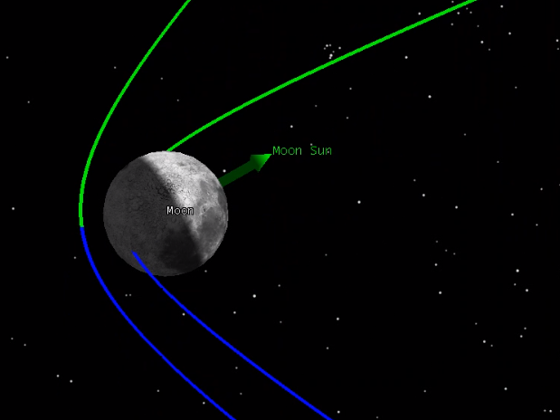
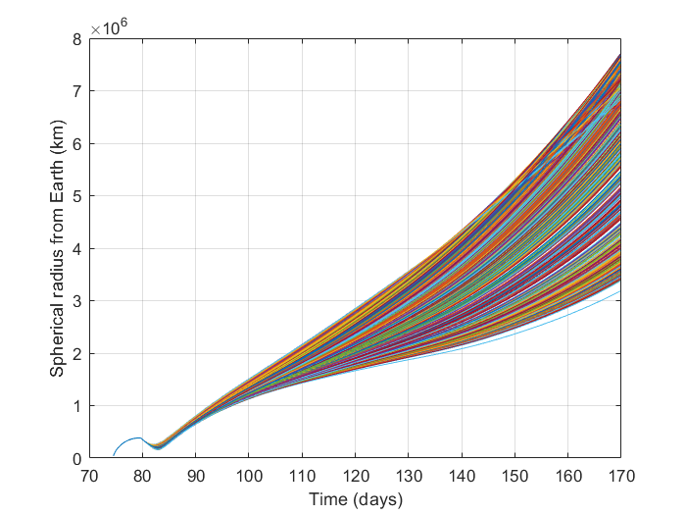
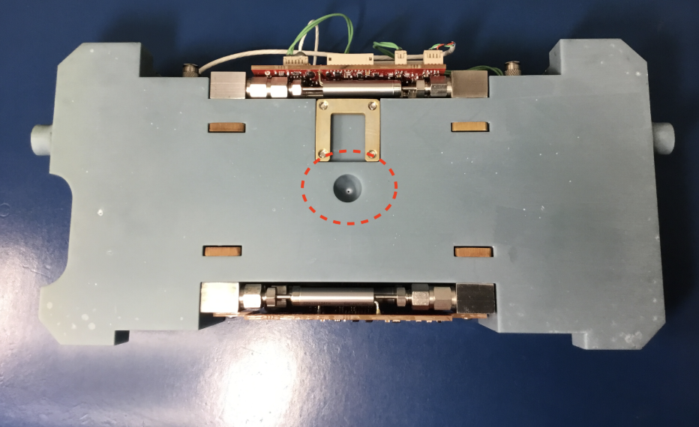
Lunar Impact Risk – Pre-Launch Analysis
Avoiding impact requires a ΔV maneuver shortly after deployment
  Earlier maneuver = less ΔV required
  ΔV attitude is assumed to be in the S/C velocity direction
Prop Subsystem:
  The capability for ΔV is possible because the propulsion system included an extra rear nozzle.
  Early in design process it was included as a requirement to move away from ICPS and other secondaries. That requirement was later removed.
  Fortuitously that extra rear nozzle allowed us to use it to avoid lunar impact (in case of an unfavorable deployment).
  Available ΔV = 4.2 m/s (after allocating propellant for momentum unloading)
  Total ΔV = 5.9 m/s, of which 1.7 m/s is need for nominal operations of the 6-month mission.
Monte Carlo:
Earth distance vs time, for a 3-burn case
  Propulsion Rear nozzle
Credit: Terry Stevenson/NASA
Notes:
Propulsion System image credits: NASA/Terry Stevenson

Slide 11
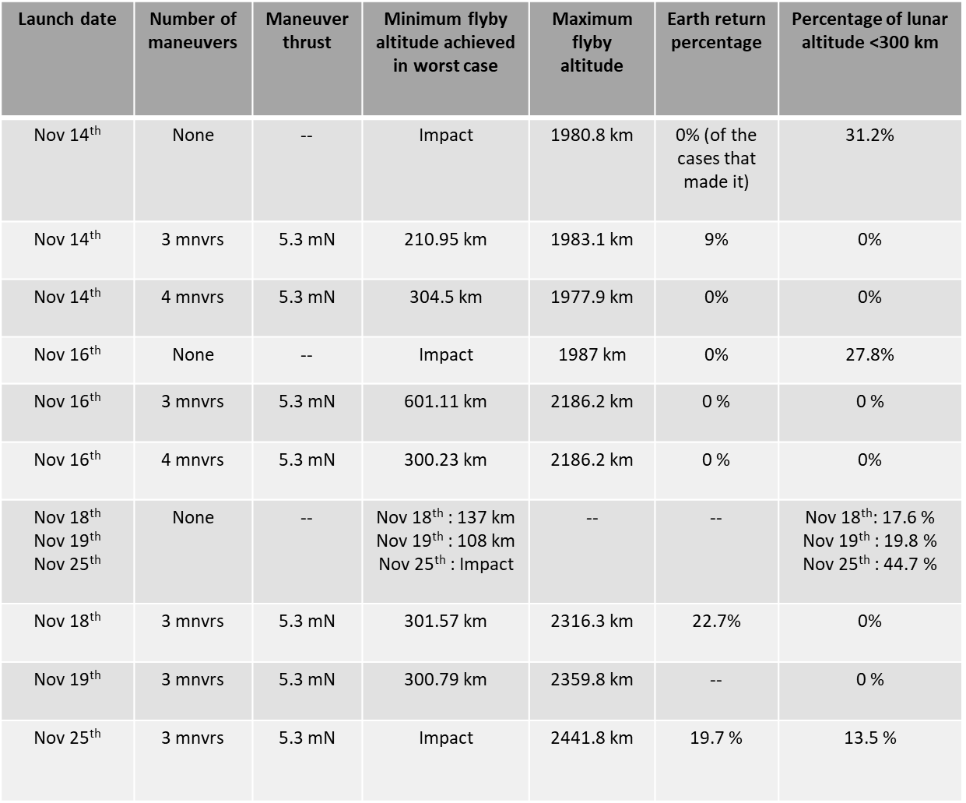
Launch Period 28 Monte Carlo analyses summary

Slide 12
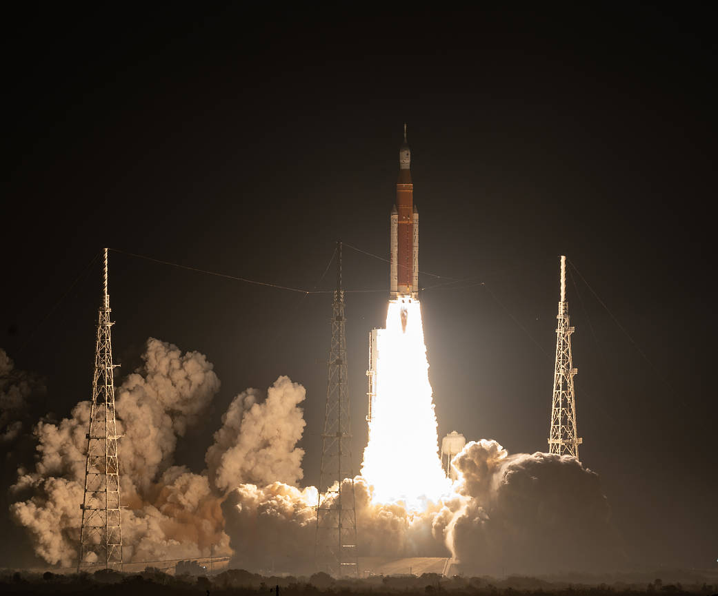
SLS launch: 16 Nov 2022
  SLS Block 1 launched 16-Nov-2022, part of Launch Period 28
  Launch occurred 06:47:44 UTC
  44 minutes into the two-hour launch window
Credit: Bill Ingals (https://www.nasa.gov/exploration/systems/sls/artemis-i-launch-0.html)

Slide 13
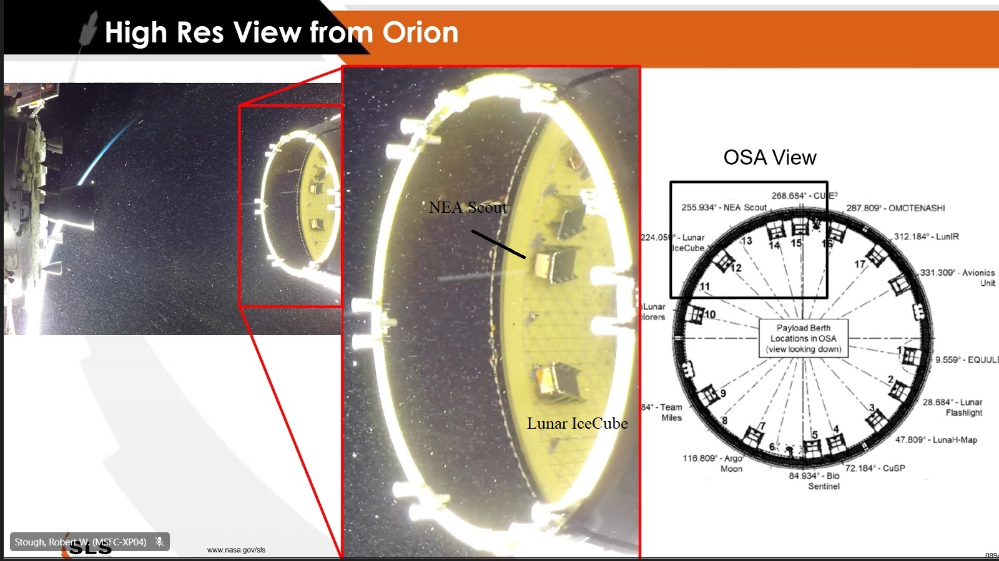
View from Orion
Credit: NASA YouTube site
https://www.youtube.com/@NASA
  BioSentinel deployment from ICPS dispenser #5
  16-Nov-2022, 10:30:42 UTC,
  3 hrs 43 minutes post-launch.
BioSentinel
Notes:
Image credit: NASA’s YouTube site

Slide 14
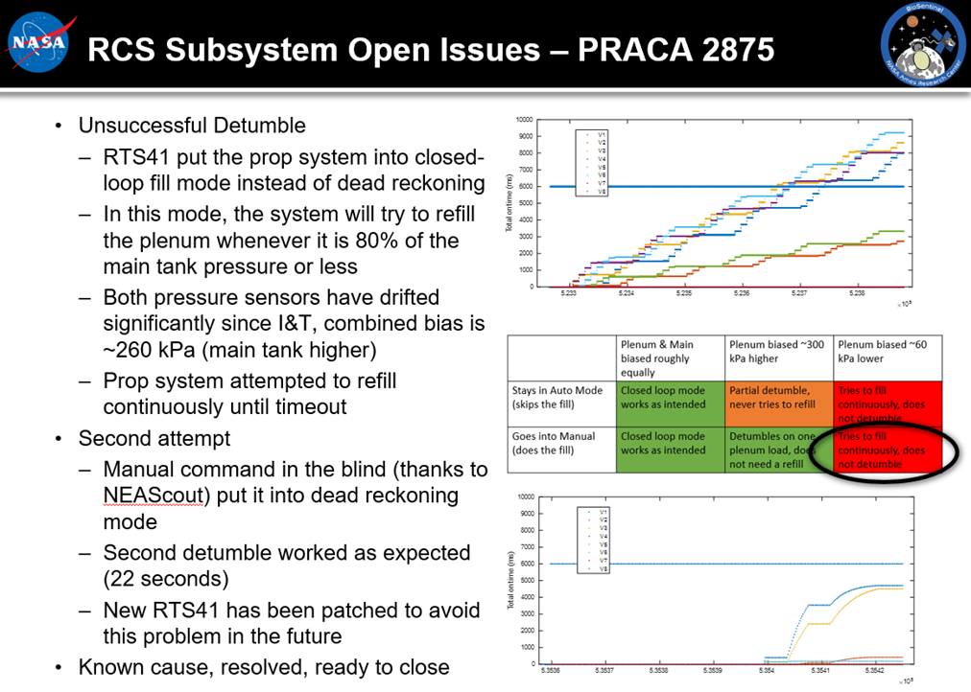
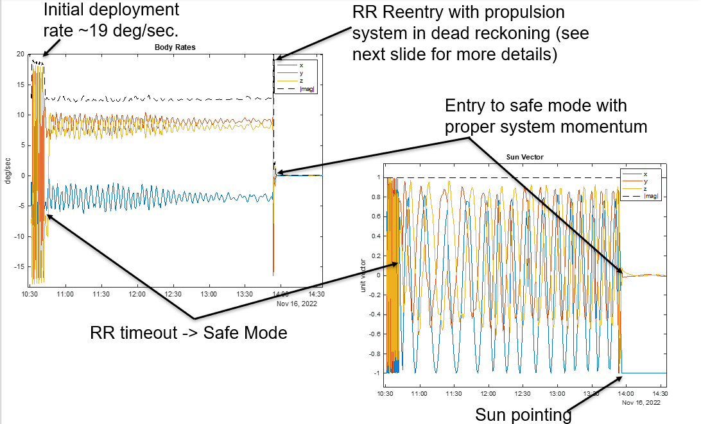
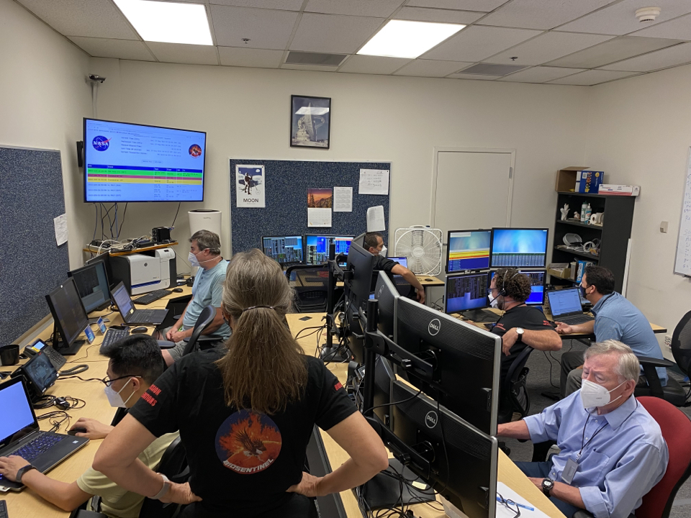
Initial Deployment – Tumbling Anomaly
Credit: Matthew Napoli/NASA
Notes:
Mission Ops team credit: NASA/Matthew Napoli

Slide 15
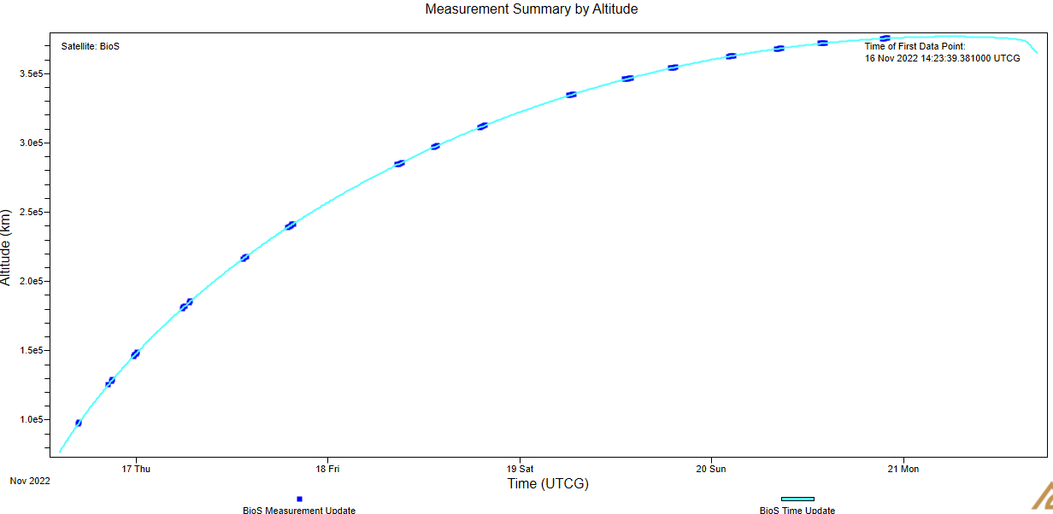
OD: Pre-Flyby
  Pre-Flyby Tracking data availability:
    Versus Time
    Versus Altitude from Earth

Slide 16
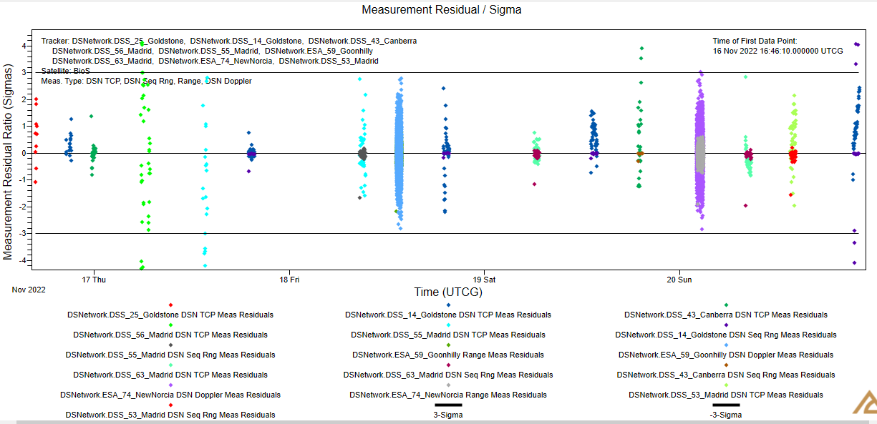
OD: Pre-Flyby (Cont.)
  Final pre-flyby OD includes TCP, Sequential Ranging, Doppler tracking data
  Tracking data from both DSN & ESA stations
  Separation orbit solution below (J2000):
Epoch | 16-Nov-2022, 10:30:42 UTC
a | 195,498.7 km
e | 0.964664
i | 30°.2527
Ω | 10°.9247
ω | 20°.4447
υ | 132°.984

Slide 17
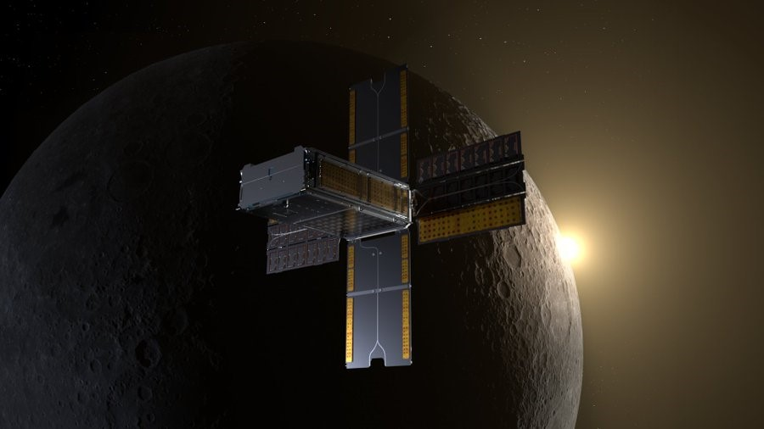
Lunar Flyby
    Flyby Epoch: 21-Nov-2022,
    15:40:39 UTC
    (5.22 days post BioSentinel
    deployment)
    Flyby Altitude: 406 km
    Thanks to NASA Eyes for
    the visualization tool!
    https://eyes.nasa.gov/apps/solar-system/#/sc_biosentinel

Slide 18
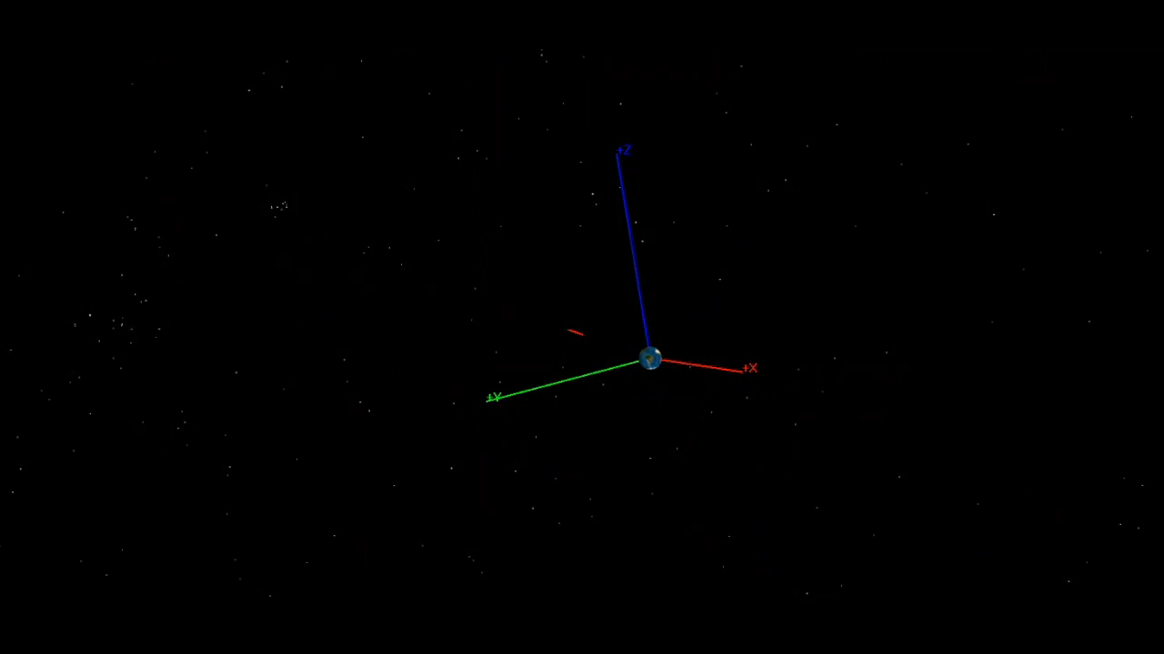
Flyby Animation
Notes:
Thanks to NASA/Rachel R. Gilbert for help with video editing!

Slide 19
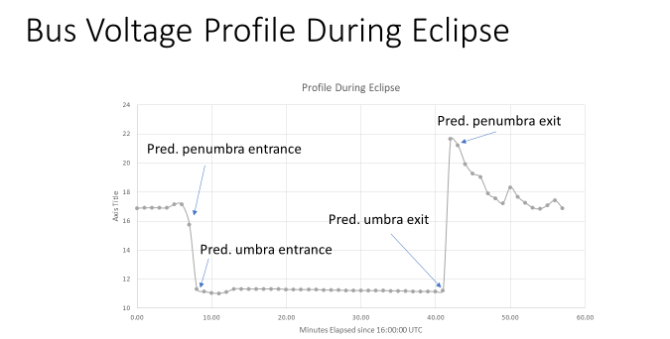
Eclipse
Bus Voltage data credit: S. Wu/NASA
    Eclipse Start: 21-Nov-2022, 16:06:56 UTC
    Eclipse End: 21-Nov-2022, 16:43:23 UTC
    Eclipse Duration: 36.5 minutes
Notes:
Data points credits: NASA/S. Wu

Slide 20
Flight Tracker
Pass | Date/Time (UTC) | Station | Notes
1 | 16 Nov 2022 320/11:41 | DSS-25 | Initial Acquisition. Rate reduction not complete, spacecraft tumbling.
1-extra | 16 Nov 2022 320/13:52 | DSS-14 | Re-enabled rate reduction.
2 | 16-Nov-2022 320/16:25 | DSS-25 | Confirmed rate reduction complete.
3 | 16-Nov-2022 320/20:20 | DSS-14 | Deployed Solar Arrays
4 | 16 Nov 2022 320/23:20 | DSS-43
5 | 17 Nov 2022 321/06:05 | DSS-56 | First Orbit Determination after this pass. Lunar avoidance maneuver called-off. Transitioned to nominal pointing
…
 | 21 Nov 2022 325/15:41 |  | Lunar Flyby @ 406km periselene altitude
21 | 21 Nov 2022 325/17:15 | DSS-14 | Post Eclipse H&S nominal
…
54 | 05 Dec 2022 339/16:00 | DSS-65 | Science Phase - Experiment #1 Start
… | Over 100 successful comm passes and 3 experiments run to date. |  | Over 100 successful comm passes and 3 experiments run to date.

Slide 21
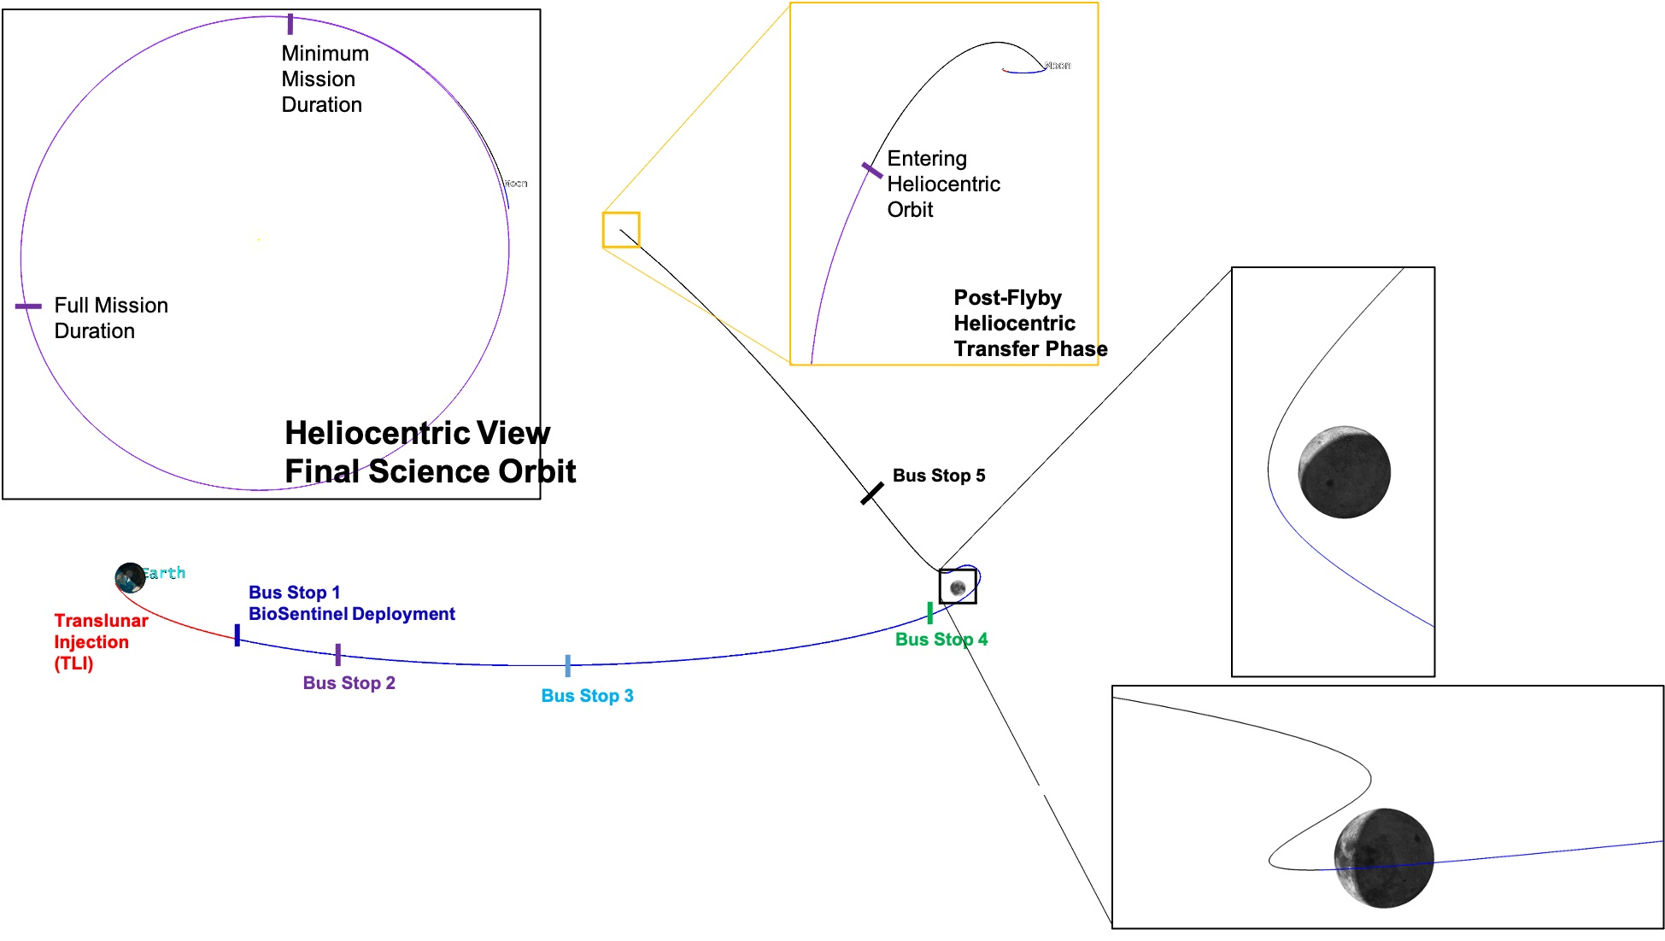
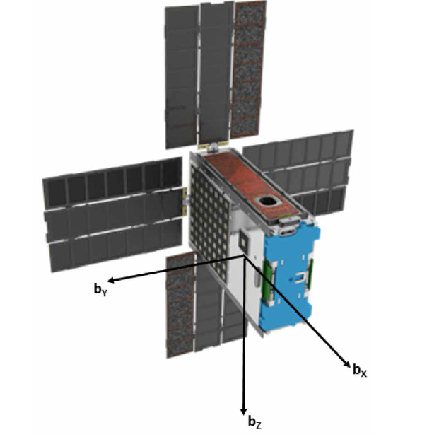
Sequence of Events
Event | Date/Time (UTC)
SLS Launch | 16-Nov-2022, 06:47:44
BioSentinel Deployment | 16-Nov-2022, 10:30:42
Full S/A deployment | 16-Nov-2022, 20:20:00
Lunar Flyby (406 km) | 21-Nov-2022, 15:40:51
Lunar Eclipse start (duration: 36.5 mins) | 21-Nov-2022, 16:06:56
Science Ops start | 5-Dec-2022, 16:00:00
Exit Earth’s Hill sphere | 12-Dec-2022, 10:30:00
BioSentinel image credit: Lightsey, G., Stevenson, T., Sorgenfrei, M.; “Development and Testing of a 3D-printed Cold Gas Thruster for an Interplanetary CubeSat”. Proc. IEEE 106, 379-390, 2018

Slide 22
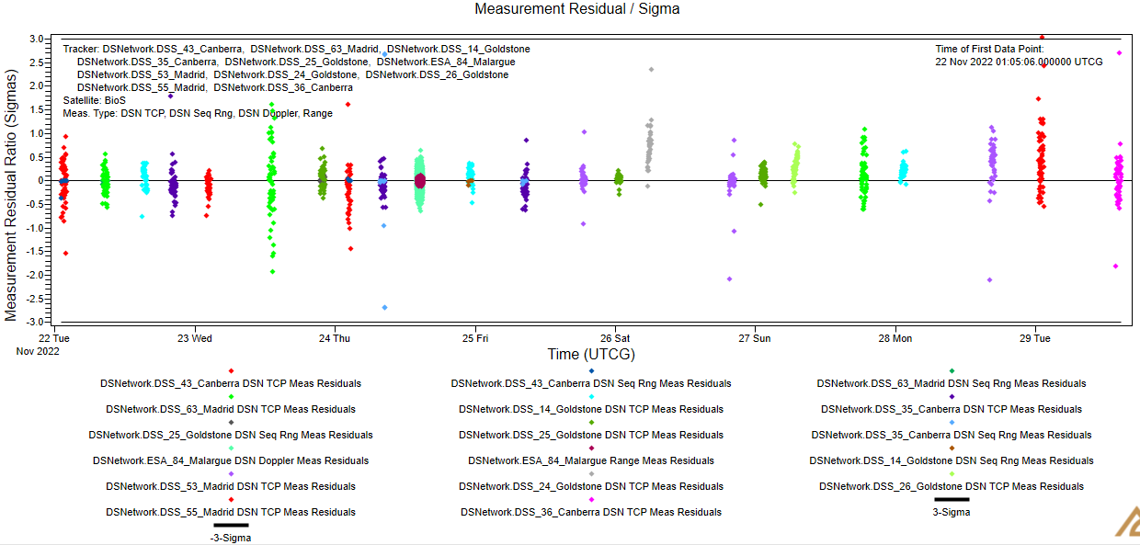
OD: Post-Flyby
  Post-flyby OD includes TCP, Sequential Ranging, Doppler tracking data
  Tracking data from both DSN & ESA stations

Slide 23
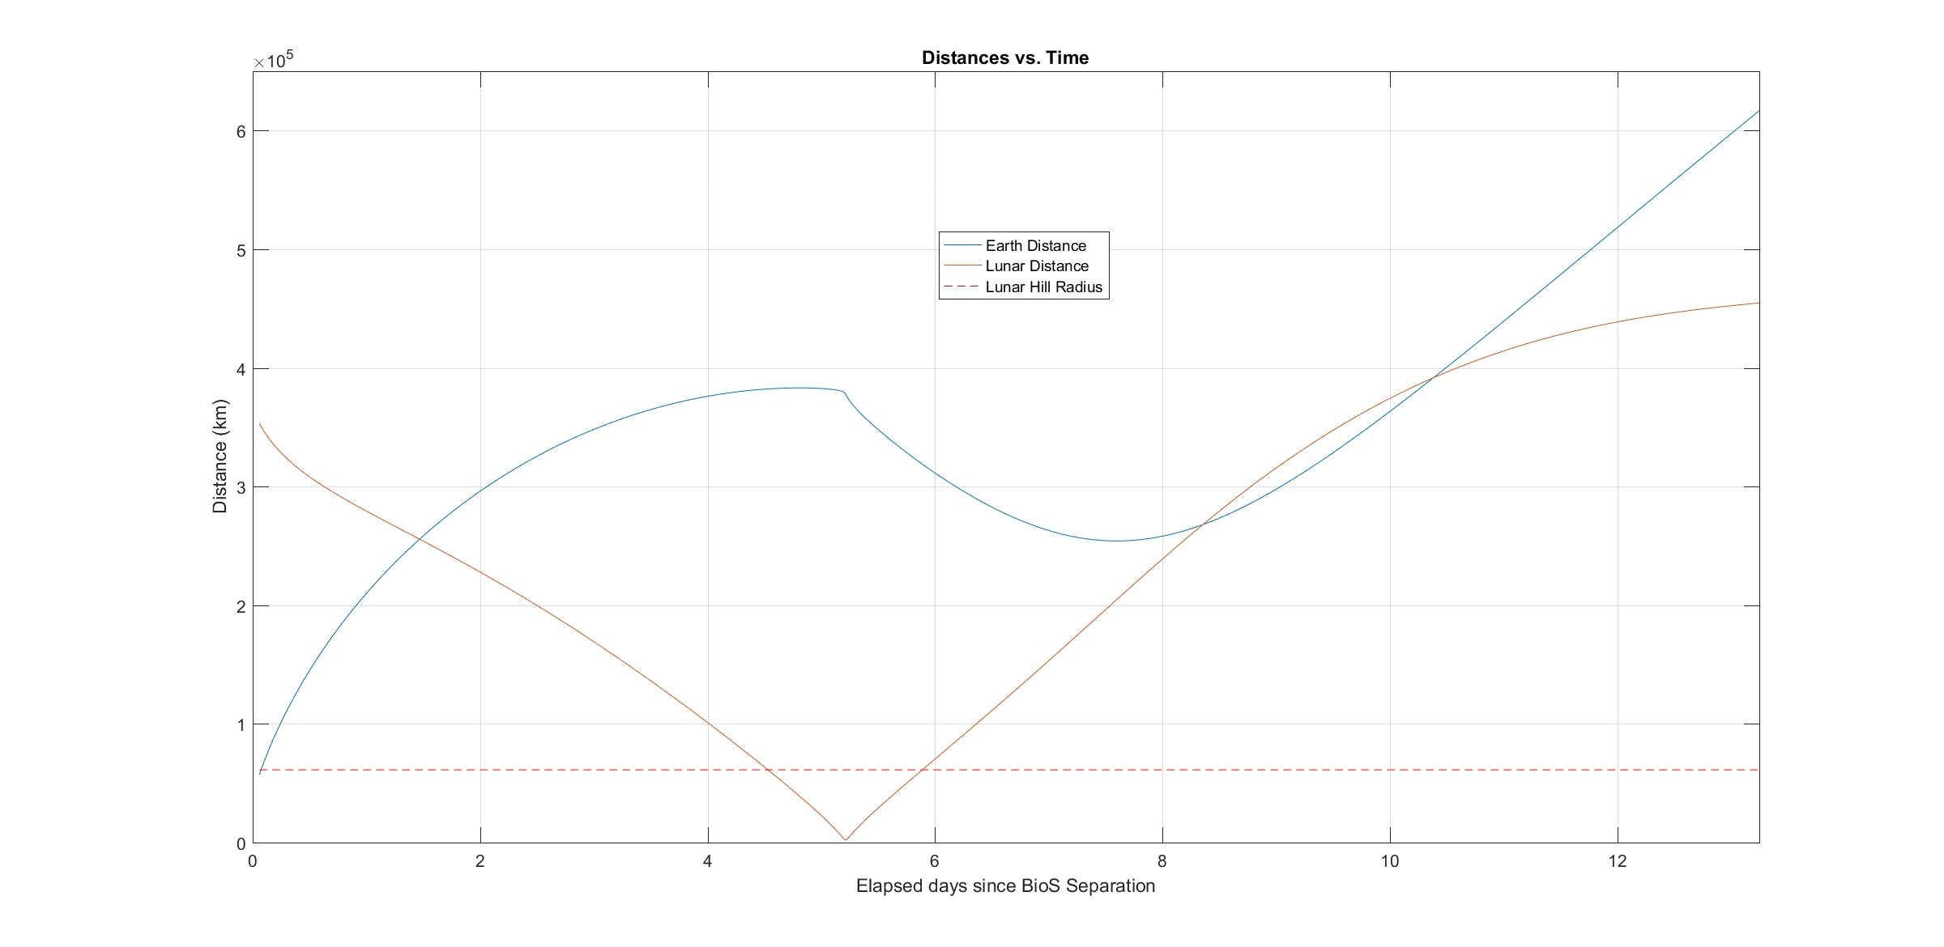
Distances to Earth and Moon (short-term)
Distance to Earth (blue curve) and Moon (red curve) vs. time since BioSentinel deployment
  The horizontal dashed red line at bottom represents the lunar Hill sphere radius
Min. post-flyby distance to Earth 254,000 km
Flyby
21-Nov-2022, 15:40:39 UTC

Slide 24
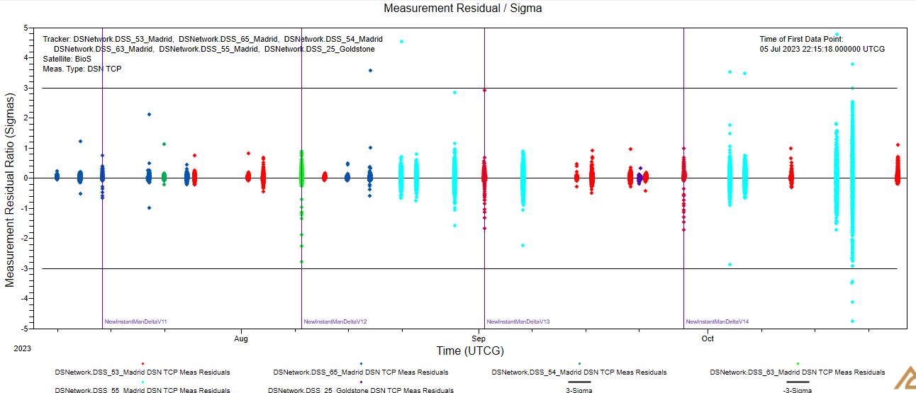
OD: Post-Flyby, Heliocentric
  Heliocentric OD includes only TCP data from DSN
  Vertical lines represent ΔH maneuvers (10⁻⁴ < ΔV < 10⁻³ m/s)
  Current semi-major axis (15-Jan-2024) is 1.0187 AU
  Earth-trailing orbit
Notes:
TCP: Total Count Phase

Slide 25
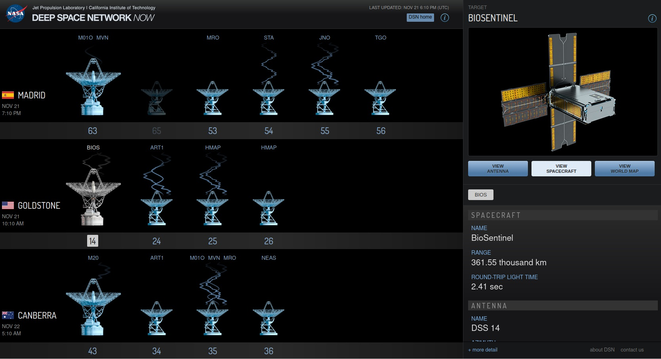
DSN Experience
DSN / ESA support
  99% successful comm passes
  NOPE and MIM have been very responsive to issues and continue to meet with team to work open issues
  Actual signal levels are ~3 dB higher than predicted for 8000 bps and 500 bps (changing) after the first few days
https://eyes.nasa.gov/dsn/dsn.html
Notes:
NOPE: Network Operations Project Engineer. MIM: Mission Interface Manager

Slide 26
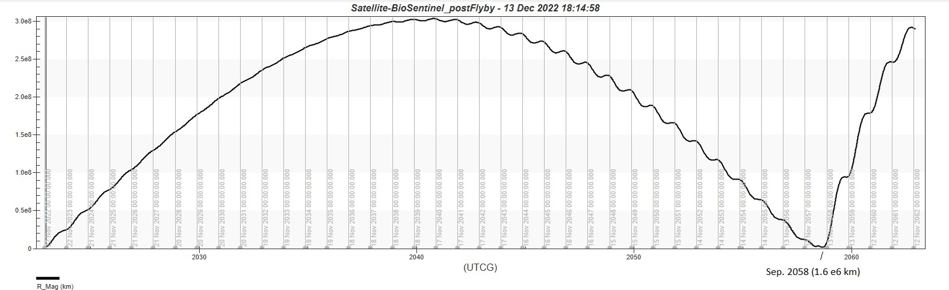
Distance to Earth (long-term)
Max. distance ~300e6 km in 2041
Min. distance post-flyby ~1.6e6 km in 2058!

Slide 27
Navigation experience
Our CONOPS required us to decide whether to do a Lunar Avoidance Maneuver no later than our 5th pass. A robust ephemeris solution was needed. Initial state vector from the ICPS and complete tracking data was fundamental. More information about the attitude and deployment magnitude from ICPS would have improved Orbit Determination (OD).
ESA tracking data provided other type of measurements such as Ranging and two-way Doppler complemented the Sequential Ranging and TCP data provided by the DSN. This was proven useful to obtain an OD solution with higher degree of confidence.

Slide 28
Navigation experience (Cont.)
After lunar flyby, OD adjustments had to be performed to accommodate the large ΔV incurred. Heliocentric orbit was successfully achieved, and ephemerides are being provided on a regular basis.
Campaign Nav support and collaboration among other CubeSat missions were very professional and useful. We would also like to highlight also the help from the Payload Office Trajectory team and the DSN team.
Great support to the ARC NAV team from SEE.

Slide 29
Mission Takeaways
  Favorable deployment trajectory for lunar flyby eliminated many of our top concerns.
  Very good performance of the IRIS radio.
  Got the BioSensor payload into deep space to run its experiments.
  DSN /ESA support has exceeded expectations.
  Secondary community has been very supportive and collaborative.
  Currently working on a Mission Extension to study Deep Space Radiation.
  Time was our enemy:
  Yeast and BioSensor payload degraded over time.
  Battery degraded. Recharging in October was critical.
  Propulsion pressure sensors drifted over time.

Slide 30
Appendices
  Extra slides

Slide 31
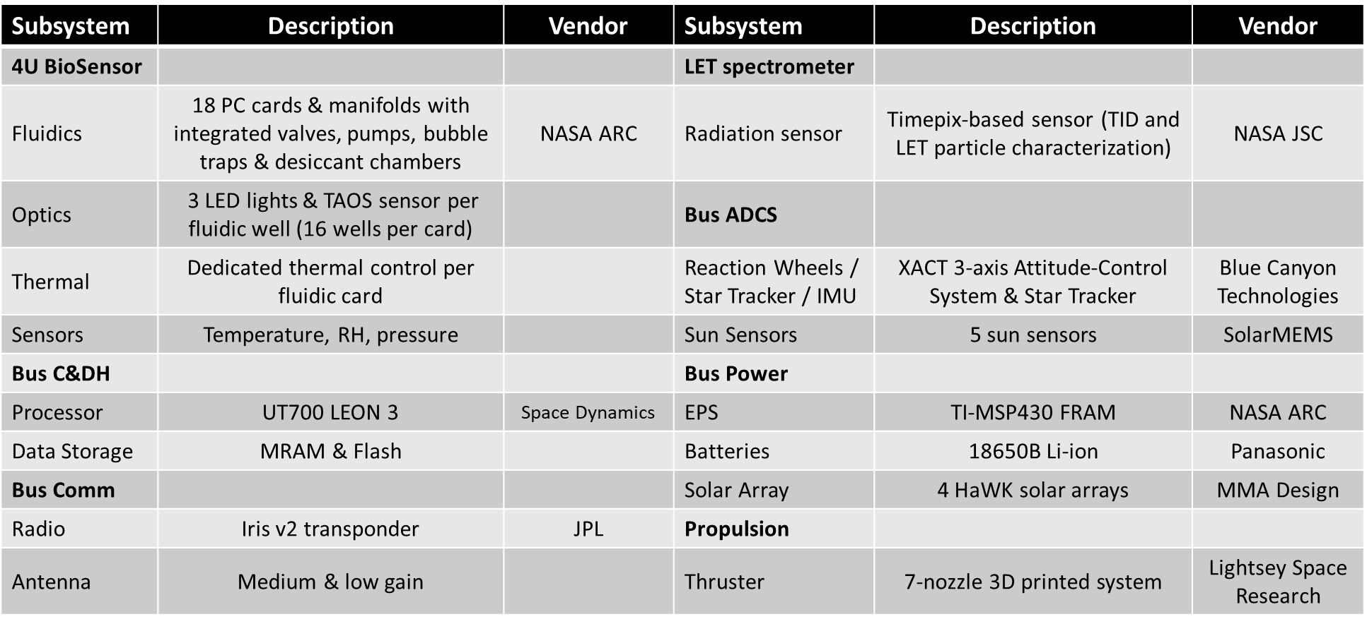
BioSentinel Subsystems

