Slide 1

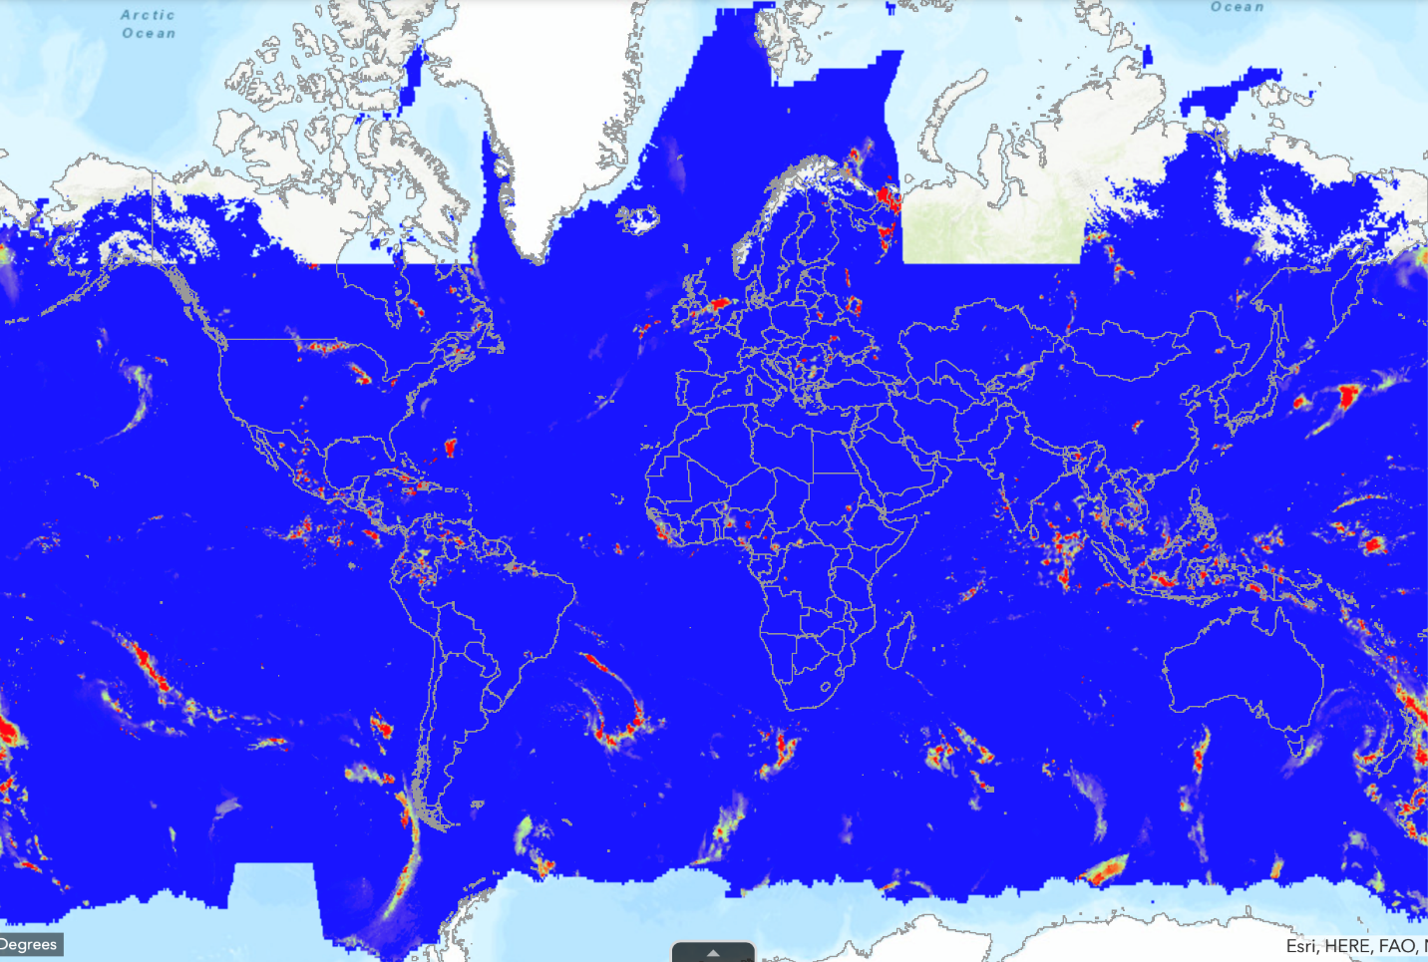
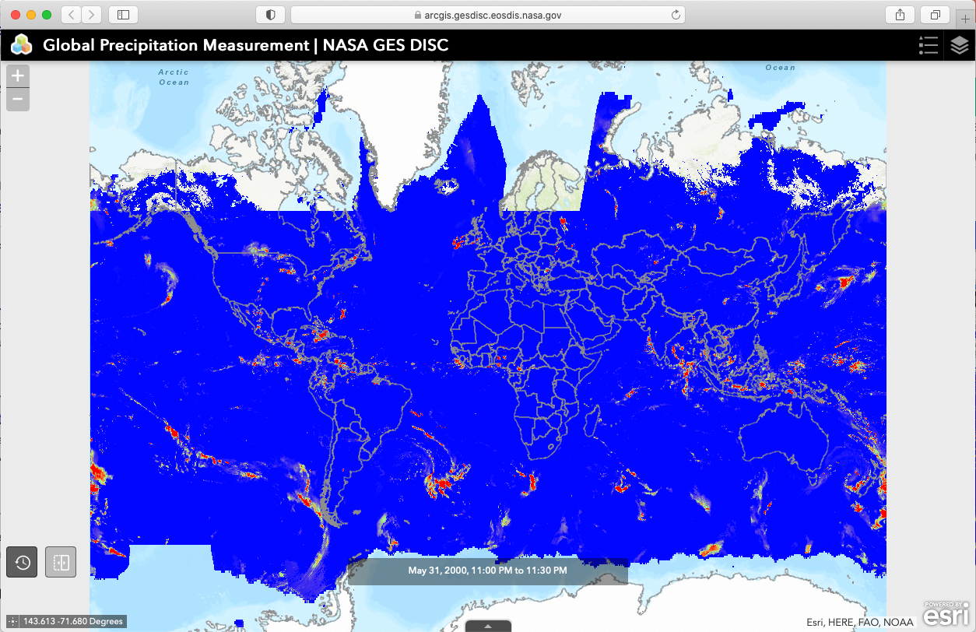
Making NASA GES DISC Level 2 Data GIS Analysis Ready
AGU/23
IN43C-
0637
Peisheng Zhao^{1,2}, Eugene Yu^{1,2}, David Meyer¹
¹NASA Goddard Earth Sciences Data & Information Services Center (GES DISC), ²Center for Spatial Information Science and Systems, George Mason University, ³ADNET System Inc.,
Introduction
Building Mosaic Datasets
Service Performance
Reprojection – from geographic to polar
There are many valuable data hosted by NASA Goddard Earth Sciences Data and Information Services Center (GES DISC) for GIS applications in the areas of extreme weather events, climatic anomaly, and public health. However, using NASA Earth Science Data poses some challenges for GIS users. Many of these users are not experts in Earth Observation and have little knowledge about NASA's Earth science data. In the GIS community, GeoTiff is the most widely used raster format, whereas NASA's data is primarily in complex multidimensional netCDF and HDF formats. This complexity makes it difficult for GIS users, especially those who are unfamiliar with these formats. Although GIS software like ArcGIS has made progress in processing multidimensional netCDF data, certain issues still remain, particularly with level 2 data. In this study, we use TROPSpheric Monitoring instrument (TROPOMI) level 2 data as an example to demonstrate how to make such data GIS analysis ready.
Create daily mosaic Datasets
Input: 48 half-hourly data files in nc4
Create monthly mosaic Datasets
Input: daily mosaic datasets
Create yearly mosaic Datasets
Input: monthly mosaic datasets
Create mosaic Datasets for all
Input: yearly mosaic datasets
Dataset: | GPM IMERG Early Precipitation L3 | Format: | netCDF
Spatial Coverage: | -180.0,-90.0,180.0,90.0 | Spatial: | 0.1 ° x 0.1 °
Temporal Coverage: | 2000-05-31 to current | Temporal: | Half-Hourly
Clients
Build a shapefile as a spatial-temporal index
ArcGIS Pro
ArcGIS Portal/Online
OGC Client
A mosaic dataset is designed to use geodatabase to manage a collection of raster datasets. It is stored as a catalog with advanced querying capabilities and viewed as a mosaicked image with processing functions.
The netCDF data collected over time can be used to add data to a mosaic dataset directly. In addition to common properties of a mosaic dataset, a netCDF mosaic dataset stores multidimensional information in the footprint table:
Variable – The variable name
Dimension – The dimension name used for mosaicing
Proxy Services
Building Mosaic Datasets for GPM Data
Time Filter
Variable Filter
Proxy Service
Service Clients
The proxy service is designed to break a supposedly single point service for a huge data store into spatiotemporally and variable-based multi-level hierarchical services at the backend and create one or a few proxy services at the frontend for users to access. Proxy services will dispatch user requests to the appropriate backend services based on the user’s request criteria. Such a service architecture not only avoids the need to convert and duplicate the huge archival data but also provides a much more flexible service framework for achieving optimal service performance and scalability.
ArcGIS Enterprise
GPM Precipitation Service
Service for GPM Precipitation in 2000
Service for GPM Precipitation in 2001
Service for GPM Precipitation in 2002
ArcGIS Enterprise
ArcGIS Enterprise
ArcGIS Image Service
OGC WMS
OGC WCS
GPM 2000 Mosaic Dataset
GPM 2001 Mosaic Dataset
GPM 2002 Mosaic Dataset
ArcGIS Image Service
OGC WMS
OGC WCS
ArcGIS Image Service
OGC WMS
OGC WCS
...............
ArcGIS Portal for GPM Data
Geoprocessing Workflow
Service for GPM Precipitation in 2018
Service for GPM Precipitation in 2019
Service for GPM Precipitation in 2020
Create Mosaic Dataset
Add Rasters to Mosaic Dataset
GPM 2018 Mosaic Dataset
GPM 2019 Mosaic Dataset
GPM 2020 Mosaic Dataset
Calculate and Set Statistic
Build Pyramid
Proxy Service
OPeNDAP Service
z
Service for MERRA2 Ice Covered Fraction
Service for MERRA2 Surface Pressure
Service for MERRA2 Air Density
Iced Covered Mosaic Dataset
Surface Pressure Mosaic Dataset
Air Density Mosaic Dataset
Data Archive
Data Archive
Data Archive
Data Archive
...............
EOS Data
EOS Data
EOS Data
EOS Data
Service for MERRA2 Surface Roughness
Service for MERRA2 Surface Soil Wetness
Service for MERRA2 Soil Temperature
Retrieving GPM Data from ArcGIS Image Service in ArcGIS Pro
ArcGIS Image Service for NASA netCDF-based EOS Data
MERRA2 Service
Surface Roughness Mosaic Dataset
Soil Wetness Mosaic Dataset
Soil Temperature Mosaic Dataset
Proxy Service for GPM and MERRA2 Datasets

