Slide 1


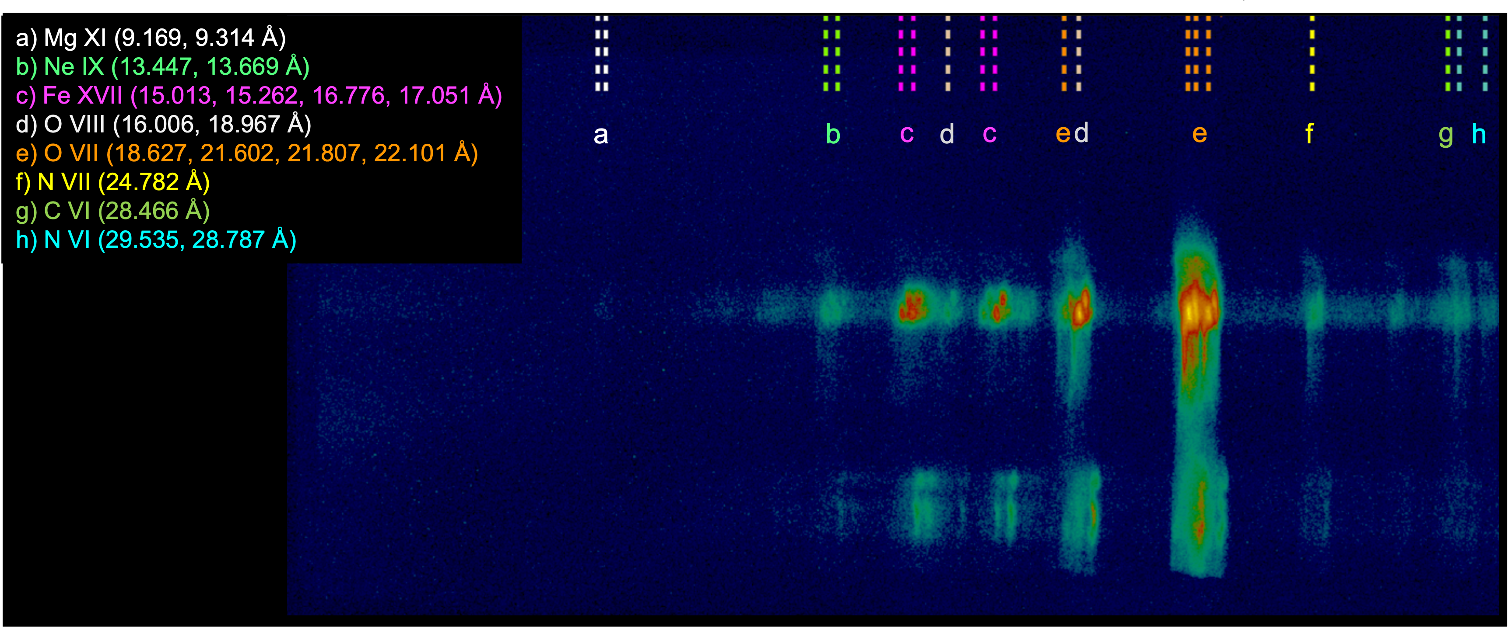

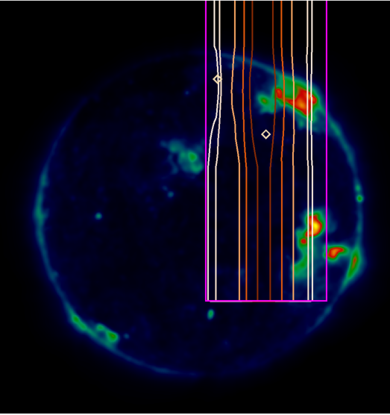
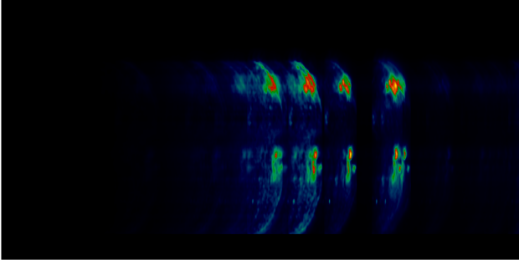
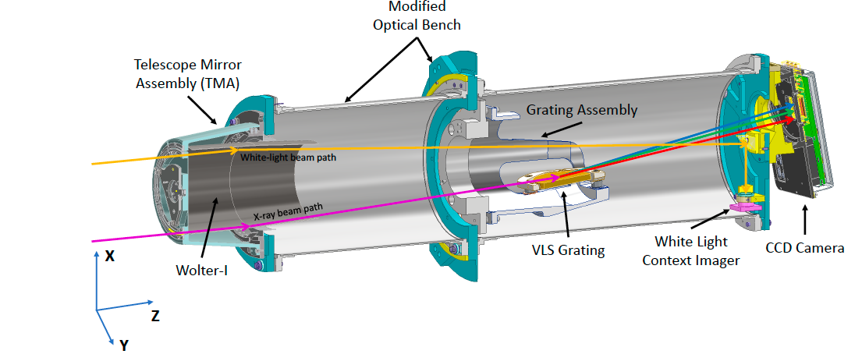
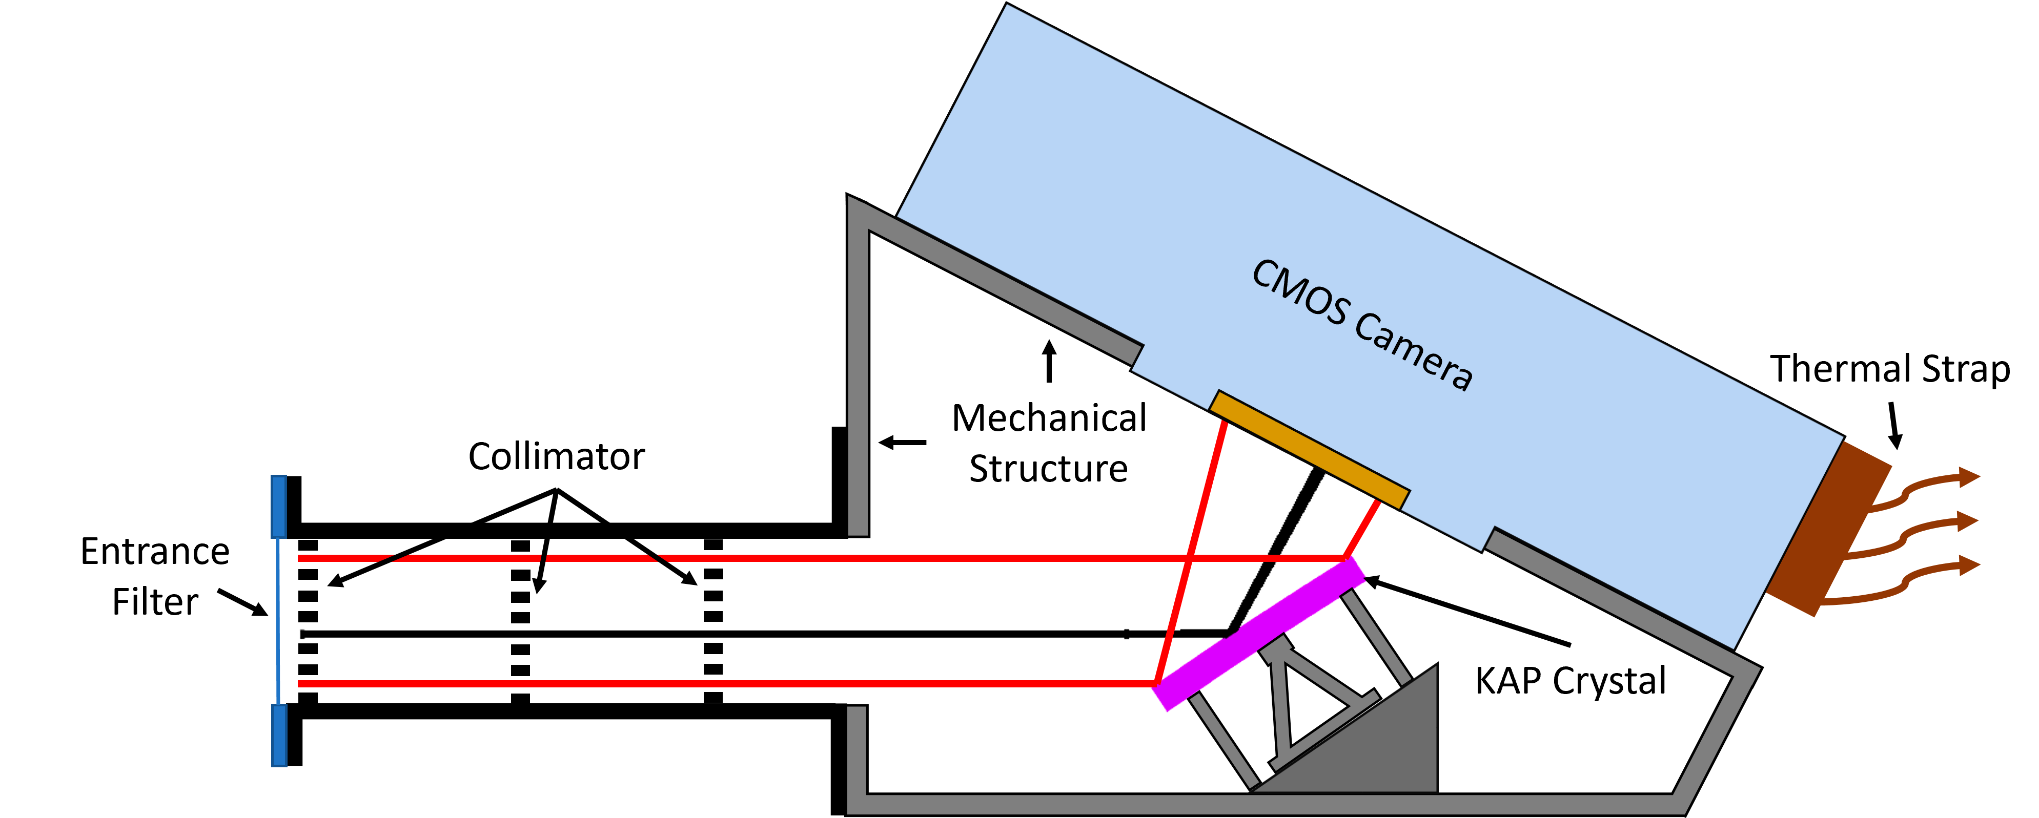
The next generation Marshall Grazing Incidence X-ray Spectrometer (MaGIXS) sounding rocket experiments
P.S. Athiray^{1,2}, Amy Winebarger^{2,} Patrick Champey², Ken Kobayashi², Sabrina Savage², Adam Kobelski², Genevieve Vigil², Brent Beabout², Dyana Beabout², Peter Cheimets³, Leon Golub³, Anthony Guillory², Harlan Haight², Edward Hertz³, Paola Testa³, William Hogue², Jagan Ranganathan², Robert Walsh⁴ and the Science Team
¹ The University of Alabama in Huntsville, ² NASA Marshall Space Flight Center, ³ Smithsonian Astrophysical Observatory, ⁴ The University of Central Lancashire
Introduction
          The Marshall Grazing Incidence X-ray Spectrometer (MaGIXS) is a slitless soft X-ray (SXR) imaging spectrometer designed to constrain frequency of heating events in solar active regions^{[1,2]}. The instrument produces spatially resolved SXR spectra, known as “spectroheliogram”, where spectral information from different spatial locations overlap on the detector. The first sounding rocket flight of MaGIXS occurred on July 30, 2021, from the White Sands Missile Range, New Mexico. Spectrally pure images of X-ray bright points are obtained through novel customized inversion techniques^{[3,4,5]}. Here we present the design of next generation MaGIXS instrument, objectives and status updates.
Science Goal : To constrain the frequency of heating events in solar active region structures
Wavelength range : 8 to 30 Å
Field of view : 9.5’ x 25’
Spot size ~ 27” HPD
Launch : 30 July 2021
Observation Highlights
First demonstration of unfolding spectroheliograms
X-ray bright points observed are consistent with high frequency heating scenario^{[5]} (see Poster )
Discovered ‘missing’ emission lines of Fe XVI, Fe XV in CHIANTI atomic database → MaGIXS-3
Missed to observe high temperature diagnostic emission lines due to internal vignetting → MaGIXS-2
MaGIXS-1
Fig. 1: MaGIXS-1 Optical Layout
Cross-Dispersion (spatial)
Slot
Dispersion (increasing λ)
Fig. 3:
MaGIXS-1 FOV
Telescope Mirror
Spectrometer Mirrors + Reflective Grating
Fig. 2: MaGIXS-1 flight observations
Instrument Upgrades : MaGIXS-2 is a simplified design from MaGIXS-1
Spectrometer mirrors are eliminated, and grating is placed behind telescope
MaGIXS-1 telescope assembly and grating will be reused.
Increases effective area, spatial resolution and field-of-view
N
MaGIXS-2
Fig. 4: MaGIXS-2 Optical Layout
Goal : Measure high temperature diagnostic emission lines from hot active region
Wavelength range : 8 to 30 Å
Field of view : 16’ x 33’
Spot size ~ 17” HPD
MaGIXS 1
MaGIXS 2
Fig. 5: MaGIXS-2 Forward Model (Right) using the solar FOV (left)
Telescope Mirror
Reflective Grating
MaGIXS 2 will be calibrated in the 100m beamline at the Stray Light Test Facility and fly in July 2024
Smaller PSF reduces spatial spectral overlap.
Greater effective area over a larger FOV than MaGIXS-1.
Telescope Mirror
Reflective Grating
MaGIXS
New High resolution Telescope Mirror
Science Upgrades
Goal: Determine if the plasma is in equilibrium or not
Measure high temperature diagnostic emission lines → Determine DEM, abundances
Measure satellite lines of Fe XVII, XVI and resonance lines of Fe XVII near 15 Å
MaGIXS-3
Reflective grating
Instrument Upgrades
A new instrument The Resolving Inversion Context X-ray Bragg crystal spectrometer (TRICXS) is added
MaGIXS will carry a new high resolution X-ray telescope mirror
Wavelength range : 8 to 30 Å (MaGIXS), 14 to 16 Å (TRICXS)
Field of view : 16’ x 33’ (MaGIXS), 3’ diameter (TRICXS)
Fig. 6: MaGIXS-3 Optical Layout
TRICXS
Acknowledgments:
We acknowledge the MaGIXS instrument team for making the data available through the 2014 NASA Heliophysics Technology and Instrument Development for Science (HTIDS) Low Cost Access to Space (LCAS) program, funded via grant NNM15AA15C. MSFC/NASA led the mission with partners including the Smithsonian Astrophysical Observatory, the University of Central Lancashire, and the Massachusetts Institute of Technology.
References:
[1] Athiray, P. S., et al. 2019, ApJ; [2] Champey, P. R. et al. 2022, JAI ; [3] Cheung, M. C. M., et al. 2019, ApJ ; [4] Winebarger, A. R et al. 2019, ApJ ; [5] Savage, S et al. 2023, ApJ;

