Slide 1
Critical Developments Made Through the Sounding Rocket Program
Dr. Amy Winebarger
Deputy Sounding Rocket Program Officer and Sounding Rocket Principal Investigator
NASA HQ and MSFC
With inputs from Giovanni Rosanova, Dr. Robert Pfaff, Dr. Kevin France, Dr. Dan McCammon, Dr. Genevieve Vigil

Slide 2
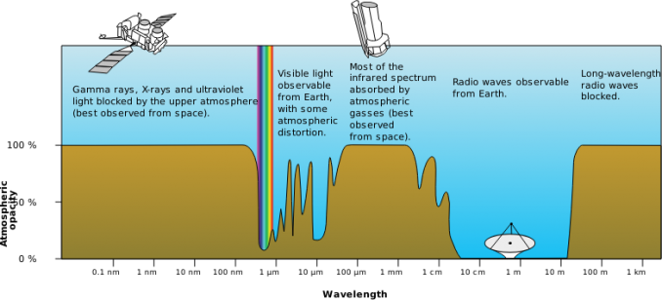
Why Sounding Rockets?
Image credit: NASA

Slide 3
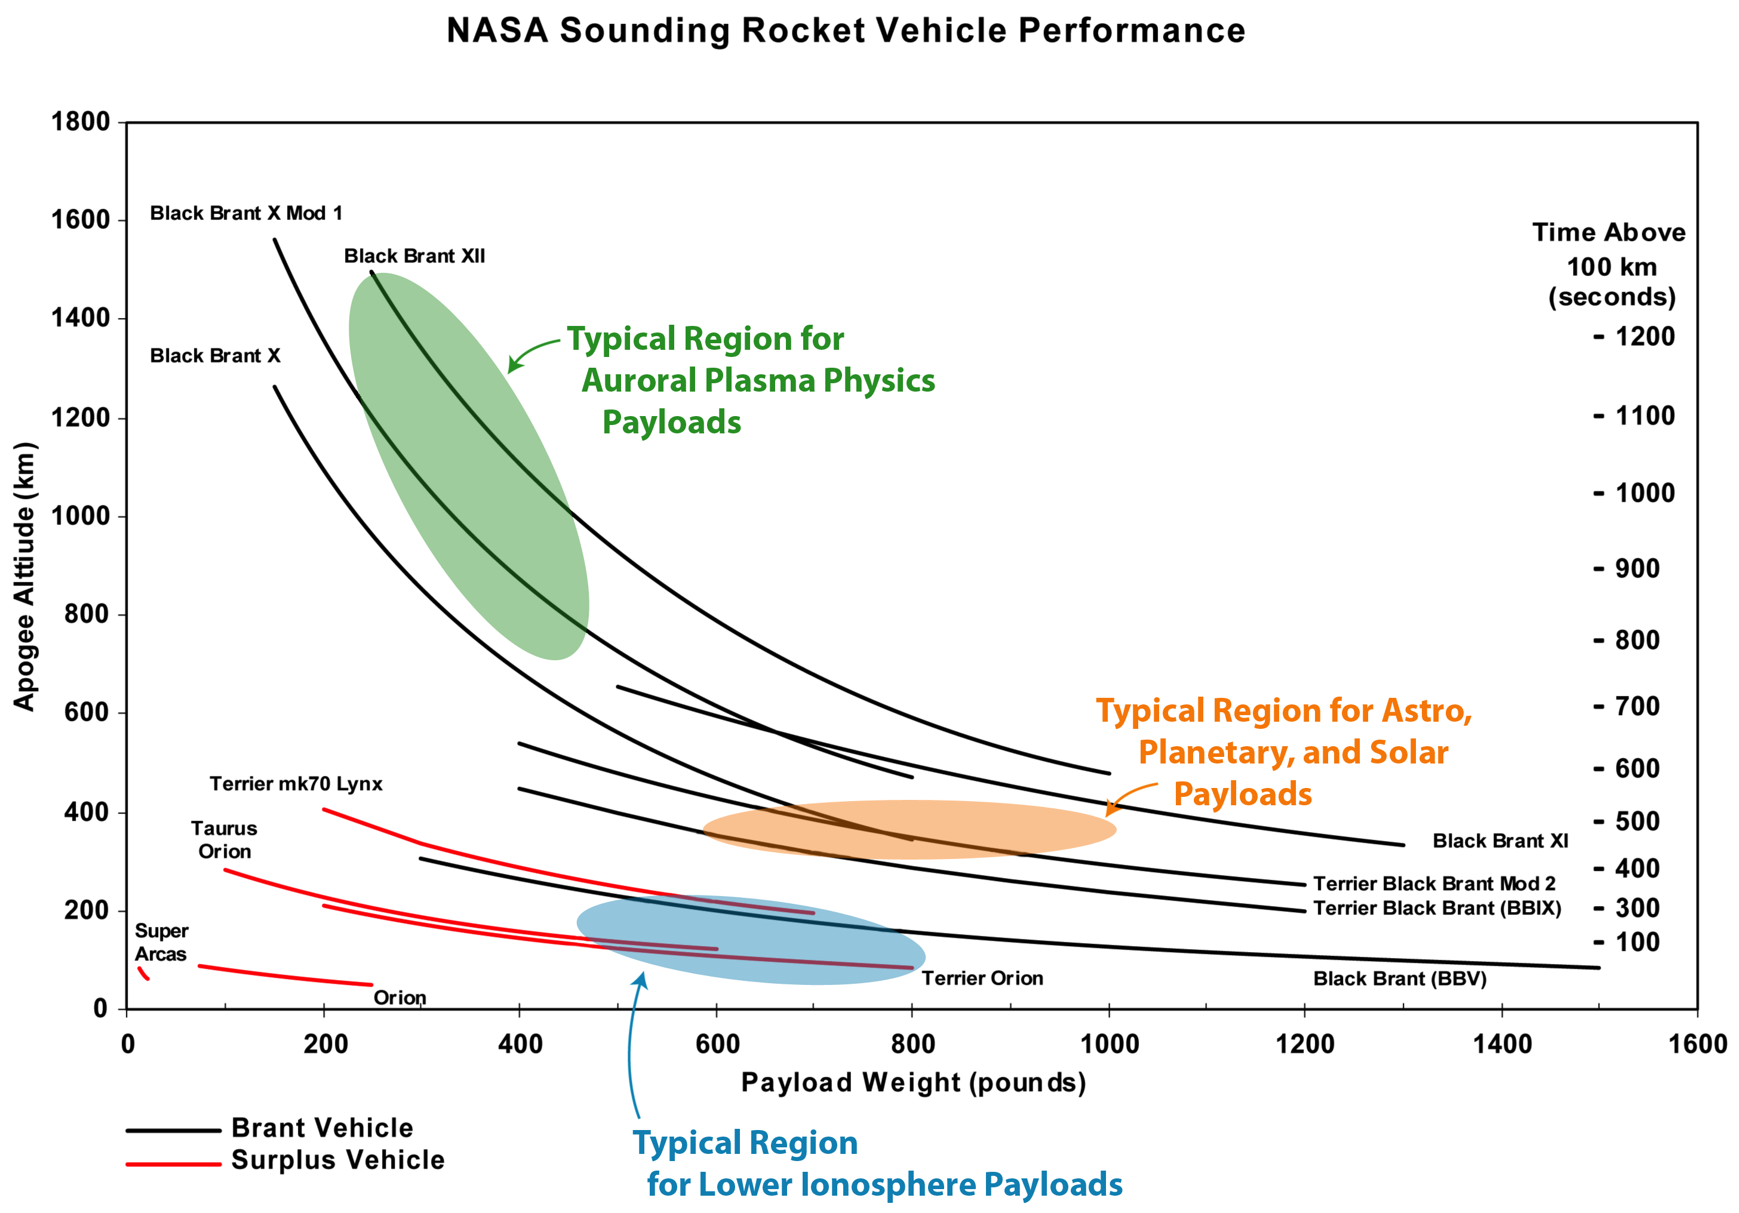
Sounding Rocket Performance
Image credit: NASA

Slide 4
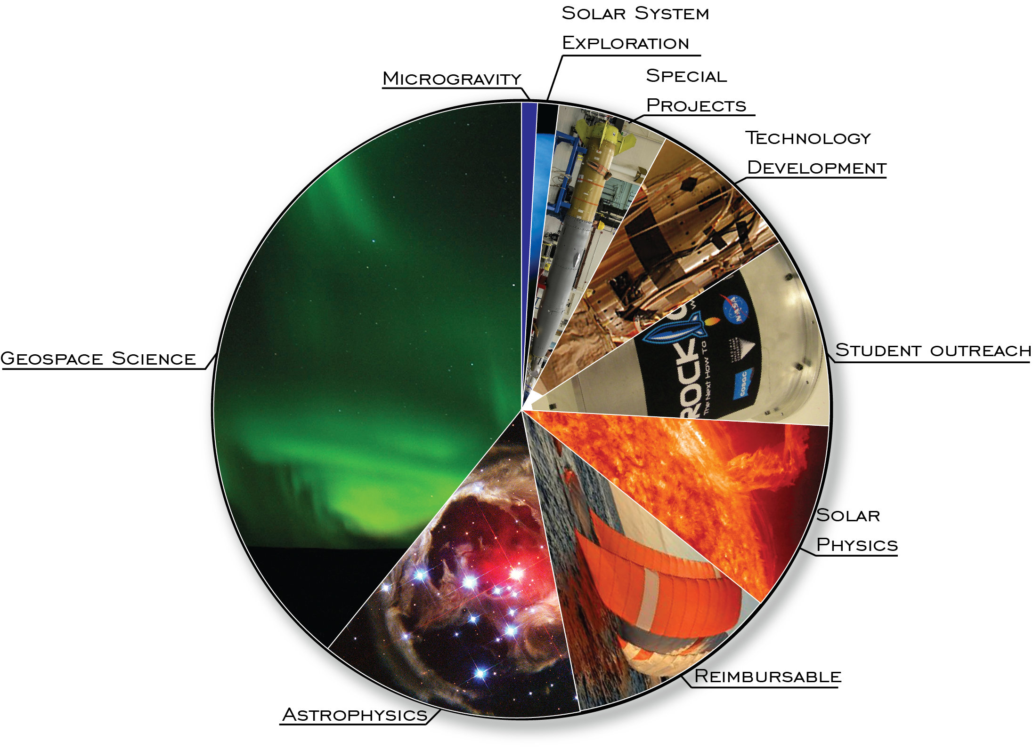
20-year launch history by discipline
Total number of launches 2000 – 2021*: 375
Microgravity Research 2
Solar System Exploration 4
Special Projects 24
Technology, Test and Support 29
Student Outreach 36
Solar & Heliospheric Sciences 39
Reimbursable 42
Astrophysics 52
Geospace Sciences 147
* Through June 2021
Image credit: NASA

Slide 5
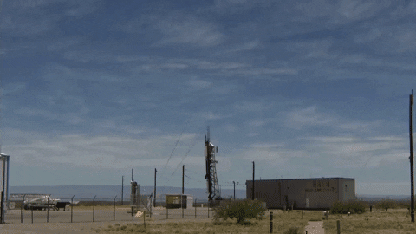
First flight in 1946
Image credit: Navy

Slide 6
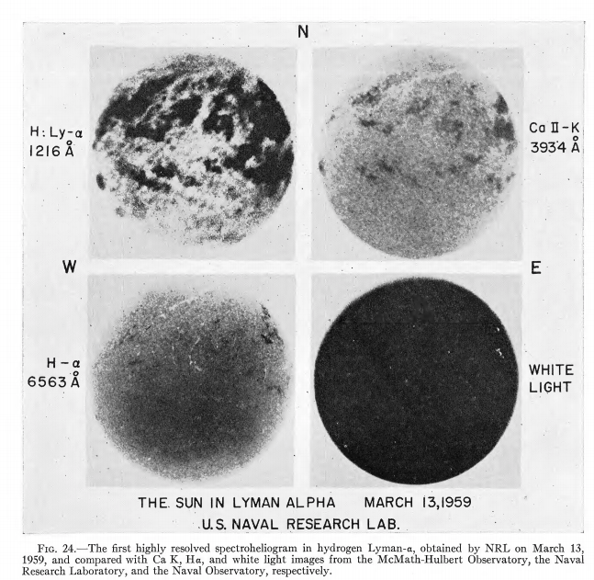
Early Results
First spectroheliogram in Lyman alpha observed on March 13, 1959.
Tousey, Astrophysical Journal, vol. 149, p.239

Slide 7
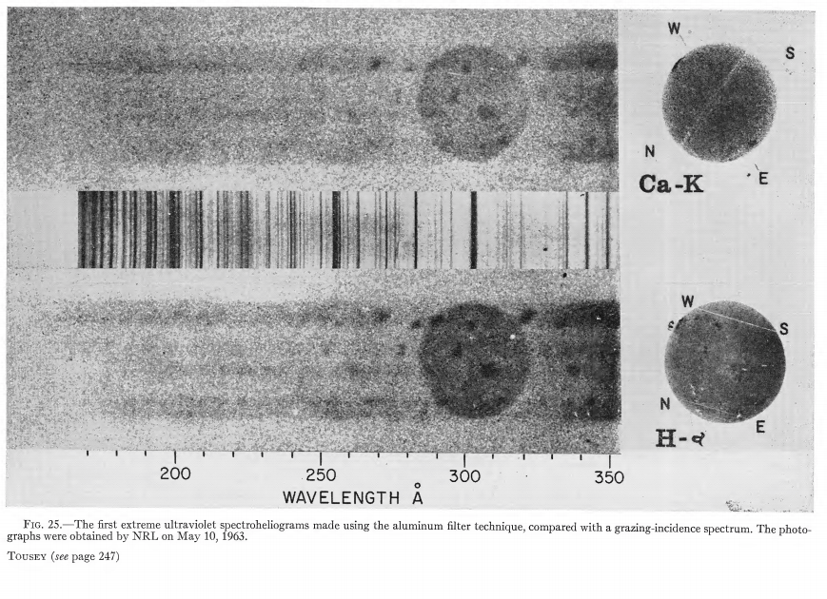
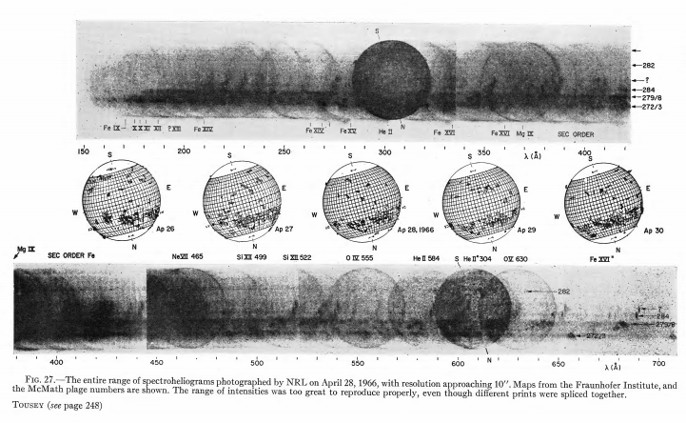
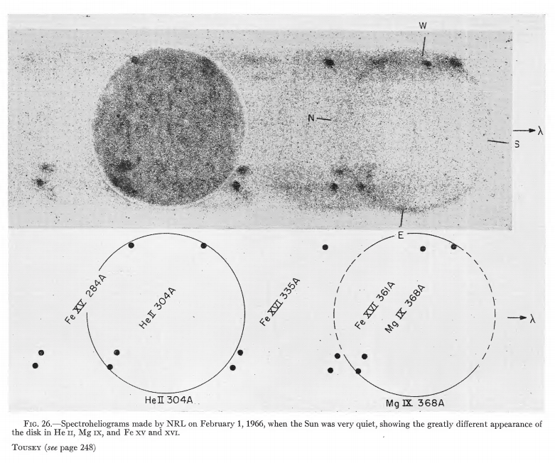
Exploration of EUV/UV spectrum
1963
1965
1966
Tousey, Astrophysical Journal, vol. 149, p.239

Slide 8
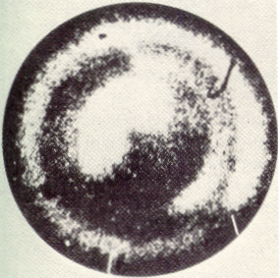
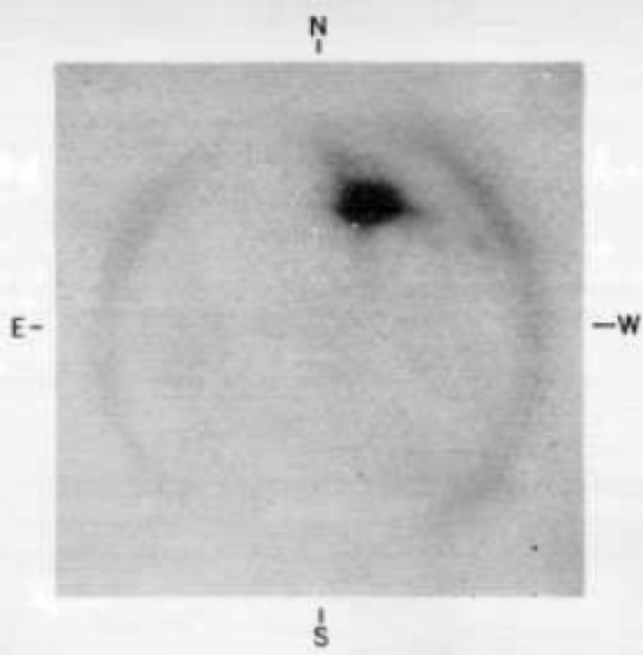
First Solar X-ray Observations
19 April 1960 with X-ray pinhole camera
Blake, Chubb, Friedman & Unzicker 1963, ApJ, 137, 3
The first resolved X-ray image of the Sun (1965 sounding rocket). Image from Giacconi et al. (1965) Space Science Reviews, Volume 4, Issue 2, pp.151-175

Slide 9
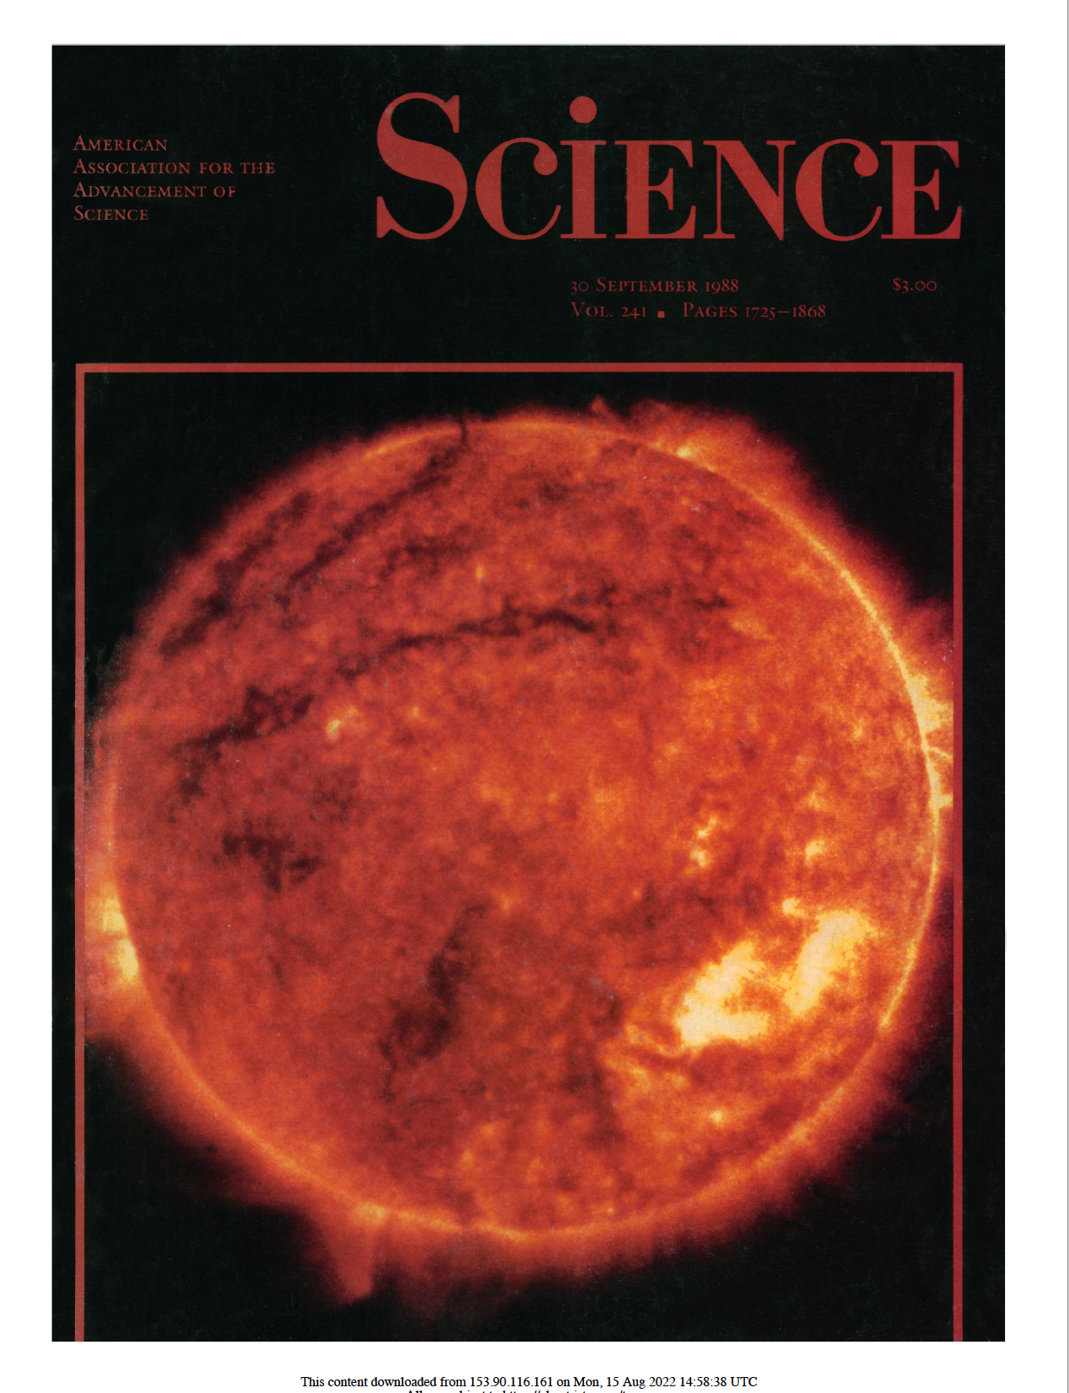
First EUV image using multilayers
In the 1980s, several scientists were developing/flying multilayers to produce narrow passband EUV images (M. Bruner, A. Walker, L. Golub)
The first EUV 173 image of the Sun was taken by Art Walker in 1987.
These instruments led to EIT, TRACE and SDO/AIA.
Walker et al., Science, 1988

Slide 10
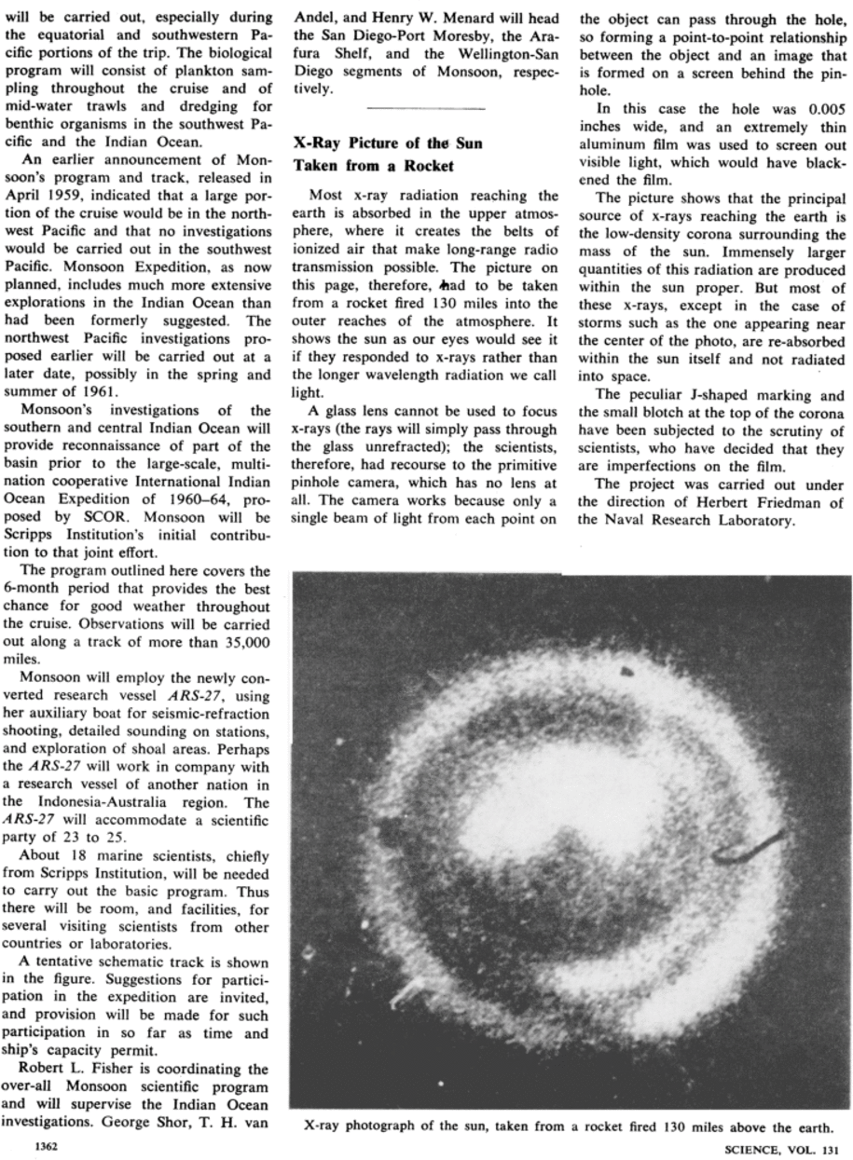
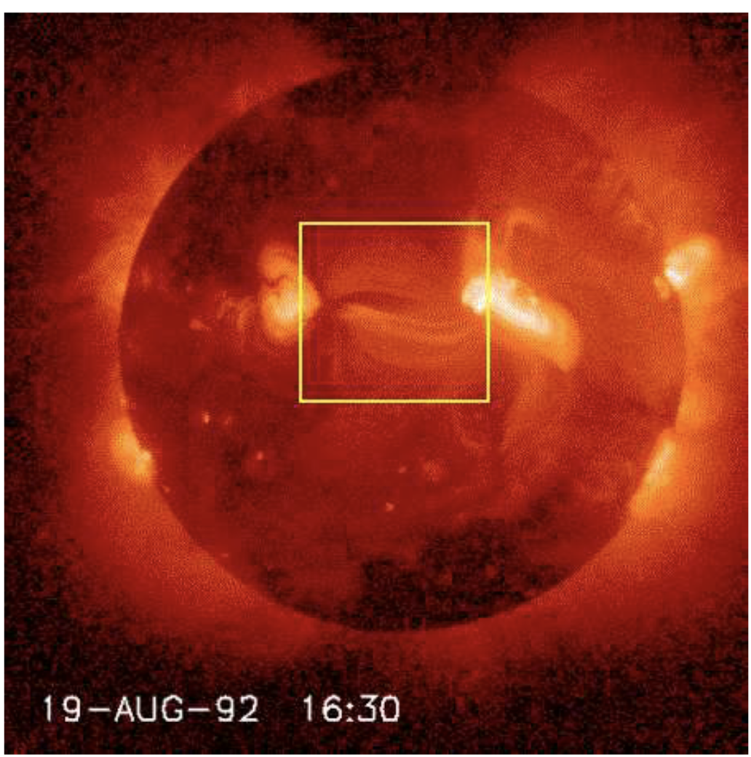
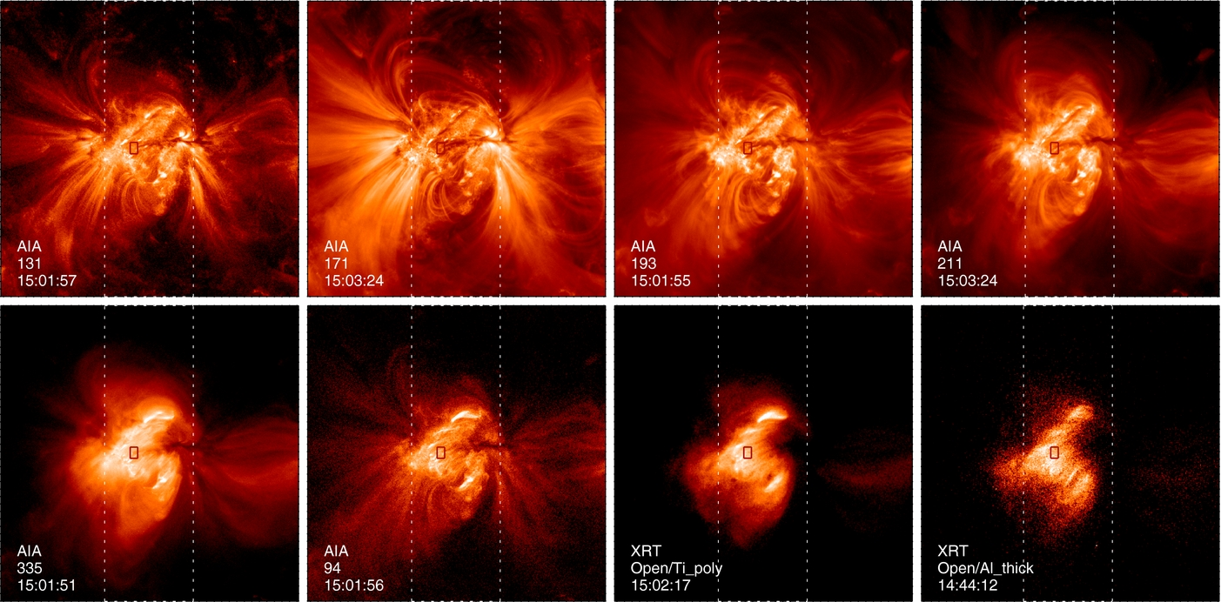
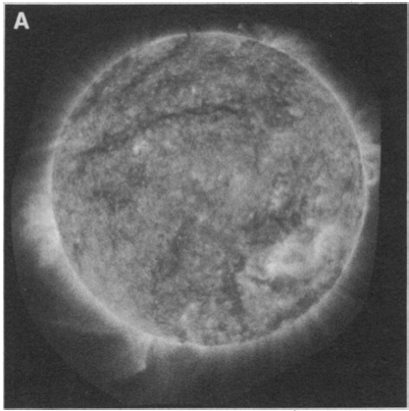
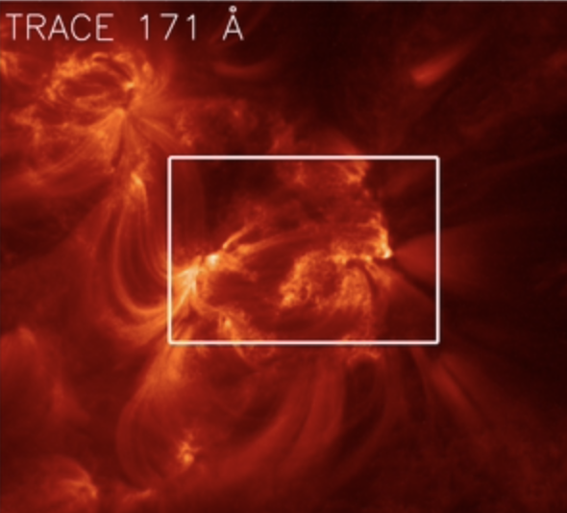
Sounding rockets lead to satellites
Yohkoh
Hinode - XRT
1960
1990
2006
SDO - AIA
TRACE
1988
1998
2010
Sounding Rocket Observations
Satellite Observations

Slide 11
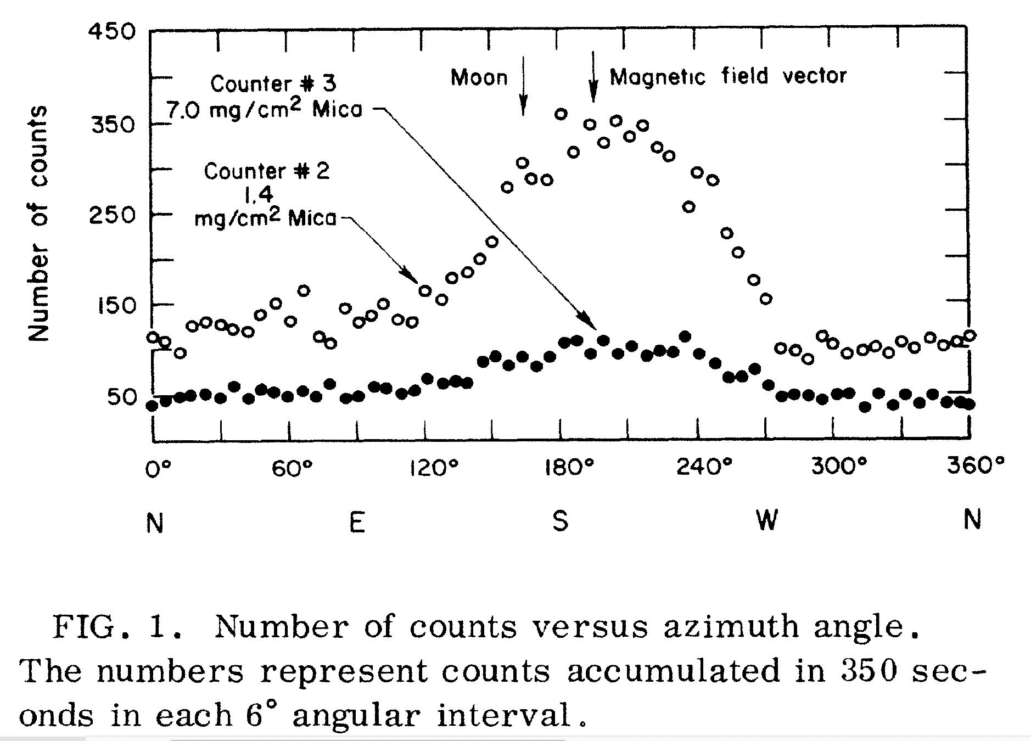
First X-ray Astrophysical Observations
Giacconi, et al. 1965, Physical Review Letters, vol. 9, Issue 11, pp. 439-443

Slide 12
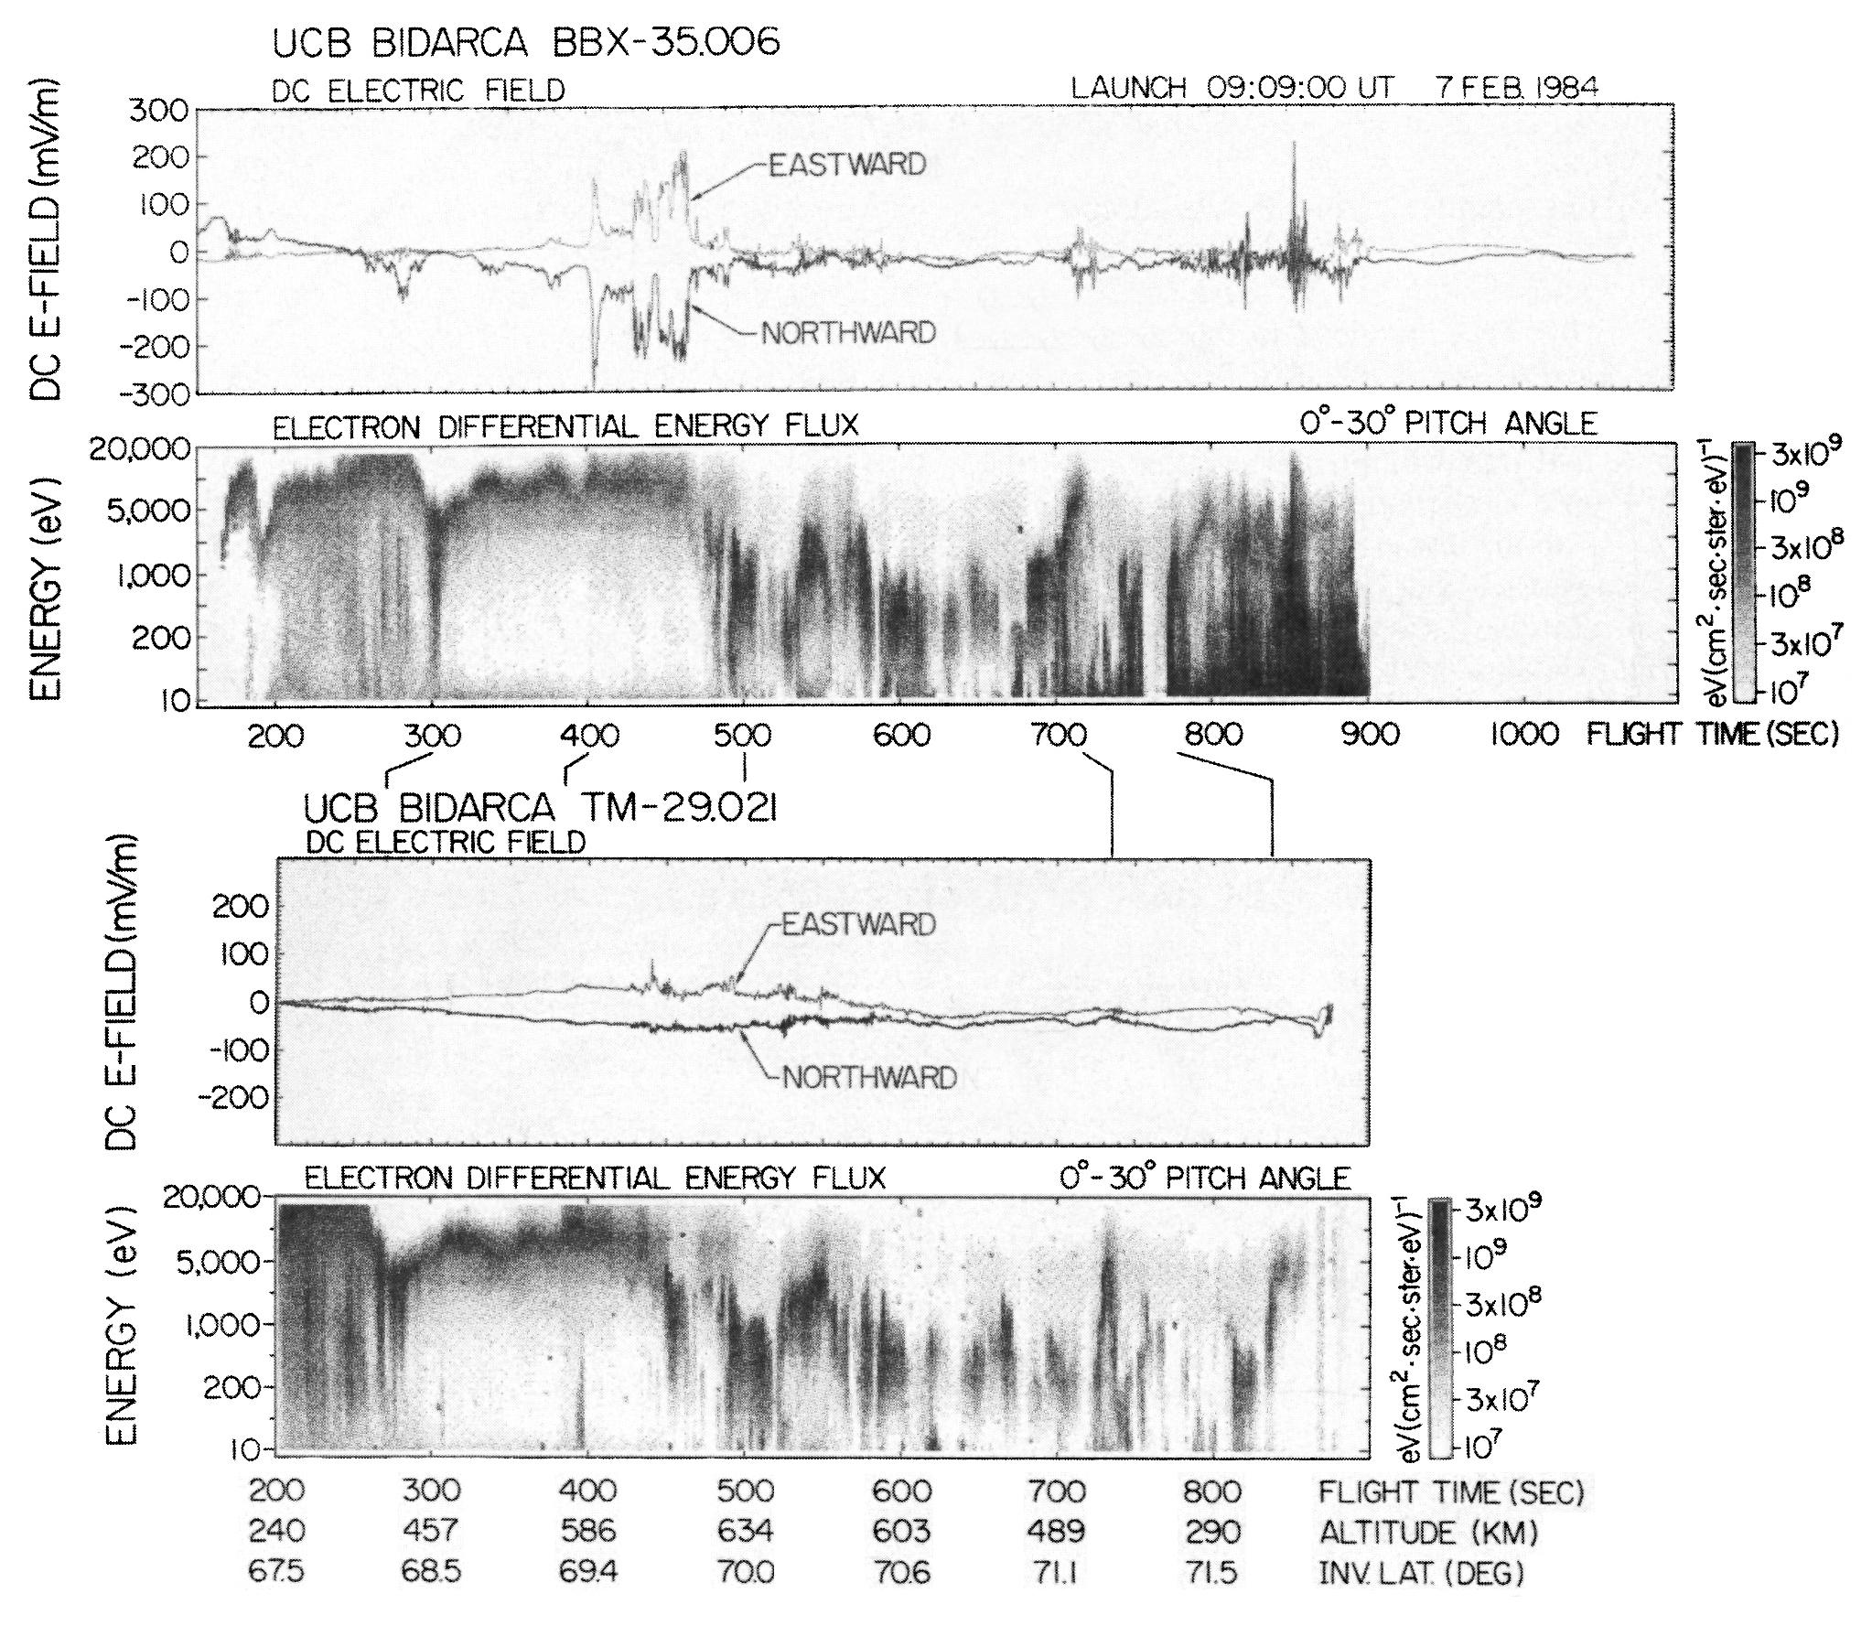
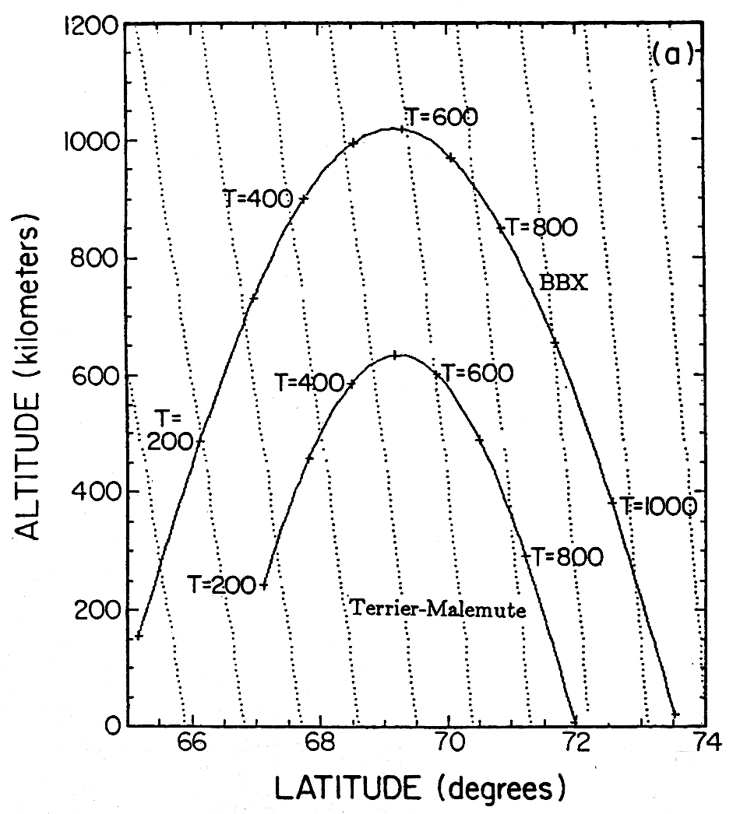
Electrostatic shocks
[Boehm et al., JGR, 1990]

Slide 13
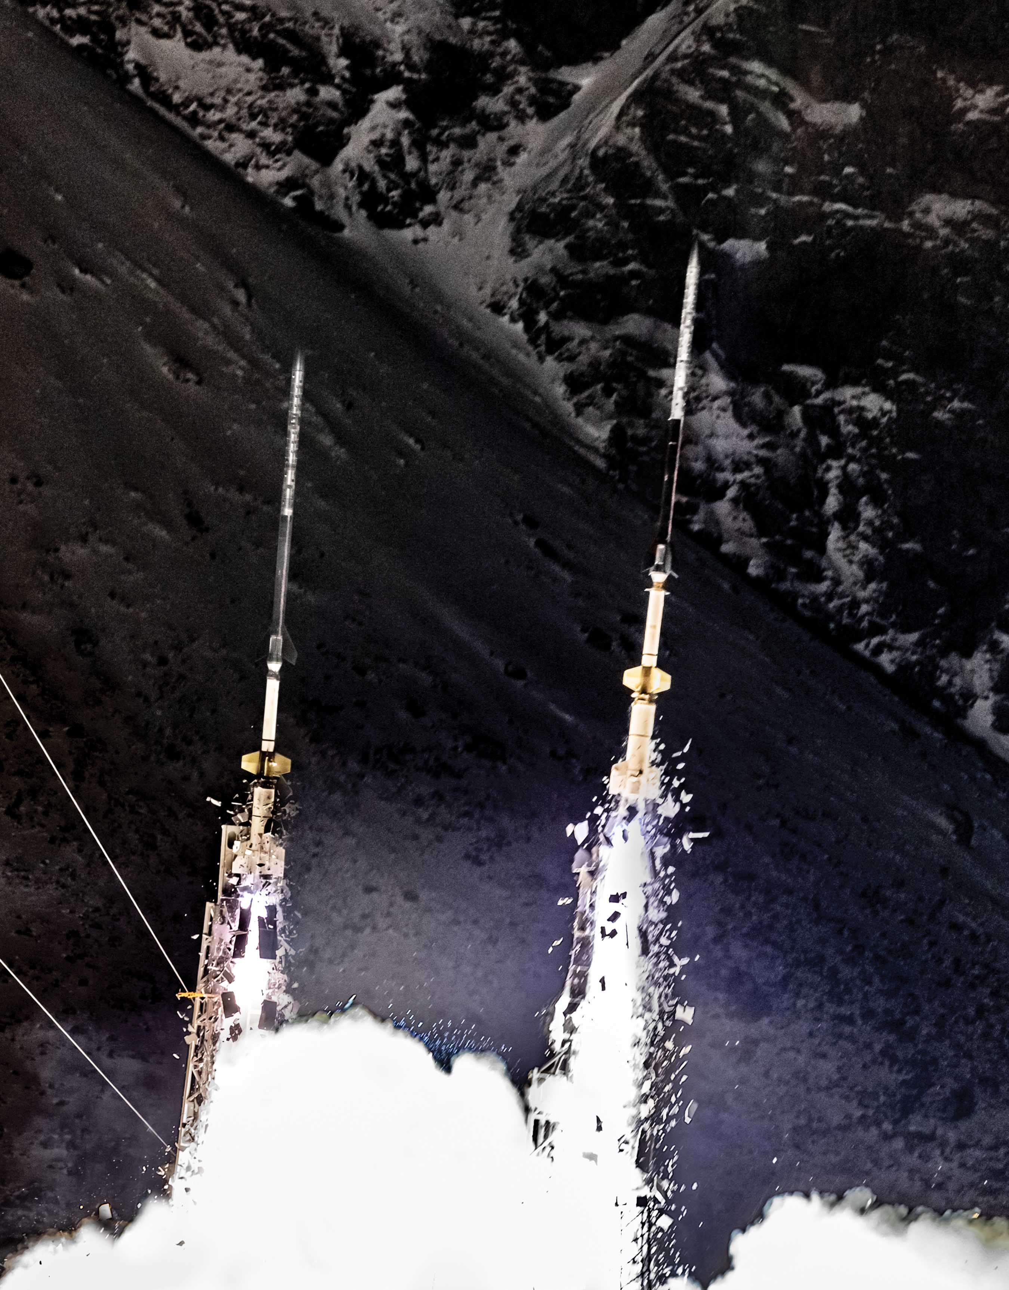
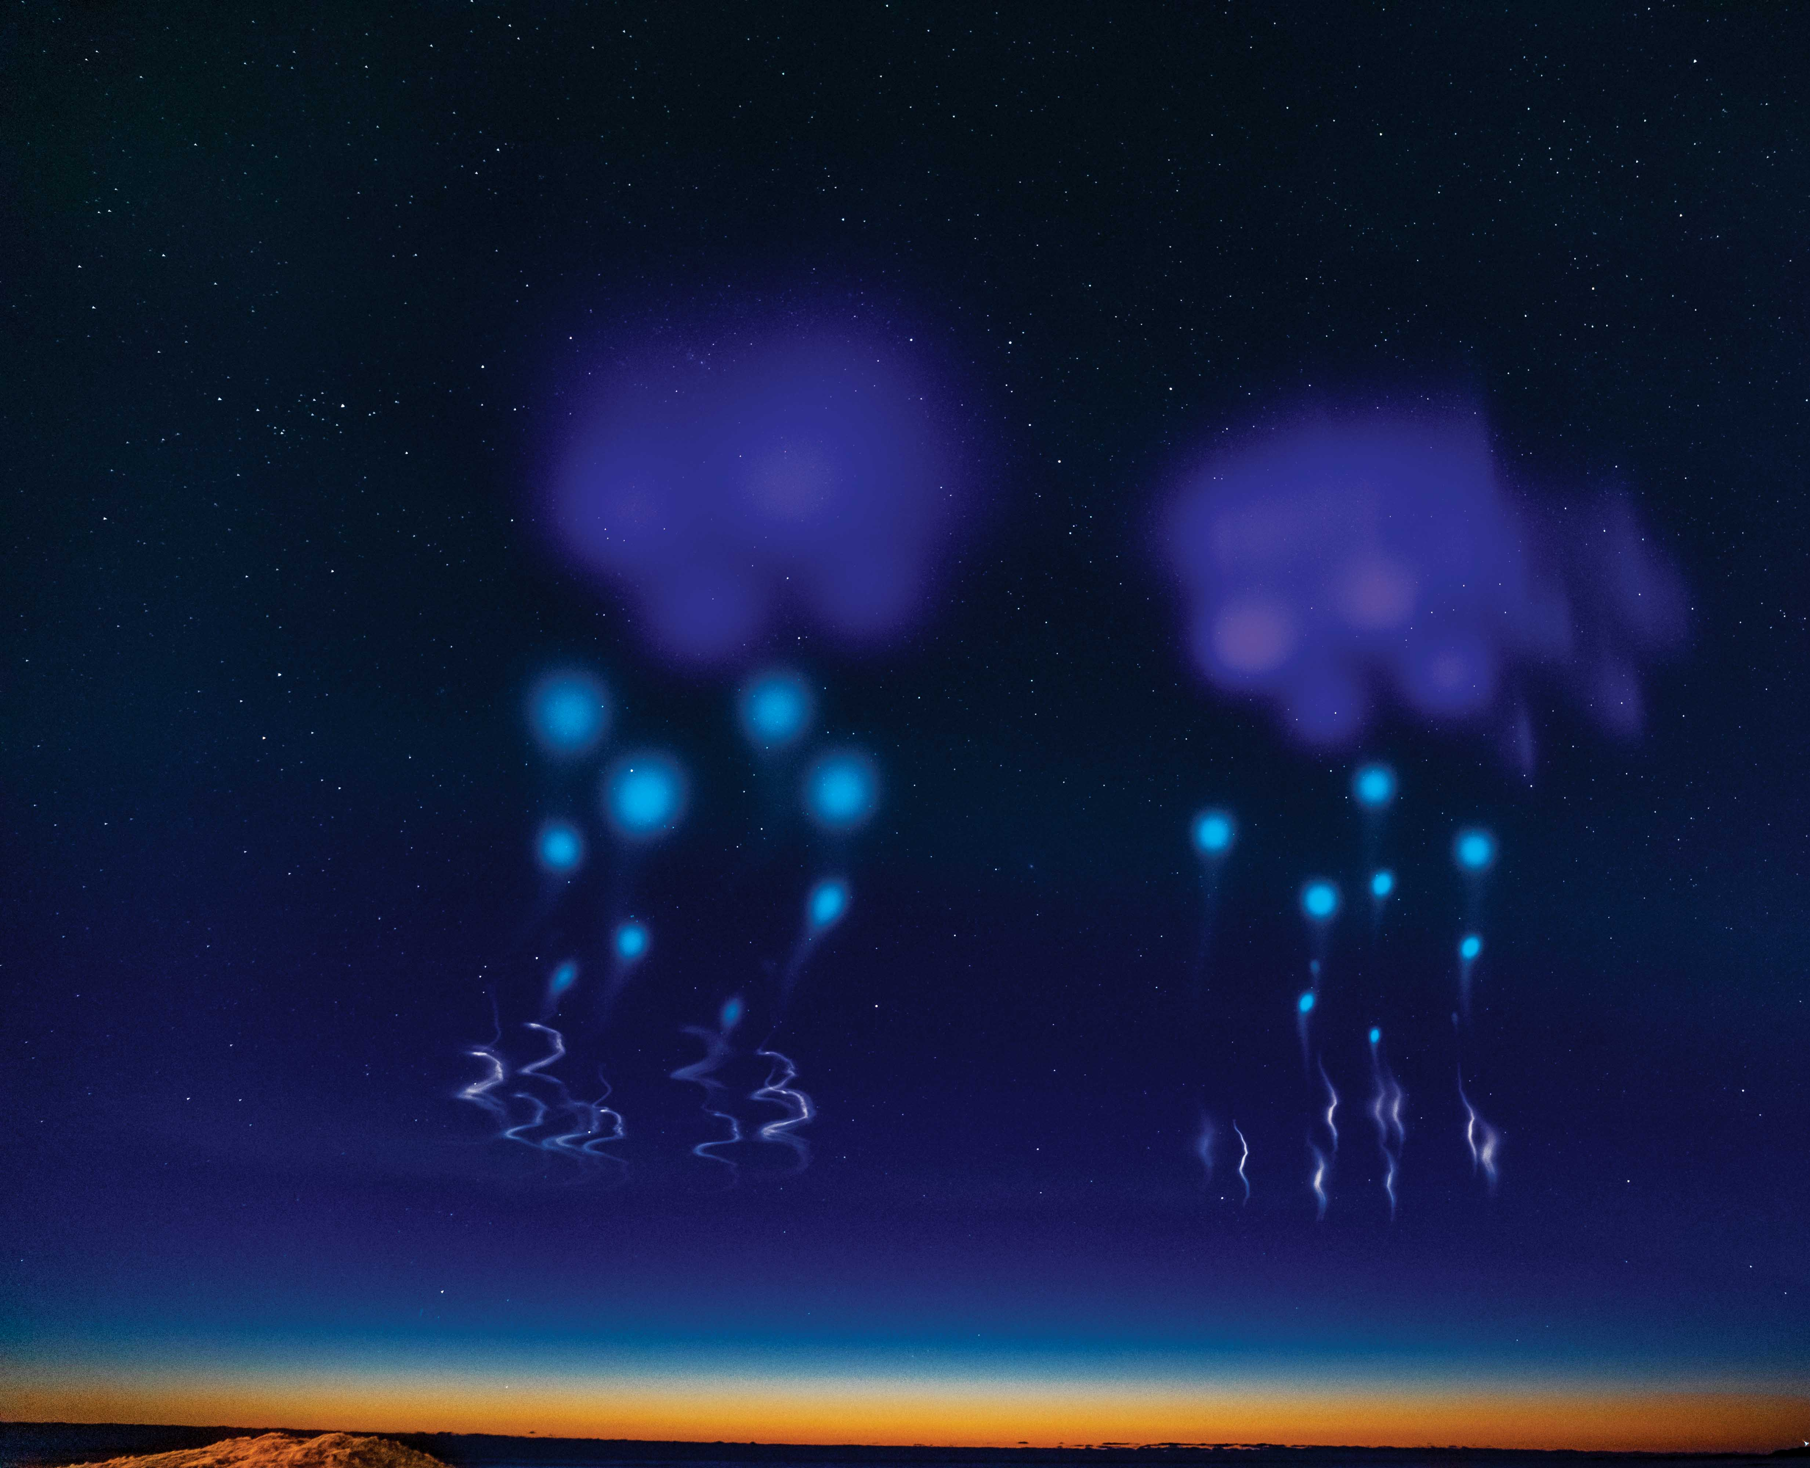
Composite image of two Black Brant XI-A rockets launching from Andoya Space, Norway in 2019.
Trimethylaluminum (TMA) vapor tracers released to study neutral winds at altitude.
Auroral Zone Upwelling Rocket Experiment (AZURE), launched April 5, 2019.
Photo credit: NASA
Photo credit: NASA
Notes:
For more detail on this mission, see SR Annual Report 2019.

Slide 14
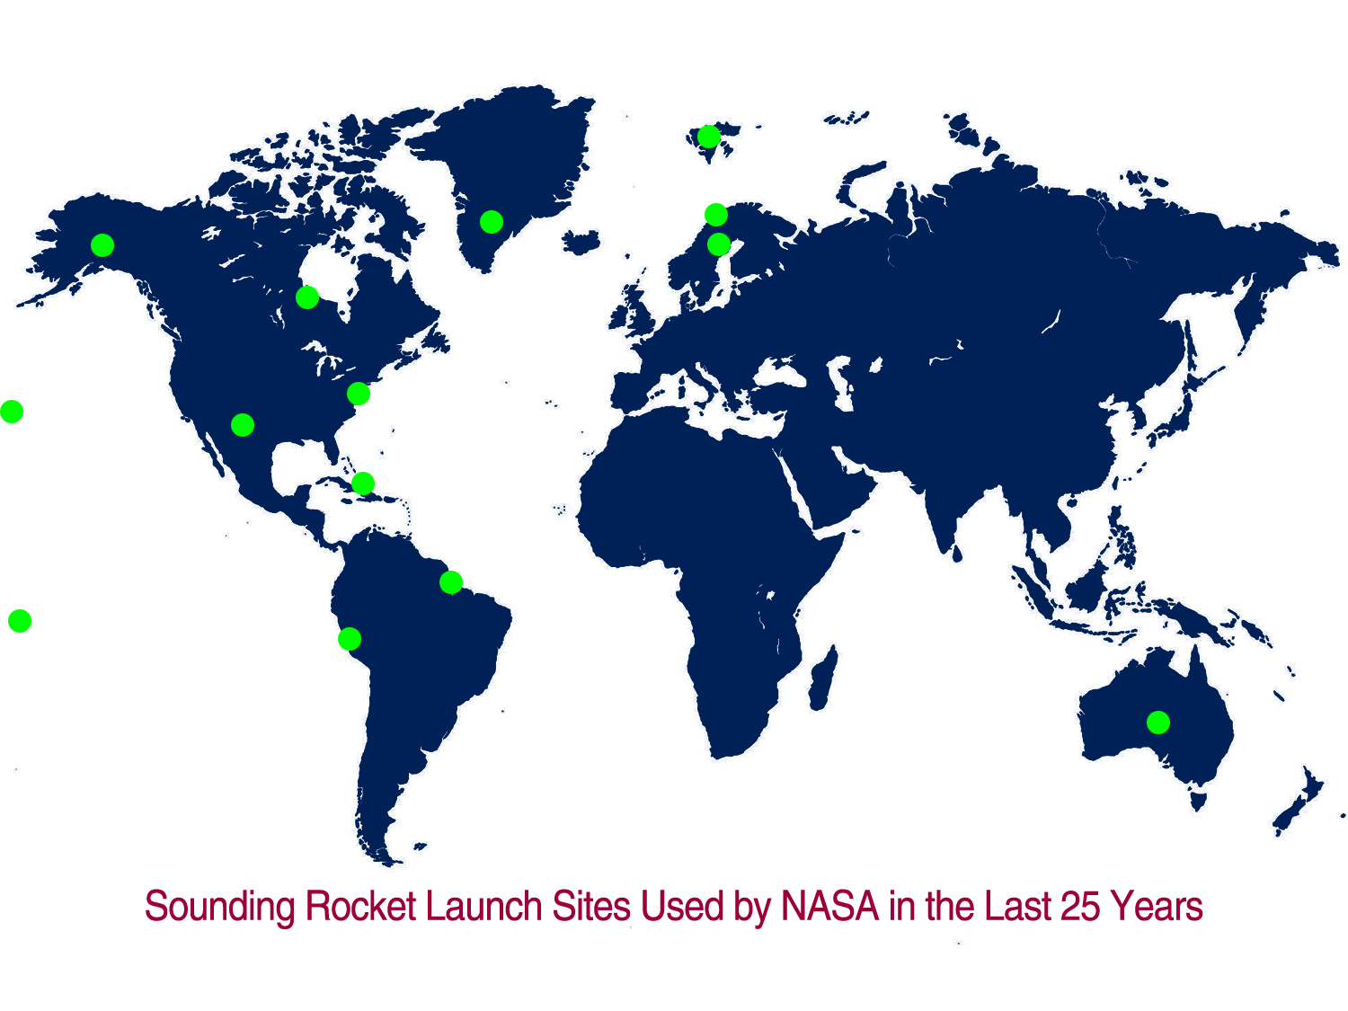
Sounding rockets go where the science is!
Image credit: NASA

Slide 15
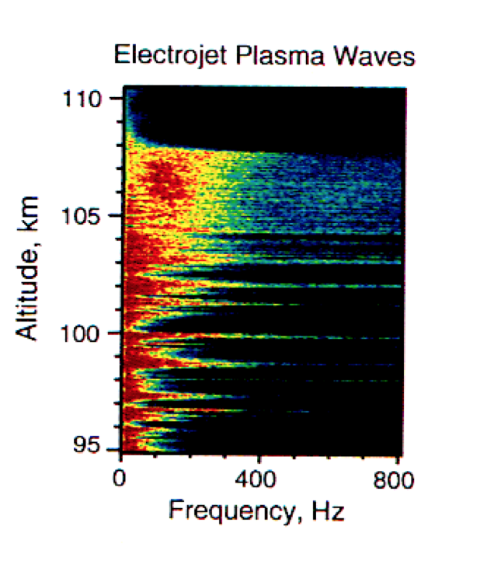
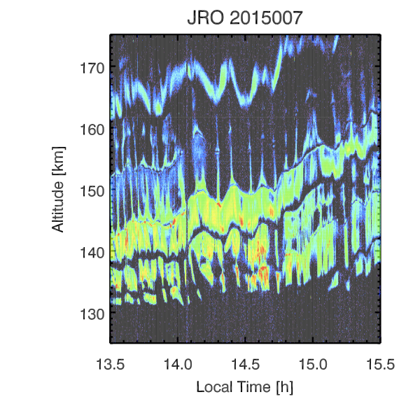
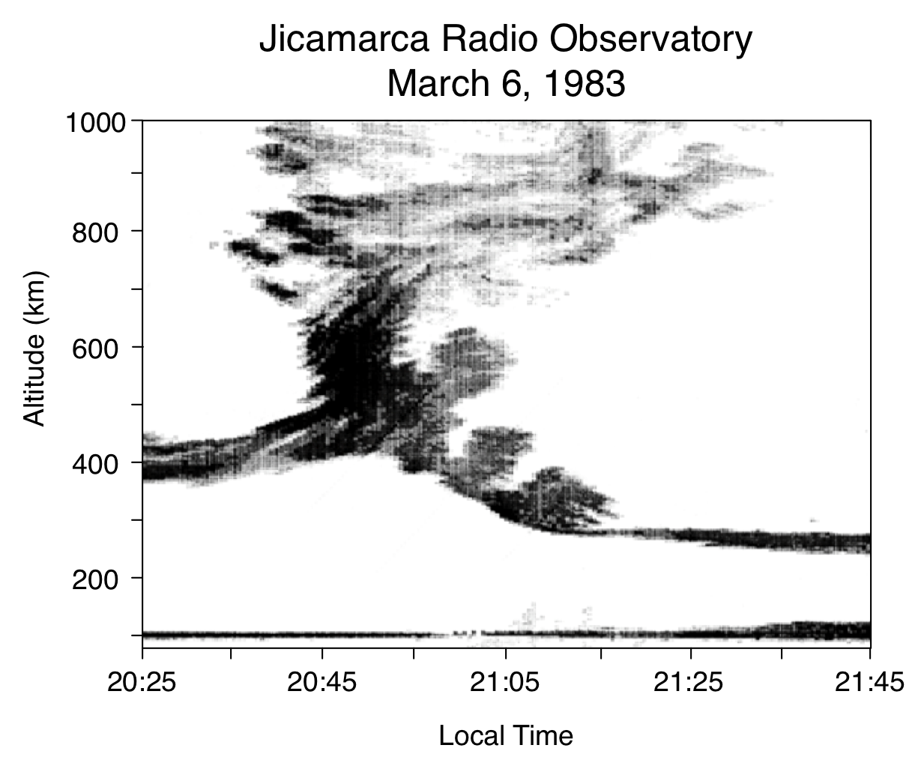
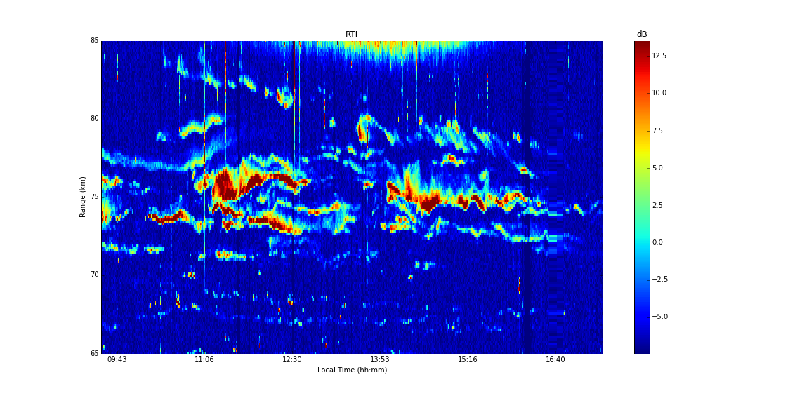
Earth’s Ionosphere at the Magnetic Equator
Contains Unique and Important Space Physics Phenomena
“150 km” echoes
Equatorial Electrojet
Spread-F Turbulence
Mesosphere Turbulence
Jicamarca Radar Echoes -- May 11, 2014
85
Altitude, km
75
65
09:43
11:06
12:30
13:53
15:16
16:40
LT(hr)
Image credit: NASA
Understanding these processes requires simultaneous rocket and radar measurements

Slide 16
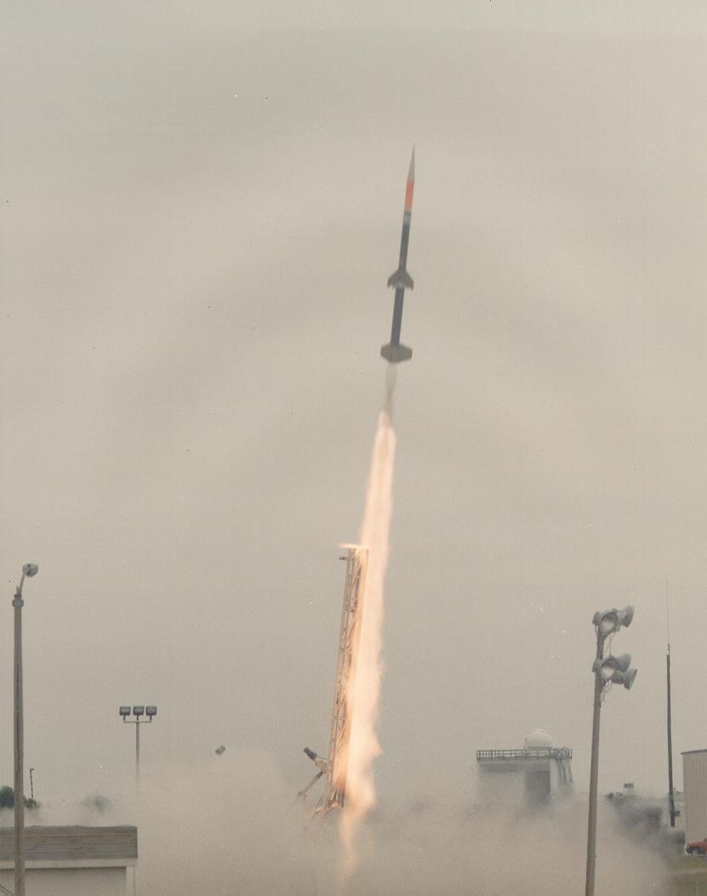
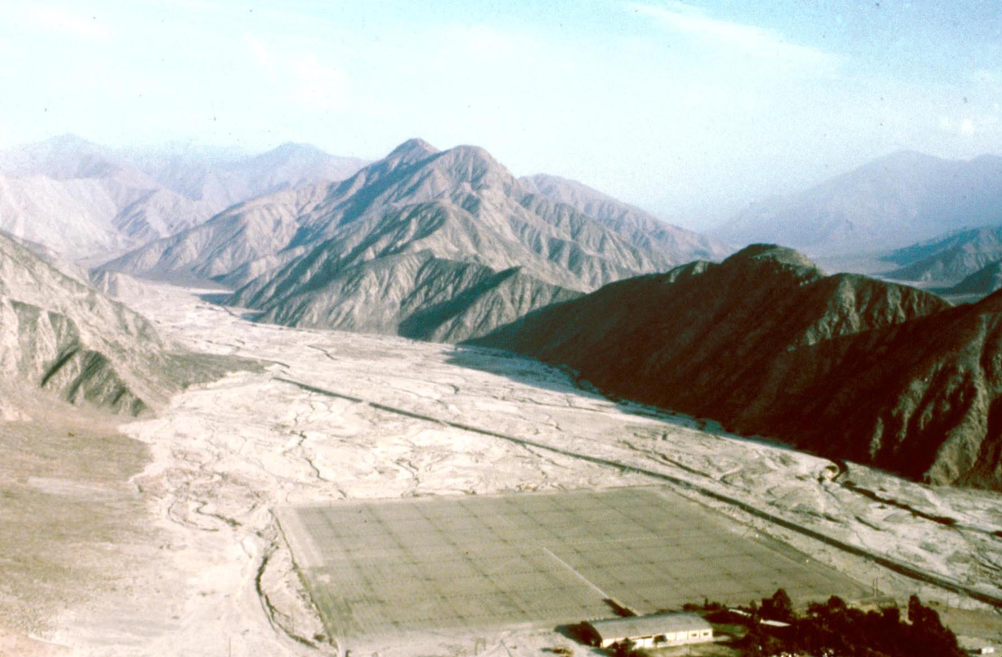
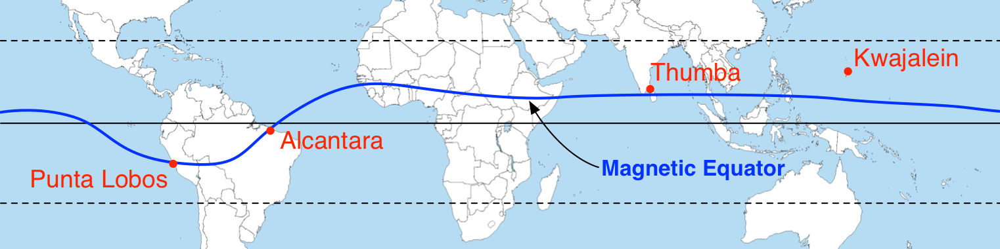
NASA Sounding Rocket Campaign in Peru…2028!
NASA Sounding Rocket Campaigns at the Geomagnetic Equator
Unprecedented, Preeminent Science at a Unique Observing Site
• 1964 India (Thumba) -- 4 rockets
• 1965 USS Croatan (off coast of Peru) -- 10 rockets
• 1970 India (Thumba) -- 6 rockets
• 1972 India (Thumba) -- 2 rockets (w/Germany)
• 1975 Peru (Punta Lobos) -- 19 rockets
• 1983 Peru (Punta Lobos) -- 18 rockets
• 1994 Brazil (Alcantara) -- 13 rockets
• 2028 Peru (Punta Lobos) -- ??
NASA/NSF Campaign Anticipated for 2028
See Dave Hysell (Cornell) or Esayas Shume (NASA HQ)
Image credit: NASA

Slide 17
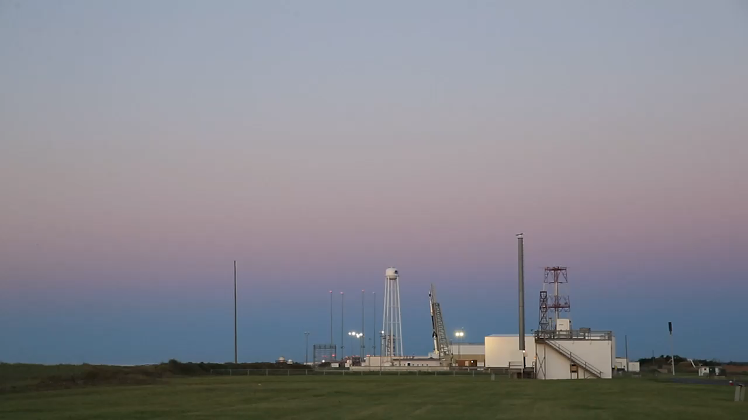
Image credit: NASA
Notes:
Hesh 36.317 GSFC video.

