Slide 1

NASA Enterprise Protection
Safeguarding US Space Systems from Harm to Avoid Disruption of Critical Space Capabilities
7 Dec 2023
David Adams
Principal Advisor, Enterprise Protection
Office of the Administrator

Slide 2
Agenda
Protecting NASA civil space systems from malicious or intentional acts
Identifying and implementing protective measures to withstand or recover from adverse conditions caused by environmental hazards or malicious causes
Integrating threat mitigation into mission design and operation models

Slide 3
Protecting Civil Space Systems

Slide 4
Genesis of NASA Radio Frequency Interference (RFI) Reporting
2007 Terra & Landsat RFI events – not well reported
US Purposeful Interference Response Team (PIRT) established
NASA Space Asset Protection Program (SAPP), now Mission Resilience and Protection Program (MRPP), established
Implemented NASA “Unexplained Incident Escalation Procedure” with support from agency partners
Enrolled missions in detection and reporting
2019: Institutionalized Agency-level requirement to report events

Slide 5
Summary of NASA RFI Events
Command link events
  Generally caused by friendly sources
  Occasional unexplained events reported to CSpOC
GPS events
  Global hotspots have become routine sources of interference
  Occasional events of concern reported to NSIC

Slide 6
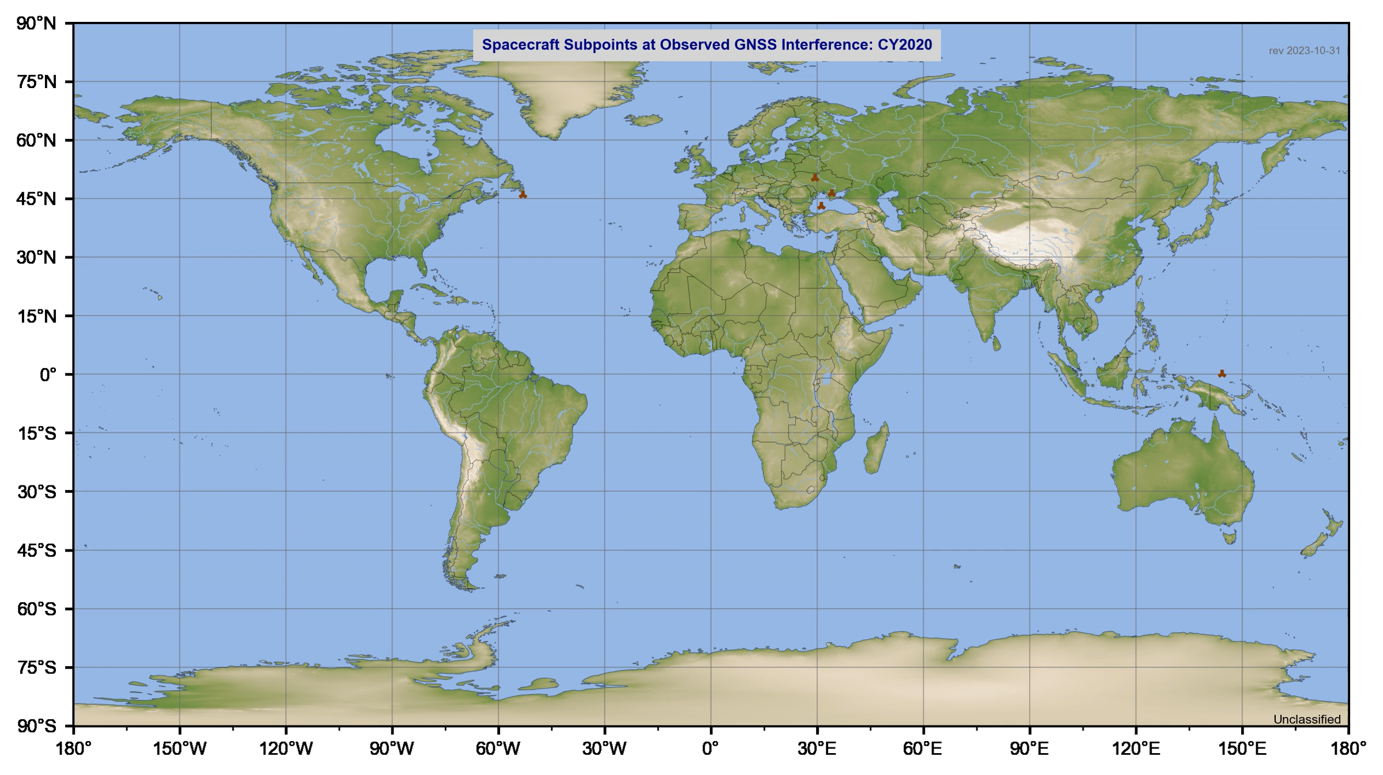

Slide 7
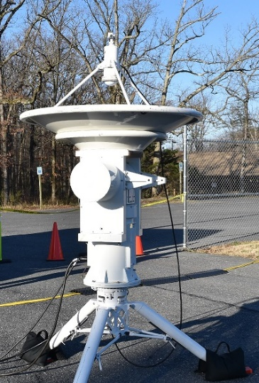
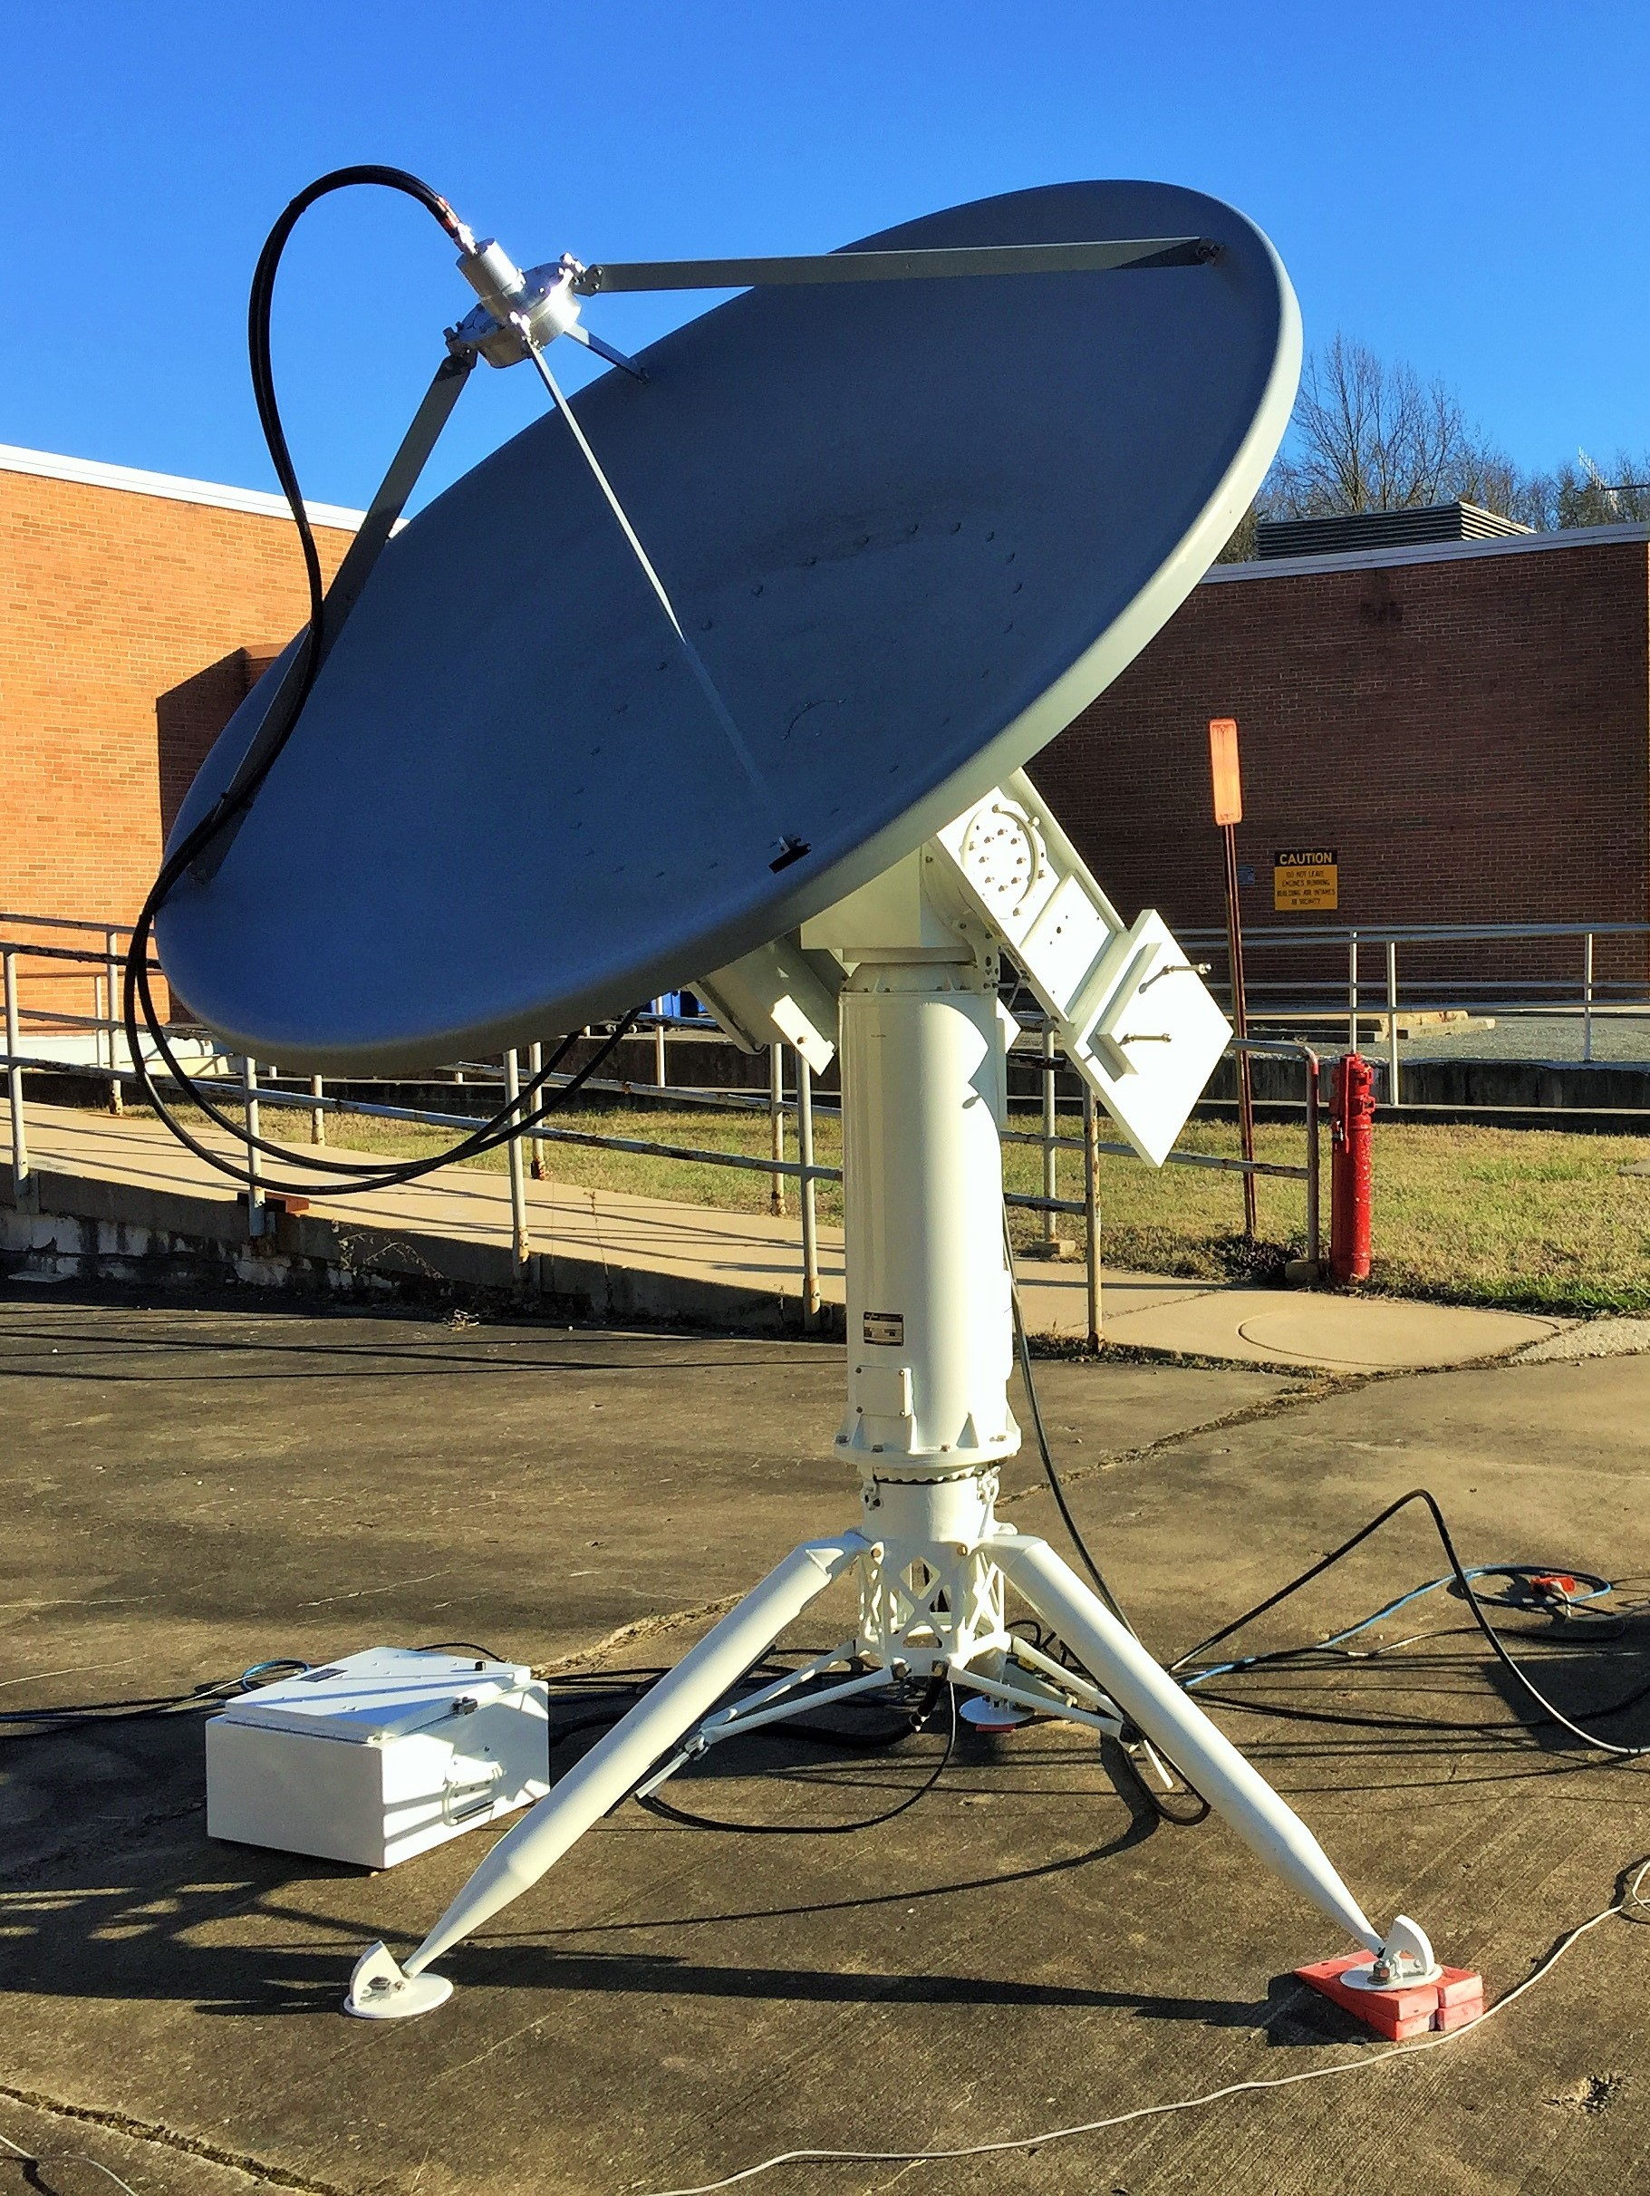
End of Mission (EOM) Experiments
Three NASA EOM experiment campaigns during the 2010s yielded the following findings to key questions:
Characterize vulnerabilities of space systems
  Unprotected command links are susceptible to capable adversaries
Assess feasibility of threat actions
  Modestly sophisticated threat systems can affect space assets
Identify signatures/indicators of threat effects
  Command receiver telemetry is particularly useful in characterizing space events
Inform mission requirements and design trades
  TT&C responses in a contested environment should be considered in design trades
Validate hardware, software and CONOPS mitigations
  Critical commands such as hardware commands merit special consideration
Improve flight ops security practices
  Implement good security hygiene in command loads

Slide 8
Identifying & Implementing Protective Measures

Slide 9
Representative Threats to Civil Space Missions
A representative set of threat actions below reflects emerging counterspace threats to a wide range of civil space missions:
  Command link jamming – sufficient RF energy directed at the spacecraft in its command link frequency may preclude the ability to receive commands during the period of RF emissions.
  Command link intrusion – valid commands with proper encryption or authentication injected within the command path may lead to a temporary or permanent loss of control.
  GPS jamming – sufficient RF energy directed at the spacecraft at GPS signal frequencies may preclude the spacecraft GPS receiver from receiving GPS signals during the period of RF emissions.
  GPS spoofing – RF energy directed at the spacecraft at GPS signal frequencies with selected phasing may alter the navigation and timing solution of the spacecraft during the period of RF emissions.
  Cyber exploitation of critical project information (CPI) – adversary acquisition and use of CPI may enable the adversary to overcome system protections and induce harm to the system or to manipulate science data.

Slide 10
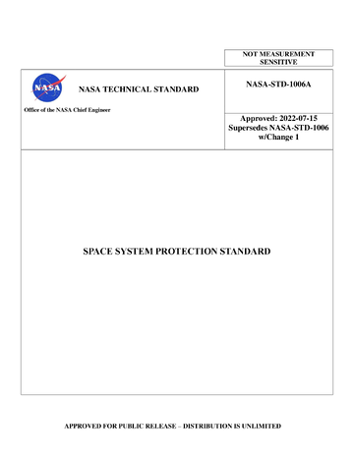
NASA Technical Standard NASA-STD-1006A
Maintain Command Authority
  Command Stack Protection: Programs/projects shall protect the command stack with encryption that meets or exceeds the FIPS 140, Level 1.
  Backup Command Link Protection: If a project uses an encrypted primary command link, any backup command link shall at minimum use authentication.
  Command Link Critical Program/Project Information (CPI): The program/project shall protect the confidentiality of command link CPI as controlled unclassified information (CUI) to prevent inadvertent disclosure to unauthorized parties.
Ensure Positioning, Navigation, and Timing (PNT) Resilience
  PNT Interference Recognition: If project-external PNT services are required, projects shall ensure that systems are resilient to the complete loss of, or temporary interference with, external PNT services.
Report Unexplained Interference
  Interference Reporting: Projects/Spectrum Managers/Operations Centers shall report unexplained interference to MRPP or to other designated notifying organizations.
  Interference Reporting Training: Projects/Spectrum Managers/Operations Centers shall conduct proficiency training for reporting unexplained interference.
https://standards.nasa.gov/standard/NASA/NASA-STD-1006

Slide 11
Mission Vulnerabilities
Data | S/C Software | SBC/ Processor/ Bus | IDS/ IPS | Crypto | Comms Link | Ground | Prevention
Compromised master or encryption keys (STD-1006) | Code re-use, malicious code, attacks on critical systems | Lack of bus segregation, malicious use of hardware commanding, SDR vulnerabilities, bad logic | Lack of resiliency (STD-1006) | Spoofing comms, replay code, tapping comm links (STD-1006) | Jamming comms, lack of authentication/ encryption (STD-1006) | Ground system exploits | Supply chain threats, trade secrets, not budgeting for cyber through lifecycle, contracting and procurement
Vulnerabilities exist across the enterprise
  STD-1006 did a lot to address some concerns across the eight newly assessed areas, still room for improvements
Space Security Best Practices Guide (BPG) focuses on three main thrusts
  Software (both space and ground)
  On-board computing, processing and bus
  Preventions and mitigations through process

Slide 12
Rationale Behind the BPG
The BPG offers cyber vulnerability-based security principles and controls applicable to both space and ground segments
The principles are meant to be easily achievable regardless of project size, scope, or whether international, corporate, or university
The principles selected focus on a risk-based approach to mitigating potential impairments to mission success
  Principles were identified as an initial starting point of the most critical implementations for missions to consider
  The underlying security principles and associated controls were identified through an iterative process to address today’s cyber actor Tactics, Techniques, and Procedures (TTPs) used in attempts to compromise mission cyber capabilities
BPG is a starting point to address the cyber challenges to NASA mission success

Slide 13
List of BPG Principles (1 of 2)
Principle Number
GV-RSK-01
MI-ARCH-01
MI-ARCH-02
MI-AUTH-01
MI-AUTH-02
MI-DCO-01
MI-DCO-02
MI-INTG-01
MI-INTG-02
Principle Title
Adaptive Risk Response and Resource Allocation Function
Mission Essential Data Flow Function
Mission Least Privilege Function
Boundary Protection Function
Comprehensive Authentication Authorization Function
Mission Adversarial Actions Detection Function
Mission Fault Management Function
Communications Survivability Function
Positioning, Navigation, and Timing Survivability Function
Principle Title
MI-MA-01
MI-MA-02
MI-MALW-01
MI-MALW-02
MI-SOFT-01
MI-SOFT-02
GR-AUTH-01
GR-AUTH-02
Principle Title
Mission Recovery Function
Cybersecurity-Safe State Function
Mission Malware Protection Function
Mission Software, Programmable Logic Devices, and Firmware Integrity Function
Software Mission Assurance Function
Software and Hardware Testing Function
Unique Identifiers for Authentication Function
Risk-informed Authorization for Non-Mission Users Function
PREVENT
MITIGATE
RECOVER

Slide 14
List of BPG Principles (2 of 2)
Principle Number
GR-AUTH-03
GR-DEVA-01
GR-INTG-01
GR-SOFT-01
GR-MALW-01
GR-MFA-01
GR-MON-01
GR-MON-02
GR-MON-03
GR-MON-04
Principle Title
Secure Workload-to-Workload Authenticator Function
Computing Device Authentication Function
Software and Firmware Integrity Verification Function
Software Installation Function
Malware Protection Function
Risk-informed Use of Multi-Factor Authentication Function
Unique Identifiers for Authentication Function
Risk-informed Authorization for Non-Mission Users Function
Network and Communications Monitoring Function
Threat Activity Response and Reporting Function
PREVENT
MITIGATE
RECOVER

Slide 15
Integrating Threat Mitigation into Mission Design & Operations

Slide 16
NASA Space Protection Approach
Each mission’s protection profile is derived from its objectives, capabilities, applicable threats, and risk posture.
NASA Space Flight Mission
Mission Requirements
Applicable Threats
(CUI or Classified)
Project Plan
Project control plan has 25 discrete subsidiary control plan categories, including:
Risk Management
System Engineering
Mission Operations
Protection
Candidate Protection Strategies
Project Protection Plan
NASA
STD-1006
Space System Protection Standard
Threat Intelligence
Best Practices, Areas of Concern
Missions leverage institutional infrastructure capabilities, such as space communications (Deep Space Network, Near Earth Network, Space Network), terrestrial communications, test chambers, and operations centers.
Office of Protective Services
Intelligence Division
MRPP

Slide 17
Systems Security Engineering
NASA is building a sustained capability for systems security engineering
  Goal: systems that are appropriately protected from adversarial threats
    …and still meet their primary objectives
  Specialty sub-discipline of systems engineering, covers the entire system
    Applies design principles from both engineering and security
    Augmented with subject-matter expertise from other disciplines such as cybersecurity specializations (e.g., network security)
  On an engineering team supporting a specific system, the Systems Security Engineer (SSE) will be the focal point for addressing system security topics for that system
  Well aligned with other comparable efforts
    NIST SP800-160 vol 1 rev 1, Engineering Trustworthy Secure Systems
    OUSD R&E Cyber Resilient Weapon Systems (CRWS)
  Ongoing pilot with NIST to apply systems security engineering in space systems
The SSE integrates appropriate capabilities into the design and operations
of a system to be sufficiently resilient and able to meet its objectives

Slide 18
Summary
Civil space systems are not immune to the contested space environment
NASA has identified measures to improve the protection and cybersecurity of space systems
NASA is integrating system security into the flight project lifecycle

Slide 19
Questions?

