Slide 1
Probabilistic Approach to Assessing Capture System Performance Margin on Mars Sample Return’s Capture, Containment, and Return System
Presenter: Calinda Yew
Co-Authors:
Giuseppe Cataldo
Brendan Feehan
Eugenia De Marco
George Antoun
Elfego Pinon

Slide 2
Agenda
Mars Sample Return (MSR) Capture, Containment, and Return System (CCRS) Overview
Capture Functional Requirement Flow-Down
Capture Performance Metrics Definition and Target
Monte Carlo Analysis Inputs and Outputs
Capture Performance Current Best Estimates (CBEs)
Conclusions

Slide 3
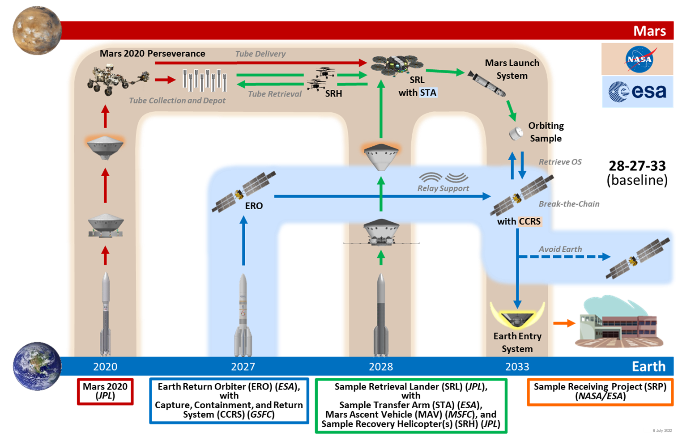
Planned Mars Sample Return (MSR) Overview
Planned Mars Sample Return (MSR) Campaign architecture consists of four separate missions
(OS)
Note: As part of the NASA response to the recent MSR Independent Review Board’s report and in light of the current budget environment, the MSR Program is undergoing a consideration of changes in its mission architecture. This paper is based upon the previous baseline MSR architecture in which CCRS/ERO would return the OS to Earth within five years of landing on Mars to retrieve samples collected by the Perseverance rover. The CCRS project will complete system development to a Preliminary Design Review level of maturity in mid-December 2023, after which the project will stop indefinitely pending results of re-architecting effort

Slide 4
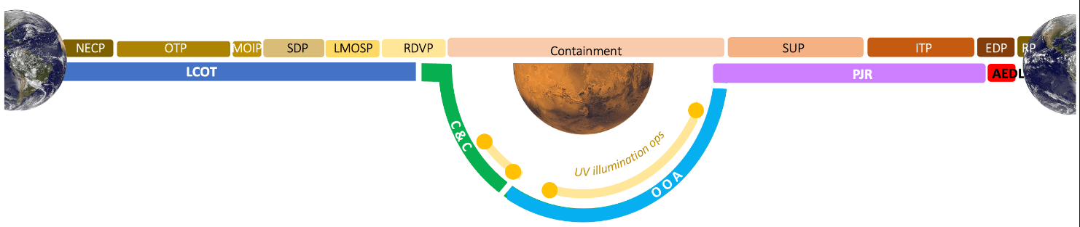
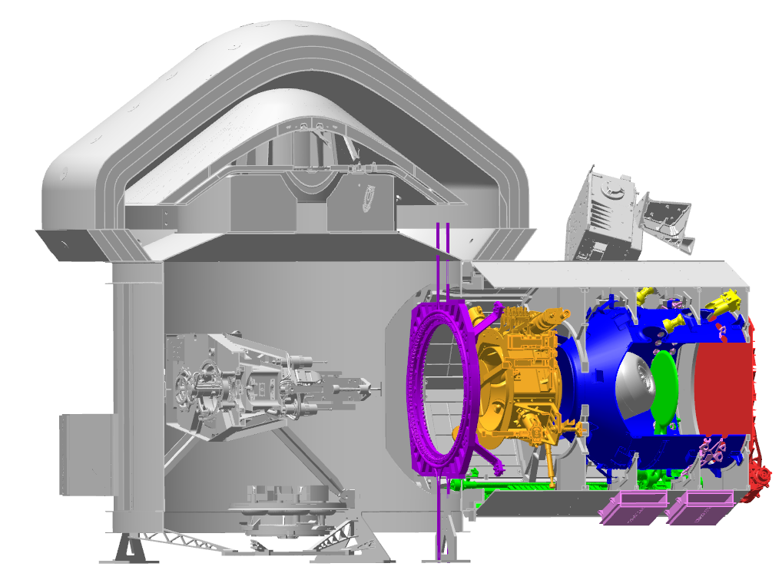
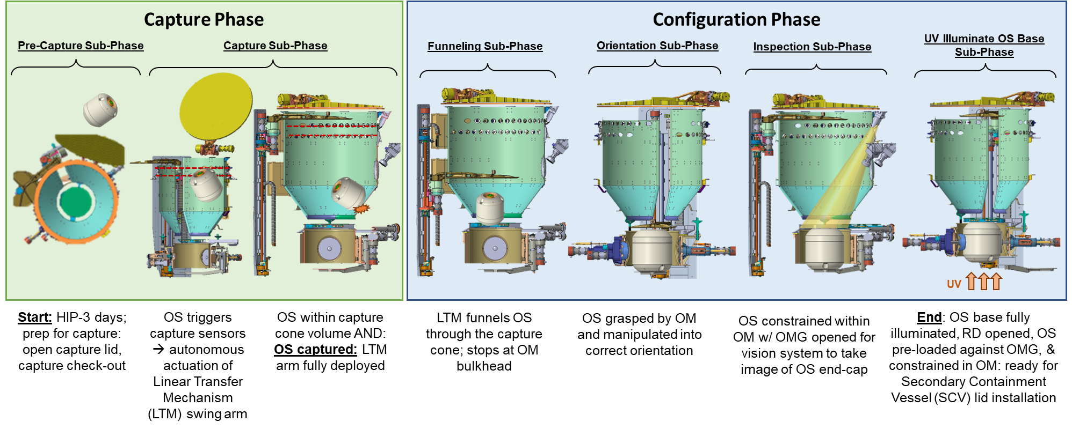

Capture & Configuration (C&C) Phase Overview
ERO
CCRS
C&C Phase Criteria
Entry: ERO reaches Homing Interface Point (HIP) – 3 days within the Rendezvous Phase (RDVP)
Exit: OS oriented & restrained in Orientation Mechanism (OM) w/ OS base fully illumination and Restraining Mechanism (RD)
C&C Key Functions
C&C Subphases
1
Open Capture Volume
2a
Detect OS
2b
Capture / Cage OS
3a
Close Capture Volume
3b
Funnel OS
4
Grasp & Orient OS
5
Confirm OS Orientation
6a
Constrain OS
6b
Illuminate OS Base

Slide 5
CCRS Capture Key & Driving System Requirements
ID | Primary Text | Comply? | What makes this requirement a driving requirement? | Relevant Phase Functions
CCRS Project SE
1038861 | CCRS shall be compliant with OS physical properties as defined in JPL D-106822, OS-CCRS Interface Requirements Control Document. | Yes | Defines the key OS properties that drive the hardware sizing and capabilities for manipulating the OS for all C&C functions | All
C&C Phase
1038138 | CCRS shall prevent the OS from exiting the capture volume after contact | Yes | Key function of capture | Open capture volume, Detect OS, Capture / Cage OS
1038858 | CCRS shall capture the OS with a maximum OS rotational kinetic energy of 0.35J immediately after Mars Launch System (MLS) separation. | Yes | Key parameter for capture; drives bounce-back time in total capture budget | Detect OS, Capture / Cage OS
1111799 | CCRS shall complete capture assuming the relative velocity between ERO and the OS is ≤ 4cm/s | Yes | Key parameter for capture; drives depth of capture volume | Detect OS, Capture / Cage OS
1111800 | CCRS shall complete capture assuming the relative velocity vector between ERO and the OS is ≤ 5 degree from the nominal CCRS capture vector | Yes | Key parameter for capture; drives depth of capture volume | Detect OS, Capture / Cage OS
1111801 | CCRS shall complete capture assuming the cross-track position error between ERO and the OS is ≤10 cm | Yes | Key parameter for capture; drives capture opening sizing | Detect OS, Capture / Cage OS
System requirements defining OS size, mass & incoming rendezvous parameters are the drivers for the capture function

Slide 6

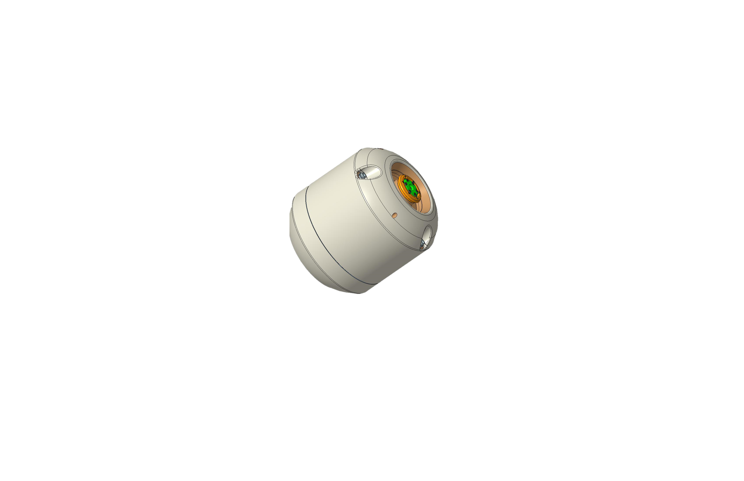
Capture Functions
ERO Rendezvous Proximity Operations
CCRS Capture
Deliver OS to capture entrance plane
Capture the OS within a volume
Capture Entrance Plane
“Capture Start”
“Capture Complete”
The capture entrance plane is a virtual plane defined as the plane containing the aperture of the capture volume in +Y_ERO direction
Physical Properties
Optical Properties
Rotation Rate
Capture definition
“OS Capture is the activity during which the OS enters the capture volume and is retained from leaving it again. It starts at the capture interface at the date when the OS center of gravity (CG) crosses the capture entrance plane. The capture function is completed when the OS is physically prevented from exiting the capture volume.”

Slide 7
Capture Performance Requirement Allocations & Flow-down
The CCRS capture function is decomposed into three sub-functions:
  OS detection & telemetry
  Telemetry processing & command generation
  Physical capture of OS
System capability of 3.75 seconds is the predicted total performance + design uncertainties
The 3.75 seconds is allocated to two CCRS subsystems and serve as not-to-exceed (NTE) performance requirements: controlled in L4 subsystem requirements docs
Item | Function [Reqt] | Subsystem | NTE Time Allocation | Description
1 | OS Detection [L4-CCRS-CCS-1117108] | Capture & Configuration System (CCS) | 0.10 seconds | CSE processing for state determination
2 | Process Signals & Send Command [L4-CCRS-AVN-1137892] | Avionics (AVN) | 0.45 seconds | Receive capture sensor statuses Perform algorithm Send command to deploy mechanism
3 | OS Physical Capture [L4-CCRS-CCS-1117109] | Capture & Configuration System (CCS) | 3.2 seconds | Deploy LTM
CCRS System Total: |  |  | 3.75 sec | System capability limit
AIAA SciTech 2024 Conference

Slide 8
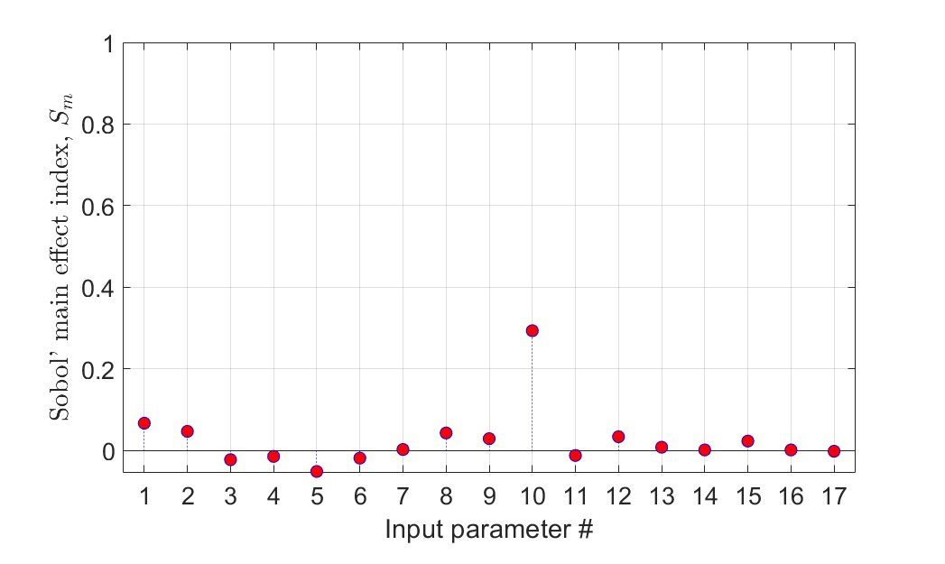
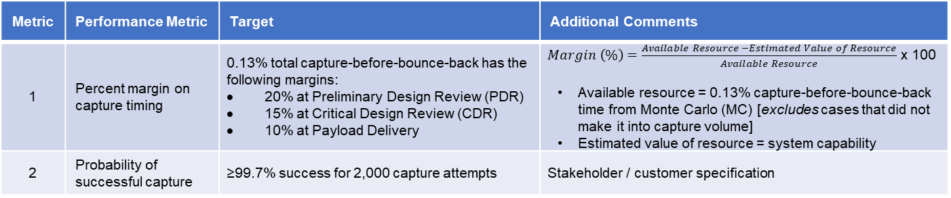
Definition of CCRS capture performance metrics & targets
Non-traditional metric requires engineering judgment to develop a margin philosophy
Presenting margin only as a percentage of available time seems to be insufficient for gauging capture performance
  A margin in %-time alone does not inform how robust the system is to parameters that drive the budget
    State margin in the sense of robustness to the driving input parameters (parameters to which CCRS is most sensitive)
    A global sensitivity analysis indicates volume margin (at the capture aperture) is likely more important [time until OS contact is driven by ±10cm cross-track error requirement]
CCRS tracks and reports two capture performance metrics
  Percent margin on capture timing (using the -3σ time in MC output distribution)
  Probability of successful capture (per L1.5 → L3.5 reqt 99.7% specification)
Based on engineering judgment, CCRS set targets for each metric:
Definition of success:
CCRS designs a capture volume to allow successful OS entry (no inadvertent LTM/CLM failure after PNR prior to and during OS entry
CCRS detects and physically cages the OS before it bounces out
# | Parameter / Variable
1 | OS mass
2 | OS Ixy product of inertia
3 | OS Ixz product of inertia
4 | OS Iyz product of inertia
5 | OS CG X wrt nominal
6 | OS CG Y wrt nominal
7 | OS CG Z wrt nominal
8 | OS velocity angle
9 | OS velocity azimuth angle
10 | OS cross-track error
11 | OS azimuth angle
12 | OS rotational KE
13 | OS spin axis azimuth angle
14 | First Euler angle
15 | Second Euler angle
16 | Third Euler angle
17 | Coefficient of Friction
Metric | Performance Metric | Target | Additional Comments
1 | Percent margin on capture timing | 0.13% total capture-before-bounce-back has the following margins: 20% at Preliminary Design Review (PDR) 15% at Critical Design Review (CDR) 10% at Payload Delivery | $Margin \left(\%\right)=\frac{Available Resource −Estimated Value of Resource}{Available Resource}$ x 100 Available resource = 0.13% capture-before-bounce-back time from Monte Carlo (MC) [excludes cases that did not make it into capture volume] Estimated value of resource = system capability
2 | Probability of successful capture | ≥99.7% success for 2,000 capture attempts | Stakeholder / customer specification
AIAA SciTech 2024 Conference

Slide 9
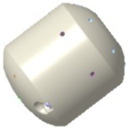

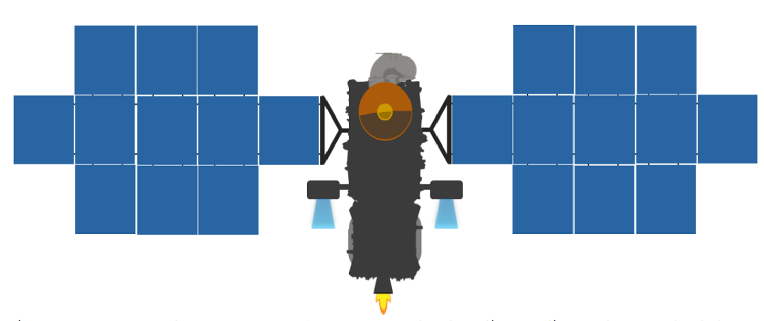
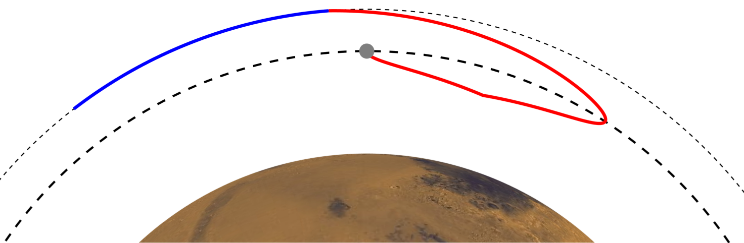
Monte Carlo Inputs
ERO
OS relative velocity magnitude
OS relative velocity vector
OS cross-track position
Spacecraft dynamics / attitude control
OS
Mass properties (MOI, mass, etc.)
CG offsets
OS max dimension / outer mold line
MAV
OS max rotational kinetic energy / spin rate
CCRS
Capture geometry
Sensor plane locations
Mechanism plane where physical capture of OS occurs
Capture cone alignment
# | Capture-before-bounce-back Input Parameter | Value [Requirement*] | Input Distribution for Monte Carlo Budget Derivation
System
1 | OS Velocity (cm/s) | 4* | Fixed
2 | OS Cross Track (cm) | ≤10* | Gaussian distribution with 3 sigma at requirement values
3 | OS Trajectory Angle (deg) | ≤5* | Uniform distribution +/- 5 deg
4 | OS Max Dimension (mm) | 332 | Assumes CG at centroid
5 | OS CG Offset (mm) | ±10 X_{OS}; ±5 radial* | Uniform CG, Uniform Offset
6 | OS Max Rotational Kinetic Energy (J) | 0.53* | Triangular distribution from 0-0.53J
7 | OS MOI Ixx, Iyy/Izz (kg-m²) | 0.079, 0.091* | Fixed for 11.5kg OS
8 | S/C dynamics (deg/sec) | ±0.025* | Fixed rotation about spacecraft CG
9 | OS Initial Orientation, 3 Euler angles (deg) | [0 360] | Uniform
Time Before Bounce-back, from OS Cleared Upper Sensor Plane |  | 6.09 | Not a gaussian distribution, nonlinear model computed for each MC case based on first funnel/OMG impact location
10 | Cone misalignment wrt capture axis (sec) | -0.1 | Estimated
Total Capture Budget: |  | 5.99

Slide 10
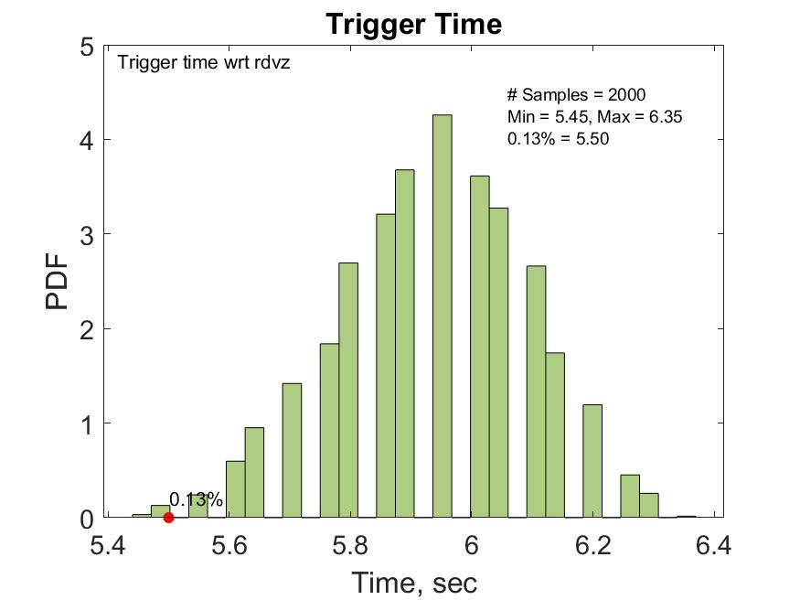
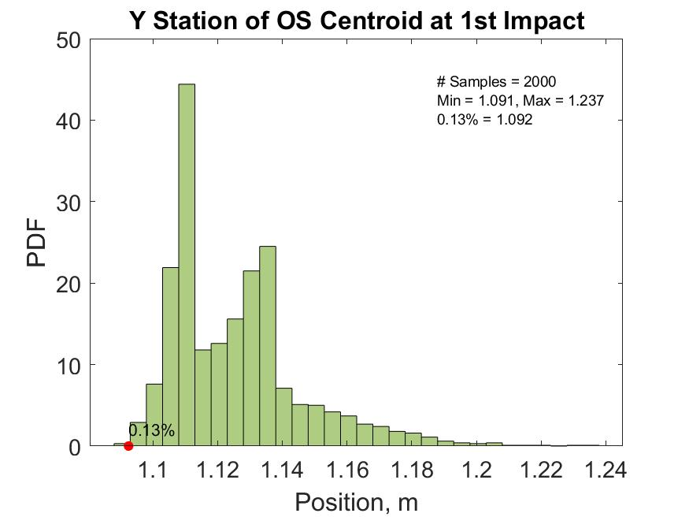
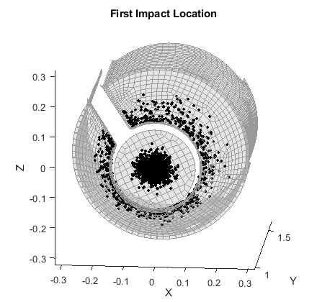
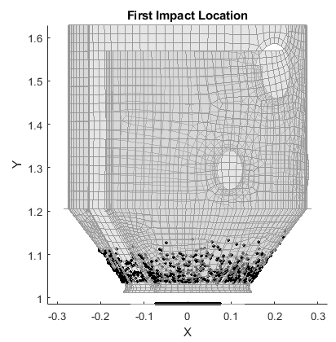
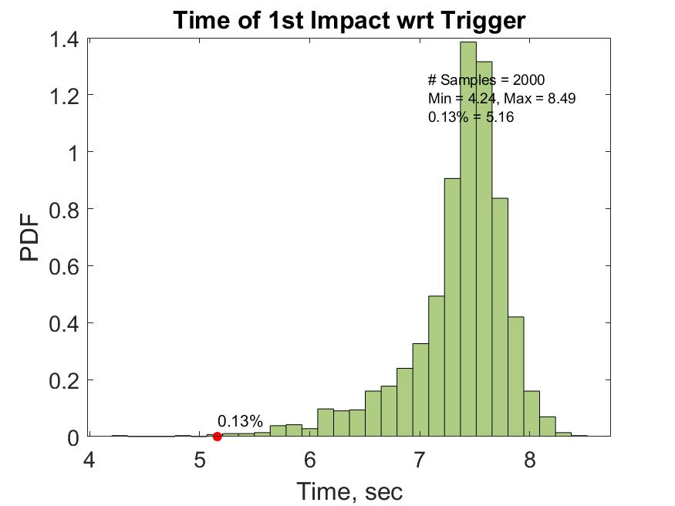
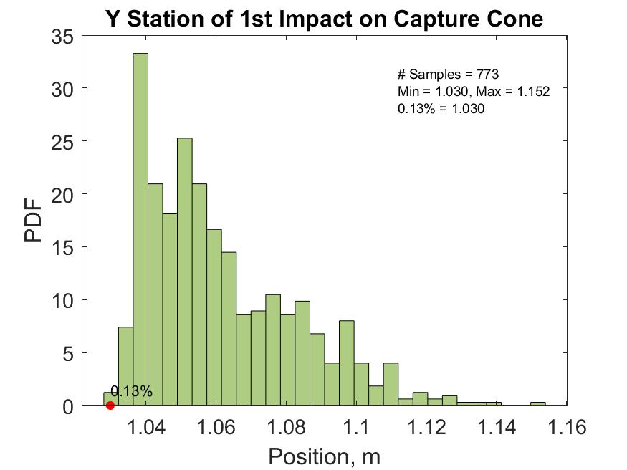
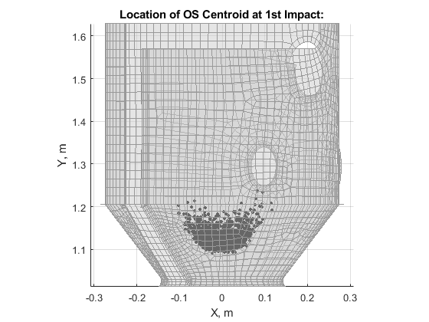
First Impact Location, Timing, & OS Centroid Position Results
1st Impact location: 1227 on Orientation Mechanism Guard (OMG); 773 on Funnel
Pre-decisional, for planning and discussion purposes only.

Slide 11
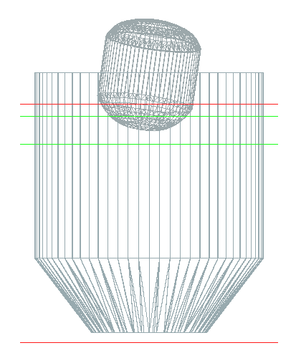
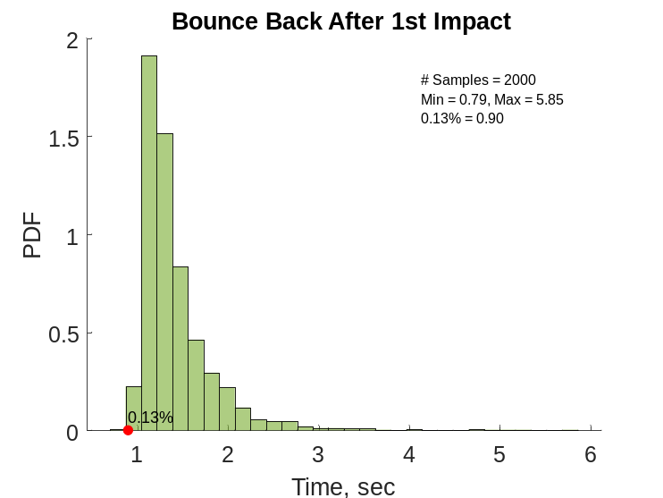
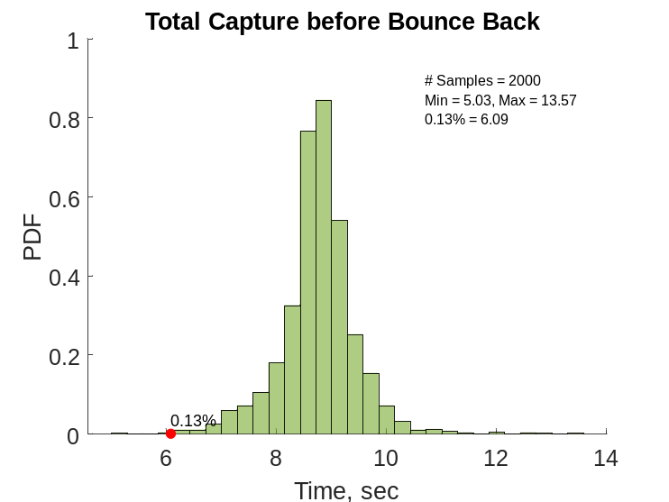
Conservative Bounce Back Time Estimate
Time of 1st impact wrt trigger:
  From MC recovered time of 1st impact wrt trigger.
Bounce back after 1st impact
  Assume 1st impact converts all incoming kinetic energy to translational velocity, calculate bounce back time between 1st impact and time when any part of OS reaches LTM plane.
Capture before bounce back time = 1 + 2
LTM
1
2
OM Guard
(Figure 5e)
1
2
=
+
Assume no energy loss, bounce back towards LTM

Slide 12
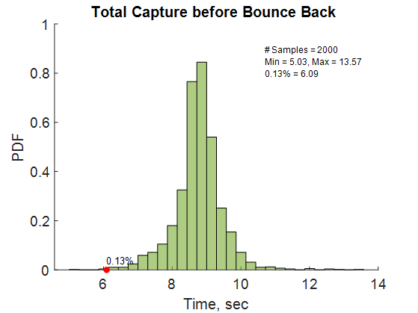
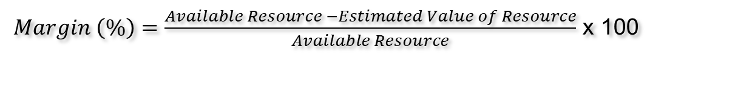
Metric #1: CBE for Percent Margin of Capture Timing
The CBE for the total allowable capture-before-bounce-back is taken from the Monte Carlo ADAMS Capture Simulation MC06a
The CBE for the system capability is the sum of the subsystem CBEs for each allocated function defined in the table on Slide 3
$Margin \left(\%\right)=\frac{Available Resource −Estimated Value of Resource}{Available Resource}$ x 100
(Figure 5e)
Available Resource = CBE Total Allowable Bounce-back Time = 6.09 sec – 0.1 sec capture cone mis-alignments = 5.99 sec
Estimated Value of Resource = CBE Totally System Capability = 2.3 seconds
Item | Hardware Item | PDR Timing CBE (sec) | Performance Margin
1 | Capture sensor electronics | 0.050 | 100%
2 | LTM swing arm | 2.85 | 11%
3 | Avionics | 0.366 | 19%
CCRS System Total PDR CBE: |  | 3.27 | 46%

Slide 13
Metric #2: Probability of Successful Capture Overview
The reliability of each component involved in executing the closed-loop capture function is used to compute the minimum probability of success that the system capability limit would be allowed to lie on the MC output distribution
Independence between the component reliabilities can be assumed since the failure of one component does not affect the failure of the others
The components functioning in series, meaning each must function for the system to work, the product rule for reliability applies:
P_{S(total)} = 99.7% = P_{S(sensors)}*P_{S(avionics)}*P_{S(LTM)}*P_{S(MC)}
where,
P_{S(total)} = total system probability of success
P_{S(sensors)} = capture sensor component reliability / probability of success
P_{S(avionics)} = avionics component reliability / probability of success
P_{S(LTM)} = LTM deployment component reliability / probability of success
P_{S(MC)} = minimum allowable probability of success for system capability (3.75 sec) on MC output distribution
(Figure 5e)
Item | Hardware Item | CBE PDR Reliability, P_{s} (%)
P_{S(sensors)} | Capture sensor electronics | 99.9999
P_{S(LTM)} | LTM swing arm | 99.9979
P_{S(avionics)} | Avionics | 99.9923
P_{s(total)}/P_{s(MC)}: |  | 99.9901
P_{s(MC)}: |  | 99.71
The MC output distribution has 6.09 sec at the 0.13%-ile → CCRS meets this performance requirement with sufficient margin
P_{S(total)} = 99.7% = P_{S(sensors)}*P_{S(avionics)}*P_{S(LTM)}*P_{S(MC)}
P_{S(MC)} = 99.71
1 – P_{S(MC)} = 0.24 → system capability of 3.75 sec ≤ 0.24%-ile on MC distro
AIAA SciTech 2024 Conference

Slide 14
Conclusions
Results summary:
Systems engineering processes and judgment must be used to assess highly-coupled functional requirements without clear target metrics defined
  Non-traditional technical resource → Time
  Determine driving parameters to generate target metrics
  Properly understand probability distributions for inputs
  Reduce conservatism, as necessary
Future work to refine conservative assumptions may be required
  With the rotational kinetic energy assumptions, the OS rebound velocity vector is in the worst-possible direction for all cases
Metric | Metric | Current Performance | Current Delta from (Table 3) Target | Details
1 | Percent System Margin Capture for Timing | 46% margin | +26% | 0.13% from Figure 5e = 6.09sec
2 | Probability of successful capture | 3.75sec must be ≤0.242% on MC Figure 5eoutput distribution | 3.75sec is well below 0.13% on distribution | 0.242%-ile = P_{f(MC)} = 1 – P_{S(MC)}

Slide 15
BACK-UP

Slide 16
Capture Performance Requirement Allocations & Flow-down
L1.5 MSR-CAM-998544
The CCRS shall capture the OS with 99.7% probability of success compliant to the OS physical dimensions in MSR-CAM-1011840 and assuming delivery to the CCRS capture interface plane center within the tolerance specified in the ERO-CCRS IRD
Definition of success:
CCRS designs a capture volume to allow successful OS entry (no inadvertent LTM/CLM failure after PNR prior to and during OS entry
CCRS detects and physically cages the OS before it bounces out
L3.5 CCRS-SRD-1086192
The CCRS shall capture the OS with a probability of success of at least 99.7%
L4 CCRS-CCS-1117154
The CCS shall maintain a capture opening of at least 549mm diameter for a minimum depth of 422mm
L4 CCRS-CCS-1177504
The CCS shall size the capture volume to have a minimum of 500mm between the end of the capture volume and the plane(s) that provide(s) both OS detection and OS physical capture
L4 CCRS-CCS-1117108
The CCS shall provide signals to avionics indicating the OS has crossed the threshold needed to capture within 0.1 sec
L4 CCRS-AVN-1137892
The avionics shall send the command to the mechanism for OS capture within 0.45 sec of receiving capture sensor signals indicating capture
L4 CCRS-CCS-1117109
The CCS shall physically prevent the OS from exiting the capture volume within 3.2 sec of deployment command from avionics
Item | Function [Reqt] | Subsystem | NTE Time Allocation | Description
1 | OS Detection [L4-CCRS-CCS-1117108] | Capture & Configuration System (CCS) | 0.10 seconds | CSE processing for state determination
2 | OS Capture [L4-CCRS-CCS-1117109] | Capture & Configuration System (CCS) | 3.2 seconds | Deploy LTM
3 | Process Signals & Send Command [L4-CCRS-AVN-1137892] | Avionics (AVN) | 0.45 seconds | Receive capture sensor statuses Perform algorithm Send command to deploy mechanism
CCRS System Total: |  |  | 3.75 sec | System capability limit
System capability of 3.75 seconds is the predicted performance + design uncertainties
The 3.75 seconds is allocated to two CCRS subsystems and serve as NTE performance requirements
Subsystem (L4) allocations of the CCRS-derived timing budget are controlled in the L3.5 SRD to L4 subsystem requirements docs
AIAA SciTech 2024 Conference

Slide 17
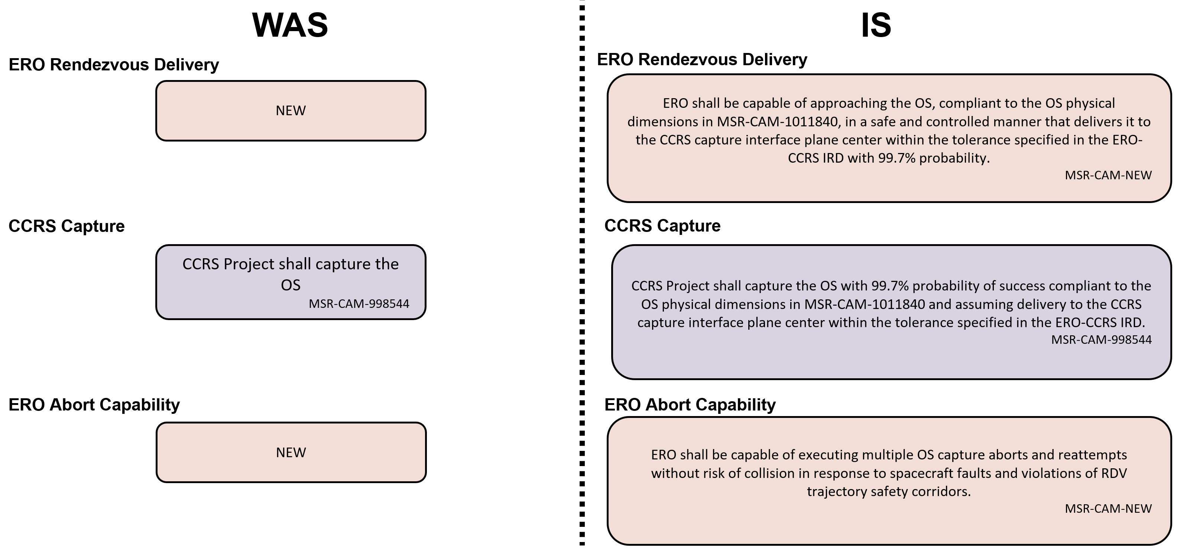
Updated L1.5 → L3.5 Requirement to Specify Performance
MSR is updating the L1.5 functional requirement “CCRS shall capture the OS,” to a performance requirement, as follows:
AIAA SciTech 2024 Conference

Slide 18
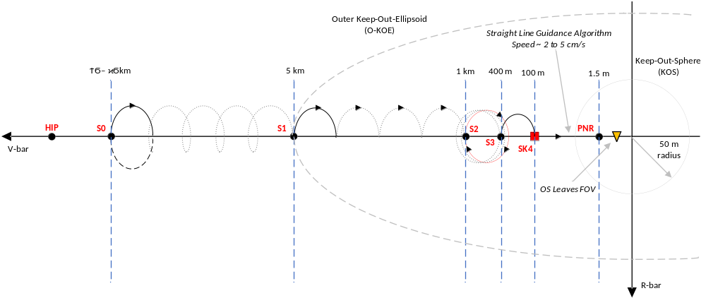
CCRS C&C Phase Start within ERO Rendezvous Trajectory
CCRS Operations within ERO operational context
OS Altitude: 300 km to 440 km
NOTE: Not to scale
HIP – 3 days: Open capture lid, op heaters on, capture sensors calibration, LTM capture maneuver check-out
Straight Line Guidance Algorithm Speed Max 4 cm/s
At PNR: ERO FDIR deferred
At Capture: CCRS autonomously deploys Linear Transfer Mechanism (LTM) to Capture / Cage OS
At SK4: Arm electronics for capture; MSR KDP Go-No-Go for Capture*
Stationkeeping Point
Waypoint/Maneuver
*CCRS Capture Ready Criteria:
capture lid in capture-ready position, capture sensors armed, LTM in capture-ready position, OM-G in capture-ready position, mechanisms at operational temperatures, avionics powered
Phases
Pre-Hopping
Hopping
Closing
Positioning
Final Approach
Safety
No CAM (Passive Safety)
CAM / SAFE CAM
Sensors
NAC LOS
LiDAR: LOS + Range
PNR = Point of No Return
HIP = Homing Interface Point
Impulse
Tangential
Radial

Slide 19
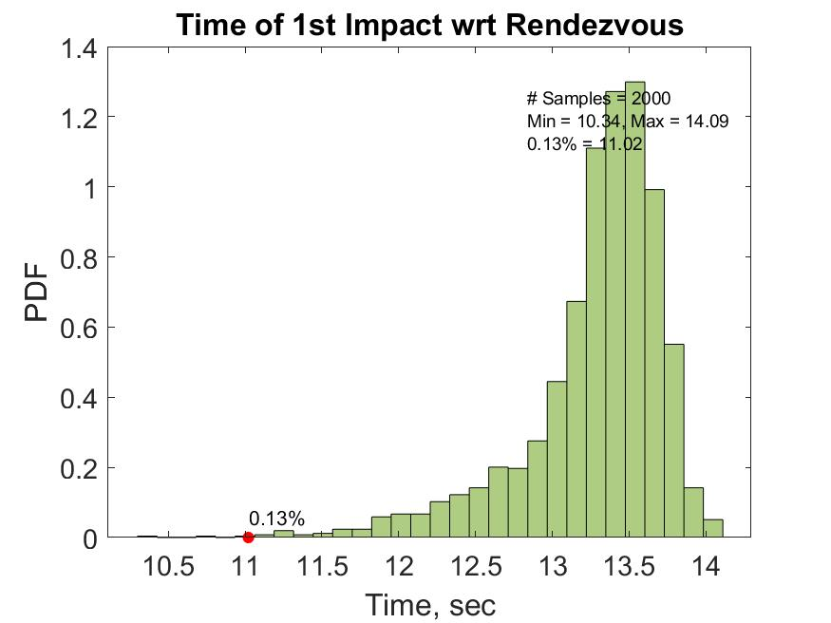
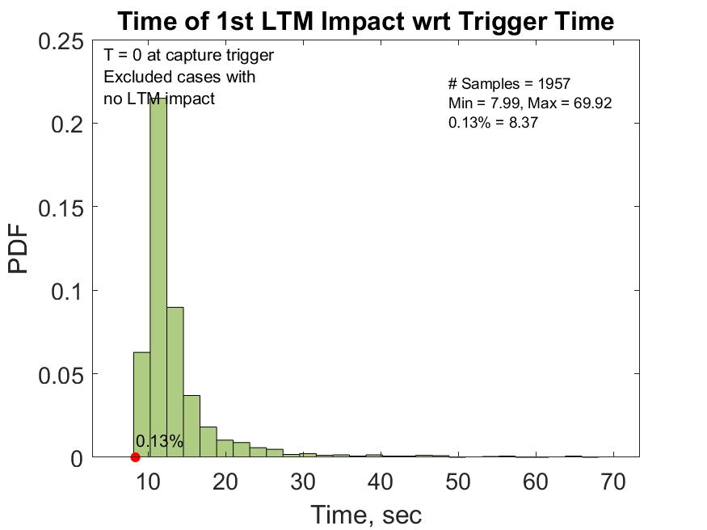
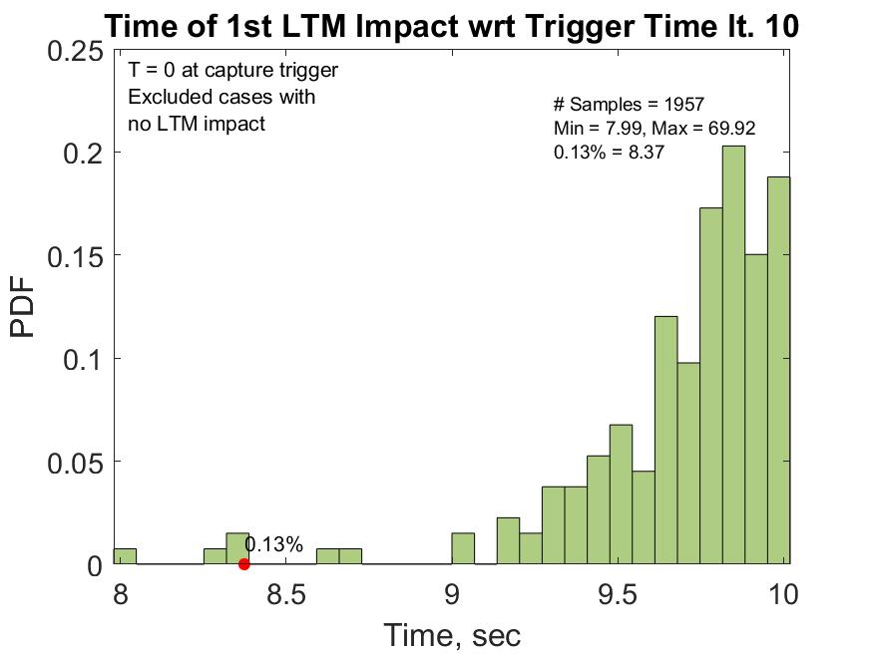
Timing Results (1/2)
Time of 1st impact accounting for energy loss and realistic rebound vector = 8.37 sec
LTM impact time from transient sim
LTM impact time from transient sim
Pre-decisional, for planning and discussion purposes only.

Slide 20
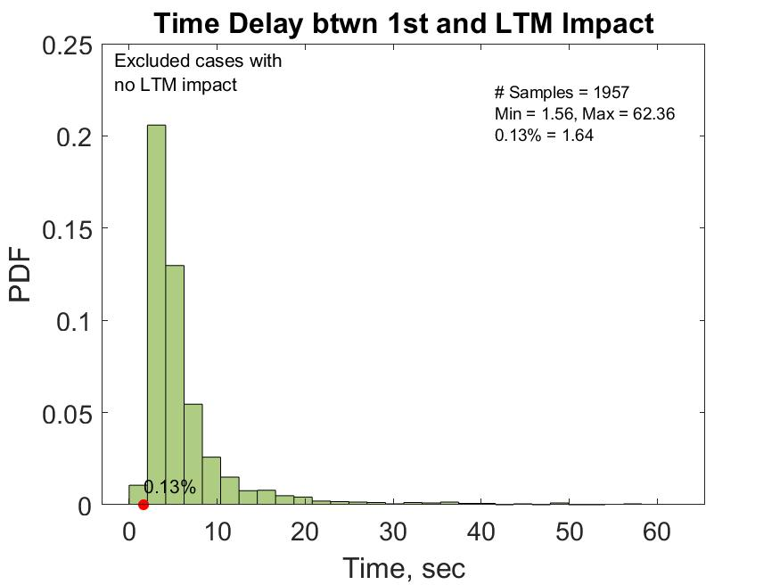
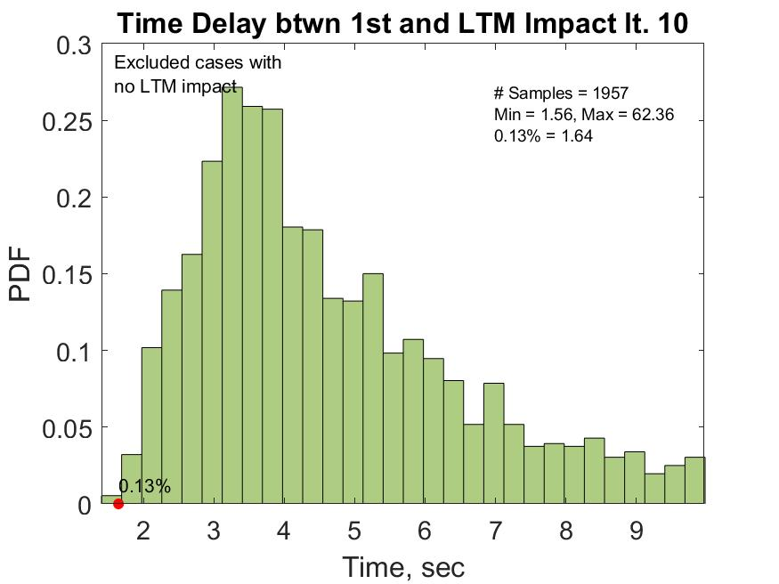
Timing Results (2/2)
LTM impact time from transient sim
LTM impact time from transient sim

