Slide 1

Evaluating Liftoff Debris for NASA’s Space Launch System (SLS) Prior to the Artemis I Launch
Michael J. Hays, SLS Blast Sub-Discipline Lead
Jennifer R. Robinson /Jacobs Space Exploration Group, SLS Launch Debris Sub-Discipline Lead
Andrew J. Herron, SLS Induced Environments Discipline Lead
Andrew M. Smith, SLS Induced Environments Alternate Discipline Lead
National Aeronautics and Space Administration / George C. Marshall Space Flight Center
2024 AIAA SciTech Forum and Exposition, January 8-12, 2024

Slide 2
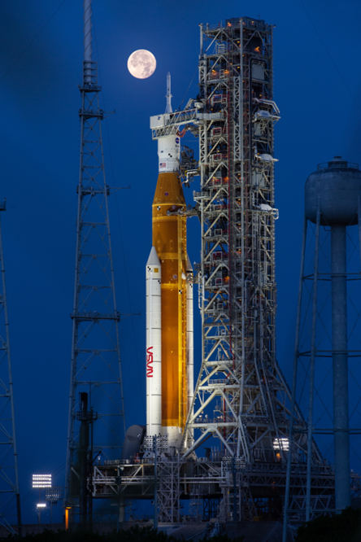
Artemis I Launch Debris Overview
Artemis I launch debris hazards routinely assessed
  Two expected debris concerns identified and cleared
Tools and processes developed to assess Day-of-Launch (DOL) unexpected debris
Debris hazards increased due to tests and environments leading up to launch
  Green Run, Wet Dress Rehearsals, Tanking Test, Hurricanes, Launch Attempts
Multiple unexpected debris hazards assessed and accepted by the program before DOL, including thermal materials, processing debris, and potential pad debris from weather events
DOL unexpected debris was minimal, easily resolved

Slide 3
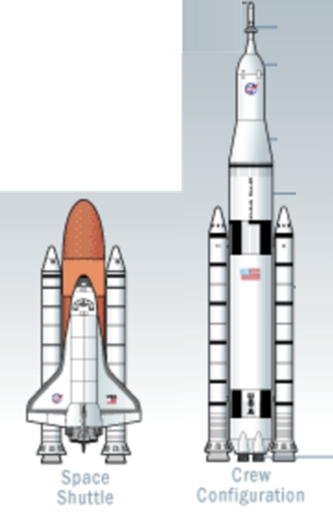
Expected Debris Assessments
SLS vehicle materials are less vulnerable to debris impacts than Shuttle materials; however,
  Longer vehicle results in higher impact energies on aft components
  Liquid engine locations closer to Booster nozzles increase risk of throat plug impacts
Expected debris includes thermal materials, ice, nozzle plug materials and other minor miscellaneous materials
Assessments of expected debris consist of
  Debris transport analyses
  Impact assessments
  Risk assessments for identified concerns
Identified issues reviewed by SLS Program for acceptance or mitigation

Slide 4
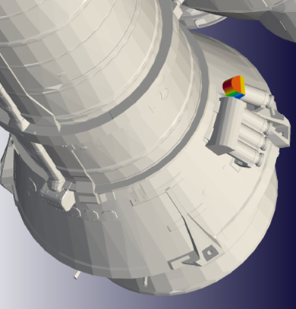
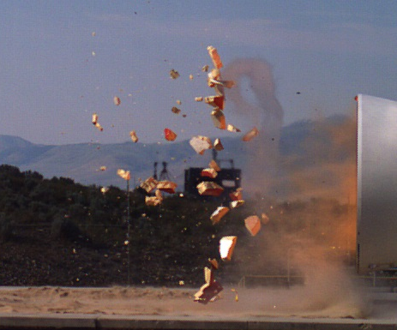
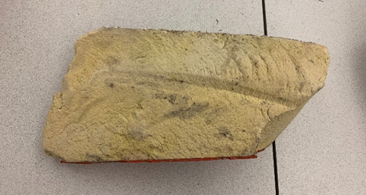
Two Expected Debris Concerns Accepted as Low Risk
Core Stage thermal protection system materials identified as concerns to the Booster Aft Separation Motor Single Fairing
  Probabilities assessed for debris release, impact, and damage
Booster Throat Plug foam identified as concern to the liquid engine nozzles
  Complex debris transport mechanism examined
  Impact tests onto ‘waterfall’ performed for availability for transport
  Fragment distribution assessed from test data
  Probability of damage calculated, given availability and transport to the nozzle surfaces
SLS Program determined the risks were low and acceptable
Booster Throat Plug Fragment Recovered after Artemis I

Slide 5
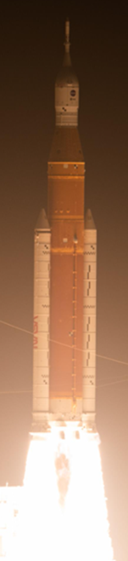
Day-of-Launch (DOL) Debris Process
Evaluating launch debris as a hazard assessment resulted in limited known design thresholds, requiring new process for DOL support
Developed DOL Launch Debris Process, coordinated with SLS Elements, Cross Programs, and imagery teams and processes
  Debris Subject Matter Experts (SMEs)
    review scans to identify potential debris Items of Interest (IOIs)
    perform needed assessments supporting risk evaluations, by Program management and mission management teams
  DOL Debris Transport and Impact Assessment Tools developed
  IOI evaluations coordinated over voice loops across four NASA Centers and several contractor sites
DOL Process exercised for multiple unexpected debris sources during simulations, tests, and launch attempts
Only one minor unexpected debris item required assessment on DOL

Slide 6
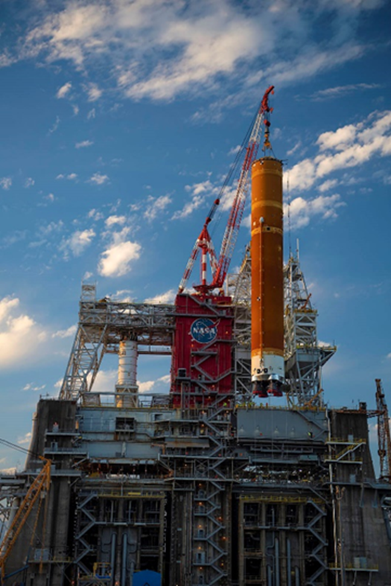
Debris Activities During Pre-Launch Tests
Core Stage Green Run Wet Dress Rehearsal and Hot Fire Tests
  Four cycles of cryogenic loading/unloading, two hot-fire cycles, and a year of environment exposure
  Cracks developed in TPS foam and were repaired as needed
Integrated Vehicle Wet Dress Rehearsals (WDR) 1 through 4
  After Rollout and WDRs debris was observed and evaluated: foreign object debris, minor vehicle TPS damage, expected ice accumulation (potential debris), and unexpected tower debris
  Unexpected items observed were corrected before launch
Launch Attempts 1 and 2
  Noted unexpected items on the tower, unexpected ice growth on the Core Stage, and TPS foam cracks at LH2/IT flange
  All evaluated with DOL process or removed before launch
Artemis I Core Stage and Stennis B-Stand

Slide 7
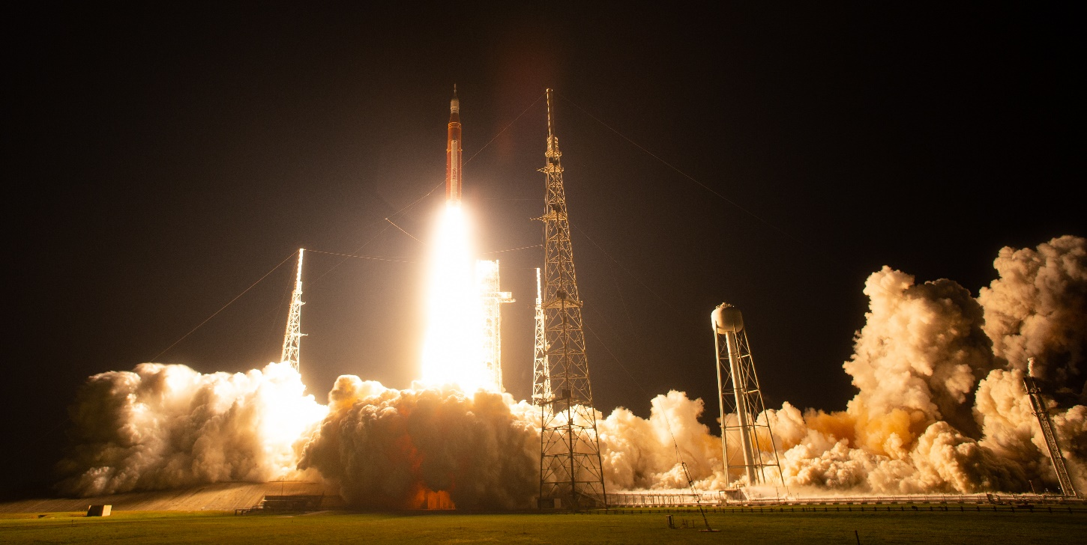
Tanking Test Through Launch
Tanking Test
  All cryogenic tanks successfully filled
  Unexpected tower debris evaluated
Rollback for Hurricane Ian
  Potential tower debris removed, and repairs completed in VAB
Weathering Hurricane Nicole
  Imagery scans and walkdowns assured minimal unexpected debris
  Minor tower softgoods damage mitigated to prevent debris release
  One vehicle thermal material loosened and required assessment
Artemis I Launch, November 16, 2022
  Areas of ice growth evaluated, confirmed within expectations
  Several known TPS cracks monitored, previously assessed for risk
  One minor TPS material assessed and cleared just before launch

Slide 8
Pre-Launch Risk Assessments
Planned and unplanned tests and processes increased the risk of debris release
Loads induced by cryogenic tanking cycles, from rollbacks, and from unexpected weather events resulted in two notable thermal materials damaged
Foam cracks on the Core Stage indicated debris releases could be larger than previously defined for expected debris, and noted as Items of Concern (IOC)
  Repair of most cracks was completed during roll-back to the VAB before launch
  Remaining cracks were evaluated, and risk assessments completed
Thermal materials on Orion hardware were observed loosened in prelaunch events
  Unexpected loose material from this location was evaluated and noted as an IOC
  The loose materials were removed during roll-back to the VAB before launch
  Remaining material was assessed as potential debris and risks evaluated
Risk assessments were completed and accepted by the SLS Program and mission management before launch

Slide 9
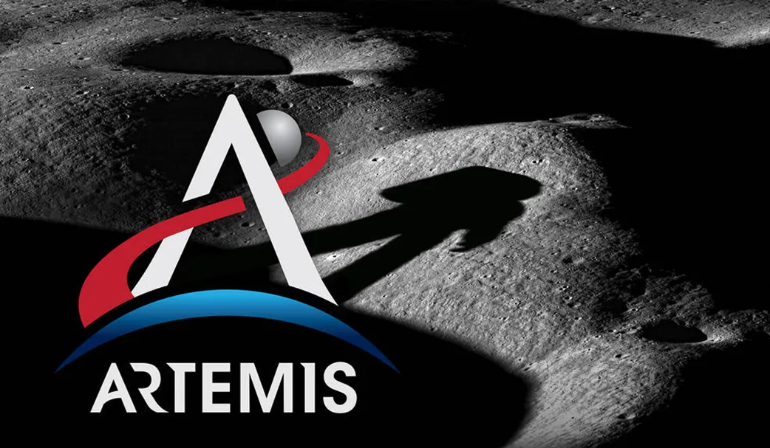
Conclusions
An integrated approach to DOL debris assessment across NASA SLS, Cross Program, and contractor organizations led to successful and efficient evaluations of unexpected launch debris and a successful Artemis I launch
Awareness of potential launch debris issues has improved, and mitigation activities more accomplished as a result of the activities leading up to launch
The many evaluations of expected and unexpected launch debris for Artemis I provide a sound basis for support to Artemis II and beyond
https://www.nasa.gov/learning-resources/for-kids-and-students/what-is-the-artemis-program-grades-k-4/

Slide 10
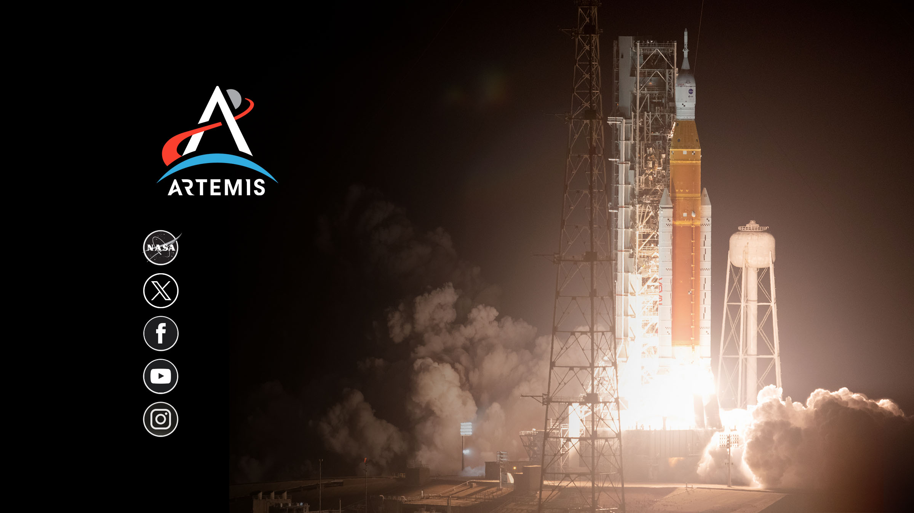
nasa.gov/artemis
@NASAArtemis
NASA Artemis
youtube.com/nasa
@NASAArtemis

