Slide 1

Flight Test Design and Implementation for
Independent Surveillance of an Airspace Through
a Distributed Ground Sensing Network
Vahram Stepanyan, Corey Ippolito, Keerthana Kannan,
Evan Kawamura, Thomas Lombaerts, Wendy Holforty
NASA Ames Research Center (ARC)
Chester Dolph
NASA Langley Research Center (LARC)
AIAA SciTech Forum 2024
This material is declared a work of the U.S. Government and
is not subject to copyright protection in the United States.

Slide 2
Outline
Flight test setup and tasks
Hardware architecture and selection
Technologies used for data analysis
Flight test results
Conclusions

Slide 3
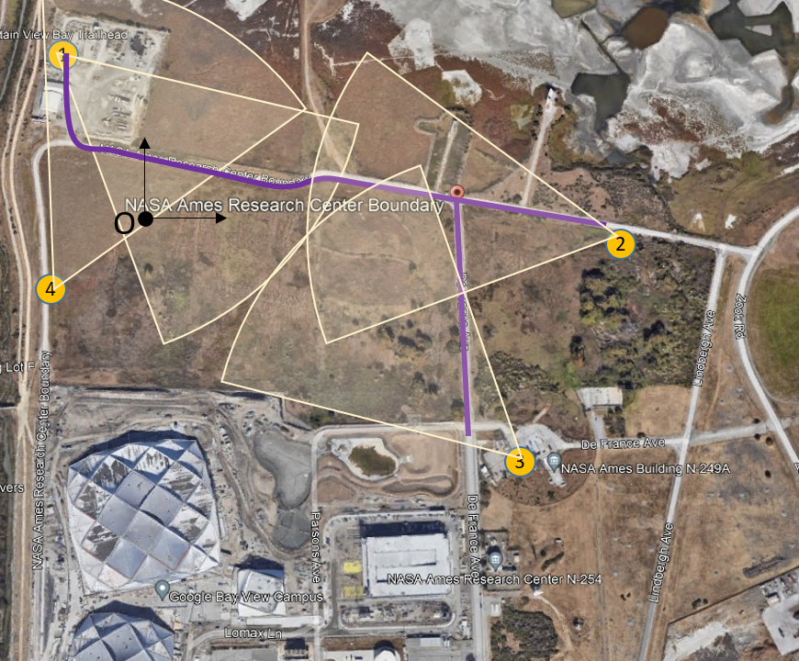
Flight Test Setup
Test scenario at NASA ARC DART site
Target flies predefined trajectory (magenta line)
Telemetry data saved/transmitted for ground truth
Distributed ground nodes at NASA ARC DART site
Each Ground Node (yellow circles) is equipped with
  Power unit, computer, modem, camera,
Locations are measured
Reference points allocated for camera registration
Clocks are synchronized via Atomic Clock registration
Two flights from Node 3 to Node 1 and back
Cameras readings saved for processing
Image angles and pixel coordinates sent to estimator
Estimator executed at Ground Node with minimum latency

Slide 4
Experiment Tasks
Pre-flight tasks
Hardware clock synchronization
Sensors
  Registration – validate the accuracy of sensor placement and orientation
  Measure the maximum range and noise level for readable images of the target vehicle
Communication
  Registration- test the communication functionality in Point-to-Point and Point-to-Multipoint settings
  Measure the communication latency in Point-to-Point and Point-to-Multipoint settings
Computing
  Measure processing latency for the image registration/segmentation algorithm
  Measure processing latency for the target tracking algorithm
Data migration
  Compare measured end-to-end latency with predicted one of the selected optimal location
In-flight tasks
Record sensors readings with time stamp
Process sensors readings and record the output with a time tag
Apply EKF based state estimation algorithm with observations delays
Display the track along with ground truth from air vehicle’s flight log

Slide 5
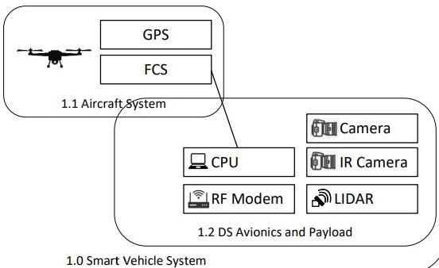
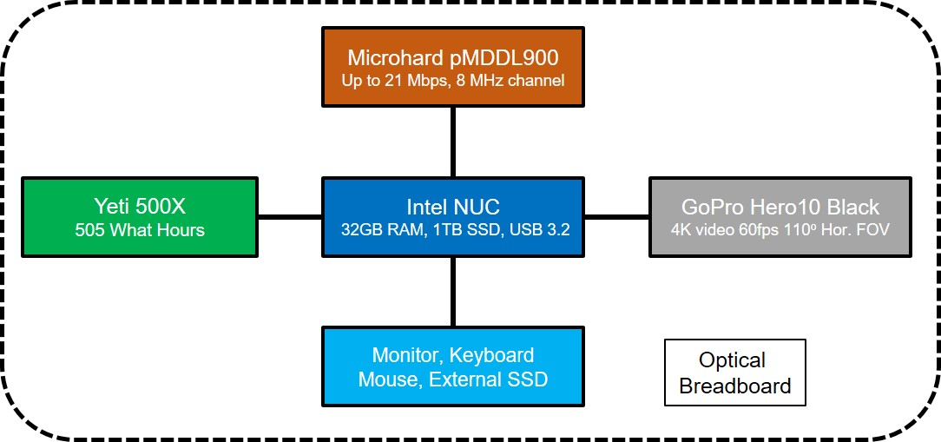
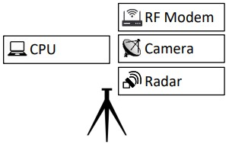
Hardware Architecture
Ground Node 1
Ground Node 2
Ground Node 3
Ground Node 4
2.0 Smart ground system

Slide 6
Hardware Selection - Air Vehicle
FREEFLY Alta X
Number of Motors: 4
Propeller Orientation: (2) CW and (2) CCW Props
Propeller Type: Folding - 840 x 230 mm (33 x 9in)
Maximum RPM 6300
Peak Battery Voltage: 50.4V
Nominal Battery Voltage: 44.4V
Motor Max Continuous Power: 17,760W
Motor Max Instantaneous Peak Power: 23,088W
Maximum Payload: 15.9kg
Typical Empty Weight: 10.4 kg
Unfolded Diameter (Including Props): 2273 mm
Autopilot Name: Custom PX4 flight control stack
Maximum Pitch/Roll Angle 45°
Maximum Yaw Rate 150° / second
Transceivers: RFD900, 1-2 Miles LOS

Slide 7
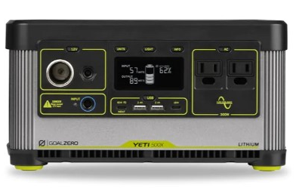
Hardware Selection - Power station
Yeti 500X portable
Charge Time (hrs) | USB-C: 8-11 hrs.; wall: 9 hrs.
External Charge | Car / USB / Wall
Battery Included | Yes
Battery Type | Lithium Ion
Battery Capacity (Wh) | 505 watt hours
Power Output to Device | USB-A: 5V up to 2.4A (12W max) / USB-C PD: 1 at 18W max, 1 at 60W max / 6mm Port:12V, up to 10A (120W max) / 12V Car Port (output), 12V up to 10A (120 max) regulated / 120V AC Inverter: 120V AC 60Hz,
Material(s) | ABS plastic/aluminum
Dimensions | 11.2 x 7.5 x 6 inches
Weight | 12 lbs. 14.4 oz.

Slide 8
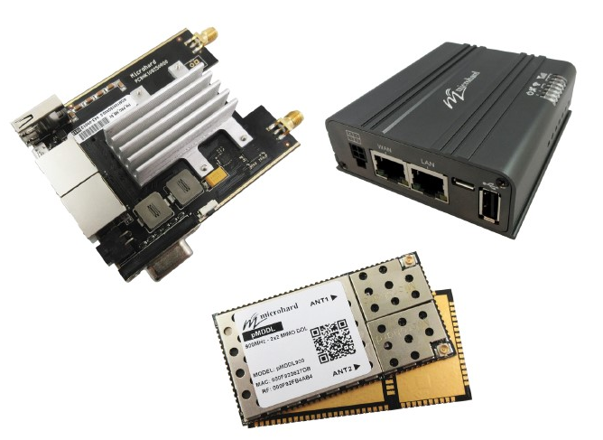
Hardware Selection - Communication
Modem
Microhard pMDDL900
2x2 MIMO OEM 900 MHz Digital Data Link
Antenas
MHS031011 - 2dBi 900MHz RUBBER DUCKY ANTENNA - RPSMA
We are using these antennas (two antennas per unit):
Features
Robust 2X2 MIMO 900 MHz Operation
Maximal Ratio Combining (MRC), Maximal Likelihood (ML) decoding
Low-Density Parity Check (LDPC)
Up to 21 Mbps Iperf Throughput @ 8 MHz channel (-78 dBm)
Up to 2 Mbps IPerf Throughput @ 4 MHz channel (-102 dBm)
Extremely small foot print and very lightweight
Serial Communication Port - RS232 TTL level (300bps to 921kbps)
Dual 10/100 Ethernet Ports (LAN/WAN)
Operating modes - Point-to-Point, Point-to-Multipoint, Relay
Adjustable total transmit power (up to 1W)
Input Voltage -Digital Voltage = 3.3V / RF Voltage = 4.2V
Interface through local console, telnet, and web browser
Weight - Approx. 230 grams
Dimensions - Approx. 3.20” x 3.50” x 1.15” (81mm x 88mm x 29mm)

Slide 9
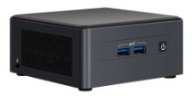
Hardware Selection - Computing Unit
Product Name | Processor | Operating System | Included Memory | Included Storage | Graphics Output
Intel® NUC 11 Performance Mini PC - NUC11PAQi70QA | Intel® Core™ i7-1165G7 Processor (12M Cache, up to 4.70 GHz) | Linux/Windows 10, 64-bit | 2x 8GB DDR4-3200 | 2TB PCIe X4 Gen4 NVMe M.2 SSD | HDMI 2.0a; USB-C (DP1.4); MiniDP 1.4

Slide 10
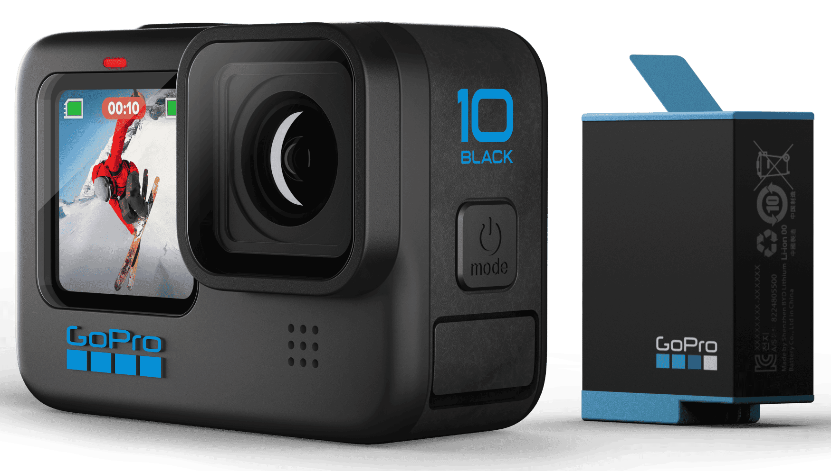
Hardware Selection - Visual Sensors
GoPro Hero10 Camera
Built-In Mounting with Folding Fingers
HyperSmooth 4.0 Video Stabilization
TimeWarp 3.0 Video
SuperPhoto + HDR
Night Lapse Video
Lenses: SuperView, Wide, Linear+Horizon Leveling, Linear, Narrow
Live Streaming in 1080p 240fps
Tools: HindSight, LiveBurst, Scheduled Capture, Duration Capture
Intuitive Touch Screen, Touch Zoom
Rugged + Waterproof to 33ft (10m)
8x Slo-Mo
Video: 5.3K 60fps, 4K 120fps, 2.7K 240fps Wide FOV
100Mbps Bit Rate
GP2 Chip
Protune
Rechargeable Battery (1720mAh Lithium-Ion)

Slide 11
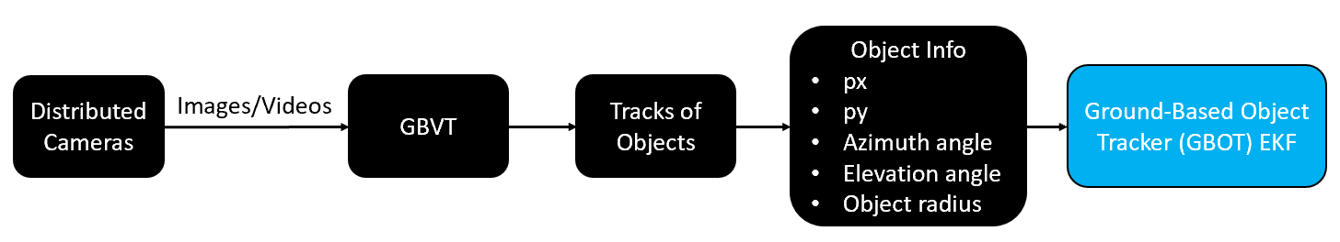
Technologies - Image Processing
Ground-based vision tracker (GBVT)
GBVT image Processing Pipeline

Slide 12
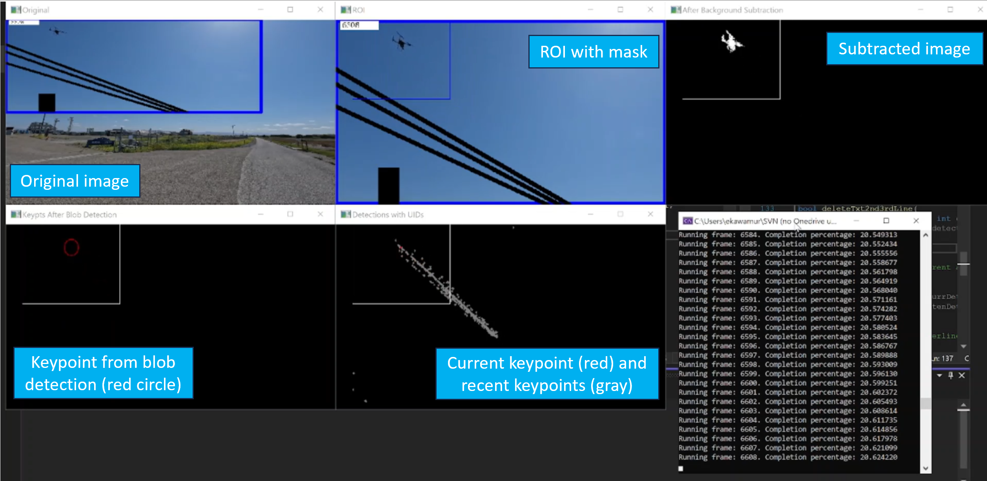
Technologies - Image Processing (Cont.)
GBVT Screenshot: Image Processing Pipeline for Ground Node 1 (6/26/23 flight test)

Slide 13
Technologies - Camera registration
Reference point
GPS coordinates
Lat, lon, alt
Camera centered ENU frame
Earth WGS84 model
Cartesian coordinates
camera reading
relative distance
Reference point
Image pixel coordinates
Camera centered right-down-forward frame
Camera rotation matrix
camera pinhole
model
3-2-1 rotation
zero roll

Slide 14
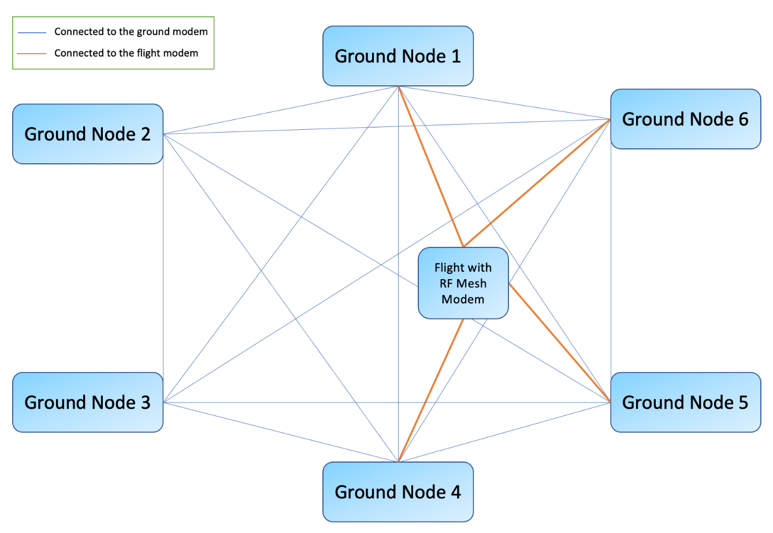
Technologies - Network Design
Mesh architecture
Provides seamless transmission
Guarantees efficiency and accuracy
Offers diverse type of connectivity
Connects also to aircraft in the area
Subset of nodes within the range
Relays flight information to all nodes
Topology can be optimized for an area

Slide 15
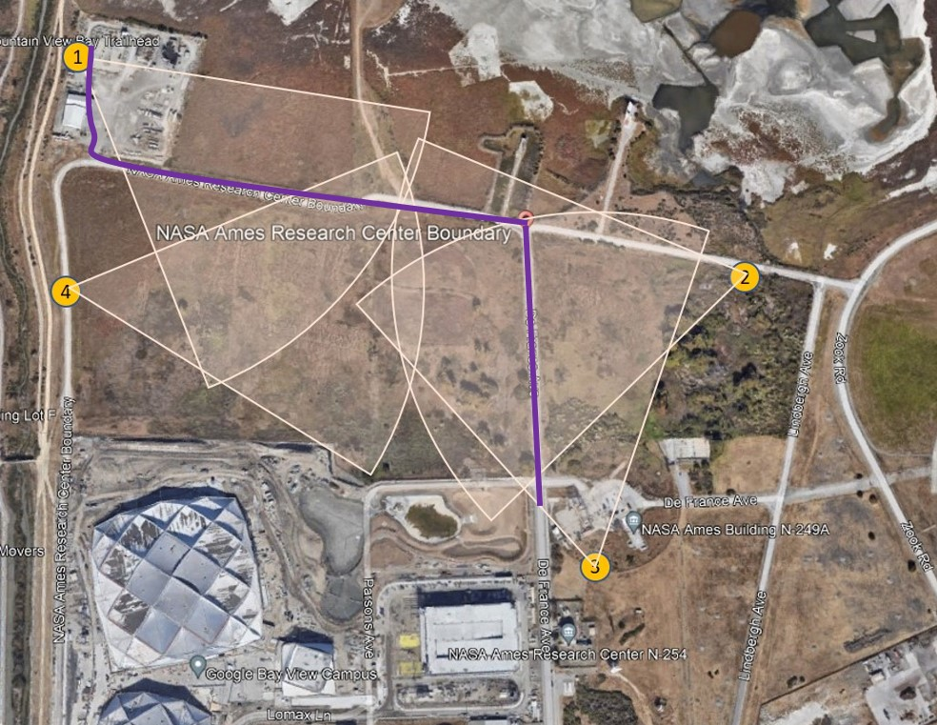
Technologies - Transmission Delays
Optimal data migration algorithm
Assumptions
Identical computing power at each Node
Identical transmit power at each node
Identical data packages
Channel interference in the mesh network
Results
Optimal location depends only on distances
  Node 1 is selected for this setup
Node 5 is a relay Node for Nodes 2 and 3
Delays are computed as
  t₂ = t₅₁ + t₂₅ , t₃ = t₅₁ + t₃₅ , t₄
t₅₁
t₄
5
t₂₅
t₃₅
Numerical results in seconds
t1 | t2 | t3 | t₄
0 | 0.0138 | 0.0138 | 0.0012

Slide 16
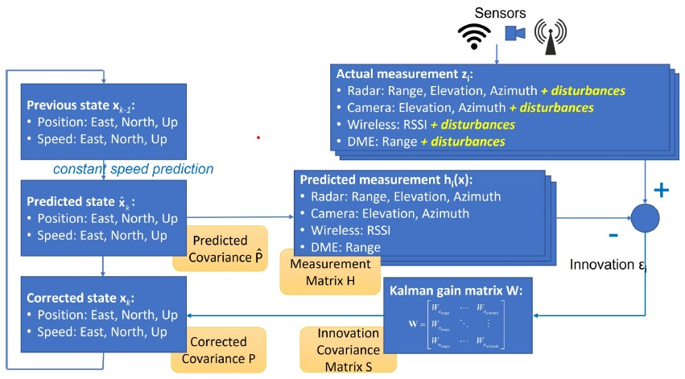
Technologies - State Estimation
Extended Kalman Filter based state estimation

Slide 17
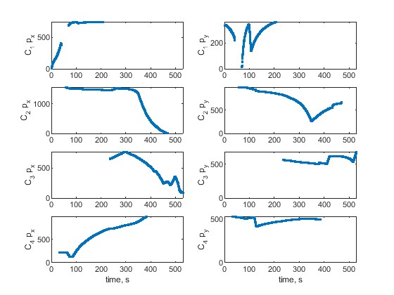
Flight Test Results
Data analysis results for one flight from Node 3 to Node 1
Image coordinates analysis
Quadcopter’s pixel coordinates from GBVT
Clock starts at Camera 1 first valid reading
Quadcopter briefly goes out of FOV in vertical direction
  It is above the Camera 1
Time interval with two or more valid readings
  [60 s , 470 s]
Observability matrix has a full rank in tis interval
Condition number is very large outside of this interval
  Large tracking errors are expected

Slide 18
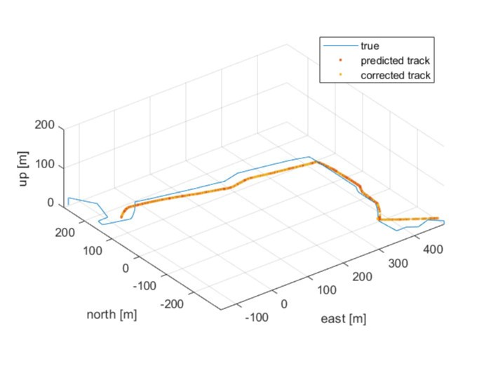
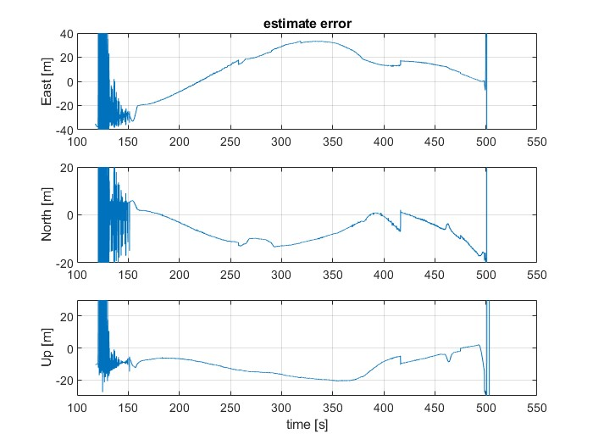
Flight Test Results (Cont.)
Comparison with ground truth
Estimated and true flight path in 3D ENU frame.
Mostly accurate in the East-North plane
Not as accurate vertically (slow drift)
Attributed to lens distortion not address here.
Acceptable errors in the time interval with two
or more overlapping camera measurement
Much larger errors outside of this interval

Slide 19
Conclusion
We have presented a flight test scenario and its implementation
Developed distributed sensing, networking and computing architecture
Goal - a single non-cooperative airborne object tracking using the real-word sensor data.
Selected hardware for each ground node
  power unit, computing unit, communication unit and sensors
Only visual sensors were used for this experiment
Integrated ground nodes in a mesh network
In-house developed technologies were validated
  image processing, optimal data migration, state estimation
Addressed hardware calibration, clock synchronization, sensor registration, communication setup
Demonstrated functionality of the presented distributed architecture using recorded data
Achieved satisfactory performance of the applied technologies
Recommendation - Adding ground nodes with optimizes topology and orientation and/or
equipping Ground Nodes with diverse sensors would significantly increases the estimation accuracy.

