Slide 1
Cohesion Through Adhesion: Enabling Space Exploration with Adhesive Bonding
D. Malik Thompson (NASA-MSFC)
12/13/2023

Slide 2


Agenda
Introduction to Marshall Space Flight Center
  Marshall Programs
Why Design With Adhesives?
Adhesive Downselection and Qualification for Flight
Development Timeframes
Process Controls for Best Practices
Environments: Meeting the Demands
Artemis Thermal Protection System
Reflective Control Device
Mars Ascent Vehicle
Case Study: Imaging X-ray Polarimetry Explorer
Materials Obsolescence
NASA Engagement
Lessons Learned
Future Challenges

Slide 3
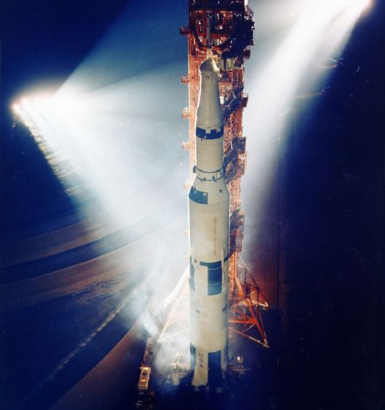
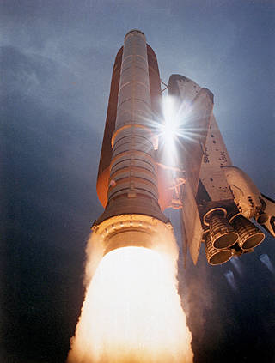
NASA- Marshall Spaceflight Center
Founded in 1960, was instrumental to the Apollo program with the production and test of the Saturn V rocket
  Critical to External Tank Project in the Shuttle Program
Key to development and manufacturing of the Space Launch system for Artemis Program
  Managing Core Stage and Solid Rocket Boosters
Specializes in propulsion, but leads numerous science and technology missions
  Space Telescopes, Solar Sail Spacecrafts, International Space Station
Cultivating numerous partnerships with universities and commercial industry
Leading Center for the Human Lander System Program

Slide 4
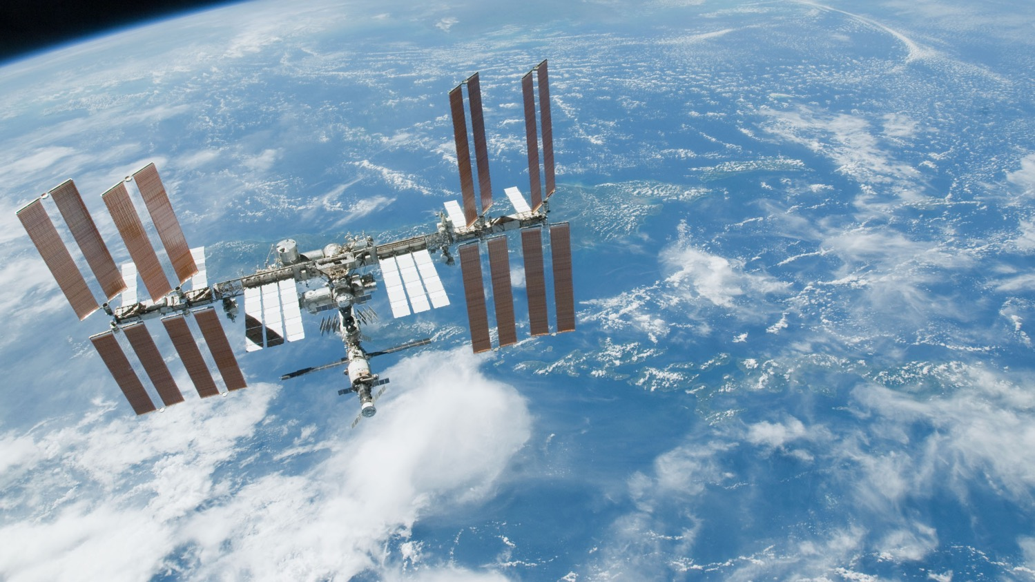
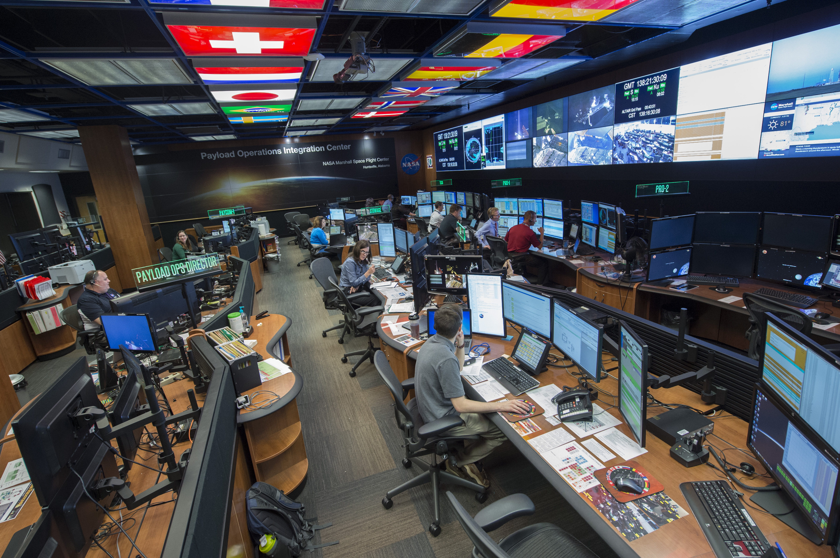

ISS: Living and Working in Space
Notes:
Marshall manages science operations around the clock on the International Space Station (ISS) from the Payload Operations Integration Center (pictured top right).
For more than 21 continuous years, we have supported science conducted on the station.
ISS serves as the world’s leading laboratory where researchers conduct cutting edge research and technology development that will enable human and robotic exploration of destinations beyond low-Earth orbit.
Marshall’s development of life support and research systems on ISS will benefit future human explorers who launch into deep space.
Marshall contributes vital elements of the Space Station’s regenerative Environmental Control and Life Support System (ECLSS), which provides water and oxygen for the crew, recycling wastewater into usable water and reducing supply costs.
Marshall’s scientific hardware on ISS, including 11 science payload EXPRESS racks and two research gloveboxes provide a foundation for how science can be conducted on and around the Moon.
Marshall manages research into 3-D printing on ISS that will provide valuable information on how Additive Manufacturing technology works in space.
Marshall is partnering with industry and academia to mature concepts for habitats that will allow astronauts to live long-term on the lunar surface and ultimately to travel to Mars.
Through the NextSTEP effort, Marshall is working with commercial partners to mature technologies and concepts for a lunar Surface Habitat and Mars Transit Habitat.
Concepts developed through this program are also informing the Gateway lunar orbit facility and commercial LEO destinations.

Slide 5
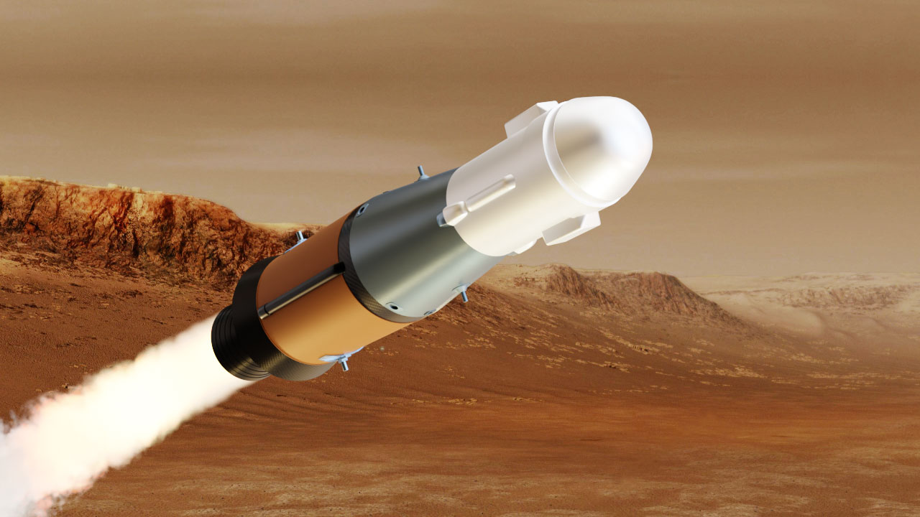
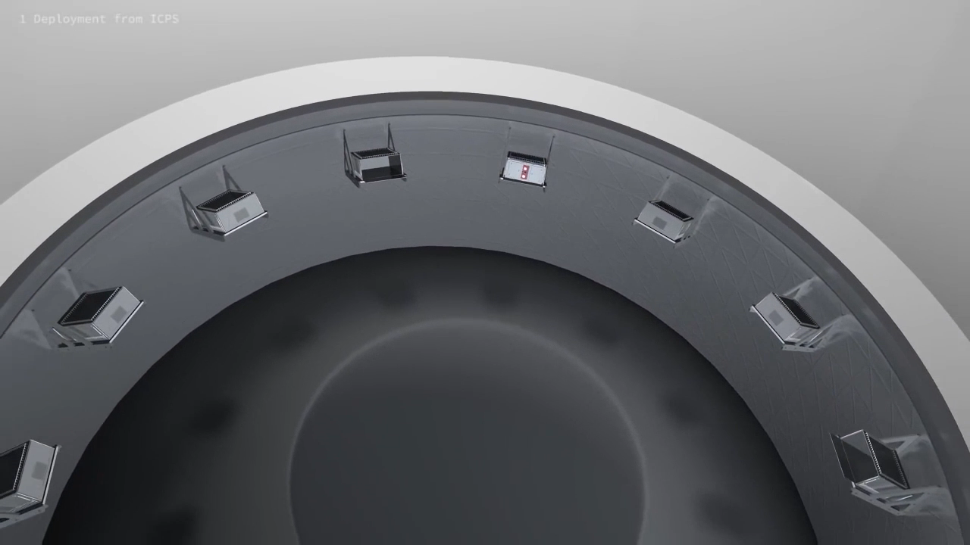
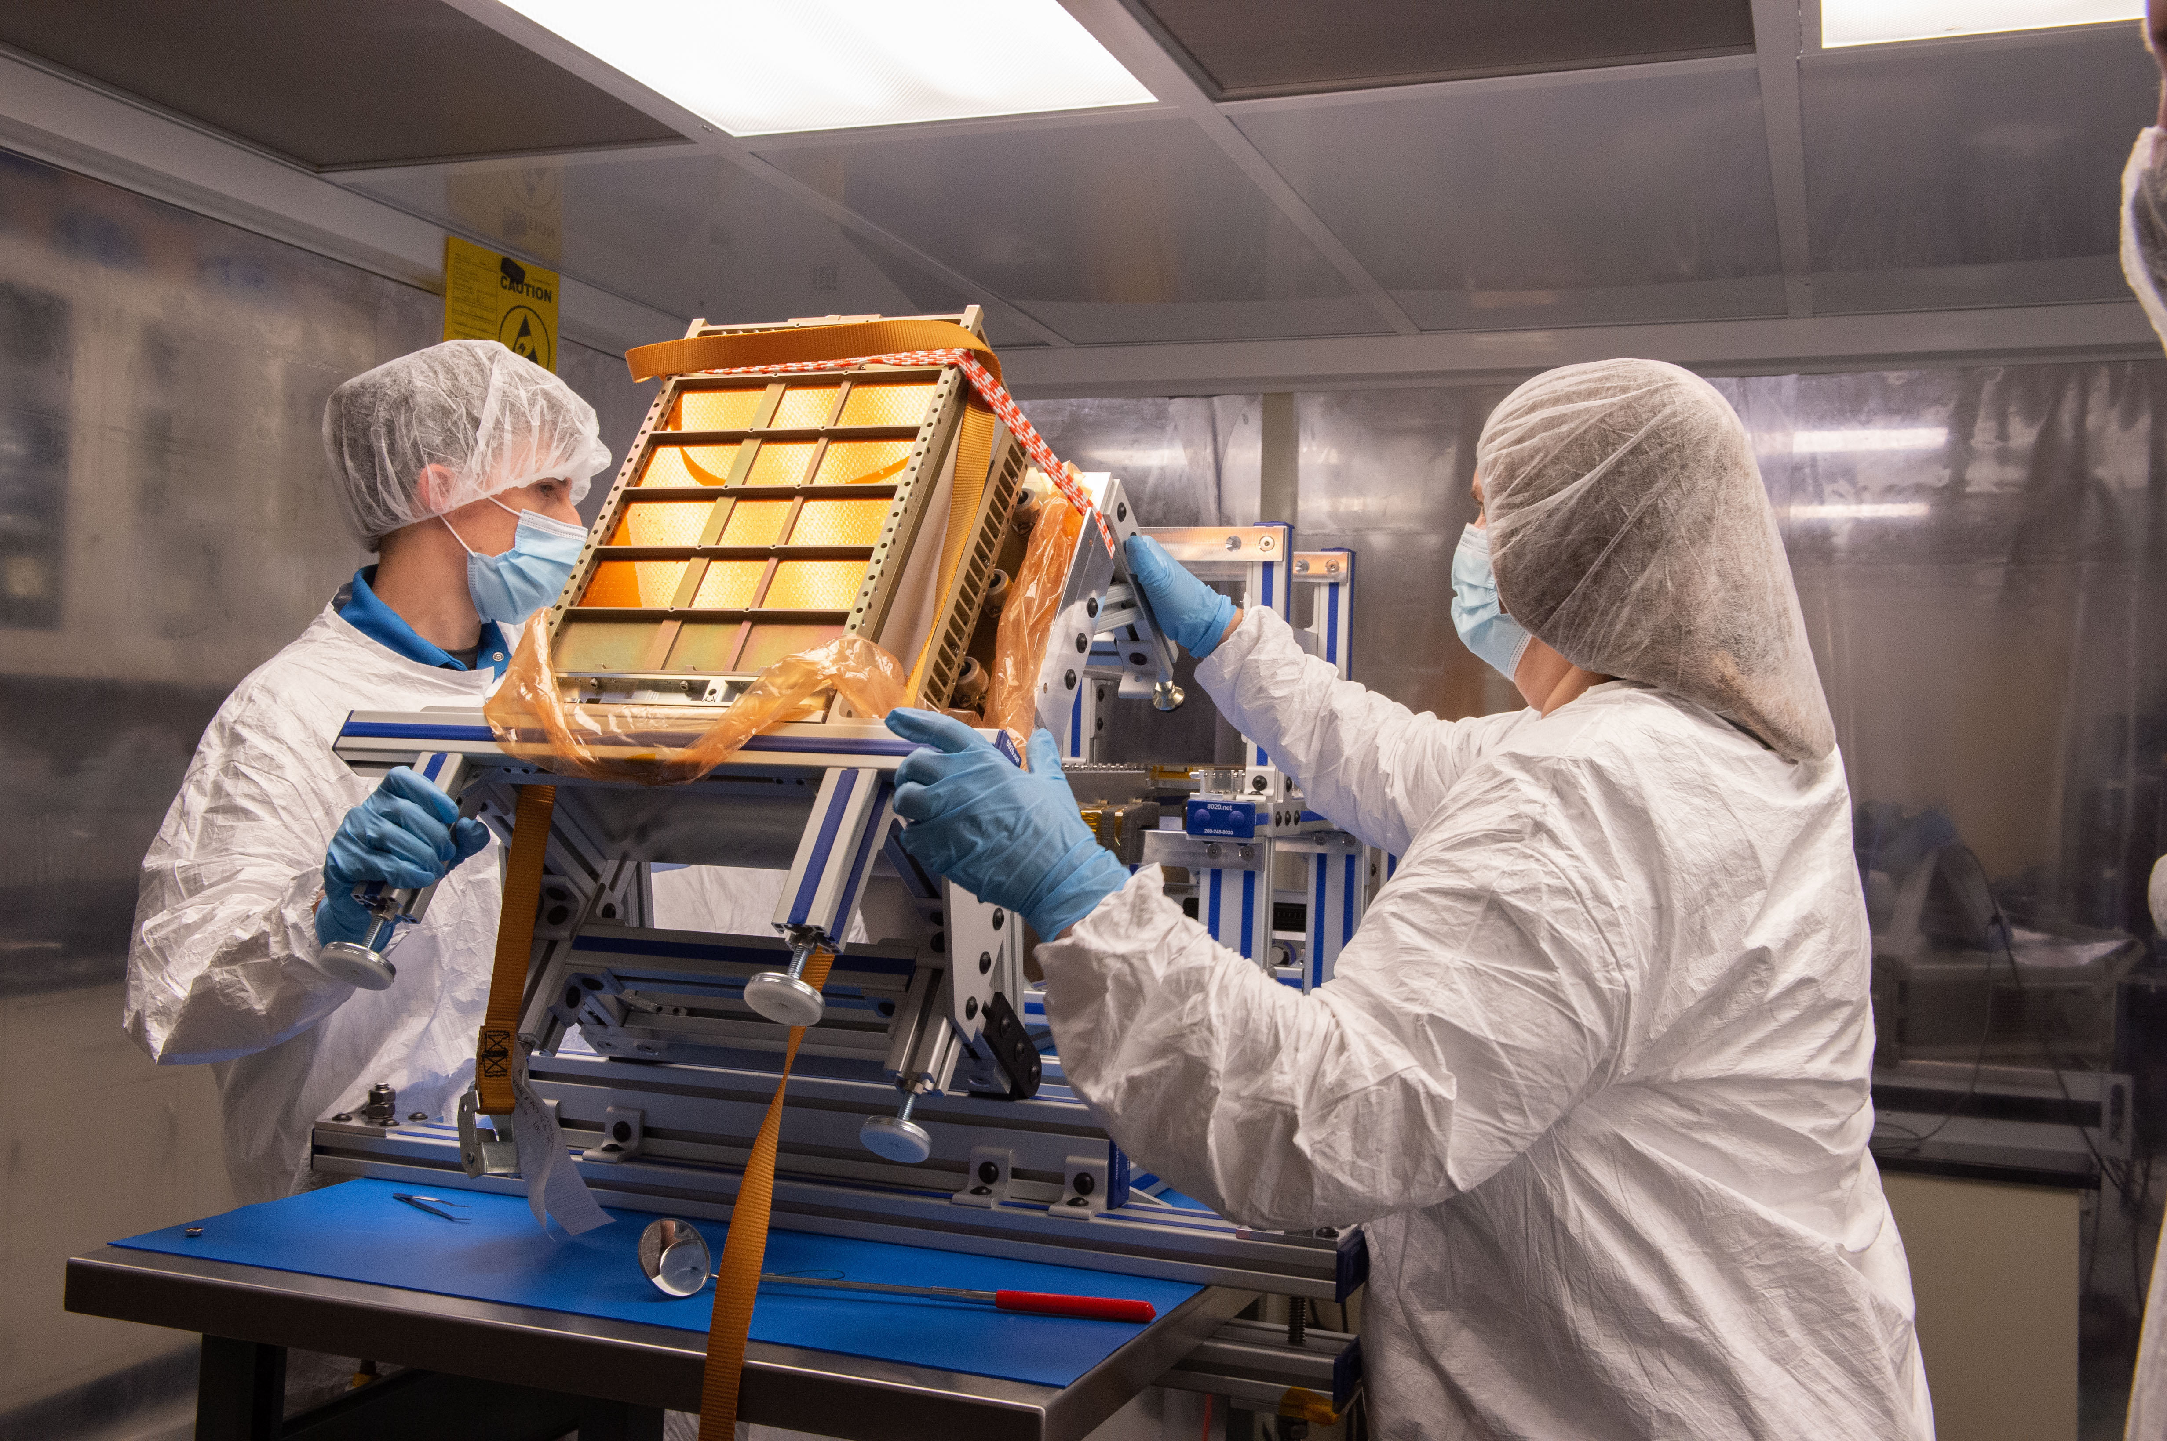
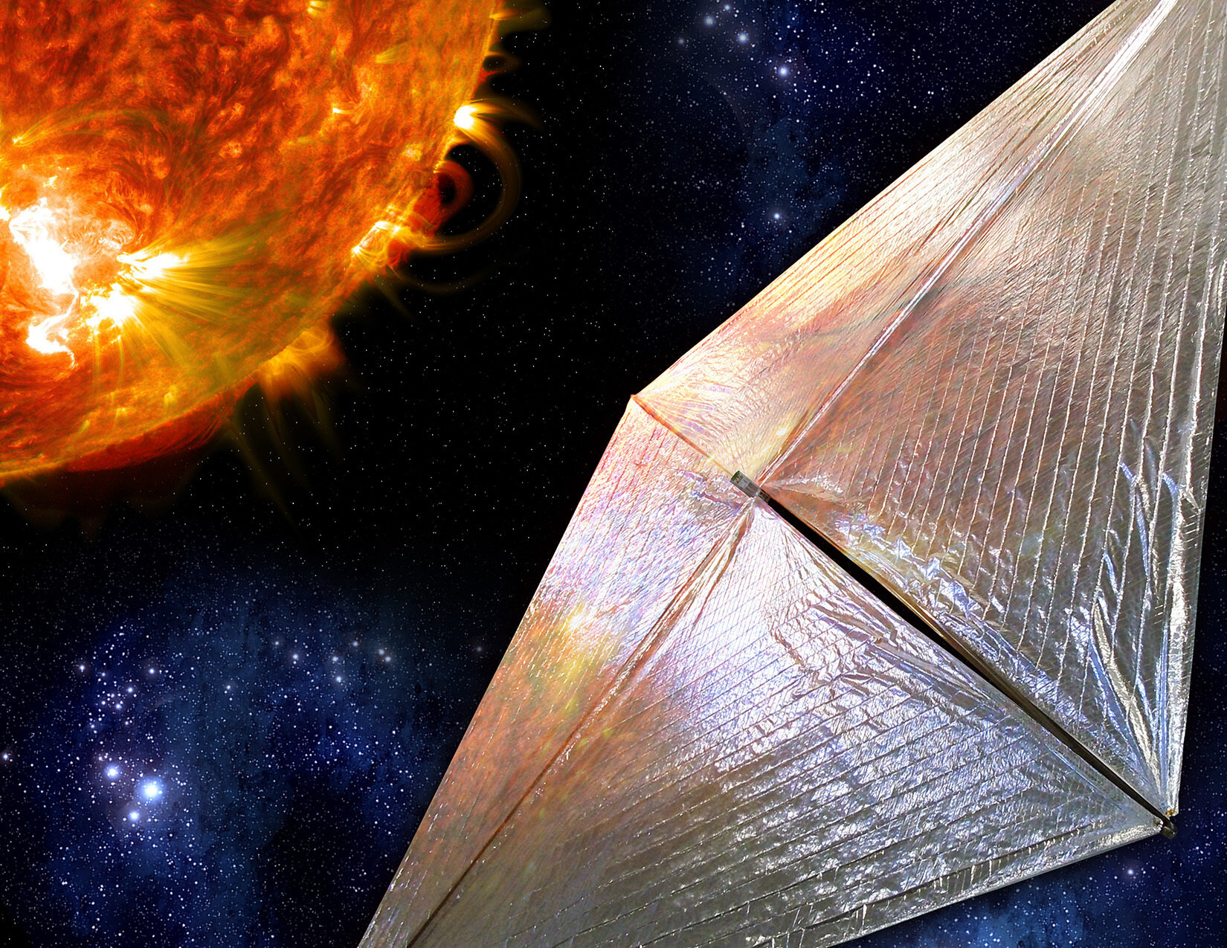
Mars Ascent Vehicle
Imaging X-ray
Polarimetry Explorer (IXPE)
Solar Cruiser
Mars Ascent Vehicle
Near-Earth Asteroid Scout
Solar Cruiser
Developing Technology for Exploration
Notes:
NEA Scout (pictured bottom left) is a secondary payload flying on SLS for the Artemis I mission and is an example of where our exploration meets science.
Here is a video of how NEA Scout will deploy from the SLS’s Orion Stage Adapter and deploy its solar sail.
It will deploy a sail thinner than a human hair and about the size of a racquetball court to generate thrust, by reflecting sunlight.
The mission will fly by and return data from an asteroid that may one day be a human destination.
That technology will be further demonstrated on the Solar Cruiser mission (bottom right).
Solar Cruiser will demonstrate the largest flown solar sail – it measures 18,000 square feet, or 1/3 of a football field.
This new technology will enable new destinations, by “Sailing on Sunlight” , enabling future spacecraft to collect observations from novel vantage points that are difficult to reach and sustain.
We are also developing the Mars Ascent Vehicle that will launch samples off the surface for the Mars sample return mission.
The MAV (illustration on bottom right) will be the first missile fired from another planet.
MAV is an example of a link between science and Marshall’s history of propulsion expertise.

Slide 6
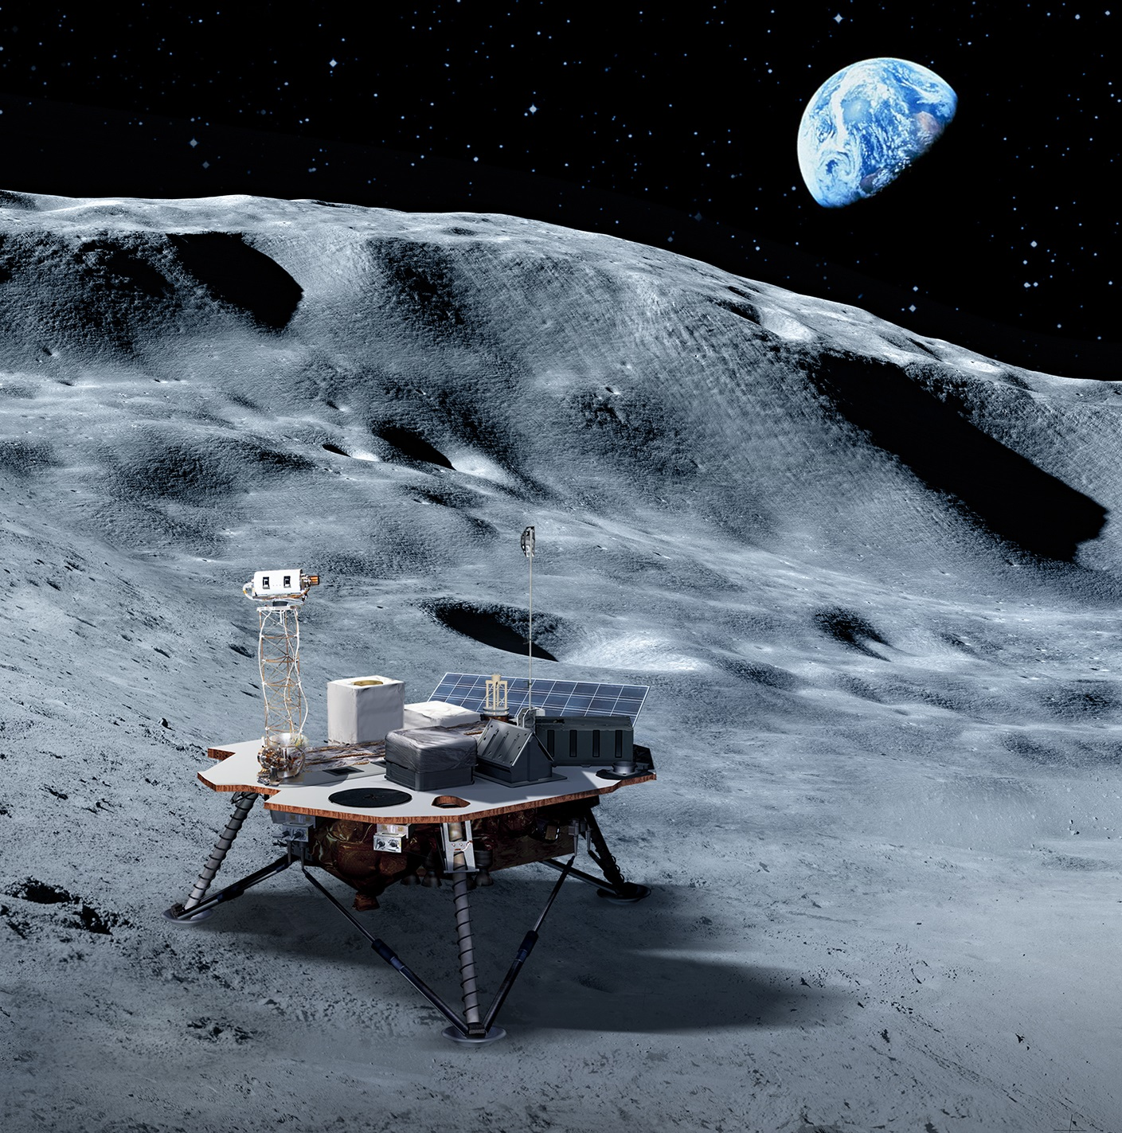
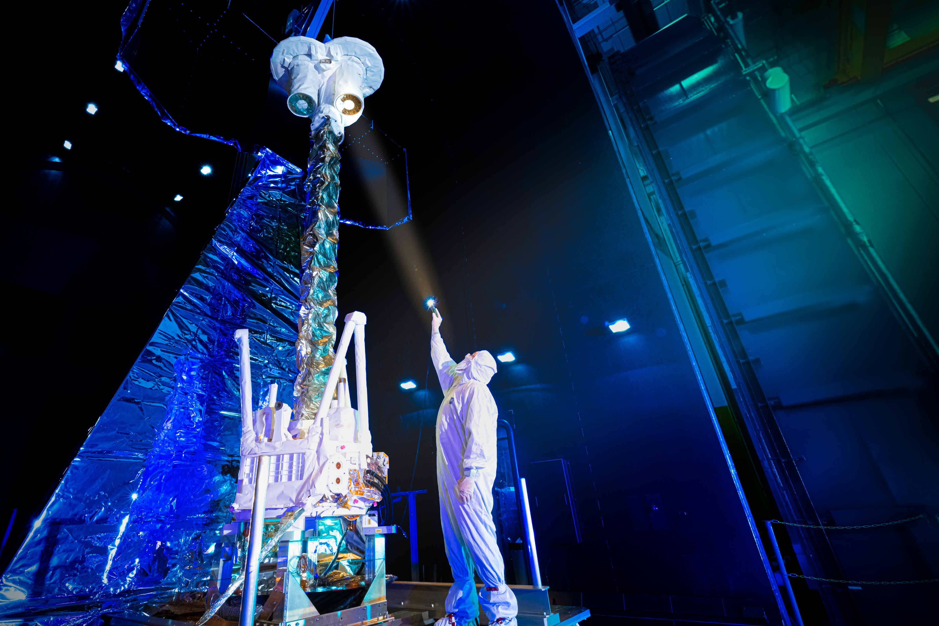
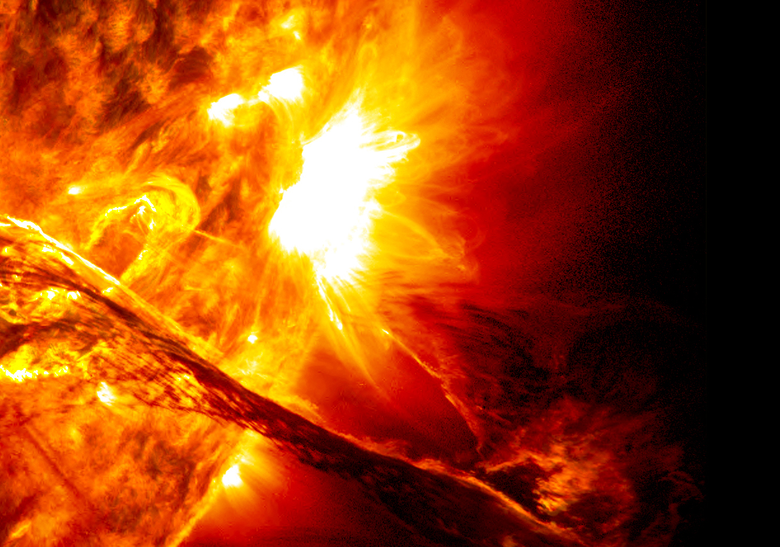

Understanding Our World and Beyond
Notes:
Science remains a reason why we explore, and Marshall’s scientists have a footprint in Marshall’s exploration efforts.
Marshall has a true specialty in x-ray astrophysics, meaning we have state-of-the-art processes for developing instruments that can show us the farthest reaches of outer space.
We’ve developed and managed great space telescopes, like Hubble and Chandra
Marshall’s IXPE (TOP RIGHT) launched in December and will help unlock secrets about super massive black holes and other phenomenon across the universe.
Meanwhile, for 20 years and counting, Chandra has changed the way we think about the universe and how we see it.
Marshall scientists are also working missions to enable our sustainable human and robotic exploration of the Moon.
We will have payloads that will fly on Commercial Lunar Payload Service (CLPS) landers to the moon’s surface. (ILLUSTRATION LEFT)
And we are also learning how to use the lunar regolith to manufacture construction material for infrastructure, such as landing pads, roads, and shelters, with projects like MMPACT.
In addition, our highly talented heliophysicists work to better understand the
Sun’s effects on Earth and the rest of the solar system. [BOTTOM RIGHT]

Slide 7
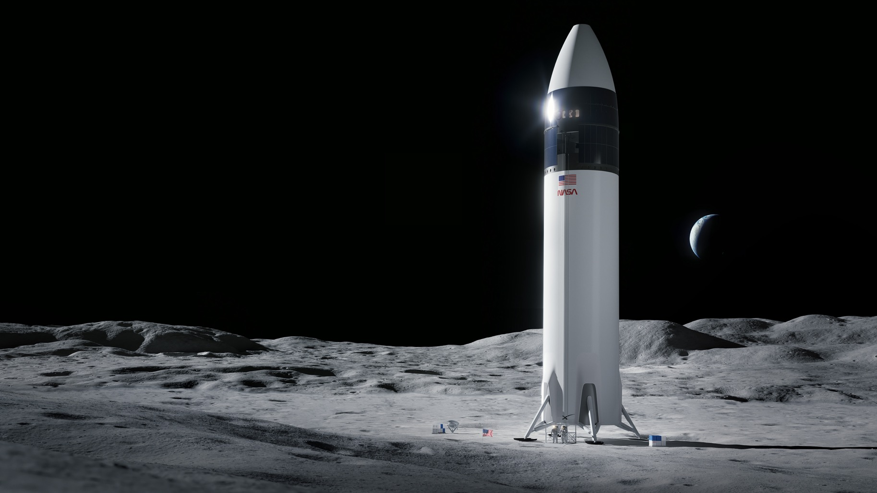
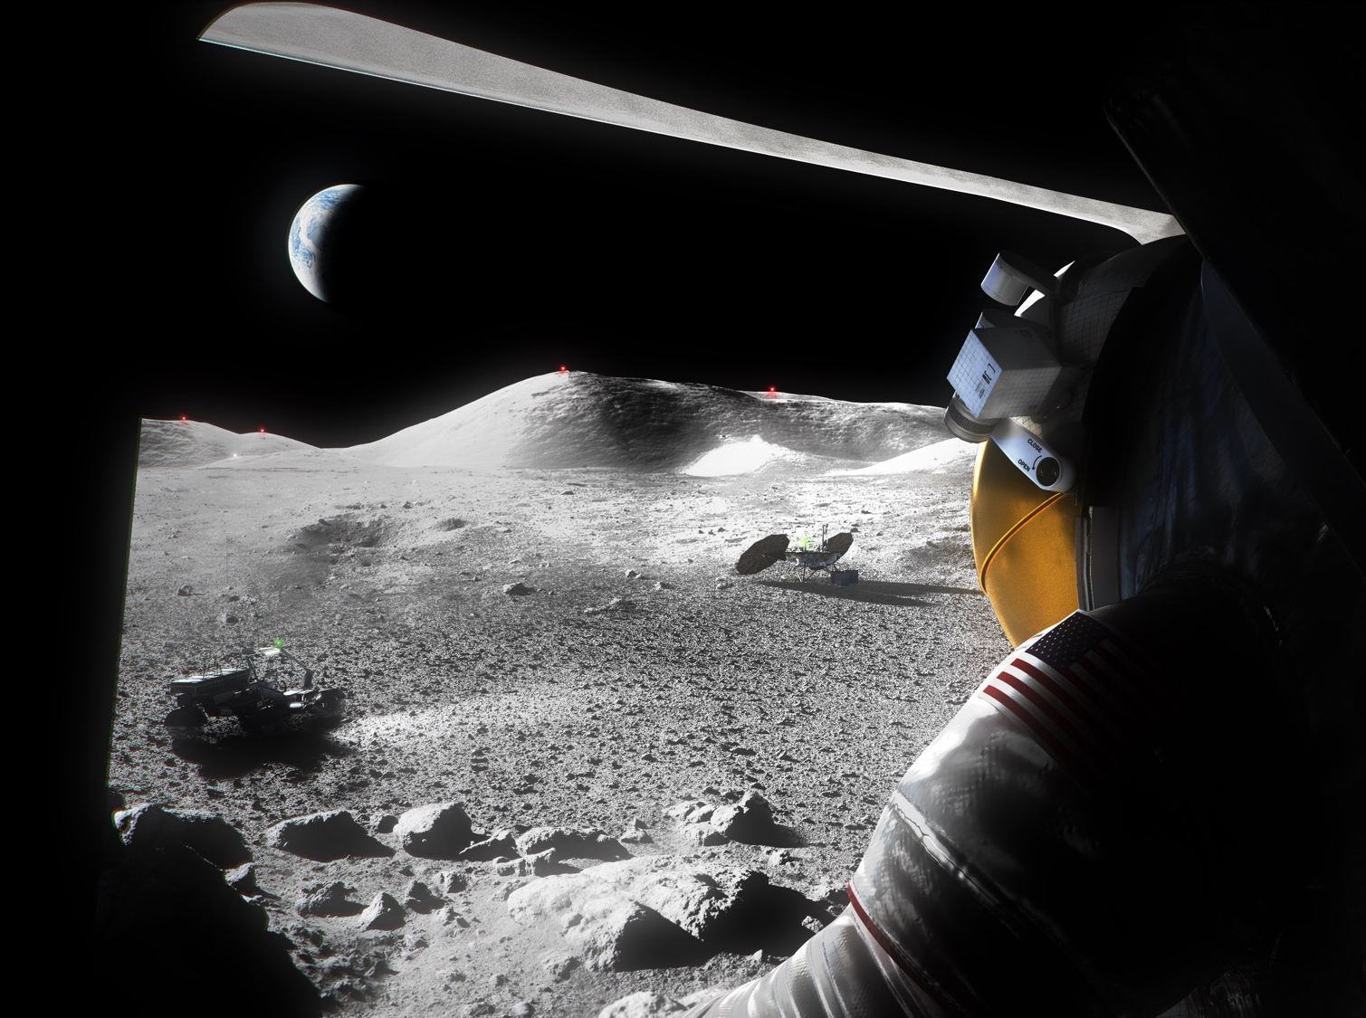
SpaceX HLS Starship
for Artemis III
Human Landing System
Notes:
Our center is at the forefront of shaping the future of deep space architecture through future Artemis missions with SLS and the Human Landing System Program.
When the next NASA astronauts land on the Moon, they will do so in industry-led human landing systems managed here at Marshall.
In addition to the Artemis III landing awarded to SpaceX’s HLS Starship (render on screen), NASA is funding the development of a second industry-led lander that, together with SpaceX, will support NASA’s plans for purchasing recurring, sustainable lunar landing services under Artemis.
This is just one more way we are essential for Artemis and America’s return to the Moon… landing the first woman and first person of color on the lunar surface later this decade.

Slide 8
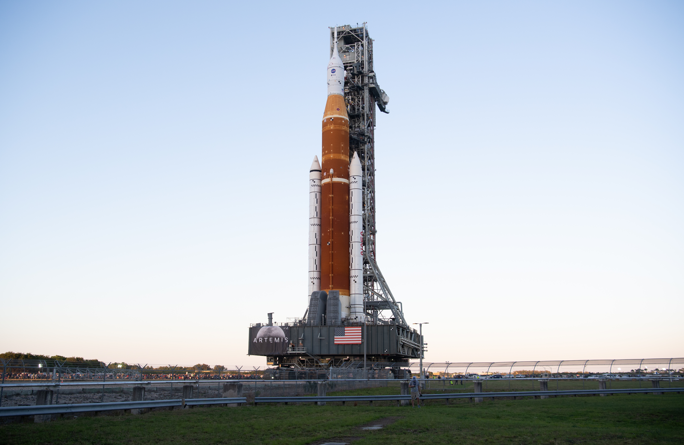
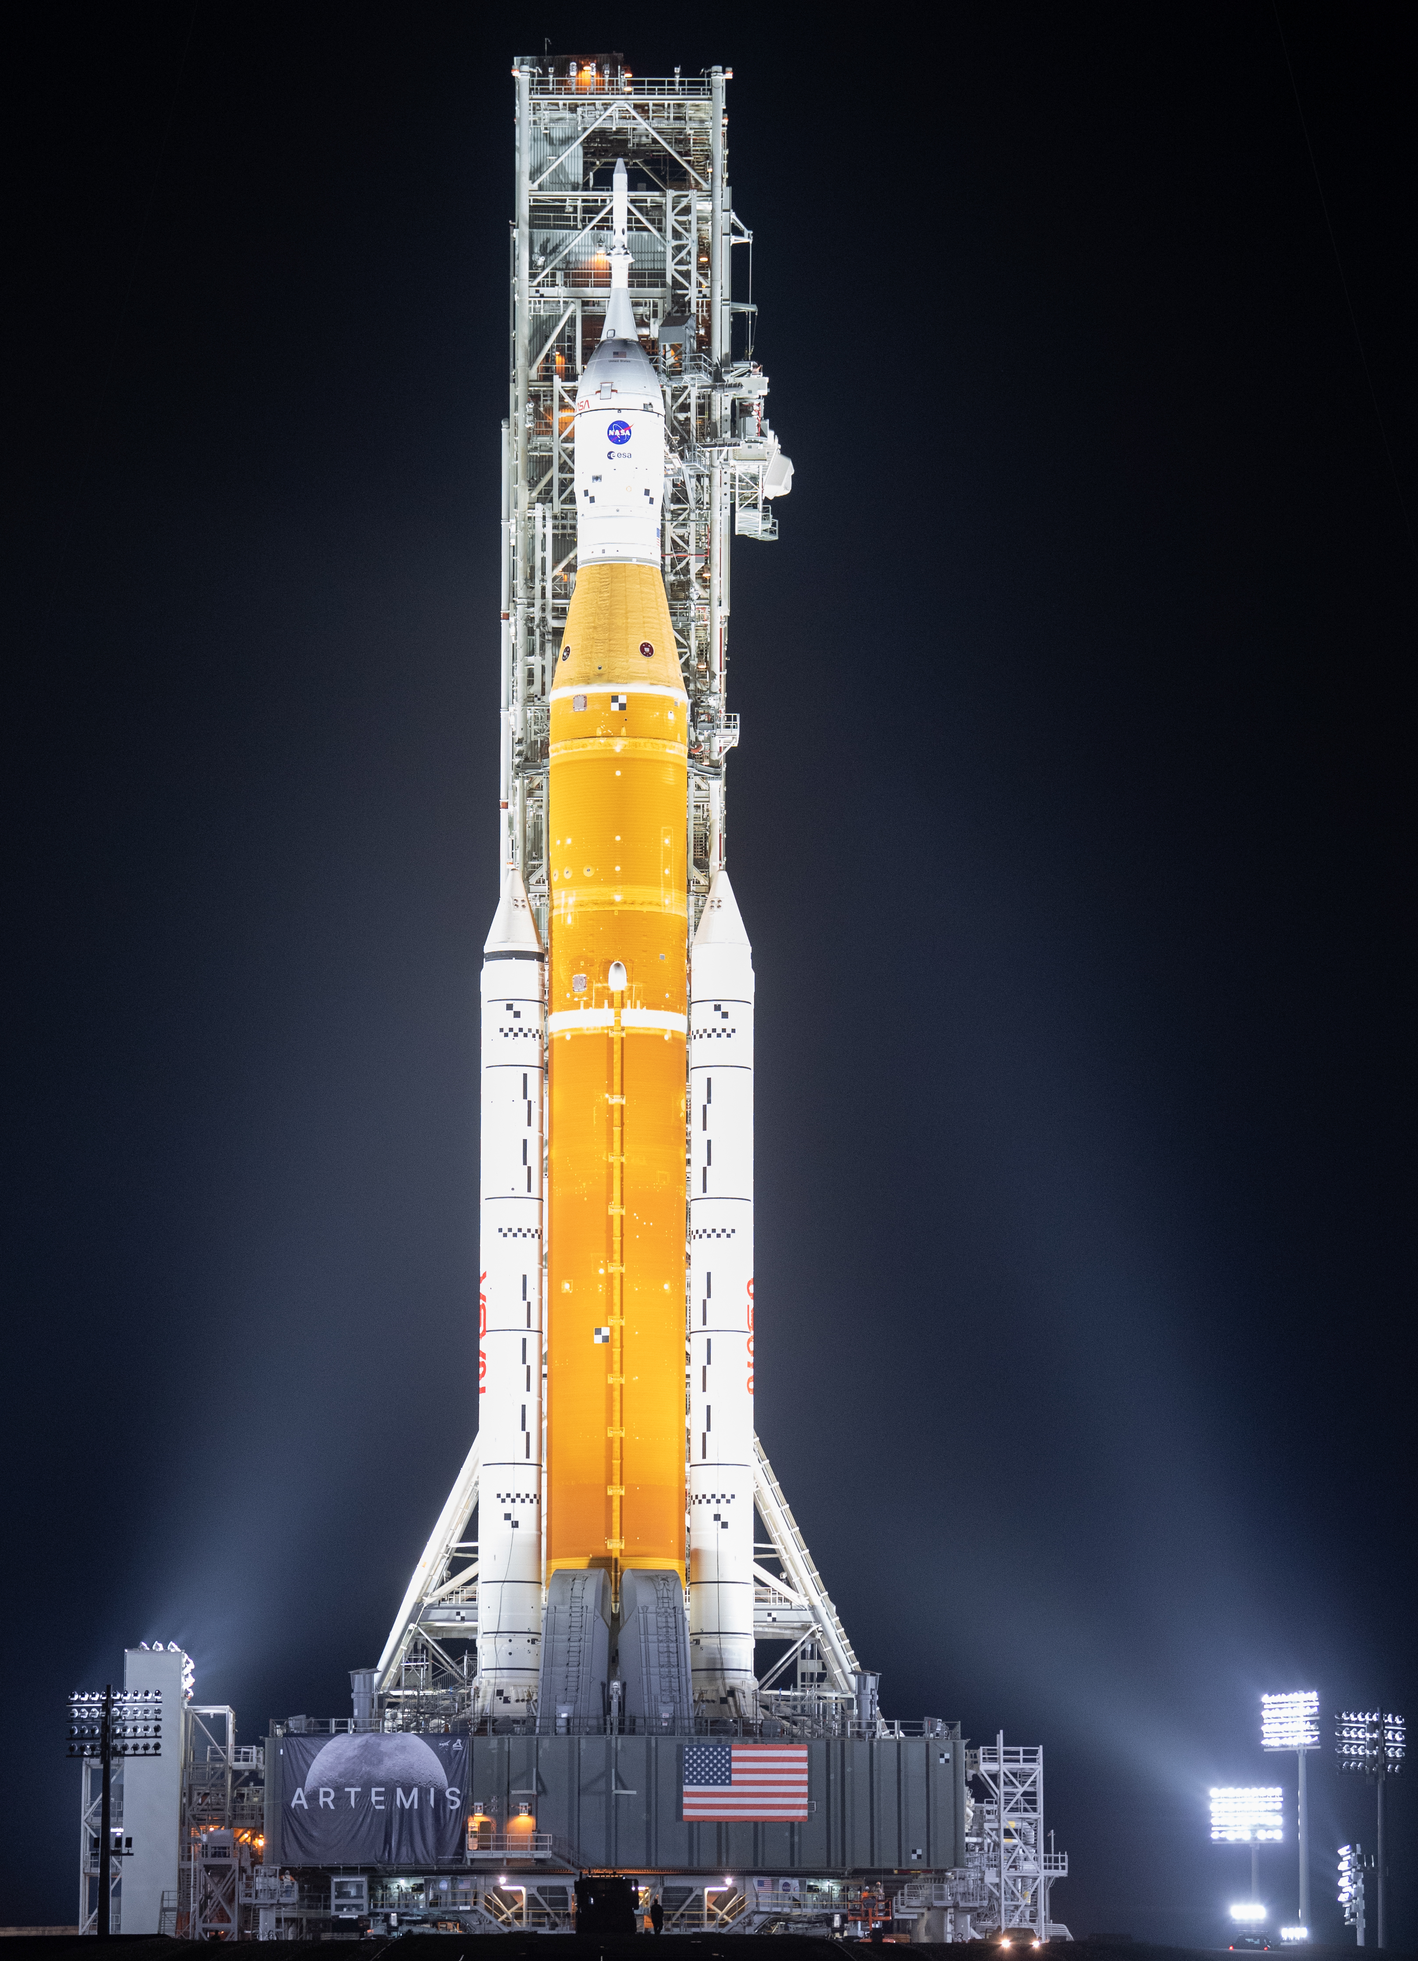
Space Launch System and Artemis
Notes:
NASA Marshall is building the most powerful rocket ever built, the Space Launch System, which is the only exploration-class vehicle capable of sending humans to deep space and the large systems necessary to live and work in deep space.
SLS has the power and capacity to lift large and complex payloads, reducing the number of launches needed to put hardware into space.
The powerhouse of SLS, called the core stage, is the largest and most complex NASA ever has built.
It’s comprised of two liquid propellant tanks and four RS-25 engines, and will produce more than two million pounds of thrust to send NASA’s Orion spacecraft, crew and cargo to the Moon.
Rocket is on the pad at Launch Pad 39B for rollout ahead of Wet Dress Rehearsal – a pivotal final test before launch.
Right now, NASA is targeting May or June for the first launch of Artemis I.

Slide 9
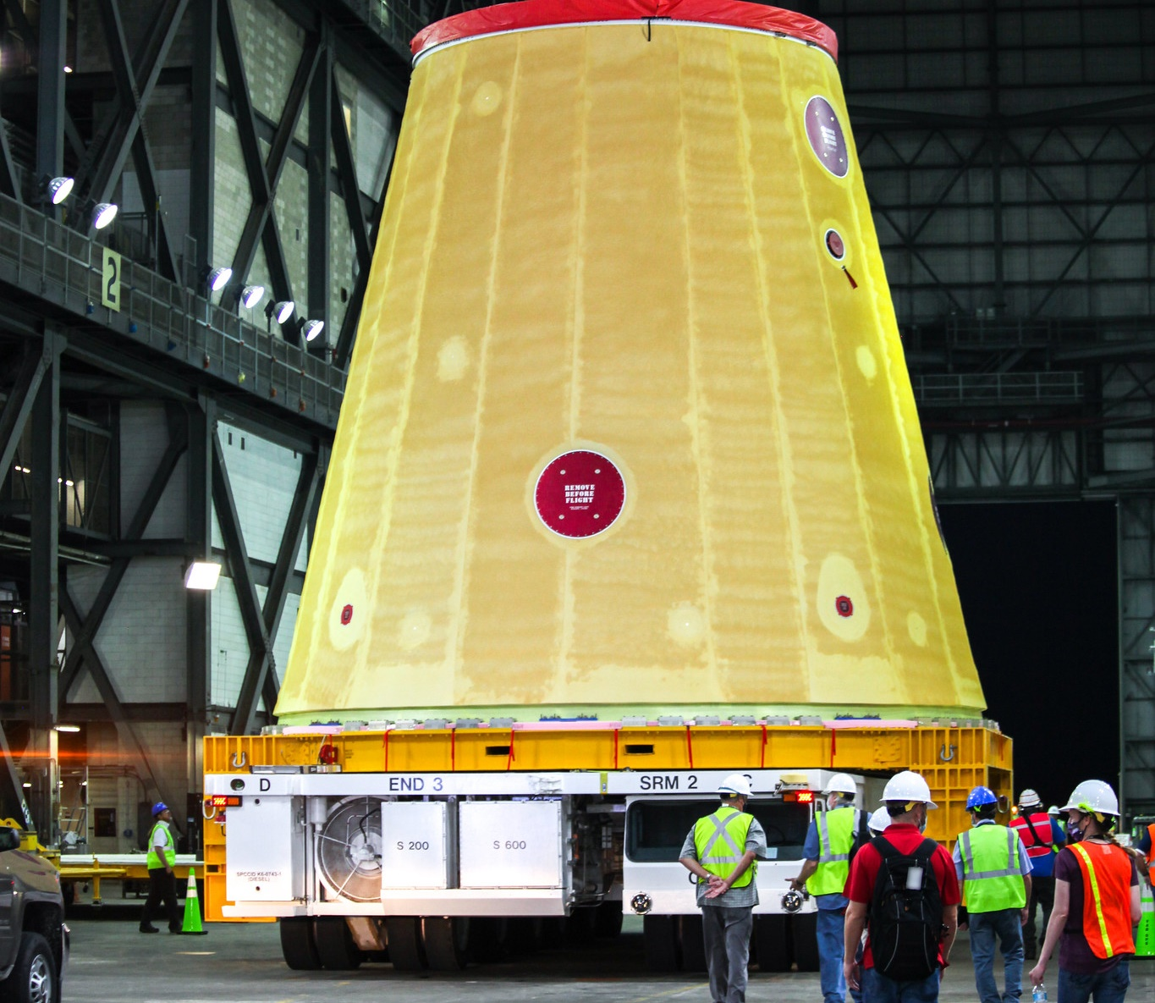
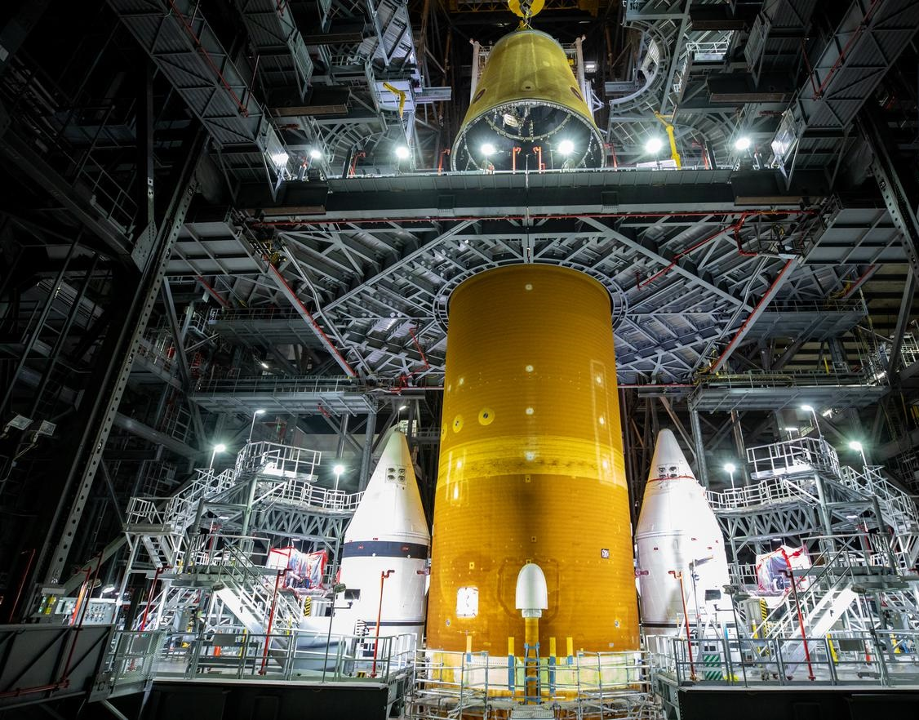
Launch vehicle stage adapter integrated with core Stagetage
Notes:
The Launch Vehicle Stage Adapter partially houses the exposed section of the Interim Cryogenic Propulsion Stage.
L-R: The Artemis I LVSA rolls into the KSC VAB. The LVSA lift and mate to the core stage in June 2021
Status:
Adapters connect different sections of the rocket.
The LVSA forward and aft cone welding is in work. The Artemis III LVSA forward cone is in early manufacturing.
Fast Facts:
LVSA:
The LVSA connects the core and upper stages.
It is 27.5’ long and 27.5’ wide at base, tapers to 5 m at top.
It’s made of friction-stir welded lightweight aluminum alloy.
The LVSA was manufactured by Teledyne Brown at MSFC.

Slide 10
Why Design with Adhesives?
Numerous trades are considered with each design
  Different schools of thought: Designing for Manufacturability, Designing for testing, Designing for functionality
  Concept of operations often try to cover as many as possible
Pros and cons are often weighted differently depending on Program needs or requirements
Pros
No stress concentrations on bonded parts
Overall mass savings
Can be applied to multitude of substrates
Useful for complex geometries
Ideal for joining different material types
Cons
Material Obsolescence
Environmental sensitivity during application
Application variability due to human factors
Susceptible to CTE mismatches
Cure times extend labor hours

Slide 11
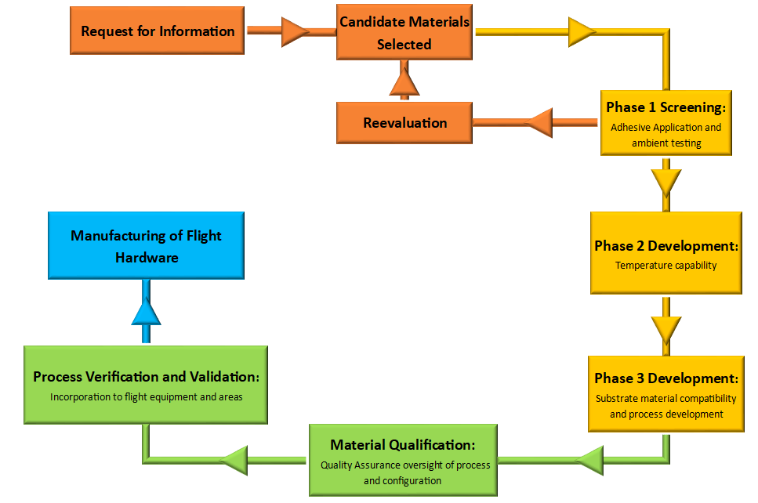
Adhesive Downselection and Qualification for Flight
Information solicited from vendors for potential candidate materials based on design functional requirements
Candidate materials selected based on project defined manufacturing and functional needs
Materials are screened for workability and confirmation of strength capabilities detailed in Technical Data Sheets
  Typically completed on aluminum substrates at ambient conditions
  If strength values cannot be effectively demonstrated, new candidates are selected
Tests are then performed at temperatures outlined in project functional requirements
Strength capabilities determined on applicable substrates
  First opportunity for process development
Material Qualification features extensive chemical, physical, and mechanical testing under Quality Oversight
  Lot-to-lot variability
  Age life testing
V&V to determine geometry specific configuration capability at full scale leading into flight production

Slide 12
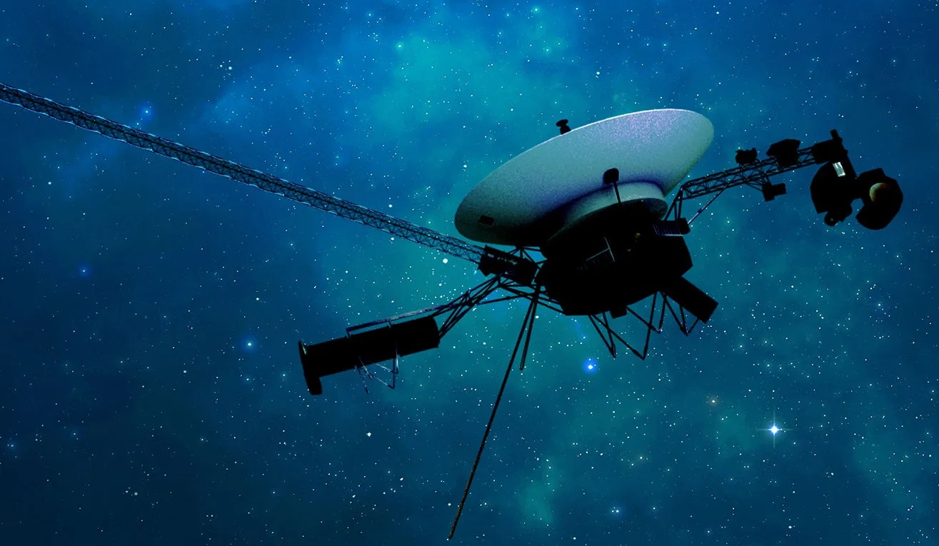
Program Development Timeframe
Timeframe for programs and projects depends primarily on the complexity and budget of the mission.
  Heavily dependent on the ratio between maturing vs matured technologies included in the design
  Longer durations for manned spaceflight missions
  Dependent on class of mission
After design reviews are completed and approved technology levels are locked in for most part throughout remainder of program
  Various Research and Development programs may count as exceptions
  Voyager Program’s tech freeze occurred in roughly 1972 for launches in 1977
Design matures through qualification testing of materials and process
  Some design changes take place to increase functionality
Voyager I Space Probe

Slide 13
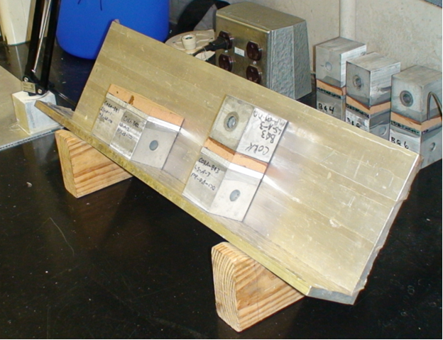
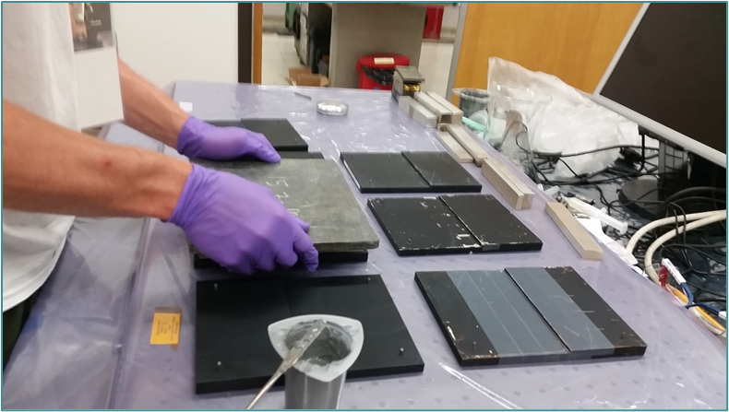
Process Controls for Best Practices
Regular Receiving and Acceptance for Production Tests are completed for all flight-use materials
Process Specifications are written and maintained throughout program life
  Applicability focused on each individual program or project, but often used a heritage references for future programs
  Governed by Center-based documents (MSFC-SPEC-445 and NASA Standard 6016)
Technician training and qualification records are kept for flight-based production
  Ex. Technicians must complete requalification activities completed after 6 months if related operations haven’t been performed
Requiring witness sampling for Quality Sensitive bonding operations such as flight hardware
  i.e. Harness cups, single lap shears, tension specimens
Lot-to-lot variability and material age life requirements often imposed by programs
Cork ablator bond tensions
Adhesive lap shear bonding

Slide 14
Environments: Meeting the Demands
NASA Programs have sent spacecraft and landers to every part of the solar system where they are exposed to some of the most extreme environments ever observed.
Ionizing Deep Space Radiation
Sustained High Temperatures
Aerodynamic Heating
>+1200°F
Solar Particle Events
Lunar Regolith and Martian Sand Impingement
Cryogenic Temperatures
Ultra-Violet Radiation Exposure
LH2 (-423°F)
LOx (-320°F)
Industry Application | Temperature Range
Military | -60- +260°F
General Automotive | -40- +260°F
Industrial | -20- +185°F
Commercial Aviation | -65- +120°F
NASA mission exposure time can vary from spikes of a few seconds to years
Instances of combined exposures are commonplace

Slide 15
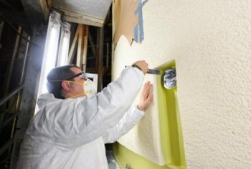
Artemis Thermal Protection System
Composed of two-part polyurethane foam used as cryogenic insulation for core stage of the Space Launch System in the Artemis Program.
  Foam sprayed onto substrates
Adjacent sections of foam are coated with a Tiecoat adhesive before they are sprayed
Tiecoat is composed of a urethane adhesive with an acetone additive
  Applied to hardware via brushing operations
  The only flight qualified adhesive for the Space Launch system
  Features high elongation to combat coefficient of thermal expansion of the foam
Material receives extensive Receiving and Acceptance testing for Flight Hardware applications
  Chemical, mechanical, and physical tests
Short pot life and short cure time has led to numerous nonconformances and excessive hardware processing times
Artemis I Forward Skirt foam trimming

Slide 16
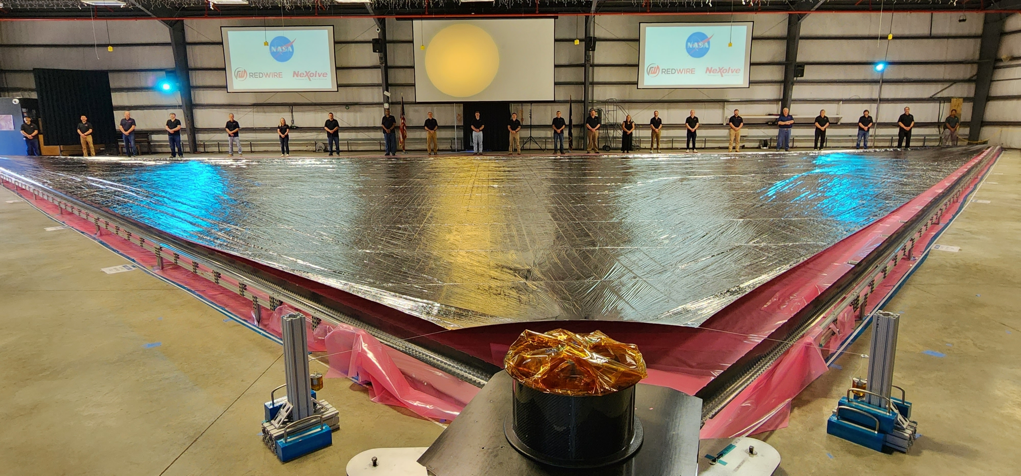
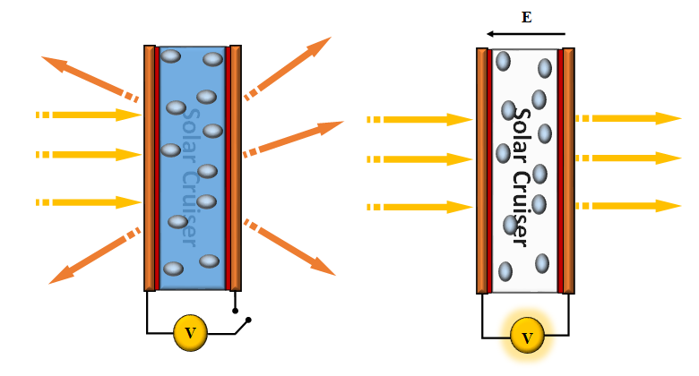
Reflective Control Devices
Technology originally demonstrated in a partnership with the University of Maryland in the early 2000s for propellant-less attitude control
  Intended use case was solar sail spacecraft
  Traditional attitude control has been achieved with small thrusters
Sought for use in the Solar Cruiser Program and future Solar sailing missions
Composed of liquid crystals dispersed in a polymeric matrix
  Usually an UV-cure optical adhesive for a binding agent between polymeric materials coated with a conductive coating
Liquid crystals in polymer matrix change directions based on current flow
  Causes opacity change and ultimately optical reflectance change
Solar Cruiser Sail Quadrant
RCD Schematic

Slide 17
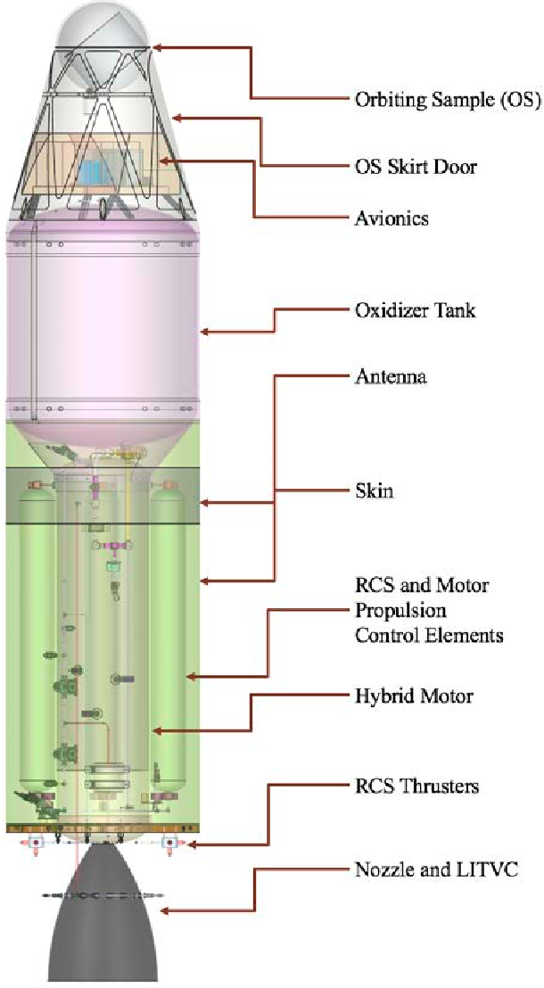
Mars Ascent Vehicle
Lightweight rocket (1000lbs on Earth) designed to carry Martian soil samples to orbit after a long duration stay on the Martian surface
  One leg of the Mars Sample Return Mission
Numerous concepts considered for propulsion system to survive flight to Mars and up to 2 years of sustained Mars surface presence.
Early iterations of concept development considered hybrid propulsion system
  Paraffin wax based solid fuel propellant
Wax material possessed high coefficient of thermal expansion
  Pulled from casing liner during cool down
A test matrix composed of 8 candidate adhesives was developed to vet their effectiveness as wax hybrid motor adhesives
  Testing included circular flat-wise tension samples and bonded thermal constraint samples
MAV Hybrid concept
Credit: Semantic Scholar

Slide 18
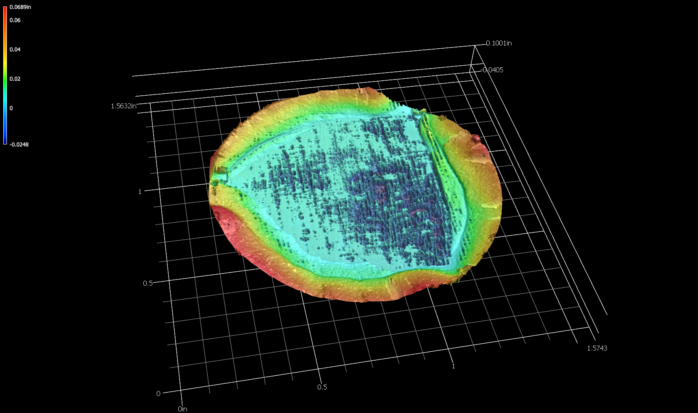
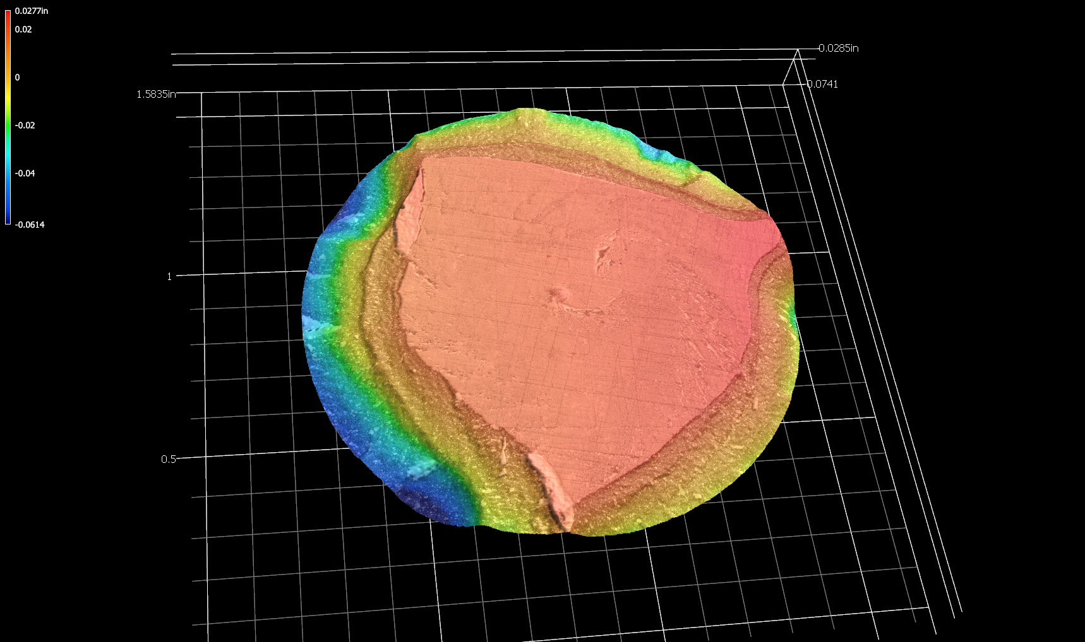
Mars Ascent Vehicle
Thermal constraint test developed is a qualitative test designed to establish capability of an adhesive system under cyclical thermal loading
  Bonded specimens are placed in a load frame with a small preload (3-5 lbf) then thermal cycled through project-defined temperature range (-94-+104F).
  Load imparted on load frame by specimen is recorded
  Test considered to pass if material stacking survives thermal cycle without disbonding
  Visual inspection completed after test
Sample failure mode topography

Slide 19
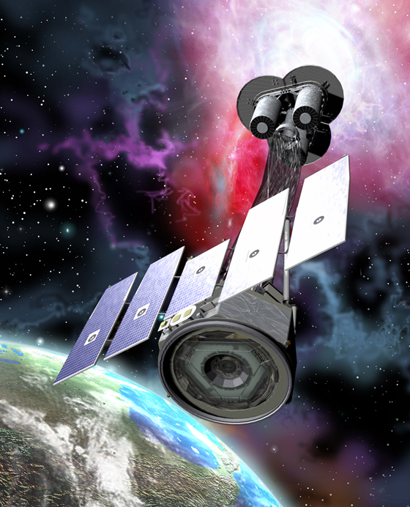
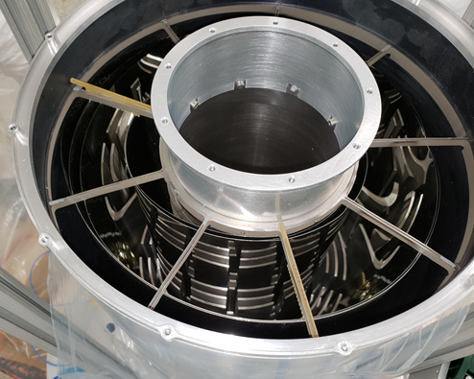
Case Study: Imaging X-ray Polarimetry Explorer
Next generation space telescope that functioned by collecting x-rays to make discoveries about exoplanets, black holes, etc.
  Successor to the Chandra Space Telescope
  X-rays collected and reflected off a series of concentric nested mirrors at the aft end of the spacecraft
  Mirrors are bonded into comb structures
Findings during Engineering Design unit showed extensive disbonding of mirrors from the retaining structure
  Utilizing a lower viscosity aerospace-grade adhesive
  Initiated a failure investigation to determine cause
Fault tree created to identify process issues
Imaging X-ray Polarimetry Explorer
IXPE Mirror Module Assembly

Slide 20
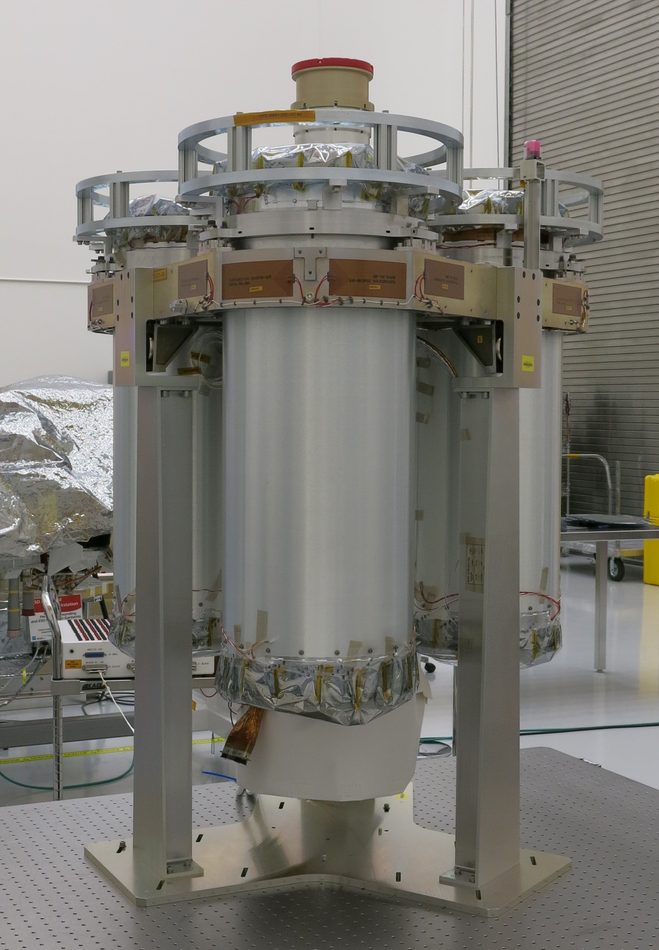
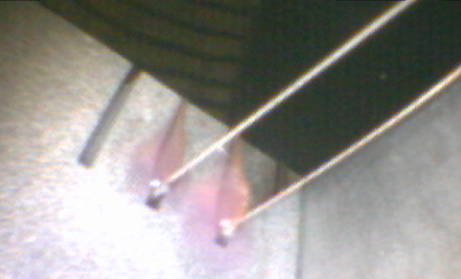
Case Study: Imaging X-ray Polarimetry Explorer
Leading theories for cause of failure
  Contamination
  Manufacturing environment
  Ineffective application process
Conducted testing to provide executable data for root cause
  Fourier Transform Infrared Spectroscopy, Scanning Electron Microscopy, and X-ray Diffuse Spectroscopy testing
  Environmental monitoring devices placed in clean rooms
  Critical review of application procedures
  Empirical testing of modified lap shear specimens
IXPE Engineering Design Unit
Mirror shell bond

Slide 21

Case Study: Imaging X-ray Polarimetry Explorer
Changes implemented to improve hardware manufacturing processes
IXPE Launched on December 9th 2021 to an orbit of ~370mi above Earth
  Boom deployed and systems activated in month that followed
Returned first image in February 2022
  Supernova remnant Cassiopeia A released on Valentines Day 2022
IXPE Continues to function to this day
Cassiopeia A

Slide 22
Case Study: Imaging X-ray Polarimetry Explorer
Corrective actions were taken to ensure best practices for component manufacturing:
  Formalized procedures that were codified with Quality oversight
  Surface preparation procedures were modified to improve adhesion
  Witness sampling was added to process
    Hardness coupons and pull specimens created during flight hardware manufacturing
  Program switched to new clean room with better environmental control

Slide 23
Materials Obsolescence
NASA utilizes materials both specifically for the Aerospace industry and others
  Not all are specialized formulations
Development and qualification process tests materials for effectiveness in space environments
Designs and production of flight hardware depend on consistence of every material
  Confidence and accepted risk tied maintaining all aspects of the design
Causes of material obsolescence
  Lack of availability of constituent parts of materials
  Changes to EPA Regulations
  Selling of rights to materials between companies
How do we respond?
  Requalify material
  Attempt to procure product and formulations
  Qualify alternatives
NASA historically has been granted waivers for various cases to complete program objectives
  Ex. Shuttle spray foam

Slide 24
DCM Replacement Study
Through Toxic Substances Control Act (TSCA), the EPA aims to prohibit hazardous chemicals that may affect public health and the environment.
EPA is evaluating Methylene Chloride, also known as CH2Cl2, MeCl, Dichloromethane (DCM) as a “high priority substance”. If alternatives are unavailable, the EPA may grant exemptions for mission-critical substances/applications.
  Affects aggregate Aerospace Industry and other industry
DCM relied on for fabrication of parts and equipment used on the International Space Station and Space Launch system
  Used for cleaning and solvent welding of polycarbonate and acrylic
Agency currently conducting a study to determine viable replacement materials across a series of functional criteria
  Clarity, Mechanical shear strength, flammability, Low outgassing/VOC

Slide 25
DCM Replacement Study Cont.
Study will begin with a Request for Information from the industry where manufacturers and distributors can recommend products and materials for use in this study.
Recommended products will be evaluated and procurements completed
Materials will be applied to test specimens composed of polycarbonate and acrylic substrates and tested in accordance with ASTM D4501
Best performing products will be recommended for use within NASA, to commercial partners, and to Aerospace Industry at large

Slide 26
Lessons Learned
It’s always just glue until there’s a problem, then it’s adhesive
Beware of singular reliance on tribal knowledge
  Formalize processes and training whenever possible
Test as close to use case as possible
Generate your own data whenever possible
Believe in your processes, but accept that they can be improved
Keep an eye on your environments before and after application

Slide 27
Engagement: Becoming Part of the Mission
Agency is always looking for new and cutting-edge materials and products
Numerous ways to get involved in NASA’s missions and goals
  Attend NASA small business and outreach events
  Create a profile on FedBiz Ops and other online solicitation databases
  Solicitations available throughout the year
Ensure your organization is compliant with all government regulations and restrictions
  Environmental, procurement, and safety
Experimental Program to Stimulate Competitive Research (EPSCoR) and Research Cooperative Agreement Notices (CAN)
  Goal to establish research activities that will make significant contributions to the strategic research and technology development priorities, and contribute to the overall research infrastructure, science and technology capabilities, higher education, and economic
  Proposals are typically generated outside or cooperatively with NASA Personnel then submitted for selection to various review committees.

Slide 28
Future Challenges
Ionizing radiation and Solar Particle Events
  Nuclear Thermal Propulsion
Bonding for Additive Thermal Protection Systems
Planetary Protection
  Must also survive sterilizing procession
Contamination Detection
  New methods for contamination detection prior to bonding
Complex Polymeric Substrates
  Materials with high coefficients of thermal expansion
Cryogenic applications
  Spacecraft and planetary surfaces
Further Enable Test Like you Fly capabilities
  New testing methods that simulate space environments for future missions

Slide 29
Thank you- Questions?
D. Malik Thompson
Aerospace Materials Engineer
NASA Marshall Space Flight Center
Dennis.m.thompson-1@nasa.gov

