Slide 1
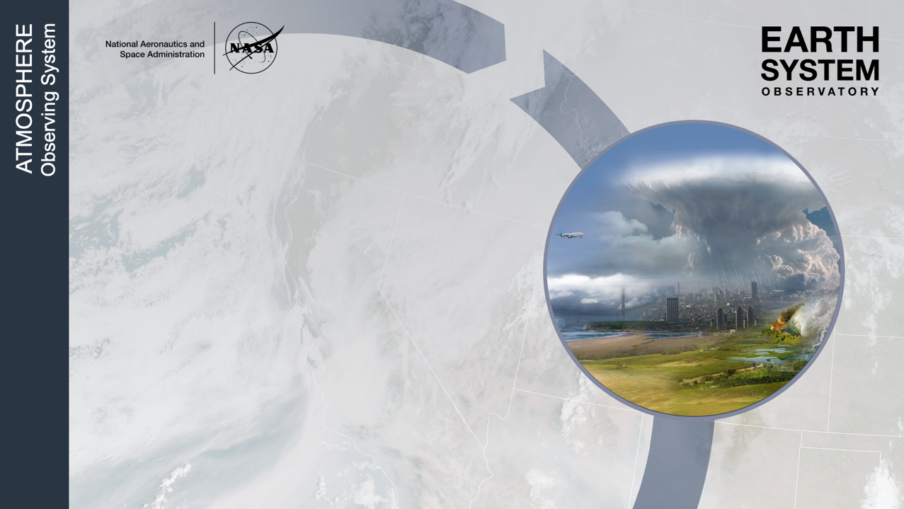
NASA Atmosphere Observing System (AOS)
Daniel J. Cecil¹, NASA MSFC
AOS Deputy Project Scientist – Suborbital
Daniel.J.Cecil@nasa.gov
Scott Braun², John Yorks², Tyler Thorsen³, Walt Petersen¹, Rich Ferrare³, Felix Seidel⁴, Jens Redemann^{5,} Jay Mace⁶
1 NASA Marshall Space Flight Center
2 NASA Goddard Space Flight Center
3 NASA Langley Research Center
4 Jet Propulsion Laboratory
5 University of Oklahoma
6 University of Utah
NRC MAPLE Workshop
Ottawa, Ontario, Canada
January 2024

Slide 2
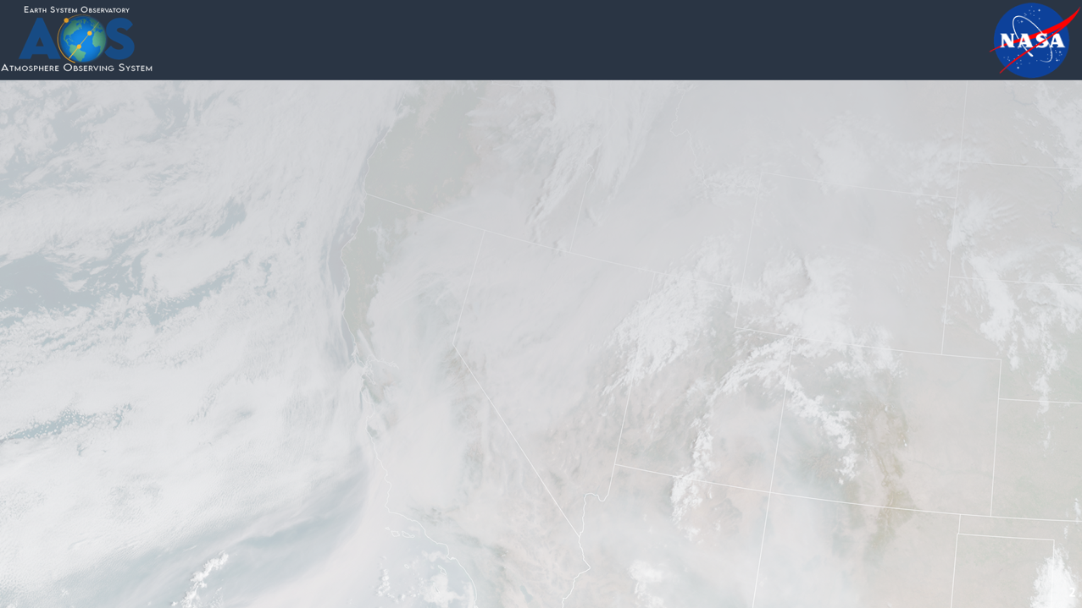
Outline
AOS Objectives
AOS Satellite Architecture Summary
  Inclined orbit (diurnally varying) – AOS-Storm
  Polar orbit (global sampling) – AOS-Sky
  Summary
AOS Suborbital
  Measurement approaches
  Aircraft capability priorities
  Summary

Slide 3
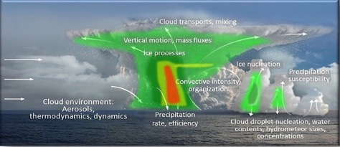

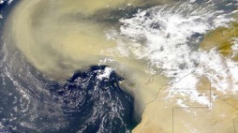
AOS Objectives Focus on Three Themes
Climate sensitivity and feedbacks
  Low and high cloud feedbacks
  Aerosol direct & indirect effects
  Cold clouds and precipitation
Absorption
(warming)
Scattering
(cooling)
Convective Storm Formation Processes
  Coupled storm dynamics and microphysics
  Importance of diurnal cycle
  High cloud properties
Aerosol processes and distributions
  Air quality and aerosol attribution
  Aerosol vertical redistribution and processing (from emission to removal)
Notes:
Third party images:
Figure from Chapter 4 of the IPCC AR6 Report (top left), Chapter 4, Figure 4.2. IPCC copyright policy is that the figure can be used for non-commercial purposes without permission (https://www.ipcc.ch/copyright/).
Aerosol skyline and Saharan dust images (bottom left and right, respectively) have CC Public Domain Mark 1.0 license.

Slide 4
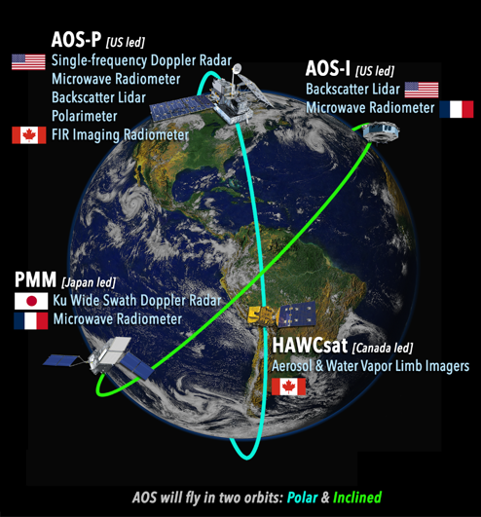
AOS Addresses Aerosol, Cloud, Convection, and Precipitation Processes
AOS-Storm (Inclined orbit, NET 7/2028)
  JAXA PMM Radar (Ku-band, Doppler)
  CNES C2OMODO tandem radiometers (89-325 GHZ)
  ALICAT backscatter lidar (532, 1064 nm)
AOS-Sky (Sun-synchronous orbit, NET 12/2030)
  Backscatter lidar (details TBD – Italian partnership?)
  Doppler radar (cloud profiling; details TBD)
  Passive microwave radiometer (89-700 GHz)
  Polarimeter (350-1570 nm)
  CSA Thin Ice Cloud Imaging Radiometer (4-73 μm)
  CSA aerosol and moisture limb imagers
AOS Suborbital
  Post-launch field programs
  Surface-based networks, supersites
  Leverage existing capabilities, more international partners
Pre-decisional
AOS-Sky [US led)
Doppler Radar
AOS-Storm [US led)
International partnerships are very important to AOS, both in the satellite constellation and in suborbital activities.
Pre-Decisional – AOS is in Phase A and NASA makes no commitments on the final design of the mission or instruments
Notes:
Overview of the orbits and payloads. There are subsequent slides highlighting each instrument.

Slide 5
AOS-Storm Overview
  NET July 2028 launch
  430 km orbit, 55° inclination
AOS-Storm (Inclined orbit, 7/2028)
  JAXA PMM Radar (Ku-band, Doppler)
  CNES C2OMODO tandem radiometers (89-325 GHZ)
  ALICAT backscatter lidar (532, 1064 nm)
Pre-decisional
AOS-Sky [US led)
Doppler Radar
AOS-Storm [US led)
Pre-Decisional – AOS is in Phase A and NASA makes no commitments on the final design of the mission or instruments

Slide 6
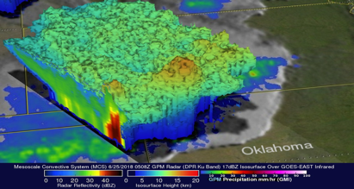
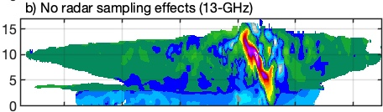
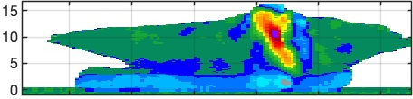
JAXA PMM Radar Capabilities
  NET July 2028 launch
  430 km orbit, 55° inclination
JAXA Wide Swath Ku Doppler Radar
Baseline Requirements
Vertical sampling, resolution:
250, 500 m for Doppler, dense
125, 250 m for normal scan
Horizontal Resolution: 5 km
Observation range (altitude):
Doppler 17 km
Dense 20 km
Normal 18-20 km
Swath: 250 km
Sensitivity (min dBZ):
Doppler 7.3 dBZ
Dense 7.3 dBZ
Normal 15 dBZ
Doppler uncertainty: 2 m/s @ 16 dBZ
Unambiguous Doppler range: ±30 m/s
Doppler obs.
Dense sampling obs.
Model “Truth”
x3
Normal scan obs.
x49
・・・
Height (km)
Simulated Ku Doppler Velocity
Nadir direction of flight
Courtesy of Pavlos Kollias
Notes:
JAXA will contribute a Ku-band wide-swath precipitation radar with nadir Doppler capability for measuring convective vertical air motions, launching into 55° inclined orbit no later than March 2029. Dense over-sampling at nadir combined with the use of the displaced phase center antenna, or DPCA, approach for better removal of spacecraft motion and non-uniform beam filling effects allows us to obtain good measurements of the structure of convective vertical motions for many convective systems. Ku-band will limit problems from attenuation to only strong convection.

Slide 7
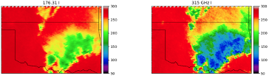
C2OMODO Radiometer Capabilities
  NET July 2028 launch
  430 km orbit, 55° inclination
C2OMODO: Convective Core Observations through MicrOwave Derivatives in the trOpics (Brogniez et al. 2022)
CNES Radiometer Scan Pattern Near Nadir
CNES Microwave Radiometers (89, 183, 325 GHz)
89 GHz
183 GHz
325 GHz
Time-differenced radiometer measurements (~1-2-minutes) contain information on convective vertical motions
89 GHz 10 km FOV 1 channel Nyquist sampling
183.31 GHz 5 km FOV 6 channels Nyquist sampling
325.15 GHz 3 km FOV 3 channels Continuous sampling
Notes:
CNES will provide two identical passive microwave radiometers with channels ranging from 89-325 GHz for characterization of ice cloud properties. The tandem radiometers provide the time rate of change of brightness temperatures over a ~2-minute period to allow inference of evolving microphysics and convective vertical ice mass flux.

Slide 8
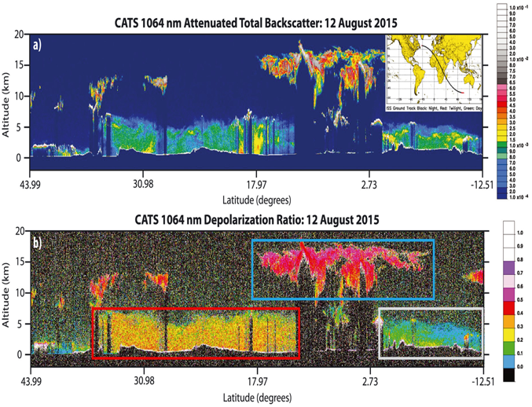
ALICAT Lidar Capabilities
  NET July 2028 launch
  430 km orbit, 55° inclination
CATS Backscatter Lidar Example
ALICAT: Atmospheric Lidar for Cloud and Aerosol Transport
Low pulse energy, high pulse repetition frequency
Frequencies: 532, 1064 nm
Provides total attenuated backscatter and depolarization at both frequencies
Heritage: Cloud Physics Lidar, Cloud-Aerosol Transport System (CATS)
Notes:
NASA will provide a two-wavelength backscatter lidar with performance similar to, or better than, CALIPSO. The lidar will provide profiles of aerosols and clouds as well as boundary layer height.

Slide 9
AOS-Sky Overview
  NET December 2030 launch
  450 km orbit, sun-sync-13:30 LTAN
AOS-Sky (Sun-synchronous orbit, NET 12/2030)
  Backscatter lidar (details TBD – Italian partnership?)
  Doppler radar (cloud profiling; details TBD)
  Passive microwave radiometer (89-700 GHz)
  Polarimeter (350-1570 nm)
  CSA Thin Ice Cloud Imaging Radiometer (4-73 μm)
  CSA aerosol and moisture limb imagers
Pre-decisional
AOS-Sky [US led)
Doppler Radar
AOS-Storm [US led)
International partnerships are very important to AOS, both in the satellite constellation and in suborbital activities.
Pre-Decisional – AOS is in Phase A and NASA makes no commitments on the final design of the mission or instruments

Slide 10
AOS-Sky Lidar
  NET December 2030 launch
  450 km orbit, sun-sync-13:30 LTAN
532 nm, 1064 Backscatter Lidar*
• Minimum is CALIOP-like performance. Target requirement of daytime SNR equivalent to CALIOP night SNR
• NASA HQ has initiated study of partnership with Italian Space Agency (ASI) for a multidisciplinary (atmosphere, ocean, land) lidar:
  3 wavelength laser (355, 532, 1064nm) with up to 13 detection channels with first-ever measurements of laser-induced Raman scattering and fluorescence
  355, 532, 1064 nm elastic backscatter and depolarization
  355 nm molecular backscatter (from rotational Raman)
• Requires formation flying of AOS-Sky and ASI lidar
Clouds
Dust
Smoke
Clouds
Notes:
The polar mission builds on the heritage of the A Train and is designed to optimize instrument synergies to obtain accurate information on processes relevant to climate sensitivity and feedback and aerosol forcing of climate, which requires globally distributed observations. It includes several advanced sensors provided by NASA and industry and contributed instruments from CSA. For the lidar in polar orbit, a partnership with ASI is under consideration. That potential partnership is a relatively new development, with not much more to say yet…

Slide 11
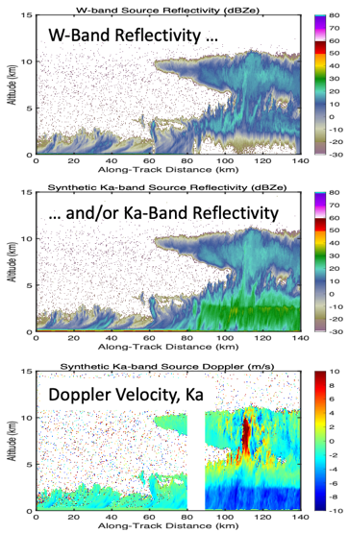
AOS-Sky Radar
  NET December 2030 launch
  450 km orbit, sun-sync-13:30 LTAN
Baseline Requirements
Quantity | Resolution @ altitude | Accuracy | Sensitivity @ altitude
Radar reflectivity, cloud-profiling | Horiz.: 2.0 km Vert.: 300 m @ 0.5 – 1.0 km 300 m @ 1.0 - 2.5 km 500 m @ 2.5 – 6 km 500 m @ 6 – 20 km | 1.5 dB * | ≤–5 dBZ @ 0.5 km – 1 km ≤–15 dBZ @ 1 km – 2.5 km ≤–20 dBZ @ 2.5 km – 6 km ≤–24 dBZ @ 6 km – 20 km
• Requirements are frequency agnostic
• Enhancements to be studied: Second frequency, narrow swath, passive measurements if Ka band, LDR
Figures at left courtesy of Matt McLinden
Notes:
For the polar radar, the requirements include a cloud-profiling capability and Doppler velocity measurements. This could potentially be a W-band radar that attenuates in moderate precipitation, a Ka-band radar with enough sensitivity for cloud profiling, or a dual-frequency radar.

Slide 12
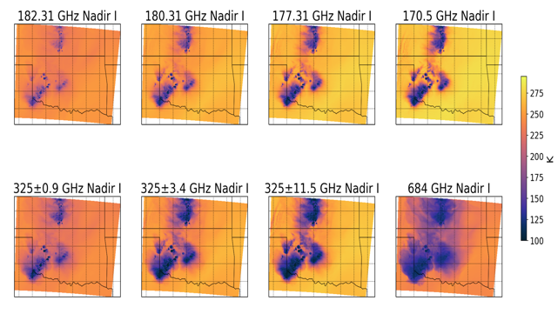
AOS-Sky Radiometer
  NET December 2030 launch
  450 km orbit, sun-sync-13:30 LTAN
Microwave Radiometer: 89-700 GHz
Baseline Requirements
Bands (# Channels) | Accuracy (K) | Polarization
89-113 GHz (1) 118 GHz (3) | ≤ 0.5 K ≤ 0.75 K | Target: Dual Minimum: Single
183.3 GHz (3) 165/205 GHz (1) | ≤0.75 K ≤0.75 K | Target: Dual Minimum: Single
310 GHz (3) 325.2 or 380.2 GHz (2) | ≤ 1.5 K ≤ 1.5 K | Target: Dual Minimum: Single
640-700 GHz (1) | ≤ 1.5 K | Dual
Courtesy of Matt McLinden
Courtesy of Yuli Liu, UMBC
Sub-mm wavelengths bring a cloud sensitivity that is new for NASA missions
Cross-track scanning, ≥750 km swath
FOV ≤10 km at nadir, ≤20 km at edge of swath
Notes:
The microwave radiometer in polar orbit measures high frequencies for characterizing cloud processes, not the lower frequencies traditionally used in prior precipitation missions.

Slide 13
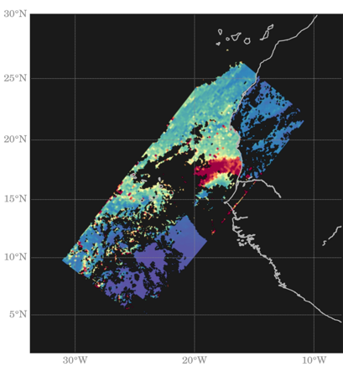

AOS-Sky Polarimeter
  NET December 2030 launch
  450 km orbit, sun-sync-13:30 LTAN
UV-VIS-NIR-SWIR Multi-angle Polarimeter
Baseline Requirements
Example AOD from HARP
Cloud-top properties available also
Type and/or Wavelength range (nm) | Number of spectral channels | Number of viewing angles per pixel
UV: 350 – 390 nm¹ | 1 | 10
VIS: 410 – 750 nm | 2 | 10
Hyperangle: 660 – 870 nm | 1 | 60
Water Vapor: ~940nm | 1 | 10
SWIR Cirrus: ~1380 | 1 | 10
VNIR-SWIR: 870 – 1570 nm | 3 | 10
300 km swath width
0.5 km IFOV (at nadir)
Notes:
Polarimeter for wide-swath characterization of cloud and aerosol processes, and for additional constraint on lidar retrievals at nadir.
Third party images:
Left image provided by Vanderlei Martins, permission obtained June 8, 2022. Email text below:
“Hi Scott,
Yes, this is a multi-angle sequence from HARP showing 10 viewing angles.
Since all other examples in your slide are for level 2, I am also attaching an example of level 2 retrieval from HARP and, another case with 60 viewing angles.
Feel free to use any combination you prefer.
Vanderlei

Slide 14

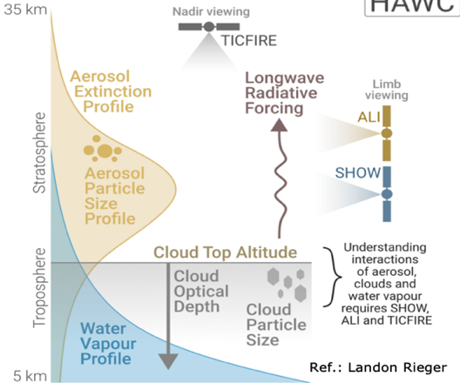
CSA Contributions
  NET December 2030 launch
  450 km orbit, sun-sync-13:30 LTAN
Canadian Space Agency Longwave-Far Infrared Imaging Radiometer (4-73 μm),
Aerosol/Moisture Limb Sounding
AOS-Sky [US led)
AOS-Storm [US led)
Details in separate presentation
Notes:
CSA provides a long-wave radiometer on the AOS polar satellite, and limb sounders (aerosol and water vapor) on a separate satellite (HAWCsat) in the same orbit.
Lower left figure provided by Landon Rieger, permission obtained July 13, 2022. Permission email text is below:
Hi Sheri and Scott,
Feel free to use that graphic wherever it's helpful, including posting it online. If you ever need a higher resolution or vector format just let me know too.
Best regards,
Landon

Slide 15





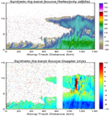
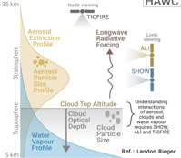



Summary of AOS Measurements
AOS-Storm:
Inclined orbit (diurnal variations)
AOS-Storm, JAXA PMM, and CNES C2OMODO:
Ku-Doppler radar
dTB/dt (~mm-wavelength)
Backscatter lidar
Launch no earlier than July 2028
AOS-Sky, CSA HAWCsat:
Cloud-profiling Doppler radar
Backscatter lidar
sub-mm radiometer
Polarimeter
Longwave radiometer
Limb sounder (aerosol+moisture)
Launch no earlier than Dec 2030
55° inclination
NET July 2028
AOS-Sky:
Polar orbit
Sun-synch
1330 LTAN
NET Dec 2030
Notes:
Summary slide: In inclined orbit with sampling across the diurnal cycle, we have the Ku-band Doppler radar; brightness temperature time rate of change; and backscatter lidar. Those launch by March 2029, after EarthCARE’s planned mission but while GPM should still have some fuel. The inclined launch comes around 2032 (take that with whatever grains of salt seem appropriate), with a broader suite of instruments. Our suborbital campaigns come after the launches, tentatively one in 2029 or 2030 and 1-2 more in 2032 or later.

Slide 16
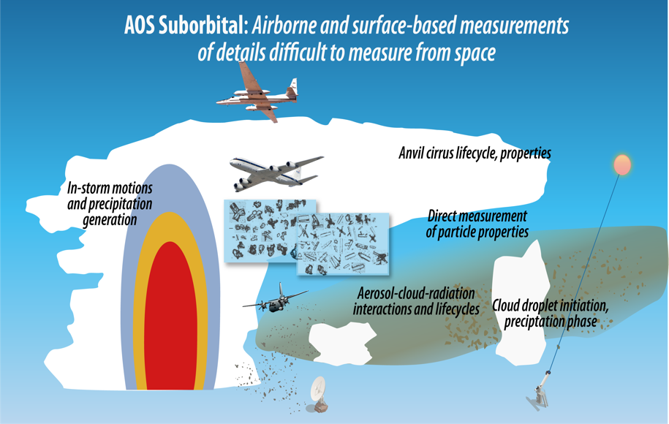
AOS Suborbital Motivation
AOS Suborbital Motivation
Collect data for AOS science investigations that:
Are only done, or better done, from Suborbital platforms
  - e.g., temporal evolution, satellite-blind zones, direct measurements
Support algorithm / model needs
Provide synergies with calibration / validation
  - Cal/val is distinct from suborbital science program
Notes:
AOS-led Suborbital field campaigns are post-launch (2029 and beyond), for the sake of maximizing cal-val opportunities.
Pre-launch, we design those programs and also work with R&A program to identify opportunities to advance the science.

Slide 17
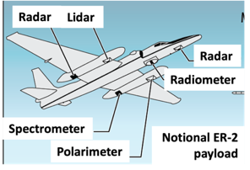
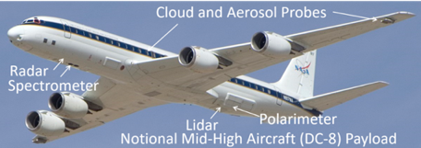
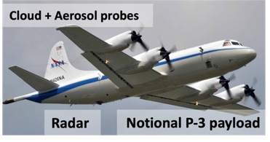
AOS Suborbital
Low Clouds: Microphysics, precipitation initiation
Convection/High Clouds: Microphysics and dynamics, anvil cirrus lifecycle.
Aerosol-Cloud-Radiation Interactions: Vertically resolved aerosol-cloud-radiation interaction processes and lifecycle.
Aircraft and payloads depicted are notional… instruments to be prioritized / deconflicted for each campaign.
Need a high altitude (over-storm) remote sensor…
…mid/high altitude aircraft to provide both remote sensing and in situ (aerosol, cloud, precip)
…low/mid altitude aircraft to provide both remote sensing and in situ (aerosol, cloud, precip)
Campaigns after launch to enable cal-val
Aircraft, surface sites, and networks from partners will be especially helpful.
Notes:
The AOS Suborbital program has multiple purposes: addressing the science themes in ways that are not suitable from satellite alone, and providing cal/val data for the satellite products. Multi-aircraft campaigns will need a combination of remote sensors and in situ probes at appropriate altitudes. Aircraft pictured here are just examples; NASA DC-8 is replaced by 777, and we hope to also leverage aircraft from non-NASA partners. Surface-based supersites and networks are needed both for long-term measurements, and for anchoring the airborne campaigns.

Slide 18
Large airborne campaigns led by AOS
Multiple (~3) campaigns / deployments, with each synergistically contributing to all three themes. Campaigns are planned as post-launch for the satellites, so they are many years away and plans must be kept general / notional; subject to change.
Aircraft focus on regions where we can leverage surface-based instrumentation, and address science objectives from all three themes.
Partner with others when / where it makes sense
Maintain flexibility to address issues that arise over the course of the next decade
Pre-Decisional – AOS is in Phase A and NASA makes no commitments on the final design of the mission or instruments

Slide 19
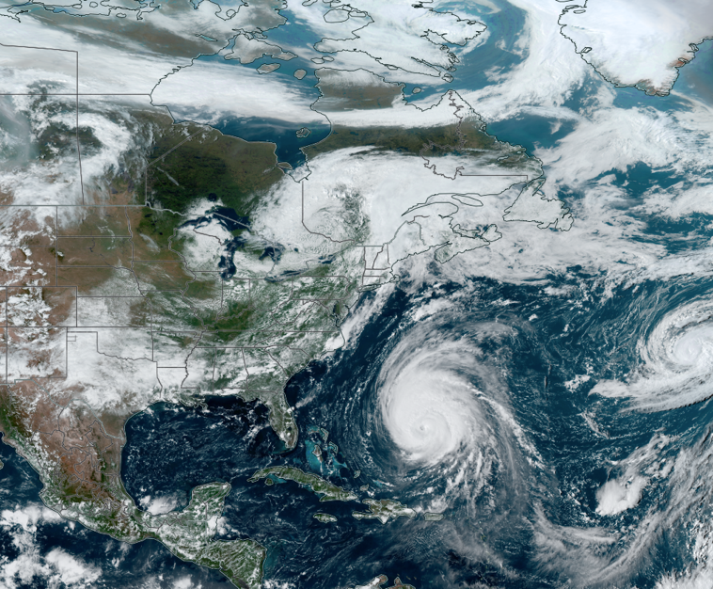
Airborne Field Campaigns
Too early to select field campaign locations, but it is useful to think about candidates
Miami – Puerto Rico – Barbados transect has a wide variety of cloud types, Saharan dust, aerosol-cloud interactions
  Anchored by well-instrumented surface sites
Colorado-Oklahoma-Alabama corridor has continental precip and aerosol types, deep strong convection of a different variety than over ocean
  Anchored by well-instrumented surface sites
  Within broader surface-based networks
More focused (single aircraft?) campaign over a high-latitude supersite?
Mid-lat campaign to add variety of cloud and aerosol types?
Pre-Decisional – AOS is in Phase A and NASA makes no commitments on the final design of the mission or instruments
Notes:
Can’t emphasize enough that these locations are just demonstrative of regions that seem suitable for AOS-led campaigns. None have been selected yet.

Slide 20







Only done from Suborbital:
Thick cloud becomes opaque to many instruments on satellite, so we investigate from multiple aircraft levels
Heavy precip attenuates radar bands on satellite; use longer wavelength on aircraft and from surface
Aerosol and cloud layers obscured from satellite by higher-altitude cloud; need aircraft at multiple levels
Pre-Decisional – AOS is in Phase A and NASA makes no commitments on the final design of the mission or instruments

Slide 21
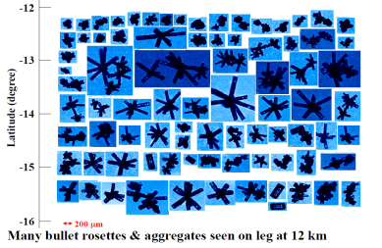
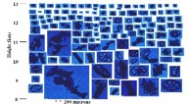
Only done from Suborbital:
In situ measurements of aerosol / cloud / precipitation particle characteristics, with details beyond what satellite remote sensors can measure
New submicron particles formed in storm outflow; in-situ aircraft obs needed
Changes in radiation measured directly within atmosphere or at surface
Surface-based instrumentation for longer-time-scale monitoring, measure processes near the surface
Pre-Decisional – AOS is in Phase A and NASA makes no commitments on the final design of the mission or instruments

Slide 22
Better done from Suborbital:
Sharp horizontal and vertical gradients within cloud and precip, unresolved by satellites
Unique combination of remote sensing + direct measurements
Meteorological observations of storm inflow / outflow
Spatial and temporal context for “snapshot” measurements from space
Air quality at nose level
Pre-Decisional – AOS is in Phase A and NASA makes no commitments on the final design of the mission or instruments

Slide 23
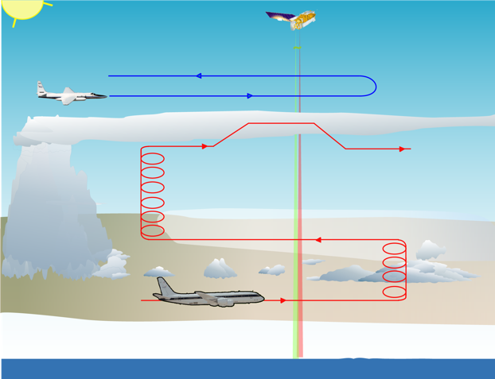
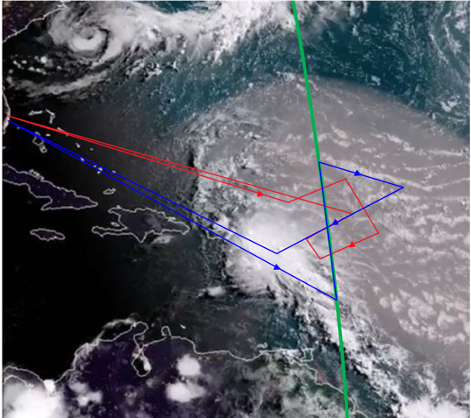
Example flight concept:
Low-cloud – dust interaction & Convection-dust interaction
AOS – Sky ground track
Pre-Decisional – AOS is in Phase A and NASA makes no commitments on the final design of the mission or instruments

Slide 24
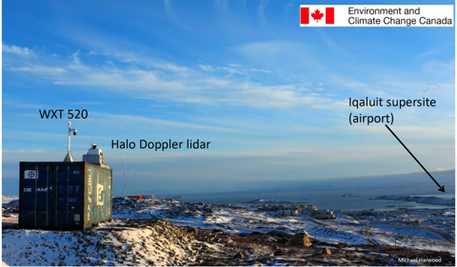



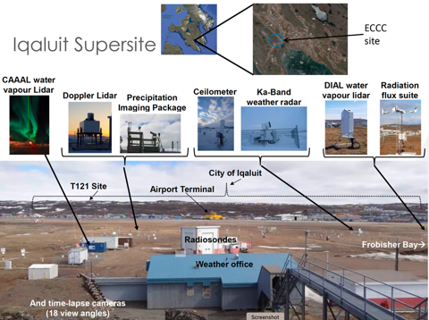
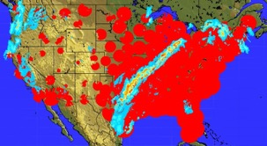
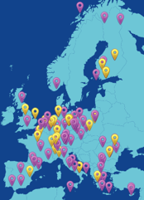
Leverage Surface Sites and Networks
Build up large sample sizes and measure temporal evolution of processes from a few fixed, well-instrumented sites and networks
Radar, profiler, or air quality networks
DOE ARM sites
ESA EarthCARE validation
Etc.
Iqaluit, Canada site as example that could potentially be augmented by an aircraft in situ campaign.
DOE ARM sites are also suitable.
NOAA radar network (lower left)
ACTRIS National Facilities (lower middle)
Pre-Decisional – AOS is in Phase A and NASA makes no commitments on the final design of the mission or instruments

Slide 25
Calibration / Validation
Leverage Suborbital science campaigns to conduct cal/val
Suborbital science payloads will have relevant remote sensors for satellite instruments, and direct in situ measurements of geophysical variables
Some cal/val requires satellite underflights that can be done during our science field campaigns, just requiring devoted flight hours / flight design
Some cal/val requires flights over particular types of targets and/or at night, … can do these as dedicated cal/val flights before, during, or after a science deployment, while the payload is still on the aircraft
Dedicated cal/val scenario: For a suitable aircraft (e.g., ER-2, G-V), operate from aircraft's home base with relevant remote sensors dedicated to satellite underflights and/or priority cal/val targets
Pre-Decisional – AOS is in Phase A and NASA makes no commitments on the final design of the mission or instruments

Slide 26
AOS Aircraft Capability Priorities
Different capabilities needed at different altitudes
High Altitude (~20 km; > FL600) satellite simulator / remote sensing
  Overfly nearly any tropospheric weather as a satellite simulator
Mid-Altitude (~3-15 km; ~ FL100 – FL500) remote sensing and in situ
  Penetrate (and overfly) clouds, precipitation, aerosol layers
Low-Altitude (Up to ~3 km; < FL100 ) remote sensing and in situ
  Penetrate low cloud, precipitation, and aerosol layers, and fly below cloud base.
DETAILS ON NEXT SLIDES
Adaptability: Configurable for various sensor types / combinations
Operational Flexibility: Ability to deploy to / operate in diverse atmospheric conditions; coordinate with other aircraft / teams
Maneuverability: Agility for targeted data collection – revise waypoints minutes (tens of minutes?) ahead of time
Real-time monitoring / downlink of quicklook data
Communication between mission scientists and flight team is critical.
- includes comms to coordinate multiple-aircraft missions
- both to ensure safety and mission success

Slide 27
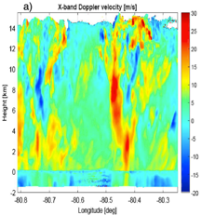
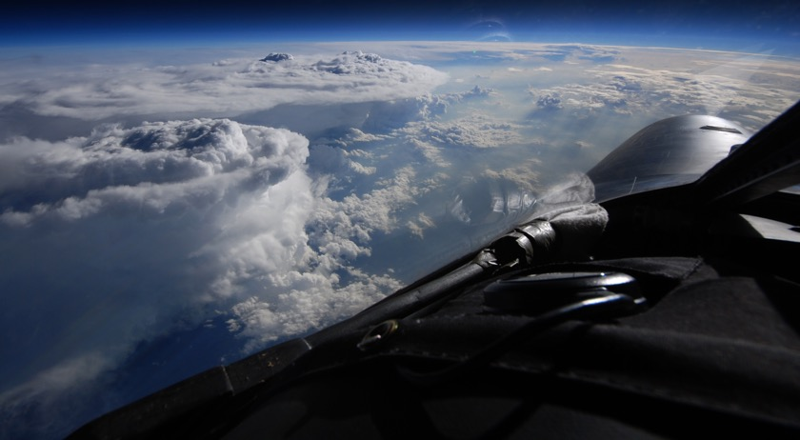
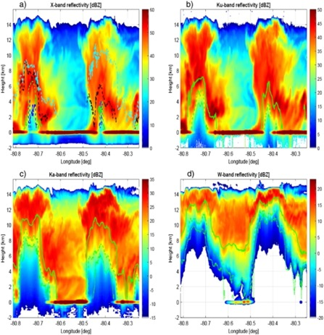
AOS High-Altitude Aircraft Priorities
Overfly nearly any tropospheric weather as a satellite simulator
Heavy remote sensing payload, several pods / compartments, some pressurized
NASA ER-2 and WB-57 as examples; demonstrated capability to overfly severe convection
X-band Doppler Vel
Ku-band reflectivity
Ka-band reflectivity
W-band reflectivity
Payload: Multiple radars (W, Ka, Ku, X-bands all desirable), radiometers, lidar, polarimeter.
Some likely need to be swapped out for each other, depending on the program or flight priorities.
~200 m/s; ~8-hr duration; ~20 km ceiling; > FL600 (rough estimates of requirements)
Key need is an ability to overfly science targets, without limitations due to weather avoidance (especially deep, strong convection).

Slide 28
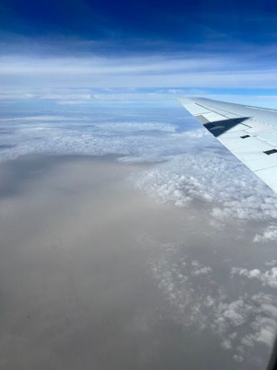
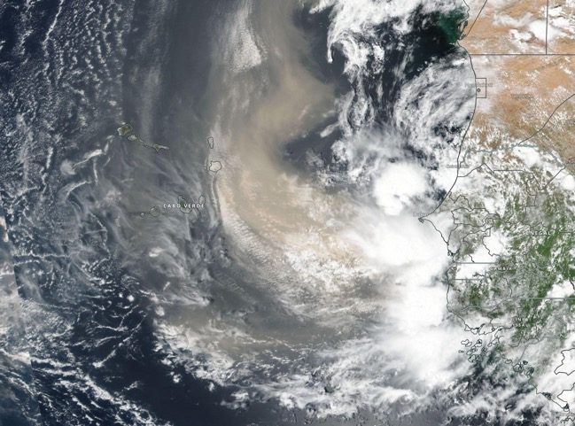
AOS Mid-Altitude Aircraft Priorities
Penetrate + overfly aerosol, clouds, precipitation
In situ particle probes, and remote sensing ports
NASA DC-8, Gulfstream as examples; hopeful that NASA 777 extends those capabilities
Saharan dust outbreak photo from NASA DC-8, courtesy Quinton Lawton, University of Miami
Mixed phase measurements in/near deep convection are limited, would be a big plus.
Many such legs flown safely by DC-8 in HIWC campaigns (2015, 2018), with real-time data and mission science support .
DC-8 and other aircraft had many safe flights through weak / moderate convection (e.g., hurricane eyewalls) and heavy aerosol layers. Need future aircraft to maintain those capabilities.
We recognize there are some no-go zones, but also lots of safe flying conditions where we need in situ measurements.

Slide 29

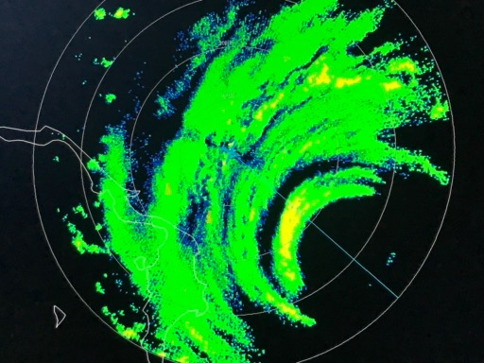
AOS Low-Altitude Aircraft Priorities
Penetrate aerosol, clouds, precipitation, and fly below cloud base
In situ particle probes, scanning, nadir, and zenith remote sensing ports
P-3 as example
Eyewall of Cat-5 Hurricane Dorian as viewed from NOAA P-3, courtesy Jon Zawislak (NOAA)
Need to sample low-levels of cloud, precipitation, and aerosol layers, and their environments.
Includes boundary layer in situ sampling.
Flexibility for basing / refueling (e.g., operate on short runways, making use of more airfields)

Slide 30
Other AOS Aircraft Considerations
Multi-aircraft, multi-national campaigns enable broader variety of scientific measurements, but add logistical / procedural complexity. They are well worth the complexity, but we’ll have to account for that complexity during planning.
How much complication / lead time is required if instruments from one nation are installed on aircraft from another nation for a field campaign? How would this occur for US (NASA) instruments operating on foreign aircraft during foreign deployments? Also, airborne operations must also pass safety review(s) that considers the aircraft and instrument operations. A multi-national payload may have a variety of safety requirements / procedures (?).
Payload flexibility is a plus. Need to be able to re-configure payload for different missions, but some reconfiguration during a mission is also helpful. For example, ER-2 can have a spare nose with a different instrument ready to swap out from flight to flight, depending on the objectives. Pallet-mounted instruments on WB-57 also easy to swap out.
A port with 17 inch glass, 16 inch clear aperture is a common size on NASA aircraft (nadir at least, perhaps zenith also). This is suitable for a lidar that goes in the cabin (instead of a pod).
In situ probes need access to undisturbed air flow.
For aerosol measurements inside the aircraft cabin, it is important to know the inlet efficiency as a function of aerosol size.
For pod-mounted instruments, some require pressurized pods, some do not.
For low-altitude aircraft, noise minimization may be a consideration for flights over populated areas.

Slide 31
Sub-Orbital Summary
AOS Suborbital Concept
  Leverage / augment surface-based networks and supersites
  Partner in relevant field campaigns
  Lead multi-aircraft field campaigns addressing cloud & precip initiation, convective storm processes and lifecycle, anvil cirrus lifecycle, aerosol-cloud-radiation interaction processes coupled with aerosol attribution and lifecycle
    High-altitude remote sensing aircraft
    Mid-high altitude remote sensing + in situ aircraft
    Low-altitude in situ aircraft
    Emphasis on coordination between aircraft and well-instrumented surface sites
Pre-Decisional – AOS is in Phase A and NASA makes no commitments on the final design of the mission or instruments

