Slide 1
SLS Ignition Overpressure-Sound Suppression System Performance Evaluated Against Historical Configurations
Andrew Herron, Michael Hays, Andrew Smith, Matt Casiano
APA-11, January 8, 2024

Slide 2
Overview
Introduction
SLS Mobile Launcher (ML) IOP/SS Overview
Leveraging SLS Tests for Artemis I
Historical Data Sources Review for Artemis I
Preparations for Artemis II
Conclusion

Slide 3
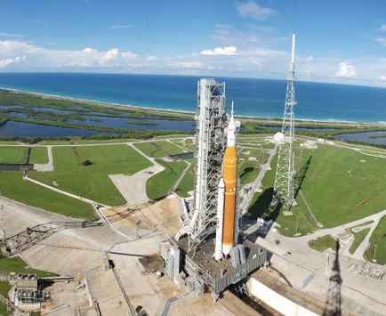
Introduction
SLS vehicle generates environments during launch that must be mitigated by water systems on the Mobile Launcher, known as the Ignition Overpressure and Sound Suppression (IOP/SS) system
In preparation for Artemis I launch, flight rationale had to be built using a number of tests and models
  Verify the integrated system works as intended
  Verify that mitigation of liftoff acoustics does not generate additional adverse phenomena
Flight operation of SLS IOP/SS is a complex mix of geometric, fluid, and acoustic interactions
  Multi-phase flow with significant gradients to water sheets/spray/mist
  RS-25s begin to ignite around T-6 seconds, entraining surrounding fluids
  Booster ignition at T-0 seconds with ignition shock propagation and plume development in short succession
Testing and analysis are ultimately partial models for this system of systems
  Only practical full test is Artemis I launch itself
  Artemis I flight rationale required leveraging all available tests
SLS-specific tests and historic water systems evaluated compared to the SLS system to develop 7-elements of flight rationale
  Solid technical understanding
  Condition relative to experience base
  Bounding case established
  Self-limiting aspects
  Margins understood
  Assessments based on data/testing/analysis
  Interactions with other elements/conditions

Slide 4
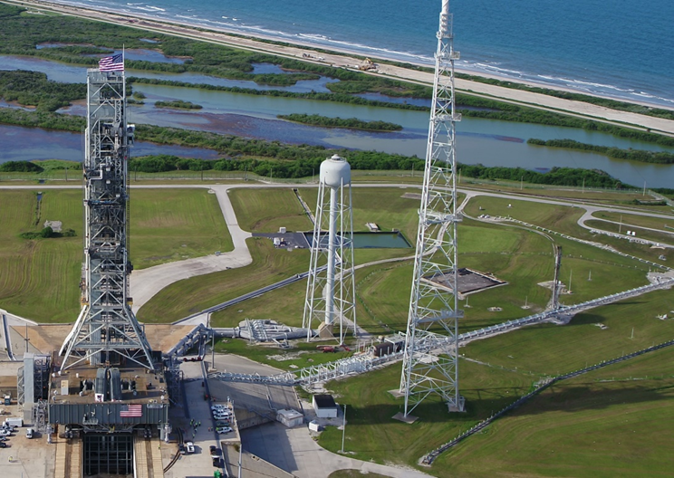
SLS IOP/SS Overview: Pad Side
Pad 39-B portion of IOP/SS system
  Water Tower
  Valve Complex
  Piping and risers into ML
Gravity fed system
Valve complex
  3 IOP Mains
  3 SS Bypass
  3 SS Mains

Slide 5
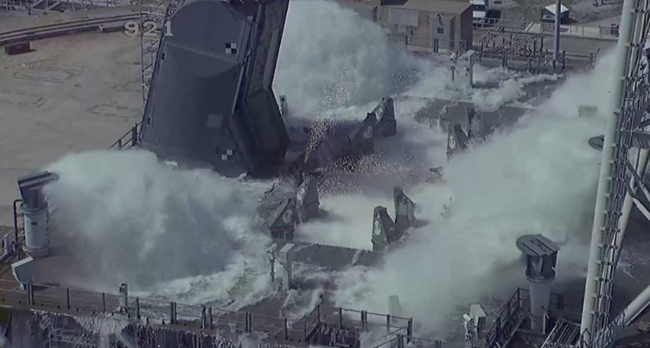
SLS IOP/SS Overview: Mobile Launcher Side
IOP nozzles direct water around the circumference of the blast hole beneath the SLS Vehicle
  IOP nozzles under four RS-25 engines
  IOP nozzles under Right Hand and Left Hand Boosters
  Also includes nozzles on top of the Main Flame Deflector
SS nozzles direct water over the ML 0 Deck
  Five Rainbird nozzles located on each of the corners and on the North Center side of the deck

Slide 6
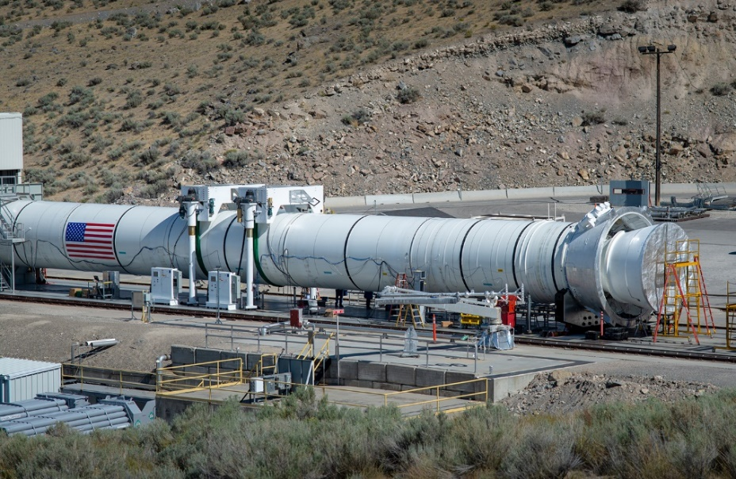
Leveraging SLS Tests for Artemis I Flight Rationale
Four primary SLS tests leading up to Artemis I
Scaled Model Acoustic Test (SMAT)
  Equivalent flow rates
  Used for initial acoustic environment specifications
ISVV-14
  Integrated Pad 39-B and Mobile Launcher to characterize the IOP/SS system
SRB Flight Support Booster (FSB) 1
  September 3rd, 2020 at Northrup Grumman Innovation Systems in Promontory, UT
  Bounding case test for measured response to water in the nozzle (loads / imagery)
Core Stage Green Run (details next slide)

Slide 7
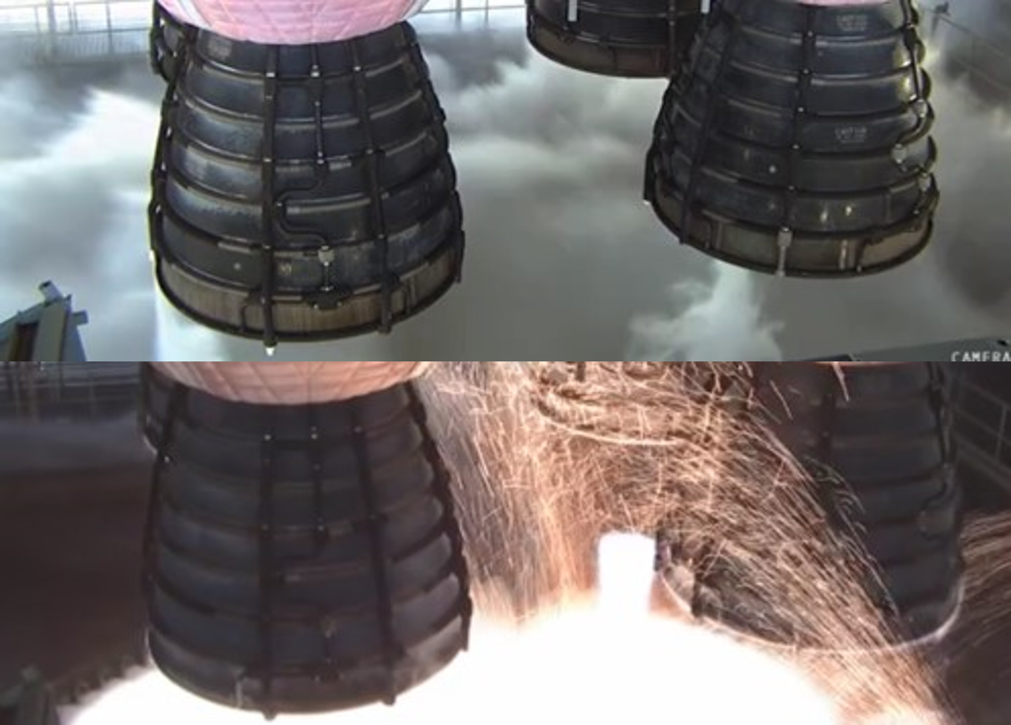
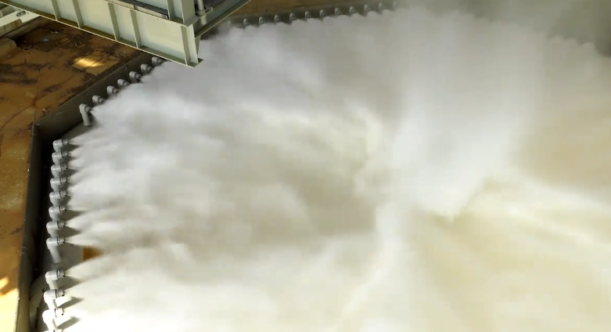
Core Stage Green Run
Core Stage Green Run
  Partial firing January 16th, 2021
  Full-duration firing of all four RS-25 engines March 18th, 2021
  Stennis B-Stand included sound suppression water system, but was substantially different in design due to different environments
RS-25 engines behave as ejectors
  Quickly entrain and remove water sprays above access platform in approximate location as Booster nozzles
Visibility through HBOI particles and RS-25 plumes
  Mobile launcher haunch cameras have expected ability to resolve Booster IOP rings and the Booster nozzle exit plane during launch

Slide 8
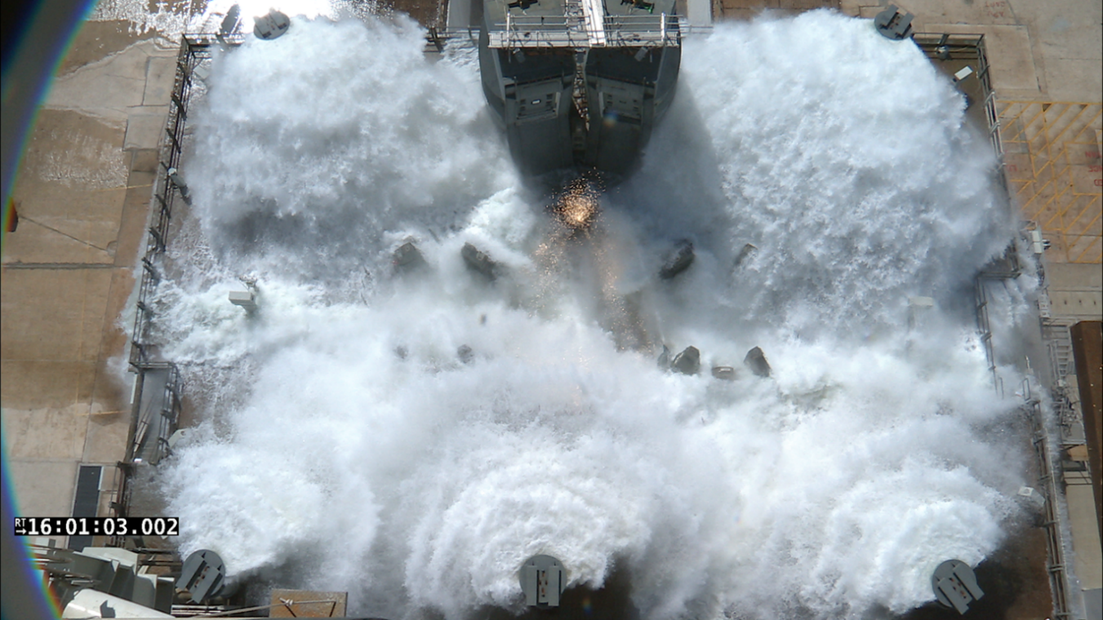
ISVV-14 Water Flow Testing
Tested the integrated Pad and ML IOP/SS system for the Artemis I configuration
Test series consisted of 7 total flows from 2 July 2019 to 9 October 2019
Focus areas
  Measured flow rates for each portion of the IOP/SS system
  Coverage regions for IOP and SS spray patterns
Complicating factors
  Valve response timing
  Water balancing between IOP ring / Rainbirds / Main Flame Deflector
  Water balancing individual Rainbirds
  Imagery assets on the ML 0 Deck
  HBOIs on the North and South sides of the blast hole
  Vehicle impingement concerns
  Hurricane Dorian

Slide 9
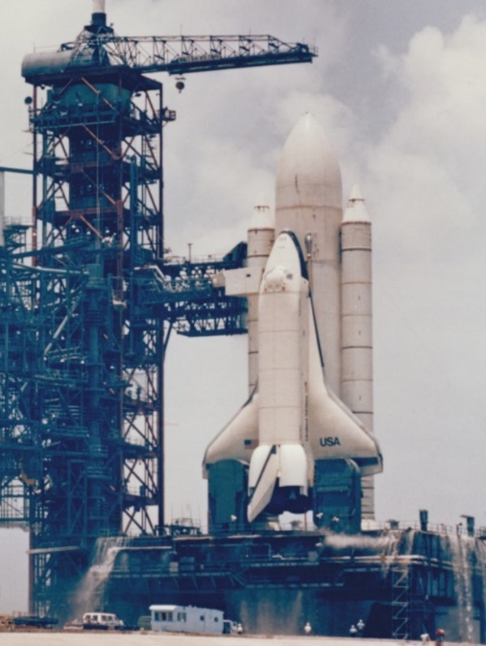
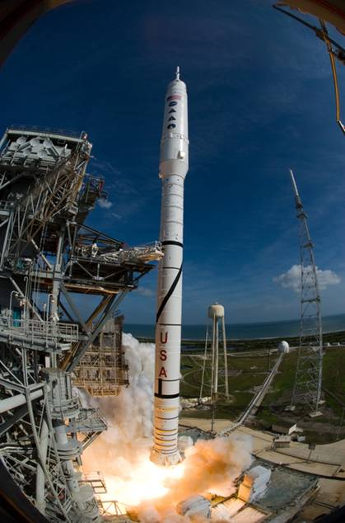
Historical Data Review
Relevant launch vehicles in industry and Space Force portfolios (current and retired) were evaluated
  Some data were readily available publicly (either directly or indirectly)
  Some data were proprietary, but available to NASA
  Some data were proprietary, but only available to NASA qualitatively
Relevant Parameters
  Use of booster motors or engines with nozzle exit planes (NEPs) in proximity to core engines
  Water nozzle proximity to vehicle NEPs
  Water nozzle configuration
  Water flow rate
Conclusions
  Use of water for ignition overpressure mitigation and sound suppression has been common in the launch vehicle industry for many decades with no demonstrated history of safety-of-flight incidents as a result of use
  Several launch vehicles are analogous but with notable differences
  Space Transportation System (STS) is most useful for SLS, with limitations, while providing 136 successful flights (for IOP/SS)

Slide 10
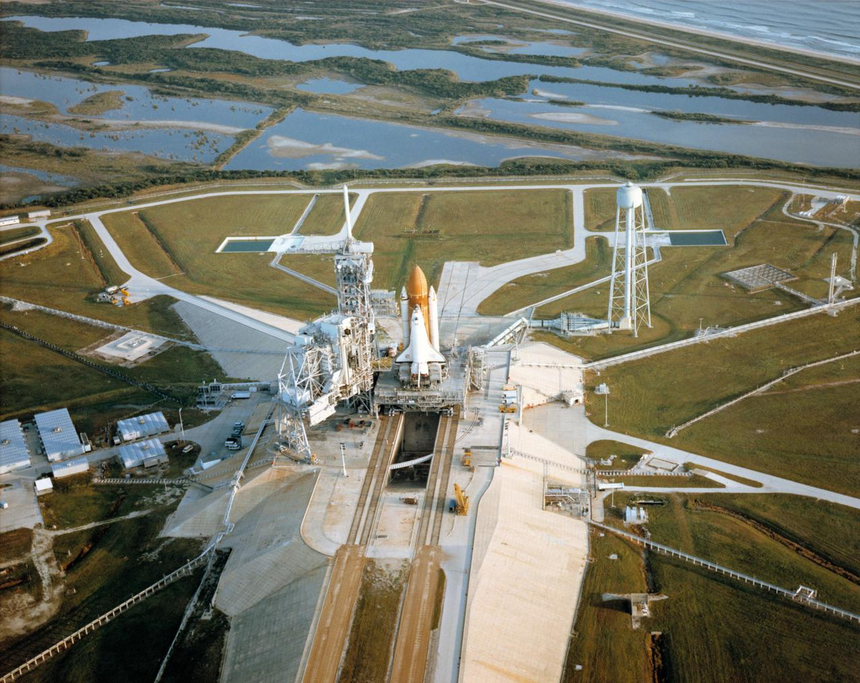
STS SSWS Overview
STS Sound Suppression Water System (SSWS) uses same water tower and valve complex as SLS (without bypass valves), same risers, same pad
Water distributed to IOP water nozzles in separate plume holes for Orbiter RS-25s and each Booster
  Note, IOP water to Booster plume holes added between STS-1 and STS-2, using water redirected from flame trench side pipe, and integrated externally to the MLP
Rainbirds for sound suppression were located on the Booster side of the MLP, similar in design and function to SLS
Crest water directed over flame diverter like SLS, but pointed in two directions to accommodate plumes from Boosters and RS-25s directed to either side

Slide 11
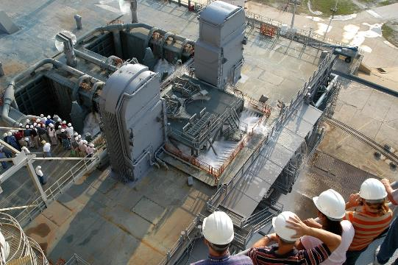
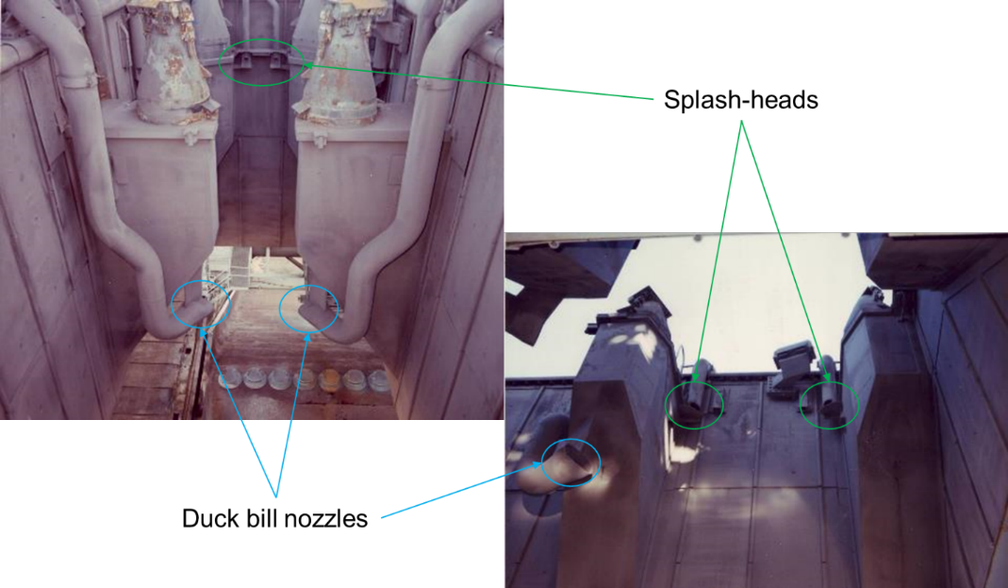
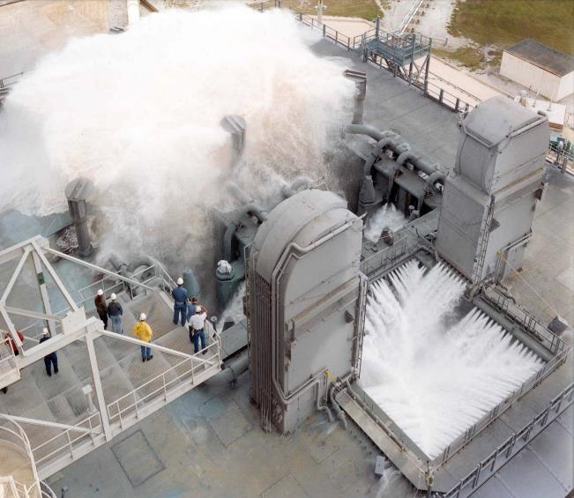
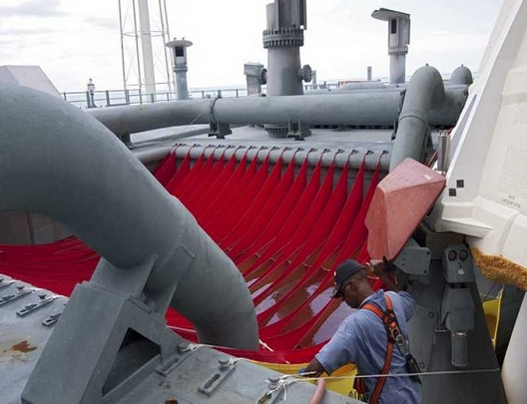
STS SSWS Overview
Rainbirds
SRB
hole
sprays
RS-25
hole
sprays

Slide 12
STS Tests of Interest – Water Flow Tests
STS Wet Dress Rehearsal (WDR) – 18 July 1979: Enterprise stacked, which obscured booster holes, and IOP configuration specific to STS-1
Water Flow Test after MLP Booster IOP Modifications (presumed) – Prior to 12 November 1981
SSW (presumably Sound Suppression Water) Test 1 and 2 – 7-11 December 1990
SSWS Test – 18 October 2001
Main Valve Replacement Validation – 7 May 2004: RS-25 engine platform was in place, performed after replacement of six main system valves in valve complex for end of life repair
Ares I-X Sound Suppression Deluge Test – 6 April 2009: Limited utility because test stands/fixtures in SRB holes were close to main flow heads
*Video found and digitized for tests 1, 3-6 above

Slide 13
STS Tests of Interest – Flight Readiness Firings
FRFs performed prior to first flight of each orbiter, with Challenger requiring a second and Discovery receiving a second prior to return to flight
  Columbia (OV-102) – 20 February 1981
  Challenger (OV-099) – 18 December 1982 and 25 January 1983
  Discover (OV-103) – 2 June 1984 and 10 August 1988 (STS-26)
  Atlantis (OV-104) – 12 September 1985
  Endeavour (OV-105) – 6 April 1992
FRFs required modifications to mobile launch platform and SSWS to mitigate on-pad plume heating and acoustic environments
  Some legs of SSWS appear to be capped (Booster IOP, rainbirds) to provide enough water to RS-25s and trench for FRF duration
  Thermal barrier on deck between RS-25s and Boosters

Slide 14
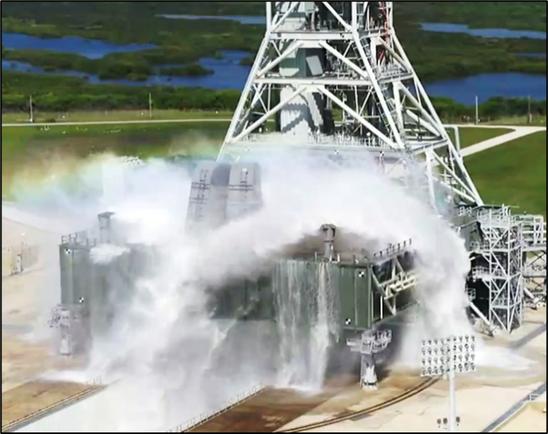
Current Effort: Artemis II ISVV-2 Water Flow Testing
Ongoing test campaign to improve the IOP/SS performance for Artemis II and Artemis III
Successfully completed 7 out of 8 planned flows
  Final configuration test planned for early 2024
Areas of focus
  Increasing overall flow rates to the SS system
  Improving flow patterns to minimize interference with ML 0 Deck imagery assets

Slide 15
Conclusion
Artemis I flight rationale was achieved through utilizing the art of partial modeling
Successful launch on November 16th, 2022
Although this was a night launch, substantial imagery was captured to verify the performance of the fully integrated IOP/SS system, complete with interactions with the SLS vehicle, plumes, and environments
IOP/SS system performed primary function of mitigating the liftoff environments generated by the SLS vehicle
NASA is preparing to take the next step by sending crew on board Artemis II
The hope of the authors is that this summary of NASA’s IOP/SS water systems will be of benefit to the engineers of tomorrow designing the next generation of launch vehicles

Slide 16
Acknowledgments
Bill Chardavoyne, David Valletta, James Ingram, and the rest of the Exploration Ground Systems Team at Kennedy Space Center have done an outstanding job designing and testing the IOP/SS system on the Mobile Launcher in support of successful Artemis missions
Beth St. Peter, Lori McDerby, Danny Osborne, Taylor Walker, and Charles Norton, along with the rest of the SLS Imagery Team have provided sustained, significant support in successfully capturing imagery data from the related tests and Artemis I
Thomas Nesman, Brandon Williams, William Dziedzic, Zoe Sampson, Jerry Smith, Bill Chardavoyne, and Nick Moss were invaluable in tracking down, finding, and providing CDs, DVDs, and VHS tapes containing historic water flow and FRF testing for the STS program. All of these resources have now been digitized for future generations.
Special thanks to Danny Osborne for digitizing those tapes, and for in some cases repairing tapes by removing damage and splicing the remaining tape back together
Randle Buttars and JR Booker were instrumental in understanding the STS SRB configuration during the FRFs and finding documentation demonstrating that configuration
Michael Applebaum, Marc Eppard, and Les Hall of Mclaurin Aerospace and Josh Wilson contributed a great deal of time and effort evaluating CFD and imagery analyses

Slide 17
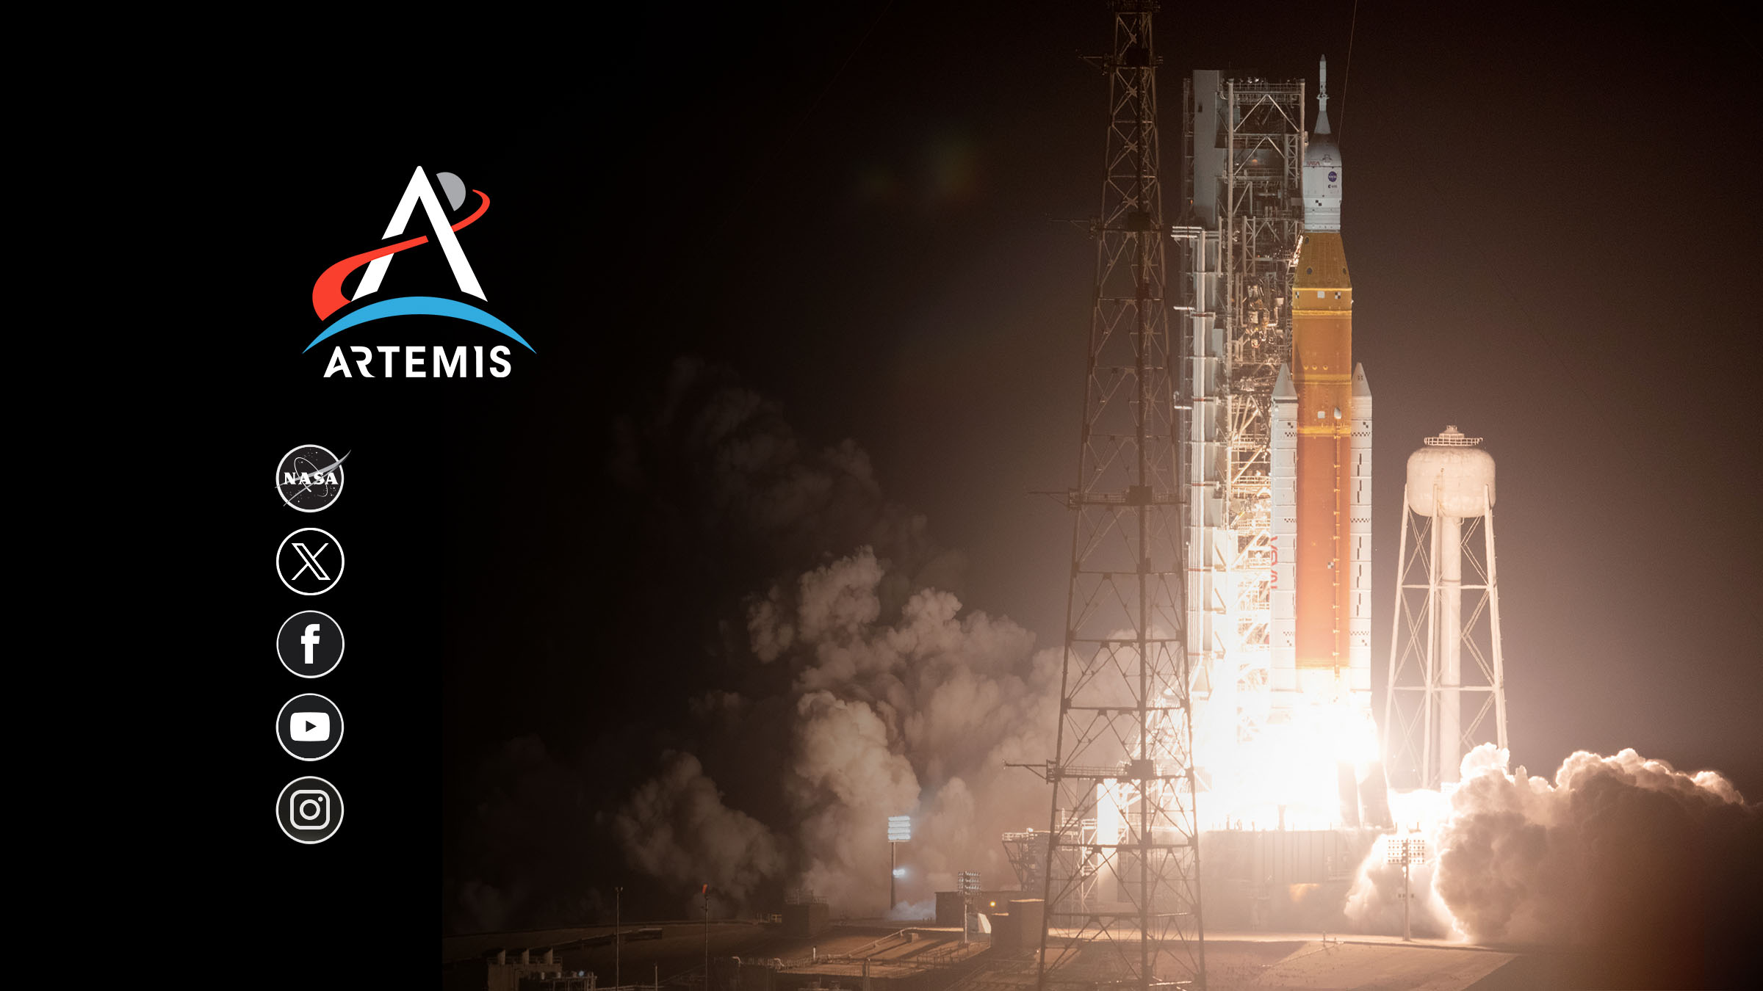
nasa.gov/artemis
@NASAArtemis
NASA Artemis
youtube.com/nasa
@NASAArtemis

