Slide 1
Demonstration of frequency-scanning burst-mode filtered Rayleigh scattering for multi-parameter
gas-phase measurements
2024 AIAA SciTech Forum
AMT-08, Laser Absorption and Scattering Techniques
January 9, 2024
Amanda M. Braun¹ Neil S. Rodrigues², Paul M. Danehy² Alexander R. Suppiah¹, James Braun³ Mikhail N. Slipchenko¹, Terrence R. Meyer¹
¹ Purdue University
²NASA Langley Research Center
³North Carolina State University
Copyright © by Purdue University and the U.S.A., as represented by the Administrator of the
National Aeronautics and Space Administration. All rights reserved.
Published by the American Institute of Aeronautics and Astronautics, Inc., with permission.
| 1

Slide 2
Acknowledgements
NASA Space Technology Graduate Research Opportunity (NSTGRO20), Dr. Paul Danehy as Mentor
N. Rodrigues and P. Danehy acknowledge the support of the NASA STMD/ESDMD Plume Surface Interaction project and the ARMD Transformative Tools and Technologies project
William Holt Ripley, Dr. Ross Burns, Dr. Timothy Fahringer
Steve Jones, Scott Bartram
Chris Crabtree from Spectral Energies, LLC
Dr. Jerome Braun

Slide 3
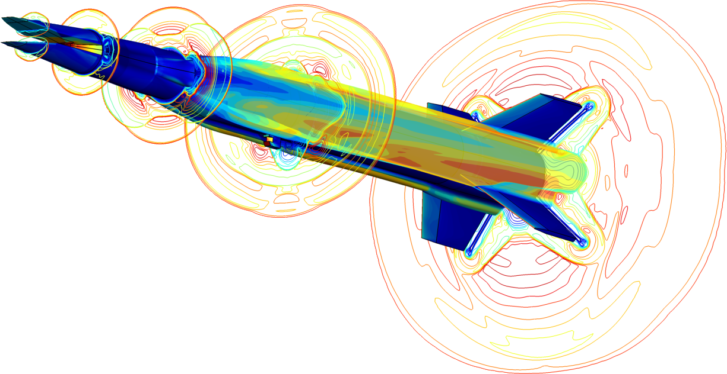
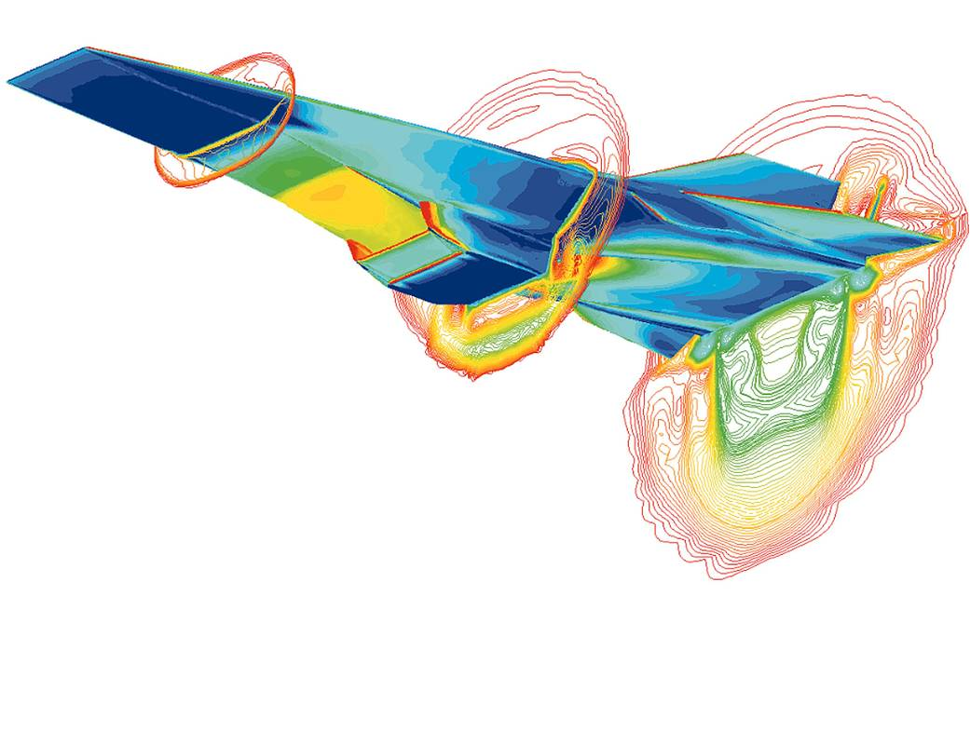
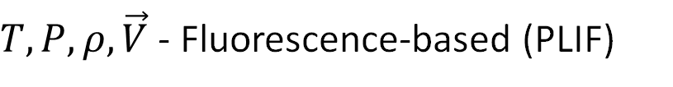
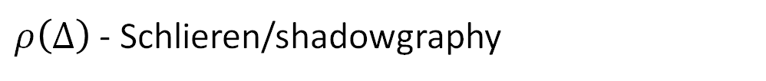
Why do we need optical diagnostics?
Mach Number
HIFiRE Flight 2 Vehicle ^{[1]}
Surface Temperature
Surface Pressure
$ρ\left(Δ\right)$ - Schlieren/shadowgraphy
Hyper-X^{[2]}
$T,P,ρ, \vec{V}$ - Fluorescence-based (PLIF)
$\vec{V}$ - Laser electronic excitation tagging (FLEET, PLEET)
$T,P,ρ, \vec{V}$ - Laser scattering (CARS, Raman, Rayleigh, DGV, PIV)

Slide 4
Why use Rayleigh scattering?
Technique
Velocity
Temperature
Pressure
Density
Unseeded
Particle Image Velocimetry
Doppler Global Velocimetry
Raman Scattering
Rayleigh Scattering
* Background interferences, weak signal levels, and difficulty making multi-parameter measurements
Notes:
Unseeded technique

Slide 5
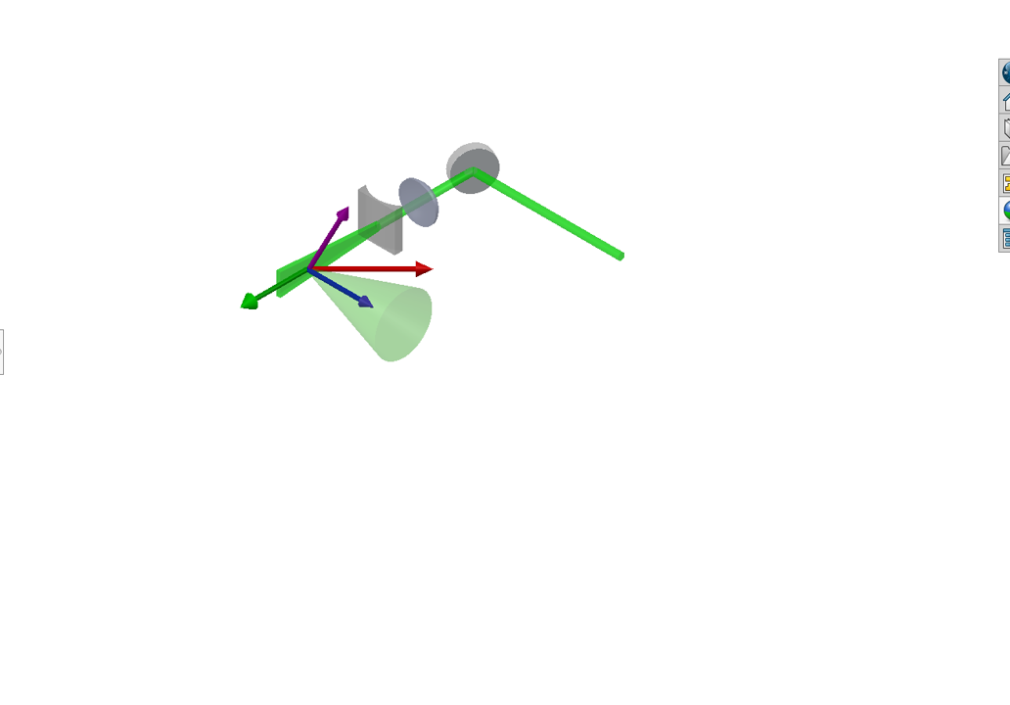
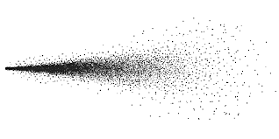
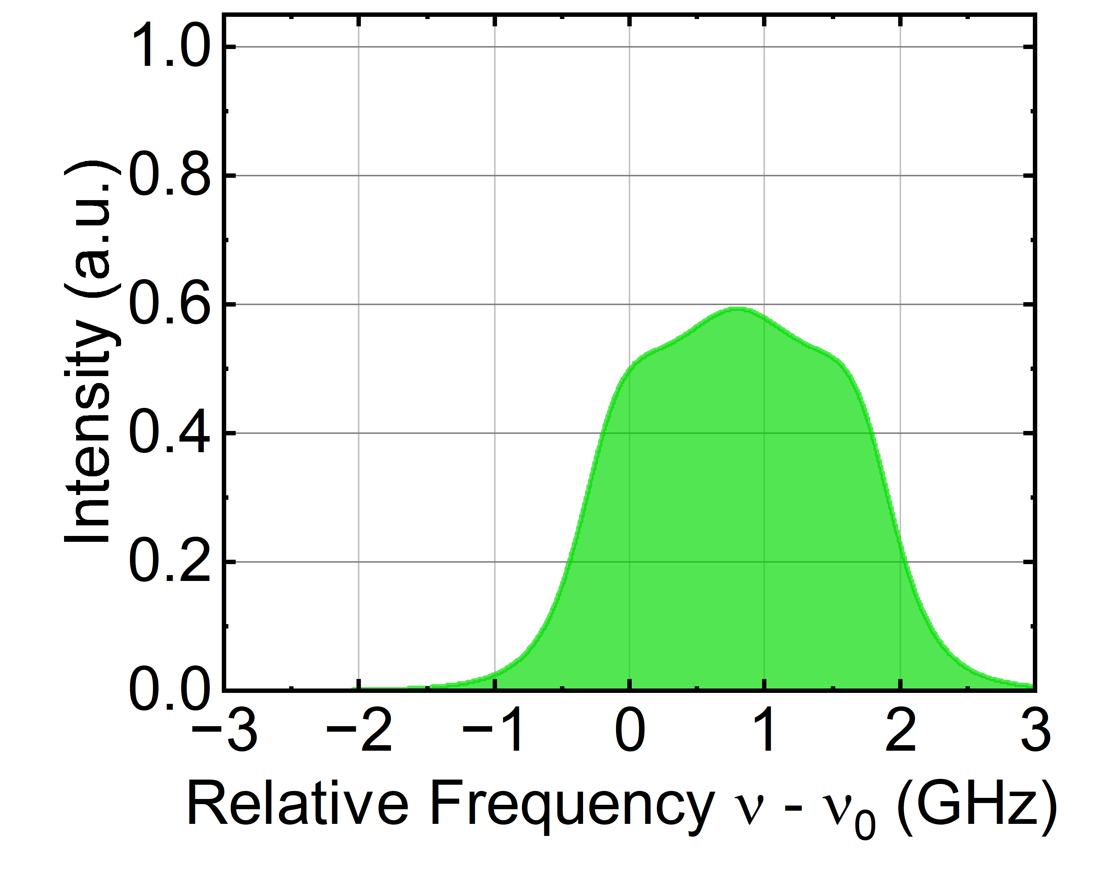








What is Rayleigh scattering?
$$\vec{V}$$
Flow Molecules
$$T, P, ρ, \vec{V}$$
Velocity Vector
$$T, P$$
Rayleigh Scattering
Incident Laser
$$ρ$$
Wave Vector
$$\vec{k}$$
$$Δν_{D}(\vec{V})$$
$$θ$$
Laser Vector
Scattering Vector
$$Δν_{D}=\frac{1}{λ} \vec{V} ∙\vec{\text{k}}$$
Doppler Shift
Notes:
Explanation

Slide 6
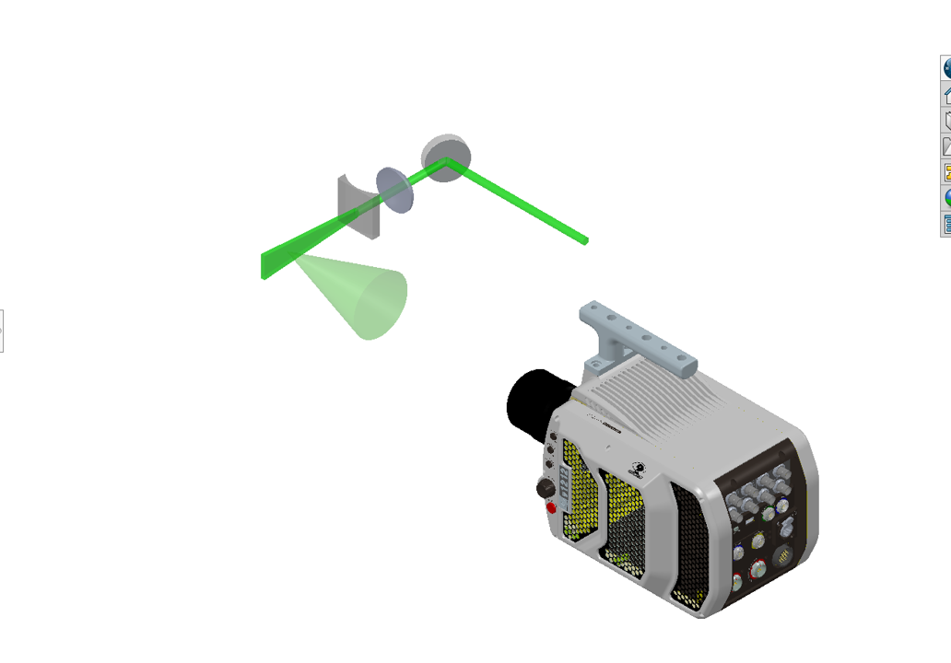
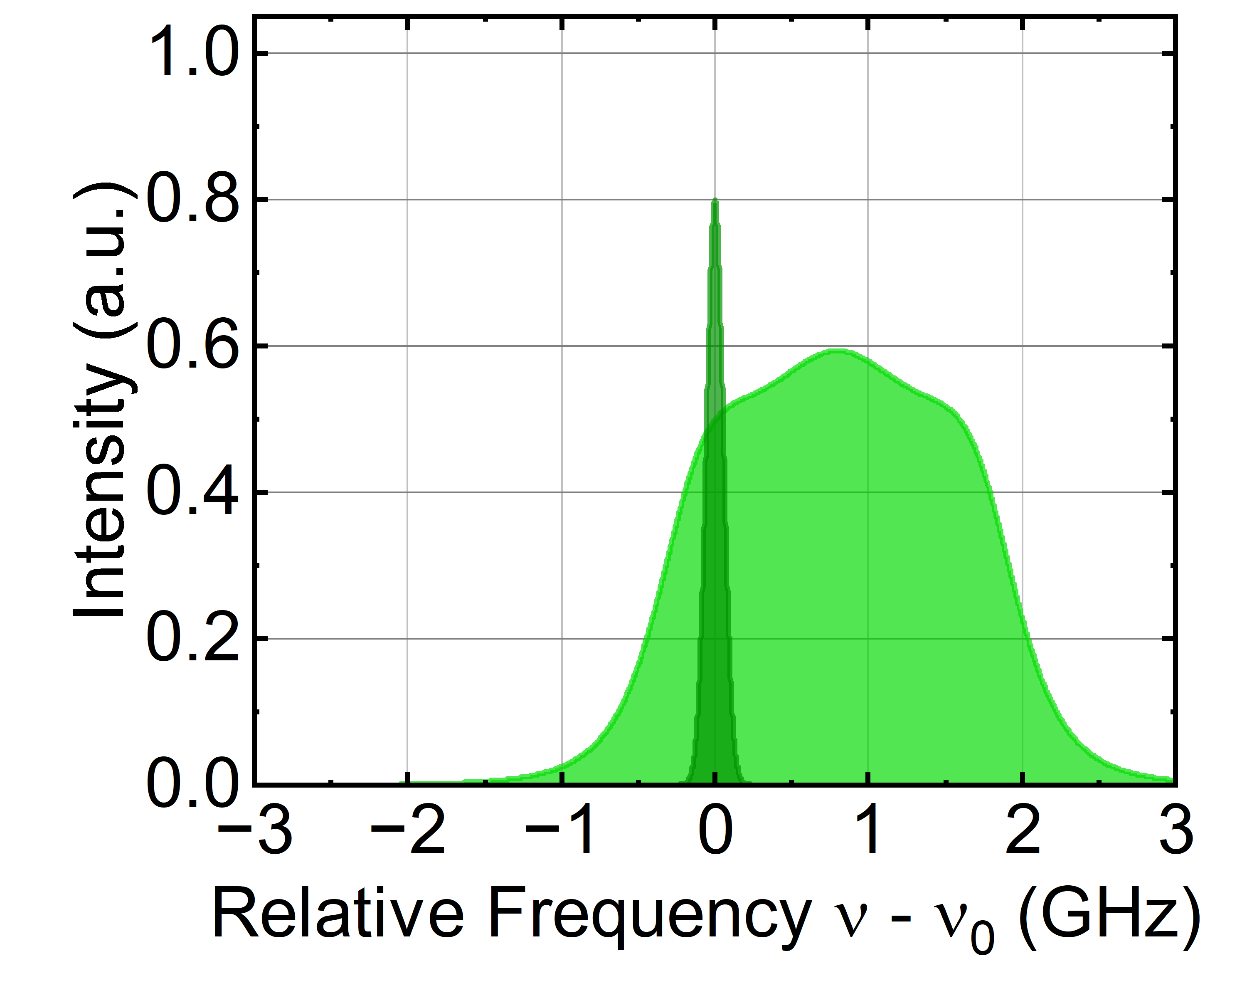
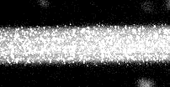


Why use filtered Rayleigh scattering?
Flow Molecules
$$T, P, ρ, \vec{V}$$
Rayleigh Scattering
$$T, P$$
Rayleigh Scattering
Incident Laser
$$ρ$$
$$Δν_{D}(\vec{V})$$
Mie/Stray Scattering
Notes:
Explanation

Slide 7
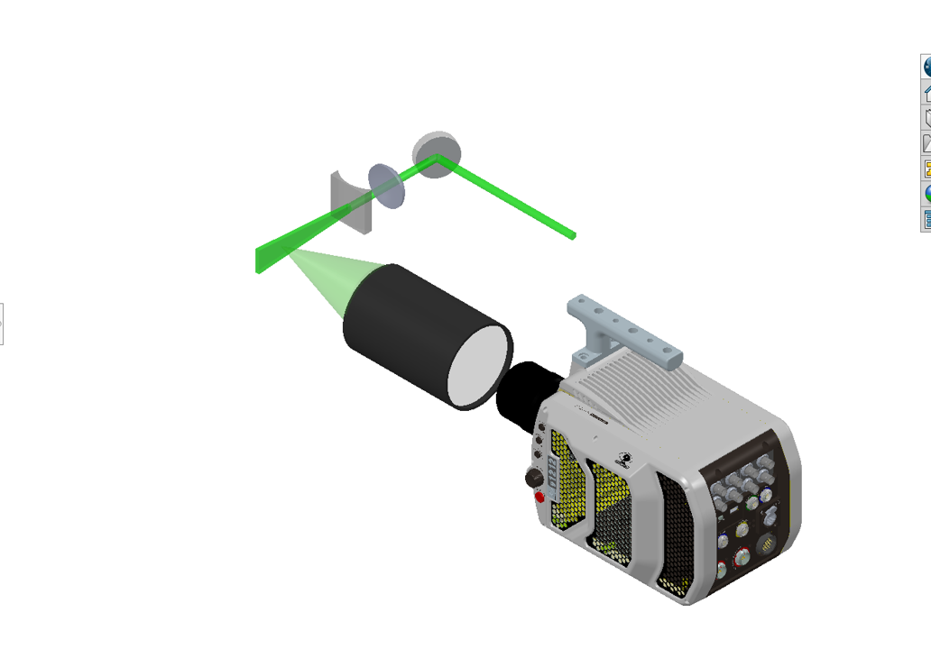
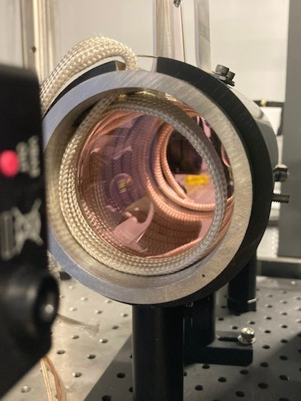
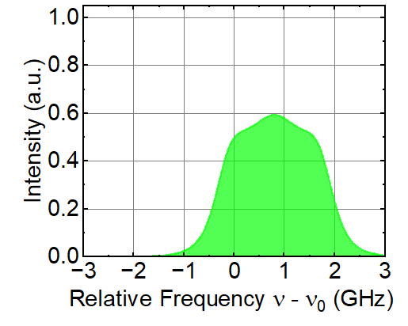
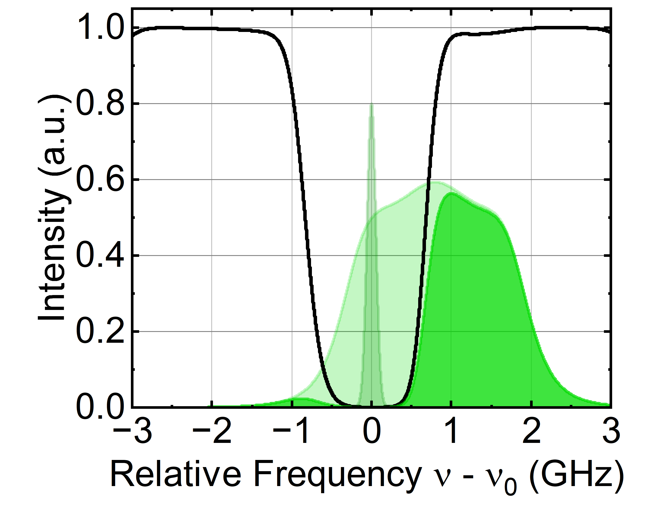
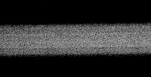


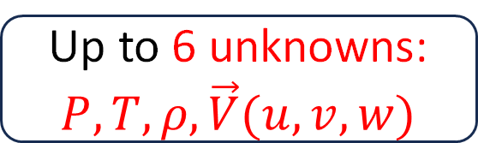

Why use filtered Rayleigh scattering?
Gaseous Iodine
Flow Molecules
$$T, P, ρ, \vec{V}$$
$$T, P$$
Rayleigh Scattering
Filter
532 nm
$$T, P$$
$$ρ$$
$$ρ$$
$$Δν_{D}(\vec{V})$$
$$Δν_{D}(\vec{V})$$
Molecular
Filter
Up to 6 unknowns: $P, T, ρ, \vec{V}(u,v,w)$
Notes:
Explanation

Slide 8
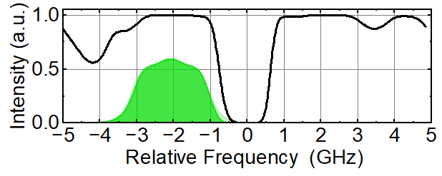
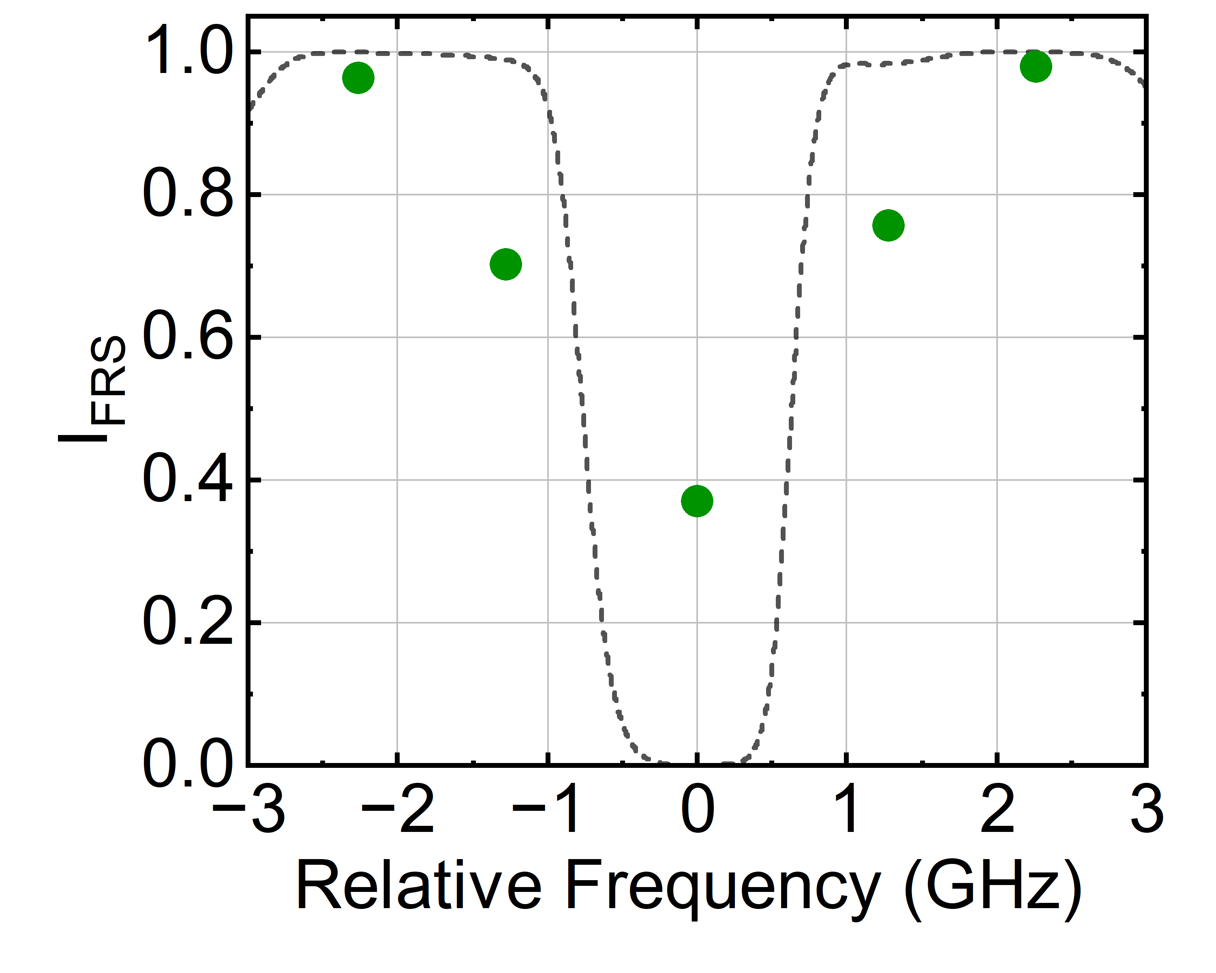
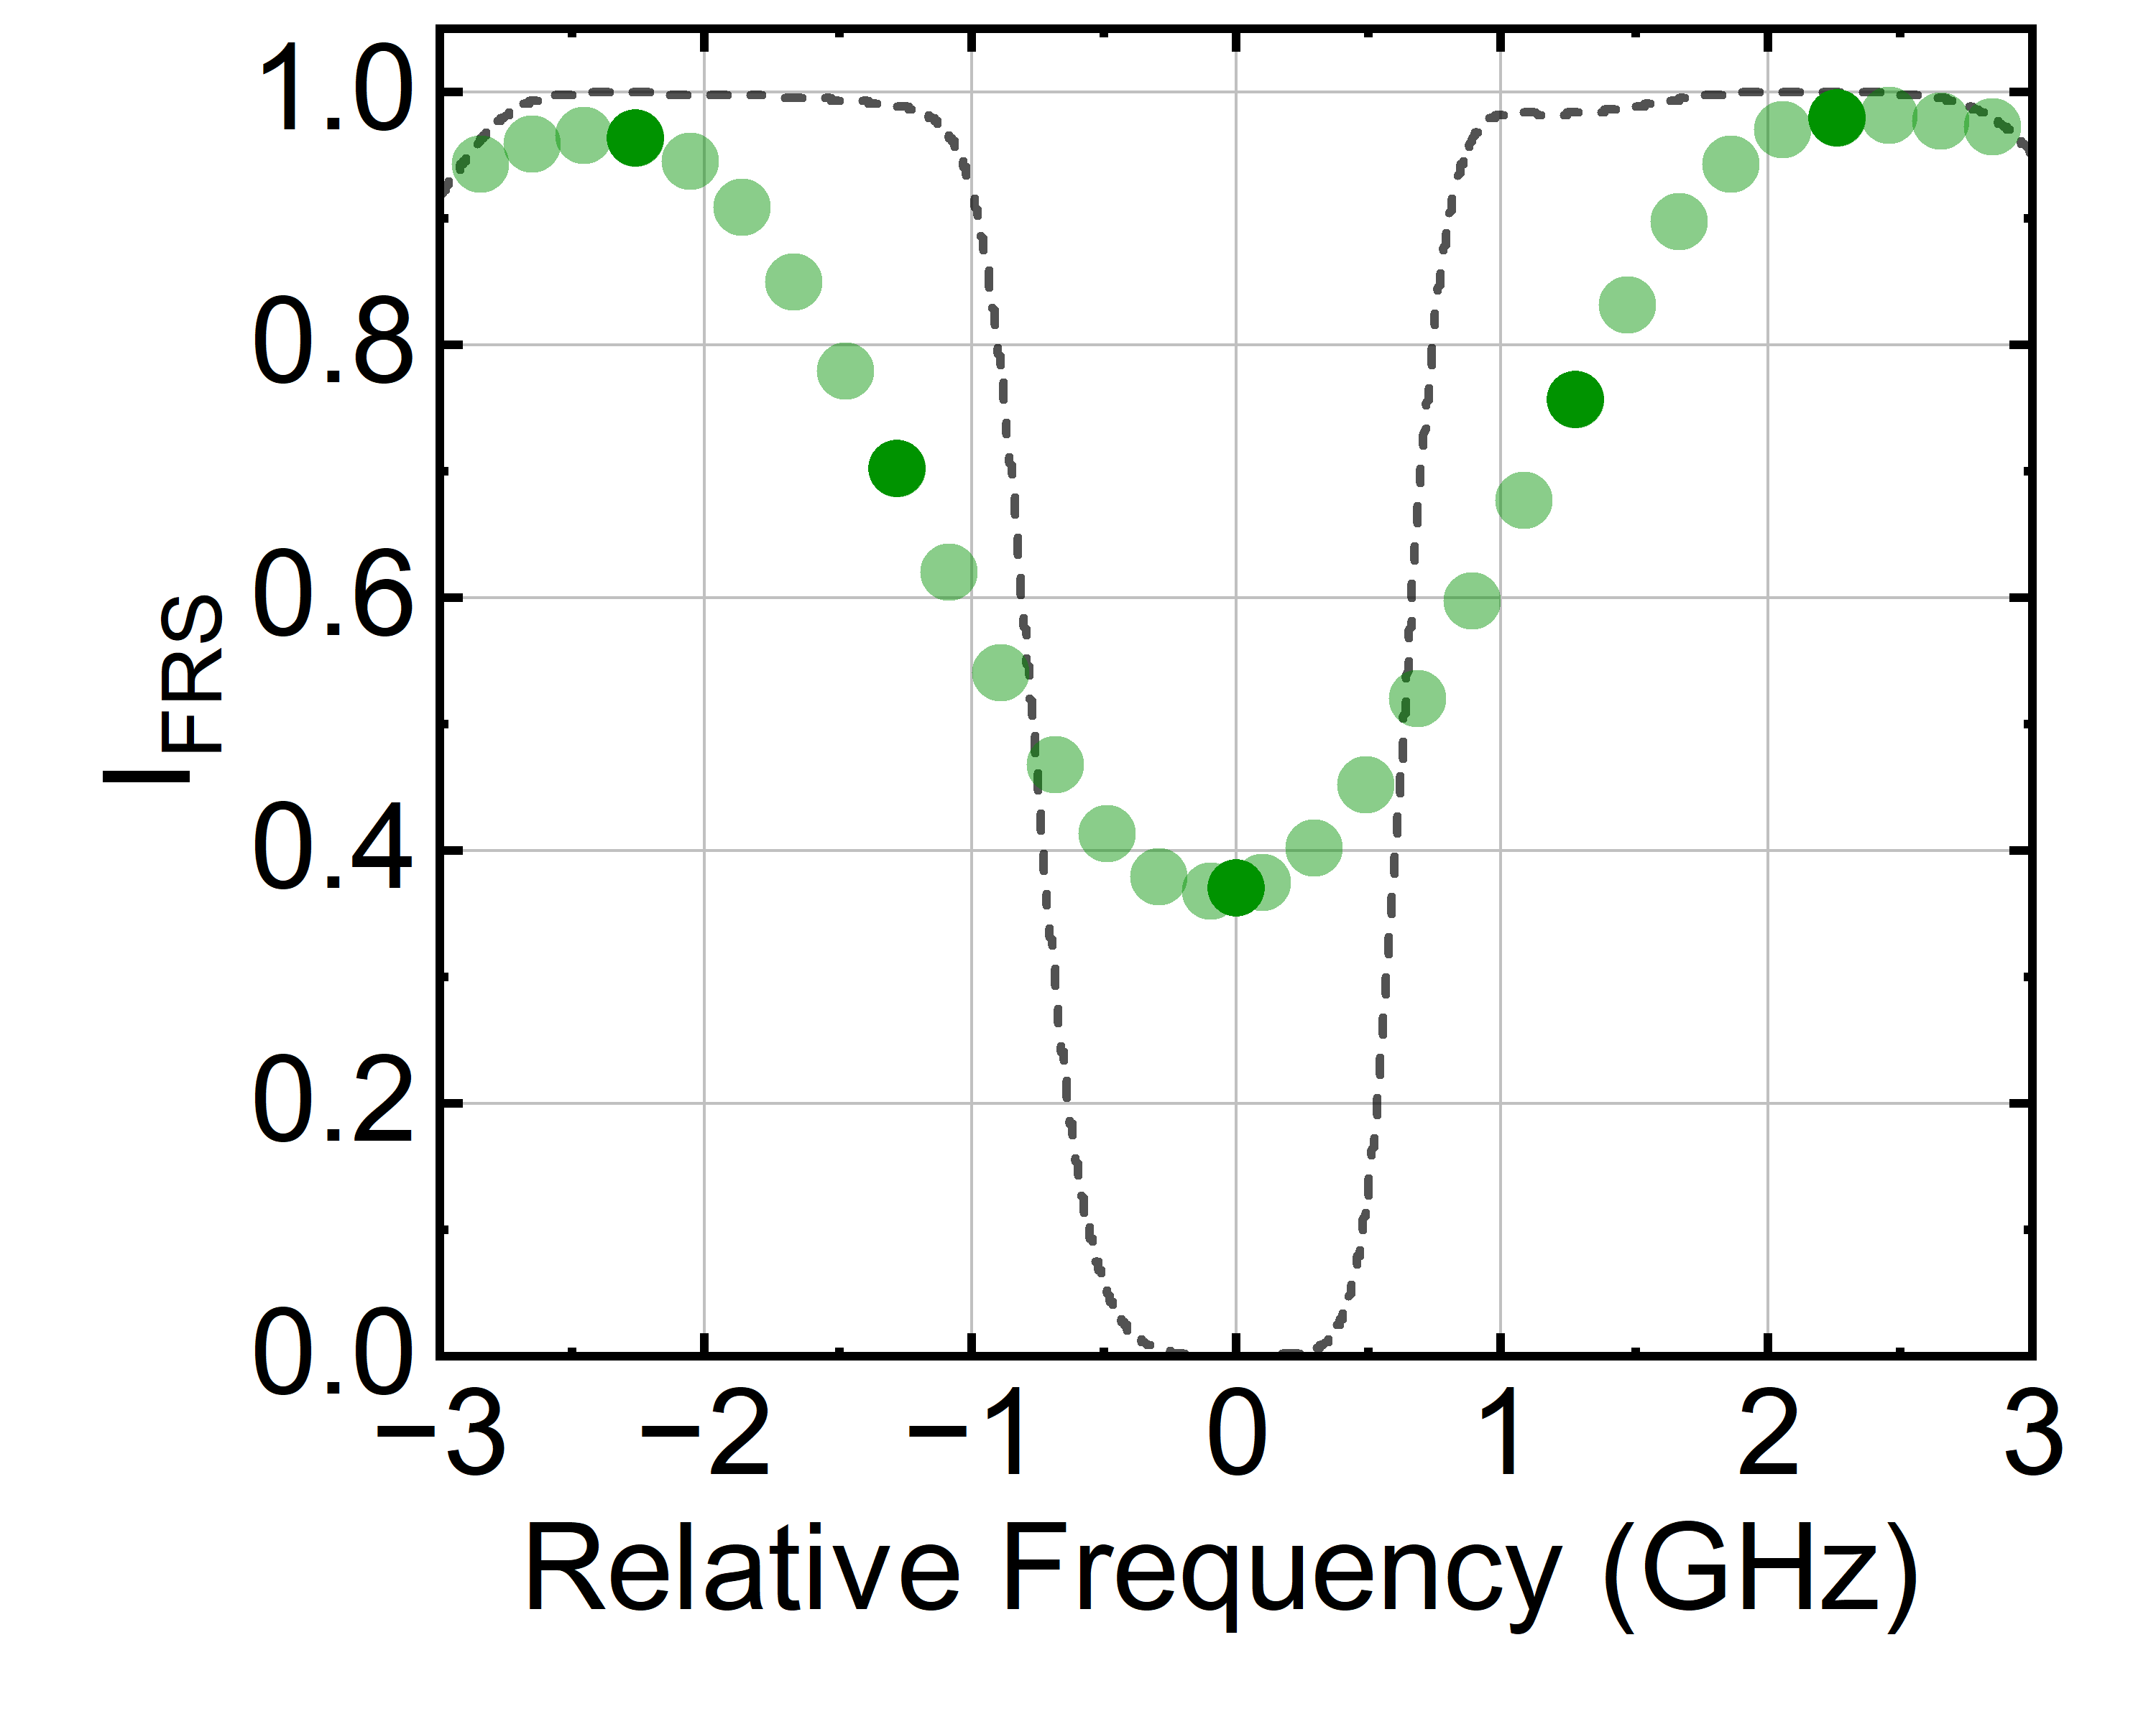
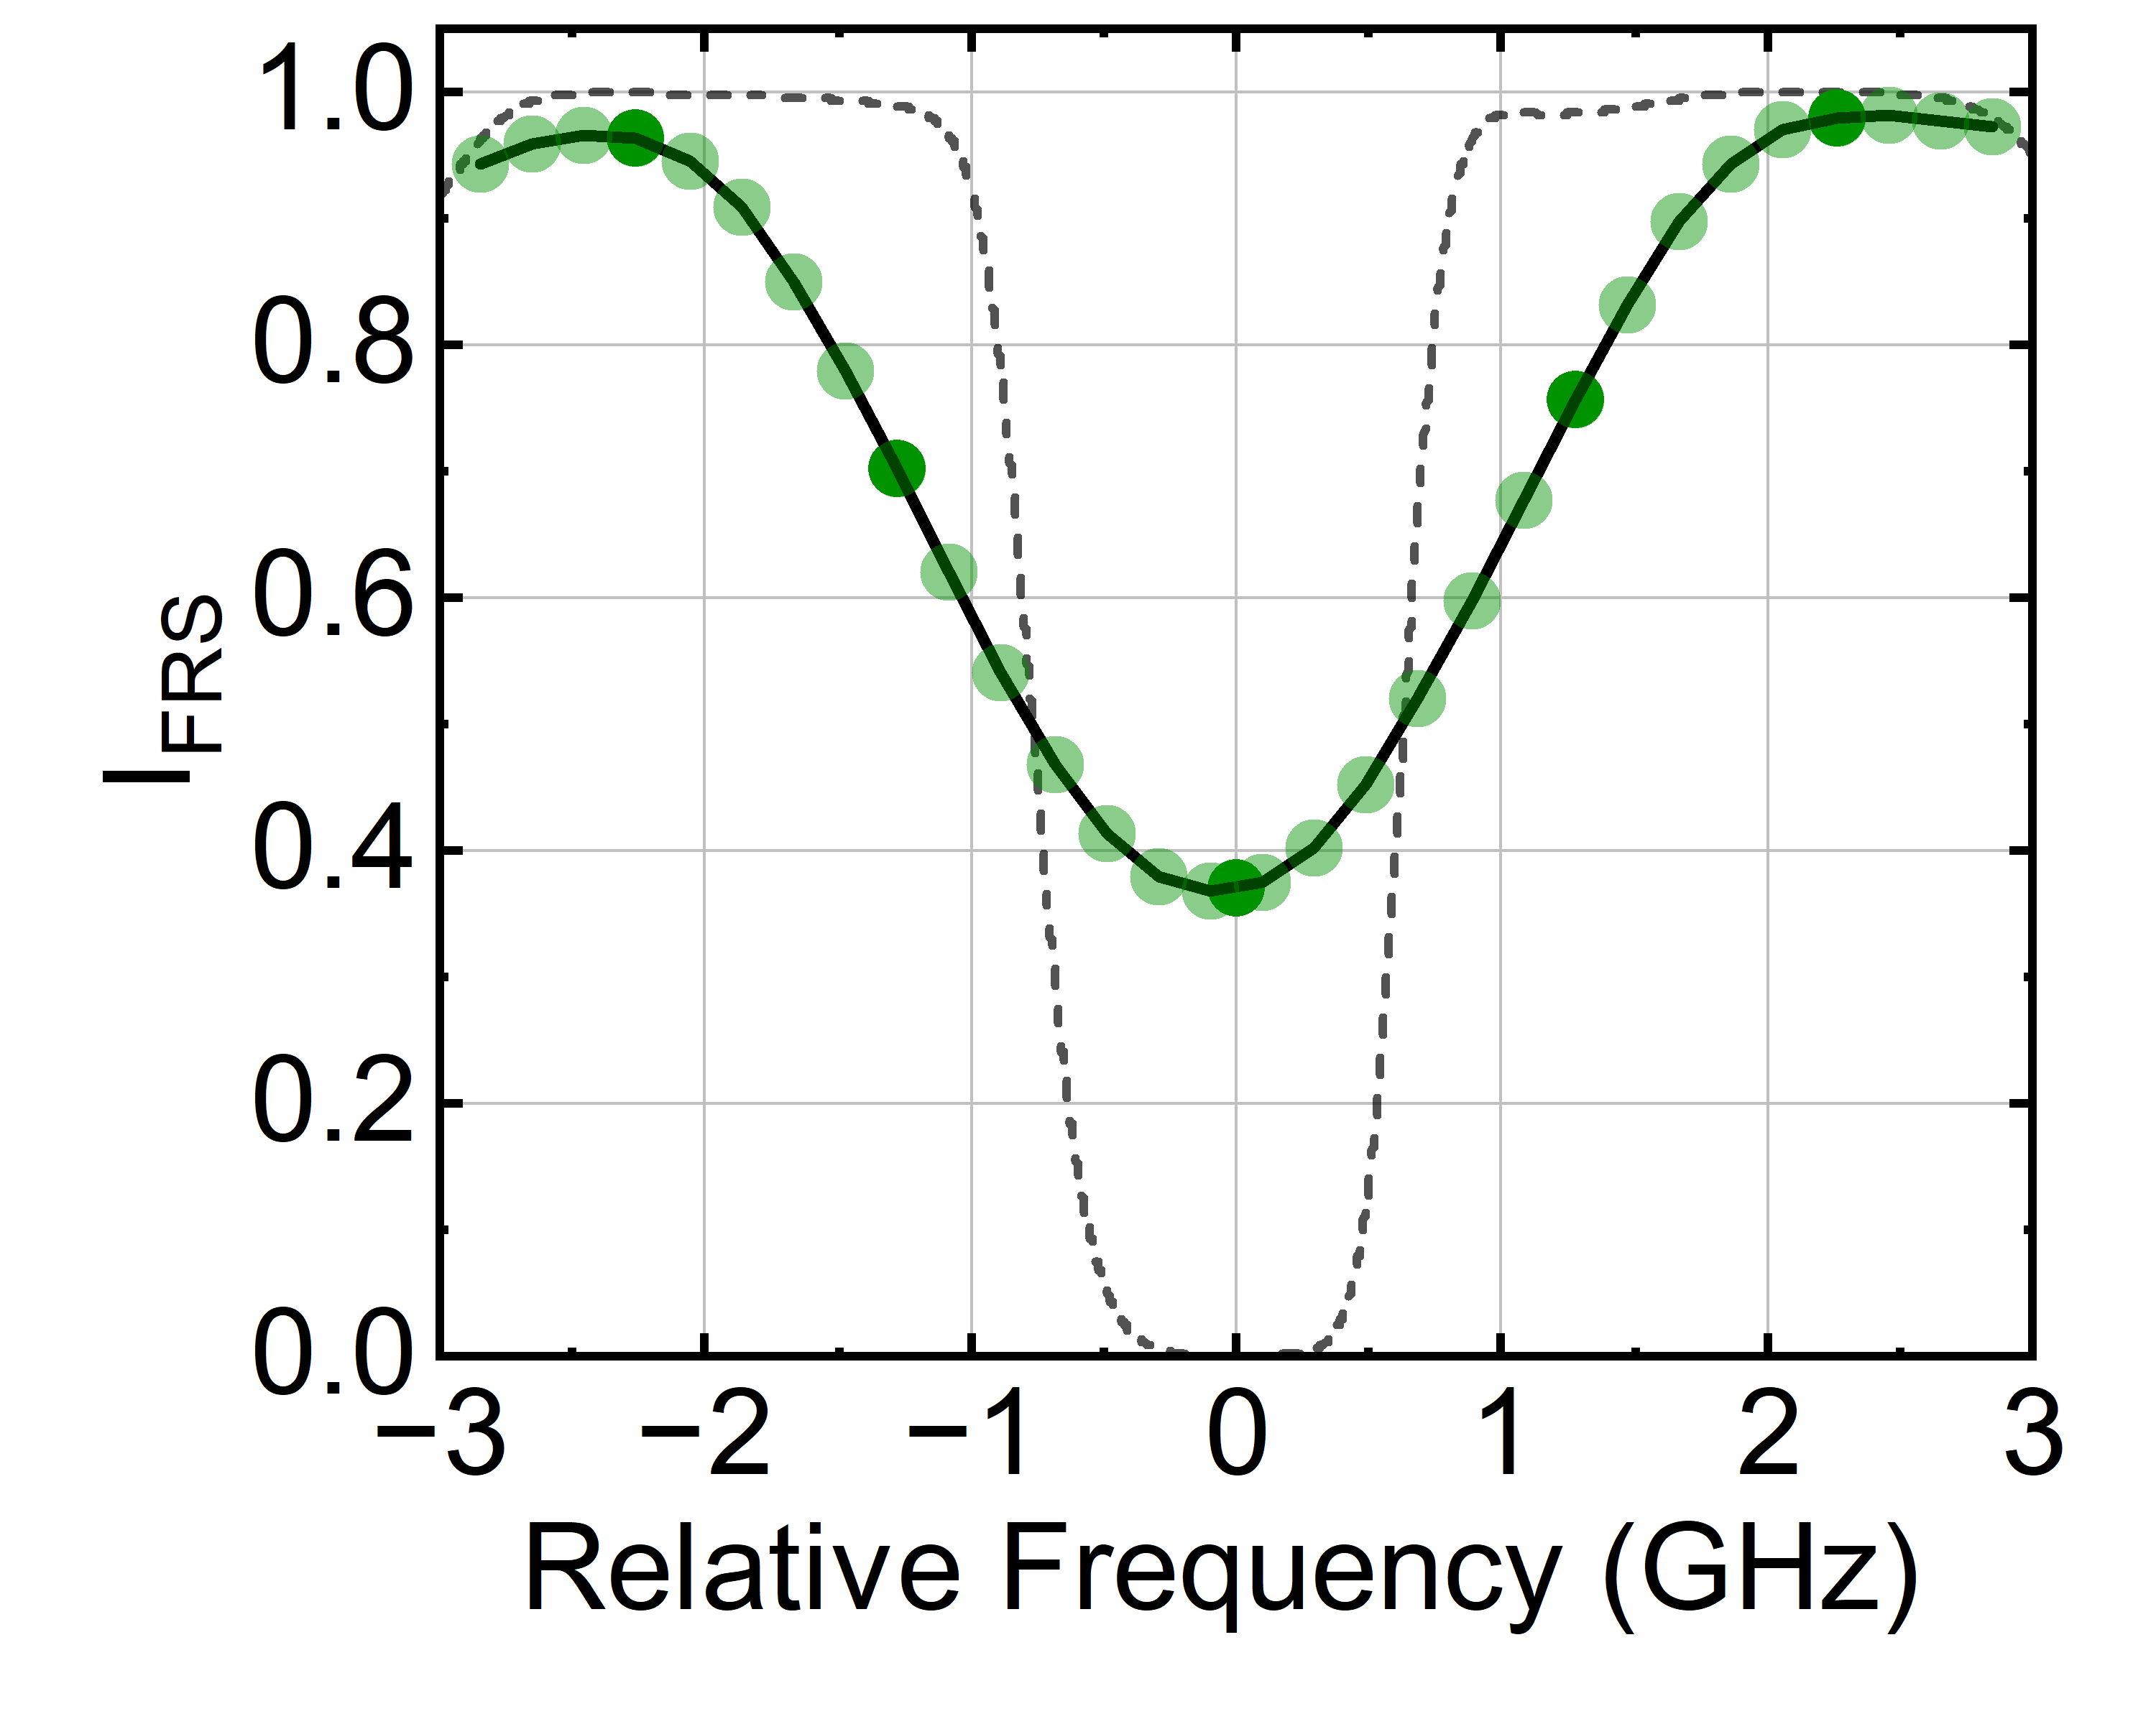
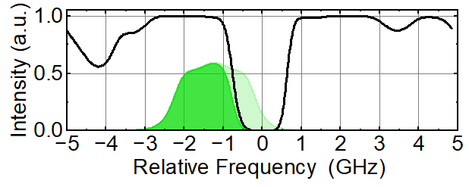
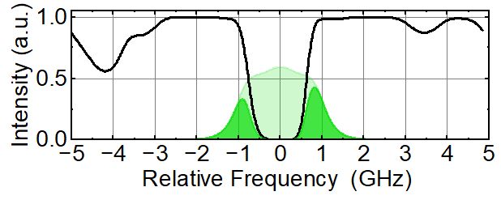
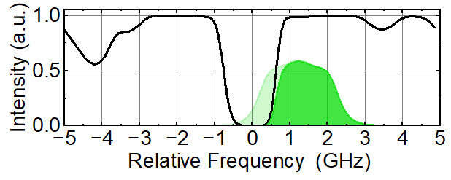
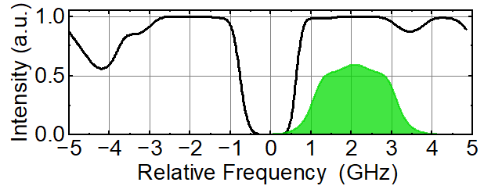
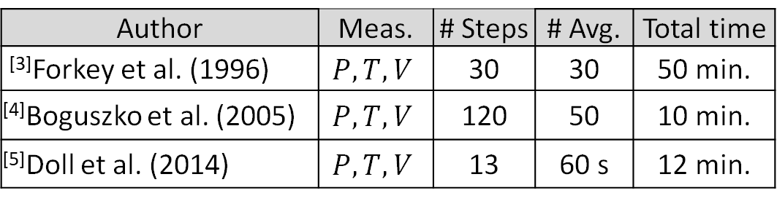
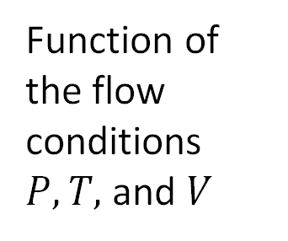
Frequency-scanning FRS for a single pixel
Function of the flow conditions $P, T,$and $V$
Author | Meas. | # Steps | # Avg. | Total time
^{[3]}Forkey et al. (1996) | $$P, T, V$$ | 30 | 30 | 50 min.
^{[4]}Boguszko et al. (2005) | $$P, T, V$$ | 120 | 50 | 10 min.
^{[5]}Doll et al. (2014) | $$P, T, V$$ | 13 | 60 s | 12 min.
Can we reduce this measurement time?

Slide 9
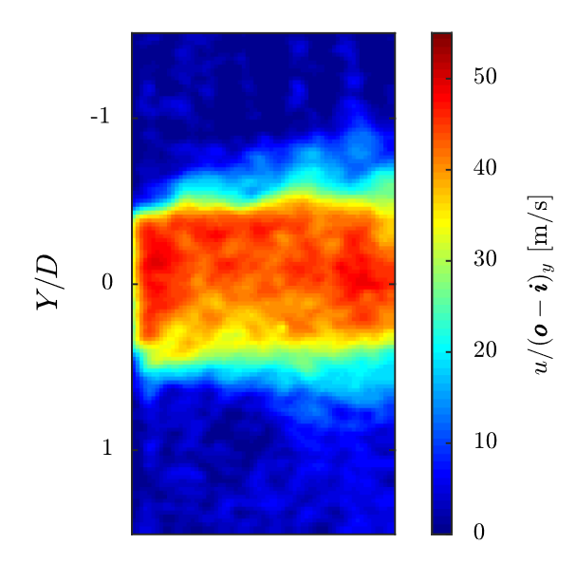
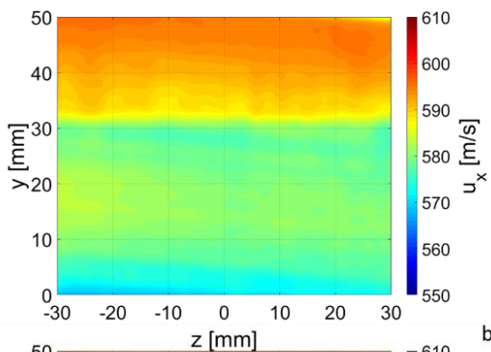
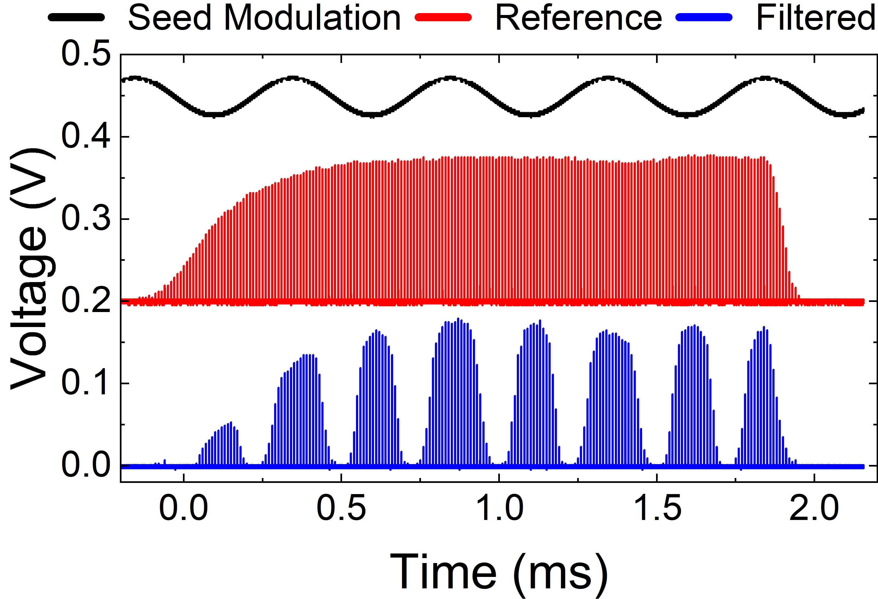
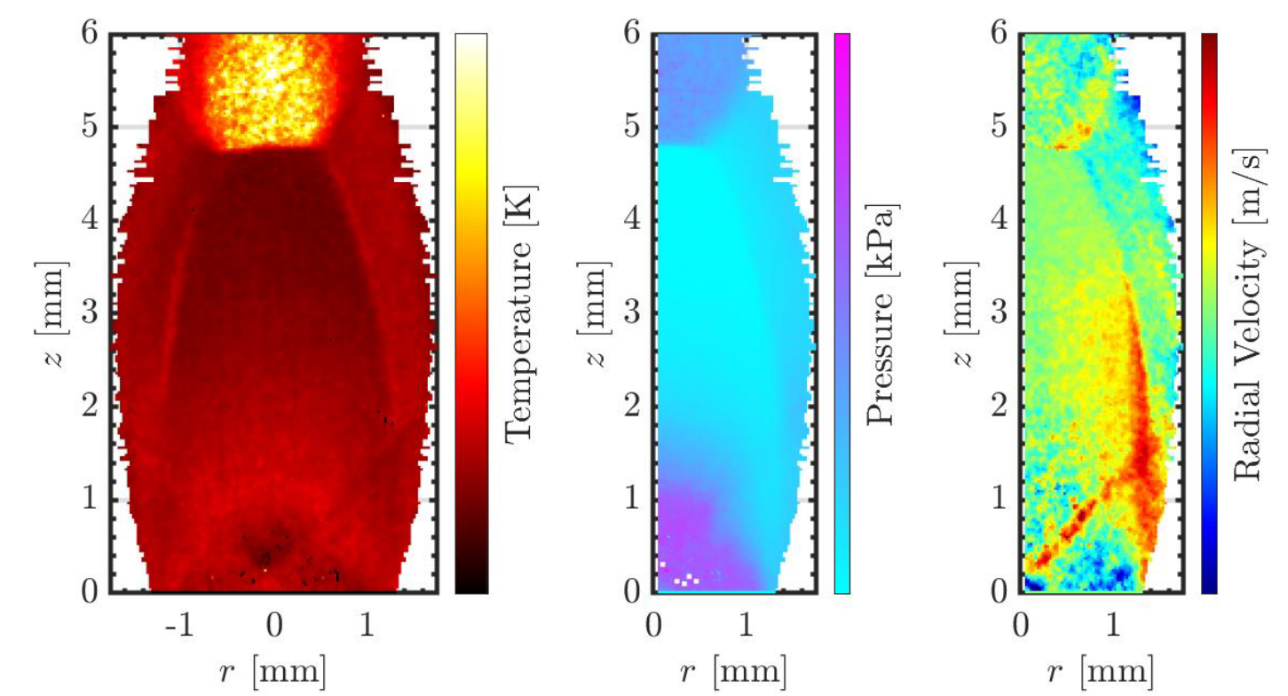
Frequency-scanning burst-mode laser
Potential to decrease measurement time to 10 ms or less
Doppler global velocimetry
^{[6]} Fahringer et al. (2020)
^{[7]} Burns et al. (2018)
^{[8]} Rodrigues et al. (2023)
Planar
laser-induced fluorescence

Slide 10
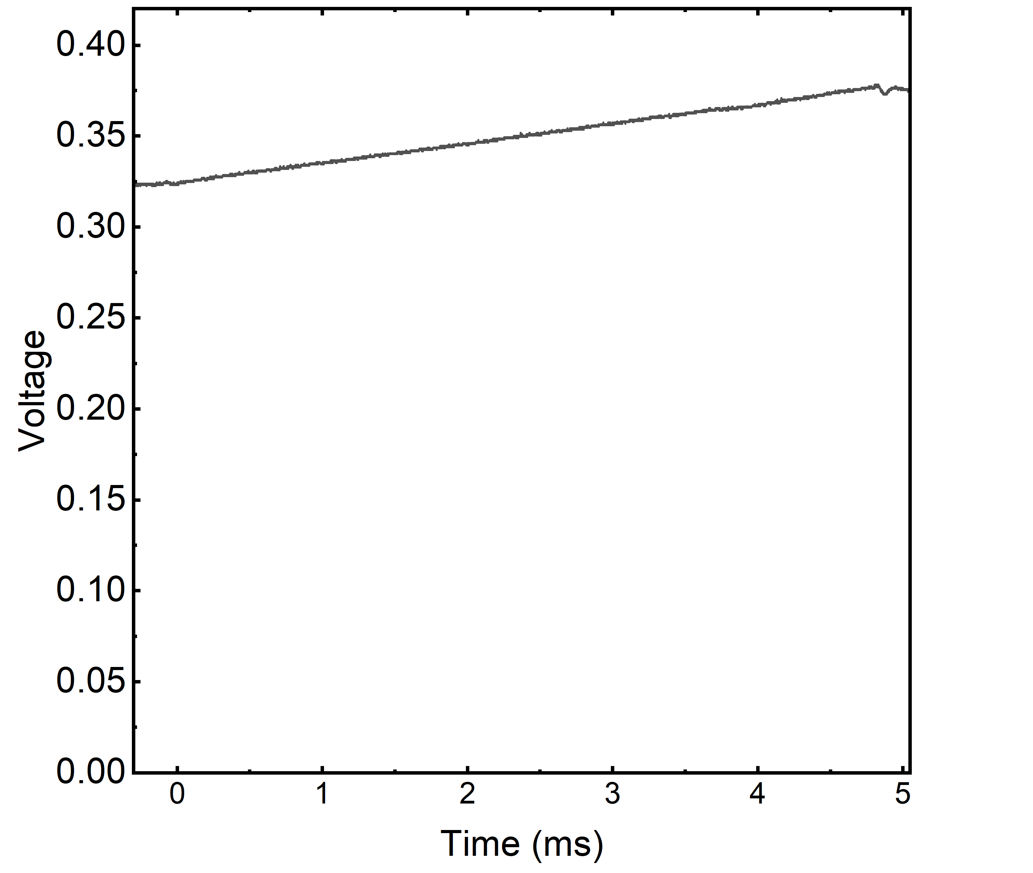
Frequency-scanning burst-mode laser
1064 nm
532 nm
SHG
Power Amplifier
Function Generator Signal
Pulse Slicing
cw Laser
Master Oscillator
Function Generator

Slide 11
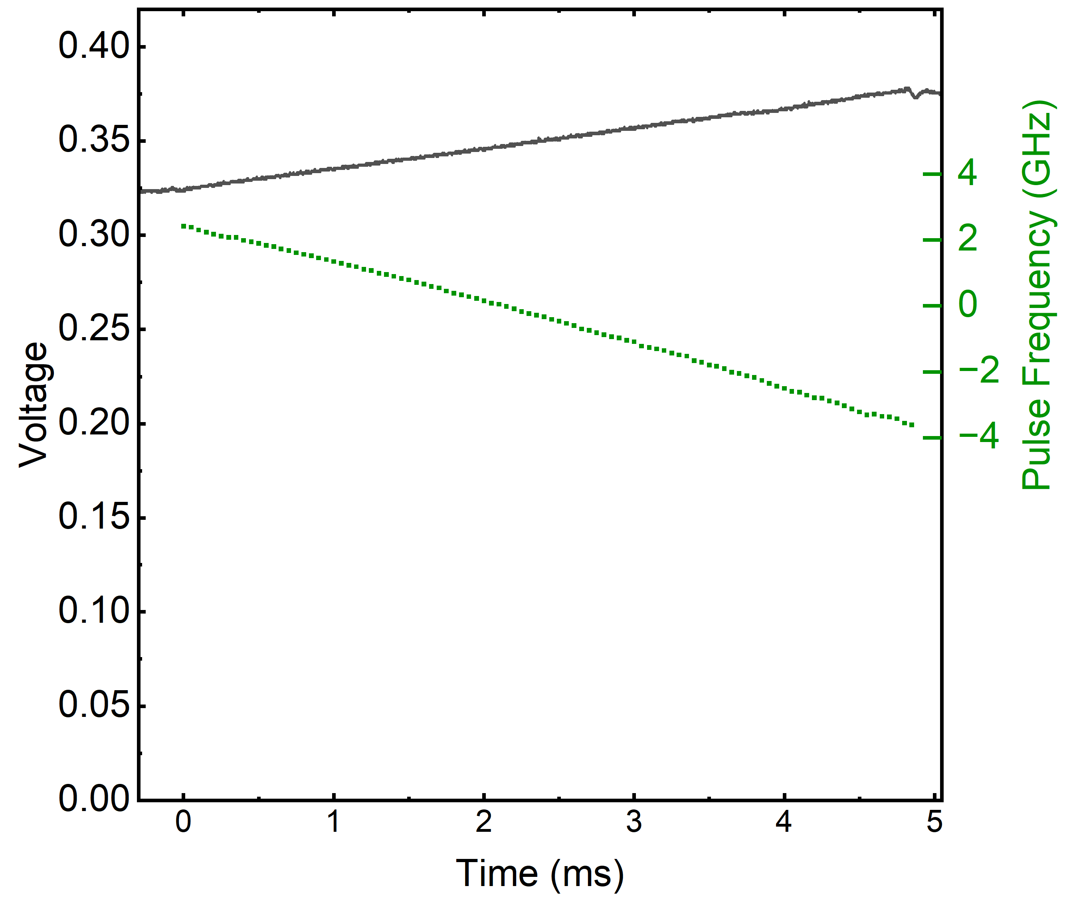
Frequency-scanning burst-mode laser
Wavemeter
1064 nm
532 nm
SHG
Power Amplifier
Relative Frequency (GHz)
Function Generator Signal
Pulse Slicing
Wavemeter Measurement
cw Laser
Master Oscillator
Function Generator

Slide 12
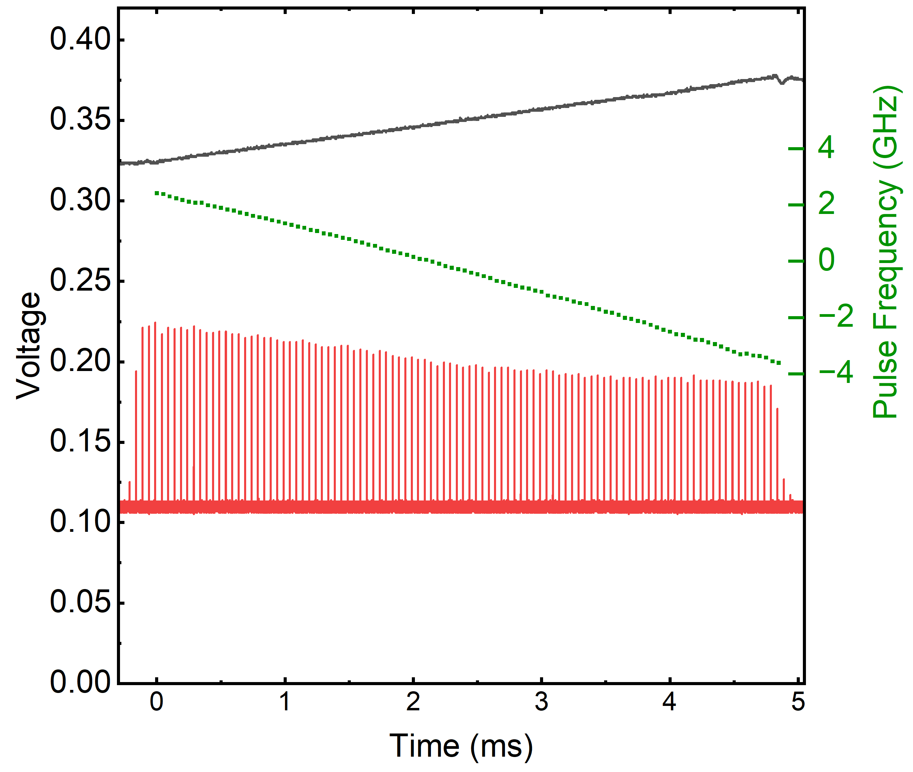
Frequency-scanning burst-mode laser
Wavemeter
1064 nm
532 nm
SHG
Unfiltered
Power Amplifier
Relative Frequency (GHz)
Function Generator Signal
Pulse Slicing
Wavemeter Measurement
Unfiltered Burst Profile
cw Laser
Master Oscillator
Function Generator

Slide 13
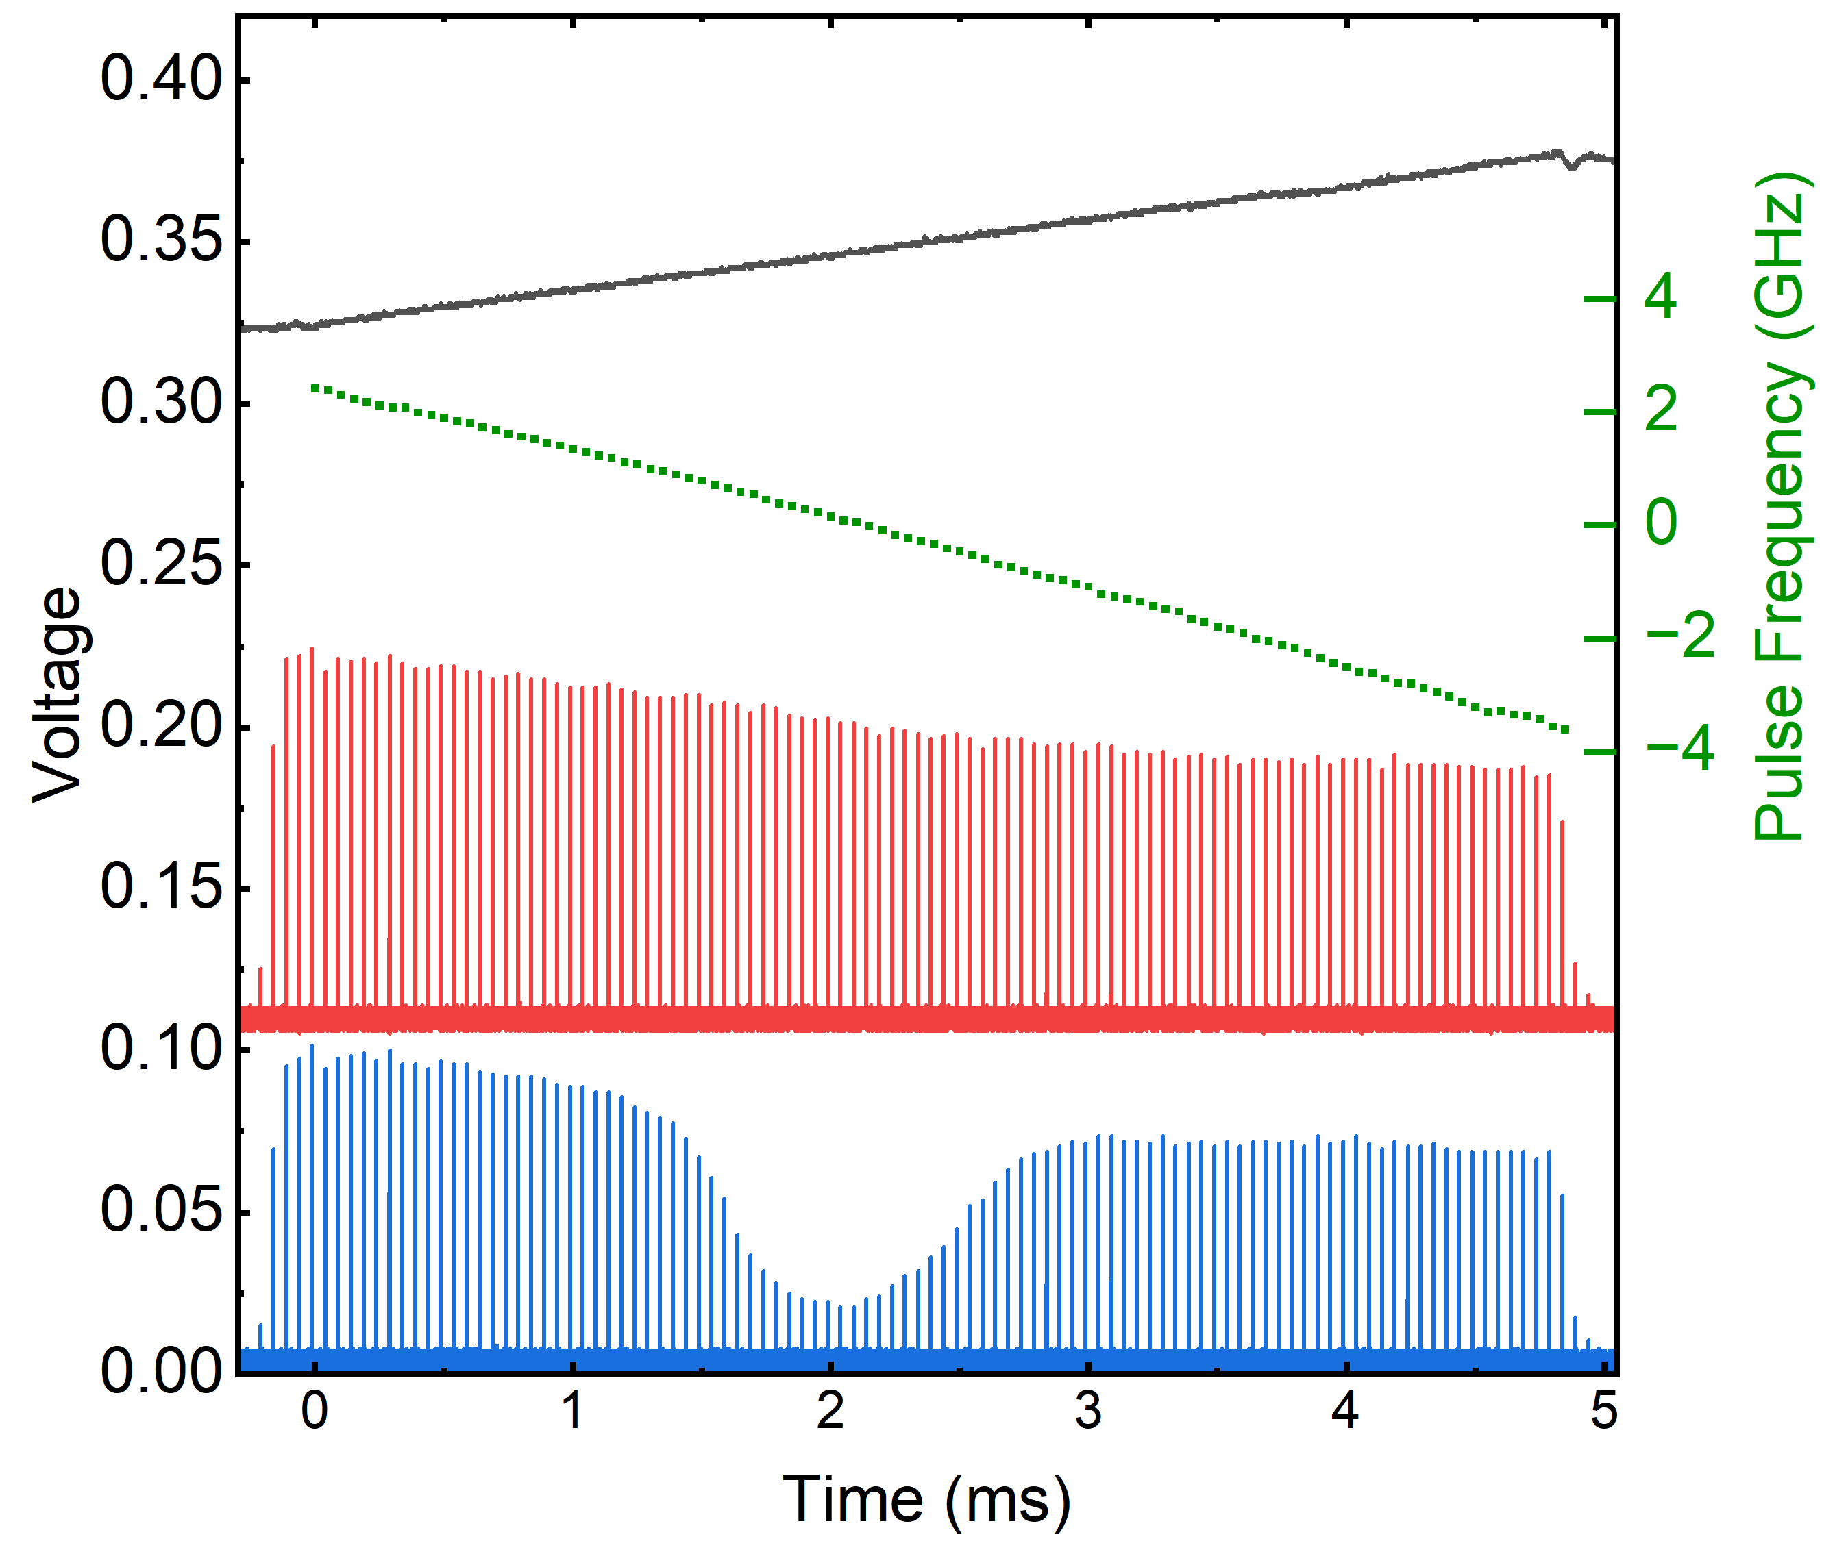
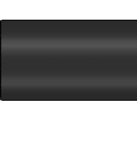
Frequency-scanning burst-mode laser
Wavemeter
1064 nm
532 nm
SHG
Unfiltered
Iodine Cell
Iodine Cell
Filtered
Power Amplifier
Relative Frequency (GHz)
Function Generator Signal
Pulse Slicing
Wavemeter Measurement
Unfiltered Burst Profile
Filtered Burst Profile
cw Laser
Master Oscillator
Function Generator

Slide 14
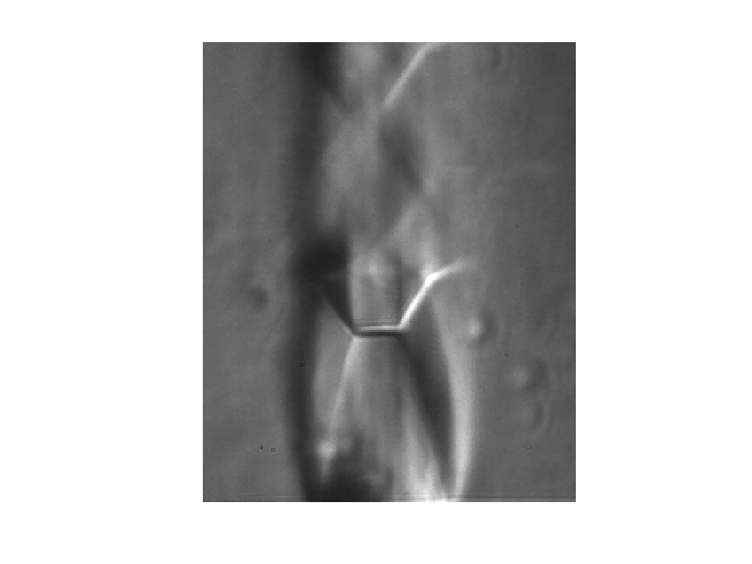
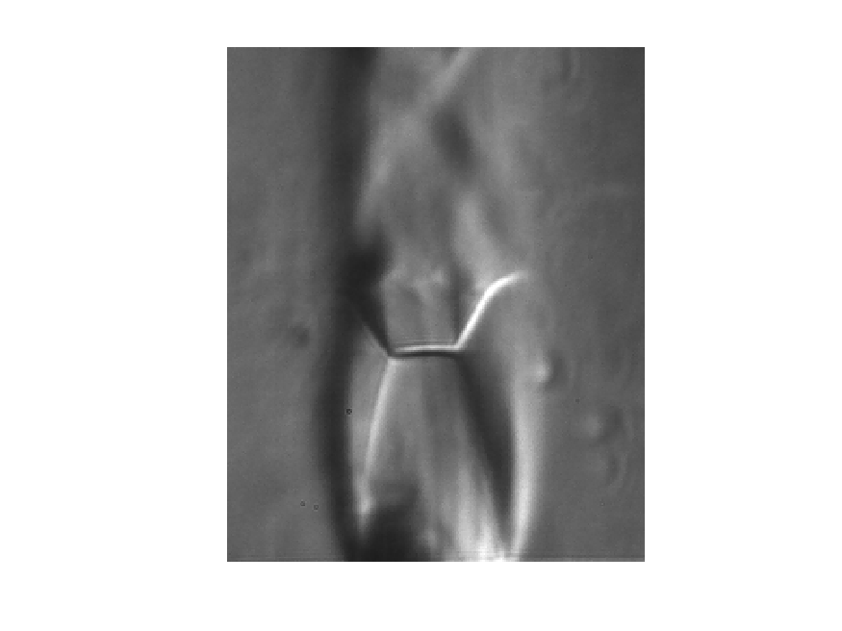






Underexpanded jet flow
Wavemeter
1064 nm
532 nm
SHG
Unfiltered
Iodine Cell
Iodine Cell
Filtered
Power Amplifier
Schlieren
Pulse Slicing
Orifice-style sonic nozzle coupled with coflow
$$NPR=\frac{P_{0}}{P_{B}}$$
Plenum pressure, $P_{0}$
Back pressure, $P_{B}$
cw Laser
Master Oscillator
Function Generator
$$NPR \sim 5$$
$$NPR \sim 6$$
$$NPR \sim 7$$
$$y$$
$$z$$
$$x$$

Slide 15
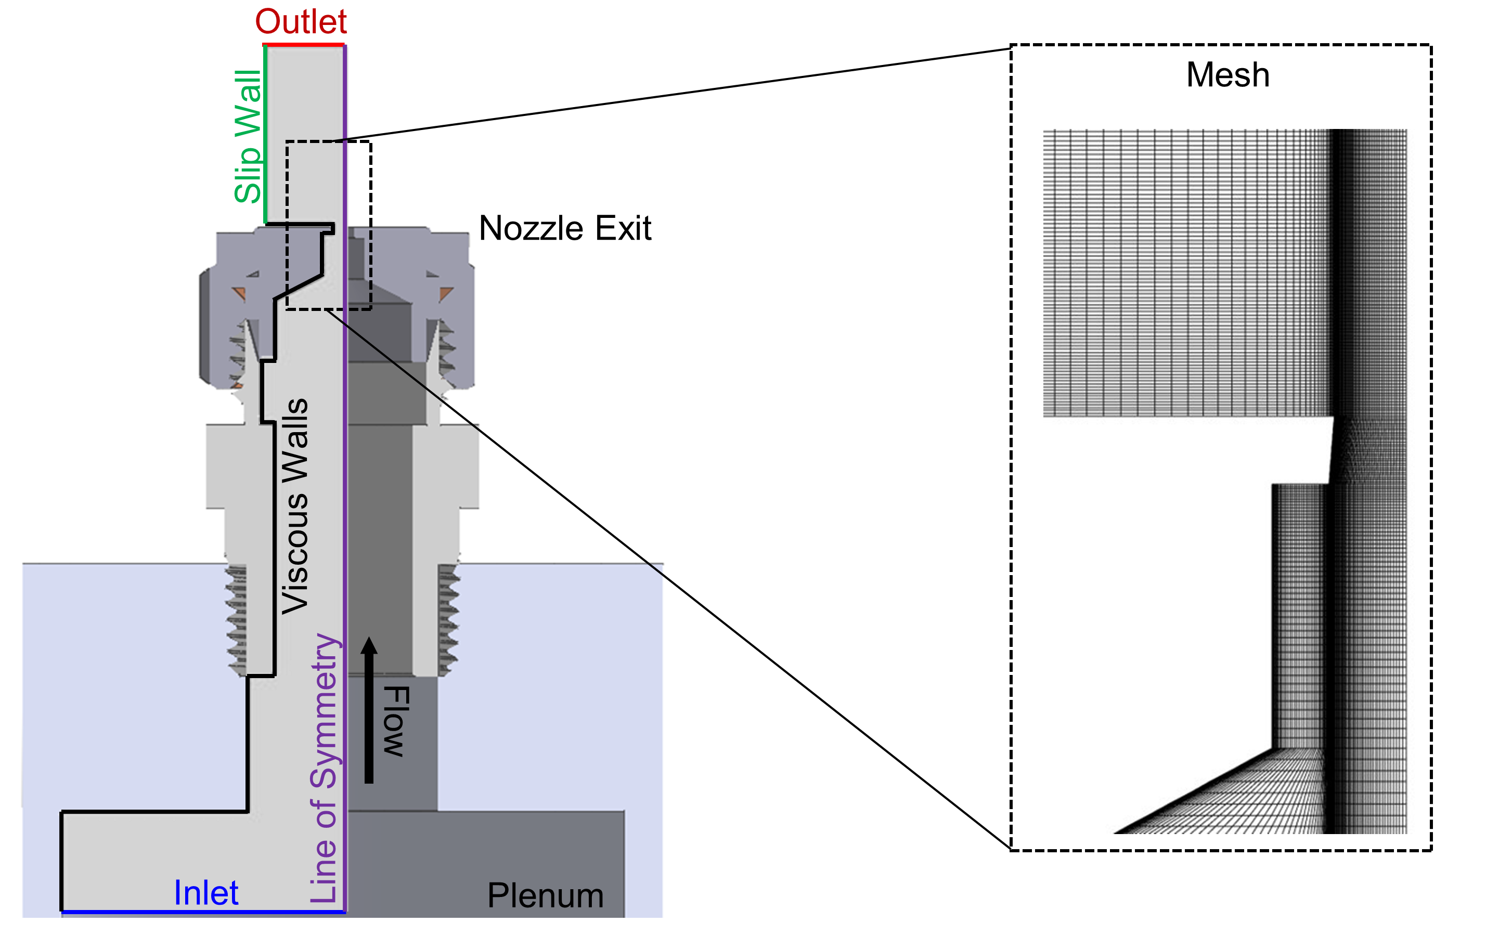
Computational fluid dynamics
Computational Fluid Dynamics
Wavemeter
1064 nm
Reynolds Averaged Navier Stokes (RANS)
2D axisymmetric mesh with ~60,000 hexahedral cells
532 nm
SHG
Unfiltered
Iodine Cell
Iodine Cell
Filtered
Power Amplifier
Pulse Slicing
cw Laser
Master Oscillator
Function Generator
$$y$$
$$z$$
$$x$$

Slide 16




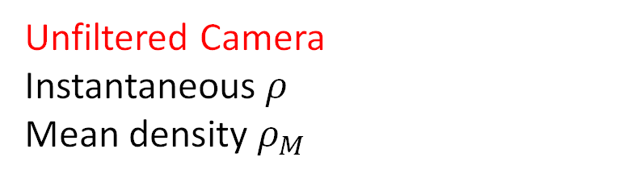
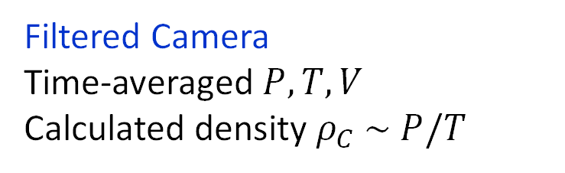
Filtered/unfiltered Rayleigh scattering images
Wavemeter
Schlieren
1064 nm
Laser Sheet
532 nm
SHG
Unfiltered
Iodine Cell
Iodine Cell
Filtered
Power Amplifier
$$k$$
Flow
Filtered Camera
$$z$$
$$k_{s}$$
Iodine Cell
+ Velocity
Pulse Slicing
$$x$$
$$y$$
cw Laser
$$k_{L}$$
Master Oscillator
Filtered Camera
Time-averaged $P, T, V$
Calculated density $ρ_{C} \sim P/T$
Function Generator
Unfiltered Camera
$$y$$
Unfiltered Camera
Instantaneous $ρ$
Mean density $ρ_{M}$
$$z$$
$$x$$

Slide 17
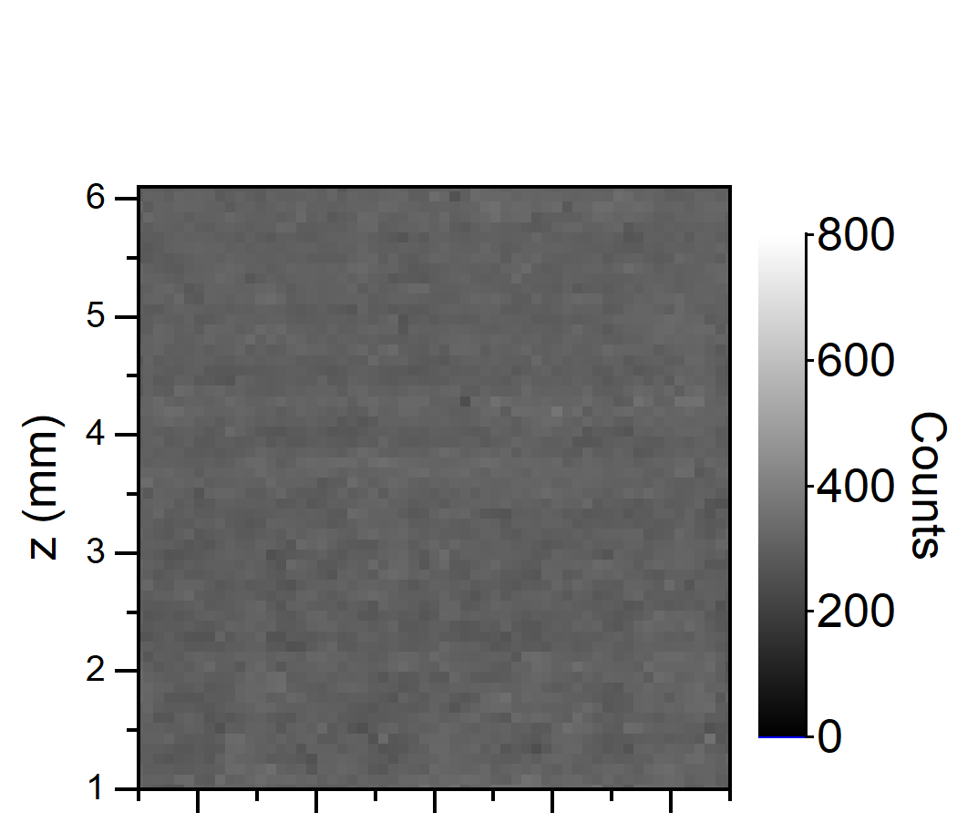
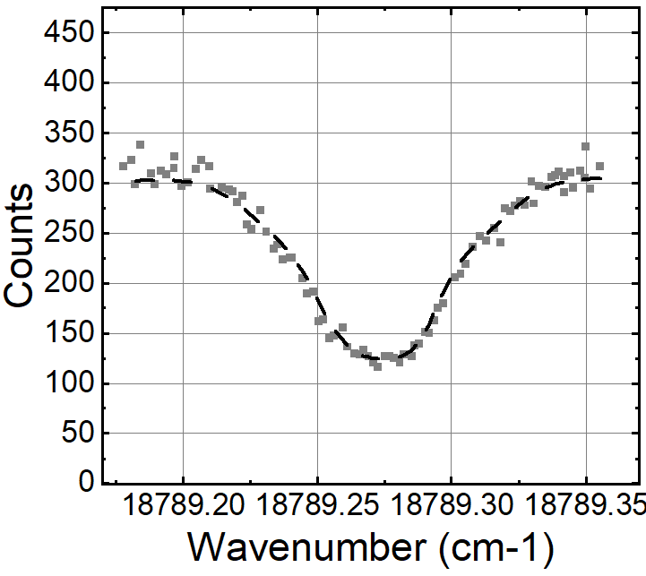
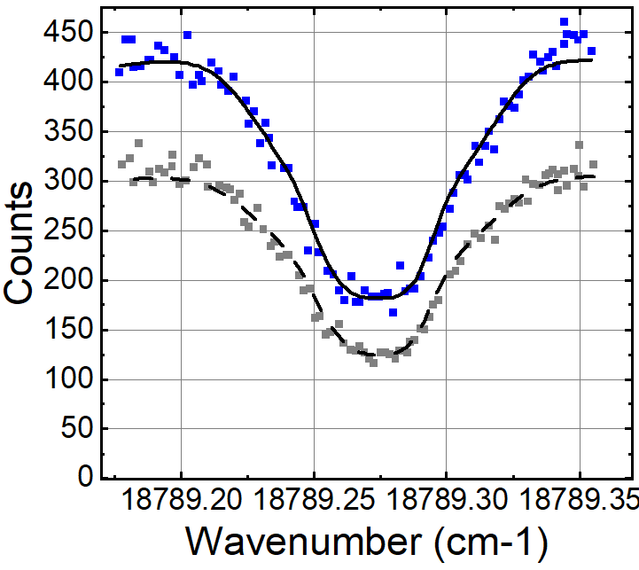
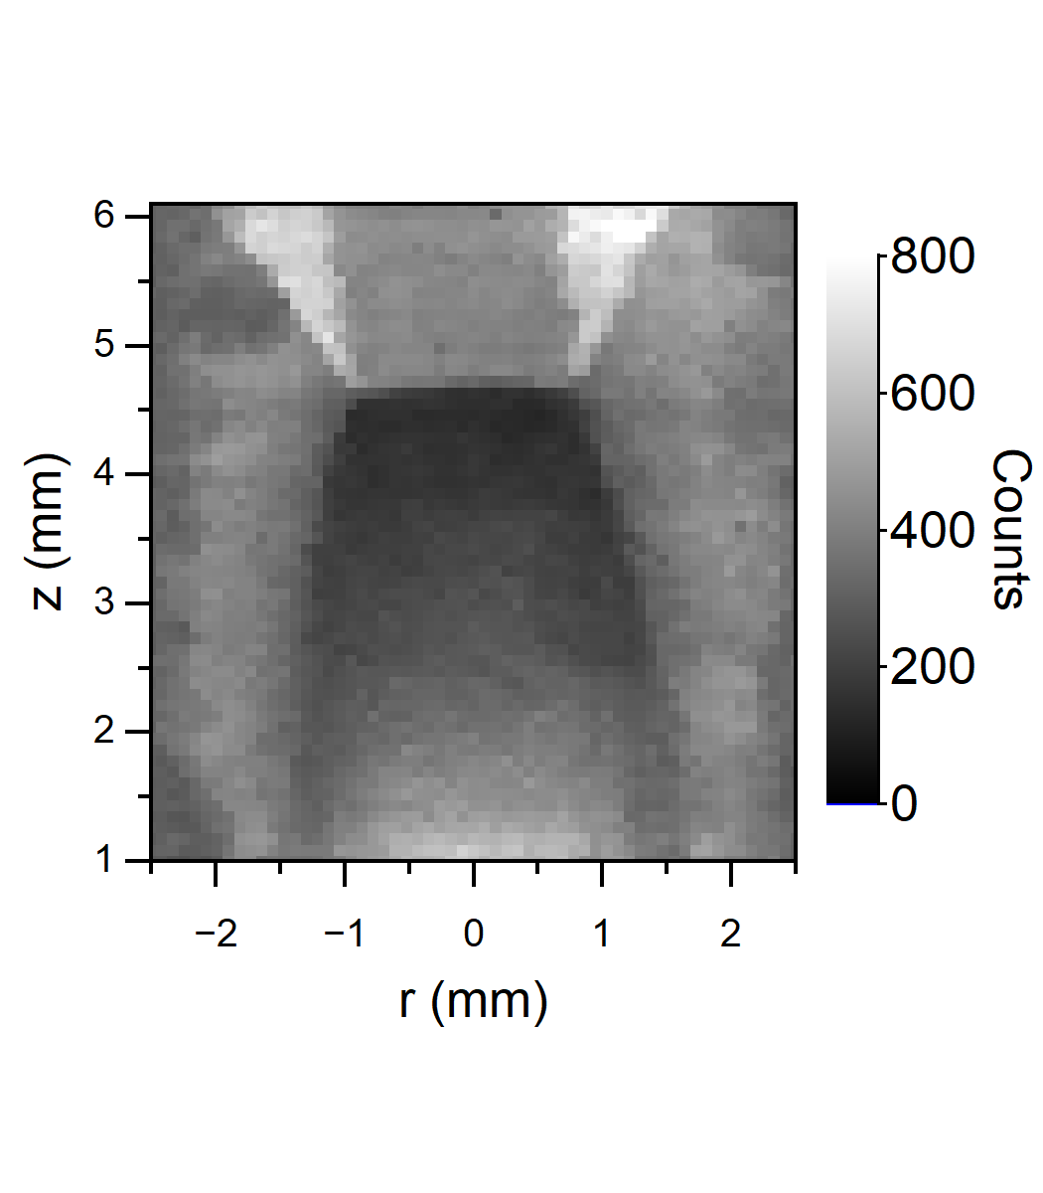


Effects of conditions on pixel intensities
$$I_{FRS}≈A\frac{P}{T}C\int_{−∞}^{∞}{R\left(ν_{0}, P, T, V\right) F(ν_{0}) dν+B\int_{−∞}^{∞}{L(ν_{0}) F(ν_{0})dν }}$$
Reference
Filtered Rayleigh
Filtered Background
$$P=1.4 \text{atm}, T=270 K, \vec{V}=−2 m/s$$
$$A=204, B=64$$
Experiment

Slide 18
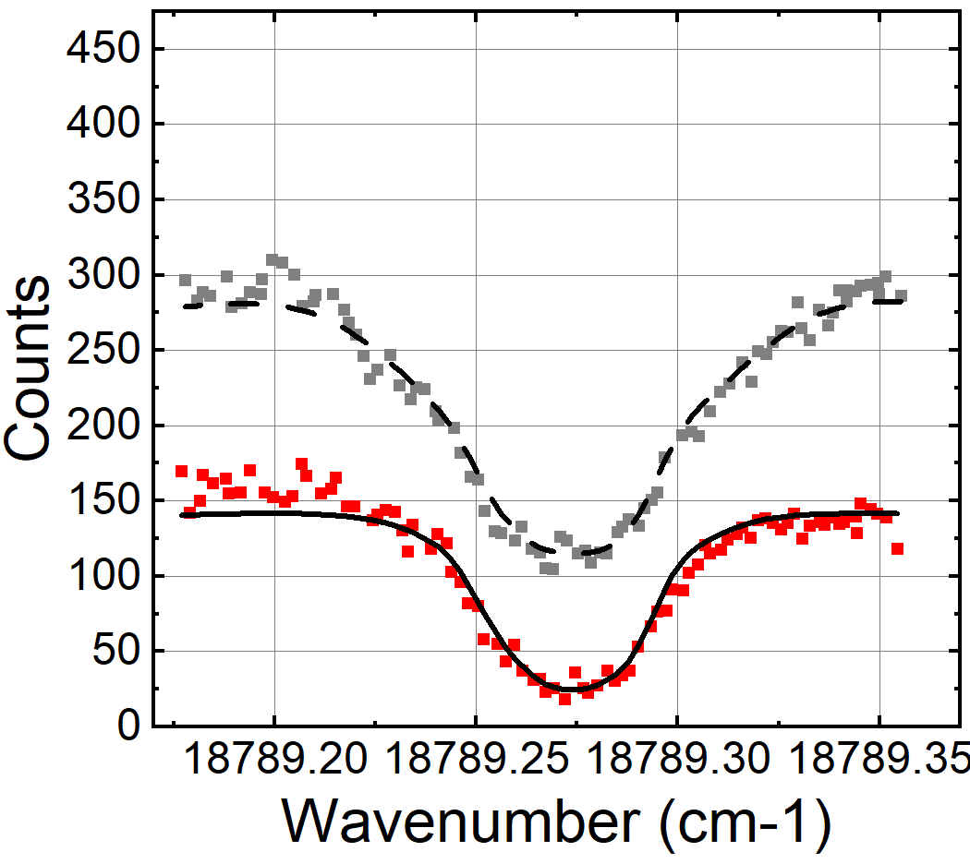
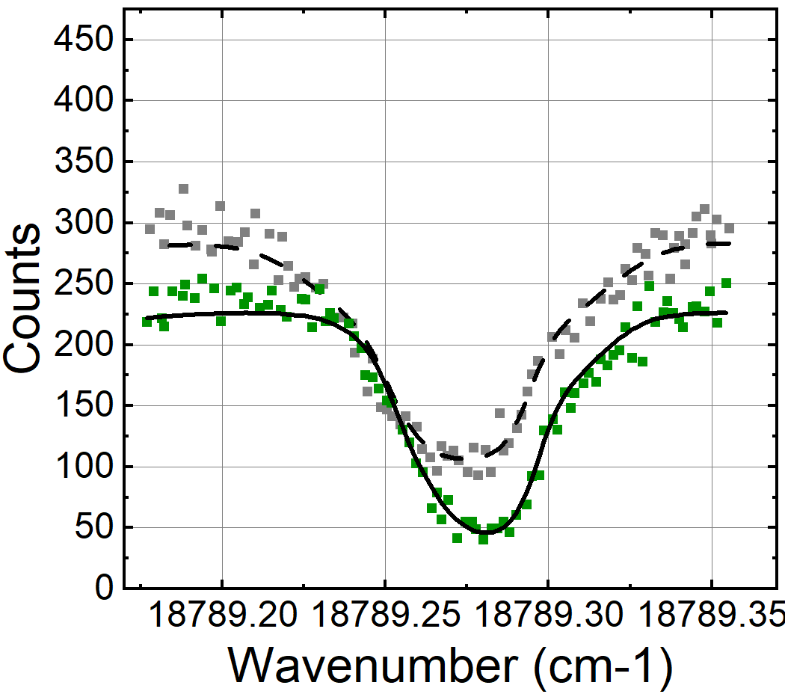



Effects of conditions on pixel intensities
$$I_{FRS}≈A\frac{P}{T}C\int_{−∞}^{∞}{R\left(ν_{0}, P, T, V\right) F(ν_{0}) dν+B\int_{−∞}^{∞}{L(ν_{0}) F(ν_{0})dν }}$$
Reference
Filtered Rayleigh
Filtered Background
$$ρ \sim P/T$$
Experiment
$$T$$
$$V$$

Slide 19
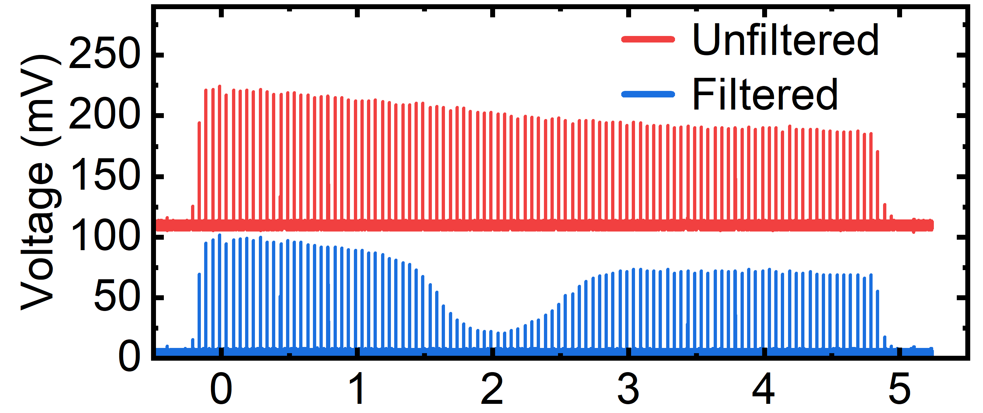
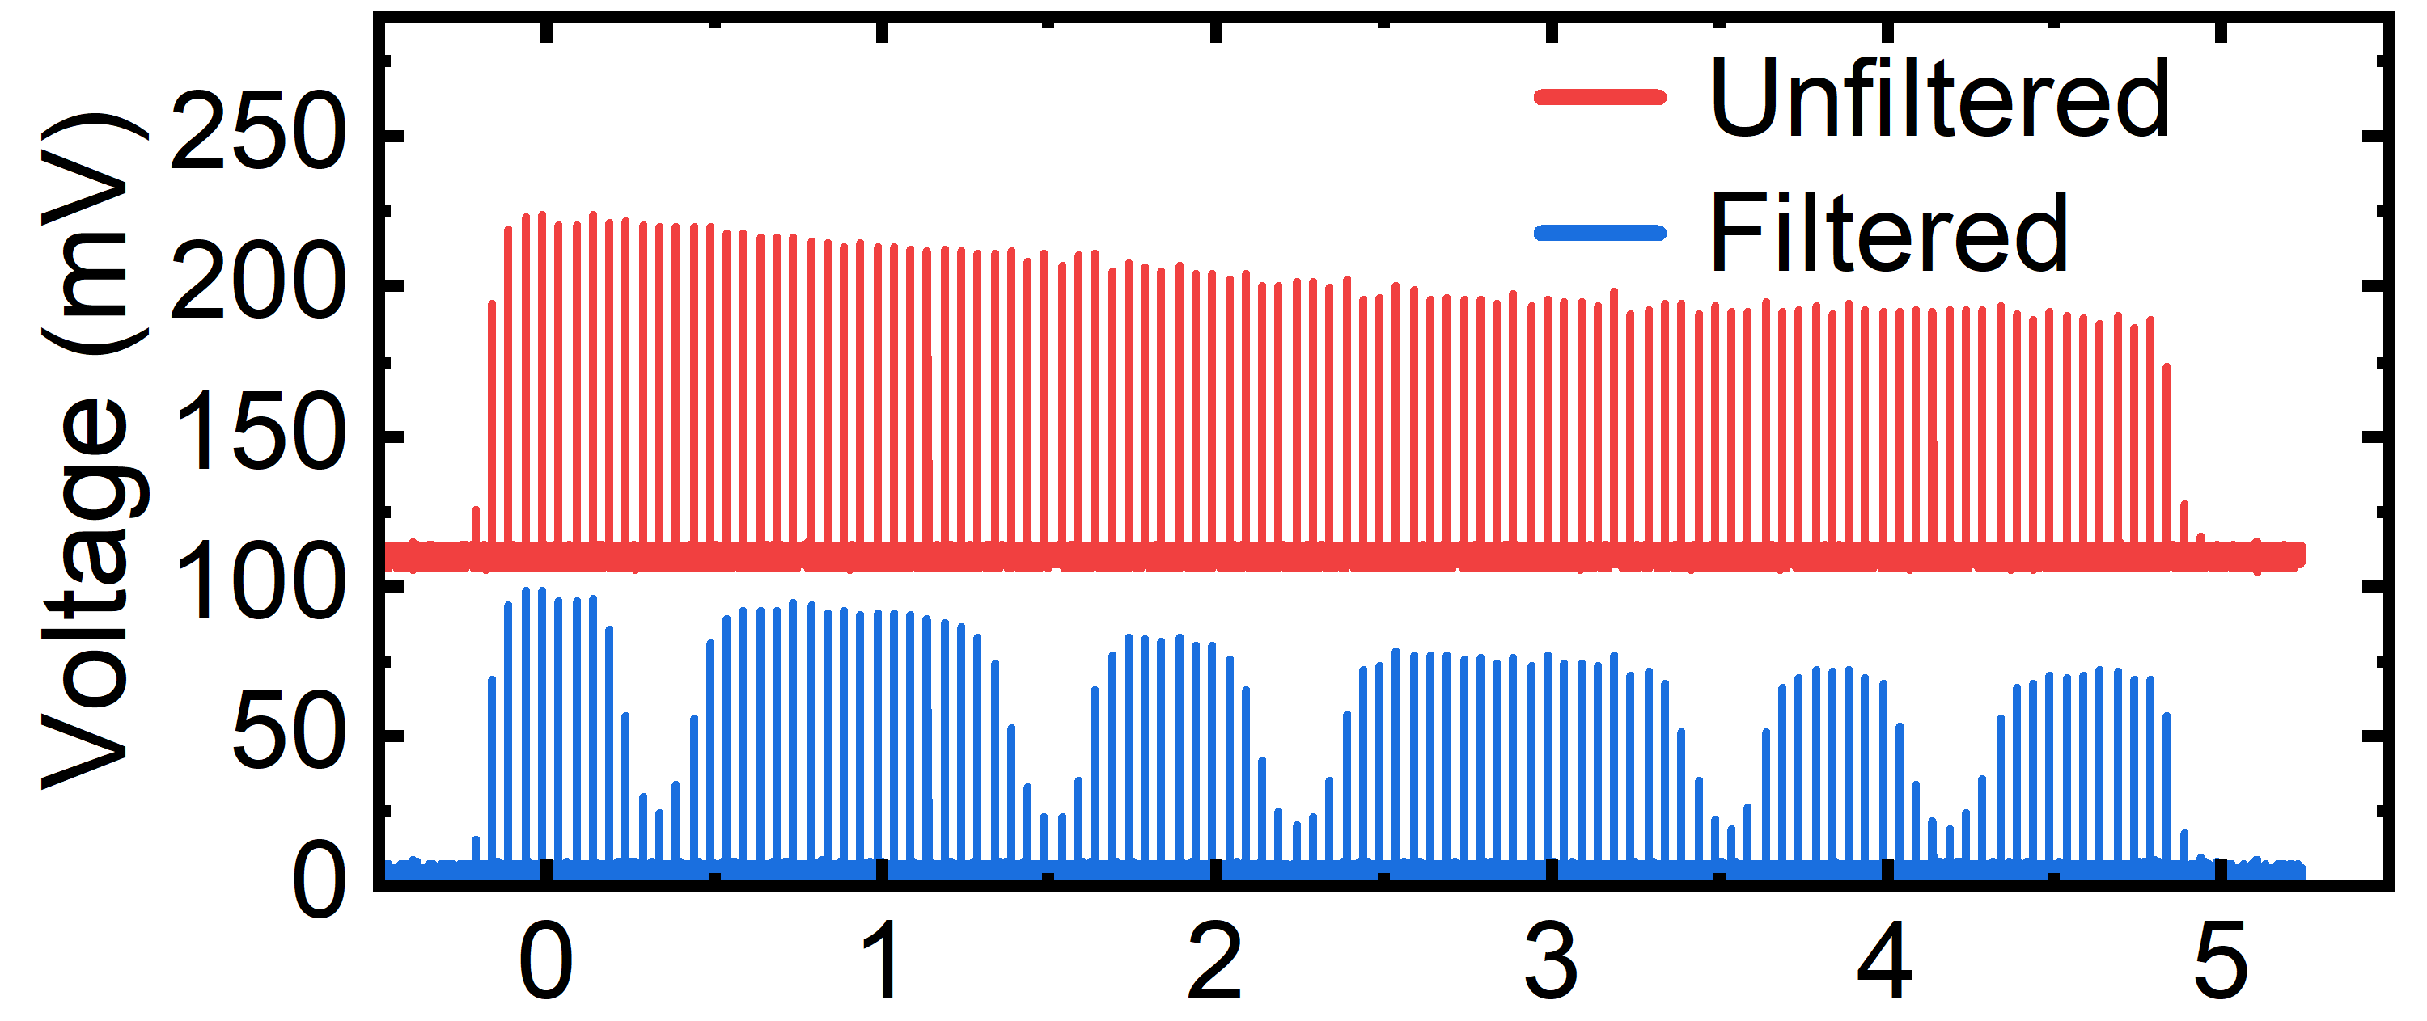




Summary of frequency-scanning parameters
Configuration | Rate | Burst | mJ/Pulse | Pulses/Scan | Scans/Burst | Total Time
1 | 20 kHz | 5 ms | 860 | 100 | 1 | 5 ms
2 | 20 kHz | 5 ms | 860 | 20 | 5 | 1 ms
3 | 200 kHz | 1 ms | 280 | 200 | 1 | 1 ms

Slide 20









Configuration 1: Single 5-ms measurement for NPR $\sim$ 7
Pressure
Temperature
Radial Velocity
Density
CFD
Experimental
Calculated density from ideal gas law
Mean density from unfiltered RS
| 20

Slide 21




Centerline pressure, temperature, and density
Centerline Mach number: Ashkenas et al.
Mach disc location: Gibbings et al.
Isentropic and normal shock relations
Pressure
Temperature
Density

Slide 22




Radial velocity at varying axial locations
Radial Velocity
z = 5 mm
z = 4 mm
z = 3 mm
z = 2 mm

Slide 23
Summary of frequency-scanning parameters
Configuration | Rate | Burst | mJ/Pulse | Pulses/Scan | Scans/Burst | Total Time
1 | 20 kHz | 5 ms | 860 | 100 | 1 | 5 ms
2 | 20 kHz | 5 ms | 860 | 20 | 5 | 1 ms
3 | 200 kHz | 1 ms | 280 | 200 | 1 | 1 ms

Slide 24















Configuration 2: Five 1-ms measurements
Pressure
Temperature
Rad. K Velocity
Calc. Density
Mean Density
1 ms
2 ms
3 ms

Slide 25



Configuration 2: Five 1-ms measurements
Pressure
Temperature
Rad. K Velocity
Calc. Density
Mean Density
1 ms

Slide 26




Configuration 2: Five 1-ms measurements
Pressure
Temperature
Rad. K Velocity
Calc. Density
Mean Density
1 ms
z = 5 mm
z = 4 mm
z = 3 mm
z = 2 mm

Slide 27
Summary of frequency-scanning parameters
Configuration | Rate | Burst | mJ/Pulse | Pulses/Scan | Scans/Burst | Total Time
1 | 20 kHz | 5 ms | 860 | 100 | 1 | 5 ms
2 | 20 kHz | 5 ms | 860 | 20 | 5 | 1 ms
3 | 200 kHz | 1 ms | 280 | 200 | 1 | 1 ms

Slide 28






Configuration 3: Single 1-ms measurements
Pressure
Temperature
Rad. Velocity
Calc. Density
Mean Density
Single 1-ms Meas.

Slide 29







Configuration 3: Single 1-ms measurements
Pressure
Temperature
Rad. Velocity
Calc. Density
Mean Density
Single 1-ms Meas.
Increasing measurement rate requires higher signal levels

Slide 30


Conclusions
Simultaneous $P, T,V$ in up to 1 ms
Comparison with CFD and empirical correlations
Increased measurement rate by 600,000x
CFD
5 ms
5 x 1 ms
Potential for 100s of kHz $P, T, V$
  Increase signal levels
  High repetition rate wavelength measurement
1 ms

Slide 31
References
[1] Baurle, R. A. (n.d.). VULCAN-CFD applications. https://vulcan-cfd.larc.nasa.gov/WebPage/vulcan_apps.html
[2] “Hyper-X ED97-43968-1: Computational Fluid Dynamics (CFD) Image of Hyper-X Research Vehicle at Mach 7 with Engine Operating.” https://www.dfrc.nasa.gov/Gallery/Photo/X-43A/HTML/ED97-43968-1.html (accessed Oct. 02, 2022).
[3] J. N. Forkey, N. D. Finkelstein, W. R. Lempert, and R. B. Miles, “Demonstration and characterization of filtered Rayleigh scattering for planar velocity measurements,” AIAA Journal, vol. 34, no. 3, pp. 442–448, Mar. 1996, doi: 10.2514/3.13087.
[4] M. Boguszko and G. S. Elliott, “Property measurement utilizing atomic/molecular filter-based diagnostics,” Progress in Aerospace Sciences, vol. 41, no. 2, pp. 93–142, Feb. 2005, doi: 10.1016/j.paerosci.2005.03.001.
[5] U. Doll, G. Stockhausen, and C. Willert, “Endoscopic filtered Rayleigh scattering for the analysis of ducted gas flows,” Exp Fluids, vol. 55, no. 3, p. 1690, Mar. 2014, doi: 10.1007/s00348-014-1690-z.
[6] T. W. Fahringer, R. A. Burns, P. M. Danehy, P. M. Bardet, and J. Felver, “Pulse-Burst Cross-Correlation Doppler Global Velocimetry,” AIAA Journal, vol. 58, no. 6, pp. 2364–2369, Jun. 2020, doi: 10.2514/1.J059172.
[7] R. A. Burns, T. W. Fahringer, and P. M. Danehy, “Velocity measurements across an oblique shock using pulse-burst cross-correlation DGV,” in AIAA Scitech 2021 Forum, American Institute of Aeronautics and Astronautics. doi: 10.2514/6.2021-0120.
[8] N. S. Rodrigues, P. M. Danehy, N. Jiang, P. Hsu, J. Leicht, and S. Roy, “100 kHz High-Spectral-Resolution NO-PLIF Measurements for Compressible Flows,” in AIAA SCITECH 2023 Forum, National Harbor, MD & Online: American Institute of Aeronautics and Astronautics, Jan. 2023. doi: 10.2514/6.2023-0405.
[9] H. Ashkenas and Sherman, Frederick, “Structure and utilization of supersonic free jets in low density wind tunnels,” vol. No. NASA-CR-60423, 1965.
[10] C. Gibbings, J, Ingham, and D. Johnson, “Flow in a Supersonic Jet expanding from a Convergent Nozzle,” 2002. Accessed: Nov. 15, 2023

Slide 32
Backup Slides

Slide 33







Filtered/unfiltered camera video
Configuration 1
Configuration 2
Configuration 3
1200
1200
300
Counts
Counts
Counts
0
0
0

Slide 34

Demonstration image sequence

Slide 35

Image processing steps

Slide 36

Sensitivity to pressure, temperature, velocity

Slide 37









Empirical Correlations
(4.8)
Centerline Mach number before Mach disc [9]
$$M\left(\frac{z}{D}, r=0\right)=C_{1}{\left(\frac{z}{D}−\frac{z_{0}}{D}\right)}^{γ−1}−\frac{1}{2}\frac{γ+1}{γ−1} {\left[C_{1}{\left(\frac{z}{D}−\frac{z_{0}}{D}\right)}^{γ−1}\right]}^{−1}+C_{2}{\left(\frac{z}{D}−\frac{z_{0}}{D}\right)}^{−3\left(γ−1\right)}$$
Centerline pressure, temperature, and density before Mach disc (isentropic relations)
Mach number, pressure, temperature, and density after the Mach disc $\hat{z}$(normal shock equations)
$$P\left(\frac{z}{D}, r=0\right)=P_{0}{\left[1+\left(\frac{γ−1}{2}\right)M{\left(\frac{z}{D}\right)}^{2}\right]}^{−γ/(γ−1)}$$
$$M{\left(\hat{z}\right)}^{2}=\frac{\left(γ−1\right)M{\left(\tilde{z}\right)}^{2}+2}{2γM{\left(\tilde{z}\right)}^{2}−\left(γ−1\right)}$$
$$T\left(\frac{z}{D}, r=0\right)=T_{0}{\left[1+\left(\frac{γ−1}{2}\right)M{\left(\frac{z}{D}\right)}^{2}\right]}^{−1}$$
$$P(\hat{z})=P\left(\tilde{z}\right)\left(\frac{2γM{\left(\tilde{z}\right)}^{2}−\left(γ−1\right)}{γ+1}\right)$$
$$ρ\left(\frac{z}{D}, r=0\right)=ρ_{0}{\left[1+\left(\frac{γ−1}{2}\right)M{\left(\frac{z}{D}\right)}^{2}\right]}^{−1/(γ−1)}$$
$$T(\hat{z})=T\left(\tilde{z}\right)\left(\frac{\left[2γM{\left(\tilde{z}\right)}^{2}−\left(γ−1\right)\right][\left(γ−1\right)M{\left(\tilde{z}\right)}^{2}+2]}{{\left(γ+1\right)}^{2}M{\left(\tilde{z}\right)}^{2}}\right)$$
Mach disc location $\tilde{z }$[10]
$$\tilde{z}=0.84{\left(\frac{P_{0}}{P_{A}} −1.893\right)}^{0.415}$$
$$ρ(\hat{z})=ρ\left(\tilde{z}\right)\left(\frac{(γ+1)M{\left(\tilde{z}\right)}^{2}}{\left(γ−1\right)M{\left(\tilde{z}\right)}^{2}+2}\right)$$

Slide 38

Wavemeter Correction

Slide 39
Uncertainty in background constant estimates

Slide 40





Background correction for density measurements
b.
Before Correction
After Correction
Background Fit

Slide 41

Background correction for density measurements
b.
Before Correction
After Correction
Background Fit

Slide 42






Unfiltered Rayleigh scattering processing
0
50
0
50
$$B$$
$\frac{I_{RS}}{I_{RS, ref}}≈\frac{A ρ+B}{A ρ_{ref}+B}$
$ρ≈ρ_{ref}$ $\frac{I_{RS}}{I_{RS, ref}}$
b.
Before Correction
After Correction
Background Fit

Slide 43








Flow property fitting process
$$I_{FRS}≈AC\frac{P}{T}\int_{−∞}^{∞}{R\left(ν_{0}, P, T, V\right) F(ν_{0}) dν+B\int_{−∞}^{∞}{L(ν_{0}) F(ν_{0})dν }}$$
Calibration
Experiment
Intensity at known $P,T,V$
Intensity at known $A,B$
Fit $I_{FRS}=f(A,B)$
Fit $I_{FRS}=f(P,T,V)$
$$I_{FRS}$$
$$I_{FRS}$$

Slide 44
Additional CFD Details
The Reynolds Averaged Navier Stokes (RANS) equations were solved with the k-ω Shear Stress Transport (SST) turbulence model
ANSYS FLUENT was used, and the mesh generated with ANSYS ICEM CFD.
A series of total pressures of varying magnitudes was applied at the inlet to mimic the different pressure ratios.
A static pressure of 1 atm was applied to the outlet.
Walls were treated as viscous with a first layer thickness (y+) of less than 1 at the nozzle walls, to capture the viscous sublayer.
A small portion of the chamber, as well as a small air volume for the jet, was modeled to capture the exhaust in the experimental setup.
Within the Fluent solver, a convergence criterion of 1e-3 was used, and cases were run until residuals plateaued.
A mesh sensitivity on a 3D domain was performed and compared to the two-dimensional simulations to verify the two-dimensionality of the domain.

Slide 45
Achieving MHz rate
Frequency-scanning
Laser Settings |  | Scan Settings |  | Total Time
Rep. Rate | Burst | Pulses/Scan | Scans/Burst
10 MHz | 1 ms | 10 | 1000 | 1 us
100 ns
Energy
Time
1 us

