Slide 1
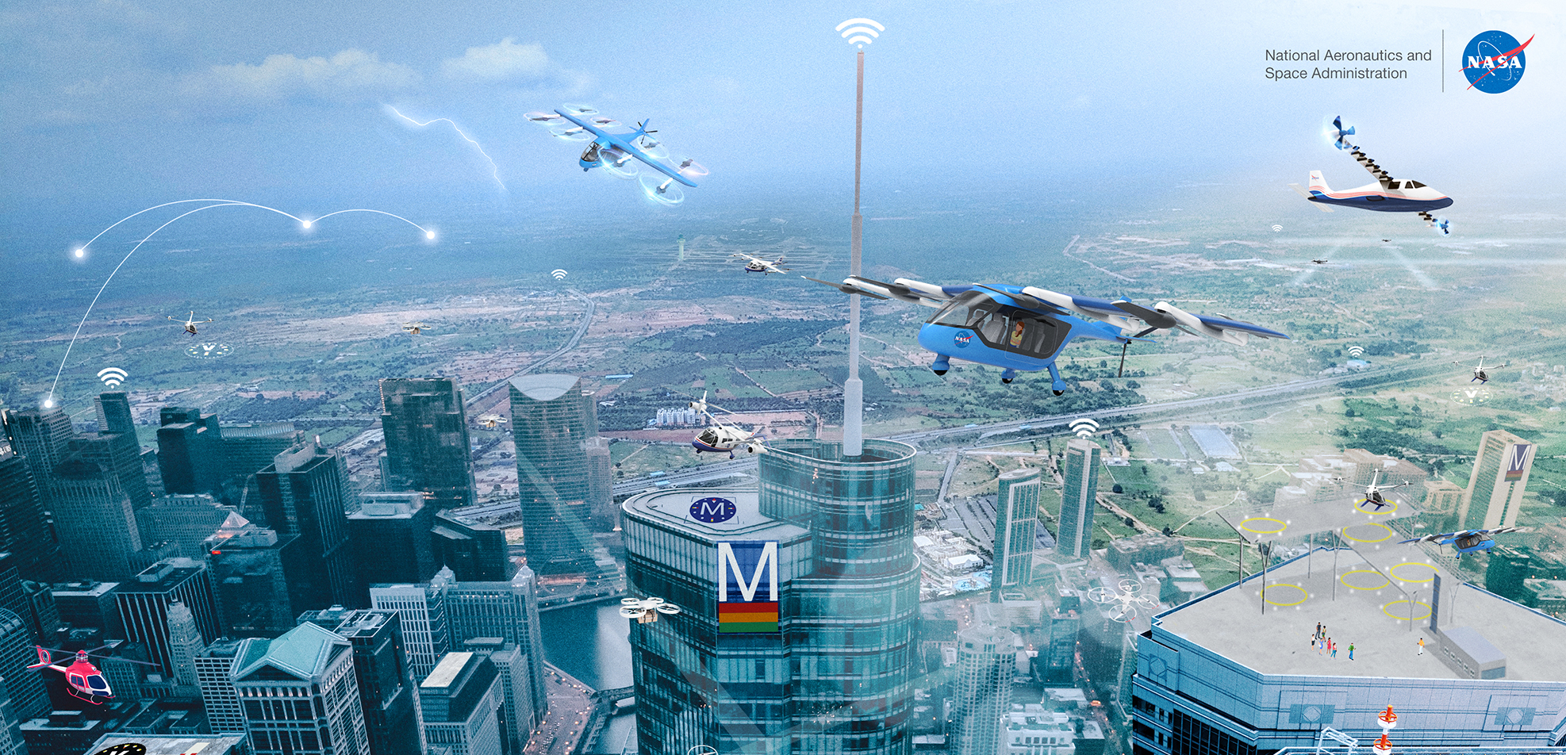
An Experimental System for Strategic Flight Path Management in Advanced Air Mobility
David A. Karr and James L. Sturdy Bryan A. Barrows and Mark G. Ballin
Analytical Mechanics Associates, Hampton, VA NASA Langley Research Center, Hampton, VA
AIAA SCITECH 2024, January 9, 2024
This material is a work of the U.S. Government and is not subject to copyright protection in the United States. Published by the American Institute of Aeronautics and Astronautics, Inc., with permission.

Slide 2
Overview
The Autonomous Operations Planner (AOP) is a reference Flight Path Management (FPM) automation system for research.
We adapted AOP from en route commercial transport operations to Urban Air Mobility (UAM) operations with dense traffic.
First application of certain key AOP functions in live flight test.
AOP met expectations.
Lessons learned.
Notes:
Will define these terms (AOP, FPM, UAM) during the presentation.

Slide 3
Companion Presentations
Designing a Flight Test of a Flight Path Management System for Advanced Air Mobility Research
Stewart L. Nelson*, Mark G Ballin, Bryan A. Barrows, Matthew C. Underwood, David J. Wing
NASA Langley Research Center, Hampton, VA, USA
James L. Sturdy Ethan R. Williams
Analytical Mechanics Associates, Hampton, VA, USA American Systems Corporation, Edwards, CA, USA
Tue, Jan 9, 1:00pm‒1:20pm (Eastern) TF-01, Blue Spring I
Sim to Flight: Evaluating Flight Path Management Automation in High Density Urban Environments
Bryan A. Barrows*, Mark G Ballin, Terique L. Barney, Stewart L. Nelson, Matthew C. Underwood, David J. Wing
NASA Langley Research Center, Hampton, VA, USA
Tue, Jan 9, 1:20pm‒1:40pm (Eastern) TF-01, Blue Spring I
*presenter

Slide 4
Flight Path Management (FPM) Automation Concept
FPM: In-flight autonomy in shared airspace
Continuous replanning to safely achieve mission objectives in the presence of traffic, flow restrictions, and weather
Goal:
A safe and operationally acceptable flight path is available to airspace users and aircraft systems throughout the flight
FPM Objectives: Create | Monitor | Evaluate | Revise | Coordinate the flight path to have:
Feasible – Conforms to aircraft performance and range; Complies with airspace structure, rules, and constraints
Deconflicted – Avoids unsafe proximity to known traffic, terrain, obstacles, weather, and airspace hazards
Harmonized – Follows cooperative rules and procedures to be compatible with other airspace users & systems
Flexible – Provides adequate degrees of freedom to enable future flight path changes
Optimal – Achieves business objectives and preferences of the pilot and fleet operator
Five Qualities:
Assumed for this research: An FPM system is located onboard each aircraft

Slide 5
Urban Air Mobility at Scale
Urban Air Mobility (UAM) – a vision for a future transportation system that provides economical high-access air travel within urban environments.
UAM Maturity Level 4 (UML-4)
Comparable to FAA’s UAM Mature Operational Stage
Hundreds of aircraft serving a metropolitan area
Dozens of vertiports, restricted airspace volumes, and corridors
The need for FPM automation:
Human-centric flight path management may not be feasible at UML-4 traffic complexity
Increasingly dense and complex operations with closer separation
Safe and assured operations
Our Assumptions for UML-4
Future eVTOL vehicles with low margin for contingencies
Short flight durations (0.5 hr or less); continuous 4D trajectory conformance
1500 ft (~0.25 NM) lateral and 450 ft vertical assumed separation
Short time constraints and strategic look-ahead (3 minutes)

Slide 6
Autonomous Operations Planner (AOP)
Reference implementation role:
Platform for assessing FPM system requirements
Advanced algorithms for complex FPM operations
Supporting NASA autonomy R&D for 20+ years
AOP core functionality:
Generates the flight path
Monitors the flight path and the factors which may impact it
Evaluates ongoing acceptability of the flight path and proposed changes
Revises the flight path, as needed, to sustain the desired qualities
Coordinates the flight path with other airspace users and service providers

Slide 7
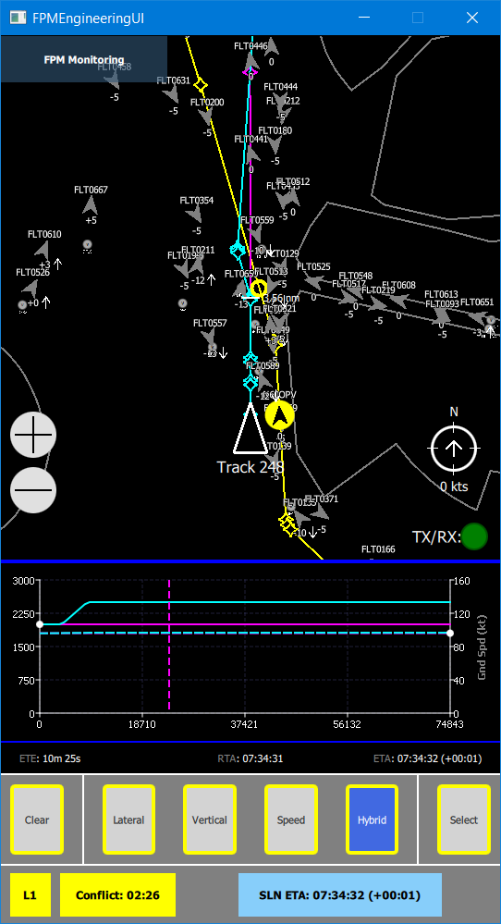
Autonomous Operations Planner (AOP)
Data Sources:
Traffic state
Traffic intent
Wind
Temperature
Weather
Airspace
Terrain
Schedule
AOP Conflict Detector
with Trajectory Prediction Uncertainty Bounds (TPUBs)
monitor,
evaluate
coordinate,
revise
AOP Strategic Resolver
with Pattern-Based Genetic Algorithm (PBGA)
generate
AOP/UAM Trajectory Generator
Behavior-Based Trajectory Generator (BBTG)
eVTOL Model
Interpolation
tables
Pilot’s FPM Engineering
User Interface
Implementation for UAM R&D

Slide 8
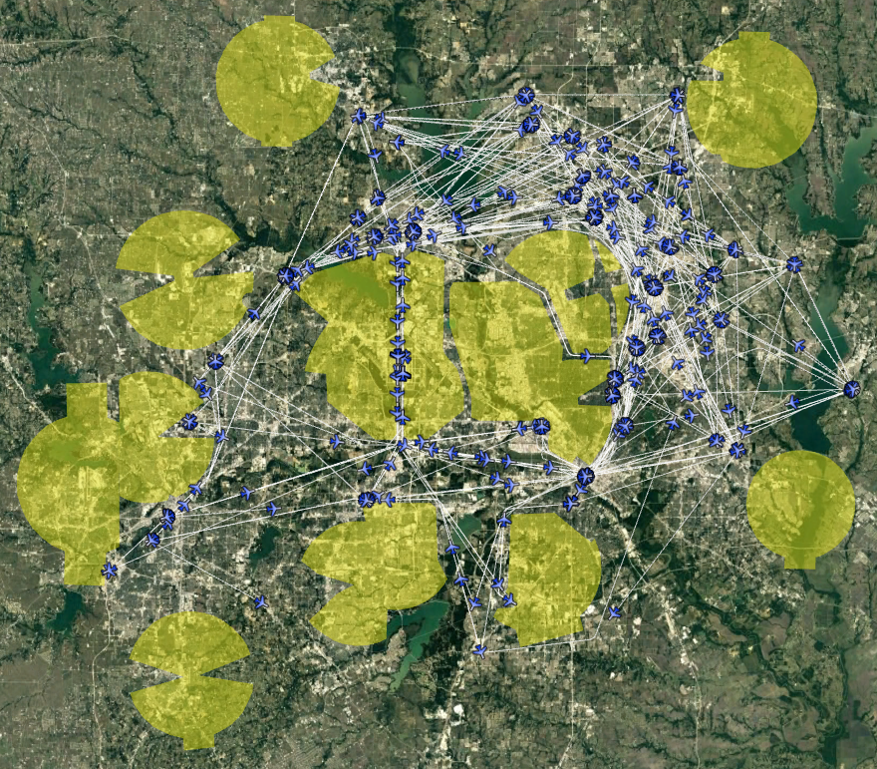
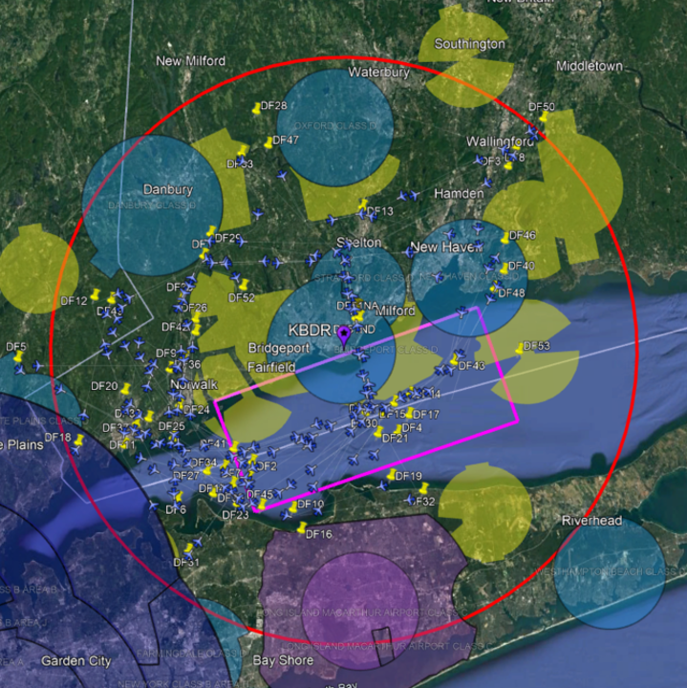
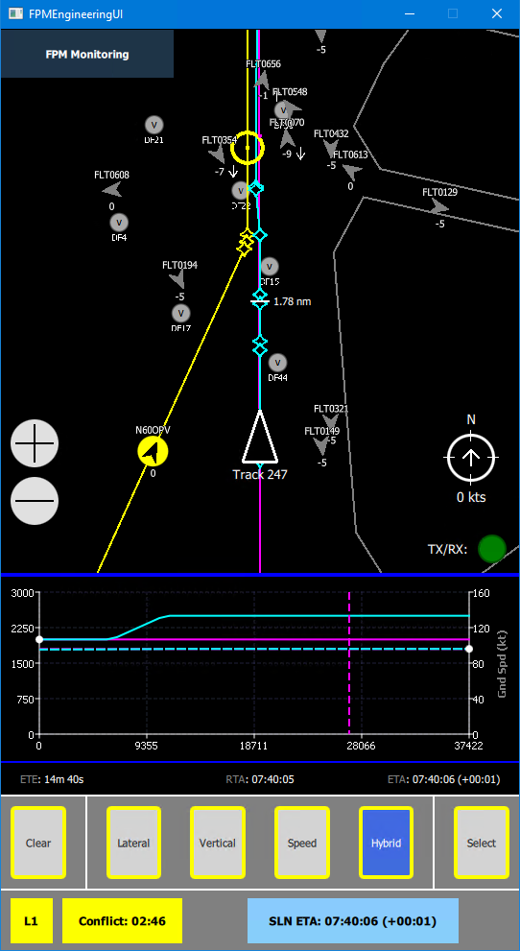
Research Activities
Initial prototype of UAM systems
Two large-scale simulation studies using Dallas-Fort Worth (DFW) demand model
Integration with actual aircraft (ground tests and flight trials)
Flight test
FPM-1 simulation study (2021)
FPM-2 simulation study (2022)
Flight test (2023)
Notes:
Compare with Bryan’s slide with the sequence of images; his captions are more specific.

Slide 9
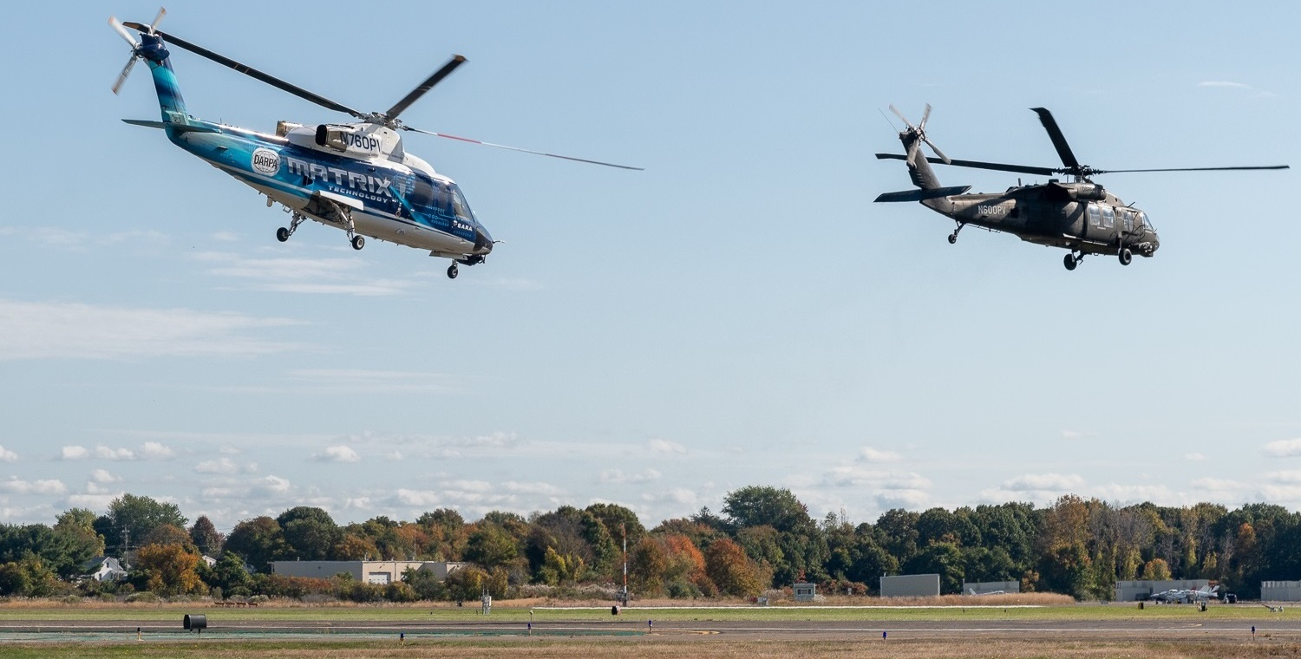
Flight Test
Sikorsky S-70TM
Optionally Piloted Vehicle (OPV) live intruder
AOP
+
NASA Middleware
+
SARA guidance
Sikorsky Autonomy Research Aircraft (SARA) ownship
NASA Middleware + OPV guidance
Airspace restrictions from UAM concept for DFW metro region
250 to 330 virtual “background” traffic aircraft from UAM / DFW simulation
Photo by NASA
Used with permission of Sikorsky,
a Lockheed Martin company.
Sikorsky Memorial Airport Stratford, Connecticut, USA
October 2023

Slide 10
Strategic Planning
Prediction all the way to the destination
Respect aircraft performance limits and operator preferences
Account for wind, air temperature, density, etc.
Track fuel/energy usage
Adjust airspeed to meet a required time of arrival (RTA)
Const speed
Level / decel
Level / accel
Const speed
Level turn
Climb / turn
Perf descent
Perf climb
Descent / decel
Transition
Climb / accel
Climb
Descent / flare
Departure
Arrival

Slide 11
Behavior-Based Trajectory Generator (BBTG)
Specialized modules (“behaviors”) for each part of each phase of flight
Constraints on nominal flight path
Compute only what is needed
VTOL behaviors, accelerations, battery usage data, turn rate limits, speed constraint types, rules for sequencing behaviors for UAM
Aircraft performance model in interpolation tables
Models for UAM quadcopter and a UAM lift-cruise aircraft
2nd-order explicit Runge-Kutta methods (midpoint, trapezoid)
$y^{′}\left(x\right)=f(x, y\left(x\right))$ where $x$ is whichever variable has a target value
Distance
Altitude
Groundspeed
Support interrupted timesteps
Karr, Vivona, Woods and Wing, "Point-Mass Aircraft Trajectory Prediction Using a Hierarchical, Highly-Adaptable Software Design," AIAA Paper 2017-3336, in AIAA Modeling and Simulation Technologies Conference, Denver, 2017.

Slide 12
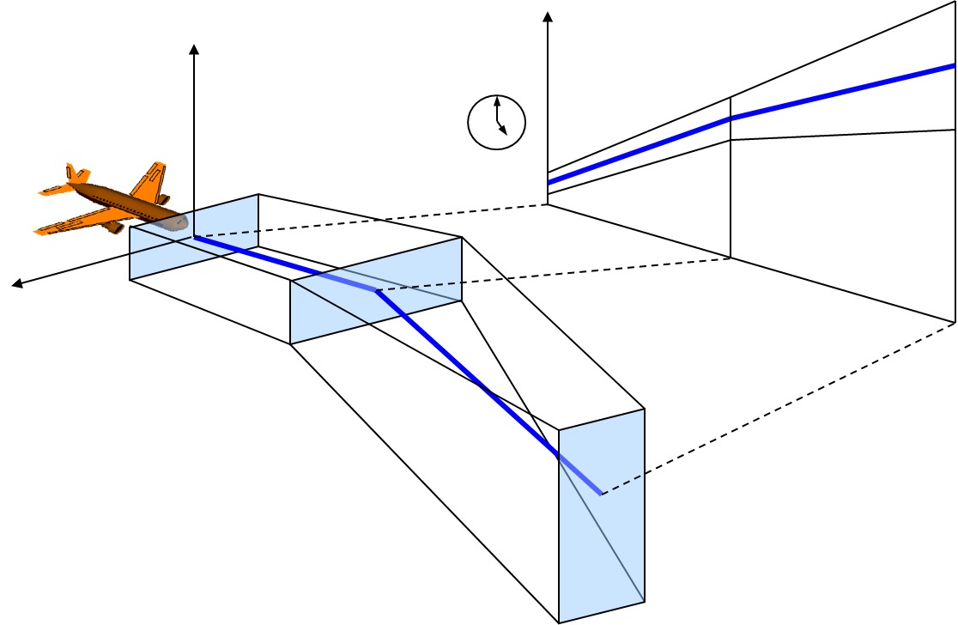
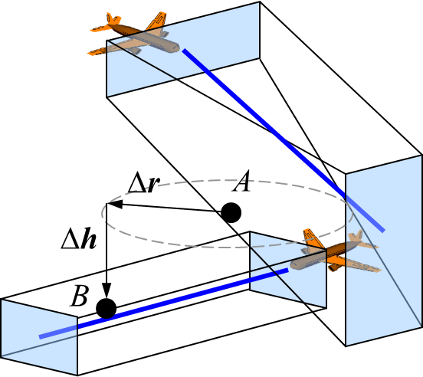
Conflict Detection (CD)
Required traffic separation 1500 ft horizontal, 450 ft vertical (“hockey puck”)
4D “envelope” around the nominal trajectory: Trajectory Prediction Uncertainty Bounds (TPUBs)
Estimation of “4D actual navigational precision” (along-path and altitude deviations, as well as lateral deviations) is essential to the CD algorithm
For flight test, ±150 ft cross-track, ±25 ft vertical, ±3 sec along-path
Based on observations during integration testing in flight
Altitude
Time
Separation requirements apply to every point in volume A vs. every point in volume B
Cross-track
Notes:
3 seconds is equivalent to about 450 ft at the typical speeds of the aircraft during test

Slide 13
Strategic Replanning: Pattern-Based Genetic Algorithm (PBGA)
Invoke to resolve a conflict or unmet RTA
Change trajectory by applying a maneuver pattern
Four choices of degrees of freedom (DOF):
Lateral
Vertical
Hybrid lateral/vertical
Speed (new for UAM)
Mutation, mating, survival of fittest (approx. 200 to 400 trajectories per DOF)
Search for optimized trajectory
Result must have no conflicts
Change altitude
Ownship
Intruder
Vertical maneuver
Ownship
Turn
Intruder
Lateral maneuver
Slow down
Ownship
Intruder
Speed up
Speed maneuver

Slide 14
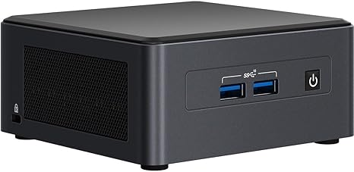
Computational Requirements of Strategic Replanning
~300 × 4 iterations of BBTG, CD, fitness
250 – 330 traffic aircraft
15 second time limit
54 cm
(2.1 in)
AOP Conflict Detector
Available computing hardware:
Intel NUC11TNHi7 Next Unit of Computing 64 GB memory, 4 cores, 8 hardware threads
Maximum clock rate 4.7 GHz
Windows operating system
AOP Strategic Resolver
AOP/UAM Trajectory Generator
⟹ Run on 4 parallel threads

Slide 15
Adapting to Equipage
Simulated commercial transports:
Flight Management System (FMS) determines the trajectory flown
AOP mimics the prediction of the FMS
Same aircraft performance tables
Same assumptions about guidance
(Sometimes) same trajectory generator (TG) source code
No compatible FMS in simulated UAM or on test aircraft
No specification for eVTOL FMS
Forced to provide some FMS functions in research code (i.e., AOP)
All active trajectories were BBTG trajectories
Scenario generation used BBTG to obtain nominal RTAs

Slide 16
Why Use One Trajectory Generator for All Trajectories
t = t₁
t = t₂
TOD
Ownship
t = t₂
Predicted loss of separation
(conflict)
t = t₁
RTA
Intruder
Other TG predicts ownship trajectory

Slide 17
Why Use One Trajectory Generator for All Trajectories
Separation maintained
Higher airspeed
Lower airspeed
t = t₁
TOD
Ownship
t = t₂
t = t₂
t = t₁
RTA
Intruder
BBTG predicts ownship trajectory

Slide 18
4D Guidance on SARA in Flight Test
AOP
Efficient Universal Trajectory Language (EUTL) Flight Plan
NASA Middleware
sensed state
breadcrumbs
Sensors
SARA or OPV Guidance
actual flight path

Slide 19
Preliminary results
34 Flight Test Management test points executed
First AOP alert for conflict detected between live aircraft
First AOP resolution of conflict between live aircraft
Continued flight verified no loss of separation
First AOP response to RTA change aboard live aircraft
Conflict alert, conflict resolution, and/or RTA change replicated in real time over multiple test points
PBGA mean elapsed time 8.8 seconds, maximum time 12.1 seconds
“Stressor” scenarios with 330 aircraft did not stress AOP
No violations of UAM airspace restrictions, even in “corridor” scenarios
Actual flight visually replicated simulation results
Including “future AOP features” previously observed in simulation (2 test points affected)
Notes:
I would like to say what the range of wind speeds was, but I don’t know where to find a consistent source of data for that.

Slide 20
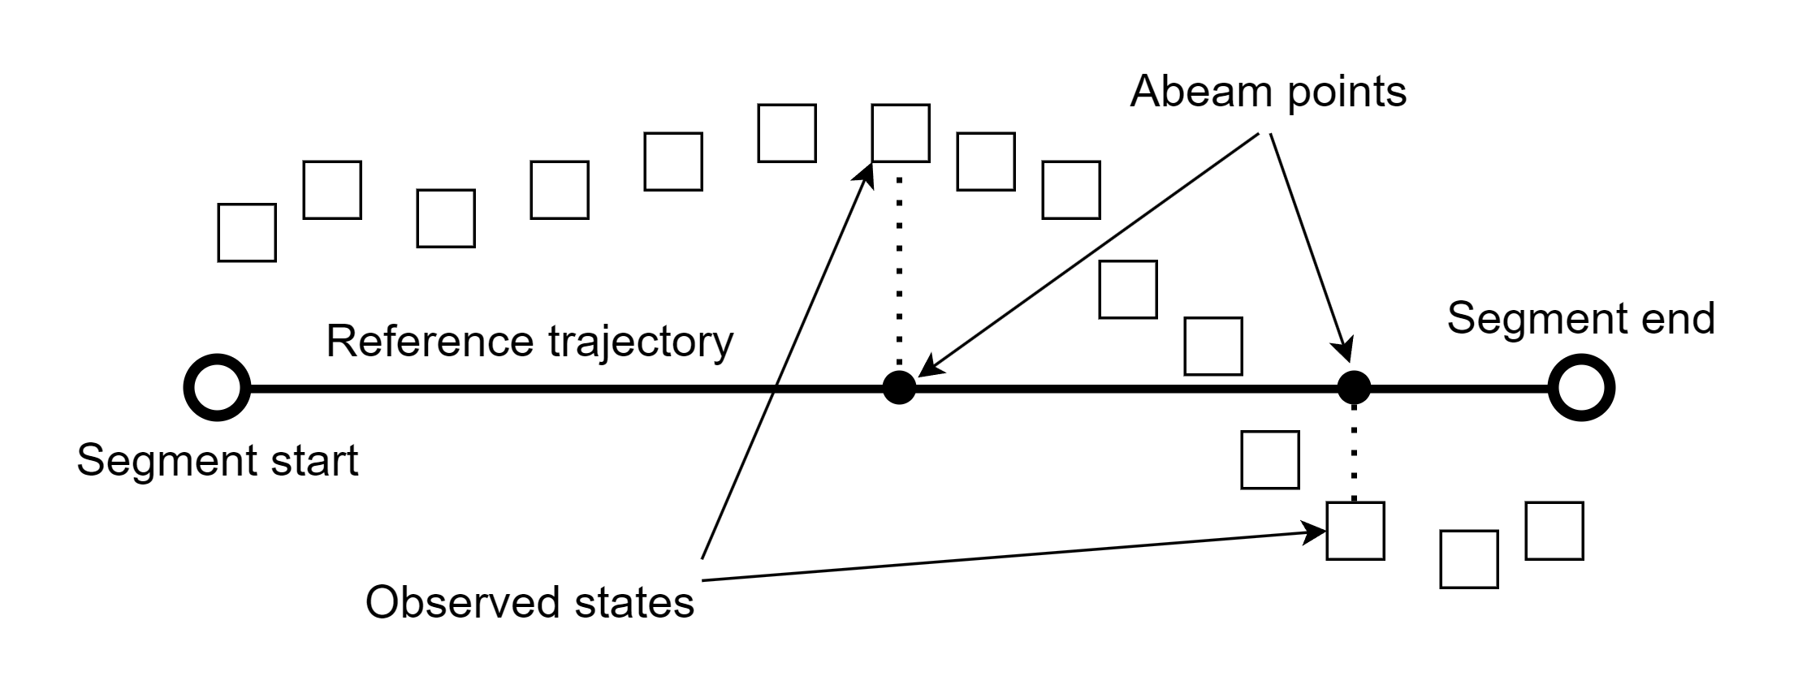
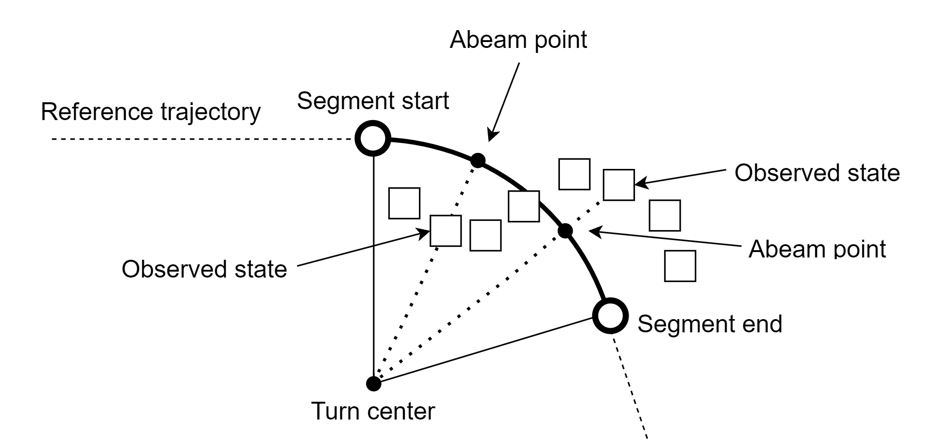
4D Conformance
Typical maximum 4D deviations during flight: < 25 ft vertical < 10 feet cross track < 1 second along path
10 runs with conformance violations
4 altitude violations
1 cross-track violation
2 along-path violations in completed runs
3 along-path violations in incomplete runs of one test point
Identified mitigations for violations and unusual deviations

Slide 21
Conclusions and Questions
Good preliminary results
More complete analysis planned for publication July 2024
Can use airspeed to plan a trajectory, ground speed to communicate the trajectory
Tight 4D conformance is achievable
AOP performance — good and bad — was well represented in simulation
There are clear paths to address observed defects
AOP is a flexible and general tool for research in advanced flight deck automation for future civil aviation operations
What degree of 4D conformance do we really want?
How will future flight decks and ground systems be configured?
What is the desired functional architecture of an FPM system?

Slide 22
Further Information
Email: david.a.karr@nasa.gov
Designing a Flight Test of a Flight Path Management System for Advanced Air Mobility Research
Stewart L. Nelson*, Mark G Ballin, Bryan A. Barrows, Matthew C. Underwood, David J. Wing
NASA Langley Research Center, Hampton, VA, USA
James L. Sturdy Ethan R. Williams
Analytical Mechanics Associates, Hampton, VA, USA American Systems Corporation, Edwards, CA, USA
Tue, Jan 9, 1:00pm‒1:20pm (Eastern) TF-01, Blue Spring I
Sim to Flight: Evaluating Flight Path Management Automation in High Density Urban Environments
Bryan A. Barrows*, Mark G Ballin, Terique L. Barney, Stewart L. Nelson, Matthew C. Underwood, David J. Wing
NASA Langley Research Center, Hampton, VA, USA
Tue, Jan 9, 1:20pm‒1:40pm (Eastern) TF-01, Blue Spring I
*presenter

Slide 23
Email: david.a.karr@nasa.gov

Slide 24
UAM Flight Path Differs from Commercial Transport
Accelerating or decelerating during a large fraction of flight time
No fuel usage
Low cruise speeds (60 to 129 knots)
Must track battery usage
Const speed
Level / decel
Level / accel
Const speed
Level turn
Climb / turn
Perf descent
Perf climb
Descent / decel
Transition
Climb / accel
Steep flight path angles
Climb
Descent / flare
Departure
Arrival
Vertical takeoff and landing

Slide 25
Sharing Intended Trajectories
Efficient Universal Trajectory Language (EUTL) developed by NASA
4D point coordinates
first turn geometry
groundspeed changes
in second turn
ID,lat,lon,alt,time,type,tcp_trk,tcp_gs,tcp_vs,radius,accel_gs,accel_vs,center_lat,center_lon,center_alt,info,name
unitless,deg,deg,ft,s,unitless,unitless,unitless,unitless,NM,m/s^2,m/s^2,deg,deg,ft,unitless,unitless
AOP110L,41.08814885,-73.00212920,2000.00000000,1600169062.90000010,Orig,NONE,NONE,NONE,0.00000000,0.00000000,0.00000000,-,-,-,-,-
AOP110L,41.07825540,-73.03501905,2000.00000000,1600169114.03785062,Orig,BOT,BGS,NONE,-0.63791351,-0.74495200,0.00000000,41.06839911,-73.02979903,609.60000000,-,-
AOP110L,41.07599900,-73.03962510,2000.00000000,1600169122.51021338,Orig,MOT,EGSBGS,NONE,0.00000000,-0.88216260,0.00000000,-,-,-,-,-
AOP110L,41.07258551,-73.04273473,2000.00000000,1600169132.37732053,Orig,EOT,EGS,NONE,0.00000000,0.00000000,0.00000000,-,-,-,-,-
AOP110L,41.02257153,-73.07118438,2000.00000000,1600169273.08290076,Orig,BOT,BGS,NONE,0.63783975,0.88204201,0.00000000,41.02675282,-73.08411222,609.60000000,-,-
AOP110L,41.01915759,-73.07428948,2000.00000000,1600169282.95052576,Orig,MOT,EGSBGS,NONE,0.00000000,0.74524741,0.00000000,-,-,-,-,-
AOP110L,41.01689988,-73.07888952,2000.00000000,1600169291.42301226,Orig,EOT,EGS,NONE,0.00000000,0.00000000,0.00000000,-,-,-,-,-
AOP110L,40.98033378,-73.19980732,2000.00000000,1600169479.82579756,Orig,BOT,BGS,NONE,0.72022116,0.25106029,0.00000000,40.99145309,-73.20572181,609.60000000,-,-
AOP110L,40.97947162,-73.20589393,2000.00000000,1600169488.67776299,Orig,MOT,EGSBGS,NONE,0.00000000,-0.27908704,0.00000000,-,-,-,-,-
AOP110L,40.98043321,-73.21195435,2000.00000000,1600169497.54954100,Orig,EOT,EGS,NONE,0.00000000,0.00000000,0.00000000,-,-,-,-,-
AOP110L,40.99897618,-73.26955271,2000.00000000,1600169588.53214574,Orig,NONE,NONE,BVS,0.00000000,0.00000000,-0.98000000,-,-,-,-,-
AOP110L,40.99950399,-73.27119400,1989.20068064,1600169591.12398243,Orig,NONE,BGS,NONE,0.00000000,0.12842323,0.00000000,-,-,-,-,-
AOP110L,41.00003682,-73.27285096,1956.80271725,1600169593.71581936,Orig,NONE,NONE,EVS,0.00000000,0.00000000,0.00000000,-,-,-,-,-
AOP110L,41.00198588,-73.27891297,1800.82463150,1600169603.07450438,Orig,BOT,EGSBGS,NONE,-0.47967828,0.12842323,0.00000000,40.99464389,-73.28305669,518.84597604,-,-
AOP110L,41.00262381,-73.28295138,1702.25057756,1600169608.98894763,Orig,MOT,EGS,NONE,0.00000000,0.00000000,0.00000000,-,-,-,-,-
AOP110L,41.00262113,-73.28334991,1692.96887645,1600169609.54584980,Orig,NONE,BGS,NONE,0.00000000,-1.01149620,0.00000000,-,-,-,-,-
AOP110L,41.00204672,-73.28700582,1601.72863607,1600169615.08028579,Orig,EOT,EGSBGS,NONE,0.00000000,-0.98032533,0.00000000,-,-,-,-,-
AOP110L,41.00030807,-73.29272688,1427.31321310,1600169625.55015039,Orig,NONE,NONE,BVS,0.00000000,0.00000000,0.98000000,-,-,-,-,-
AOP110L,41.00023421,-73.29296988,1419.40034214,1600169626.04917860,Orig,NONE,EGSBGS,NONE,0.00000000,-0.97715360,0.00000000,-,-,-,-,-
AOP110L,41.00016142,-73.29320936,1412.28815528,1600169626.54820681,Orig,NONE,NONE,EVS,0.00000000,0.00000000,0.00000000,-,-,-,-,-
AOP110L,40.99695935,-73.30374240,823.72237610,1600169670.30829620,Orig,NONE,NONE,BVS,0.00000000,0.00000000,-0.98000000,-,-,-,-,-
AOP110L,40.99695910,-73.30374322,818.80181597,1600169670.65940666,Orig,NONE,EGS,NONE,0.00000000,0.00000000,0.00000000,-,-,-,-,-
AOP110L,40.99695910,-73.30374322,813.48488784,1600169671.01051712,Orig,NONE,NONE,EVS,0.00000000,0.00000000,0.00000000,-,-,-,-,-
AOP110L,40.99695910,-73.30374322,807.36896317,1600169671.39987731,Orig,NONE,NONE,BVS,0.00000000,0.00000000,0.98000000,-,-,-,-,-
AOP110L,40.99695910,-73.30374322,769.00000000,1600169676.28526998,Orig,NONE,NONE,EVS,0.00000000,0.00000000,0.00000000,-,-,-,-,-
top of descent
reduce speed
to hover
touchdown

Slide 26
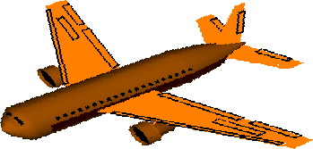
Conflict Detection
Predict future losses of separation with traffic aircraft and other hazards
“Hockey puck” protected zone for aircraft-aircraft encounters
Protected zone for flight test: R = 1500 ft radius, H = 450 ft
Any penetration of one aircraft’s protected zone by another aircraft is a conflict
Any penetration of an “area hazard” is a conflict
R
H
H

Slide 27
Using PBGA for UAM
Time scales are shorter than in previous research
Conflict alert 3 minutes before loss of separation
Less than 20 seconds to produce resolution (less than 15 seconds in some scenarios)
Traffic density higher than in previous research
150 aircraft in first batch simulation, observed long elapsed times for PBGA
250 to 330 aircraft “seen” by AOP in flight test
Elapsed time of CD for N traffic aircraft has at least linear growth
New development: run four parallel threads

Slide 28
Installation of AOP on SARA
Intel NUC11TNHi7 Next Unit of Computing (NUC)
64 GB of memory
4 cores
8 hardware threads
Maximum clock rate 4.7 GHz
Windows operating system
54 cm
(2.1 in)

Slide 29
AOP Defect #1
Replanning for an RTA without checking for conflicts
Example: speed reduction to meet RTA allows trailing aircraft to overtake
Workaround for flight test:
BBTG produces new flight plan in response to new RTA
Pilot executes flight plan
PBGA resolves the resulting conflict
Pilot selects and executes resolution flight plan
Proposed design:
BBTG produces new flight plan in response to new RTA
AOP checks flight plan for conflicts
If conflict, PBGA generates new flight plan
Pilot executes flight plan

Slide 30
AOP Defect #2
Instability of conflict detection (CD) results
Cause: assumption that trajectories for CD must always be recomputed with latest data
Inherited from operating environment where definitive trajectories were not available
Some conflict geometries are highly sensitive to input data
Recomputation with new data leads to new predicted trajectories
Proposed design:
Use only the broadcast 4D trajectories (4DTs) for ownship and traffic in CD
Implications for operating environment
Broadcast of 4DT is a conditional guarantee to follow it
When should the guarantee expire?
Contingencies: what conditions for early cancellation of 4DT?

Slide 31
Why Use One Trajectory Generator for All Trajectories
t = t₁
t = t₂
TOD
Other TG predicts ownship trajectory
Ownship
t = t₂
Loss of separation
t = t₁
RTA
Intruder
t = t₁
BBTG predicts ownship trajectory
TOD
Ownship
t = t₂
t = t₂
t = t₁
RTA
Higher airspeed
Lower airspeed
Intruder

