Slide 1


NASA Innovative Advanced Concepts Program
Michael LaPointe, NIAC Program Executive
John Nelson, NIAC Deputy Program Executive
SciTech - January 11, 2024
SciTech 2024/NFF-06: Laying the Foundations for a Paradigm Shift from Conventional to Advanced Propulsion Technologies Funding Mechanisms and Streams

Slide 2
What is NIAC?
NASA Innovative Advanced Concepts:
NIAC supports early studies of visionary yet credible concepts that could one day “change the possible” in aerospace
Quick Facts:
Initially funded as an external institute through USRA (1998-2007)
Program restarted within NASA in 2011, managed by NASA Headquarters
Funded through the NASA Space Technology Mission Directorate (STMD)
https://www.nasa.gov/about-niac/

Slide 3
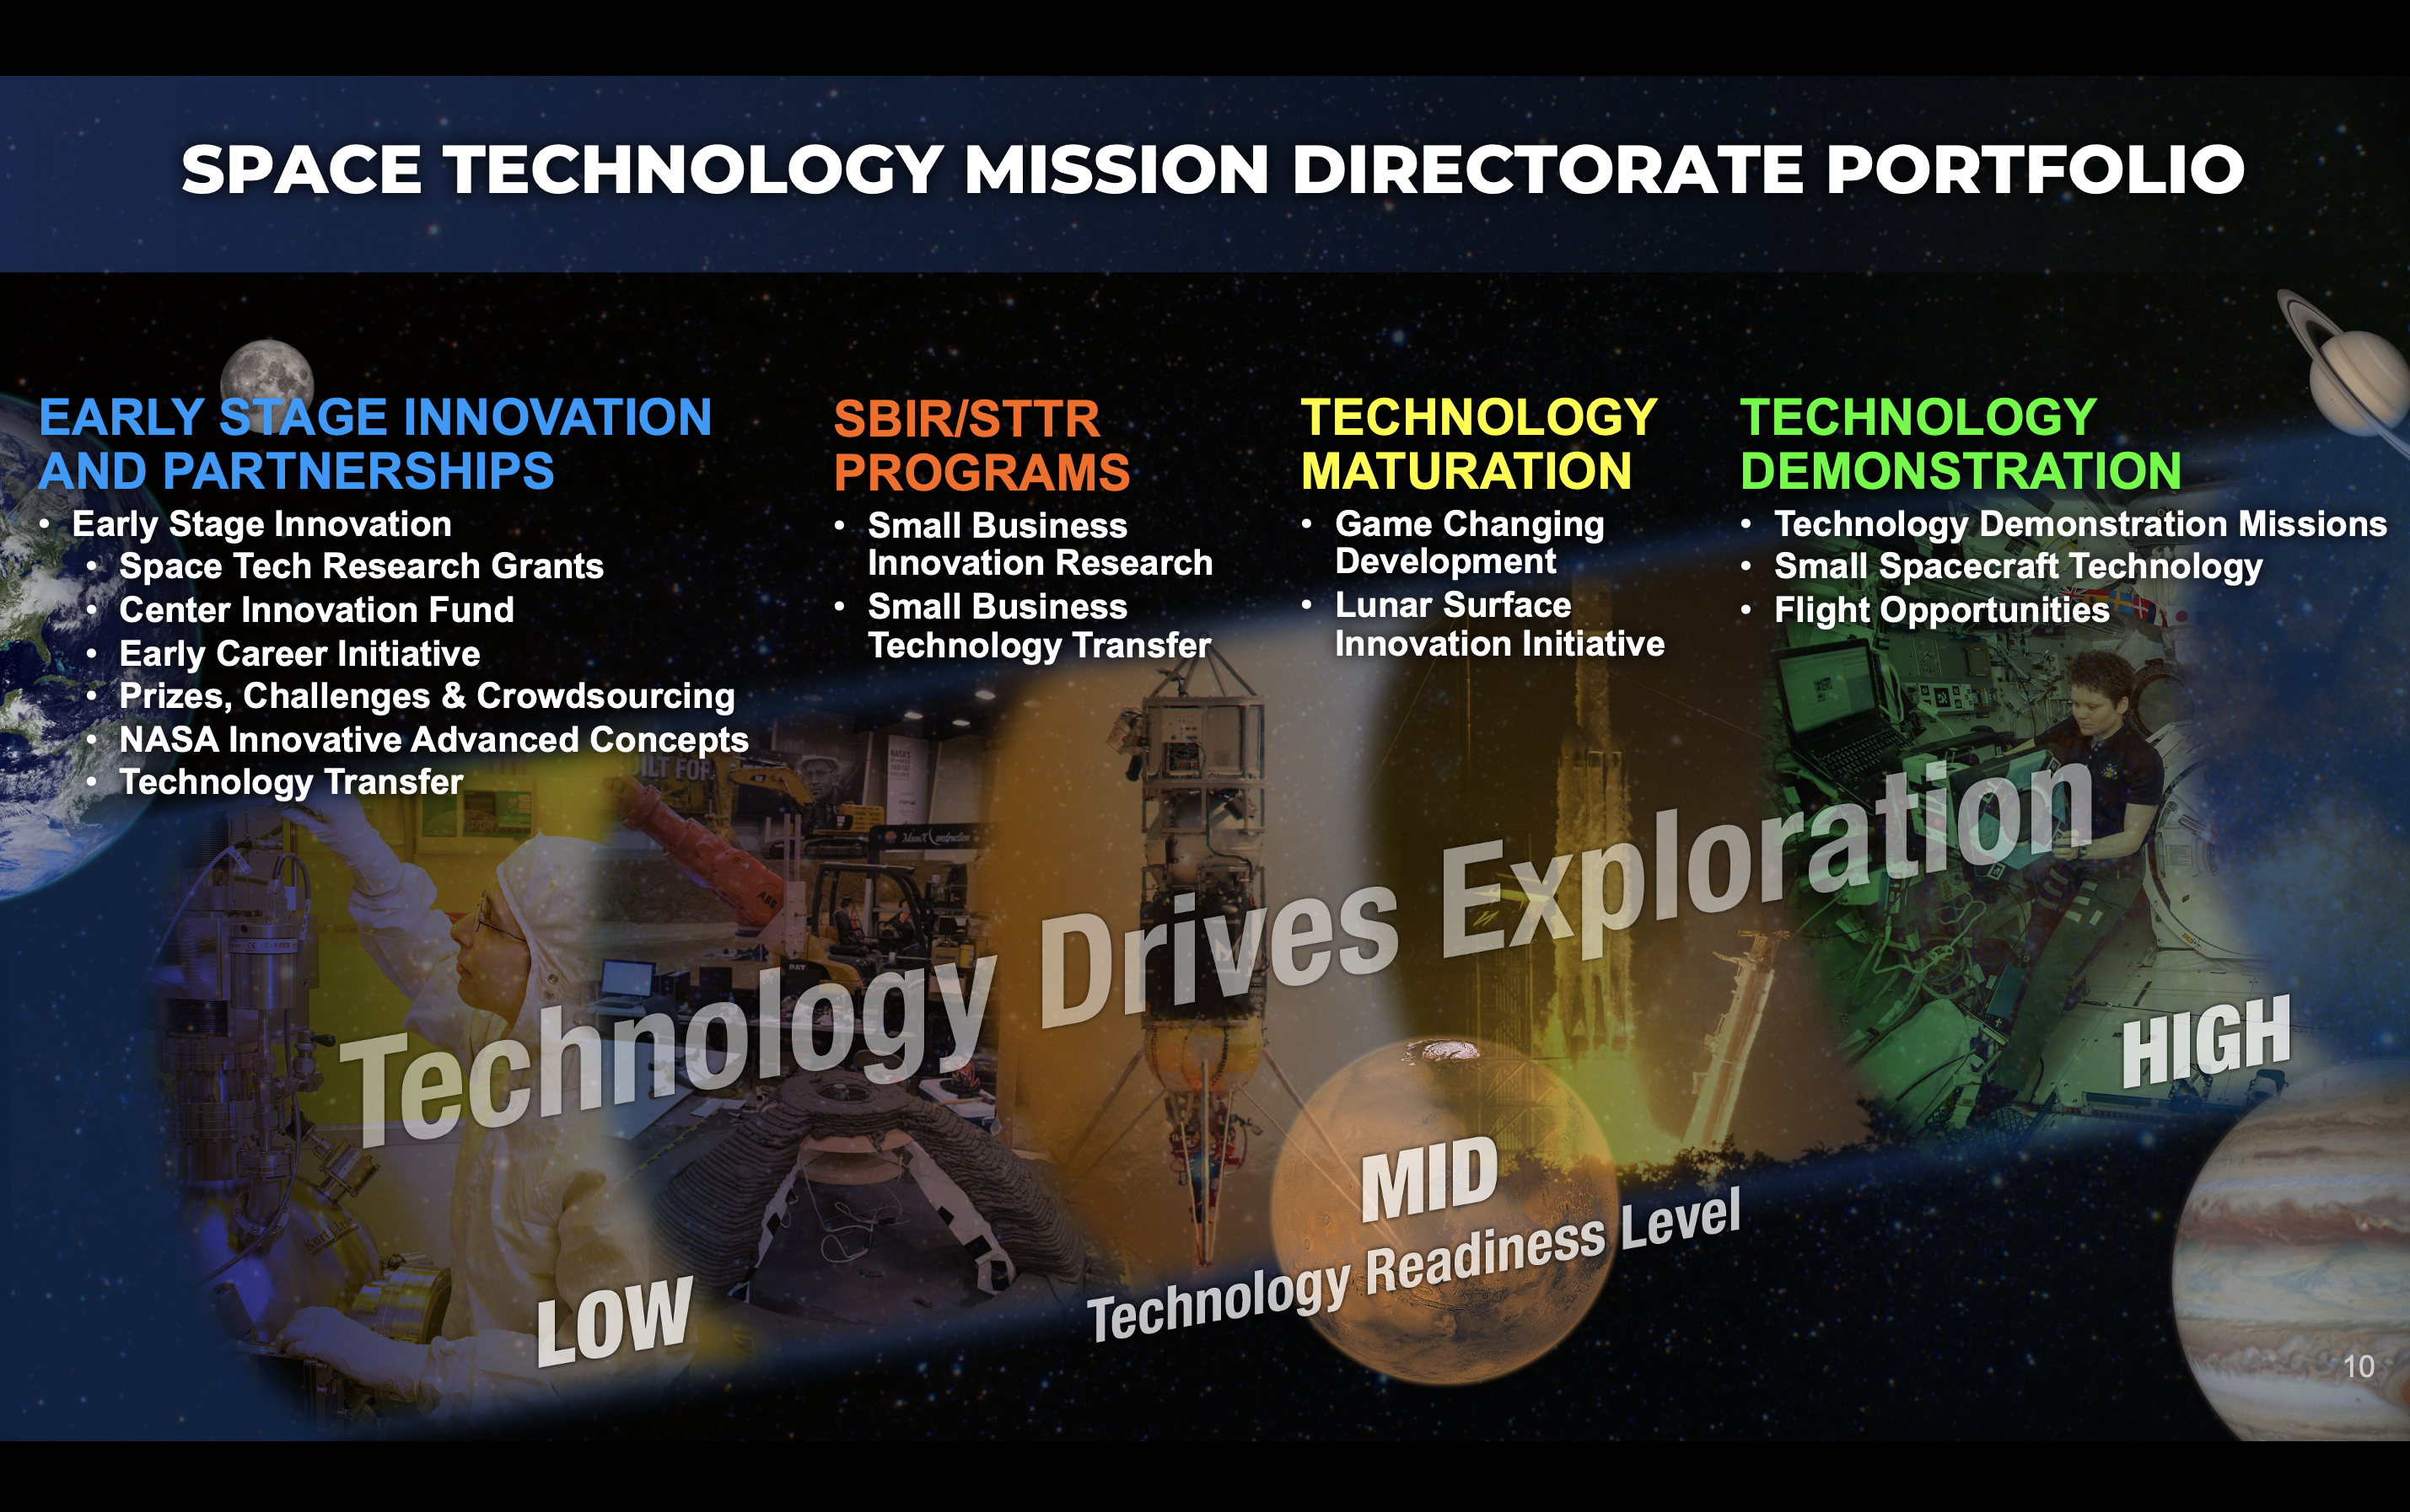
STMD Portfolio

Slide 4
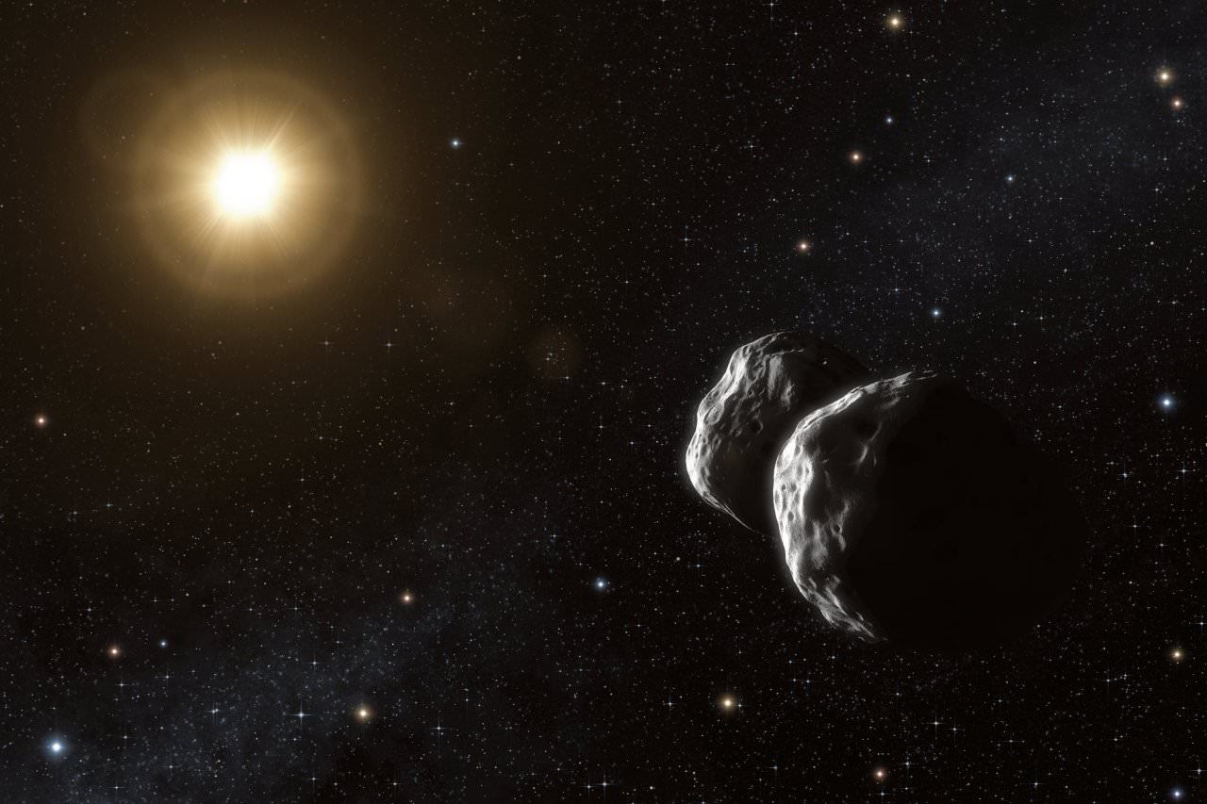

Three Stages of Reaction to Revolutionary Ideas
1 - It’s completely impossible
2 - It’s possible, but it’s not worth doing
3 – I said it was a good idea all along!
-Arthur C. Clarke

Slide 5

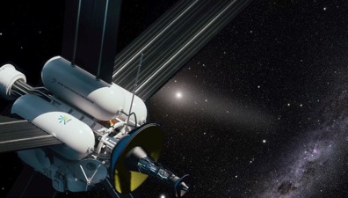

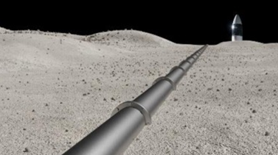

NIAC Scope
Early-stage concepts for NASA missions 10-20+ years out
High risk, high reward (TRL < 2 at time of award)
Open to ideas from all disciplines
Projects are technically credible
Proposed NIAC concepts must demonstrate innovation and have a clear potential impact in transforming future missions
https://www.nasa.gov/niac-funded-studies/

Slide 6
NIAC Study Phases
NIAC Program Solicitations
PHASE I Establish the feasibility of the concept
Opens: June
Up to $175K 9 MONTHS for concept definition and initial analysis in a mission context Open to any U.S. organization 2-Step process 12-16 awards / year
PHASE II Address the most challenging aspects to demonstrate viability
Opens: January
Up to $600K total 2 YEARS for further development of the most promising Phase I concepts, including comparative mission analysis, pathways forward, and spin off technologies 5-7 awards / year
PHASE III Implement strategy for technology transition and utilization
Opens: February
Up to $2M total 2 YEARS with the goal to strategically transition successful Phase II concepts with the highest potential impact for NASA, OGAs or commercial partners Instituted in 2018 1 award / year

Slide 7


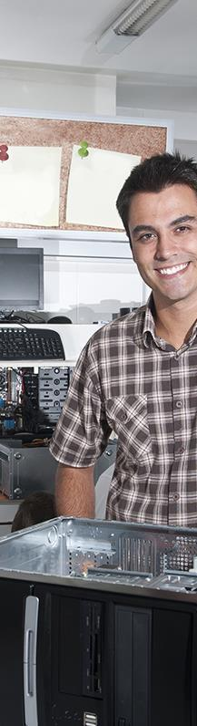
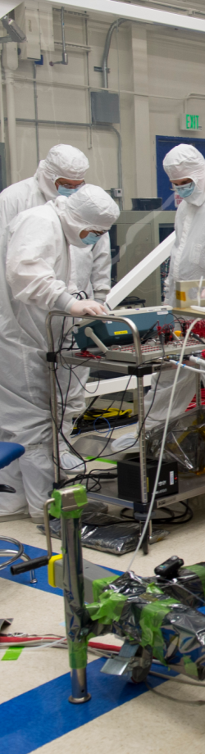



NIAC Study Phases
Funding Innovation Across the Nation
Universities
National
Labs
Industry
Small
Businesses
NASA
Researchers
Individuals &
Garage Inventors

Slide 8
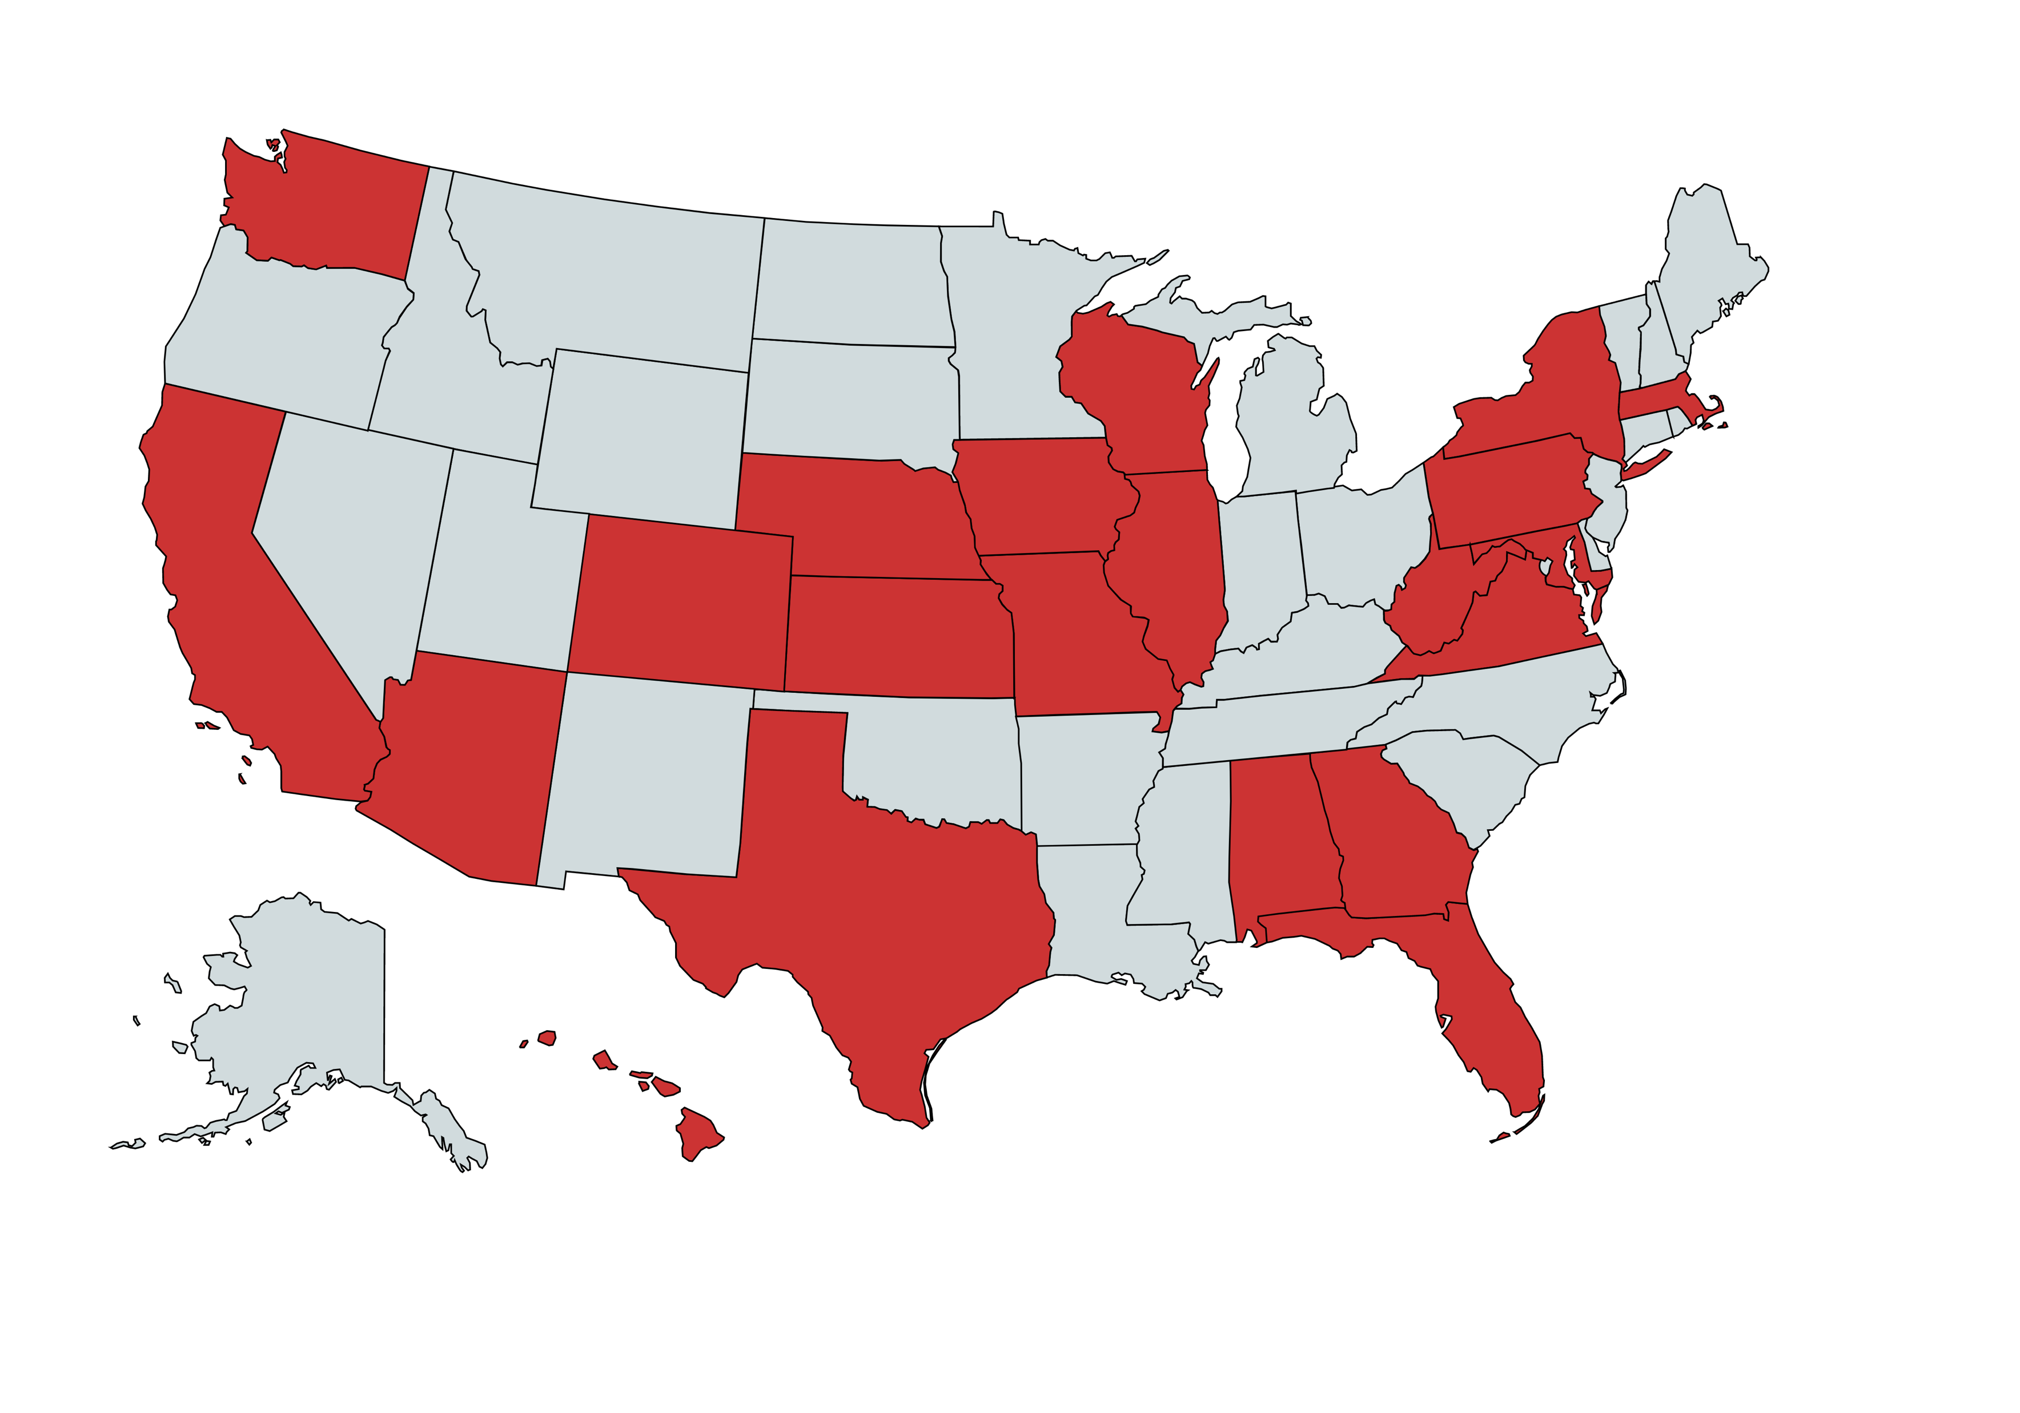
NIAC Awards: Educational Institutions (2011 – 2023)
Academic Institutes
NIAC Funded Institutions 2011 – 2023 (Academic)
University of Nebraska, Lincoln
Northwestern University
Rensselaer Polytechnic Institute
University at Buffalo - The State University of New York
University of Washington, Seattle
Iowa State University
University of Wisconsin, Madison
Carnegie Mellon University
Cornell University
Stanford University
Massachusetts Institute of Technology
University of California, Santa Cruz
Pennsylvania State University
California Polytechnic State University
Harvard University
Rochester Institute of Technology
University of California, Berkeley
University of Pennsylvania
University of California, Los Angeles
University of Maryland, College Park
University of California, Davis
Johns Hopkins University
University of California, Santa Barbara
West Virginia University
Virginia Polytechnic Institute and State University
University of Southern California
University of Arizona
Auburn University
University of Colorado, Boulder
Georgia Institute of Technology
University of Alabama, Huntsville
University of Missouri, Rolla
University of Miami
Wichita State University
University of Central Florida
Arizona State University
Colorado School of Mines
University of Texas, El Paso
University of Florida, Gainesville
Embry-Riddle Aeronautical University
University of Hawaii
Texas A&M University
NIAC

Slide 9
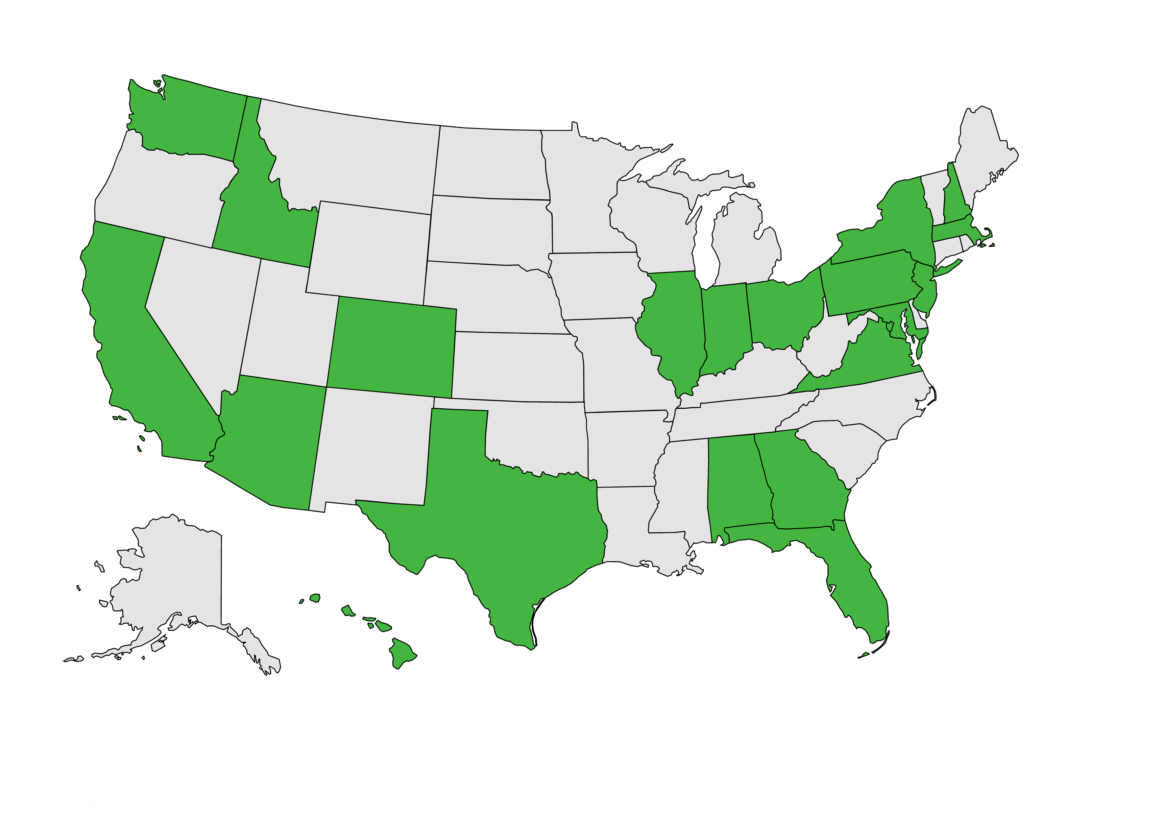
NIAC Awards: NASA, Business, Industry
Industry/Government
Alabama
NASA Marshall Space Flight Center
Arizona
Howe Industries, LLC
Planetary Science Institute
California
Aerospace Corporation
Anthony Longman, Inc. (2013)
Artemis Innovative Management Solutions
Deep Space Industries
eSionic
Global Aerospace Corporation
ICS Associates, Inc.
Made in Space, Inc.
Marc M. Cohen, Architect (2012)
Masten Space Systems
NASA Ames Research Center
NASA Jet Propulsion Laboratory
Planetary Science Institute
Positron Dynamics, CA
Raytheon
Space Studies Institute
TransAstra Corp.
Y.K. Bee Corporation
Colorado
Ball Aerospace & Technologies Corporation
Exoterra Resource, LLC
District of Columbia
Naval Research Laboratory
NIAC Funded Institutions 2011 – 2023 (Non-academic)
Massachusetts
Busek Co., Inc.
Draper Laboratory
Massachusetts Institute of Technology, Haystack Observatory
New Jersey
Princeton Satellite Systems, Inc.
New York
3DeWitt, LLC
Ohio
COMPASS
NASA Glenn Research Center
Ohio Aerospace Institute
Pennsylvania
Astrobotic Technology, Inc.
Texas
Lunar Resources, Inc.
Nanohmics, Inc.
NASA Johnson Space Center
Virginia
Leidos, Inc.
NASA Langley Research Center
Raytheon BBN Technologies
Washington
Deep Space Industries
MSNW, LLC
Planet Enterprises
Positron Dynamics, WA
Tethers Unlimited
Ultra Safe Nuclear Corporation
Created with mapchart.net
Hawaii
Neoteric Physics, Inc.
Idaho
University Space Research Association
HBar Technologies
Indiana
ITT Space Systems, LLC
Techshot, Inc.
Illinois
Hbar Technologies Maryland
NASA Goddard Space Flight Center
Nosanov Consulting, LLC
Florida
BEAM Engineering for Advanced Measurements
IMSG Laboratories, Inc.
Medical Solutions Group
NASA Kennedy Space Center
Georgia
SpaceWorks Engineering, Inc
Georgia Tech Research Corporation
NIAC

Slide 10
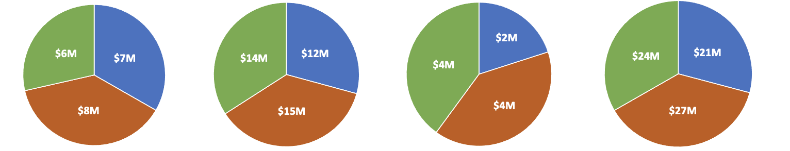
Funding by Organization Type
$72M Awarded (FY11-FY23)
Dollars are assigned to the Fellow’s Organization
Phase I
Phase II
Phase III
Total
NASA Academia Other
Funding Values:
Phase I: $100K through FY17; $125K FY18-FY21; $175k FY22+
Phase II: $500K through FY21, $600K FY22+
Phase III: $2M (initiated FY18)

Slide 11
Phase I Key Information (1/2)
Proposal Process
Phase I Proposal Submission & Selection Process:
Two-step Process; Step A is fully-open; Step B by Invitation only
Independent Peer Review panel process used to evaluate proposals
Recommendations made to NASA HQ/STMD for selection and award
Eligibility:
Offerors and team members may be affiliated with any U.S. educational institution, commercial or not-for-profit organization, research laboratory, agency, or NASA
Non-U.S. organizations may partner in, or lead, NIAC studies on a no-exchange of funds basis, and subject to NASA’s policy on foreign participation.
Awards:
All awardees can expect to receive grants, except for federal agencies and NASA centers, which will receive inter/intra-agency transfers or contracts.

Slide 12
NIAC Program Summary
NIAC Summary
NIAC funds:
Early-stage feasibility studies of visionary concepts that address government and commercial aerospace goals
Solicited from any field of study that offers a radically different approach or disruptive innovation that may significantly enhance or enable new human or robotic science and exploration missions
Framed in terms of a mission context that clearly identifies scientific or technical advancements and associated benefits compared to current approaches
Comparatively high risk and far term, NIAC concepts are transformational investments in our future national space capabilities

Slide 13

ADDITIONAL STMD OPPORTUNITIES
https://www.nasa.gov/stmd-solicitations-and-opportunities/

Slide 14






ESIP’s Portfolio of Programs: STRG
Space Technology Research Grants (STRG)
Low TRL technology portfolio of research in advanced space technology
Theoretical feasibility of ideas and approaches that are critical to making science, space travel, and exploration more effective, affordable, and sustainable
The NASA Space Technology Graduate Research Opportunities solicitation seeks to sponsor graduate student researchers who show significant potential to contribute to NASA’s goal of creating innovative new space technologies
The Early Career Faculty, Early-Stage Innovations, Lunar Surface Technology Research Opportunities, and Space Technology Research Institutes solicitations are of high priority to NASA’s Mission Directorates and the aerospace community in areas where it is anticipated that academia is ideally suited to provide significant innovations
https://www.nasa.gov/about-strg/

Slide 15
ESIP’s Portfolio of Programs: PCC
Prizes, Challenges and Crowdsourcing (PCC)
NASA’s work in space and aeronautics continues to be of great interest to the public and we recognize that good ideas can come from anywhere.
NASA’s prizes, challenges, and crowdsourcing opportunities are one way for the agency to engage the public’s interest and ingenuity, making space exploration and other avenues of NASA research an endeavor of and by people everywhere.
Opportunities within the Prizes, Challenges, and Crowdsourcing program are distributed through Centennial Challenges and the Center of Excellence for Collaborative Innovation (CoECI). The program also helps to promote other agency-wide opportunities to foster a community of “solvers” supporting NASA
Newsletter: https://lp.constantcontactpages.com/su/2odejsb
https://www.nasa.gov/prizes-challenges-and-crowdsourcing/

Slide 16
ESIP’s Portfolio of Programs: SBIR/STTR
Small Business Innovative Research (SBIR) and
Small Business Technology Transfer (STTR)
Early-stage funding for research & development (R&D)
Up to $1 million during first three years, plus up to nearly $3 million or more through Post Phase II opportunities (NASA has zero equity in IP)
A door into potential work with NASA programs and other government agencies
A way to de-risk your technology as you work to mature it
SBIR: A U.S. small business with 500 or fewer employees is eligible to submit a proposal for funding.
STTR: Requires collaboration between the small business submitting a proposal and a research institution.
https://sbir.nasa.gov/

Slide 17
ESIP’s Portfolio of Programs
Program Acronym | NIAC | STRG | CIF/ECI | PCC | SBIR/STTR | T2
Program Name | NASA Innovative Advanced Concepts | Space Tech Research Grants | Center Innovation Fund / Early Career Initiative | Prizes, Challenges, and Crowdsourcing | Small Business Innovation Research / Small Business Tech Transfer | Technology Transfer
Primary Audience | Government, Industry, Academia | Academia | NASA Internal | General Public, Academia, Industry | Small Business, Research Institutions | Industry
Program Description | Nurtures visionary ideas that could transform future NASA missions by engaging America’s innovators and entrepreneurs as partners in the journey. | Challenges the spectrum of academic researchers to making science, space travel, and exploration more effective, affordable, and sustainable. | Stimulate and encourage creativity and innovation within the NASA Centers and Early Career leaders. | Makes opportunities available for public participation in NASA research and technology solutions to support.​ | Engages small businesses, research institutions, and entrepreneurs in technology R&D that meet NASA needs and could be commercialized. | Ensures that innovations developed for exploration and discovery are maximizing the benefit to the Nation and enabling spinoffs.
TRL | Low | Low | Low | Low | Low/Mid | Low/Mid
Size | 30+ grants annually | 300+ grants with dozens of universities | ~140 projects across NASA Centers | >80 projects across NASA | >500 contracts with hundreds of small businesses | >1,500 Active Patents & >700 Licenses

Slide 18
ESIP Portfolio of Solicitations/ Activities
 | Solicitation/ Activity Title | Award Type | Topic Specificity* | Frequency of Award | Prerequisite or Eligible Applicants | Size ($ max) (based on lifecycle $) | Volume of Annual Awards
NIAC | NASA Innovative Advanced Concepts (NIAC) Phase I | Grant | Open | Annual | Government, Industry, Academia​ | Small ( < $500K ) | Few ( <20 )
 | NASA Innovative Advanced Concepts (NIAC) Phase II | Grant | Specific | Annual | NIAC Phase I Awardees​ | Medium ($500K - $1M) | Few ( <20 )
 | NASA Innovative Advanced Concepts (NIAC) Phase III | Contract | Specific | Annual | NIAC Phase II Awardees​ | Large ( > $1M) | Few ( <20 )
CIF/ECI | Center Innovation Fund (CIF) | Internal Award | Open | Annual | NASA Centers​ NASA Early Career Researchers​ | Small ( < $500K ) | Many ( >50)
 | Early Career Initiative (ECI) | Internal Award | Open | Annual | NASA Centers​ NASA Early Career Researchers​ | Large ( > $1M) | Few ( <20 )
STRG | NASA Space Technology Graduate Research Opportunities (NSTGRO) | Grant | Open | Annual | Graduate Students, US Universities​ | Small ( < $500K ) | Many ( >50)
 | Early Career Faculty (ECF) | Grant | Specific | Annual | Early Career Faculty at US Universities​ | Medium ($500K - $1M) | Few ( <20 )
 | Early Stage Innovations (ESI) | Grant | Specific | Annual | US Universities​ | Medium ($500K - $1M) | Few ( <20 )
 | Lunar Surface Technology Research (LuSTR) Opportunities | Grant | Specific | Annual | US Universities​ | Large ( > $1M) | Few ( <20 )
 | Space Technology Research Institutes (STRI)** | Grant | Specific | Every Other Year | US Universities​ | Large ( > $1M) | Few ( <20 )
* "Specific" has a specified topic. “Hybrid” can be open within a broad topic or related to the original topic. “Open” has no specified topic
**Every-Other Year Cycle
18

Slide 19
ESIP Portfolio of Solicitations/ Activities
 | Solicitation/ Activity Title | Award Type | Topic Specificity* | Frequency of Award | Prerequisite or Eligible Applicatnts | Size ($ Range) (based on lifecycle $) | Volume of Annual Awards
I-Corps | NASA Innovation Corps (I-Corps) Pilot | Grant | Open | On-going | Academia / Higher-Ed / Non-Profit Research Institutions​ | Small ( < $500K ) | Few ( <20 )
SBIR/STTR*** | SBIR/STTR Phase I | Contract | Specific | Annual | Small Businesses​ | Small ( < $500K ) | Many ( >50)
 | SBIR Phase II | Contract | Specific | Annual | SBIR Phase I Awardees​ | Medium ($500K - $1M) | Many ( >50)
 | STTR Phase II | Contract | Specific | Annual | STTR Phase I Awardees​ | Medium ($500K - $1M) | Medium (20 - 50)
 | SBIR Ignite Phase I | Contract | Specific | Annual | Small Businesses​ | Small ( < $500K ) | Few ( <20 )
 | SBIR Ignite Phase II | Contract | Specific | Annual | SBIR Ignite Phase I Awardees​ | Medium ($500K - $1M) | Few ( <20 )
 | SBIR/STTR Sequentials | Contract | Specific | Annual | SBIR/STTR Phase II Awardees​ | Large ( > $1M) | Few ( <20 )
 | CCRPP | Grant | Specific | On-going | SBIR/STTR Phase II Awardees​ | Medium – Large ($500K - $2.5M) | Few ( <20 )
* "Specific" has a specified topic. “Hybrid” can be open within a broad topic or related to the original topic. “Open” has no specified topic
***Universities are required partners for STTRs
19

Slide 20
ESIP Portfolio of Solicitations/ Activities
 | Solicitation/ Activity Title | Award Type | Topic Specificity* | Frequency of Award | Prerequisite for application or Eligible Applicants | Size ($ max) (based on lifecycle $) | Volume of Annual Awards
SBIR/STTR*** | SBIR/STTR Phase II – E | Contract | Specfic | On-going | SBIR/STTR Phase II Awardees​ | Small ( < $500K ) | Medium (20 - 50)
 | SBIR I-Corps | Contract | N/A | Annual | SBIR Awardees​ | Small ( < $500K ) | Medium (20 - 50)
 | SBIR/STTR Phase III | N/A | Hybrid | On-going | Phase I/Phase II Awardees​ | N/A | N/A
PCC | Crowdsourcing Contenders | Award | Open | Annual | NASA Employees ​Propose Projects, Public participates in resulting challenges | Small ( < $500K ) | Few ( <20 )
 | NASA Spark | Crowdsourcing | Open | Ad-Hoc | NASA Employees​ | N/A | Many ( >50)
 | NTL Projects | Prizes, Challenges, Crowdsourcing | Hybrid | Ad-Hoc | NASA Employees ​Propose Projects, Public participates in resulting challenges | Varies | Many ( >50)
 | Centennial Challenge Projects | Prize | Specific | Ad-Hoc | NASA Employees ​develop competitions, Public participates in resulting challenges | Large ( > $1M) | Few ( <20 )
Tech Transfer | Invention Disclosure | Invention Disclosure | Open | Ad-Hoc | Internal Audience​ | N/A | N/A
 | Software Release | Software Release | Open | Ad-Hoc | External and Internal Audiences​ | N/A | N/A
 | Patent Licensing | Patent License | Open | Ad-Hoc | Industry​ | N/A | N/A
* "Specific" has a specified topic. “Hybrid” can be open within a broad topic or related to the original topic. “Open” has no specified topic
***Universities are required partners for STTRs
20

Slide 21
NIAC BACKUP CHARTS

Slide 22
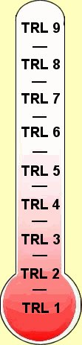
NASA TRL Scale
NASA Technology Readiness Levels
TRL 9 - Actual system "flight proven" through successful mission operations
TRL 8 - Actual system completed and "flight qualified" through test and demonstration (Ground or Flight)
TRL 7 - System prototype demonstration in a space environment
TRL 6 - System/subsystem model or prototype demonstration in a relevant environment (Ground or Space)
TRL 5 - Component and/or breadboard validation in relevant environment
TRL 4 - Component and/or breadboard validation in laboratory environment
TRL 3 - Analytical and experimental critical function and/or characteristic proof-of-concept
TRL 2 - Technology concept and/or application formulated
TRL 1 - Basic principles observed and reported
NIAC

Slide 23

NIAC Phase I Process
NIAC Phase I Process: A Two-Step Call
STEP A
3-page whitepaper describing your technology development concept in a Mission Context
We review the Step A Proposals and invite all qualifying proposals to STEP B
INVITATION
STEP B
      8-page proposal
      detailing your concept and describing the work you would do
  The Step B proposals are reviewed by an expert panel, ranked, and presented to the Selection Official at NASA HQ, who makes the final selection of projects
  Selected Studies are awarded up to $175K for a 9-month Study
NIAC

Slide 24
NIAC Step A Elimination Criteria
Not an aerospace architecture
Proposed concept is unclear or not adequately articulated
No representative mission
Previously explored
Incremental
Not technically credible
Not programmatically credible
Too narrowly focused
Develops pre-mission tools or processes
Most often
NIAC

Slide 25
More on Representative Mission
NIAC does not fund isolated technology development
Instead, NIAC provides an opportunity to show why your new and innovative concept matters to NASA
Innovation must be expressed in a relevant implementation, so NASA can compare “apples to oranges” across a wide range of innovation
Some examples:
New Propulsion: What is the total system mass? Where would it matter? What are the alternatives?
New Instrument: How would it fit in a spacecraft/lander/rover? What are the mass/power/communication requirements?
New Life Support: How would it be integrated into a habitat or crew vehicle? What are its mass/power/thermal requirements (e.g., equivalent system mass)?
NIAC

Slide 26
NSPIRES
Step A proposals and invited Step B proposals must be submitted through NSPIRES
All evaluations and award selections will be announced via NSPIRES
Information on how to register, access and submit proposals via NSPIRES can be found at the NSPIRES FAQ page (follow “NSPIRES Help” and then “FAQs”)
Every organization, including partner organizations that are part of the proposal team, must be registered in NSPIRES
Familiarize yourself with the system and begin the submittal process well in advance of the deadline!
NIAC

Slide 27
NIAC Proposal Process Summary
Step A Proposal Review. Step A proposals that are within scope (i.e., do not violate any of the eliminating criteria), technically compliant, credible, and competitive will be considered for invitation to Step B.
Panel Peer Review. Step B proposals will be assigned to one of several Technical Review Panels of independent subject matter experts to evaluate proposals against the evaluation criteria in Section 5.2.
Prioritized Recommendation. The most competitive proposals identified by the Technical Review Panels, and the responsible NASA officials will prepare a prioritized recommendation for the Selecting Official.
Selection. The Selecting Official will make the final selection of Step B proposals to be negotiated for award, based on the technical reviews, prioritized recommendations, feedback from NASA Mission Directorates, and considerations such as budgetary restrictions or portfolio balance.
NIAC

