Slide 1
Pre-Flight Hazardous Gas Assessment Methodology for the Space Launch System
Brian R. Richardson
NASA/Marshall Space Flight Center/ER42
AIAA SciTech Conference, Jan. 8-12th 2024, Orlando, FL
Published by the American Institute of Aeronautics and Astronautics, Inc., with permission.

Slide 2
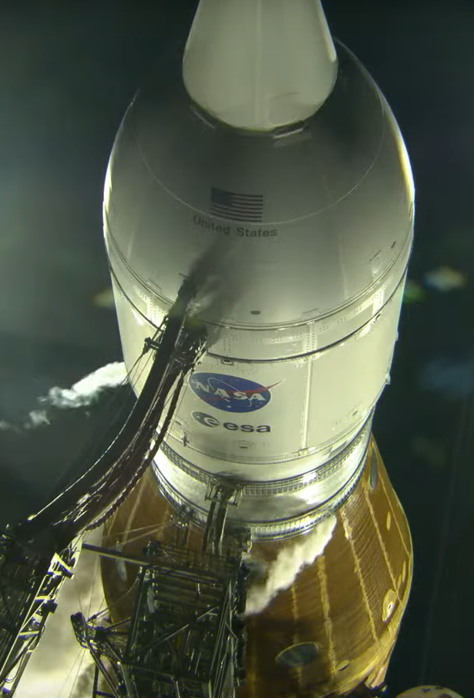
Artemis I Hazardous Gas Overview
Hazardous Gas Leakages and Expulsions Occur During Nominal Space Launch System (SLS) Pre-Flight Operations
Hazardous Gas Sources Pose a Fire/Explosion Risk to the SLS Vehicle and are Controlled Through Risk Assessments and/or Active Mitigation
  Large Hydrogen (H2) Expulsions
    RS-25 Lead H2, Core Auxiliary Power Unit, H2 Propellant Boil-Off
    Mitigated Using Hydrogen Burn-Off Igniters (HBOIs) and Burn Stack
  Large Oxygen (O2) Expulsions
    O2 Propellant Boil-Off
    Unmitigated
Artemis I O2 Venting

Slide 3
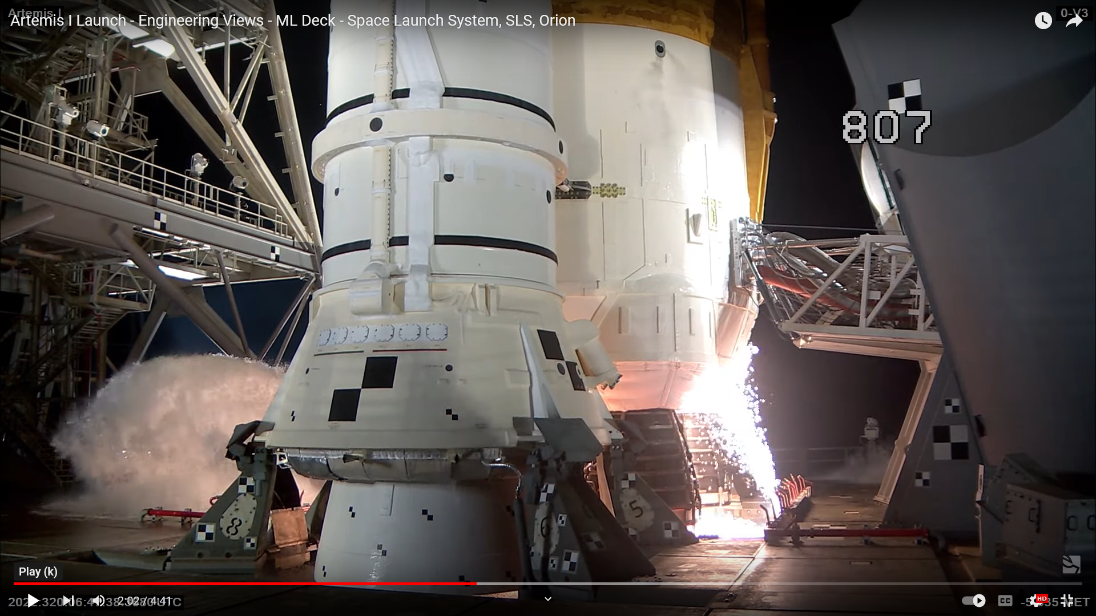
Artemis I Hazardous Gas Overview (Cont.)
Hazardous Gas Leakages Sources (Continued)
  H2 and O2 Leakages at Umbilical Interfaces
    Core Stage Engine Section Umbilical Plates, H2 Tank Vent Umbilical, Upper Stage Fill/Drain and Vent Umbilical Interfaces
    Mitigated Using Inert Purge Gas: Helium/Nitrogen
  H2 and O2 Leakages into Vehicle Compartments
    Vehicle Compartments between Propellant Tanks and Stages
    Mitigated Using Inert Purge Gas: Helium/Nitrogen
Known Hazards are Controlled and Assigned a Risk Score
  Herein present fluid analysis to quantify 3 hazards
  CAPU, Umbilical Plate Purge, Umbilical Plate Venting
Compartment Venting
Umbilical Interface
HBOIs

Slide 4
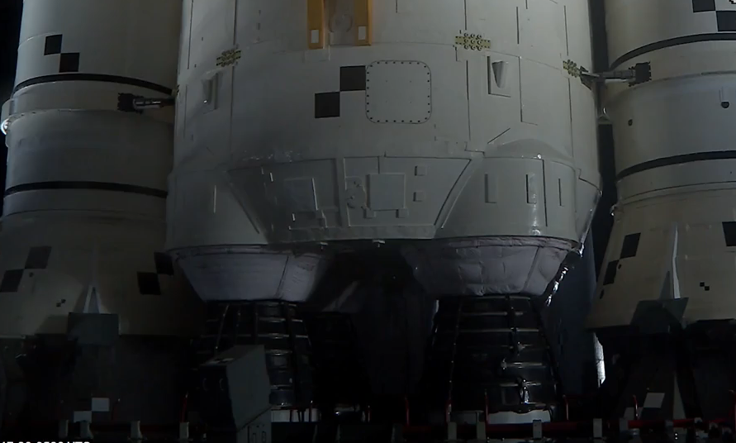
Artemis I Pre-Flight Hazardous Gas: CAPU
Inert, Helium-Only CAPU Pulses
HBOIs Fire

Slide 5
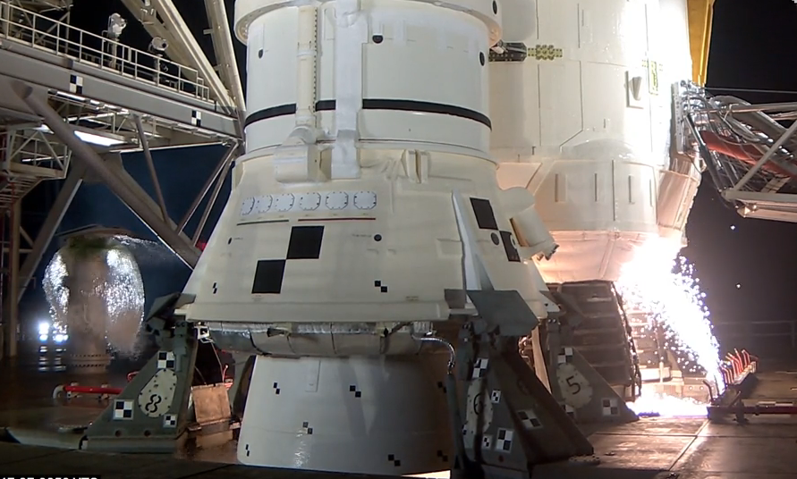
Artemis I Pre-Flight Hazardous Gas: CAPU
RS-25s Fire, HBOI downward deflection
CAPU exhaust gas burning, orange flames

Slide 6
Notional Visualization of the Hazard
Nominal HBOI Functionality
HBOI particles reach CAPU exhaust ports.
Outcome: Hydrogen flame forms below heat shield, detonable Hydrogen-Air mixture cannot form
Off-Nominal HBOI Functionality
HBOI particles fail to reach CAPU exhaust ports.
Outcome: Unburned Hydrogen-Air mixture forms below heat shield leading to potential detonation/deflagration
CAPU Exhaust
Pulse - Hydrogen
CAPU Exhaust
Pulse - Hydrogen
SLS Base Heat Shield
SLS Base Heat Shield
Ignition as CAPU exhaust exits base heat shield
What is the strength of the Overpressure Wave at the Base Heat Shield?
Combustion Event!
CAPU exhaust flame
Overpressure Wave
detonable Hydrogen-Air Vapor Cloud forms
Ignition of Hydrogen-Air Vapor Cloud
This Scenario is Required to Produce Hazardous Pop Environment for SLS
CAPU HBOI Particles Deflected by wind/water, or entrainment
CAPU HBOI Particle Cone
CAPU exhaust ports protrude ~5 inches from CS base heat shield

Slide 7
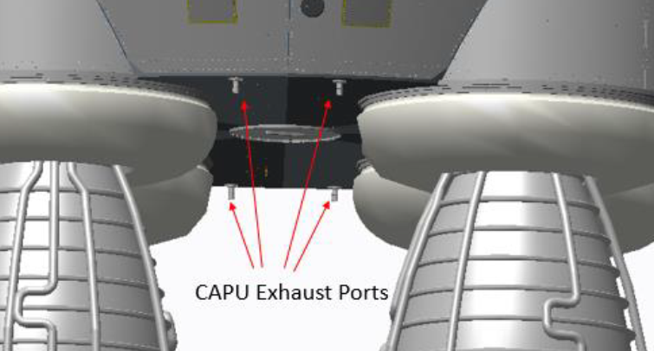
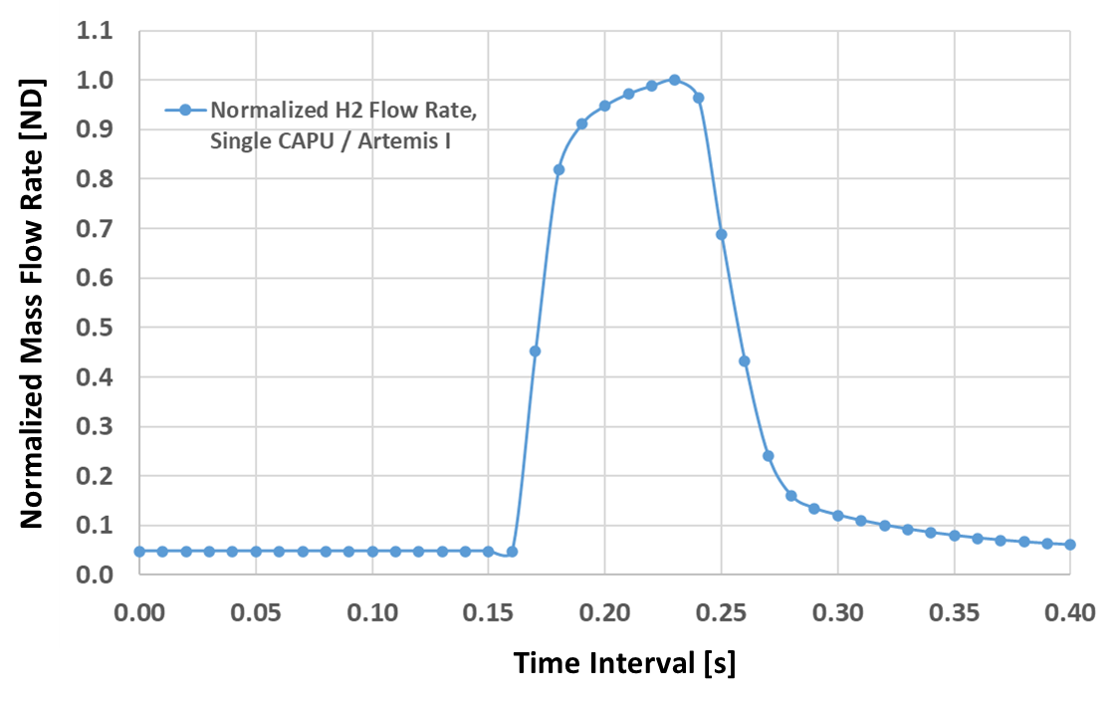
CAPU Exhaust Duct Geometry and CFD Model
CFD model results shown herein include the Artemis I flight CAPU exhaust port geometry
Density-based, Navier-Stokes solver Loci-CHEM used to simulate time-accurate, transient CAPU exhaust pulses of hydrogen
Computational domain with relevant geometry discretized using hybrid-unstructured mesh

Slide 8
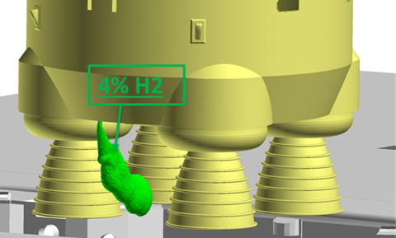
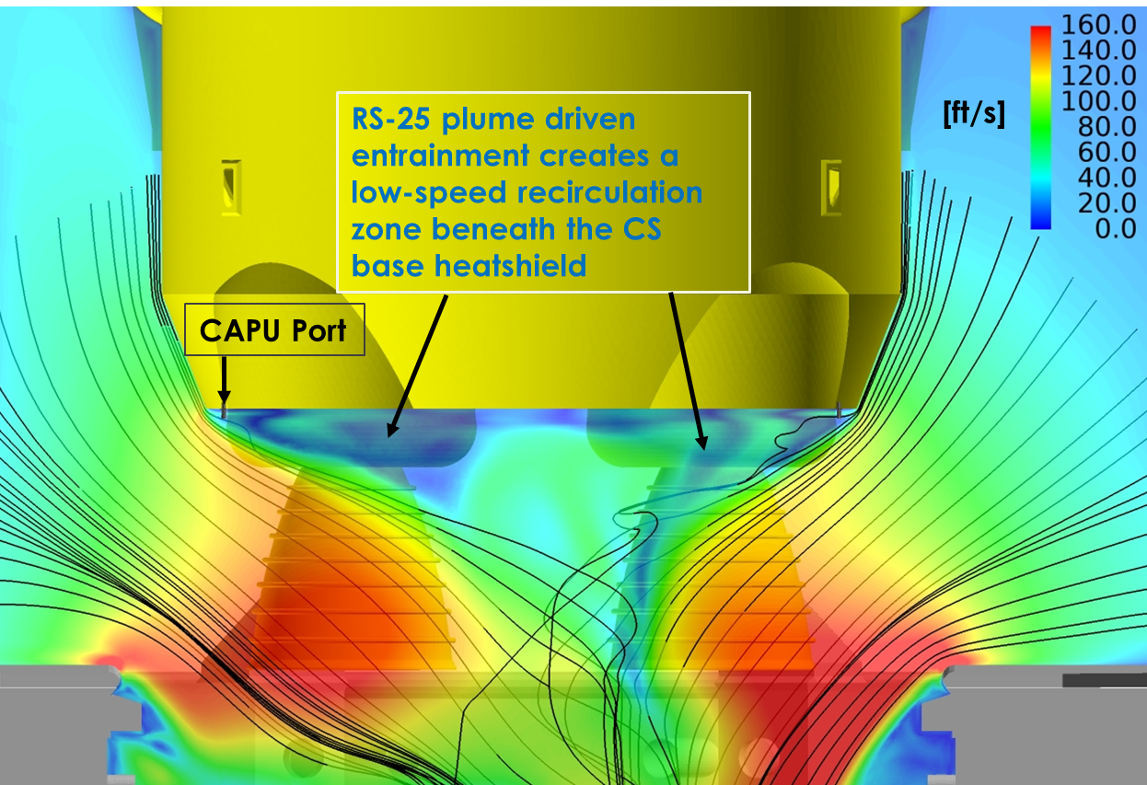
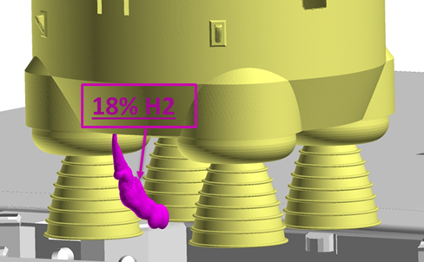

Identify Detonable Mixtures in CFD Results
Entrainment Velocity Field from RS-25 Plumes
Iso-Surface: Lower Flammable Limit H2/air
LOCI\Chem CFD simulation results used to determine maximum accumulation of detonable H2/air.
Iso-Surface: Lower Explosive Limit H2/air
Iso-Surface: Upper Explosive Limit H2/air
Plume entrainment pulls CAPU exhaust gas toward centerline of SLS

Slide 9
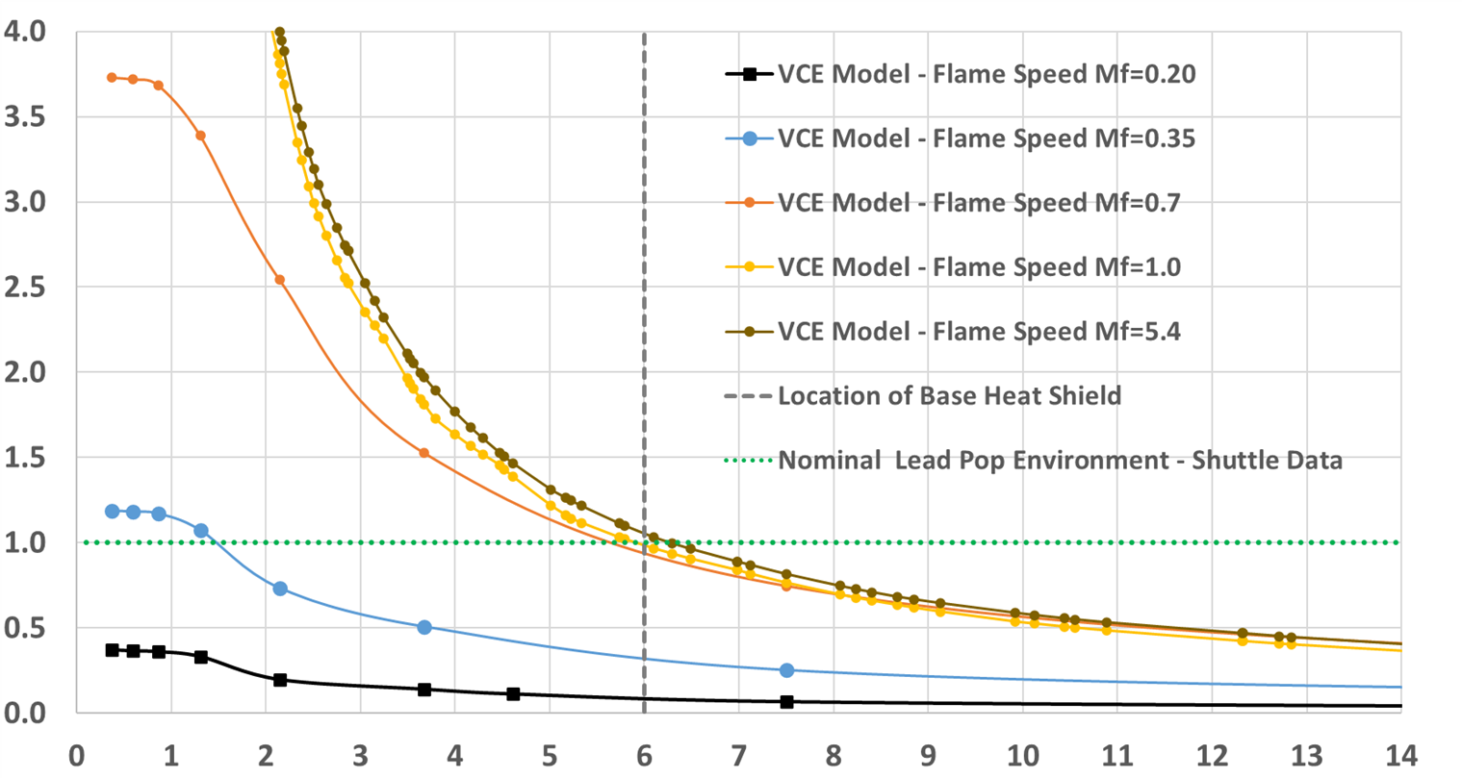
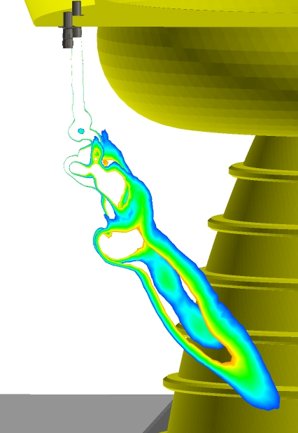

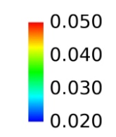
CFD & VCE Results – No Wind Case, South Side of Pad
Cross-section through CAPU exhaust plume CFD results showing detonable volume
VCE Model results for CAPU exhaust gas
Normalized Overpressure Magnitude [ND]
Center of detonable gas ~6 feet from CS base
heatshield
Note: The gas tendrils cannot detonate, however, the mass of the H₂ in them was added to the detonable mass for conservatism.
Distance From Detonable Gas Center [feet]
Assuming the worst-possible case flame speed case, a strong detonation, the overpressure magnitude imparted on the base heat shield is similar to the Nominal Lead Pop environment
ER42(21-069)

Slide 10
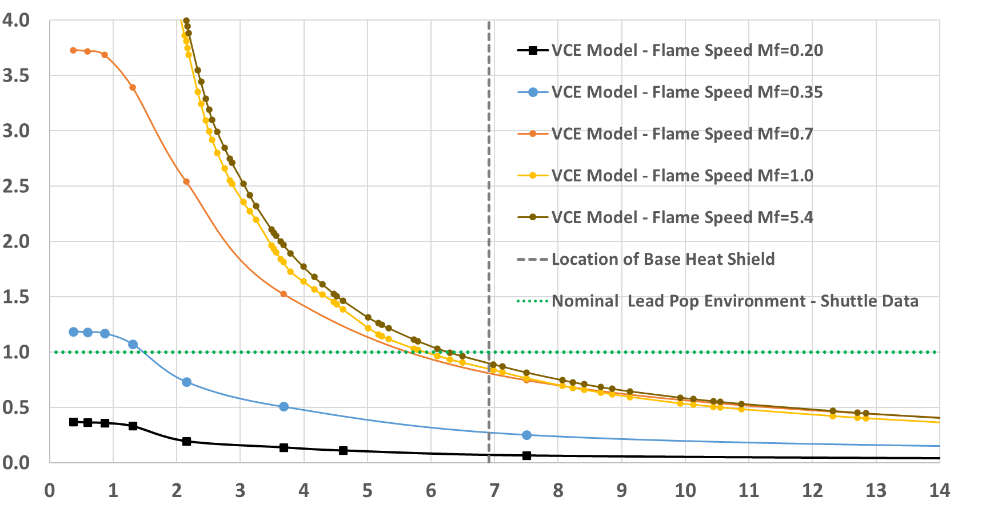
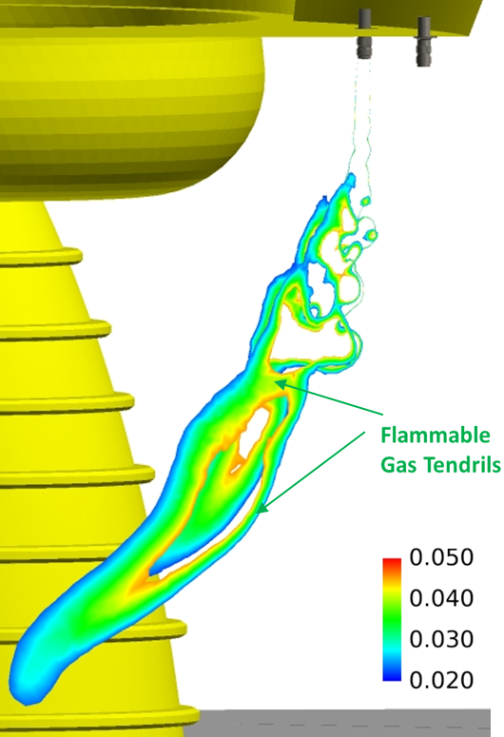
CFD & VCE Results – No Wind Case, North Side of Pad
Cross-section through CAPU exhaust plume CFD results showing detonable volume
VCE Model results for CAPU exhaust gas
Normalized Overpressure Magnitude [ND]
Center of detonable gas ~6.8 feet from CS base heatshield
Note: The gas tendrils cannot detonate, however, the mass of the H₂ in them was added to the detonable mass for conservatism.
Distance From Detonable Gas Center [feet]
Assuming the worst-possible case flame speed case, a strong detonation, the overpressure magnitude imparted on the base heat shield is slightly less the Nominal Lead Pop environment

Slide 11
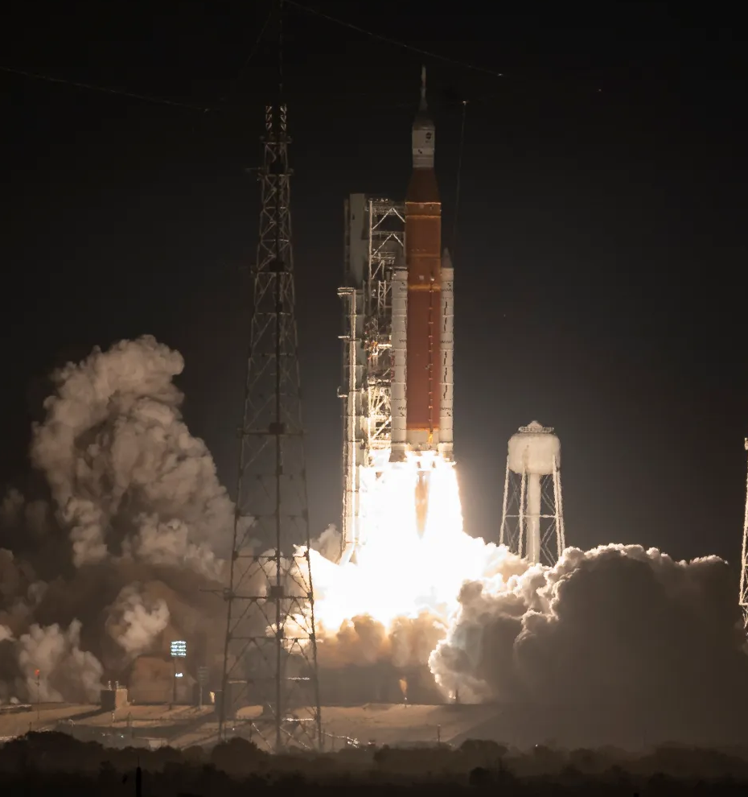
CFD Analysis Impact and Artemis I Observations
CFD/VCE analysis of CAPU exhaust risk showed a failure of the HBOI system was unlikely to produce a catastrophic consequence for the vehicle.
During Artemis I launch, HBOI systems performed nominally
  CAPU exhaust gas ignited and burned continuously through launch sequence
  No off-nominal H2 pops observed

Slide 12
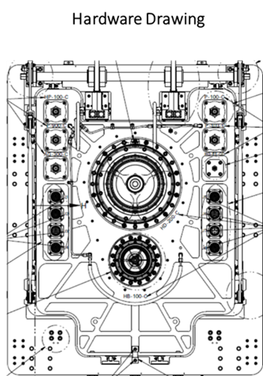
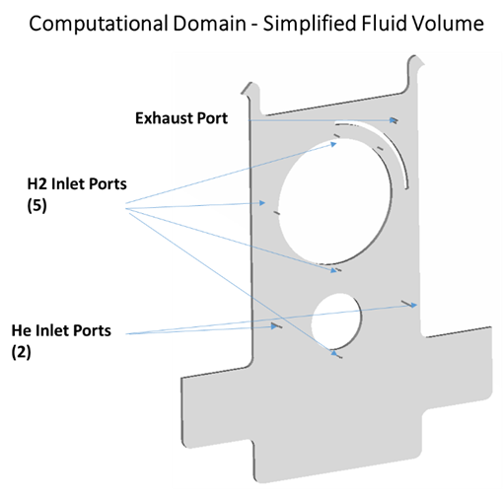
Umbilical Plate Hazardous Gas Monitoring Investigation
H2 Leakages Occur Inside SLS Umbilical Plate Cavities
Cavity purged with Helium, H2 concentration monitored during purge
Umbilical plate purge system tested at Launch Equipment Test Facility (LETF)
Tests produced inconsistent H2 concentration results that varied by leak location and test-to-test
Known flow rates of H2 leakage gas and Helium purge gas
Loci-STREAM CFD simulations used to investigate source of test data inconsistencies

Slide 13
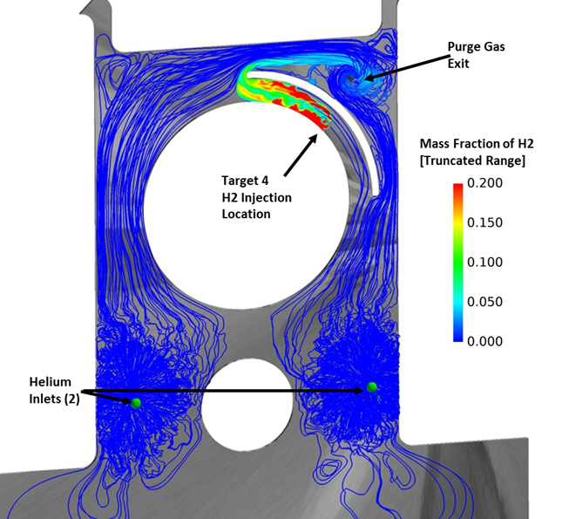
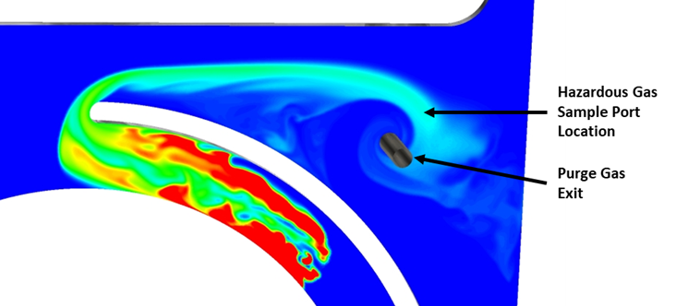
Initial Sample Location Bias CFD Findings
Target 4 H2 Leakage Location
Hydrogen does not uniformly mix and diffuse into Helium in umbilical plate cavity before reaching exit.
Sampling location bias is one cause of errant H2 concentration readings at LETF

Slide 14
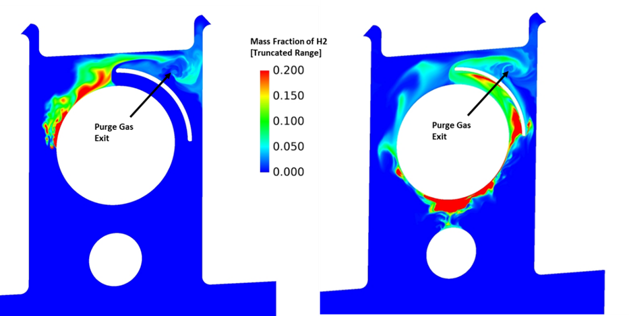
Leakage Location Variation CFD Findings
Target 2 H2 Leakage Location
Target 3 H2 Leakage Location
H2 concentration sensor moved to outlet in LETF but test data inconsistencies continued.
H2 and Ghe mixing uniformity within cavity dependent on path between leakage location and exit.

Slide 15
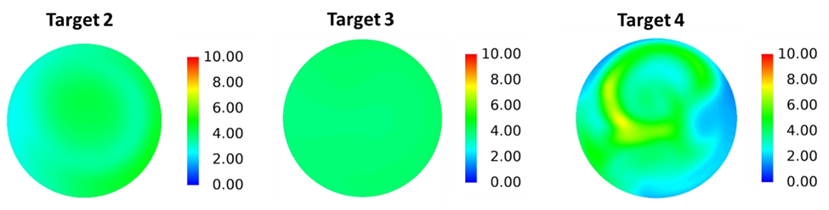
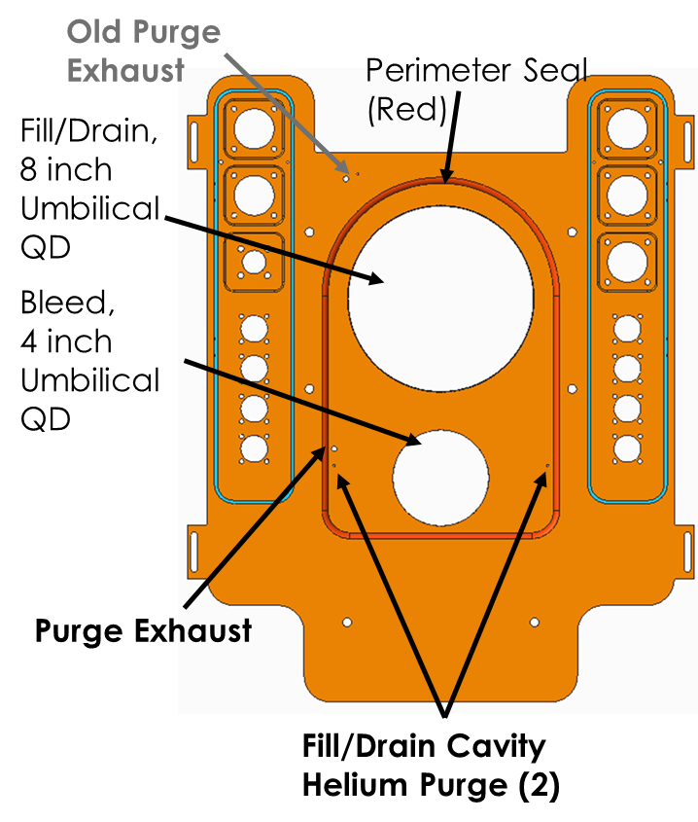
Final CFD Findings
Time-averaged H2 Concentration at New Hazardous Gas Sampling Location
New Seal Design
Time-averaged concentration of H2 gas at exit not dependent on leakage location. Minor variation in spatial distribution of H2 compared to variation in test data.
CFD simulation results eliminated incomplete H2/Ghe mixing as the cause of the test data inconsistencies. Seal leakage eventually identified as the root cause.
Umbilical plate seal and Ghe purge system were redesigned with recommendations from CFD analyses. CFD results and test data agreed for final redesign.

Slide 16
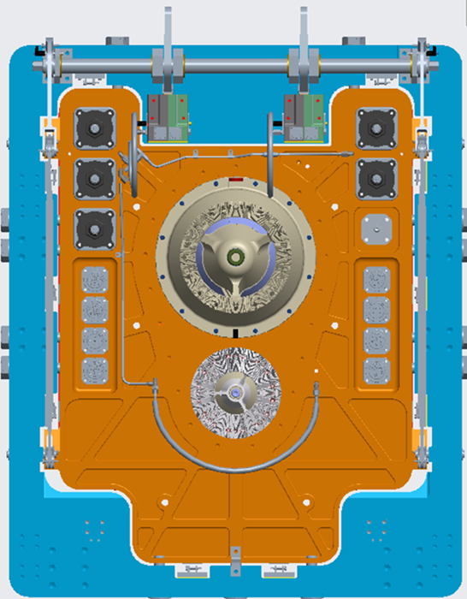
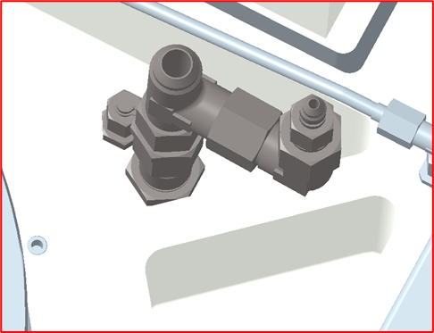
SLS CS LH2 Umbilical Plate External System and Hazard Description
Umbilical Plate External View
Artemis I H2 leakages have occurred at the 8 inch and 4 inch QD interfaces within the interior plate cavity.
Helium (Ghe) is used to purge the cavity. The combined Ghe/H2 gas is vented to the atmosphere outside the umbilical plate.
The Ghe purge is designed to dilute the H2 leakages to a non-hazardous concentration.
Fill/Drain Cavity Purge External Exhaust Port
Fill/Drain,
8 inch Umbilical QD
Bleed,
4 inch Umbilical QD
Exhaust Port to External Atmosphere
Haz. Gas Sample Port to Mass Spectrometer
Artemis I experienced multiple Launch Commit Criteria (LCC) violations due to H2 leakages overwhelming the purge system.
Fill/Drain Cavity
Helium Purge (2)
ER42(22-073)

Slide 17
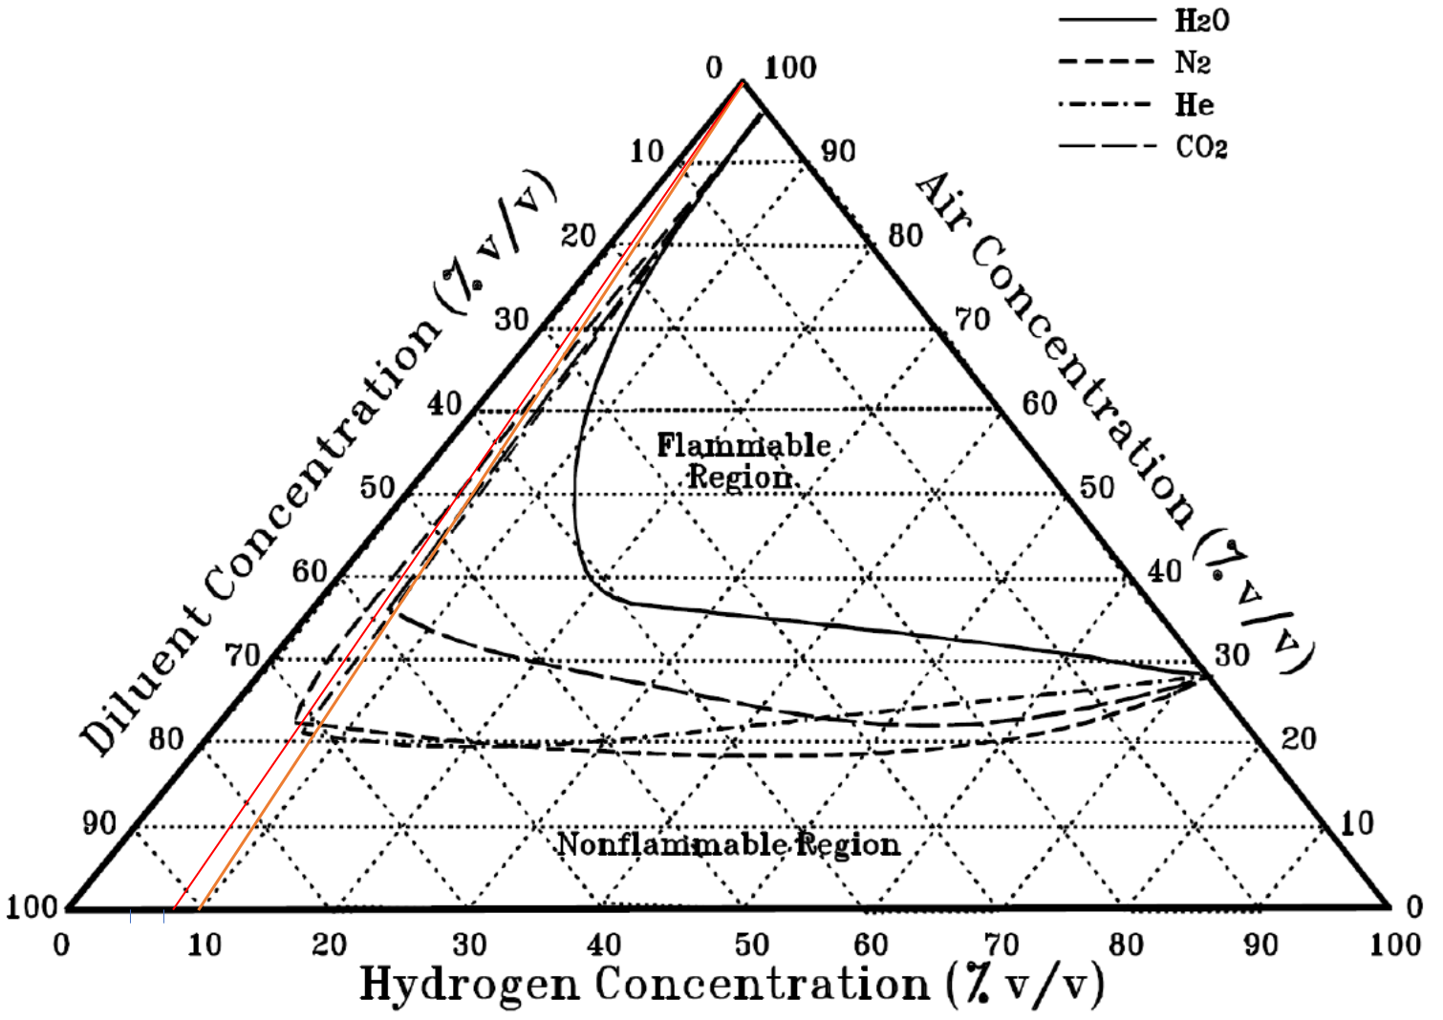
Flammability of H2/Helium/Air Mixtures
Flammability Diagram H2-He-Air
For a nominal umbilical leak scenario, the H2/GHe exhaust gas is not flammable when mixed with external air
    LCC violation occurs when exhaust gas exceeds 4% H2
    The lower flammability limit of H2 in air is 4%
A 4% H2 / 96% Ghe mixture is not flammable in air
    The flammability diagram and empirical data show that ~8% H2 is required to produce a flame when mixed with air
CFD simulation used to model the flammable volume of gas generated by the H2/Ghe exhaust mixing with air to provide additional information beyond the graphical flammability limits
    CFD simulations visualize location of flammable gas and potential H2 accumulation regions for various flow conditions
    Goal was to inform risk acceptance of an Artemis I launch waiver that allowed for a 10% H2 concentration exhaust exiting the umbilical plate cavity
8% H2/ 92% Ghe gas mixture just skirts the edge of the flammable region in the diagram when mixed uniformly with air. 10% H2 or greater falls well into the flammable mixture region.
ER42(22-073)

Slide 18

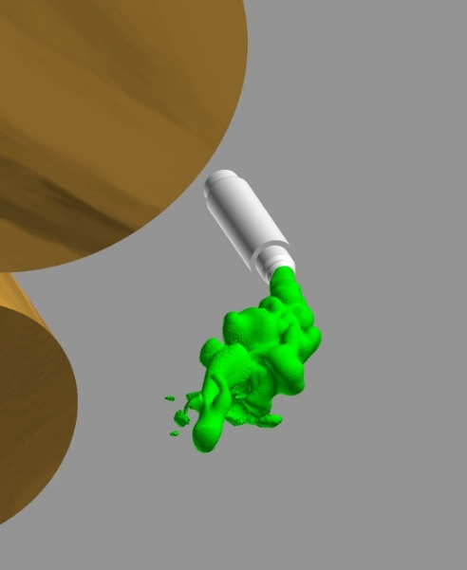
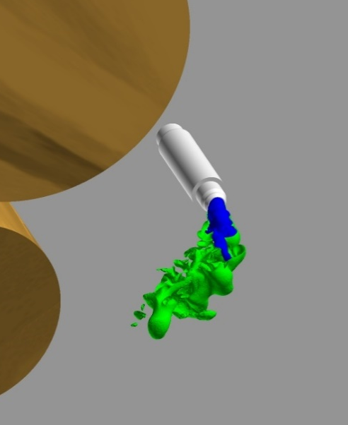
10% H2 / 90% Ghe, 3 Knot and 25 knot Cross-flow CFD Results
3 Knot Wind – 10% H2
25 Knot Wind – 10% H2
CFD Snapshot: Composite Iso-surfaces – Flammable H2-He-Air mixture between blue & green iso-surfaces
CFD Snapshot: Iso-surface of LFL of H2 – Volume contains all flammable H2
CFD Snapshot: Composite Iso-surfaces – Flammable H2-He-Air mixture between blue & green iso-surfaces
Fluid Observations
25 knot wind slightly shortens and bends the flammable gas
Primary hazard is thermal damage to umbilical lines due to sustained burning of H2 – H2 does not accumulate
Wind Direction
LFL Iso-surface extends ~8 inches from exhaust port
Wind bends flammable volume – no significant change in volume compared to gentle wind
ER42(22-073)

Slide 19
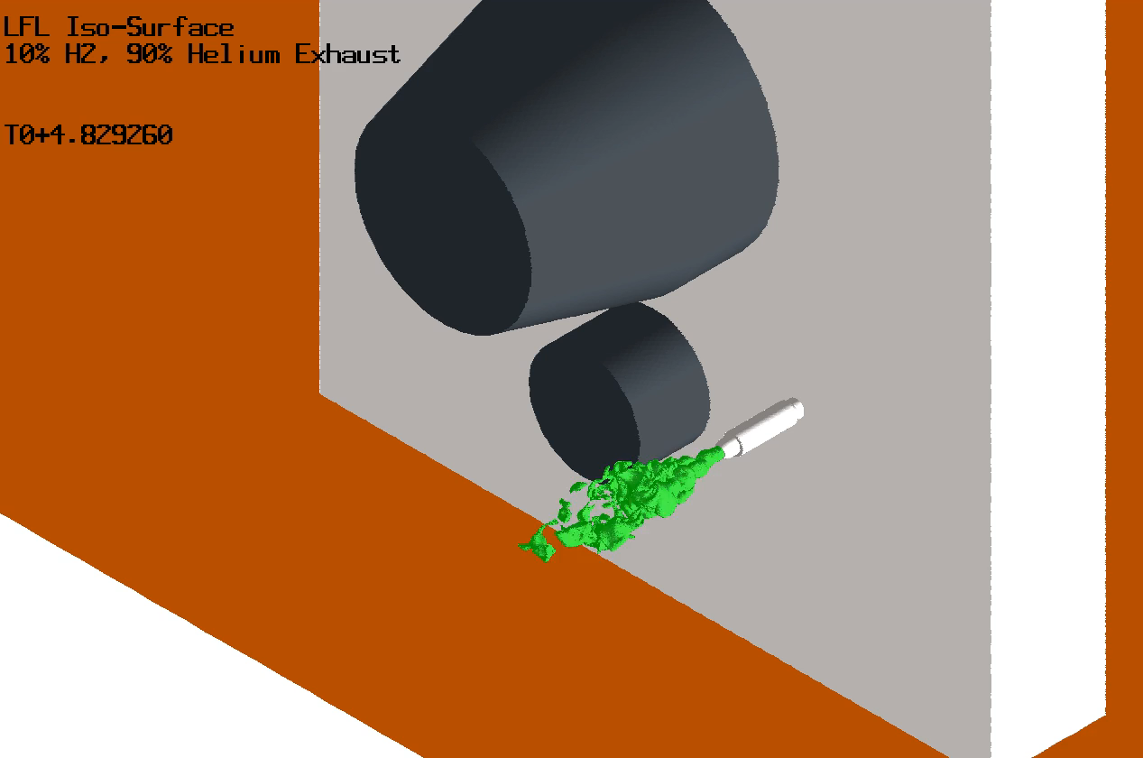
10% H2 / 90% Ghe, 3 Knot Animation of H2 LFL
The animation shows that the LFL iso-surface volume fluctuates but does not grow with time.
Wind Direction
ER42(22-073)

Slide 20
CFD Analysis Impact and Artemis I Observations
CFD analysis showed that at 10% H2 concentration, the vented exhaust gas could potentially support a sustained combustion event if ignited
No credible ignition source was identified in the flammable gas volume
Impact to Artemis I
  CFD analysis of the umbilical exhaust venting was used to develop an Artemis I flight waiver
  The waiver allowed for a 10% H2 concentration in the exhaust gas before violating the LCC
  The waiver was used during the successful Artemis I flight on Nov. 16th 2022

