Slide 1
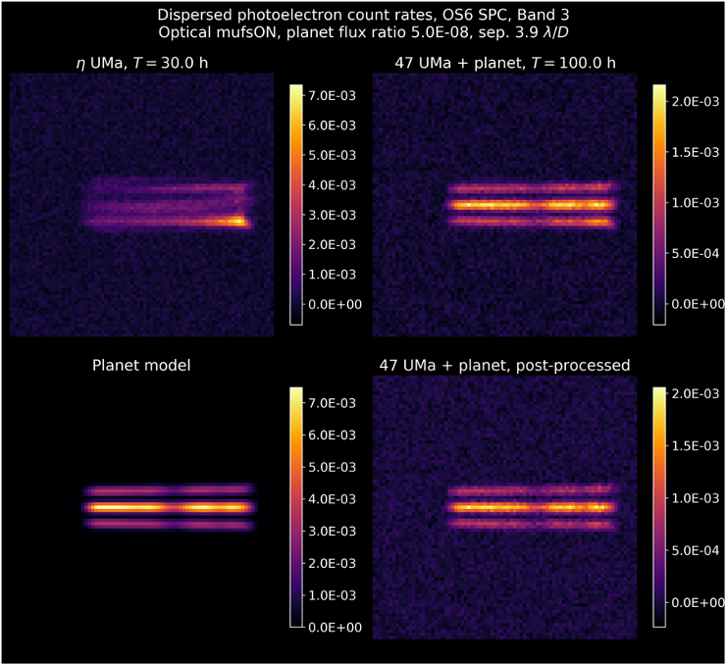
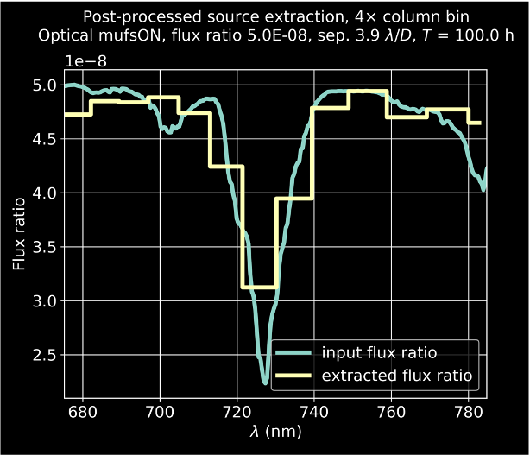
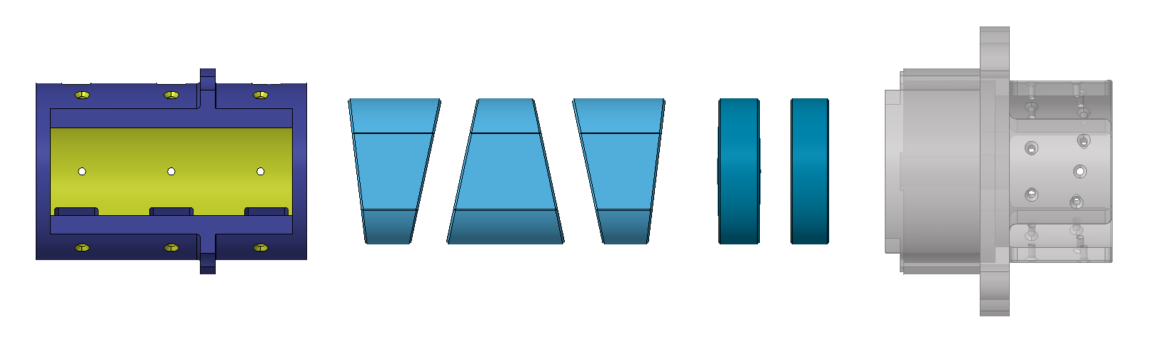
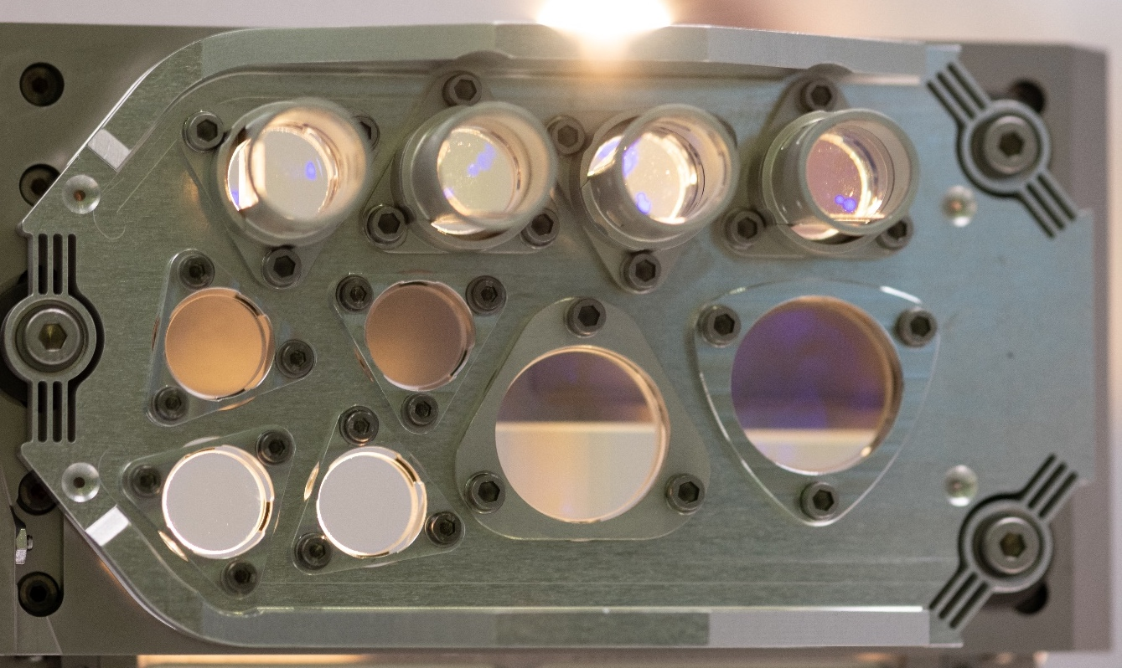
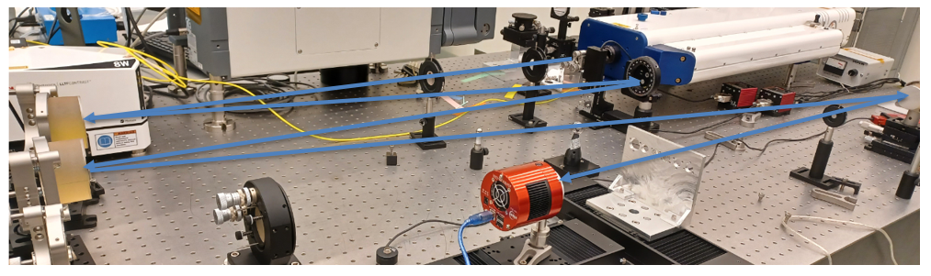
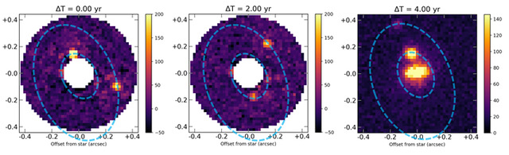
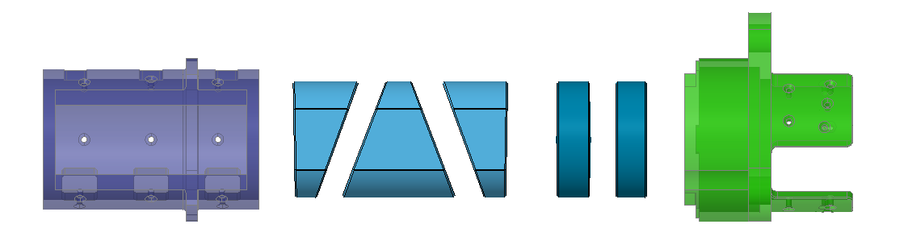
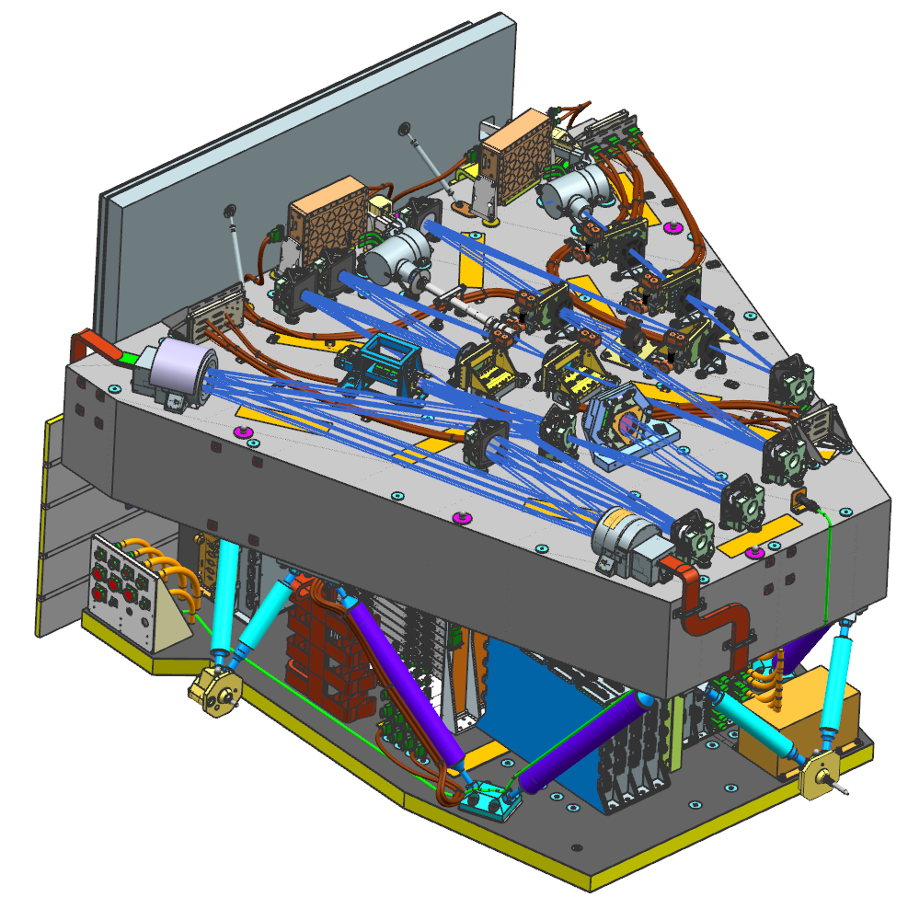
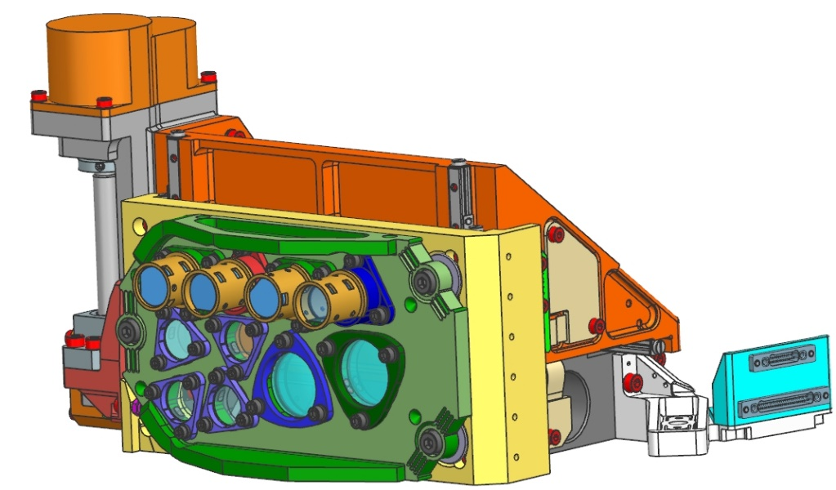
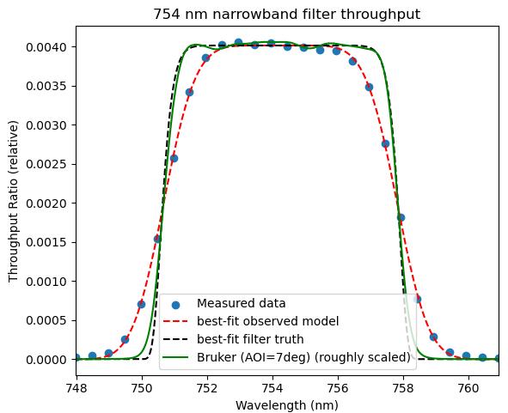
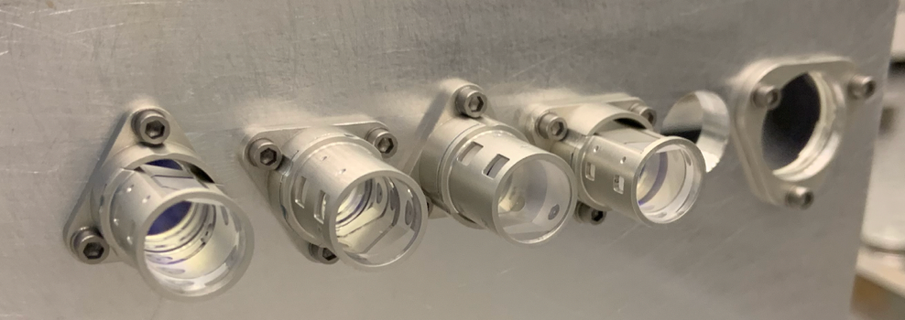
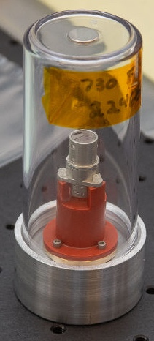
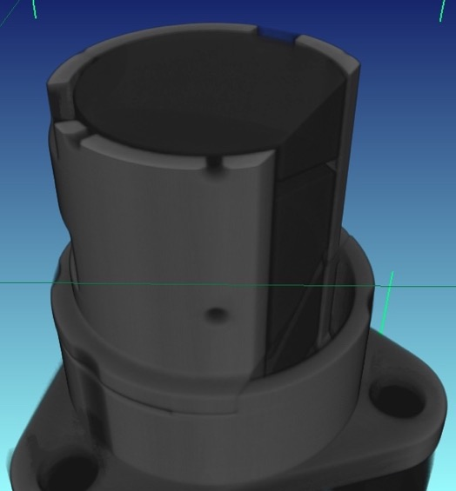
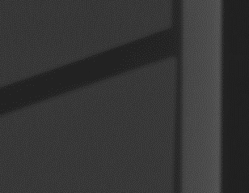
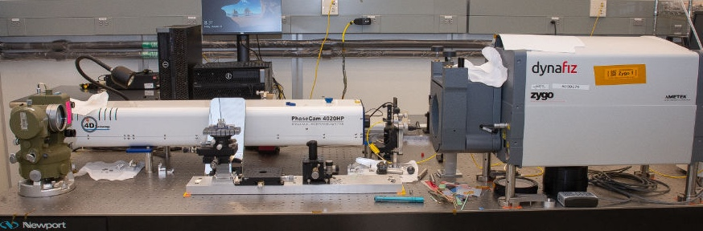
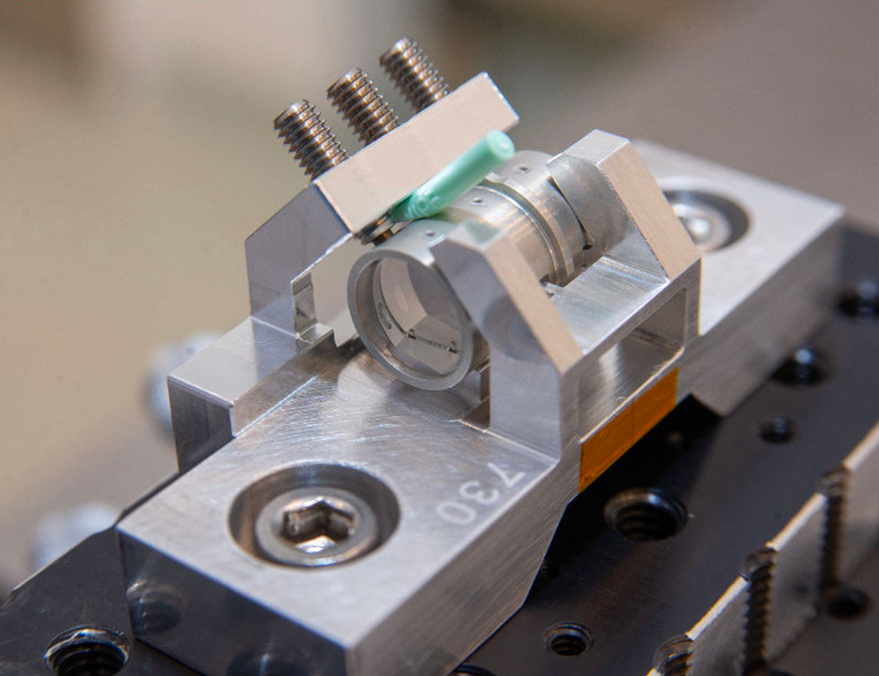
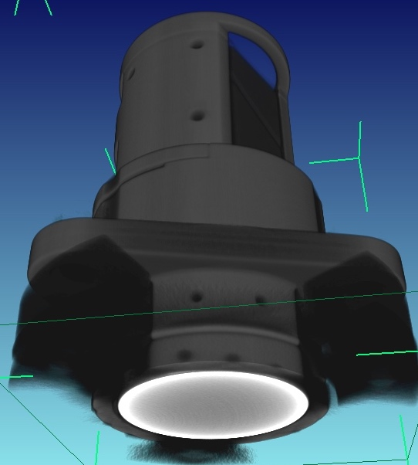
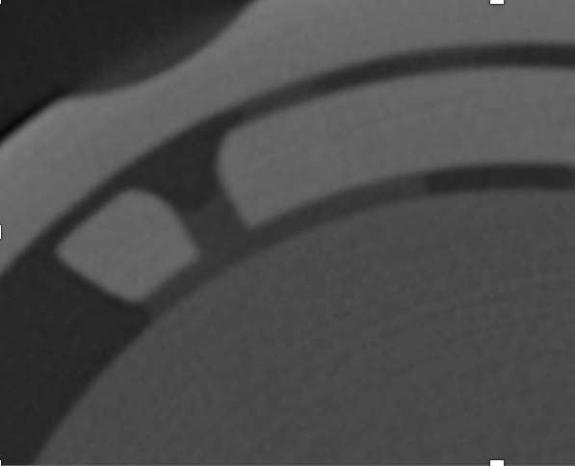
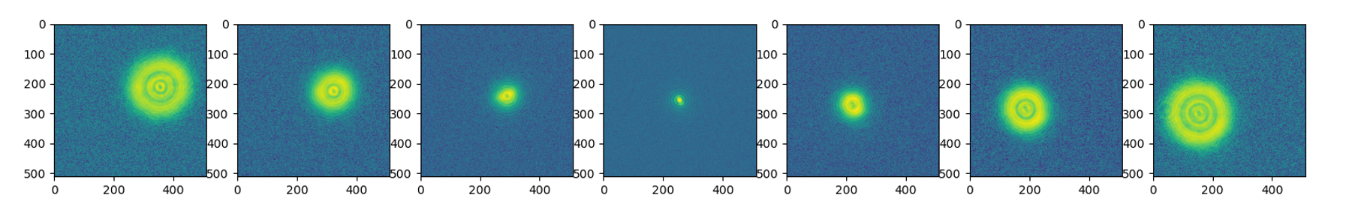
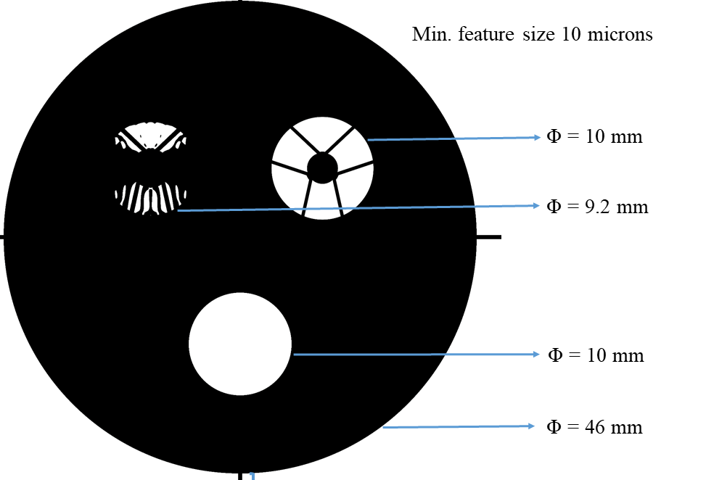
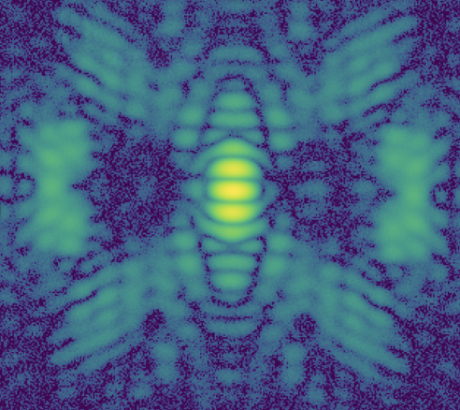
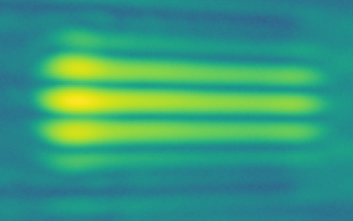
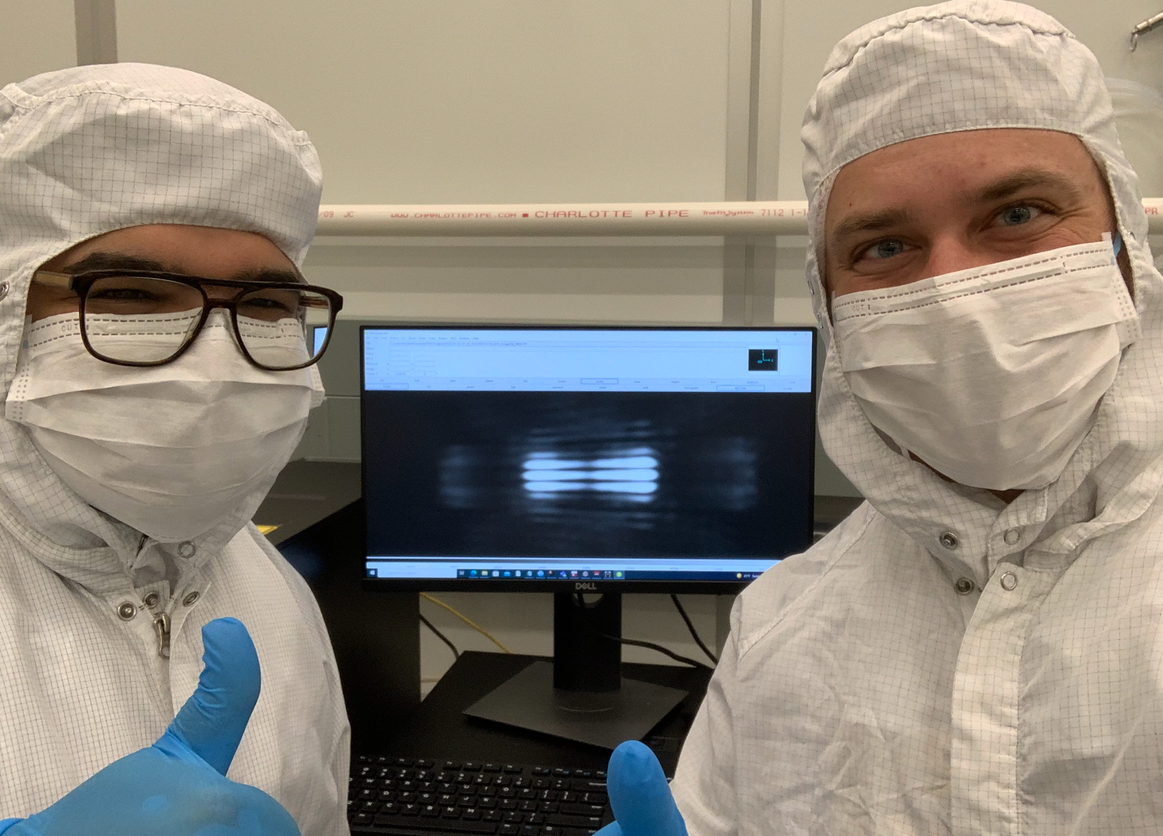
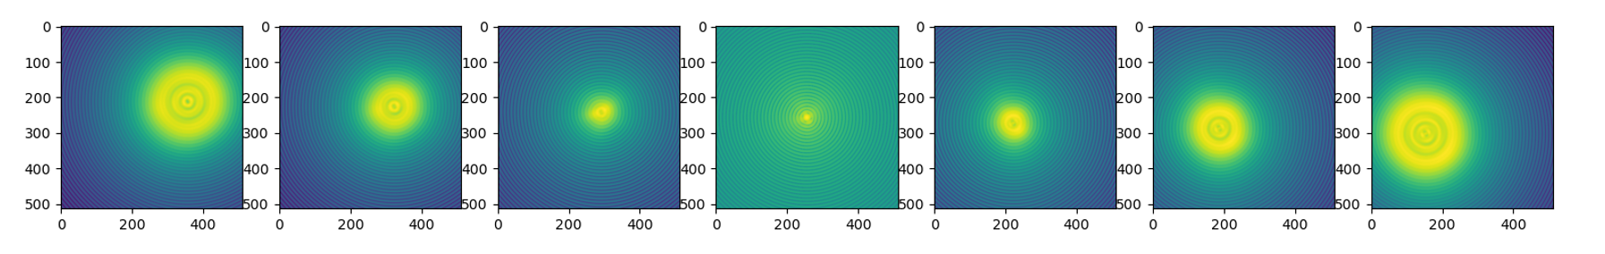
Verification and Calibration of Spectroscopy and Polarization modes for the Roman Coronagraph Instrument
Overview
The Coronagraph Instrument (CGI) on the Nancy Grace Roman Space Telescope (RST) has a primary direct imaging mode, as well as four prism assemblies that provide the instruments spectroscopy and polarimetry modes:
Zero Optical Deviation (ZOD) prisms
660nm. Full-band capability. Dispersion optimized for R50 at the center of CGI Band 2
730nm. Full-band capability. Dispersion optimized for R50 at the center of CGI Band 3
Wollaston Prism Assemblies – Full-band capability, operational intent: Band 1 and Band 4
Vertically oriented (0 deg)
Diagonally oriented (45 deg)
Direct Imaging (DI) Lens. Full-band operation (Bands 1-4)
Example Spectra with CGI Slit+Prism on Target + Reference Stars (Groff et al. 2021)
Science Simulations
Spectra of the stars and targeted planet use the prism assembly with a deployable slit in the CGI field stop mechanism
Requires a specialized calibration sequence for both speckle subtraction and wavelength solutions via special narrowband filters included in CGI (due to the slit being arbitrarily deployable to the planet location via an X-Y selection mechanism)
Error budget for wavelength accuracy includes a detailed error budget for slit alignment impacts on photometry and wavelength accuracy
Telescope pointing error/drift for target and reference stars
Slit deployment accuracy
Ground calibration of prism dispersion and narrowband filters
On-orbit Performance estimates for spectroscopy used a standard calibration star and 47 Uma as a baseline “target” star
Modeled spectrum targets a methane absorption feature, which CGI Band 2 and Band 3 bandpass/spectral resolution were designed against
General CGI calibration paper: Zellem et al. SPIE 2022
Simulated Spectral Retrievals: Saxena et al. AJ 2021
ZOD and Wollaston Prisms in CGI
The DI lens, ZOD prism, and Wollaston prism assemblies are located in the Dispersion Polarization Alignment Mechanism (DPAM)
Wollaston 0°
ZOD 730
Wollaston 45°
ZOD 660
S-TIH1
S-BSL7R
PBM2R
CGI Simulator (CGIsim) Testbed at Goddard Space Flight Center
Example Images from CGI Data Challenge 2018-2020 (Turnbull et al. 2021)
Suprasil 3001
MGF2
DI Lens
Flight Elements During Performance Test
The assemblies were deployed into the CGI Simulator (CGIsim), which replicates the final pupil geometry, size, and position provided by CGI. This allows for comprehensive performance verification and development of instrument-level calibration procedures
Calibrating Absolute Wavelength Accuracy
Wavelength accuracy requirement of 2-nm at instrument level
Requires careful dispersion calibration of prism
Since slit deploys to arbitrary field position, also requires extremely careful calibration of the narrowband filters in as-assembled instrument configuration
Demonstration using flight reject filter prior to CGI I&T shows extremely precise calibration possible with designed test
Tunable filter scan in CGI simulator testbed
Compare to independent filter measurement with calibrated GSFC Bruker Fourier Transform Spectrograph in collimated light
Instrument Level Calibration with final flight pupil:
Measure narrowband filter transmission profile in-CGI with wavelength scans using a laser line tunable filter
Spectral retrieval performance verified after calibration using an NKT SELECT tunable filter
Environmental Testing
Assemblies were subjected to proto-flight thermal and random vibration levels rolled up from instrument-level test inputs
Assemblies are so small that standard survival metrics cannot be used (e.g. sine signature sweeps)
Alignment and bond integrity were verified via 3D x-ray tomography before and after environmental testing
Example views of scans, element alignment checkout, and bond cross-sections used as success criteria for survival
Optical performance also verified before and after environmental testing
Method | Center (nm) | Width (nm)
CGIsim testbed | 754.24 ± 0.01 | 7.19 ± 0.06
Bruker (AOI=7°) | 754.25 | 7.19
Active Alignment for Wavefront Error and Dispersion
Theodolite co-witnesses Interferometer beam through and around prism assembly
Dispersion directly verified with theodolite during alignment and bonding activities with extremely high fidelity
Wavefront Error (WFE )Verified in double-pass during alignment
Spherical reference and CaliBall used for interferometric lens alignment
Alignment optimized to meet back focal distance for the central band of the subassembly under test to maximize on-orbit confocality of one band with respect to another.
Assemblies left in setup during application and curing of adhesive to ensure alignment was unchanged pre- and post-cure of the adhesive
Wavefront Error Verification
Prisms and lens assemblies aligned with active feedback from double-pass interferometry at 632.8nm
Independent wavefront verification of each assembly at its central operating wavelength via Focus Diverse Phase Retrieval before and after thermal/vibration environmental testing
 | Pre-Environment WFE (nm rms) | Post-Environment WFE (nm rms)
DI Lens | 14.67 ±1.91 | 14.40 ±1.91
ZOD660 | 14.79 ±1.91 | 13.89 ±1.91
ZOD 730 | 7.90 ±1.91 | 5.7±1.91
Wollaston 0 | 30.2±1.91 | 27.83 ±1.91
Wollaston 45 | 19.10±1.91 | 18.02±1.91
Prism Testing
The assemblies were tested using a Black Silicon “Emoji Mask” fabricated by the Goddard Detectors Branch containing three precision masks: (1) a Spectroscopy Shaped Pupil, (2) RST Telescope Pupil, (3) open aperture
CGI Operational Bands
Baseline Filter Bands | Center | Cut-on | Cut-off | Bandwidth %
CGI Band 1 (Wollaston Prism) | 575 | 546 | 604 | 10.1
CGI Band 2 (Spectroscopy Shaped Pupil) | 660 | 610 | 710 | 15.2
CGI Band 3 (Spectroscopy Shaped Pupil) | 730 | 675 | 785 | 15.1
CGI Band 4 (Wollaston Prism) | 825 | 784 | 866 | 9.8

