Slide 1
The Design of the Low-Earth Orbit Flight Test of an Inflatable Decelerator (LOFTID) Reentry Vehicle (RV)
R.J. Bodkin
NASA
2024 SciTech Forum, January 8-12, 2024
Published by the American Institute of Aeronautics and Astronautics, Inc., with permission.

Slide 2
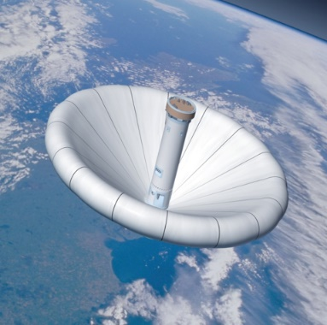
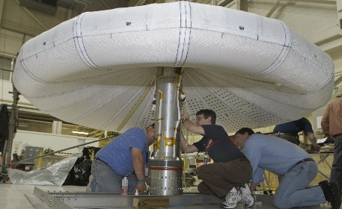
Brief History of HIADs (Hypersonic Inflatable Aerodynamic Decelerators)
Inflatable heatshields haver been sporadically researched since the mid-1960’s
IRVE (Inflatable Reentry vehicle Experiment)
  Began 2003
  Launched September 6, 2007
  Launch vehicle Anomaly
PAIDAE (Program to Advance Inflatable Decelerators for Atmospheric Entry)
    Ground Program to looking for improved materials and structures
    Began in 2006
IRVE-II
    Launched August 17,2009
    Successful Flight
    Reflight of IRVE with lessons learned incorporated

Slide 3
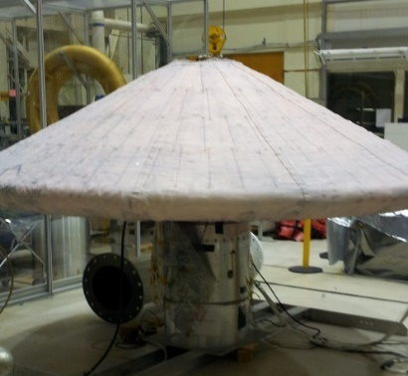
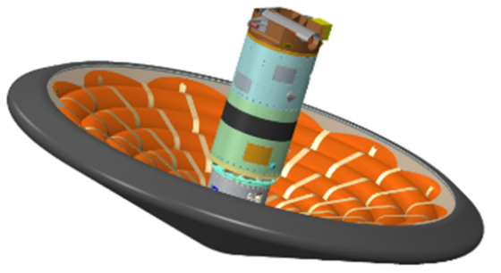
Brief History of HIADs
IRVE-3
  Successful Flight Launched July 23, 2012
  New structure and new CG off-set
  Built spare center body that was assembled
THOR (Terrestrial HIAD Orbital Re-entry)
  Flight project intended to fly on Antares Commercial Resupply Mission
  THOR was canceled after ORB-3 mishap
  Introduced concept of ejectable data recorder and shroud separation system
HULA (HIAD on ULA) Concept
  Original study looking at orbital reentry
  HULA progressed to LOFTID

Slide 4
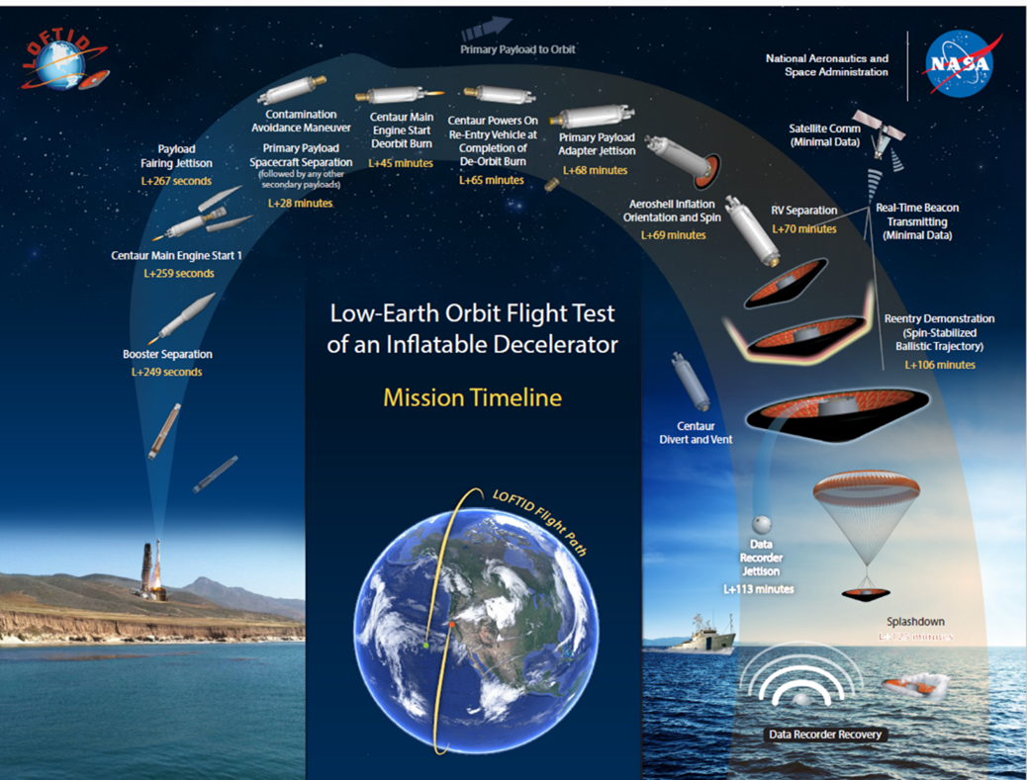
The Design of the Low-Earth Orbit Flight Test of an Inflatable Decelerator (LOFTID) Reentry Vehicle (RV)
LOFTID Concept of Operations
  RV Launches off on Atlas V with JPSS-2
  Centaur performs orbit adjustment burn
  Centaur de-orbits LOFTID
  Payload adapter jettisoned and LOFTID inflates
  Approximately 50000 ft EDM is ejected
  Parachute deploys at approximately 10000 ft

Slide 5
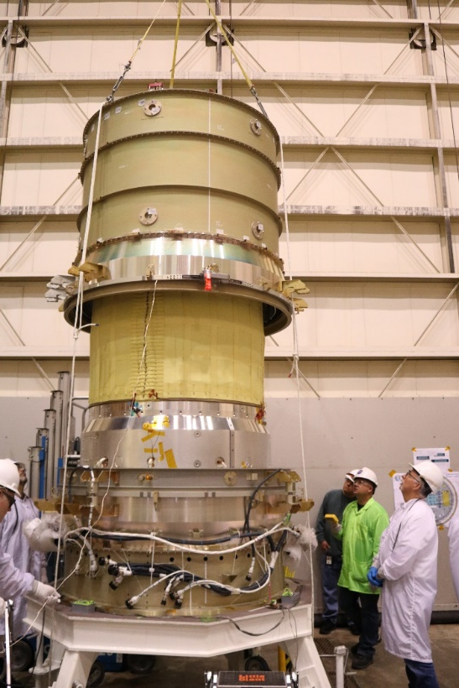
Payload Adapter Separation System (PASS)
LOFTID rideshare configuration Payload Adapter Canister prior to start of LOFTID mission
Utilized ULA 1666S Separation System
NASA Long Stroke Separation System
6x Constant Force Springs to provide positive force margin for full separation
Webbing to react spring force against stowed aeroshell
Inner Shroud to prevent damaging contact between PLA and stowed aeroshell

Slide 6
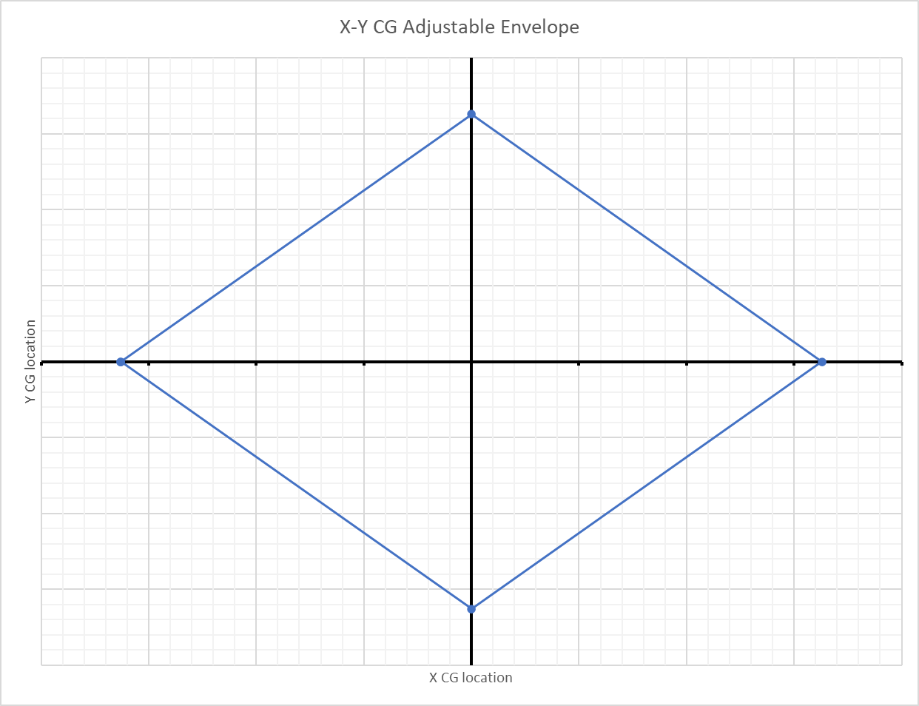
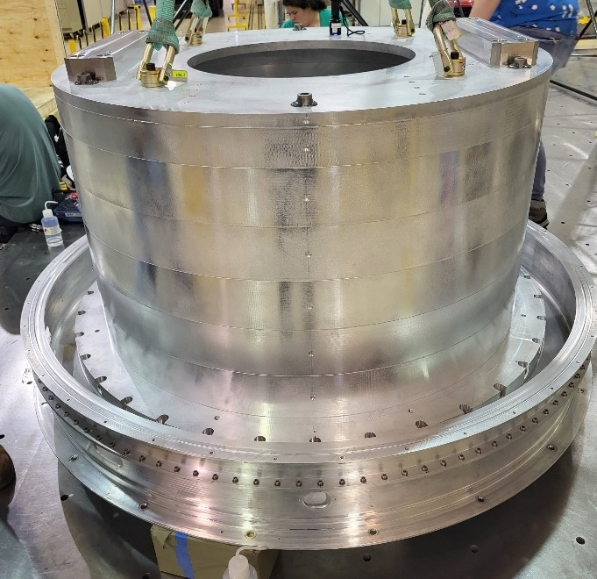
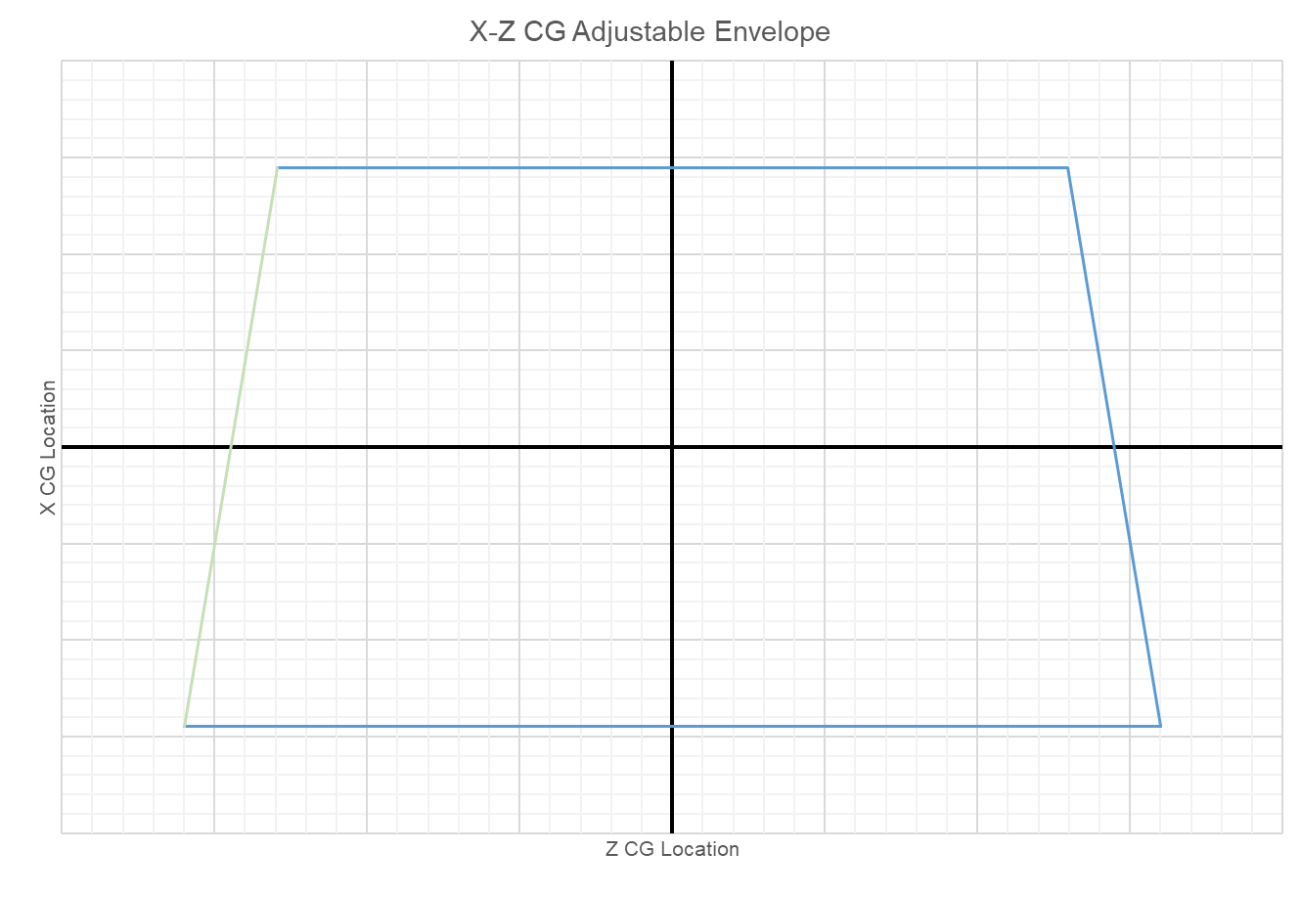
Mass Simulator
Was required in the event Re-entry Vehicle (RV) suffered a late issue and was unable to launch
Steel and Aluminum structure that used same launch vehicle interface as the RV
Required to be ready prior to RV assembly
Required large CG adjustment Range

Slide 7
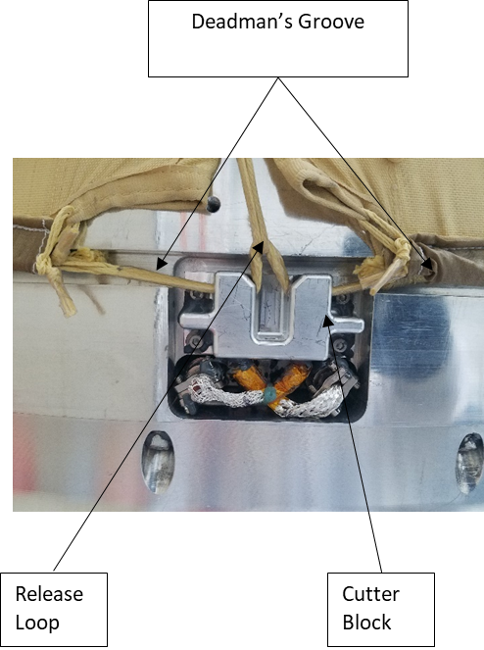
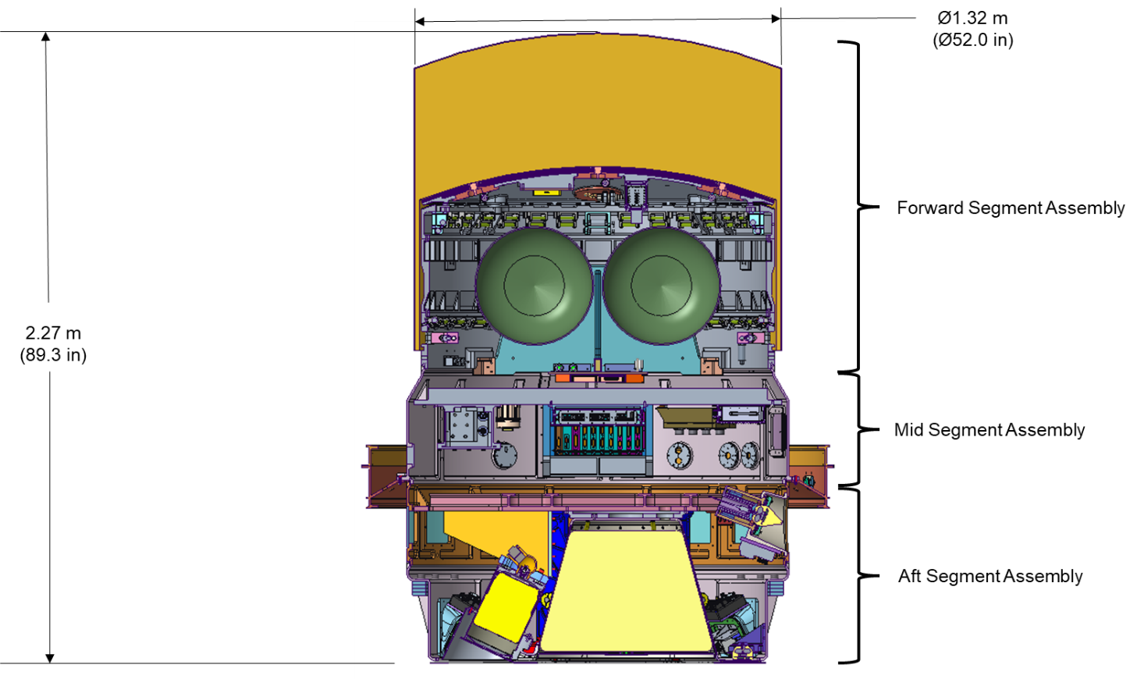
The Design of LOFTID
LOFTID Packed

Slide 8
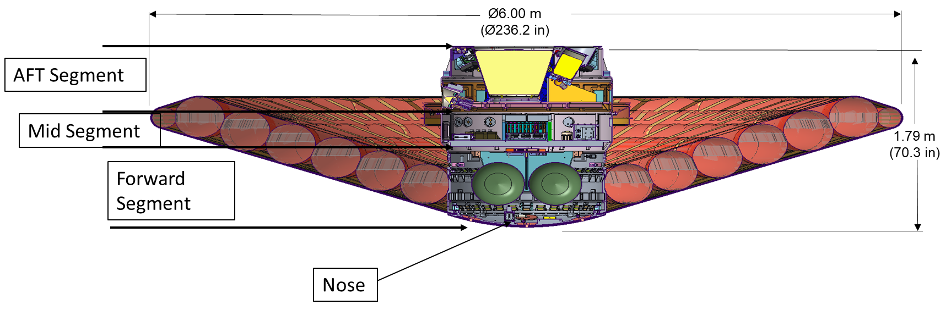
The Design of LOFTID
LOFTID Deployed

Slide 9
LOFTID Segments
Forward Segment
  Forward Segment Radial Axial (Radax) Joint
  Inflation System and Mid-Segment Pass-Thru
  Aeroshell interface
  Rigid Nose Interface
  Segment comprised of multiple components
    Forward Ring
    Mid Segment Plates
    Aft Ring
Mid Segment
  Forward Segment Radax Joint
  Aft Segment Radax
  Vehicle Avionics
  Electrical pass throughs
  RV/LV interface
  Segment comprised of single ring
Aft Segment
  Aft Segment Radax Joint
  Parachute System
  Recovery Aids
  Camera System
  Communications Antennas
  Ejectable Data Recorder
  Segment comprised of 2 ring structures

Slide 10
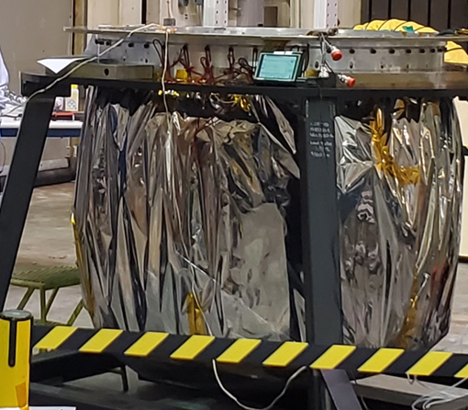
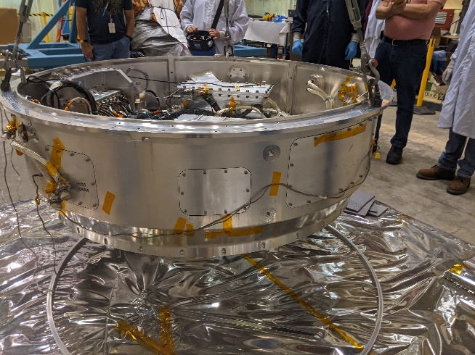
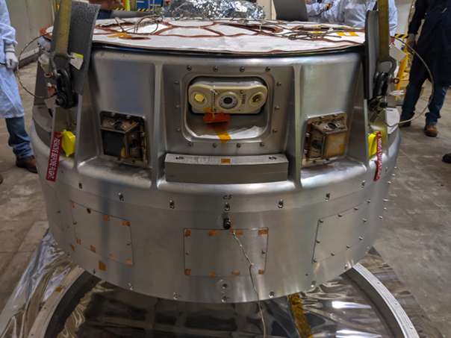
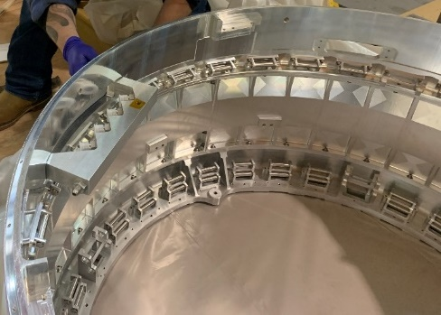
The Design of the Low-Earth Orbit Flight Test of an Inflatable Decelerator (LOFTID) Reentry Vehicle (RV)
Forward Segment
Mid Segment
Aft Segment
Mid-segment Plate
Aft Interface Ring
Aft Segment Ring
Forward Ring

Slide 11
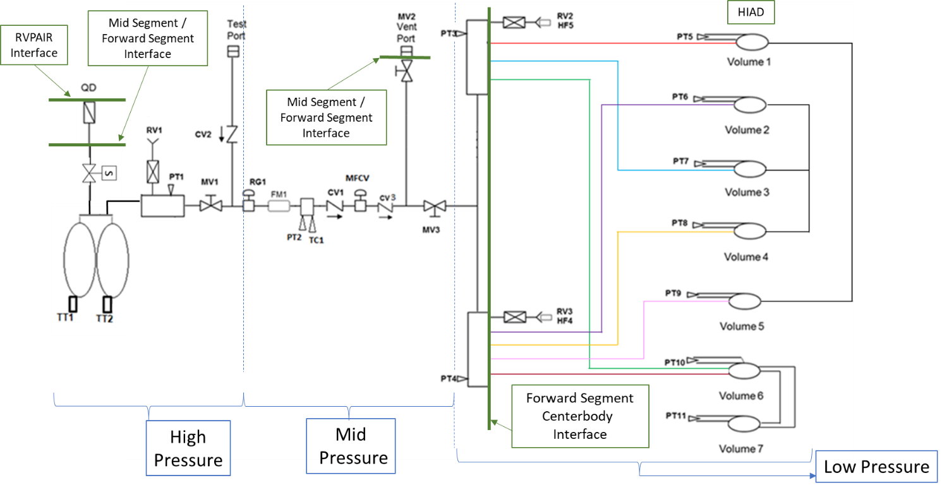
Forward Segment – Inflation System
  Most components IRVE-3 Heritage
  New set points
    Regulator
    MFCV
  Upsized low pressure relief valves
  Flowmeter blade angle change

Slide 12
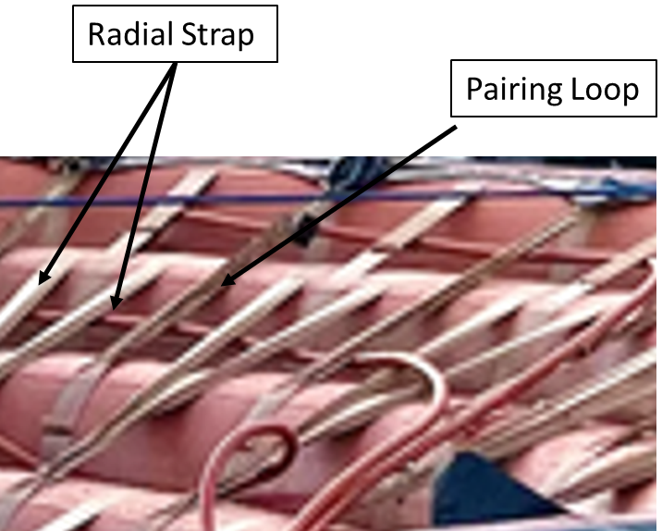
Forward Segment – Aeroshell Structure
  Stacked Tori design
    First flown on IRVE-3
  Zylon webbing reacts reentry loads
  Zylon braid
    Teflon Gas Barrier
    RTV maintains braid organization during inflation
    2 Zylon cords provide in plane stiffness

Slide 13
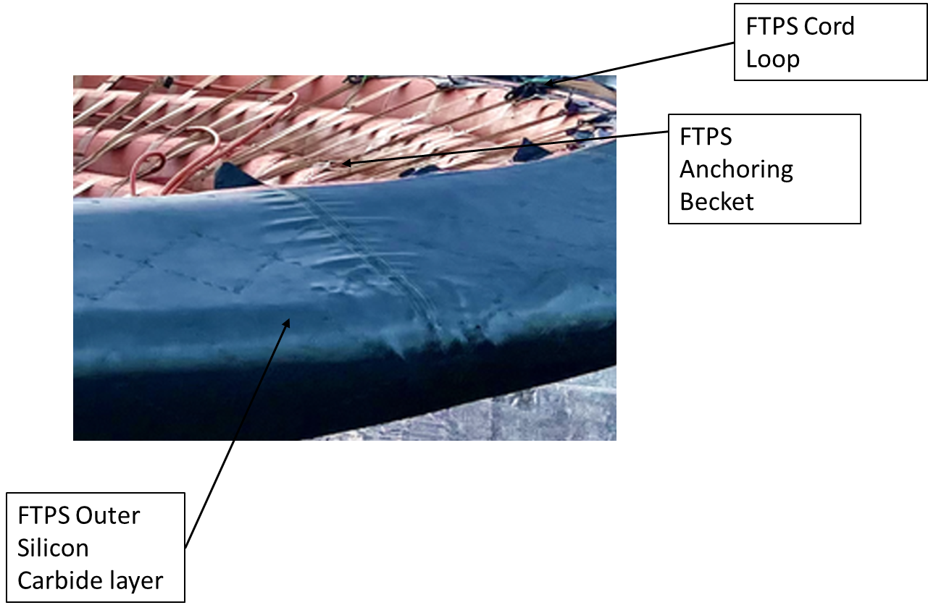
Forward Segment – Aeroshell Flexible Thermal Protection System (FTPS)
  FTPS Quilted Structure
    Silicone Carbide
    KFA5
    Pyrogel
    Teflon Zylon laminate gas barrier
  FTPS mounting
    Forward mounting to a bar under rigid nose
    Aft mounting to Cord loop

Slide 14
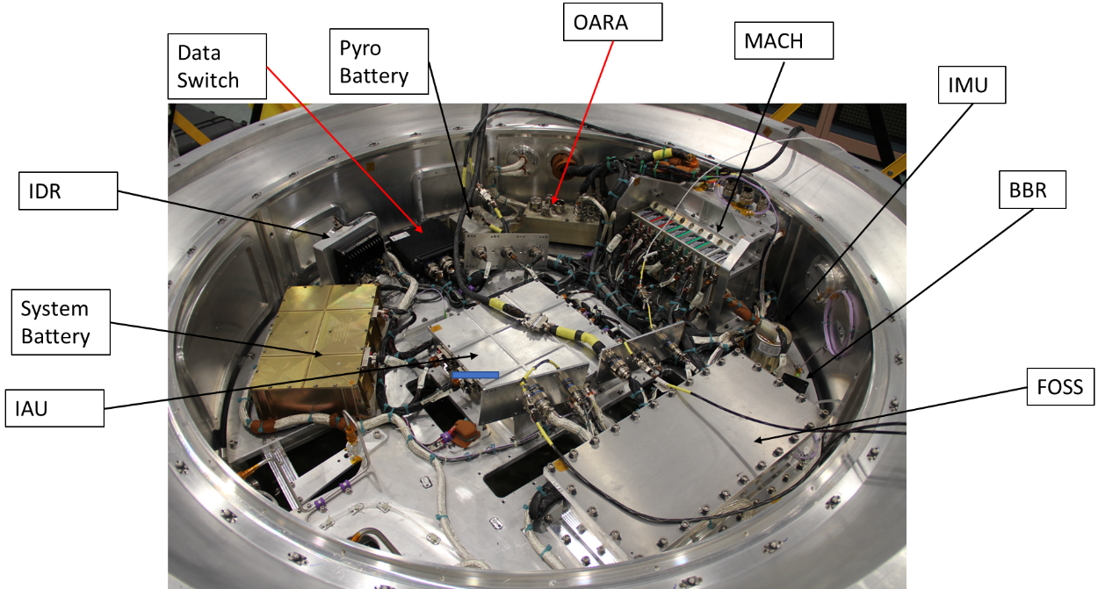
Mid Segment
  Majority of Avionics reside in mid-segment
  Modular Avionics Control Hardware (MACH) system
    Flight Heritage
    Served as event controller
    Flight computer
  Fiber Optic Sensing System (FOSS)
    LSP experiment flown to measure temperatures

Slide 15
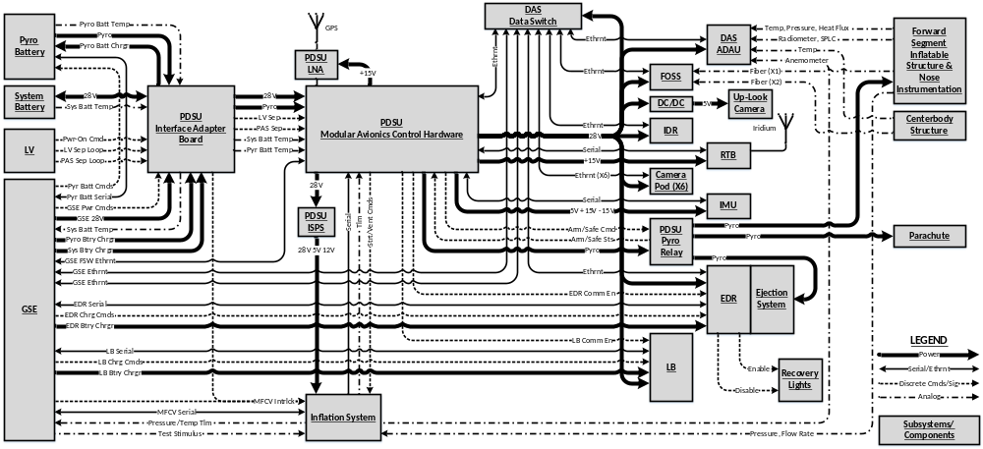
Mid Segment - Avionics

Slide 16
Mid Segment - Avionics
  Pyrotechnic Safing and Arming
    Controlled by the MACH and Ordinance Arming Relay Assembly (OARA)
      Inflation System and Release cutters inhibited by loop back that wasn’t released until payload adapter released
      EDR and Parachute inhibited by loop back connector until RV released from Centaur
  Aeroshell Data Acquisition Unit (ADAU)
    Capture approximately 100 aeroshell measurements in flight
      Mounted to rigid nose

Slide 17
Mid Segment – Software
  Mach Software
    NASA Core Flight System (cFS)
      Modular layered platform for real time flight applications
  Data Recorder Software
    Based on libPCAP
      Widely used open source library for network traffic capture
  Camera Controller Software
    Based on GStreamer
      Open source multimedia framework
      Hardware support for encoding and decoding of video streams

Slide 18
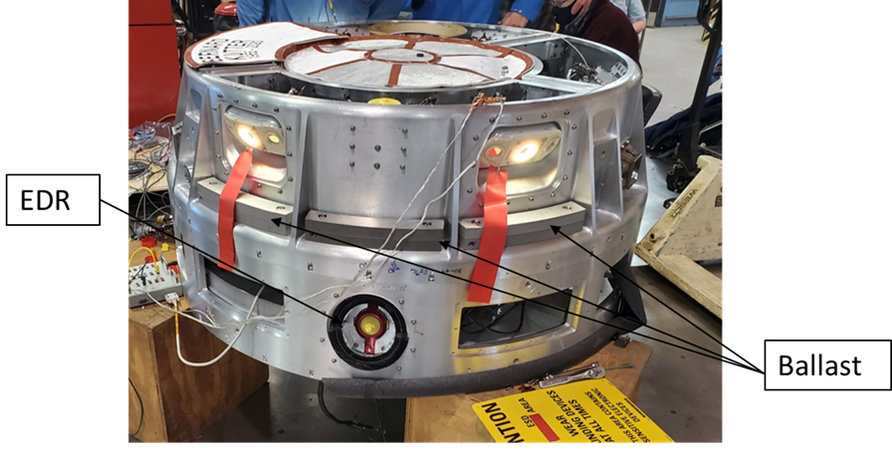
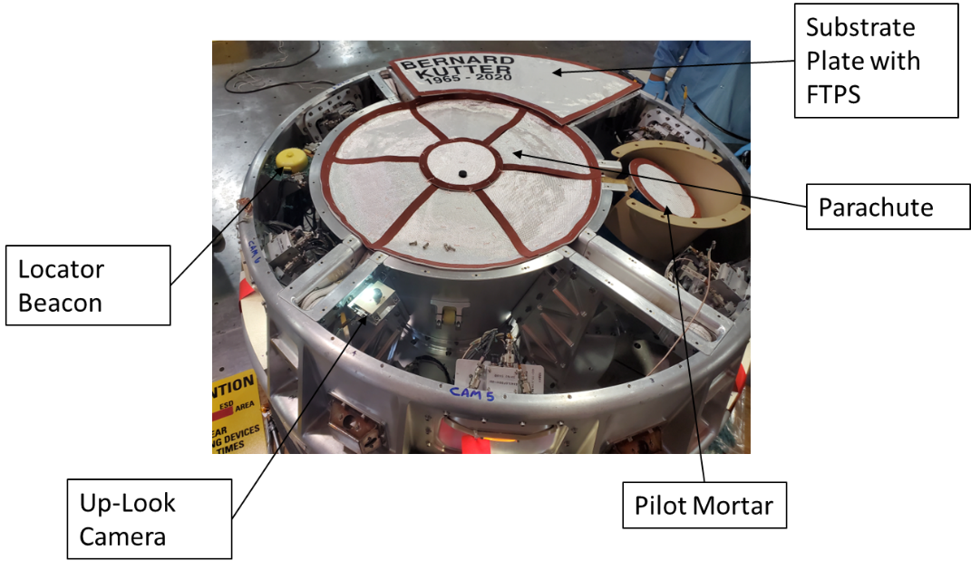
Aft Segment
Contains 6 Camera pods designed by MSFC
  1 Visual Camera
  2 IR cameras
  LED light ring
Recovery Lights
Corner Cubes
EDR System
Parachute System
Up look Camera
GPS and Iridium Antennas

Slide 19
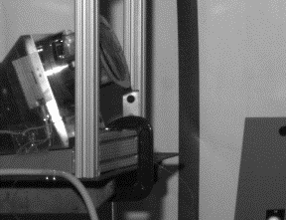
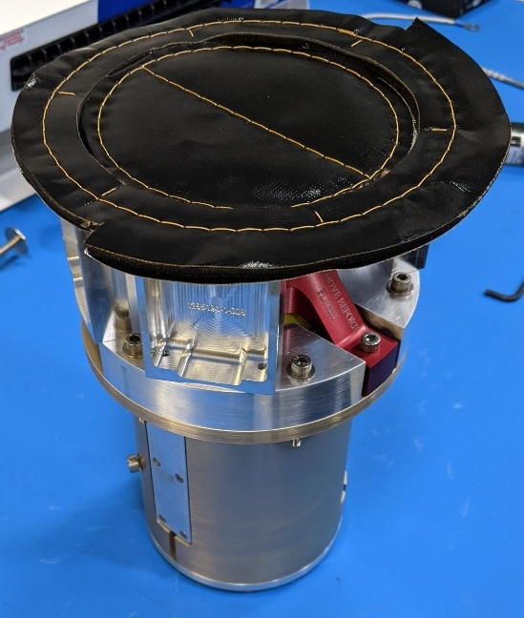
Aft Segment – EDR
  Spring based system to deploy EDM
  System utilized a NEA
  NEA Stud remained with EDM

Slide 20
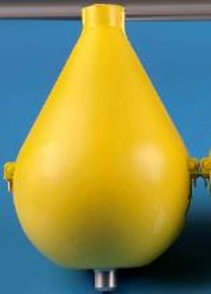
Aft Segment – EDM
  EDM was utilized extensively in the RV
    Used as Ejectable Data Module
    Used as Internal Data Module
    Used as locator beacon
      Modified OML
  Designed to land at terminal velocity
  Transmitted location via Iridium and LoRa network

Slide 21
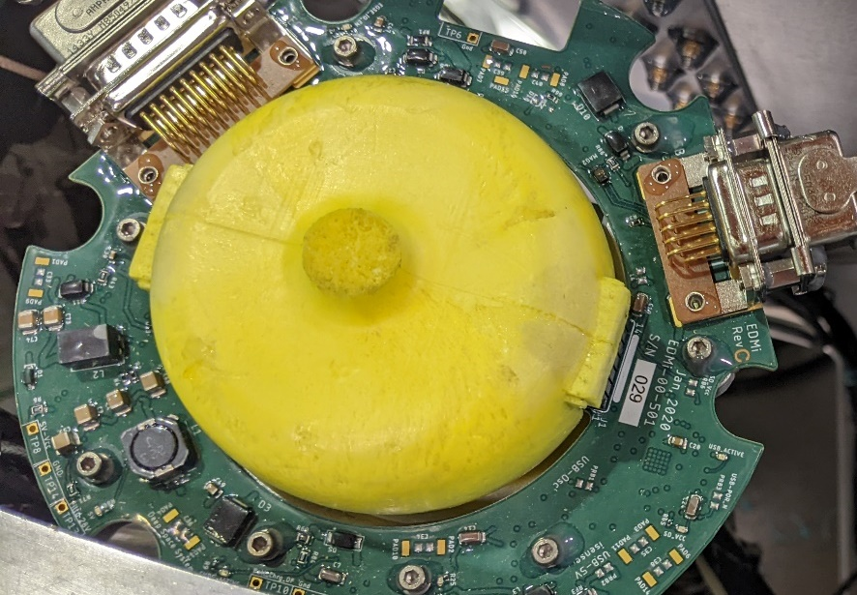
Aft Segment – Beacons
  During Flight vehicle transmitted a minimum data set on the Real Time Beacon (RTB)
    Used Iridium network
  Vehicle transitioned to Locator Beacon after parachute deployment
    Locator Beacon modified data module
    Transmitted position on two networks
      Iridium Network
      LoRa Network

Slide 22
Flight Results
Iridium data downlink was intermittent and only received after reentry
  During ground testing was hit or miss if data would be transmitted
  Lost communications for 1 hour during EDR recovery test in relatively calm seas
Most data was captured
  Full aeroshell performance data was captured
  Software issue not found during pre-flight testing resulted in loss of some data

Slide 23
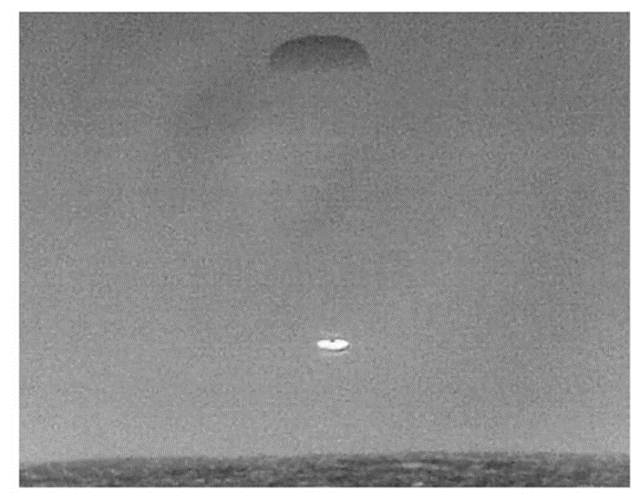
Flight Results
  EDR was tracked and recovered after the RV
    Data set matched onboard RV storage until ejection
  RV was successfully recovered after landing within sight of the recovery vessel

Slide 24
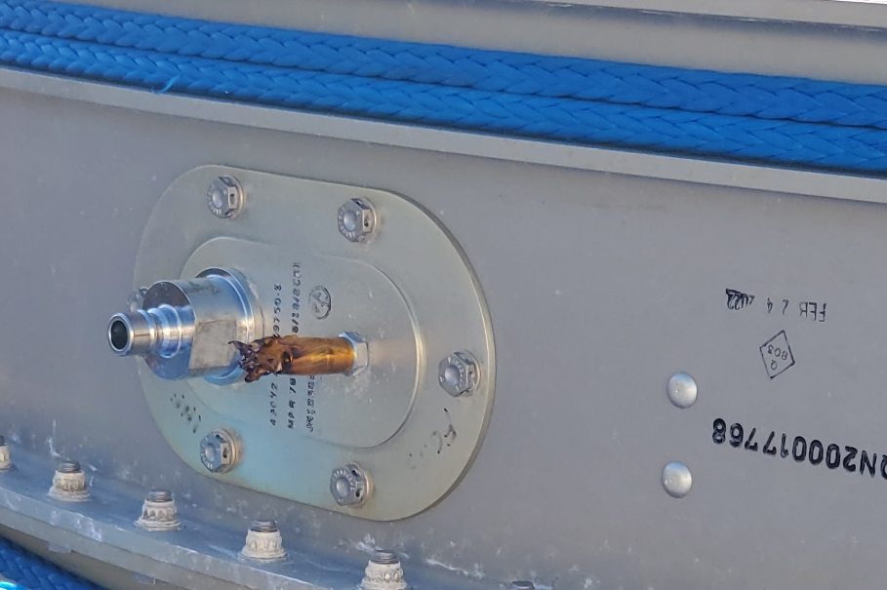
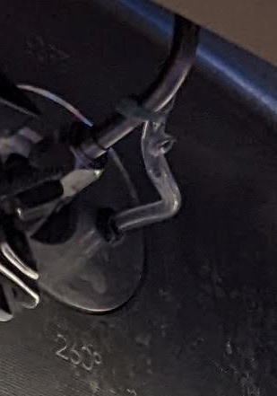
Flight Results
Tygon tubing - area circled shows blistering on the FOSS repressurization line
Kapton tape - note how pristine the surrounding area is compared to the tape

Slide 25
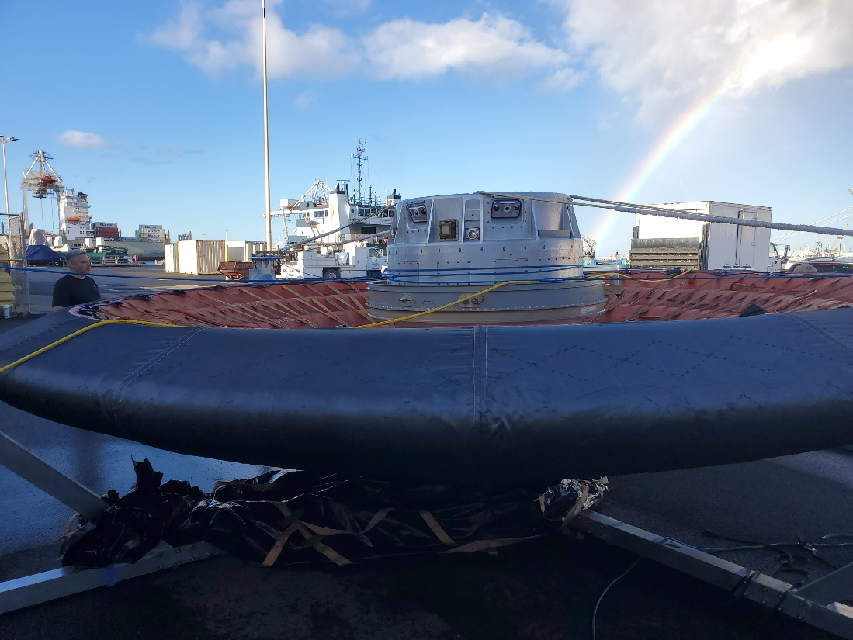
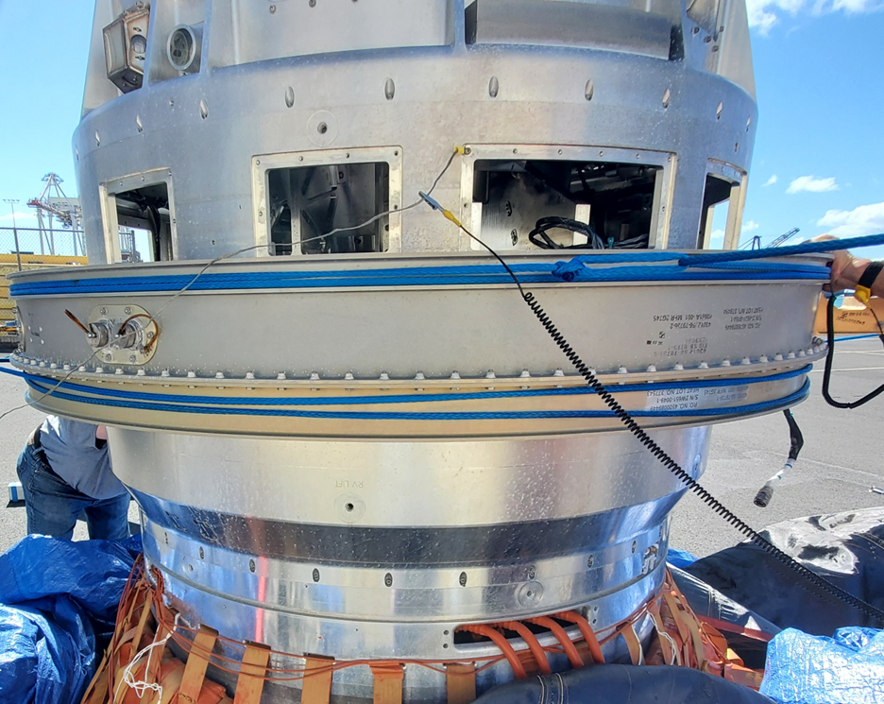
Flight Results

Slide 26
The Design of the Low-Earth Orbit Flight Test of an Inflatable Decelerator (LOFTID) Reentry Vehicle (RV)
Thank you to my co-authors
Robert Akamine
Hillary Blakely
Paul Brewster
Dr. Neil Cheatwood
Terry Clark
John DiNonno
Robert Dillman
Anjie Emmett
Sean Hancock
Stephen Hughes
Robert Mosher
Brian Saulman
Greg Swanson

Slide 27
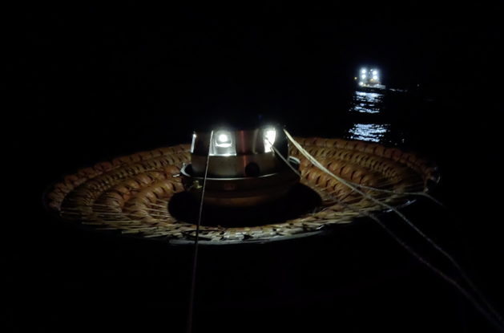
Questions?

Slide 28
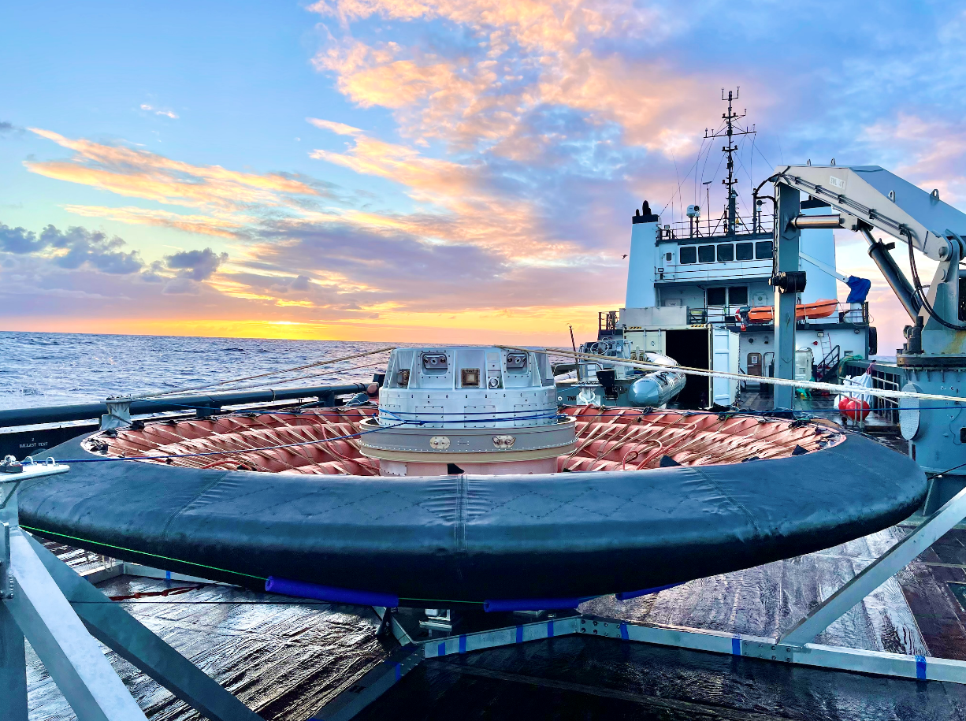
Thank you!

