Slide 1


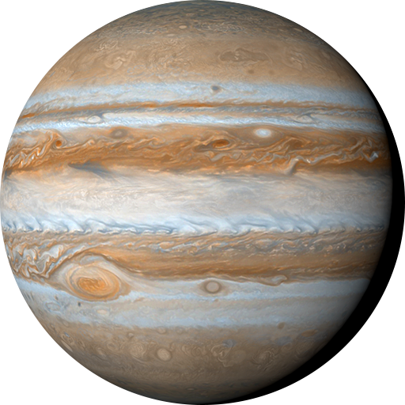


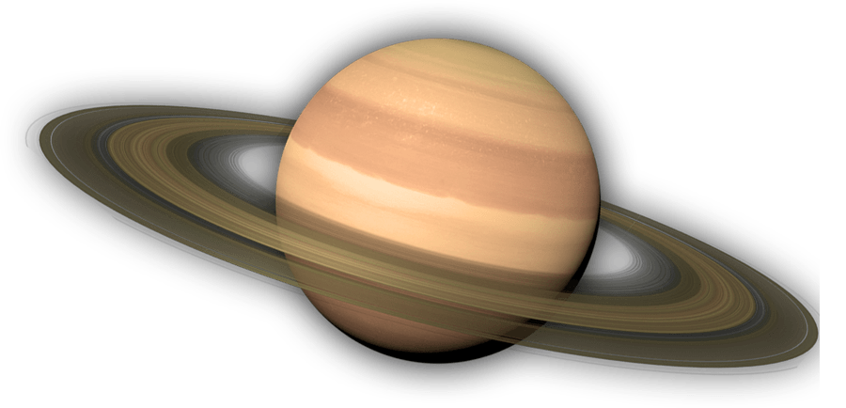
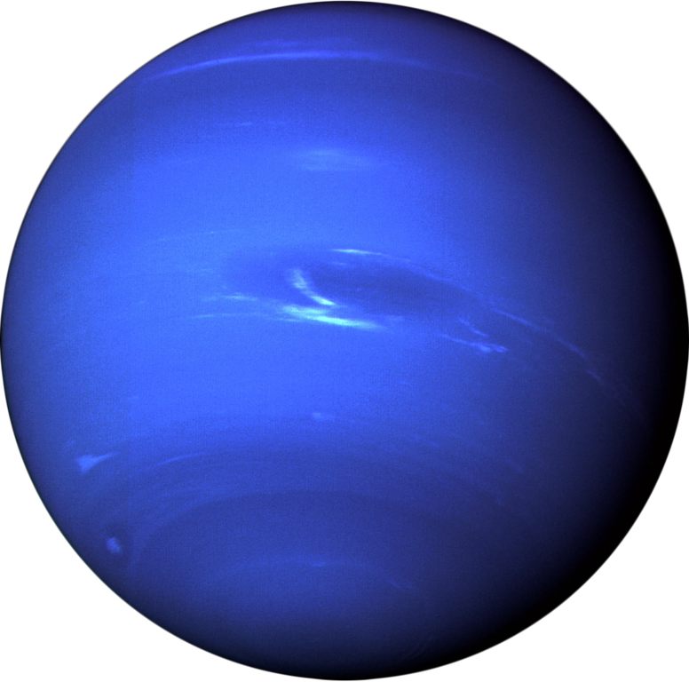
Landscape of Space Nuclear Propulsion
2024 AIAA Science and Technology Forum and Exposition
January 8-12, 2024
Dr. Anthony Calomino
Space Nuclear Technologies Portfolio Manager
Space Technologies Mission Directorate / NASA HQ

Slide 2


Why we are here…
Ice in Moon craters…
Nuclear Rocket
Entire rocket takes off from Earth, lands on the Moon, and returns to Earth
Verified in 2009 by the NASA LCROSS mission (Lunar CRater Observation and Sensing Satellite)

Slide 3
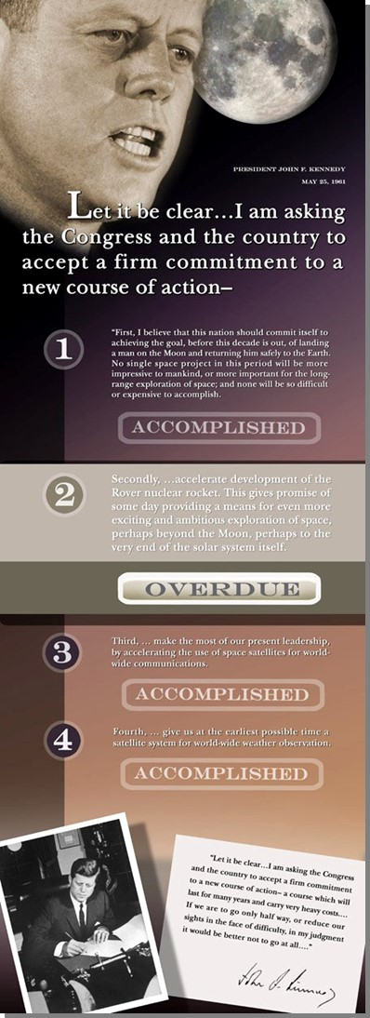
From the beginning…
Interest in Nuclear Systems began with the Start of the Space Age
“First, I believe that this nation should commit itself to achieving the goal, before this decade is out, of landing a man on the Moon and returning him safely to the Earth…” Accomplished
“Secondly … accelerate development of the Rover nuclear rocket. This gives promise of some day providing a means for even more exciting and ambitious exploration of space…” Overdue
Special Message to Congress on Urgent National Needs
President John F. Kennedy
Delivered in person before Congress, 25 May 1961

Slide 4
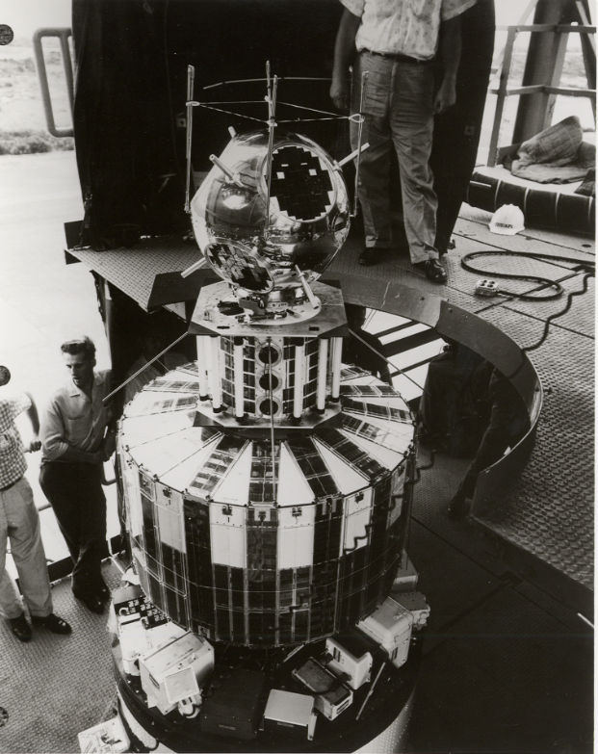
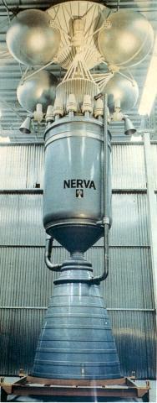
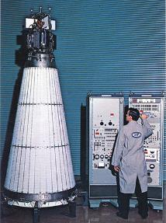
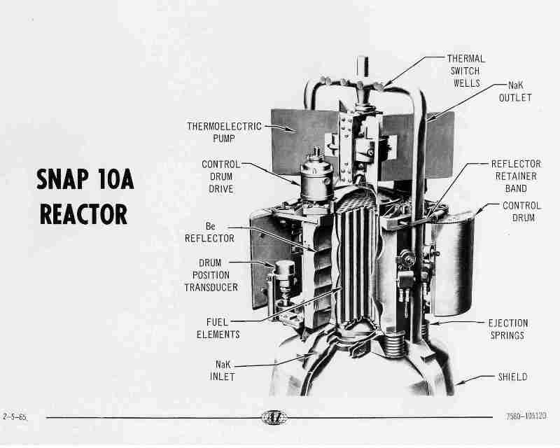
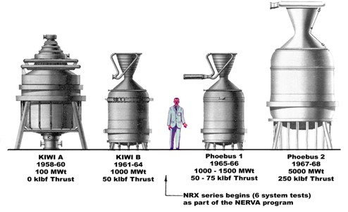
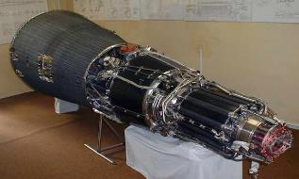
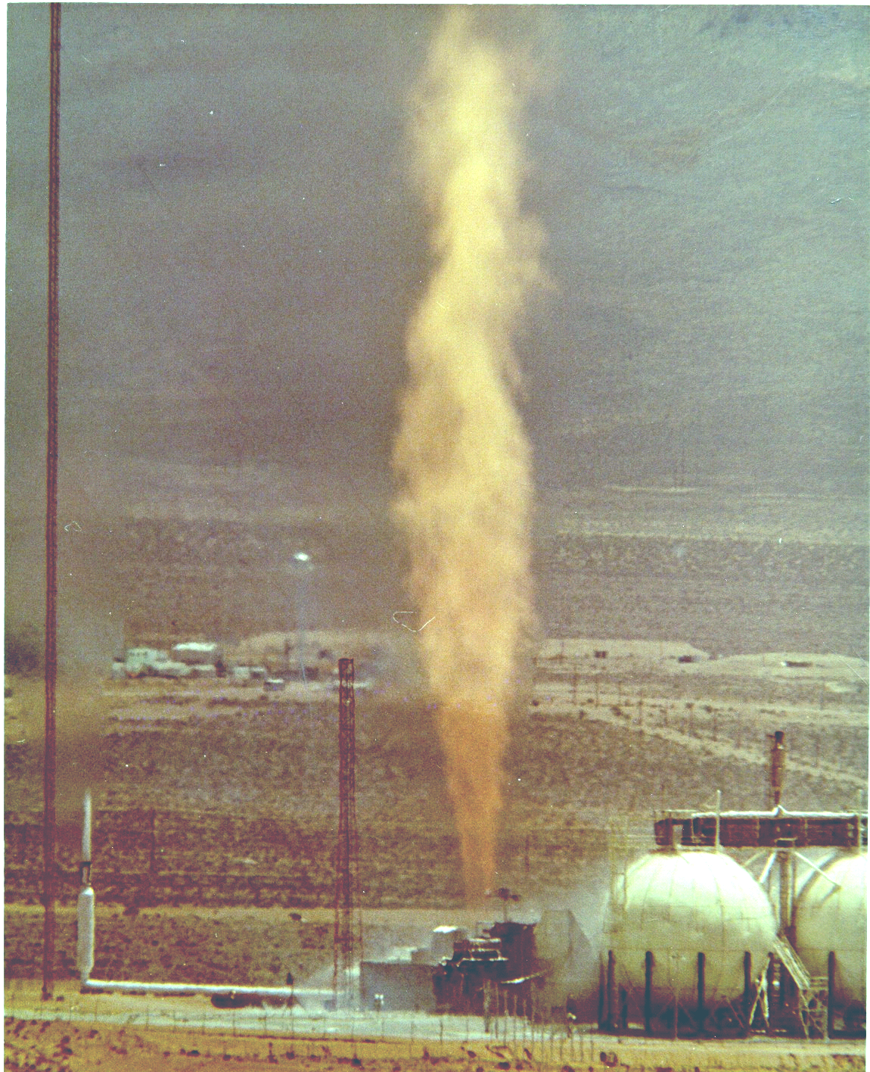
Space Nuclear Legacy Systems
Radioisotope Thermal Generators (RTGS)
June 29, 1961 – Transit 4A: The first U.S. spacecraft (U.S. Navy navigation satellite) to utilize nuclear energy powered by a RTG
Space power reactors
April 3, 1965 – System for Nuclear Auxiliary Power (SNAP) 10A: world’s first (and only US) reactor in space, 42 kWt / 0.6 kWe
Soviet reactors typically 100 kWt 3kWe (some systems >150 kWt)
Space Propulsion
1959-1972 – RoverNERVA: Developed and tested Nuclear Thermal Propulsion (NTP) reactors/engines, 100MWt – 5000MWt
  Partial and full-power 25 to 250k lbf thrust
  Max cumulative burns up to 100 minutes, specific impulse over 800s, peak fuel temperatures up to 2,750K
  Maximum number of restarts 28 for a single engine
Transit 4A (with payloads)
Phoebus 2A: most powerful nuclear rocket engine ever tested is shown during a high-power test. The reactor operated for about 32 minutes, 12 minutes at power levels of more than 4.0 million kilowatts.
NERVA
SNAP 10A
Russian TOPAZ

Slide 5
What’s Changed
Landscape: Rapidly growing commercial space base and emerging cislunar economy
Advances: Improvements in nuclear materials, manufacturing methods, fuel forms, and reactor design
Space Policy Changes: National Security Presidential Memorandum (NSPM) 20 on the Launch of Spacecraft Containing Space Nuclear Systems, Space Policy Directive - 6
    Clarified risk posture for government and commercial nuclear launches
    Established ambitious goals for government development and demonstration of space nuclear power and propulsion capabilities
  Focus on reactor developments that enable HALEU fuel (≤ 19.75% enriched)
    Strengthen government investment through collaboration and commonality
    Establish all-government launch and operation safety policies and procedures7
    Broaden engagement with domestic and international terrestrial nuclear industry
    Enhance domestic investments in small modular reactors for terrestrial power production
Technology developments to date indicate use of HALEU can enable mass-optimized reactor designs

Slide 6
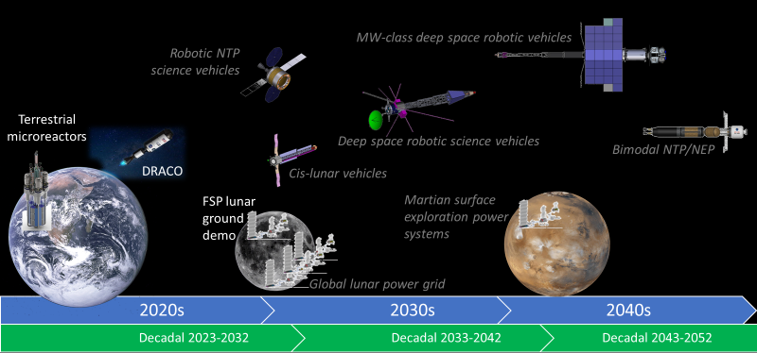
Future of Space Fission Power Systems – Notional Roadmap

Slide 7
Propulsion Comparison
 | Chemical Propulsion | Nuclear Thermal Propulsion | Nuclear Electric Propulsion
Thrust | High (5,000-50,000 lbs) Short burn | High (5,000-50,000 lbs) Short burn | Low (<5 lbs) Long burn
Propellant Efficiency | Low (~450 sec) High vehicle mass | Moderate (~900 sec) Low vehicle mass | High (~2000 sec) Low vehicle mass
Complexity | Low Traditional turbomachinery Refueling | Moderate Reactor-turbine power balance | High Power conversion and distribution Secondary chemical stage
Technology Needs | Low Cryogenic storage Refueling | High Reactor materials and fuels Cryogenic storage | Moderate Power plant & deployable radiators High-power thrusters

Slide 8

NASA Mars Transportation Option Trade Space
Nuclear Propulsion Systems in the Trade Space*
DARPA-NASA DRACO Nuclear Thermal Propulsion flight demonstration mission
NASA Fission Surface Power Project Lunar Surface Demonstration
  USSF Joint Emergent Technology Supplying On-orbit Nuclear Power
Access Mars Transportation White Paper with this QR code or at: www.nasa.gov/MoonToMarsArchitecture
*Source: NASA Mars Transportation White Paper; Mars Architecture Concept Review 2022
4 transportation options, 2 lander options, and a range of surface systems

Slide 9
NASA Space Nuclear Propulsion Roadmap

Slide 10
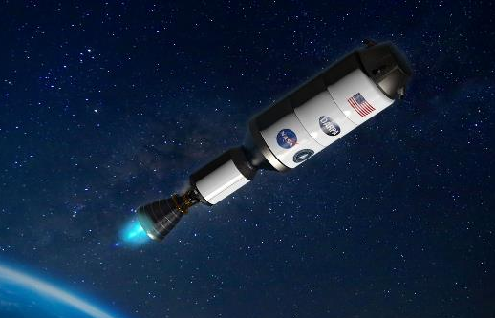
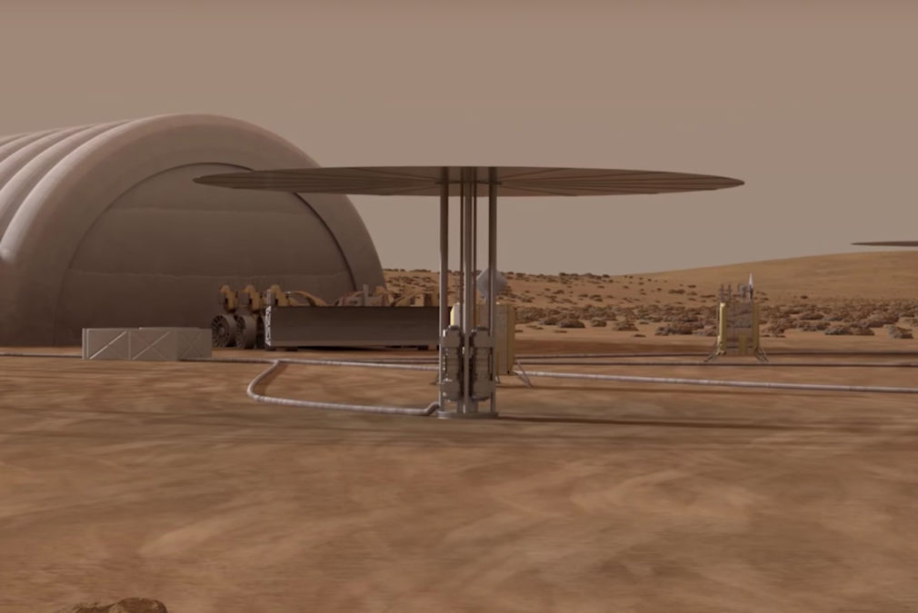
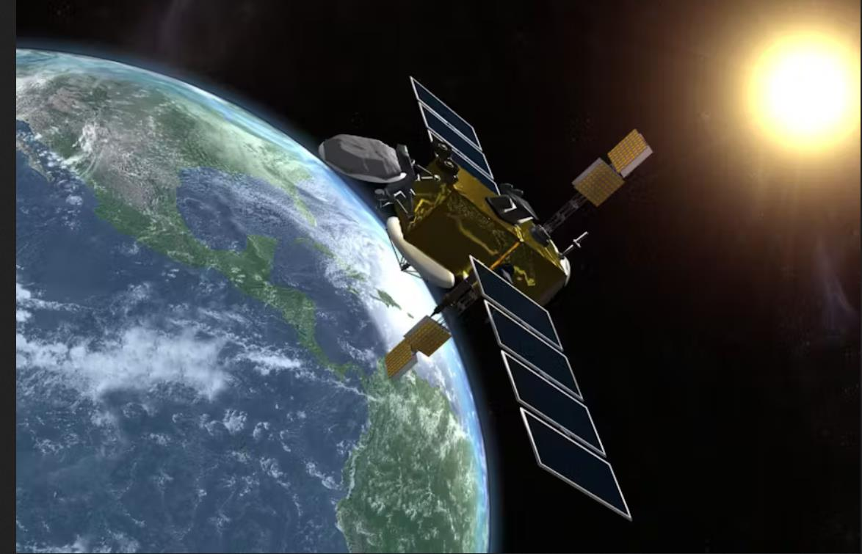
Renaissance of Nuclear Developments and Investments
Growing Investment
DARPA-NASA DRACO Nuclear Thermal Propulsion flight demonstration mission
NASA Fission Surface Power Project Lunar Surface Demonstration
  USSF Joint Emergent Technology Supplying On-orbit Nuclear Power
– Many Developments Aiming for NEAR-TERM Realization –

Slide 11
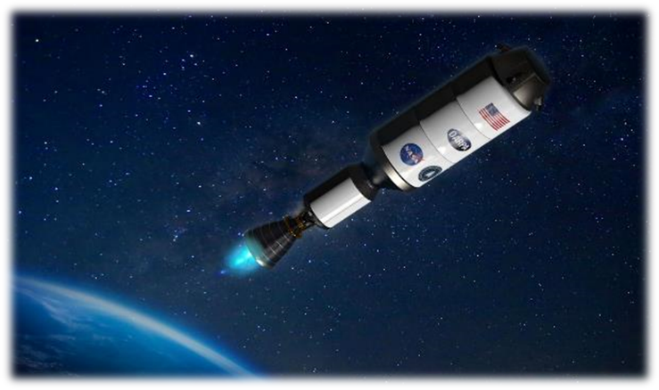





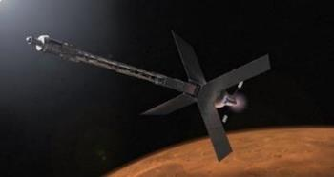
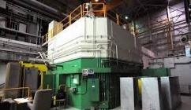
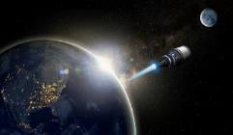





NASA Space Nuclear Propulsion
Provides a robust and reliable energy to both human and scientific exploration missions
Offers energy-dense systems with high ratios of power to mass and volume
Shares a strong interest from industry and other government organizations for space transportation
Propulsion: Speed, Maneuverability, Resiliency
On-demand orbital changes
Rapid transit for intercepts beyond GEO
Earth to Moon orbit in 1 day vs. 3 days
Human transit to Mars
Enables high-value deep space science missions
Interagency Commonality
Industry Engagements
DoD-SCO

