Slide 1

Transformational Propulsion for In-Space Fast Transits
John W. Dankanich and John A. Carr
NASA Marshall Space Flight Center
Laura M. Burke, Geoffrey A. Landis, Timothy J. Peshek and Zachary C. Zoloty,
NASA Glenn Research Center
Robert C. O’Brien
DOE Idaho National Laboratory
SciTech, January 8-12, 2024
Copyright © by U.S. Government; publicly available.
Published by the American Institute of Aeronautics and Astronautics, Inc., with permission.

Slide 2
Outline
Motivation
Terms of Reference / Scope / Objectives
Mission Design
Driving Technologies: SOA and Potential
  Nuclear Thermal Propulsion
  Nuclear Electric Propulsion
  Solar Electric Propulsion
  Nuclear Pulsed / Transformational Propulsion
Summary
Recommendations

Slide 3
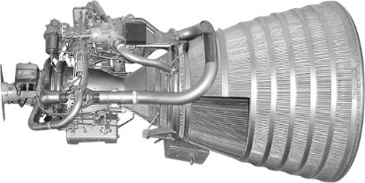
Motivation
The RL10 Represents the SOA in high performance exploration class propulsion
  1 x RL10 engine (Artemis 1-3)
  Exploration Upper Stage, 4 x RL10 engines
  First tested in 1959 and flown in 1963
Technologies today are largely the same
  Largely deflagration of a combustion product passed through a choked nozzle and expanded
  Even electric propulsion is largely unchanged since the Hall thrusters (1972) and Gridded ion (1964)
  Yes, Advanced in materials, tweaks to propellant chemistry, new manufacturing…
Ambitious programs made progress, but no significant resources provided for exploration class transformational space transportation since the 1970s.
  Project Orion (58-63), NERVA (61-73), etc.
  Recently constrained to preliminary investigations, low-level technology, studies (NASA, DOE, NIAC, ARPA-E, NSF, etc.), but no recent strategic system development
Transformational propulsion is required for ambitious missions (fast crewed transits, interstellar probe, gravity lens, etc.), but has not received significant investment in 50 years.

Slide 4
Scope / Objectives
Expectation of a quick / high level assessment (~0.5 FTE, 3 months)
Literature review
All Chemical Comparison Assessment
Conventional Nuclear Thermal propulsion
      Near-term and lower TRL concepts
Electric Propulsion
      Solar electric power generation: near-term and far-term
      Nuclear electric power generation: near-term and far-term
        Heat rejection technologies
      Range of thruster options: Hall Thrusters, VaSIMR, MPDs, etc.
Unconventional Nuclear (e.g. NIAC concepts)
Recommendations for near-term investments
What could we achieve with plausible yet transformational propulsion, and what should we do today to make meaningful progress?

Slide 5
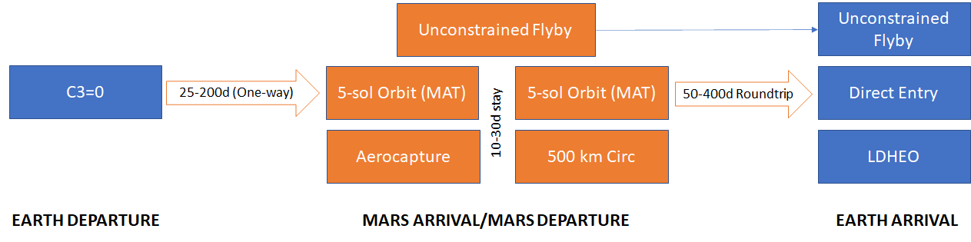
Trades / Generalized
High thrust and Low thrust propulsion systems
  High thrust departure and capture burns with I_{SP} values representative of LOX/LCH4, LOX/LH2, and NTR (900-1800s)
  Low thrust burns during interplanetary transits capturing EP propulsion system I_{SP} values from 2,000s to 20,000s
All Results in the Appendix

Slide 6
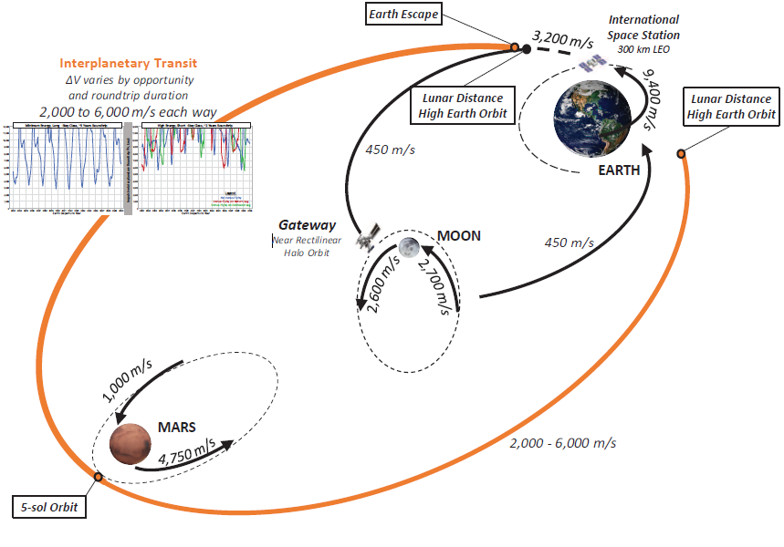
Traditional – All Chemical
Chai, P. R., Rucker, M. A., Burke, L. M., Chappell, M. B., Edwards, S. J., and Trent, D. J., “Characterization of In-Space Propulsion Trade Space to Support Initial Human Mars Segment,” ASCEND 20223, AIAA 2023-4644, October 23-25, 2023.

Slide 7
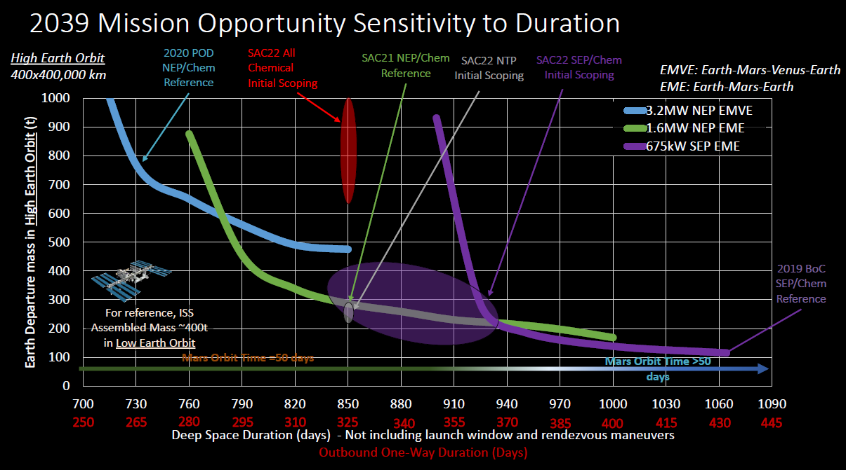
Subset of Mars Architecture Trades

Slide 8
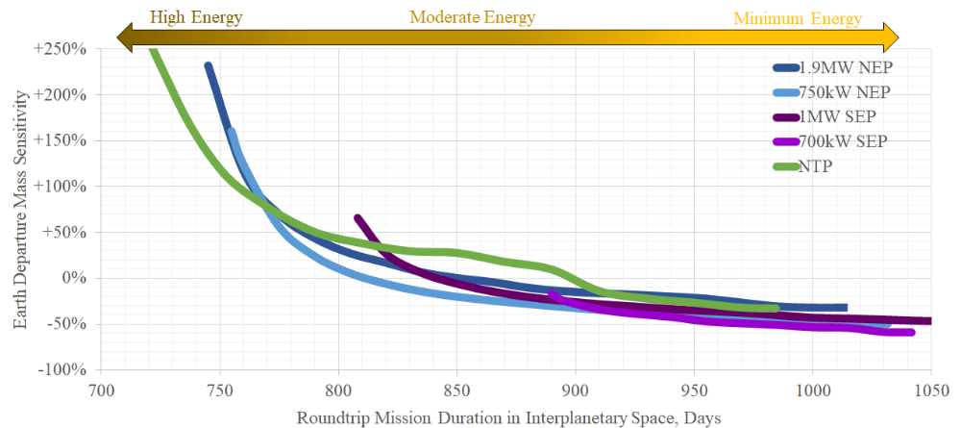
Energy Sensitivities for Conventional Options
Chai, P. R., Sais, A. J., Gaug, N. M., and Qu, M., “In-Space Transportation Sensitivity to Roundtrip Mission Duration and Mars Vicinity Stay Time,” ASCEND 20223, AIAA 2023-4644, October 23-25, 2023.

Slide 9
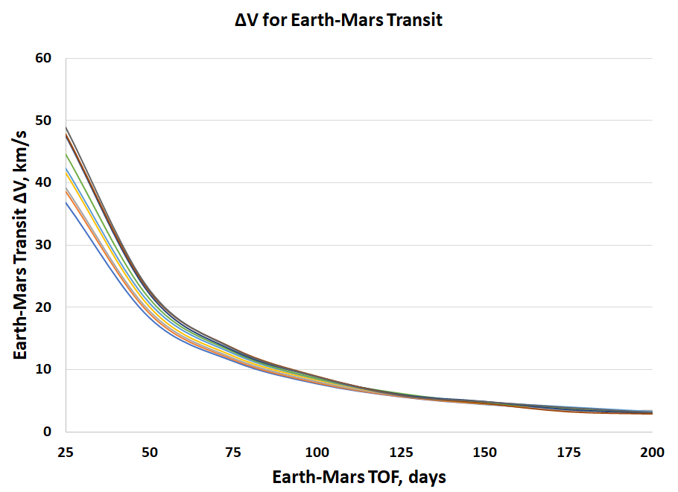
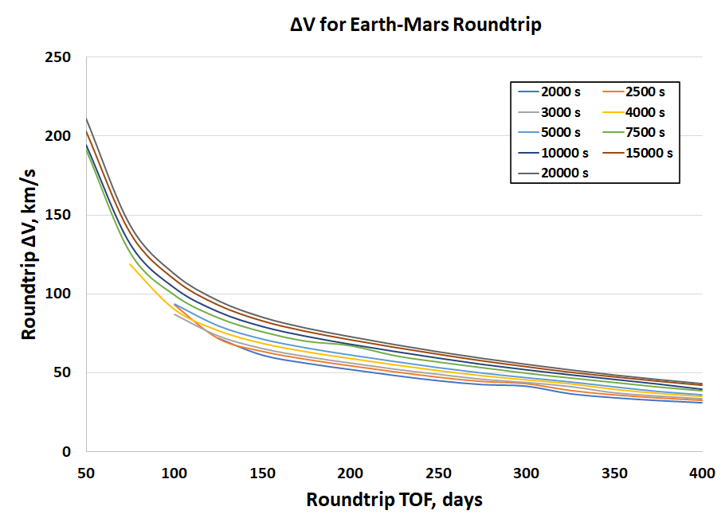
It simply gets really hard really fast…
~3 km/s
~6.6 km/s
Energy requirements increase by more than an order of magnitude for “rapid” transits.

Slide 10
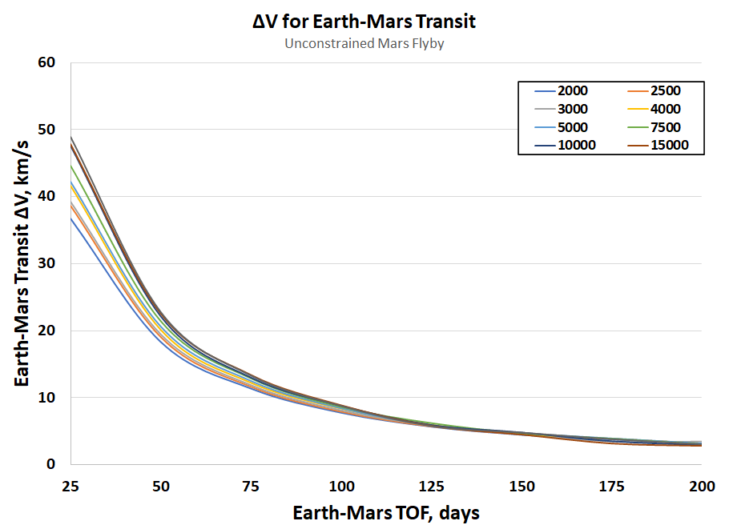
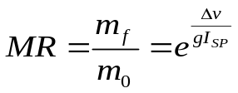
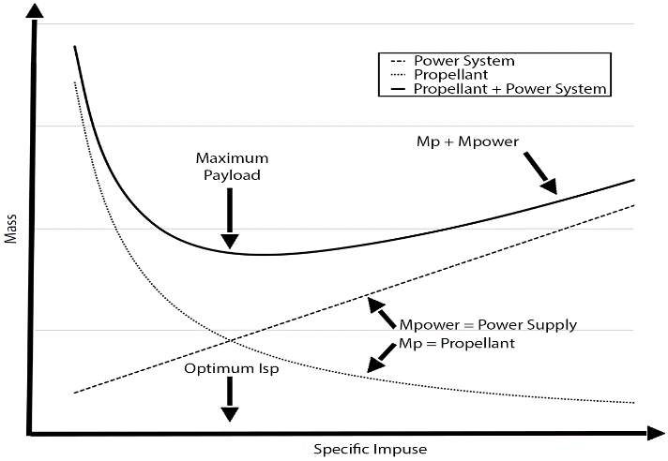
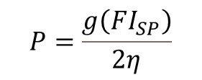
Performance Drivers
$$P=\frac{g\left(FI_{SP}\right)}{2η}$$
~3 km/s
Cannot tolerate a ΔV increase faster than Specific Impulse.
α_{System} (Kg/kWe) drives the limiting performance.

Slide 11
Performance Drivers
$$P=\frac{g\left(FI_{SP}\right)}{2η}$$
All-Chem
Cannot tolerate a ΔV increase faster than Specific Impulse.
α_{System} (Kg/kWe) drives the limiting performance.

Slide 12
Performance Drivers
$$P=\frac{g\left(FI_{SP}\right)}{2η}$$
900s NTP
All-Chem
Cannot tolerate a ΔV increase faster than Specific Impulse.
α_{System} (Kg/kWe) drives the limiting performance.

Slide 13
Performance Drivers
$$P=\frac{g\left(FI_{SP}\right)}{2η}$$
900s NTP
All-Chem
Cannot tolerate a ΔV increase faster than Specific Impulse.
α_{System} (Kg/kWe) drives the limiting performance.

Slide 14
Performance Drivers
$$P=\frac{g\left(FI_{SP}\right)}{2η}$$
900s NTP
DRACO
All-Chem
Cannot tolerate a ΔV increase faster than Specific Impulse.
α_{System} (Kg/kWe) drives the limiting performance.

Slide 15
Performance Drivers
$$P=\frac{g\left(FI_{SP}\right)}{2η}$$
1800s NTP
900s NTP
All-Chem
Cannot tolerate a ΔV increase faster than Specific Impulse.
α_{System} (Kg/kWe) drives the limiting performance.

Slide 16
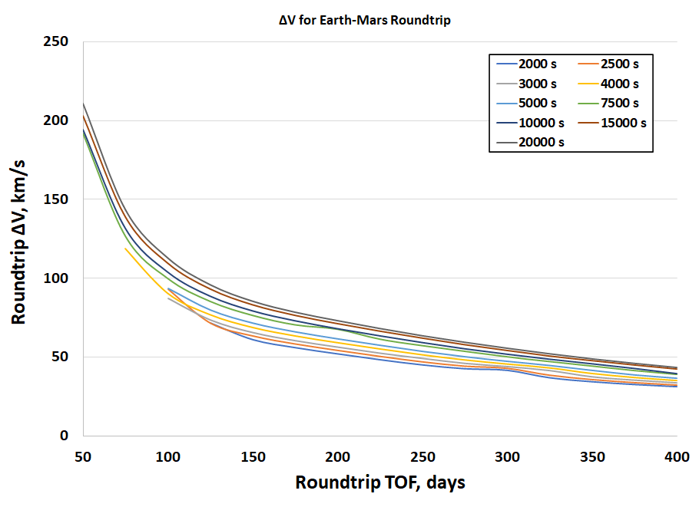
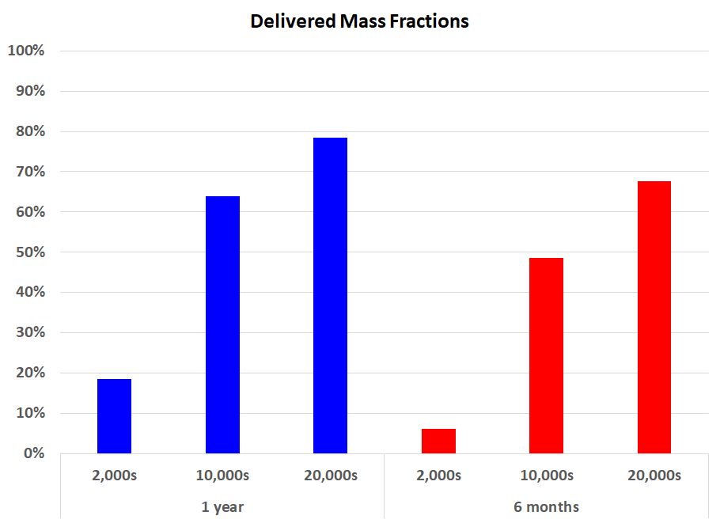
Performance Drivers
~6.6 km/s at 850 days
Roundtrip ΔV rises quickly for rapid transits.

Slide 17
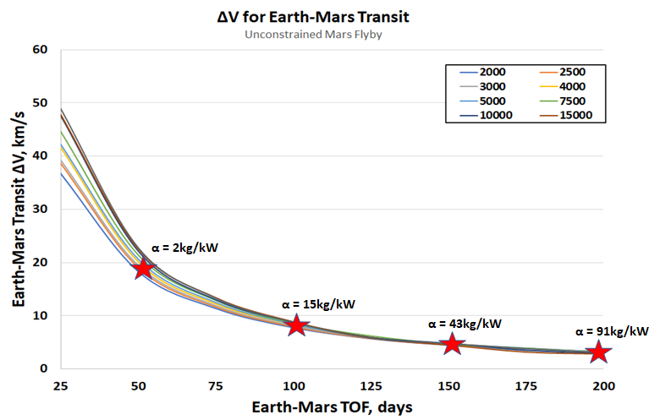
Performance Drivers
α_{System} (Kg/kWe) drives the limiting performance.

Slide 18
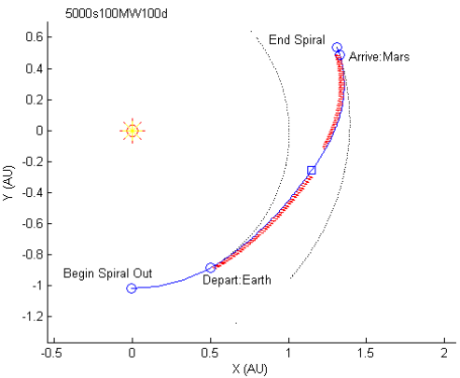
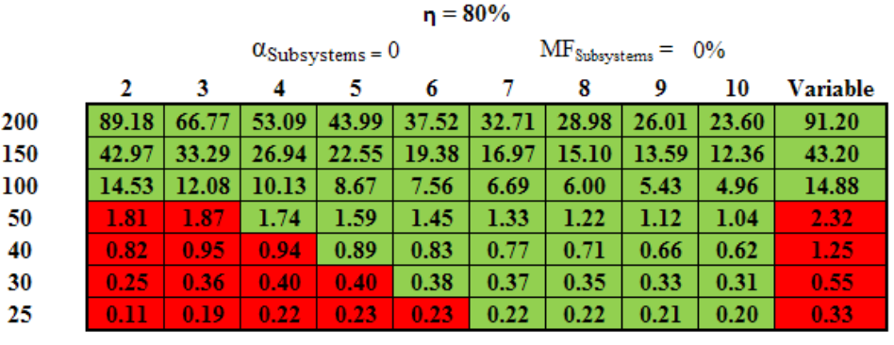
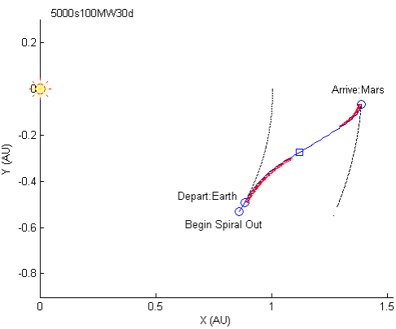

Old Study
Dankanich and Ilin, AIAA 2010-6771
Methods were created to determine feasibility with medium fidelity optimization.

Slide 19
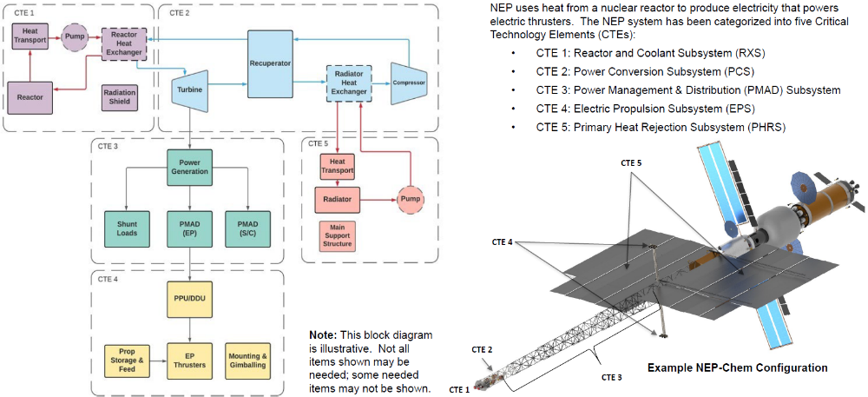
Critical Technology Elements

Slide 20
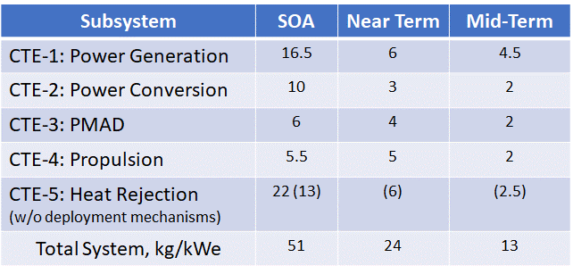
Critical Technology Elements - Planned
The current NEP TMP has significant progress potential, especially for power generation and heat rejection systems.

Slide 21
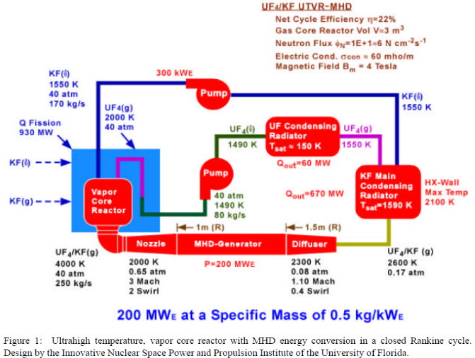
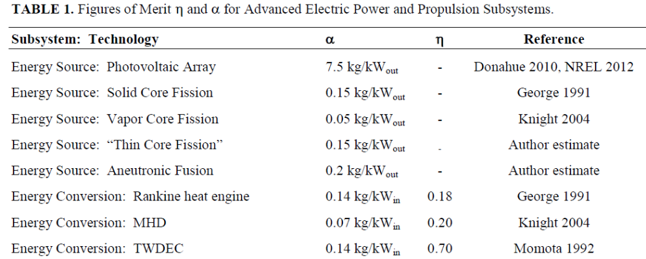
NEP Power Generation and Conversion
Chang Diaz, F. R., IAC 2002
Scott, John H. et al., NETS 2013
39 Days to Mars (131 day return) plausible with System Alpha < 1 kg/kWe
A very low mass power generation and conversion solution is required.
Multiple options have been conceived.

Slide 22
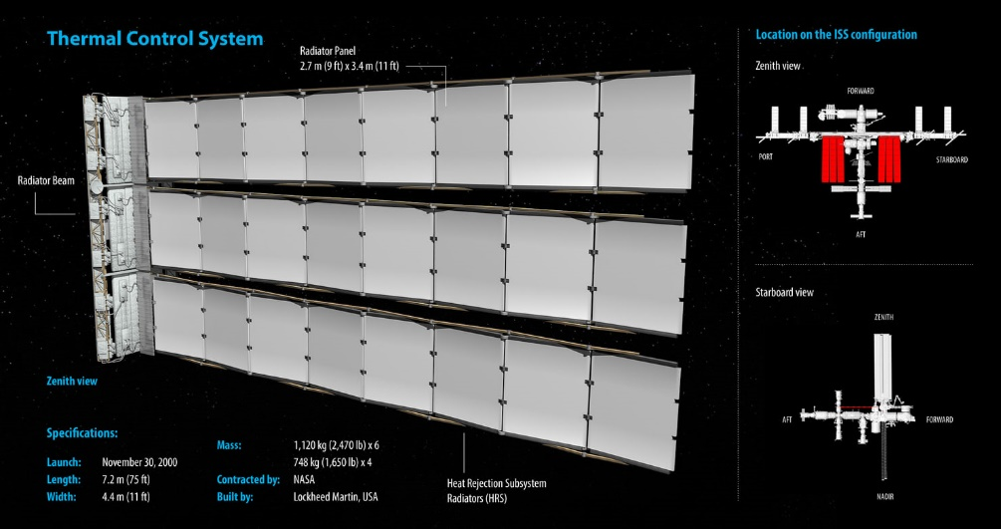
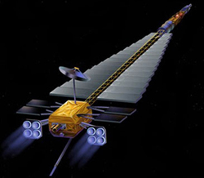
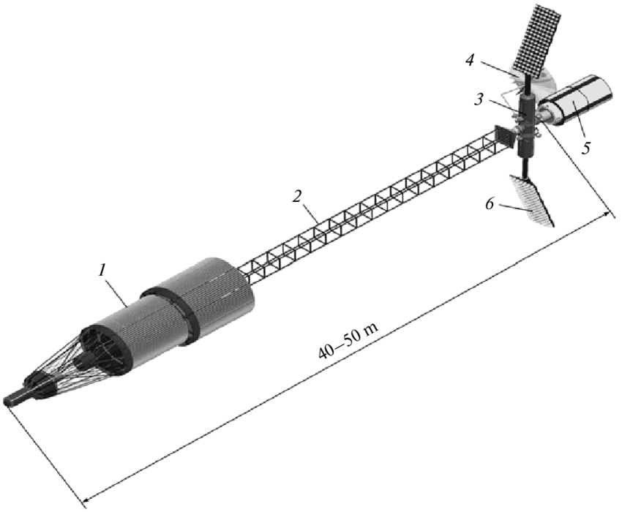
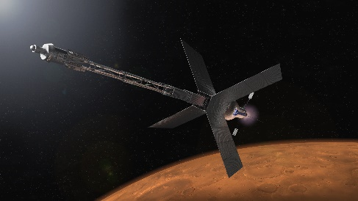
NEP: Heat Rejection
SOA Heat Rejection ~300k improves vastly with higher temperature (600k) heat rejection; 10X
Another 10x at 1500K plausible
Advanced concepts: Liquid Droplet Radiators, Belt radiators, Curie Point Radiator, etc.
Transformational: Dual purpose structural oscillating heat-pipes
Deployment / Structural mass becomes limiting factor
There is a path to ~0 kg/kW heat rejection with ROI for interim progress.

Slide 23

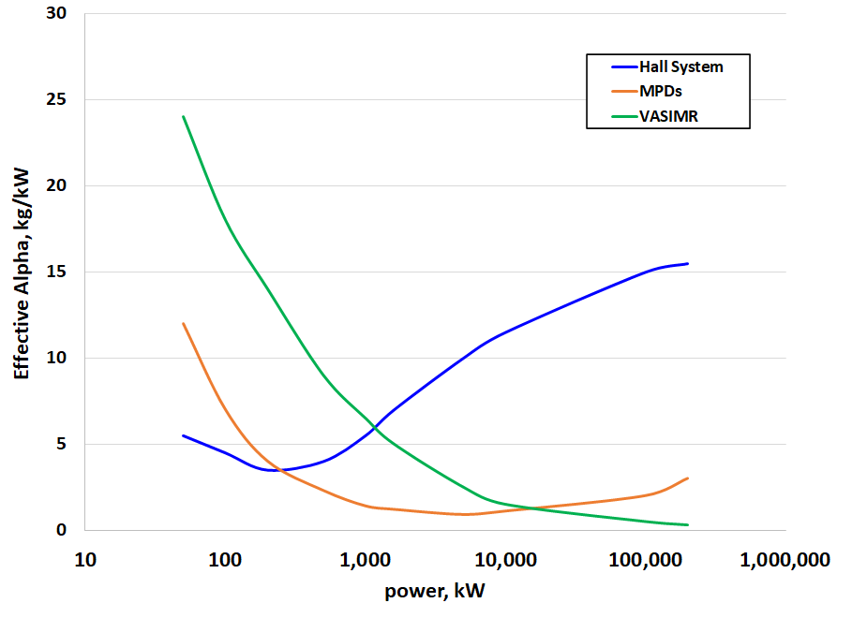
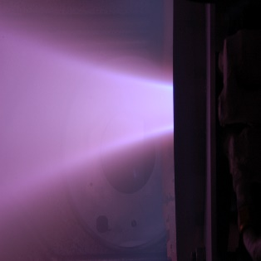
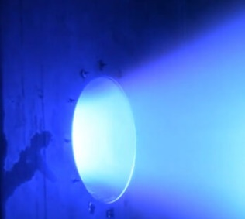
Propulsion System Options
Multiple options available for the propulsion system.
Open work to add fidelity.
e.g. We have COMPASS for Hall and VASIMR, but not MPDs

Slide 24
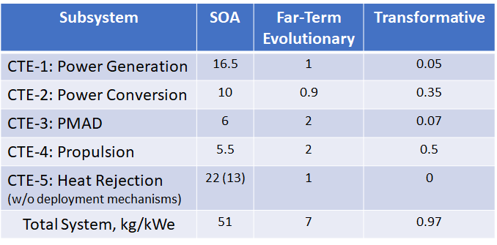
Critical Technology Elements – Far Term vs. Transformational
Evolutionary approaches have limited potential.

Slide 25
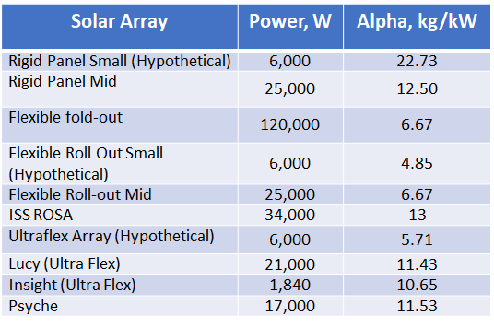
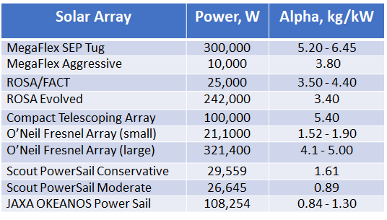
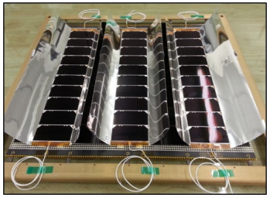
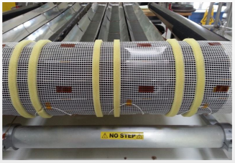
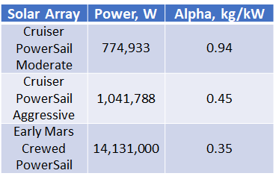
Solar Power
SOA Technology
Evolutionary: ~Low-risk 10-year Horizon
Speculative Power Sails
Redwire Solar Array FACT Flysheet, 2021
Solar Power is Very Promising; especially near-term ~low-risk.

Slide 26
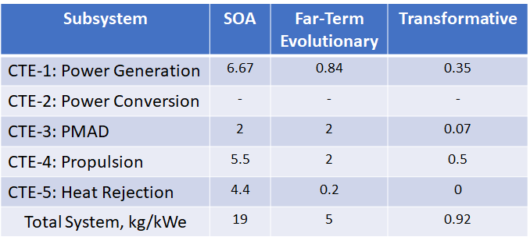
Critical Technology Elements – Far Term vs. Transformational
Solar has Comparable Potential and Far Superior Near-term Performance

Slide 27
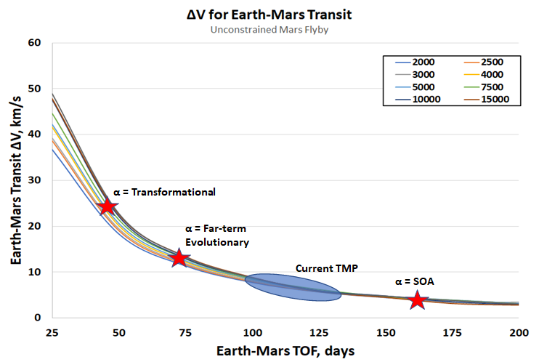
Performance Plan vs. Potential
Investments are Required Beyond Evolutionary Approaches

Slide 28
Nuclear Pulsed / Other
Non-extensive list:
Orion: Pulsed nuclear detonation with pusher plate.
VISTA: Laser ignition Inertial Confinement Fusion (ICF) based, 145 days roundtrip Mars (uncrewed)
Daedalus: ICF based up to 12% speed of light; uncrewed
Propagating Magnetic Wave Plasma Accelerator (PMWAC): Field Reversed Configuration (FRC) Fusion; thruster α = 6E-5 kg/kW.
Piloted Spherical Torus Nuclear Fusion Propulsion: Steady-state fusion.
Dusty Plasma Fission Fragment Rocket Engine (FFRE): Allows heavy fission products to escape the reactor. 290-day roundtrip with 60-day stay and 170mT Lander and Habitat (DRA 5.0).
The Fusion Driven Rocket: Magnetically driven liners imploding onto plasma targets.
Pulsed Fission-Fusion: High current z-pinch compression of material liners onto fission-fusion fuel targets.
Pulsed Plasma Rocket (PPR): ~150day roundtrip missions.
Gradient Field Imploding Linear Fusion Propulsion: Magneto-Inertial Fusion (MIF), Shifts from pulsed target compression to static high gradient allowing the use of superconducting field coils.
Etc. (DOE and APRE-E investment derived, more likely to be identified through these external investments).
Wide range of transformational propulsion options with limited opportunities for maturation beyond concept studies.
Most require significant resources for meaningful progress i.e. high AD².

Slide 29
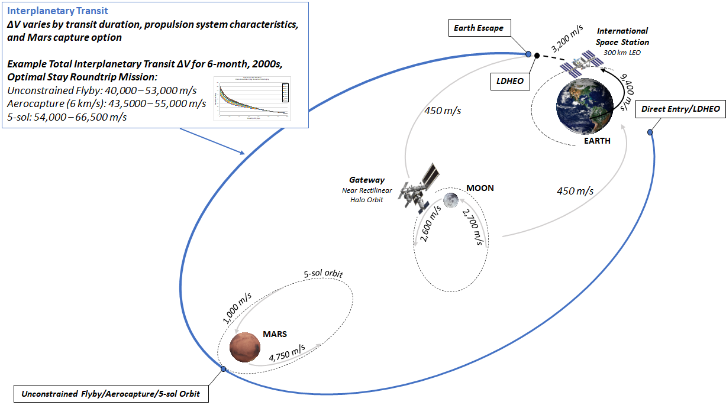
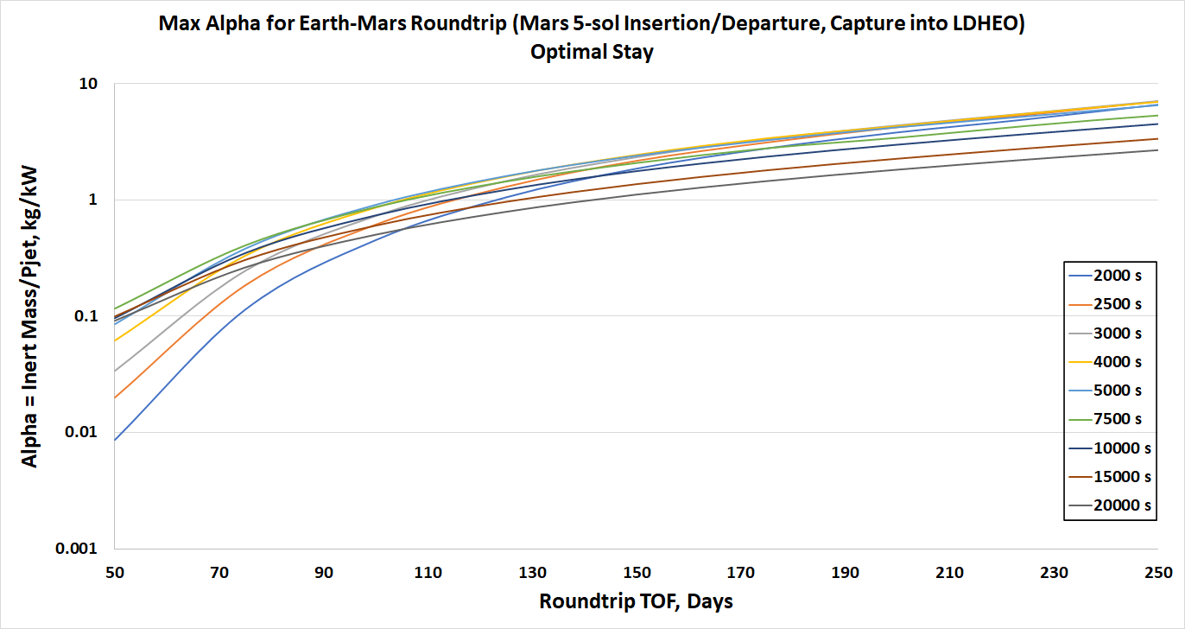
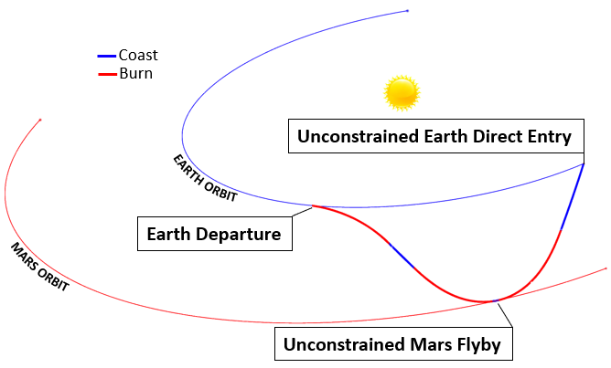
Results
Far-term evolutionary NEP and SEP enables roundtrip transit times of 250 days and 220 days respectively.
Transformative performance for either NEP or SEP enables one-way and roundtrip transits of 50 days and 100 days respectively
Viable round-trip mission less than 3 months if direct Earth entry velocities can be tolerated.

