Slide 1
Hillary Blakeley, RJ Bodkin, and Anjie Emmett NASA Langley Research Center
Heritage to Flight:
The Test Program that Brought an Inflation System Back to Life for LOFTID
AIAA SciTech Forum 8-12 January 2024

Slide 2
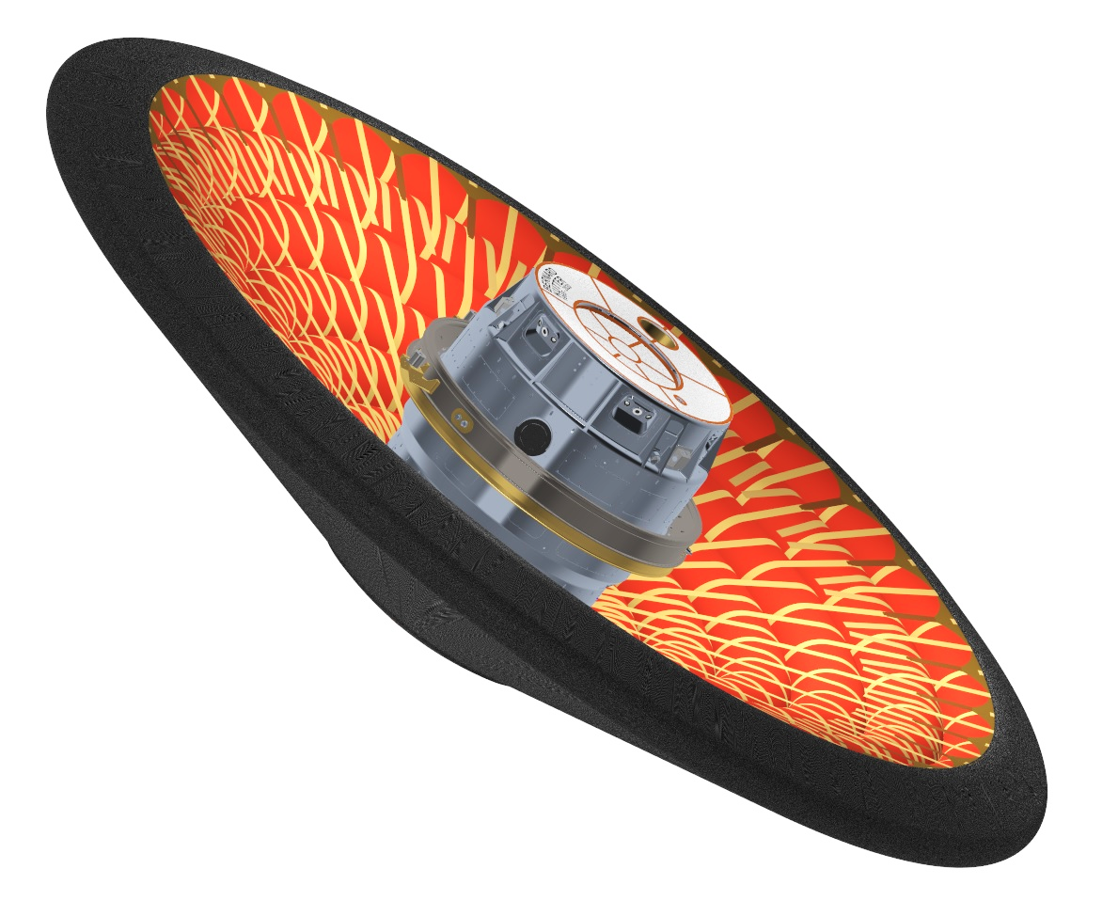
HIAD
IRVE
LOFTID
Hypersonic Inflatable
Aerodynamic Decelerator
Successful
Flight Tests
Inflatable
Structure
(IS)
Flexible
Thermal
Protection
System
(FTPS)
2022
6m
Orbital Reentry
2009 and 2012
3m
Suborbital Reentry
Notes:
Deployable aeroshell made of an Inflatable Structure (IS) that maintains shape during atmospheric flight, and a Flexible Thermal Protection System (FTPS) that protects the entry vehicle through hypersonic atmospheric entry
A Hypersonic Inflatable Aerodynamic Decelerator (HIAD) is a deployable aeroshell technology consisting of two main elements:
Inflatable Structure (IS) that is heat resistant and sufficiently rigid to maintain shape against aerodynamic forces
Flexible Thermal Protection System (FTPS) that shields the Inflatable Structure and payload from the extreme aeroheating and shear environments of atmospheric entry

Slide 3
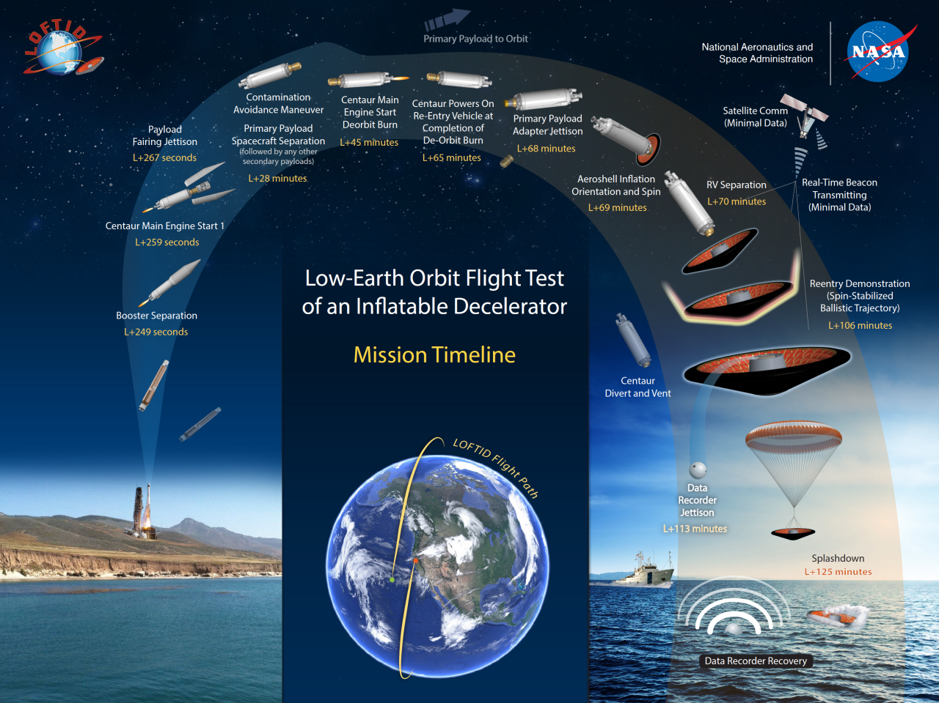
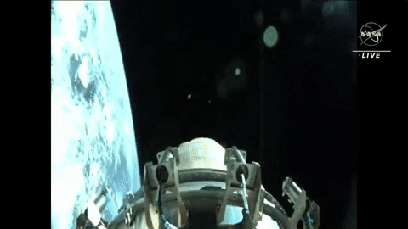
LOFTID
LOFTID Deployment
LOFTID Recovery
Notes:
Low-Earth Orbit Flight Test of an Inflatable Decelerator (LOFTID) was a technology demonstration mission entering a Reentry Vehicle (RV) with a 6-meter diameter inflatable aeroshell from orbit, demonstrating HIAD technology at scale and entry conditions relevant to Earth and Mars applications
LOFTID launched on a United Launch Alliance (ULA) Atlas V rocket as a ride-share payload out of Vandenberg Space Force Base (VSFB)

Slide 4
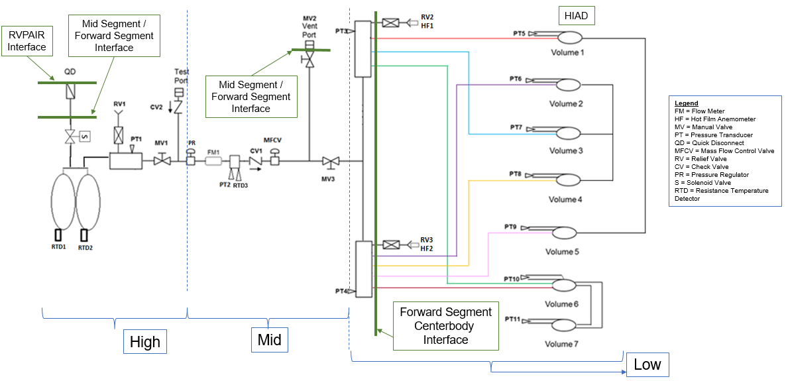
Inflation System Schematic
*Note: IRVE had a different Fill and Gang Scheme

Slide 5
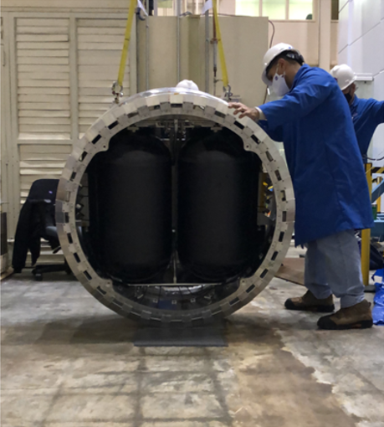
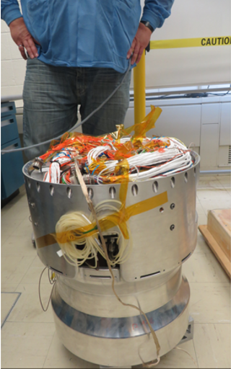
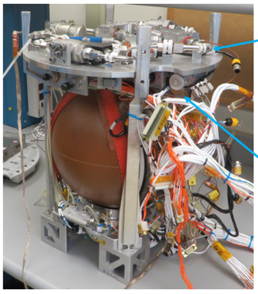
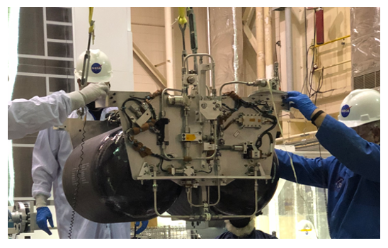
IRVE-3 vs LOFTID Structures
IRVE-3 /
THOR
LOFTID
18”
52”

Slide 6
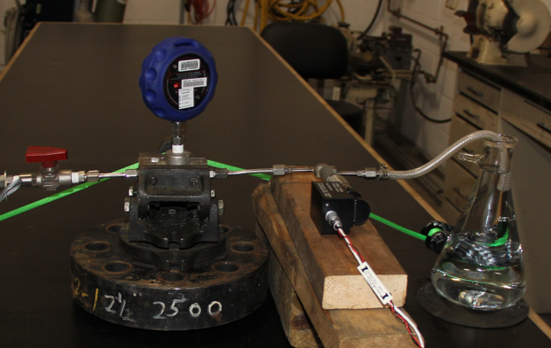
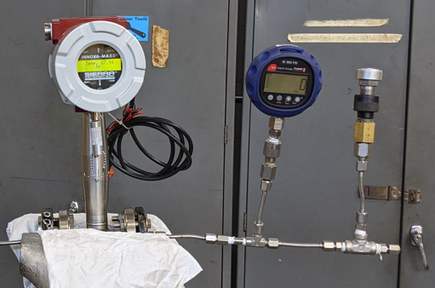
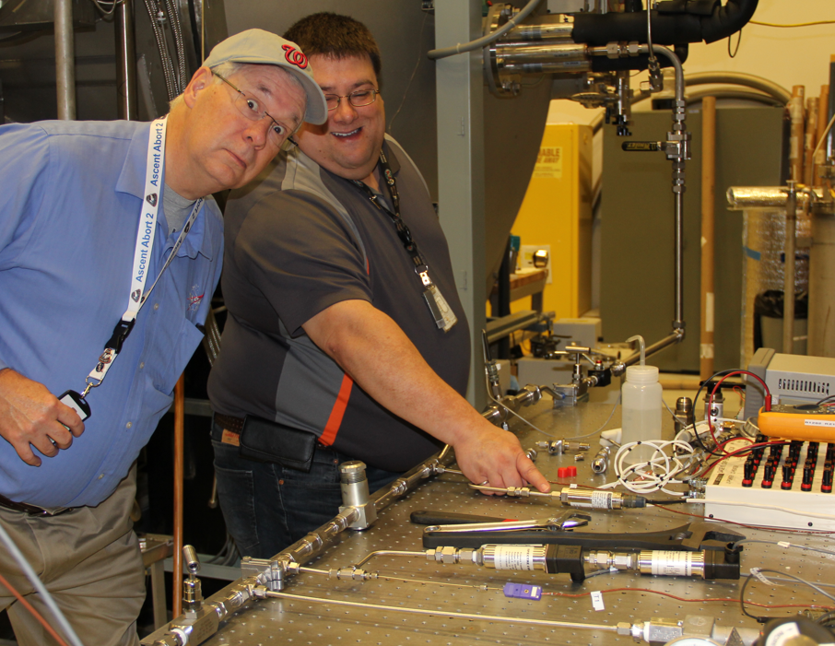
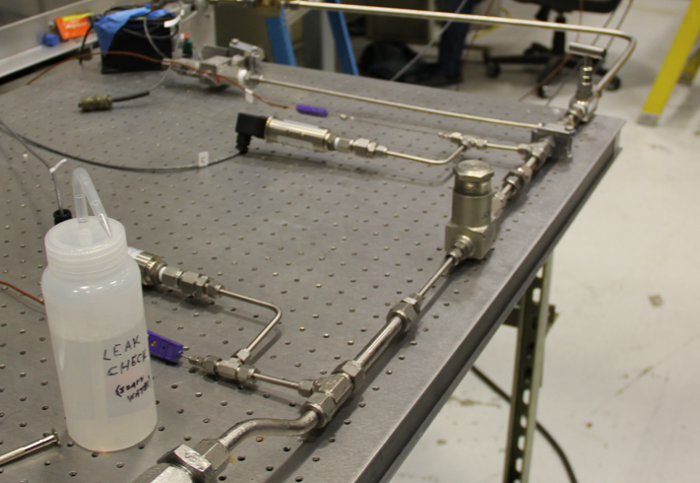
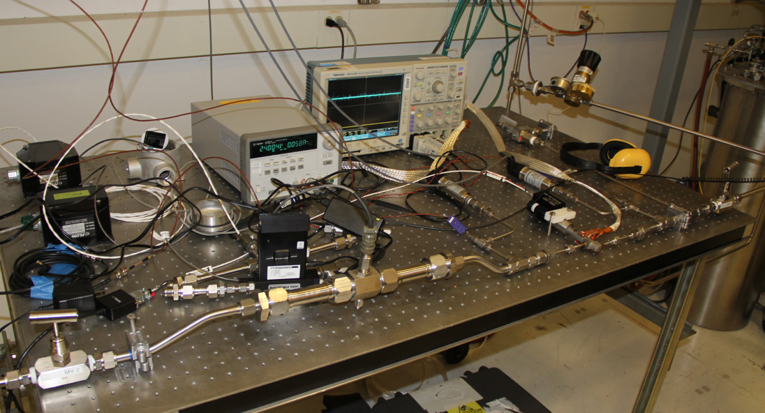
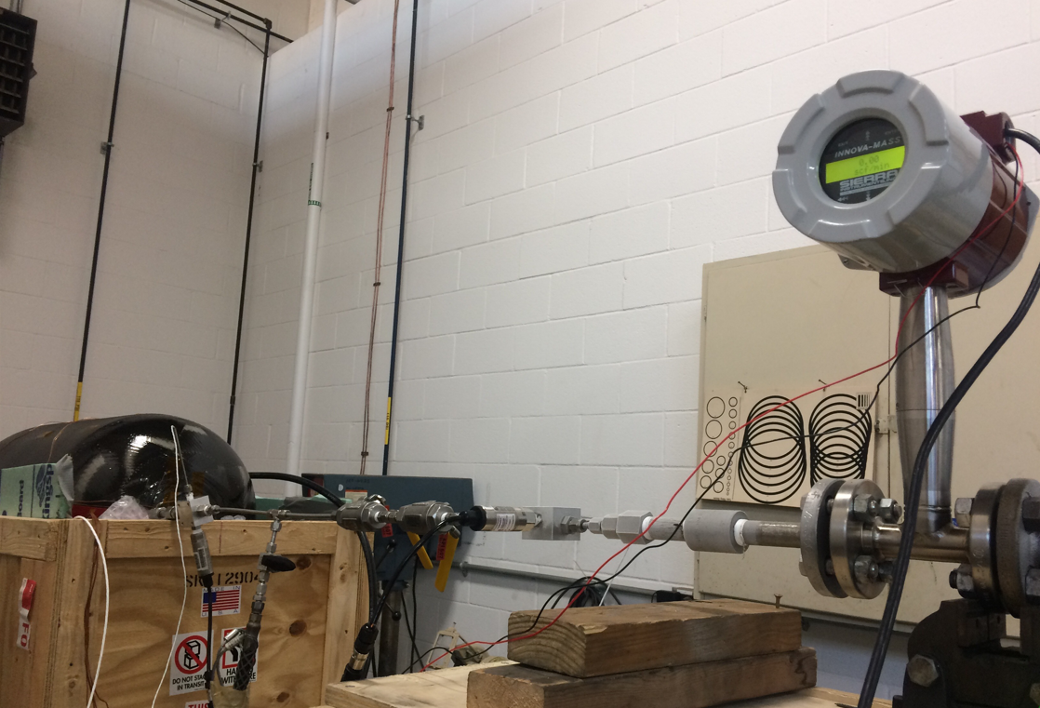
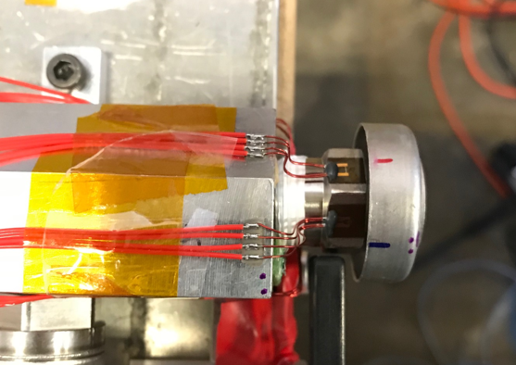
Test Campaign, Phase I: Component Level
Seal Capability
Crack Pressure and Flow Capability
Tank Blowdown
Performance
Hot Film Anemometer Excitation
Pressure and Flow Characterization

Slide 7
Test Campaign, Phase II: Subsystem Level
Vacuum Characterization Flow Testing at Marshall Space Flight Center
Functional Testing at Langley Research Center
Vibration Testing at Goddard Space Flight Center
Leak Check at Langley Research Center
Functional Testing While Integrated into the Reentry Vehicle

Slide 8
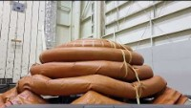
Test Campaign, Phase II: Subsystem Level
Inflatable Volume Tori Simulator (IVTS) Test

Slide 9
Test Campaign, Phase III: Reentry Vehicle (RV) System Level Testing
T=0.0s
T=34.0s
T=36.0s
T=0.5s
T=0.05s
T=210.0s
Complete System Test (CST)

Slide 10
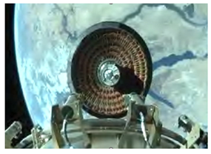
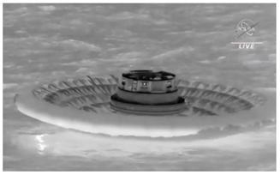
Inflation System Flight Performance
Successful deployment, reentry, and recovery of the largest blunt body aeroshell ever.
Software issue caused loss of almost all Inflation System data

Slide 11
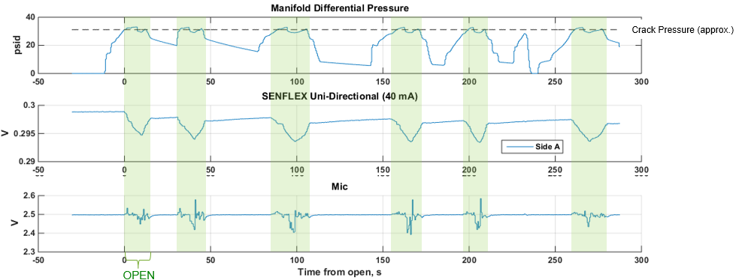
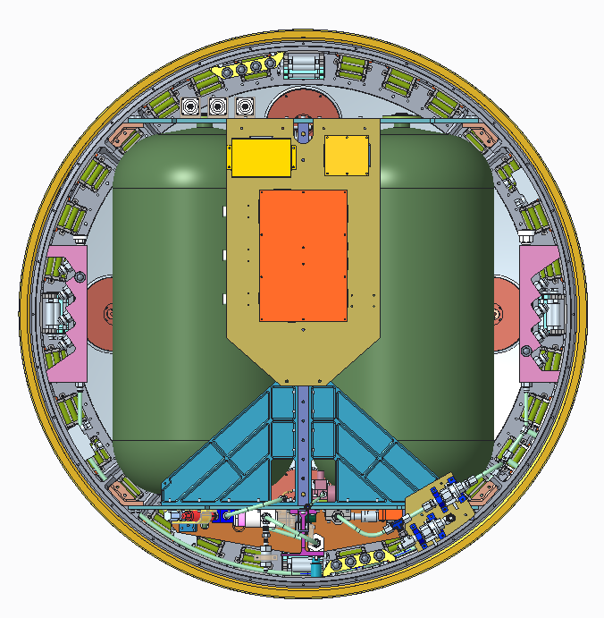
Inflation System Flight Data
Component Level Testing
HFA Excitation
Flight and RV Level Testing
HFA Excitation

Slide 12
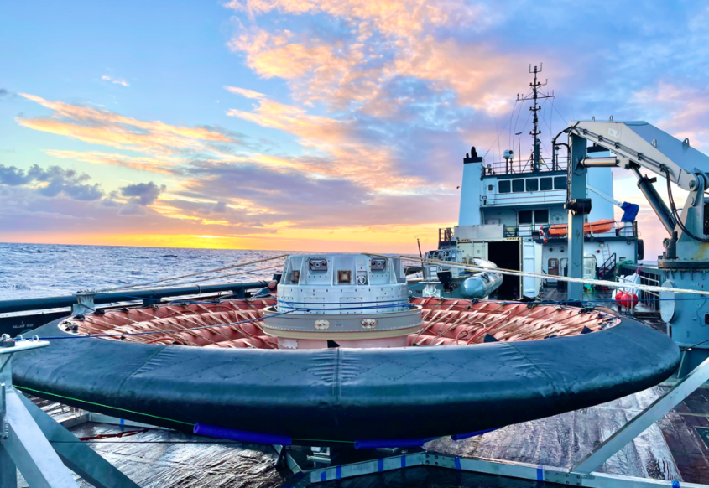
Test Campaign Summary Take Aways
Extensive testing at the component and subsystem levels enable a flexible and adaptive system.
The greatest risks to an aggressive pneumatics testing campaign are the soft seals.
No test, or test results, are inconsequential. Don’t be afraid to be DETAILED!

