Slide 1
Core Flight System (cFS) Training cFS Draco
Module 1: Introduction

Slide 2
Course Audience & Prerequisites
Audience: Flight Software Developers
Prerequisites:
C programming experience
Linux experience
System requirements for hands-on exercises:
Linux build environment
With sudo privileges or a /proc/sys/fs/mqueue/msg_max >= 1024
git, gcc, cmake, clang
Python 3.8, PyQt5, PyZMQ

Slide 3
Course Agenda
Introduction
cFE Services
Executive Services
Software Bus
Event Services
Time Services
Table Services
Application Layer
cFS Applications
cFS Libraries

Slide 4
Course Learning Objectives
Understand the architecture of the cFS
Build and execute the cFS
Interact with the cFS through a ground system
Modify a cFS application

Slide 5
Introduction Agenda
What is cFS?
cFS Community
cFS Architectural Overview

Slide 6
What is cFS?

Slide 7
cFS History and Organization
cFS was conceived, architected, and built by NASA Goddard Space Flight Center, Flight Software Systems Branch (Code 582)
https://sed.gsfc.nasa.gov/index.php/etd/582
History dates to early 2000’s
Used on virtually all GSFC missions
Widespread use across NASA and beyond
The cFS Project at GSFC/582 still supports and evolves cFS:
Regular maintenance
New hardware and operating systems
New applications and features
Internal (CUI) applications and features
Contact the GSFC/582 cFS team: cfs-program@lists.nasa.gov

Slide 8
cFS Overview
A platform and project independent reusable software framework and set of reusable software applications
Platform Abstraction Layer supports portability
Applications provide mission functionality
Compile-time configuration parameters and run-time command/table parameters add flexibility and scalability
Key aspects:
Dynamic run-time environment
Layered architecture
Component-based design

Slide 9
cFS Architecture Layers
CFDP
Checksum
Data Storage
File Manager
Housekeeping
Health/Safety
Tools
Application
Limit Checker
Memory Dwell
Memory Mgr.
Scheduler
SB Network
Stored Cmds.
Python
Ground System
Core Flight
Executive
Core Flight Executive API
Application
Generator
Core Flight Executive
Performance
Tools
Platform
Abstraction
OS Abstraction API
Platform Support Package API
Performance
Analyzer
RTEMS
VxWorks
Linux
Mcp750-VxWorks
Unit Tests
Build System
RTOS / Boot
Real Time OS
Board Support Package
PROM Boot FSW
cFE Open Source Release
OSAL Open Source Release
Application Open Source Releases
3rd Party
Mission Developed

Slide 10
Key Definitions
Framework – The set of individual services, applications, tools, and infrastructure supported by the open source community Configuration Control Board (CCB).
Bundle – An executable version of the framework configured for a nominal Linux system. Links compatible versions of the framework elements as a recommended starting point for new cFS-based systems.
Component – An individual application, service, or tool that can be used in a cFS-based system
Distribution – A set of custom components packaged together with the framework; generally created and provided by a cFS user (individual or group) with specific needs (e.g. a NASA center, the GSFC SmallSat Project Office)
cFE vs cFS:
cFE is the Core Flight Executive services and API
cFS is a general collective term for the framework and the growing set of components

Slide 11
cFS Community

Slide 12
Community-based Product Model
Components
Applications
Platforms
Tools
Components
Specifications
Component
Supplier
cFS
Distribution
Tools
Apps
Service
Platform
cFS
Framework
cFS
Distributor
NASA
A NASA multi-center configuration control board (CCB) manages releases of the open source cFS Framework and component specifications
CCB is chaired by GSFC Code 582 staff
Community members (regardless of affiliation)
Supply applications, platforms, and tools
Create cFS distributions

Slide 13
User Responsibilities
The cFS Framework has a NASA NPR-7150.2C Class E classification
“Software developed to explore a design concept or hypothesis but not used to make decisions for an operational Class A, B, or C system or to-be-built Class A, B, or C system”
The cFS Framework provides artifacts to support Class B missions and a subset of artifacts to support Class A missions
End-users are responsible for classifying the software system that uses the cFS Framework
End-users are responsible for complying with International Traffic in arms Regulations (ITAR)
Projects are responsible for verifying all of their requirements
Many projects treat cFS in the same way as operating systems

Slide 14
Obtaining cFS “Products”
cFS Bundle
Contains the cFS Framework packaged with additional components to create a system that can easily be built, executed, and unit tested on a Linux platform
http://github.com/nasa/cFS
User Components
Search https://github.com/nasa/ or do a general web search on NASA cFS
Distributions
Listed on a later slide
Some distributions contain many of the common apps which give you a good starting point for apps
Engage with the Community
Ask the community mailing list (cfs-community@lists.nasa.gov)

Slide 15
cFS Product Model
NASA cFS Framework
cFS Distribution
Support
Tools
Unit Test
Unit Test
Tools
Build Tools
Table
Build Tools
Table
cFE Apps
cFE Apps
Apps
Applications
App Library
App Library
App Libraries
cFE API
cFE API
Core Flight
Executive
cFE
cFE
cFS
Framework
OS Abstraction
API
Platform Support
Package API
OS Abstraction
API
Platform Support
Package API
Platform
Abstraction
OS
Abstractions
PSPs
OS
Abstract
OS
Abstract
PSPs
PSPs
The NASA Configuration Control Board (CCB) manages the “cFS Framework”
“cFS Distribution” created by augmenting the NASA cFS Framework with components (platforms, apps, and tools) to create an operational system

Slide 16
cFS Distributions
Name/Link | Intended Audience | Overview
cFS Framework-101 | cFS Framework training package | This is a training tool for individuals to learn how to develop software with NASA-developed Core Flight software (CFS) framework. No agreement is necessary through this catalog. Training is created by JSC and is open source.
cFS Bundle | Initial cFS build for a developer or a project | This repository contains submodules for the cFE, OSAL, and apps, as well as instructions for building the system. This distribution has been compiled/linked but has not been verified as an operational system.
NASA Operational Simulator for Small Satellites (NOS3) | Initial cFS platform for a project | NOS3 provides a complete cFS system designed to support satellite flight software development throughout the project life cycle. It includes • 42 Spacecraft dynamics and visualization, NASA GSFC • cFS – core Flight System, NASA GSFC • COSMOS – Ball Aerospace • ITC Common – Loggers and developer tools, NASA IV&V ITC • NOS Engine – Middleware bus simulator, NASA IV&V ITC
OpenSatKit (OSK) | cFS training platform for new cFS developers | OSK provides a complete cFS system to simplify the cFS learning curve, cFS deployment, and application development. The kit combines three open source tools to achieve these goals: • cFS – core Flight System, NASA GSFC • COSMOS – command and control platform for embedded systems, Ball Aerospace • 42 dynamic simulator, NASA GSFC

Slide 17
Community Operational Procedures
Version Control
Main Branch – always has the latest code
Integration Candidates – updated after the weekly CCB meeting
Release Candidates – periodically tagged from master
User Contributions
A Contributor License Agreement (CLA) is required for each contributor to the open source
Feature Deprecation
Mark feature as deprecated on any release
Provide tools/process that will warn applications when a feature is marked as deprecated
Only deprecate on major versions

Slide 18
Core Flight System Architectural Overview

Slide 19
Architecture Goals
Reduce time to deploy high quality flight software
Reduce project schedule and cost uncertainty
Directly facilitate formalized software reuse
Enable collaboration across organizations
Simplify sustaining engineering/on-orbit FSW maintenance
Scale from small instruments to Hubble class missions
Build a platform for advanced concepts and prototyping
Create common standards and tools across the center

Slide 20
cFS Architecture Layers
Development Tools
& Ground Systems
Python
Ground System
Application
Generator
Performance
Tools
Performance
Analyzer
Unit Tests
Build System
Application
CFDP
Checksum
Data Storage
File Manager
Housekeeping
Health/Safety
Limit Checker
Memory Dwell
Memory Mgr.
Scheduler
SB Network
Stored Cmds.
Core Flight
Executive
Core Flight Executive API
Core Flight Executive
Platform
Abstraction
OS Abstraction API
Platform Support Package API
RTEMS
VxWorks
Linux
Mcp750-VxWorks
RTOS / Boot
Real Time OS
Board Support Package
PROM Boot FSW
cFE Open Source Release
OSAL Open Source Release
Application Open Source Releases
3rd Party
Mission Developed

Slide 21
Operating System / Boot Layer
Provides the commercial, open-source, or custom software interface between the processor and the FSW. Real-time multi-tasking preemptive scheduling operating systems used for flight applications.
Development Tools
& Ground Systems
Python
Ground System
Application
Generator
Performance
Tools
Performance
Analyzer
Unit Tests
Build System
Application
CFDP
Checksum
Data Storage
File Manager
Housekeeping
Health/Safety
Limit Checker
Memory Dwell
Memory Mgr.
Scheduler
SB Network
Stored Cmds.
Core Flight
Executive
Core Flight Executive API
Core Flight Executive
Platform
Abstraction
OS Abstraction API
Platform Support Package API
RTEMS
VxWorks
Linux
Mcp750-VxWorks
RTOS / Boot
Real Time OS
Board Support Package
PROM Boot FSW
cFE Open Source Release
OSAL Open Source Release
Application Open Source Releases
3rd Party
Mission Developed

Slide 22
Platform Abstraction - OSAL
The OS Abstraction Layer (OSAL) is a software library that provides a single Application Program Interface (API) to the core Flight Executive (cFE) regardless of the underlying real-time operating system.
Development Tools
& Ground Systems
Python
Ground System
Application
Generator
Performance
Tools
Performance
Analyzer
Unit Tests
Build System
Application
CFDP
Checksum
Data Storage
File Manager
Housekeeping
Health/Safety
Limit Checker
Memory Dwell
Memory Mgr.
Scheduler
SB Network
Stored Cmds.
Core Flight
Executive
Core Flight Executive API
Core Flight Executive
Platform
Abstraction
OS Abstraction API
Platform Support Package API
RTEMS
VxWorks
Linux
Mcp750-VxWorks
RTOS / Boot
Real Time OS
Board Support Package
PROM Boot FSW
cFE Open Source Release
OSAL Open Source Release
Application Open Source Releases
3rd Party
Mission Developed

Slide 23
Platform Abstraction - PSP
The Platform Support Package (PSP) is a software library that provides a single Application Program Interface (API) to underlying avionics hardware and board support package.
Development Tools
& Ground Systems
Python
Ground System
Application
Generator
Performance
Tools
Performance
Analyzer
Unit Tests
Build System
Application
CFDP
Checksum
Data Storage
File Manager
Housekeeping
Health/Safety
Limit Checker
Memory Dwell
Memory Mgr.
Scheduler
SB Network
Stored Cmds.
Core Flight
Executive
Core Flight Executive API
Core Flight Executive
Platform
Abstraction
OS Abstraction API
Platform Support Package API
RTEMS
VxWorks
Linux
Mcp750-VxWorks
RTOS / Boot
Real Time OS
Board Support Package
PROM Boot FSW
cFE Open Source Release
OSAL Open Source Release
Application Open Source Releases
3rd Party
Mission Developed

Slide 24
Core Flight Executive
The cFE is a portable, platform-independent framework that creates an application runtime environment by providing services that are common to most flight applications.
Development Tools
& Ground Systems
Python
Ground System
Application
Generator
Performance
Tools
Performance
Analyzer
Unit Tests
Build System
Application
CFDP
Checksum
Data Storage
File Manager
Housekeeping
Health/Safety
Limit Checker
Memory Dwell
Memory Mgr.
Scheduler
SB Network
Stored Cmds.
Core Flight
Executive
Core Flight Executive API
Core Flight Executive
Platform
Abstraction
OS Abstraction API
Platform Support Package API
RTEMS
VxWorks
Linux
Mcp750-VxWorks
RTOS / Boot
Real Time OS
Board Support Package
PROM Boot FSW
cFE Open Source Release
OSAL Open Source Release
Application Open Source Releases
3rd Party
Mission Developed

Slide 25
Applications
Applications provide mission functionality using a combination of cFS community apps and mission-specific apps.
Development Tools
& Ground Systems
Python
Ground System
Application
Generator
Performance
Tools
Performance
Analyzer
Unit Tests
Build System
Application
CFDP
Checksum
Data Storage
File Manager
Housekeeping
Health/Safety
Limit Checker
Memory Dwell
Memory Mgr.
Scheduler
SB Network
Stored Cmds.
Core Flight
Executive
Core Flight Executive API
Core Flight Executive
Platform
Abstraction
OS Abstraction API
Platform Support Package API
RTEMS
VxWorks
Linux
Mcp750-VxWorks
RTOS / Boot
Real Time OS
Board Support Package
PROM Boot FSW
cFE Open Source Release
OSAL Open Source Release
Application Open Source Releases
3rd Party
Mission Developed

Slide 26
Development Tools & Ground Systems
Development tools and ground systems are used to test and run the cFS. A variety of ground systems can be used with cFS. Ground system and tool selection generally vary by project.
Development Tools
& Ground Systems
Python
Ground System
Application
Generator
Performance
Tools
Performance
Analyzer
Unit Tests
Build System
Application
CFDP
Checksum
Data Storage
File Manager
Housekeeping
Health/Safety
Limit Checker
Memory Dwell
Memory Mgr.
Scheduler
SB Network
Stored Cmds.
Core Flight
Executive
Core Flight Executive API
Core Flight Executive
Platform
Abstraction
OS Abstraction API
Platform Support Package API
RTEMS
VxWorks
Linux
Mcp750-VxWorks
RTOS / Boot
Real Time OS
Board Support Package
PROM Boot FSW
cFE Open Source Release
OSAL Open Source Release
Application Open Source Releases
3rd Party
Mission Developed

Slide 27
cFS Applications
Can run anywhere the cFS framework has been deployed
GSFC has released 12 applications that provide common command and data handling functionality such as
Stored command management and execution
Onboard data storage file management
Missions use a combination of custom and reused applications

Slide 28
Mission Application Example
MAC, BME, & PSE
S-Comm
GPS
Cmd &
Tlm
Cmd &
Tlm
Spacecraft
Data
Recorder
CS
LC
CF
MM
MD
Power &
Support
Space
Wire
Recorder
Manager
SCH
DS
SC
FM
EDAC
Memory
Scrub
HK
Inter-app Message Router (Software Bus)
HS
TBL
1553 Bus
Controller
Time Manager
Telemetry
Output
Command
Ingest
SB
TIME
ES
EVS
S/C
Data
Instr.
Data
Time
Registers
SBC
1553
DIO
cFS App
cFE Service
Mission C&DH App
Hardware

Slide 29
cFS Mission Directory Structure
cFS Distribution
apps
cfe
osal
tools
Each app is in a separate subdirectory
cFE source files
OSAL source files
Ground and build tools
build
libs
psp
_defs
Contains cmake-generated files
cFS Libraries
PSP source files
cmake configuration
files

Slide 30
cFE Directory Structure
cFE
docs
modules
cmake
VDD
Users Guide
App Developers Guide
Source and header files for module implementations
Files required by build system

Slide 31
cFE Module Structure
cFE core components are organized as modules
Modular structure allows advanced users to add, remove, or override entire core services as necessary to support their particular mission requirements
cFE “out of the box” provides reference implementations that meet the needs of most missions

Slide 32
Module Directory Structure
<Module Name>
eds
fsw
ut-coverage
config
Command and Telemetry interface description as a CCSDS Electronic Data Sheet
Module implementation files
Coverage tests to provide line and branch testing
inc
src
Public/Interface headers for the component
Source files and private headers for the component

Slide 33
Current Modules
Module | Purpose/Content
cfe_assert | A CFE-compatible library wrapping the basic UT assert library.
cfe_testcase | A CFE-compatible library implementing test cases for CFE core apps.
config | Provides APIs for accessing cFE configuration settings.
core_api | Contains the public interface definition of the complete CFE core - public API/headers only, no implementation.
core_private | Contains the inter-module interface definition of the CFE core - internal API/headers only, no implementation.
es | Implementation of the Executive Services (ES) core module.
evs | Implementation of the Event Services (EVS) core module.
fs | Implementation of the File Services (FS) core module.
msg | Implementation of the Message (MSG) core module.
resourceid | Implementation of the Resource ID core module.
sb | Implementation of the Software Bus (SB) core module.
sbr | Implementation of the Software Bus (SB) Routing module.
tbl | Implementation of the Table Services (TBL) core module.
time | Implementation of the Time Services (TIME) core module.

Slide 34
Config Module
The Config module provides getters and setters for configuration parameters specified in “config” folders under cfe or apps
Allows projects to change configuration parameters without forking.​
Breaks up configuration files into smaller, more logical/consistent pieces.​
Specifies which files can be over-written by putting user modifiable files into one ‘config’ location​
Eliminates multiple files of the same name being on the filesystem – such that it is clear to user’s which file is being used in build process (default files have ‘default’ prefix in filename while override files do not).​
Makes clear what configuration parameters affect the interface definition (ie. commands, tlm, tables, dump files, etc) vs what parameters are internal to the app itself.​
Standardizes where definitions are located.​
Backward compatible – Example files provided in ‘sample_defs to demonstrate how to integrate build while maintaining backward compatibility for projects choosing to do so (ie using historic/nominal mission/platform config files). ​
New in Draco

Slide 35
EDS
Electronic Data Sheets (EDS) are a standard way of capturing interface information for a component (hardware or software)
If enabled in the workflow, EDSs can be used to generate interface header files, as well as cmd/tlm databases.
EDS has been integrated into cFE and 4 open-source apps (LC, SC, CF, and HS). Still have 6 to go (DS, CS, HK, MD, MM, and FM)
As a compile time option, able to support generation of JSON database (based on EDS input) which can be ingested into our cFS test framework (CTF) for execution of build verification testing (requirement verification/functional testing).
Tooling exists to support the generation of other database formats as a compile time option (COSMOS is currently being worked).
EDS definitions also being used as cmd/tlm definitions for Lua scripting engine (still a work in progress – plan to release with Equuleus)
New in Draco

Slide 36
Module 1: Backup Charts
cFS References

Slide 37
Where is the cFS?
cFS Framework, http://github.com/nasa/cFS
Source code
Requirements and user guides
OSAL, https://github.com/nasa/osal
Source code
Requirements and user guides
Tools
Links to GSFC applications, https://cfs.gsfc.nasa.gov

Slide 38
GSFC Open Source Apps
Application | Function
CFDP | Transfers/receives file data to/from the ground
Checksum | Performs data integrity checking of memory, tables and files
Command Ingest Lab | Accepts CCSDS telecommand packets over a UDP/IP port
Data Storage | Records housekeeping, engineering and science data onboard for downlink
File Manager | Interfaces to the ground for managing files
Housekeeping | Collects and re-packages telemetry from other applications.
Health and Safety | Ensures critical tasks check-in, services watchdog, detects CPU hogging, calculates CPU utilization
Limit Checker | Provides the capability to monitor values and take action when exceed threshold
Memory Dwell | Allows ground to telemeter the contents of memory locations. Useful for debugging
Memory Manager | Provides the ability to load and dump memory
Software Bus Network | Passes Software Bus messages over various “plug-in” network protocols
Scheduler | Schedules onboard activities via (e.g. HK requests)
Scheduler Lab | Simple activity scheduler with a one second resolution
Stored Command | Onboard Commands Sequencer (absolute and relative)
Stored Command Absolute | Allows concurrent processing of up to 5 (configurable) absolute time sequences
Telemetry Output Lab | Sends CCSDS telemetry packets over a UDP/IP port

Slide 39
Core Flight System (cFS) Training
Module 2: Core Flight Executive (cFE)
Services
August 3, 2019

Slide 40
Course Agenda
Introduction
cFE Services
Executive Services
Software Bus
Event Services
Time Services
Table Services
Application Layer
cFS Applications
cFS Libraries

Slide 41
cFE Services - cFS Context
Development Tools
& Ground Systems
Python
Ground System
Application
Generator
Performance
Tools
Performance
Analyzer
Unit Tests
Build System
Application
CFDP
Checksum
Data Storage
File Manager
Housekeeping
Health/Safety
Limit Checker
Memory Dwell
Memory Mgr.
Scheduler
SB Network
Stored Cmds.
Core Flight
Executive
Core Flight Executive API
Core Flight Executive
Platform
Abstraction
OS Abstraction API
Platform Support Package API
RTEMS
VxWorks
Linux
Mcp750-VxWorks
RTOS / Boot
Real Time OS
Board Support Package
PROM Boot FSW
cFE Open Source Release
OSAL Open Source Release
Application Open Source Releases
3rd Party
Mission Developed

Slide 42
What are the cFE Services?
Executive Services (ES)
Manages the software system and creates an application runtime environment
Software Bus (SB) Services
Provides an application publish/subscribe messaging service
Event Services (EVS)
Provides a service for sending, filtering, and logging event messages
Time Services (TIME)
Manages spacecraft time
Table Services (TBL)
Manages application table images

Slide 43
Common cFE Service Design
Each cFE service has:
An application that provides a ground interface for operators to manage the service
An API that is used by other applications
Any cFS
App
Software Bus (SB)
Communications
Non-SB
Communications
Function call
cFS Application
Internal Software Module,
Library, or Data Store
Commands
cFE
Service
App
cFE Service API
File
Telemetry
External Entity or Data
Store (variable/table)

Slide 44
Application Runtime Environment
cFE Services provide an Application Runtime Environment
The cFE service API provides a functional interface to use the services
Obtaining information beyond the housekeeping packet
Commands to send one time telemetry packets
Commands to write onboard service configuration data to files

Slide 45
Application-Centric Architecture
Applications are an architectural component that owns cFE and operating system resources
Resources are acquired during initialization and released when an application terminates
Helps achieve the architectural goal for a loosely coupled system that is scalable, interoperable, testable (each app is unit tested), and maintainable
Concurrent execution model
Each app has its own execution thread and apps can spawn child tasks
The cFE service and Platform Abstraction APIs provide a portable functional interface
Write once run anywhere the cFS framework has been deployed
Defer embedded software complexities due to cross compilation and target operating systems
Framework provides seamless application transition from technology efforts to flight projects
Reload apps during operations without rebooting

Slide 46
Configuration Parameter Scope
Mission configuration parameters – used for ALL processors in a mission (e.g. time epoch, maximum message size, etc.)
Platform Configuration parameters – used for the specific processor (e.g. time client/server config, max number of applications, max number of tables, etc.)
Same project can be set up to run on different platforms (PC-Linux, LEON3-RTEMS, etc.) using different parameters
Just because something is configurable doesn’t mean you want to change it

Slide 47
Unique Identifier Configuration Parameters
Software Bus Message Identifiers
cfe_msgids.h (message IDs for the cFE should not have to change)
app_msgids.h (message IDs for the Applications) are platform configurations
Executive Service Performance Identifiers
cFE performance IDs are embedded in the core
app_perfids.h (performance IDs for the applications) are mission configuration
Task priorities are not configuration parameters but must be managed from a processor perspective
Note cFE strings are case sensitive

Slide 48
cFS Application Mission and Platform Configuration Files
File Name Pattern | Scope | Content
module_fcncodes.h | INTERFACE | Function Codes and associated documentation for the CMD interface of the component
module_msgdefs.h | INTERFACE | Definitions for the CMD/TLM message payload(s) of the component (definitions coupled to source code)
module_tbldefs.h | INTERFACE | Definitions for the table file payload(s) of the component (definitions coupled to source code)
module_msgstruct.h | INTERFACE | Structures that define the CMD/TLM message interface(s) of the component (definitions coupled to message passing interface)
module_tblstruct.h | INTERFACE | Structures that define the table file interface(s) of the component (definitions coupled to message passing interface)
module_interface_cfg.h | INTERFACE | Other configuration that affects the interface(s) of the component (table files and/or messages) (Generally replaces module_mission_cfg.h)
module_eventids.h | INTERFACE | CFE EVS Event IDs for the component, with descriptions/documentation
module_global_cfg.h | MISSION | Constants that need to be consistent across all instances, but do not directly affect interface(s)
module_version.h | MISSION | Version number of the component
module_msgids.h | PLATFORM | CFE Software Bus Message ID definitions for CMD/TLM interface(s) of the component
module_internal_cfg.h | PLATFORM | Software configuration that does not affect interfaces, and may be different per instance/platform (Generally replaces module_platform_cfg.h)
module_perfids.h | PLATFORM | CFE ES Performance monitor IDs for the component, with descriptions/documentation
module_verify.h | FSW | Compile-time configuration validation (typically included from only one source file)
module_app.[ch] | FSW | Application entry point, initialization, and main task loop
module_cmds.[ch] | FSW | Application command processor functions
module_dispatch.[ch] | FSW | Dispatch table for validating incoming commands and invoking appropriate command processor
New in Draco
Electronic Data Sheets (EDS) definitions will supersede the "INTERFACE" header files listed above

Slide 49
Exercise 1 – Build and Run the cFE
Part 1 - Setup
To setup the cFS Bundle directly from the latest set of interoperable repositories:
git clone https://github.com/nasa/cFS.git
cd cFS
git checkout draco-rc5
git submodule update --init
Copy in the default makefile and definitions:
cp cfe/cmake/Makefile.sample Makefile
cp -r cfe/cmake/sample_defs sample_defs
Subsequent exercises assume that cFS was cloned into the home directory (“~/cFS”)

Slide 50
Exercise 1 – Build and Run the cFE
Part 2 – Build and Run
The cFS Framework, including sample applications, will build and run on the pc-linux platform support package (should run on most Linux distributions), via the steps described in https://github.com/nasa/cFE/tree/master/cmake/README.md. Quick-start is below:
To prep, compile, and run (from cFS directory above):
make SIMULATION=native prep
make
make install
cd build/exe/cpu1/
./core-cpu1
Should see startup messages and CFE_ES_Main entering CORE_READY state. Note the code must be executed from the build/exe/cpu1 directory to find the startup script and shared objects.
Shortcut:
“make SIMULATION=native install” will do the prep/make/install steps in one call.

Slide 51
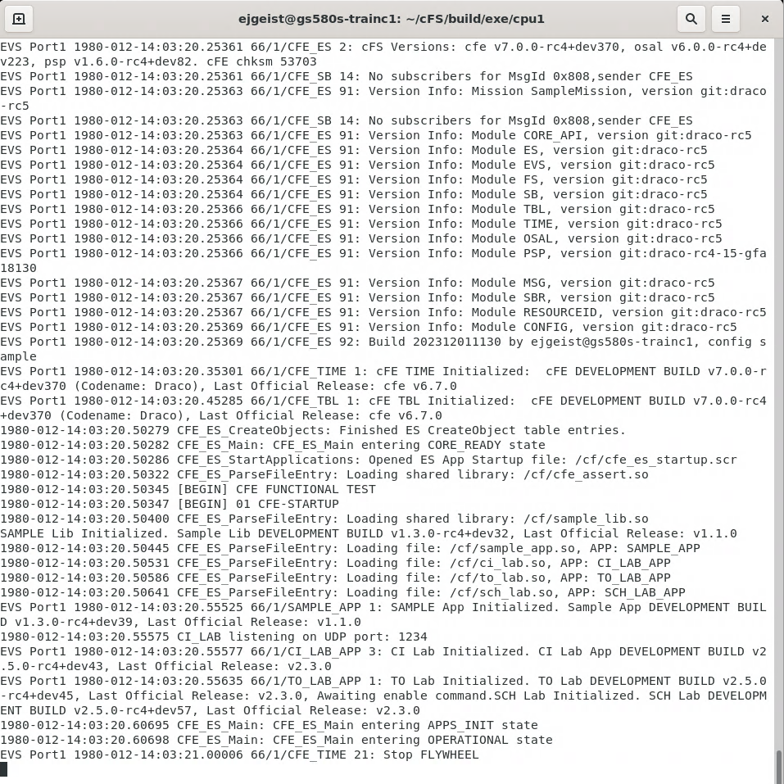
Exercise 1 Recap
Version info for each module
cFE
Services Initialized
CORE_READY

Slide 52
Core Flight System (cFS) Training
Module 2a: Executive Services

Slide 53
Course Agenda
Introduction
cFE Services
Executive Services
Software Bus
Event Services
Time Services
Table Services
Application Layer
cFS Applications
cFS Libraries

Slide 54
Executive Services - cFS Context
Development Tools
& Ground Systems
Python
Ground System
Application
Generator
Performance
Tools
Performance
Analyzer
Unit Tests
Build System
Application
CFDP
Checksum
Data Storage
File Manager
Housekeeping
Health/Safety
Limit Checker
Memory Dwell
Memory Mgr.
Scheduler
SB Network
Stored Cmds.
Core Flight
Executive
Core Flight Executive API
Core Flight Executive
Platform
Abstraction
OS Abstraction API
Platform Support Package API
RTEMS
VxWorks
Linux
Mcp750-VxWorks
RTOS / Boot
Real Time OS
Board Support Package
PROM Boot FSW
cFE Open Source Release
OSAL Open Source Release
Application Open Source Releases
3rd Party
Mission Developed

Slide 55
Executive Services (ES) – Overview
Initializes the cFE
Reports reset type
Maintains an exception-reset log across processor resets
Initializes cFE specific memory and RAM disk
Creates the application runtime environment
Primary interface to underlying operating system task services
Manages application resources
Starts cFE services (ES, EVS, TBL, SB, and TIME)
Starts initial applications according to cfe_es_startup.scr
Supports starting, stopping, and loading applications during runtime
Manages Memory
Provides a dynamic memory pool service
Provides Critical Data Stores (CDSs) that are preserved across processor resets

Slide 56
Executive Services - Context
Any cFS
Application
CFE_ES_*
API Calls
Software Bus (SB)
Communications
Non-SB
Communications
cFE
Executive
Services
cFS Application
Software
Scheduler
HK
Requests
Internal Software Module,
Library, or Data Store
File
External Entity or Data
Store (variable/table)

Slide 57
Executive Services - Boot Sequence
The Boot PROM boots the OS Kernel
Selects primary and secondary images based on flags and checksum validation
Copies OS image to RAM, optionally decompressing it
Jumps to the OS image in RAM
The OS kernel boots the cFE
Performs self – decompression (optional)
Initializes and mounts Non-Volatile File System
Starts up cFE
cFE boots cFE interface apps and mission components (C&DH, GNC, Science applications)
Creates/Attaches to Critical Data Store (CDS)
Creates/Attaches to RAM File System
Starts cFE services (ES, EVS, TBL, SB, & TIME)
Starts the applications based on cfe_es_startup.scr

Slide 58
Executive Services - Startup
From BSP
Startup
RAM
Initialize OS Data structures (task table, queues etc.)
Log entry
Exception and
Reset Log
Volatile
File System
Initialize File Systems
cFE Core
cFS App 1
Initialize Core
Applications*
Non-Volatile
File System
Initialize
cFE Apps and shared libraries (as specified in ES startup script)
Startup Script
And cFE Apps/Libs
cFE Applications
cFS App N
*Note:
Service initialization order: ES, EVS, SB, TIME, TBL
Service start order: EVS, SB, ES, TIME, TBL
Start
Multitasking
The cFE core is started as one unit. The cFE core can either be loaded by the OS or linked with the OS and loaded into Non-Volatile memory as a static executable.

Slide 59
Executive Services - Startup Script
The startup script is a text file, written by the user that contains a list of entries (one entry for each application)
Used by the ES application for automating the startup of applications.
ES application allows the use of a volatile and nonvolatile startup scripts. The project may utilize zero, one or two startup scripts.
Object Type | This is CFE_APP for an Application, CFE_LIB for a library.
Path/Filename | This is a cFE Virtual Filename, not a target OS device/pathname.
Entry Point | This is the name of the “main” function for the App.
CFE Name | This is the cFE name for the App or Library.
Priority | This is the Priority of the App, not used for a Library.
Stack Size | This is the Stack Size of the App, not used for a Library.
Load Address | This is the optional Load Address for the App or Library. It is currently not implemented and should always be 0x0.
Exception Action | This is the action the cFE should take if the App has an exception: 0 = Do a cFE Processor Reset Non-Zero = Restart the App

Slide 60
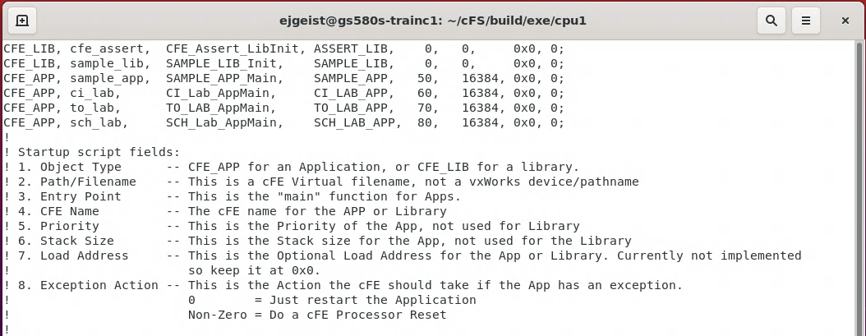
Executive Services – Example Script

Slide 61
Executive Services – Logs
Exception and Reset Log
Logs information related to resets and exceptions
System Log
cFE apps use this log when errors are encountered during initialization before the Event Services is fully initialized
Mission apps can also use it during initialization
Recommended that apps should register with event service immediately after registering with ES so app events are captured in the EVS log
Implemented as an array of bytes that has variable length strings produced by printf() type statements

Slide 62
Executive Services – Reset Behavior
Power-on Reset
Operating system loaded and started prior to cFE
Initializes file system
Critical data stores and logs cleared (initialized by hardware first)
ES starts each cFE service and then the mission applications
Processor Reset Preserves
File system
Critical Data Store (CDS)
ES System Log
ES Exception and Reset (ER) log
Performance Analysis data
ES Reset info (i.e. reset type, boot source, number of processor resets)
Time Data (i.e. MET, STCF, Leap Seconds)
A power-on reset will be performed after a configurable number of processor resets
Ground responsible for managing processor reset counter

Slide 63
Executive Services – Retrieving Onboard State
Telemetry
Housekeeping Status
Log file states, App, Resets, Performance Monitor, Heap Stats
Telemetry packets generated by command
Single App Information
Memory Pool Statistics Packet
Files generated by command
System Log
Exception-Reset Log
Performance Monitor
Critical Data Store Registry
All registered apps
All registered tasks

Slide 64
Executive Services - System Integration and App Development (1 of 2)
Child Tasks
Recommend creating during app initialization
Relative parent priority depends on child’s role
Performing lengthy process may be lower priority
Servicing short duration I/O may be higher priority
See CFE_ES_CreateChildTask documentation

Slide 65
Executive Services - System Integration and App Development (2 of 2)
Query startup type (Power On vs Processor)
Not commonly used since CDS performs data preservation
Critical Data Store (CDS)
E.g. Data Storage maintains open file management data in a CDS
Typical code idiom in app’s initialization
Result = CFE_ES_RegisterCDS()
if (Result == CFE_SUCCESS)
Populate CDS
else if (Result == CFE_ES_CDS_ALREADY_EXISTS)
Restore CDS data
… Continually update CDS as application executes
Memory Pool
Ideally apps would allocate memory pools during initialization but there aren’t any restrictions
cFE Examples: Software Bus, Tables, and Events
App Examples: CFDP and Housekeeping

Slide 66
Executive Services – APIs (1 of 6)
Resource ID APIs | Purpose
CFE_ES_AppID_ToIndex | Calculates a zero-based integer value that may be used for indexing into a local resource table/array.
CFE_ES_LibID_ToIndex | Calculates a zero-based integer value that may be used for indexing into a local resource table/array.
CFE_ES_TaskID_ToIndex | Calculates a zero-based integer value that may be used for indexing into a local resource table/array.
CFE_ES_CounterID_ToIndex | Calculates a zero-based integer value that may be used for indexing into a local resource table/array.
Entry/Exit APIs | Purpose
CFE_ES_Main | This is the entry point into the cFE software (not intended to be called by user).
CFE_ES_ResetCFE | This API causes an immediate reset of the cFE Kernel and all cFE Applications.
Application Control APIs | Purpose
CFE_ES_RestartApp | This API causes a cFE Application to be unloaded and restarted from the same file as the last start.
CFE_ES_ReloadApp | This API causes a cFE Application to be stopped and restarted from the specified file.
CFE_ES_DeleteApp | This API causes a cFE Application to be stopped deleted.

Slide 67
Executive Services – APIs (2 of 6)
App Behavior APIs | Purpose
CFE_ES_ExitApp | This API is the "Exit Point" for the cFE application
CFE_ES_RunLoop | This is the API that allows an app to check for exit requests from the system, or request shutdown from the system.
CFE_ES_WaitForSystemState | Allow an Application to Wait for a minimum global system state
CFE_ES_WaitForStartupSync | Allow an Application to Wait for the "OPERATIONAL" global system state
CFE_ES_IncrementTaskCounter | Increments the execution counter for the calling task
Child Task APIs | Purpose
CFE_ES_CreateChildTask | Creates a new task under an existing Application
CFE_ES_GetTaskIDByName | Get a Task ID associated with a specified Task name
CFE_ES_GetTaskName | Get a Task name for a specified Task ID
CFE_ES_DeleteChildTask | Deletes a task under an existing Application
CFE_ES_ExitChildTask | Exits a child task

Slide 68
Executive Services – APIs (3 of 6)
cFE Information APIs | Purpose
CFE_ES_GetResetType | Return the most recent Reset Type
CFE_ES_GetAppID | Get an Application ID for the calling Application
CFE_ES_GetTaskID | Get the task ID of the calling context
CFE_ES_GetAppIDByName | Get an Application ID associated with a specified Application name
CFE_ES_GetLibIDByName | Get a Library ID associated with a specified Library name
CFE_ES_GetAppName | Get an Application name for a specified Application ID
CFE_ES_GetLibName | Get a Library name for a specified Library ID
CFE_ES_GetAppInfo | Get Application Information given a specified App ID
CFE_ES_GetTaskInfo | Get Task Information given a specified Task ID
CFE_ES_GetLibInfo | Get Library Information given a specified Resource ID
CFE_ES_GetModuleInfo | Get Information given a specified Resource ID

Slide 69
Executive Services – APIs (4 of 6)
Miscellaneous APIs | Purpose
CFE_ES_BackgroundWakeup | Wakes up the CFE background task
CFE_ES_WriteToSysLog | Write a string to the cFE System Log
CFE_ES_CalculateCRC | Calculate a CRC on a block of memory
CFE_ES_ProcessAsyncEvent | Notification that an asynchronous event was detected by the underlying OS/PSP
Critical Data Store APIs | Purpose
CFE_ES_RegisterCDS | Reserve space (or re-obtain previously reserved space) in the Critical Data Store (CDS)
CFE_ES_GetCDSBlockIDByName | Get a CDS Block ID associated with a specified CDS Block name
CFE_ES_GetCDSBlockName | Get a Block name for a specified Block ID
CFE_ES_CopyToCDS | Save a block of data in the Critical Data Store (CDS)
CFE_ES_RestoreFromCDS | Recover a block of data from the Critical Data Store (CDS)

Slide 70
Executive Services – APIs (5 of 6)
Memory Manager APIs | Purpose
CFE_ES_PoolCreateNoSem | Initializes a memory pool created by an application without using a semaphore during processing.
CFE_ES_PoolCreate | Initializes a memory pool created by an application while using a semaphore during processing.
CFE_ES_PoolCreateEx | Initializes a memory pool created by an application with application specified block sizes.
CFE_ES_PoolDelete | Deletes a memory pool that was previously created
CFE_ES_GetPoolBuf | Gets a buffer from the memory pool created by #CFE_ES_PoolCreate or #CFE_ES_PoolCreateNoSem
CFE_ES_GetPoolBufInfo | Gets info on a buffer previously allocated via #CFE_ES_GetPoolBuf
CFE_ES_PutPoolBuf | Releases a buffer from the memory pool that was previously allocated via #CFE_ES_GetPoolBuf
CFE_ES_GetMemPoolStats | Extracts the statistics maintained by the memory pool software
Performance Monitor APIs | Purpose
CFE_ES_PerfLogEntry | Entry marker for use with Software Performance Analysis Tool.
CFE_ES_PerfLogExit | Exit marker for use with Software Performance Analysis Tool.
CFE_ES_PerfLogAdd | Adds a new entry to the data buffer

Slide 71
Executive Services – APIs (6 of 6)
Generic Counter APIs | Purpose
CFE_ES_RegisterGenCounter | This routine registers a generic thread-safe counter which can be used for inter-task management.
CFE_ES_DeleteGenCounter | This routine deletes a previously registered generic counter.
CFE_ES_IncrementGenCounter | This routine increments the specified generic counter.
CFE_ES_SetGenCount | This routine sets the specified generic counter to the specified value.
CFE_ES_GetGenCount | This routine gets the value of a generic counter.
CFE_ES_GetGenCounterIDByName | Get the Id associated with a generic counter name
CFE_ES_GetGenCounterName | Get a Counter name for a specified Counter ID

Slide 72
A Note on Resource IDs
Resource IDs are implemented as a separate module
Resource IDs increase the type safety of cFE
ES uses several Resource IDs extensively in its API calls:
CFE_ES_AppId_t
CFE_ES_LibId_t
CFE_ES_TaskId_t
CFE_ES_CounterId_t
The ResourceID module provides utility functions to compare IDs and convert between integer types and ResourceIDs

Slide 73
Executive Services – Command List
Command List | Purpose
CFE_ES_StartPerfDataCmd | Start performance data
CFE_ES_StopPerfDataCmd | Stop performance data
CFE_ES_SetPerfFilterMaskCmd | Set performance filter mask
CFE_ES_SetPerfTriggerMaskCmd | Set performance trigger mask
CFE_ES_HousekeepingCmd | On-board command (HK request)
CFE_ES_NoopCmd | ES task ground command (NO-OP)
CFE_ES_ResetCountersCmd | ES task ground command (reset counters)
CFE_ES_RestartCmd | Restart cFE (may reset processor)
CFE_ES_StartAppCmd | Load (and start) single application
CFE_ES_StopAppCmd | Stop single application
CFE_ES_RestartAppCmd | Restart a single application
CFE_ES_ReloadAppCmd | Reload a single application
CFE_ES_QueryOneCmd | Request tlm packet with single app data
CFE_ES_QueryAllCmd | Write all app data to file
CFE_ES_QueryAllTasksCmd | Write all Task Data to a file
CFE_ES_ClearSyslogCmd | Clear executive services system log
CFE_ES_OverWriteSyslogCmd | Set syslog mode
CFE_ES_WriteSyslogCmd | Process Cmd to write ES System Log to file
CFE_ES_ClearERLogCmd | Clear The exception and reset log
CFE_ES_WriteERLogCmd | Process Cmd to write exception & reset log to a file
CFE_ES_VerifyCmdLength | Verify command packet length
CFE_ES_ResetPRCountCmd | ES task ground command (Processor Reset Count)
CFE_ES_SetMaxPRCountCmd | Set Maximum Processor reset count
CFE_ES_DeleteCDSCmd | Delete Specified Critical Data Store
CFE_ES_SendMemPoolStatsCmd | Telemeter Memory Pool Statistics
CFE_ES_DumpCDSRegistryCmd | Dump CDS Registry to a file

Slide 74
Executive Services – Platform Configuration Parameters
Parameter List | Purpose
CFE_PLATFORM_ES_MAX_APPLICATIONS | Max Number of Applications
CFE_PLATFORM_ES_MAX_LIBRARIES | Max Number of Shared libraries
CFE_PLATFORM_ES_ER_LOG_ENTRIES | Max Number of ER (Exception and Reset) log entries
CFE_PLATFORM_ES_ER_LOG_MAX_CONTEXT_SIZE | Maximum size of CPU Context in ES Error Log
CFE_PLATFORM_ES_SYSTEM_LOG_SIZE | Size of the cFE System Log
CFE_PLATFORM_ES_OBJECT_TABLE_SIZE | Number of entries in the ES Object table
CFE_PLATFORM_ES_MAX_GEN_COUNTERS | Max Number of Generic Counters
CFE_PLATFORM_ES_APP_SCAN_RATE | ES Application Control Scan Rate
CFE_PLATFORM_ES_APP_KILL_TIMEOUT | ES Application Kill Timeout
CFE_PLATFORM_ES_RAM_DISK_SECTOR_SIZE | ES Ram Disk Sector Size
CFE_PLATFORM_ES_RAM_DISK_NUM_SECTORS | ES Ram Disk Number of Sectors
CFE_PLATFORM_ES_RAM_DISK_PERCENT_RESERVED | Percentage of Ram Disk Reserved for Decompressing Apps
CFE_PLATFORM_ES_RAM_DISK_MOUNT_STRING | RAM Disk Mount string
CFE_PLATFORM_ES_CDS_SIZE | Critical Data Store Size
CFE_PLATFORM_ES_USER_RESERVED_SIZE | User Reserved Memory Size
CFE_PLATFORM_ES_RESET_AREA_SIZE | ES Reset Area Size
CFE_PLATFORM_ES_NONVOL_STARTUP_FILE | ES Nonvolatile Startup Filename
CFE_PLATFORM_ES_NONVOL_DISK_MOUNT_STRING | Default virtual path for persistent storage
CFE_PLATFORM_ES_VOLATILE_STARTUP_FILE | ES Volatile Startup Filename
CFE_PLATFORM_ES_DEFAULT_APP_LOG_FILE | Default Application Information Filename
CFE_PLATFORM_ES_DEFAULT_TASK_LOG_FILE | Default Application Task Information Filename
CFE_PLATFORM_ES_DEFAULT_SYSLOG_FILE | Default System Log Filename
CFE_PLATFORM_ES_DEFAULT_ER_LOG_FILE | Default Exception and Reset (ER) Log Filename
CFE_PLATFORM_ES_DEFAULT_PERF_DUMP_FILENAME | Default Performance Data Filename
CFE_PLATFORM_ES_DEFAULT_CDS_REG_DUMP_FILE | Default Critical Data Store Registry Filename
CFE_PLATFORM_ES_DEFAULT_POR_SYSLOG_MODE | Default System Log Mode following Power On Reset

Slide 75
Executive Services – Platform Configuration Parameters
Command List | Purpose
CFE_PLATFORM_ES_DEFAULT_PR_SYSLOG_MODE | Default System Log Mode following Processor Reset
CFE_PLATFORM_ES_PERF_DATA_BUFFER_SIZE | Max Size of Performance Data Buffer
CFE_PLATFORM_ES_PERF_FILTMASK_NONE | Filter Mask Setting for Disabling All Performance Entries
CFE_PLATFORM_ES_PERF_FILTMASK_ALL | Filter Mask Setting for Enabling All Performance Entries
CFE_PLATFORM_ES_PERF_FILTMASK_INIT | Default Filter Mask Setting for Performance Data Buffer
CFE_PLATFORM_ES_PERF_TRIGMASK_NONE | Default Filter Trigger Setting for Disabling All Performance Entries
CFE_PLATFORM_ES_PERF_TRIGMASK_ALL | Filter Trigger Setting for Enabling All Performance Entries
CFE_PLATFORM_ES_PERF_TRIGMASK_INIT | Default Filter Trigger Setting for Performance Data Buffer
CFE_PLATFORM_ES_PERF_CHILD_PRIORITY | Performance Analyzer Child Task Priority
CFE_PLATFORM_ES_PERF_CHILD_STACK_SIZE | Performance Analyzer Child Task Stack Size
CFE_PLATFORM_ES_PERF_CHILD_MS_DELAY | Performance Analyzer Child Task Delay
CFE_PLATFORM_ES_PERF_ENTRIES_BTWN_DLYS | Performance Analyzer Child Task Number of Entries Between Delay
CFE_PLATFORM_ES_DEFAULT_STACK_SIZE | Default Stack Size for an Application
CFE_PLATFORM_ES_START_TASK_PRIORITY | ES Task Priority
CFE_PLATFORM_ES_START_TASK_STACK_SIZE | ES Task Stack Size
CFE_PLATFORM_ES_CDS_MAX_NUM_ENTRIES | Maximum Number of Registered CDS Blocks
CFE_PLATFORM_ES_MAX_PROCESSOR_RESETS | Number of Processor Resets Before a Power On Reset
CFE_PLATFORM_ES_MEMPOOL_ALIGN_SIZE_MIN | Define Memory Pool Alignment Size
CFE_PLATFORM_ES_POOL_MAX_BUCKETS | Maximum number of block sizes in pool structures
CFE_PLATFORM_ES_MAX_MEMORY_POOLS | Maximum number of memory pools
CFE_PLATFORM_ES_STARTUP_SYNC_POLL_MSEC | Poll timer for startup sync delay
CFE_PLATFORM_ES_STARTUP_SCRIPT_TIMEOUT_MSEC | Startup script timeout

Slide 76
Executive Services – Platform Configuration Parameters
Command List | Purpose
CFE_PLATFORM_ES_MEM_BLOCK_SIZE[01-16] | Default ES Memory Pool Block Sizes
CFE_PLATFORM_ES_MEM_MAX_BLOCK_SIZE | Default ES Memory Pool Block Sizes
CFE_PLATFORM_CDS_MEM_BLOCK_SIZE[01-16] | ES Critical Data Store Memory Pool Block Sizes
CFE_PLATFORM_CDS_MEM_MAX_BLOCK_SIZE | ES Critical Data Store Memory Pool Block Sizes

Slide 77
Executive Services – Mission Configuration Parameters
Parameter List | Purpose
CFE_MISSION_ES_CDS_MAX_NAME_LENGTH | Maximum Length of CDS Name
CFE_MISSION_ES_DEFAULT_CRC | Mission Default CRC algorithm
CFE_MISSION_ES_MAX_APPLICATIONS | Mission Max Apps in a message
CFE_MISSION_ES_PERF_MAX_IDS | Define Max Number of Performance IDs for messages
CFE_MISSION_ES_POOL_MAX_BUCKETS | Maximum number of block sizes in pool structures
CFE_MISSION_ES_CDS_MAX_FULL_NAME_LEN | Maximum Length of Full CDS Name in messages

Slide 78
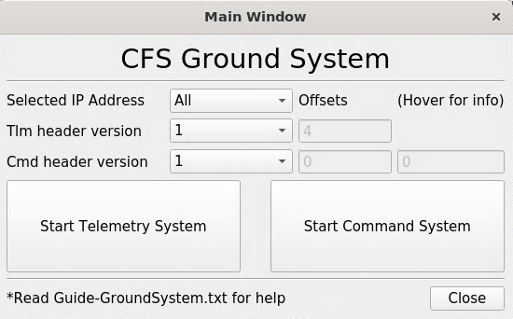
Exercise 2 - Command cFE Executive Service
Part 1 – Start the Ground System
The cFS-GroundSystem tool can be used to send commands and receive telemetry (see https://github.com/nasa/cFS-GroundSystem/tree/master/Guide-GroundSystem.txt, the Guide-GroundSystem.txt). Note it depends on PyQt5 and PyZMQ:
1. Ensure that cFE is running
2. Open a new terminal
3. Compile cmdUtil and start the ground system executable
cd ~/cFS/tools/cFS-GroundSystem/Subsystems/cmdUtil
make
cd ../..
python3 GroundSystem.py
4. Select "Start Command System"
4

Slide 79
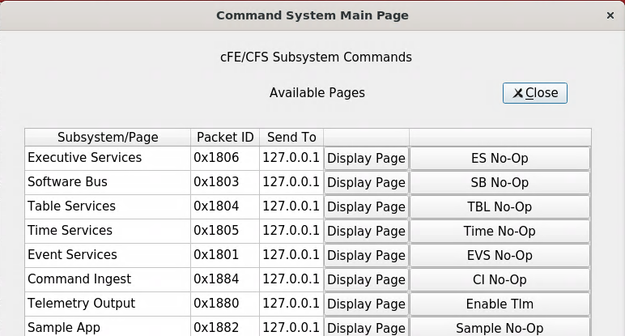
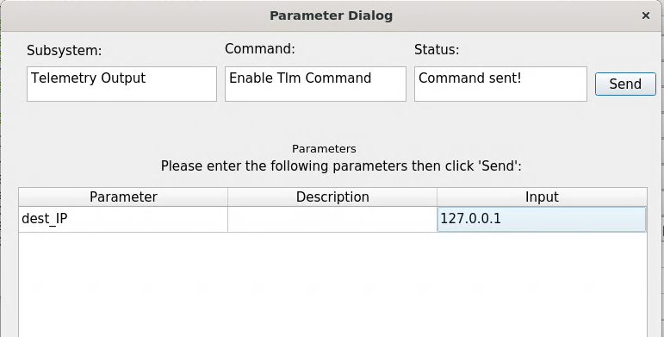
Exercise 2 - Command cFE Executive Service
5
Part 1 Continued
5. Select "Enable Tlm"
6. Enter IP address of system executing cFS (127.0.0.1 if running locally) into the "Input" field and click "Send"
7. In the original ground system window, select
"Start Telemetry System"
**At this point, telemetry should be visible in the ground system**
6
7

Slide 80
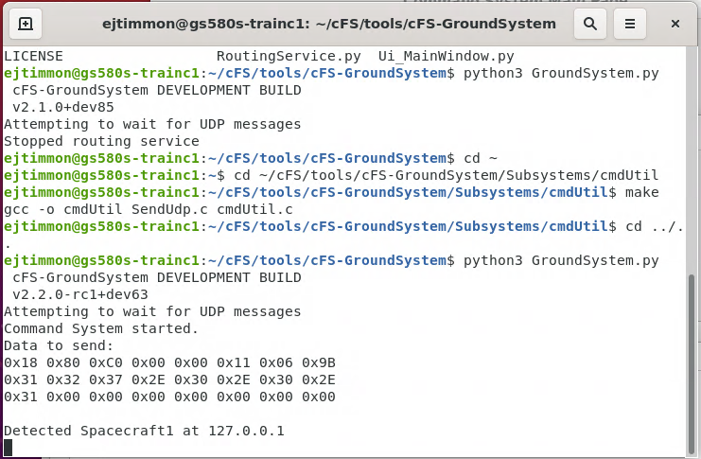
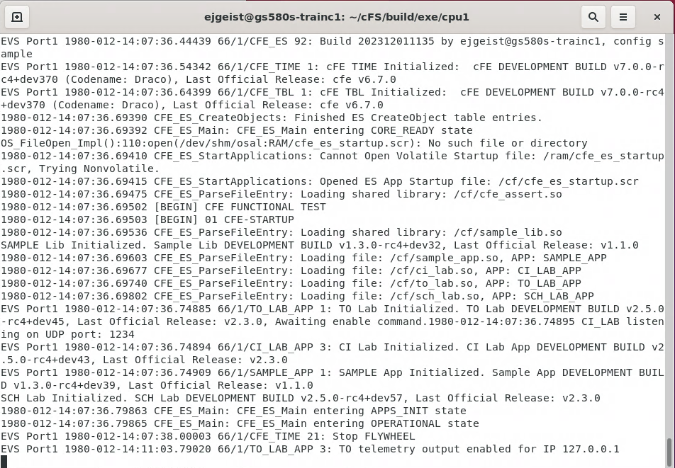
Exercise 2 – Part 1 Recap
Python GUI Terminal Window
cFS Terminal
Window

Slide 81
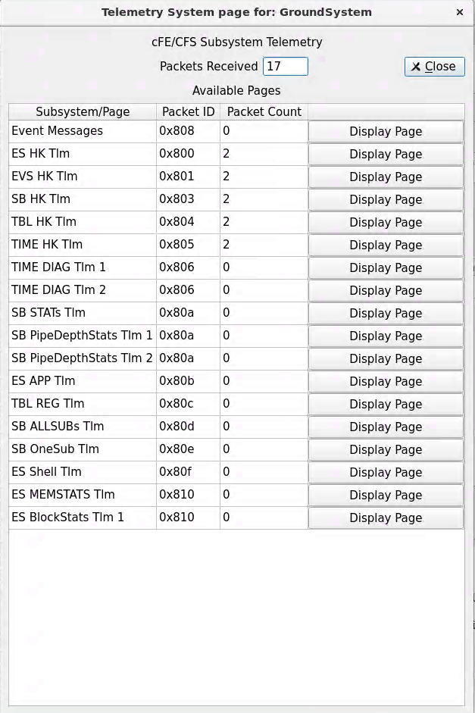
Exercise 2 – Part 1 Recap
After Step 7, cFE housekeeping packet counts should start incrementing

Slide 82
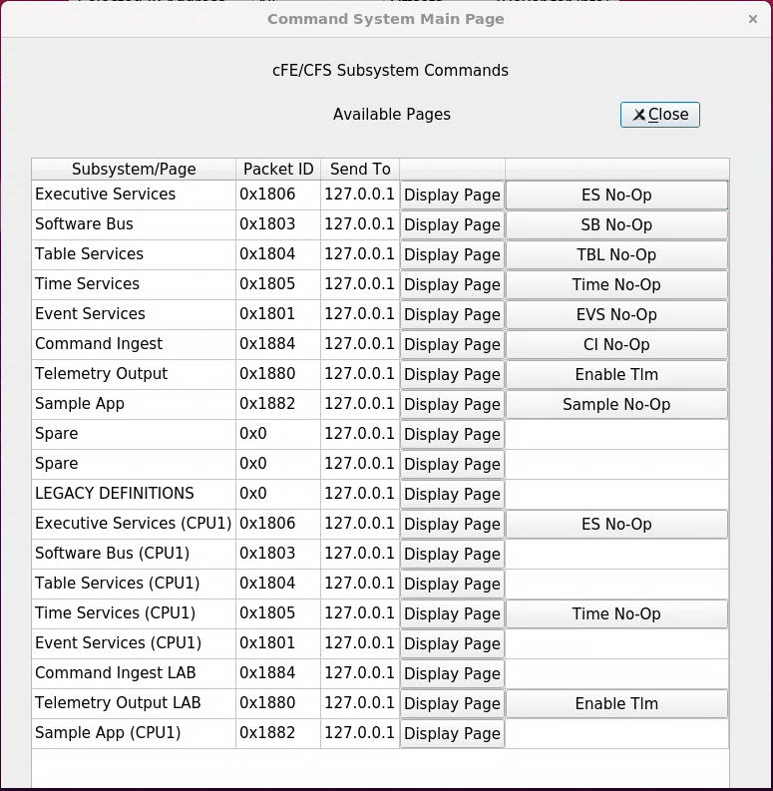
Exercise 2 - Command cFE Executive Service
Part 2 – Command Executive Services
Send a No-Op Command
1. On the Command System Main Page, select "ES No-Op".
A no-op message should appear in the cFS screen.
Restart an application
2. On the Command System Main Page, click the "Display Page" button beside "Executive Services CPU1".
2
1

Slide 83
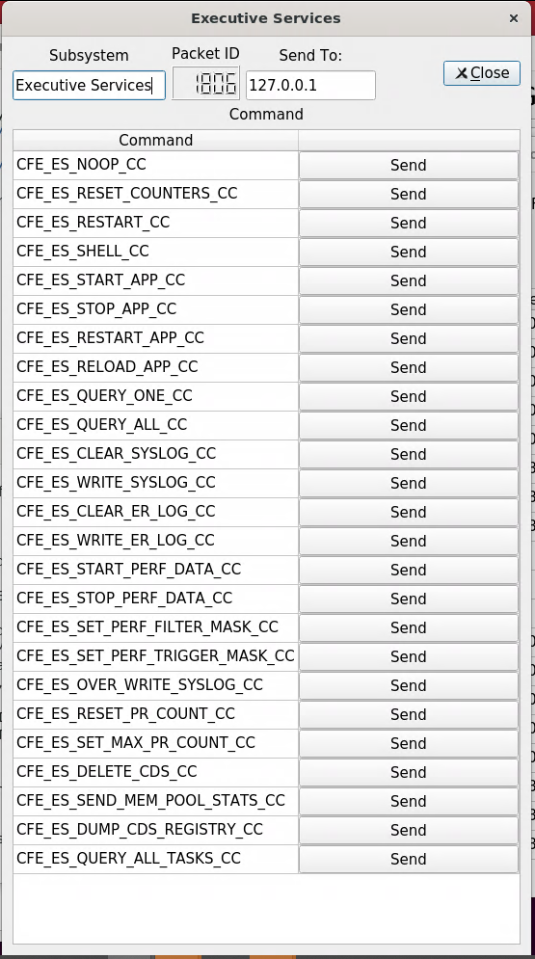
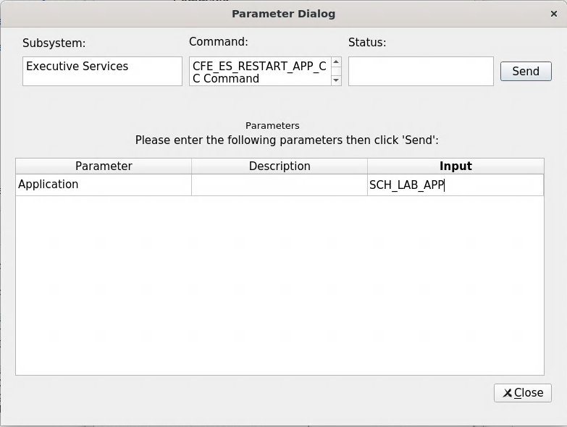
Exercise 2 - Command cFE Executive Service
Part 2 – Command Executive Services - Continued
3. Click the "Send" button beside “CFE_ES_RESTART_APP_CC".
4. Enter "SCH_LAB_APP" in the "Input" field.
5. Click "Send".
**NOTE: "SCH_LAB_APP" is the cFE name specified for one of the apps in the cfe_es_startup.scr file. Many cFE ES commands require the cFE name of an application or library as a parameter**
3
5
4

Slide 84
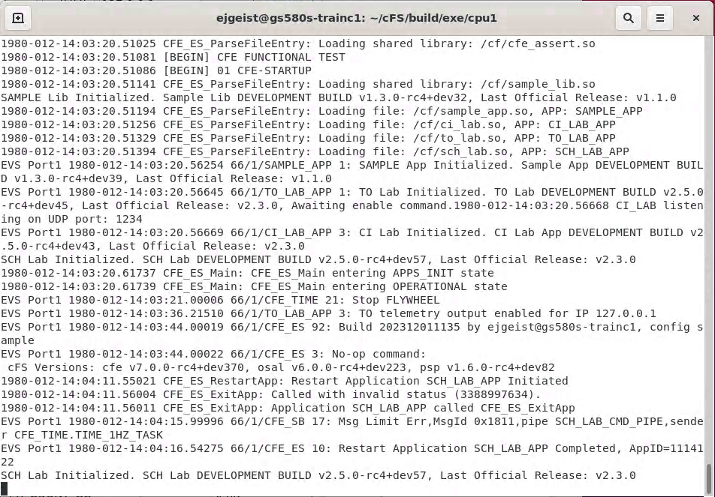
Exercise 2 Part 2 Recap
ES No-Op Command
ES Restart App Command

Slide 85
Core Flight System (cFS) Training
Module 2b: Software Bus Services

Slide 86
Course Agenda
Introduction
cFE Services
Executive Services
Software Bus
Event Services
Time Services
Table Services
Application Layer
cFS Applications
cFS Libraries

Slide 87
Software Bus - cFS Context
Development Tools
& Ground Systems
Python
Ground System
Application
Generator
Performance
Tools
Performance
Analyzer
Unit Tests
Build System
Application
CFDP
Checksum
Data Storage
File Manager
Housekeeping
Health/Safety
Limit Checker
Memory Dwell
Memory Mgr.
Scheduler
SB Network
Stored Cmds.
Core Flight
Executive
Core Flight Executive API
Core Flight Executive
Platform
Abstraction
OS Abstraction API
Platform Support Package API
RTEMS
VxWorks
Linux
Mcp750-VxWorks
RTOS / Boot
Real Time OS
Board Support Package
PROM Boot FSW
cFE Open Source Release
OSAL Open Source Release
Application Open Source Releases
3rd Party
Mission Developed

Slide 88
Software Bus (SB) Services - Overview
Provides a portable inter-application message service using a publish/subscribe model
Routes messages to all applications that have subscribed to the message (i.e., broadcast model)
Subscribing is done at application startup
Message routing can be added/removed at runtime
Sender does not know who subscribes (i.e., connectionless)
Reports errors detected during transfer of messages
Outputs Statistics Packet and the Routing Information when commanded

Slide 89
Software Bus - Context
Sending
cFS
App
CFE_SB_TransmitMsg()
Software Bus (SB)
Communications
Non-SB
Communications
cFE
Software Bus
HK
Requests
cFS Application
Software
Scheduler
Receiving
cFS
App(s)
CFE_SB_ReceiveBuffer()
Internal Software Module,
Library, or Data Store
File
External Entity or Data
Store (variable/table)

Slide 90
Software Bus Terms
Pipe – Destination to which SB Messages are sent; queues that can hold SB Messages until they are read out and processed
Message – A collection of data treated as a single entity
Buffer – The generic piece of data moved on the Software Bus
Alignment is enforced at the buffer level
In general, applications receive buffers and cast them to a specific message type to use them

Slide 91
Software Bus and Message Module
cFE SB handles the routing of messages
cFE Message Module handles the definition and parsing of individual messages

Slide 92
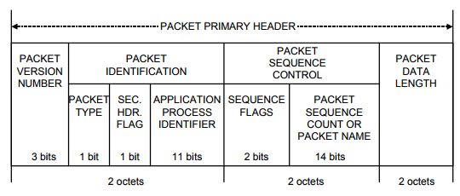
Software Bus – Messages (1 of 2)
Messages are routed by a “MessageID”
This should always be treated as opaque – applications should not try to directly access the fields of a MessageID
By default, the Message Module provides two implementations (MISSION_MSG_V1 and MISSION_MSG_V2)
MISSION_MSG_V1 maps directly to the CCSDS Stream ID
CCSDS Primary Header (Always big endian)

Slide 93
Software Bus – Messages (2 of 2)
CCSDS Command Packets
Secondary packet header contains a command function code
cFS apps typically define a single command packet and use the function code to dispatch a command processing function
Commands can originate from the ground or from onboard applications
CCSDS Telemetry Packets
Secondary packet header contains a time stamp of when the data was produced
Telemetry is sent on the software bus by apps and can be ingested by other apps, stored onboard and sent to the ground

Slide 94
Software Bus – Message Formats
Message formats are defined in the Message Module, along with functions to access message header fields (CFE_MSG_GetApId, CFE_MSG_GetSequenceCount, etc.)
union CFE_MSG_Message {
CCSDS_SpacePacket_t CCSDS;
uint8 Byte[sizeof(CCSDS_SpacePacket_t)];
}
struct CFE_MSG_CommandHeader {
CFE_MSG_Message_t Msg;
CFE_MSG_CommandSecondaryHeader_t Sec;
}
struct CFE_MSG_TelemetryHeader {
CFE_MSG_Message_t Msg;
CFE_MSG_TelemetrySecondaryHeader_t Sec;
uint8 Spare[4];
}

Slide 95
Software Bus – Reset Behavior
No data is preserved for either a Power-On or Processor Reset
All routing is reestablished as applications create pipes and subscribe to messages
Any packet in transit at the time of the reset is discarded
All packet sequence counters reset to 1

Slide 96
Software Bus – Retrieving Onboard State
Telemetry
Housekeeping Status
Counters (No subscribers, send errors, pipe overflows, etc.), Memory Stats
Telemetry packets generated by command
Statistics
Subscription Report
Files generated by command
Routing Info
Pipe Info
Message ID to Route

Slide 97
Software Bus - System Integration
Message IDs should be unique across the system if possible
The software bus places no restrictions on who can send or receive messages
One-to-one
One-to-many
Many-to-one
Many-to-many
The Software Bus Network is a separate application that can be used to extend the software bus across multiple processors

Slide 98
Software Bus – App Development (1 of 2)
Apps must create a pipe to receive messages
Apps can create multiple pipes if necessary
Apps must subscribe to each individual message ID they want to receive
Apps typically subscribe to at least 2 MIDs: one for housekeeping requests and one for commands
Commands are typically grouped under a single MID with multiple command codes
Apps can subscribe and unsubscribe to messages at any time
Sending Messages:
Receiving Messages:
CFE_MSG_Init
CFE_MSG_SetFcnCode
CFE_SB_TransmitMsg
CFE_SB_TimeStampMsg
CFE_SB_CreatePipe
CFE_SB_Subscribe
CFE_SB_ReceiveBuffer

Slide 99
Software Bus – App Development (2 of 2)
Must first subscribe to messages
To receive messages, can pend or poll using the TimeOut parameter
CFE_Status_t CFE_SB_ReceiveBuffer(CFE_SB_Buffer_t **BufPtr,
CFE_SB_PipeId_t PipeId,
int32 TimeOut);
Function | Purpose
CFE_SB_Subscribe | Subscribes to the message ID using default parameters for Quality of Service and Message Limit
CFE_SB_SubscribeEx | Subscribes to the message ID specifying custom parameters for Quality of Service and Message Limit

Slide 100
cFE Software Bus APIs
Pipe Management APIs | Purpose
CFE_SB_CreatePipe | Creates a new software bus pipe.
CFE_SB_DeletePipe | Delete a software bus pipe.
CFE_SB_PipeId_ToIndex | Obtain an index value correlating to an SB Pipe ID
CFE_SB_SetPipeOpts | Set options on a pipe.
CFE_SB_GetPipeOpts | Get options on a pipe.
CFE_SB_GetPipeName | Get the pipe name for a given id.
CFE_SB_GetPipeIdByName | Get pipe id by pipe name.
Message Subscription Control APIs | Purpose
CFE_SB_SubscribeEx | Subscribe to a message on the software bus
CFE_SB_Subscribe | Subscribe to a message on the software bus with default parameters
CFE_SB_SubscribeLocal | Subscribe to a message while keeping the request local to a CPU
CFE_SB_Unsubscribe | Remove a subscription to a message on the software bus
CFE_SB_UnsubscribeLocal | Remove a subscription to a message on the software bus on the current CPU

Slide 101
cFE Software Bus APIs
Send/Receive Message APIs | Purpose
CFE_SB_TransmitMsg | Transmit a message
CFE_SB_ReceiveBuffer | Receive a message from a software bus pipe
Zero Copy APIs | Purpose
CFE_SB_AllocateMessageBuffer | Get a buffer pointer to use for "zero copy" SB sends.
CFE_SB_ReleaseMessageBuffer | Release an unused "zero copy" buffer pointer.
CFE_SB_TransmitBuffer | Transmit a buffer
Message Characteristics APIs | Purpose
CFE_SB_SetUserDataLength | Sets the length of user data in a software bus message.
CFE_SB_TimeStampMsg | Sets the time field in a software bus message with the current spacecraft time.
CFE_SB_MessageStringSet | Copies a string into a software bus message
CFE_SB_GetUserData | Get a pointer to the user data portion of a software bus message.
CFE_SB_GetUserDataLength | Gets the length of user data in a software bus message.
CFE_SB_MessageStringGet | Copies a string out of a software bus message

Slide 102
cFE Software Bus APIs
Message ID APIs | Purpose
CFE_SB_IsValidMsgId | Identifies whether a given CFE_SB_MsgId_t is valid
CFE_SB_MsgId_Equal | Identifies whether two #CFE_SB_MsgId_t values are equal
CFE_SB_MsgIdToValue | Converts a #CFE_SB_MsgId_t to a normal integer
CFE_SB_ValueToMsgId | Converts a normal integer into a #CFE_SB_MsgId_t

Slide 103
cFE Message Module APIs
Generic Message APIs | Purpose
CFE_MSG_Init | Initialize a message
Message Primary Header APIs | Purpose
CFE_MSG_GetSize | Gets the total size of a message.
CFE_MSG_SetSize | Sets the total size of a message.
CFE_MSG_GetType | Gets the message type.
CFE_MSG_SetType | Sets the message type.
CFE_MSG_GetHeaderVersion | Gets the message header version.
CFE_MSG_SetHeaderVersion | Sets the message header version.
CFE_MSG_GetHasSecondaryHeader | Gets the message secondary header boolean
CFE_MSG_SetHasSecondaryHeader | Sets the message secondary header boolean
CFE_MSG_GetApId | Gets the message application ID
CFE_MSG_SetApId | Sets the message application ID
CFE_MSG_GetSegmentationFlag | Gets the message segmentation flag
CFE_MSG_SetSegmentationFlag | Sets the message segmentation flag
CFE_MSG_GetSequenceCount | Gets the message sequence count
CFE_MSG_SetSequenceCount | Sets the message sequence count
CFE_MSG_GetNextSequenceCount | Gets the next sequence count value (rolls over if appropriate)

Slide 104
cFE Message Module APIs
Message Extended Header APIs | Purpose
CFE_MSG_GetEDSVersion | Gets the message EDS version
CFE_MSG_SetEDSVersion | Sets the message EDS version
CFE_MSG_GetEndian | Gets the message endian
CFE_MSG_SetEndian | Sets the message endian
CFE_MSG_GetPlaybackFlag | Gets the message playback flag
CFE_MSG_SetPlaybackFlag | Sets the message playback flag
CFE_MSG_GetSubsystem | Gets the message subsystem
CFE_MSG_SetSubsystem | Sets the message subsystem
CFE_MSG_GetSystem | Gets the message system
CFE_MSG_SetSystem | Sets the message system
Message Secondary Header APIs | Purpose
CFE_MSG_GenerateChecksum | Calculates and sets the checksum of a message
CFE_MSG_ValidateChecksum | Validates the checksum of a message.
CFE_MSG_SetFcnCode | Sets the function code field in a message.
CFE_MSG_GetFcnCode | Gets the function code field from a message.
CFE_MSG_GetMsgTime | Gets the time field from a message.
CFE_MSG_SetMsgTime | Sets the time field in a message.

Slide 105
cFE Message Module APIs
Message Id APIs | Purpose
CFE_MSG_GetMsgId | Gets the message id from a message.
CFE_MSG_SetMsgId | Sets the message id bits in a message.
CFE_MSG_GetTypeFromMsgId | Gets message type using message ID

Slide 106
cFE Software Bus Command List
SB Command List | Purpose
CFE_SB_NoopCmd | Software Bus No-Op
CFE_SB_ResetCountersCmd | Resets counters in the Software Bus housekeeping telemetry
CFE_SB_EnableSubReportingCmd | Enable Subscription Reporting Command
CFE_SB_DisableSubReportingCmd | Disable Subscription Reporting Command
CFE_SB_SendHKTlmCmd | Function to send the SB housekeeping packet
CFE_SB_EnableRouteCmd | Enable Software Bus Route
CFE_SB_DisableRouteCmd | Disable Software Bus Route
CFE_SB_SendStatsCmd | Send Software Bus Statistics
CFE_SB_WriteRoutingInfoCmd | Write Software Bus Routing Info to a File
CFE_SB_WritePipeInfoCmd | Write Pipe Info to a File
CFE_SB_WriteMapInfoCmd | Write Map Info to a File
CFE_SB_SendPrevSubsCmd | Generates a series of packets that contain information regarding all subscriptions previously received by SB.

Slide 107
Software Bus – Platform Configuration Parameters
Parameter | Purpose
CFE_PLATFORM_SB_MAX_MSG_IDS | Maximum Number of Unique Message IDs SB Routing Table can hold
CFE_PLATFORM_SB_MAX_PIPES | Maximum Number of Unique Pipes SB Routing Table can hold
CFE_PLATFORM_SB_MAX_DEST_PER_PKT | Maximum Number of unique local destinations a single MsgId can have
CFE_PLATFORM_SB_DEFAULT_MSG_LIMIT | Default Subscription Message Limit
CFE_PLATFORM_SB_BUF_MEMORY_BYTES | Size of the SB buffer memory pool
CFE_PLATFORM_SB_HIGHEST_VALID_MSGID | Highest Valid Message Id
CFE_PLATFORM_SB_DEFAULT_ROUTING_FILENAME | Default Routing Information Filename
CFE_PLATFORM_SB_DEFAULT_PIPE_FILENAME | Default Pipe Information Filename
CFE_PLATFORM_SB_DEFAULT_MAP_FILENAME | Default Message Map Filename
CFE_PLATFORM_SB_FILTERED_EVENT[1-8] | SB Event Filtering
CFE_PLATFORM_SB_FILTER_MASK[1-8] | SB Event Filtering Mask
CFE_PLATFORM_SB_MEM_BLOCK_SIZE_[01-16] | Define SB Memory Pool Block Sizes
CFE_PLATFORM_SB_MAX_BLOCK_SIZE | Defines Max SB Memory Pool Block Size
CFE_PLATFORM_SB_START_TASK_PRIORITY | SB Task Priority
CFE_PLATFORM_SB_START_TASK_STACK_SIZE | SB Task Stack Size

Slide 108
Software Bus – Mission Configuration Parameters
Parameter | Purpose
CFE_MISSION_SB_MAX_SB_MSG_SIZE | Maximum SB Message Size
CFE_MISSION_SB_MAX_PIPES | Maximum Number of pipes that SB command/telemetry messages may hold

Slide 109
Exercise 3 - Command cFE Software Bus
Part 1 – Send a No-Op Command
1. Ensure that cFE is running
2. Open a new terminal
3. Start the ground system executable (as in Exercise 2)
4. Enable Telemetry (as in Exercise 2)
5. Send an SB No-Op command
Click the “SB No-Op" button beside "Software Bus"
5

Slide 110
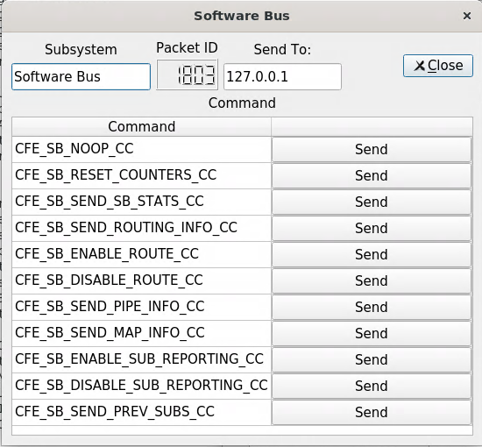
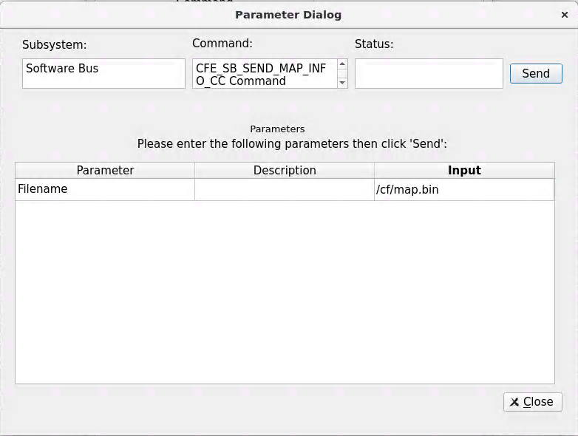
Exercise 3 - Command cFE Software Bus
Part 2 – Write the Routing Map
Click the “Display Page” button beside “Software Bus”
In the "Software Bus" window, click the "Send" button beside “CFE_SEND_MAP_INFO_CC"
Enter "/cf/map.bin" in the "Input" field next to "Filename"
Click "Send“
Nothing appears in the cFE window unless debug messages have been enabled, but the file "map.bin" now exists in the build/exe/cpu1/cf directory. View with "hexdump -C cf/map.bin"
**NOTE: The “Send Map Info" command is one of several commands that together provide the full routing information for the software bus. This can be useful for troubleshooting purposes**
1
4
2
3

Slide 111
Exercise 3 Recap
SB No-Op Command

Slide 112
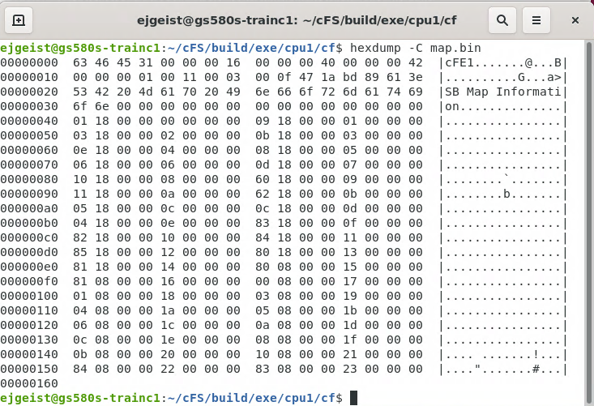
Exercise 3 Recap
File Header
Msg ID
Routing Table
Index

Slide 113
CCSDS References
Consultative Committee for Space Data Systems
CCSDS Home: https://public.ccsds.org/default.aspx
CCSDS Space Packet Protocol: https://public.ccsds.org/Pubs/133x0b1s.pdf

Slide 114
Core Flight System (cFS) Training
Module 2c: Event Services

Slide 115
Course Agenda
Introduction
cFE Services
Executive Services
Time Services
Event Services
Software Bus
Table Services
Application Layer
cFS Applications
cFS Libraries

Slide 116
Event Services - cFS Context
Development Tools
& Ground Systems
Python
Ground System
Application
Generator
Performance
Tools
Performance
Analyzer
Unit Tests
Build System
Application
CFDP
Checksum
Data Storage
File Manager
Housekeeping
Health/Safety
Limit Checker
Memory Dwell
Memory Mgr.
Scheduler
SB Network
Stored Cmds.
Core Flight
Executive
Core Flight Executive API
Core Flight Executive
Platform
Abstraction
OS Abstraction API
Platform Support Package API
RTEMS
VxWorks
Linux
Mcp750-VxWorks
RTOS / Boot
Real Time OS
Board Support Package
PROM Boot FSW
cFE Open Source Release
OSAL Open Source Release
Application Open Source Releases
3rd Party
Mission Developed

Slide 117
Event Services (EVS) - Overview
Provides an interface for sending time-stamped text messages on the software bus
Considered asynchronous because they are not part of telemetry periodically generated by an application
Processor unique identifier
Optionally logged to a local event log
Optionally output to a hardware port
Four event types defined
Debug, Informational, Error, Critical
Event message control
Apps can filter individual messages based on identifier
Enable/disable event types at the processor and application scope

Slide 118
Event Services - Context
Any cFS
Application
CFE_EVS_SendEvent
Software Bus (SB)
Communications
Non-SB
Communications
cFE
Event
Services
cFS Application
Software
Scheduler
HK
Requests
Internal Software Module,
Library, or Data Store
File
External Entity or Data
Store (variable/table)
Event Message
Event Message
Local Event Log
Output Port

Slide 119
Event Services – Message Format
Spacecraft time (retrieved via CFE_TIME_GetTime())
Spacecraft ID
Processor ID
Application (defined in cfe_es_startup.scr)
Event ID is unique within an application
Event Text is created using printf() format options
“Short Format” platform option allows messages to be sent without text portion
EVS Port1 1980-012-15:06:19.78559 66/1/CFE_ES 91: Version Info: Module CONFIG, version git:draco-rc5
EVS Port1 1980-012-15:06:19.78559 66/1/CFE_ES 91: Version Info: Module CONFIG, version git:draco-rc5
EVS Port1 1980-012-15:06:19.78559 66/1/CFE_ES 91: Version Info: Module CONFIG, version git:draco-rc5
EVS Port1 1980-012-15:06:19.78559 66/1/CFE_ES 91: Version Info: Module CONFIG, version git:draco-rc5
EVS Port1 1980-012-15:06:19.78559 66/1/CFE_ES 91: Version Info: Module CONFIG, version git:draco-rc5
EVS Port1 1980-012-15:06:19.78559 66/1/CFE_ES 91: Version Info: Module CONFIG, version git:draco-rc5

Slide 120
Event Services – Event Filtering
Applications register events for filtering during initialization
Registering immediately after ES app registration allows events to be used rather than syslog writes
Bit-wise AND “filter mask”
Boolean AND performed on event ID message counter, if result is zero then the event is sent
Mask applied before the sent counter is incremented
0x0000 => Every message sent
0x0003 => Every 4th message sent
0xFFFE => Only first two messages sent
CFE_EVS_MAX_FILTER_COUNT (cfe_evs_task.h) defines maximum count for a filtered event ID
Once reached event becomes locked
Prevents erratic filtering behavior with counter rollover
Ground can unlock filter by resetting or deleting the filter

Slide 121
Event Services - Ports
cFE supports up to 4 ports
Port behavior can be customized in cfe_evs_utils.c
By default, all ports call OS_printf
Event messages are sent to enabled ports in addition to the software bus
By default, enabled ports are defined with the configuration parameter: CFE_PLATFORM_EVS_PORT_DEFAULT
Enabled ports can be changed in runtime with the command CFE_EVS_EnablePortsCmd

Slide 122
Event Services – Message Control
Processor scope
Enable/disable event messages based on type
Debug, Information, Error, Critical
Application scope
Enable/disable all events
Enable/disable based on type
Event message scope
During initialization apps can register events for filtering for up to CFE_PLATFORM_EVS_MAX_EVENT_FILTERS defined in cfe_platform_cfg.h
Filters can be modified by command

Slide 123
Event Services – Reset Behavior
Power-on Reset
No data preserved
Application initialization routines register with the service
If configured local event log enabled
Processor Reset
If configured with an event log, preserves
Messages
Mode: Discard or Overwrite
Log Full and Overflow status

Slide 124
Event Services – Retrieving Onboard State
Telemetry
Housekeeping Status
Log Enabled, Overflow, Full, Enabled
For each App: AppID, Events Sent Count, Enabled
Files generated by command
Application data
Active flag – Are events enabled
Event Count
For each filtered event
Event ID
Filter Mask
Event Count – Number of times Event ID has been issued
Local Event Log
If enabled, events are written to a local buffer
Log “mode” can be set to overwrite or discard
Serves as backup to onboard-recorder during initialization or error scenarios
Suitable for multi-processor architectures

Slide 125
Event Services - System Integration and App Development
System Integration
DEBUG logging level should be disabled in flight
Telemetry Output should subscribe to and downlink event messages
App Development
Any app can subscribe to event messages (like any other software bus message)
An app must register with event services before it can send any events
Apps should write to the ES system log if event services cannot be registered
Calls to any variety of CFE_EVS_SendEvent will have no effect if the app is not registered with EVS
cFE libraries cannot register with EVS
Event Filtering in Apps
Apps should limit the amount of filtering done with in the app (ground should have ultimate control over filtering)
Apps should avoid “spamming” event messages

Slide 126
cFE Event Services APIs
Registration APIs | Purpose
CFE_EVS_Register | Register an application for receiving event services
Send Event APIs | Purpose
CFE_EVS_SendEvent | Generate a software event.
CFE_EVS_SendEventWithAppID | Generate a software event given the specified Application ID.
CFE_EVS_SendTimedEvent | Generate a software event with a specific time tag.
Reset Event Filter APIs | Purpose
CFE_EVS_ResetFilter | Resets the calling application's event filter for a single event ID.
CFE_EVS_ResetAllFilters | Resets all of the calling application's event filters.

Slide 127
Event Services – Command List
Command List | Purpose
CFE_EVS_NoopCmd | This function processes "no-op" commands received on the EVS command pipe
CFE_EVS_ClearLogCmd | This function processes "clear log" commands received on the EVS command pipe
CFE_EVS_ReportHousekeepingCmd | Request for housekeeping status telemetry packet
CFE_EVS_ResetCountersCmd | This function resets all the global counter variables that are part of the task telemetry
CFE_EVS_SetFilterCmd | This routine sets the filter mask for the given event_id in the calling task's filter array
CFE_EVS_EnablePortsCmd | This routine sets the command given ports to an enabled state
CFE_EVS_DisablePortsCmd | This routine sets the command given ports to a disabled state
CFE_EVS_EnableEventTypeCmd | This routine sets the given event types to an enabled state across all registered applications
CFE_EVS_DisableEventTypeCmd | This routine sets the given event types to a disabled state across all registered applications
CFE_EVS_SetEventFormatModeCmd | This routine sets the Event Format Mode
CFE_EVS_EnableAppEventTypeCmd | This routine sets the given event type for the given application identifier to an enabled state

Slide 128
Event Services – Command List
Command List | Purpose
CFE_EVS_DisableAppEventTypeCmd | This routine sets the given event type for the given application identifier to a disabled state
CFE_EVS_EnableAppEventsCmd | This routine enables application events for the given application identifier
CFE_EVS_DisableAppEventsCmd | This routine disables application events for the given application identifier
CFE_EVS_ResetAppCounterCmd | This routine sets the application event counter to zero for the given application identifier
CFE_EVS_ResetFilterCmd | This routine sets the application event filter counter to zero for the given application identifier and event identifier
CFE_EVS_ResetAllFiltersCmd | This routine sets all application event filter counters to zero for the given application identifier
CFE_EVS_AddEventFilterCmd | This routine adds the given event filter for the given application identifier and event identifier
CFE_EVS_DeleteEventFilterCmd | This routine deletes the event filter for the given application identifier and event identifier
CFE_EVS_WriteAppDataFileCmd | This routine writes all application data to a file for all applications that have registered with the EVS
CFE_EVS_SetLogModeCmd | Sets the logging mode to the command specified value.
CFE_EVS_WriteLogDataFileCmd | Requests the Event Service to generate a file containing the contents of the local event log.

Slide 129
Event Services – Platform Configuration Parameters
Parameter | Purpose
CFE_PLATFORM_EVS_START_TASK_PRIORITY | Define EVS Task Priority
CFE_PLATFORM_EVS_START_TASK_STACK_SIZE | Define EVS Task Stack Size
CFE_PLATFORM_EVS_MAX_EVENT_FILTERS | Define Maximum Number of Event Filters per Application
CFE_PLATFORM_EVS_MAX_APP_EVENT_BURST | Maximum number of event before squelching
CFE_PLATFORM_EVS_APP_EVENTS_PER_SEC | Sustained number of event messages per second per app before squelching
CFE_PLATFORM_EVS_DEFAULT_LOG_FILE | Default Event Log Filename
CFE_PLATFORM_EVS_LOG_MAX | Maximum Number of Events in EVS Local Event Log
CFE_PLATFORM_EVS_DEFAULT_APP_DATA_FILE | Default EVS Application Data Filename
CFE_PLATFORM_EVS_PORT_DEFAULT | Default EVS Output Port State
CFE_PLATFORM_EVS_DEFAULT_TYPE_FLAG | Default EVS Event Type Filter Mask
CFE_PLATFORM_EVS_DEFAULT_LOG_MODE | Default EVS Local Event Log Mode
CFE_PLATFORM_EVS_DEFAULT_MSG_FORMAT_MODE | Default EVS Message Format Mode
New in cFS Draco

Slide 130
Event Services – Mission Configuration Parameters
Parameter | Purpose
CFE_MISSION_EVS_MAX_MESSAGE_LENGTH | Maximum Event Message Length

Slide 131
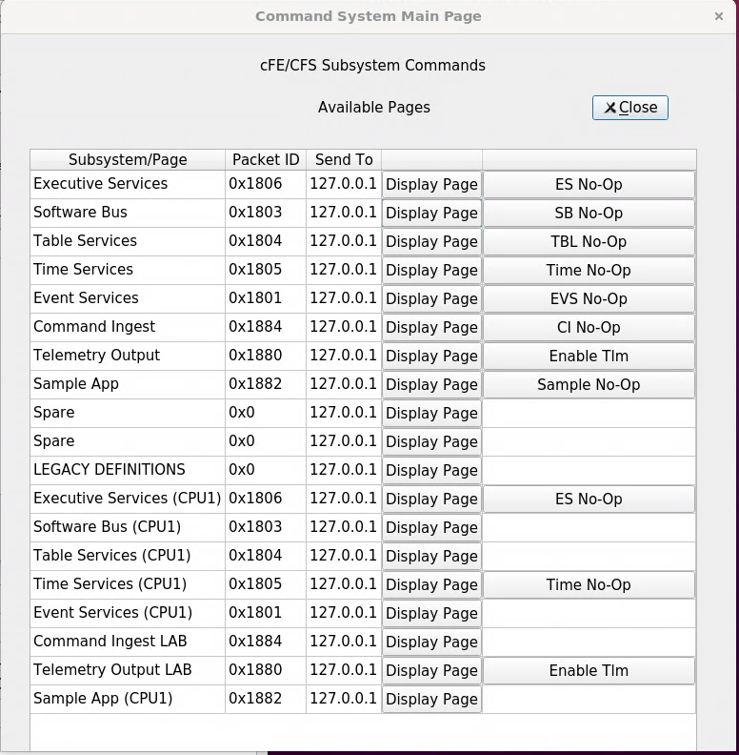
Exercise 4 - Command cFE Event Service
Part 1 – Test an Informational Event Message
1. Ensure that cFE is running
2. Open a new terminal
3. Start the ground system executable (as in Exercise 2)
4. Enable Telemetry (as in Exercise 2)
5. Send an EVS No-Op command
Click the “EVS No-Op“ button beside “Event Services”
6. Send a CI_LAB No-Op command
Click the “CI No-Op“ button beside “Command Ingest”

Slide 132
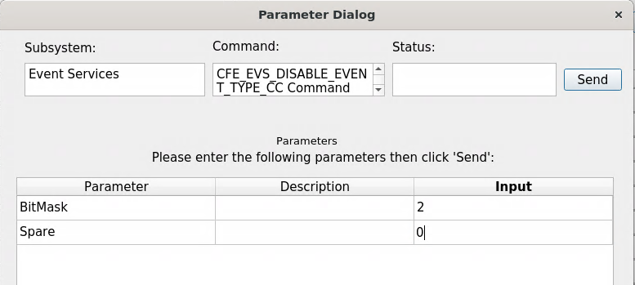
Exercise 4 - Command cFE Event Service
Part 2 – Disable Informational Messages
Click the “Display Page” button beside “Event Services”
In the Event Services command window, click the "Send" button beside “CFE_EVS_DISABLE_EVENT_TYPE_CC"
Enter "2" as the "BitMask" Input and "0" as the "Spare" input.
Click send
Send a CI_LAB No-Op command
On the “Command System Main Page” window, click the “CI No-Op“ button beside “Command Ingest”
Unlike the first time, nothing should show up in the cFE window. The CI_LAB no-op event message is an information level event message. Therefore, it was enabled until step #7 disabled informational messages.
1
4
3
2

Slide 133
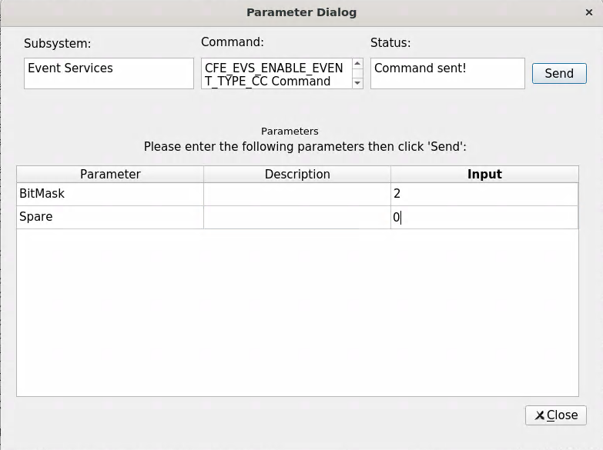
Exercise 4 - Command cFE Event Service
Part 3: Re-enable informational messages
1. Click the “Display Page” button beside “Event Services”
2. In the Event Services command window, click the "Send" button beside “CFE_EVS_ENABLE_EVENT_TYPE_CC"
3. Enter "2" as the "BitMask" Input and "0" as the "Spare" input.
4. Click send
2
4
3

Slide 134
Exercise 4 Recap
CI No-Op Command

Slide 135
Core Flight System (cFS) Training
Module 2d: Time Services

Slide 136
Course Agenda
Introduction
cFE Services
Executive Services
Software Bus
Event Services
Time Services
Table Services
Application Layer
cFS Applications
cFS Libraries

Slide 137
Time Services - cFS Context
Development Tools
& Ground Systems
Python
Ground System
Application
Generator
Performance
Tools
Performance
Analyzer
Unit Tests
Build System
Application
CFDP
Checksum
Data Storage
File Manager
Housekeeping
Health/Safety
Limit Checker
Memory Dwell
Memory Mgr.
Scheduler
SB Network
Stored Cmds.
Core Flight
Executive
Core Flight Executive API
Core Flight Executive
Platform
Abstraction
OS Abstraction API
Platform Support Package API
RTEMS
VxWorks
Linux
Mcp750-VxWorks
RTOS / Boot
Real Time OS
Board Support Package
PROM Boot FSW
cFE Open Source Release
OSAL Open Source Release
Application Open Source Releases
3rd Party
Mission Developed

Slide 138
Time Services - Overview
Provides time correlation, distribution and synchronization services
Provides a user interface for correlation of spacecraft time to the ground reference time (epoch)
Provides calculation of spacecraft time, derived from mission elapsed time (MET), a spacecraft time correlation factor (STCF), and optionally, leap seconds
Provides a functional API for cFE applications to query the time
Distributes a “time at the tone” command packet, containing the correct time at the moment of the 1Hz tone signal
Distributes a “1Hz wakeup” command packet
Forwards tone and time-at-the-tone packets
Designing and configuring time is tightly coupled with the mission avionics design

Slide 139
Time Services - Context
Any cFS
Application
Time Requests
1Hz Wakeup
Message
Software Bus (SB)
Communications
cFE
Time Services
Time Data
Non-SB
Communications
HK
Requests
Time
1Hz
Child Task
Software
Scheduler
Local Clock,
1Hz interrupt
cFS Application
Internal Software Module,
Library, or Data Store
File
Tone interrupt
PSP
Local Timing Hardware
Tone Message
External Entity or Data
Store (variable/table)
Time
1Hz Tone
Child Task
Local/External
Tone Source

Slide 140
Time Services – Time Formats
Supports two formats
International Atomic Time (TAI)
Number of seconds and sub-seconds elapsed since the ground epoch
TAI = MET + STCF
Mission Elapsed Counter (MET) time since powering on the hardware containing the counter
Spacecraft Time Correlation Factor (STCF) set by ground ops
Note STCF can correlate MET to any time epoch so TAI is mandated
Coordinated Universal Time (UTC)
Synchronizes time with astronomical observations
UTC = TAI – Leap Seconds
Leap Seconds account for earth’s slowing rotation

Slide 141
Time Services – “Flywheeling”
Flywheeling occurs when TIME is not getting a valid tone signal or external "time at the tone" message. It can result in the drifting apart of times being stored by different spacecraft systems.
Flywheeling occurs when at least one of the following conditions is true:
loss of tone signal
loss of "time at the tone" data packet
signal and packet not within valid window
commanded into fly-wheel mode

Slide 142
Time Services – Reset Behavior
Power-On-Reset
Initializes all counters in housekeeping telemetry
Validity state set to Invalid
STCF, Leap Seconds, and 1 Hz Adjustment set to zero
Processor reset, preserves:
MET
STCF
Leap Seconds
Clock Signal Selection
Current Time Client Delay (if applicable)

Slide 143
Time Services – Retrieving Onboard State
Telemetry
Housekeeping Status
Clock state, Leap Seconds, MET, STCF 1Hz Adjust
Telemetry packets generated by command
Diagnostic Packet
Files generated by command
None

Slide 144
Time Services – Configuration Considerations
What is your time format?
Are you setting time or receiving time?
Is your MET provided by local hardware?
Is time coming from an external source?
How long can you go without synchronizing time?

Slide 145
Time Services – Configuration Parameters
CFE_PLATFORM_TIME_CFG_SERVER
CFE_PLATFORM_TIME_CFG_CLIENT
Only one can be TRUE
Server Only
Server and Client
CFE_PLATFORM_TIME_CFG_VIRTUAL
CFE_PLATFORM_TIME_CFG_SOURCE
CFE_PLATFORM_TIME_MAX_DELTA_SECS
CFE_PLATFORM_TIME_MAX_DELTA_SUBS
CFE_PLATFORM_TIME_CFG_BIGENDIAN
CFE_PLATFORM_TIME_CFG_SIGNAL
CFE_PLATFORM_TIME_MAX_LOCAL_SECS
CFE_PLATFORM_TIME_MAX_LOCAL_SUBS
CFE_PLATFORM_TIME_CFG_TONE_LIMIT
CFE_PLATFORM_TIME_CFE_START_FLY
CFE_PLATFORM_TIME_CFE_LATCH_FLY
Source Only
CFE_PLATFORM_TIME_CFG_SRC_MET
CFE_PLATFORM_TIME_CFG_SRC_GPS
CFE_PLATFORM_TIME_CFG_SRC_TIME
Only one can be TRUE

Slide 146
cFE Time Services APIs
Get Current Time APIs | Purpose
CFE_TIME_GetTime | Get the current spacecraft time
CFE_TIME_GetTAI | Get the current TAI (MET + SCTF) time
CFE_TIME_GetUTC | Get the current UTC (MET + SCTF - Leap Seconds) time
CFE_TIME_GetMET | Get the current value of the Mission Elapsed Time (MET)
CFE_TIME_GetMETseconds | Get the current seconds count of the mission-elapsed time
CFE_TIME_GetMETsubsecs | Get the current sub-seconds count of the mission-elapsed time
Get Time Information APIs | Purpose
CFE_TIME_GetSTCF | Get the current value of the spacecraft time correction factor (STCF)
CFE_TIME_GetLeapSeconds | Get the current value of the leap seconds counter
CFE_TIME_GetClockState | Get the current state of the spacecraft clock
CFE_TIME_GetClockInfo | Provides information about the spacecraft clock
Time Arithmetic APIs | Purpose
CFE_TIME_Add | Adds two time values
CFE_TIME_Subtract | Subtracts two time values
CFE_TIME_Compare | Compares two time values

Slide 147
cFE Time Services APIs
Time Conversion APIs | Purpose
CFE_TIME_MET2SCTime | Convert specified MET into Spacecraft Time
CFE_TIME_Sub2MicroSecs | Converts a sub-seconds count to an equivalent number of microseconds
CFE_TIME_Micro2SubSecs | Converts a number of microseconds to an equivalent sub-seconds count
External Time Source APIs | Purpose
CFE_TIME_ExternalTone | Provides the 1 Hz signal from an external source
CFE_TIME_ExternalMET | Provides the Mission Elapsed Time from an external source
CFE_TIME_ExternalGPS | Provide the time from an external source that has data common to GPS receivers
CFE_TIME_ExternalTime | Provide the time from an external source that measures time relative to a known epoch
CFE_TIME_RegisterSynchCallback | Registers a callback function that is called whenever time synchronization occurs
CFE_TIME_UnregisterSynchCallback | Unregisters a callback function that is called whenever time synchronization occurs
Miscellaneous Time APIs | Purpose
CFE_TIME_Print | Print a time value as a string
CFE_TIME_Local1HzISR | Drives the time processing logic from the system PSP layer.

Slide 148
Time Services Commands
Command Functions | Purpose
CFE_TIME_Add1HZAdjustmentCmd | Add Delta to Spacecraft Time Correlation Factor each 1Hz
CFE_TIME_AddAdjustCmd | Add Delta to Spacecraft Time Correlation Factor
CFE_TIME_AddDelayCmd | Add Time to Tone Time Delay
CFE_TIME_SendDiagnosticTlm | Request TIME Diagnostic Telemetry
CFE_TIME_NoopCmd | Time No-Op
CFE_TIME_ResetCountersCmd | Resets counters within the housekeeping telemetry
CFE_TIME_SetLeapSecondsCmd | Set Leap Seconds
CFE_TIME_SetMETCmd | Set Mission Elapsed Time
CFE_TIME_SetSignalCmd | Set Tone Signal Source
CFE_TIME_SetSourceCmd | Set Time Source
CFE_TIME_SetStateCmd | Set Time State
CFE_TIME_SetSTCFCmd | Set Spacecraft Time Correlation Factor
CFE_TIME_SetTimeCmd | Set Spacecraft Time
CFE_TIME_Sub1HZAdjustmentCmd | Subtract Delta from Spacecraft Time Correlation Factor each 1Hz
CFE_TIME_SubAdjustCmd | Subtract Delta from Spacecraft Time Correlation Factor
CFE_TIME_SubDelayCmd | Subtract Time from Tone Time Delay

Slide 149
Time Services – Platform Configuration Parameters
Parameter | Purpose
CFE_PLATFORM_TIME_CFG_[SERVER/CLIENT] | Time Server or Time Client Selection
CFE_PLATFORM_TIME_CFG_BIGENDIAN | Time Tone In Big-Endian Order
CFE_PLATFORM_TIME_CFG_VIRTUAL | Local MET or Virtual MET Selection for Time Servers
CFE_PLATFORM_TIME_CFG_SIGNAL | Include or Exclude the Primary/Redundant Tone Selection Cmd
CFE_PLATFORM_TIME_CFG_SOURCE | Include or Exclude the Internal/External Time Source Selection Cmd
CFE_PLATFORM_TIME_CFG_SRC_[MET/GPS/TIME] | Choose the External Time Source for Server only
CFE_PLATFORM_TIME_MAX_DELTA_[SECS/SUBS] | Define the Max Delta Limits for Time Servers using an Ext Time Source
CFE_PLATFORM_TIME_MAX_LOCAL_[SECS/SUBS] | Define the Local Clock Rollover Value in seconds and subseconds
CFE_PLATFORM_TIME_CFG_TONE_LIMIT | Define Timing Limits From One Tone To The Next
CFE_PLATFORM_TIME_CFG_START_FLY | Define Time to Start Flywheel Since Last Tone
CFE_PLATFORM_TIME_CFG_LATCH_FLY | Define Periodic Time to Update Local Clock Tone Latch
CFE_PLATFORM_TIME_START_TASK_PRIORITY | Defines the cFE_TIME Task priority.
CFE_PLATFORM_TIME_TONE_TASK_PRIORITY | Defines the cFE_TIME Tone Task priority.
CFE_PLATFORM_TIME_1HZ_TASK_PRIORITY | Defines the cFE_TIME 1HZ Task priority.

Slide 150
Time Services – Platform Configuration Parameters
Parameter | Purpose
CFE_PLATFORM_TIME_START_TASK_STACK_SIZE | Defines the cFE_TIME Main Task Stack Size
CFE_PLATFORM_TIME_TONE_TASK_STACK_SIZE | Defines the cFE_TIME Tone Task Stack Size
CFE_PLATFORM_TIME_1HZ_TASK_STACK_SIZE | Defines the cFE_TIME 1HZ Task Stack Size

Slide 151
Time Services – Mission Configuration Parameters
Parameter | Purpose
CFE_MISSION_TIME_CFG_DEFAULT_[TAI/UTC] | Select either UTC or TAI as the default (mission specific) time format.
CFE_MISSION_TIME_CFG_FAKE_TONE | Default Time Format
CFE_MISSION_TIME_AT_TONE_[WAS/WILL_BE] | Default Time and Tone Order
CFE_MISSION_TIME_MIN_ELAPSED | Min Time Elapsed
CFE_MISSION_TIME_MAX_ELAPSED | Max Time Elapsed
CFE_MISSION_TIME_DEF_MET_[SECS/SUBS] | Default Time Values
CFE_MISSION_TIME_DEF_STCF_[SECS/SUBS] | Default Time Values
CFE_MISSION_TIME_DEF_DELAY_[SECS/SUBS] | Default Time Values
CFE_MISSION_TIME_DEF_LEAPS | Default Time Values
CFE_MISSION_TIME_EPOCH_YEAR | Default ground time epoch values
CFE_MISSION_TIME_EPOCH_DAY | Default ground time epoch values
CFE_MISSION_TIME_EPOCH_HOUR | Default ground time epoch values
CFE_MISSION_TIME_EPOCH_MINUTE | Default ground time epoch values
CFE_MISSION_TIME_EPOCH_SECOND | Default ground time epoch values
CFE_MISSION_TIME_EPOCH_MICROS | Default ground time epoch values
CFE_MISSION_TIME_FS_FACTOR | Define the s/c vs file system time conversion constant
New in cFS Draco

Slide 152
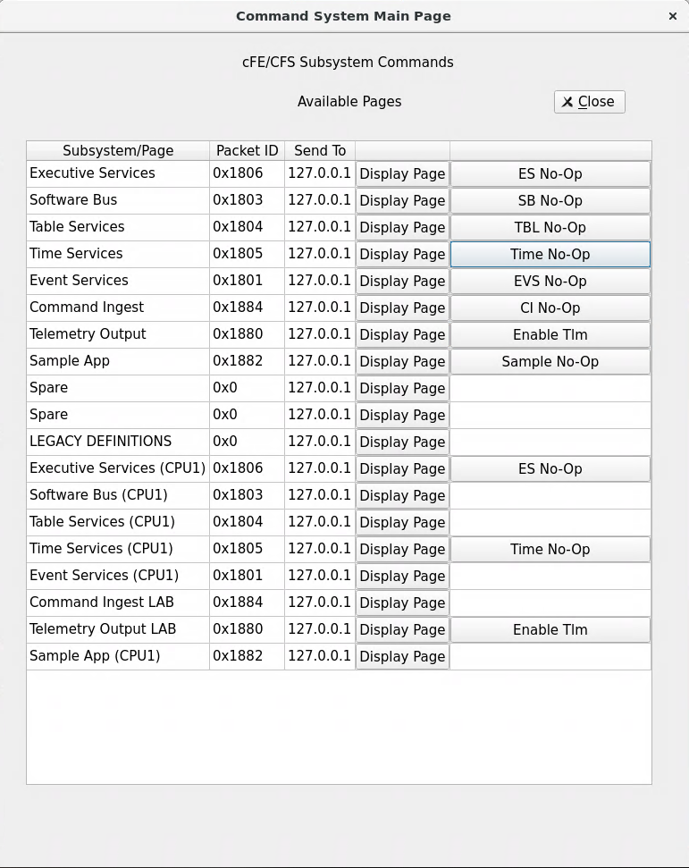
Exercise 5 - Command cFE Time Service
Part 1 – Test an Informational Event Message
Ensure that cFE is running
Open a new terminal
Start the ground system executable (as in Exercise 2)
Enable Telemetry (as in Exercise 2)
Send a TIME No-Op command
Click the “Time No-Op“ button beside “Time Services”

Slide 153
Exercise 5 Part 1 Recap
TIME
No-Op
Command

Slide 154
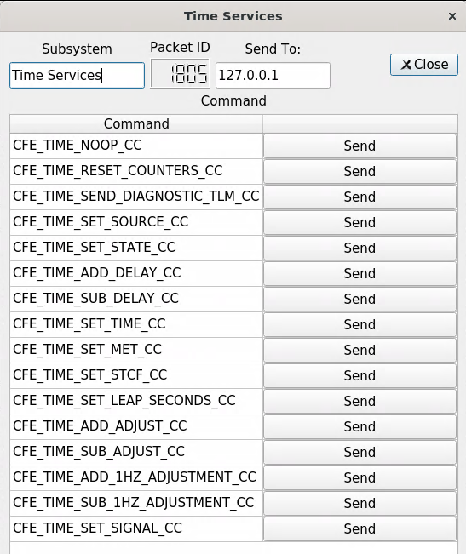
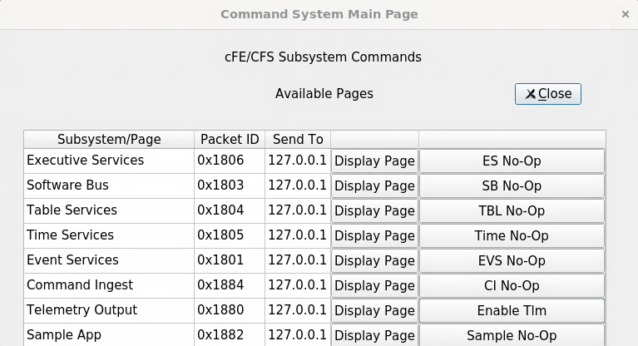
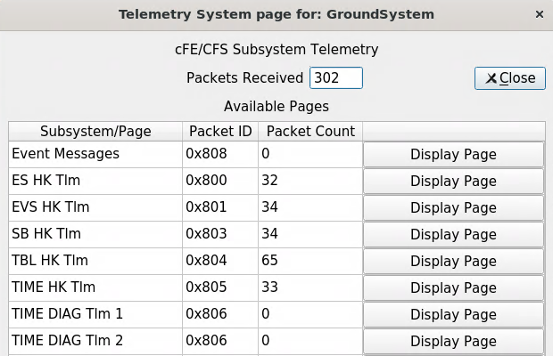
Exercise 5 - Command cFE Time Service
Part 2 – Get TIME Diagnostic Telemetry
4
Start the Telemetry System in the Ground System if not already done
Click “Display Page” next to “TIME DIAG Tlm 1”
In the command system, click “Display Page” next to “Time Services”
Click “Send” next to “CFE_TIME_SEND_DIAGNOSTIC_TLM_CC”
1
3
2

Slide 155
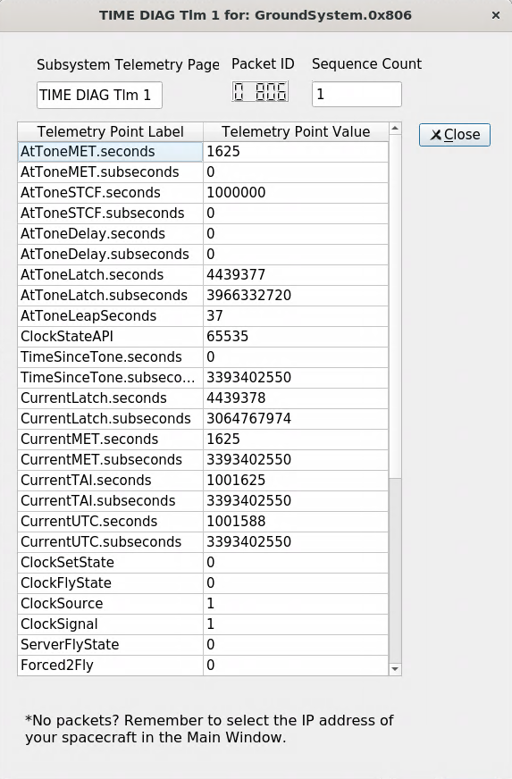
Exercise 5 Part 2 Recap
Diagnostic telemetry showing default TIME settings

Slide 156
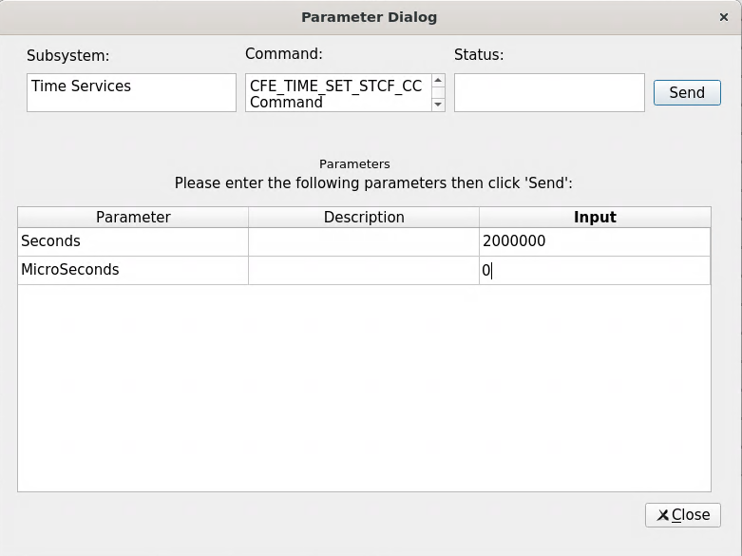
Exercise 5 - Command cFE Time Service
3
Part 3 – Change STCF
In the command system, “Time Services” display page click “CFE_TIME_SET_STCF_CC”
Set the “Seconds” field to “2000000” and the “MicroSeconds” field to “0” and click “Send”
Ensure that the time diagnostic telemetry window is still open, and click “Send” next to “CFE_TIME_SEND_DIAGNOSTIC_TLM_CC” in the Time Services command window
Click “CFE_TIME_NOOP_CC” in the Time Services command window
4
1
2

Slide 157
Exercise 5 Part 3 Recap
Diagnostic telemetry now shows the updated STCF
Event message confirming command to update the STCF
When the STCF is increased, the system time jumps forward

Slide 158
Core Flight System (cFS) Training
Module 2e: Table Services

Slide 159
Course Agenda
Introduction
cFE Services
Executive Services
Time Services
Event Services
Software Bus
Table Services
Application Layer
cFS Applications
cFS Libraries

Slide 160
Table Services - cFS Context
Development Tools
& Ground Systems
Python
Ground System
Application
Generator
Performance
Tools
Performance
Analyzer
Unit Tests
Build System
Application
CFDP
Checksum
Data Storage
File Manager
Housekeeping
Health/Safety
Limit Checker
Memory Dwell
Memory Mgr.
Scheduler
SB Network
Stored Cmds.
Core Flight
Executive
Core Flight Executive API
Core Flight Executive
Platform
Abstraction
OS Abstraction API
Platform Support Package API
RTEMS
VxWorks
Linux
Mcp750-VxWorks
RTOS / Boot
Real Time OS
Board Support Package
PROM Boot FSW
cFE Open Source Release
OSAL Open Source Release
Application Open Source Releases
3rd Party
Mission Developed

Slide 161
Table Services (TBL) - Overview
What is a table?
Tables are logical groups of parameters that are managed as a named entity
Parameters typically change the behavior of a FSW algorithm
Examples include controller gains, conversion factors, and filter algorithm parameters
Tables service provides ground commands to load a table from a file and dump a table to a file
Table loads are synchronized with applications
Tables are binary files
Ground support tools are required to create and display table contents
The cFE can be built without table support
Note the cFE services don’t use tables

Slide 162
Table Services - Context
Any cFS
Application
CFE_TBL_*
API Calls
Software Bus (SB)
Communications
Non-SB
Communications
cFE
Table
Services
cFS Application
Software
Scheduler
HK
Requests
Internal Software Module,
Library, or Data Store
File
External Entity or Data
Store (variable/table)
Table File

Slide 163
Table Services – Managing Tables
Inactive
Buffer
Table Maintenance
Function
(Typically run on HK cycle)
Load
Poll
File
Table
Service
Dump
Run Loop Processing
Get Pointer
Active
Buffer
Active Table - Image accessed by app while it executes
Inactive Table - Image manipulated by ops (could be stored commands)
Load → Validate → Activate
Loads can be partial or complete
For partial loads current active contents copied to inactive buffer prior to updates from file
Apps can supply a “validate function” that is executed when commanded
Dump
Command specifies whether to dump the active or inactive buffer to a file
Table operations are synchronous with the application that owns the table to ensure table data integrity
Non-Blocking table updates allow tables to be used in Interrupt Service Routines

Slide 164
Table Services - Load Table
Transfer
File to Flight
Load
Table
Validate
Table
Activate
Table
Validate
Contents¹
Activate
Table^{1,2}
App
CFDP
TBL Service
File
Inactive Table Buffer
Active Table Buffer
cFS
Validate
Table Cmd
Activate
Table Cmd
Ground
xfer File Cmd
Table Load Cmd
Time
Apps typically validate & activate tables during their “housekeeping” execution cycle
In addition to instructing cFE to copy the contents, apps may have app-specific processing

Slide 165
Table Services - Dump Table
Dump
Table
Transfer
File to Ground
App
TBL Service
CFDP
cFS
Active or Inactive Table Buffer
File
Ground
Table Dump Cmd
xfer File Cmd
Time

Slide 166
Table Services –Table Buffer Types
Single Buffer
The active buffer is the only buffer dedicated to the application’s table
Table service shares inactive buffers to service multiple apps with single buffer tables
CFE_PLATFORM_TBL_MAX_SIMULTANEOUS_LOADS defines the number of concurrent table load sessions
Most efficient use of memory and adequate for most situations
Double Buffer
Dedicated inactive image for each double buffered table
Useful for fast table image swaps (.e.g. high rate app and/or very large table) and delayed activation of table’s content (e.g. ephemeris)
E.g. Stored Command’s Absolute Time Command table
Shared single buffer pool must be sized to accommodate the largest single buffer image

Slide 167
Table Services –Table Attributes
Validation Function
Applications register validation functions during initialization
Table activates for tables with validation functions will be rejected if the validation has not been performed
Mission critical data table values are usually verified
Critical Tables
Table data is stored in a Critical Data Store (CDS)
Contents updated for each table active command
User Defined Address
Application provides the memory address for the active table buffer
Typically used in combination with a dump-only table
Dump-Only
Contents can’t be changed via the load/validate/activate sequence
The dump is controlled by the application that owns the table so it can synchronize the dump and avoid dumps that contain partial updates

Slide 168
Table Services – Reset Behavior
Table registry is cleared for power-on and processor resets
Applications must register tables for any type of reset
Applications must initialize their table data for any type of reset
Critical Table Exception
If a table is registered as critical then during a processor reset table service will locate and load the preserved table data from a critical data store

Slide 169
Table Services – Retrieving Onboard State
Telemetry
Housekeeping Status
Table registry statistics (number of tables and pending loads)
Last table validation results (CRC, validation status, total validations)
Last updated table
Last file loaded
Last file dumped
Last table loaded
Telemetry packets generated by command
Table registry info for specified table
Files generated by command
Full Table Registry

Slide 170
Table Services System Integration and App Development (1 of 2)
Commands are typically used to initiate an action; not tables
For example, change a control mode
Sometimes convenience commands are provided to change table elements
For example, scheduler app provides an enable/disable scheduler table entry
Typically tables do not contain dynamic data computed by the FSW
The cFE doesn’t preclude this and it has been used as a convenient method to collect data, save to a file, and transfer it to the ground
These are defined as dump-only tables
Static tables can be checksummed
Tables can be shared between applications but this is rare
Tables are not intended to be an inter-application communication mechanism

Slide 171
Table Services System Integration and App Development (2 of 2)
Load/dump files are binary files with the following sections:
cFE File Header
Table Header
Table Data
Table header defined in cfe_tbl_internal.h
{
uint32 Reserved; /**< Future Use: NumTblSegments in File? */
uint32 Offset; /**< Byte Offset at which load should commence */
uint32 NumBytes; /**< Number of bytes to load into table */
char TableName[CFE_TBL_MAX_FULL_NAME_LEN]; /**< Fully qualified name of table */
} CFE_TBL_File_Hdr_t;

Slide 172
cFE Table Services APIs
Registration APIs | Purpose
CFE_TBL_Register | Register a table with cFE to obtain Table Management Services
CFE_TBL_Share | Obtain handle of table registered by another application
CFE_TBL_Unregister | Unregister a table
Manage Table Content APIs | Purpose
CFE_TBL_Load | Load a specified table with data from specified source
CFE_TBL_Update | Update contents of a specified table, if an update is pending
CFE_TBL_Validate | Perform steps to validate the contents of a table image
CFE_TBL_Manage | Perform standard operations to maintain a table
CFE_TBL_DumpToBuffer | Copies the contents of a Dump Only Table to a shared buffer
CFE_TBL_Modified | Notify cFE Table Services that table contents have been modified by the Application
Access Table Content APIs | Purpose
CFE_TBL_GetAddress | Obtain the current address of the contents of the specified table
CFE_TBL_ReleaseAddress | Release previously obtained pointer to the contents of the specified table
CFE_TBL_GetAddresses | Obtain the current addresses of an array of specified tables
CFE_TBL_ReleaseAddresses | Release the addresses of an array of specified tables

Slide 173
cFE Table Services APIs
Get Table Information APIs | Purpose
CFE_TBL_GetStatus | Obtain current status of pending actions for a table
CFE_TBL_GetInfo | Obtain characteristics/information of/about a specified table
CFE_TBL_NotifyByMessage | Instruct cFE Table Services to notify Application via message when table requires management

Slide 174
Table Services Commands
Command Functions | Purpose
CFE_TBL_NoopCmd | Table No-Op
CFE_TBL_ResetCountersCmd | Resets the counters within the Table Services housekeeping telemetry
CFE_TBL_LoadCmd | Loads the contents of the specified file into an inactive buffer for the table specified within the file.
CFE_TBL_DumpCmd | This command will cause the Table Services to put the contents of the specified table buffer into the command specified file.
CFE_TBL_ValidateCmd | Validate Table
CFE_TBL_ActivateCmd | Activate Table
CFE_TBL_DumpRegistryCmd | This command will cause Table Services to write some of the contents of the Table Registry to the command specified file.
CFE_TBL_SendRegistryCmd | This command will cause Table Services to telemeter the contents of the Table Registry for the command specified table.
CFE_TBL_DeleteCDSCmd | This command will delete the Critical Data Store (CDS) associated with the specified Critical Table.
CFE_TBL_AbortLoadCmd | This command will cause Table Services to discard the contents of a table buffer that was previously loaded with the data in a file as specified by a Table Load command.

Slide 175
Table Services – Platform Configuration Parameters
Parameter | Purpose
CFE_PLATFORM_TBL_START_TASK_PRIORITY | Defines the cFE_TBL Task priority
CFE_PLATFORM_TBL_START_TASK_STACK_SIZE | Define TBL Task Stack Size
CFE_PLATFORM_TBL_BUF_MEMORY_BYTES | Size of Table Services Table Memory Pool
CFE_PLATFORM_TBL_MAX_DBL_TABLE_SIZE | Maximum Size Allowed for a Double Buffered Table
CFE_PLATFORM_TBL_MAX_SNGL_TABLE_SIZE | Maximum Size Allowed for a Single Buffered Table
CFE_PLATFORM_TBL_MAX_NUM_TABLES | Maximum Number of Tables Allowed to be Registered
CFE_PLATFORM_TBL_MAX_CRITICAL_TABLES | Maximum Number of Critical Tables that can be Registered
CFE_PLATFORM_TBL_MAX_NUM_HANDLES | Maximum Number of Table Handles
CFE_PLATFORM_TBL_MAX_SIMULTANEOUS_LOADS | Maximum Number of Simultaneous Loads to Support
CFE_PLATFORM_TBL_MAX_NUM_VALIDATIONS | Maximum Number of Simultaneous Table Validations
CFE_PLATFORM_TBL_DEFAULT_REG_DUMP_FILE | Default Filename for a Table Registry Dump
CFE_PLATFORM_TBL_VALID_SCID_COUNT | Number of Spacecraft ID's specified for validation
CFE_PLATFORM_TBL_VALID_SCID_[1/2] | Spacecraft ID values used for table load validation
CFE_PLATFORM_TBL_VALID_PRID_COUNT | Number of Processor ID's specified for validation
CFE_PLATFORM_TBL_VALID_PRID_[1/2/3/4] | Processor ID values used for table load validation

Slide 176
Table Services – Mission Configuration Parameters
Parameter | Purpose
CFE_MISSION_TBL_MAX_NAME_LENGTH | Maximum Table Name Length
CFE_MISSION_TBL_MAX_FULL_NAME_LEN | Maximum Length of Full Table Name in messages

Slide 177
Exercise 6 - Command cFE Table Service
1. Ensure that cFE is running
2. Open a new terminal
3. Start the ground system executable (as in Exercise 2)
4. Enable Telemetry (as in Exercise 2)
5. Send a TBL No-Op command
Click the “TBL No-Op“ button beside “Table Services”
6. Send a "Load Table" command
Click the “Display Page” button beside “Table Services”
In the "Table Services" window, click the "Send" button beside “CFE_TBL_LOAD_CC"
Enter “/cf/sample_app_tbl.tbl" in the "Input" field next to "LoadFilename"
Click "Send"
7. Dump the table registry
In the "Table Services " window, click the "Send" button beside “CFE_TBL_DUMP_REGISTRY_CC"
Enter "/cf/tbl_reg.bin" in the "Input" field next to "DumpFilename"
Click "Send"
**Nothing appears in the cFE window for Step 7 unless debug messages have been enabled, but the file "tbl_reg.bin" now exists in the build/exe/cpu1/cf directory. View with "hexdump -C cf/tbl_reg.bin"**

Slide 178
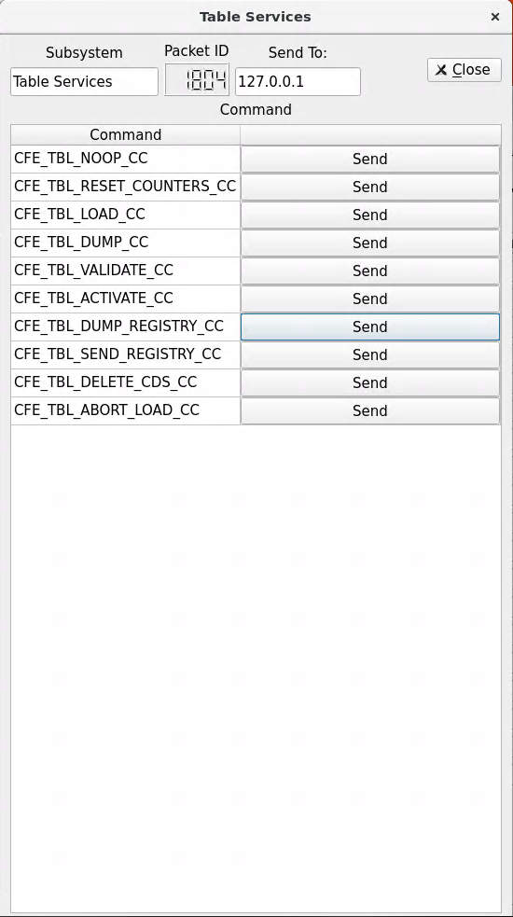
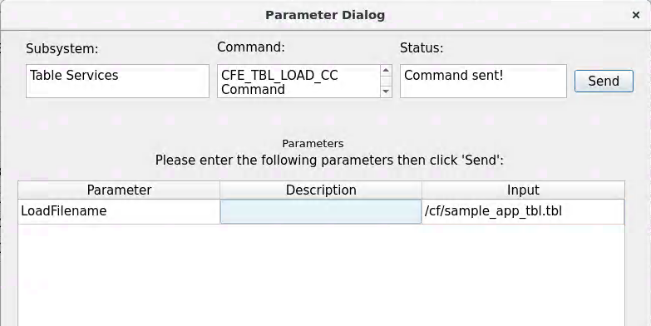
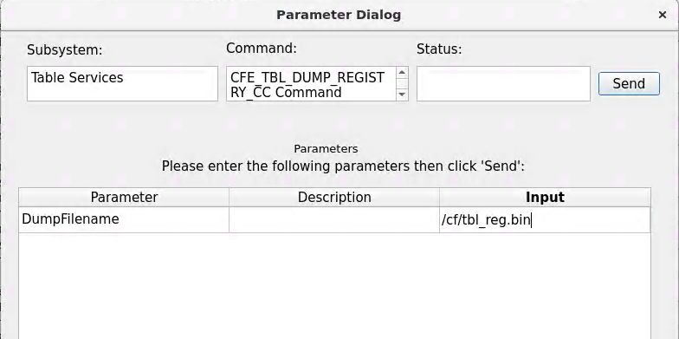
Exercise 6 - Recap
6
7

Slide 179
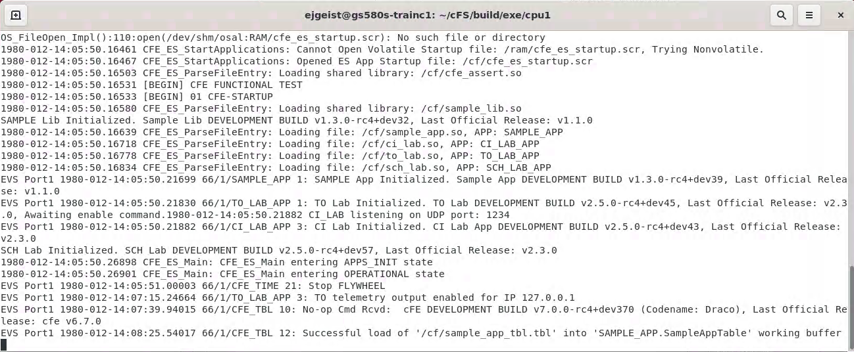
Exercise 6 - Recap
TBL No-Op Command
Tbl Load Command

Slide 180
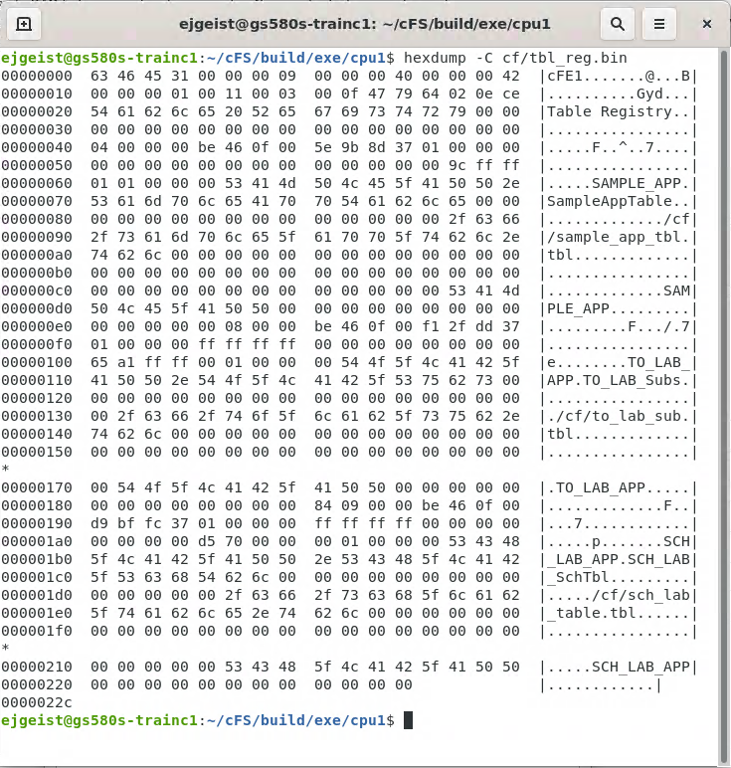
Exercise 6 - Recap
3 Tables in System

Slide 181
Core Flight System (cFS) Training
Module 3: Application Development

Slide 182
Course Agenda
Introduction
cFE Services
Executive Services
Time Services
Event Services
Software Bus
Table Services
Application Layer
cFS Applications
cFS Libraries

Slide 183
Applications - cFS Context
Development Tools
& Ground Systems
Python
Ground System
Application
Generator
Performance
Tools
Performance
Analyzer
Unit Tests
Build System
Application
CFDP
Checksum
Data Storage
File Manager
Housekeeping
Health/Safety
Limit Checker
Memory Dwell
Memory Mgr.
Scheduler
SB Network
Stored Cmds.
Core Flight
Executive
Core Flight Executive API
Core Flight Executive
Platform
Abstraction
OS Abstraction API
Platform Support Package API
RTEMS
VxWorks
Linux
Mcp750-VxWorks
RTOS / Boot
Real Time OS
Board Support Package
PROM Boot FSW
cFE Open Source Release
OSAL Open Source Release
Application Open Source Releases
3rd Party
Mission Developed

Slide 184
cFS Applications
Can run anywhere the cFS framework has been deployed
Provide “higher level” functions than the cFE itself
Command and data handling
Guidance, navigation, and control
Onboard data processing
GSFC has released 12 applications that provide common command and data handling functionality such as
Stored command management and execution
Onboard data storage file management
Missions use a combination of custom and reused applications

Slide 185
cFS Libraries
What is a library?
A collection of utilities available for use by apps
No main task execution in the library
Exist at the application layer of the cFS
Specified in the cfe_es_startup.scr script and loaded at cFE startup
Libraries can’t use application services that require registration
e.g. Event Services
Checksum can’t do library code space

Slide 186
Application Build Context

Slide 187
cFS Mission Directory Structure
cFS Distribution
apps
cfe
osal
tools
Each app is in a separate subdirectory
cFE source files
OSAL source files
Ground and build tools
build
libs
psp
_defs
Contains cmake-generated files
cFS Libraries
PSP source files
cmake configuration
files

Slide 188
App Directory Structure
App XX
docs
unit_test
fsw
config
Unit test source and data
Configuration files
VDD
Users Guide
Requirements
tables
inc
Default table definitions
Config parameters
Message IDs
src
Header files
Source files

Slide 189
cFS Mission Directory Structure
cFS Distribution
apps
cfe
osal
tools
Each app is in a separate subdirectory
cFE source files
OSAL source files
Ground and build tools
build
libs
psp
_defs
Contains cmake-generated files
cFS Libraries
PSP source files
cmake configuration
files

Slide 190
_def Directory Structure
Targets.cmake
Identifies the target architectures and configurations
Identifies the apps to be built
Identifies files that will be copied from *_def to platform specific directories
Copied file examples
cpu1_cfe_es_startup.scr
cpu1_msgids.h
cpu1_osconfig.h
Overrides
Configuration files from /config directories can be overridden by files placed in the _defs directory

Slide 191
Application Runtime Context

Slide 192
Application Runtime Context
Scheduler
Commands,
Telemetry Requests
User
App
Ground
Commands
Telemetry
Command Ingest
Telemetry Output
Ground
Commands
Telemetry
Ground System
CFS App
Mission App
Ground System

Slide 193
Application Runtime Context
SCH, CI, and TO provide a runtime context that can be tailored for a particular environment
Scheduler (SCH) App
Sends software bus messages at pre-defined time intervals
Apps often use scheduled messages as wakeup signals
Command Ingest (CI) App
Receives commands from an external source, typically the ground system, and sends them on the software bus
Telemetry Output (TO) App
Receives telemetry packets from the software bus and sends them to an external source, typically the ground system

Slide 194
Mission Application Example
MAC, BME, & PSE
S-Comm
GPS
Cmd &
Tlm
Cmd &
Tlm
Spacecraft
Data
Recorder
CS
LC
CF
MM
MD
Power &
Support
Space
Wire
Recorder
Manager
SCH
DS
SC
FM
EDAC
Memory
Scrub
HK
Inter-app Message Router (Software Bus)
HS
TBL
1553 Bus
Controller
Time Manager
Telemetry
Output
Command
Ingest
SB
TIME
ES
EVS
S/C
Data
Instr.
Data
Time
Registers
SBC
1553
DIO
CFS App
cFE Service
Mission C&DH App
Hardware

Slide 195
Existing Applications

Slide 196
GSFC Open Source Apps
Application | Function
CFDP | Transfers/receives file data to/from the ground
Checksum | Performs data integrity checking of memory, tables and files
Command Ingest Lab | Accepts CCSDS telecommand packets over a UDP/IP port
Data Storage | Records housekeeping, engineering and science data onboard for downlink
File Manager | Interfaces to the ground for managing files
Housekeeping | Collects and re-packages telemetry from other applications.
Health and Safety | Ensures critical tasks check-in, services watchdog, detects CPU hogging, calculates CPU utilization
Limit Checker | Monitors telemetry and responds to limit violations
Memory Dwell | Allows ground to telemeter the contents of memory locations. Useful for debugging
Memory Manager | Provides the ability to load and dump memory
Software Bus Network | Passes Software Bus messages over various “plug-in” network protocols
Scheduler | Schedules onboard activities (e.g. HK requests)
Scheduler Lab | Simple activity scheduler with a one second resolution
Stored Command | Onboard Commands Sequencer (absolute and relative)
Stored Command Absolute | Allows concurrent processing of up to 5 (configurable) absolute time sequences
Telemetry Output Lab | Sends CCSDS telemetry packets over a UDP/IP port

Slide 197
Fault Detection and Correction Apps
Limit Checker (LC) – Monitors telemetry and responds to limit violations
Health & Safety (HS) – Ensures critical tasks check-in, services watchdog, detects CPU hogging, calculates CPU utilization
Checksum (CS) – Performs data integrity checking of memory, tables and files
Stored Commands (SC) – Onboard commands sequencer (absolute and relative); used in combination with LC

Slide 198
Operational Scenarios Health & Safety
TO
HS monitors applications
HS monitors event messages
HS Table specified actions are taken in response to application and event monitoring:
Reset applications or the processor
Send Event message
Initiate Stored Command (SC) recovery sequence
3b
Health & Safety
Reporting Events
1
cFE
Executive Services
HS
Application Info
Reset calls
3a
Enable/Disable Monitor Cmd
Start RTS
Events
3c
2
SC
Recovery
Cmds
All
Apps
Start ATS/RTS Cmd
Mission Specific Application
Not pictured: HS manages watchdog, reports CPU utilization & detects hogging, and outputs aliveness heartbeat to UART.

Slide 199
Operational Scenarios Fault Detection
LC monitors table specified telemetry and data (watchpoints)
LC evaluates actionpoints and takes action upon detected failure condition:
Initiate Stored Command (SC) recovery sequence
Send failure event messages
SC
Recovery
Cmds
All
Apps
Start ATS/RTS Cmd
Telemetry/Data Packets
Start RTS
1
2a
LC
TO
2b
Limit Fail
Events
Enable/Disable Action/Watchpoint Cmds
- Mission Specific Application

Slide 200
File & Data Management Apps
File Manager (FM) – Provides onboard file system operations
Data Storage (DS) – Records housekeeping, engineering and science data onboard for downlink
CFDP (CF) – Transfers/receives file data to/from the ground
Housekeeping (HK) – Collects and re-packages telemetry from other applications

Slide 201
Operational Scenarios File Management
File Management Cmds
5
Stored commands sent to initialize file system(s) and create partitions
Applications create Science, HK, and/or Engineering files
SC (typically via ATS) sends CFDP downlink directory commands
Ground commands sent to uplink and downlink files
Ground commands sent to manage the files and directories in the file system(s).
Recorder Management
Cmds
FM
SC
SDR
App
FM
1
File System Info
File Info
3
Downlink Directory Cmds
Pwr DSB, Init SDR Cmds
Copy, Move, etc.
SDR
CFDP
File Info
Delete File
5
2
Science, HK, Eng. Files
Any
App
Uplink/Downlink File/Directory Cmds
- CFDP Hot Directory
- Mission Specific Application
- Optional Step

Slide 202
Operational Scenarios Uplink System Tables
Uplink table – table is written to File System
Optionally CRC the table file (via FM file info command)
Disable background checksuming of the table
Send Table commands:
Load – reads table file and copies contents into active buffer
Validate – authenticates table data in the active buffer
Activate – writes/commits table data to RAM
Application handshakes with Table Services to read updated table data
Enable background checksumming of the table
2
File Info Cmd
FM
Any
App
Read Data
Read File
File Systems
Processor RAM
Handshake
Read File
Write File
Read Data
Write Data
CS
cFE
Table
App
CFDP
Enable CS of specific File Cmd
5
Disable CS of specific File Cmd
Table Load/Verify/Commit Cmds
Uplink File Cmd
3
4
1
- Optional Step

Slide 203
Operational Scenarios Dump System Tables
File Systems
Processor RAM
Write File
Read File
Send Table dump command – table file is written to File System
Downlink file – table is written to ground File System.
Read Data
cFE
Table
App
CFDP
Table Dump Cmd
Downlink File Cmd
1
2

Slide 204
System Operations Applications
Scheduler (SCH) – Schedules onboard activities; many other applications depend on Scheduler
Command Ingest (CI) – Receives ground commands, validates them, and distributes them throughout the system; this app is often custom
Telemetry Output (TO) – Downlinks telemetry; this app is often custom
Stored Commands (SC) – Executes onboard command sequences (absolute and relative)

Slide 205
Operational Scenarios Uplink
Commands sent from ground system are received by communication hardware
Communication hardware processes commands received and sends code blocks to receiving application.
Communication application strips off any hardware protocol wrappers, packages Code Blocks for transfer over software bus , and forwards Code Blocks to CI application
CI assembles command packets, performs command authentication, and sends commands to subscribed applications
2
3
Code
Blocks
Comm
App
Comm
Cards
Code Blocks
CI
(or equivalent)
4
Application
Commands
RF
Uplink
1
Operator
Commands
Any
App
Command
Database
Mission Specific Application

Slide 206
Operational Scenarios Telemetry Packet Downlink
3
2
Telemetry is collected from the various applications in the system and routed to TO application
TO collects, filters, and builds real-time VCDUs for downlink. The VCDU’s are packaged and routed over the software bus
Communication application strips off software bus headers, packages VCDUs in hardware protocol wrappers and outputs VCDUs across hardware link.
Telemetry is received by the ground system from communication hardware
Comm
App
VCDUs
Comm
Cards
VCDUs
TO
(or equivalent)
RF
downlink
Application
Telemetry
1
4
Any
App
Telemetry
Database
Mission Specific Application

Slide 207
Application Design

Slide 208
Application Design Resources
cFE/docs/cFE Application Developers Guide.doc
Provides a good description of how to use cFE services/features
Provides one example of an application template
sample_app
Provides an operational example of a basic application
https://github.com/nasa/sample_app/
Application frameworks
Organizations have created frameworks in C and C++ but they are not publically available
“Hello World” app generation tools
Multiple tools exist, but none have been sanctioned as demonstrating best practices
Application design patterns
There are patterns but they have not been formally captured
When creating a new app look for an existing app that has similar operational context

Slide 209
Application Design Practices
Allocate resources during initialization to help keep run loop deterministic
Use a lower priority child task for long operations like a memory dump
Create child tasks during initialization
Register with EVS immediately after initialization so local event log can be used instead of system log
NOOP command sends an informational event message with app’s version number
Reset Counters command resets housekeeping telemetry counters to 0
Use SCH app to periodically send a “send housekeeping” message
Housekeeping data includes command counters and general app status
3 to 5 seconds is a common interval
Attitude Determination and Control apps don’t typically use this pattern

Slide 210
Generic App Design
Start
- Initialize App
- Register for cFE services
Exit
Call ES Exit to free resources
Yes
ES
Exit?
No
There are several variants in terms of control/data flow. For example
Pend with time out
Multiple input pipes
Exiting an application should not occur during normal operations
Stopping/starting an app has been used for in-orbit maintenance
Pend on
SB Msg
Gnd
Cmd?
No
HK Tlm
Request?
No
App Specific Processing
Yes
Yes
Process
Command
Send HK
Tlm Packet

Slide 211
I/O Application Design Pattern
Commands
Parent
App
Telemetry
Semaphore
Ctrl,
Data
Buffer
or Queue
Interrupt
Service
Routine
Ctrl,
Data
Device
Hardware
Data
Recv
Child
Task
Send
Child
Task
Device
Hardware
Interrupt
Interrupt
Device
Data
Device
Commands
General control/data conceptual flow
Each communication bus has a specific protocol
Architectural role
Read device data and publish on software bus
Receive software bus messages and send to the device

Slide 212
Exercise 7 – Add FM App to Build
Stop both the cFS and the Python ground system before starting this exercise.
1. Navigate to the apps subdirectory
cd ~/cfs/apps
2. Checkout the File Manager (FM) app
git clone https://github.com/nasa/FM.git fm
cd fm
git checkout draco-rc5
3. Navigate to the sample_defs directory
cd ../../sample_defs
4. In targets.cmake, add FM to the CPU1 app list
SET(cpu1_APPLIST ci_lab to_lab sch_lab fm)
5. Add the following line to the cpu1_cfe_es_startup.scr file
CFE_APP, fm, FM_AppMain, FM, 50, 16384, 0x0, 0;
6. Build and run cFS

Slide 213
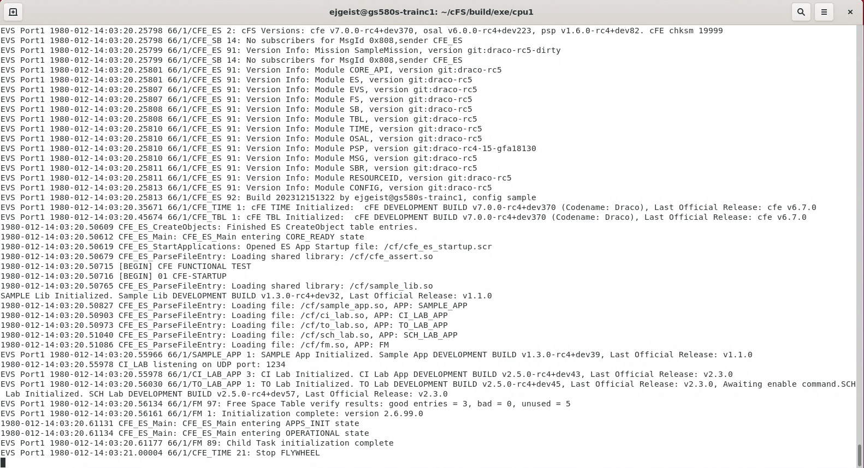
Exercise 7 Recap
FM Startup Messages

Slide 214
Exercise 8 - Add a command to sample_app
Part 1 – Add new command code event message
Stop both the cFS and the Python ground system before starting this exercise.
1. Navigate to the sample_app source directory
cd apps/sample_app/fsw/src
2. Open the sample_app_msg.h file and add a new command code
#define SAMPLE_APP_HELLO_WORLD_CC 3
3. Open the sample_app_events.h file and add a new event message and update the number of events.
#define SAMPLE_APP_HELLO_WORLD_INF_EID 8
4. In sample_app.c, add a case for the new command code in SAMPLE_APP_ProcessGroundCommand
case SAMPLE_APP_HELLO_WORLD_CC:
if (SAMPLE_APP_VerifyCmdLength(&SBBufPtr->Msg, sizeof(SAMPLE_APP_NoopCmd_t))) {
SAMPLE_APP_HelloCmd((SAMPLE_APP_NoopCmd_t * )SBBufPtr);
}
break;

Slide 215
Exercise 8 - Add a command to sample_app
Part 2 – Add code to handle new command
5. In sample_app.c, add a new function called SAMPLE_HelloCmd
int32 SAMPLE_APP_HelloCmd( const SAMPLE_APP_NoopCmd_t * Msg ) {
SAMPLE_APP_Data.CmdCounter++;
CFE_EVS_SendEvent(SAMPLE_APP_HELLO_WORLD_INF_EID,
CFE_EVS_EventType_INFORMATION,
"Hello, World. This is sample_app!");
return CFE_SUCCESS;
}
6. Add a function prototype for the new function in sample_app.h
int32 SAMPLE_APP_HelloCmd(const SAMPLE_APP_NoopCmd_t * Msg);
7. Recompile cFS and launch it
make
make install
cd build/exe/cpu1
./core-cpu1

Slide 216
Exercise 8 - Add a command to sample_app
Part 3 – Add ground command to GroundSystem.py
1. Navigate to the /cmdGui directory from the top level cFS directory
cd tools/cFS-GroundSystem/Subsystems/cmdGui
2. Open the CHeaderParser-hdr-paths.txt and uncomment the ‘sample_app_msg.h’ line (make sure all other lines should are commented out)
#../../../../apps/to_lab/fsw/src/to_lab_msg.h
#../../../../apps/ci_lab/fsw/src/ci_lab_msg.h
../../../../apps/sample_app/fsw/src/sample_app_msg.h
#../../../../cfe/fsw/cfe-core/src/inc/cfe_es_msg.h
#../../../../cfe/fsw/cfe-core/src/inc/cfe_time_msg.h
#../../../../cfe/fsw/cfe-core/src/inc/cfe_evs_msg.h
#../../../../cfe/fsw/cfe-core/src/inc/cfe_sb_msg.h
#../../../../cfe/fsw/cfe-core/src/inc/cfe_tbl_msg.h
3. Run the CHeaderParser.py script
python3 CHeaderParser.py
- When prompted, select a name for the command file to be saved as:
Example: APPS_SAMPLE_APP_CMD
- Respond ‘no’ when asked if any of the commands require parameters.

Slide 217
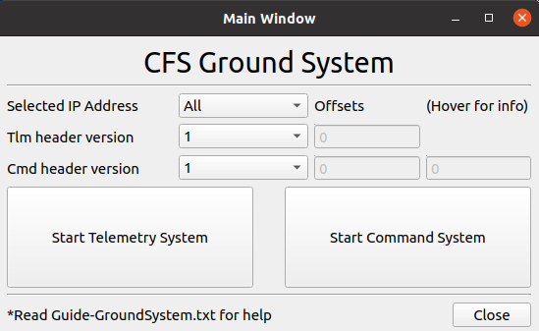
Exercise 8 - Add a command to sample_app
Part 3 – Add ground command to GroundSystem.py (continued)
4. Edit the command-pages.txt file to update the name of the SAMPLE_APP cmd file with the name chosen on step 3.
Command Ingest, CI_LAB_CMD, 0x1884, LE, UdpCommands.py, 127.0.0.1, 1234
Telemetry Output, TO_LAB_CMD, 0x1880, LE, UdpCommands.py, 127.0.0.1, 1234
Sample App, APPS_SAMPLE_APP_CMD, 0x1882, LE, UdpCommands.py, 127.0.0.1, 1234
Spare, , 0x0000, LE, UdpCommands.py, 127.0.0.1, 1234
Spare, , 0x0000, LE, UdpCommands.py, 127.0.0.1, 1234
5. Navigate to /cFS-GroundSystem and launch GroundSystem.py
cd ../..
python3 GroundSystem.py

Slide 218
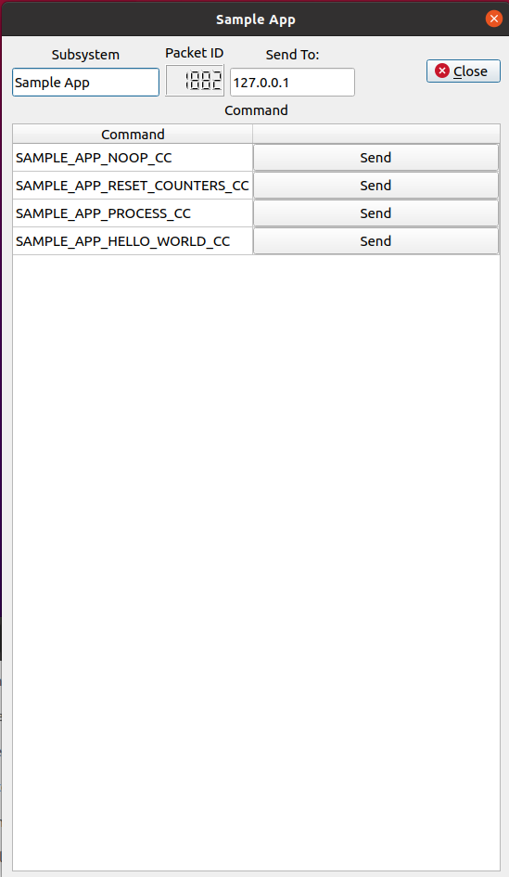
Exercise 8 - Add a command to sample_app
Part 3 – Add ground command to GroundSystem.py (continued)
6. Launch Sample App Command Display Page and Send Command

Slide 219
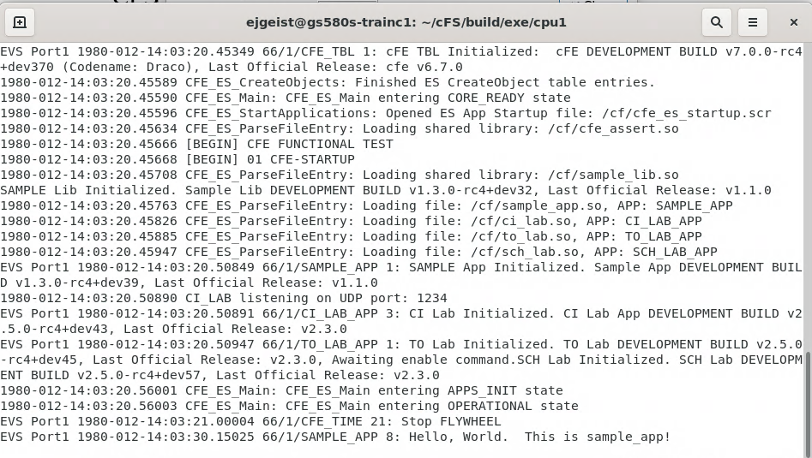
Exercise 8 Recap
Sample App
Hello World message

Slide 220
Acronyms

Slide 221
Acronyms
Acronym | Definition | Acronym | Definition
API | Application Programmer Interface | CM | Configuration Management
APID | Application Process ID | CMD | Command
ATS | Absolute Time Sequence | COTS | Commercial Off The Shelf
BC | Bus Controller | CRC | Cyclic Redundancy Check
BSP | Board Support Package | CS | Checksum
C&DH | Command and Data Handling | DS | Data Storage
CCB | Configuration Control Board | EEPROM | Electrically Erasable Programmable Read-Only Memory
CCSDS | Consultative Committee for Space Data Systems | ES | Executive Services
CDS | Critical Data Store | EVS | Event Services
CESE | Center for Experimental Software Engineering | FDC | Failure Detection and Correction
CFDP | CCSDS File Delivery Protocol | FDIR | Failure Detection, Isolation, and Recovery
cFE | Core Flight Executive | FM | File Management, Fault Management
cFS | Core Flight Software System

Slide 222
Acronyms
Acronym | Definition | Acronym | Definition
FSW | Flight Software | ITC | Independent Test Capability
GNC | Guidance Navigation and Control | ITOS | Integration Test and Operations System
GSFC | Goddard Space Flight Center | IV&V | Independent Verification and Validation
GOTS | Government Off The Shelf | LC | Limit Checker
GPM | Global Precipitation Measurement | Mbps | Megabits-per seconds
GPS | Global Positioning System | MD | Memory Dwell
Hi-Fi | High-Fidelity Simulation | MET | Mission Elapsed Timer
HK | Housekeeping | MM | Memory Manager
HS | Health & Safety | MS | Memory Scrub
HW | Hardware | NACK | Negative-acknowledgement
Hz | Hertz | NASA | National Aeronautics Space Agency
ITAR | International Traffic in Arms Regulations | NOOP | No Operation
ISR | Interrupt Service Routine | OS | Operating System

Slide 223
Acronyms
Acronym | Definition | Acronym | Definition
OSAL | Operating System Abstraction Layer | SC | Stored Command
PSP | Platform Support Package | SCH | Scheduler
PROM | Programmable Read-Only Memory | S-COMM | S-Band Communication Card
RAM | Random-Access Memory | SDR | Spacecraft Data Recorder
RT | Remote Terminal | SpW | Spacewire
R/T | Real-time | STCF | Spacecraft Time Correlation Factor
RTEMS | Real-Time Executive for Multiprocessor Systems (an RTOS) | SW | Software, Spacewire
RTOS | Real-Time Operating System | TAI | International Atomic Time
RTS | Relative Time Sequence | TBD | To be determined
SARB | Software Architecture Review Board | TBL | Table Services
S/C | Spacecraft | TLM | Telemetry
SB | Software Bus | TO | Telemetry Output
SBC | Single-Board Computer | UART | Universal Asynchronous Receiver/Transmitter

Slide 224
Acronyms
Acronym | Definition | Acronym | Definition
UDP | User Datagram Protocol | UTC | Coordinated Universal Time
UT | Unit Test | VCDU | Virtual Channel Data Unit

